Slide 1
Heart failure related cardiogenic shock: An ISHLT consensus conference content summary
Manreet K. Kanwar, MD, Filio Billia, MD, PhD, Varinder Randhawa, MD, PhD, Jennifer A. Cowger, MD, MS, Christopher M. Barnett, MD, MPH, Sharon Chih, MBBS, PhD, Stephan Ensminger, MD, DPhil, Jaime Hernandez-Montfort, MD, MSc, Shashank S. Sinha, MD, MSc, Esther Vorovich, MD, MSCE, Alastair Proudfoot, MD, PhD, Hoong S. Lim, MD, Vanessa Blumer, MD, Douglas L. Jennings, Pharm D, A. Reshad Garan, MD, Maria F. Renedo, MD, Thomas C. Hanff, MD, MSCE, David A. Baran, MD
The Journal of Heart and Lung Transplantation
DOI: 10.1016/j.healun.2023.09.014
Copyright © 2023 International Society for the Heart and Lung Transplantation Terms and Conditions

Slide 2
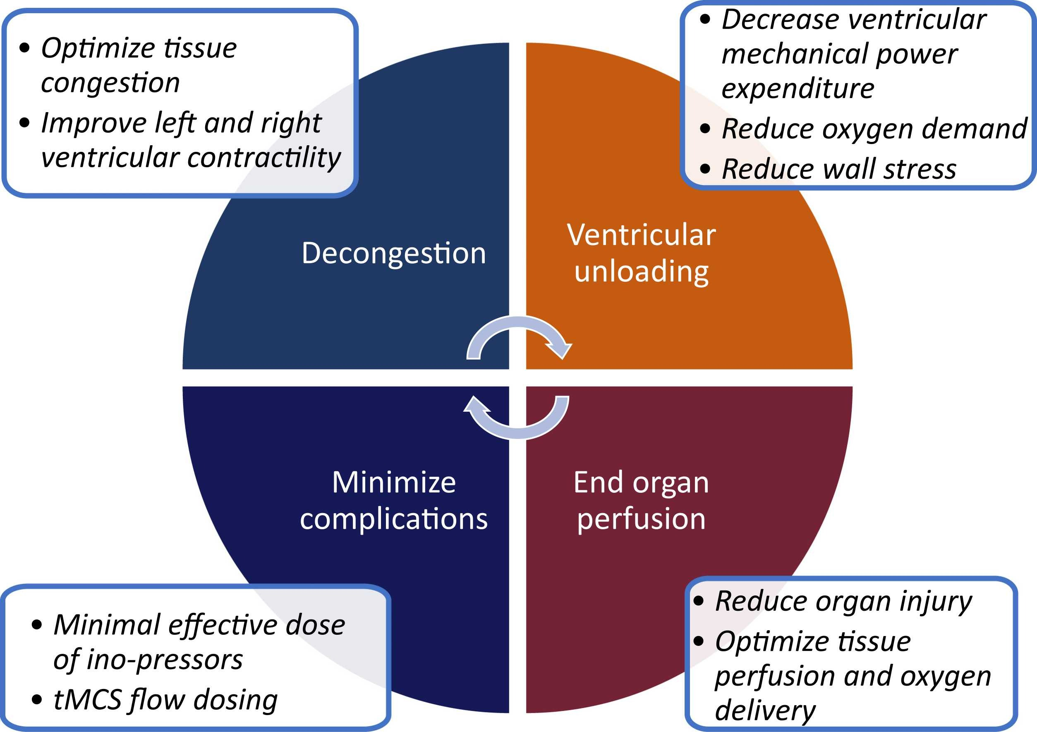
Figure 1
The Journal of Heart and Lung Transplantation DOI: (10.1016/j.healun.2023.09.014)
Copyright © 2023 International Society for the Heart and Lung Transplantation Terms and Conditions
Notes:
The goals of tMCS deployment include hemodynamic stabilization and restoration of systemic perfusion. tMCS, temporary mechanical circulatory support.

Slide 3
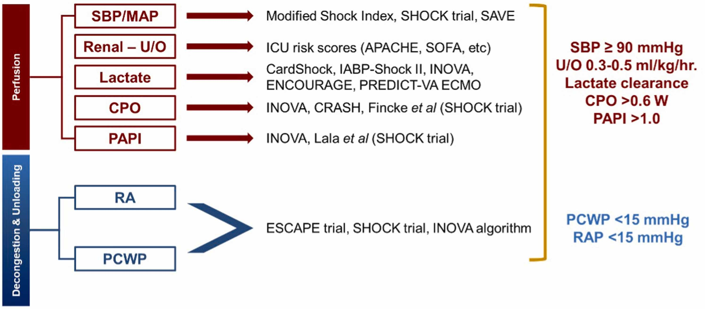
Figure 2
The Journal of Heart and Lung Transplantation DOI: (10.1016/j.healun.2023.09.014)
Copyright © 2023 International Society for the Heart and Lung Transplantation Terms and Conditions
Notes:
Suggested parameters for perfusion and de-congestion/unloading goals in HF-CS. CPO, cardiac power output; HF-CS, heart failure-cardiogenic shock; MAP, mean arterial pressure; PAPI, pulmonary artery pulsatility index, PCWP, pulmonary capillary wedge pressure; RA, right atrial pressure; SBP, systolic blood pressure; U/O, urine output.

