Slide 1
Bronchiolitis obliterans syndrome 2001: an update of the diagnostic criteria
Marc Estenne, MD, Janet R Maurer, MD, Annette Boehler, MD, James J Egan, MD, Adaani Frost, MD, Marshall Hertz, MD, George B Mallory, MD, Gregory I Snell, MD, Samuel Yousem, MD
The Journal of Heart and Lung Transplantation
Volume 21 Issue 3 Pages 297-310 (March 2002)
DOI: 10.1016/S1053-2498(02)00398-4

Slide 2
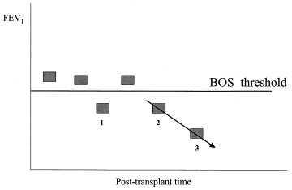
Figure 1
The Journal of Heart and Lung Transplantation 2002 21297-310DOI: (10.1016/S1053-2498(02)00398-4)
Notes:
Event 1: drop below bos threshold, not validated by second measurement. event 2: first bos measurement and time of onset of bos defined by validating event #3. fev1 decline = slope of values 2 and 3 and any additional measurement over a 1–3 month period.

Slide 3
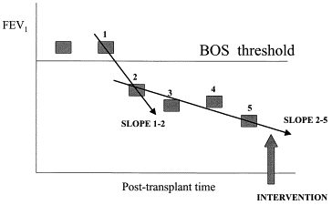
Figure 2
The Journal of Heart and Lung Transplantation 2002 21297-310DOI: (10.1016/S1053-2498(02)00398-4)
Notes:
Though initial decline below bos threshold shows a steep decline (slope 1–2), preintervention value 2 which defines bos onset (and is validated by subsequent values) and subsequent values 3–5 define the slope prior to intervention. benefit of therapeutic intervention will be defined by comparison with the slope 2–5.

