Slide 1
ISHLT consensus statement: Perioperative management of patients with pulmonary hypertension and right heart failure undergoing surgery
Dana P. McGlothlin, MD, John Granton, MD, Walter Klepetko, MD, Maurice Beghetti, MD, Erika B. Rosenzweig, MD, Paul A. Corris, MD, Evelyn Horn, MD, Manreet K. Kanwar, MD, Karen McRae, MD, Antonio Roman, MD, Ryan Tedford, MD, Roberto Badagliacca, MD, Sonja Bartolome, MD, Raymond Benza, MD, Marco Caccamo, DO, Rebecca Cogswell, MD, Celine Dewachter, MD, Laura Donahoe, MD, Elie Fadel, MD, PhD, Harrison W. Farber, MD, Jeffrey Feinstein, MD, Veronica Franco, MD, Robert Frantz, MD, Michael Gatzoulis, MD, Choon Hwa (Anne) Goh, MD, Marco Guazzi, MD, Georg Hansmann, MD, Stuart Hastings, MD, Paul M. Heerdt, MD, PhD, Anna Hemnes, MD, Antoine Herpain, MD, Chih-Hsin Hsu, MD, Kim Kerr, MD, Nicholas A. Kolaitis, MD, Jasleen Kukreja, MD, Michael Madani, MD, Stuart McCluskey, MD, Michael McCulloch, MD, Bernhard Moser, MD, Manchula Navaratnam, MD, Göran Rådegran, MD, Cara Reimer, MD, Laurent Savale, MD, Oksana A. Shlobin, MD, Jana Svetlichnaya, MD, Keith Swetz, MD, Jessica Tashjian, MD, Thenappan Thenappan, MD, Carmine Dario Vizza, MD, Shawn West, MD, Warren Zuckerman, MD, Andreas Zuckermann, MD, Teresa De Marco, MD
The Journal of Heart and Lung Transplantation
Volume 41 Issue 9 Pages 1135-1194 (September 2022)
DOI: 10.1016/j.healun.2022.06.013
Copyright © 2022 International Society for Heart and Lung Transplantation Terms and Conditions

Slide 2
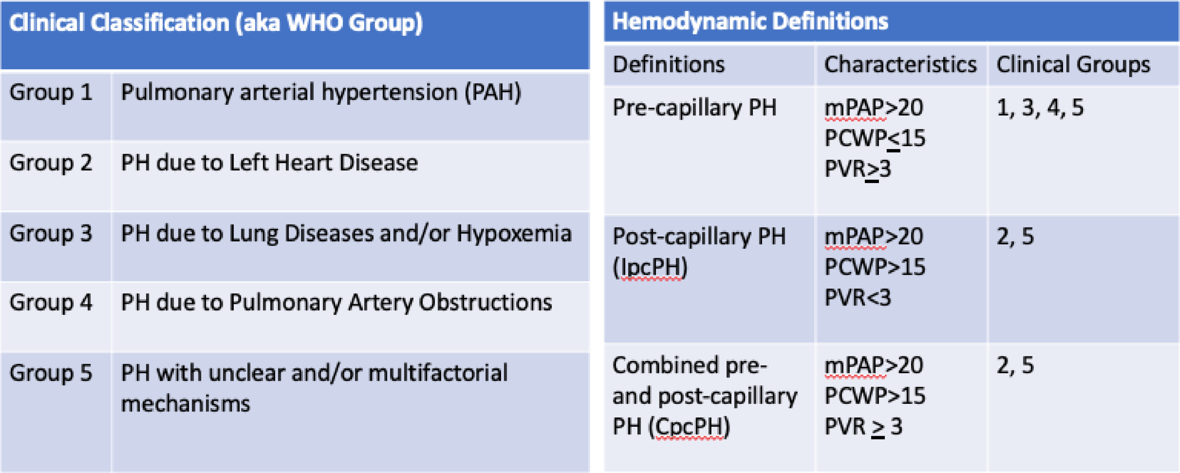
Figure 1
The Journal of Heart and Lung Transplantation 2022 411135-1194DOI: (10.1016/j.healun.2022.06.013)
Copyright © 2022 International Society for Heart and Lung Transplantation Terms and Conditions
Notes:
Hemodynamic and clinical classifications of PH. Abbreviations: mPAP, mean pulmonary artery pressure ; PCWP, pulmonary capillary wedge pressure ; PVR, pulmonary vascular resistance.

Slide 3
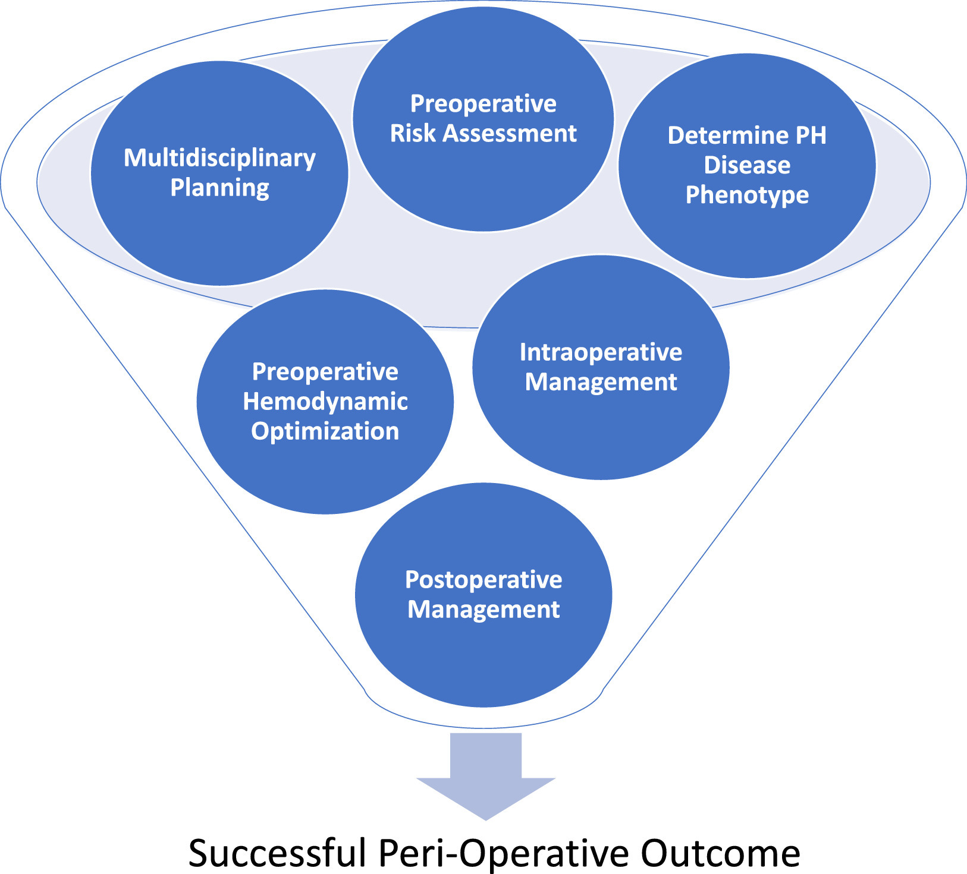
Figure 2
The Journal of Heart and Lung Transplantation 2022 411135-1194DOI: (10.1016/j.healun.2022.06.013)
Copyright © 2022 International Society for Heart and Lung Transplantation Terms and Conditions
Notes:
Recipe for successful perioperative outcome.

Slide 4
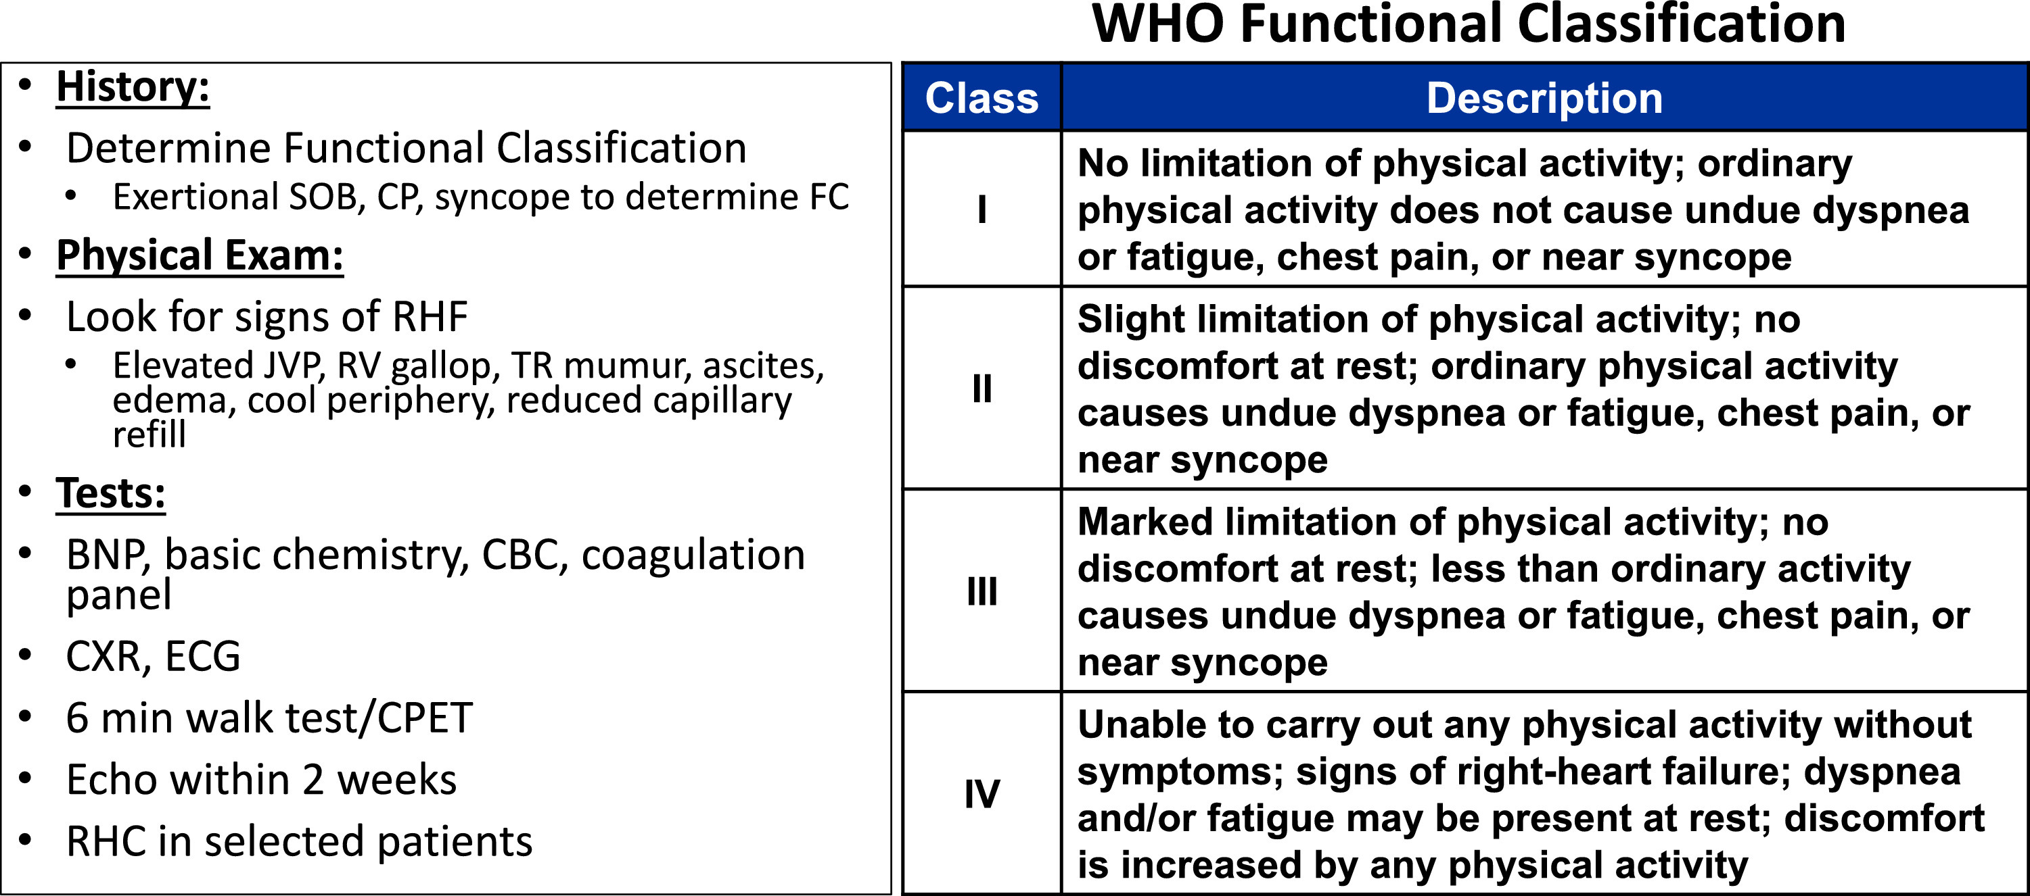
Figure 3
The Journal of Heart and Lung Transplantation 2022 411135-1194DOI: (10.1016/j.healun.2022.06.013)
Copyright © 2022 International Society for Heart and Lung Transplantation Terms and Conditions
Notes:
Preoperative assessment checklist.

Slide 5
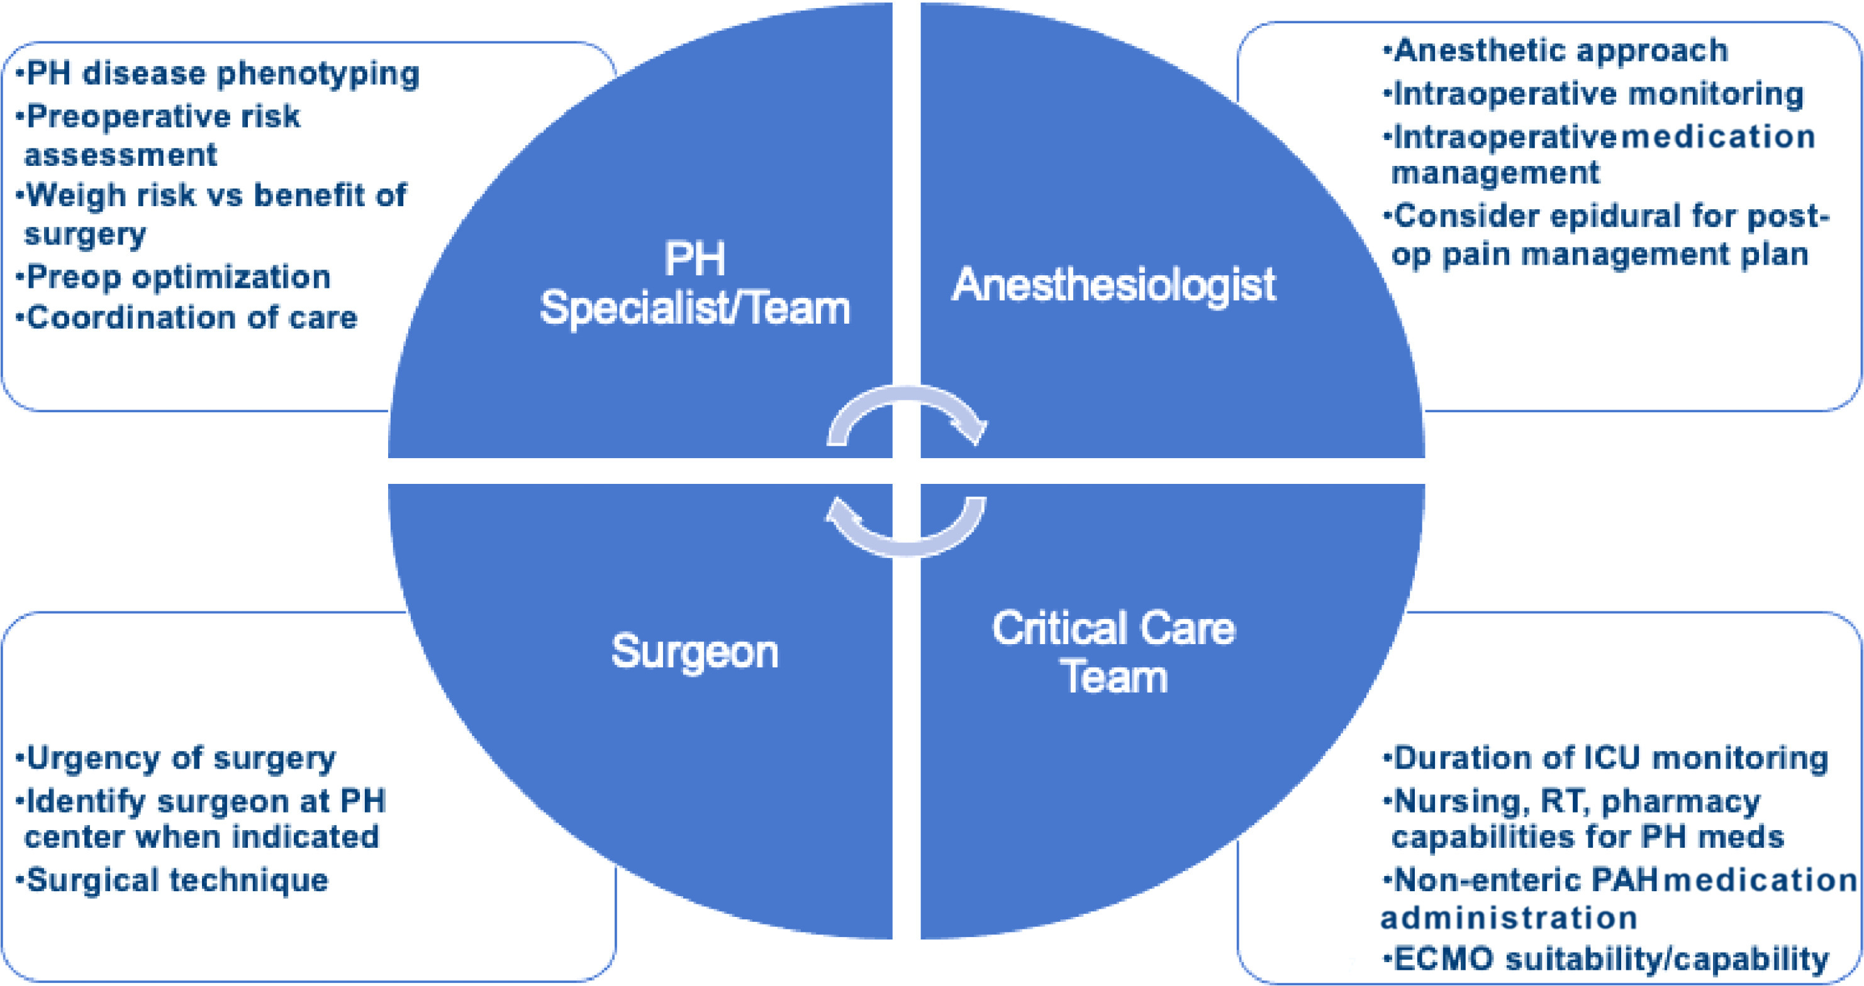
Figure 4
The Journal of Heart and Lung Transplantation 2022 411135-1194DOI: (10.1016/j.healun.2022.06.013)
Copyright © 2022 International Society for Heart and Lung Transplantation Terms and Conditions
Notes:
Preoperative multidisciplinary communications and planning: the core team.

Slide 6
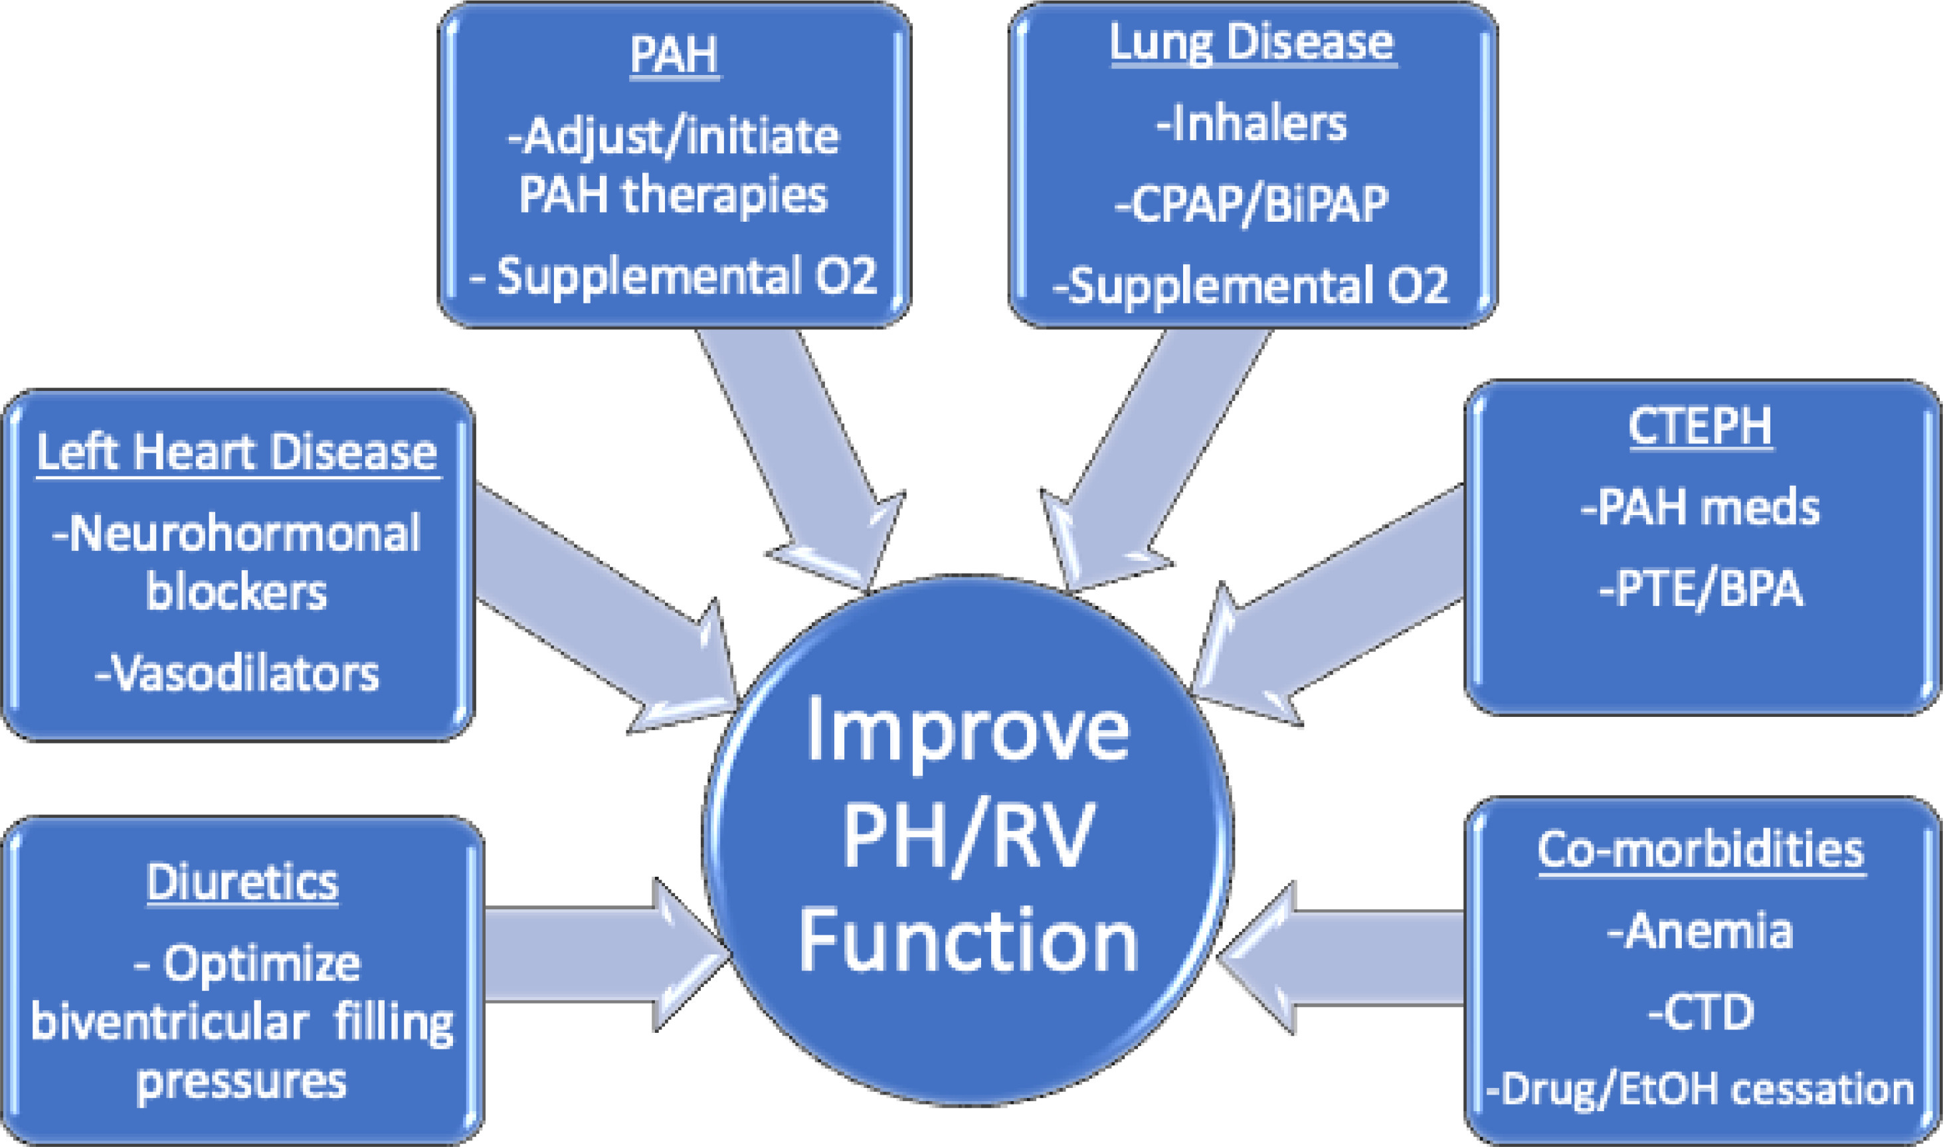
Figure 5
The Journal of Heart and Lung Transplantation 2022 411135-1194DOI: (10.1016/j.healun.2022.06.013)
Copyright © 2022 International Society for Heart and Lung Transplantation Terms and Conditions
Notes:
Preoperative optimization.

Slide 7
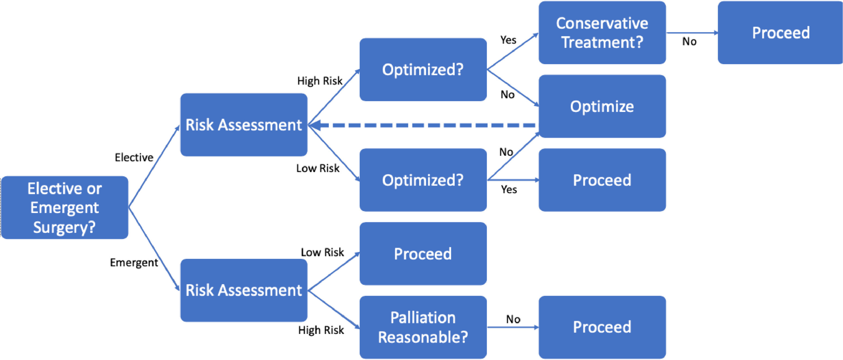
Figure 6
The Journal of Heart and Lung Transplantation 2022 411135-1194DOI: (10.1016/j.healun.2022.06.013)
Copyright © 2022 International Society for Heart and Lung Transplantation Terms and Conditions
Notes:
Schematic for preoperative assessment.

Slide 8
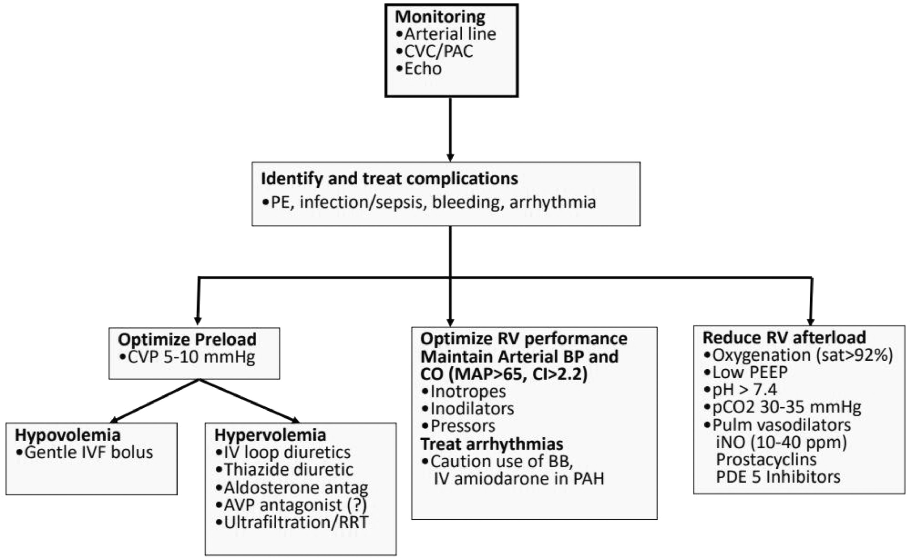
Figure 7
The Journal of Heart and Lung Transplantation 2022 411135-1194DOI: (10.1016/j.healun.2022.06.013)
Copyright © 2022 International Society for Heart and Lung Transplantation Terms and Conditions
Notes:
Peri-Operative Management Algorithm. Abbreviations: CVC, central venous catheter; PAC, pulmonary artery catheter; PE, pulmonary embolism; CVP, central venous pressure; IVF, intravenous fluid; AVP, arginine vasopressin; RRT, renal replacement therapy; RV, right ventricular; BP, blood pressure; CO, cardiac output; MAP, mean arterial blood pressure; CI, cardiac index; BB, beta blockers; PEEP, positive end-expiratory pressure; iNO, inhaled nitric oxide; PDE 5 Inhibitors, phosphodiesterase type 5 inhibitors.

Slide 9
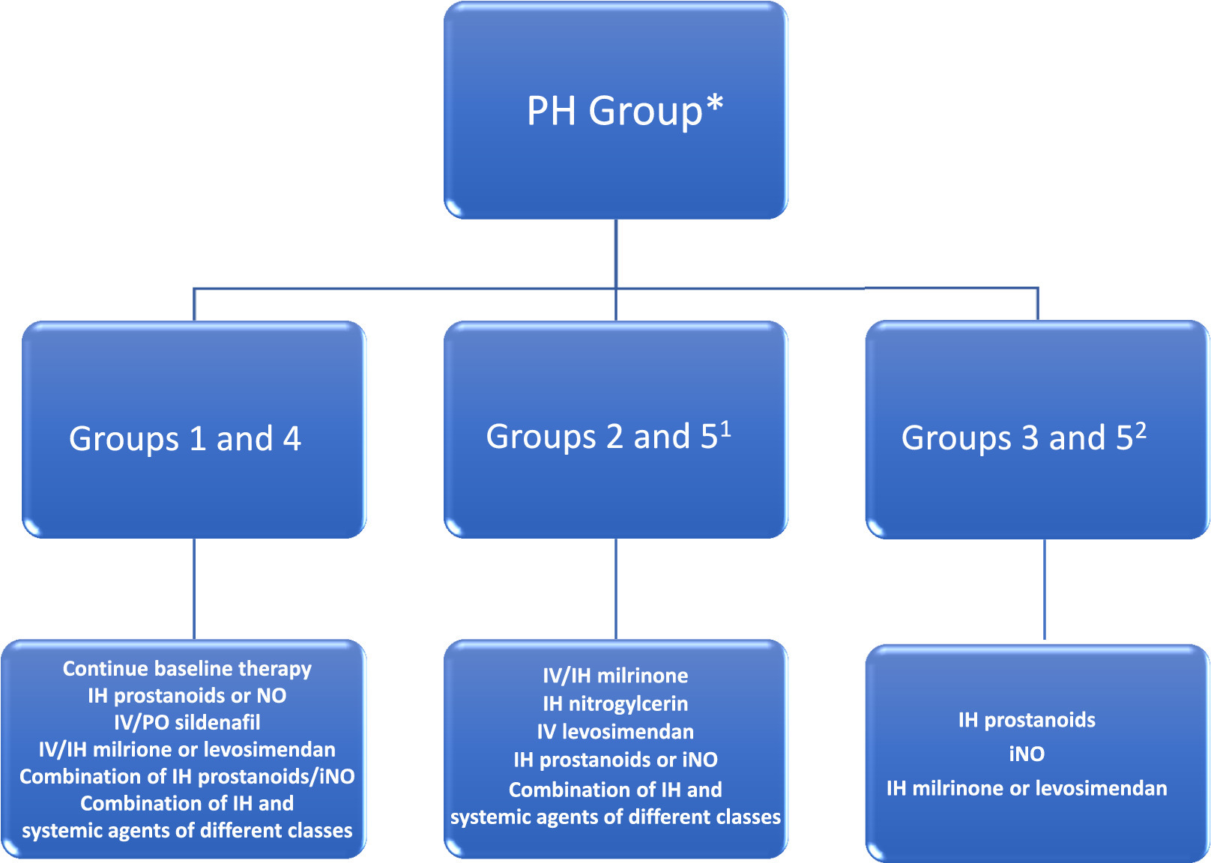
Figure 8
The Journal of Heart and Lung Transplantation 2022 411135-1194DOI: (10.1016/j.healun.2022.06.013)
Copyright © 2022 International Society for Heart and Lung Transplantation Terms and Conditions
Notes:
Summary of potential roles of vasodilator therapies for postoperative Ph based on Ph group * Note that off-label pulmonary vasodilator therapies mentioned have not been systematically studied for safety and efficacy beyond Group 1 PAH and should be used with caution, including monitoring for worsening hypoxemia, pulmonary edema, and systemic hypotension 1 If behaves like Group 2 PH 2 If behaves like Group 3 PH.

Slide 10
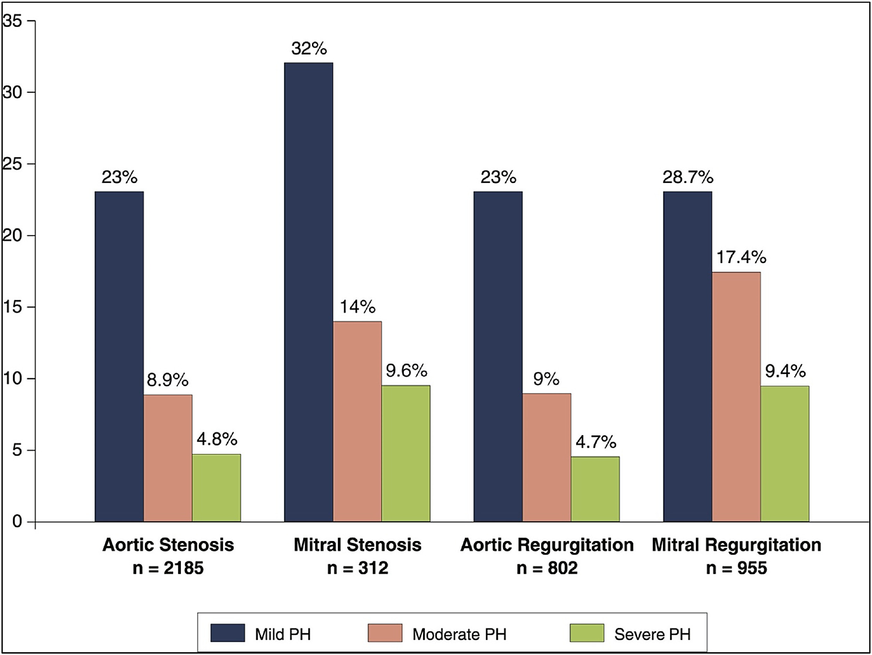
Figure 9
The Journal of Heart and Lung Transplantation 2022 411135-1194DOI: (10.1016/j.healun.2022.06.013)
Copyright © 2022 International Society for Heart and Lung Transplantation Terms and Conditions
Notes:
Prevalence and severity of PH due to left-sided valvular disease. Reprinted with permission from Magne J et al. JACC Cardiovasc Imaging. 2015 Jan;8(1):83–99

Slide 11
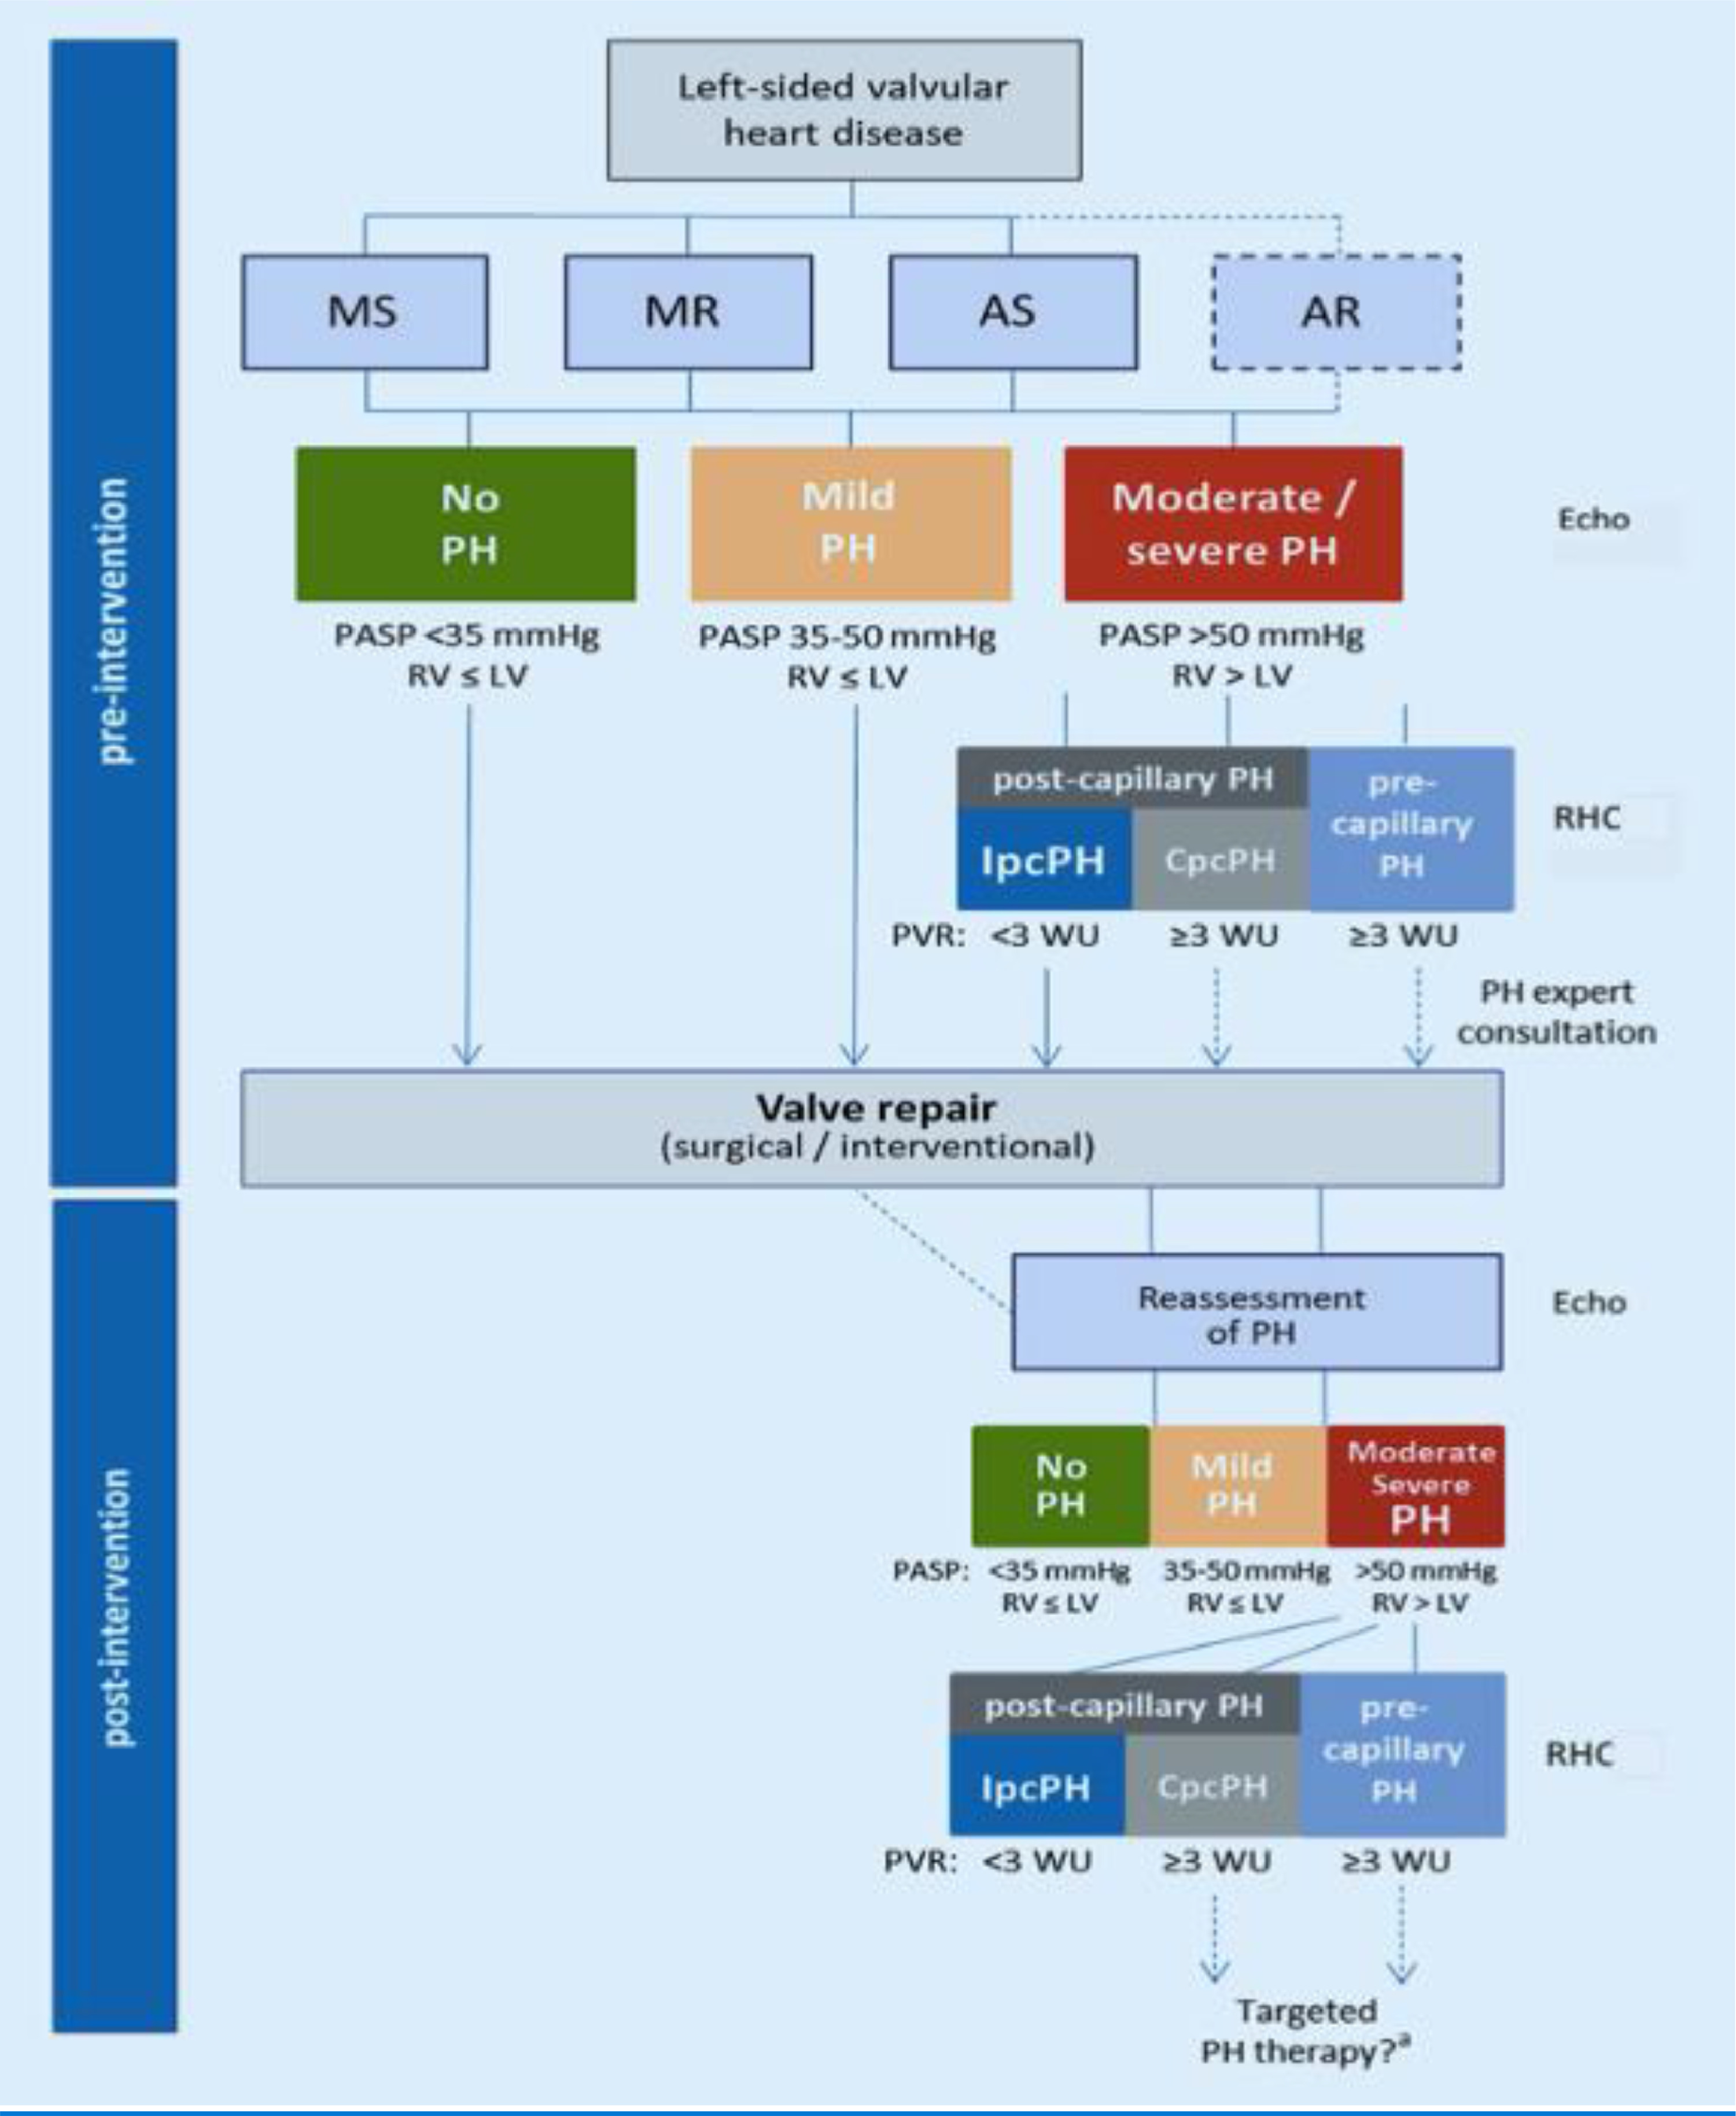
Figure 10
The Journal of Heart and Lung Transplantation 2022 411135-1194DOI: (10.1016/j.healun.2022.06.013)
Copyright © 2022 International Society for Heart and Lung Transplantation Terms and Conditions
Notes:
Diagnostic approach and hemodynamic assessment pre- and post-valve intervention for patients with PH due to left-sided valvular disease Adapted from Tichelbacker T, Dumitrescu D, Gerhardt F, et al. Pulmonary hypertension and valvular heart disease. Herz. 2019;44:491-501.¹⁴⁵ a: Targeted PH therapies are not approved to treat PH due to left heart disease including left-sided valvular heart disease. However, if pre-capillary PH or CpcPH are present after valve repair, pulmonary vascular disease may be present, representing a potential treatment target. Such patients should be evaluated is specialized centers, and clinical trials are needed.

Slide 12
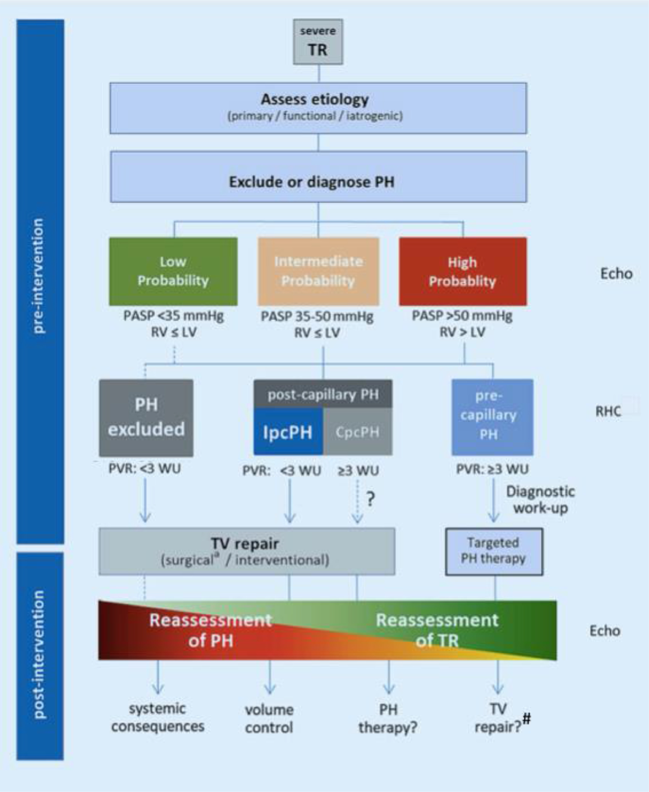
Figure 11
The Journal of Heart and Lung Transplantation 2022 411135-1194DOI: (10.1016/j.healun.2022.06.013)
Copyright © 2022 International Society for Heart and Lung Transplantation Terms and Conditions
Notes:
Suggested diagnostic approach, hemodynamic assessment, and patient selection for surgical or interventional therapies in patients with tricuspid regurgitation Adapted from Tichelbacker T, Dumitrescu D, Gerhardt F, et al. Pulmonary hypertension and valvular heart disease. Herz. 2019;44:491-501.¹⁴⁵ a: Isolated surgical repair of TR is considered a high-risk procedure # TV repair for secondary TR related to a pressure overloaded RV with Group 1 PAH is not recommended.

