Slide 1
ISHLT consensus statement for the selection and management of pediatric and congenital heart disease patients on ventricular assist devices Endorsed by the American Heart Association
Angela Lorts, MD, MBA, Jennifer Conway, MD, Martin Schweiger, MD, Iki Adachi, MD, Shahnawaz Amdani, MD, Scott R. Auerbach, MD, Charlotte Barr, Mark S. Bleiweis, MD, Elizabeth D. Blume, MD, Danielle S. Burstein, MD, Ari Cedars, MD, Sharon Chen, MD, Melissa K. Cousino-Hood, PhD, Kevin P. Daly, MD, Lara A. Danziger-Isakov, MD, MPH, Nicole Dubyk, BScN, RN, Lucas Eastaugh, MBBS, FRACP, FCSANZ, Joshua Friedland-Little, MD, Robert Gajarski, MD, Asif Hasan, MB, BS, FRCS, Beth Hawkins, NP, Aamir Jeewa, MD, Steven J. Kindel, MD, Shigetoyo Kogaki, MD, PhD, Jodie Lantz, PCNS, Sabrina P. Law, MD, Katsuhide Maeda, MD, Jacob Mathew, MD, Lindsay J. May, MD, Oliver Miera, MD, Jenna Murray, NP, Robert A. Niebler, MD, Matthew J. O'Connor, MD, Mustafa Özbaran, MD, David M. Peng, MD, Joseph Philip, MD, FAAP, Leigh Christopher Reardon, MD, David N. Rosenthal, MD, Joseph Rossano, MD, Leonardo Salazar, MD, Kurt R. Schumacher, MD, Kathleen E. Simpson, MD, Brigitte Stiller, MD, David L. Sutcliffe, MD, Hari Tunuguntla, MD, Christina VanderPluym, MD, Chet Villa, MD, Peter D. Wearden, MD, Farhan Zafar, MD, Daniel Zimpfer, MD, Matthew D. Zinn, DO, Independent Reviewers: David Morales, MD, Jennifer Cowger, MD, Holger Buchholz, MD, Antonio Amodeo, MD
The Journal of Heart and Lung Transplantation
Volume 40 Issue 8 Pages 709-732 (August 2021)
DOI: 10.1016/j.healun.2021.04.015
Copyright © 2021 International Society for Heart and Lung Transplantation Terms and Conditions

Slide 2
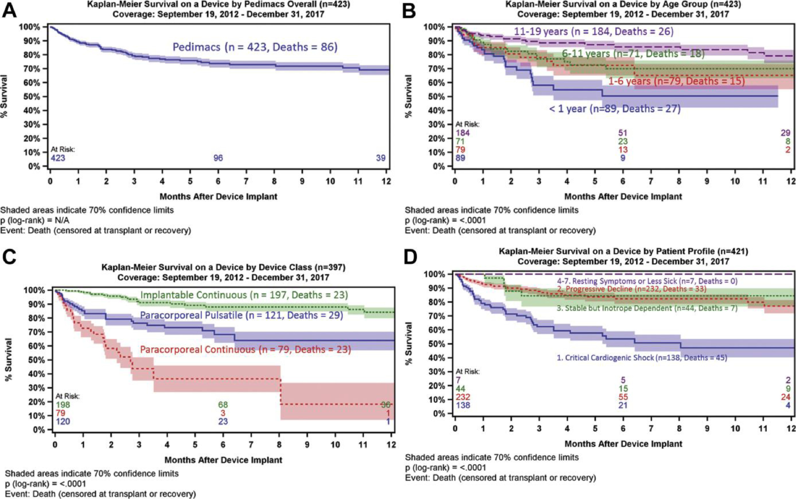
Figure 1
The Journal of Heart and Lung Transplantation 2021 40709-732DOI: (10.1016/j.healun.2021.04.015)
Copyright © 2021 International Society for Heart and Lung Transplantation Terms and Conditions
Notes:
Survival curves from 3rd Annual Pedimacs report.¹²

Slide 3
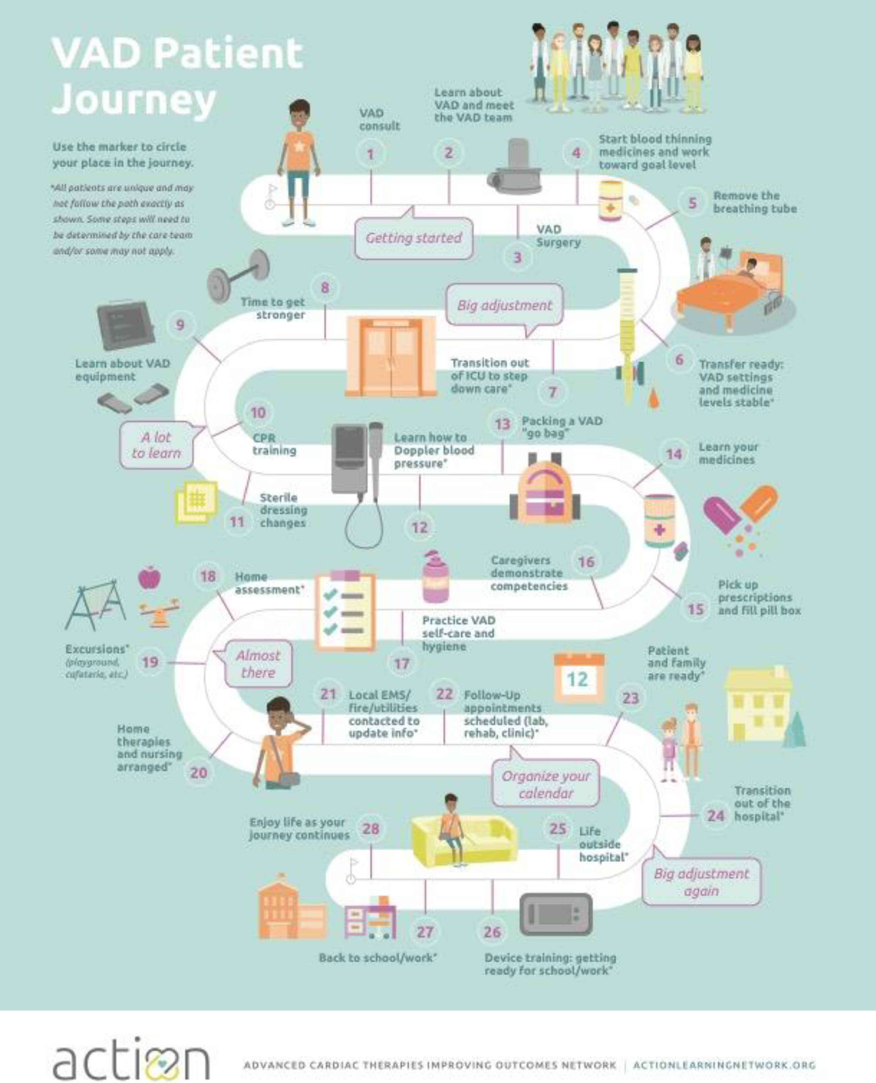
Figure 2
The Journal of Heart and Lung Transplantation 2021 40709-732DOI: (10.1016/j.healun.2021.04.015)
Copyright © 2021 International Society for Heart and Lung Transplantation Terms and Conditions
Notes:
Discharge journey map from ACTION network (www.actionlearningnetwork.org) for patients on CF VADs.

