Slide 1
HFSA/SAEM/ISHLT clinical expert consensus document on the emergency management of patients with ventricular assist devices
Michael M. Givertz, MD, Ersilia M. DeFilippis, MD, Monica Colvin, MD, Chad E. Darling, MD, Tonya Elliott, RN, MSN, Eman Hamad, MD, Brian C. Hiestand, MD, Jennifer L. Martindale, MD, Sean P. Pinney, MD, Keyur B. Shah, MD, Juliane Vierecke, MD, Mark Bonnell, MD
The Journal of Heart and Lung Transplantation
Volume 38 Issue 7 Pages 677-698 (July 2019)
DOI: 10.1016/j.healun.2019.05.004
Copyright © 2019 Dr. Michael M. Givertz Terms and Conditions

Slide 2
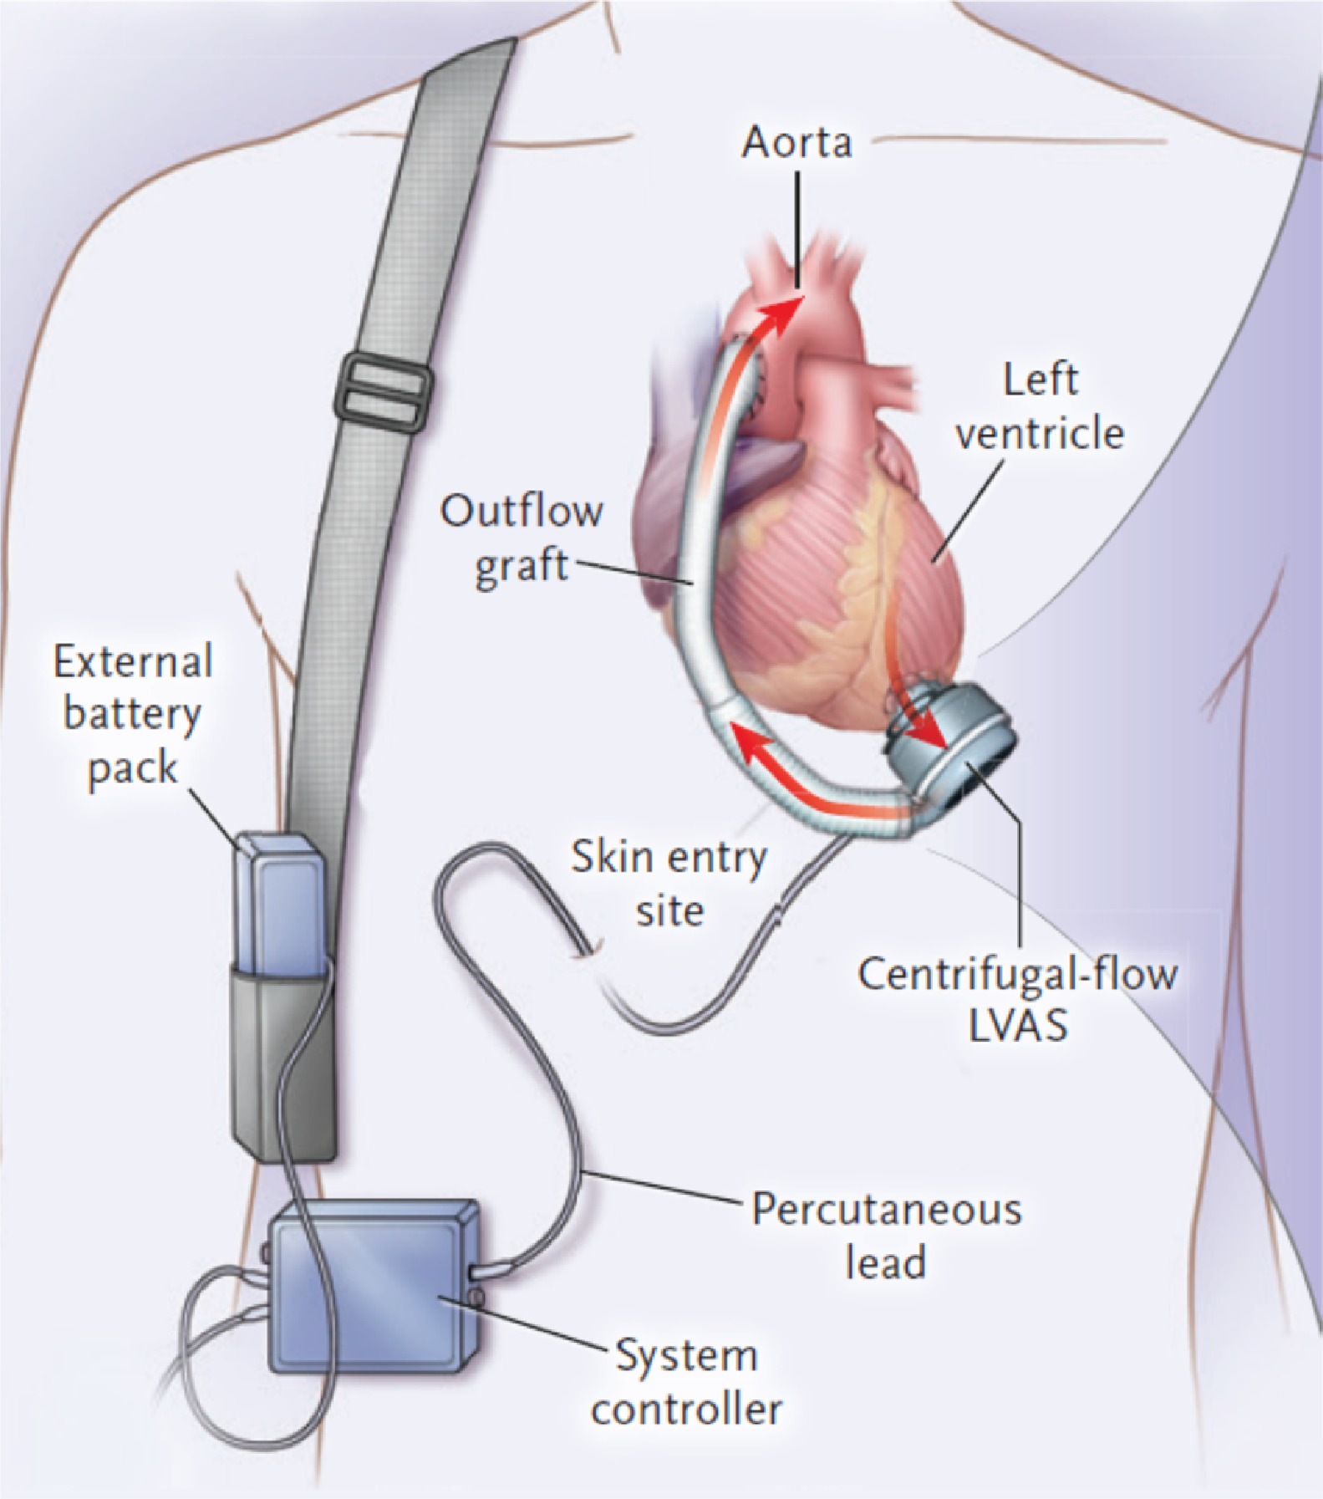
Figure 1
The Journal of Heart and Lung Transplantation 2019 38677-698DOI: (10.1016/j.healun.2019.05.004)
Copyright © 2019 Dr. Michael M. Givertz Terms and Conditions
Notes:
Components of a typical left ventricular assist device (LVAD). A continuous flow a (CF) LVAD consists of a pump connected to the cardiac apex and ascending aorta via an inflow cannula and outflow graft, respectively, a percutaneous driveline that exits the skin on the right, and a system controller that is typically worn on a belt. Power to the controller and pump is provided by external batteries or a power-based unit. Adapted from Mehra et al,¹² with permission.

Slide 3
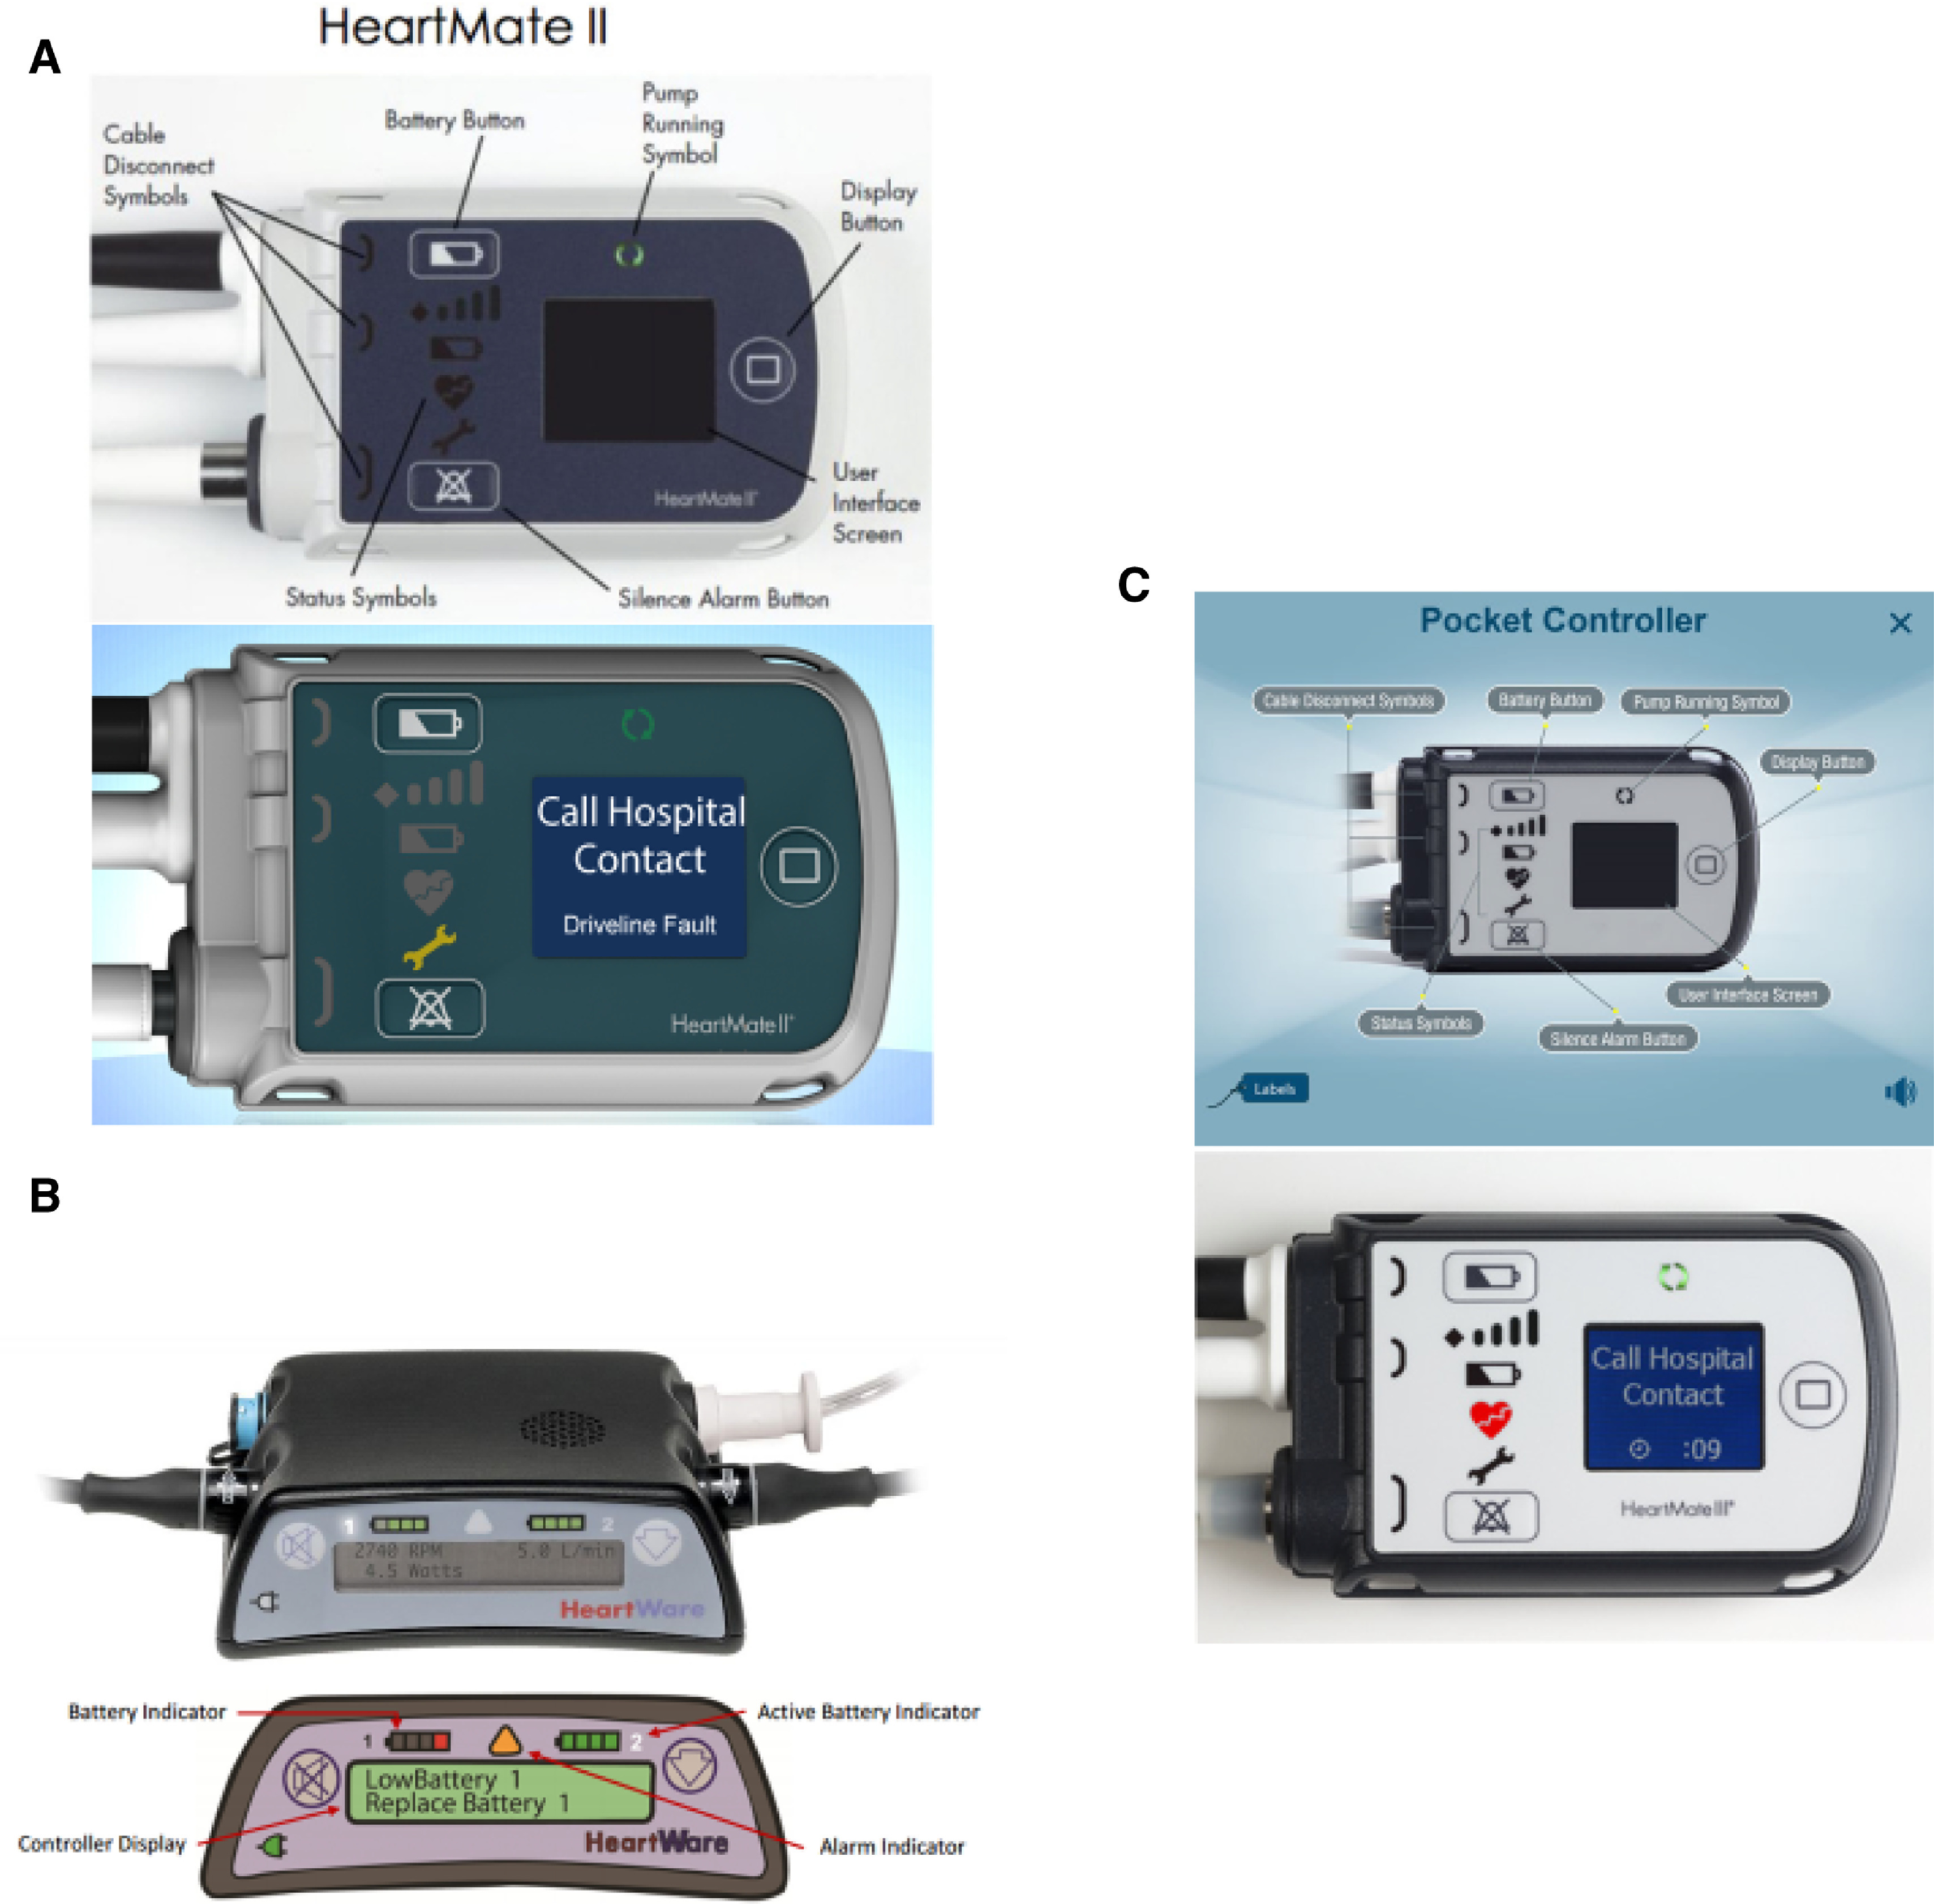
Figure 2
The Journal of Heart and Lung Transplantation 2019 38677-698DOI: (10.1016/j.healun.2019.05.004)
Copyright © 2019 Dr. Michael M. Givertz Terms and Conditions
Notes:
Left ventricular assist device (LVAD) controllers with an alarm display. (A) HeartMate II pocket controller showing controller display/buttons (top) and driveline fault alarm with a yellow wrench (below). The patient is instructed to contact the ventricular assist device (VAD) team for further advice on troubleshooting and management. (B) HeartWare HVAD with controller display/buttons (top) and low battery alarm (below). The patient is instructed to replace the battery. (C) HeartMate 3 pocket controller (top) and red heart alarm (below). The patient is instructed to call the hospital contact (LVAD program).

Slide 4
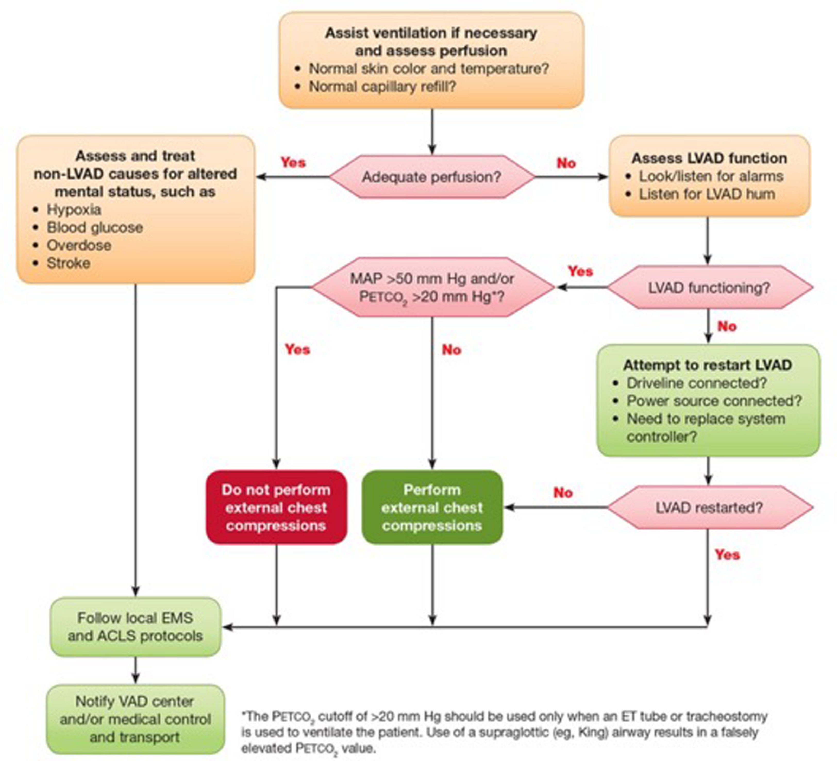
Figure 3
The Journal of Heart and Lung Transplantation 2019 38677-698DOI: (10.1016/j.healun.2019.05.004)
Copyright © 2019 Dr. Michael M. Givertz Terms and Conditions
Notes:
Assessment of the unresponsive left ventricular assist device (LVAD) patient. Shown is the American Heart Association (AHA) algorithm for the assessment of an LVAD patient who is unresponsive or has altered mental status.

Slide 5
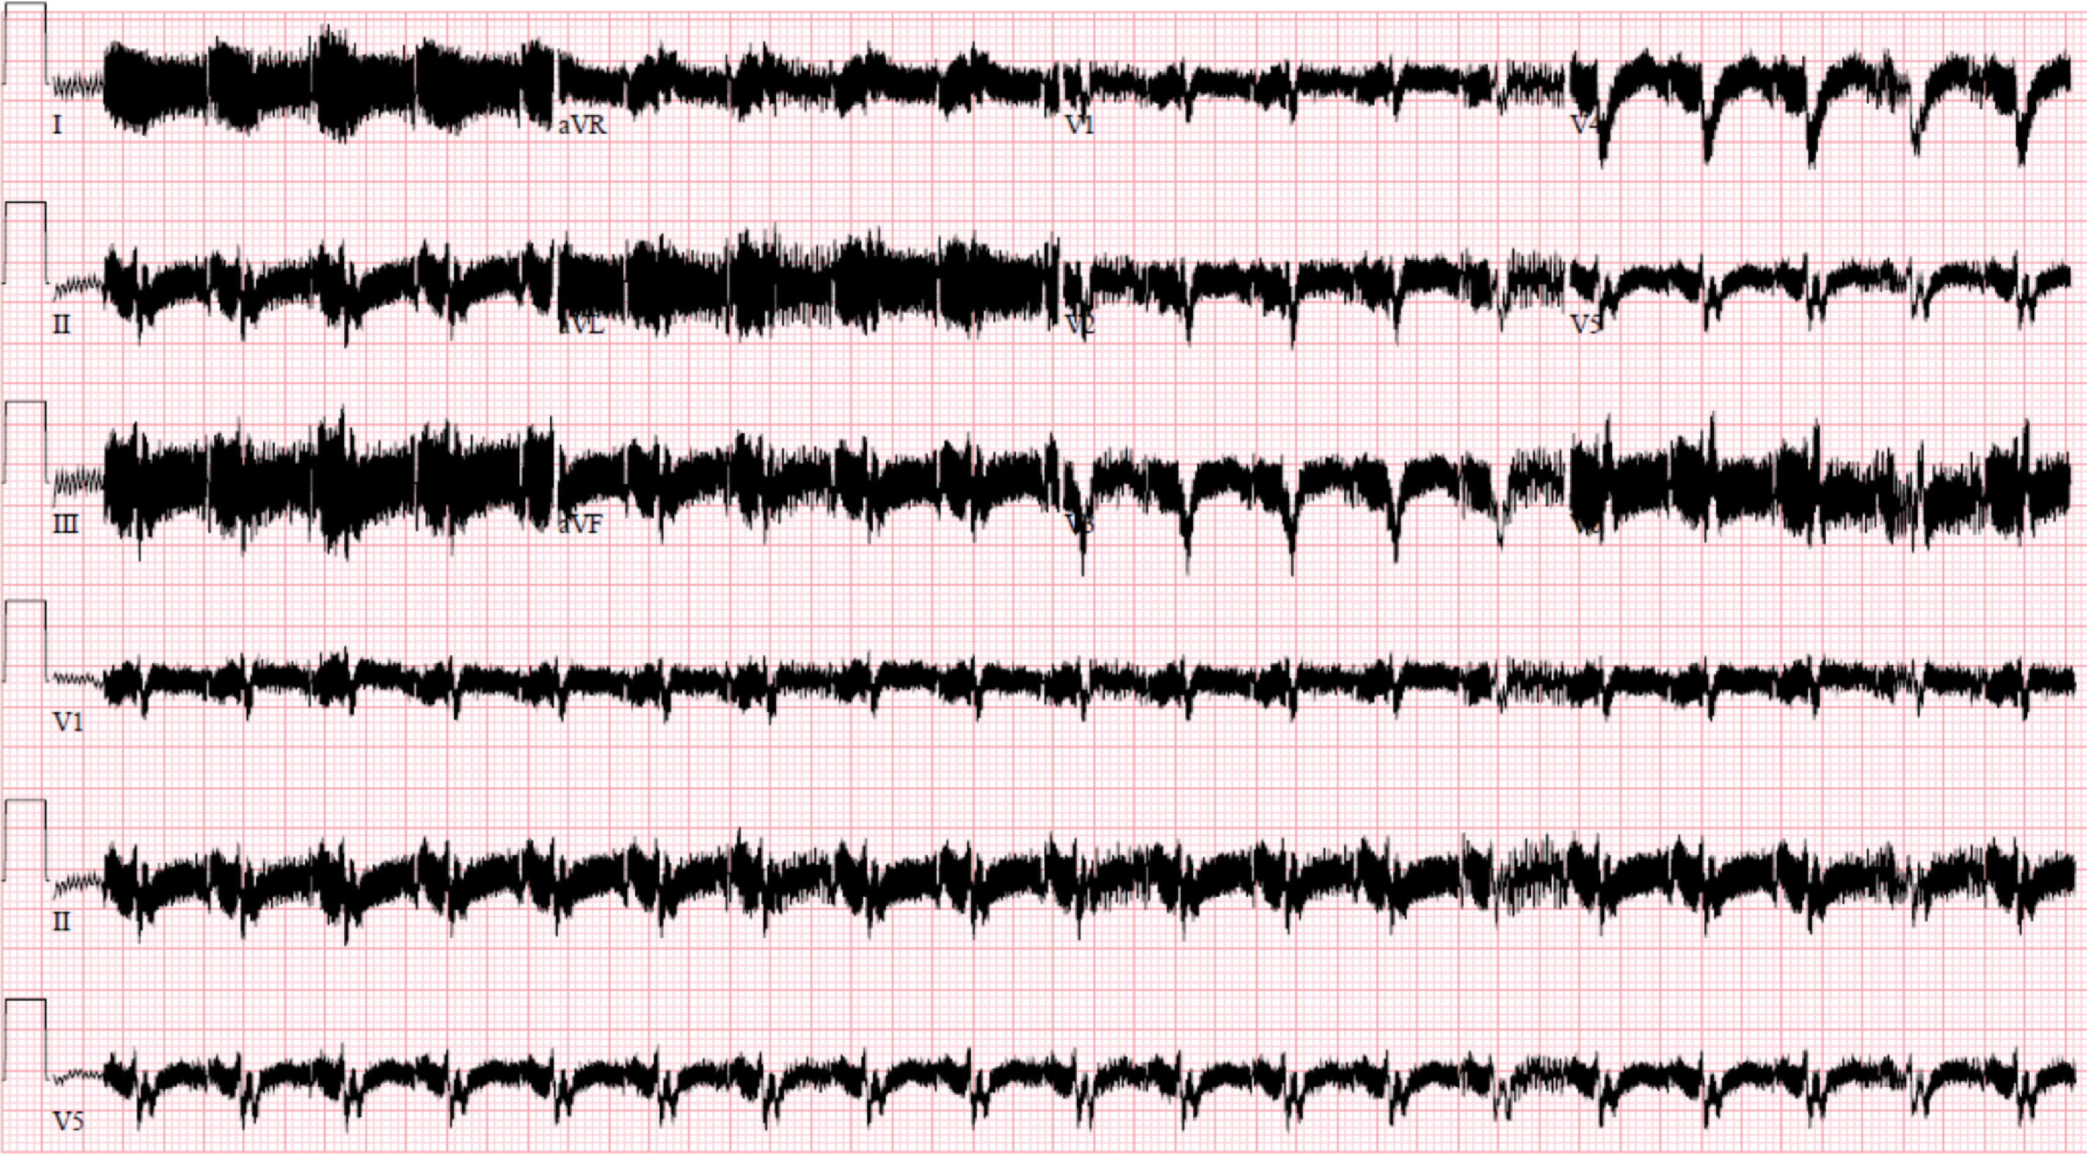
Figure 4
The Journal of Heart and Lung Transplantation 2019 38677-698DOI: (10.1016/j.healun.2019.05.004)
Copyright © 2019 Dr. Michael M. Givertz Terms and Conditions
Notes:
Representative electrocardiogram (ECG) from a patient with a left ventricular assist device (LVAD). Demonstrated is marked baseline artifact generated from the electrical pump.

Slide 6
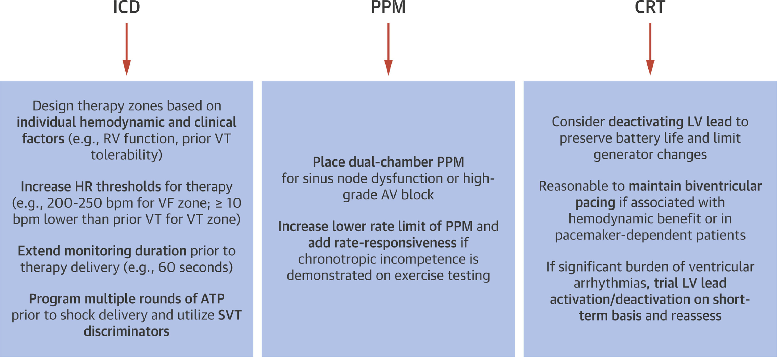
Figure 5
The Journal of Heart and Lung Transplantation 2019 38677-698DOI: (10.1016/j.healun.2019.05.004)
Copyright © 2019 Dr. Michael M. Givertz Terms and Conditions
Notes:
Unique aspects of cardiac implantable electronic device programming in patients with ventricular assist devices (VADs). There are limited data to guide the programming of cardiac implantable electronic devices (CIEDs) in patients with VADs. Because ventricular tachycardia (VT) can occur with minimal or no symptoms, the goal of implantable cardioverter defibrillator (ICD) programming is to minimize inappropriate therapies and optimize functional status. For patients with symptomatic bradycardia resulting from sinus node dysfunction or high-grade atrioventricular AV block, implantation of a permanent pacemaker (PPM) may be indicated. The benefit of cardiac resynchronization therapy (CRT) post-VAD implantation is unproven, and deactivating the left ventricular lead may help to preserve battery life. Adapted from Berg et al,³⁴ with permission.

Slide 7
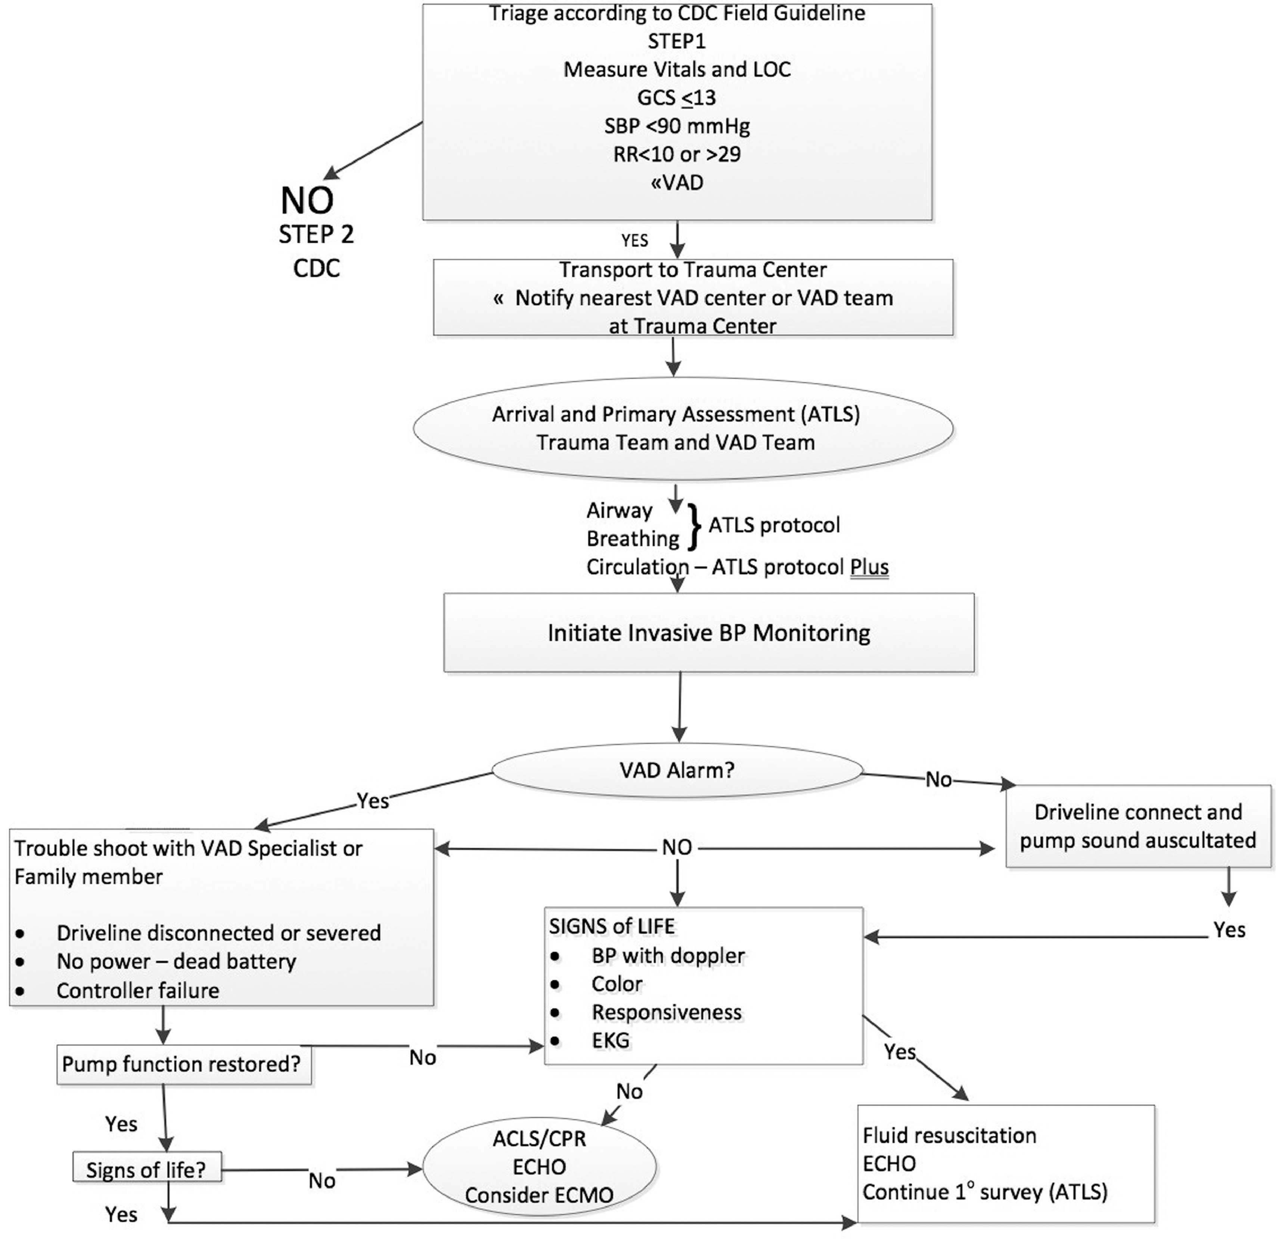
Figure 6
The Journal of Heart and Lung Transplantation 2019 38677-698DOI: (10.1016/j.healun.2019.05.004)
Copyright © 2019 Dr. Michael M. Givertz Terms and Conditions
Notes:
Proposed algorithm for management of trauma in a patient with a left ventricular assist device (LVAD).

Slide 8
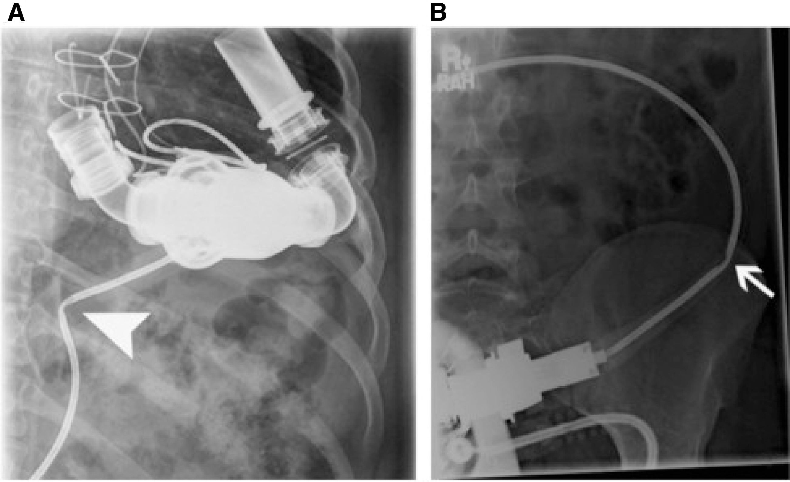
Figure 7
The Journal of Heart and Lung Transplantation 2019 38677-698DOI: (10.1016/j.healun.2019.05.004)
Copyright © 2019 Dr. Michael M. Givertz Terms and Conditions
Notes:
Imaging to look for damage in the percutaneous driveline. A plain film of the abdomen shows the left ventricular assist device (LVAD) in the left upper quadrant with kinking of the driveline. From Morris et al,¹¹⁹ with permission.

Slide 9
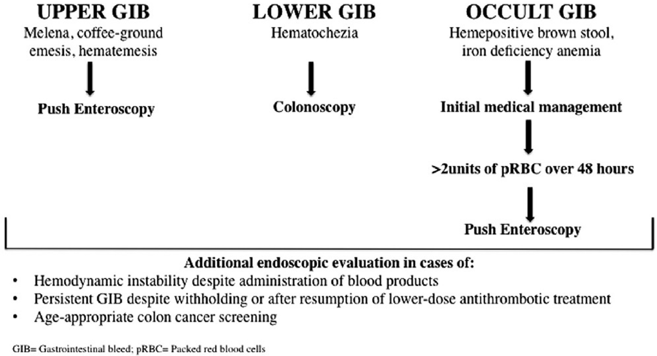
Figure 8
The Journal of Heart and Lung Transplantation 2019 38677-698DOI: (10.1016/j.healun.2019.05.004)
Copyright © 2019 Dr. Michael M. Givertz Terms and Conditions
Notes:
Algorithm for gastrointestinal bleeding in patients with a ventricular assist device (VAD). From Axelrad et al,⁵⁸ with permission.

Slide 10
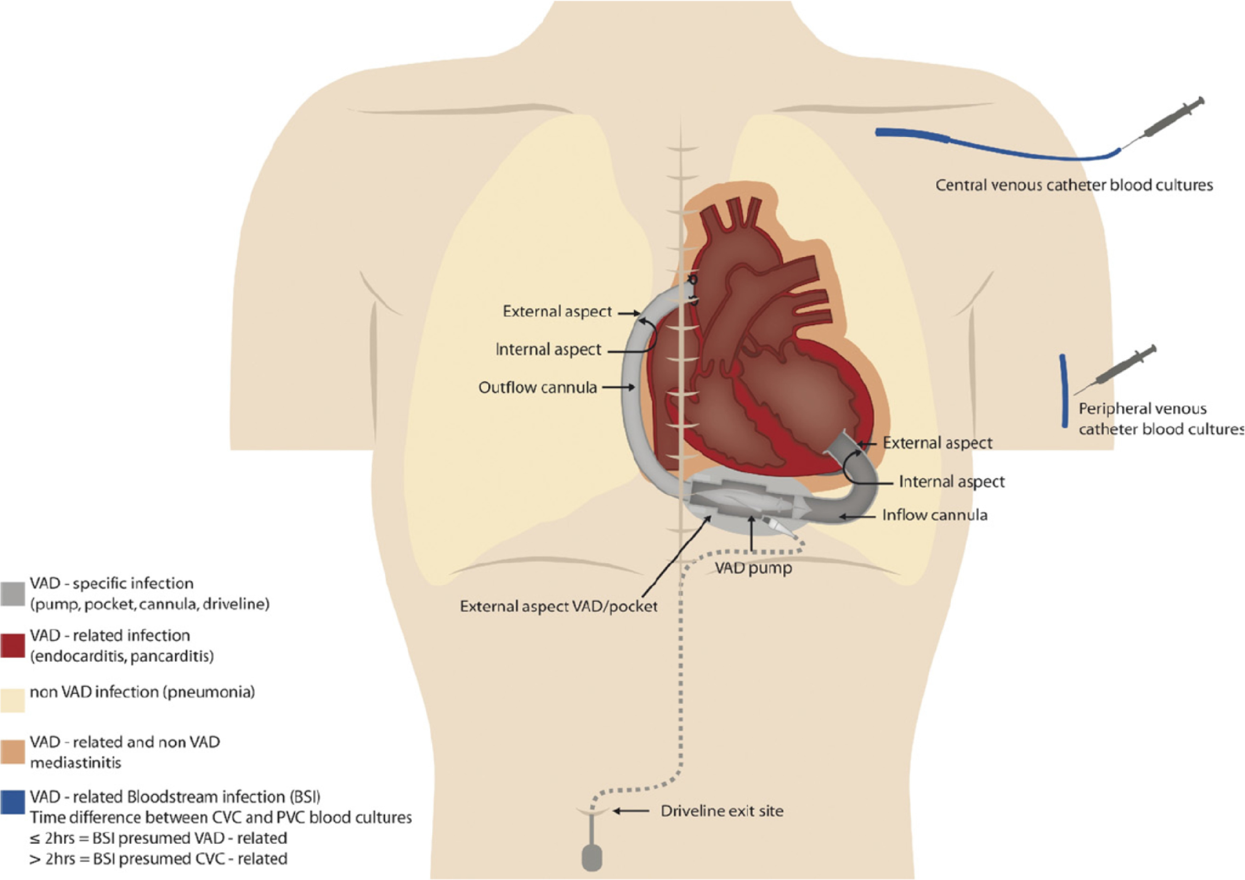
Figure 9
The Journal of Heart and Lung Transplantation 2019 38677-698DOI: (10.1016/j.healun.2019.05.004)
Copyright © 2019 Dr. Michael M. Givertz Terms and Conditions
Notes:
Standardization of infections in patients with ventricular assist devices (VADs). Illustration of VAD-specific, VAD-related, and non-VAD infections. BSI, bloodstream infection; CVC, central venous catheter; PVC, peripheral vascular catheter. From Hannan et al,⁷⁷ with permission.

Slide 11
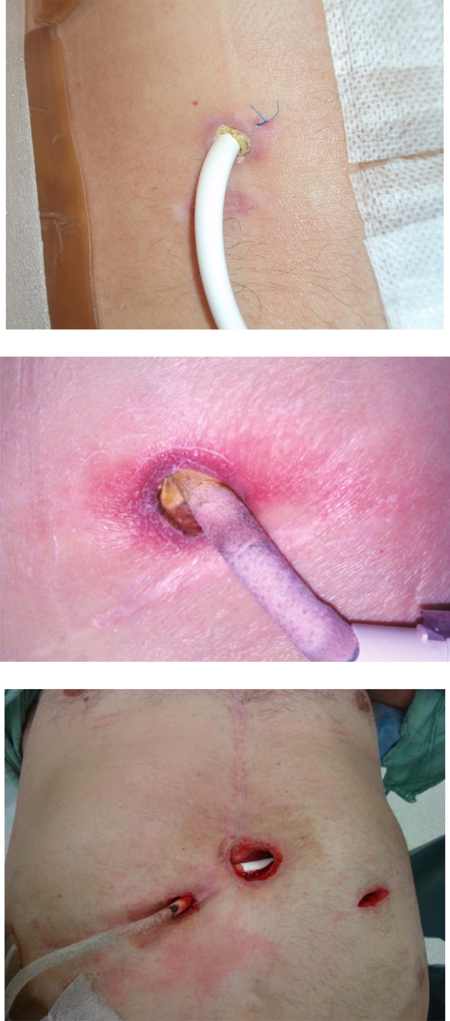
Figure 10
The Journal of Heart and Lung Transplantation 2019 38677-698DOI: (10.1016/j.healun.2019.05.004)
Copyright © 2019 Dr. Michael M. Givertz Terms and Conditions
Notes:
Stages of left ventricular assist device (LVAD) driveline infection. Top panel: stage 1 is shown as erythema involving the superficial aspect of skin without purulent drainage. Middle panel: stage 2 is represented by superficial infection and cellulitis with surrounding warmth and erythema. Bottom panel: stage 3 is a deep tissue infection that involves soft tissue layers including fascia and muscle requiring extensive surgical debridement.

