Slide 1
Chronic lung allograft dysfunction: Definition and update of restrictive allograft syndrome―A consensus report from the Pulmonary Council of the ISHLT
Allan R. Glanville, MBBS, MD, Geert M. Verleden, MD, PhD, Jamie L. Todd, MD, Christian Benden, MD, FCCP, Fiorella Calabrese, MD, Jens Gottlieb, MD, Ramsey R. Hachem, MD, Deborah Levine, MD, Federica Meloni, MD, PhD, Scott M. Palmer, MD, MHS, Antonio Roman, MD, Masaaki Sato, MD, PhD, Lianne G. Singer, MD, FRCPC, Sofya Tokman, MD, Stijn E. Verleden, PhD, Jan von der Thüsen, MBBS, PhD, Robin Vos, MD, PhD, Gregory Snell, MD
The Journal of Heart and Lung Transplantation
Volume 38 Issue 5 Pages 483-492 (May 2019)
DOI: 10.1016/j.healun.2019.03.008
Copyright © 2019 International Society for Heart and Lung Transplantation Terms and Conditions

Slide 2
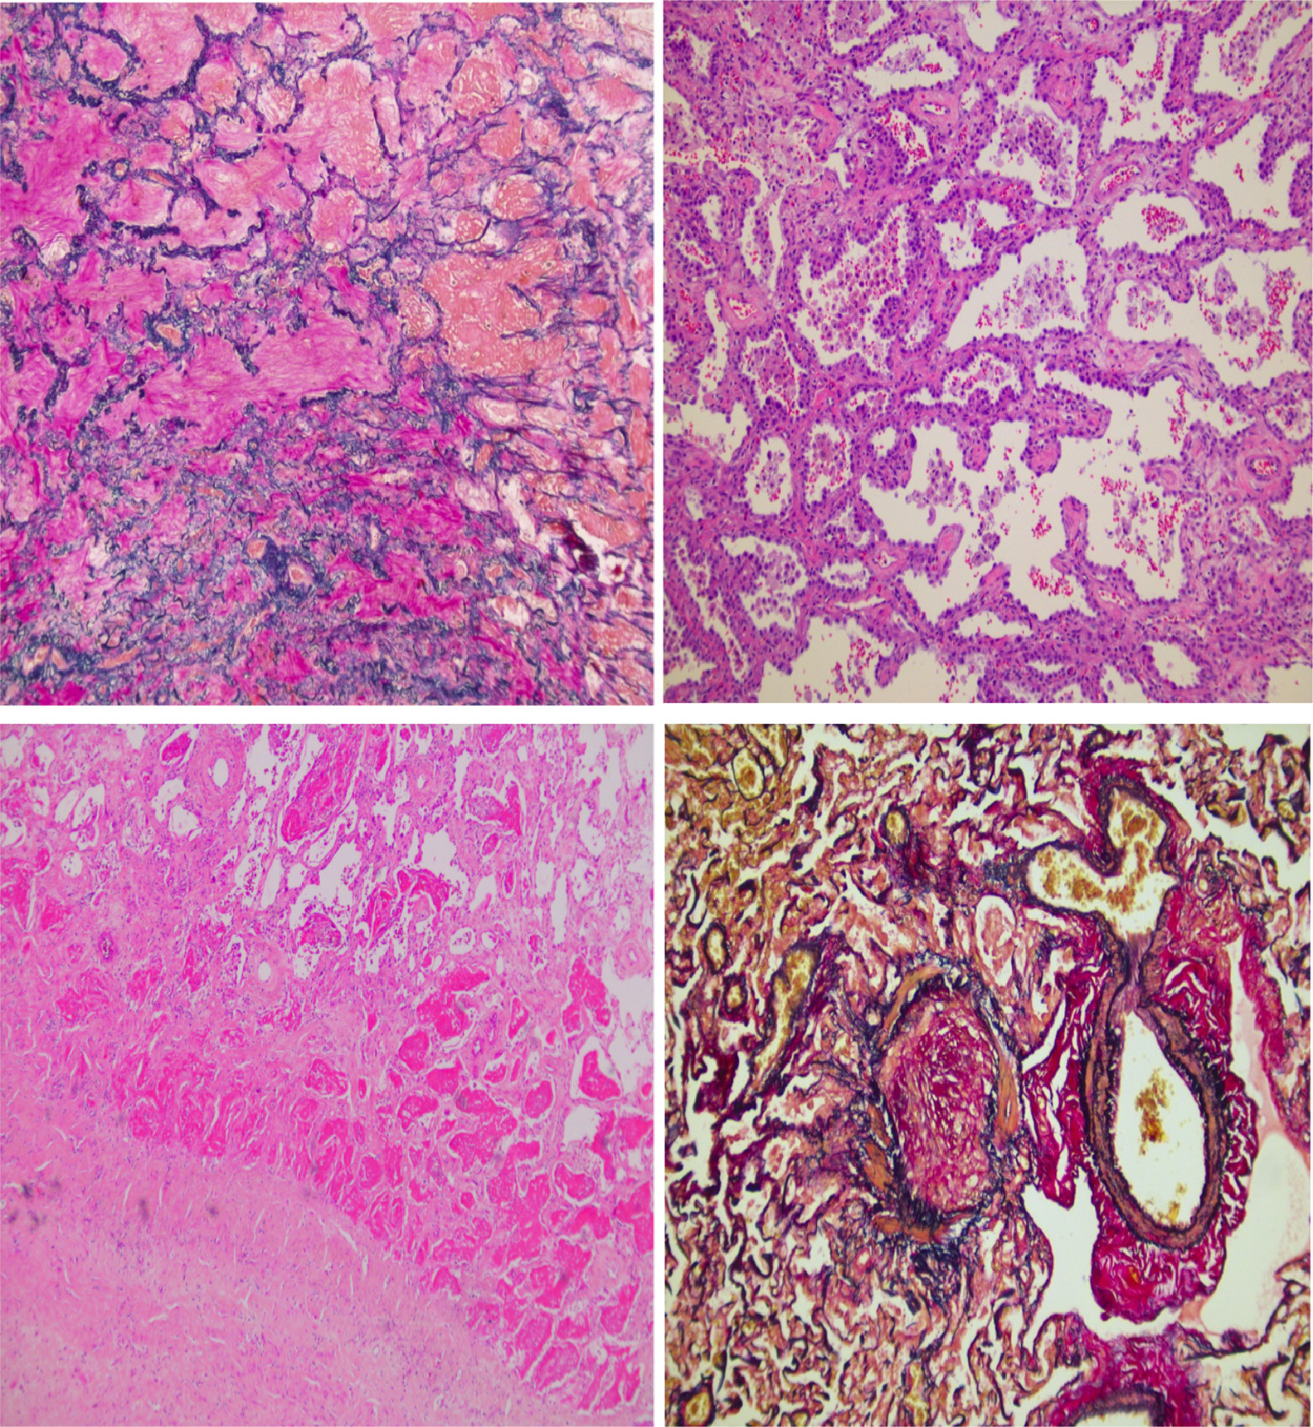
Figure 1
The Journal of Heart and Lung Transplantation 2019 38483-492DOI: (10.1016/j.healun.2019.03.008)
Copyright © 2019 International Society for Heart and Lung Transplantation Terms and Conditions
Notes:
Histopathologic changes commonly encountered in RAS. (A) Intra-alveolar fibroelastosis (IAFE). (B) Non-specific interstitial pneumonia (NSIP). (C) Acute fibrinous and organizing pneumonia (AFOP). (D) Obliterative bronchiolitis (OB).

