Slide 1
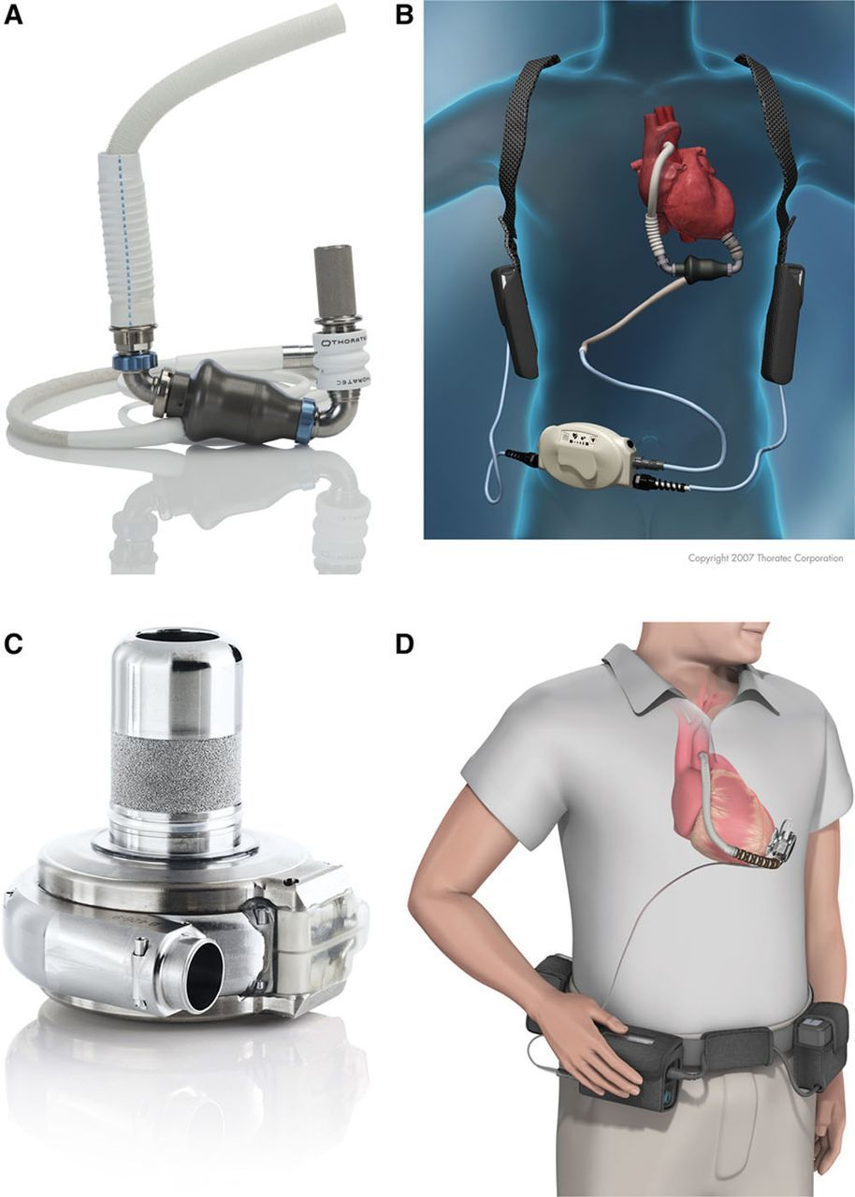
© 2017 American Heart Association, Inc.
Jennifer L. Cook. Circulation. Recommendations for the Use of Mechanical Circulatory Support: Ambulatory and Community Patient Care: A Scientific Statement From the American Heart Association, Volume: 135, Issue: 25, Pages: e1145-e1158, DOI: (10.1161/CIR.0000000000000507)

Slide 2
© 2017 American Heart Association, Inc.
Jennifer L. Cook. Circulation. Recommendations for the Use of Mechanical Circulatory Support: Ambulatory and Community Patient Care: A Scientific Statement From the American Heart Association, Volume: 135, Issue: 25, Pages: e1145-e1158, DOI: (10.1161/CIR.0000000000000507)

