Slide 1
Antibody-mediated rejection of the lung: A consensus report of the International Society for Heart and Lung Transplantation
Deborah J. Levine, MD, Allan R. Glanville, MBBS, MD, Christina Aboyoun, BA, MBA, John Belperio, MD, Christian Benden, MD, FCCP, Gerald J. Berry, MD, Ramsey Hachem, MD, Don Hayes, Jr., MD, MS, Desley Neil, MBBS, PhD, Nancy L. Reinsmoen, PhD, D(ABHI), Laurie D. Snyder, MD, Stuart Sweet, MD, PhD, Dolly Tyan, PhD, Geert Verleden, MD, PhD, Glen Westall, MBBS, PhD, Roger D. Yusen, MD, MPH, Martin Zamora, MD, Adriana Zeevi, PhD
The Journal of Heart and Lung Transplantation
Volume 35 Issue 4 Pages 397-406 (April 2016)
DOI: 10.1016/j.healun.2016.01.1223
Copyright © 2016 International Society for Heart and Lung Transplantation Terms and Conditions

Slide 2
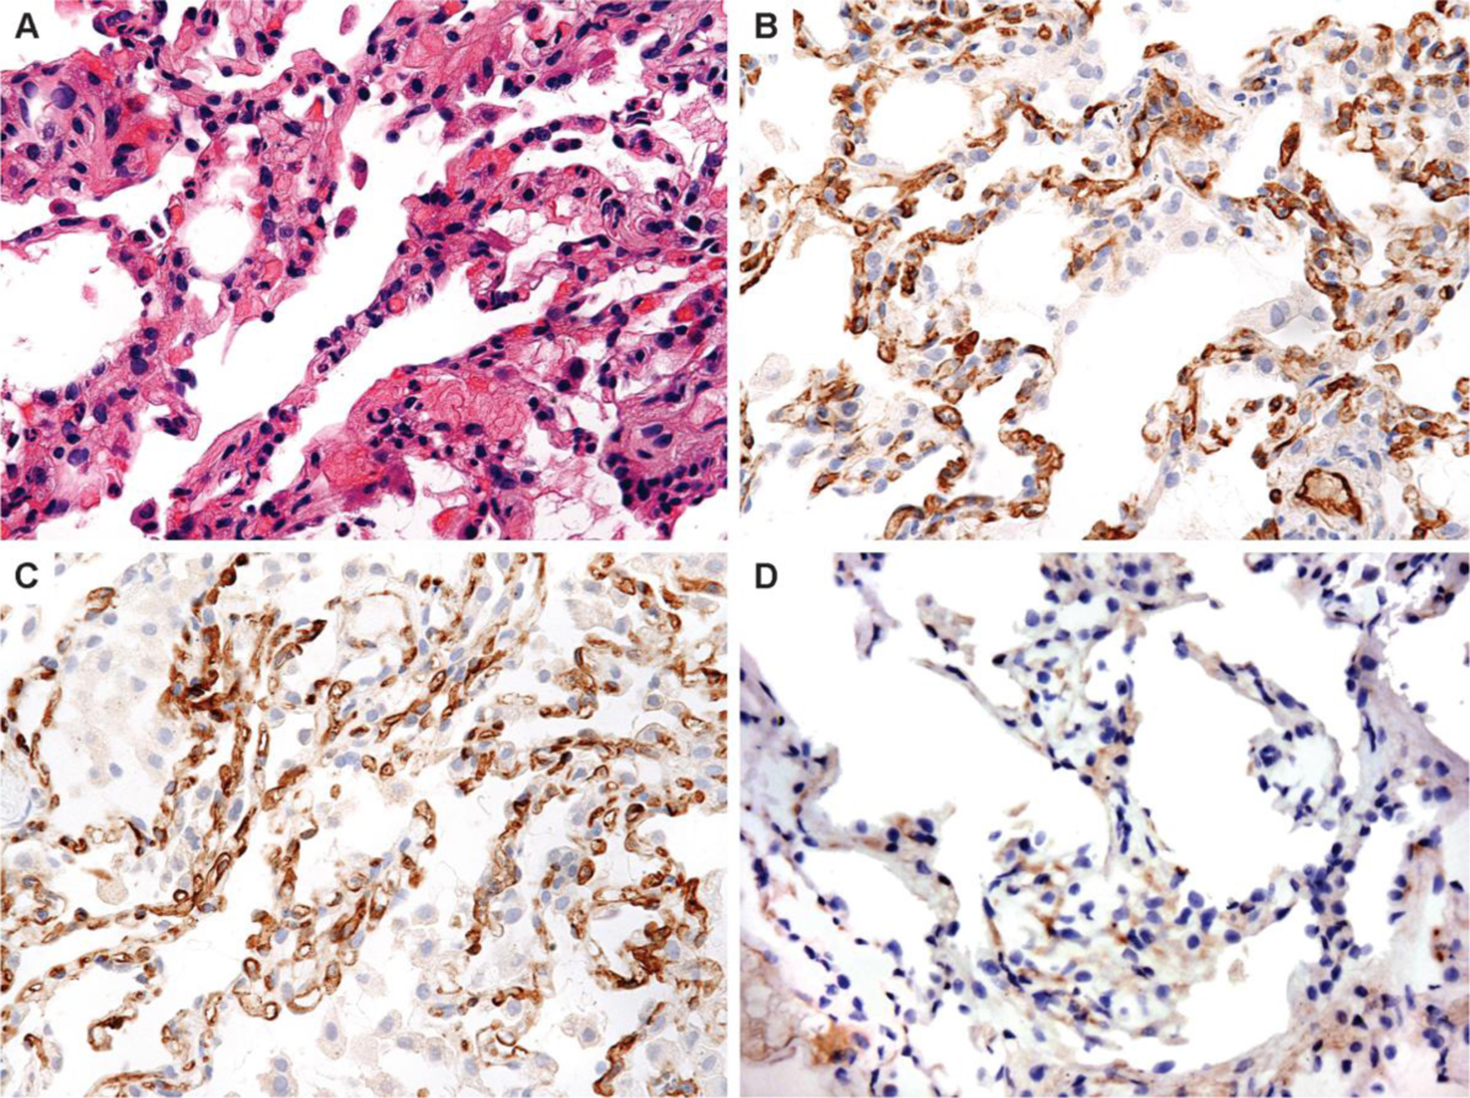
Figure 1
The Journal of Heart and Lung Transplantation 2016 35397-406DOI: (10.1016/j.healun.2016.01.1223)
Copyright © 2016 International Society for Heart and Lung Transplantation Terms and Conditions
Notes:
(A) Transbronchial biopsy at high-power magnification showing no cellular rejection or neutrophilic margination (hematoxylin–eosin stain; original magnification ×400). (B) C4d staining showing diffuse, strong, linear staining of the interstitial alveolar capillaries (×400). (C) Persistent C4d staining 6 weeks after study in (B) (×400). (D) Absence of C4d staining 3 months after study in (B) (×400).

Slide 3
Figure 2
The Journal of Heart and Lung Transplantation 2016 35397-406DOI: (10.1016/j.healun.2016.01.1223)
Copyright © 2016 International Society for Heart and Lung Transplantation Terms and Conditions
Notes:
Classification of antibody-mediated rejection (AMR) according to presence (clinical) or absence (sub-clinical) of allograft dysfunction, and confidence of diagnosis.

