Slide 1
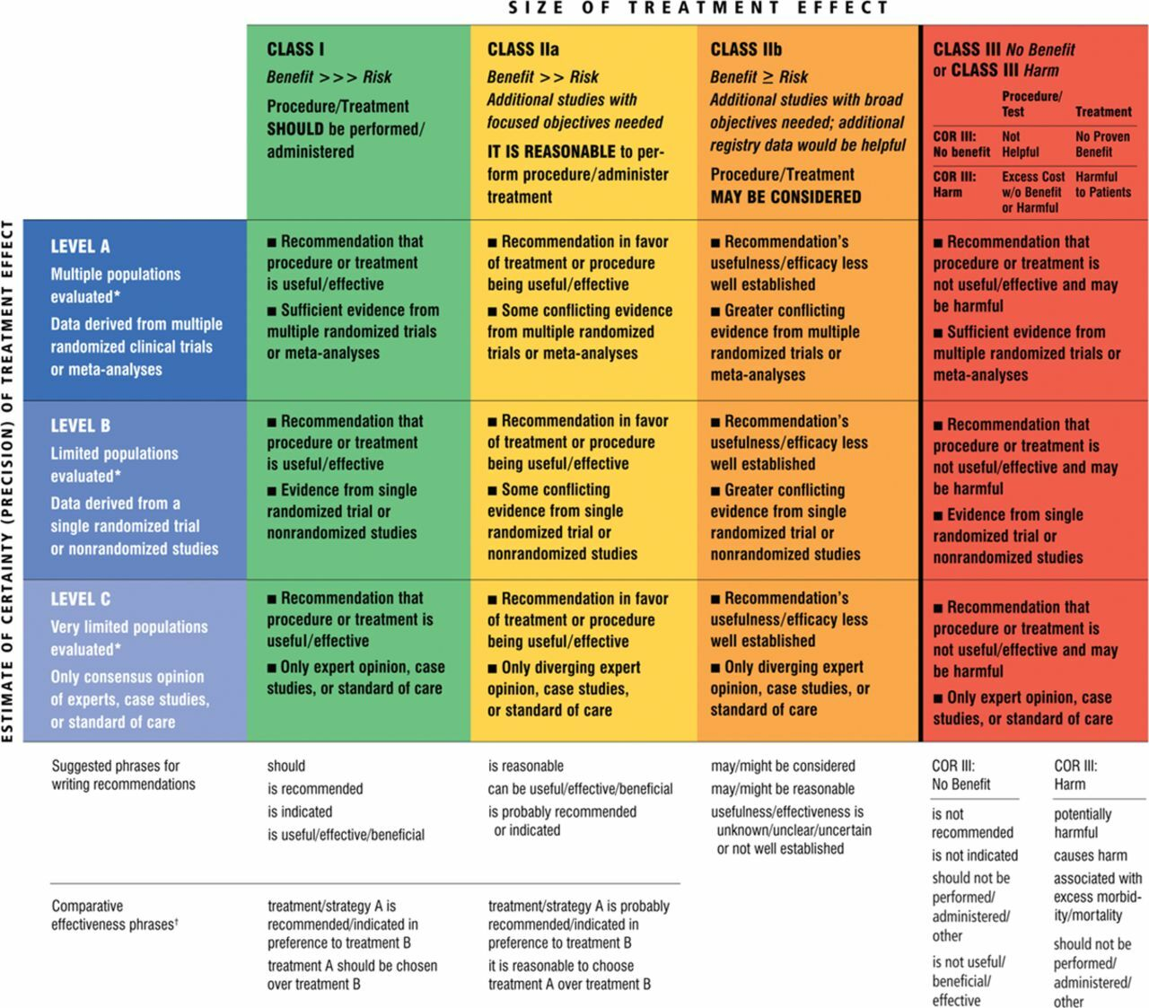
© 2013 American Heart Association, Inc.
Clyde W. Yancy. Circulation. 2013 ACCF/AHA Guideline for the Management of Heart Failure, Volume: 128, Issue: 16, Pages: e240-e327, DOI: (10.1161/CIR.0b013e31829e8776)

Slide 2
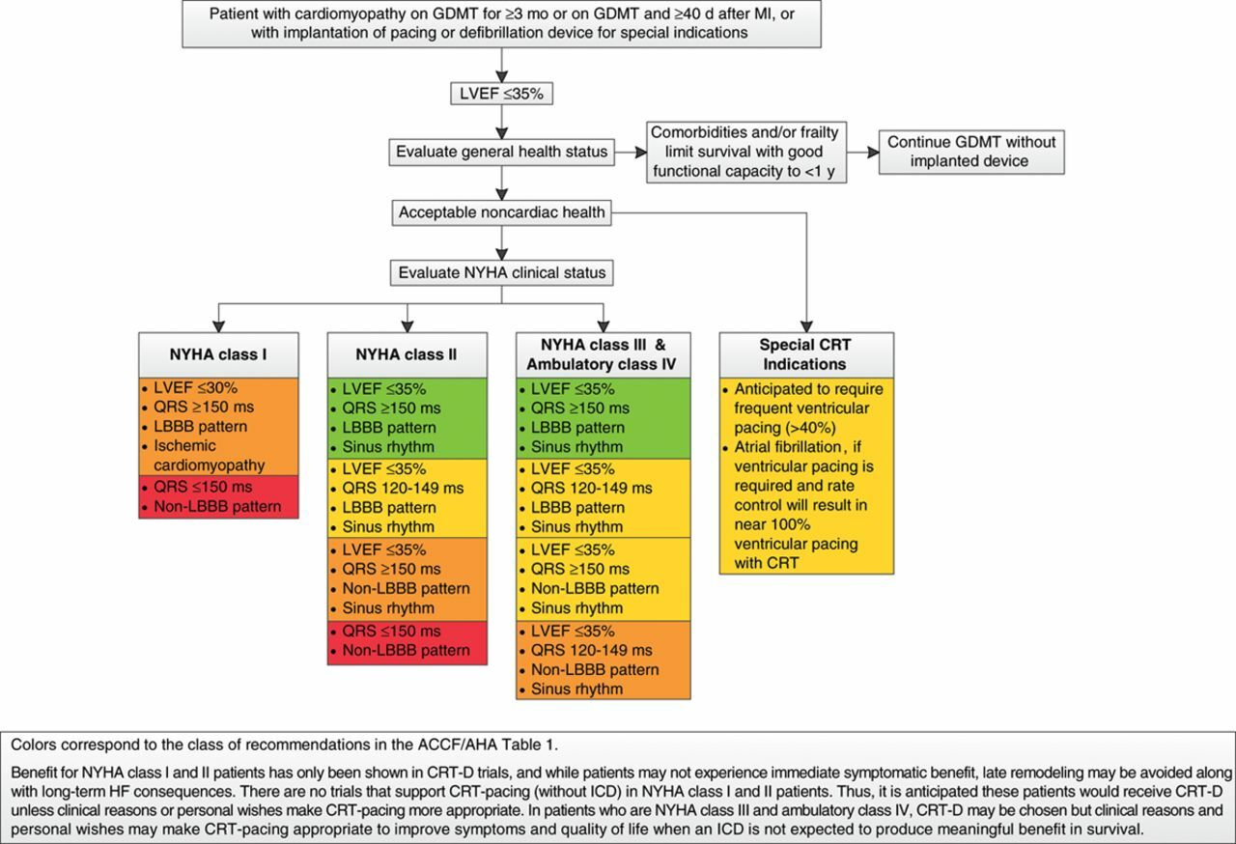
© 2013 American Heart Association, Inc.
Clyde W. Yancy. Circulation. 2013 ACCF/AHA Guideline for the Management of Heart Failure, Volume: 128, Issue: 16, Pages: e240-e327, DOI: (10.1161/CIR.0b013e31829e8776)

Slide 3
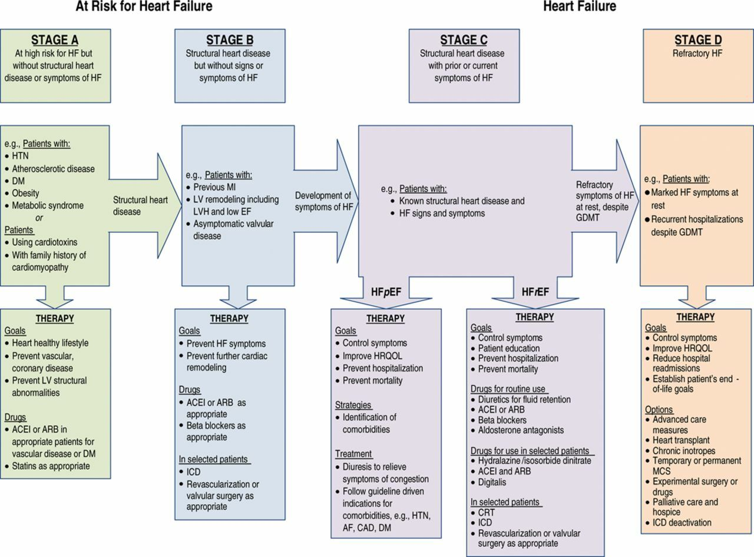
© 2013 American Heart Association, Inc.
Clyde W. Yancy. Circulation. 2013 ACCF/AHA Guideline for the Management of Heart Failure, Volume: 128, Issue: 16, Pages: e240-e327, DOI: (10.1161/CIR.0b013e31829e8776)

Slide 4
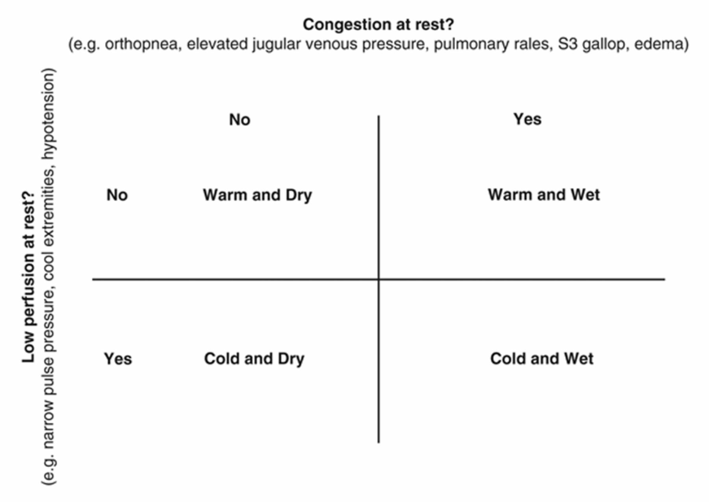
© 2013 American Heart Association, Inc.
Clyde W. Yancy. Circulation. 2013 ACCF/AHA Guideline for the Management of Heart Failure, Volume: 128, Issue: 16, Pages: e240-e327, DOI: (10.1161/CIR.0b013e31829e8776)

Slide 5
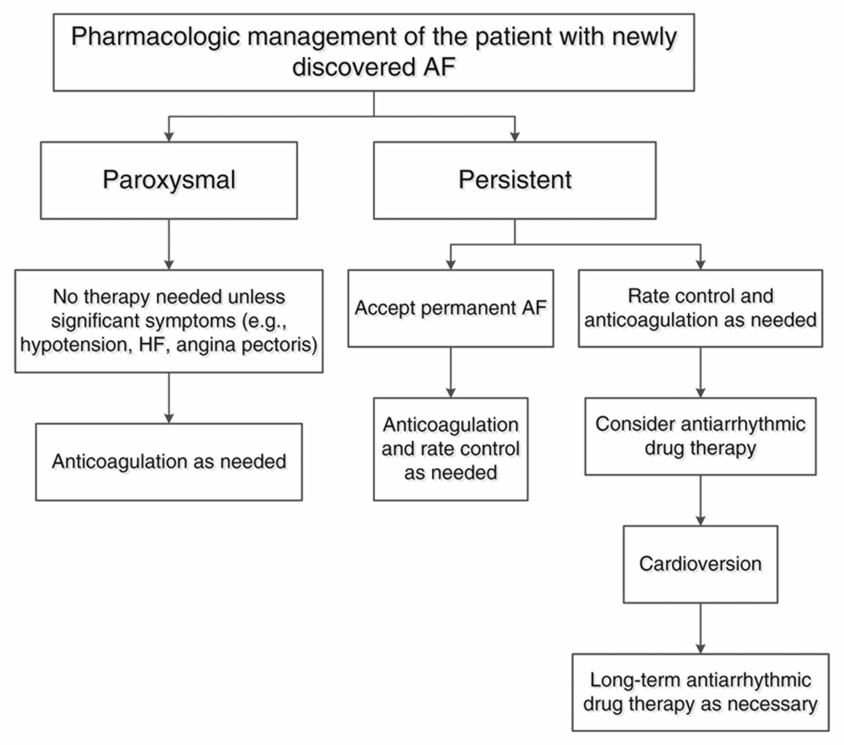
© 2013 American Heart Association, Inc.
Clyde W. Yancy. Circulation. 2013 ACCF/AHA Guideline for the Management of Heart Failure, Volume: 128, Issue: 16, Pages: e240-e327, DOI: (10.1161/CIR.0b013e31829e8776)

Slide 6
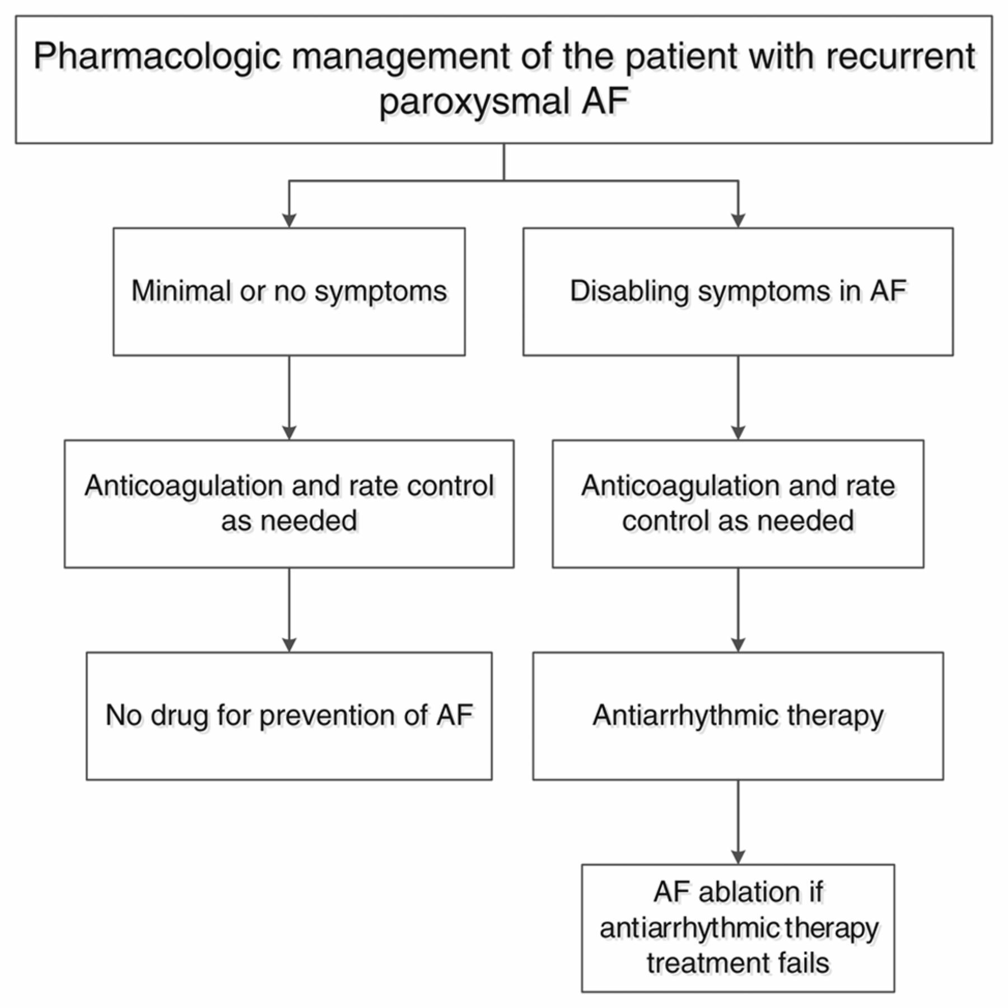
© 2013 American Heart Association, Inc.
Clyde W. Yancy. Circulation. 2013 ACCF/AHA Guideline for the Management of Heart Failure, Volume: 128, Issue: 16, Pages: e240-e327, DOI: (10.1161/CIR.0b013e31829e8776)

