Slide 1
Working formulation for the standardization of definitions of infections in patients using ventricular assist devices
Margaret M. Hannan, MD, Shahid Husain, MD, Frauke Mattner, MD, Lara Danziger-Isakov, MD, Richard J. Drew, MB, G. Ralph Corey, MD, Stephan Schueler, MD, PhD, William L. Holman, MD, Leo P. Lawler, MD, Steve M. Gordon, MD, Niall G. Mahon, MD, John M. Herre, MD, Kate Gould, MB, Jose G. Montoya, MD, Robert F. Padera, MD, PhD, Robert L. Kormos, MD, John V. Conte, MD, Martha L. Mooney, MD
The Journal of Heart and Lung Transplantation
Volume 30 Issue 4 Pages 375-384 (April 2011)
DOI: 10.1016/j.healun.2011.01.717
Copyright © 2011 International Society for Heart and Lung Transplantation Terms and Conditions

Slide 2
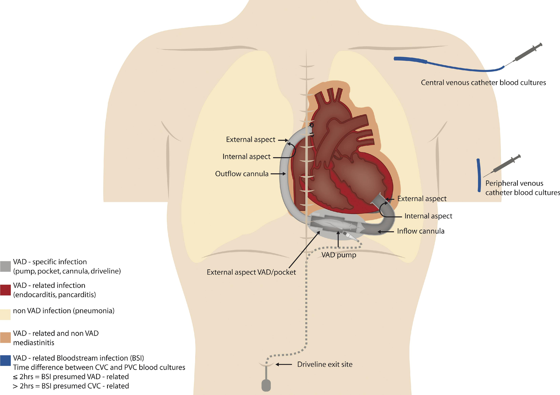
Figure 1
The Journal of Heart and Lung Transplantation 2011 30375-384DOI: (10.1016/j.healun.2011.01.717)
Copyright © 2011 International Society for Heart and Lung Transplantation Terms and Conditions
Notes:
Illustration of ventricular assist device VAD-specific, VAD-related, and non-VAD infection. CVC, central venous catheter; PVC, peripheral vascular catheter.

