Slide 1
International Society for Heart and Lung Transplantation working formulation of a standardized nomenclature for cardiac allograft vasculopathy—2010
Mandeep R. Mehra, MD, Maria G. Crespo-Leiro, MD, Anne Dipchand, MD, Stephan M. Ensminger, MD, PhD, Nicola E. Hiemann, MD, Jon A. Kobashigawa, MD, Joren Madsen, MD, PhD, Jayan Parameshwar, MD, Randall C. Starling, MD, MPH, Patricia A. Uber, BS, PharmD
The Journal of Heart and Lung Transplantation
Volume 29 Issue 7 Pages 717-727 (July 2010)
DOI: 10.1016/j.healun.2010.05.017
Copyright © 2010 International Society for Heart and Lung Transplantation Terms and Conditions

Slide 2
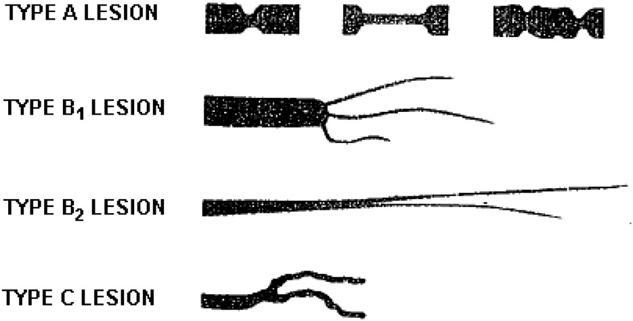
Figure 1
The Journal of Heart and Lung Transplantation 2010 29717-727DOI: (10.1016/j.healun.2010.05.017)
Copyright © 2010 International Society for Heart and Lung Transplantation Terms and Conditions
Notes:
Anatomic abnormalities in transplant coronary vascular disease.⁶ Type A lesion: discrete, tubular or multiple stenoses. Type B1 lesion: abrupt onset with distal diffuse concentric narrowing and obliterated vessels. Type B2 lesion: gradual, concentric tapering with distal portion having some residual lumen. Type C lesion: narrowed irregular distal branches with terminations that are often non-tapered and squared off, ending abruptly.

