Slide 1
Report of the Psychosocial Outcomes Workgroup of the Nursing and Social Sciences Council of the International Society for Heart and Lung Transplantation: Present Status of Research on Psychosocial Outcomes in Cardiothoracic Transplantation: Review and Recommendations for the Field
Sandra Cupples, DNSc, RN, Mary Amanda Dew, PhD, Kathleen L. Grady, PhD, APN, Sabina De Geest, PhD, RN, Fabienne Dobbels, PhD, Dorothy Lanuza, PhD, RN, Wayne Paris, PhD
The Journal of Heart and Lung Transplantation
Volume 25 Issue 6 Pages 716-725 (June 2006)
DOI: 10.1016/j.healun.2006.02.005
Copyright © 2006 International Society for Heart and Lung Transplantation Terms and Conditions

Slide 2
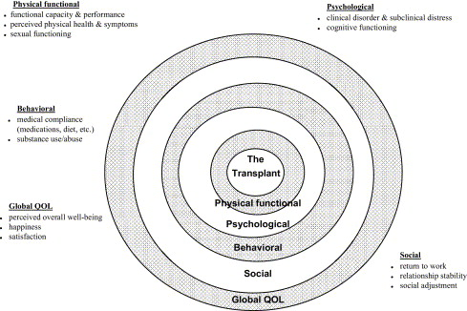
Figure 1
The Journal of Heart and Lung Transplantation 2006 25716-725DOI: (10.1016/j.healun.2006.02.005)
Copyright © 2006 International Society for Heart and Lung Transplantation Terms and Conditions
Notes:
Conceptualization of key post-transplant psychosocial domains and specific outcomes within each. This multidimensional conceptual perspective derives from the larger field of psychosocial and QOL research in the context of chronic illness.^{53,98,99} Adapted from Dew MA, Switzer GE, DiMartini AF, et al. Psychosocial assessments and outcomes in organ transplantation. Prog Transplant 2000; 10;239–59. Used with permission.

