Slide 1
A review of lung transplant donor acceptability criteria
Jonathan B Orens, MD, Annette Boehler, MD, Marc de Perrot, MD, Marc Estenne, MD, Allan R Glanville, MD, FRACP, Shaf Keshavjee, MD, Robert Kotloff, MD, Judith Morton, MBBS, FRACP, Sean M Studer, MD, Dirk Van Raemdonck, MD, PhD, Thomas Waddel, MD, MSc, PhD, FRCSC, Gregory I Snell, MBBS, FRACP
The Journal of Heart and Lung Transplantation
Volume 22 Issue 11 Pages 1183-1200 (November 2003)
DOI: 10.1016/S1053-2498(03)00096-2

Slide 2
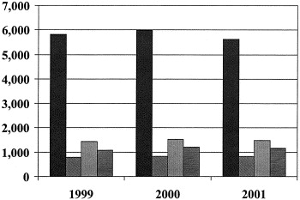
FIGURE 1
The Journal of Heart and Lung Transplantation 2003 221183-1200DOI: (10.1016/S1053-2498(03)00096-2)
Notes:
Cadaveric donors offered (≥ 1 organ) and lungs recovered and transplanted, January 1999 to November 2001. Filled bars: donors offered; diagonally lined bars: lung donors; vertically lined bars: lungs recovered; horizontally lined bars: lungs transplanted. (data source: UNOS/OPTN, as of March 29, 2002).

Slide 3
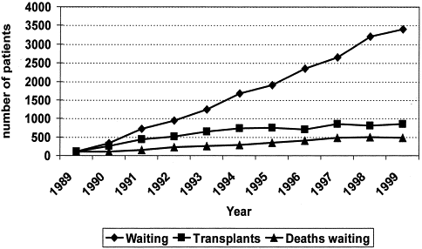
FIGURE 2
The Journal of Heart and Lung Transplantation 2003 221183-1200DOI: (10.1016/S1053-2498(03)00096-2)
Notes:
Yearly increase in the number of patients waiting, lung transplants performed and deaths while on the waiting list. (From Trulock, Semin Resp Crit Care Med, 2001 [UNOS data] with permission).

