Slide 1
ACC/AHA guidelines for the evaluation and management of chronic heart failure in the adult: executive summary
Sharon A Hunt, MD, David W Baker, MD, MPH, Marshall H Chin, MD, MPH, Michael P Cinquegrani, MD, Arthur M Feldman, MD, PhD, Gary S Francis, MD, Theodore G Ganiats, MD, Sidney Goldstein, MD, Gabriel Gregoratos, MD, Mariell L Jessup, MD, R.Joseph Noble, MD, Milton Packer, MD, Marc A Silver, MD, Lynne Warner Stevenson, MD, Raymond J Gibbons, MD, Elliott M Antman, MD, Joseph S Alpert, MD, David P Faxon, MD, Valentin Fuster, MD, PhD, Gabriel Gregoratos, MD, Alice K Jacobs, MD, Loren F Hiratzka, MD, Richard O Russell, MD, Sidney C Smith, MD
The Journal of Heart and Lung Transplantation
Volume 21 Issue 2 Pages 189-203 (February 2002)
DOI: 10.1016/S1053-2498(01)00776-8

Slide 2
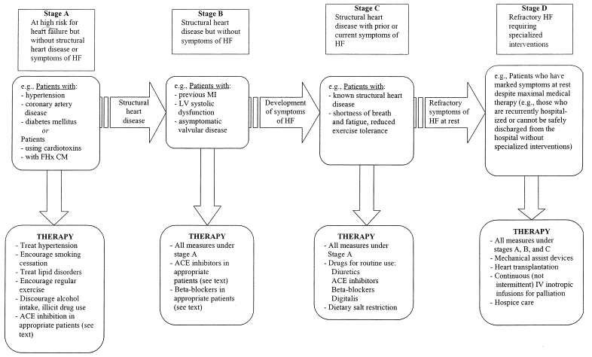
FIGURE
The Journal of Heart and Lung Transplantation 2002 21189-203DOI: (10.1016/S1053-2498(01)00776-8)
Notes:
Stages in the evolution of HF and recommended therapy by stage. FHx CM indicates family history of cardiomyopathy; MI, myocardial infarction; LV, left ventricular; and IV, intravenous.

