Slide 1
Maximizing use of organs recovered from the cadaver donor: cardiac recommendations1
Jonathan G Zaroff, MD, Bruce R Rosengard, MD, William F Armstrong, MD, Wayne D Babcock, BSN, Anthony D’Alessandro, MD, G.William Dec, MD, Niloo M Edwards, MD, Robert S Higgins, MD, Valluvan Jeevanandum, MD, Myron Kauffman, MD, James K Kirklin, MD, Stephen R Large, MD, Daniel Marelli, MD, Tammie S Peterson, RN, W.Steves Ring, MD, Robert C Robbins, MD, Stuart D Russell, MD, David O Taylor, MD, Adrian Van Bakel, MD, John Wallwork, MB, James B Young, MD
The Journal of Heart and Lung Transplantation
Volume 21 Issue 11 Pages 1153-1160 (November 2002)
DOI: 10.1016/S1053-2498(02)00526-0

Slide 2
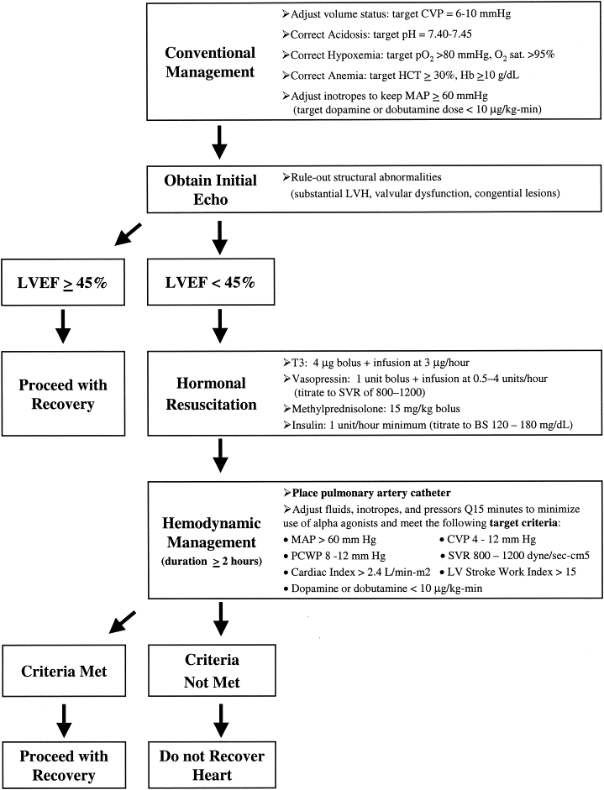
FIGURE 1
The Journal of Heart and Lung Transplantation 2002 211153-1160DOI: (10.1016/S1053-2498(02)00526-0)
Notes:
Recommended heart donor management algorithm, which has been incorporated into UNOS critical pathway. CVP indicates central venous pressure; sat., saturation; HCT, hematocrit; MAP, mean arterial pressure; echo, echocardiography; LVEF, left ventricular ejection fraction; T3, triiodothyronine; SVR, systemic vascular resistance; BG, blood glucose; PCWP, pulmonary capillary wedge pressure.

