Slide 1
Report of the xenotransplantation advisory committee of the international society for heart and lung transplantation:
D.K.C. Cooper, MD, A.M. Keogh, MD, J. Brink, P.A. Corris, W. Klepetko, MD, R.N. Pierson, MD, M. Schmoeckel, MD, R. Shirakura, MD, L. Warner Stevenson, MD
The Journal of Heart and Lung Transplantation
Volume 19 Issue 12 Pages 1125-1165 (December 2000)
DOI: 10.1016/S1053-2498(00)00224-2

Slide 2
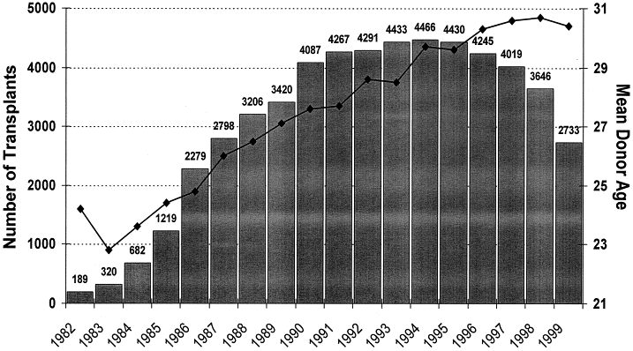
FIGURE 1
The Journal of Heart and Lung Transplantation 2000 191125-1165DOI: (10.1016/S1053-2498(00)00224-2)
Notes:
Number of heart transplants performed annually worldwide in the years 1982–1999, inclusive (Courtesy J. Hosenpud, MD, International Society for Heart and Lung Transplantation/United Network for Organ Sharing Registry).

Slide 3
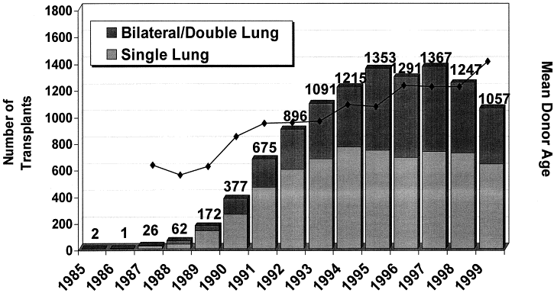
FIGURE 2
The Journal of Heart and Lung Transplantation 2000 191125-1165DOI: (10.1016/S1053-2498(00)00224-2)
Notes:
Number of single and bilateral/double lung transplants performed annually worldwide in the years 1985–1999, inclusive (Courtesy J. Hosenpud, MD, International Society for Heart and Lung Transplantation/United Network for Organ Sharing Registry).

