Slide 1
THE INTERNATIONAL THORACIC ORGAN TRANSPLANT (TTX) REGISTRY OF THE INTERNATIONAL SOCIETY FOR HEART AND LUNG TRANSPLANTATION:
ANNUAL REPORT

Slide 2
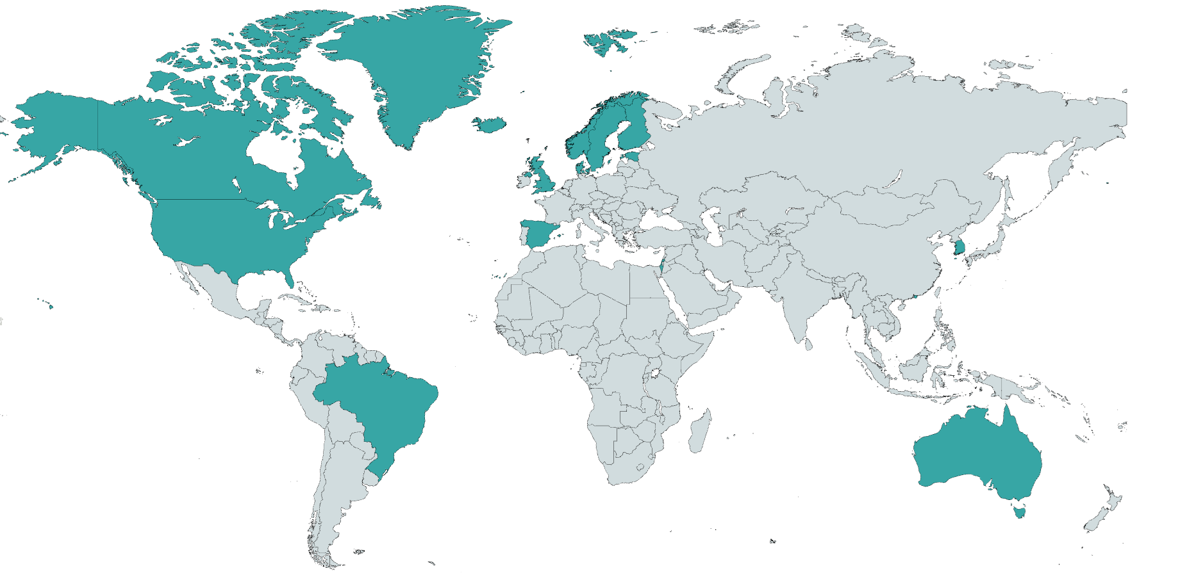
MAJOR CONTRIBUTORS TO THE ISHLT TTX REGISTRY

Slide 3
MAJOR CONTRIBUTORS TO THE ISHLT TTX REGISTRY
Organization | Countries | Heart | Heart-Lung | Lung
BC Transplant | Canada | x | x | x
Brazilian Association of Organ Transplantation | Brazil | x | x | x
Canadian Blood Services | Canada | x | x | x
Hong Kong – Queen Mary Hospital | Hong Kong | x |  | x
Korean Organ Transplantation Registry (KOTRY) | South Korea | x |  | x
NHS Blood and Transplant | United Kingdom | x | x | x
Organización Nacional de Trasplantes (ONT) | Spain |  | x | x
Registro Español de Trasplante Cardíaco | Spain | x | x
Scandiatransplant | Denmark, Estonia, Finland, Iceland, Norway, Sweden | x | x | x
St. Vincent’s Hospital | Australia | x
The Israeli National Transplant Center | Israel | x |  | x
United Network for Organ Sharing (UNOS) | United States | x | x | x

Slide 4
TTX REGISTRY STEERING COMMITTEE
Rebecca Cogswell – Medical Director/Chair
Göran Dellgren – Vice Chair
Michael Perch – Associate Dir. for Lung/Heart-Lung Transplantation
Eileen Hsich – Associate Dir. for Heart Transplantation
TP Singh – Associate Dir. for Pediatric Heart Transplantation
Don Hayes – Associate Dir. for Pediatric Lung/Heart-Lung Transplantation
Wida Cherikh – Biostatistician

Slide 5
ACKNOWLEDGMENTS:
We wish to extend our sincere thanks
to the many thoracic transplant
surgeons, physicians and data
coordinators in transplant programs
throughout the world whose submission of data has made these analyses possible.

Slide 6
TTX REGISTRY DATABASE:
Number of Transplants Reported by Organ and Age Group
Organ | Transplants Performed during 1992-2024
 | Adult | Pediatric | Total
Heart | 98,176 | 14,357 | 112,533
Heart-Lung | 1,906 | 301 | 2,207
Lung | 67,861 | 1,925 | 69,786
Note: Excludes transplants with unknown organ type or age.

Slide 7
HEART TRANSPLANTATION
Descriptive Analysis

Slide 8
Adult and Pediatric Heart Transplants, 1992-2023
Number of Transplants by Year and Location
NOTE: This figure includes only the transplants that are reported to the ISHLT Transplant Registry. As such, the presented data may not mirror the changes in the number of transplants performed worldwide.

Slide 9
Adult Heart Transplants, 1992-2023
Number of Transplants by Year and Location
NOTE: This figure includes only the transplants that are reported to the ISHLT Transplant Registry. As such, the presented data may not mirror the changes in the number of transplants performed worldwide.

Slide 10
Pediatric Heart Transplants, 1992-2023
Number of Transplants by Year and Location
NOTE: This figure includes only the transplants that are reported to the ISHLT Transplant Registry. As such, the presented data may not mirror the changes in the number of transplants performed worldwide.

Slide 11
Heart Transplants, 1992-2024
 | Adult Heart | Pediatric Heart
 | (N = 98,176) | (N = 14,357)
Geographic location
Europe | 17.0% | 15.2%
North America | 78.2% | 81.6%
Other | 4.8% | 3.2%
Transplant era
1992-2000 | 23.8% | 20.0%
2001-2009 | 21.5% | 23.7%
2010-2017 | 24.3% | 27.6%
2018-2024 | 30.3% | 28.7%
DCD transplant | 2.4% | 0.4%
Multiorgan transplant | 4.5% | 0.7%
Total organ preservation time (hours) | 3.2 (1.5 - 5.1) | 3.6 (1.7 - 5.6)
Summary statistics included transplants with non-missing data;
Categorical factors are expressed as percentages and continuous factors are expressed as median (5th – 95th percentiles)
Notes:
Abbreviations: DCD = donation after circulatory death

Slide 12
Heart Transplants, 1992-2024
 | Adult Heart | Pediatric Heart
 | (N = 98,176) | (N = 14,357)
Recipient age (years) | 55.0 (26.0 - 68.0) | 6.0 (0.1 - 17.0)
Recipient male | 75.3% | 55.6%
Recipient BMI (kg/m²) | 26.2 (19.4 - 35.0) | 16.6 (12.4 - 27.8)
Recipient previous transplant | 2.8% | 4.9%
Recipient prior cardiac surgery | 44.2% | N/A
Pre-transplant ventilator | 3.2% | 16.5%
Recipient total bilirubin (mg/dl) | 0.7 (0.2 - 2.6) | 0.6 (0.2 - 3.9)
Recipient eGFR (mL/min/1.73m²) | 60.3 (30.1 - 102.1) | 88.9 (32.9 - 173.5)
PVR (Wood units) | 2.1 (0.6 - 5.4) | 2.6 (0.6 – 13.1)
Summary statistics included transplants with non-missing data
Continuous factors are expressed as median (5th – 95th percentiles)
Notes:
Abbreviations: BMI = body mass index; eGFR = estimated glomerular filtration rate; PVR = pulmonary vascular resistance

Slide 13
Heart Transplants, 1992-2024
 | Adult Heart | Pediatric Heart
 | (N = 98,176) | (N = 14,357)
Donor age (years) | 32.0 (16.0 - 54.0) | 8.0 (0.0 - 34.0)
Donor male | 70.3% | 58.4%
Donor history of diabetes | 3.1% | 1.0%
Donor history of hypertension | 13.7% | 1.6%
Donor drug use | 54.3% | 15.1%
Donor anti-HCV positive | 8.7% | 5.0%
Donor HCV NAT positive | 4.9% | 0.0%
Donor LV ejection fraction (%) | 60.0 (50.0 - 75.0) | 65.0 (50.0 - 77.0)
Donor-recipient predicted heart mass difference (%) | 0.9 (-22.6 - 37.7) | N/A
Donor-recipient weight ratio | N/A | 1.3 (0.8 - 2.5)
Summary statistics included transplants with non-missing data
Continuous factors are expressed as median (5th – 95th percentiles)
Notes:
Abbreviations: HCV= hepatitis C virus; NAT = nucleic acid testing

Slide 14
Heart Transplants by ABO Blood Group, 1992-2024
Adult Transplants
Pediatric Transplants

Slide 15
Heart Transplants by Diagnosis, 1992-2024
Adult Transplants
Pediatric Transplants
Notes:
Abbreviations: CHD, congenital heart disease; DCM, dilated cardiomyopathy; NICM, non-ischemic cardiomyopathy; HCM, hypertrophic cardiomyopathy; ICM, ischemic cardiomyopathy; RICM, restrictive cardiomyopathy; VCM, valvular cardiomyopathy

Slide 16
Annual Number of Adult Heart Transplants by Diagnosis, 1992-2023
Notes:
Abbreviations: CHD, congenital heart disease; NICM, non-ischemic cardiomyopathy; HCM, hypertrophic cardiomyopathy; ICM, ischemic cardiomyopathy; RICM, restrictive cardiomyopathy; VCM, valvular cardiomyopathy

Slide 17
Annual Number of Pediatric Heart Transplants by Diagnosis, 1992-2023
Notes:
Abbreviations: CHD, congenital heart disease; DCM, dilated cardiomyopathy

Slide 18
Heart Transplants by Peak PRA/CPRA, 1992-2024
Adult Transplants
Pediatric Transplants
Notes:
Abbreviations: PRA/CPRA, panel reactive antibody/calculated panel reactive antibody

Slide 19
Adult Heart Transplants, 2005-2024
% Bridged with Mechanical Circulatory Support*
* MCS includes ECMO, durable LVAD, and temporary MCS (IABP, microaxial LVAD, extracorporeal LVAD). Excludes transplants with RVAD, BiVAD, or TAH.
Notes:
Abbreviations: MCS, mechanical circulatory support; ECMO, extracorporeal membrane oxygenation; LVAD, left ventricular assist device; IABP, intra-aortic balloon pump; RVAD, right ventricular assist device; TAH, total artificial heart

Slide 20
Adult Heart Transplants by Year and Mechanical Circulatory Support Type, 2005-2024
Note: Temporary MCS includes IABP, microaxial LVAD, extracorporeal LVAD. Excludes transplants with RVAD, BiVAD, or TAH.
Notes:
Abbreviations: MCS, mechanical circulatory support; ECMO, extracorporeal membrane oxygenation; LVAD, left ventricular assist device; IABP, intra-aortic balloon pump; RVAD, right ventricular assist device; TAH, total artificial heart

Slide 21
Adult Heart Transplants, 2005-2024
% of Recipients Bridged with Mechanical Circulatory Support by Year
Note: Temporary MCS includes IABP, microaxial LVAD, extracorporeal LVAD. Excludes transplants with RVAD, BiVAD, or TAH. Annual percentage was calculated among all transplants each year.
Notes:
Abbreviations: MCS, mechanical circulatory support; ECMO, extracorporeal membrane oxygenation; LVAD, left ventricular assist device; IABP, intra-aortic balloon pump; RVAD, right ventricular assist device; TAH, total artificial heart

Slide 22
Pediatric Heart Transplants, 2005-2024
% Bridged with Mechanical Circulatory Support*
* MCS includes ECMO, durable LVAD, and temporary MCS (IABP, microaxial LVAD, extracorporeal LVAD). Excludes transplants with RVAD, BiVAD, or TAH.
Notes:
Abbreviations: MCS, mechanical circulatory support; ECMO, extracorporeal membrane oxygenation; LVAD, left ventricular assist device; IABP, intra-aortic balloon pump; RVAD, right ventricular assist device; TAH, total artificial heart

Slide 23
Pediatric Heart Transplants by Year and Mechanical Circulatory Support Type, 2005-2024
Note: Temporary MCS includes IABP, microaxial LVAD, extracorporeal LVAD. Excludes transplants with RVAD, BiVAD, or TAH.
Notes:
Abbreviations: MCS, mechanical circulatory support; ECMO, extracorporeal membrane oxygenation; LVAD, left ventricular assist device; IABP, intra-aortic balloon pump; RVAD, right ventricular assist device; TAH, total artificial heart

Slide 24
Pediatric Heart Transplants, 2005-2024
% of Recipients Bridged with Mechanical Circulatory Support by Year
Note: Temporary MCS includes IABP, microaxial LVAD, extracorporeal LVAD. Excludes transplants with RVAD, BiVAD, or TAH. Annual percentage was calculated among all transplants each year.
Notes:
Abbreviations: MCS, mechanical circulatory support; ECMO, extracorporeal membrane oxygenation; LVAD, left ventricular assist device; IABP, intra-aortic balloon pump; RVAD, right ventricular assist device; TAH, total artificial heart

Slide 25
Annual Number of Heart Transplants with ECMO by Region, 2005-2023
Notes:
Abbreviation: ECMO, extracorporeal membrane oxygenation

Slide 26
Annual Number of Heart Transplants with Durable LVAD by Region, 2005-2023
Notes:
Abbreviation: LVAD, left ventricular assist device

Slide 27
Annual Number of Heart Transplants with Temporary MCS by Region, 2005-2023
Notes:
Abbreviation: MCS, mechanical circulatory support;

Slide 28
Annual Number of Heart Transplants from HCV Seropositive Donors, 2005-2023
Notes:
Abbreviations: HCV, hepatitis C virus

Slide 29
Annual Number of Heart Transplants from Donors with Drug Use*, 2005-2023
* Includes cocaine and other non-intravenous drug use

Slide 30
Heart Transplants by Donor Cause of Death, 1992-2024
Adult Transplants
Pediatric Transplants
Notes:
Abbreviation: CNS, central nervous system

Slide 31
Adult Primary Heart Alone Transplants, 1992-2023
Kaplan-Meier Survival by Era
All pairwise comparisons were statistically significant at p < 0.0001, except 2010-2017 vs. 2018-2023 (p=0.0818)
1992-2000 | 21692 | 20245 | 19798 | 19602 | 19437 | 19315 | 19188 | 19051 | 18888 | 18780 | 18689 | 18603 | 18495
2001-2009 | 19117 | 18188 | 17949 | 17798 | 17687 | 17582 | 17491 | 17381 | 17251 | 17169 | 17096 | 17024 | 16925
2010-2017 | 20306 | 19636 | 19393 | 19254 | 19141 | 19067 | 18982 | 18892 | 18792 | 18725 | 18664 | 18613 | 18541
2018-2023 | 20600 | 20079 | 19831 | 19620 | 19424 | 19285 | 18837 | 18144 | 17746 | 17476 | 17380 | 17209 | 15961
Number at risk
Note: The Y-axis was truncated to better highlight the differences in survival rates.

Slide 32
Pediatric Primary Heart Alone Transplants, 1992-2023
Kaplan-Meier Survival by Era
1992-2000 | 2629 | 2371 | 2305 | 2275 | 2249 | 2223 | 2199 | 2181 | 2161 | 2154 | 2138 | 2124 | 2113
2001-2009 | 3057 | 2901 | 2859 | 2825 | 2802 | 2788 | 2771 | 2754 | 2739 | 2725 | 2713 | 2700 | 2684
2010-2017 | 3511 | 3431 | 3400 | 3375 | 3353 | 3335 | 3309 | 3288 | 3274 | 3259 | 3248 | 3239 | 3227
2018-2023 | 3125 | 3074 | 3039 | 3011 | 2979 | 2958 | 2903 | 2799 | 2742 | 2707 | 2677 | 2644 | 2499
Number at risk
Note: The Y-axis was truncated to better highlight the differences in survival rates.

Slide 33
ADULT HEART TRANSPLANTATION
Multivariable Cox Model

Slide 34
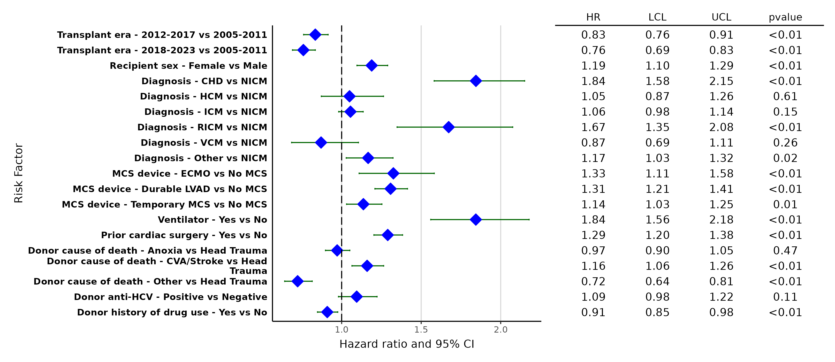
Adult Primary Heart Alone Transplants, 2005-2023
Categorical Risk Factors For One-Year Mortality with 95% Confidence Limits
Notes:
Abbreviations: CHD = congenital heart disease, NICM = non-ischemic cardiomyopathy, HCM = hypertrophic cardiomyopathy, ICM = ischemic cardiomyopathy, RICM = restrictive cardiomyopathy, VCM = valvular cardiomyopathy, ECMO = extracorporeal membrane oxygenation, LVAD = left ventricular assist device, MCS = mechanical circulatory support, CVA = cerebrovascular accident, HCV = hepatitis C virus

Slide 35
Adult Primary Heart Alone Transplants, 2005-2023
Statistically Significant Continuous Risk Factors for One-Year Mortality
Continuous Factors (see figures)
Recipient age (years)
Recipient eGFR (mL/min/1.73 m²)
Recipient bilirubin (mg/dL)
PVR (Wood units)
Donor age (years)
Organ preservation time (hours)
Notes:
Abbreviations: eGFR, estimated glomerular filtration rate; PVR, pulmonary vascular resistance

Slide 36
Adult Primary Heart Alone Transplants, 2005-2023
Statistically Significant Continuous Risk Factors For One-Year Mortality with 95% Confidence Limits
Recipient age (years)

Slide 37
Adult Primary Heart Alone Transplants, 2005-2023
Statistically Significant Continuous Risk Factors For One-Year Mortality with 95% Confidence Limits
Recipient eGFR (mL/min/1.73m²)
p < 0.0001
Notes:
Abbreviations: eGFR, estimated glomerular filtration rate

Slide 38
Adult Primary Heart Alone Transplants, 2005-2023
Statistically Significant Continuous Risk Factors For One-Year Mortality with 95% Confidence Limits
Recipient bilirubin (mg/dL)
p < 0.0001

Slide 39
Adult Primary Heart Alone Transplants, 2005-2023
Statistically Significant Continuous Risk Factors For One-Year Mortality with 95% Confidence Limits
PVR (Wood units)
p < 0.0001
Notes:
Abbreviations: PVR, pulmonary vascular resistance

Slide 40
Adult Primary Heart Alone Transplants, 2005-2023
Statistically Significant Continuous Risk Factors For One-Year Mortality with 95% Confidence Limits
Donor age (years)

Slide 41
Adult Primary Heart Alone Transplants, 2005-2023
Statistically Significant Continuous Risk Factors For One-Year Mortality with 95% Confidence Limits
Organ preservation time (hours)
p < 0.0001

Slide 42
PEDIATRIC HEART TRANSPLANTATION
Multivariable Cox Model

Slide 43
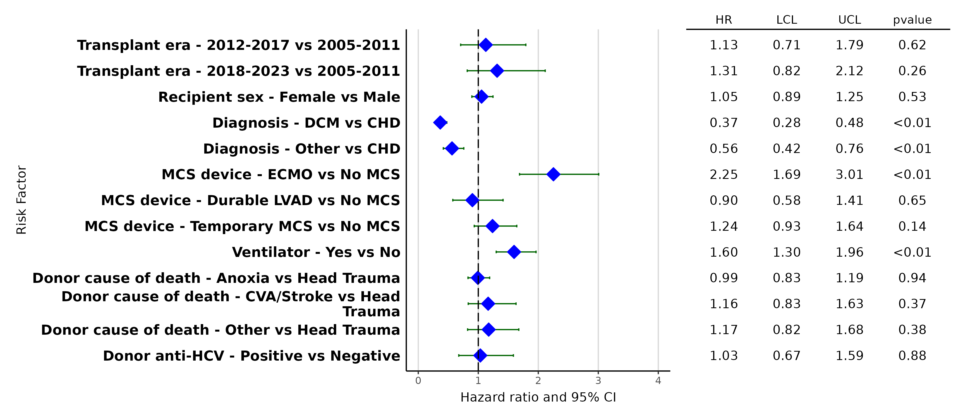
Pediatric Primary Heart Alone Transplants, 2005-2023
Categorical Risk Factors For One-Year Mortality with 95% Confidence Limits
Notes:
Abbreviations: DCM = dilated cardiomyopathy, CHD = congenital heart disease, ECMO = extracorporeal membrane oxygenation, LVAD = left ventricular assist device, MCS = mechanical circulatory support, CVA = cerebrovascular accident, HCV = hepatitis C virus

Slide 44
Pediatric Primary Heart Alone Transplants, 2005-2023
Statistically Significant Continuous Risk Factors for One-Year Mortality
Continuous Factors (see figures)
Recipient eGFR (mL/min/1.73 m²)
Peak PRA/CPRA (%)
Organ preservation time (hours)
Notes:
Abbreviations: eGFR, estimated glomerular filtration rate; PRA/CPRA, panel reactive antibody/calculated panel reactive antibody

Slide 45
Pediatric Heart Transplants, 2005-2023
Statistically Significant Continuous Risk Factors For One-Year Mortality with 95% Confidence Limits
Recipient eGFR (mL/min/1.73m²)
p < 0.0001
Notes:
Abbreviations: eGFR, estimated glomerular filtration rate

Slide 46
Pediatric Primary Heart Alone Transplants, 2005-2023
Statistically Significant Continuous Risk Factors For One-Year Mortality with 95% Confidence Limits
Peak PRA/CPRA (%)
p = 0.0059
Notes:
Abbreviations: PRA/CPRA, panel reactive antibody/calculated panel reactive antibody

Slide 47
Pediatric Primary Heart Alone Transplants, 2005-2023
Statistically Significant Continuous Risk Factors For One-Year Mortality with 95% Confidence Limits
Organ preservation time (hours)
p = 0.0022

Slide 48
LUNG TRANSPLANTATION
Descriptive Analysis

Slide 49
Adult and Pediatric Lung Transplants, 1992-2023
Number of Transplants by Year and Location
NOTE: This figure includes only the transplants that are reported to the ISHLT Transplant Registry. As such, the presented data may not mirror the changes in the number of transplants performed worldwide.

Slide 50
Adult Lung Transplants, 1992-2023
Number of Transplants by Year and Location
NOTE: This figure includes only the transplants that are reported to the ISHLT Transplant Registry. As such, the presented data may not mirror the changes in the number of transplants performed worldwide.

Slide 51
Pediatric Lung Transplants, 1992-2023
Number of Transplants by Year and Location
NOTE: This figure includes only the transplants that are reported to the ISHLT Transplant Registry. As such, the presented data may not mirror the changes in the number of transplants performed worldwide.

Slide 52
Lung Transplants, 1992-2024
 | Adult Lung | Pediatric Lung
 | (N = 67,861) | (N = 1,925)
Geographic location
Europe | 18.8% | 21.2%
North America | 79.5% | 76.0%
Other | 1.7% | 2.8%
Transplant era
1992-2000 | 11.9% | 24.9%
2001-2009 | 21.7% | 31.2%
2010-2017 | 30.8% | 26.6%
2018-2024 | 35.6% | 17.2%
DCD transplant | 5.2% | 1.5%
Multiorgan transplant | 2.6% | 4.6%
Total organ preservation time (hours) | 5.3 (2.7 - 10.5) | 5.4 (1.8 - 7.9)
Procedure Type
Single | 31.9% | 2.5%
Double | 68.1% | 97.5%
Summary statistics included transplants with non-missing data
Continuous factors are expressed as median (5th – 95th percentiles)
Notes:
Abbreviations: DCD, donation after circulatory death

Slide 53
Lung Transplants, 1992-2024
 | Adult Lung | Pediatric Lung
 | (N = 67,861) | (N = 1,925)
Recipient age (years) | 58.0 (26.0 - 70.0) | 14.0 (0.6 - 17.0)
Recipient male | 58.0% | 42.2%
Recipient BMI (kg/m²) | 24.9 (17.5 - 32.4) | 16.9 (13.1 - 24.2)
Recipient previous transplant | 3.4% | 5.8%
Pre-transplant ECMO | 4.0% | 5.4%
Pre-transplant ventilator | 5.2% | 17.9%
Pre-transplant intravenous inotropes | 70 (0.1%) | 78 (4.9%
Recipient total bilirubin (mg/dl) | 0.5 (0.2 - 1.3) | 0.4 (0.1 - 2.1)
Recipient eGFR (mL/min/1.73m²) | 86.5 (52.5 - 140.6) | 124.7 (56.8 - 227.2)
PVR (Wood units) | 2.7 (1.0 - 8.7) | 4.8 (1.7 - 32.4)
Summary statistics included transplants with non-missing data
Continuous factors are expressed as median (5th – 95th percentiles)
Notes:
Abbreviations: BMI, body mass index; ECMO, extracorporeal membrane oxygenation; eGFR, estimated glomerular filtration rate; PVR, pulmonary vascular resistance

Slide 54
Lung Transplants, 1992-2024
 | Adult Lung | Pediatric Lung
 | (N = 67,861) | (N = 1,925)
Donor age (years) | 36.0 (16.0 - 62.0) | 14.0 (0.0 - 49.0)
Donor male | 58.7% | 49.4%
Male donor to female recipient | 15.7% | 26.7%
Donor history of diabetes | 7.0% | 1.9%
Donor history of hypertension | 22.2% | 4.7%
Donor drug use | 44.8% | 16.6%
Donor cigarette use | 14.5% | 4.2%
Donor anti-HCV positive | 8.7% | 6.5%
Donor HCV NAT positive | 2.8% | 0.0%
Donor pO2 | 420.0 (63.3 - 571.0) | 434.0 (81.4 - 575.0)
Donor pO2/FiO2 ratio | 438.0 (168.8 - 584.5) | 451.0 (201.0 - 586.0)
Donor LV ejection fraction (%) | 60.0 (34.0 - 73.0) | 60.0 (35.0 - 77.0)
Donor-recipient height ratio | 1.0 (0.9 - 1.1) | 1.0 (0.9 - 1.2)
Summary statistics included transplants with non-missing data
Continuous factors are expressed as median (5th – 95th percentiles)
Notes:
Abbreviations: HCV, hepatitis C virus; NAT, nucleic acid testing; LV, left ventricle

Slide 55
Lung Transplants by ABO Blood Group, 1992-2024
Adult Transplants
Pediatric Transplants

Slide 56
Annual Number of Lung Transplants with ECMO by Region
2005-2023 (Adults) and 2009-2023 (Pediatrics)
Notes:
Abbreviations: ECMO, extracorporeal membrane oxygenation

Slide 57
Lung Transplants by Diagnosis, 1992-2024
Adult Transplants
Pediatric Transplants
Notes:
Abbreviations: CF, cystic fibrosis; COPD, chronic obstructive pulmonary disease; IPF, idiopathic pulmonary fibrosis; ILD, not IIP, interstitial lung disease, not idiopathic interstitial pneumonia; PVD, pulmonary vascular disease; OB, obliterative bronchiolitis.

Slide 58
Annual Number of Adult Lung Transplants by Diagnosis, 1992-2023
Notes:
Abbreviations: CF, cystic fibrosis; COPD, chronic obstructive pulmonary disease; IPF, idiopathic pulmonary fibrosis; OB, obliterative bronchiolitis.

Slide 59
Annual Number of Lung Transplants with Cystic Fibrosis Diagnoses by Region, 2005-2023

Slide 60
Annual Number of Pediatric Lung Transplants by Diagnosis, 1992-2023
Notes:
Abbreviations: ILD-Not IIP, interstitial lung disease, not idiopathic interstitial pneumonia, IPAH, idiopathic pulmonary artery hypertension; PH, not IPAH, pulmonary hypertension, not idiopathic pulmonary artery hypertension; OB, obliterative bronchiolitis.

Slide 61
Lung Transplants by Peak PRA/CPRA, 1992-2024
Adult Transplants
Pediatric Transplants
Notes:
Abbreviations: PRA/CPRA, panel reactive antibody/calculated panel reactive antibody

Slide 62
Lung Transplants by Donor Cause of Death, 1992-2024
Adult Transplants
Pediatric Transplants
Notes:
Abbreviations: CNS, central nervous system

Slide 63
Annual Number of Lung Transplants from HCV Seropositive Donors, 2005-2023
Notes:
Abbreviations: HCV, hepatitis C virus

Slide 64
Annual Number of Lung Transplants from Donors with Drug Use*, 2005-2023
* Includes cocaine and other non-intravenous drug use

Slide 65
Adult Primary Lung Alone Transplants, 1992-2023
Kaplan-Meier Survival by Era
1992-2000 | 7709 | 6984 | 6764 | 6621 | 6513 | 6415 | 6302 | 6214 | 6126 | 6041 | 5980 | 5903 | 5825
2001-2009 | 13948 | 13172 | 12840 | 12627 | 12448 | 12286 | 12136 | 12009 | 11871 | 11747 | 11630 | 11501 | 11357
2010-2017 | 19458 | 18814 | 18508 | 18315 | 18132 | 17960 | 17795 | 17610 | 17445 | 17297 | 17142 | 17009 | 16841
2018-2023 | 19519 | 18876 | 18477 | 18191 | 17916 | 17671 | 17272 | 16560 | 16251 | 15886 | 15680 | 15490 | 14413
Number at risk
Note: The Y-axis was truncated to better highlight the differences in survival rates.

Slide 66
Pediatric Primary Lung Alone Transplants, 1992-2023
Kaplan-Meier Survival by Era
1992-2000 | 433 | 398 | 382 | 376 | 368 | 364 | 355 | 345 | 337 | 335 | 334 | 330 | 323
2001-2009 | 550 | 515 | 502 | 499 | 494 | 493 | 486 | 484 | 480 | 476 | 464 | 458 | 454
2010-2017 | 453 | 438 | 430 | 422 | 420 | 416 | 410 | 408 | 403 | 400 | 395 | 389 | 382
2018-2023 | 239 | 229 | 225 | 221 | 217 | 215 | 210 | 206 | 202 | 198 | 195 | 189 | 175
Number at risk
Note: The Y-axis was truncated to better highlight the differences in survival rates.

Slide 67
ADULT LUNG TRANSPLANTATION
Multivariable Cox Model

Slide 68
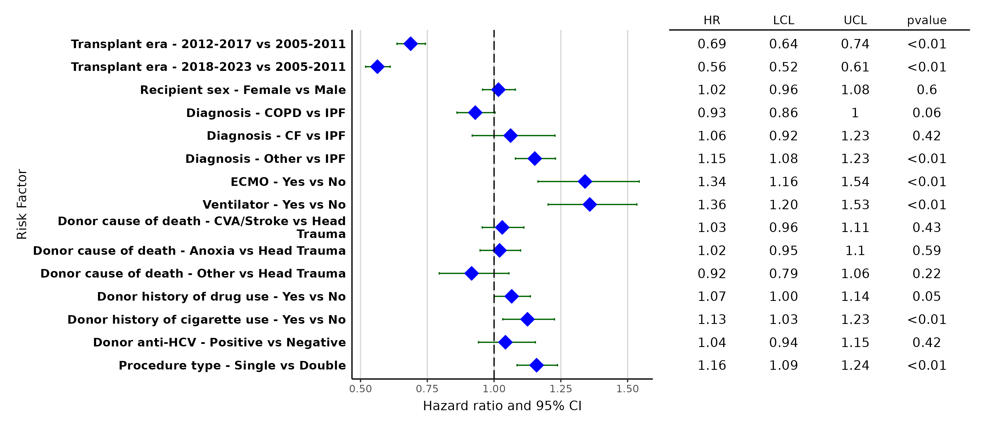
Adult Primary Lung Alone Transplants, 2005-2023
Categorical Risk Factors For One-Year Mortality with 95% Confidence Limits
Notes:
Abbreviations: CF, cystic fibrosis; COPD, chronic obstructive pulmonary disease; IPF, idiopathic pulmonary fibrosis, ECMO, extracorporeal membrane oxygenation; CVA, cerebrovascular; HCV, hepatitis C virus

Slide 69
Adult Primary Lung Alone Transplants, 2005-2023
Statistically Significant Continuous Risk Factors for One-Year Mortality
Continuous Factors (see figures)
Recipient age (years)
Recipient eGFR (mL/min/1.73m²)
Recipient bilirubin (mg/dL) Donor age (years)
Donor-recipient height ratio
Organ preservation time (hours)
Notes:
Abbreviations: eGFR, estimated glomerular filtration rate

Slide 70
Adult Primary Lung Alone Transplants, 2005-2023
Statistically Significant Continuous Risk Factors For One-Year Mortality with 95% Confidence Limits
Recipient age (years)
p < 0.0001

Slide 71
Adult Primary Lung Alone Transplants, 2005-2023
Statistically Significant Continuous Risk Factors For One-Year Mortality with 95% Confidence Limits
Recipient eGFR (mL/min/1.73m²)
p < 0.0001
Notes:
Abbreviations: eGFR, estimated glomerular filtration rate

Slide 72
Adult Primary Lung Alone Transplant, 2005-2023
Statistically Significant Continuous Risk Factors For One-Year Mortality with 95% Confidence Limits
Recipient bilirubin (mg/dL)
p < 0.0001

Slide 73
Adult Primary Lung Alone Transplants, 2005-2023
Statistically Significant Continuous Risk Factors For One-Year Mortality with 95% Confidence Limits
Donor age (years)
p < 0.0001

Slide 74
Adult Primary Lung Alone Transplants, 2005-2023
Statistically Significant Continuous Risk Factors For One-Year Mortality with 95% Confidence Limits
Donor-recipient height ratio
p < 0.0001

Slide 75
Adult Primary Lung Alone Transplants, 2005-2023
Statistically Continuous Risk Factors For One-Year Mortality with 95% Confidence Limits
Organ preservation time (hours)
p < 0.0001

Slide 76
PEDIATRIC LUNG TRANSPLANTATION
Multivariable Cox Model

Slide 77
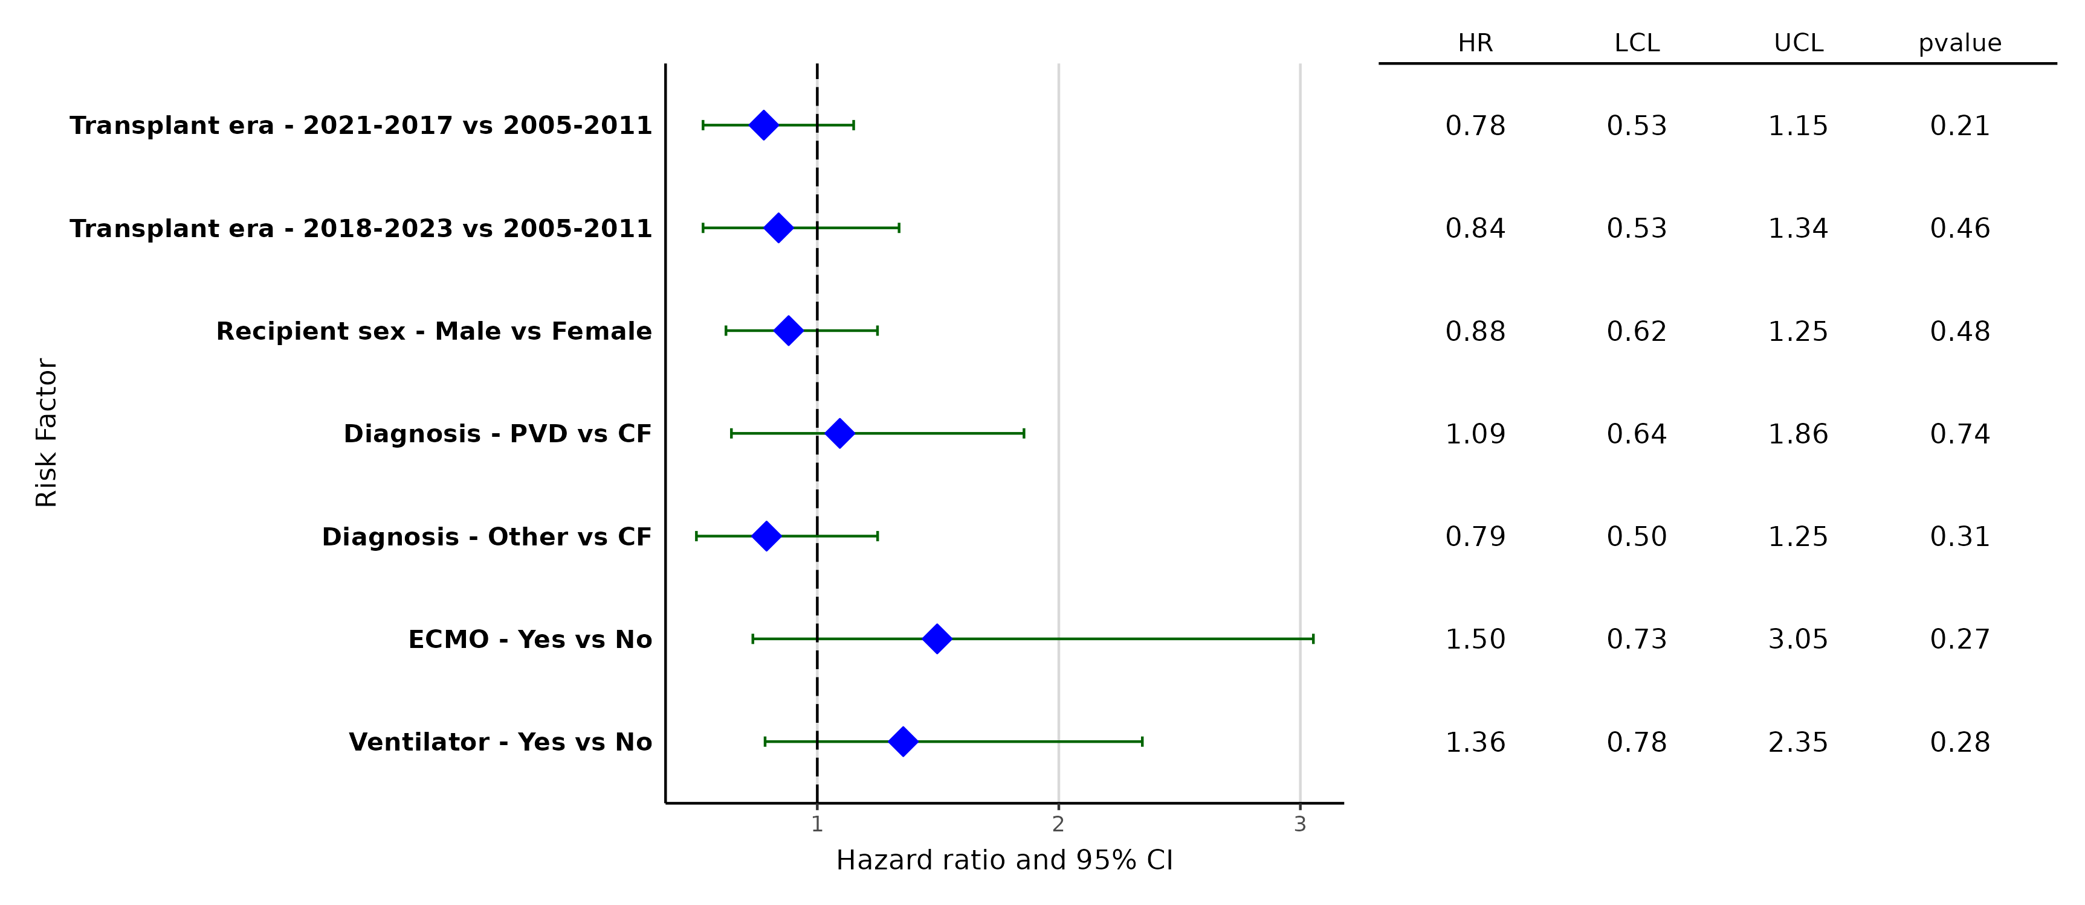
Pediatric Primary Lung Alone Transplants, 2005-2023
Categorical Risk Factors For One-Year Mortality with 95% Confidence Limits
Notes:
Abbreviations: CF, cystic fibrosis; PVD, pulmonary vascular disease; ECMO, extracorporeal membrane oxygenation

Slide 78
Pediatric Primary Lung Alone Transplants, 2005-2023
Statistically Significant Continuous Risk Factors for One-Year Mortality
Continuous Factors (see figures)
Donor age (years)

Slide 79
Pediatric Primary Lung Alone Transplants, 2005-2023
Statistically Significant Continuous Risk Factors For One-Year Mortality with 95% Confidence Limits
Donor age (years)

