Slide 1
SPECIAL REPORT:
EARLY POST-TRANSPLANT DIALYSIS
IN PRIMARY, DECEASED DONOR TRANSPLANT RECIPIENTS
Based on ISHLT TTX Registry database as of April 19, 2019

Slide 2
Table of Contents
Rates of Early Post-transplant Dialysis: slides 3-4
Distribution of Baseline Characteristics by Early Post-transplant Dialysis: slides 5-20
Incidence of Early Post-transplant Dialysis by Select Baseline Characteristics: slides 21-32
Multivariable Logistic Models for Early Post-transplant Dialysis: slides 33-59
Incidence of Dialysis and Severe Renal Dysfunction at 1 Year by Early Post-transplant Dialysis: slides 60-62
Kaplan-Meier Survival by Early Post-transplant Dialysis: slides 63-71

Slide 3
Incidence of Early Post-transplant Dialysis

Slide 4
Incidence of Early Post-transplant Dialysis
(Primary Transplants: January 1994 – June 2018)
Age/Organ | Number of Transplants | Early Post-transplant Dialysis
 |  | N | %
Adult Heart | 50,131 | 4,976 | 9.9%
Pediatric Heart | 7969 | 501 | 6.3%
Adult Lung | 34,510 | 2,098 | 6.1%
Pediatric Lung | 1,185 | 66 | 5.6%
Note: Analysis included first time recipients of single deceased donor transplants; Pediatric heart/lung transplants were included in the pediatric lung transplant cohort. Early dialysis included dialysis that occurred post-transplantation from time to surgical intensive care until hospital discharge.

Slide 5
Distribution of Characteristics by Early Post-transplant Dialysis

Slide 6
Primary Heart Transplants, January 1994 – June 2018
Recipient Characteristics by Early Post-transplant Dialysis
 | Adult Heart |  | P-value¹ | Pediatric Heart |  | P-value¹
 | No Dialysis | Dialysis |  | No Dialysis | Dialysis
 | (N = 45,155 ) | (N = 4,976) |  | (N = 7,468) | (N = 501)
Age (years) | 55 (27 - 68) | 56 (28 - 68) | <0.0001 | 5 (0.1 - 17) | 5 (0.1 - 17) | 0.0186
Male | 75.6% | 77.5% | 0.0036 | 55.8% | 57.7% | 0.407
BMI (kg/m²) | 26.2 (19.5 - 34.3) | 26.9 (19.7 - 35.0) | <0.0001 | 16.4 (12.4 - 27.1) | 16.5 (12.1 - 26.2) | 0.8564
Pre-transplant ECMO | 0.5% | 1.8% | <0.0001 | 5.6% | 23.4% | <0.0001
Pre-transplant ventilator | 2.0% | 6.4% | <0.0001 | 16.0% | 41.7% | <0.0001
Pre-transplant diabetes | 22.8% | 27.9% | <0.0001 | 0.4% | 1.0% | 0.0523
Pre-transplant dialysis | 1.4% | 11.8% | <0.0001 | 1.4% | 21.0% | <0.0001
eGFR² (mL/min/1.73 m²) | 69.7 (33.9 - 115.1) | 55.7 (14.0 - 107.8) | <0.0001 | 85.7 (31.2 - 163.7) | 57.8 (14.0 - 140.4) | <0.0001
Prior cardiac surgery | 45.4% | 58.6% | <0.0001 | 46.1% | 67.5% | <0.0001
Summary statistics excluded transplants with missing data
Continuous factors are expressed as median (5th – 95th percentiles)
¹ P-value was calculated using a chi-square (for categorical variables) or Wilcoxon Rank-Sum test (for continuous variables)
² GFR was estimated using the CKD-EPI formula for adults and modified Schwartz formula for pediatrics

Slide 7
Primary Heart Transplants, January 1994 – June 2018
Baseline Characteristics by Early Post-transplant Dialysis
 | Adult Heart |  | P-value¹ | Pediatric Heart |  | P-value¹
 | No Dialysis | Dialysis |  | No Dialysis | Dialysis
 | (N =45,155) | (N = 4,976) |  | (N = 7,468) | (N = 501)
Donor age (years) | 30 (16 - 53) | 34 (17 - 56) | <0.0001 | 6 (0 - 30) | 6 (0 - 38) | 0.1599
Donor male | 70.6% | 67.9% | 0.0001 | 58.9% | 57.9% | 0.6465
Ischemic time (hours) | 3.1 (1.5 - 4.8) | 3.3 (1.6 - 5.3) | <0.0001 | 3.5 (1.6 - 5.6) | 3.9 (2.0 - 6.5) | <0.0001
Predicted heart mass (PHM) difference (%) | 0.5 (-23.2 - 37.0) | -0.9 (-24.6 - 34.3) | <0.0001 | N/A | N/A | N/A
Donor-recipient weight ratio | N/A | N/A |  | 1.3 (0.8 - 2.3) | 1.3 (0.8 - 2.4) | 0.4703
Transplant era |  |  | <0.0001 |  |  | 0.4140
1994-2002 | 15995 (35.4%) | 1315 (26.4%) |  | 2125 (28.5%) | 145 (28.9%)
2003-2011 | 15546 (34.4%) | 1687 (33.9%) |  | 2803 (37.5%) | 174 (34.7%)
2012-2018 | 13614 (30.1%) | 1974 (39.7%) |  | 2540 (34.0%) | 182 (36.3%)
Region of transplant center |  |  | <0.0001 |  |  | <0.0001
Europe | 2248 (5.0%) | 410 (8.2%) |  | 145 (1.9%) | 9 (1.8%)
North America | 42003 (93.0%) | 4340 (87.2%) |  | 7231 (96.8%) | 472 (94.2%)
Other | 904 (2.0%) | 226 (4.5%) |  | 92 (1.2%) | 20 (4.0%)
Summary statistics excluded transplants with missing data
Continuous factors are expressed as median (5th – 95th percentiles)
¹ P-value was calculated using a chi-square (for categorical variables) or Wilcoxon Rank-Sum test (for continuous variables)

Slide 8
Adult Primary Heart Transplants
Diagnosis by Early Post-transplant Dialysis
(Transplants: January 1994 – June 2018)
p-value reflects the overall group difference

Slide 9
Adult Primary Heart Transplants
Donor/Recipient PHM Difference by Early Post-transplant Dialysis
(Transplants: January 1994 – June 2018)
p-value reflects the overall group difference

Slide 10
Adult Primary Heart Transplants
MCS Device Type by Early Post-transplant Dialysis
(Transplants: January 2000 – June 2018)
p-value reflects the overall group difference

Slide 11
Pediatric Primary Heart Transplants
Diagnosis by Early Post-transplant Dialysis
(Transplants: January 1994 – June 2018)
p-value reflects the overall group difference

Slide 12
Pediatric Primary Heart Transplants
Donor/Recipient Weight Ratio by Early Post-transplant Dialysis
(Transplants: January 1994 – June 2018)
p-value reflects the overall group difference

Slide 13
Pediatric Primary Heart Transplants
MCS Device Type by Early Post-transplant Dialysis
(Transplants: January 2000 – June 2018)
p-value reflects the overall group difference

Slide 14
Primary Lung Transplants, January 1994 – June 2018
Recipient Characteristics by Early Post-transplant Dialysis
 | Adult Lung |  | P-value¹ | Pediatric Lung² |  | P-value¹
 | No Dialysis | Dialysis |  | No Dialysis | Dialysis
 | (N = 32,412) | (N = 2,098) |  | (N = 1,119) | (N = 66)
Age (years) | 57 (25 - 69) | 56 (25 - 69) | <0.0001 | 13 (0 - 17) | 12 (0 - 17) | 0.0341
Male | 56.6% | 57.3% | 0.5492 | 42.7% | 36.4% | 0.3101
BMI (kg/m²) | 24.8 (17.6 - 32.2) | 25.6 (17.8 - 33.2) | <0.0001 | 17.0 (13.1 - 24.3) | 17.3 (12.0 - 24.8) | 0.5858
Pre-transplant ECMO | 1.9% | 8.5% | <0.0001 | 3.7% | 22.7% | <0.0001
Pre-transplant ventilator | 4.2% | 11.6% | <0.0001 | 16.2% | 40.6% | <0.0001
Pre-transplant diabetes | 15.3% | 19.9% | <0.0001 | 14.9% | 12.5% | 0.5949
Pre-transplant dialysis | 0.3% | 3.7% | <0.0001 | 0.4% | 7.7% | <0.0001
eGFR³ (mL/min/1.73 m²) | 98.3 (57.9 - 129.6) | 93.4 (40.5 - 128.5) | <0.0001 | 121.4 (60.4 - 219.4) | 93.2 (14.0 - 293.0) | 0.0006
Prior lung surgery | 17.5% | 18.9% | 0.135 | 17.3% | 34.5% | 0.001
PCW (mm/Hg) | 25.0 (14.0 - 49.0) | 28.0 (15.0 - 62.0) | <0.0001 | 11.0 (4.0 - 28.0) | 14.0 (7.0 - 46.0) | 0.0084
Summary statistics excluded transplants with missing data
Continuous factors are expressed as median (5th – 95th percentiles)
¹ P-value was calculated using a chi-square (for categorical variables) or Wilcoxon Rank-Sum test (for continuous variables)
² Pediatric heart/lung transplants were included in the pediatric lung transplants cohort
³ GFR was estimated using the CKD-EPI formula for adults and modified Schwartz formula for pediatrics

Slide 15
Primary Lung Transplants, January 1994 – June 2018
Baseline Characteristics by Early Post-transplant Dialysis
 | Adult Lung |  | P-value¹ | Pediatric Lung² |  | P-value¹
 | No Dialysis | Dialysis |  | No Dialysis | Dialysis
 | (N = 32,412) | (N = 2,098) |  | (N = 1,119) | (N = 66)
Donor age (years) | 32 (16 - 59) | 35 (17- 61) | <0.0001 | 12 (0 - 43) | 7 (0 - 48) | 0.1329
Donor male | 60.30% | 56.20% | 0.0002 | 52.00% | 40.90% | 0.0795
Ischemic time (hours) | 4.8 (2.4 - 7.4) | 5.3 (2.6 - 7.8) | <0.0001 | 5.3 (2.9 - 7.6) | 5.7 (3.1 - 7.7) | 0.0663
Donor-recipient height ratio | 1.0 (0.9 - 1.1) | 1.0 (0.9 - 1.1) | <0.0001 | 1.0 (0.9 - 1.2) | 1.0 (0.9 - 1.3) | 0.4278
Transplant era |  |  | <0.0001 |  |  | 0.2117
1994-2002 | 7025 (21.7%) | 403 (19.2%) |  | 389 (34.8%) | 16 (24.2%)
2003-2011 | 12410 (38.3%) | 753 (35.9%) |  | 443 (39.6%) | 31 (47.0%)
2012-2018 | 12977 (40.0%) | 942 (44.9%) |  | 287 (25.6%) | 19 (28.8%)
Region of transplant center |  |  | <0.0001 |  |  | 0.0057
Europe | 1045 (3.2%) | 100 (4.8%) |  | 28 (2.5%) | 6 (9.1%)
North America | 30882 (95.3%) | 1920 (91.5%) |  | 1079 (96.4%) | 60 (90.9%)
Other | 485 (1.5%) | 78 (3.7%) |  | 12 (1.1%) | 0 (0.0%)
Summary statistics excluded transplants with missing data
Continuous factors are expressed as median (5th – 95th percentiles)
¹ P-value was calculated using a chi-square (for categorical variables) or Wilcoxon Rank-Sum test (for continuous variables)
² Pediatric heart/lung transplants were included in the pediatric lung transplant cohort

Slide 16
Adult Primary Lung Transplants
Diagnosis by Early Post-transplant Dialysis
(Transplants: January 1994 – June 2018)
p-value reflects the overall group difference
Notes:
Combine IPF (aka IIP now) and ILD for lung.

Slide 17
Adult Primary Lung Transplants
Diagnosis by Procedure and Early Post-transplant Dialysis
(Transplants: January 1994 – June 2018)
Single Lung
Double Lung
p-value reflects the overall group difference
p-value reflects the overall group difference

Slide 18
Adult Primary Lung Transplants
Donor/Recipient Height Ratio by Early Post-transplant Dialysis
(Transplants: January 1994 – June 2018)
p-value reflects the overall group difference

Slide 19
Pediatric Primary Lung Transplants
Diagnosis by Early Post-transplant Dialysis
(Transplants: January 1994 – June 2018)
Pediatric heart/lung transplants were included in the pediatric lung transplant cohort; p-value reflects the overall group difference.

Slide 20
Pediatric Primary Lung Transplants
Donor/Recipient Height Ratio by Early Post-transplant Dialysis
(Transplants: January 1994 – June 2018)
Pediatric heart/lung transplants were included in the pediatric lung transplant cohort; p-value reflects the overall group difference.

Slide 21
Incidence of Early Post-transplant Dialysis by Select Baseline Characteristics

Slide 22
Adult Primary Heart Transplants
Incidence of Early Post-transplant Dialysis by Diagnosis
(Transplants: January 1994 – June 2018)
p-value reflects the overall group difference

Slide 23
Adult Primary Heart Transplants
Incidence of Early Post-transplant Dialysis
by Donor/Recipient PHM Difference
(Transplants: January 1994 – June 2018)
p-value reflects the overall group difference

Slide 24
Adult Primary Heart Transplants
Incidence of Early Post-transplant Dialysis by MCS Device Type
(Transplants: January 2000 – June 2018)
p-value reflects the overall group difference

Slide 25
Pediatric Primary Heart Transplants
Incidence of Early Post-transplant Dialysis by Diagnosis
(Transplants: January 1994 – June 2018)
p-value reflects the overall group difference

Slide 26
Pediatric Primary Heart Transplants
Incidence of Early Post-transplant Dialysis by Donor/Recipient Weight Ratio
(Transplants: January 1994 – June 2018)
p-value reflects the overall group difference

Slide 27
Pediatric Primary Heart Transplants
Incidence of Early Post-transplant Dialysis by MCS Device Type
(Transplants: January 2000 – June 2018)
p-value reflects the overall group difference

Slide 28
Adult Primary Lung Transplants
Incidence of Early Post-transplant Dialysis by Diagnosis
(Transplants: January 1994 – June 2018)
p-value reflects the overall group difference

Slide 29
Adult Primary Lung Transplants
Incidence of Early Post-transplant Dialysis by Procedure and Diagnosis
(Transplants: January 1994 – June 2018)
Single Lung
Double Lung
p-value reflects the overall group difference
p-value reflects the overall group difference

Slide 30
Adult Primary Lung Transplants
Incidence of Early Post-transplant Dialysis by
Donor/Recipient Height Ratio
(Transplants: January 1994 – June 2018)
p-value reflects the overall group difference

Slide 31
Pediatric Primary Lung Transplants
Incidence of Early Post-transplant Dialysis by Diagnosis
(Transplants: January 1994 – June 2018)
Pediatric heart/lung transplants were included in the pediatric lung transplant cohort; p-value reflects the overall group difference.

Slide 32
Pediatric Primary Lung Transplants
Incidence of Early Post-transplant Dialysis by Donor/Recipient Height Ratio
(Transplants: January 1994 – June 2018)
Pediatric heart/lung transplants were included in the pediatric lung transplant cohort; p-value reflects the overall group difference.

Slide 33
Multivariable Logistic Model for Early Post-transplant Dialysis
Adult Heart

Slide 34
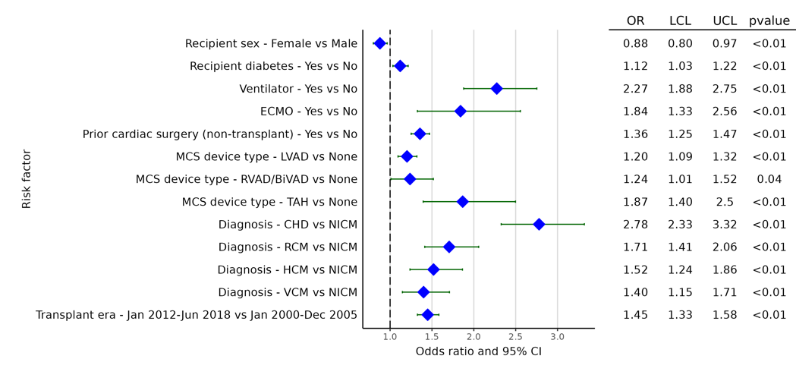
Adult Heart Transplants (January 2000 - June 2018)
Statistically Significant Categorical Risk Factors For Early Post-transplant Dialysis with 95% Confidence Limits
(N = 38,795)

Slide 35
Adult Heart Transplants (January 2000 - June 2018)
Statistically Significant Continuous Risk Factors for Early Post-transplant Dialysis
Continuous Factors (see figures)
Recipient age (years) | Donor age (years)
Recipient BMI (kg/m²) | Donor-recipient PHM difference (%)
Recipient bilirubin (mg/dl) | Ischemic time (hours)
Recipient eGFR (mL/min/1.73 m²)

Slide 36
Adult Heart Transplants (January 2000 - June 2018)
Statistically Significant Continuous Risk Factors For Early Post-transplant Dialysis with 95% Confidence Limits
Recipient age (years)
p = 0.0356
(N = 38,795)

Slide 37
Adult Heart Transplants (January 2000 - June 2018)
Statistically Significant Continuous Risk Factors For Early Post-transplant Dialysis with 95% Confidence Limits
Recipient BMI (kg/m²)
(N = 38,795)

Slide 38
Adult Heart Transplants (January 2000 - June 2018)
Statistically Significant Continuous Risk Factors For Early Post-transplant Dialysis with 95% Confidence Limits
Recipient bilirubin (mg/dl)
p < 0.0001
(N = 38,795)

Slide 39
Adult Heart Transplants (January 2000 - June 2018)
Statistically Significant Continuous Risk Factors For Dialysis at Discharge with 95% Confidence Limits
Recipient eGFR (mL/min/1.73m²)
p < 0.0001
(N = 38,795)

Slide 40
Adult Heart Transplants (January 2000 - June 2018)
Statistically Significant Continuous Risk Factors For Early Post-transplant Dialysis with 95% Confidence Limits
Donor age (years)
p < 0.0001
(N = 38,795)

Slide 41
Adult Heart Transplants (January 2000 - June 2018)
Statistically Significant Continuous Risk Factors For Early Post-transplant Dialysis with 95% Confidence Limits
Ischemic time (hours)
p < 0.0001
(N = 38,795)

Slide 42
Adult Heart Transplants (January 2000 - June 2018)
Statistically Significant Continuous Risk Factors For Dialysis at Discharge with 95% Confidence Limits
Donor-recipient PHM difference (%)
p = 0.0375
(N = 38,795)

Slide 43
Multivariable Logistic Model for Early Post-transplant Dialysis
Pediatric Heart

Slide 44
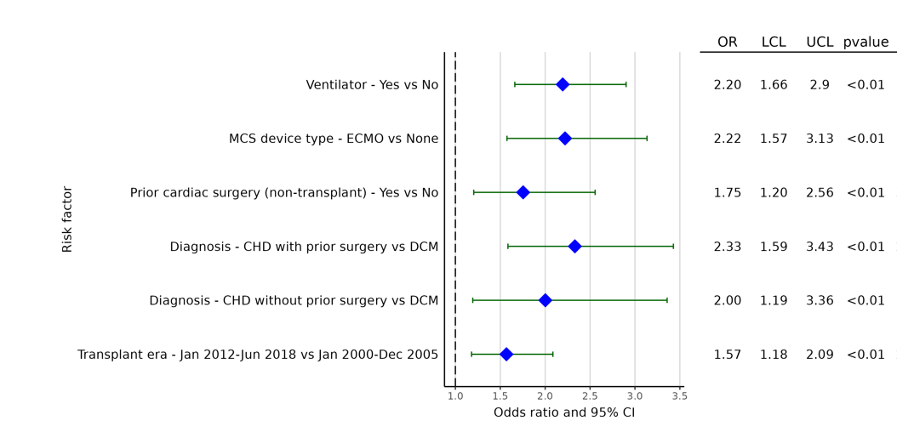
Pediatric Heart Transplants (January 2000 - June 2018)
Statistically Significant Categorical Risk Factors For Early Post-transplant Dialysis with 95% Confidence Limits
(N = 6,535)

Slide 45
Pediatric Heart Transplants (January 2000 - June 2018)
Statistically Significant Continuous Risk Factors For Early Post-transplant Dialysis
Continuous Factors (see figures)
Recipient eGFR (mL/min/1.73 m²) | Ischemic time (hours)
Donor age (years)
Donor/recipient weight ratio

Slide 46
Pediatric Heart Transplants (January 2000 - June 2018)
Statistically Significant Continuous Risk Factors For Dialysis at Discharge with 95% Confidence Limits
Recipient eGFR (mL/min/1.73m²)
p < 0.0001
(N = 6,535)

Slide 47
Pediatric Heart Transplants (January 2000 - June 2018)
Statistically Significant Continuous Risk Factors For Early Post-transplant Dialysis with 95% Confidence Limits
Donor age (years)
p = 0.0016
(N = 6,535)

Slide 48
Pediatric Heart Transplants (January 2000 - June 2018)
Statistically Significant Continuous Risk Factors For Early Post-transplant Dialysis with 95% Confidence Limits
Donor recipient weight ratio
p = 0.0294
(N = 6,535)

Slide 49
Pediatric Heart Transplants (January 2000 - June 2018)
Statistically Significant Continuous Risk Factors For Early Post-transplant Dialysis with 95% Confidence Limits
Ischemic time (hours)
p < 0.0001
(N = 6,535)

Slide 50
Multivariable Logistic Model for Early Post-transplant Dialysis
Early Post-transplant Dialysis for Adult Lung

Slide 51
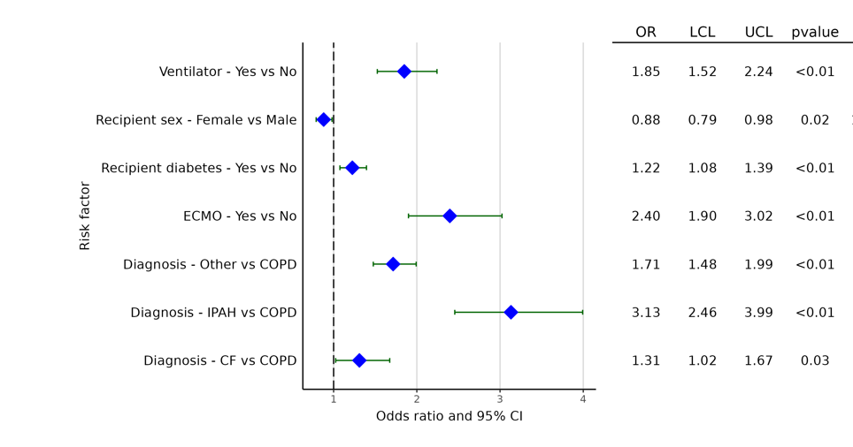
Adult Lung Transplants (January 2000 - June 2018)
Statistically Significant Categorical Risk Factors For Early Post-transplant Dialysis with 95% Confidence Limits
(N= 30,068)

Slide 52
Adult Lung Transplants (January 2000 - June 2018)
Statistically Significant Continuous Risk Factors For Early Post-transplant Dialysis
Continuous Factors (see figures)
Recipient BMI (kg/m²) | Donor age (years)
Total Bilirubin (mg/dl) | Ischemic time (hours)
Recipient eGFR (mL/min/1.73 m²)

Slide 53
Adult Lung Transplants (January 2000 - June 2018)
Statistically Significant Continuous Risk Factors For Early Post-transplant Dialysis with 95% Confidence Limits
Recipient BMI (kg/m²)
p <0.0001
(N = 30,068)

Slide 54
Adult Lung Transplants (January 2000 - June 2018)
Statistically Significant Continuous Risk Factors For Early Post-transplant Dialysis with 95% Confidence Limits
Recipient bilirubin (mg/dl)
p = 0.0101
(N = 30,068)

Slide 55
Adult Lung Transplants (January 2000 - June 2018)
Statistically Significant Continuous Risk Factors For Dialysis at Discharge with 95% Confidence Limits
Recipient eGFR (mL/min/1.73m²)
p <0.0001
(N = 30,068)

Slide 56
Adult Lung Transplants (January 2000 - June 2018)
Statistically Significant Continuous Risk Factors For Early Post-transplant Dialysis with 95% Confidence Limits
Donor age (years)
p = 0.0002
(N = 30,068)

Slide 57
Adult Lung Transplants (January 2000 - June 2018)
Statistically Significant Continuous Risk Factors For Early Post-transplant Dialysis with 95% Confidence Limits
Ischemic time (hours)
p <0.0001
(N = 30,068)

Slide 58
Multivariable Logistic Model for Early Post-transplant Dialysis
Pediatric Lung

Slide 59
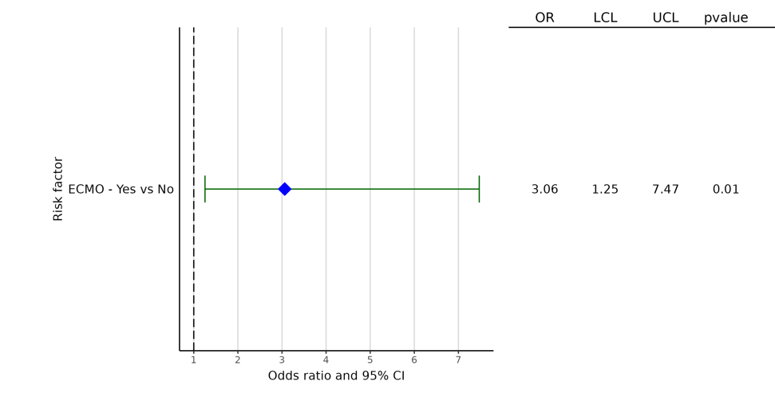
Pediatric Primary Lung Transplants (January 2000 - June 2018)
Statistically Significant Categorical Risk Factors For Early Post-transplant Dialysis with 95% Confidence Limits
Pediatric heart/lung transplants were included in the pediatric lung transplant cohort.
(N = 907)

Slide 60
Incidence of Dialysis and Severe Renal Dysfunction at One-Year by Early
Post-transplant Dialysis

Slide 61
Incidence of Dialysis and Severe Renal Dysfunction within One Year by Early Post-transplant Dialysis
(Transplants: January 2000 – June 2017)
Severe renal dysfunction was defined as need for dialysis, renal transplant, or creatine>2.5 mg/dl at one year; p-value was calculated using a chi-square test.
Notes:
heart

Slide 62
Incidence of Dialysis and Severe Renal Dysfunction within One Year by Early Post-transplant Dialysis
(Transplants: January 2000 – June 2017)
Pediatric heart/lung transplants were included in the pediatric lung transplant cohort; severe renal dysfunction was defined as need for dialysis, renal transplant, or creatine>2.5 mg/dl at one year; p-value was calculated using a chi-square test.
Notes:
lung

Slide 63
Kaplan-Meier Survival within 365 Days by Dialysis Status

Slide 64
Adult Heart Primary Transplants, January 1994 – June 2017
Kaplan-Meier Survival by Early Post-transplant Dialysis

Slide 65
Pediatric Heart Primary Transplants, January 1994 – June 2017
Kaplan-Meier Survival by Early Post-transplant Dialysis

Slide 66
Adult Heart Primary Transplants, January 1994 – June 2017
Kaplan-Meier Survival by Usage of Dialysis
Notes:
Definition:
Pre-tx dialysis: pre-transplant dialysis is yes, regardless of the presence of early post-tx dialysis
De-novo dialysis: pre-transplant dialysis is no and early post-tx dialysis is yes
No dialysis: Pre-tx dialysis is no and early post-tx dialysis is no

Slide 67
Pediatric Heart Primary Transplants, January 1994 – June 2017
Kaplan-Meier Survival by Usage of Dialysis
p <0.0001
Notes:
Definition:
Pre-tx dialysis: pre-transplant dialysis is yes, regardless of the presence of early post-tx dialysis
De-novo dialysis: pre-transplant dialysis is no and early post-tx dialysis is yes
No dialysis: Pre-tx dialysis is no and early post-tx dialysis is no

Slide 68
Adult Lung Primary Transplants, January 1994 – June 2017
Kaplan-Meier Survival by Early Post-transplant Dialysis

Slide 69
Pediatric Lung Primary Transplants, January 1994 – June 2017
Kaplan-Meier Survival by Early Post-transplant Dialysis
Pediatric heart/lung transplants were included in the pediatric lung transplant cohort

Slide 70
Adult Lung Primary Transplants, January 1994 – June 2017
Kaplan-Meier Survival by Usage of Dialysis
Notes:
Definition:
Pre-tx dialysis: pre-transplant dialysis is yes, regardless of the presence of early post-tx dialysis
De-novo dialysis: pre-transplant dialysis is no and early post-tx dialysis is yes
No dialysis: Pre-tx dialysis is no and early post-tx dialysis is no

Slide 71
Pediatric Lung Primary Transplants, January 1994 – June 2017
Kaplan-Meier Survival by Usage of Dialysis
Pediatric heart/lung transplants were included in the pediatric lung transplant cohort; transplants with pre-transplant dialysis were excluded due to N < 10.
Notes:
Definition:
Pre-tx dialysis: pre-transplant dialysis is yes, regardless of the presence of early post-tx dialysis
De-novo dialysis: pre-transplant dialysis is no and early post-tx dialysis is yes
No dialysis: Pre-tx dialysis is no and early post-tx dialysis is no

