Slide 1
SPECIAL REPORT:
DEATH/RETRANSPLANT AMONG PRIMARY, DECEASED DONOR TRANSPLANT RECIPIENTS
Based on ISHLT TTX Registry database as of April 19, 2019

Slide 2

Table of Contents
Baseline Characteristics by Organ/Age Group: slides 3-6
Kaplan-Meier Freedom from Death/Retransplant: slides 7-28
Competing Risk Cumulative Incidence of Retransplant: slides 29-40
Multivariable Cox Models of Time to Death/Retransplant within 10 Years: slides 41-66
2023
JHLT. 2023 Oct; 42(10): 1321-1333

Slide 3
Baseline Characteristics

Slide 4
Primary Transplants, January 1992 – June 2017
Baseline characteristics
 | Adult Heart (N=97140) | Pediatric Heart (N=11909) | Adult Lung (N=60680) | Pediatric Lung (N=2052) | P-value*
Geographic location |  |  |  |  | <0.0001
Europe | 39936 (41.1%) | 3192 (26.8%) | 21658 (35.7%) | 789 (38.5%)
North America | 50356 (51.8%) | 8076 (67.8%) | 34424 (56.7%) | 1115 (54.3%)
Other | 6848 (7.0%) | 641 (5.4%) | 4598 (7.6%) | 148 (7.2%)
Transplant era |  |  |  |  | <0.0001
1992-2000 | 35159 (36.2%) | 3376 (28.3%) | 11341 (18.7%) | 535 (26.1%)
2001-2009 | 31921 (32.9%) | 4158 (34.9%) | 20790 (34.3%) | 759 (37.0%)
2010-2017 | 30060 (30.9%) | 4375 (36.7%) | 28549 (47.0%) | 758 (36.9%)
Summary statistics excluded transplants with missing data
Continuous factors are expressed as median (5th – 95th percentiles)
* P-value was calculated using a chi-square (for categorical variables) or Kruskal-Wallis test (for categorical variables)

Slide 5
Primary Transplants, January 1992 – June 2017
Baseline characteristics
 | Adult Heart (N=97140) | Pediatric Heart (N=11909) | Adult Lung (N=60680) | Pediatric Lung (N=2052) | P-value*
Recipient age (years) | 54.0 (26.0 - 67.0) | 6.7 (0.1 - 17.0) | 55.0 (24.0 - 68.0) | 14.0 (0.0 - 17.0) | N/A
Recipient male | 77.9% | 55.9% | 56.1% | 42.9% | <0.0001
Recipient BMI (kg/m²) | 25.7 (19.3 - 33.7) | 16.2 (12.1 - 26.3) | 23.8 (17.1 - 31.7) | 16.8 (12.9 - 23.6) | <0.0001
Recipient pre-transplant ECMO | 0.5% | 5.9% | 2.0% | 3.8% | <0.0001
Recipient pre-transplant ventilator | 2.6% | 18.8% | 4.4% | 16.2% | <0.0001
Recipient pre-transplant dialysis | 2.4% | 2.6% | 0.5% | 0.5% | <0.0001
Recipient eGFR (mL/min/1.73 m²)** | 75.3 (35.2 - 142.6) | 82.6 (27.1 - 159.7) | 95.1 (53.9 - 162.2) | 122.1 (60.1 - 214.8) | <0.0001
Donor age (years) | 33.0 (16.0 - 56.0) | 8.1 (0.2 - 38.7) | 38.0 (16.0 - 62.0) | 14.0 (0.0 - 51.0) | <0.0001
Ischemic time (hours) | 3.0 (1.5 - 5.0) | 3.6 (1.6 - 5.8) | 4.9 (2.4 - 7.6) | 5.5 (3.0 - 8.3) | <0.0001
Summary statistics excluded transplants with missing data
Continuous factors are expressed as median (5th – 95th percentiles)
* P-value was calculated using a chi-square (for categorical variables) or Kruskal-Wallis test (for categorical variables)
** GFR was estimated using the Cockcroft Gault formula for adults and modified Schwartz formula for pediatrics

Slide 6
Primary Transplants, January 1992 – June 2017
Diagnosis by Age/Organ Group
Adult Heart
Adult Lung
Diagnosis | N | Percent
Congenital Heart Disease | 2319 | 2.49
Hypertrophic Cardiomyopathy | 2210 | 2.38
Ischemic Cardiomyopathy | 37778 | 40.61
Non-Ischemic Cardiomyopathy | 44745 | 48.1
Restrictive Cardiomyopathy | 2082 | 2.24
Valvular Heart Disease | 3208 | 3.45
Other | 674 | 0.72
All | 97140 | 100
Diagnosis | N | %
Cystic Fibrosis | 9330 | 15.68
Chronic Obstructive Pulmonary Disease | 22397 | 37.64
Idiopathic Pulmonary Fibrosis | 15033 | 25.27
Other | 12736 | 21.41
All | 60680 | 100
Pediatric Heart
Pediatric Lung
Diagnosis | N | %
Congenital Heart Disease | 4603 | 39.75
Dilated Cardiomyopathy | 5494 | 47.44
Other | 1483 | 12.81
All | 11909 | 100
Diagnosis | N | %
Cystic Fibrosis | 1201 | 60.02
Interstitial Lung Disease | 103 | 5.15
Obliterative Bronchiolitis | 103 | 5.15
Pulmonary Vascular Disease | 336 | 16.79
Other | 258 | 12.89
All | 2052 | 100

Slide 7
Kaplan-Meier Freedom from Composite Outcome of Death/Retransplant

Slide 8
Kaplan-Meier Freedom from Death/Retransplant
by Age Group and Organ
(Deceased Donor Transplants: January 1992 – June 2017)
Median time to death/retransplant by group:
- Adult Heart = 11.3 years
- Pediatric Heart = 14.2 years
- Adult Lung = 5.8 years
- Pediatric Lung = 4.6 years
Notes:
All pairwise comparisons were significant at p < 0.05

Slide 9
Kaplan-Meier Freedom from Death/Retransplant for Adult Heart Recipients
by Transplant Era
(Deceased Donor Heart Transplants: January 1992 – June 2017)
Median time to death/retransplant by group:
- 1992-2000 = 10.2 years
- 2001-2009 = 12.1 years
- 2010-2017 = NA

Slide 10
Kaplan-Meier Freedom from Death/Retransplant for Pediatric Heart Recipients
by Transplant Era
(Deceased Donor Heart Transplants: January 1992 – June 2017)
Median time to death/retransplant by group:
- 1992-2000 = 11.3 years
- 2001-2009 = 15.1 years
- 2010-2017 = NA
All pairwise comparisons were significant at p < 0.05.

Slide 11
Kaplan-Meier Freedom from Death/Retransplant for Adult Lung Recipients
by Transplant Era
(Deceased Donor Lung Transplants: January 1992 – June 2017)
Median time to death/retransplant by group:
- 1992-2000 = 4.3 years
- 2001-2009 = 6.0 years
- 2010-2017 = 6.3 years

Slide 12
Kaplan-Meier Freedom from Death/Retransplant for Pediatric Lung Recipients
by Transplant Era
(Deceased Donor Lung Transplants: January 1992 – June 2017)
Median time to death/retransplant by group:
- 1992-2000 = 3.1 years
- 2001-2009 = 4.7 years
- 2010-2017 = 5.5 years

Slide 13
Kaplan-Meier Freedom from Death/Retransplant for Adult Heart Recipients
by Geographic Location
(Deceased Donor Transplants: January 1992 – June 2017)
Median time to death/retransplant by group:
- Europe = 11.6 years
- North America = 11.1 years
- Other = 11.4 years

Slide 14
Kaplan-Meier Freedom from Death/Retransplant for Adult Heart Recipients
by Age Group
(Deceased Donor Heart Transplants: January 1992 – June 2017)
Median time to death/retransplant by group:
- 18-39 yrs = 13.2 years
- 40-59 yrs = 11.8 years
- 60+ yrs = 9.7 years
All pairwise comparisons were significant at p < 0.05.

Slide 15
Kaplan-Meier Freedom from Death/Retransplant for Adult Heart Recipients
by Sex
(Deceased Donor Heart Transplants: January 1992 – June 2017)
Median time to death/retransplant by group:
- Female = 11.8 years
- Male = 11.1 years
p < 0.0001

Slide 16
Kaplan-Meier Freedom from Death/Retransplant for Adult Heart Recipients
by eGFR (mL/min/1.73m²)*
(Deceased Donor Heart Transplants: January 1992 – June 2017)
Median time to death/retransplant by group:
- < 30 = 7.2 years
- 30-59 = 10.3 years
- ≥ 60 = 12.0 years
All pairwise comparisons were significant at p < 0.05.
* GFR was estimated using the Cockcroft-Gault formula.

Slide 17
Kaplan-Meier Freedom from Death/Retransplant for Pediatric Heart Recipients
by Geographic Location
(Deceased Donor Heart Transplants: January 1992 – June 2017)
Median time to death/retransplant by group:
- Europe = 16.9 years
- North America = 13.5 years
- Other = 11.1 years
All pairwise comparisons were significant at p < 0.05.

Slide 18
Kaplan-Meier Freedom from Death/Retransplant for Pediatric Heart Recipients
by Age Group
(Deceased Donor Heart Transplants: January 1992 – June 2017)
Median time to death/retransplant by group:
- < 1 yr = 18.2 years
- 1-10 yrs = 14.5 years
- 11-17 yrs = 12.4 years
No pairwise comparisons were significant at p < 0.05 except 1-10 yrs vs. 11-17 yrs.

Slide 19
Kaplan-Meier Freedom from Death/Retransplant for Pediatric Heart Recipients
by Sex
(Deceased Donor Heart Transplants: January 1992 – June 2017)
Median time to death/retransplant by group:
- Female = 13.5 years
- Male = 15.0 years
p = 0.0001

Slide 20
Kaplan-Meier Freedom from Death/Retransplant for Pediatric Heart Recipients
by eGFR (mL/min/1.73m²)
(Deceased Donor Heart Transplants: January 1992 – June 2017)
Median time to death/retransplant by group:
- < 30 = 9.9 years
- 30-59 = 15.4 years
- ≥ 60 = 14.0 years
All pairwise comparisons were significant at p < 0.05 except 30-59 vs. 60+.
* GFR was estimated using the modified Schwartz formula.

Slide 21
Kaplan-Meier Freedom from Death/Retransplant for Adult Lung Recipients
by Geographic Location
(Deceased Donor Lung Transplants: January 1992 – June 2017)
Median time to death/retransplant by group:
- Europe = 6.8 years
- North America = 5.4 years
- Other = 6.2 years

Slide 22
Kaplan-Meier Freedom from Death/Retransplant for Adult Lung Recipients
by Age Group
(Deceased Donor Lung Transplants: January 1992 – June 2017)
Median time to death/retransplant by group:
- 18-39 yrs = 7.0 years
- 40-59 yrs = 6.2 years
- 60+ yrs = 4.8 years
All pairwise comparisons were significant at p < 0.05.

Slide 23
Kaplan-Meier Freedom from Death/Retransplant for Adult Lung Recipients
by Sex
(Deceased Donor Lung Transplants: January 1992 – June 2017)
Median time to death/retransplant by group:
- Female = 6.2 years
- Male = 5.6 years
p < 0.0001

Slide 24
Kaplan-Meier Freedom from Death/Retransplant for Adult Lung Recipients
by eGFR (mL/min/1.73m²)*
(Deceased Donor Lung Transplants: January 1992 – June 2017)
Median time to death/retransplant by group:
- < 60 = 4.7 years
- 60-89 = 5.3 years
- ≥ 90 = 5.8 years
All pairwise comparisons were significant at p < 0.05.
* GFR was estimated using the Cockcroft-Gault formula.

Slide 25
Kaplan-Meier Freedom from Death/Retransplant for Pediatric Lung Recipients
by Geographic Location
(Deceased Donor Lung Transplants: January 1992 – June 2017)
Median time to death/retransplant by group:
- Europe = 5.5 years
- North America = 4.1 years
- Other = 4.1 years
No pairwise comparisons were significant at p < 0.05 except Europe vs. North America.

Slide 26
Kaplan-Meier Freedom from Death/Retransplant for Pediatric Lung Recipients
by Age Group
(Deceased Donor Lung Transplants: January 1992 – June 2017)
Median time to death/retransplant by group:
- < 1 yr = 4.8 years
- 1-10 yrs = 5.6 years
- 11-17 yrs = 4.2 years
No pairwise comparisons were significant at p < 0.05 except 1-10 yrs vs. 11-17 yrs.

Slide 27
Kaplan-Meier Freedom from Death/Retransplant for Pediatric Lung Recipients
by Sex
(Deceased Donor Lung Transplants: January 1992 – June 2017)
Median time to death/retransplant by group:
- Female = 4.2 years
- Male = 4.9 years
p = 0.0130

Slide 28
Kaplan-Meier Freedom from Death/Retransplant for Pediatric Lung Recipients
by eGFR (mL/min/1.73m²)*
(Deceased Donor Lung Transplants: January 1992 – June 2017)
Median time to death/retransplant by group:
- < 90 = 4.0 years
- ≥ 90 = 4.7 years
p = 0.8017
* GFR was estimated using the modified Schwartz formula.

Slide 29
Competing Risk
Cumulative Incidence of Retransplant

Slide 30
(Deceased Donor Transplants: January 1992 – June 2017)
Cumulative Incidence of Retransplant
By Age Group and Organ

Slide 31
Cumulative Incidence of Retransplant for Pediatric Heart Recipients
By Geographic Location
(Deceased Donor Lung Transplants: January 1992 – June 2017)
Notes:
Europe N =124
North America N=614
Other N=21

Slide 32
Cumulative Incidence of Retransplant for Pediatric Lung Recipients
By Geographic Location
(Deceased Donor Lung Transplants: January 1992 – June 2017)
Note: Rates are not shown due to small number of transplants in Other region.
Notes:
Europe N =79
North America N=145
Other N=10

Slide 33
Cumulative Incidence of Retransplant for Adult Heart Recipients by Age
(Deceased Donor Heart Transplants: January 1992 – June 2017)

Slide 34
Cumulative Incidence of Retransplant for Pediatric Heart Recipients
by Age
(Deceased Donor Heart Transplants: January 1992 – June 2017)

Slide 35
Cumulative Incidence of Retransplant for Adult Lung Recipients
By Age Group
(Deceased Donor Lung Transplants: January 1992 – June 2017)
Notes:
.

Slide 36
Cumulative Incidence of Retransplant for Pediatric Lung Recipients By Age Group
(Deceased Donor Lung Transplants: January 1992 – June 2017)
Notes:
.

Slide 37
Cumulative Incidence of Retransplant for Adult Heart Recipients by Transplant Era
(Deceased Donor Heart Transplants: January 1992 – June 2017)

Slide 38
Cumulative Incidence of Retransplant for Pediatric Heart Recipients by Transplant Era
(Deceased Donor Heart Transplants: January 1992 – June 2017)

Slide 39
Cumulative Incidence of Retransplant for Adult Lung Recipients
By Era
(Deceased Donor Lung Transplants: January 1992 – June 2017)

Slide 40
Cumulative Incidence of Retransplant for Pediatric Lung Recipients
By Era
(Deceased Donor Lung Transplants: January 1992 – June 2017)

Slide 41
Multivariable Cox Model
Death/Retransplant Within 10 Years for Adult Heart

Slide 42
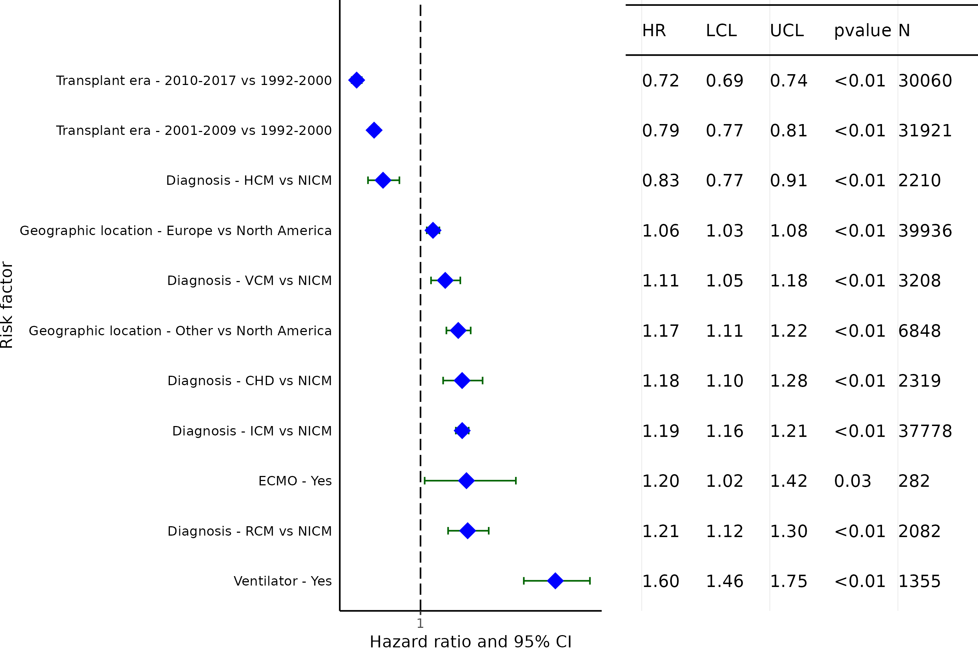
Adult Heart Transplants (January 1992- June 2017)
Statistically Significant Categorical Risk Factors For 10-Year Death/Retransplant with 95% Confidence Limits
(N = 97,140)

Slide 43
Adult Heart Transplants (January 1992- June 2017)
Statistically Significant Risk Factors For 10-Year Death/Retransplant
Continuous Factors (see figures)
Recipient age (years) | Donor age (years)
Recipient BMI (kg/m²) | Ischemic time (hours)
Recipient eGFR (mL/min/1.73 m²)

Slide 44
Adult Heart Transplants (January 1992- June 2017)
Statistically Significant Risk Factors For 10-Year Death/Retransplant with 95% Confidence Limits
Recipient age (years)
p < 0.0001
(N = 97,140)

Slide 45
Adult Heart Transplants (January 1992- June 2017)
Statistically Significant Risk Factors For 10-Year Death/Retransplant with 95% Confidence Limits
Recipient BMI (kg/m²)
p < 0.0001
(N = 97,140)

Slide 46
Adult Heart Transplants (January 1992- June 2017)
Statistically Significant Risk Factors For 10-Year Death/Retransplant with 95% Confidence Limits
Recipient eGFR (mL/min/1.73 m²)
p < 0.0001
* GFR was estimated using the Cockcroft Gault formula
(N = 97,140)

Slide 47
Adult Heart Transplants (January 1992- June 2017)
Statistically Significant Risk Factors For 10-Year Death/Retransplant with 95% Confidence Limits
Donor age (years)
p < 0.0001
(N = 97,140)

Slide 48
Adult Heart Transplants (January 1992- June 2017)
Statistically Significant Risk Factors For 10-Year Death/Retransplant with 95% Confidence Limits
Ischemic time (hours)
p < 0.0001
(N = 97,140)

Slide 49
Multivariable Cox Model
Death/Retransplant Within 10 Years for Pediatric Heart

Slide 50
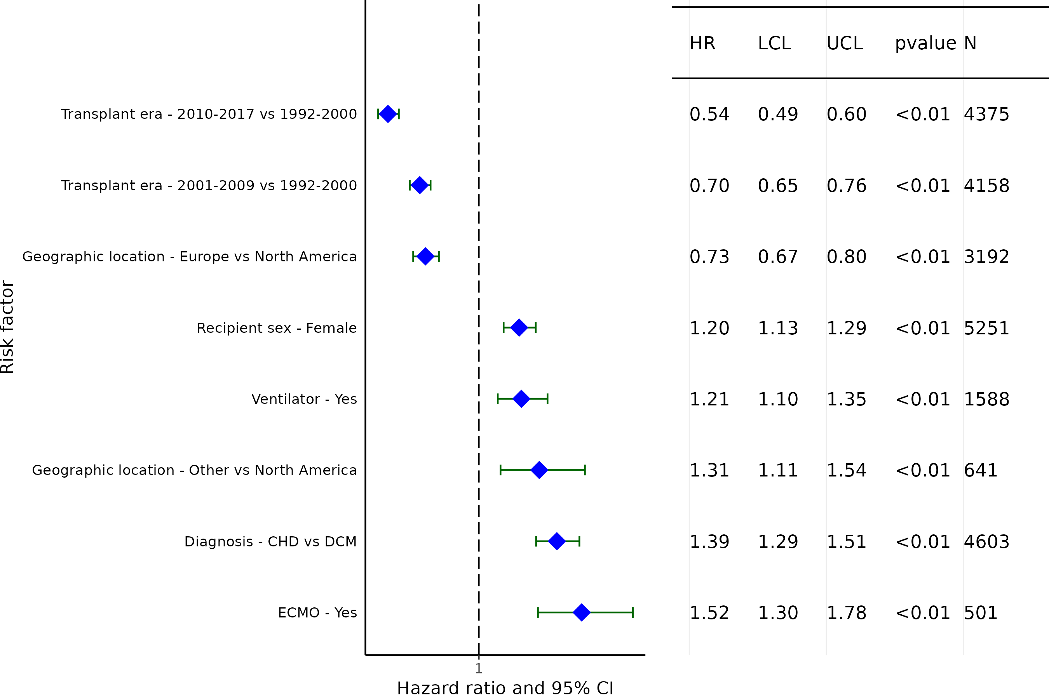
Pediatric Heart Transplants (January 1992- June 2017)
Pediatric Heart Transplants (January 1992- June 2017)
Statistically Significant Categorical Risk Factors For 10-Year Death/Retransplant with 95% Confidence Limits
(N = 11,909)

Slide 51
Pediatric Heart Transplants (January 1992- June 2017)
Statistically Significant Risk Factors For 10-Year Death/Retransplant
Continuous Factors (see figures)
Recipient age (years) | Donor age (years)
Recipient eGFR (mL/min/1.73 m²)

Slide 52
Pediatric Heart Transplants (January 1992- June 2017)
Statistically Significant Risk Factors For 10-Year Death/Retransplant with 95% Confidence Limits
Recipient age (years)
p = 0.0011
(N = 11,909)

Slide 53
Pediatric Heart Transplants (January 1992- June 2017)
Statistically Significant Risk Factors For 10-Year Death/Retransplant with 95% Confidence Limits
Recipient eGFR (mL/min/1.73 m²)
p = 0.0088
* GFR was estimated using the modified Schwartz formula
(N = 11,909)

Slide 54
Pediatric Heart Transplants (January 1992- June 2017)
Statistically Significant Risk Factors For 10-Year Death/Retransplant with 95% Confidence Limits
Donor age (years)
p = 0.0004
(N = 11,909)

Slide 55
Multivariable Cox Model
Death/Retransplant Within 10 Years for Adult Lung

Slide 56
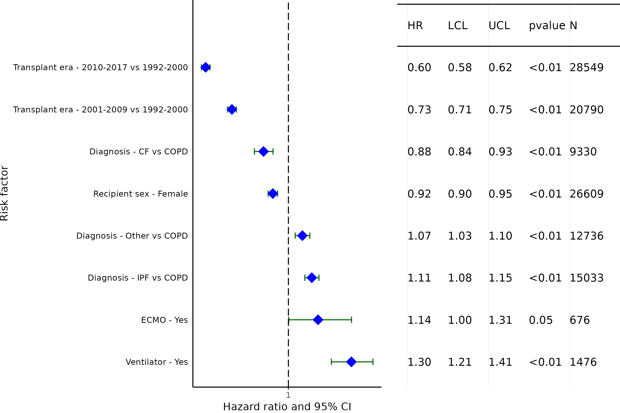
Adult Lung Transplants (January 1992- June 2017)
Statistically Significant Categorical Risk Factors For 10-Year Death/Retransplant with 95% Confidence Limits
(N = 60,680)

Slide 57
Adult Lung Transplants (January 1992 - June 2017)
Statistically Significant Risk Factors For 10-Year Death/Retransplant
Continuous Factors (see figures)
Recipient age (years) | Recipient eGFR (mL/min/1.73 m²)
Recipient BMI (kg/m²) | Donor age (years)
Ischemic time (hours)

Slide 58
Adult Lung Transplants (January 1992 - June 2017)
Statistically Significant Risk Factors For 10-Year Death/Retransplant with 95% Confidence Limits
Recipient age (years)
p < 0.0001
(N = 60,680)

Slide 59
Adult Lung Transplants (January 1992 - June 2017)
Statistically Significant Risk Factors For 10-Year Death/Retransplant with 95% Confidence Limits
Recipient BMI (kg/m²)
p < 0.0001
(N = 60,680)

Slide 60
Adult Lung Transplants (January 1992 - June 2017)
Statistically Significant Risk Factors For 10-Year Death/Retransplant with 95% Confidence Limits
Recipient eGFR (mL/min/1.73 m²)
p < 0.0001
* GFR was estimated using the Cockcroft Gault formula
(N = 60,680)

Slide 61
Adult Lung Transplants (January 1992 - June 2017)
Statistically Significant Risk Factors For 10-Year Death/Retransplant with 95% Confidence Limits
Donor age (years)
p < 0.0001
(N = 60,680)

Slide 62
Adult Lung Transplants (January 1992 - June 2017)
Statistically Significant Risk Factors For 10-Year Death/Retransplant with 95% Confidence Limits
Ischemic time (hours)
p < 0.0001
(N = 60,680)

Slide 63
Multivariable Cox Model
Death/Retransplant Within 10 Years for Pediatric Lung

Slide 64
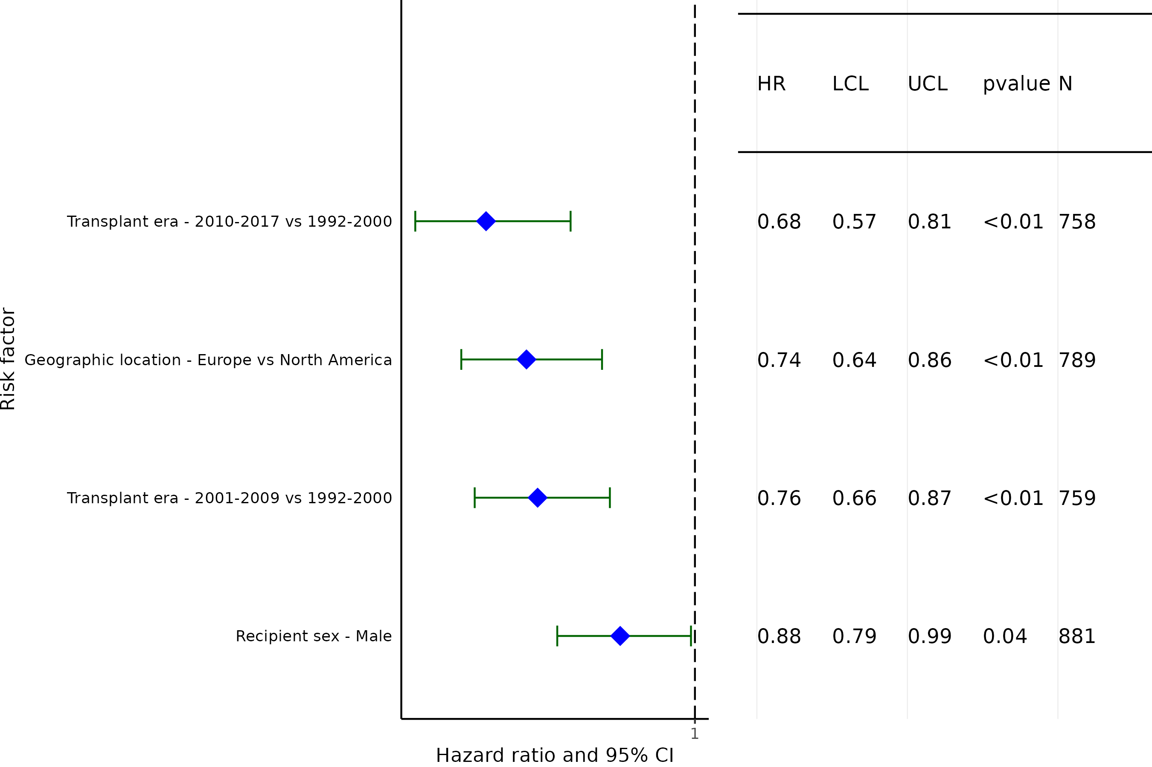
Pediatric Lung Transplants (January 1992- June 2017)
Statistically Significant Categorical Risk Factors For 10-Year Death/Retransplant with 95% Confidence Limits
(N = 2,052)

Slide 65
Pediatric Lung Transplants (January 1992 - June 2017)
Risk Factors For 10-Year Death/Retransplant
Continuous Factors (see figures)
Recipient age (years)

Slide 66
Pediatric Lung Transplants (January 1992 - June 2017)
Statistically Significant Risk Factors For 10-Year Death/Retransplant with 95% Confidence Limits
Recipient age (years)
p = 0.0407
(N = 2,052)

