Slide 1

FOCUS THEME:
PULMONARY VASCULAR DISEASES (PVD)
Pediatric Lung and Heart-Lung
2022
JHLT. 2022 Oct; 41(10): 1335-1375

Slide 2
Table of Contents
Number of Deceased Donor Transplants and Recipient Characteristics by Transplant Year/Era: slides 3-15
Kaplan-Meier Survival Analyses: slides 16-31
  Survival within 12 months: slides 16-23
  Survival within 5 years conditional on survival to 1 year: slides 24-30
  Freedom from BOS/CLAD within 5 years conditional on survival to discharge: slides 31-33
Multivariable Analyses: slides 34-39
  Cox model for mortality within 12 months: slides 34-37
  Cox model for mortality within 5 years conditional on survival to 1 year: slides 38-39
2022
JHLT. 2022 Oct; 41(10): 1335-1375

Slide 3
Number of Deceased Donor Transplants and Recipient Characteristics by Transplant Era/Year
2022
JHLT. 2022 Oct; 41(10): 1335-1375

Slide 4
Pediatric Lung and Heart-Lung Transplants
Diagnosis Distribution (Transplants: January 1992 – June 2018)
 | Jan 1992-Dec 2000 (N = 855) | Jan 2001-Dec 2009 (N = 952) | Jan 2010-Jun 2018 (N = 970) | P-value
Diagnosis |  |  |  | <0.0001
- Pulmonary vascular disease (PVD) | 247 (30.8%) | 162 (17.9%) | 194 (20.5%)
- Idiopathic pulmonary arterial hypertension (IPAH) | 107 (13.3%) | 105 (11.6%) | 135 (14.3%)
- Pulmonary hypertension (PH-not IPAH) | 140 (17.5%) | 57 (6.3%) | 59 (6.2%)
- Cystic Fibrosis (CF) | 391 (48.8%) | 504 (55.6%) | 482 (51.0%)
- Obstructive bronchiolitis (OB non-Retransplant) | 14 (1.7%) | 51 (5.6%) | 49 (5.2%)
- Interstitial lung disease (ILD not IIP) | 19 (2.4%) | 44 (4.9%) | 54 (5.7%)
- Retransplant | 51 (6.4%) | 56 (6.2%) | 49 (5.2%)
- Other | 80 (10.0%) | 89 (9.8%) | 118 (12.5%)
2022
Continuous factors are expressed as median (5th – 95th percentiles)
JHLT. 2022 Oct; 41(10): 1335-1375
Summary statistics included transplants with non-missing data
Notes:
Comparisons for categorical variables were made using the chi-square statistic. Multiple groups were compared using single p-value.
A significant p-value means that at least one of the groups is different than the others but it doesn’t identify which group it is.

Slide 5
Pediatric Lung and Heart Lung Transplants with PVD
Recipient Characteristics (Transplants: January 1992 – June 2018)
 | Jan 1992-Dec 2000 (N = 247) | Jan 2001-Dec 2009 (N = 162) | Jan 2010-Jun 2018 (N = 194) | P-value
Geographic Location
- Europe | 28.7% | 29.0% | 46.4% | <0.0001
- North America | 67.6% | 63.6% | 43.8%
- Other | 3.6% | 7.4% | 9.8%
Age (years) (continuous) | 11.0 (0.0 - 17.0) | 13.0 (0.0 - 17.0) | 13.0 (0.0 - 17.0) | 0.071
Age (categorical)
- <1 years | 10.9% | 9.9% | 5.7% | 0.206
- 1-5 years | 23.1% | 16.7% | 22.7%
- 6-10 years | 14.6% | 11.7% | 12.9%
- 11-17 years | 51.4% | 61.7% | 58.8%
Male | 45.7% | 41.4% | 43.8% | 0.681
Weight (kg) | 53.0 (41.0 - 78.0) | 54.7 (40.9 - 82.0) | 53.0 (41.0 - 78.6) | 0.664
Height (cm) | 163.0 (148.0 - 180.0) | 162.0 (149.9 - 181.3) | 162.0 (146.0 - 180.0) | 0.836
BMI (kg/m²) | 19.7 (15.6 - 27.7) | 19.9 (15.9 - 27.8) | 20.1 (15.9 - 31.2) | 0.444
2022
Summary statistics included transplants with non-missing data
Continuous factors are expressed as median (5th – 95th percentiles)
JHLT. 2022 Oct; 41(10): 1335-1375
Notes:
Comparisons for categorical variables were made using the chi-square statistic. Multiple groups were compared using single p-value.
Comparisons for continuous variables were made using Kruskal-Wallis test.
A significant p-value means that at least one of the groups is different than the others but it doesn’t identify which group it is.

Slide 6
Pediatric Lung and Heart Lung Transplants with PVD
Recipient Characteristics (Transplants: January 1992 – June 2018)
 | Jan 1992-Dec 2000 (N = 247) | Jan 2001-Dec 2009 (N = 162) | Jan 2010-Jun 2018 (N = 194) | P-value
ABO blood type
- A | 44.5% | 46.9% | 35.6% | 0.368
- AB | 4.1% | 5.6% | 6.7%
- B | 9.8% | 9.3% | 11.9%
- O | 41.6% | 38.3% | 45.9%
Donor-recipient sex match
- Female-Female | 27.5% | 28.6% | 33.0% | 0.022
- Female-Male | 15.4% | 16.8% | 25.3%
- Male-Female | 26.7% | 29.8% | 23.2%
- Male-Male | 30.4% | 24.8% | 18.6%
Transplant procedure
- Lung | 40.1% | 57.4% | 80.9% | <0.0001
- Heart-Lung | 59.9% | 42.6% | 19.1%
2022
Summary statistics included transplants with non-missing data
JHLT. 2022 Oct; 41(10): 1335-1375

Slide 7
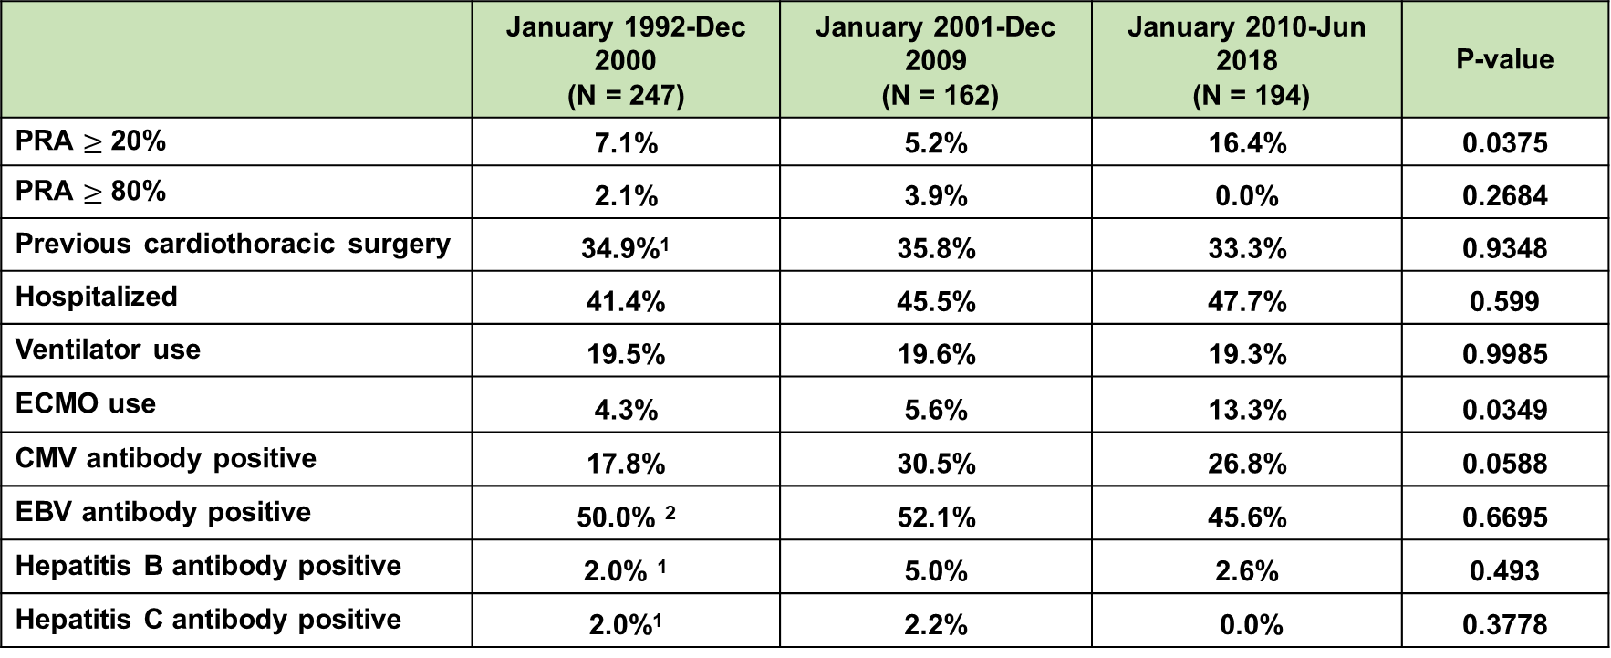
Pediatric Lung and Heart Lung Transplants with PVD
Recipient Characteristics (Transplants: January 1992 – June 2018)
 | January 1992-Dec 2000 (N = 247) | January 2001-Dec 2009 (N = 162) | January 2010-Jun 2018 (N = 194) | P-value
PRA $≥$ 20% | 7.1% | 5.2% | 16.4% | 0.0375
PRA $≥$ 80% | 2.1% | 3.9% | 0.0% | 0.2684
Previous cardiothoracic surgery | 34.9%¹ | 35.8% | 33.3% | 0.9348
Hospitalized | 41.4% | 45.5% | 47.7% | 0.599
Ventilator use | 19.5% | 19.6% | 19.3% | 0.9985
ECMO use | 4.3% | 5.6% | 13.3% | 0.0349
CMV antibody positive | 17.8% | 30.5% | 26.8% | 0.0588
EBV antibody positive | 50.0% ² | 52.1% | 45.6% | 0.6695
Hepatitis B antibody positive | 2.0% ¹ | 5.0% | 2.6% | 0.493
Hepatitis C antibody positive | 2.0%¹ | 2.2% | 0.0% | 0.3778
2022
Summary statistics included transplants with non-missing data
¹ Based on Apr 1994 – Dec 2000 transplants
JHLT. 2022 Oct; 41(10): 1335-1375
² Based on Oct 1999– Dec 2000 transplants
Notes:
Comparisons for categorical variables were made using the chi-square statistic. Multiple groups were compared using single p-value.
Comparisons for continuous variables were made using Kruskal-Wallis test.
A significant p-value means that at least one of the groups is different than the others but it doesn’t identify which group it is.

Slide 8
Pediatric Lung and Heart Lung Transplants with PVD
Recipient Characteristics (Transplants: January 1992 – June 2018)
 | Jan 1992-Dec 2000 (N = 247) | Jan 2001-Dec 2009 (N = 162) | Jan 2010-Jun 2018 (N = 194) | P-value
Bilirubin (mg/dl) | 0.7 (0.3 - 2.0) ¹ | 0.5 (0.2 - 1.7) | 0.4 (0.2 - 1.2) | 0.0007
Creatinine(mg/dl) | 0.5 (0.2 - 1.1) ¹ | 0.6 (0.2 - 1.1) | 0.4 (0.1 - 1.0) | 0.0014
GFR (mL/min/1.73m²)* | 88.8 (57.1 - 119.1) ¹ | 89.3 (55.9 - 156.4) | 96.9 (59.4 - 163.1) | 0.082
PCW mean (mmHg) | 13.5 (4.0 - 35.0) ¹ | 12.0 (4.0 - 32.0) | 11.0 (6.0 - 21.0) | 0.278
PA mean (mmHg) | 58.0 (19.5 - 79.5) ¹ | 60.5 (16.0 - 80.0) | 59.0 (13.0 - 80.0) | 0.6798
PVR (Wood units) | 17.2 (3.6 - 37.3) ¹ | 13.3 (0.8 - 27.7) | 8.9 (0.4 - 31.9) | 0.4378
FEV1% predicted | 47.0 (26.0 - 69.0) | 72.0 (47.0 - 99.0) | 76.0 (42.0 - 99.0) | 0.0047
FVC% predicted | 53.0 (30.0 - 86.0) | 78.0 (50.0 - 104.0) | 80.0 (50.0 - 102.0) | 0.0286
2022
Summary statistics included transplants with non-missing data
Continuous factors are expressed as median (5th – 95th percentiles)
* GFR was estimated using the modified Schwartz formula
JHLT. 2022 Oct; 41(10): 1335-1375
¹ Based on Apr 1994 – Dec 2000 transplants
Notes:
Comparisons for categorical variables were made using the chi-square statistic. Multiple groups were compared using single p-value.
Comparisons for continuous variables were made using Kruskal-Wallis test.
A significant p-value means that at least one of the groups is different than the others but it doesn’t identify which group it is.

Slide 9
Pediatric Lung and Heart-Lung Transplants
Diagnosis Distribution by Location and Era
(Transplants: January 1992 – June 2018)
Europe
North America
Other
2022
JHLT. 2022 Oct; 41(10): 1335-1375

Slide 10
Pediatric Lung and Heart Lung Transplants with PVD
Median Recipient Age
Median Recipient BMI
(Transplants: January 1992 – June 2018)
(Transplants: January 1992 – June 2018)
2022
JHLT. 2022 Oct; 41(10): 1335-1375

Slide 11
Pediatric Lung and Heart-Lung Transplants with PVD
Recipient Sex Distribution by Location and Era
(Transplants: January 1992 – June 2018)
Europe
North America
Other
2022
JHLT. 2022 Oct; 41(10): 1335-1375

Slide 12
Pediatric Lung and Heart Lung Transplants with PVD
Donor-Recipient Sex Distribution by Location and Era
(Transplants: January 1992 – June 2018)
Europe
North America
Other
2022
JHLT. 2022 Oct; 41(10): 1335-1375

Slide 13
Pediatric Lung and Heart Lung Transplants with PVD
Recipient ABO Blood Type Distribution by Location and Era
(Transplants: January 1992 – June 2018)
Europe
North America
Other
2022
JHLT. 2022 Oct; 41(10): 1335-1375

Slide 14
Pediatric Lung and Heart Lung Transplants with PVD
Cause of Death (Deaths: January 1992 – June 2018)
Cause of Death | ≤1 Year (N = 130) | 1 Year - 5 Years (N = 101) | >5 Years (N = 51)
OB/BOS | 5 (3.8%) | 45 (44.6%) | 21 (41.2%)
Acute Rejection | 7 (5.4%) | 2 (2.0%) | 1 (2.0%)
Malignancy | 2 (1.5%) | 3 (3.0%) | 1 (2.0%)
Infection | 21 (16.2%) | 11 (10.9%) | 3 (5.9%)
Graft Failure | 35 (26.9%) | 24 (23.8%) | 15 (29.4%)
Cardiovascular | 19 (14.6%) | 3 (3.0%) | 4 (7.8%)
Multiple Organ Failure | 15 (11.5%) | 5 (5.0%) | 2 (3.9%)
Other | 26 (20.0%) | 8 (7.9%) | 4 (7.8%)
2022
JHLT. 2022 Oct; 41(10): 1335-1375

Slide 15
Primary Pediatric Lung and Heart Lung Transplants with PVD
Cumulative Incidence of Retransplant
(Transplants: January 1995 – June 2017)
2022
JHLT. 2022 Oct; 41(10): 1335-1375
Notes:
Incidence was computed using a competing-risks extension of the Kaplan-Meier method.

Slide 16
Survival Analyses
Kaplan-Meier Survival Within 12 Months
2022
JHLT. 2022 Oct; 41(10): 1335-1375

Slide 17
Pediatric Lung and Heart Lung Transplants with PVD
Kaplan-Meier Survival within 12 Months by Era
(Transplants: January 2000 - June 2017)
2022
JHLT. 2022 Oct; 41(10): 1335-1375

Slide 18
Pediatric Lung and Heart Lung Transplants with PVD
Kaplan-Meier Survival within 12 Months by Era and Location
(Transplants: January 2000 - June 2017)
North America
2022
JHLT. 2022 Oct; 41(10): 1335-1375
Notes:
No data for 2000-2008 era for the Other Region

Slide 19
Pediatric Lung and Heart Lung Transplants with PVD
Kaplan-Meier Survival within 12 Months by Recipient Age
(Transplants: January 2000 - June 2017)
2022
JHLT. 2022 Oct; 41(10): 1335-1375

Slide 20
Pediatric Lung and Heart-Lung Transplants
Kaplan-Meier Survival within 12 Months by Diagnosis
(Transplants: January 2000 - June 2017)
2022
JHLT. 2022 Oct; 41(10): 1335-1375

Slide 21
Pediatric Lung and Heart-Lung Transplants
Kaplan-Meier Survival within 12 Months by Diagnosis
(Transplants: January 2000 - June 2017)
2022
JHLT. 2022 Oct; 41(10): 1335-1375

Slide 22
Pediatric Lung and Heart Lung Transplants with PVD
Kaplan-Meier Survival within 12 Months by Recipient eGFR*
(Transplants: January 2000 - June 2017)
2022
JHLT. 2022 Oct; 41(10): 1335-1375
*GFR was estimated using the modified Schwartz formula

Slide 23
Pediatric Lung and Heart Lung Transplants with PVD
Kaplan-Meier Survival within 12 Months by Procedure Type
(Transplants: January 2000 - June 2017)
2022
JHLT. 2022 Oct; 41(10): 1335-1375

Slide 24
Survival Analyses
Kaplan-Meier Survival Within 5 Years Conditional on Survival to Discharge
2022
JHLT. 2022 Oct; 41(10): 1335-1375

Slide 25
Pediatric Lung and Heart Lung Transplants with PVD
Kaplan-Meier Survival within 5 Years Conditional on Survival to 1 Year
By Era (Transplants: January 1996 - June 2013)
p = 0.15
2022
JHLT. 2022 Oct; 41(10): 1335-1375

Slide 26
Pediatric Lung and Heart Lung Transplants with PVD
Kaplan-Meier Survival within 5 Years Conditional on Survival to 1 Year
By Recipient Age (Transplants: January 1996 - June 2013)
2022
JHLT. 2022 Oct; 41(10): 1335-1375

Slide 27
Pediatric Lung and Heart Lung Transplants
Kaplan-Meier Survival within 5 Years Conditional on Survival to 1 Year
By Diagnosis (Transplants: January 1996 – June 2013)
2022
JHLT. 2022 Oct; 41(10): 1335-1375

Slide 28
Pediatric Lung and Heart Lung Transplants
Kaplan-Meier Survival within 5 Years Conditional on Survival to 1 Year
By Diagnosis (Transplants: January 1996 – June 2013)
2022
JHLT. 2022 Oct; 41(10): 1335-1375

Slide 29
Pediatric Lung and Heart Lung Transplants with PVD
Kaplan-Meier Survival within 5 Years Conditional on Survival to 1 Year
by Recipient eGFR* (Transplants: January 1996 - June 2013)
2022
JHLT. 2022 Oct; 41(10): 1335-1375

Slide 30
Pediatric Lung and Heart Lung Transplants with PVD
Kaplan-Meier Survival within 5 Years Conditional on Survival to 1 Year
by Procedure Type (Transplants: January 1996 - June 2013)
2022
JHLT. 2022 Oct; 41(10): 1335-1375

Slide 31
Survival Analyses
Kaplan-Meier Freedom from BOS Conditional on Survival to Discharge
2022
JHLT. 2022 Oct; 41(10): 1335-1375

Slide 32
Pediatric Lung and Heart Lung Transplants with PVD
Freedom from BOS/CLAD Conditional on Survival to Discharge
By Era (Transplants: January 1996 - June 2013)
p = 0.62
2022
JHLT. 2022 Oct; 41(10): 1335-1375

Slide 33
Pediatric Lung and Heart Lung Transplants with PVD
Freedom from BOS/CLAD Conditional on Survival to Discharge
By Recipient Age (Transplants: January 1996 - June 2013)
No pairwise comparisons were significant at p < 0.05 =
2022
JHLT. 2022 Oct; 41(10): 1335-1375

Slide 34
Multivariable Cox Analyses
Mortality within 12 Months
2022
JHLT. 2022 Oct; 41(10): 1335-1375

Slide 35
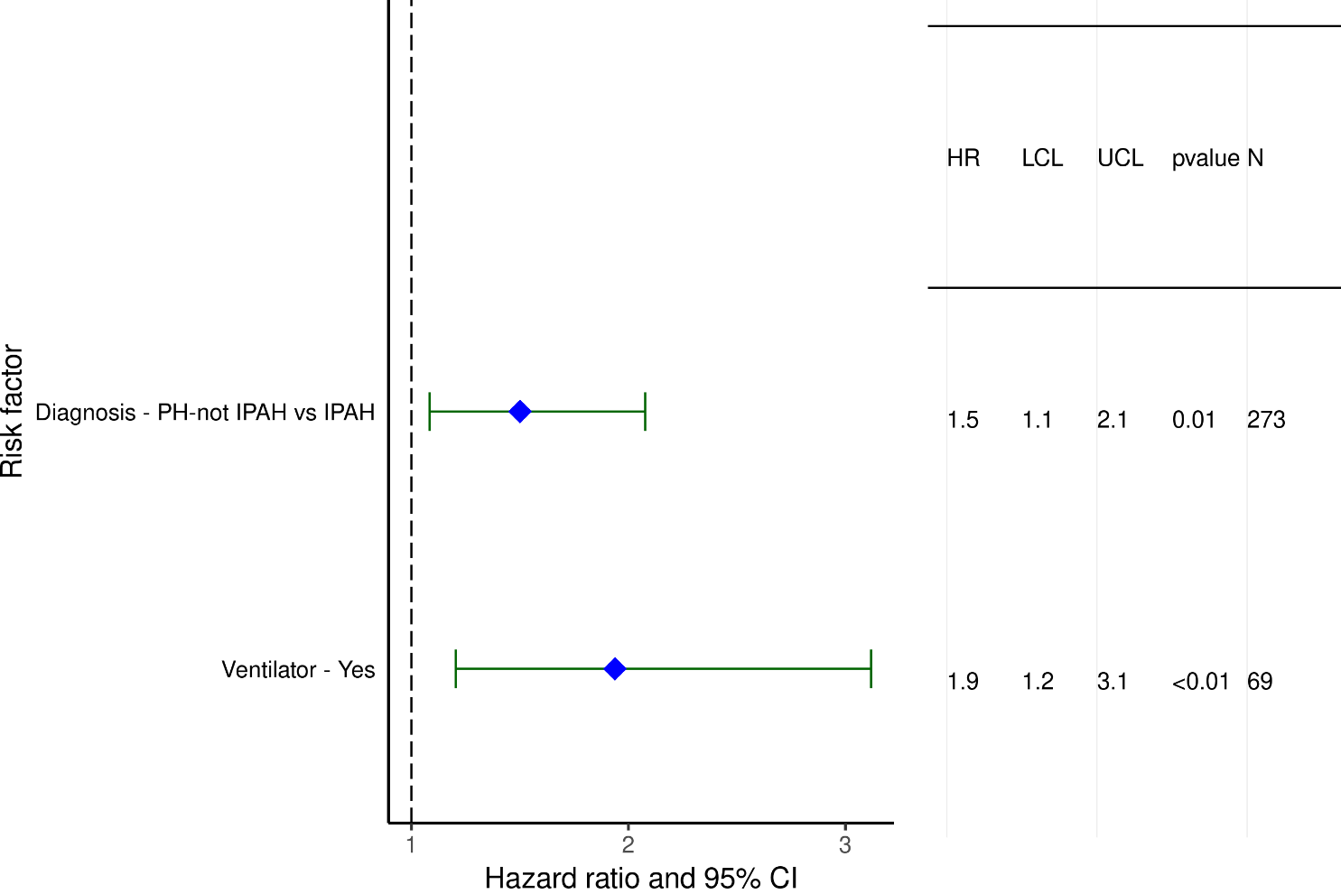
Pediatric Lung and Heart-Lung Recipients with PVD (1990-6/2017)
Statistically Significant Categorical Risk Factors For 1-Year Mortality with 95% Confidence Limits
2022
(N = 637)
JHLT. 2022 Oct; 41(10): 1335-1375

Slide 36
Pediatric Lung and Heart-Lung Recipients with PVD (1990-6/2017)
Statistically Significant Continuous Risk Factors For 1-Year Mortality
Continuous Factors (see figures)
Recipient eGFR (mL/min/1.73 m²)
2022
JHLT. 2022 Oct; 41(10): 1335-1375

Slide 37
Pediatric Lung and Heart-Lung Recipients with PVD (1990-6/2017)
Statistically Significant Risk Factors For 1-Year Mortality with 95% Confidence Limits
Recipient eGFR (mL/min/1.73 m²)
p = 0.0108
2022
(N = 637)
JHLT. 2022 Oct; 41(10): 1335-1375

Slide 38
Multivariable Cox Analyses
Mortality within 5 Years Conditional on Survival to 1 Year
2022
JHLT. 2022 Oct; 41(10): 1335-1375

Slide 39
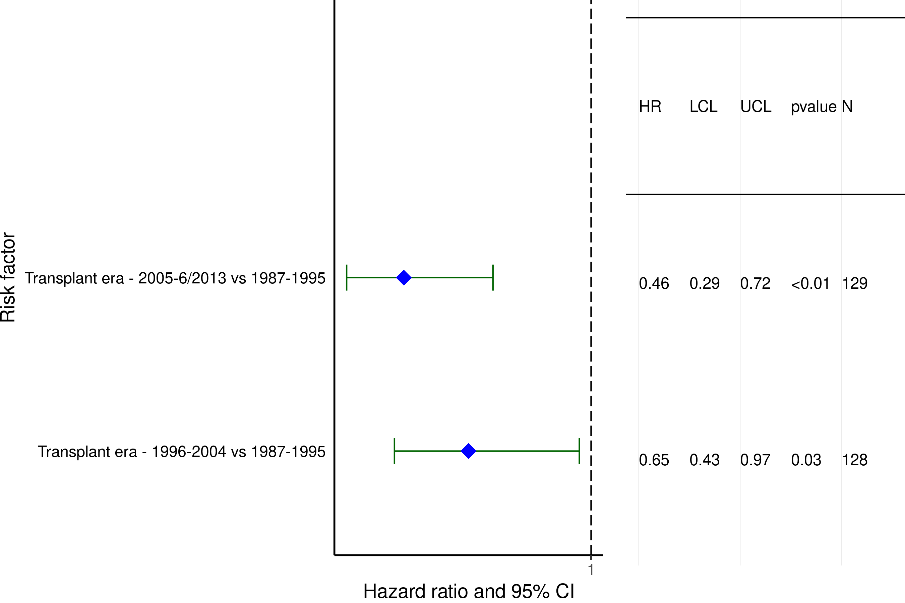
Pediatric Lung and Heart-Lung Recipients with PVD (1987-6/2013)
Statistically Significant Categorical Risk Factors For 5-Year Mortality Conditional on 1-Year Survival with 95% Confidence Limits
2022
(N = 411)
JHLT. 2022 Oct; 41(10): 1335-1375

