Slide 1

FOCUS THEME:
INFANT TRANSPLANTS
Pediatric Heart
2022
JHLT. 2022 Oct; 41(10): 1335-1375

Slide 2
Table of Contents
Number of Deceased Donor Transplants and Characteristics of Transplants: slides 3-15
Induction and Maintenance immunosuppression: slides 16-19
Post-Transplant Functional Status, Rejection, and Morbidities: slides 20-24
Kaplan-Meier Analyses: slides 25-40
Multivariable Cox Analyses: slides 41-47
  Mortality within 12 months: slides 41-45
  Mortality within 5 years conditional on survival to 1 year: slides 46-47
2022
JHLT. 2022 Oct; 41(10): 1335-1375

Slide 3
Number of Deceased Donor Transplants and Characteristics of Transplants
2022
JHLT. 2022 Oct; 41(10): 1335-1375

Slide 4
Infant Heart Transplants (Age at Transplant < 1 Year) by Transplant Year
(Transplants: January 1988 – December 2017)
2022
JHLT. 2022 Oct; 41(10): 1335-1375

Slide 5
Infant Heart Transplants (Age at Transplant <1 Year) by Location and Year (Transplants: January 1988 – June 2018)
2022
JHLT. 2022 Oct; 41(10): 1335-1375

Slide 6
Infant Heart Transplants (Age at Transplant <1 Year)
by Diagnosis and Era (Transplants: January 1990 – June 2018)
2010-2018
2022
JHLT. 2022 Oct; 41(10): 1335-1375
Notes:
NOTE: Transplants with unknown diagnoses are excluded from this tabulation

Slide 7
Infant Heart Transplants (Age at Transplant <1 Year) with CHD
by Era and Previous Surgery/PGE Use
(Transplants: January 1995 – June 2018)
2022
JHLT. 2022 Oct; 41(10): 1335-1375

Slide 8
Infant Heart Transplants (Age at Transplant <1 Year)
(Transplants: January 2000 – June 2018)
Recipients Bridged with MCS by Era
Recipients on Ventilator by Era
2022
JHLT. 2022 Oct; 41(10): 1335-1375

Slide 9
Infant Heart Transplants (Age at Transplant <1 Year) with DCM and CHD
% of Patients Bridged with Mechanical Circulatory Support
(Transplants: January 2005 – June 2018)
2022
JHLT. 2022 Oct; 41(10): 1335-1375

Slide 10
Infant Heart Transplants (Age at Transplant <1 Year)
(Transplants: January 1995 – June 2018)
PRA >10%
PRA >25%
2022
JHLT. 2022 Oct; 41(10): 1335-1375

Slide 11
Infant Heart Transplants (Age at Transplant <1 Year)
By Donor Age (Transplants: January 2005 – June 2018)
2022
JHLT. 2022 Oct; 41(10): 1335-1375
Notes:
NOTE: Transplants where donor age is unknown are excluded from this tabulation.

Slide 12
Infant Heart Transplants (Age at Transplant <1 Year)
Distribution of Donor/Recipient Weight Ratio by Era
(Transplants: January 2005 – June 2018)
2022
JHLT. 2022 Oct; 41(10): 1335-1375

Slide 13
Infant Heart Transplants (Age at Transplant <1 Year)
Distribution of Ischemic Time by Era (Transplants: January 2005 – June 2018)
2022
JHLT. 2022 Oct; 41(10): 1335-1375

Slide 14
Infant Heart Transplants (Age at Transplant <1 Year)
Distribution of Donor/Recipient ABO Match by Era
(Transplants: January 2000 – June 2018)
2022
JHLT. 2022 Oct; 41(10): 1335-1375
Notes:
Compatible includes identical and compatible

Slide 15
Infant Heart Transplants (Age at Transplant <1 Year)
Distribution of Donor/Recipient ABO Match by Transplant Year
(Transplants: January 2000 – June 2018)
2022
JHLT. 2022 Oct; 41(10): 1335-1375
Notes:
Compatible includes identical and compatible

Slide 16
Induction and Maintenance Immunosuppression
2022
JHLT. 2022 Oct; 41(10): 1335-1375

Slide 17
Infant Heart Transplants (Age at Transplant <1 Year)
Induction Immunosuppression by Era
(Transplants: January 2005 – June 2018)
No pairwise comparisons between eras were significant at p < 0.05 except for Any Induction
2022
Analysis is limited to patients who were alive at discharge.
JHLT. 2022 Oct; 41(10): 1335-1375

Slide 18
Infant Heart Transplants (Age at Transplant <1 Year)
Maintenance Immunosuppression at Discharge by Era
(Transplants: January 2005 – June 2018)
2022
Analysis is limited to patients who were alive at discharge.
JHLT. 2022 Oct; 41(10): 1335-1375

Slide 19
Infant Heart Transplants (Age at Transplant <1 Year)
Maintenance Immunosuppression at 1 Year Follow-up by Era
(Follow-ups: January 2005 – June 2018)
2022
Analysis is limited to patients who were alive at follow-up.
JHLT. 2022 Oct; 41(10): 1335-1375

Slide 20
Post-transplant Functional Status, Rejection, and Morbidities
2022
JHLT. 2022 Oct; 41(10): 1335-1375

Slide 21
Infant Heart Transplants (Age at Transplant <1 Year)
Functional Status of Surviving Recipients
(Follow-ups: January 2010 – June 2018)
2022
JHLT. 2022 Oct; 41(10): 1335-1375
Notes:
Functional status is collected using Lansky score for pediatric recipients.

Slide 22
Infant Heart Transplants (Age at Transplant <1 Year)
Post-transplant Re-hospitalization of Surviving Recipients
(Follow-ups: January 2010 – June 2018)
2022
JHLT. 2022 Oct; 41(10): 1335-1375

Slide 23
Infant Heart Transplants (Age at Transplant <1 Year)
Percentage Experiencing Treated Rejection between Discharge and 1-Year Follow-Up (Follow-ups: January 2005 – June 2018)
Pairwise comparisons were significant at p<0.05 for 2012-2018
No pairwise comparisons were significant at p<0.05
Analysis is limited to patients who were alive at follow-up.
2022
Treated rejection = Recipient was reported to (1) have at least one acute rejection episode that was treated with an anti-rejection agent; or (2) have been hospitalized for rejection.
JHLT. 2022 Oct; 41(10): 1335-1375
Notes:
Comparisons were made using the chi-square statistic. Adjustments for multiple comparisons were done using Bonferroni method.

Slide 24
Infant Heart Transplants (Age at Transplant <1 Year)
Percentage Experiencing Treated Rejection between Discharge and 1-Year Follow-Up
(Follow-ups: January 2005 – June 2018)
No pairwise comparisons were significant at p<0.05
No pairwise comparisons were significant at p<0.05.
Analysis is limited to patients who were alive at follow-up.
2022
Treated rejection = Recipient was reported to (1) have at least one acute rejection episode that was treated with an anti-rejection agent; or (2) have been hospitalized for rejection.
JHLT. 2022 Oct; 41(10): 1335-1375
Notes:
Comparisons were made using the chi-square statistic. Adjustments for multiple comparisons were done using Bonferroni method.

Slide 25
Kaplan-Meier Analyses
2022
JHLT. 2022 Oct; 41(10): 1335-1375

Slide 26
Infant Heart Transplants (Age at Transplant <1 Year)
Survival by Era
(Transplants: January 1995 – June 2017)
All pairwise comparisons were significant at p < 0.05 except 1995- 2004 vs. 2005-2009
2022
JHLT. 2022 Oct; 41(10): 1335-1375

Slide 27
Infant Primary Heart Transplants (Age at Transplant <1 Year)
Cumulative Incidence of Retransplant
(Transplants: January 1995 – June 2017)
2022
JHLT. 2022 Oct; 41(10): 1335-1375
Notes:
Incidence was computed using a competing-risks extension of the Kaplan-Meier method.

Slide 28
Infant Heart Transplants (Age at Transplant < 1 Year)
Survival by Diagnosis
(Transplants: January 1995 – June 2017)
No pairwise comparisons were significant at p < 0.05 except DCM vs. CHD (with prior surgery), CHD (no prior surgery), and Other
2022
JHLT. 2022 Oct; 41(10): 1335-1375
Notes:
Recipients with diagnosis of retransplant excluded (N=18)

Slide 29
Infant Heart Transplants (Age at Transplant <1 Year)
Survival by Donor-Recipient ABO Match
(Transplants: January 2005 – June 2017)
p = 0.0979
2022
JHLT. 2022 Oct; 41(10): 1335-1375
Notes:
Compatible includes identical and compatible

Slide 30
Infant Heart Transplants (Age at Transplant <1 Year)
Survival by Era and Mechanical Circulatory Support
(Transplants: January 2005 – June 2017)
All pairwise comparisons were significant at p < 0.05 except: No Device vs. VAD.
2005-2011
2012-2017
2022
JHLT. 2022 Oct; 41(10): 1335-1375

Slide 31
Infant Heart Transplants (Age at Transplant <1 Year)
Kaplan-Meier Survival by Treated Rejection within First Year Conditional on
Survival to 1 Year (Transplants: January 2005 – June 2017)
p < 0.0001
2022
Treated rejection = Recipient was reported to (1) have at least one acute rejection episode that was treated with an anti-rejection agent; or (2) have been hospitalized for rejection.
No rejection = Recipient had (1) no acute rejection episodes and (2) was reported either as not hospitalized for rejection or did not receive anti-rejection agents.
JHLT. 2022 Oct; 41(10): 1335-1375

Slide 32
Infant Heart Transplants (Age at Transplant <1 Year)
Freedom from Cardiac Allograft Vasculopathy by Era
(Transplants: January 1995 – June 2017)
p <0.0001
2022
JHLT. 2022 Oct; 41(10): 1335-1375

Slide 33
Infant Heart Transplants (Age at Transplant <1 Year)
Freedom from Cardiac Allograft Vasculopathy by Induction
(Transplants: January 1995 – June 2017)
p = 0.4279
2022
JHLT. 2022 Oct; 41(10): 1335-1375

Slide 34
Infant Heart Transplants (Age at Transplant <1 Year)
Freedom from Cardiac Allograft Vasculopathy by Calcineurin Inhibitor
(Transplants: January 1995 – June 2017)
p = 0.0044
2022
JHLT. 2022 Oct; 41(10): 1335-1375

Slide 35
Infant Heart Transplants (Age at Transplant <1 Year)
Freedom from Cardiac Allograft Vasculopathy by Treated Rejection Within First Year
Conditional on Surviving to 1 Year (Follow-ups: January 2005 – June 2018)
p < 0.0001
2022
Treated rejection = Recipient was reported to (1) have at least one acute rejection episode that was treated with an anti-rejection agent; or (2) have been hospitalized for rejection.
No rejection = Recipient had (1) no acute rejection episodes and (2) was reported either as not hospitalized for rejection or did not receive anti-rejection agents.
JHLT. 2022 Oct; 41(10): 1335-1375

Slide 36
Infant Heart Transplants (Age at Transplant <1 Year)
Freedom from Cardiac Allograft Vasculopathy by PRA
(Transplants: January 1995 – June 2017)
p = 0.1397
2022
JHLT. 2022 Oct; 41(10): 1335-1375

Slide 37
Infant Heart Transplants (Age at Transplant <1 Year)
Freedom from Severe Renal Dysfunction*
(Transplants: January 1995 – June 2017)
2022
* Severe renal dysfunction = post-transplant dialysis, renal transplant, or Schwartz eGFR < 30 mL/min/1.73 m²
JHLT. 2022 Oct; 41(10): 1335-1375

Slide 38
Infant Heart Transplants (Age at Transplant <1 Year)
Freedom from PTLD/Lymphoma by Induction Use
(Transplants: January 1995 – June 2017)
p = 0.4789
2022
JHLT. 2022 Oct; 41(10): 1335-1375

Slide 39
Infant Heart Transplants (Age at Transplant <1 Year)
Freedom from PTLD/Lymphoma by Calcineurin Inhibitor Type
(Transplants: January 1995 – June 2017)
p = 0.0706
2022
JHLT. 2022 Oct; 41(10): 1335-1375

Slide 40
Infant Heart Transplants (Age at Transplant <1 Year)
Survival Conditional on Surviving to 1 Year by Diagnosis and Era
(Transplants: January 1990 – June 2017)
No pairwise comparisons were significant at p < 0.05
2022
JHLT. 2022 Oct; 41(10): 1335-1375

Slide 41
Multivariable Cox Analysis
Mortality within 12 Months
2022
JHLT. 2022 Oct; 41(10): 1335-1375

Slide 42
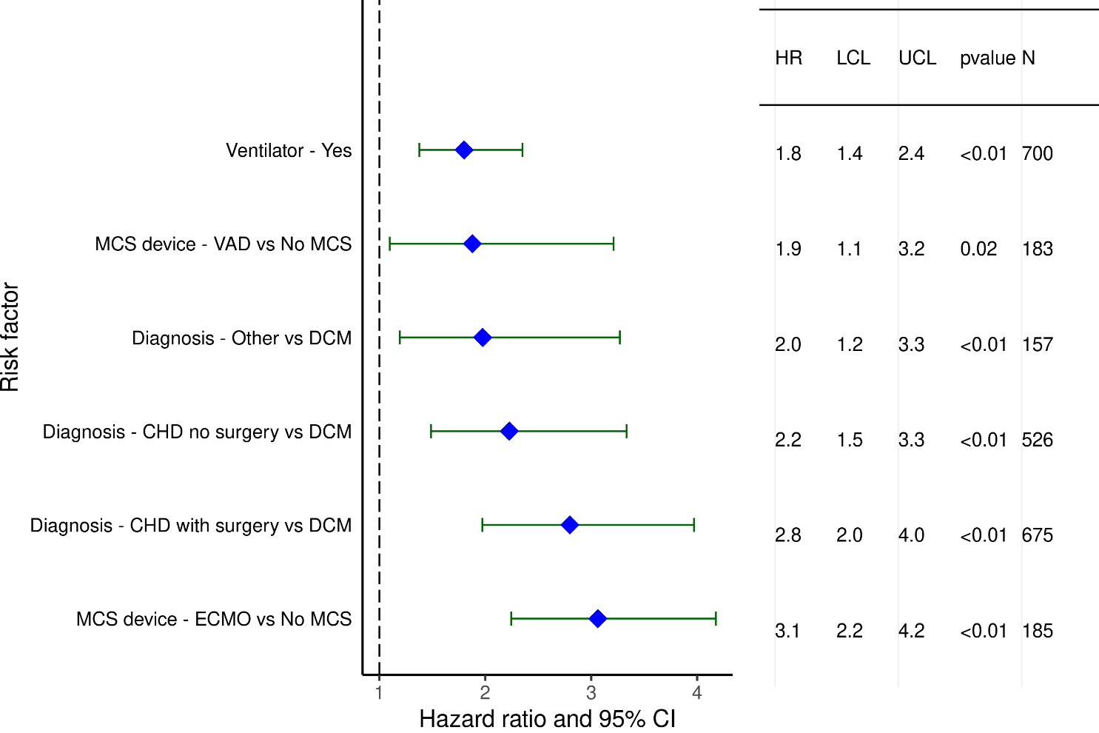
Infant Heart Transplants (January 2000 – June 2017)
Statistically Significant Risk Factors For 1-Year Mortality with 95% Confidence Limits
2022
(N = 2,109)
JHLT. 2022 Oct; 41(10): 1335-1375

Slide 43
Infant Heart Transplants (January 2000 – June 2017)
Statistically Significant Continuous Risk Factors For 1-Year Mortality
Continuous Factors (see figures)
Recipient GFR (mL/min/1.73 m²) | Ischemic time (hours)
2022
JHLT. 2022 Oct; 41(10): 1335-1375

Slide 44
Infant Heart Transplants (January 2000- June 2017)
Statistically Significant Risk Factors For 1-Year Mortality with 95% Confidence Limits
Recipient GFR (mL/min/1.73 m²)
p = 0.0007
2022
GFR was estimated using the modified Schwartz formula
(N = 2,109)
JHLT. 2022 Oct; 41(10): 1335-1375

Slide 45
Infant Heart Transplants (January 2000- June 2017)
Statistically Significant Risk Factors For 1-Year Mortality with 95% Confidence Limits
Ischemic time (hours)
p = 0.0014
2022
(N = 2,109)
JHLT. 2022 Oct; 41(10): 1335-1375

Slide 46
Multivariable Cox Analysis
Mortality within 5 Years Conditional on Survival to 1 Year
2022
JHLT. 2022 Oct; 41(10): 1335-1375

Slide 47
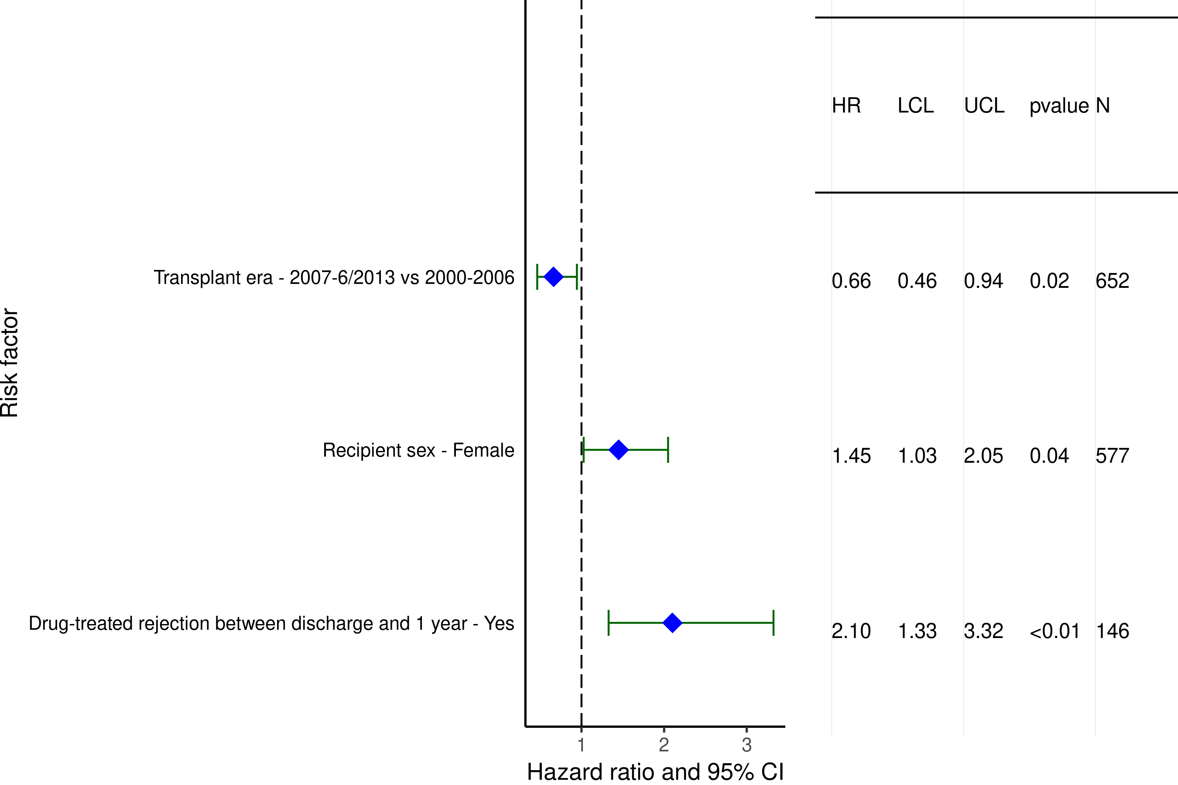
Infant Heart Transplants (January 2000 – June 2013)
Statistically Significant Categorical Risk Factors For 5-Year Mortality Conditional on Surviving to 1 Year with 95% Confidence Limits
2022
(N = 2,109)
JHLT. 2022 Oct; 41(10): 1335-1375

