Slide 1

FOCUS THEME:
CHRONIC OBSTRUCTIVE PULMONARY DISEASE (COPD)
Adult Lung
2022
JHLT. 2022 Oct; 41(10): 1335-1375

Slide 2
Table of Contents
Number of Deceased Donor Transplants and Baseline Characteristics by Transplant Year/Era: slides 3-13
Post-transplant Functional Status and Causes of Death: slides 14-18
Kaplan-Meier Survival Analyses: slides 19-43
  Survival within 12 months: slides 19-27
  Survival within 5 years conditional on survival to 1 year: slides 28-36
  Freedom from BOS/CLAD and non-skin malignancy: slides 37-43
Multivariable Analyses: slides 44-66
  Cox model for mortality within 12 months: slides 44-50
  Cox model for mortality within 5 years conditional on survival to 1 year: slides 51-57
  Cox model for BOS/CLAD conditional on survival to discharge: slides 58-66
2022
JHLT. 2022 Oct; 41(10): 1335-1375

Slide 3
Number of Deceased Donor Transplants and Baseline Characteristics by Transplant Era/Year
2022
JHLT. 2022 Oct; 41(10): 1335-1375

Slide 4
Adult Lung Transplants
By Diagnosis (Transplants: January 1992 – June 2018)
 | Jan 1992-Dec 2000 (N = 11,796) | Jan 2001-Dec 2009 (N = 21,806) | Jan 2010-Jun 2018 (N = 33,891) | P-value
Diagnosis |  |  |  | <0.0001
- COPD | 4162 (37.3%) | 7102 (33.1%) | 8917 (26.5%)
- A1ATD | 1169 (10.5%) | 1131 (5.3%) | 1054 (3.1%)
- CF | 1717 (15.4%) | 3470 (16.2%) | 4771 (14.2%)
- IPAH | 578 (5.2%) | 563 (2.6%) | 945 (2.8%)
- IPF | 1677 (15.0%) | 4899 (22.8%) | 9755 (29.0%)
- Retransplant | 394 (3.5%) | 921 (4.3%) | 1364 (4.1%)
- Other | 1471 (13.2%) | 3392 (15.8%) | 6822 (20.3%)
2022
Continuous factors are expressed as median (5th – 95th percentiles)
JHLT. 2022 Oct; 41(10): 1335-1375
Summary statistics included transplants with non-missing data
Notes:
Comparisons for categorical variables were made using the chi-square statistic. Multiple groups were compared using single p-value.
Comparisons for continuous variables were made using Kruskal-Wallis test.
A significant p-value means that at least one of the groups is different than the others but it doesn’t identify which group it is.

Slide 5
Adult Lung Transplants with COPD
Recipient Characteristics (Transplants: January 1992 – June 2018)
 | Jan 1992-Dec 2000 (N = 4,162) | Jan 2001-Dec 2009 (N = 7,102) | Jan 2010-Jun 2018 (N = 8,917) | P-value
Geographic Location |  |  |  | <0.0001
- Europe | 23.0% | 35.0% | 44.5%
- North America | 71.1% | 58.2% | 46.5%
- Other | 5.8% | 6.8% | 9.0%
Age (years) (continuous) | 55.0 (42.0 - 64.0) | 58.0 (45.0 - 66.0) | 60.0 (48.0 - 69.0) | <0.0001
Age (years) (categorical) |  |  |  | <0.0001
- 18-29 | 0.6% | 0.2% | 0.2%
- 30-39 | 2.6% | 1.3% | 0.7%
- 40-49 | 17.9% | 10.8% | 6.4%
- 50-59 | 54.9% | 48.5% | 40.9%
- 60-69 | 23.9% | 38.3% | 49.2%
- ≥70 | 0.2% | 0.7% | 3.5%
Female | 51.7% | 48.5% | 46.7% | <0.0001
Weight (kg) | 64.6 (45.4 - 91.6) | 66.7 (47.0 - 93.4) | 68.0 (47.8 - 94.0) | <0.0001
Height (cm) | 168.0 (153.0 - 185.0) | 167.9 (154.0 - 183.0) | 169.0 (154.9 - 184.0) | 0.0015
BMI (kg/m²) | 22.9 (17.0 - 30.9) | 23.6 (17.7 - 30.5) | 23.8 (17.9 - 30.6) | <0.0001
2022
Summary statistics included transplants with non-missing data
JHLT. 2022 Oct; 41(10): 1335-1375
Continuous factors are expressed as median (5th – 95th percentiles)
Notes:
Comparisons for categorical variables were made using the chi-square statistic. Multiple groups were compared using single p-value.
Comparisons for continuous variables were made using Kruskal-Wallis test.
A significant p-value means that at least one of the groups is different than the others but it doesn’t identify which group it is.

Slide 6
Adult Lung Transplants with COPD
Recipient Characteristics (Transplants: January 1992 – June 2018)
 | Jan 1992-Dec 2000 (N = 4,162) | Jan 2001-Dec 2009 (N = 7,102) | Jan 2010-Jun 2018 (N = 8,917) | P-value
ABO blood type |  |  |  | 0.2239
- A | 42.1% | 43.5% | 43.9%
- AB | 4.9% | 5.0% | 4.6%
- B | 11.0% | 10.8% | 11.5%
- O | 42.0% | 40.6% | 40.0%
PRA ≥ 20% | 3.1% | 5.9% | 13.1% | <0.0001
PRA ≥ 80% | 0.3% | 0.7% | 2.1% | <0.0001
Diabetes | 2.5% | 5.7% | 8.4% | <0.0001
History of malignancy | 3.1% | 5.5% | 8.1% | <0.0001
History of smoking | - | 94.9% | 95.7% | 0.1602
Pre-transplant dialysis | 0.2% | 0.4% | 0.4% | 0.1971
Previous lung surgery | 18.4%¹ | 12.6% | 7.4% | <0.0001
Hospitalized | 4.9% | 5.6% | 6.6% | 0.0096
Ventilator use | 1.2% | 1.9% | 2.3% | 0.0034
ECMO use | 0.0% | 0.3% | 0.5% | 0.0021
2022
Summary statistics included transplants with non-missing data
JHLT. 2022 Oct; 41(10): 1335-1375
¹ Based on Apr 1994 – Dec 2000 transplants
Notes:
Comparisons for categorical variables were made using the chi-square statistic. Multiple groups were compared using single p-value.
Comparisons for continuous variables were made using Kruskal-Wallis test.
A significant p-value means that at least one of the groups is different than the others but it doesn’t identify which group it is.

Slide 7
Adult Lung Transplants with COPD
Recipient Characteristics (Transplants: January 1992 – June 2018)
 | Jan 1992-Dec 2000 (N = 4,162) | Jan 2001-Dec 2009 (N = 7,102) | Jan 2010-Jun 2018 (N = 8,917) | P-value
CMV antibody positive | 70.2% | 65.3% | 59.7% | <0.0001
EBV antibody positive | 77.6% ² | 86.6% | 93.1% | <0.0001
Hepatitis B antibody positive | 2.2% ¹ | 4.2% | 5.9% | <0.0001
Hepatitis C antibody positive | 1.6% ¹ | 2.1% | 2.6% | 0.022
Bilirubin (mg/dl) | 0.5 (0.2 - 1.1) ¹ | 0.5 (0.2 - 1.1) | 0.4 (0.2 - 1.1) | <0.0001
Creatinine (mg/dl) | 0.8 (0.5 - 1.3) ¹ | 0.8 (0.5 - 1.3) | 0.8 (0.5 - 1.2) | <0.0001
GFR (mL/min/1.73m²) * | 86.7 (51.3 - 147.0) ¹ | 87.3 (50.5 - 142.1) | 91.0 (55.0 - 147.1) | <0.0001
PCW mean (mmHg) | 11.0 (4.0 - 21.0) ¹ | 12.0 (5.0 - 22.0) | 12.0 (5.0 - 23.0) | <0.0001
PA mean (mmHg) | 24.0 (15.0 - 38.0) ¹ | 25.0 (15.0 - 38.0) | 25.0 (16.0 - 41.0) | <0.0001
PVR (Wood units) | 2.6 (1.0 - 5.3) ¹ | 2.5 (1.0 - 5.5) | 2.6 (1.0 - 6.1) | 0.0251
FEV1% predicted | 19.0 (11.0 - 50.0) | 20.0 (12.0 - 61.0) | 20.0 (12.0 - 60.0) | <0.0001
FVC% predicted | 50.0 (26.0 - 79.0) | 51.0 (28.0 - 83.0) | 53.0 (30.0 - 87.0) | <0.0001
2022
Summary statistics included transplants with non-missing data
* GFR was estimated using the Cockcroft-Gault formula
JHLT. 2022 Oct; 41(10): 1335-1375
¹ Based on Apr 1994 – Dec 2000 transplants
² Based on Oct 1999– Dec 2000 transplants
Notes:
Comparisons for categorical variables were made using the chi-square statistic. Multiple groups were compared using single p-value.
Comparisons for continuous variables were made using Kruskal-Wallis test.
A significant p-value means that at least one of the groups is different than the others but it doesn’t identify which group it is.

Slide 8
Adult Lung Transplants with COPD
Recipient Characteristics (Transplants: January 1992 – June 2018)
 | Jan 1992-Dec 2000 (N = 4,162) | Jan 2001-Dec 2009 (N = 7,102) | Jan 2010-Jun 2018 (N = 8,917) | P-value
Donor-recipient sex match |  |  |  | <0.0001
- Male-Male | 40.1% | 44.0% | 46.5%
- Male-Female | 24.5% | 18.6% | 18.9%
- Female-Male | 8.1% | 7.5% | 6.9%
- Female-Female | 27.4% | 29.9% | 27.8%
Transplant procedure |  |  |  | <0.0001
- Single | 74.8% | 47.6% | 23.5%
- Double/bilateral | 25.2% | 52.4% | 76.5%
2022
Summary statistics included transplants with non-missing data
JHLT. 2022 Oct; 41(10): 1335-1375

Slide 9
Adult Lung Transplants
Diagnosis Distribution by Location and Era
(Transplants: January 1992 – June 2018)
Europe
North America
Other
2022
JHLT. 2022 Oct; 41(10): 1335-1375

Slide 10
Adult Lung Transplants with COPD
Median Recipient Age by Location
Median Recipient BMI by Location
(Transplants: January 1992 – June 2018)
(Transplants: January 1992 – June 2018)
2022
JHLT. 2022 Oct; 41(10): 1335-1375

Slide 11
Adult Lung Transplants with COPD
Recipient Sex Distribution by Location and Era
(Transplants: January 1992 – June 2018)
Europe
North America
Other
2022
JHLT. 2022 Oct; 41(10): 1335-1375

Slide 12
Adult Lung Transplants with COPD
Donor-Recipient Sex Distribution by Location and Era
(Transplants: January 1992 – June 2018)
Europe
North America
Other
2022
JHLT. 2022 Oct; 41(10): 1335-1375

Slide 13
Adult Lung Transplants with COPD
Recipient ABO Blood Type Distribution by Location and Era
(Transplants: January 1992 – June 2018)
Europe
North America
Other
2022
JHLT. 2022 Oct; 41(10): 1335-1375

Slide 14
Post-transplant Functional Status and
Causes of Death
2022
JHLT. 2022 Oct; 41(10): 1335-1375

Slide 15
Adult Lung Transplants with COPD
Functional Status at 1 Year Follow-Up by Era
(Follow-ups: January 2005 – June 2018)
2022
JHLT. 2022 Oct; 41(10): 1335-1375
Notes:
Functional status is collected using Karnofsky score for pediatric recipients.

Slide 16
Adult Lung Recipients with COPD
Cause of Death (Deaths: January 1992 – June 2018)
Cause of Death | ≤1 Year (N = 2,696) | >1 Year - 5 Years (N = 3,759) | >5 Years (N = 3,025)
OB/BOS | 75 (2.8%) | 936 (24.9%) | 717 (23.7%)
Acute Rejection | 63 (2.3%) | 53 (1.4%) | 9 (0.3%)
Malignancy | 114 (4.2%) | 477 (12.7%) | 492 (16.3%)
Infection | 848 (31.5%) | 733 (19.5%) | 492 (16.3%)
Graft Failure | 472 (17.5%) | 665 (17.7%) | 490 (16.2%)
Cardiovascular | 223 (8.3%) | 216 (5.7%) | 238 (7.9%)
Multiple Organ Failure | 303 (11.2%) | 202 (5.4%) | 154 (5.1%)
Other | 598 (22.2%) | 477 (12.7%) | 433 (14.3%)
2022
JHLT. 2022 Oct; 41(10): 1335-1375

Slide 17
Adult Lung Transplants with COPD
Relative Incidence of Leading Causes of Death
(Deaths: January 2010 – June 2018)
2022
Since only leading causes of death are shown, the sum of percentages for each time period is less than 100%.
JHLT. 2022 Oct; 41(10): 1335-1375

Slide 18
Adult Lung Transplants with COPD
Cumulative Incidence of Leading Causes of Death
(Transplants: January 2010 – June 2017)
2022
JHLT. 2022 Oct; 41(10): 1335-1375
Notes:
Incidence was computed using a competing-risks extension of the Kaplan-Meier method.

Slide 19
Survival Analyses
Kaplan-Meier Survival Within 12 Months
2022
JHLT. 2022 Oct; 41(10): 1335-1375

Slide 20
Adult Lung Transplants with COPD
Kaplan-Meier Survival within 12 Months by Era
(Transplants: January 2000 - June 2017)
2022
Note: Y-axis is truncated for clearer presentation
JHLT. 2022 Oct; 41(10): 1335-1375

Slide 21
Adult Lung Transplants with COPD
Kaplan-Meier Survival within 12 Months by Era and Location
(Transplants: January 2000 - June 2017)
North America
Other
2022
JHLT. 2022 Oct; 41(10): 1335-1375

Slide 22
Adult Lung Transplants with COPD
Kaplan-Meier Survival within 12 Months by Recipient Age
(Transplants: January 2000 - June 2017)
2022
JHLT. 2022 Oct; 41(10): 1335-1375

Slide 23
Adult Lung Transplants with COPD
Kaplan-Meier Survival within 12 Months by Recipient Age and Location
(Transplants: January 2000 - June 2017)
No pairwise comparisons were significant at p < 0.05
North America
Other
2022
JHLT. 2022 Oct; 41(10): 1335-1375
Notes:
Combined 60-69 with 70+ due to small numbers of 70+

Slide 24
Adult Lung Transplants
Kaplan-Meier Survival within 12 Months by Diagnosis
(Transplants: January 2000 - June 2017)
2022
JHLT. 2022 Oct; 41(10): 1335-1375

Slide 25
Adult Lung Transplants with COPD
Kaplan-Meier Survival within 12 Months by Procedure Type
(Transplants: January 2000 - June 2017)
2022
Note: Y-axis is truncated for clearer presentation
JHLT. 2022 Oct; 41(10): 1335-1375

Slide 26
Adult Lung Transplants with COPD
Kaplan-Meier Survival within 12 Months by Age and Procedure Type
(Transplants: January 2000 - June 2017)
2022
Note: Y-axis is truncated for clearer presentation
JHLT. 2022 Oct; 41(10): 1335-1375

Slide 27
Adult Lung Transplants with COPD
Kaplan-Meier Survival within 12 Months by Recipient GFR*
(Transplants: January 2000 - June 2017)
2022
Note: Y-axis is truncated for clearer presentation
JHLT. 2022 Oct; 41(10): 1335-1375
* GFR was estimated using the Cockcroft-Gault formula

Slide 28
Survival Analyses
Kaplan-Meier Survival Within 5 Years Conditional on Survival to Discharge
2022
JHLT. 2022 Oct; 41(10): 1335-1375

Slide 29
Adult Lung Transplants with COPD
Kaplan-Meier Survival within 5 Years Conditional on Survival to 1 Year
By Era (January 1996 - June 2013)
All pairwise comparisons were significant at p < 0.05 except 2002-2007 vs. 2008-2013
2022
JHLT. 2022 Oct; 41(10): 1335-1375

Slide 30
Adult COPD Lung Transplants
Kaplan-Meier Survival within 5 Years Conditional on Survival to 1 Year
By Location and Era (Transplants: January 1996 - June 2013)
Europe
North America
2022
JHLT. 2022 Oct; 41(10): 1335-1375

Slide 31
Adult Lung Transplants with COPD
Kaplan-Meier Survival within 5 Years Conditional on Survival to 1 Year
By Recipient Age (January 1996 - June 2013)
No pairwise comparisons were significant at p < 0.05 except 40-59 vs. ≥ 60 Years
2022
JHLT. 2022 Oct; 41(10): 1335-1375

Slide 32
Adult COPD Lung Transplants
Kaplan-Meier Survival within 5 Years Conditional on Survival to 1 Year
by Location and Recipient Age (Transplants: January 1996 - June 2013)
No pairwise comparisons were significant at p < 0.05
North America
Other
2022
JHLT. 2022 Oct; 41(10): 1335-1375

Slide 33
Adult Lung Transplants
Kaplan-Meier Survival within 5 Years Conditional on Survival to 1 Year
by Diagnosis (Transplants: January 1996 - June 2013)
2022
JHLT. 2022 Oct; 41(10): 1335-1375

Slide 34
Adult COPD Lung Transplants
Kaplan-Meier Survival within 5 Years Conditional on Survival to 1 Year
by Procedure Type (Transplants: January 1996 - June 2013)
2022
JHLT. 2022 Oct; 41(10): 1335-1375

Slide 35
Adult COPD Lung Transplants
Kaplan-Meier Survival within 5 Years Conditional on Survival to 1 Year
by Recipient Age and Procedure Type (Transplants: January 2000 - June 2017)
2022
JHLT. 2022 Oct; 41(10): 1335-1375

Slide 36
Adult COPD Lung Transplants
Kaplan-Meier Survival within 5 Years Conditional on Survival to 1 Year
by Recipient GFR* (Transplants: January 1996 - June 2013)
2022
Note: Y-axis is truncated for clearer presentation
JHLT. 2022 Oct; 41(10): 1335-1375
* GFR was estimated using the Cockcroft-Gault formula

Slide 37
Survival Analyses
Kaplan-Meier Freedom from BOS/CLAD and Non-Skin Malignancy
2022
JHLT. 2022 Oct; 41(10): 1335-1375

Slide 38
Adult Lung Transplants with COPD
Freedom from BOS/CLAD Conditional on Survival to Discharge
By Era (Transplants: January 1996 - June 2013)
All pairwise comparisons were significant at p < 0.05 except 2002-2007 vs. 2008-2013
2022
JHLT. 2022 Oct; 41(10): 1335-1375

Slide 39
Adult COPD Lung Transplants
Freedom from BOS/CLAD Conditional on Survival to Discharge
By Recipient Age (Transplants: January 1996 - June 2013)
No pairwise comparisons were significant at p < 0.05 =
2022
JHLT. 2022 Oct; 41(10): 1335-1375

Slide 40
Adult Lung Transplants with COPD
Freedom from BOS/CLAD Conditional on Survival to Discharge
By Procedure Type (Transplants: January 1996 - June 2013)
p < 0.0001=
2022
JHLT. 2022 Oct; 41(10): 1335-1375

Slide 41
Adult COPD Lung Transplants
Freedom from BOS/CLAD Conditional on Survival to Discharge
By Recipient Age and Procedure Type (Transplants: January 1996 - June 2013)
2022
JHLT. 2022 Oct; 41(10): 1335-1375

Slide 42
Adult Lung Transplants with COPD
Freedom from New Onset Non-Skin Malignancy Conditional on Survival 1 Year
By Procedure Type (Transplants: January 1996 - June 2017)
p < 0.0001=
2022
JHLT. 2022 Oct; 41(10): 1335-1375

Slide 43
Adult Lung Transplants with COPD
Freedom from New Onset Non-Skin Malignancy Conditional on Survival to 1 Year
By Procedure Type (Transplants: January 1996 - June 2017)
p < 0.0001=
p=0.5061
Lung Cancer
Non-Lung Cancer
2022
JHLT. 2022 Oct; 41(10): 1335-1375

Slide 44
Multivariable Cox Analyses
Mortality within 12 Months
2022
JHLT. 2022 Oct; 41(10): 1335-1375

Slide 45
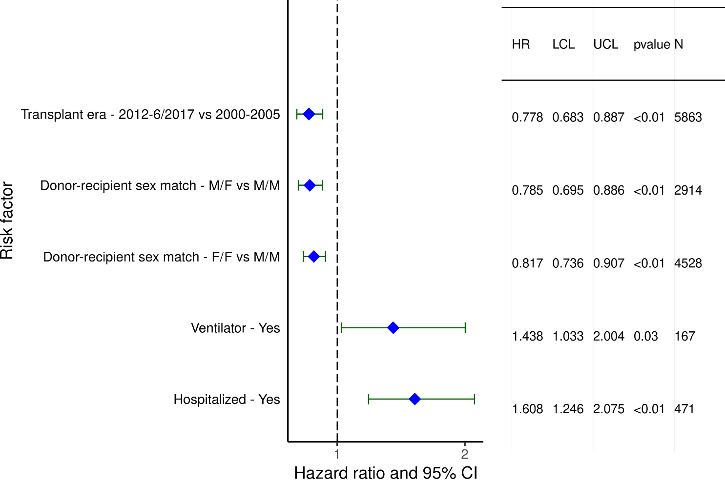
Adult Lung Transplant Recipients with COPD (2000-6/2017)
Statistically Significant Categorical Risk Factors For 1-Year Mortality with 95% Confidence Limits
2022
(N = 15,643)
JHLT. 2022 Oct; 41(10): 1335-1375

Slide 46
Adult Lung Transplant Recipients with COPD (2000-6/2017)
Statistically Significant Continuous Risk Factors For 1-Year Mortality
Continuous Factors (see figures)
Recipient age (years) | PVR (Wood units)
Donor age (years) | Center volume in previous 3 yrs
2022
JHLT. 2022 Oct; 41(10): 1335-1375

Slide 47
Adult Lung Transplant Recipients with COPD (2000-6/2017)
Statistically Significant Risk Factors For 1-Year Mortality with 95% Confidence Limits
Recipient age (years)
p < 0.0001
2022
(N = 15,643)
JHLT. 2022 Oct; 41(10): 1335-1375

Slide 48
Adult Lung Transplant Recipients with COPD (2000-6/2017)
Statistically Significant Risk Factors For 1-Year Mortality with 95% Confidence Limits
PVR (Wood units)
p = 0.0307
2022
(N = 15,643)
JHLT. 2022 Oct; 41(10): 1335-1375

Slide 49
Adult Lung Transplant Recipients with COPD (2000-6/2017)
Statistically Significant Risk Factors For 1-Year Mortality with 95% Confidence Limits
Donor age (years)
p = 0.0002
2022
(N = 15,643)
JHLT. 2022 Oct; 41(10): 1335-1375

Slide 50
Adult Lung Transplant Recipients with COPD (2000-6/2017)
Statistically Significant Risk Factors For 1-Year Mortality with 95% Confidence Limits
Center volume in previous 3 yrs
p < 0.0001
2022
(N = 15,643)
JHLT. 2022 Oct; 41(10): 1335-1375

Slide 51
Multivariable Cox Analyses
Mortality within 5 Years Conditional on Survival to 1 Year
2022
JHLT. 2022 Oct; 41(10): 1335-1375

Slide 52
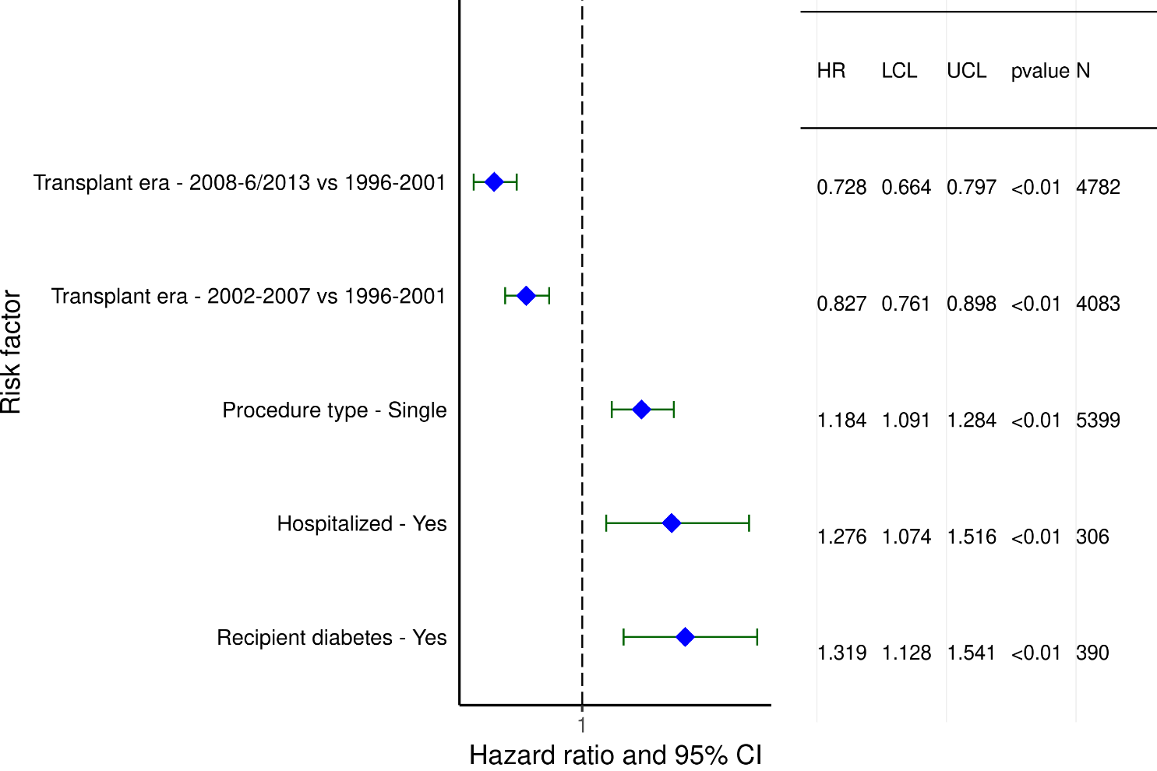
Adult Lung Transplant Recipients with COPD (1996-6/2013)
Statistically Significant Categorical Risk Factors For 5-Year Mortality Conditional on Survival to 1 Year with 95% Confidence Limits
2022
(N = 11,683)
JHLT. 2022 Oct; 41(10): 1335-1375

Slide 53
Adult Lung Transplant Recipients with COPD (1996-6/2013)
Statistically Significant Continuous Risk Factors For 5-Year Mortality Conditional on Survival to 1 Year
Continuous Factors (see figures)
Recipient age (years) | Recipient BMI (kg/m²)
Center volume in previous 3 yrs | Ischemic time (hours)
2022
JHLT. 2022 Oct; 41(10): 1335-1375

Slide 54
Adult Lung Transplant Recipients with COPD (1996-6/2013)
Statistically Significant Risk Factors For 5-Year Mortality Conditional on Survival to 1 Year with 95% Confidence Limits
Recipient age (years)
p < 0.0001
2022
(N = 11,683)
JHLT. 2022 Oct; 41(10): 1335-1375

Slide 55
Adult Lung Transplant Recipients with COPD (1996-6/2013)
Statistically Significant Risk Factors For 5-Year Mortality Conditional on Survival to 1 Year with 95% Confidence Limits
Recipient BMI (kg/m²)
p = 0.0002
2022
(N = 11,683)
JHLT. 2022 Oct; 41(10): 1335-1375

Slide 56
Adult Lung Transplant Recipients with COPD (1996-6/2013)
Statistically Significant Risk Factors For 5-Year Mortality Conditional on Survival to 1 Year with 95% Confidence Limits
Center volume in previous 3 yrs
p = 0.0008
2022
(N = 11,683)
JHLT. 2022 Oct; 41(10): 1335-1375

Slide 57
Adult Lung Transplant Recipients with COPD (1996-6/2013)
Statistically Significant Risk Factors For 5-Year Mortality Conditional on Survival to 1 Year with 95% Confidence Limits
Ischemic time (hours)
p = 0.0156
2022
(N = 11,683)
JHLT. 2022 Oct; 41(10): 1335-1375

Slide 58
Multivariable Cox Analyses
Freedom from BOS/CLAD within 5 Years Conditional on Survival to Discharge
2022
JHLT. 2022 Oct; 41(10): 1335-1375

Slide 59
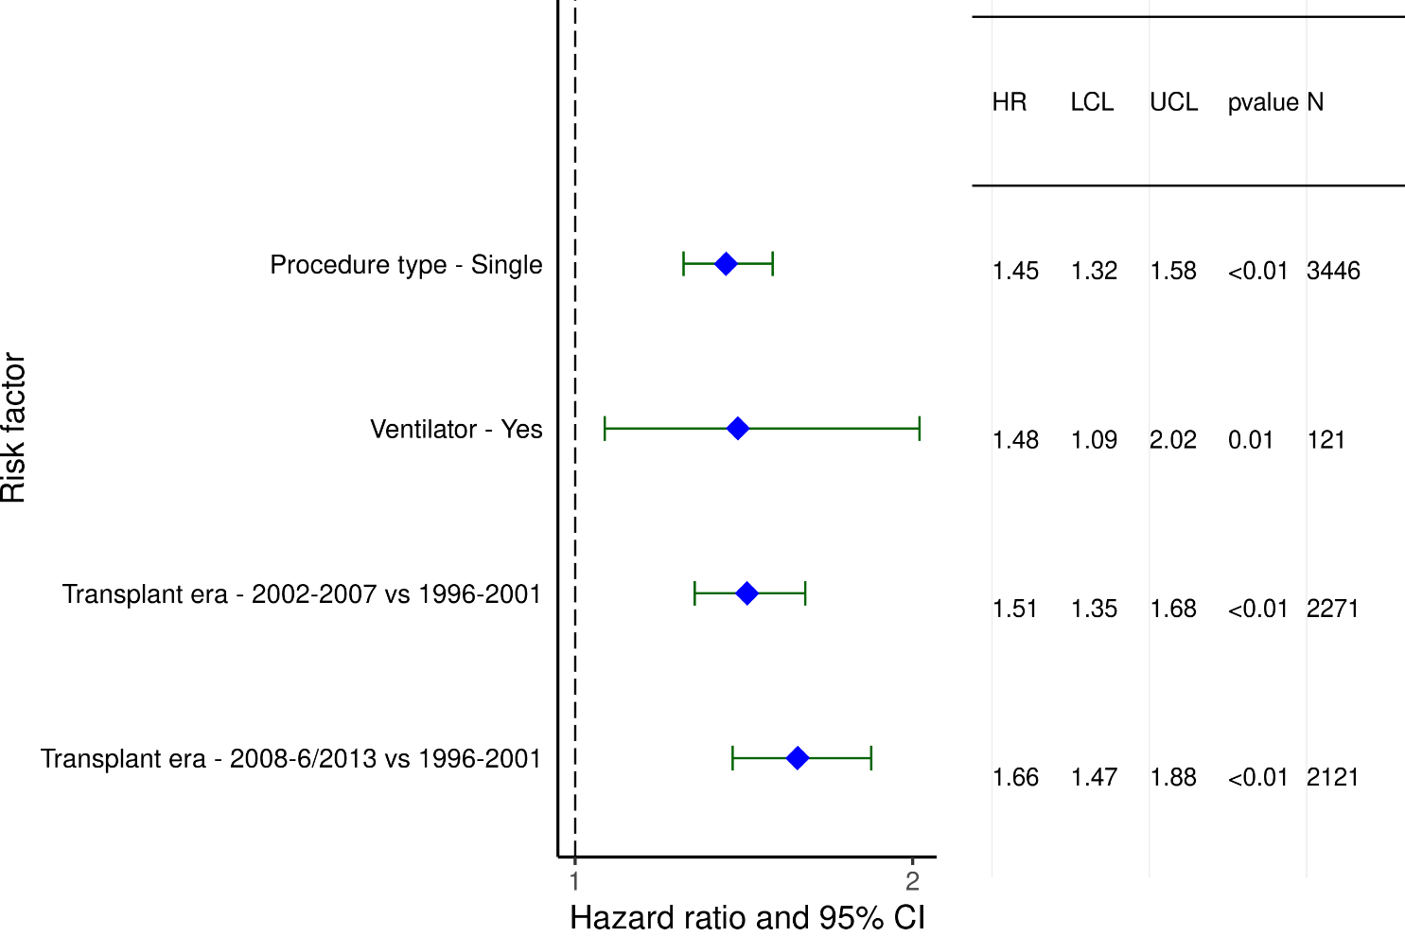
Adult Lung Transplant Recipients with COPD (1996-6/2013)
Statistically Significant Categorical Risk Factors for BOS/CLAD within
5 Years Conditional on Survival to Discharge with 95% Confidence Limits
2022
(N = 6,181)
JHLT. 2022 Oct; 41(10): 1335-1375

Slide 60
Adult Lung Transplant Recipients with COPD (1996-6/2013)
Statistically Significant Continuous Risk Factors for BOS/CLAD within
5 Years Conditional on Survival to Discharge
Continuous Factors (see figures)
Recipient BMI (kg/m²) | PCW (mm/Hg)
PVR (Wood units) | PRA (%)
Donor age (years) | Center volume in previous 3 yrs
2022
JHLT. 2022 Oct; 41(10): 1335-1375

Slide 61
Adult Lung Transplant Recipients with COPD (1996-6/2013)
Statistically Significant Risk Factors for BOS/CLAD within 5 Years Conditional on Survival to Discharge with 95% Confidence Limits
Recipient BMI (kg/m²)
p = 0.0026
2022
(N = 6,181)
JHLT. 2022 Oct; 41(10): 1335-1375

Slide 62
Adult Lung Transplant Recipients with COPD (1996-6/2013)
Statistically Significant Risk Factors for BOS/CLAD within 5 Years Conditional on Survival to Discharge with 95% Confidence Limits
PCW (mm/Hg)
p = 0.0225
2022
(N = 6,181)
JHLT. 2022 Oct; 41(10): 1335-1375

Slide 63
Adult Lung Transplant Recipients with COPD (1996-6/2013)
Statistically Significant Risk Factors for BOS/CLAD within 5 Years Conditional on Survival to Discharge with 95% Confidence Limits
PVR (Wood units)
p = 0.0106
2022
(N = 6,181)
JHLT. 2022 Oct; 41(10): 1335-1375

Slide 64
Adult Lung Transplant Recipients with COPD (1996-6/2013)
Statistically Significant Risk Factors for BOS/CLAD within 5 Years Conditional on Survival to Discharge with 95% Confidence Limits
PRA (%)
p = 0.0011
2022
(N = 6,181)
JHLT. 2022 Oct; 41(10): 1335-1375

Slide 65
Adult Lung Transplant Recipients with COPD (1996-6/2013)
Statistically Significant Risk Factors for BOS/CLAD within 5 Years Conditional on Survival to Discharge with 95% Confidence Limits
Donor age (years)
p = 0.0002
2022
(N = 6,181)
JHLT. 2022 Oct; 41(10): 1335-1375

Slide 66
Adult Lung Transplant Recipients with COPD (1996-6/2013)
Statistically Significant Risk Factors for BOS/CLAD within 5 Years Conditional on Survival to Discharge with 95% Confidence Limits
Center volume in previous 3 yrs
p < 0.0001
2022
(N = 6,181)
JHLT. 2022 Oct; 41(10): 1335-1375

