Slide 1

FOCUS THEME:
RESTRICTIVE/HYPERTROPHIC CARDIOMYOPATHIES (RCM/HCM)
Adult Heart
2022
JHLT. 2022 Oct; 41(10): 1335-1375
Notes:
Hypertrophic

Slide 2
Table of Contents
Number of Deceased Donor Transplants and Characteristics of Transplants: slides 3-14
Immunosuppression and Rejection: slides 15-18
Recipient Causes of Death: slides 19-25
Kaplan-Meier Survival Analyses: slides 26-37
Multivariable Cox Analyses: slides 38-49
  Mortality within 12 months: slides 38-45
  Mortality within 5 years conditional on survival to 1 year: slides 46-49
2022
JHLT. 2022 Oct; 41(10): 1335-1375

Slide 3
Number of Deceased Donor Transplants and Characteristics of Transplant
2022
JHLT. 2022 Oct; 41(10): 1335-1375

Slide 4
Adult Heart Transplants with RCM/HCM
Diagnosis Categories (Transplants: January 1992 – June 2018)
 | Jan 1992-Dec 2000 (N = 760) | Jan 2001-Dec 2009 (N = 1,417) | Jan 2010-Jun 2018 (N = 2,129) | P-value
Hypertrophic cardiomyopathy (HCM) | 352 (46.3%) | 752 (53.1%) | 1065 (50.0%) | <0.0001
Restrictive cardiomyopathy: Amyloid | 53 (7.0%) | 114 (8.0%) | 299 (14.0%)
Restrictive cardiomyopathy: Sarcoid | 25 (3.3%) | 50 (3.5%) | 133 (6.2%)
Restrictive cardiomyopathy: Radiation/chemo | 9 (1.2%) | 26 (1.8%) | 53 (2.5%)
Other restrictive cardiomyopathy (RCM) | 321 (42.2%) | 475 (33.5%) | 579 (27.2%)
- Idiopathic | 203 (26.7%) | 240 (16.9%) | 266 (12.5%)
- Endocardial Fibrosis | 9 (1.2%) | 12 (0.8%) | 16 (0.8%)
- Other RCM/HCM | 109 (14.3%) | 223 (15.7%) | 297 (14.0%)
2022
Summary statistics included transplants with non-missing data
JHLT. 2022 Oct; 41(10): 1335-1375
Continuous factors are expressed as median (5th – 95th percentiles)
Notes:
Comparisons for categorical variables were made using the chi-square statistic. Multiple groups were compared using single p-value.
Comparisons for continuous variables were made using Kruskal-Wallis test.
A significant p-value means that at least one of the groups is different than the others but it doesn’t identify which group it is.

Slide 5
Adult Heart Transplants with RCM/HCM
Recipient Characteristics (Transplants: January 1992 – June 2018)
 | Jan 1992-Dec 2000 (N = 760) | Jan 2001-Dec 2009 (N = 1,417) | Jan 2010-Jun 2018 (N = 2,129) | P-value
Geographic Location |  |  |  | <0.0001
- Europe | 47.8% | 49.5% | 41.4%
- North America | 46.7% | 46.1% | 52.0%
- Other | 5.5% | 4.4% | 6.6%
Age (years) (continuous) | 47.0 (22.0 - 63.0) | 49.0 (22.0 - 65.0) | 52.0 (23.0 - 68.0) | <0.0001
Female | 38.7% | 44.7% | 42.2% | 0.0233
Weight (kg) | 69.1 (48.4 - 96.0) | 72.0 (49.9 - 100.0) | 75.0 (51.3 - 105.9) | <0.0001
Height (cm) | 170.0 (152.4 - 185.0) | 170.2 (154.0 - 186.0) | 170.2 (154.0 - 188.0) | 0.036
BMI (kg/m²) | 23.7 (17.9 - 31.8) | 24.7 (18.7 - 32.8) | 25.5 (19.1 - 34.2) | <0.0001
ABO blood type |  |  |  | 0.0881
- A | 46.8% | 42.6% | 41.0%
- AB | 4.0% | 5.0% | 4.4%
- B | 11.0% | 13.8% | 14.0%
- O | 38.2% | 38.5% | 40.6%
PRA ≥ 20% | 3.5% | 7.6% | 19.1% | <0.0001
PRA ≥ 80% | 0.6% | 1.5% | 3.6% | 0.0017
CMV antibody positive | 57.5% | 53.9% | 54.4% | 0.5138
2022
Summary statistics included transplants with non-missing data
JHLT. 2022 Oct; 41(10): 1335-1375
Continuous factors are expressed as median (5th – 95th percentiles)
Notes:
Comparisons for categorical variables were made using the chi-square statistic. Multiple groups were compared using single p-value.
Comparisons for continuous variables were made using Kruskal-Wallis test.
A significant p-value means that at least one of the groups is different than the others but it doesn’t identify which group it is.

Slide 6
Adult Heart Transplants with RCM/HCM
Recipient Characteristics (Transplants: January 1992 – June 2018)
 | Jan 1992-Dec 2000 (N = 760) | Jan 2001-Dec 2009 (N = 1,417) | Jan 2010-Jun 2018 (N = 2,129) | P-value
History of malignancy | 5.0%¹ | 6.5% | 11.5% | <0.0001
History of smoking | - | 31.2%² | 33.3% | 0.4412
Pre-transplant dialysis | 0.8%¹ | 2.4% | 3.0% | 0.1206
Prior cardiac surgery | 22.0%¹ | 25.7% | 27.5% | 0.1348
Hospitalized | 59.2% | 47.7% | 54.9% | 0.0005
Inotrope use | 43.6% | 43.9% | 44.5% | 0.9403
ECMO use | 0% | 0.4% | 0.9% | 0.1422
IABP use | 2.2% | 2.8% | 6.9% | <0.0001
Ventilator use | 2.2% | 1.6% | 0.9% | 0.1609
MCS use |  |  |  | <0.0001
- BIVAD | - | 2.0% | 1.3%
- TAH | - | 0.7% | 2.2%
- VAD | - | 6.7% | 14.5%
- None | - | 90.6% | 82.1%
2022
Summary statistics included transplants with non-missing data
¹ Based on Apr 1994 – Dec 2000 transplants
JHLT. 2022 Oct; 41(10): 1335-1375
² Based on Jul 2004– Dec 2009 transplants
Notes:
Comparisons for categorical variables were made using the chi-square statistic. Multiple groups were compared using single p-value.
Comparisons for continuous variables were made using Kruskal-Wallis test.
A significant p-value means that at least one of the groups is different than the others but it doesn’t identify which group it is.

Slide 7
Adult Heart Transplants with RCM/HCM
Recipient Characteristics (Transplants: January 1992 – June 2018)
 | Jan 1992-Dec 2000 (N=760) | Jan 2001-Dec 2009 (N=1,417) | Jan 2010-Jun 2018 (N=2,129) | P-value
Bilirubin (mg/dl) | 0.9 (0.3 - 2.7) ¹ | 0.9 (0.3 - 2.9) | 0.8 (0.3 - 2.4) | <0.0001
Creatinine (mg/dl) | 1.2 (0.7 - 2.2) ¹ | 1.1 (0.7 - 2.2) | 1.2 (0.7 - 2.0) | 0.1459
GFR (mL/min/1.73m²) * | 69.3 (34.6 - 142.8) ¹ | 71.7 (37.4 - 139.4) | 74.7 (39.5 - 142.6) | 0.0202
PCW mean (mmHg) | 20.0 (8.0 - 32.0) ¹ | 20.0 (8.0 - 30.0) | 18.0 (7.0 - 30.0) | 0.0008
PA mean (mmHg) | 30.0 (16.0 - 50.0) ¹ | 28.0 (15.0 - 45.0) | 27.0 (14.0 - 43.0) | <0.0001
PVR (Wood units) | 2.5 (0.7 - 6.5) ¹ | 2.3 (0.8 - 5.8) | 2.2 (0.6 - 5.1) | 0.0212
2022
Summary statistics included transplants with non-missing data
Continuous factors are expressed as median (5th – 95th percentiles)
* GFR was estimated using the Cockcroft-Gault formula
JHLT. 2022 Oct; 41(10): 1335-1375
¹ Based on Apr 1994 – Dec 2000 transplants

Slide 8
Adult Heart Transplants with RCM/HCM
Diagnosis by Age Group
(Transplants: January 1992 – June 2018)
2022
2022
JHLT. 2022 Oct; 41(10): 1335-1375
JHLT. 2022 Oct; 41(10): 1335-1375

Slide 9
Adult Heart Transplants with RCM/HCM
Distribution of Donor and Recipient Age
(Transplants: January 1992 – June 2018)
2022
JHLT. 2022 Oct; 41(10): 1335-1375
Notes:
Excluded transplants with missing donor age

Slide 10
Adult Heart Transplants with RCM/HCM
Donor-Recipient Sex Distribution by Location and Era
(Transplants: January 1992 – June 2018)
Europe
North America
Other
2022
JHLT. 2022 Oct; 41(10): 1335-1375

Slide 11
Adult Heart Transplants
Diagnosis by Era
2010-2018
1992-2000
2022
2001-2009
JHLT. 2022 Oct; 41(10): 1335-1375
Notes:
DCM is categorized as NICM
1992-2000 N=34,707
2001-2009 N=31,167
2010-2018 N=33,600

Slide 12
Adult Heart Transplants with RCM/HCM
Distribution of Diagnosis by Era
(Transplants: January 1992 – June 2018)
2022
JHLT. 2022 Oct; 41(10): 1335-1375

Slide 13
Adult Heart Transplants
Distribution of Diagnosis by Location
(Transplants: January 2010 – June 2018)
2022
JHLT. 2022 Oct; 41(10): 1335-1375
Notes:
Europe N=37,813
North America N=54,419
Other N=7,242

Slide 14
Adult Heart Transplants with RCM/HCM
Distribution of Diagnosis by Region
(Transplants: January 1992 – June 2018)
2022
JHLT. 2022 Oct; 41(10): 1335-1375

Slide 15
Immunosuppression and Rejection
2022
JHLT. 2022 Oct; 41(10): 1335-1375

Slide 16
Adult Heart Transplants with RCM/HCM
Induction Immunosuppression
(Transplants: January 1994 – June 2018)
2022
Analysis is limited to patients who were alive at the time of discharge
JHLT. 2022 Oct; 41(10): 1335-1375
Notes:
N = 2,376

Slide 17
Adult Heart Transplants with RCM/HCM
Maintenance Immunosuppression at Time of Discharge
(Transplants: January 1994 – June 2018)
2022
Analysis is limited to patients who were alive at the time of discharge.
JHLT. 2022 Oct; 41(10): 1335-1375
Notes:
N = 2,381

Slide 18
Adult Heart Transplants with RCM/HCM
% of Recipients Experiencing Treated Rejection Between Discharge and 1-Year Follow-Up by Transplant Era
(Follow-Ups: January 2005 – June 2018)
p<0.0001
2022
Analysis is limited to patients who were alive at the time of the follow-up.
Treated rejection = Recipient was reported to (1) have at least one acute rejection episode that was treated with an anti-rejection agent; or (2) have been hospitalized for rejection.
JHLT. 2022 Oct; 41(10): 1335-1375

Slide 19
Recipient Causes of Death
2022
JHLT. 2022 Oct; 41(10): 1335-1375

Slide 20
Adult Heart Transplants with HCM
Cause of Death (Deaths: January 1995 – June 2018)
Cause of Death | ≤ 1 Year (N=270) | >1 Year -5 Years (N=76) | >5 Years (N=141)
Cardiac Allograft Vasculopathy | 8 (3.0%) | 6 (7.9%) | 14 (9.9%)
Acute Rejection | 14 (5.2%) | 9 (11.8%) | 2 (1.4%)
Malignancy | 5 (1.9%) | 12 (15.8%) | 34 (24.1%)
Infection | 69 (25.6%) | 4 (5.3%) | 17 (12.1%)
Graft Failure | 77 (28.5%) | 26 (34.2%) | 43 (30.5%)
Multiple Organ Failure | 47 (17.4%) | 6 (7.9%) | 7 (5.0%)
Renal Failure | 2 (0.7%) | 0 (0.0%) | 6 (4.3%)
Pulmonary | 3 (1.1%) | 4 (5.3%) | 4 (2.8%)
Cerebrovascular | 19 (7.0%) | 2 (2.6%) | 4 (2.8%)
Other | 26 (9.6%) | 7 (9.2%) | 10 (7.1%)
Total Deaths (N) | 310 | 101 | 202
2022
Percentages represent % of deaths in the respective time period and are calculated excluding deaths with unknown causes of death.
*Total number of deaths includes deaths with unknown causes.
JHLT. 2022 Oct; 41(10): 1335-1375

Slide 21
Adult Heart Transplants with Amyloid
Cause of Death (Deaths: January 1995 – June 2018)
Cause of Death | ≤1 Year (N=64) | >1 Year-5 Years (N=57) | >5 Years (N=41)
Cardiac Allograft Vasculopathy | 1 (1.6%) | 2 (3.5%) | 0 (0.0%)
Acute Rejection | 3 (4.7%) | 4 (7.0%) | 1 (2.4%)
Malignancy | 0 (0.0%) | 1 (1.8%) | 7 (17.1%)
Infection | 19 (29.7%) | 15 (26.3%) | 4 (9.8%)
Graft Failure | 11 (17.2%) | 5 (8.8%) | 8 (19.5%)
Multiple Organ Failure | 9 (14.1%) | 5 (8.8%) | 5 (12.2%)
Renal Failure | 0 (0.0%) | 3 (5.3%) | 2 (4.9%)
Pulmonary | 2 (3.1%) | 2 (3.5%) | 1 (2.4%)
Cerebrovascular | 3 (4.7%) | 1 (1.8%) | 1 (2.4%)
Other | 16 (25.0%) | 19 (33.3%) | 12 (29.3%)
Total Deaths (N) | 67 | 68 | 51
2022
Percentages represent % of deaths in the respective time period and are calculated excluding deaths with unknown causes of death.
*Total number of deaths includes deaths with unknown causes.
JHLT. 2022 Oct; 41(10): 1335-1375

Slide 22
Adult Heart Transplants with Sarcoid
Cause of Death (Deaths: January 1995 – June 2018)
Cause of Death | ≤1 Year (N=16) | >1 Year-5 Years (N=6) | >5 Years (N=15)
Cardiac Allograft Vasculopathy | 1 (6.3%) | 0 (0.0%) | 1 (6.7%)
Acute Rejection | 1 (6.3%) | 0 (0.0%) | 0 (0.0%)
Malignancy | 0 (0.0%) | 0 (0.0%) | 2 (13.3%)
Infection | 7 (43.8%) | 2 (33.3%) | 1 (6.7%)
Graft Failure | 2 (12.5%) | 3 (50.0%) | 4 (26.7%)
Multiple Organ Failure | 1 (6.3%) | 0 (0.0%) | 1 (6.7%)
Renal Failure | 0 (0.0%) | 0 (0.0%) | 2 (13.3%)
Pulmonary | 2 (12.5%) | 0 (0.0%) | 4 (26.7%)
Cerebrovascular | 1 (6.3%) | 1 (16.7%) | 0 (0.0%)
Other | 1 (6.3%) | 0 (0.0%) | 0 (0.0%)
Total Deaths (N) | 17 | 8 | 19
2022
Percentages represent % of deaths in the respective time period and are calculated excluding deaths with unknown causes of death.
*Total number of deaths includes deaths with unknown causes.
JHLT. 2022 Oct; 41(10): 1335-1375

Slide 23
Adult Heart Transplants with Other RCM
Cause of Death (Deaths: January 1995 – June 2018)
Cause of Death | ≤ 1 Year (N=264) | >1 Year-5 Years (N=110) | >5 Years (N=123)
Cardiac Allograft Vasculopathy | 3 (1.1%) | 11 (10.0%) | 14 (11.4%)
Acute Rejection | 10 (3.8%) | 3 (2.7%) | 0 (0.0%)
Malignancy | 4 (1.5%) | 13 (11.8%) | 35 (28.5%)
Infection | 65 (24.6%) | 18 (16.4%) | 11 (8.9%)
Graft Failure | 70 (26.5%) | 26 (23.6%) | 27 (22.0%)
Multiple Organ Failure | 59 (22.3%) | 13 (11.8%) | 14 (11.4%)
Renal Failure | 4 (1.5%) | 1 (0.9%) | 5 (4.1%)
Pulmonary | 6 (2.3%) | 5 (4.5%) | 4 (3.3%)
Cerebrovascular | 16 (6.1%) | 5 (4.5%) | 6 (4.9%)
Other | 27 (10.2%) | 15 (13.6%) | 7 (5.7%)
Total Deaths (N) | 289 | 132 | 171
2022
Percentages represent % of deaths in the respective time period and are calculated excluding deaths with unknown causes of death.
*Total number of deaths includes deaths with unknown causes.
JHLT. 2022 Oct; 41(10): 1335-1375
Notes:
Other RCM/HCM includes radiation/chemo

Slide 24
Adult Heart Transplants with RCM/HCM
Relative Incidence of Leading Causes of Death
(Deaths: January 2010 – June 2018)
2022
Since only leading causes of death are shown, the sum of percentages for each time period is less than 100%.
JHLT. 2022 Oct; 41(10): 1335-1375

Slide 25
Adult Heart Transplants with RCM/HCM
Cumulative Incidence of Leading Causes of Death
(Transplants: January 2010 – June 2017)
2022
JHLT. 2022 Oct; 41(10): 1335-1375
Notes:
Incidence was computed using a competing-risks extension of the Kaplan-Meier method.

Slide 26
Kaplan-Meier Survival Analyses
2022
JHLT. 2022 Oct; 41(10): 1335-1375

Slide 27
Adult Heart Transplants with RCM/HCM
Freedom from Cardiac Allograft Vasculopathy by Diagnosis
(Transplants: January 1992 – June 2017)
2022
JHLT. 2022 Oct; 41(10): 1335-1375

Slide 28
Adult Heart Transplants
Kaplan-Meier Survival within 12 Months by Diagnosis
(Transplants: January 1992 - June 2017)
2022
Note: Y-axis is truncated for clearer presentation
JHLT. 2022 Oct; 41(10): 1335-1375

Slide 29
Adult Heart Transplants with RCM/HCM
Kaplan-Meier Survival within 12 Months by Diagnosis
(Transplants: January 1992 - June 2017)
2022
JHLT. 2022 Oct; 41(10): 1335-1375

Slide 30
Adult Heart Transplants with RCM/HCM
Kaplan-Meier Survival within 12 Months
(Transplants: January 1992 - June 2017)
By Era
By Region
2022
JHLT. 2022 Oct; 41(10): 1335-1375

Slide 31
Adult Heart Transplants with RCM/HCM
Kaplan-Meier Survival within 12 Months
(Transplants: January 1992 - June 2017)
By Recipient Sex
By Recipient Age (Years)
2022
JHLT. 2022 Oct; 41(10): 1335-1375

Slide 32
Adult Heart Transplants with RCM/HCM
Kaplan-Meier Survival within 12 Months
(Transplants: January 1994 - June 2017)
By Recipient PVR
By Recipient GFR (mL/min/1.73 m²)
2022
JHLT. 2022 Oct; 41(10): 1335-1375

Slide 33
Adult Heart Transplants
Kaplan-Meier Survival within 5 Years Conditional on Survival to 1 Year by Diagnosis
(Transplants: January 1992 - June 2013)
Radiation/chemo vs. Other RCM/HCM
2022
Note: Y-axis is truncated for clearer presentation
JHLT. 2022 Oct; 41(10): 1335-1375

Slide 34
Adult Heart Transplants with RCM/HCM
Kaplan-Meier Survival within 5 Years Conditional on Survival to 1 Year by Diagnosis
(Transplants: January 1992 - June 2013)
2022
JHLT. 2022 Oct; 41(10): 1335-1375

Slide 35
Adult Heart Transplants with RCM/HCM
Kaplan-Meier Survival within 5 Years Conditional on Survival to 1 Year
(Transplants: January 1992 - June 2013)
By Era
By Location
No pairwise comparison were significant at p < 0.05
2022
Note: Y-axis is truncated for clearer presentation
JHLT. 2022 Oct; 41(10): 1335-1375

Slide 36
Adult Heart Transplants with RCM/HCM
Kaplan-Meier Survival within 5 Years Conditional on Survival to 1 Year
(Transplants: January 1992 - June 2013)
By Recipient Sex
By Recipient Age (Years)
2022
JHLT. 2022 Oct; 41(10): 1335-1375
Note: Y-axis is truncated for clearer presentation

Slide 37
Adult Heart Transplants with RCM/HCM
Kaplan-Meier Survival within 5 Years Conditional on Survival to 1 Year
(Transplants: Jan 1992 - Jun 2013)
By PVR
By Severe Renal Dysfunction Within 1 Year*
2022
*Creatinine >2.5 mg/dl, dialysis, or renal transplant
JHLT. 2022 Oct; 41(10): 1335-1375

Slide 38
Multivariable Cox Analysis
Mortality within 12 Months
2022
JHLT. 2022 Oct; 41(10): 1335-1375

Slide 39
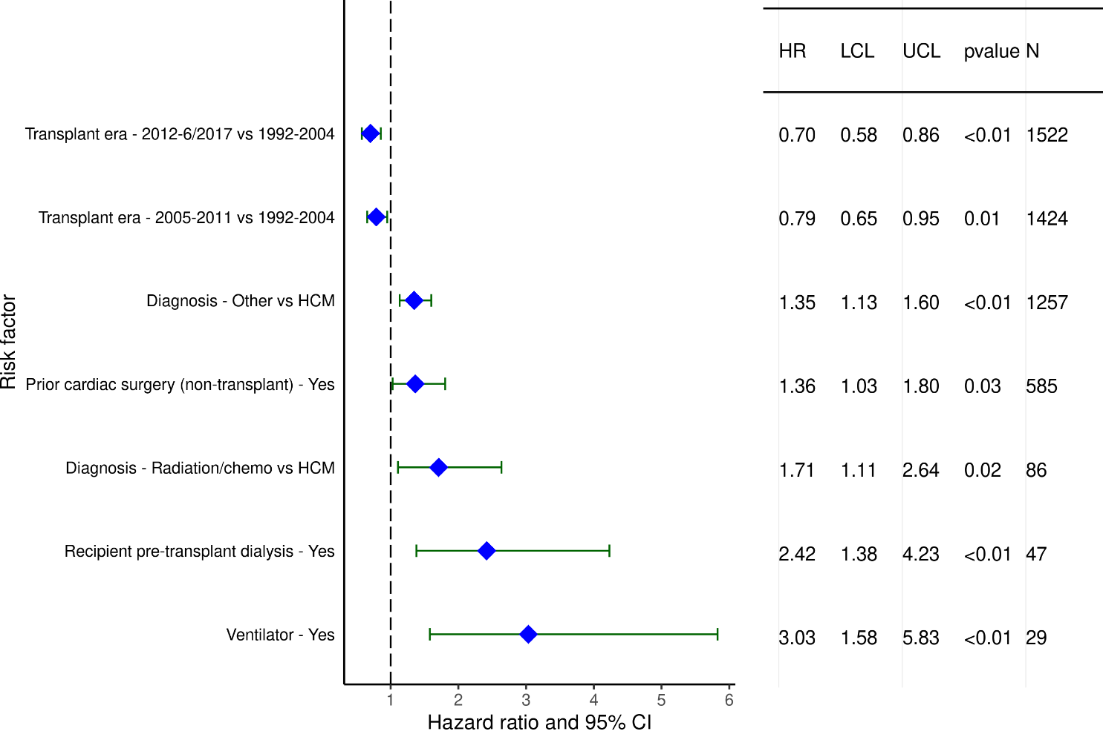
Adult Heart Transplants with RCM/HCM (1992-6/2017)
Statistically Significant Categorical Risk Factors For 1-Year Mortality with 95% Confidence Limits
2022
(N = 4,292)
JHLT. 2022 Oct; 41(10): 1335-1375

Slide 40
Adult Heart Transplants with RCM/HCM (1992-6/2017)
Statistically Significant Continuous Risk Factors For 1-Year Mortality
Continuous Factors (see figures)
Recipient bilirubin (mg/dl) | Recipient eGFR (mL/min/1.73 m²)
PVR (Woods unit) | Donor age (years)
Center volume in previous 3 yrs
2022
JHLT. 2022 Oct; 41(10): 1335-1375

Slide 41
Adult Heart RCM/HCM Transplants (1992-6/2017)
Statistically Significant Risk Factors For 1-Year Mortality with 95% Confidence Limits
Recipient bilirubin (mg/dl)
p = 0.0059
2022
(N = 4,292)
JHLT. 2022 Oct; 41(10): 1335-1375

Slide 42
Adult Heart Transplants with RCM/HCM (1992-6/2017)
Statistically Significant Risk Factors For 1-Year Mortality with 95% Confidence Limits
Recipient eGFR (mL/min/1.73 m²)
p = 0.0002
2022
(N = 4,292)
JHLT. 2022 Oct; 41(10): 1335-1375

Slide 43
Adult Heart Transplants with RCM/HCM (1992-6/2017)
Statistically Significant Risk Factors For 1-Year Mortality with 95% Confidence Limits
PVR (Wood units)
p = 0.0002
2022
(N = 4,292)
JHLT. 2022 Oct; 41(10): 1335-1375

Slide 44
Adult Heart Transplants with RCM/HCM (1992-6/2017)
Statistically Significant Risk Factors For 1-Year Mortality with 95% Confidence Limits
Donor age (years)
p < 0.0001
2022
(N = 4,292)
JHLT. 2022 Oct; 41(10): 1335-1375

Slide 45
Adult Heart Transplants with RCM/HCM (1992-6/2017)
Statistically Significant Risk Factors For 1-Year Mortality with 95% Confidence Limits
Center volume in previous 3 yrs
p = 0.002
2022
(N = 4,292)
JHLT. 2022 Oct; 41(10): 1335-1375

Slide 46
Multivariable Cox Analysis
Mortality within 5 Years Conditional on Survival to 1 Year
2022
JHLT. 2022 Oct; 41(10): 1335-1375

Slide 47
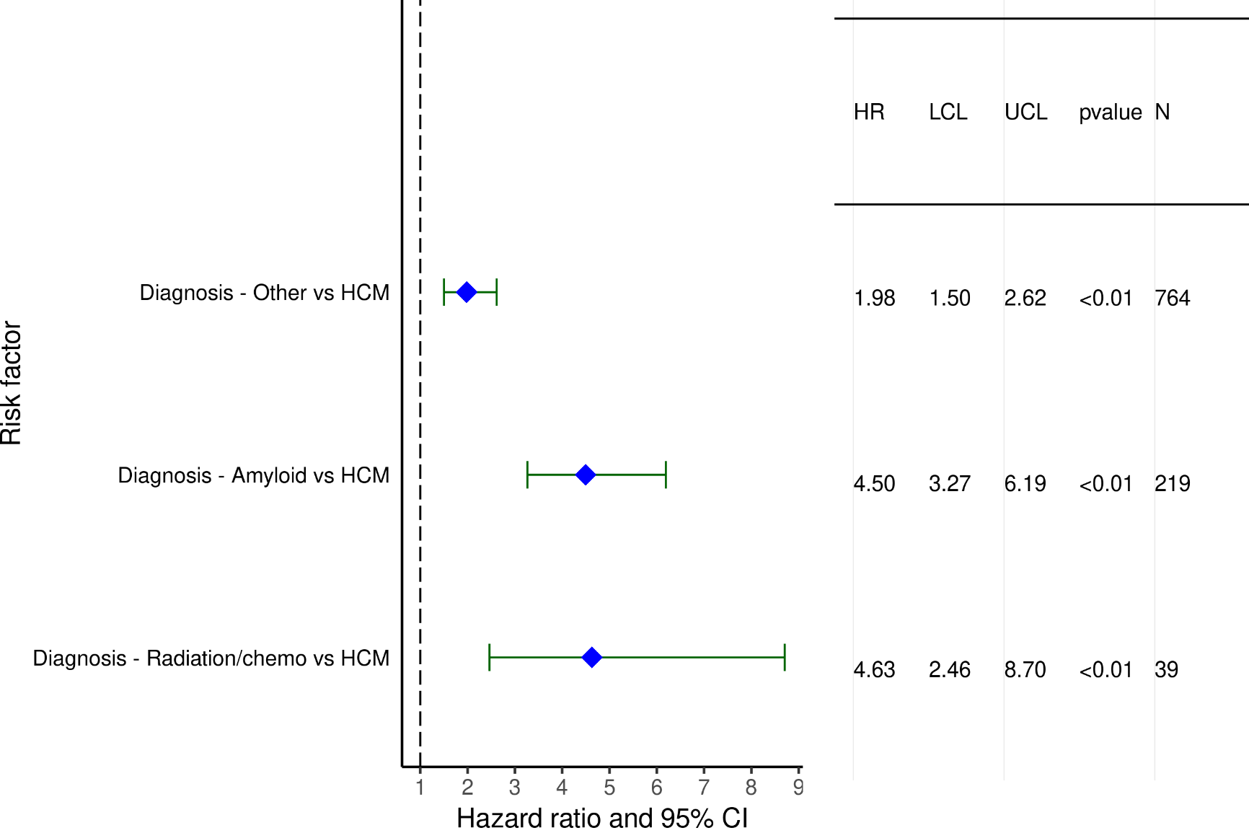
Adult Heart Transplants with RCM/HCM (1992-6/2013)
Statistically Significant Categorical Risk Factors For 5-Year Mortality Conditional on Survival to 1 Year with 95% Confidence Limits
2022
(N = 2,490)
JHLT. 2022 Oct; 41(10): 1335-1375

Slide 48
Adult Heart RCM/HCM Transplants (1992-6/2013)
Statistically Significant Continuous Risk Factors For 5-Year Mortality Conditional on Survival to 1 Year
Continuous Factors (see figures)
PA mean (mm/Hg)
2022
JHLT. 2022 Oct; 41(10): 1335-1375

Slide 49
Adult Heart Transplants with RCM/HCM (1992-6/2013)
Risk Factors For 5-Year Mortality Conditional on Survival to 1 Year with 95% Confidence Limits
PA mean (mm/Hg)
p = 0.0180
2022
(N = 2,490)
JHLT. 2022 Oct; 41(10): 1335-1375

