Slide 1

FOCUS THEME:
TRENDS IN RECIPIENT CHARACTERISTICS AND IMPACT ON OUTCOMES
LUNG TRANSPLANTATION
Pediatric Recipients
2021
JHLT. 2021 Oct; 40(10): 1023-1072

Slide 2
Table of Contents
Characteristics of Recipients of Deceased Donor Transplants by Transplant Year/Era: slides 3-10
Kaplan-Meier Survival Analyses: slides 11-26
  Survival within 12 months: slides 11-17
  Survival within 5 years conditional on survival to 1 year: slides 18-24
  Freedom from BOS conditional on survival to discharge: slides 25-26
Multivariable Cox Analyses: slides 27-37
  Mortality within 12 months: slides 27-30
  Mortality within 5 years conditional on survival to 1 year: slides 31-34
  BOS conditional on survival to discharge: slides 35-37
2021
JHLT. 2021 Oct; 40(10): 1023-1072

Slide 3
Recipient Characteristics by Transplant Era/Year
2021
JHLT. 2021 Oct; 40(10): 1023-1072

Slide 4
Pediatric Lung Transplants
Recipient Characteristics (Transplants: Jan 1992 – Jun 2018)
 | Jan 1992-Dec 2000 (N = 592) | Jan 2001-Dec 2009 (N = 824) | Jan 2010-Jun 2018 (N = 907) | P-value
Geographic location:
- Europe | 188 (31.8%) | 312 (37.9%) | 395 (43.6%) | <0.0001
- North America | 391 (66.0%) | 457 (55.5%) | 417 (46.0%)
- Other | 13 (2.2%) | 55 (6.7%) | 95 (10.5%)
Age (years) | 13 (0 - 17) | 14 (1 - 17) | 14.0 (1 - 17) | <0.0001
Male | 43.1% | 41.6% | 390 (43.0%) | 0.8071
Weight (kg) | 47.0 (40.0 - 70.4) | 47.6 (40.3 - 70.0) | 48.0 (40.0 - 70.3) | 0.6623
Height (cm) | 160.0 (144.0 - 173.0) | 160.0 (149.0 - 175.0) | 158.0 (147.3 - 175.3) | 0.5553
BMI (kg/m²) | 18.4 (15.7 - 26.9) | 18.9 (16.1 - 25.1) | 18.8 (15.7 - 26.4) | 0.5297
Blood type:
- A | 41.9% | 41.3% | 44.8% | 0.463
- AB | 5.5% | 4.7% | 4.5%
- B | 10.4% | 12.9% | 10.1%
- O | 42.1% | 41.1% | 40.6%
2021
Continuous factors are expressed as median (5th – 95th percentiles)
Summary statistics included transplants with known/non-missing data
JHLT. 2021 Oct; 40(10): 1023-1072
Notes:
Comparisons for categorical variables were made using the chi-square statistic. Multiple groups were compared using single p-value.
Comparisons for continuous variables were made using Kruskal-Wallis test.
A significant p-value means that at least one of the groups is different than the others but it doesn’t identify which group it is.

Slide 5
Pediatric Lung Transplants
Recipient Characteristics
(Transplants: Jan 1992 – Jun 2018)
 | Jan 1992-Dec 2000 (N = 592) | Jan 2001-Dec 2009 (N = 824) | Jan 2010-Jun 2018 (N = 907) | P-value
PRA ≥ 20% | 3.2% | 3.9% | 13.0% | <0.0001
PRA ≥ 80% | 1.7% | 2.7% | 1.0% | 0.2741
CMV antibody positive | 26.7% | 34.1% | 38.0% | 0.0042
EBV antibody positive | 44.4% ¹ | 54.4% | 52.7% | 0.4293
Hep B antibody positive | 1.2% ² | 4.7% | 4.1% | 0.0583
Hep C antibody positive | 0.8% ² | 0.9% | 0.2% | 0.3872
History of malignancy | 2.7% ² | 5.5% | 5.2% | 0.172
Previous lung surgery | 29.2% ² | 19.6% | 14.6% | 0.003
Ventilator use | 36.6% | 37.1% | 42.2% | 0.0615
ECMO use | 18.8% | 14.2% | 19.6% | <0.0001
Hospitalized | 1.3% | 1.2% | 9.8% | 0.1921
2021
Summary statistics included transplants with non-missing data
JHLT. 2021 Oct; 40(10): 1023-1072
¹ Based on Oct 1999 – Dec 2000 transplants
² Based on Apr 1994 – Dec 2000 transplants
Notes:
Comparisons for categorical variables were made using the chi-square statistic. Multiple groups were compared using single p-value.
Comparisons for continuous variables were made using Kruskal-Wallis test.
A significant p-value means that at least one of the groups is different than the others but it doesn’t identify which group it is.

Slide 6
Pediatric Lung Transplants
Recipient Characteristics
(Transplants: Jan 1992 – Jun 2018)
 | Jan 1992-Dec 2000 (N = 592) | Jan 2001-Dec 2009 (N = 824) | Jan 2010-Jun 2018 (N = 907) | P-value
Bilirubin (mg/dl) | 0.4 (0.1 - 1.4) ¹ | 0.3 (0.1 - 1.1) | 0.3 (0.1 - 1.2) | <0.0001
Creatinine (mg/dl) | 0.5 (0.2 - 1.1)¹ | 0.5 (0.2 - 1.0) | 0.4 (0.1 - 0.8) | <0.0001
GFR (mL/min/1.73 m²) * | 105.3 (57.1 - 175.9) ¹ | 113.6 (65.7 - 211.3) | 134.0 (69.9 - 293.0) | <0.0001
PCW mean (mmHg) | 9.0 (1.0 - 22.0) ¹ | 10.0 (4.0 - 20.0) | 11.0 (5.0 - 21.0) | <0.0001
PA mean (mmHg) | 50.0 (20.0 - 80.0) ¹ | 30.0 (17.0 - 71.0) | 30.0 (13.0 - 75.0) | 0.0095
PVR (Wood units) | 4.2 (2.2 - 18.8) ¹ | 3.6 (2.0 - 10.0) | 3.9 (2.0 - 16.5) | <0.0001
FEV1% predicted | 27.0 (15.0 - 81.0) | 26.0 (13.0 - 79.0) | 26.0 (12.0 - 81.0) | <0.0001
FVC% predicted | 42.0 (20.0 - 89.0) | 40.0 (20.0 - 85.0) | 40.0 (15.0 - 81.0) | <0.0001
* GFR was estimated using the modified Schwartz formula
2021
Summary statistics included transplants with known/non-missing data
JHLT. 2021 Oct; 40(10): 1023-1072
¹ Based on Apr 1994 – Dec 2000 transplants
Notes:
Comparisons for categorical variables were made using the chi-square statistic. Multiple groups were compared using single p-value.
Comparisons for continuous variables were made using Kruskal-Wallis test.
A significant p-value means that at least one of the groups is different than the others but it doesn’t identify which group it is.

Slide 7
Pediatric Lung Transplants
Recipient Blood Type Distribution by Location and Era
(Transplants: Jan 1992 – Jun 2018)
Blood Type:
Europe
North America
Other
2021
JHLT. 2021 Oct; 40(10): 1023-1072

Slide 8
Pediatric Lung Transplants
Recipient Diagnosis Distribution by Location and Era
(Transplants: Jan 1992 – Jun 2018)
Europe
North America
Other
2021
JHLT. 2021 Oct; 40(10): 1023-1072

Slide 9
Pediatric Lung Transplants
Donor-Recipient Sex Distribution by Location and Era
(Transplants: Jan 1992 – Jun 2018)
Europe
North America
Other
2021
JHLT. 2021 Oct; 40(10): 1023-1072

Slide 10
Pediatric Lung Transplants
Median Recipient Age by Location
Median Recipient BMI by Location
Median Recipient GFR* by Location
(Transplants: Jan 1992 – Jun 2018)
(Transplants: Jan 1992 – Jun 2018)
(Transplants: Jan 1994 – Jun 2018)
* GFR was estimated using the modified Schwartz formula
2021
JHLT. 2021 Oct; 40(10): 1023-1072

Slide 11
Survival Analyses
Kaplan-Meier Survival Within 12 Months
2021
JHLT. 2021 Oct; 40(10): 1023-1072

Slide 12
Pediatric Lung Transplants
Kaplan-Meier Survival within 12 Months by Era
(Transplants: Jan 2000 – Jun 2017)
No pairwise comparisons were significant at p < 0.05 except 2000-2005 vs. 2012-2017
2021
JHLT. 2021 Oct; 40(10): 1023-1072

Slide 13
Pediatric Lung Transplants
Kaplan-Meier Survival within 12 Months by Location and Era
(Transplants: Jan 2000 - Jun 2017)
Transplant Era:
North America
Other
2021
JHLT. 2021 Oct; 40(10): 1023-1072

Slide 14
Pediatric Lung Transplants
Kaplan-Meier Survival within 12 Months by Location and Recipient Age
(Transplants: Jan 2000 - Jun 2017)
North America
Other
2021
JHLT. 2021 Oct; 40(10): 1023-1072
Notes:
Note: There were no transplants in recipients 0-5 years in “Other” location.

Slide 15
Pediatric Lung Transplants
Kaplan-Meier Survival within 12 Months by Recipient Age and Era
(Transplants: Jan 2000 - Jun 2017)
Age 6-10 years
Age 11-17 years
2021
JHLT. 2021 Oct; 40(10): 1023-1072

Slide 16
Pediatric Lung Transplants
Kaplan-Meier Survival within 12 Months
By Recipient Diagnosis
(Transplants: Jan 2000 - Jun 2017)
By Recipient GFR*
(Transplants: Jan 2000 - Jun 2017)
* GFR was estimated using the modified Schwartz formula
2021
JHLT. 2021 Oct; 40(10): 1023-1072

Slide 17
Pediatric Lung Transplants
Kaplan-Meier Survival within 12 Months
By Procedure Type
By Recipient History of Malignancy
(Transplants: Jan 2000 - Jun 2017)
(Transplants: Jan 2000 - Jun 2017)
p < 0.0001
p = 0.9987
2021
JHLT. 2021 Oct; 40(10): 1023-1072

Slide 18
Survival Analyses
Kaplan-Meier Survival Within 5 Years Conditional on Survival to 1 Year
2021
JHLT. 2021 Oct; 40(10): 1023-1072

Slide 19
Pediatric Lung Transplants
Kaplan-Meier Survival within 5 Years Conditional on Survival to 1 Year
By Era (Transplants: Jan 1996 - Jun 2013)
No pairwise comparisons were significant at p < 0.05 except 1996-2001 vs. 2008-2013
2021
JHLT. 2021 Oct; 40(10): 1023-1072

Slide 20
Pediatric Lung Transplants
Kaplan-Meier Survival within 5 Years Conditional on Survival to 1 Year
by Location and Era (Transplants: Jan 1996 - Jun 2013)
Europe
North America
2021
* There were no transplants during 1996-2001 in “Other” location
JHLT. 2021 Oct; 40(10): 1023-1072

Slide 21
Pediatric Lung Transplants
Kaplan-Meier Survival within 5 Years Conditional on Survival to 1 Year
by Location and Recipient Age (Transplants: Jan 1996 - Jun 2013)
Recipient Age:
No pairwise comparisons were significant at p < 0.05
Europe
North America
2021
JHLT. 2021 Oct; 40(10): 1023-1072
Notes:
Note: There were 72 txs in recipients 11-17 years and no transplants in recipients <11 years in “Other” location.

Slide 22
Pediatric Lung Transplants
Kaplan-Meier Survival within 5 Years Conditional on Survival to 1 Year
by Recipient Age and Era (Transplants: Jan 1996 - Jun 2013)
Transplant Era:
No pairwise comparisons were significant at p < 0.05
No pairwise comparisons were significant at p < 0.05
Recipient 0-5 years
Recipient 6-10 years
Recipient 11-17 years
2021
JHLT. 2021 Oct; 40(10): 1023-1072

Slide 23
Pediatric Lung Transplants
Kaplan-Meier Survival within 5 Years Conditional on Survival to 1 Year
By Recipient Diagnosis
Transplants: Jan 1996 – Jun 2013
By Recipient GFR
Transplants: Jan 1996 – Jun 2013
* GFR was estimated using the modified Schwartz formula
2021
JHLT. 2021 Oct; 40(10): 1023-1072

Slide 24
Pediatric Lung Transplants
Kaplan-Meier Survival within 5 Years Conditional on Survival to 1 Year
By Recipient Procedure Type
By Recipient History of Malignancy
(Transplants: Jan 1996 - Jun 2013)
(Transplants: Jan 1996 - Jun 2013)
p = 0.2603
p = 0.3728
2021
JHLT. 2021 Oct; 40(10): 1023-1072

Slide 25
Survival Analyses
Kaplan-Meier Freedom from BOS Conditional on Survival to Discharge
2021
JHLT. 2021 Oct; 40(10): 1023-1072

Slide 26
Pediatric Lung Transplants
Freedom from BOS Conditional on Survival to Discharge
By Era
(Transplants: Jan 1996 - Jun 2013)
By Recipient Age
(Transplants: Jan 1996 - Jun 2013)
No pairwise comparisons were significant at p < 0.05 except recipient 0-5 years vs. 11-17 years =
No pairwise comparisons were significant at p < 0.05 =
2021
JHLT. 2021 Oct; 40(10): 1023-1072

Slide 27
Multivariable Cox Analyses
Mortality within 12 Months
2021
JHLT. 2021 Oct; 40(10): 1023-1072

Slide 28
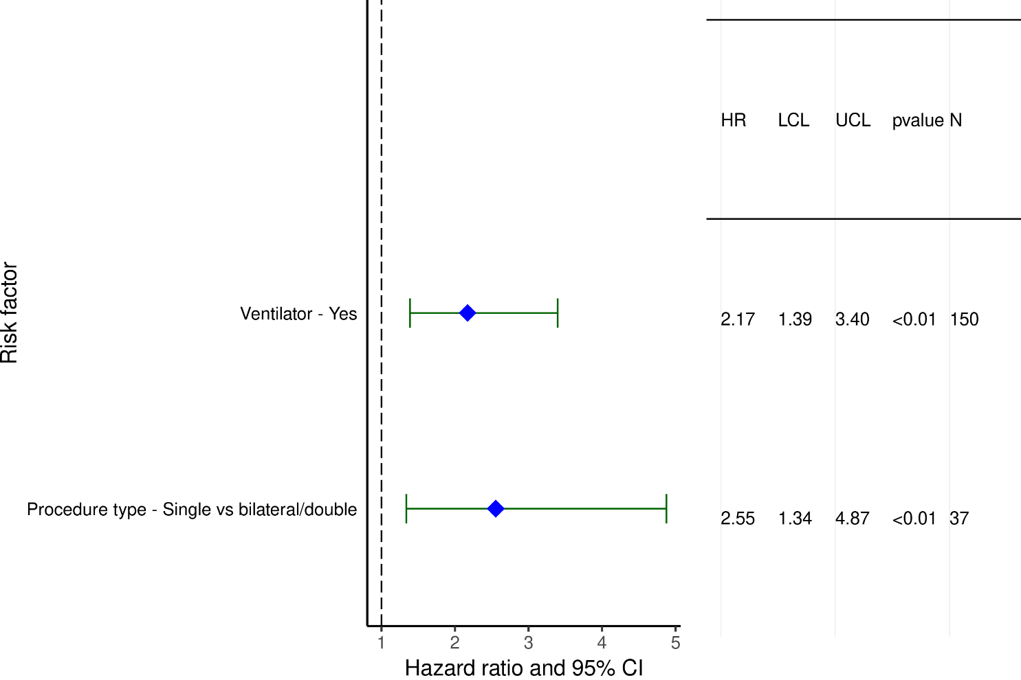
Pediatric Lung Transplants (2000-6/2017)
Statistically Significant Categorical Risk Factors For 1-Year Mortality
with 95% Confidence Limits
2021
(N = 1,681)
JHLT. 2021 Oct; 40(10): 1023-1072
Notes:
None of the interaction terms (era * recipient age, era * diagnosis, era * GFR) were significant

Slide 29
Pediatric Lung Transplants (2000-6/2017)
Statistically Significant Risk Factors For 1-Year Mortality
Continuous Factors (see figures)
Donor age (years)
2021
JHLT. 2021 Oct; 40(10): 1023-1072

Slide 30
Pediatric Lung Transplants (2000-6/2017)
Statistically Significant Risk Factors For 1-Year Mortality with 95% Confidence Limits
Donor age (years)
2021
(N = 1,681)
JHLT. 2021 Oct; 40(10): 1023-1072

Slide 31
Multivariable Analyses
Mortality within 5 Years Conditional on Survival to 1 Year
2021
JHLT. 2021 Oct; 40(10): 1023-1072
Notes:
Note: Due to relatively small number of transplants and number of deaths, only select risk factors were considered for 5-year model (recipient age, diagnosis category, hospitalized, recipient GFR, donor age, Tx volume, and tx era) and no interaction terms could be considered in 5-year conditional mortality model.

Slide 32
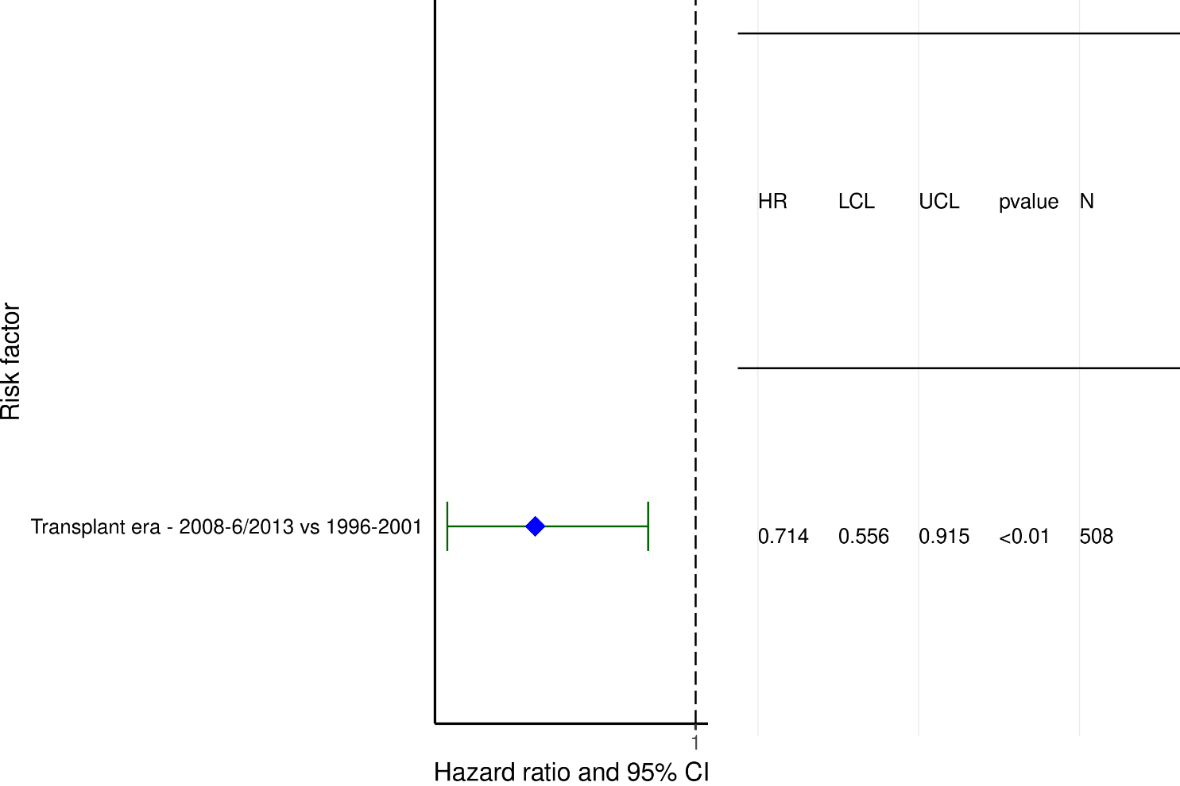
Pediatric Lung Transplants (1996-6/2013)
Statistically Significant Categorical Risk Factors For 5-Year Mortality
Conditional on 1 Year Survival with 95% Confidence Limits
2021
(N = 1,226)
JHLT. 2021 Oct; 40(10): 1023-1072

Slide 33
Pediatric Lung Transplants (1996-6/2013)
Statistically Significant Risk Factors For 5-Year Mortality
Conditional on Survival to 1 Year
Continuous Factors (see figures)
Recipient age (years)
2021
JHLT. 2021 Oct; 40(10): 1023-1072

Slide 34
Pediatric Lung Transplants (1996-6/2013)
Statistically Significant Risk Factors For 5-Year Mortality
Conditional on 1-Year Survival with 95% Confidence Limits
Recipient age (years)
p < 0.0001
2021
(N = 1,226)
JHLT. 2021 Oct; 40(10): 1023-1072

Slide 35
Multivariable Cox Analyses
BOS within 5 Years Conditional on Survival to Discharge
2021
JHLT. 2021 Oct; 40(10): 1023-1072
Notes:
Note: Due to relatively small number of transplants and number with BOS, select risk factors were considered (recipient age, diagnosis category, hospitalized, recipient GFR, donor age, Tx volume, and tx era) and no interaction terms could be considered in 5-year conditional BOS model.

Slide 36
Pediatric Lung Transplants (1996-6/2013)
Statistically Significant Risk Factors For BOS within 5 Years
Conditional on Survival to Discharge
Continuous Factor (see figure)
Recipient age (years)
2021
(N = 666)
JHLT. 2021 Oct; 40(10): 1023-1072

Slide 37
Pediatric Lung Transplants (1996-6/2013)
Statistically Significant Risk Factors For BOS within 5 Years
Conditional on Survival to Discharge with 95% Confidence Limits
Recipient age (years)
p = 0.0220
2021
(N = 666)
JHLT. 2021 Oct; 40(10): 1023-1072

