Slide 1

FOCUS THEME:
TRENDS IN RECIPIENT CHARACTERISTICS AND IMPACT ON OUTCOMES
HEART TRANSPLANTATION
Pediatric Recipients
2021
JHLT. 2021 Oct; 40(10): 1023-1072

Slide 2
Table of Contents
Characteristics of Recipients of Deceased Donor Transplants by Transplant Year/Era: slides 3-12
Kaplan-Meier Survival Analyses: slides 13-34
  Survival within 12 months: slides 13-21
  Survival within 5 years conditional on survival to 1 year: slides 22-29
  Freedom from CAV conditional on survival to discharge: slides 30-34
Multivariable Cox Analyses: slides 35-58
  Mortality within 12 months: slides 35-46
  Mortality within 5 years conditional on survival to 1 year: slides 47-53
  CAV conditional on survival to discharge: slides 54-58
2021
JHLT. 2021 Oct; 40(10): 1023-1072

Slide 3
Recipient Characteristics by Transplant Era/Year
2021
JHLT. 2021 Oct; 40(10): 1023-1072

Slide 4
Pediatric Heart Transplants
Recipient Characteristics (Transplants: Jan 1992 – Jun 2018)
 | Jan 1992-Dec 2000 (N = 3,666) | Jan 2001-Dec 2009 (N = 4,476) | Jan 2010-Jun 2018 (N = 5,307) | P-value
Geographic location:
- Europe | 1068 (29.1%) | 1210 (27.0%) | 1321 (24.9%) | <0.0001
- North America | 2481 (67.7%) | 3057 (68.3%) | 3586 (67.6%)
- Other | 117 (3.2%) | 209 (4.7%) | 400 (7.5%)
Age (years) | 6 (0 - 17) | 7 (0 - 17) | 7 (0 - 17) | 0.0005
Male | 58.2% | 54.6% | 54.5% | 0.0009
Weight (kg) | 54.9 (40.8 - 89.0) | 56.0 (41.0 - 92.0) | 56.0 (41.9 - 90.8) | 0.1097
Height (cm) | 165.0 (147.0 - 183.0) | 164.0 (147.0 - 182.9) | 163.0 (145.0 - 180.3) | 0.0002
BMI (kg/m²) | 19.9 (16.1 - 30.0) | 20.9 (16.3 - 32.4) | 21.1 (16.4 - 31.7) | <0.0001
Blood type:
- A | 42.9% | 40.6% | 38.2% | <0.0001
- AB | 5.0% | 4.0% | 4.2%
- B | 11.1% | 12.2% | 13.9%
- O | 40.9% | 43.2% | 43.8%
2021
Continuous factors are expressed as median (5th – 95th percentiles)
Summary statistics included transplants with known/non-missing data
JHLT. 2021 Oct; 40(10): 1023-1072
Notes:
Comparisons for categorical variables were made using the chi-square statistic. Multiple groups were compared using single p-value.
Comparisons for continuous variables were made using Kruskal-Wallis test.
A significant p-value means that at least one of the groups is different than the others but it doesn’t identify which group it is.

Slide 5
Pediatric Heart Transplants
Recipient Characteristics
(Transplants: Jan 1992 – Jun 2018)
 | Jan 1992-Dec 2000 (N = 3,666) | Jan 2001-Dec 2009 (N = 4,476) | Jan 2010-Jun 2018 (N = 5,307) | P-value
PRA ≥20% | 6.7% | 15.1% | 23.8% | <0.0001
PRA ≥80% | 1.3% | 5.1% | 5.9% | <0.0001
CMV antibody positive | 37.5% | 45.1% | 39.8% | <0.0001
EBV antibody positive | 52.4%¹ | 58.5% | 53.8% | 0.0008
Hep B antibody positive | 2.5%² | 4.1% | 3.8% | 0.0477
Hep C antibody positive | 1.2%² | 1.0% | 0.8% | 0.3002
History of malignancy | 3.2%² | 2.4% | 2.2% | 0.0653
Pre-transplant dialysis | 1.9%² | 4.1% | 3.3% | 0.0002
Previous cardiac surgery | 29.7%² | 41.2% | 55.1% | <0.0001
2021
Summary statistics included transplants with known/non-missing data
JHLT. 2021 Oct; 40(10): 1023-1072
¹ Based on Oct 1999 – Dec 2000 transplants
² Based on Apr 1994 – Dec 2000 transplants
Notes:
Comparisons for categorical variables were made using the chi-square statistic. Multiple groups were compared using single p-value.
Comparisons for continuous variables were made using Kruskal-Wallis test.
A significant p-value means that at least one of the groups is different than the others but it doesn’t identify which group it is.

Slide 6
Pediatric Heart Transplants
Recipient Characteristics
(Transplants: Jan 1992 – Jun 2018)
 | Jan 1992-Dec 2000 (N = 3,666) | Jan 2001-Dec 2009 (N = 4,476) | Jan 2010-Jun 2018 (N = 5,307) | P-value
Bilirubin (mg/dl) | 0.8 (0.2 - 3.2) ¹ | 0.7 (0.2 - 3.4) | 0.6 (0.2 - 2.9) | <0.0001
Creatinine (mg/dl) | 0.6 (0.3 - 1.3)¹ | 0.5 (0.2 - 1.4) | 0.4 (0.2 - 1.1) | <0.0001
GFR (mL/min/1.73 m²) * | 80.7 (39.6 - 127.2) ¹ | 82.6 (39.4 - 138.8) | 94.0 (50.8 - 164.2) | <0.0001
PCW mean (mmHg) | 17.0 (7.0 - 30.0) ¹ | 16.0 (6.0 - 31.0) | 15.0 (6.0 - 30.0) | <0.0001
PA mean (mmHg) | 25.0 (13.0 - 52.0) ¹ | 24.0 (12.0 - 49.0) | 22.0 (12.0 - 48.0) | <0.0001
PVR (woods unit) | 3.0 (0.8 - 11.8) ¹ | 3.0 (0.8 - 12.2) | 2.6 (0.6 - 11.8) | 0.0046
* GFR was estimated using the modified Schwartz formula
2021
Summary statistics included transplants with known/non-missing data
JHLT. 2021 Oct; 40(10): 1023-1072
¹ Based on Apr 1994 – Dec 2000 transplants
Notes:
Comparisons for categorical variables were made using the chi-square statistic. Multiple groups were compared using single p-value.
Comparisons for continuous variables were made using Kruskal-Wallis test.
A significant p-value means that at least one of the groups is different than the others but it doesn’t identify which group it is.

Slide 7
Pediatric Heart Transplants
Recipient Characteristics
(Transplants: Jan 1992 – Jun 2018)
 | Jan 1992-Dec 2000 (N = 3,666) | Jan 2001-Dec 2009 (N = 4,476) | Jan 2010-Jun 2018 (N = 5,307) | P-value
Inotrope use | 42.2% ¹ | 49.6% | 50.5% | <0.0001
IABP use | 1.1% | 0.5% | 0.5% | 0.0114
ECMO use | 4.4% ² | 8.6% | 4.4% | <0.0001
MCS use
- None | - | 86.3% | 74.3% | <0.0001
- VAD | - | 9.8% | 20.0%
- TAH | - | 0.2% | 0.3%
- BIVAD | - | 3.7% | 5.4%
Ventilator use | 17.4% | 21.2% | 16.6% | <0.0001
Hospitalized | 64.7% | 69.3% | 72.2% | <0.0001
2021
Summary statistics included transplants with known/non-missing data
¹ Based on Apr 1994 – Dec 2000 transplants
JHLT. 2021 Oct; 40(10): 1023-1072
² Based on Apr 1995 – Dec 2000 transplants
Notes:
Comparisons for categorical variables were made using the chi-square statistic. Multiple groups were compared using single p-value.
Comparisons for continuous variables were made using Kruskal-Wallis test.
A significant p-value means that at least one of the groups is different than the others but it doesn’t identify which group it is.

Slide 8
Pediatric Heart Transplants
Recipient Blood Type Distribution by Location and Era
(Transplants: Jan 1992 – Jun 2018)
Blood Type:
Europe
North America
Other
2021
JHLT. 2021 Oct; 40(10): 1023-1072

Slide 9
Pediatric Heart Transplants
Recipient Diagnosis Distribution by Location and Era
(Transplants: Jan 1992 – Jun 2018)
Europe
North America
Other
2021
JHLT. 2021 Oct; 40(10): 1023-1072

Slide 10
Pediatric Heart Transplants
Donor-Recipient Sex Distribution by Location and Era
(Transplants: Jan 1992 – Jun 2018)
Europe
North America
Other
2021
JHLT. 2021 Oct; 40(10): 1023-1072

Slide 11
Pediatric Heart Transplants
Median Recipient Age by Location
Median Recipient BMI by Location
(Transplants: Jan 1992 – Jun 2018)
(Transplants: Jan 1992 – Jun 2018)
2021
JHLT. 2021 Oct; 40(10): 1023-1072

Slide 12
Pediatric Heart Transplants
Recipients with Pre-tx Dialysis
Recipients with History of Malignancy
(Transplants: Jan 1994 – Jun 2018)
(Transplants: Jan 1994 – Jun 2018)
2021
JHLT. 2021 Oct; 40(10): 1023-1072

Slide 13
Survival Analyses
Kaplan-Meier Patient Survival within 12 Months
2021
JHLT. 2021 Oct; 40(10): 1023-1072

Slide 14
Pediatric Heart Transplants
Kaplan-Meier Survival within 12 Months by Era
(Transplants: Jan 2000 – Jun 2017)
All pairwise comparisons were significant at p < 0.05
2021
JHLT. 2021 Oct; 40(10): 1023-1072

Slide 15
Pediatric Heart Transplants
Kaplan-Meier Survival within 12 Months by Location and Era
(Transplants: Jan 2000 - Jun 2017)
Transplant Era:
North America
Other
2021
JHLT. 2021 Oct; 40(10): 1023-1072

Slide 16
Pediatric Heart Transplants
Kaplan-Meier Survival within 12 Months by Location and Recipient Age
(Transplants: Jan 2000 - Jun 2017)
Recipient Age:
North America
Other
2021
JHLT. 2021 Oct; 40(10): 1023-1072

Slide 17
Pediatric Heart Transplants
Kaplan-Meier Survival within 12 Months by Recipient Age and Era
(Transplants: Jan 2000 - Jun 2017)
Transplant Era:
Recipient 1-10 years
Recipient 11-17 years
2021
JHLT. 2021 Oct; 40(10): 1023-1072

Slide 18
Pediatric Heart Transplants
Kaplan-Meier Survival within 12 Months by Recipient Diagnosis and Era
(Transplants: Jan 2000 - Jun 2017)
Transplant Era:
Diagnosis: CHD
Diagnosis: Retransplant
2021
Note: Y-axis is truncated for clearer presentation
JHLT. 2021 Oct; 40(10): 1023-1072

Slide 19
Pediatric Heart Transplants
Kaplan-Meier Survival within 12 Months by MCS Device and Era (Transplants: Jan 2000 - Jun 2017)
VAD/TAH
No MCS
2021
Note: Y-axis is truncated for clearer presentation
JHLT. 2021 Oct; 40(10): 1023-1072

Slide 20
Pediatric Heart Transplants
Kaplan-Meier Survival within 12 Months by Recipient GFR* and Era
(Transplants: Jan 2000 - Jun 2017)
GFR 30-59 mL/min/1.73 m²
GFR ≥ 60 mL/min/1.73 m²
2021
Note: Y-axis is truncated for clearer presentation
JHLT. 2021 Oct; 40(10): 1023-1072
* GFR was estimated using the modified Schwartz formula

Slide 21
Pediatric Heart Transplants
Kaplan-Meier Survival within 12 Months
By Recipient Pre-transplant Dialysis
By Recipient History of Malignancy
(Transplants: Jan 1994 - Jun 2017)
(Transplants: Jan 1994 - Jun 2017)
p < 0.0001
p = 0.0312
2021
JHLT. 2021 Oct; 40(10): 1023-1072

Slide 22
Survival Analyses
Kaplan-Meier Patient Survival within 5 Years Conditional on Survival to 1 Year
2021
JHLT. 2021 Oct; 40(10): 1023-1072

Slide 23
Pediatric Heart Transplants
Kaplan-Meier Survival within 5 Years Conditional on Survival to 1 Year
By Era (Transplants: Jan 1996 - Jun 2013)
All pairwise comparisons were significant at p < 0.05 except 1996-2001 vs. 2002-2007
2021
Note: Y-axis is truncated for clearer presentation
JHLT. 2021 Oct; 40(10): 1023-1072

Slide 24
Pediatric Heart Transplants
Kaplan-Meier Survival within 5 Years Conditional on Survival to 1 Year
by Location and Era (Transplants: Jan 1996 - Jun 2013)
Transplant Era:
Europe
North America
2021
Note: Y-axis is truncated for clearer presentation
JHLT. 2021 Oct; 40(10): 1023-1072

Slide 25
Pediatric Heart Transplants
Kaplan-Meier Survival within 5 Years Conditional on Survival to 1 Year
by Location and Transplant Era (Transplants: Jan 1996 - Jun 2013)
Recipient Age:
All pairwise comparisons were significant at p < 0.05 except recipient <1 year vs. 1-10 years
No pairwise comparisons were significant at p < 0.05
Europe
North America
2021
Note: Y-axis is truncated for clearer presentation
JHLT. 2021 Oct; 40(10): 1023-1072

Slide 26
Pediatric Heart Transplants
Kaplan-Meier Survival within 5 Years Conditional on Survival to 1 Year
by Recipient Age and Era (Transplants: Jan 1996 - Jun 2013)
All pairwise comparisons were significant at p < 0.05 except 2002-2007 vs. 2008-2013
No pairwise comparisons were significant at p < 0.05 except 1996-2001 vs. 2008-2013
Recipient <1 year
Recipient 1-10 years
2021
Note: Y-axis is truncated for clearer presentation
JHLT. 2021 Oct; 40(10): 1023-1072

Slide 27
Pediatric Heart Transplants
Kaplan-Meier Survival within 5 Years Conditional on Survival to 1 Year
by Recipient Diagnosis and Era (Transplants: Jan 1996 - Jun 2013)
No pairwise comparisons were significant at p < 0.05
No pairwise comparisons were significant at p < 0.05
DCM
CHD
2021
Note: Y-axis is truncated for clearer presentation
JHLT. 2021 Oct; 40(10): 1023-1072

Slide 28
Pediatric Heart Transplants
Kaplan-Meier Survival within 5 Years Conditional on Survival to 1 Year
by Recipient GFR and Era (Transplants: Jan 1996 - Jun 2013)
No pairwise comparisons were significant at p < 0.05
All pairwise comparisons were significant at p < 0.05 except 1996-2001 vs. 2002-2007
GFR <30 (mL/min/1.73 m²)
GFR 30-59 (mL/min/1.73 m²)
GFR ≥60 (mL/min/1.73 m²)
2021
JHLT. 2021 Oct; 40(10): 1023-1072
* GFR was estimated using the modified Schwartz formula

Slide 29
Pediatric Heart Transplants
Kaplan-Meier Survival within 5 Years Conditional on Survival to 1 Year
By Recipient Pre-tx Dialysis
By Recipient History of Malignancy
(Transplants: Jan 1996 - Jun 2013)
(Transplants: Jan 1996 - Jun 2013)
p = 0.0667
p = 0.6174
2021
JHLT. 2021 Oct; 40(10): 1023-1072

Slide 30
Survival Analyses
Kaplan Meier Freedom from CAV within 5 Years Conditional on Survival to Discharge
2021
JHLT. 2021 Oct; 40(10): 1023-1072

Slide 31
Pediatric Heart Transplants
Freedom from CAV Conditional on Survival to Discharge
By Era (Transplants: Jan 1996 - Jun 2013)
No pairwise comparisons were significant at p < 0.05
2021
JHLT. 2021 Oct; 40(10): 1023-1072

Slide 32
Pediatric Heart Transplants
Freedom from CAV Conditional on Survival to Discharge
By Recipient Age and Era (Transplants: Jan 1996 - Jun 2013)
Transplant Era:
Recipient age: <1 year
Recipient age: 1-10 years
Recipient age: 11-17 years
2021
JHLT. 2021 Oct; 40(10): 1023-1072

Slide 33
Pediatric Heart Transplants
Freedom from CAV Conditional on Survival to Discharge
by Recipient Diagnosis and Era (Transplants: Jan 1996 - Jun 2013)
No pairwise comparisons were significant at p < 0.05
No pairwise comparisons were significant at p < 0.05
DCM
CHD
2021
JHLT. 2021 Oct; 40(10): 1023-1072

Slide 34
Pediatric Heart Transplants
Freedom from CAV Conditional on Survival to Discharge
by Recipient GFR and Era (Transplants: Jan 1996 - Jun 2013)
No pairwise comparisons were significant at p < 0.05
No pairwise comparisons were significant at p < 0.05
GFR <30 (mL/min/1.73 m²)
GFR 30-59 (mL/min/1.73 m²)
GFR ≥60 (mL/min/1.73 m²)
2021
JHLT. 2021 Oct; 40(10): 1023-1072
* GFR was estimated using the modified Schwartz formula

Slide 35
Multivariable Cox Analyses
Mortality within 12 Months
2021
JHLT. 2021 Oct; 40(10): 1023-1072
Notes:
The following interactions were considered: era-age interaction, era-diagnosis, era-GFR interactions

Slide 36
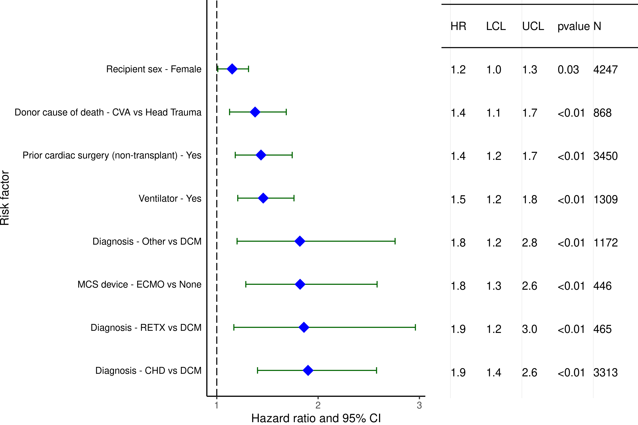
Pediatric Heart Transplants (2000-6/2017)
Statistically Significant Risk Factors For 1 Year Mortality with 95% Confidence Limits
2021
(N = 9,376)
JHLT. 2021 Oct; 40(10): 1023-1072

Slide 37
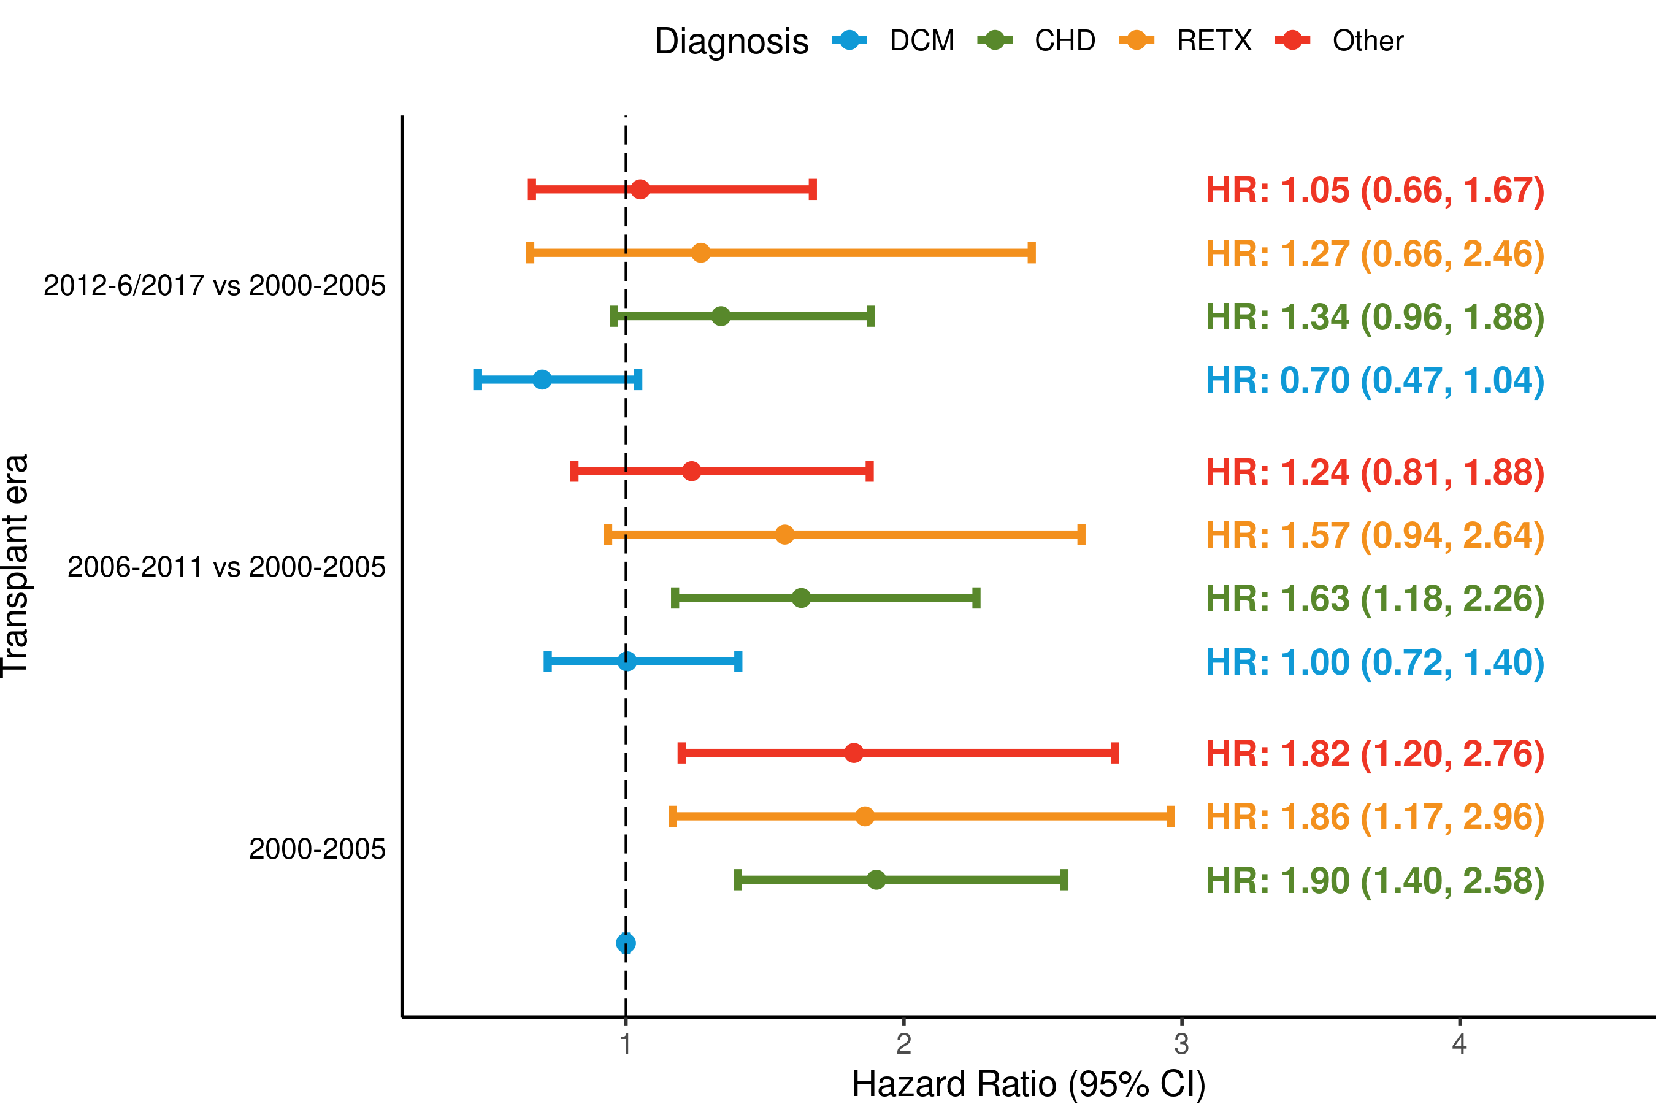
Pediatric Heart Transplants (2000-6/2017)
Risk Factors For 1-Year Mortality with 95% Confidence Limits
Transplant era and diagnosis interaction
2021
(N = 9,376)
JHLT. 2021 Oct; 40(10): 1023-1072
p-value for era = 0.0644; p-value for diagnosis = 0.0001; p-value for interaction = 0.8922

Slide 38
Pediatric Heart Transplants (2000-6/2017)
Statistically Significant Risk Factors For 1-Year Mortality
Continuous Factors (see figures)
Recipient age (years) | PRA (%)
Recipient GFR* (mL/min/1.73 m²) | Ischemic time (hours)
Recipient bilirubin (mg/dl) | Ped TX center volume in previous 3 yrs
* GFR was estimated using the modified Schwartz formula
2021
JHLT. 2021 Oct; 40(10): 1023-1072

Slide 39
Pediatric Heart Transplants (2000-6/2017)
Recipient age (years)
Statistically Significant Risk Factors For 1-Year Mortality with 95% Confidence Limits
2021
(N = 9,376)
JHLT. 2021 Oct; 40(10): 1023-1072

Slide 40
Pediatric Heart Transplants (2000-6/2017)
Transplant era and recipient age interaction
Risk Factors For 1-Year Mortality
2021
(N = 9,376)
JHLT. 2021 Oct; 40(10): 1023-1072
p-value for era = 0.0644; p-value for age = 0.003; p-value for interaction = 0.3055

Slide 41
Pediatric Heart Transplants (2000-6/2017)
Statistically Significant Risk Factors For 1-Year Mortality with 95% Confidence Limits
Recipient GFR* (mL/min/1.73 m²)
* GFR was estimated using the modified Schwartz formula
2021
(N = 9,376)
JHLT. 2021 Oct; 40(10): 1023-1072

Slide 42
Pediatric Heart Transplants (2000-6/2017)
Risk Factors For 1-Year Mortality
Transplant era and recipient GFR* interaction
* GFR was estimated using the modified Schwartz formula
(N = 9,376)
2021
JHLT. 2021 Oct; 40(10): 1023-1072
p-value for era = 0.0644; p-value for GFR < 0.0001; p-value for interaction = 0.6439

Slide 43
Pediatric Heart Transplants (2000-6/2017)
Statistically Significant Risk Factors For 1-Year Mortality with 95% Confidence Limits
Recipient bilirubin (mg/dl)
(N = 9,376)
2021
JHLT. 2021 Oct; 40(10): 1023-1072
Notes:
Multivariable analysis was performed using a proportional hazards model censoring all patients at 5 years. Continuous factors were fit using a restricted cubic spline.

Slide 44
Pediatric Heart Transplants (2000-6/2017)
Statistically Significant Risk Factors For 1-Year Mortality with 95% Confidence Limits
PRA (%)
2021
(N = 9,376)
JHLT. 2021 Oct; 40(10): 1023-1072

Slide 45
Pediatric Heart Transplants (2000-6/2017)
Ischemic time (hours)
Statistically Significant Risk Factors For 1-Year Mortality with 95% Confidence Limits
2021
(N = 9,376)
JHLT. 2021 Oct; 40(10): 1023-1072
Notes:
Multivariable analysis was performed using a proportional hazards model censoring all patients at 5 years. Continuous factors were fit using a restricted cubic spline.

Slide 46
Pediatric Heart Transplants (2000-6/2017)
Ped TX center volume in previous 3 yrs
Statistically Significant Risk Factors For 1-Year Mortality with 95% Confidence Limits
(N = 9,376)
2021
JHLT. 2021 Oct; 40(10): 1023-1072

Slide 47
Multivariable Cox Analyses
Mortality within 5 Years Conditional on Survival to 1 Year
2021
JHLT. 2021 Oct; 40(10): 1023-1072
Notes:
The following interactions were considered: era-age interaction and era-diagnosis interactions

Slide 48
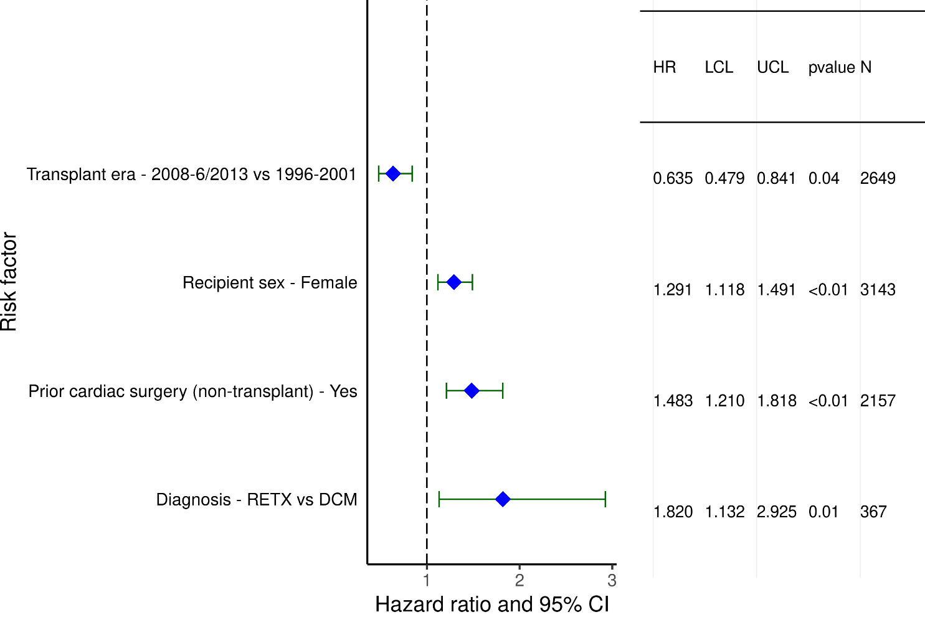
Pediatric Heart Transplants (1996-6/2013)
Statistically Significant Risk Factors For 5-Year Mortality Conditional on Survival to 1 Year with 95% Confidence Limits
2021
(N = 7,022)
JHLT. 2021 Oct; 40(10): 1023-1072

Slide 49
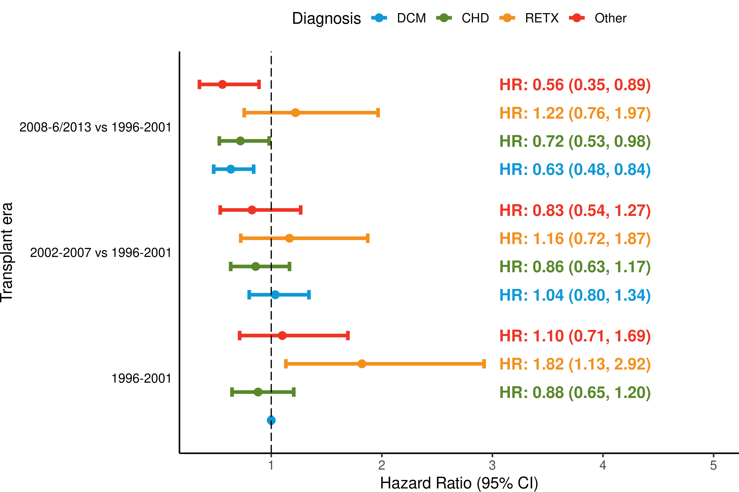
Pediatric Heart Transplants (1996-6/2013)
Statistically Significant Risk Factors For 5-Year Mortality Conditional on Survival to 1 Year with 95% Confidence Limits
Transplant era and recipient diagnosis interaction
2021
(N = 7,022)
JHLT. 2021 Oct; 40(10): 1023-1072
p-value for era = 0.0031; p-value for diagnosis = 0.0155; p-value for interaction = 0.3435

Slide 50
Pediatric Heart Transplants (1996-6/2013)
Statistically Significant Risk Factors For 5-Year Mortality Conditional on Survival to 1 Year
Continuous Factors (see figures)
Recipient age (years) | PRA (%)
2021
JHLT. 2021 Oct; 40(10): 1023-1072

Slide 51
Pediatric Heart Transplants (1996-6/2013)
Statistically Significant Risk Factors For 5-Year Mortality Conditional on Survival to 1 Year with 95% Confidence Limits
Recipient age (years)
(N = 7,022)
2021
JHLT. 2021 Oct; 40(10): 1023-1072

Slide 52
Pediatric Heart Transplants (1996-6/2013)
Transplant era and recipient age interaction
Statistically Significant Risk Factors For 5-Year Mortality Conditional on Survival to 1 Year with 95% Confidence Limits
2021
(N = 7,022)
JHLT. 2021 Oct; 40(10): 1023-1072
p-value for era = 0.0031; p-value for age < 0.0001; p-value for interaction = 0.5989

Slide 53
Pediatric Heart Transplants (1996-6/2013)
PRA (%)
Statistically Significant Risk Factors For 5-Year Mortality Conditional on Survival to One Year with 95% Confidence Limits
2021
(N = 7,022)
JHLT. 2021 Oct; 40(10): 1023-1072

Slide 54
Multivariable Cox Analyses
CAV within 5 Years Conditional on Survival to Discharge
2021
JHLT. 2021 Oct; 40(10): 1023-1072
Notes:
No interaction terms were considered for CAV model

Slide 55
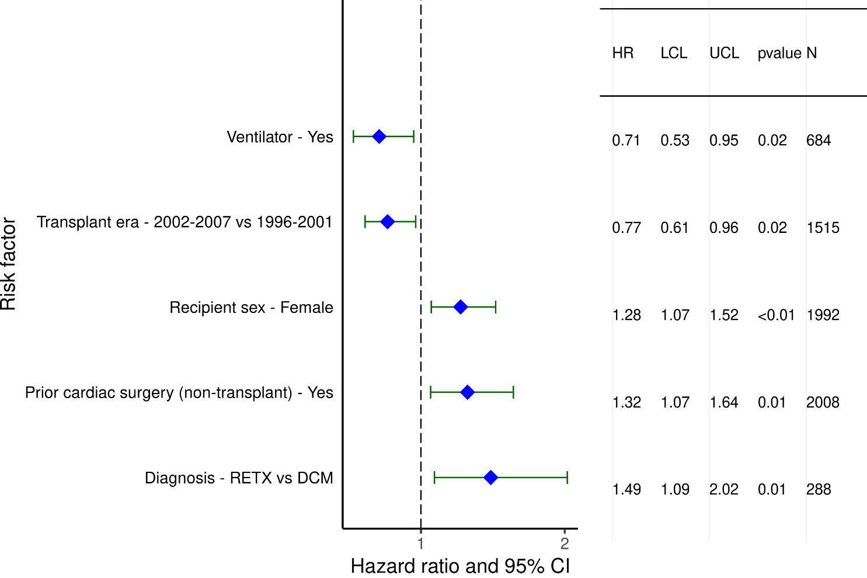
Pediatric Heart Transplants (1996-6/2013)
Statistically Significant Risk Factors For 5-Year CAV Conditional on Survival to Discharge with 95% Confidence Limits
2021
(N = 4,455)
JHLT. 2021 Oct; 40(10): 1023-1072

Slide 56
Pediatric Heart Transplants (1996-6/2013)
Statistically Significant Risk Factors For 5-Year CAV
Conditional on Survival to Discharge
Continuous Factors (see figures)
Recipient age (years) | PRA (%)
2021
JHLT. 2021 Oct; 40(10): 1023-1072

Slide 57
Pediatric Heart Transplants (1996-6/2013)
Recipient age (years)
Statistically Significant Risk Factors For 5-Year CAV Conditional on Survival to Discharge with 95% Confidence Limits
2021
(N = 4,455)
JHLT. 2021 Oct; 40(10): 1023-1072

Slide 58
Pediatric Heart Transplants (1996-6/2013)
PRA (%)
Statistically Significant Risk Factors For 5-Year CAV Conditional on Survival to Discharge with 95% Confidence Limits
2021
(N = 4,455)
JHLT. 2021 Oct; 40(10): 1023-1072

