Slide 1

FOCUS THEME:
TRENDS IN RECIPIENT CHARACTERISTICS AND IMPACT ON OUTCOMES
LUNG TRANSPLANTATION
Adult Recipients
2021
JHLT. 2021 Oct; 40(10): 1023-1072

Slide 2
Table of Contents
Characteristics of Recipients of Deceased Donor Transplants by Transplant Year/Era: slides 3-11
Kaplan-Meier Survival Analyses: slides 12-37
  Survival within 12 months: slides 12-22
  Survival within 5 years conditional on survival to 1 year: slides 23-33
  Freedom from BOS conditional on survival to discharge: slides 34-40
Multivariable Cox Analyses: slides 41-81
  Mortality within 12 months: slides 41-55
  Mortality within 5 years conditional on survival to 1 year: slides 56-67
  BOS within 5 years conditional on survival to discharge: slides 66-81
2021
JHLT. 2021 Oct; 40(10): 1023-1072

Slide 3
Recipient Characteristics by Transplant Era/Year
2021
JHLT. 2021 Oct; 40(10): 1023-1072

Slide 4
Adult Lung Transplants
Recipient Characteristics (Transplants: Jan 1992 – Jun 2018)
 | Jan 1992-Dec 2000 (N = 11,796) | Jan 2001-Dec 2009 (N = 21,806) | Jan 2010-Jun 2018 (N = 33,891) | P-value
Geographic location:
- Europe | 3751 (31.8%) | 7818 (35.9%) | 12414 (36.6%) | <0.0001
- North America | 7324 (62.1%) | 12545 (57.5%) | 18594 (54.9%)
- Other | 721 (6.1%) | 1443 (6.6%) | 2883 (8.5%)
Age (years) | 50 (23 - 63) | 54 (23 - 66) | 57 (24 - 69) | <0.0001
Male | 51.9% | 55.6% | 58.0% | <0.0001
Weight (kg) | 75.7 (53.5 - 101.6) | 78.0 (54.0 - 106.1) | 80.0 (54.4 - 108.9) | <0.0001
Height (cm) | 174.0 (157.0 - 188.0) | 174.0 (157.5 - 188.0) | 174.0 (157.5 - 188.0) | 0.0463
BMI (kg/m²) | 25.0 (19.1 - 32.4) | 25.7 (19.3 - 33.7) | 26.5 (19.6 - 34.6) | <0.0001
ABO
- A | 45.2% | 43.3% | 42.0% | <0.0001
- AB | 5.2% | 5.3% | 5.8%
- B | 12.2% | 13.1% | 14.1%
- O | 37.4% | 38.2% | 38.1%
2021
Continuous factors are expressed as median (5th – 95th percentiles)
JHLT. 2021 Oct; 40(10): 1023-1072
Summary statistics included transplants with known/non-missing data
Notes:
Comparisons for categorical variables were made using the chi-square statistic. Multiple groups were compared using single p-value.
Comparisons for continuous variables were made using Kruskal-Wallis test.
A significant p-value means that at least one of the groups is different than the others but it doesn’t identify which group it is.

Slide 5
Adult Lung Transplants
Recipient Characteristics
(Transplants: Jan 1992 – Jun 2018)
 | Jan 1992-Dec 2000 (N = 11,796) | Jan 2001-Dec 2009 (N = 21,806) | Jan 2010-Jun 2018 (N = 33,891) | P-value
PRA ≥ 20% | 3.4% | 6.2% | 14.6% | <0.0001
PRA ≥ 80% | 0.4% | 0.7% | 2.0% | <0.0001
CMV antibody positive | 62.9% | 59.5% | 56.2% | <0.0001
EBV antibody positive | 76.7% ¹ | 86.0% | 90.5% | <0.0001
Hep B antibody positive | 2.4% ² | 4.1% | 4.8% | <0.0001
Hep C antibody positive | 1.7% ² | 1.8% | 1.8% | 0.8656
Diabetes | 6.1% ² | 15.2% | 20.1% | <0.0001
History of malignancy | 2.7% ² | 5.2% | 7.9% | <0.0001
History of smoking | - | 62.5%³ | 57.9% | <0.0001
Previous lung surgery | 25.7% ² | 21.8% | 15.0% | <0.0001
Ventilator use | 2.5% | 4.2% | 6.5% | <0.0001
Hospitalized | 9.2% | 12.0% | 21.7% | <0.0001
2021
Summary statistics included transplants with known/non-missing data
¹ Based on Oct 1999– Dec 2000 transplants
² Based on Apr 1994 – Dec 2000 transplants
JHLT. 2021 Oct; 40(10): 1023-1072
³ Based on Jul 2004 – Dec 2009 transplants
Notes:
Comparisons for categorical variables were made using the chi-square statistic. Multiple groups were compared using single p-value.
Comparisons for continuous variables were made using Kruskal-Wallis test.
A significant p-value means that at least one of the groups is different than the others but it doesn’t identify which group it is.

Slide 6
Adult Lung Transplants
Recipient Characteristics
(Transplants: Jan 1992 – Jun 2018)
 | Jan 1992-Dec 2000 (N = 11,796) | Jan 2001-Dec 2009 (N = 21,806) | Jan 2010-Jun 2018 (N = 33,891) | P-value
Bilirubin (mg/dl) | 0.5 (0.2 - 1.3) ¹ | 0.5 (0.2 - 1.2) | 0.5 (0.2 - 1.2) | <0.0001
Creatinine (mg/dl) | 0.9 (0.5 - 1.4) ¹ | 0.8 (0.5 - 1.3) | 0.8 (0.5 - 1.3) | <0.0001
GFR (mL/min/1.73 m²) * | 90.5 (50.8 - 154.1) ¹ | 93.5 (53.0 - 157.5) | 97.9 (55.5 - 169.9) | <0.0001
PCW mean (mmHg) | 11.0 (4.0 - 21.0) ¹ | 10.0 (4.0 - 22.0) | 10.0 (3.0 - 21.0) | <0.0001
PA mean (mmHg) | 25.0 (15.0 - 54.0) ¹ | 25.0 (14.0 - 49.0) | 25.0 (14.0 - 49.0) | 0.0095
PVR (Wood units) | 2.7 (1.0 - 7.6) ¹ | 2.7 (1.0 - 7.3) | 2.8 (1.1 - 7.9) | <0.0001
FEV1% predicted | 23.0 (12.0 - 78.0) | 29.0 (13.0 - 77.0) | 35.0 (14.0 - 78.0) | <0.0001
FVC% predicted | 48.0 (24.0 - 86.0) | 47.0 (25.0 - 82.0) | 46.0 (25.0 - 82.0) | <0.0001
*GFR was estimated using the Cockcroft-Gault formula
2021
Summary statistics included transplants with known/non-missing data
JHLT. 2021 Oct; 40(10): 1023-1072
¹ Based on Apr 1994 - Dec 2000 transplants
Notes:
Comparisons for categorical variables were made using the chi-square statistic. Multiple groups were compared using single p-value.
Comparisons for continuous variables were made using Kruskal-Wallis test.
A significant p-value means that at least one of the groups is different than the others but it doesn’t identify which group it is.

Slide 7
Adult Lung Transplants
Recipient Blood Type Distribution by Location and Era
(Transplants: Jan 1992 – Jun 2018)
Blood Type:
Europe
North America
Other
2021
JHLT. 2021 Oct; 40(10): 1023-1072

Slide 8
Adult Lung Transplants
Recipient Diagnosis Distribution by Location and Era
(Transplants: Jan 1992 – Jun 2018)
Europe
North America
Other
2021
JHLT. 2021 Oct; 40(10): 1023-1072

Slide 9
Adult Lung Transplants
Donor-Recipient Sex Distribution by Location and Era
(Transplants: Jan 1992 – Jun 2018)
Europe
North America
Other
2021
JHLT. 2021 Oct; 40(10): 1023-1072

Slide 10
Adult Lung Transplants
Median Recipient Age by Location
Median Recipient BMI by Location
Median Recipient GFR* by Location
(Transplants: Jan 1992 – Jun 2018)
(Transplants: Jan 1992 – Jun 2018)
(Transplants: Jan 1994 – Jun 2018)
*GFR was estimated using the Cockcroft-Gault formula
2021
JHLT. 2021 Oct; 40(10): 1023-1072

Slide 11
Adult Lung Transplants
Recipients with History of Malignancy
Recipients with Diabetes
Recipients with History of Smoking*
(Transplants: Jan 1994 – Jun 2018)
(Transplants: Jan 1994 – Jun 2018)
(Transplants: Jan 2004 – Jun 2018)
*Cigarette use for more than 20 pack years
2021
JHLT. 2021 Oct; 40(10): 1023-1072

Slide 12
Survival Analyses
Kaplan-Meier Patient Survival within 12 Months
2021
JHLT. 2021 Oct; 40(10): 1023-1072

Slide 13
Adult Lung Transplants
Kaplan-Meier Survival within 12 Months by Era
(Transplants: Jan 2000 – Jun 2017)
All pairwise comparisons were significant at p < 0.05
2021
JHLT. 2021 Oct; 40(10): 1023-1072

Slide 14
Adult Lung Transplants
Kaplan-Meier Survival within 12 Months by Location and Era
(Transplants: Jan 2000 - Jun 2017)
Transplant Era:
North America
Other
2021
JHLT. 2021 Oct; 40(10): 1023-1072

Slide 15
Adult Lung Transplants
Kaplan-Meier Survival within 12 Months by Location and Recipient Age
(Transplants: Jan 2000 - Jun 2017)
Recipient Age:
North America
Other
2021
JHLT. 2021 Oct; 40(10): 1023-1072

Slide 16
Adult Lung Transplants
Kaplan-Meier Survival within 12 Months by Recipient Age and Era
(Transplants: Jan 2000 - Jun 2017)
Transplant Era:
Age 40-59 years
Age ≥ 60 years
2021
JHLT. 2021 Oct; 40(10): 1023-1072

Slide 17
Adult Lung Transplants
Kaplan-Meier Survival within 12 Months by Diagnosis and Era
(Transplants: Jan 2000 - Jun 2017)
Transplant Era:
Diagnosis: COPD
2021
JHLT. 2021 Oct; 40(10): 1023-1072

Slide 18
Adult Lung Transplants
Kaplan-Meier Survival within 12 Months by Diagnosis and Era
(Transplants: Jan 2000 - Jun 2017)
Transplant Era:
Diagnosis: Retransplant
2021
JHLT. 2021 Oct; 40(10): 1023-1072

Slide 19
Adult Lung Transplants
Kaplan-Meier Survival within 12 Months by Recipient GFR* and Era
(Transplants: Jan 2000 - Jun 2017)
GFR 60-89 (mL/min/1.73 m²)
GFR ≥ 90 (mL/min/1.73 m²)
2021
JHLT. 2021 Oct; 40(10): 1023-1072
* GFR was estimated using the Cockcroft-Gault formula

Slide 20
Adult Lung Transplants
Kaplan-Meier Survival within 12 Months by Recipient Diabetes and Era
(Transplants: Jan 2000 - Jun 2017)
Transplant Era:
Recipient with No Diabetes
2021
JHLT. 2021 Oct; 40(10): 1023-1072

Slide 21
Adult Lung Transplants
Kaplan-Meier Survival within 12 Months
By Recipient History of Malignancy (Transplants: Jan 1994 - Jun 2017)
p = 0.9827
2021
JHLT. 2021 Oct; 40(10): 1023-1072

Slide 22
Adult Lung Transplants
Kaplan-Meier Survival within 12 Months by Procedure Type and Era
(Transplants: Jan 2000 - Jun 2017)
Transplant Era:
Bilateral/Double Lung
2021
JHLT. 2021 Oct; 40(10): 1023-1072

Slide 23
Survival Analyses
Kaplan-Meier Patient Survival within 5 Years Conditional on Survival to 1 Year
2021
JHLT. 2021 Oct; 40(10): 1023-1072

Slide 24
Adult Lung Transplants
Kaplan-Meier Survival within 5 Years Conditional on Survival to 1 Year
By Era (Transplants: Jan 1996 - Jun 2013)
All pairwise comparisons were significant at p < 0.05 except 2002-2007 vs. 2008-2013
2021
JHLT. 2021 Oct; 40(10): 1023-1072

Slide 25
Adult Lung Transplants
Kaplan-Meier Survival within 5 Years Conditional on Survival to 1 Year
by Location and Era (Transplants: Jan 1996 - Jun 2013)
Transplant Era:
Europe
North America
2021
Note: Y-axis is truncated for clearer presentation
JHLT. 2021 Oct; 40(10): 1023-1072

Slide 26
Adult Lung Transplants
Kaplan-Meier Survival within 5 Years Conditional on Survival to 1 Year
by Location and Recipient Age (Transplants: Jan 1996 - Jun 2013)
Recipient Age:
All pairwise comparisons were significant at p < 0.05 except recipient 18-39 years vs. 40-59 years
All pairwise comparisons were significant at p < 0.05
Europe
North America
2021
JHLT. 2021 Oct; 40(10): 1023-1072

Slide 27
Adult Lung Transplants
Kaplan-Meier Survival within 5 Years Conditional on Survival to 1 Year
by Recipient Age and Era (Transplants: Jan 1996 - Jun 2013)
Transplant Era:
All pairwise comparisons were significant at p < 0.05
All pairwise comparisons were significant at p < 0.05 except 2002-2007 vs. 2008-2013
Recipient 18-39 years
Recipient 40-59 years
2021
JHLT. 2021 Oct; 40(10): 1023-1072

Slide 28
Adult Lung Transplants
Kaplan-Meier Survival within 5 Years Conditional on Survival to 1 Year
by Recipient Diagnosis and Era (Transplants: Jan 1996 - Jun 2013)
Transplant Era:
All pairwise comparisons were significant at p < 0.05 except 2002-2007 vs. 2008-2013
Diagnosis: CF
Diagnosis: COPD
2021
JHLT. 2021 Oct; 40(10): 1023-1072

Slide 29
Adult Lung Transplants
Kaplan-Meier Survival within 5 Years Conditional on Survival to 1 Year
By Recipient Diagnosis and Era (Transplants: Jan 1996 - Jun 2013)
Transplant Era:
No pairwise comparisons were significant at p < 0.05
Diagnosis: IPF
Diagnosis: Retransplant
2021
JHLT. 2021 Oct; 40(10): 1023-1072

Slide 30
Adult Lung Transplants
Kaplan-Meier Survival within 5 Years Conditional on Survival to 1 Year
by Recipient GFR* and Era (Transplants: Jan 1996 - Jun 2013)
No pairwise comparisons were significant at p < 0.05
No pairwise comparisons were significant at p < 0.05 except 1996-2001 vs. 2008-2013
GFR <60 (mL/min/1.73 m²)
GFR 60-89 (mL/min/1.73 m²)
2021
JHLT. 2021 Oct; 40(10): 1023-1072
* GFR was estimated using the Cockcroft-Gault formula

Slide 31
Adult Lung Transplants
Kaplan-Meier Survival within 5 Years Conditional on Survival to 1 Year
by Recipient Diabetes and Era (Transplants: Jan 1996 - Jun 2013)
All pairwise comparisons were significant at p<0.05 except 2002-2007 vs. 2008-2013
Recipient with Diabetes
Recipient with No Diabetes
2021
JHLT. 2021 Oct; 40(10): 1023-1072

Slide 32
Adult Lung Transplants
Kaplan-Meier Survival within 5 Years Conditional on Survival to 1 Year
By Recipient History of Malignancy (Transplants: Jan 1996 - Jun 2013)
p = 0.1106
2021
JHLT. 2021 Oct; 40(10): 1023-1072

Slide 33
Adult Lung Transplants
Kaplan-Meier Survival within 5 Years Conditional on Survival to 1 Year
by Procedure Type and Era (Transplants: Jan 1996 - Jun 2013)
All pairwise comparisons were significant at p<0.05 except 2002-2007 vs. 2008-2013
Single Lung
Bilateral/Double Lung
2021
JHLT. 2021 Oct; 40(10): 1023-1072

Slide 34
Survival Analyses
Kaplan-Meier Freedom from BOS within 5 Years Conditional on Survival to Discharge
2021
JHLT. 2021 Oct; 40(10): 1023-1072

Slide 35
Adult Lung Transplants
Freedom from BOS Conditional on Survival to Discharge
By Era (Transplants: Jan 1996 - Jun 2013)
All pairwise comparisons were significant at p < 0.05 except 2002-2007 vs. 2008-2013 =
2021
JHLT. 2021 Oct; 40(10): 1023-1072

Slide 36
Adult Lung Transplants
Freedom from BOS Conditional on Survival to Discharge
By Recipient Age and Era (Transplants: Jan 1996 - Jun 2013)
Recipient 18-39 years
Recipient 40-59 years
Recipient ≥ 60 years
2021
JHLT. 2021 Oct; 40(10): 1023-1072

Slide 37
Adult Lung Transplants
Freedom from BOS Conditional on Survival to Discharge
by Recipient Diagnosis and Era (Transplants: Jan 1996 - Jun 2013)
Transplant Era:
All pairwise comparison were significant at p < 0.05 except 2002-2007 vs. 2008-2013
Diagnosis: CF
Diagnosis: COPD
2021
JHLT. 2021 Oct; 40(10): 1023-1072

Slide 38
Adult Lung Transplants
Freedom from BOS Conditional on Survival to Discharge
by Recipient Diagnosis and Era (Transplants: Jan 1996 - Jun 2013)
Transplant Era:
No pairwise comparisons were significant at p < 0.05
Diagnosis: IPF
Diagnosis: Retransplant
2021
JHLT. 2021 Oct; 40(10): 1023-1072

Slide 39
Adult Lung Transplants
Freedom from BOS Conditional on Survival to Discharge
by Recipient GFR* and Era (Transplants: Jan 1996 - Jun 2013)
All pairwise comparison were significant at p < 0.05 except 2002-2007 vs. 2008-2013
All pairwise comparison were significant at p < 0.05 except 2002-2007 vs. 2008-2013
GFR <60 (mL/min/1.73 m²)
GFR 60-89 (mL/min/1.73 m²)
2021
JHLT. 2021 Oct; 40(10): 1023-1072
* GFR was estimated using the Cockcroft-Gault formula

Slide 40
Adult Lung Transplants
Freedom from BOS Conditional on Survival to Discharge
by Recipient Diabetes and Era (Transplants: Jan 1996 - Jun 2013)
All pairwise comparisons were significant at p<0.05 except 2002-2007 vs. 2008-2013
Recipient with Diabetes
Recipient with No Diabetes
2021
JHLT. 2021 Oct; 40(10): 1023-1072

Slide 41
Multivariable Cox Analyses
Mortality within 12 Months
2021
JHLT. 2021 Oct; 40(10): 1023-1072

Slide 42
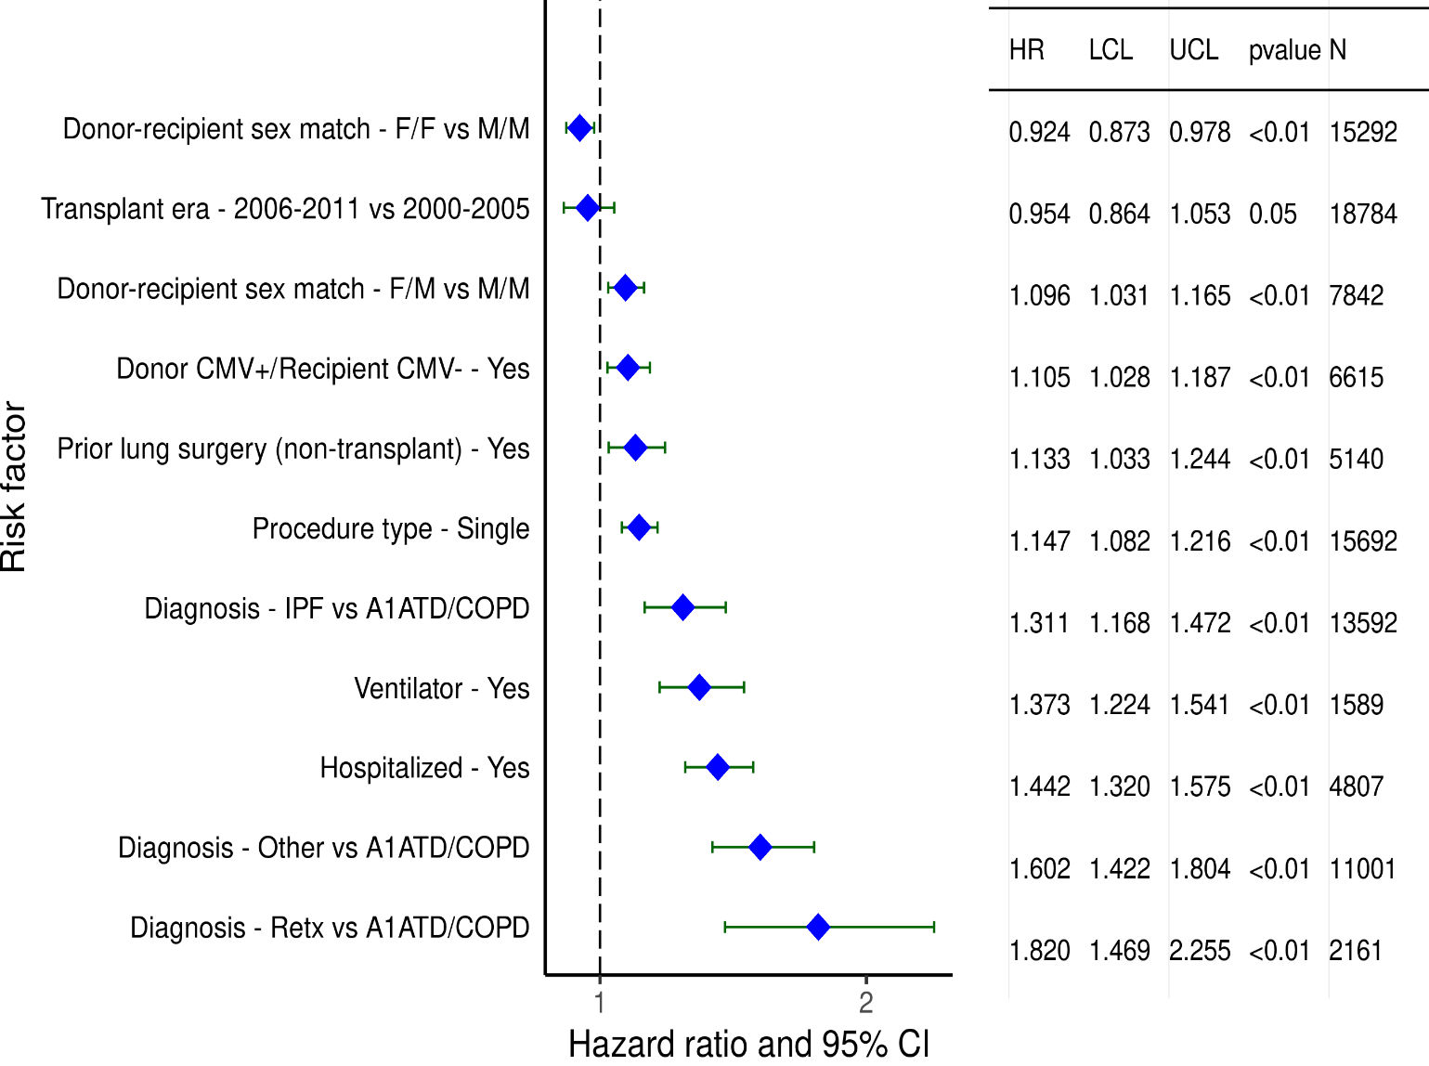
Adult Lung Transplants (2000-6/2017)
Statistically Significant Risk Factors For 1-Year Mortality with 95% Confidence Limits
2021
(N = 53,072)
JHLT. 2021 Oct; 40(10): 1023-1072

Slide 43
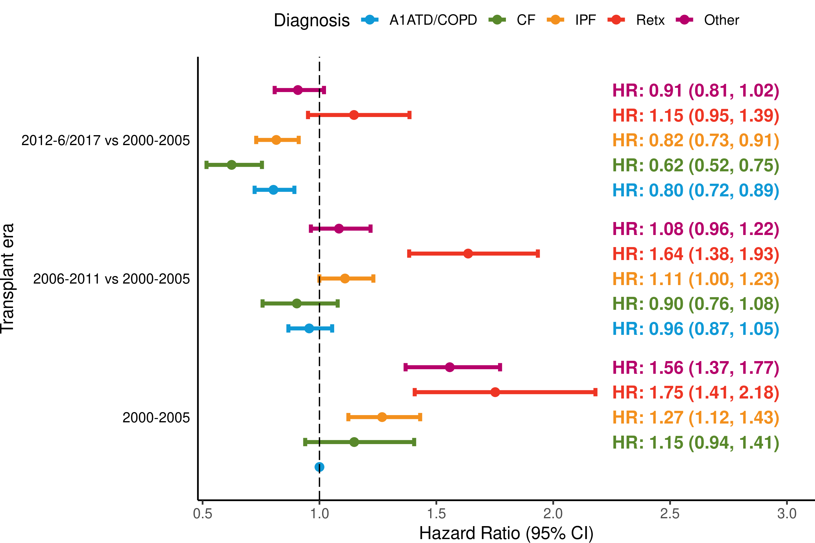
Adult Lung Transplants (2000-6/2017)
Statistically Significant Risk Factors For 1-Year Mortality with 95% Confidence Limits
Transplant era and diagnosis interaction
2021
(N = 53,072)
JHLT. 2021 Oct; 40(10): 1023-1072
p-value for era < 0.0001; p-value diagnosis < 0.0001; p-value for interaction = 0.0002

Slide 44
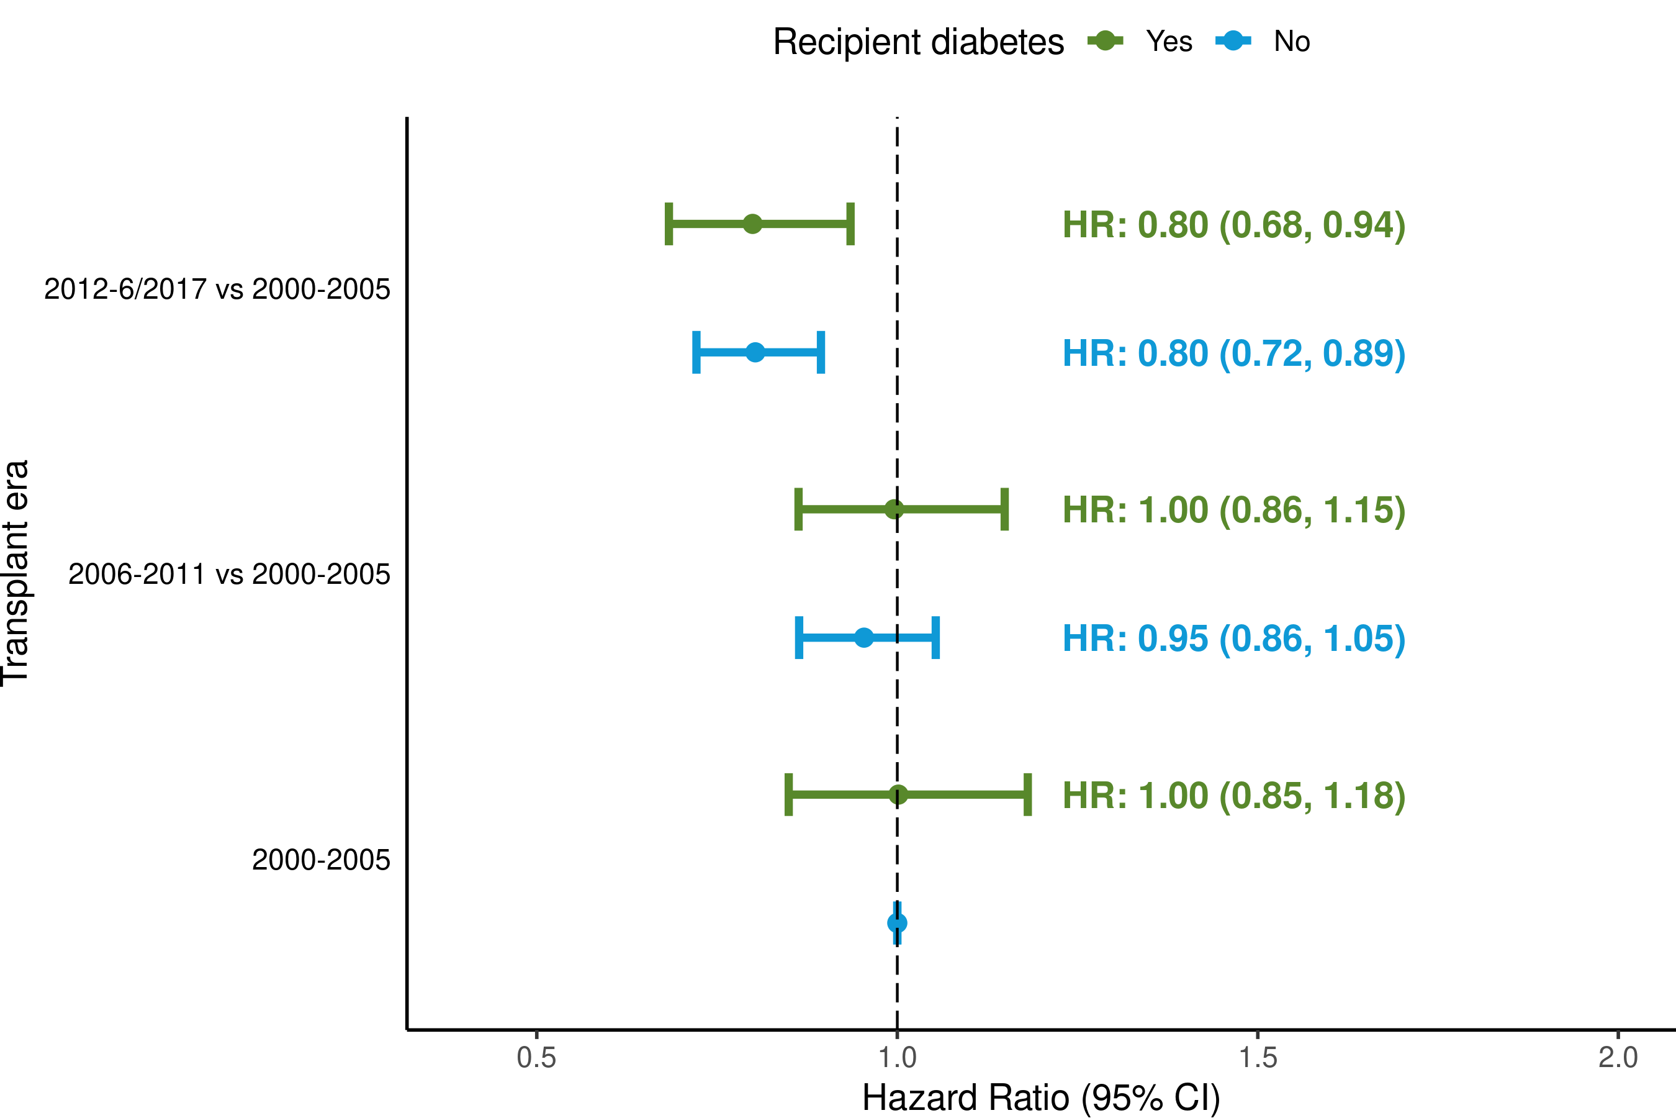
Adult Lung Transplants (2000-6/2017)
Risk Factors For 1-Year Mortality with 95% Confidence Limits
Transplant era and recipient diabetes interaction
2021
(N = 53,072)
JHLT. 2021 Oct; 40(10): 1023-1072
p-value for era < 0.0001; p-value for diabetes = 0.8999; p-value for interaction = 0.8285

Slide 45
Adult Lung Transplants (2000-6/2017)
Statistically Significant Risk Factors For 1-Year Mortality
Continuous Factors (see figures)
Recipient age (years) | Donor age (years)
PCW (mm/Hg) | Recipient BMI (kg/m²)
Recipient GFR* (mL/min/1.73 m²) | Center volume in previous 3 yrs
Ischemic time (hours) | Recipient bilirubin (mg/dl)
* GFR was estimated using the Cockcroft-Gault formula
2021
JHLT. 2021 Oct; 40(10): 1023-1072

Slide 46
Adult Lung Transplants (2000-6/2017)
Statistically Significant Risk Factors For 1-Year Mortality with 95% Confidence Limits
Recipient age (years)
p < 0.0001
2021
(N = 53,072)
JHLT. 2021 Oct; 40(10): 1023-1072

Slide 47
Adult Lung Transplants (2000-6/2017)
Statistically Significant Risk Factors For 1 Year Mortality
Transplant era and recipient age interaction
(N = 53,072)
2021
JHLT. 2021 Oct; 40(10): 1023-1072
p-value for era < 0.0001; p-value for age < 0.0001; p-value for interaction = 0.0029

Slide 48
Adult Lung Transplants (2000-6/2017)
Statistically Significant Risk Factors For 1-Year Mortality with 95% Confidence Limits
PCW (mm/Hg)
p = 0.0014
2021
(N = 53,072)
JHLT. 2021 Oct; 40(10): 1023-1072

Slide 49
Adult Lung Transplants (2000-6/2017)
Statistically Significant Risk Factors For 1-Year Mortality with 95% Confidence Limits
Recipient BMI (kg/m²)
p < 0.0001
2021
(N = 53,072)
JHLT. 2021 Oct; 40(10): 1023-1072

Slide 50
Adult Lung Transplants (2000-6/2017)
Statistically Significant Risk Factors For 1-Year Mortality with 95% Confidence Limits
Recipient GFR* (mL/min/1.73 m²)
p < 0.0001
2021
(N = 53,072)
JHLT. 2021 Oct; 40(10): 1023-1072
* GFR was estimated using the Cockcroft-Gault formula

Slide 51
Adult Lung Transplants (2005-6/2017)
Risk Factors For 1-Year Mortality
Transplant era and recipient GFR* interaction
(N = 53,072)
2021
* GFR was estimated using the Cockcroft-Gault formula
JHLT. 2021 Oct; 40(10): 1023-1072
Overall p-value for era < 0.0001; p-value for GFR < 0.0001; p-value for interaction = 0.3627

Slide 52
Adult Lung Transplants (2000-6/2017)
Statistically Significant Risk Factors For 1-Year Mortality with 95% Confidence Limits
Recipient bilirubin (mg/dl)
p < 0.0001
2021
(N = 53,072)
JHLT. 2021 Oct; 40(10): 1023-1072

Slide 53
Adult Lung Transplants (2000-6/2017)
Statistically Significant Risk Factors For 1-Year Mortality with 95% Confidence Limits
Donor age (years)
p < 0.0001
2021
(N = 53,072)
JHLT. 2021 Oct; 40(10): 1023-1072

Slide 54
Adult Lung Transplants (2000-6/2017)
Statistically Significant Risk Factors For 1-Year Mortality with 95% Confidence Limits
Ischemic time (hours)
p = 0.0007
2021
(N = 53,072)
JHLT. 2021 Oct; 40(10): 1023-1072

Slide 55
Adult Lung Transplants (2000-6/2017)
Statistically Significant Risk Factors For 1-Year Mortality with 95% Confidence Limits
Center volume in previous 3 yrs
p < 0.0001
2021
(N = 53,072)
JHLT. 2021 Oct; 40(10): 1023-1072

Slide 56
Multivariable Cox Analyses
Mortality within 5 Years Conditional on Survival to 1 Year
2021
JHLT. 2021 Oct; 40(10): 1023-1072

Slide 57
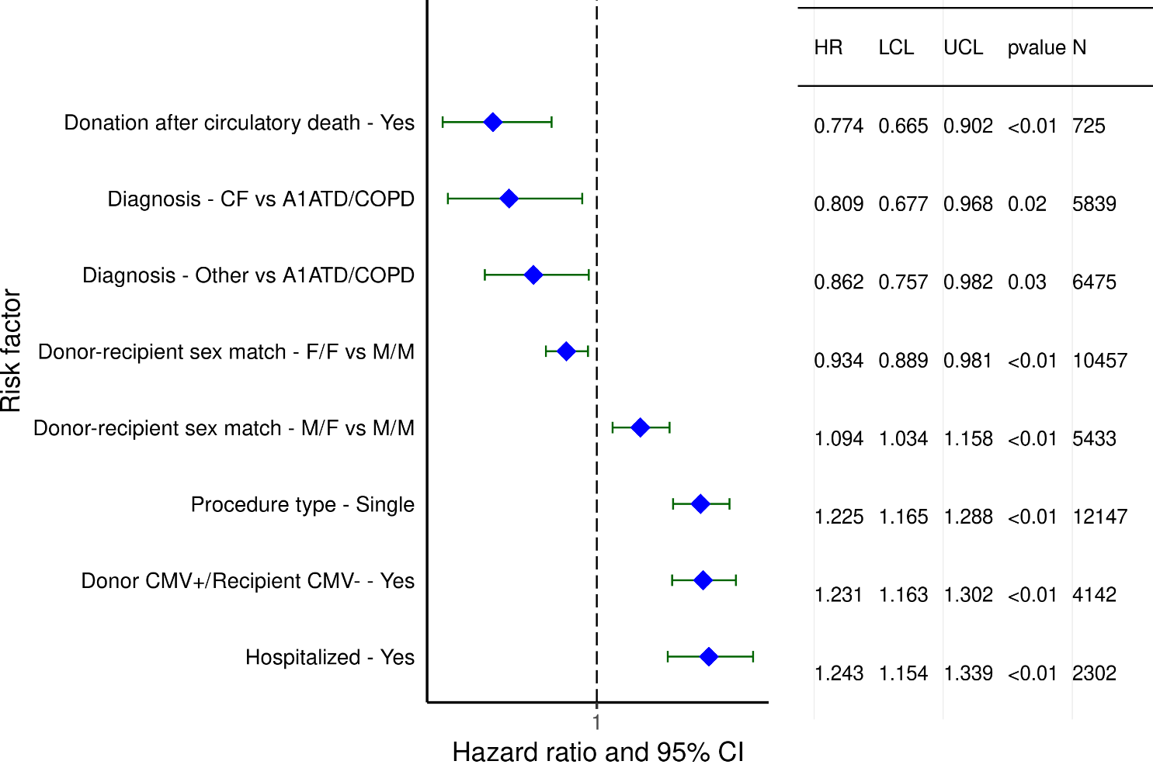
Adult Lung Transplants (1996-6/2013)
Statistically Significant Risk Factors For 5-Year Mortality Conditional on Survival to 1 Year with 95% Confidence Limits
(N = 35,214)
2021
JHLT. 2021 Oct; 40(10): 1023-1072

Slide 58
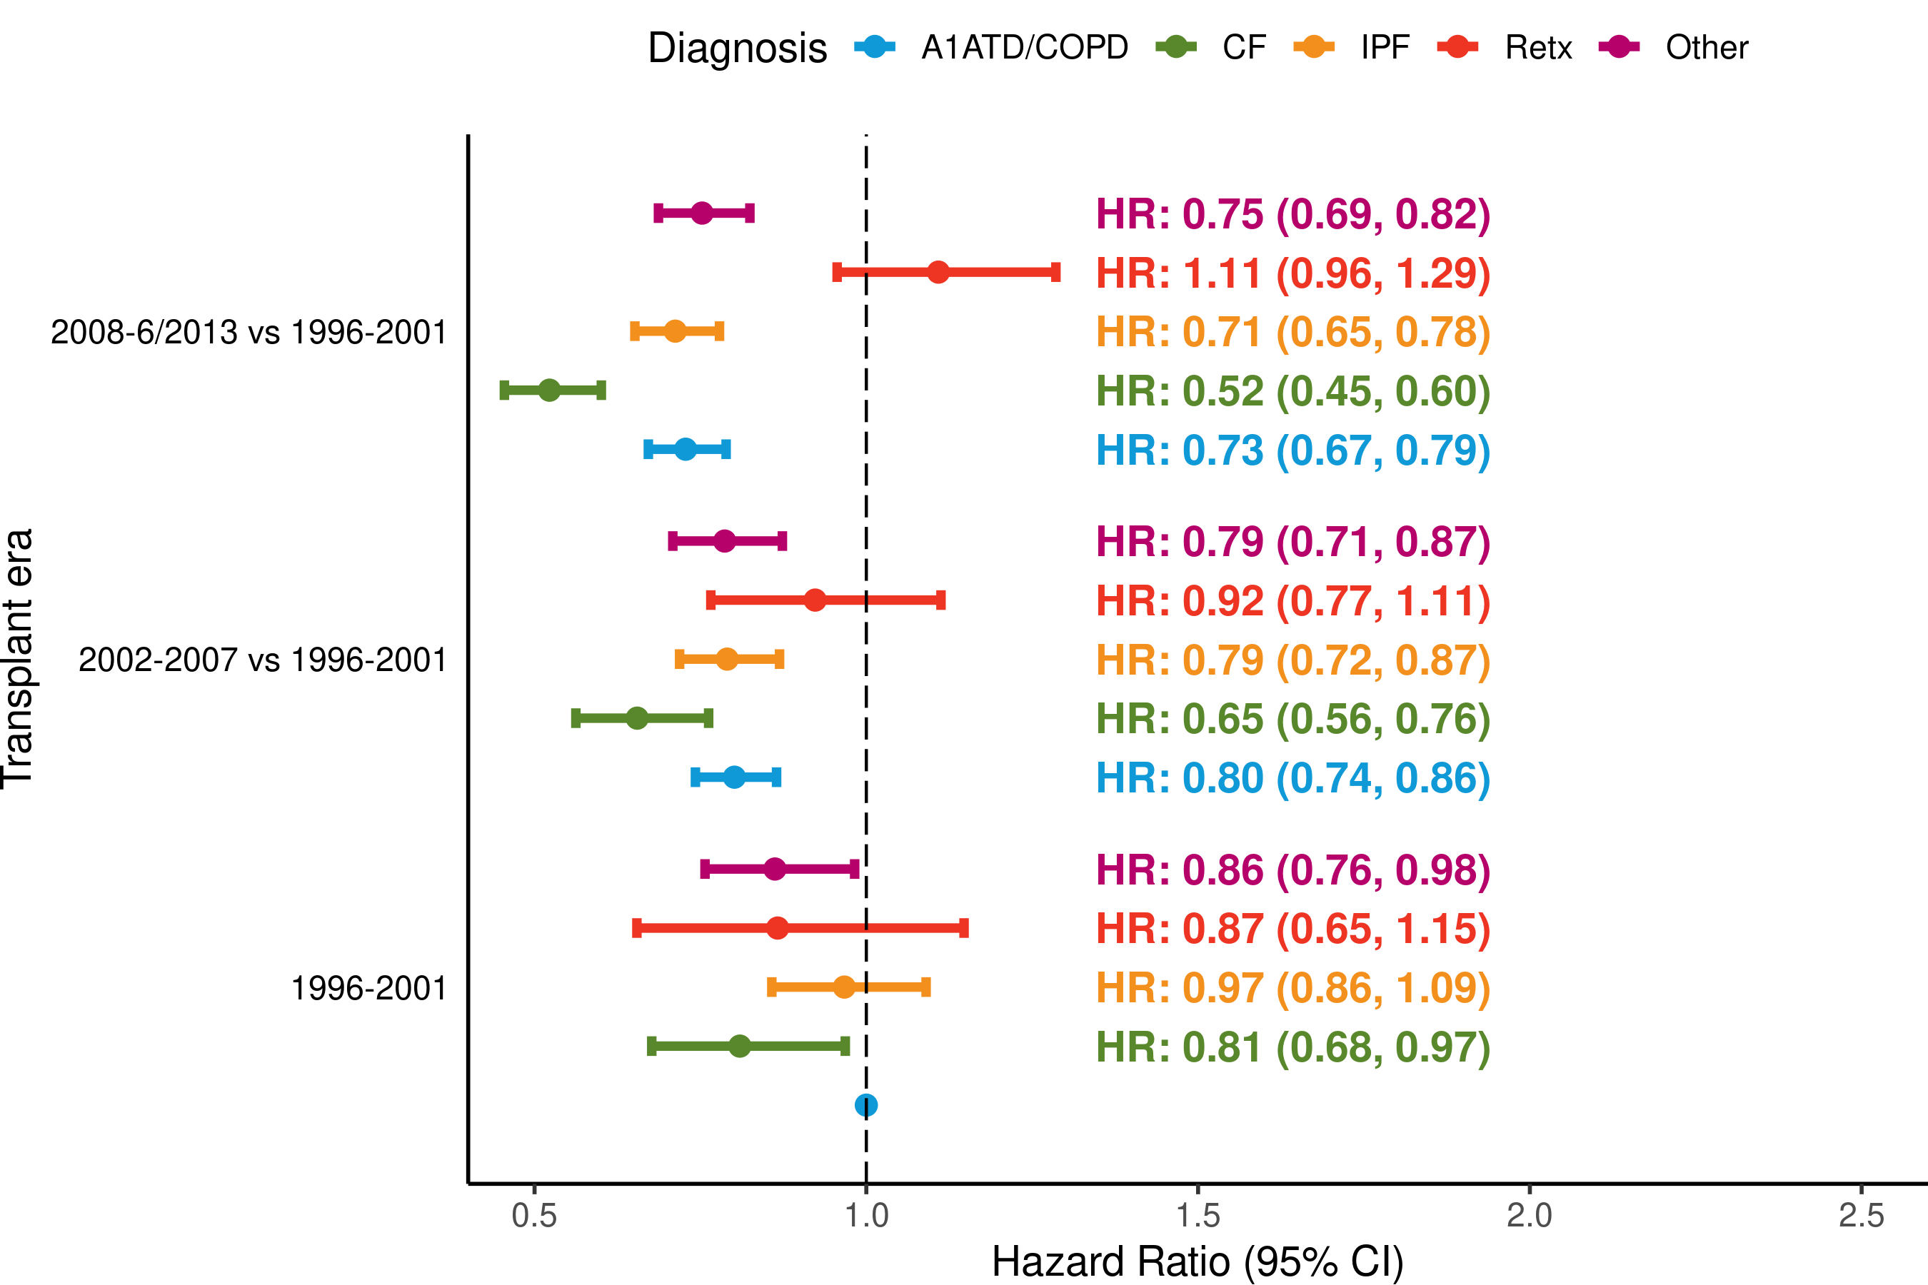
Adult Lung Transplants (1996-6/2013)
Risk Factors For 5-Year Mortality Conditional on Survival to 1 Year with 95% Confidence Limits
Transplant era and diagnosis interaction
2021
(N = 35,214)
JHLT. 2021 Oct; 40(10): 1023-1072
p-value for era < 0.0001; p-value for diagnosis < 0.0001; p-value for interaction = 0.0003

Slide 59
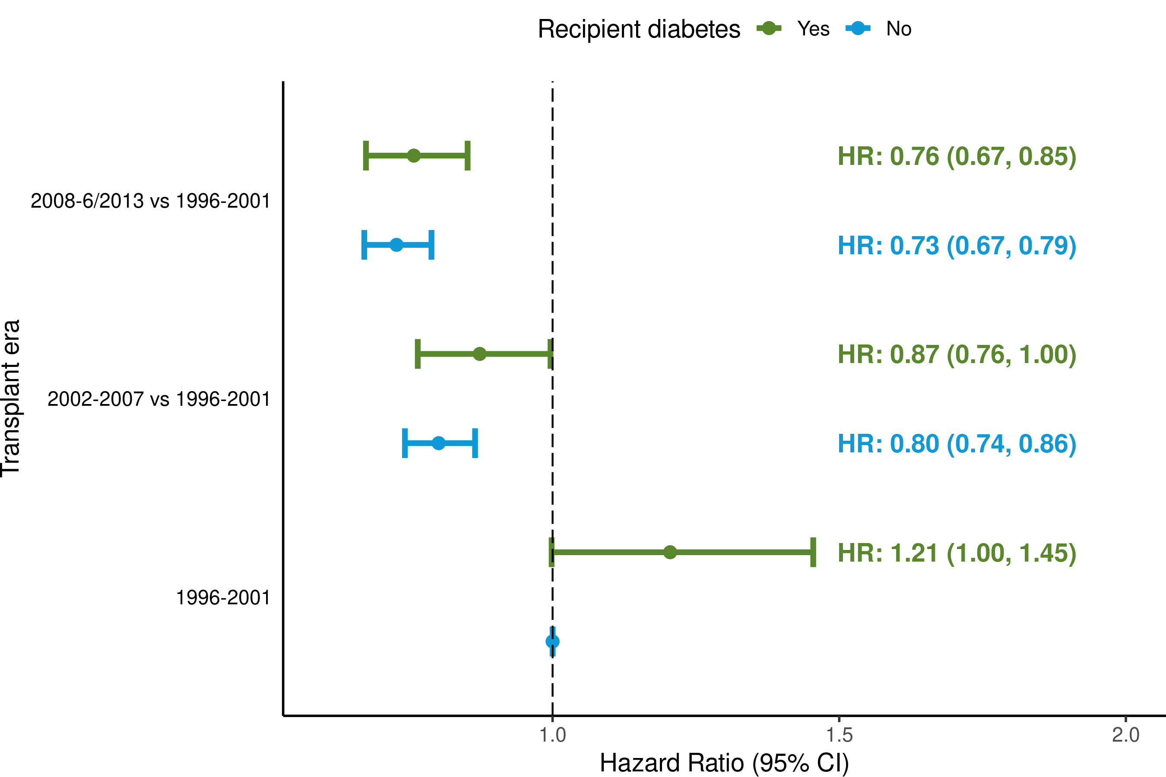
Adult Lung Transplants (1996-6/2013)
Risk Factors For 5-Year Mortality Conditional on Survival to 1 Year with 95% Confidence Limits
Transplant era and recipient diabetes interaction
2021
(N = 35,214)
JHLT. 2021 Oct; 40(10): 1023-1072
p-value for era < 0.0001; p-value for diabetes = 0.0971; p-value for interaction = 0.3842

Slide 60
Adult Lung Transplants (1996-6/2013)
Statistically Significant Risk Factors For 5-Year Mortality Conditional on Survival to 1 Year
Continuous Factors (see figures)
Recipient age (years) | Ischemic time (hours)
Recipient BMI (kg/m²) | Center volume in previous 3 yrs
Recipient GFR* (mL/min/1.73 m2)
* GFR was estimated using the Cockcroft-Gault formula
2021
JHLT. 2021 Oct; 40(10): 1023-1072

Slide 61
Adult Lung Transplants (1996-6/2013)
Statistically Significant Risk Factors For 5-Year Mortality Conditional on Survival to 1 Year with 95% Confidence Limits
Recipient age (years)
2021
(N = 35,214)
JHLT. 2021 Oct; 40(10): 1023-1072

Slide 62
Adult Lung Transplants (1996-6/2013)
Risk Factors For 5 Year Mortality Conditional on Survival to 1 Year
Transplant era and recipient age interaction
2021
(N = 35,214)
JHLT. 2021 Oct; 40(10): 1023-1072
p-value for era < 0.0001; p-value for age < 0.0001; p-value for interaction = 0.2675

Slide 63
Adult Lung Transplants (1996-6/2013)
Statistically Significant Risk Factors For 5-Year Mortality Conditional on Survival to 1 Year with 95% Confidence Limits
Recipient BMI (kg/m²)
2021
(N = 35,214)
JHLT. 2021 Oct; 40(10): 1023-1072

Slide 64
Adult Lung Transplants (1996-6/2013)
Statistically Significant Risk Factors For 5-Year Mortality Conditional on Survival to 1 Year with 95% Confidence Limits
Recipient GFR* (mL/min/1.73 m²)
2021
(N = 35,214)
JHLT. 2021 Oct; 40(10): 1023-1072
* GFR was estimated using the Cockcroft-Gault formula

Slide 65
Adult Lung Transplants (1996-6/2013)
Risk Factors For 5 Year Mortality Conditional on Survival to 1 Year
Transplant era and recipient GFR* interaction
(N = 35,214)
2021
* GFR was estimated using the Cockcroft-Gault formula
JHLT. 2021 Oct; 40(10): 1023-1072
p-value for era < 0.0001; p-value for GFR = 0.0109; p-value for interaction = 0.7915

Slide 66
Adult Lung Transplants (1996-6/2013)
Statistically Significant Risk Factors For 5-Year Mortality Conditional on Survival to 1 Year with 95% Confidence Limits
Ischemic time (hours)
(N = 35,214)
2021
JHLT. 2021 Oct; 40(10): 1023-1072

Slide 67
Adult Lung Transplants (1996-6/2013)
Statistically Significant Risk Factors For 5-Year Mortality Conditional on Survival to 1 Year with 95% Confidence Limits
Center volume in previous 3 yrs
2021
(N = 35,214)
JHLT. 2021 Oct; 40(10): 1023-1072

Slide 68
Multivariable Cox Analyses
BOS within 5 Years Conditional on Survival to Discharge
2021
JHLT. 2021 Oct; 40(10): 1023-1072

Slide 69
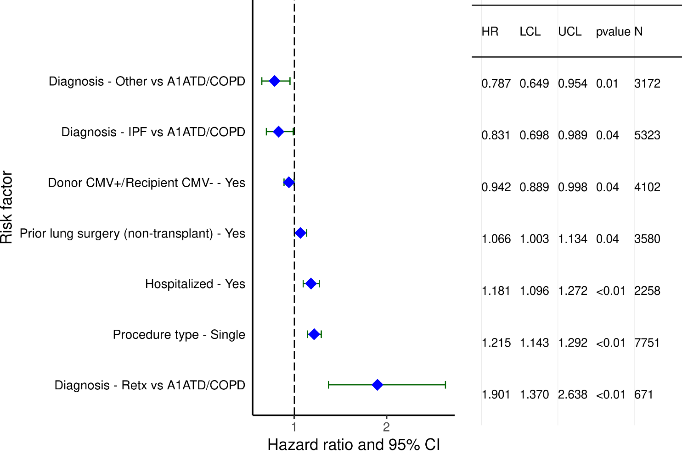
Adult Lung Transplants (1996-6/2013)
Statistically Significant Risk Factors for BOS within
5 Years Conditional on Survival to Discharge with 95% Confidence Limits
2021
(N = 18,830)
JHLT. 2021 Oct; 40(10): 1023-1072

Slide 70
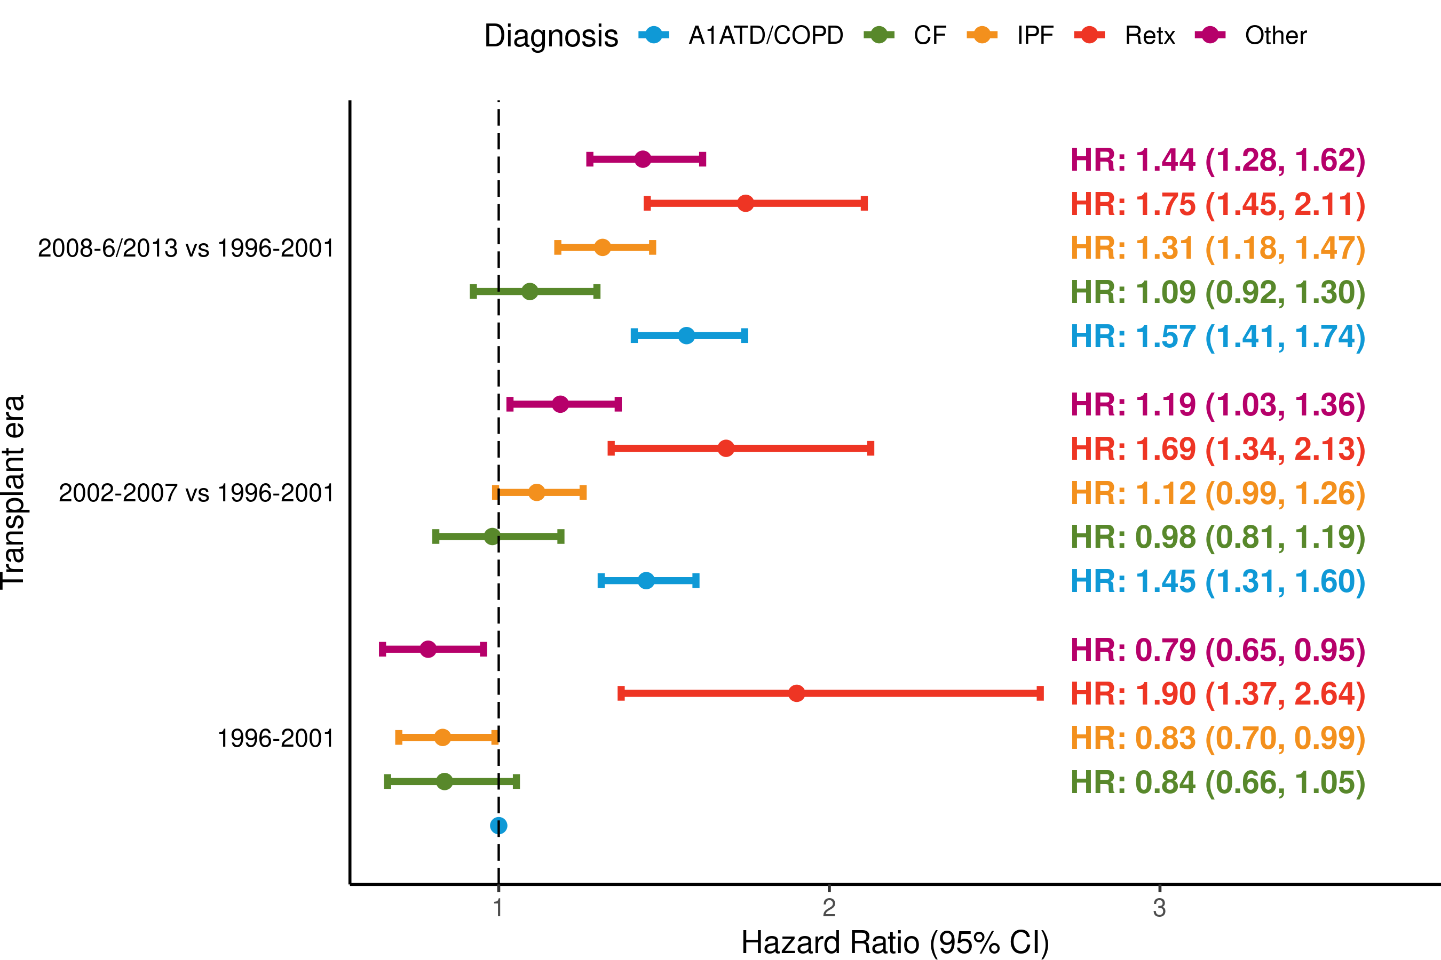
Adult Lung Transplants (1996-6/2013)
Risk Factors for BOS within 5 Years Conditional on Survival to Discharge with 95% Confidence Limits
Transplant era and diagnosis interaction
(N = 18,830)
2021
JHLT. 2021 Oct; 40(10): 1023-1072
p-value for era < 0.0001; p-value for diagnosis < 0.0001; p-value for interaction = 0.0401

Slide 71
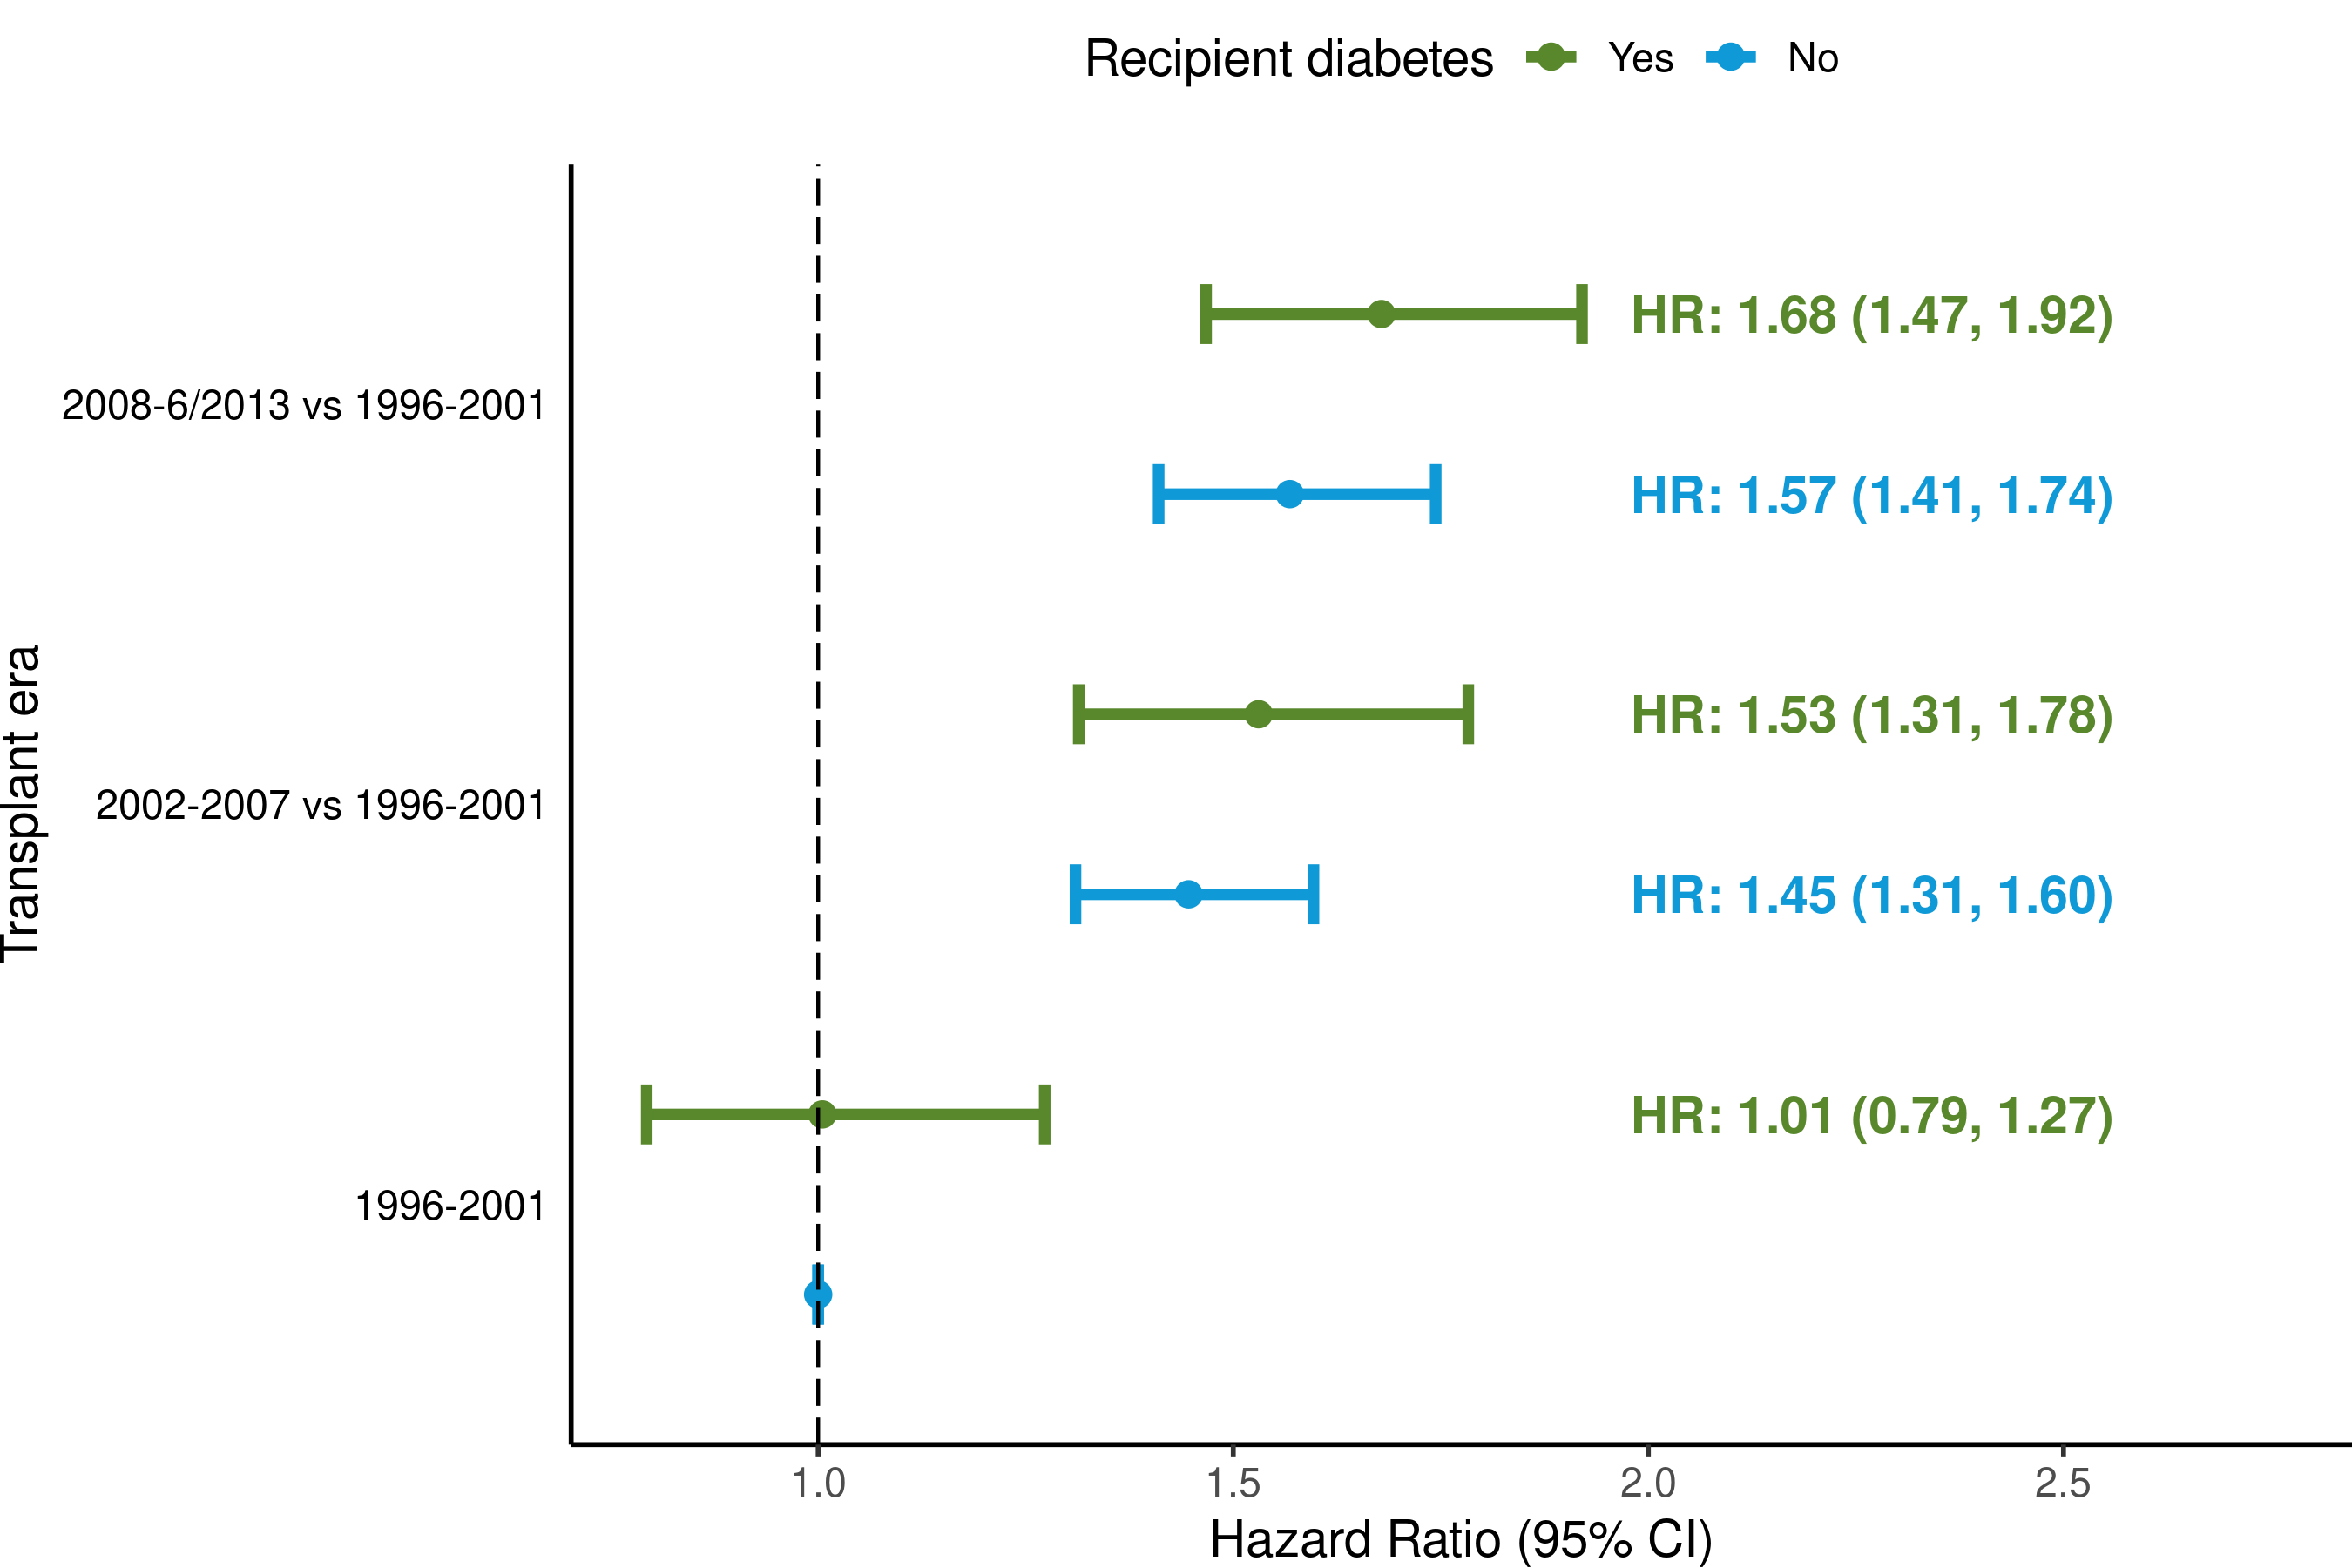
Adult Lung Transplants (1996-6/2013)
Risk Factors for BOS within 5 Years Conditional on Survival to Discharge with 95% Confidence Limits
Transplant era and recipient diabetes interaction
2021
(N = 18,830)
JHLT. 2021 Oct; 40(10): 1023-1072
p-value for era < 0.0001; p-value diabetes = 0.388; p-value for interaction = 0.8869

Slide 72
Adult Lung Transplants (1996-6/2013)
Statistically Significant Risk Factors for BOS within 5 Years Conditional on Survival to Discharge
Continuous Factors (see figures)
Recipient age (years) | Donor age (years)
Recipient BMI (kg/m²) | Ischemic time (hours)
PA mean (mm/Hg) | Center volume in previous 3 yrs
Recipient bilirubin (mg/dl)
2021
JHLT. 2021 Oct; 40(10): 1023-1072

Slide 73
Adult Lung Transplants (1996-6/2013)
Statistically Significant Risk Factors for BOS within 5 Years Conditional on Survival to Discharge with 95% Confidence Limits
Recipient age (years)
2021
(N = 18,830)
JHLT. 2021 Oct; 40(10): 1023-1072

Slide 74
Adult Lung Transplants (1996-6/2013)
Risk Factors for BOS within 5 Years Conditional on Survival to Discharge
Transplant era and recipient age interaction
2021
(N = 18,830)
JHLT. 2021 Oct; 40(10): 1023-1072
p-value for era < 0.0001; p-value age < 0.0001; p-value for interaction = 0.4661

Slide 75
Adult Lung Transplants (1996-6/2013)
Risk Factors for BOS within 5 Years Conditional on Survival to Discharge
Transplant era and recipient GFR* interaction
2021
(N = 18,830)
* GFR was estimated using the Cockcroft-Gault formula
JHLT. 2021 Oct; 40(10): 1023-1072
p-value for era < 0.0001; p-value GFR = 0.8297; p-value for interaction = 0.4776

Slide 76
Adult Lung Transplants (1996-6/2013)
Statistically Significant Risk Factors for BOS within Years Conditional on Survival to Discharge with 95% Confidence Limits
Recipient BMI (kg/m²)
2021
(N = 18,830)
JHLT. 2021 Oct; 40(10): 1023-1072

Slide 77
Adult Lung Transplants (1996-6/2013)
Statistically Significant Risk Factors for BOS within 5 Years Conditional on Survival to Discharge with 95% Confidence Limits
PA mean (mm/Hg)
2021
(N = 18,830)
JHLT. 2021 Oct; 40(10): 1023-1072

Slide 78
Adult Lung Transplants (1996-6/2013)
Statistically Significant Risk Factors for BOS within 5 Years Conditional on Survival to Discharge with 95% Confidence Limits
Recipient bilirubin (mg/dl)
2021
(N = 18,830)
JHLT. 2021 Oct; 40(10): 1023-1072

Slide 79
Adult Lung Transplants (1996-6/2013)
Statistically Significant Risk Factors for BOS within 5 Years Conditional on Survival to Discharge with 95% Confidence Limits
Donor age (years)
(N = 18,830)
2021
JHLT. 2021 Oct; 40(10): 1023-1072

Slide 80
Adult Lung Transplants (1996-6/2013)
Statistically Significant Risk Factors for BOS within 5 Years Conditional on Survival to Discharge with 95% Confidence Limits
Ischemic time (hours)
2021
(N = 18,830)
JHLT. 2021 Oct; 40(10): 1023-1072

Slide 81
Adult Lung Transplants (1996-6/2013)
Statistically Significant Risk Factors for BOS within 5 Years Conditional on Survival to Discharge with 95% Confidence Limits
Center volume in previous 3 yrs
2021
(N = 18,830)
JHLT. 2021 Oct; 40(10): 1023-1072

