Slide 1

FOCUS THEME:
TRENDS IN RECIPIENT CHARACTERISTICS AND IMPACT ON OUTCOMES
HEART TRANSPLANTATION
Adult Recipients
2021
JHLT. 2021 Oct; 40(10): 1023-1072

Slide 2
Table of Contents
Characteristics of Recipients of Deceased Donor Transplants by Transplant Year/Era: slides 3-13
Kaplan-Meier Survival Analyses: slide 14-40
  Survival within 12 months: slides 14-24
  Survival within 5 years conditional on survival to 1 year: slides 25-33
  Freedom from CAV conditional on survival to discharge: slides 34-40
Multivariable Cox Analyses: slides 41-82
  Mortality within 12 months: slides 41-58
  Mortality within 5 years conditional on survival to 1 year: slides 59-71
  CAV conditional on survival to discharge: slides 72-82
2021
JHLT. 2021 Oct; 40(10): 1023-1072

Slide 3
Recipient Characteristics by Transplant Era/Year
2021
JHLT. 2021 Oct; 40(10): 1023-1072

Slide 4
Adult Heart Transplants
Recipient Characteristics (Transplants: Jan 1992 – Jun 2018)
 | Jan 1992-Dec 2000 (N = 37,616) | Jan 2001-Dec 2009 (N = 33,588) | Jan 2010-Jun 2018 (N = 36,830) | P-value
Geographic location: |  |  |  | <0.0001
- Europe | 16,663 (44.3%) | 14,161 (42.2%) | 13,103 (35.6%)
- North America | 19,119 (50.8%) | 17,186 (51.2%) | 20,265 (55.0%)
- Other | 1,834 (4.9%) | 2,241 (6.7%) | 3,462 (9.4%)
Age (years) | 54 (28 - 65) | 54 (25 - 66) | 55 (25 - 68) | <0.0001
Male | 80.7% | 77.6% | 74.4% | <0.0001
Weight (kg) | 75.7 (53.5 - 101.6) | 78.0 (54.0 - 106.1) | 80.0 (54.4 - 108.9) | <0.0001
Height (cm) | 174.0 (157.0 - 188.0) | 174.0 (157.5 - 188.0) | 174.0 (157.5 - 188.0) | 0.0463
BMI (kg/m²) | 25.0 (19.1 - 32.4) | 25.7 (19.3 - 33.7) | 26.5 (19.6 - 34.6) | <0.0001
Blood type:
- A | 45.2% | 43.3% | 42% | <0.0001
- AB | 5.2% | 5.3% | 5.8%
- B | 12.2% | 13.1% | 14.1%
- O | 37.4% | 38.2% | 38.1%
2021
Continuous factors are expressed as median (5th – 95th percentiles)
Summary statistics included transplants with known/non-missing data
JHLT. 2021 Oct; 40(10): 1023-1072
Notes:
Comparisons for categorical variables were made using the chi-square statistic. Multiple groups were compared using single p-value.
Comparisons for continuous variables were made using Kruskal-Wallis test.
A significant p-value means that at least one of the groups is different than the others but it doesn’t identify which group it is.

Slide 5
Adult Heart Transplants
Recipient Characteristics
(Transplants: Jan 1992 – Jun 2018)
 | Jan 1992-Dec 2000 (N = 37,616) | Jan 2001-Dec 2009 (N = 33,588) | Jan 2010-Jun 2018 (N = 36,830) | P-value
PRA ≥ 20% | 5.2% | 10.0% | 17.9% | <0.0001
PRA ≥ 80% | 0.9% | 2.3% | 3.6% | <0.0001
CMV antibody positive | 67.7% | 64.0% | 59.6% | <0.0001
EBV antibody positive | 85.0% ¹ | 85.6% | 87.1% | 0.0001
Hep B antibody positive | 3.8% ² | 5.2% | 4.9% | <0.0001
Hep C antibody positive | 2.5% ² | 2.1% | 1.9% | 0.0006
Diabetes | 16.7% ² | 22.3% | 27.0% | <0.0001
History of malignancy | 3.8% ² | 5.8% | 8.7% | <0.0001
History of smoking | - | 48.9% ³ | 45.0% | <0.0001
Pre-transplant dialysis | 3.0% ² | 4.1% | 4.8% | <0.0001
Previous cardiac surgery | 37.8%² | 43.6% | 50.1% | <0.0001
2021
Summary statistics included transplants with known/non-missing data
¹ Based on Oct 1999 – Dec 2000 transplants
² Based on Apr 1994 – Dec 2000 transplants
JHLT. 2021 Oct; 40(10): 1023-1072
³ Based on Jul 2004 – Dec 2009 transplants
Notes:
Comparisons for categorical variables were made using the chi-square statistic. Multiple groups were compared using single p-value.
Comparisons for continuous variables were made using Kruskal-Wallis test.
A significant p-value means that at least one of the groups is different than the others but it doesn’t identify which group it is.

Slide 6
Adult Heart Transplants
Recipient Characteristics
(Transplants: Jan 1992 – Jun 2018)
 | Jan 1992-Dec 2000 (N = 37,616) | Jan 2001-Dec 2009 (N = 33,588) | Jan 2010-Jun 2018 (N = 36,830) | P-value
Bilirubin (mg/dl) | 0.8 (0.3 - 2.5) ¹ | 0.8 (0.3 - 3.1) | 0.7 (0.3 - 2.3) | <0.0001
Creatinine (mg/dl) | 1.2 (0.7 - 2.2) ¹ | 1.2 (0.7 - 2.2) | 1.2 (0.7 - 2.2) | <0.0001
GFR (mL/min/1.73 m²) * | 72.0 (36.6 - 130.5) ¹ | 75.6 (36.9 - 143.6) | 77.8 (37.7 - 149.1) | <0.0001
PCW mean (mmHg) | 20.0 (6.7 - 33.0) ¹ | 18.0 (6.0 - 32.0) | 17.0 (5.0 - 31.0) | <0.0001
PA mean (mmHg) | 31.0 (14.0 - 50.0) ¹ | 28.0 (14.0 - 47.0) | 26.0 (13.0 - 45.0) | <0.0001
PVR (Woods unit) | 2.2 (0.7 - 6.0) ¹ | 2.2 (0.6 - 5.6) | 2.1 (0.6 - 5.1) | <0.0001
* GFR was estimated using the Cockcroft-Gault formula
2021
Summary statistics included transplants with known/non-missing data
JHLT. 2021 Oct; 40(10): 1023-1072
¹ Based on Apr 1994 – Dec 2000 transplants
Notes:
Comparisons for categorical variables were made using the chi-square statistic. Multiple groups were compared using single p-value.
Comparisons for continuous variables were made using Kruskal-Wallis test.
A significant p-value means that at least one of the groups is different than the others but it doesn’t identify which group it is.

Slide 7
Adult Heart Transplants
Recipient Characteristics
(Transplants: Jan 1992 – Jun 2018)
 | Jan 1992-Dec 2000 (N = 37,616) | Jan 2001-Dec 2009 (N = 33,588) | Jan 2010-Jun 2018 (N = 36,830) | P-value
Inotrope use | 46.7% ¹ | 43.4% | 35.7% | <0.0001
IABP use | 6.0% | 6.2% | 6.6% | 0.0672
ECMO use | 0.2% ² | 0.7% | 1.1% | <0.0001
Type of MCS use
- None | - | 77.2% | 55.6% | <0.0001
- VAD | - | 18.9% | 40.4%
- TAH | - | 0.7% | 1.3%
- BIVAD | - | 3.3% | 2.7%
Ventilator use | 3.4% | 3.2% | 1.7% | <0.0001
Hospitalized | 60.7% | 47.6% | 44.6% | <0.0001
2021
Summary statistics included transplants with known/non-missing data
JHLT. 2021 Oct; 40(10): 1023-1072
¹ Based on Apr 1994 – Dec 2000 transplants
² Based on Apr 1995 – Dec 2000 transplants
Notes:
Comparisons for categorical variables were made using the chi-square statistic. Multiple groups were compared using single p-value.
Comparisons for continuous variables were made using Kruskal-Wallis test.
A significant p-value means that at least one of the groups is different than the others but it doesn’t identify which group it is.

Slide 8
Adult Heart Transplants
Recipient Blood Type Distribution by Location and Era
(Transplants: Jan 1992 – Jun 2018)
Blood Type:
Europe
North America
Other
2021
JHLT. 2021 Oct; 40(10): 1023-1072

Slide 9
Adult Heart Transplants
Recipient Diagnosis Distribution by Location and Era
(Transplants: Jan 1992 – Jun 2018)
Europe
North America
Other
2021
JHLT. 2021 Oct; 40(10): 1023-1072

Slide 10
Adult Heart Transplants
Donor-Recipient Sex Distribution by Location and Era
(Transplants: Jan 1992 – Jun 2018)
Europe
North America
Other
2021
JHLT. 2021 Oct; 40(10): 1023-1072

Slide 11
Adult Heart Transplants
Median Recipient Age by Location
Median Recipient BMI by Location
Median Recipient GFR by Location
(Transplants: Jan 1992 – Jun 2018)
(Transplants: Jan 1992 – Jun 2018)
(Transplants: Jan 1994 – Jun 2018)
2021
JHLT. 2021 Oct; 40(10): 1023-1072

Slide 12
Adult Heart Transplants
Recipients with Pre-tx Dialysis
Recipients with History of Malignancy
(Transplants: Jan 1994 – Jun 2018)
(Transplants: Jan 1994 – Jun 2018)
2021
JHLT. 2021 Oct; 40(10): 1023-1072

Slide 13
Adult Heart Transplants
Recipients with Diabetes
Recipients with History of Smoking*
(Transplants: Jan 1994 – Jun 2018)
(Transplants: Jan 2004 – Jun 2018)
*Cigarette use for more than 20 pack years
2021
JHLT. 2021 Oct; 40(10): 1023-1072

Slide 14
Survival Analyses
Kaplan-Meier Patient Survival within 12 Months
2021
JHLT. 2021 Oct; 40(10): 1023-1072

Slide 15
Adult Heart Transplants
Kaplan-Meier Survival within 12 Months by Era
(Transplants: Jan 2000 – Jun 2017)
All pairwise comparisons were significant at p < 0.05 except 2000-2005 vs. 2006-2011
2021
Note: Y-axis is truncated for clearer presentation
JHLT. 2021 Oct; 40(10): 1023-1072

Slide 16
Adult Heart Transplants
Kaplan-Meier Survival within 12 Months by Location and Era
(Transplants: Jan 2000 - Jun 2017)
Transplant Era:
North America
Other
2021
JHLT. 2021 Oct; 40(10): 1023-1072

Slide 17
Adult Heart Transplants
Kaplan-Meier Survival within 12 Months by Location and Recipient Age
(Transplants: Jan 2000 - Jun 2017)
Recipient Age:
North America
Other
2021
JHLT. 2021 Oct; 40(10): 1023-1072

Slide 18
Adult Heart Transplants
Kaplan-Meier Survival within 12 Months by Recipient Age and Era
(Transplants: Jan 2000 - Jun 2017)
Recipient Age: 40-59 years
Recipient Age: ≥ 60 years
2021
Note: Y-axis is truncated for clearer presentation
JHLT. 2021 Oct; 40(10): 1023-1072

Slide 19
Adult Heart Transplants
Kaplan-Meier Survival within 12 Months by Recipient PRA and Era
(Transplants: Jan 2000 - Jun 2017)
Transplant Era:
PRA 1-79%
PRA ≥80%
2021
Note: Y-axis is truncated for clearer presentation
JHLT. 2021 Oct; 40(10): 1023-1072

Slide 20
Adult Heart Transplants
Kaplan-Meier Survival within 12 Months by Recipient GFR* and Era
(Transplants: Jan 2000 - Jun 2017)
GFR 30-59 (mL/min/1.73 m²)
GFR ≥ 60 (mL/min/1.73 m²)
2021
Note: Y-axis is truncated for clearer presentation
JHLT. 2021 Oct; 40(10): 1023-1072
* GFR was estimated using the Cockcroft-Gault formula

Slide 21
Adult Heart Transplants
Kaplan-Meier Survival within 12 Months by Recipient MCS and Era
(Transplants: Jan 2000 - Jun 2017)
MCS Type: VAD
2021
Note: Y-axis is truncated for clearer presentation
JHLT. 2021 Oct; 40(10): 1023-1072

Slide 22
Adult Heart Transplants
Kaplan-Meier Survival within 12 Months by Recipient MCS and Era
(Transplants: Jan 2000 - Jun 2017)
MCS Type: BIVAD
2021
Note: Y-axis is truncated for clearer presentation
JHLT. 2021 Oct; 40(10): 1023-1072

Slide 23
Adult Heart Transplants
Kaplan-Meier Survival within 12 Months by Recipient Diabetes and Era
(Transplants: Jan 1994 - Jun 2017)
Transplant Era:
Recipient with No Diabetes
2021
Note: Y-axis is truncated for clearer presentation
JHLT. 2021 Oct; 40(10): 1023-1072

Slide 24
Adult Heart Transplants
Kaplan-Meier Survival within 12 Months
By Recipient Pre-transplant Dialysis
By Recipient History of Malignancy
(Transplants: Jan 1994 - Jun 2017)
(Transplants: Jan 1994 - Jun 2017)
p < 0.0001
p = 0.8909
2021
JHLT. 2021 Oct; 40(10): 1023-1072

Slide 25
Survival Analyses
Kaplan-Meier Patient Survival within 5 Years Conditional on Survival to 1 Year
2021
JHLT. 2021 Oct; 40(10): 1023-1072

Slide 26
Adult Heart Transplants
Kaplan-Meier Survival within 5 Years Conditional on Survival to 1 Year
By Era (Transplants: Jan 1996 - Jun 2013)
All pairwise comparisons were significant at p < 0.05 except 1996-2001 vs. 2002-2007
2021
Note: Y-axis is truncated for clearer presentation
JHLT. 2021 Oct; 40(10): 1023-1072

Slide 27
Adult Heart Transplants
Kaplan-Meier Survival within 5 Years Conditional on Survival to 1 Year
by Location and Era (Transplants: Jan 1996 - Jun 2013)
Transplant Era:
Europe
North America
2021
Note: Y-axis is truncated for clearer presentation
JHLT. 2021 Oct; 40(10): 1023-1072

Slide 28
Adult Heart Transplants
Kaplan-Meier Survival within 5 Years Conditional on Survival to 1 Year
by Location and Recipient Age (Transplants: Jan 1996 - Jun 2013)
Recipient Age:
All pairwise comparisons were significant at p < 0.05
No pairwise comparisons were significant at p < 0.05
Europe
North America
2021
Note: Y-axis is truncated for clearer presentation
JHLT. 2021 Oct; 40(10): 1023-1072

Slide 29
Adult Heart Transplants
Kaplan-Meier Survival within 5 Years Conditional on Survival to 1 Year
by Recipient Age and Era (Transplants: Jan 1996 - Jun 2013)
All pairwise comparisons were significant at p < 0.05 except 1996-2001 vs. 2002-2007
All pairwise comparisons were significant at p < 0.05 except 2002-2007 vs. 2008-2013
Recipient 18-39 years
Recipient 40-59 years
2021
Note: Y-axis is truncated for clearer presentation
JHLT. 2021 Oct; 40(10): 1023-1072

Slide 30
Adult Heart Transplants
Kaplan-Meier Survival within 5 Years Conditional on Survival to 1 Year
by Recipient PRA and Era (Transplants: Jan 1996 - Jun 2013)
No pairwise comparisons were significant at p < 0.05
No pairwise comparisons were significant at p < 0.05
PRA 0%
PRA 1-79%
2021
Note: Y-axis is truncated for clearer presentation
JHLT. 2021 Oct; 40(10): 1023-1072

Slide 31
Adult Heart Transplants
Kaplan-Meier Survival within 5 Years Conditional on Survival to 1 Year
by Recipient GFR* and Era (Transplants: Jan 1996 - Jun 2013)
No pairwise comparisons were significant at p < 0.05 except 1996-2001 vs. 2008-2013
No pairwise comparisons were significant at p < 0.05 except 1996-2001 vs. 2008-2013
GFR <30 (mL/min/1.73 m²)
GFR 30-59 (mL/min/1.73 m²)
2021
Note: Y-axis is truncated for clearer presentation
JHLT. 2021 Oct; 40(10): 1023-1072
* GFR was estimated using the Cockcroft-Gault formula

Slide 32
Adult Heart Transplants
Kaplan-Meier Survival within 5 Years Conditional on Survival to 1 Year
by Recipient Diabetes and Era (Transplants: Jan 1996 - Jun 2013)
Pairwise comparisons were significant at p <0.05 except 1996-2001 vs. 2002-2007
Recipient with Diabetes
Recipient with No Diabetes
2021
Note: Y-axis is truncated for clearer presentation
JHLT. 2021 Oct; 40(10): 1023-1072

Slide 33
Adult Heart Transplants
Kaplan-Meier Survival within 5 Years Conditional on Survival to 1 Year
By Recipient Pre-tx Dialysis
By Recipient History of Malignancy
(Transplants: Jan 1996 - Jun 2013)
(Transplants: Jan 1996 - Jun 2013)
p < 0.0001
p = 0.6979
2021
JHLT. 2021 Oct; 40(10): 1023-1072

Slide 34
Survival Analyses
Kaplan-Meier Freedom from CAV within 5 Years Conditional on Survival to Discharge
2021
JHLT. 2021 Oct; 40(10): 1023-1072

Slide 35
Adult Heart Transplants
Freedom from CAV Conditional on Survival to Discharge
By Era (Transplants: Jan 1996 - Jun 2013)
No pairwise comparisons were significant at p < 0.05 except 1996-2001 vs. 2002-2007
2021
Note: Y-axis is truncated for clearer presentation
JHLT. 2021 Oct; 40(10): 1023-1072

Slide 36
Adult Heart Transplants
Freedom from CAV Conditional on Survival to Discharge
By Recipient Age and Era (Transplants: Jan 1996 - Jun 2013)
Transplant Era:
Recipient 18-39 years
Recipient 40-59 years
2021
Note: Y-axis is truncated for clearer presentation
JHLT. 2021 Oct; 40(10): 1023-1072

Slide 37
Adult Heart Transplants
Freedom from CAV Conditional on Survival to Discharge
By PRA and Era (Transplants: Jan 1996 - Jun 2013)
Transplant Era:
PRA 0%
PRA 1-79%
2021
Note: Y-axis is truncated for clearer presentation
JHLT. 2021 Oct; 40(10): 1023-1072

Slide 38
Adult Heart Transplants
Freedom from CAV within 5 Years Conditional on Survival to Discharge
by Recipient Diabetes and Era (Transplants: Jan 1996 - Jun 2013)
No pairwise comparison was significant at p <0.05
Recipient with Diabetes
Recipient with No Diabetes
2021
JHLT. 2021 Oct; 40(10): 1023-1072

Slide 39
Adult Heart Transplants
Freedom from CAV within 5 Years Conditional on Survival to Discharge
by Recipient GFR* and Era (Transplants: Jan 1996 - Jun 2013)
No pairwise comparisons were significant at p < 0.05
No pairwise comparisons were significant at p < 0.05
GFR <30 (mL/min/1.73 m²)
GFR 30-59 (mL/min/1.73 m²)
2021
Note: Y-axis is truncated for clearer presentation
JHLT. 2021 Oct; 40(10): 1023-1072
* GFR was estimated using the Cockcroft-Gault formula

Slide 40
Adult Heart Transplants
Freedom from CAV Conditional on Survival to Discharge
By Diagnosis (Transplants: Jan 1996 - Jun 2013)
No pairwise comparisons were significant at p < 0.05 except NICM vs. ICM
2021
Note: Y-axis is truncated for clearer presentation
JHLT. 2021 Oct; 40(10): 1023-1072

Slide 41
Multivariable Cox Regression
Mortality within 12 Month
2021
JHLT. 2021 Oct; 40(10): 1023-1072

Slide 42
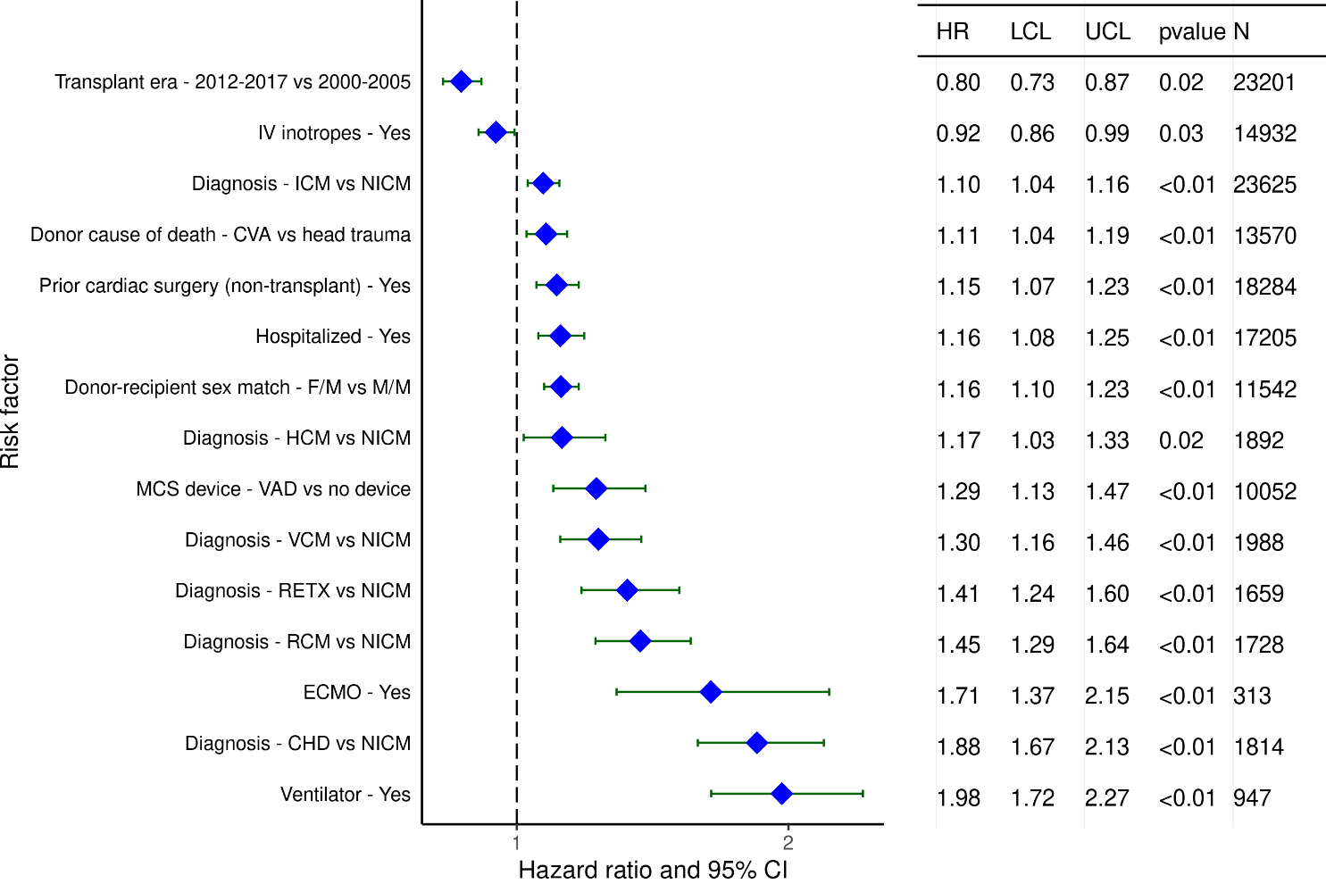
Adult Heart Transplants (2000-6/2017)
Statistically Significant Risk Factors For 1-Year Mortality with 95% Confidence Limits
2021
(N = 67,223)
JHLT. 2021 Oct; 40(10): 1023-1072

Slide 43
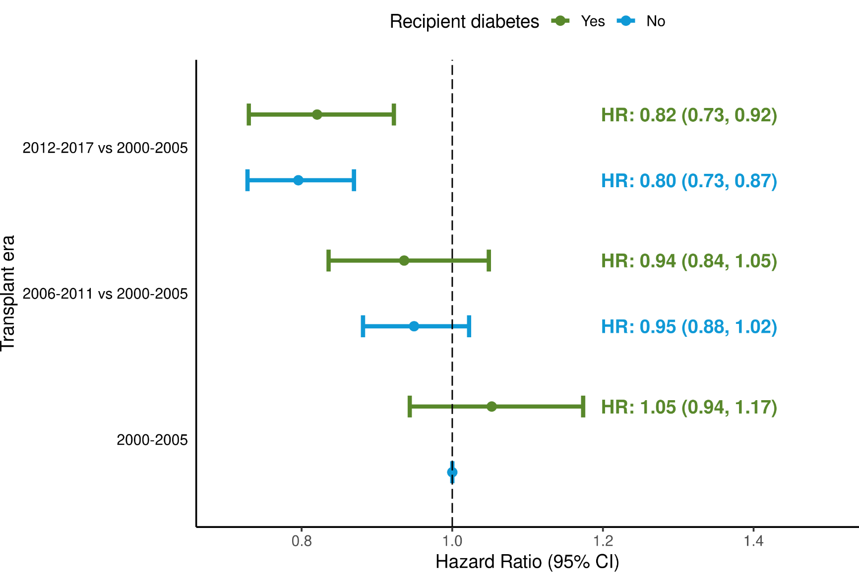
Adult Heart Transplants (2000-6/2017)
Risk Factors For 1-Year Mortality with 95% Confidence Limits
Transplant era and recipient diabetes interaction
2021
(N = 67,223)
JHLT. 2021 Oct; 40(10): 1023-1072
p-value for era < 0.0001; p-value for diabetes = 0.7446; p-value for interaction = 0.6688

Slide 44
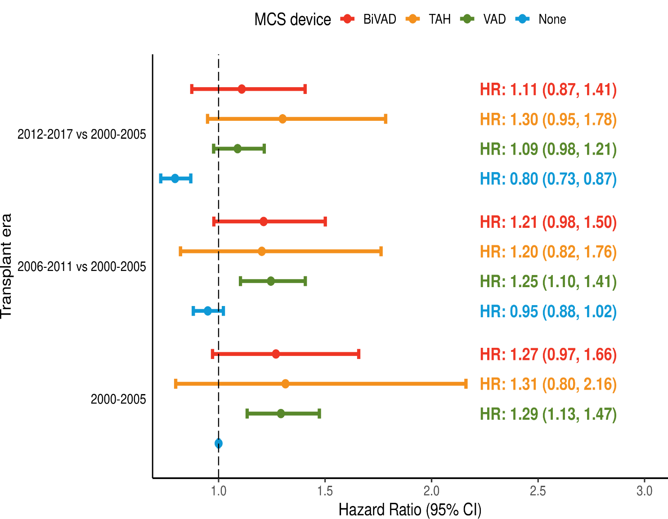
Adult Heart Transplants (2000-6/2017)
Risk Factors For 1-Year Mortality with 95% Confidence Limits
Transplant era and MCS device type interaction
2021
(N = 67,223)
JHLT. 2021 Oct; 40(10): 1023-1072
p-value for era < 0.0001; p-value for MCS < 0.0001; p-value for interaction = 0.9292

Slide 45
Adult Heart Transplants (2000-6/2017)
Statistically Significant Risk Factors For 1-Year Mortality
Continuous Factors (see figures)
Recipient age (years) | PRA (%)
Recipient GFR* (mL/min/1.73 m²) | PA mean (mm/Hg)
PVR (woods unit) | Donor age (years)
Recipient BMI (kg/m²) | Ischemic time (hours)
Recipient bilirubin (mg/dl) | Center volume in previous 3 yrs
* GFR was estimated using the Cockcroft-Gault formula
2021
JHLT. 2021 Oct; 40(10): 1023-1072

Slide 46
Adult Heart Transplants (2000-6/2017)
Statistically Significant Risk Factors For 1-Year Mortality with 95% Confidence Limits
Recipient age (years)
2021
(N = 67,223)
JHLT. 2021 Oct; 40(10): 1023-1072

Slide 47
Adult Heart Transplants (2000-6/2017)
Risk Factors For 1-Year Mortality
Transplant era and recipient age interaction
2021
(N = 67,223)
JHLT. 2021 Oct; 40(10): 1023-1072
p-value for era < 0.0001; p-value for age < 0.0001; p-value for interaction = 0.4965

Slide 48
Adult Heart Transplants (2000-6/2017)
Statistically Significant Risk Factors For 1-Year Mortality with 95% Confidence Limits
Recipient GFR* (mL/min/1.73 m²)
2021
(N = 67,223)
JHLT. 2021 Oct; 40(10): 1023-1072
*Estimated using the Cockcroft-Gault formula

Slide 49
Adult Heart Transplants (2000-6/2017)
Risk Factors For 1-Year Mortality
Transplant era and recipient GFR* interaction
(N = 67,223)
2021
*Estimated using the Cockcroft-Gault formula
JHLT. 2021 Oct; 40(10): 1023-1072
p-value for era < 0.0001; p-value for GFR < 0.0001; p-value for interaction = 0.5082

Slide 50
Adult Heart Transplants (2000-6/2017)
Statistically Significant Risk Factors For 1-Year Mortality with 95% Confidence Limits
Recipient BMI (kg/m²)
2021
(N = 67,223)
JHLT. 2021 Oct; 40(10): 1023-1072

Slide 51
Adult Heart Transplants (2000-6/2017)
Statistically Significant Risk Factors For 1-Year Mortality with 95% Confidence Limits
PVR (woods unit)
2021
(N = 67,223)
JHLT. 2021 Oct; 40(10): 1023-1072

Slide 52
Adult Heart Transplants (2000-6/2017)
Statistically Significant Risk Factors For 1-Year Mortality with 95% Confidence Limits
PA mean (mm/Hg)
2021
(N = 67,223)
JHLT. 2021 Oct; 40(10): 1023-1072

Slide 53
Adult Heart Transplants (2000-6/2017)
Statistically Significant Risk Factors For 1-Year Mortality with 95% Confidence Limits
Recipient bilirubin (mg/dl)
p < 0.0001
2021
(N = 67,223)
JHLT. 2021 Oct; 40(10): 1023-1072

Slide 54
Adult Heart Transplants (2000-6/2017)
Statistically Significant Risk Factors For 1 Year Mortality with 95% Confidence Limits
PRA (%)
2021
(N = 67,223)
JHLT. 2021 Oct; 40(10): 1023-1072

Slide 55
Adult Heart Transplants (2000-6/2017)
Risk Factors For 1-Year Mortality
Transplant era and PRA interaction
2021
(N = 67,223)
JHLT. 2021 Oct; 40(10): 1023-1072
p-value for era < 0.0001; p-value for PRA = 0.0231; p-value for interaction = 0.2093

Slide 56
Adult Heart Transplants (2000-6/2017)
Statistically Significant Risk Factors For 1-Year Mortality with 95% Confidence Limits
Donor age (years)
2021
(N = 67,223)
JHLT. 2021 Oct; 40(10): 1023-1072

Slide 57
Adult Heart Transplants (2000-6/2017)
Statistically Significant Risk Factors For 1 Year Mortality with 95% Confidence Limits
Ischemic time (hours)
p < 0.0001
2021
(N = 67,223)
JHLT. 2021 Oct; 40(10): 1023-1072

Slide 58
Adult Heart Transplants (2000-6/2017)
Statistically Significant Risk Factors For 1 Year Mortality with 95% Confidence Limits
Center volume in previous 3 yrs
p < 0.0001
2021
(N = 67,223)
JHLT. 2021 Oct; 40(10): 1023-1072

Slide 59
Multivariable Cox Analyses
Mortality within 5 Years Conditional on Survival to 1 Year
2021
JHLT. 2021 Oct; 40(10): 1023-1072

Slide 60
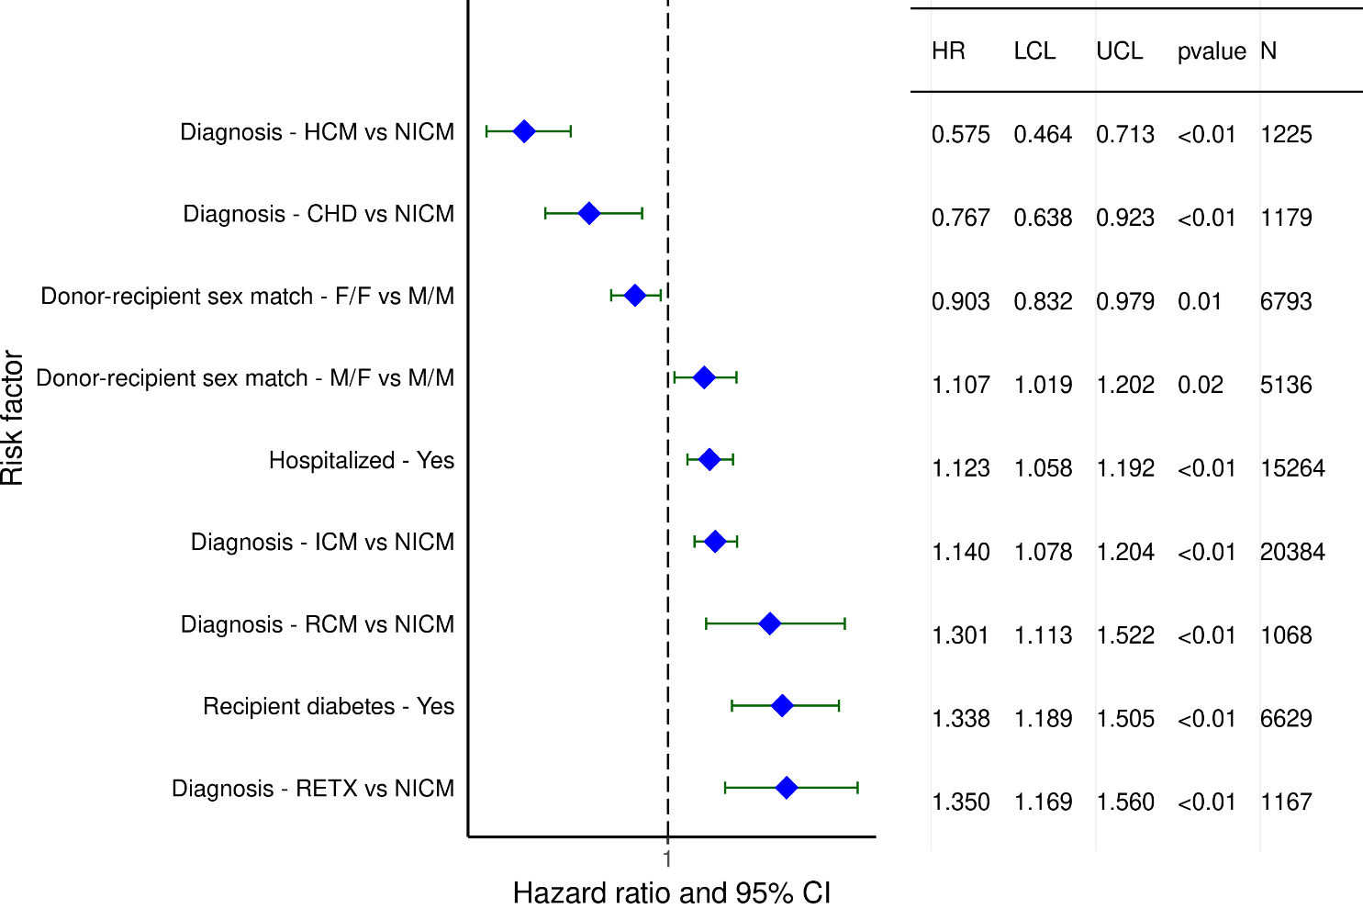
Adult Heart Transplants (1996-6/2013)
Statistically Significant Risk Factors For 5-Year Mortality Conditional on Survival to 1 Year with 95% Confidence Limits
(N = 53,105)
2021
JHLT. 2021 Oct; 40(10): 1023-1072

Slide 61
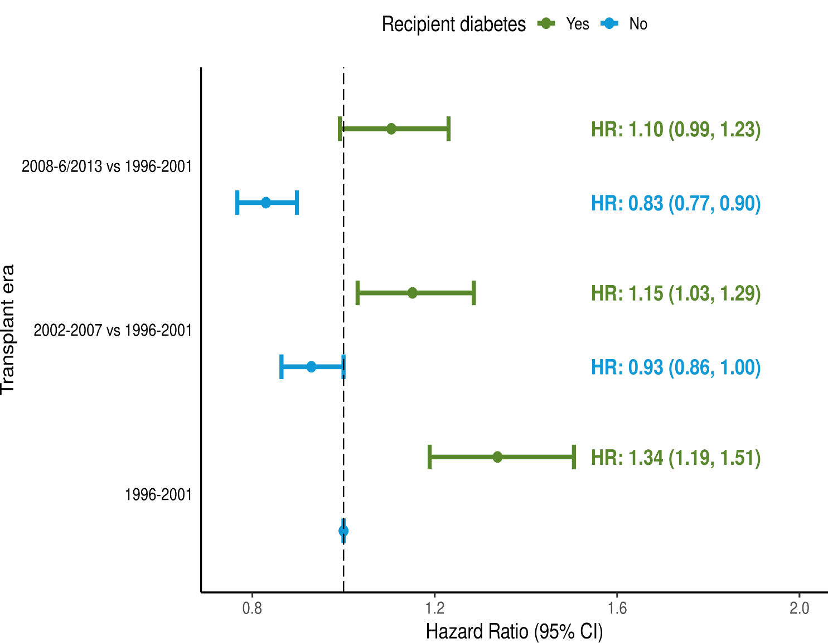
Adult Heart Transplants (1996-6/2013)
Risk Factors For 5-Year Mortality Conditional on Survival to 1 Year with 95% Confidence Limits
Transplant era and recipient diabetes interaction
(N = 53,105)
2021
JHLT. 2021 Oct; 40(10): 1023-1072
p-value for era < 0.0001; p-value for diabetes < 0.0001; p-value for interaction = 0.5679

Slide 62
Adult Heart Transplants (1996-6/2013)
Statistically Significant Risk Factors For 5-Year Mortality Conditional on Survival to 1 Year
Continuous Factors (see figures)
Recipient age (years) | Recipient GFR* (mL/min/1.73 m²)
Recipient BMI (kg/m2) | Donor age (years)
PVR (woods unit) | Center volume in previous 3 yrs
* GFR was estimated using the Cockcroft-Gault formula
2021
JHLT. 2021 Oct; 40(10): 1023-1072

Slide 63
Adult Heart Transplants (1996-6/2013)
Statistically Significant Risk Factors For 5-Year Mortality Conditional on Survival to 1 Year with 95% Confidence Limits
Recipient age (years)
2021
(N = 53,105)
JHLT. 2021 Oct; 40(10): 1023-1072

Slide 64
Adult Heart Transplants (1996-6/2013)
Risk Factors For 5-Year Mortality Conditional on Survival to 1 Year
Transplant era and recipient age interaction
(N = 53,105)
2021
JHLT. 2021 Oct; 40(10): 1023-1072
p-value for era < 0.0001; p-value for age < 0.0001; p-value for interaction = 0.2601

Slide 65
Adult Heart Transplants (1996-6/2013)
Statistically Significant Risk Factors For 5-Year Mortality Conditional on Survival to 1 Year with 95% Confidence Limits
Recipient BMI (kg/m²)
2021
(N = 53,105)
JHLT. 2021 Oct; 40(10): 1023-1072

Slide 66
Adult Heart Transplants (1996-6/2013)
Statistically Significant Risk Factors For 5-Year Mortality Conditional on Survival to 1 Year with 95% Confidence Limits
PVR (woods unit)
2021
(N = 53,105)
JHLT. 2021 Oct; 40(10): 1023-1072

Slide 67
Adult Heart Transplants (1996-6/2013)
Statistically Significant Risk Factors For 5-Year Mortality Conditional on Survival to 1 Year with 95% Confidence Limits
Recipient GFR* (mL/min/1.73 m²)
(N = 53,105)
2021
JHLT. 2021 Oct; 40(10): 1023-1072
*Estimated using the Cockcroft-Gault formula

Slide 68
Adult Heart Transplants (1996-6/2013)
Risk Factors For 5-Year Mortality Conditional on Survival to 1 Year
Transplant era and recipient GFR* interaction
2021
(N = 53,105)
*Estimated using the Cockcroft-Gault formula
JHLT. 2021 Oct; 40(10): 1023-1072
p-value for era < 0.0001; p-value for GFR < 0.0001; p-value for interaction = 0.6226

Slide 69
Adult Heart Transplants (1996-6/2013)
Risk Factors For 5-Year Mortality Conditional on Survival to 1 Year
Transplant era and PRA interaction
(N = 53,105)
2021
JHLT. 2021 Oct; 40(10): 1023-1072
p-value for era < 0.0001; p-value for PRA = 0.9895; p-value for interaction = 0.97

Slide 70
Adult Heart Transplants (1996-6/2013)
Statistically Significant Risk Factors For 5-Year Mortality Conditional on Survival to 1 Year with 95% Confidence Limits
Donor age (years)
2021
(N = 53,105)
JHLT. 2021 Oct; 40(10): 1023-1072

Slide 71
Adult Heart Transplants (1996-6/2013)
Statistically Significant Risk Factors For 5-Year Mortality Conditional on Survival to 1 Year with 95% Confidence Limits
Center volume in previous 3 yrs
2021
(N = 53,105)
JHLT. 2021 Oct; 40(10): 1023-1072

Slide 72
Multivariable Analyses
CAV within 5 Years Conditional on Survival to Discharge
2021
JHLT. 2021 Oct; 40(10): 1023-1072

Slide 73
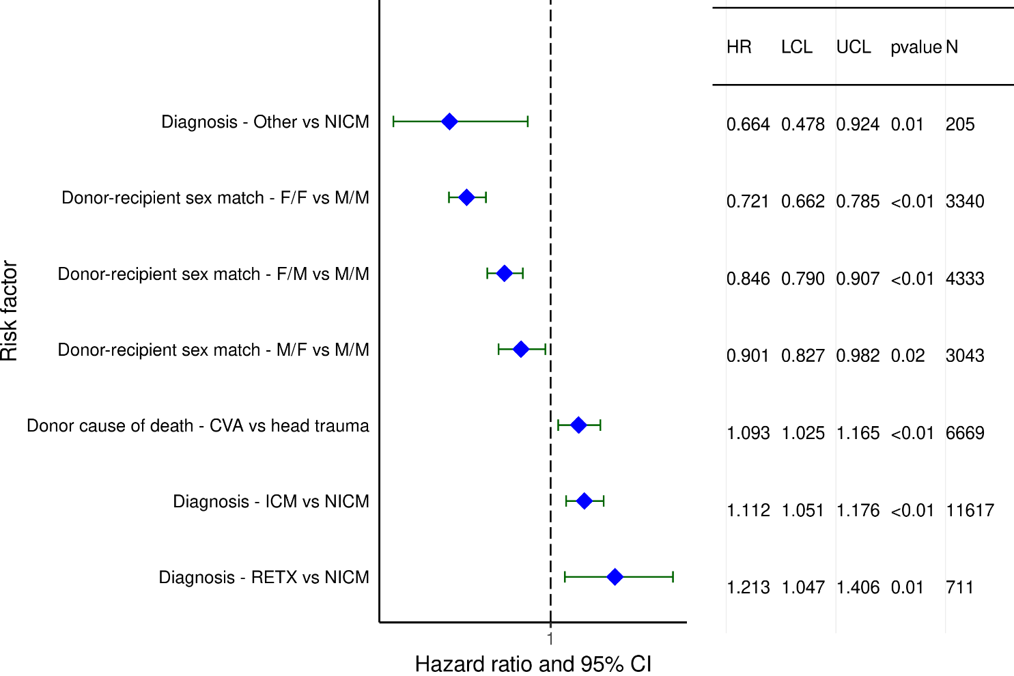
Adult Heart Transplants (1996-6/2013)
Statistically Significant Risk Factors for Development of CAV within 5 Years Conditional on Survival to Transplant Discharge with 95% Confidence Limits
2021
(N = 26,554)
JHLT. 2021 Oct; 40(10): 1023-1072

Slide 74
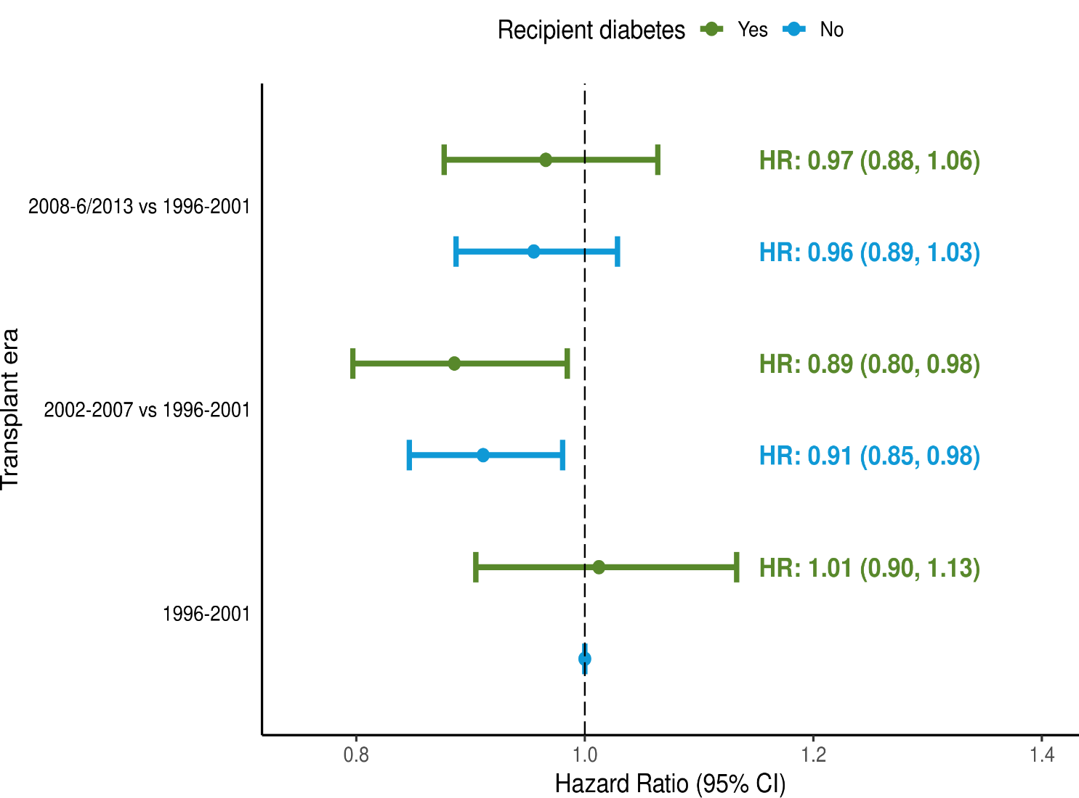
Adult Heart Transplants (1996-6/2013)
Risk Factors for Development of CAV within 5 Years
Conditional on Survival to Transplant Discharge with 95% Confidence Limits
Transplant era and recipient diabetes interaction
2021
(N = 26,554)
JHLT. 2021 Oct; 40(10): 1023-1072
p-value for era = 0.2171; p-value for diabetes = 0.9465; p-value for interaction = 0.8318

Slide 75
Adult Heart Transplants (1996-6/2013)
Statistically Significant Risk Factors for Development of CAV within 5 Years
Conditional on Survival to Transplant Discharge
Continuous Factors (see figures)
Recipient age (years) | Donor age (years)
Recipient BMI (kg/m²) | Center volume in previous 3 yrs
2021
JHLT. 2021 Oct; 40(10): 1023-1072

Slide 76
Adult Heart Transplants (1996-6/2013)
Statistically Significant Risk Factors for Development of CAV within 5 Years Conditional on Survival to Transplant Discharge with 95% Confidence Limits
Recipient age (years)
2021
(N = 26,554)
JHLT. 2021 Oct; 40(10): 1023-1072

Slide 77
Adult Heart Transplants (1996-6/2013)
Risk Factors for Development of CAV within 5 Years
Conditional on Survival to Transplant Discharge with 95% Confidence Limits
Transplant era and recipient age interaction
2021
(N = 26,554)
JHLT. 2021 Oct; 40(10): 1023-1072
p-value for era = 0.2171; p-value for age = 0.0008; p-value for interaction = 0.8078

Slide 78
Adult Heart Transplants (1996-6/2013)
Statistically Significant Risk Factors for Development of CAV within 5 Years Conditional on Survival to Transplant Discharge with 95% Confidence Limits
Recipient BMI (kg/m2)
2021
(N = 26,554)
JHLT. 2021 Oct; 40(10): 1023-1072

Slide 79
Adult Heart Transplants (1996-6/2013)
Risk Factors for Development of CAV within 5 Years
Conditional on Survival to Transplant Discharge with 95% Confidence Limits
Transplant era and recipient GFR* interaction
2021
(N = 26,554)
*Estimated using the Cockcroft-Gault formula
JHLT. 2021 Oct; 40(10): 1023-1072
p-value for era = 0.2171; p-value for GFR = 0.5958; p-value for interaction = 0.9298

Slide 80
Adult Heart Transplants (1996-6/2013)
Risk Factors for Development of CAV within 5 Years
Conditional on Survival to Transplant Discharge with 95% Confidence Limits
Transplant era and PRA interaction
2021
(N = 26,554)
JHLT. 2021 Oct; 40(10): 1023-1072
p-value for era = 0.2171; p-value for PRA = 0.6741; p-value for interaction = 0.5672

Slide 81
Adult Heart Transplants (1996-6/2013)
Statistically Significant Risk Factors for Development of CAV within 5 Years Conditional on Survival to Transplant Discharge with 95% Confidence Limits
Donor age (years)
2021
(N = 26,554)
JHLT. 2021 Oct; 40(10): 1023-1072

Slide 82
Adult Heart Transplants (1996-6/2013)
Statistically Significant Risk Factors for Development of CAV within 5 Years Conditional on Survival to Transplant Discharge with 95% Confidence Limits
Center volume in previous 3 yrs
2021
(N = 26,554)
JHLT. 2021 Oct; 40(10): 1023-1072

