Slide 1

HEART TRANSPLANTATION
Pediatric Recipients
2019
JHLT. 2019 Oct; 38(10): 1015-1066

Slide 2
Table of Contents
Donor, recipient and center characteristics: slides 3-29
Post-transplant – survival and other outcomes: slides 30-53
Induction and maintenance immunosuppression: slides 54-64
Rejection and post-transplant morbidities: slides 65-99
Retransplantation: slides 100-106
Multivariable analyses: slides 107-131
Focus theme: slides 132-227
  Donor-recipient size match (version 1): slides 132-179
    Select characteristics: slides 133-143
    Post-transplant outcomes: slides 144-165
    Multivariable analyses: slides 166-179
  Donor and recipient size match (version 2): slides 180-227
    Select characteristics: slides 181-191
    Post-transplant outcomes: slides 192-213
    Multivariable analyses: slides 214-227
2019
JHLT. 2019 Oct; 38(10): 1015-1066

Slide 3
Donor, Recipient and Center Characteristics
2019
JHLT. 2019 Oct; 38(10): 1015-1066

Slide 4
Pediatric Heart Transplants
Number of Centers Reporting Transplants
2019
JHLT. 2019 Oct; 38(10): 1015-1066

Slide 5
(Transplants: January 2005 – June 2018)
Pediatric Heart Transplants
Number of Centers by Center Volume
2019
JHLT. 2019 Oct; 38(10): 1015-1066

Slide 6
Pediatric Heart Transplants
Distribution of Transplants by Center Volume
(Transplants: January 2005 – June 2018)
2019
JHLT. 2019 Oct; 38(10): 1015-1066

Slide 7
Pediatric Heart Transplants
Recipient Age Distribution by Center Volume
(Transplants: January 2005 – June 2018)
Recipient Age (Years):
2019
JHLT. 2019 Oct; 38(10): 1015-1066

Slide 8
Pediatric Heart Transplants
Distribution of Transplants by Location and Average Center
Volume
(Transplants: January 2005 – June 2018)
2019
JHLT. 2019 Oct; 38(10): 1015-1066

Slide 9
Pediatric Heart Transplants
Recipient Age Distribution
(Transplants: January 2005 – June 2018)
2019
JHLT. 2019 Oct; 38(10): 1015-1066

Slide 10
Pediatric Heart Transplants
Recipient Age (in Years) Distribution by Year of Transplant
NOTE: This figure includes only the heart transplants that are reported to the ISHLT Transplant Registry. As such, this should not be construed as evidence that the number of hearts transplanted worldwide has increased and/or decreased in recent years.
2019
JHLT. 2019 Oct; 38(10): 1015-1066

Slide 11
Pediatric Heart Transplants
Recipient Age Distribution by Location
(Transplants: January 2005 – June 2018)
Recipient Age (Years):
2019
JHLT. 2019 Oct; 38(10): 1015-1066

Slide 12
Pediatric Heart Transplants
Donor Age Distribution
(Transplants: January 2005 – June 2018)
2019
JHLT. 2019 Oct; 38(10): 1015-1066
Notes:
NOTE: Transplants where donor age is unknown are excluded from this tabulation.

Slide 13
Pediatric Heart Transplants
Donor and Recipient Age
(Transplants: January 2005 – June 2018)
2019
JHLT. 2019 Oct; 38(10): 1015-1066

Slide 14
Pediatric Heart Transplants
Donor Age Distribution by Location
(Transplants: January 2005 – June 2018)
Donor Age (Years):
2019
JHLT. 2019 Oct; 38(10): 1015-1066
Notes:
NOTE: Transplants where donor age is unknown are excluded from this tabulation.

Slide 15
Pediatric Heart Transplants
Distribution of Transplants by Donor/Recipient Weight Ratio
(Transplants: January 2005 – June 2018)
2019
JHLT. 2019 Oct; 38(10): 1015-1066

Slide 16
Pediatric Heart Transplants
Recipient Diagnosis (Age: < 1 Year)
2010-6/2018
2019
JHLT. 2019 Oct; 38(10): 1015-1066
Notes:
NOTE: Transplants with unknown diagnoses are excluded from this tabulation

Slide 17
Pediatric Heart Transplants
Recipient Diagnosis (Age: 1-5 Years)
2010-6/2018
2019
JHLT. 2019 Oct; 38(10): 1015-1066
Notes:
NOTE: Transplants with unknown diagnoses are excluded from this tabulation

Slide 18
Pediatric Heart Transplants
Recipient Diagnosis (Age: 6-10 Years)
2010-6/2018
2019
JHLT. 2019 Oct; 38(10): 1015-1066
Notes:
NOTE: Transplants with unknown diagnoses are excluded from this tabulation

Slide 19
Pediatric Heart Transplants
Recipient Diagnosis (Age: 11-17 Years)
2010-6/2018
2019
JHLT. 2019 Oct; 38(10): 1015-1066
Notes:
NOTE: Transplants with unknown diagnoses are excluded from this tabulation

Slide 20
Pediatric Heart Transplants
Diagnosis Distribution by Location
(Transplants: January 2005 – June 2018)
2019
JHLT. 2019 Oct; 38(10): 1015-1066
Notes:
NOTE: Transplants with unknown diagnoses are excluded from this tabulation.

Slide 21
Pediatric Heart Transplants
% of Patients Bridged with Mechanical Circulatory Support*
by Year
(Transplants: January 2005 – December 2017)
2019
* LVAD, RVAD, TAH, ECMO
JHLT. 2019 Oct; 38(10): 1015-1066

Slide 22
Pediatric Heart Transplants
% of Patients Bridged with Mechanical Circulatory Support*
(Transplants: January 2010 – June 2018)
2019
* LVAD, RVAD, TAH, ECMO
JHLT. 2019 Oct; 38(10): 1015-1066

Slide 23
Pediatric Heart Transplants
% of Patients Bridged with Mechanical Circulatory Support*
by Diagnosis
(Transplants: January 2010 – June 2018)
2019
* LVAD, RVAD, TAH, ECMO
JHLT. 2019 Oct; 38(10): 1015-1066

Slide 24
Pediatric Heart Transplants
% of Patients Bridged with Mechanical Circulatory Support*
by Age Group
(Transplants: January 2010 – June 2018)
2019
* LVAD, RVAD, TAH, ECMO
JHLT. 2019 Oct; 38(10): 1015-1066

Slide 25
Pediatric Heart Transplants
% of Patients Bridged with Mechanical Circulatory Support*
by Age Group and Diagnosis
(Transplants: January 2010 – June 2018)
<1 year
1-5 years
6-10 years
11-17 years
2019
* LVAD, RVAD, TAH, ECMO
JHLT. 2019 Oct; 38(10): 1015-1066

Slide 26
Pediatric Heart Transplants
PRA Distribution by Year
(Transplants: January 2005 – December 2017)
2019
CPRA and PRA values were combined. If Class I and Class II PRA values were reported separately, the higher of the two values was used.
JHLT. 2019 Oct; 38(10): 1015-1066

Slide 27
Pediatric Heart Transplants
PRA Distribution by Age Group
(Transplants: January 2010 – June 2018)
p<0.0001
2019
CPRA and PRA values were combined. If Class I and Class II PRA values were reported separately, the higher of the two values was used.
JHLT. 2019 Oct; 38(10): 1015-1066

Slide 28
Pediatric Heart Transplants
PRA Distribution by Diagnosis
(Transplants: January 2010 – June 2018)
p<0.0001
2019
CPRA and PRA values were combined. If Class I and Class II PRA values were reported separately, the higher of the two values was used.
JHLT. 2019 Oct; 38(10): 1015-1066

Slide 29
Pediatric Heart Transplants
PRA Distribution by Age Group and Diagnosis
(Transplants: January 2010 – June 2018)
<1 Year
1-5 Years
6-10 Years
11-17 Years
2019
CPRA and PRA values were combined. If Class I and Class II PRA values were reported separately, the higher of the two values was used.
JHLT. 2019 Oct; 38(10): 1015-1066

Slide 30
Post-Transplant:
Survival and Other Outcomes
2018
JHLT. 2019 Oct; 38(10): 1015-1066

Slide 31
Pediatric Heart Transplants
Kaplan-Meier Survival
(Transplants: January 1992 – June 2017)
Median survival (years):
<1=24.5; 1-5=20.2; 6-10=15.9; 11-17=14.3
No pairwise comparisons were significant at p < 0.05 except 1-5 vs. 11-17.
2019
JHLT. 2019 Oct; 38(10): 1015-1066
Notes:
Survival was calculated using the Kaplan-Meier method, which incorporates information from all transplants for whom any follow-up has been provided. Since many patients are still alive and some patients have been lost to follow-up, the survival rates are estimates rather than exact rates because the time of death is not known for all patients. The median survival is the estimated time point at which 50% of all of the recipients have died.
Survival rates were compared using the log-rank test statistic. Adjustments for multiple comparisons were done using Scheffe’s method. Results of log-rank test should be interpreted with caution when curves cross.

Slide 32
Pediatric Heart Transplants
Kaplan-Meier Survival Conditional on Survival to 1 Year
(Transplants: January 1992 – June 2017)
Median survival (years):
<1=NA; 1-5=21.9; 6-10=17.4; 11-17=16.7
All pairwise comparisons were significant at p < 0.05.
2019
JHLT. 2019 Oct; 38(10): 1015-1066
Notes:
Survival was calculated using the Kaplan-Meier method, which incorporates information from all transplants for whom any follow-up has been provided. Since many patients are still alive and some patients have been lost to follow-up, the survival rates are estimates rather than exact rates because the time of death is not known for all patients. Conditional survival is shown in this figure; this is the survival following 1 year for all patients who survived to 1 year. The conditional median survival is the estimated time point at which 50% of the recipients who survive to at least 1 year have died. Because the decline in survival is greatest during the first year following transplantation, the conditional survival provides a more realistic expectation of survival time for recipients who survive the early post-transplant period.
Survival rates were compared using the log-rank test statistic. Adjustments for multiple comparisons were done using Scheffe’s method. Results of log-rank test should be interpreted with caution when curves cross.

Slide 33
Pediatric Heart Transplants
Kaplan-Meier Survival Conditional on Survival to 5 Years
(Transplants: January 1992 – June 2013)
All pairwise comparisons were significant at p < 0.05 except 6-10 vs. 11-17.
2019
JHLT. 2019 Oct; 38(10): 1015-1066
Notes:
Survival was calculated using the Kaplan-Meier method, which incorporates information from all transplants for whom any follow-up has been provided. Since many patients are still alive and some patients have been lost to follow-up, the survival rates are estimates rather than exact rates because the time of death is not known for all patients. Conditional survival is shown in this figure; this is the survival following 5 years for all patients who survived to 5 years.
Survival rates were compared using the log-rank test statistic. Adjustments for multiple comparisons were done using Scheffe’s method. Results of log-rank test should be interpreted with caution when curves cross.

Slide 34
Pediatric Heart Transplants
Kaplan-Meier Survival Conditional on Survival to 10 Years
(Transplants: January 1992 – June 2008)
All pairwise comparisons were significant at p < 0.05 except 1-5 vs. 11-17.
2019
JHLT. 2019 Oct; 38(10): 1015-1066
Notes:
Survival was calculated using the Kaplan-Meier method, which incorporates information from all transplants for whom any follow-up has been provided. Since many patients are still alive and some patients have been lost to follow-up, the survival rates are estimates rather than exact rates because the time of death is not known for all patients. Conditional survival is shown in this figure; this is the survival following 10 years for all patients who survived to 10 years.
Survival rates were compared using the log-rank test statistic. Adjustments for multiple comparisons were done using Scheffe’s method. Results of log-rank test should be interpreted with caution when curves cross.

Slide 35
Pediatric Heart Transplants
Kaplan-Meier Survival by Era
(Transplants: January 1982 – June 2017)
All pairwise comparisons were significant at p < 0.05.
Median survival (years):
1982-1991= 9.9; 1992-2001=14.6; 2002-2009=NA; 2010-6/2017=NA
2019
JHLT. 2019 Oct; 38(10): 1015-1066
Notes:
Survival was calculated using the Kaplan-Meier method, which incorporates information from all transplants for whom any follow-up has been provided. Since many patients are still alive and some patients have been lost to follow-up, the survival rates are estimates rather than exact rates because the time of death is not known for all patients. The median survival is the estimated time point at which 50% of all of the recipients have died.
Survival rates were compared using the log-rank test statistic. Adjustments for multiple comparisons were done using Scheffe’s method.

Slide 36
Pediatric Heart Transplants
Conditional Kaplan-Meier Survival for Recent Era
(Transplants: January 2005 – June 2017)
All pairwise comparisons with 11-17 were significant at p<0.05. No other pairwise comparisons were significant at p<0.05.
2019
JHLT. 2019 Oct; 38(10): 1015-1066
Notes:
Survival was calculated using the Kaplan-Meier method, which incorporates information from all transplants for whom any follow-up has been provided. Since many patients are still alive and some patients have been lost to follow-up, the survival rates are estimates rather than exact rates because the time of death is not known for all patients. Conditional survival is shown in this figure; this is the survival following 1 year for all patients who survived to 1 year. Because the decline in survival is greatest during the first year following transplantation, the conditional survival provides a more realistic expectation of survival time for recipients who survive the early post-transplant period.
Survival rates were compared using the log-rank test statistic. Adjustments for multiple comparisons were done using Scheffe’s method. Results of log-rank test should be interpreted with caution when curves cross.

Slide 37
Pediatric Heart Transplants
Kaplan-Meier Survival by Era
Age: < 1 Year
(Transplants: January 1982 – June 2017)
All pairwise comparisons were significant at p<0.05.
Median survival (years):
1982-1991= 8.3.; 1992-2001=21.0; 2002-2009=NA; 2010-6/2017=NA
2019
JHLT. 2019 Oct; 38(10): 1015-1066
Notes:
Survival was calculated using the Kaplan-Meier method, which incorporates information from all transplants for whom any follow-up has been provided. Since many patients are still alive and some patients have been lost to follow-up, the survival rates are estimates rather than exact rates because the time of death is not known for all patients. The median survival is the estimated time point at which 50% of all of the recipients have died.
Survival rates were compared using the log-rank test statistic. Adjustments for multiple comparisons were done using Scheffe’s method.

Slide 38
Pediatric Heart Transplants
Kaplan-Meier Survival by Era
Age: 1-5 Years
(Transplants: January 1982 – June 2017)
All pairwise comparisons were significant at p<0.05 except 1982-1991 vs. 1992-2001 and 2002-2009 vs. 2010-6/2017.
Median survival (years):
1982-1991=12.2.; 1992-2001=17.1; 2002-2009=NA; 2010-6/2017=NA
2019
JHLT. 2019 Oct; 38(10): 1015-1066
Notes:
Survival was calculated using the Kaplan-Meier method, which incorporates information from all transplants for whom any follow-up has been provided. Since many patients are still alive and some patients have been lost to follow-up, the survival rates are estimates rather than exact rates because the time of death is not known for all patients. The median survival is the estimated time point at which 50% of all of the recipients have died.
Survival rates were compared using the log-rank test statistic. Adjustments for multiple comparisons were done using Scheffe’s method.

Slide 39
Pediatric Heart Transplants
Kaplan-Meier Survival by Era
Age: 6-10 Years
(Transplants: January 1982 – June 2017)
All pairwise comparisons were significant at p<0.05 except
2002-2009 vs. 2010-6/2017.
Median survival (years):
1982-1991= 9.6.; 1992-2001=12.9; 2002-2009=NA; 2010-6/2017=NA
2019
JHLT. 2019 Oct; 38(10): 1015-1066
Notes:
Survival was calculated using the Kaplan-Meier method, which incorporates information from all transplants for whom any follow-up has been provided. Since many patients are still alive and some patients have been lost to follow-up, the survival rates are estimates rather than exact rates because the time of death is not known for all patients. The median survival is the estimated time point at which 50% of all of the recipients have died.
Survival rates were compared using the log-rank test statistic. Adjustments for multiple comparisons were done using Scheffe’s method.

Slide 40
Pediatric Heart Transplants
Kaplan-Meier Survival by Era
Age: 11-17 Years
(Transplants: January 1982 – June 2017)
Median survival (years):
1982-1989=10.0.; 1990-2004=12.2; 2005-2009=NA; 2010-6/2017=NA
All pairwise comparisons were significant at p<0.05 except 2005-2009 vs. 2010-6/2017.
2019
JHLT. 2019 Oct; 38(10): 1015-1066
Notes:
Survival was calculated using the Kaplan-Meier method, which incorporates information from all transplants for whom any follow-up has been provided. Since many patients are still alive and some patients have been lost to follow-up, the survival rates are estimates rather than exact rates because the time of death is not known for all patients. The median survival is the estimated time point at which 50% of all of the recipients have died.
Survival rates were compared using the log-rank test statistic. Adjustments for multiple comparisons were done using Scheffe’s method. Results of log-rank test should be interpreted with caution when curves cross.

Slide 41
Pediatric Heart Transplants
Kaplan-Meier Survival by Recipient Sex
(Transplants: January 2005 – June 2017)
p = 0.1424
2019
JHLT. 2019 Oct; 38(10): 1015-1066
Notes:
Survival was calculated using the Kaplan-Meier method, which incorporates information from all transplants for whom any follow-up has been provided. Since many patients are still alive and some patients have been lost to follow-up, the survival rates are estimates rather than exact rates because the time of death is not known for all patients.
Survival rates were compared using the log-rank test statistic.

Slide 42
Pediatric Heart Transplants
Kaplan-Meier Survival by Donor/Recipient Sex
(Transplants: January 2005 – June 2017)
No pairwise comparisons were significant at p<0.05.
2019
JHLT. 2019 Oct; 38(10): 1015-1066
Notes:
Survival was calculated using the Kaplan-Meier method, which incorporates information from all transplants for whom any follow-up has been provided. Since many patients are still alive and some patients have been lost to follow-up, the survival rates are estimates rather than exact rates because the time of death is not known for all patients.
Survival rates were compared using the log-rank test statistic. Adjustments for multiple comparisons were done using Scheffe’s method.

Slide 43
Pediatric Heart Transplants
Kaplan-Meier Survival by Diagnosis
Age: < 1 Year
(Transplants: January 2005 – June 2017)
p<0.0001
2019
JHLT. 2019 Oct; 38(10): 1015-1066
Notes:
Survival was calculated using the Kaplan-Meier method, which incorporates information from all transplants for whom any follow-up has been provided. Since many patients are still alive and some patients have been lost to follow-up, the survival rates are estimates rather than exact rates because the time of death is not known for all patients.
Survival rates were compared using the log-rank test statistic.

Slide 44
Pediatric Heart Transplants
Kaplan-Meier Survival by Diagnosis
Age: 1-5 Years
(Transplants: January 2005 – June 2017)
CHD vs. DCM: p<0.0001
CHD vs. Retransplant: p=0.0965
DCM vs. Retransplant: p<0.0001
2019
JHLT. 2019 Oct; 38(10): 1015-1066
Notes:
Survival was calculated using the Kaplan-Meier method, which incorporates information from all transplants for whom any follow-up has been provided. Since many patients are still alive and some patients have been lost to follow-up, the survival rates are estimates rather than exact rates because the time of death is not known for all patients.
Survival rates were compared using the log-rank test statistic. Adjustments for multiple comparisons were done using Scheffe’s method.

Slide 45
Pediatric Heart Transplants
Kaplan-Meier Survival by Diagnosis
Age: 6-10 Years
(Transplants: January 2005 – June 2017)
CHD vs. DCM: p=0.0432
CHD vs. Retransplant: p=0.9865
DCM vs. Retransplant: p=0.4292
2019
JHLT. 2019 Oct; 38(10): 1015-1066
Notes:
Survival was calculated using the Kaplan-Meier method, which incorporates information from all transplants for whom any follow-up has been provided. Since many patients are still alive and some patients have been lost to follow-up, the survival rates are estimates rather than exact rates because the time of death is not known for all patients.
Survival rates were compared using the log-rank test statistic. Adjustments for multiple comparisons were done using Scheffe’s method. Results of log-rank test should be interpreted with caution when curves cross.

Slide 46
Pediatric Heart Transplants
Kaplan-Meier Survival by Diagnosis
Age: 11-17 Years
(Transplants: January 2005 – June 2017)
CHD vs. DCM: p=0.0026
CHD vs. Retransplant: p=0.0648
DCM vs. Retransplant: p<0.0001
2019
JHLT. 2019 Oct; 38(10): 1015-1066
Notes:
Survival was calculated using the Kaplan-Meier method, which incorporates information from all transplants for whom any follow-up has been provided. Since many patients are still alive and some patients have been lost to follow-up, the survival rates are estimates rather than exact rates because the time of death is not known for all patients.
Survival rates were compared using the log-rank test statistic. Adjustments for multiple comparisons were done using Scheffe’s method. Results of log-rank test should be interpreted with caution when curves cross.

Slide 47
Pediatric Heart Transplants
Kaplan-Meier Survival by PRA
Diagnosis=CHD
(Transplants: January 2005 – June 2017)
0-9% vs. 10-39%: p=0.6092
0-9% vs. 40%+: p=0.0151
10-39% vs. 40%+: p=0.5698
2019
CPRA and PRA values were combined. If Class I and Class II PRA values were reported separately, the higher of the two values was used.
JHLT. 2019 Oct; 38(10): 1015-1066
Notes:
Survival was calculated using the Kaplan-Meier method, which incorporates information from all transplants for whom any follow-up has been provided. Since many patients are still alive and some patients have been lost to follow-up, the survival rates are estimates rather than exact rates because the time of death is not known for all patients.
Survival rates were compared using the log-rank test statistic. Adjustments for multiple comparisons were done using Scheffe’s method.

Slide 48
Pediatric Heart Transplants
Kaplan-Meier Survival by PRA
Diagnosis=DCM
(Transplants: January 2005 – June 2017)
0-9% vs. 10-39%: p=0.9759
0-9% vs. 40%+: p=0.8927
10-39% vs. 40%+: p=0.9793
2019
CPRA and PRA values were combined. If Class I and Class II PRA values were reported separately, the higher of the two values was used.
JHLT. 2019 Oct; 38(10): 1015-1066
Notes:
Survival was calculated using the Kaplan-Meier method, which incorporates information from all transplants for whom any follow-up has been provided. Since many patients are still alive and some patients have been lost to follow-up, the survival rates are estimates rather than exact rates because the time of death is not known for all patients.
Survival rates were compared using the log-rank test statistic. Adjustments for multiple comparisons were done using Scheffe’s method.

Slide 49
Pediatric Heart Transplants
Kaplan-Meier Survival by PRA
Diagnosis=Retransplant
(Transplants: January 2005 – June 2017)
0-9% vs. 10-39%: p=0.9938
0-9% vs. 40%+: p=0.6240
10-39% vs. 40%+: p=0.7717
2019
CPRA and PRA values were combined. If Class I and Class II PRA values were reported separately, the higher of the two values was used.
JHLT. 2019 Oct; 38(10): 1015-1066
Notes:
Survival was calculated using the Kaplan-Meier method, which incorporates information from all transplants for whom any follow-up has been provided. Since many patients are still alive and some patients have been lost to follow-up, the survival rates are estimates rather than exact rates because the time of death is not known for all patients.
Survival rates were compared using the log-rank test statistic. Adjustments for multiple comparisons were done using Scheffe’s method.

Slide 50
Pediatric Heart Transplants
Kaplan-Meier Patient vs. Graft Survival
(Transplants: January 2005 – June 2017)
p = 0.0001
2019
JHLT. 2019 Oct; 38(10): 1015-1066
Notes:
Survival was calculated using the Kaplan-Meier method, which incorporates information from all transplants for whom any follow-up has been provided. Since many patients are still alive and some patients have been lost to follow-up, the survival rates are estimates rather than exact rates because the time of death is not known for all patients.
Survival rates were compared using the log-rank test statistic.

Slide 51
Pediatric Heart Transplants
Kaplan-Meier Survival by Mechanical Circulatory Support
Usage*
(Transplants: January 2010 – June 2017)
ECMO, no VAD or TAH vs. VAD or TAH, no ECMO: p =0.0062 ECMO, no VAD or TAH vs. No ECMO/VAD/TAH: p=0.0037
VAD or TAH, no ECMO vs. No ECMO/VAD/TAH: p=0.9820
2019
* LVAD, RVAD, TAH, ECMO
JHLT. 2019 Oct; 38(10): 1015-1066
Notes:
Survival was calculated using the Kaplan-Meier method, which incorporates information from all transplants for whom any follow-up has been provided. Since many patients are still alive and some patients have been lost to follow-up, the survival rates are estimates rather than exact rates because the time of death is not known for all patients.
Survival rates were compared using the log-rank test statistic. Adjustments for multiple comparisons were done using Scheffe’s method. Results of log-rank test should be interpreted with caution when curves cross.

Slide 52
Pediatric Heart Transplants
Functional Status of Surviving Recipients
(Follow-ups: January 2010 – June 2018)
2019
JHLT. 2019 Oct; 38(10): 1015-1066
Notes:
Functional status is collected using Lansky score for pediatric recipients.
This figure shows the functional status reported on the 1-year, 2-year and 3-year annual follow-ups. Because all follow-ups between January 2009 and June 2017 were included, the bars do not include the same patients.

Slide 53
Pediatric Heart Transplants
Rehospitalization Post-transplant of Surviving Recipients
(Follow-ups: January 2010 – June 2018)
2019
JHLT. 2019 Oct; 38(10): 1015-1066
Notes:
This figure shows the hospitalizations reported on the 1-year, 3-year and 5-year annual follow-ups, representing the hospitalizations between discharge and 1 year, between the 2-year and 3-year follow-up, and between the 4-year and 5-year follow-up, respectively. Because all follow-ups between January 2009 and June 2017 were included, the bars do not include the same patients.

Slide 54
Induction and Maintenance Immunosuppression
2019
JHLT. 2019 Oct; 38(10): 1015-1066

Slide 55
Pediatric Heart Transplants
Induction Immunosuppression
(Transplants: January 2005 – June 2018)
N = 5,222
2019
Analysis is limited to patients who were alive at discharge.
JHLT. 2019 Oct; 38(10): 1015-1066

Slide 56
Pediatric Heart Transplants
Induction Immunosuppression by Era
(Transplants: January 2005 – June 2018)
All pairwise comparisons between eras were significant at p < 0.05 except for IL-2R Antagonist.
2019
Analysis is limited to patients who were alive at discharge.
JHLT. 2019 Oct; 38(10): 1015-1066

Slide 57
Pediatric Heart Transplants
Kaplan-Meier Survival by Induction Group Conditional on
Survival to 14 Days
(Transplants: January 2005 – June 2017)
No pairwise comparisons were significant at p<0.05.
2019
JHLT. 2019 Oct; 38(10): 1015-1066
Notes:
Survival was calculated using the Kaplan-Meier method, which incorporates information from all transplants for whom any follow-up has been provided. Since many patients are still alive and some patients have been lost to follow-up, the survival rates are estimates rather than exact rates because the time of death is not known for all patients.
Survival rates were compared using the log-rank test statistic. Adjustments for multiple comparisons were done using Scheffe’s method.

Slide 58
Pediatric Heart Transplants
Maintenance Immunosuppression at Time of Transplant
Discharge by Era
(Transplants: January 2005 – June 2018)
2019
Analysis is limited to patients who were alive at discharge.
JHLT. 2019 Oct; 38(10): 1015-1066

Slide 59
Pediatric Heart Transplants
Maintenance Immunosuppression at Time of 1 Year Follow-up
(Follow-ups: January 2005 – June 2018)
N = 4,534
2019
Analysis is limited to patients who were alive at follow-up.
JHLT. 2019 Oct; 38(10): 1015-1066

Slide 60
Pediatric Heart Transplants
Maintenance Immunosuppression Drug Combinations at
1 Year Follow-up
(Follow-ups: January 2005 – June 2018)
2019
Analysis is limited to patients who were alive at follow-up.
JHLT. 2019 Oct; 38(10): 1015-1066

Slide 61
Pediatric Heart Transplants
Kaplan-Meier Survival Based on Prednisone Use
Conditional on Survival to 1 Year
(Transplants: January 2005 – June 2017)
p < 0.0001
2019
JHLT. 2019 Oct; 38(10): 1015-1066
Notes:
Survival was calculated using the Kaplan-Meier method, which incorporates information from all transplants for whom any follow-up has been provided. Since many patients are still alive and some patients have been lost to follow-up, the survival rates are estimates rather than exact rates because the time of death is not known for all patients. The cohorts were conditioned on survival to 1 year, so that prednisone use during the first year could be used as a stratification factor.
Survival rates were compared using the log-rank test statistic. A significant p-value means that at least one of the groups is different than the others but it doesn’t identify which group it is.

Slide 62
Pediatric Heart Transplants
Kaplan-Meier Survival by Calcineurin Inhibitor Use at
Discharge
(Transplants: January 2005 – June 2017)
Conditional on Survival to 14 Days
p = 0.2895
2019
JHLT. 2019 Oct; 38(10): 1015-1066
Notes:
Survival was calculated using the Kaplan-Meier method, which incorporates information from all transplants for whom any follow-up has been provided. Since many patients are still alive and some patients have been lost to follow-up, the survival rates are estimates rather than exact rates because the time of death is not known for all patients.
Survival rates were compared using the log-rank test statistic. Results of log-rank test should be interpreted with caution when curves cross.

Slide 63
Pediatric Heart Transplants
Kaplan-Meier Survival by Maintenance Immunosuppression
at Discharge
(Transplants: January 2005 – June 2017)
Conditional on Survival to 14 Days
No pairwise comparisons were significant at p<0.05.
2019
JHLT. 2019 Oct; 38(10): 1015-1066
Notes:
Survival was calculated using the Kaplan-Meier method, which incorporates information from all transplants for whom any follow-up has been provided. Since many patients are still alive and some patients have been lost to follow-up, the survival rates are estimates rather than exact rates because the time of death is not known for all patients.
Survival rates were compared using the log-rank test statistic. Results of log-rank test should be interpreted with caution when curves cross. Adjustments for multiple comparisons were done using Scheffe’s method.

Slide 64
Pediatric Heart Transplants
Kaplan-Meier Survival by Calcineurin Inhibitor Use
Conditional on Survival to 1 Year
(Transplants: January 2005 – June 2017)
No pairwise comparisons were significant at p<0.05
2019
JHLT. 2019 Oct; 38(10): 1015-1066
Notes:
Survival was calculated using the Kaplan-Meier method, which incorporates information from all transplants for whom any follow-up has been provided. Since many patients are still alive and some patients have been lost to follow-up, the survival rates are estimates rather than exact rates because the time of death is not known for all patients. The cohorts were conditioned on survival to 1 year, so that cyclosporine vs. tacrolimus use during the first year could be used as a stratification factor.
Survival rates were compared using the log-rank test statistic. A significant p-value means that at least one of the groups is different than the others but it doesn’t identify which group it is. Results of log-rank test should be interpreted with caution when curves cross.

Slide 65
Rejection and Post-Transplant Morbidities
2019
JHLT. 2019 Oct; 38(10): 1015-1066

Slide 66
Pediatric Heart Transplants
Kaplan-Meier Survival Based on Treated Rejection within 1st Year
Conditional on Survival to 1 Year
(1-Year Follow-ups: January 2005 – June 2017)
p < 0.0001
Treated rejection = Recipient was reported to (1) have at least one acute rejection episode that was treated with an anti-rejection agent; or (2) have been hospitalized for rejection.
No rejection = Recipient had (i) no acute rejection episodes and (ii) was reported either as not hospitalized for rejection or did not receive anti-rejection agents.
2019
JHLT. 2019 Oct; 38(10): 1015-1066
Notes:
Survival was calculated using the Kaplan-Meier method, which incorporates information from all transplants for whom any follow-up has been provided. Since many patients are alive and some patients have been lost to follow-up, the survival rates are estimates rather than exact rates because the time of death is not known for all patients and may never occur for some patients. Conditional survival is shown in this figure; this is the survival rate following 1 year for all patients who survived to 1 year.
Survival rates were compared using the log-rank test statistic.

Slide 67
Pediatric Heart Transplants
Kaplan-Meier Survival Based on Treated Rejection within 1st Year
Age = < 1 Year
Conditional on Survival to 1 Year
(1-Year Follow-ups: January 2005 – June 2017)
p = 0.0128
Treated rejection = Recipient was reported to (1) have at least one acute rejection episode that was treated with an anti-rejection agent; or (2) have been hospitalized for rejection.
No rejection = Recipient had (i) no acute rejection episodes and (ii) was reported either as not hospitalized for rejection or did not receive anti-rejection agents.
2019
JHLT. 2019 Oct; 38(10): 1015-1066
Notes:
Survival was calculated using the Kaplan-Meier method, which incorporates information from all transplants for whom any follow-up has been provided. Since many patients are alive and some patients have been lost to follow-up, the survival rates are estimates rather than exact rates because the time of death is not known for all patients and may never occur for some patients. Conditional survival is shown in this figure; this is the survival rate following 1 year for all patients who survived to 1 year.
Survival rates were compared using the log-rank test statistic.

Slide 68
Pediatric Heart Transplants
Kaplan-Meier Survival Based on Treated Rejection within 1st Year
Age = 1-5 Years
Conditional on Survival to 1 Year
(1-Year Follow-ups: January 2005 – June 2017)
p = 0.0042
Treated rejection = Recipient was reported to (1) have at least one acute rejection episode that was treated with an anti-rejection agent; or (2) have been hospitalized for rejection.
No rejection = Recipient had (i) no acute rejection episodes and (ii) was reported either as not hospitalized for rejection or did not receive anti-rejection agents.
2019
JHLT. 2019 Oct; 38(10): 1015-1066
Notes:
Survival was calculated using the Kaplan-Meier method, which incorporates information from all transplants for whom any follow-up has been provided. Since many patients are alive and some patients have been lost to follow-up, the survival rates are estimates rather than exact rates because the time of death is not known for all patients and may never occur for some patients. Conditional survival is shown in this figure; this is the survival rate following 1 year for all patients who survived to 1 year.
Survival rates were compared using the log-rank test statistic.

Slide 69
Pediatric Heart Transplants
Kaplan-Meier Survival Based on Treated Rejection within 1st Year
Age = 6-10 Years
Conditional on Survival to 1 Year
(1-Year Follow-ups: January 2005 – June 2017)
p = 0.0053
Treated rejection = Recipient was reported to (1) have at least one acute rejection episode that was treated with an anti-rejection agent; or (2) have been hospitalized for rejection.
No rejection = Recipient had (i) no acute rejection episodes and (ii) was reported either as not hospitalized for rejection or did not receive anti-rejection agents.
2019
JHLT. 2019 Oct; 38(10): 1015-1066
Notes:
Survival was calculated using the Kaplan-Meier method, which incorporates information from all transplants for whom any follow-up has been provided. Since many patients are alive and some patients have been lost to follow-up, the survival rates are estimates rather than exact rates because the time of death is not known for all patients and may never occur for some patients. Conditional survival is shown in this figure; this is the survival rate following 1 year for all patients who survived to 1 year.
Survival rates were compared using the log-rank test statistic. Results of log-rank test should be interpreted with caution when curves cross.

Slide 70
Pediatric Heart Transplants
Kaplan-Meier Survival Based on Treated Rejection within 1st Year
Age = 11-17 Years
Conditional on Survival to 1 Year
(1-Year Follow-ups: January 2005 – June 2017)
p < 0.0001
Treated rejection = Recipient was reported to (1) have at least one acute rejection episode that was treated with an anti-rejection agent; or (2) have been hospitalized for rejection.
No rejection = Recipient had (i) no acute rejection episodes and (ii) was reported either as not hospitalized for rejection or did not receive anti-rejection agents.
2019
JHLT. 2019 Oct; 38(10): 1015-1066
Notes:
Survival was calculated using the Kaplan-Meier method, which incorporates information from all transplants for whom any follow-up has been provided. Since many patients are alive and some patients have been lost to follow-up, the survival rates are estimates rather than exact rates because the time of death is not known for all patients and may never occur for some patients. Conditional survival is shown in this figure; this is the survival rate following 1 year for all patients who survived to 1 year.
Survival rates were compared using the log-rank test statistic.

Slide 71
Pediatric Heart Transplants
Kaplan-Meier Survival Based on Treated Rejection within 1st Year
by Calcineurin Use at Discharge
Conditional on Survival to 1 Year
(1-Year Follow-ups: January 2005 – June 2017)
Pairwise comparisons within each Calcineurin use group were significant and no pairwise comparisons within rejection group were significant at p<0.05.
Treated rejection = Recipient was reported to (1) have at least one acute rejection episode that was treated with an anti-rejection agent; or (2) have been hospitalized for rejection.
No rejection = Recipient had (i) no acute rejection episodes and (ii) was reported either as not hospitalized for rejection or did not receive anti-rejection agents.
2019
JHLT. 2019 Oct; 38(10): 1015-1066
Notes:
Survival was calculated using the Kaplan-Meier method, which incorporates information from all transplants for whom any follow-up has been provided. Since many patients are alive and some patients have been lost to follow-up, the survival rates are estimates rather than exact rates because the time of death is not known for all patients and may never occur for some patients. Conditional survival is shown in this figure; this is the survival rate following 1 year for all patients who survived to 1 year.
Survival rates were compared using the log-rank test statistic. Adjustments for multiple comparisons were done using Bonferroni method.

Slide 72
Pediatric Heart Transplants
Percentage Experiencing Treated Rejection between Discharge
and 1-Year Follow-Up by Era
(Follow-ups: January 2005 – June 2018)
All pairwise comparisons were significant at p<0.05.
Analysis is limited to patients who were alive at follow-up.
Treated rejection = Recipient was reported to (1) have at least one acute rejection episode that was treated with an anti-rejection agent; or (2) have been hospitalized for rejection.
2019
JHLT. 2019 Oct; 38(10): 1015-1066
Notes:
Comparisons were made using the chi-square statistic. Adjustments for multiple comparisons were done using Bonferroni method.

Slide 73
Pediatric Heart Transplants
Percentage Experiencing Treated Rejection between Discharge
and 1-Year Follow-Up by Induction
(Follow-ups: January 2005 – June 2018)
No pairwise comparisons were significant at p<0.05.
Analysis is limited to patients who were alive at follow-up.
Treated rejection = Recipient was reported to (1) have at least one acute rejection episode that was treated with an anti-rejection agent; or (2) have been hospitalized for rejection.
2019
JHLT. 2019 Oct; 38(10): 1015-1066
Notes:
Comparisons were made using the chi-square statistic. Adjustments for multiple comparisons were done using Bonferroni method.

Slide 74
Pediatric Heart Transplants
Percentage Experiencing Treated Rejection between Discharge and
1-Year Follow-Up by Induction Type
(Follow-ups: January 2005 – June 2018)
No pairwise comparisons were significant at p<0.05
Analysis is limited to patients who were alive follow-up.
Treated rejection = Recipient was reported to (1) have at least one acute rejection episode that was treated with an anti-rejection agent; or (2) have been hospitalized for rejection.
2019
JHLT. 2019 Oct; 38(10): 1015-1066
Notes:
Comparisons were made using the chi-square statistic. Adjustments for multiple comparisons were done using Bonferroni method.

Slide 75
Pediatric Heart Transplants
Percentage Experiencing Treated Rejection between Discharge and 1-Year Follow-Up by Maintenance Immunosuppression and
Induction
(Follow-ups: January 2005 – June 2018)
CyA + No Induction vs. TAC + No Induction (Overall and 6-10), CyA +No Induction vs. TAC + Induction (Overall,<1), CyA + Induction vs. TAC + No Induction (Overall and 11-17) and CyA + Induction vs. TAC + Induction (Overall, <1 and 11-17) were significant at p < 0.05. No other pairwise comparisons were significant at p < 0.05.
Analysis is limited to patients who were alive at follow-up.
Treated rejection = Recipient was reported to (1) have at least one acute rejection episode that was treated with an anti-rejection agent; or (2) have been hospitalized for rejection.
2019
JHLT. 2019 Oct; 38(10): 1015-1066
Notes:
Comparisons were made using the chi-square statistic. Adjustments for multiple comparisons were done using Bonferroni method.

Slide 76
Pediatric Heart Transplants
Percentage Experiencing Treated Rejection between Discharge and 1-Year Follow-Up by Maintenance Immunosuppression
(Follow-ups: January 2005 – June 2018)
CyA + MMF/MPA vs. TAC + MMF/MPA for Overall, <1, 1-5 and 11-17 years and CyA/AZA vs. TAC + MMF/MPA for 6-10 years were significant at p < 0.05. No other pairwise comparisons were significant at p < 0.05.
Analysis is limited to patients who were alive at follow-up.
Treated rejection = Recipient was reported to (1) have at least one acute rejection episode that was treated with an anti-rejection agent; or (2) have been hospitalized for rejection.
2019
JHLT. 2019 Oct; 38(10): 1015-1066
Notes:
Comparisons were made using the chi-square statistic. Adjustments for multiple comparisons were done using Bonferroni method.

Slide 77
Pediatric Heart Transplants
Percentage Experiencing Treated Rejection between Discharge and 1-Year Follow-Up by Calcineurin Inhibitor Use at Discharge
(Follow-ups: January 2005 – June 2018)
All pairwise comparisons were significant at p<0.05
Analysis is limited to patients who were alive at follow-up.
Treated rejection = Recipient was reported to (1) have at least one acute rejection episode that was treated with an anti-rejection agent; or (2) have been hospitalized for rejection.
2019
JHLT. 2019 Oct; 38(10): 1015-1066
Notes:
Comparisons were made using the chi-square statistic. Adjustments for multiple comparisons were done using Bonferroni method.

Slide 78
Pediatric Heart Transplants
Freedom from Cardiac Allograft Vasculopathy
(Transplants: January 1995 – June 2017)
2019
JHLT. 2019 Oct; 38(10): 1015-1066
Notes:
Freedom from CAV was computed using the Kaplan-Meier method.
The development of CAV is reported on annual follow-ups; a date of diagnosis is not provided. For this figure the midpoint between the date of previous follow-up (when event had not occurred) and the date of follow-up when the event was reported was used as the date of occurrence. Patients were included in the analysis until an unknown response for the outcome of interest was reported. Therefore, the rates seen here may differ from those reported in the cumulative prevalence slide which is based on only those patients with known responses for each of the outcomes at all follow-up time points.

Slide 79
Pediatric Heart Transplants
Freedom from Cardiac Allograft Vasculopathy by Era
(Transplants: January 1995 – June 2017)
p <0.0001
2019
JHLT. 2019 Oct; 38(10): 1015-1066
Notes:
Freedom from CAV rates by era were computed using the Kaplan-Meier method.
The development of CAV is reported on annual follow-ups; a date of diagnosis is not provided. For this figure the midpoint between the date of previous follow-up (when event had not occurred) and the date of follow-up when the event was reported was used as the date of occurrence. Patients were included in the analysis until an unknown response for the outcome of interest was reported. Therefore, the rates seen here may differ from those reported in the cumulative prevalence slide which is based on only those patients with known responses for each of the outcomes at all follow-up time points.
Survival rates were compared using the log-rank test statistic.

Slide 80
Pediatric Heart Transplants
Freedom from Cardiac Allograft Vasculopathy by Induction
(Transplants: January 1995 – June 2017)
p = 0.0077
2019
JHLT. 2019 Oct; 38(10): 1015-1066
Notes:
Freedom from CAV was computed using the Kaplan-Meier method.
The development of CAV is reported on annual follow-ups; a date of diagnosis is not provided. For this figure the midpoint between the date of previous follow-up (when event had not occurred) and the date of follow-up when the event was reported was used as the date of occurrence. Patients were included in the analysis until an unknown response for the outcome of interest was reported. Therefore, the rates seen here may differ from those reported in the cumulative prevalence slide which is based on only those patients with known responses for each of the outcomes at all follow-up time points.
Survival rates were compared using the log-rank test statistic.

Slide 81
Pediatric Heart Transplants
Freedom from Cardiac Allograft Vasculopathy by Calcineurin
Conditional on Survival to 1 Year
Inhibitor Use
(Transplants: January 2005 – June 2017)
p = 0.1290
2019
JHLT. 2019 Oct; 38(10): 1015-1066
Notes:
Freedom from CAV was computed using the Kaplan-Meier method.
The development of CAV is reported on annual follow-ups; a date of diagnosis is not provided. For this figure the midpoint between the date of previous follow-up (when event had not occurred) and the date of follow-up when the event was reported was used as the date of occurrence. Patients were included in the analysis until an unknown response for the outcome of interest was reported. Therefore, the rates seen here may differ from those reported in the cumulative prevalence slide which is based on only those patients with known responses for each of the outcomes at all follow-up time points.
Survival rates were compared using the log-rank test statistic. A significant p-value means that at least one of the groups is different than the others but it doesn’t identify which group it is. Results of log-rank test should be interpreted with caution when curves cross.

Slide 82
Pediatric Heart Transplants
Freedom from Cardiac Allograft Vasculopathy
by Age Group
(Transplants: January 2005 – June 2017)
p <0.0001
2019
JHLT. 2019 Oct; 38(10): 1015-1066
Notes:
Freedom from CAV was computed using the Kaplan-Meier method.
The development of CAV is reported on annual follow-ups; a date of diagnosis is not provided. For this figure the midpoint between the date of previous follow-up (when event had not occurred) and the date of follow-up when the event was reported was used as the date of occurrence. Patients were included in the analysis until an unknown response for the outcome of interest was reported. Therefore, the rates seen here may differ from those reported in the cumulative prevalence slide which is based on only those patients with known responses for each of the outcomes at all follow-up time points.
Survival rates were compared using the log-rank test statistic. A significant p-value means that at least one of the groups is different than the others but it doesn’t identify which group it is. Results of log-rank test should be interpreted with caution when curves cross.

Slide 83
Pediatric Heart Transplants
Freedom from Cardiac Allograft Vasculopathy
by Ischemic Time
(Transplants: January 2005 – June 2017)
p = 0.6940
2019
JHLT. 2019 Oct; 38(10): 1015-1066
Notes:
Freedom from CAV was computed using the Kaplan-Meier method.
The development of CAV is reported on annual follow-ups; a date of diagnosis is not provided. For this figure the midpoint between the date of previous follow-up (when event had not occurred) and the date of follow-up when the event was reported was used as the date of occurrence. Patients were included in the analysis until an unknown response for the outcome of interest was reported. Therefore, the rates seen here may differ from those reported in the cumulative prevalence slide which is based on only those patients with known responses for each of the outcomes at all follow-up time points.
Survival rates were compared using the log-rank test statistic. A significant p-value means that at least one of the groups is different than the others but it doesn’t identify which group it is. Results of log-rank test should be interpreted with caution when curves cross.

Slide 84
Pediatric Heart Transplants
Freedom from Cardiac Allograft Vasculopathy by Ischemic
Time and Recipient Age
(Transplants: January 2005 – June 2017)
<1 year: p=0.9977
1-10 years: p=0.6582 11-17 years: p=0.9994
2019
JHLT. 2019 Oct; 38(10): 1015-1066
Notes:
Freedom from CAV was computed using the Kaplan-Meier method.
The development of CAV is reported on annual follow-ups; a date of diagnosis is not provided. For this figure the midpoint between the date of previous follow-up (when event had not occurred) and the date of follow-up when the event was reported was used as the date of occurrence. Patients were included in the analysis until an unknown response for the outcome of interest was reported. Therefore, the rates seen here may differ from those reported in the cumulative prevalence slide which is based on only those patients with known responses for each of the outcomes at all follow-up time points.
Survival rates were compared using the log-rank test statistic. Adjustments for multiple comparisons were done using Scheffe’s method. Results of log-rank test should be interpreted with caution when curves cross.

Slide 85
Pediatric Heart Transplants
Graft Survival Following Report of Cardiac Allograft
Vasculopathy by Age Group
(Transplants: January 2005 – June 2017)
Age at transplant:
p = 0.5299
2019
JHLT. 2019 Oct; 38(10): 1015-1066
Notes:
Survival was computed using the Kaplan-Meier method.
The development of CAV is reported on annual follow-ups; a date of diagnosis is not provided. For this figure the midpoint between the date of previous follow-up (when event had not occurred) and the date of follow-up when the event was reported was used as the date of occurrence. Survival was computed from this time point.
Survival rates were compared using the log-rank test statistic. A significant p-value means that at least one of the groups is different than the others but it doesn’t identify which group it is. Results of log-rank test should be interpreted with caution when curves cross.

Slide 86
Pediatric Heart Transplants
Freedom from Severe Renal Dysfunction* by Age Group
(Transplants: January 2005 – June 2017)
All pairwise comparisons were significant at p<0.05 except <1 vs. 1-5 and 6-10 vs. 11-17.
2019
JHLT. 2019 Oct; 38(10): 1015-1066
Notes:
Freedom from severe renal dysfunction rate was computed using the Kaplan-Meier method.
The development of severe renal dysfunction is reported on annual follow-ups; a date of diagnosis is not provided. For this figure the midpoint between the date of previous follow-up (when event had not occurred) and the date of follow-up when the event was reported was used as the date of occurrence. Patients were included in the analysis until an unknown response for the outcome of interest was reported. Therefore, the rates seen here may differ from those reported in the cumulative prevalence slide which is based on only those patients with known responses for each of the outcomes at all follow-up time points.
Survival rates were compared using the log-rank test statistic. Adjustments for multiple comparisons were done using Scheffe’s method. Results of log-rank test should be interpreted with caution when curves cross.

Slide 87
Pediatric Heart Transplants
Freedom from Severe Renal Dysfunction* by Calcineurin
Conditional on Survival to 1 Year
Inhibitor Use
(Transplants: January 2005 – June 2017)
p = 0.7620
2019
JHLT. 2019 Oct; 38(10): 1015-1066
Notes:
Freedom from severe renal dysfunction rate was computed using the Kaplan-Meier method.
The development of severe renal dysfunction is reported on annual follow-ups; a date of diagnosis is not provided. For this figure the midpoint between the date of previous follow-up (when event had not occurred) and the date of follow-up when the event was reported was used as the date of occurrence. Patients were included in the analysis until an unknown response for the outcome of interest was reported. Therefore, the rates seen here may differ from those reported in the cumulative prevalence slide which is based on only those patients with known responses for each of the outcomes at all follow-up time points.
Survival rates were compared using the log-rank test statistic. A significant p-value means that at least one of the groups is different than the others but it doesn’t identify which group it is. Results of log-rank test should be interpreted with caution when curves cross.

Slide 88
Pediatric Heart Transplants
Freedom from Renal Replacement Therapy by Age Group
(Transplants: January 1995 – June 2017)
All pairwise comparisons were significant at <0.05 except <1 vs. 1-5 and 6-10 vs. 11-17.
2019
JHLT. 2019 Oct; 38(10): 1015-1066
Notes:
Freedom from renal replacement therapy rate was computed using the Kaplan-Meier method.
The development of renal replacement therapy is reported on annual follow-ups; a date of diagnosis is not provided. For this figure the midpoint between the date of previous follow-up (when event had not occurred) and the date of follow-up when the event was reported was used as the date of occurrence. Patients were included in the analysis until an unknown response for the outcome of interest was reported. Therefore, the rates seen here may differ from those reported in the cumulative prevalence slide which is based on only those patients with known responses for each of the outcomes at all follow-up time points.
Survival rates were compared using the log-rank test statistic. Adjustments for multiple comparisons were done using Scheffe’s method. Results of log-rank test should be interpreted with caution when curves cross.

Slide 89
Pediatric Heart Transplants
Post-Transplant Malignancy
Cumulative Morbidity Rates in Survivors
(Transplants: January 1995 – June 2017)
Malignancy/Type |  | 1-Year Survivors | 5-Year Survivors | 10-Year Survivors
No Malignancy |  | 6,471 (98.2%) | 3,786 (95.4%) | 1,662 (90%)
Malignancy (all types combined) |  | 116 (1.8%) | 183 (4.6%) | 185 (10%)
Malignancy Type* | Lymphoma | 107 | 174 | 169
 | Other | 9 | 12 | 19
 | Skin | 0 | 1 | 2
 | Type not reported | 0 | 0 | 1
*Recipients may have experienced more than one type of malignancy so sum of individual malignancy types may be greater than total number with malignancy.
2019
JHLT. 2019 Oct; 38(10): 1015-1066
Notes:
This table shows the percentage of patients with malignancies reported within 1, 5 and 10 years following transplantation. The percentages are based on patients with known responses. To reduce bias, only patients with responses reported on every follow-up through the 5-year annual follow-up were included in the “5-Year Survivors” column. Similarly, only patients with responses reported on every follow-up through the 10-year annual follow-up were included in the “10-Year Survivors” column.

Slide 90
Pediatric Heart Transplants
Post-Transplant Malignancy
Cumulative Morbidity Rates in Survivors
(Transplants: January 1995 – June 2017)
 | Malignancy | Recipient Age
 |  | <1 | 1-5 | 6-10 | 11-17
1-Year Survivors | No Malignancy | 1,746 (99.1%) | 1,490 (98.5%) | 929 (96.9%) | 2,306 (98%)
 | Malignancy* | 16 (0.9%) | 22 (1.5%) | 30 (3.1%) | 48 (2%)
5-Year Survivors | No Malignancy | 1,036 (95.6%) | 868 (93.2%) | 587 (95.6%) | 1,295 (96.6%)
 | Malignancy* | 48 (4.4%) | 63 (6.8%) | 27 (4.4%) | 45 (3.4%)
10-Year Survivors | No Malignancy | 514 (90.7%) | 423 (87.4%) | 264 (91.3%) | 461 (90.9%)
 | Malignancy* | 53 (9.3%) | 61 (12.6%) | 25 (8.7%) | 46 (9.1%)
2019
* All types combined
JHLT. 2019 Oct; 38(10): 1015-1066
Notes:
This table shows the percentage of patients with malignancies reported within 1, 5 and 10 years following transplantation. The percentages are based on patients with known responses. To reduce bias, only patients with responses reported on every follow-up through the 5-year annual follow-up were included in the “5-Year Survivors” rows. Similarly, only patients with responses reported on every follow-up through the 10-year annual follow-up were included in the “10-Year Survivors” rows.

Slide 91
Pediatric Heart Transplants
Freedom from Malignancy
(Transplants: January 1995 - June 2017)
2019
JHLT. 2019 Oct; 38(10): 1015-1066
Notes:
Freedom from malignancy rates were computed using the Kaplan-Meier method.
When available, diagnosis date is used. Otherwise the midpoint between the date of previous follow-up (when malignancy had not been reported) and the date of follow-up when the malignancy was reported was used as the date of occurrence. Patients were included in the analysis until an unknown response for malignancy was reported. Therefore, the rates seen here may differ from those reported in the cumulative prevalence slide which is based on only those patients with known responses for malignancy at all follow-up time points.

Slide 92
Pediatric Heart Transplants
Freedom from Lymphoma by Induction
(Transplants: January 1995 – June 2017)
p = 0.1288
2019
JHLT. 2019 Oct; 38(10): 1015-1066
Notes:
Freedom from malignancy rates were computed using the Kaplan-Meier method.
When available, diagnosis date is used. Otherwise the midpoint between the date of previous follow-up (when malignancy had not been reported) and the date of follow-up when the malignancy was reported was used as the date of occurrence. Patients were included in the analysis until an unknown response for malignancy was reported. Therefore, the rates seen here may differ from those reported in the cumulative prevalence slide which is based on only those patients with known responses for malignancy at all follow-up time points.
Survival rates were compared using the log-rank test statistic.

Slide 93
Pediatric Heart Transplants
Relationship of Rejection and Cardiac Allograft Vasculopathy
(Transplants: January 2005 – June 2015)
Rejection During 1st Year | Reported CAV between 1st and 3rd years post-transplant
 | Yes | No | All
Yes | 54 (6.3%) | 802 (93.7%) | 856 (100%)
No | 69 (3.6%) | 1,834 (96.4%) | 1,903 (100%)
p = 0.0016
2019
JHLT. 2019 Oct; 38(10): 1015-1066
Notes:
Because of a modification in the data collection, the analysis is limited to transplants occurring on or after January 2004.
Percentages were compared using the chi-squared test statistic.

Slide 94
Pediatric Heart Transplants
Cause of Death
(Deaths: January 2005 – June 2018)
Cause of death | 0-30 Days (N = 280) | 31 Days - 1 Year (N = 347) | >1 Year - 3 Years (N = 283) | >3 Years - 5 Years (N = 235) | >5 Years - 10 Years (N = 435) | >10 Years (N = 554)
Cardiac allograft vasculopathy | 3 (1.1%) | 9 (2.6%) | 37 (13.1%) | 39 (16.6%) | 90 (20.7%) | 127 (22.9%)
Acute rejection | 14 (5.0%) | 52 (15.0%) | 47 (16.6%) | 35 (14.9%) | 44 (10.1%) | 24 (4.3%)
Lymphoma | 0 | 10 (2.9%) | 9 (3.2%) | 10 (4.3%) | 19 (4.4%) | 36 (6.5%)
Malignancy, other | 0 | 2 (0.6%) | 3 (1.1%) | 1 (0.4%) | 7 (1.6%) | 22 (4.0%)
CMV | 0 | 6 (1.7%) | 0 | 0 | 0 | 0
Infection, non-CMV | 18 (6.4%) | 51 (14.7%) | 15 (5.3%) | 15 (6.4%) | 20 (4.6%) | 37 (6.7%)
Graft failure | 107 (38.2%) | 75 (21.6%) | 119 (42.0%) | 81 (34.5%) | 177 (40.7%) | 191 (34.5%)
Technical | 23 (8.2%) | 2 (0.6%) | 0 | 1 (0.4%) | 4 (0.9%) | 6 (1.1%)
Other | 22 (7.9%) | 23 (6.6%) | 14 (4.9%) | 20 (8.5%) | 24 (5.5%) | 37 (6.7%)
Multiple organ failure | 39 (13.9%) | 65 (18.7%) | 14 (4.9%) | 11 (4.7%) | 23 (5.3%) | 28 (5.1%)
Renal failure | 0 | 7 (2.0%) | 4 (1.4%) | 4 (1.7%) | 3 (0.7%) | 17 (3.1%)
Pulmonary | 9 (3.2%) | 29 (8.4%) | 13 (4.6%) | 10 (4.3%) | 15 (3.4%) | 14 (2.5%)
Cerebrovascular | 45 (16.1%) | 16 (4.6%) | 8 (2.8%) | 8 (3.4%) | 9 (2.1%) | 15 (2.7%)
2019
JHLT. 2019 Oct; 38(10): 1015-1066
Notes:
Percentages were based only on known causes of death.

Slide 95
Pediatric Heart Transplants
Cause of Death for Age <1 Year
(Deaths: January 2005 – June 2018)
Cause of death | 0-30 Days (N = 81) | 31 Days - 1 Year (N = 130) | >1 Year - 3 Years (N = 69) | >3 Years - 5 Years (N = 49) | >5 Years - 10 Years (N = 52) | >10 Years (N = 92)
Cardiac allograft vasculopathy | 2 (2.5%) | 4 (3.1%) | 7 (10.1%) | 6 (12.2%) | 13 (25.0%) | 25 (27.2%)
Acute rejection | 6 (7.4%) | 10 (7.7%) | 11 (15.9%) | 2 (4.1%) | 2 (3.8%) | 4 (4.3%)
Lymphoma | 0 | 1 (0.8%) | 4 (5.8%) | 3 (6.1%) | 9 (17.3%) | 13 (14.1%)
Malignancy, other | 0 | 0 | 1 (1.4%) | 1 (2.0%) | 0 | 4 (4.3%)
CMV | 0 | 2 (1.5%) | 0 | 0 | 0 | 0
Infection, non-CMV | 3 (3.7%) | 15 (11.5%) | 6 (8.7%) | 4 (8.2%) | 3 (5.8%) | 9 (9.8%)
Graft failure | 35 (43.2%) | 29 (22.3%) | 25 (36.2%) | 16 (32.7%) | 18 (34.6%) | 27 (29.3%)
Technical | 6 (7.4%) | 0 | 0 | 0 | 1 (1.9%) | 1 (1.1%)
Other | 7 (8.6%) | 11 (8.5%) | 6 (8.7%) | 7 (14.3%) | 1 (1.9%) | 2 (2.2%)
Multiple organ failure | 13 (16.0%) | 28 (21.5%) | 3 (4.3%) | 3 (6.1%) | 2 (3.8%) | 5 (5.4%)
Renal failure | 0 | 7 (5.4%) | 1 (1.4%) | 1 (2.0%) | 0 | 1 (1.1%)
Pulmonary | 3 (3.7%) | 19 (14.6%) | 5 (7.2%) | 3 (6.1%) | 2 (3.8%) | 0
Cerebrovascular | 6 (7.4%) | 4 (3.1%) | 0 | 3 (6.1%) | 1 (1.9%) | 1 (1.1%)
2019
JHLT. 2019 Oct; 38(10): 1015-1066
Notes:
Percentages were based only on known causes of death.

Slide 96
Pediatric Heart Transplants
Cause of Death for Age 1-5 Years
(Deaths: January 2005 – June 2018)
Cause of death | 0-30 Days (N = 52) | 31 Days - 1 Year (N = 91) | >1 Year - 3 Years (N = 65) | >3 Years - 5 Years (N = 46) | >5 Years - 10 Years (N = 63) | >10 Years (N = 129)
Cardiac allograft vasculopathy | 0 | 1 (1.1%) | 10 (15.4%) | 8 (17.4%) | 9 (14.3%) | 28 (21.7%)
Acute rejection | 4 (7.7%) | 27 (29.7%) | 8 (12.3%) | 9 (19.6%) | 4 (6.3%) | 7 (5.4%)
Lymphoma | 0 | 3 (3.3%) | 1 (1.5%) | 4 (8.7%) | 4 (6.3%) | 11 (8.5%)
Malignancy, other | 0 | 1 (1.1%) | 1 (1.5%) | 0 | 3 (4.8%) | 5 (3.9%)
CMV | 0 | 1 (1.1%) | 0 | 0 | 0 | 0
Infection, non-CMV | 3 (5.8%) | 11 (12.1%) | 3 (4.6%) | 4 (8.7%) | 6 (9.5%) | 5 (3.9%)
Graft failure | 25 (48.1%) | 19 (20.9%) | 30 (46.2%) | 12 (26.1%) | 22 (34.9%) | 40 (31.0%)
Technical | 3 (5.8%) | 0 | 0 | 0 | 0 | 1 (0.8%)
Other | 1 (1.9%) | 3 (3.3%) | 1 (1.5%) | 4 (8.7%) | 2 (3.2%) | 10 (7.8%)
Multiple organ failure | 4 (7.7%) | 16 (17.6%) | 3 (4.6%) | 1 (2.2%) | 6 (9.5%) | 8 (6.2%)
Renal failure | 0 | 0 | 0 | 0 | 1 (1.6%) | 3 (2.3%)
Pulmonary | 4 (7.7%) | 3 (3.3%) | 4 (6.2%) | 4 (8.7%) | 3 (4.8%) | 5 (3.9%)
Cerebrovascular | 8 (15.4%) | 6 (6.6%) | 4 (6.2%) | 0 | 3 (4.8%) | 6 (4.7%)
2019
JHLT. 2019 Oct; 38(10): 1015-1066
Notes:
Percentages were based only on known causes of death.

Slide 97
Pediatric Heart Transplants
Cause of Death for Age 6-10 Years
(Deaths: January 2005 – June 2018)
Cause of death | 0-30 Days (N = 47) | 31 Days - 1 Year (N = 29) | >1 Year - 3 Years (N = 23) | >3 Years - 5 Years (N = 24) | >5 Years - 10 Years (N = 62) | >10 Years (N = 125)
Cardiac allograft vasculopathy | 1 (2.1%) | 0 | 4 (17.4%) | 2 (8.3%) | 12 (19.4%) | 25 (20.0%)
Acute rejection | 2 (4.3%) | 2 (6.9%) | 1 (4.3%) | 9 (37.5%) | 7 (11.3%) | 7 (5.6%)
Lymphoma | 0 | 2 (6.9%) | 1 (4.3%) | 0 | 4 (6.5%) | 6 (4.8%)
Malignancy, other | 0 | 0 | 0 | 0 | 2 (3.2%) | 3 (2.4%)
CMV | 0 | 3 (10.3%) | 0 | 0 | 0 | 0
Infection, non-CMV | 1 (2.1%) | 7 (24.1%) | 2 (8.7%) | 1 (4.2%) | 5 (8.1%) | 9 (7.2%)
Graft failure | 11 (23.4%) | 1 (3.4%) | 7 (30.4%) | 7 (29.2%) | 19 (30.6%) | 48 (38.4%)
Technical | 5 (10.6%) | 0 | 0 | 1 (4.2%) | 2 (3.2%) | 0
Other | 6 (12.8%) | 3 (10.3%) | 2 (8.7%) | 1 (4.2%) | 1 (1.6%) | 7 (5.6%)
Multiple organ failure | 9 (19.1%) | 7 (24.1%) | 2 (8.7%) | 0 | 5 (8.1%) | 6 (4.8%)
Renal failure | 0 | 0 | 2 (8.7%) | 0 | 1 (1.6%) | 6 (4.8%)
Pulmonary | 0 | 1 (3.4%) | 1 (4.3%) | 1 (4.2%) | 3 (4.8%) | 4 (3.2%)
Cerebrovascular | 12 (25.5%) | 3 (10.3%) | 1 (4.3%) | 2 (8.3%) | 1 (1.6%) | 4 (3.2%)
2019
JHLT. 2019 Oct; 38(10): 1015-1066
Notes:
Percentages were based only on known causes of death.

Slide 98
Pediatric Heart Transplants
Cause of Death for Age 11-17 Years
(Deaths: January 2005 – June 2018)
Cause of death | 0-30 Days (N = 100) | 31 Days - 1 Year (N = 97) | >1 Year - 3 Years (N = 126) | >3 Years - 5 Years (N = 116) | >5 Years - 10 Years (N = 258) | >10 Years (N = 208)
Cardiac allograft vasculopathy | 0 | 4 (4.1%) | 16 (12.7%) | 23 (19.8%) | 56 (21.7%) | 49 (23.6%)
Acute rejection | 2 (2.0%) | 13 (13.4%) | 27 (21.4%) | 15 (12.9%) | 31 (12.0%) | 6 (2.9%)
Lymphoma | 0 | 4 (4.1%) | 3 (2.4%) | 3 (2.6%) | 2 (0.8%) | 6 (2.9%)
Malignancy, other | 0 | 1 (1.0%) | 1 (0.8%) | 0 | 2 (0.8%) | 10 (4.8%)
CMV | 11 (11.0%) | 18 (18.6%) | 4 (3.2%) | 6 (5.2%) | 6 (2.3%) | 14 (6.7%)
Infection, non-CMV | 36 (36.0%) | 26 (26.8%) | 57 (45.2%) | 46 (39.7%) | 118 (45.7%) | 76 (36.5%)
Graft failure | 9 (9.0%) | 2 (2.1%) | 0 | 0 | 1 (0.4%) | 4 (1.9%)
Technical | 8 (8.0%) | 6 (6.2%) | 5 (4.0%) | 8 (6.9%) | 20 (7.8%) | 18 (8.7%)
Other | 13 (13.0%) | 14 (14.4%) | 6 (4.8%) | 7 (6.0%) | 10 (3.9%) | 9 (4.3%)
Multiple organ failure | 0 | 0 | 1 (0.8%) | 3 (2.6%) | 1 (0.4%) | 7 (3.4%)
Renal failure | 2 (2.0%) | 6 (6.2%) | 3 (2.4%) | 2 (1.7%) | 7 (2.7%) | 5 (2.4%)
Pulmonary | 19 (19.0%) | 3 (3.1%) | 3 (2.4%) | 3 (2.6%) | 4 (1.6%) | 4 (1.9%)
2019
JHLT. 2019 Oct; 38(10): 1015-1066
Notes:
Percentages were based only on known causes of death.

Slide 99
Pediatric Heart Transplants
Relative Incidence of Leading Causes of Death
(Deaths: January 2005 – June 2018)
2019
JHLT. 2019 Oct; 38(10): 1015-1066

Slide 100
Retransplantation
2019
JHLT. 2019 Oct; 38(10): 1015-1066

Slide 101
Pediatric Heart Retransplants by Year of Retransplant
2019
Only patients who were less than 18 years old at retransplant are included.
JHLT. 2019 Oct; 38(10): 1015-1066

Slide 102
Pediatric Heart Retransplants by Inter-transplant Interval and Recipient Age
(Retransplants: January 1995 – June 2018)
2019
Only patients who were less than 18 years old at retransplant are included. Analysis is based on the recipient age at retransplant.
JHLT. 2019 Oct; 38(10): 1015-1066

Slide 103
Pediatric Heart Retransplants
Kaplan-Meier Survival Rates for Primary and Repeat
Transplants
(Transplants: January 1995 – June 2017)
p < 0.0001
2019
Only patients who were less than 18 years old at of retransplant are included.
JHLT. 2019 Oct; 38(10): 1015-1066
Notes:
Survival was calculated using the Kaplan-Meier method, which incorporates information from all transplants for whom any follow-up has been provided. Since many patients are still alive and some patients have been lost to follow-up, the survival rates are estimates rather than exact rates because the time of death is not known for all patients.
Survival rates were compared using the log-rank test statistic.

Slide 104
Pediatric Heart Retransplants
Kaplan-Meier Survival Rates by Inter-transplant Interval
(Transplants: January 1995 – June 2017)
Comparison of survival for retransplant groups: p < 0.0001
2019
Only patients who were less than 18 years old at retransplant are included.
JHLT. 2019 Oct; 38(10): 1015-1066
Notes:
Survival was calculated using the Kaplan-Meier method, which incorporates information from all transplants for whom any follow-up has been provided. Since many patients are still alive and some patients have been lost to follow-up, the survival rates are estimates rather than exact rates because the time of death is not known for all patients.
Survival rates were compared using the log-rank test statistic. A significant p-value means that at least one of the groups is different than the others but it doesn’t identify which group it is. Results of log-rank test should be interpreted with caution when curves cross.

Slide 105
Pediatric Heart Retransplants
Kaplan-Meier Survival Rates by Retransplant Reason
(Transplants: January 1995 – June 2017)
No pairwise comparisons were significant at p < 0.05 except CAV vs. Primary Failure.
2019
Only patients who were less than 18 years old at retransplant are included.
JHLT. 2019 Oct; 38(10): 1015-1066
Notes:
Survival was calculated using the Kaplan-Meier method, which incorporates information from all transplants for whom any follow-up has been provided. Since many patients are still alive and some patients have been lost to follow-up, the survival rates are estimates rather than exact rates because the time of death is not known for all patients.
Survival rates were compared using the log-rank test statistic.

Slide 106
Pediatric Heart Transplants
Kaplan-Meier Survival Conditional on Survival to 1 Year for Primary and
Repeat Transplants
(Transplants: January 1995 – June 2017)
p < 0.0001
2019
Only patients who were less than 18 years old at retransplant are included.
JHLT. 2019 Oct; 38(10): 1015-1066
Notes:
Survival was calculated using the Kaplan-Meier method, which incorporates information from all transplants for whom any follow-up has been provided. Since many patients are still alive and some patients have been lost to follow-up, the survival rates are estimates rather than exact rates because the time of death is not known for all patients. Conditional survival is shown in this figure; this is the survival following 1 year for all patients who survived to 1 year.
Survival rates were compared using the log-rank test statistic.

Slide 107
Multivariable Analyses
Note: One- and five-year mortality models are included in the Focus theme section.
2019
JHLT. 2019 Oct; 38(10): 1015-1066

Slide 108
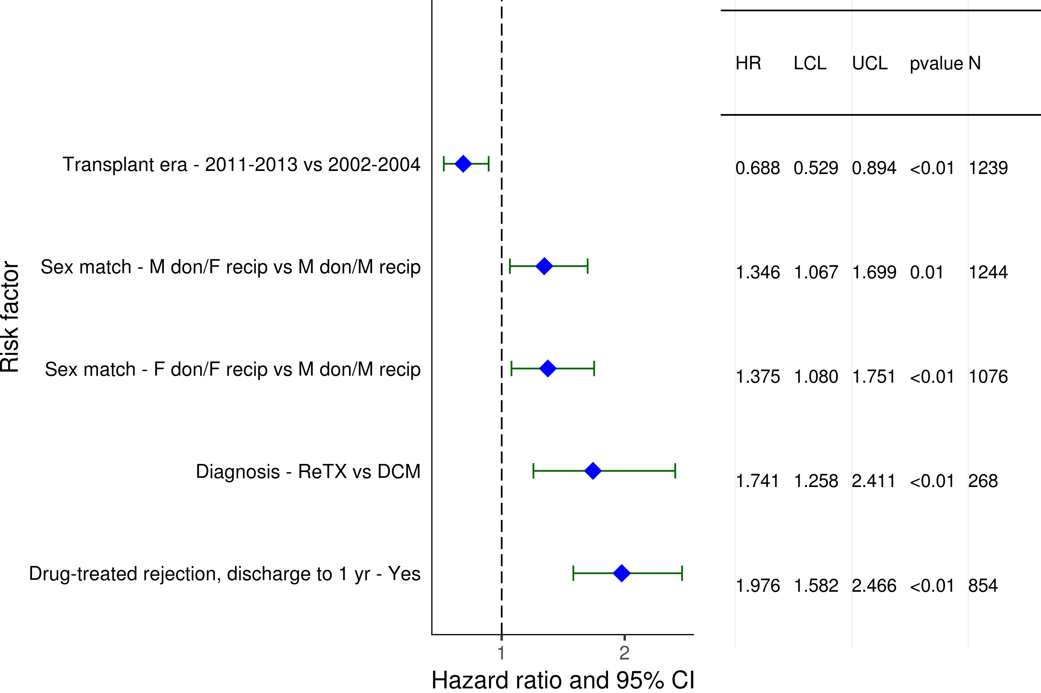
Pediatric Heart Transplants (1/2002-6/2013)
Statistically Significant Risk Factors For 5 Year Mortality Conditional on Survival to 1 year with 95% Confidence Limits
2019
(N = 5,058)
JHLT. 2019 Oct; 38(10): 1015-1066

Slide 109
Pediatric Heart Transplants (1/2002-6/2013)
Statistically Significant Risk Factors For 5 Year Mortality Conditional on Survival to 1 year
Continuous Factors (see figures)
Recipient age (years) | Recipient weight percentile
2019

Slide 110
Pediatric Heart Transplants (1/2002-6/2013)
Recipient age (years)
Statistically Significant Risk Factors For 5 Year Mortality Conditional on Survival to 1 year with 95% Confidence Limits
p < 0.0001
2019
(N = 5,058)
JHLT. 2019 Oct; 38(10): 1015-1066
Notes:
Multivariable analysis was performed using a proportional hazards model censoring all patients at 5 years. Continuous factors were fit using a restricted cubic spline.

Slide 111
Pediatric Heart Transplants (1/2002-6/2013)
Recipient weight percentile
Statistically Significant Risk Factors For 5 Year Mortality Conditional on Survival to 1 year with 95% Confidence Limits
p = 0.0109
2019
(N = 5,058)
JHLT. 2019 Oct; 38(10): 1015-1066
Notes:
Multivariable analysis was performed using a proportional hazards model censoring all patients at 5 years. Continuous factors were fit using a restricted cubic spline.

Slide 112
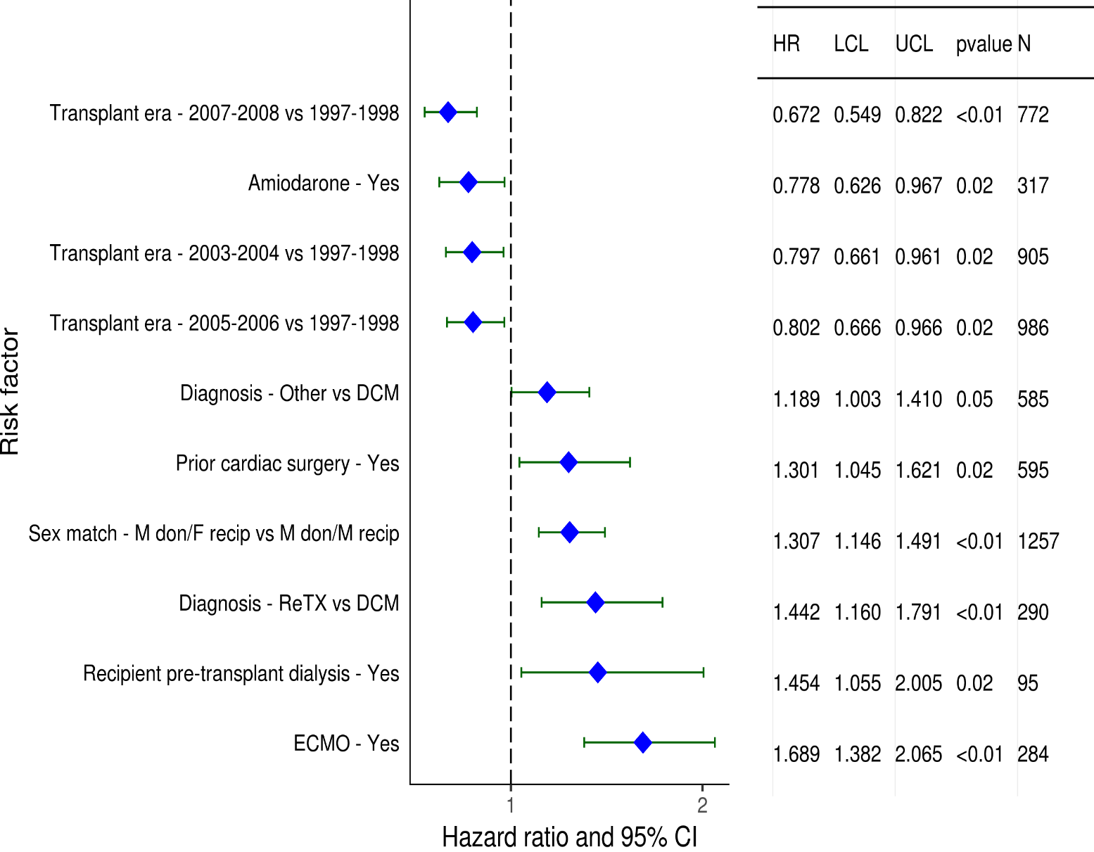
Pediatric Heart Transplants (1/1997-6/2008)
Statistically Significant Risk Factors For 10 Year Mortality with 95% Confidence Limits
2019
(N = 5,128)
JHLT. 2019 Oct; 38(10): 1015-1066

Slide 113
Pediatric Heart Transplants (1/1997-6/2008)
Statistically Significant Risk Factors For 10 Year Mortality
Continuous Factors (see figures)
Recipient age (years) | Donor age (years)
Recipient eGFR (mL/min/1.73 m²) | Center volume: prev ped TXs within 3 yrs
PRA (%) | Recipient height percentile
Recipient weight percentile
2019
JHLT. 2019 Oct; 38(10): 1015-1066

Slide 114
Pediatric Heart Transplants (1/1997-6/2008)
Recipient age (years)
Statistically Significant Risk Factors For 10 Year Mortality with 95% Confidence Limits
p < 0.0001
2019
(N = 5,128)
JHLT. 2019 Oct; 38(10): 1015-1066
Notes:
Multivariable analysis was performed using a proportional hazards model censoring all patients at 5 years. Continuous factors were fit using a restricted cubic spline.

Slide 115
Pediatric Heart Transplants (1/1997-6/2008)
Donor age (years)
Statistically Significant Risk Factors For 10 Year Mortality with 95% Confidence Limits
p = 0.0106
2019
(N = 5,128)
JHLT. 2019 Oct; 38(10): 1015-1066
Notes:
Multivariable analysis was performed using a proportional hazards model censoring all patients at 5 years. Continuous factors were fit using a restricted cubic spline.

Slide 116
Pediatric Heart Transplants (1/1997-6/2008)
Recipient eGFR (mL/min/1.73 m²)
Statistically Significant Risk Factors For 10 Year Mortality with 95% Confidence Limits
p = 0.0007
2019
(N = 5,128)
JHLT. 2019 Oct; 38(10): 1015-1066
Notes:
Multivariable analysis was performed using a proportional hazards model censoring all patients at 5 years. Continuous factors were fit using a restricted cubic spline.

Slide 117
Pediatric Heart Transplants (1/1997-6/2008)
Center volume: prev ped TXs within 3 yrs
Statistically Significant Risk Factors For 10 Year Mortality with 95% Confidence Limits
p = 0.0142
2019
(N = 5,128)
JHLT. 2019 Oct; 38(10): 1015-1066
Notes:
Multivariable analysis was performed using a proportional hazards model censoring all patients at 5 years. Continuous factors were fit using a restricted cubic spline.

Slide 118
Pediatric Heart Transplants (1/1997-6/2008)
PRA (%)
Statistically Significant Risk Factors For 10 Year Mortality with 95% Confidence Limits
p = 0.0062
2019
(N = 5,128)
JHLT. 2019 Oct; 38(10): 1015-1066
Notes:
Multivariable analysis was performed using a proportional hazards model censoring all patients at 5 years. Continuous factors were fit using a restricted cubic spline.

Slide 119
Pediatric Heart Transplants (1/1997-6/2008)
Recipient height percentile
Statistically Significant Risk Factors For 10 Year Mortality with 95% Confidence Limits
p = 0.0024
2019
(N = 5,128)
JHLT. 2019 Oct; 38(10): 1015-1066
Notes:
Multivariable analysis was performed using a proportional hazards model censoring all patients at 5 years. Continuous factors were fit using a restricted cubic spline.

Slide 120
Pediatric Heart Transplants (1/1997-6/2008)
Recipient weight percentile
Statistically Significant Risk Factors For 10 Year Mortality with 95% Confidence Limits
p = 0.0240
2019
(N = 5,128)
JHLT. 2019 Oct; 38(10): 1015-1066
Notes:
Multivariable analysis was performed using a proportional hazards model censoring all patients at 5 years. Continuous factors were fit using a restricted cubic spline.

Slide 121
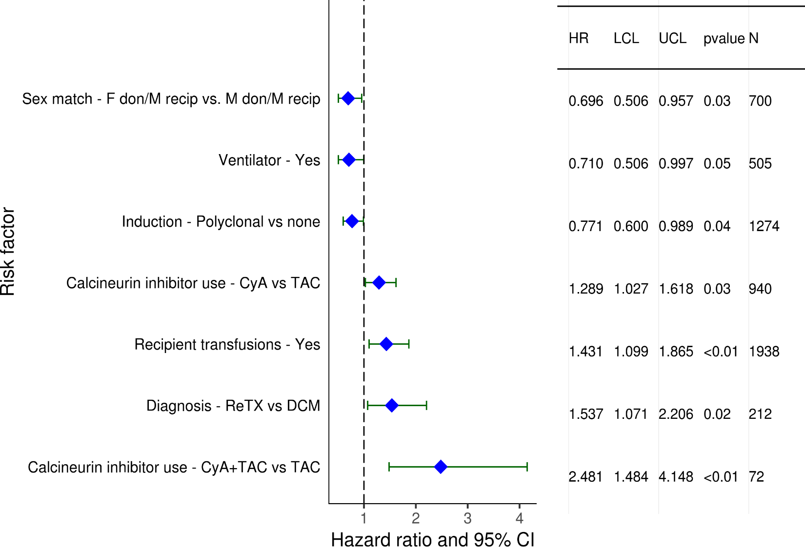
Pediatric Heart Transplants (1/2002-6/2013)
Statistically Significant Risk Factors for Developing CAV within 5 Years with 95% Confidence Limits
Conditional on Survival to Discharge
2019
(N = 3,269)
JHLT. 2019 Oct; 38(10): 1015-1066

Slide 122
Pediatric Heart Transplants (1/2002-6/2013)
Conditional on Survival to Transplant Discharge
Statistically Significant Risk Factors for Developing CAV within 5 Years
Continuous Factors (see figures)
Recipient age (years) | Donor age (years)
Recipient PRA (%)
2019
JHLT. 2019 Oct; 38(10): 1015-1066

Slide 123
Pediatric Heart Transplants (1/2002-6/2013)
Statistically Significant Risk Factors for Developing CAV within 5 Years with 95% Confidence Limits
Recipient age (years)
Conditional on Survival to Discharge
p = 0.0234
2019
(N = 3,269)
JHLT. 2019 Oct; 38(10): 1015-1066
Notes:
Multivariable analysis was performed using a proportional hazards model censoring all patients at 5 years. Continuous factors were fit using a restricted cubic spline.

Slide 124
Pediatric Heart Transplants (1/2002-6/2013)
Statistically Significant Risk Factors for Developing CAV within 5 Years with 95% Confidence Limits
Donor age (years)
Conditional on Survival to Discharge
p < 0.0001
2019
(N = 3,269)
JHLT. 2019 Oct; 38(10): 1015-1066
Notes:
Multivariable analysis was performed using a proportional hazards model censoring all patients at 5 years. Continuous factors were fit using a restricted cubic spline.

Slide 125
Pediatric Heart Transplants (1/2002-6/2013)
Statistically Significant Risk Factors for Developing CAV within 5 Years with 95% Confidence Limits
Conditional on Survival to Discharge
Recipient PRA (%)
p = 0.0090
2019
(N = 3,269)
JHLT. 2019 Oct; 38(10): 1015-1066
Notes:
Multivariable analysis was performed using a proportional hazards model censoring all patients at 5 years. Continuous factors were fit using a restricted cubic spline.

Slide 126
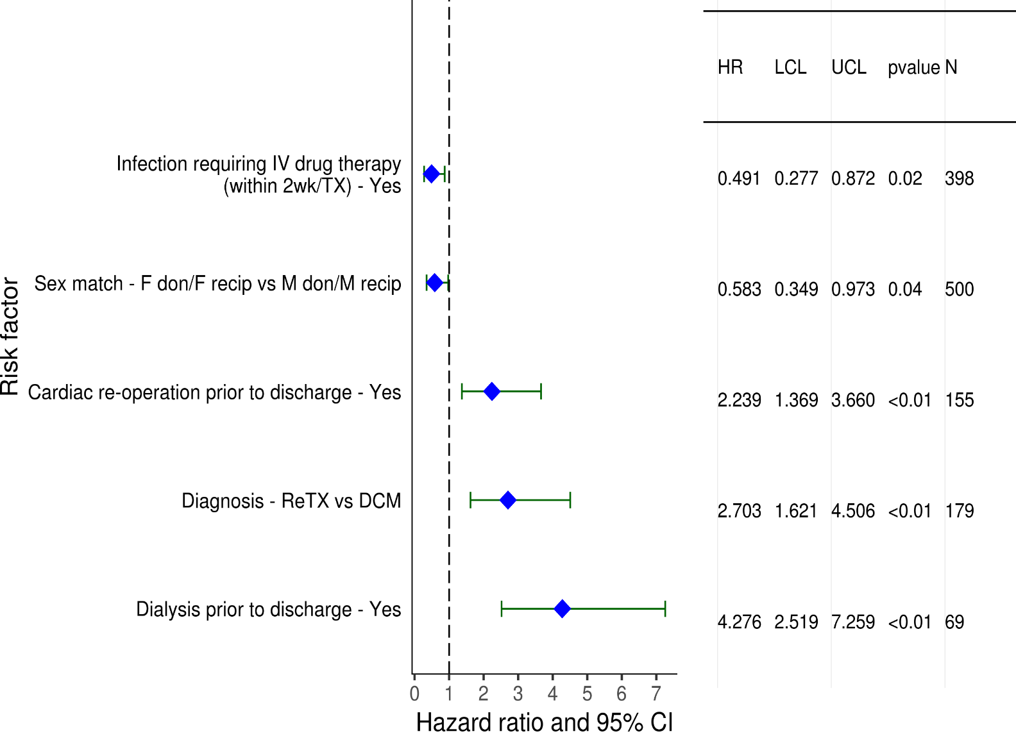
Pediatric Heart Transplants (1/1997-6/2008)
Statistically Significant Risk Factors for Developing Renal Dysfunction within 10 Years with 95% Confidence Limits
Limited to Recipients without Severe Renal Dysfunction* Pre-Transplant
(N = 2,622)
2019
* Severe renal dysfunction = Creatinine > 2.5 mg/dl (221 μmol/L), dialysis, or renal transplant
JHLT. 2019 Oct; 38(10): 1015-1066

Slide 127
Pediatric Heart Transplants (1/1997-6/2008)
Statistically Significant Risk Factors for Developing Renal Dysfunction within 10 Years
Limited to Recipients without Severe Renal Dysfunction Pre-Transplant
Continuous Factors (see figures)
Recipient age (years) | Recipient eGFR (mL/min/1.73 m2)
Center volume: prev ped TXs within 3 yrs | Recipient PRA (%)
2019
JHLT. 2019 Oct; 38(10): 1015-1066

Slide 128
Pediatric Heart Transplants (1/1997-6/2008)
Statistically Significant Risk Factors for Developing Renal Dysfunction within 10 Years with 95% Confidence Limits
Limited to Recipients without Severe Renal Dysfunction Pre-Transplant
Recipient age (years)
p < 0.0001
2019
(N = 2,622)
JHLT. 2019 Oct; 38(10): 1015-1066

Slide 129
Pediatric Heart Transplants (1/1997-6/2008)
Statistically Significant Risk Factors for Developing Renal Dysfunction within 10 Years with 95% Confidence Limits
Limited to Recipients without Severe Renal Dysfunction Pre-Transplant
Recipient eGFR (mL/min/1.73 m²)
p = 0.0081
2019
(N = 2,622)
JHLT. 2019 Oct; 38(10): 1015-1066

Slide 130
Pediatric Heart Transplants (1/1997-6/2008)
Statistically Significant Risk Factors for Developing Renal Dysfunction within 10 Years with 95% Confidence Limits
Center volume: prev ped TXs within 3 yrs
Limited to Recipients without Severe Renal Dysfunction Pre-Transplant
p = 0.0019
2019
(N = 2,622)
JHLT. 2019 Oct; 38(10): 1015-1066

Slide 131
Pediatric Heart Transplants (1/1997-6/2008)
Statistically Significant Risk Factors for Developing Renal Dysfunction within 10 Years with 95% Confidence Limits
Limited to Recipients without Severe Renal Dysfunction Pre-Transplant
Recipient PRA (%)
p = 0.0393
2019
(N = 2,622)
JHLT. 2019 Oct; 38(10): 1015-1066

Slide 132
Focus Theme:
Donor-Recipient Size Match
(Version 1)
For slides 133-179, weight match and height match were used to measure size match and calculated as:
weight match = [(donor weight – recipient weight) / donor weight] x 100; height match = [(donor height – recipient height) / donor height] x 100.
2019
JHLT. 2019 Oct; 38(10): 1015-1066
Notes:
Weight match = [(donor weight – recipient weight) / donor weight] x 100
Height match = [(donor height – recipient height) / donor height] x 100

Slide 133
Focus Theme -
Select Characteristics
2019
JHLT. 2019 Oct; 38(10): 1015-1066
Notes:
Weight match = [(donor weight – recipient weight) / donor weight] x 100
Height match = [(donor height – recipient height) / donor height] x 100

Slide 134
Pediatric Heart Transplants
Donor-Recipient Height Match and Weight Match
(Transplants: January 2010 – June 2018)
2019
R = 0.695, p<0.0001
JHLT. 2019 Oct; 38(10): 1015-1066
Notes:
Weight match = [(donor weight – recipient weight) / donor weight] x 100
Height match = [(donor height – recipient height) / donor height] x 100

Slide 135
Pediatric Heart Transplants
Transplants with Donor-Recipient Weight Match of <-20% and >20% by Transplant Year
(Transplants: January 1992 – December 2017)
Year of Transplant
2019
JHLT. 2019 Oct; 38(10): 1015-1066
Notes:
Weight match = [(donor weight – recipient weight) / donor weight] x 100
Height match = [(donor height – recipient height) / donor height] x 100

Slide 136
Pediatric Heart Transplants
Distribution of Donor-Recipient Weight Match by Recipient Age
(Transplants: January 2010 – June 2018)
2019
JHLT. 2019 Oct; 38(10): 1015-1066
Notes:
Weight match = [(donor weight – recipient weight) / donor weight] x 100
Height match = [(donor height – recipient height) / donor height] x 100

Slide 137
Pediatric Heart Transplants
Distribution of Donor-Recipient Weight Match by Donor-Recipient Sex Match
(Transplants: January 2010 – June 2018)
2019
JHLT. 2019 Oct; 38(10): 1015-1066
Notes:
Weight match = [(donor weight – recipient weight) / donor weight] x 100
Height match = [(donor height – recipient height) / donor height] x 100

Slide 138
Pediatric Heart Transplants
Distribution of Donor-Recipient Weight Match by Donor Age
(Transplants: January 2010 – June 2018)
2019
JHLT. 2019 Oct; 38(10): 1015-1066
Notes:
Weight match = [(donor weight – recipient weight) / donor weight] x 100
Height match = [(donor height – recipient height) / donor height] x 100

Slide 139
Pediatric Heart Transplants
Distribution of Donor-Recipient Weight Match by Recipient PVR
(Transplants: January 2010 – June 2018)
2019
JHLT. 2019 Oct; 38(10): 1015-1066
Notes:
Weight match = [(donor weight – recipient weight) / donor weight] x 100
Height match = [(donor height – recipient height) / donor height] x 100

Slide 140
Pediatric Heart Transplants
Distribution of Donor-Recipient Weight Match by Ischemic Time
(Transplants: January 2010 – June 2018)
2019
JHLT. 2019 Oct; 38(10): 1015-1066
Notes:
Weight match = [(donor weight – recipient weight) / donor weight] x 100
Height match = [(donor height – recipient height) / donor height] x 100

Slide 141
Pediatric Heart Transplants
Distribution of Donor-Recipient Weight Match by Geographic Location
(Transplants: January 2010 – June 2018)
2019
JHLT. 2019 Oct; 38(10): 1015-1066
Notes:
Weight match = [(donor weight – recipient weight) / donor weight] x 100
Height match = [(donor height – recipient height) / donor height] x 100

Slide 142
Pediatric Heart Transplants
Distribution of Donor-Recipient Weight Match by Mechanical Circulatory Support (MCS)*
(Transplants: January 2010 – June 2018)
2019
* LVAD, RVAD, TAH, ECMOO
JHLT. 2019 Oct; 38(10): 1015-1066
Notes:
Weight match = [(donor weight – recipient weight) / donor weight] x 100
Height match = [(donor height – recipient height) / donor height] x 100

Slide 143
Pediatric Heart Transplants
Distribution of Donor-Recipient Height Match by Donor Age
(Transplants: January 2010 – June 2018)
2019
JHLT. 2019 Oct; 38(10): 1015-1066
Notes:
Weight match = [(donor weight – recipient weight) / donor weight] x 100
Height match = [(donor height – recipient height) / donor height] x 100

Slide 144
Focus Theme -
Post-transplant Outcomes
2019
JHLT. 2019 Oct; 38(10): 1015-1066
Notes:
Weight match = [(donor weight – recipient weight) / donor weight] x 100
Height match = [(donor height – recipient height) / donor height] x 100

Slide 145
Pediatric Heart Transplants
% of Recipients Experiencing Treated Rejection Between Discharge and 1-Year Follow-Up by Donor-Recipient Weight Match
(Transplants: January 2010 – June 2017)
p = 0.8346
Treated rejection = Recipient was reported to (1) have at least one acute rejection episode that was treated with an anti-rejection agent; or (2) have been hospitalized for rejection.
2019
JHLT. 2019 Oct; 38(10): 1015-1066
Notes:
Weight match = [(donor weight – recipient weight) / donor weight] x 100
Height match = [(donor height – recipient height) / donor height] x 100

Slide 146
Pediatric Heart Transplants
Kaplan-Meier Survival Within 1 Year by Donor-Recipient Height Match
(Transplants: January 2006 – June 2017)
No pairwise comparisons were significant at p<0.05.
2019
JHLT. 2019 Oct; 38(10): 1015-1066
Notes:
Weight match = [(donor weight – recipient weight) / donor weight] x 100
Height match = [(donor height – recipient height) / donor height] x 100
Survival was calculated using the Kaplan-Meier method, which incorporates information from all transplants for whom any follow-up has been provided. Since many patients are still alive and some patients have been lost to follow-up, the survival rates are estimates rather than exact rates because the time of death is not known for all patients.
Survival rates were compared using the log-rank test statistic. Adjustments for multiple comparisons were done using Scheffe’s method. Results of log-rank test should be interpreted with caution when curves cross.

Slide 147
Pediatric Heart Transplants
Kaplan-Meier Survival Within 1 Year by Donor-Recipient Height Match
(Transplants: January 2006 – June 2017)
Recipient Age Group: <1 Year
No pairwise comparisons were significant at p<0.05.
2019
JHLT. 2019 Oct; 38(10): 1015-1066
Notes:
Weight match = [(donor weight – recipient weight) / donor weight] x 100
Height match = [(donor height – recipient height) / donor height] x 100
Survival was calculated using the Kaplan-Meier method, which incorporates information from all transplants for whom any follow-up has been provided. Since many patients are still alive and some patients have been lost to follow-up, the survival rates are estimates rather than exact rates because the time of death is not known for all patients.
Survival rates were compared using the log-rank test statistic. Adjustments for multiple comparisons were done using Scheffe’s method. Results of log-rank test should be interpreted with caution when curves cross.

Slide 148
Pediatric Heart Transplants
Kaplan-Meier Survival Within 1 Year by Donor-Recipient Height Match
(Transplants: January 2006 – June 2017)
Recipient Age Group: 1-5 Years
No pairwise comparisons were significant at p<0.05.
2019
JHLT. 2019 Oct; 38(10): 1015-1066
Notes:
Weight match = [(donor weight – recipient weight) / donor weight] x 100
Height match = [(donor height – recipient height) / donor height] x 100
Survival was calculated using the Kaplan-Meier method, which incorporates information from all transplants for whom any follow-up has been provided. Since many patients are still alive and some patients have been lost to follow-up, the survival rates are estimates rather than exact rates because the time of death is not known for all patients.
Survival rates were compared using the log-rank test statistic. Adjustments for multiple comparisons were done using Scheffe’s method. Results of log-rank test should be interpreted with caution when curves cross.

Slide 149
Pediatric Heart Transplants
Kaplan-Meier Survival Within 1 Year by Donor-Recipient Height Match
(Transplants: January 2006 – June 2017)
Recipient Age Group: 6-10 Years
No pairwise comparisons were significant at p<0.05.
2019
JHLT. 2019 Oct; 38(10): 1015-1066
Notes:
Weight match = [(donor weight – recipient weight) / donor weight] x 100
Height match = [(donor height – recipient height) / donor height] x 100
Survival was calculated using the Kaplan-Meier method, which incorporates information from all transplants for whom any follow-up has been provided. Since many patients are still alive and some patients have been lost to follow-up, the survival rates are estimates rather than exact rates because the time of death is not known for all patients.
Survival rates were compared using the log-rank test statistic. Adjustments for multiple comparisons were done using Scheffe’s method. Results of log-rank test should be interpreted with caution when curves cross.

Slide 150
Pediatric Heart Transplants
Kaplan-Meier Survival Within 1 Year by Donor-Recipient Height Match
(Transplants: January 2006 – June 2017)
Recipient Age Group: 11-17 Years
No pairwise comparisons were significant at p<0.05.
2019
JHLT. 2019 Oct; 38(10): 1015-1066
Notes:
Weight match = [(donor weight – recipient weight) / donor weight] x 100
Height match = [(donor height – recipient height) / donor height] x 100
Note: number is too small for <-20% group.
Survival was calculated using the Kaplan-Meier method, which incorporates information from all transplants for whom any follow-up has been provided. Since many patients are still alive and some patients have been lost to follow-up, the survival rates are estimates rather than exact rates because the time of death is not known for all patients.
Survival rates were compared using the log-rank test statistic. Adjustments for multiple comparisons were done using Scheffe’s method. Results of log-rank test should be interpreted with caution when curves cross.

Slide 151
Pediatric Heart Transplants
Kaplan-Meier Survival Within 1 Year by Donor-Recipient Weight Match
(Transplants: January 2006 – June 2017)
No pairwise comparisons were significant at p<0.05.
2019
JHLT. 2019 Oct; 38(10): 1015-1066
Notes:
Weight match = [(donor weight – recipient weight) / donor weight] x 100
Height match = [(donor height – recipient height) / donor height] x 100
Survival was calculated using the Kaplan-Meier method, which incorporates information from all transplants for whom any follow-up has been provided. Since many patients are still alive and some patients have been lost to follow-up, the survival rates are estimates rather than exact rates because the time of death is not known for all patients.
Survival rates were compared using the log-rank test statistic. Adjustments for multiple comparisons were done using Scheffe’s method. Results of log-rank test should be interpreted with caution when curves cross.

Slide 152
Pediatric Heart Transplants
Kaplan-Meier Survival Within 1 Year by Donor-Recipient Weight Match
(Transplants: January 2006 – June 2017)
Recipient Age Group: <1 Year
No pairwise comparisons were significant at p<0.05.
2019
JHLT. 2019 Oct; 38(10): 1015-1066
Notes:
Weight match = [(donor weight – recipient weight) / donor weight] x 100
Height match = [(donor height – recipient height) / donor height] x 100
Survival was calculated using the Kaplan-Meier method, which incorporates information from all transplants for whom any follow-up has been provided. Since many patients are still alive and some patients have been lost to follow-up, the survival rates are estimates rather than exact rates because the time of death is not known for all patients.
Survival rates were compared using the log-rank test statistic. Adjustments for multiple comparisons were done using Scheffe’s method. Results of log-rank test should be interpreted with caution when curves cross.

Slide 153
Pediatric Heart Transplants
Kaplan-Meier Survival Within 1 Year by Donor-Recipient Weight Match
(Transplants: January 2006 – June 2017)
Recipient Age Group: 1-5 Years
No pairwise comparisons were significant at p<0.05 except <-30% vs. >30%.
2019
JHLT. 2019 Oct; 38(10): 1015-1066
Notes:
Weight match = [(donor weight – recipient weight) / donor weight] x 100
Height match = [(donor height – recipient height) / donor height] x 100
Survival was calculated using the Kaplan-Meier method, which incorporates information from all transplants for whom any follow-up has been provided. Since many patients are still alive and some patients have been lost to follow-up, the survival rates are estimates rather than exact rates because the time of death is not known for all patients.
Survival rates were compared using the log-rank test statistic. Adjustments for multiple comparisons were done using Scheffe’s method. Results of log-rank test should be interpreted with caution when curves cross.

Slide 154
Pediatric Heart Transplants
Kaplan-Meier Survival Within 1 Year by Donor-Recipient Weight Match
(Transplants: January 2006 – June 2017)
Recipient Age Group: 6-10 Years
No pairwise comparisons were significant at p<0.05.
2019
JHLT. 2019 Oct; 38(10): 1015-1066
Notes:
Weight match = [(donor weight – recipient weight) / donor weight] x 100
Height match = [(donor height – recipient height) / donor height] x 100
Survival was calculated using the Kaplan-Meier method, which incorporates information from all transplants for whom any follow-up has been provided. Since many patients are still alive and some patients have been lost to follow-up, the survival rates are estimates rather than exact rates because the time of death is not known for all patients.
Survival rates were compared using the log-rank test statistic. Adjustments for multiple comparisons were done using Scheffe’s method. Results of log-rank test should be interpreted with caution when curves cross.

Slide 155
Pediatric Heart Transplants
Kaplan-Meier Survival Within 1 Year by Donor-Recipient Weight Match
(Transplants: January 2006 – June 2017)
Recipient Age Group: 11-17 Years
No pairwise comparisons were significant at p<0.05.
2019
JHLT. 2019 Oct; 38(10): 1015-1066
Notes:
Weight match = [(donor weight – recipient weight) / donor weight] x 100
Height match = [(donor height – recipient height) / donor height] x 100
Survival was calculated using the Kaplan-Meier method, which incorporates information from all transplants for whom any follow-up has been provided. Since many patients are still alive and some patients have been lost to follow-up, the survival rates are estimates rather than exact rates because the time of death is not known for all patients.
Survival rates were compared using the log-rank test statistic. Adjustments for multiple comparisons were done using Scheffe’s method. Results of log-rank test should be interpreted with caution when curves cross.

Slide 156
Pediatric Heart Transplants
Kaplan-Meier Survival Within 5 Years by Donor-Recipient Height Match
(Transplants: January 2006 – June 2017)
No pairwise comparisons were significant at p<0.05.
2019
JHLT. 2019 Oct; 38(10): 1015-1066
Notes:
Weight match = [(donor weight – recipient weight) / donor weight] x 100
Height match = [(donor height – recipient height) / donor height] x 100
Survival was calculated using the Kaplan-Meier method, which incorporates information from all transplants for whom any follow-up has been provided. Since many patients are still alive and some patients have been lost to follow-up, the survival rates are estimates rather than exact rates because the time of death is not known for all patients.
Survival rates were compared using the log-rank test statistic. Adjustments for multiple comparisons were done using Scheffe’s method. Results of log-rank test should be interpreted with caution when curves cross.

Slide 157
Pediatric Heart Transplants
Kaplan-Meier Survival Within 5 Years by Donor-Recipient Height Match
(Transplants: January 2006 – June 2017)
Recipient Age Group: <1 Year
No pairwise comparisons were significant at p<0.05.
2019
JHLT. 2019 Oct; 38(10): 1015-1066
Notes:
Weight match = [(donor weight – recipient weight) / donor weight] x 100
Height match = [(donor height – recipient height) / donor height] x 100
Survival was calculated using the Kaplan-Meier method, which incorporates information from all transplants for whom any follow-up has been provided. Since many patients are still alive and some patients have been lost to follow-up, the survival rates are estimates rather than exact rates because the time of death is not known for all patients.
Survival rates were compared using the log-rank test statistic. Adjustments for multiple comparisons were done using Scheffe’s method. Results of log-rank test should be interpreted with caution when curves cross.

Slide 158
Pediatric Heart Transplants
Kaplan-Meier Survival Within 5 Years by Donor-Recipient Height Match
(Transplants: January 2006 – June 2017)
Recipient Age Group: 1-5 Years
No pairwise comparisons were significant at p<0.05.
2019
JHLT. 2019 Oct; 38(10): 1015-1066
Notes:
Weight match = [(donor weight – recipient weight) / donor weight] x 100
Height match = [(donor height – recipient height) / donor height] x 100
Survival was calculated using the Kaplan-Meier method, which incorporates information from all transplants for whom any follow-up has been provided. Since many patients are still alive and some patients have been lost to follow-up, the survival rates are estimates rather than exact rates because the time of death is not known for all patients.
Survival rates were compared using the log-rank test statistic. Adjustments for multiple comparisons were done using Scheffe’s method. Results of log-rank test should be interpreted with caution when curves cross.

Slide 159
Pediatric Heart Transplants
Kaplan-Meier Survival Within 5 Years by Donor-Recipient Height Match
(Transplants: January 2006 – June 2017)
Recipient Age Group: 6-10 Years
No pairwise comparisons were significant at p<0.05.
2019
JHLT. 2019 Oct; 38(10): 1015-1066
Notes:
Weight match = [(donor weight – recipient weight) / donor weight] x 100
Height match = [(donor height – recipient height) / donor height] x 100
Survival was calculated using the Kaplan-Meier method, which incorporates information from all transplants for whom any follow-up has been provided. Since many patients are still alive and some patients have been lost to follow-up, the survival rates are estimates rather than exact rates because the time of death is not known for all patients.
Survival rates were compared using the log-rank test statistic. Adjustments for multiple comparisons were done using Scheffe’s method. Results of log-rank test should be interpreted with caution when curves cross.

Slide 160
Pediatric Heart Transplants
Kaplan-Meier Survival Within 5 Years by Donor-Recipient Height Match
(Transplants: January 2006 – June 2017)
Recipient Age Group: 11-17 Years
No pairwise comparisons were significant at p<0.05.
2019
JHLT. 2019 Oct; 38(10): 1015-1066
Notes:
Weight match = [(donor weight – recipient weight) / donor weight] x 100
Height match = [(donor height – recipient height) / donor height] x 100
Note: number was too small for <-20% group.
Survival was calculated using the Kaplan-Meier method, which incorporates information from all transplants for whom any follow-up has been provided. Since many patients are still alive and some patients have been lost to follow-up, the survival rates are estimates rather than exact rates because the time of death is not known for all patients.
Survival rates were compared using the log-rank test statistic. Adjustments for multiple comparisons were done using Scheffe’s method. Results of log-rank test should be interpreted with caution when curves cross.

Slide 161
Pediatric Heart Transplants
Kaplan-Meier Survival Within 5 Years by Donor-Recipient Weight Match
(Transplants: January 2006 – June 2017)
Overall p-value=0.1767
No pairwise comparisons were significant at p<0.05.
2019
JHLT. 2019 Oct; 38(10): 1015-1066
Notes:
Weight match = [(donor weight – recipient weight) / donor weight] x 100
Height match = [(donor height – recipient height) / donor height] x 100
Survival was calculated using the Kaplan-Meier method, which incorporates information from all transplants for whom any follow-up has been provided. Since many patients are still alive and some patients have been lost to follow-up, the survival rates are estimates rather than exact rates because the time of death is not known for all patients.
Survival rates were compared using the log-rank test statistic. Adjustments for multiple comparisons were done using Scheffe’s method. Results of log-rank test should be interpreted with caution when curves cross.

Slide 162
Pediatric Heart Transplants
Kaplan-Meier Survival Within 5 Years by Donor-Recipient Weight Match
(Transplants: January 2006 – June 2017)
Recipient Age Group: <1 Year
Overall p-value=0.1767
No pairwise comparisons were significant at p<0.05.
2019
JHLT. 2019 Oct; 38(10): 1015-1066
Notes:
Weight match = [(donor weight – recipient weight) / donor weight] x 100
Height match = [(donor height – recipient height) / donor height] x 100
Survival was calculated using the Kaplan-Meier method, which incorporates information from all transplants for whom any follow-up has been provided. Since many patients are still alive and some patients have been lost to follow-up, the survival rates are estimates rather than exact rates because the time of death is not known for all patients.
Survival rates were compared using the log-rank test statistic. Adjustments for multiple comparisons were done using Scheffe’s method. Results of log-rank test should be interpreted with caution when curves cross.

Slide 163
Pediatric Heart Transplants
Kaplan-Meier Survival Within 5 Years by Donor-Recipient Weight Match
(Transplants: January 2006 – June 2017)
Recipient Age Group: 1-5 Years
Overall p-value=0.1767
No pairwise comparisons were significant at p<0.05.
2019
JHLT. 2019 Oct; 38(10): 1015-1066
Notes:
Weight match = [(donor weight – recipient weight) / donor weight] x 100
Height match = [(donor height – recipient height) / donor height] x 100
Survival was calculated using the Kaplan-Meier method, which incorporates information from all transplants for whom any follow-up has been provided. Since many patients are still alive and some patients have been lost to follow-up, the survival rates are estimates rather than exact rates because the time of death is not known for all patients.
Survival rates were compared using the log-rank test statistic. Adjustments for multiple comparisons were done using Scheffe’s method. Results of log-rank test should be interpreted with caution when curves cross.

Slide 164
Pediatric Heart Transplants
Kaplan-Meier Survival Within 5 Years by Donor-Recipient Weight Match
(Transplants: January 2006 – June 2017)
Recipient Age Group: 6-10 Years
Overall p-value=0.1767
No pairwise comparisons were significant at p<0.05.
2019
JHLT. 2019 Oct; 38(10): 1015-1066
Notes:
Weight match = [(donor weight – recipient weight) / donor weight] x 100
Height match = [(donor height – recipient height) / donor height] x 100
Survival was calculated using the Kaplan-Meier method, which incorporates information from all transplants for whom any follow-up has been provided. Since many patients are still alive and some patients have been lost to follow-up, the survival rates are estimates rather than exact rates because the time of death is not known for all patients.
Survival rates were compared using the log-rank test statistic. Adjustments for multiple comparisons were done using Scheffe’s method. Results of log-rank test should be interpreted with caution when curves cross.

Slide 165
Pediatric Heart Transplants
Kaplan-Meier Survival Within 5 Years by Donor-Recipient Weight Match
(Transplants: January 2006 – June 2017)
Recipient Age Group: 11-17 Years
Overall p-value=0.1767
No pairwise comparisons were significant at p<0.05.
2019
JHLT. 2019 Oct; 38(10): 1015-1066
Notes:
Weight match = [(donor weight – recipient weight) / donor weight] x 100
Height match = [(donor height – recipient height) / donor height] x 100
Survival was calculated using the Kaplan-Meier method, which incorporates information from all transplants for whom any follow-up has been provided. Since many patients are still alive and some patients have been lost to follow-up, the survival rates are estimates rather than exact rates because the time of death is not known for all patients.
Survival rates were compared using the log-rank test statistic. Adjustments for multiple comparisons were done using Scheffe’s method. Results of log-rank test should be interpreted with caution when curves cross.

Slide 166
Focus Theme -
Multivariable Analyses
2019
JHLT. 2019 Oct; 38(10): 1015-1066
Notes:
Weight match = [(donor weight – recipient weight) / donor weight] x 100
Height match = [(donor height – recipient height) / donor height] x 100

Slide 167
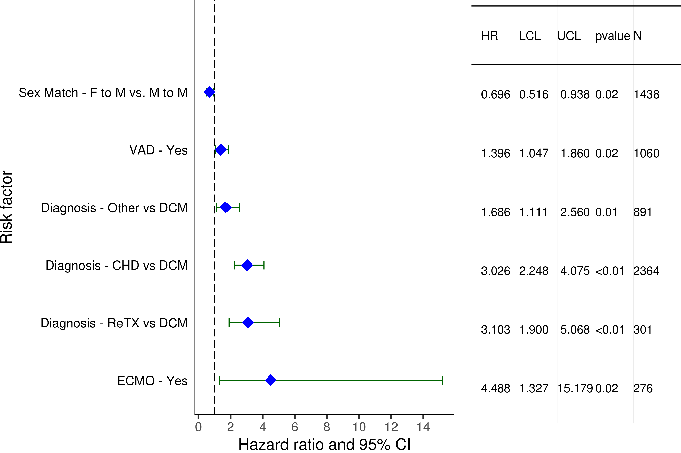
Pediatric Heart Transplants (1/2006-6/2017)
Statistically Significant Risk Factors For 1 Year Mortality with 95% Confidence Limits
2019
(N = 6,691)
JHLT. 2019 Oct; 38(10): 1015-1066
Notes:
Weight match = [(donor weight – recipient weight) / donor weight] x 100
Height match = [(donor height – recipient height) / donor height] x 100

Slide 168
Pediatric Heart Transplants (1/2006-6/2017)
Statistically Significant Risk Factors For 1 Year Mortality
Continuous Factors (see figures)
Ischemic time (hours) | Recipient eGFR (mL/min/1.73 m²)
Recipient bilirubin (mg/dl) | Donor-recipient weight match (%)
2019
JHLT. 2019 Oct; 38(10): 1015-1066
Notes:
Weight match = [(donor weight – recipient weight) / donor weight] x 100
Height match = [(donor height – recipient height) / donor height] x 100

Slide 169
Pediatric Heart Transplants (1/2006-6/2017)
Recipient eGFR (mL/min/1.73 m²)
Statistically Significant Risk Factors For 1 Year Mortality with 95% Confidence Limits
2019
(N = 6,691)
JHLT. 2019 Oct; 38(10): 1015-1066
Notes:
Weight match = [(donor weight – recipient weight) / donor weight] x 100
Height match = [(donor height – recipient height) / donor height] x 100

Slide 170
Pediatric Heart Transplants (1/2006-6/2017)
Recipient bilirubin (mg/dl)
Statistically Significant Risk Factors For 1 Year Mortality with 95% Confidence Limits
2019
(N = 6,691)
JHLT. 2019 Oct; 38(10): 1015-1066
Notes:
Weight match = [(donor weight – recipient weight) / donor weight] x 100
Height match = [(donor height – recipient height) / donor height] x 100

Slide 171
Pediatric Heart Transplants (1/2006-6/2017)
Ischemic time (hours)
Statistically Significant Risk Factors For 1 Year Mortality with 95% Confidence Limits
2019
(N = 6,691)
JHLT. 2019 Oct; 38(10): 1015-1066
Notes:
Weight match = [(donor weight – recipient weight) / donor weight] x 100
Height match = [(donor height – recipient height) / donor height] x 100

Slide 172
Pediatric Heart Transplants (1/2006-6/2017)
Donor-recipient weight match (%)
Statistically Significant Risk Factors For 1 Year Mortality with 95% Confidence Limits
2019
(N = 6,691)
JHLT. 2019 Oct; 38(10): 1015-1066
Notes:
Weight match = [(donor weight – recipient weight) / donor weight] x 100
Height match = [(donor height – recipient height) / donor height] x 100

Slide 173
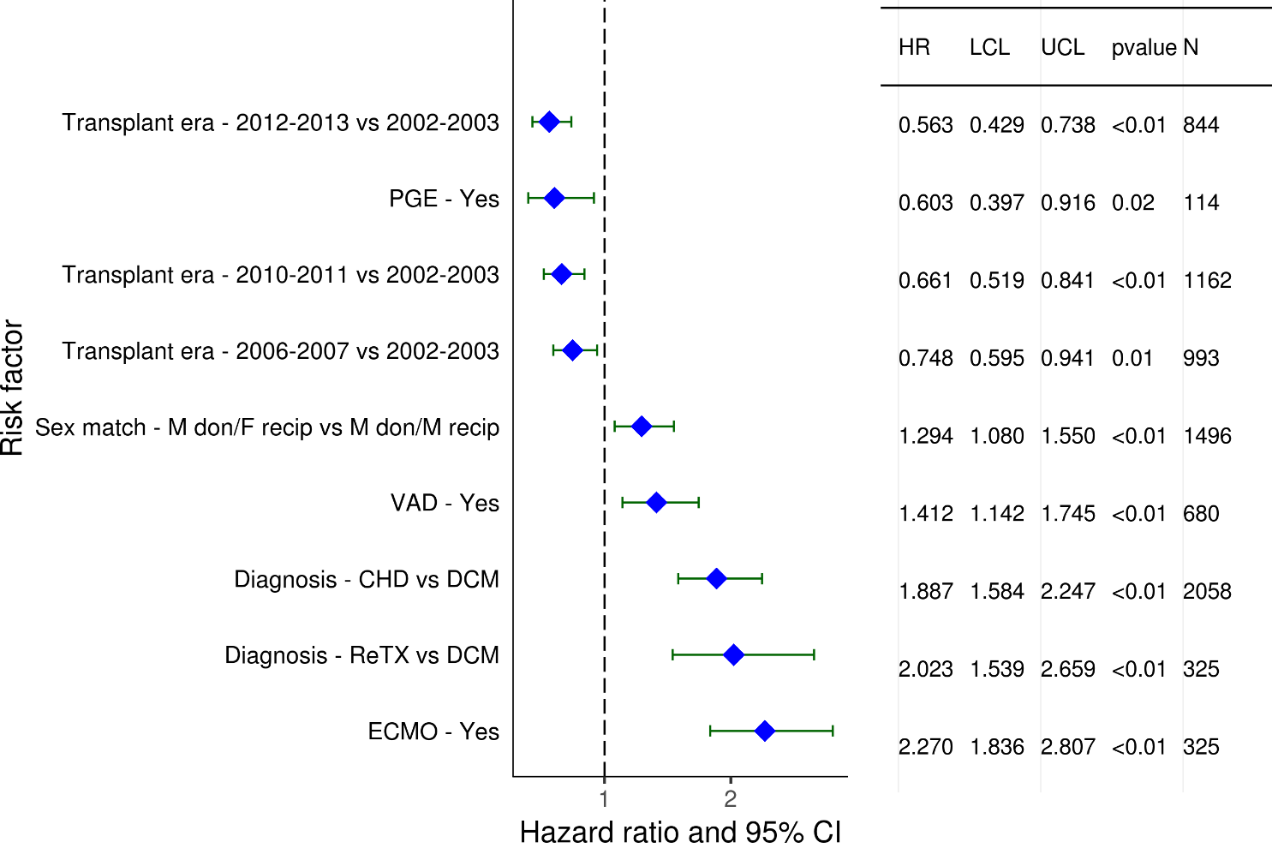
Pediatric Heart Transplants (1/2002-6/2013)
Statistically Significant Risk Factors For 5 Year Mortality with 95% Confidence Limits
2019
(N = 5,986)
JHLT. 2019 Oct; 38(10): 1015-1066
Notes:
Weight match = [(donor weight – recipient weight) / donor weight] x 100
Height match = [(donor height – recipient height) / donor height] x 100

Slide 174
Pediatric Heart Transplants (1/2002-6/2013)
Statistically Significant Risk Factors For 5 Year Mortality
Continuous Factors (see figures)
Recipient age (years) | Donor age (years)
Ischemic time (hours) | Recipient eGFR (mL/min/1.73 m²)
Donor-recipient height match (%)
2019
JHLT. 2019 Oct; 38(10): 1015-1066
Notes:
Weight match = [(donor weight – recipient weight) / donor weight] x 100
Height match = [(donor height – recipient height) / donor height] x 100

Slide 175
Pediatric Heart Transplants (1/2002-6/2013)
Recipient age (years)
Statistically Significant Risk Factors For 5 Year Mortality with 95% Confidence Limits
2019
(N = 5,986)
JHLT. 2019 Oct; 38(10): 1015-1066
Notes:
Weight match = [(donor weight – recipient weight) / donor weight] x 100
Height match = [(donor height – recipient height) / donor height] x 100
Weight match = [(donor weight – recipient weight) / donor weight] x 100
Height match = [(donor height – recipient height) / donor height] x 100

Slide 176
Pediatric Heart Transplants (1/2002-6/2013)
Donor age (years)
Statistically Significant Risk Factors For 5 Year Mortality with 95% Confidence Limits
2019
(N = 5,986)
JHLT. 2019 Oct; 38(10): 1015-1066
Notes:
Weight match = [(donor weight – recipient weight) / donor weight] x 100
Height match = [(donor height – recipient height) / donor height] x 100

Slide 177
Pediatric Heart Transplants (1/2002-6/2013)
Recipient eGFR (mL/min/1.73 m²)
Statistically Significant Risk Factors For 5 Year Mortality with 95% Confidence Limits
2019
(N = 5,986)
JHLT. 2019 Oct; 38(10): 1015-1066
Notes:
Weight match = [(donor weight – recipient weight) / donor weight] x 100
Height match = [(donor height – recipient height) / donor height] x 100

Slide 178
Pediatric Heart Transplants (1/2002-6/2013)
Ischemic time (hours)
Statistically Significant Risk Factors For 5 Year Mortality with 95% Confidence Limits
2019
(N = 5,986)
JHLT. 2019 Oct; 38(10): 1015-1066
Notes:
Weight match = [(donor weight – recipient weight) / donor weight] x 100
Height match = [(donor height – recipient height) / donor height] x 100

Slide 179
Pediatric Heart Transplants (1/2002-6/2013)
Donor-recipient height match (%)
Statistically Significant Risk Factors For 5 Year Mortality with 95% Confidence Limits
2019
(N = 5,986)
JHLT. 2019 Oct; 38(10): 1015-1066
Notes:
Weight match = [(donor weight – recipient weight) / donor weight] x 100
Height match = [(donor height – recipient height) / donor height] x 100

Slide 180
Focus Theme:
Donor-Recipient Size Match
(Version 2)
For slides 181-227, weight match and height match were used to measure size match and calculated as:
weight match = [(donor weight – recipient weight) / recipient weight] x 100;
height match = [(donor height – recipient height) / recipient height] x 100
2019
JHLT. 2019 Oct; 38(10): 1015-1066
Notes:
Weight match = [(donor weight – recipient weight) / recipient weight] x 100
Height match = [(donor height – recipient height) / recipient height] x 100

Slide 181
Focus Theme -
Select Characteristics
2019
JHLT. 2019 Oct; 38(10): 1015-1066
Notes:
Weight match = [(donor weight – recipient weight) / recipient weight] x 100
Height match = [(donor height – recipient height) / recipient height] x 100

Slide 182
Pediatric Heart Transplants
Donor-Recipient Height Match and Weight Match
(Transplants: January 2010 – June 2018)
2019
R = 0.75, p<0.0001
JHLT. 2019 Oct; 38(10): 1015-1066
Notes:
Weight match = [(donor weight – recipient weight) / recipient weight] x 100
Height match = [(donor height – recipient height) / recipient height] x 100

Slide 183
Pediatric Heart Transplants
Transplants with Donor-Recipient Weight Match of <-20% and >20% by Transplant Year
(Transplants: January 1982 – June 2018)
Year of Transplant
2019
JHLT. 2019 Oct; 38(10): 1015-1066
Notes:
Weight match = [(donor weight – recipient weight) / recipient weight] x 100
Height match = [(donor height – recipient height) / recipient height] x 100

Slide 184
Pediatric Heart Transplants
Distribution of Donor-Recipient Weight Match by Recipient Age
(Transplants: January 2010 – June 2018)
2019
JHLT. 2019 Oct; 38(10): 1015-1066
Notes:
Weight match = [(donor weight – recipient weight) / recipient weight] x 100
Height match = [(donor height – recipient height) / recipient height] x 100

Slide 185
Pediatric Heart Transplants
Distribution of Donor-Recipient Weight Match by Donor-Recipient Sex Match
(Transplants: January 2010 – June 2018)
2019
JHLT. 2019 Oct; 38(10): 1015-1066
Notes:
Weight match = [(donor weight – recipient weight) / recipient weight] x 100
Height match = [(donor height – recipient height) / recipient height] x 100

Slide 186
Pediatric Heart Transplants
Distribution of Donor-Recipient Weight Match by Donor Age
(Transplants: January 2010 – June 2018)
2019
JHLT. 2019 Oct; 38(10): 1015-1066
Notes:
Weight match = [(donor weight – recipient weight) / recipient weight] x 100
Height match = [(donor height – recipient height) / recipient height] x 100

Slide 187
Pediatric Heart Transplants
Distribution of Donor-Recipient Weight Match by Recipient PVR
(Transplants: January 2010 – June 2018)
2019
JHLT. 2019 Oct; 38(10): 1015-1066
Notes:
Weight match = [(donor weight – recipient weight) / recipient weight] x 100
Height match = [(donor height – recipient height) / recipient height] x 100

Slide 188
Pediatric Heart Transplants
Distribution of Donor-Recipient Weight Match by Ischemic Time
(Transplants: January 2010 – June 2018)
2019
JHLT. 2019 Oct; 38(10): 1015-1066
Notes:
Weight match = [(donor weight – recipient weight) / recipient weight] x 100
Height match = [(donor height – recipient height) / recipient height] x 100

Slide 189
Pediatric Heart Transplants
Distribution of Donor-Recipient Weight Match by Geographic Location
(Transplants: January 2010 – June 2018)
2019
JHLT. 2019 Oct; 38(10): 1015-1066
Notes:
Weight match = [(donor weight – recipient weight) / recipient weight] x 100
Height match = [(donor height – recipient height) / recipient height] x 100

Slide 190
Pediatric Heart Transplants
Distribution of Donor-Recipient Weight Match by Mechanical Circulatory Support (MCS)*
* LVAD, RVAD, TAH, ECMOO
JHLT. 2019 Oct; 38(10): 1015-1066
Notes:
Weight match = [(donor weight – recipient weight) / recipient weight] x 100
Height match = [(donor height – recipient height) / recipient height] x 100

Slide 191
Pediatric Heart Transplants
Distribution of Donor-Recipient Height Match by Donor Age
(Transplants: January 2010 – June 2018)
2019
JHLT. 2019 Oct; 38(10): 1015-1066
Notes:
Weight match = [(donor weight – recipient weight) / recipient weight] x 100
Height match = [(donor height – recipient height) / recipient height] x 100

Slide 192
Focus Theme -
Post-transplant Outcomes
2019
JHLT. 2019 Oct; 38(10): 1015-1066
Notes:
Weight match = [(donor weight – recipient weight) / recipient weight] x 100
Height match = [(donor height – recipient height) / recipient height] x 100

Slide 193
Pediatric Heart Transplants
% of Recipients Experiencing Treated Rejection Between Discharge and 1-Year Follow-Up by Donor-Recipient Weight Match
(Transplants: January 2010 – June 2017)
p = 0.9221
Treated rejection = Recipient was reported to (1) have at least one acute rejection episode that was treated with an anti-rejection agent; or (2) have been hospitalized for rejection.
2019
JHLT. 2019 Oct; 38(10): 1015-1066
Notes:
Weight match = [(donor weight – recipient weight) / recipient weight] x 100
Height match = [(donor height – recipient height) / recipient height] x 100

Slide 194
Pediatric Heart Transplants
Kaplan-Meier Survival Within 1 Year by Donor-Recipient Height Match
(Transplants: January 2006 – June 2017)
No pairwise comparisons were significant at p<0.05.
2019
JHLT. 2019 Oct; 38(10): 1015-1066
Notes:
Weight match = [(donor weight – recipient weight) / recipient weight] x 100
Height match = [(donor height – recipient height) / recipient height] x 100
Survival was calculated using the Kaplan-Meier method, which incorporates information from all transplants for whom any follow-up has been provided. Since many patients are still alive and some patients have been lost to follow-up, the survival rates are estimates rather than exact rates because the time of death is not known for all patients.
Survival rates were compared using the log-rank test statistic. Adjustments for multiple comparisons were done using Scheffe’s method. Results of log-rank test should be interpreted with caution when curves cross.

Slide 195
Pediatric Heart Transplants
Kaplan-Meier Survival Within 1 Year by Donor-Recipient Height Match
(Transplants: January 2006 – June 2017)
Recipient Age Group: <1 Year
No pairwise comparisons were significant at p<0.05.
2019
JHLT. 2019 Oct; 38(10): 1015-1066
Notes:
Weight match = [(donor weight – recipient weight) / recipient weight] x 100
Height match = [(donor height – recipient height) / recipient height] x 100
Survival was calculated using the Kaplan-Meier method, which incorporates information from all transplants for whom any follow-up has been provided. Since many patients are still alive and some patients have been lost to follow-up, the survival rates are estimates rather than exact rates because the time of death is not known for all patients.
Survival rates were compared using the log-rank test statistic. Adjustments for multiple comparisons were done using Scheffe’s method. Results of log-rank test should be interpreted with caution when curves cross.

Slide 196
Pediatric Heart Transplants
Kaplan-Meier Survival Within 1 Year by Donor-Recipient Height Match
(Transplants: January 2006 – June 2017)
Recipient Age Group: 1-5 Years
No pairwise comparisons were significant at p<0.05.
2019
JHLT. 2019 Oct; 38(10): 1015-1066
Notes:
Weight match = [(donor weight – recipient weight) / recipient weight] x 100
Height match = [(donor height – recipient height) / recipient height] x 100
Survival was calculated using the Kaplan-Meier method, which incorporates information from all transplants for whom any follow-up has been provided. Since many patients are still alive and some patients have been lost to follow-up, the survival rates are estimates rather than exact rates because the time of death is not known for all patients.
Survival rates were compared using the log-rank test statistic. Adjustments for multiple comparisons were done using Scheffe’s method. Results of log-rank test should be interpreted with caution when curves cross.

Slide 197
Pediatric Heart Transplants
Kaplan-Meier Survival Within 1 Year by Donor-Recipient Height Match
(Transplants: January 2006 – June 2017)
Recipient Age Group: 6-10 Years
No pairwise comparisons were significant at p<0.05.
2019
JHLT. 2019 Oct; 38(10): 1015-1066
Notes:
Weight match = [(donor weight – recipient weight) / recipient weight] x 100
Height match = [(donor height – recipient height) / recipient height] x 100
Survival was calculated using the Kaplan-Meier method, which incorporates information from all transplants for whom any follow-up has been provided. Since many patients are still alive and some patients have been lost to follow-up, the survival rates are estimates rather than exact rates because the time of death is not known for all patients.
Survival rates were compared using the log-rank test statistic. Adjustments for multiple comparisons were done using Scheffe’s method. Results of log-rank test should be interpreted with caution when curves cross.

Slide 198
Pediatric Heart Transplants
Kaplan-Meier Survival Within 1 Year by Donor-Recipient Height Match
(Transplants: January 2006 – June 2017)
Recipient Age Group: 11-17 Years
No pairwise comparisons were significant at p<0.05.
2019
JHLT. 2019 Oct; 38(10): 1015-1066
Notes:
Weight match = [(donor weight – recipient weight) / recipient weight] x 100
Height match = [(donor height – recipient height) / recipient height] x 100
Note: number is too small for <-20% group.
Survival was calculated using the Kaplan-Meier method, which incorporates information from all transplants for whom any follow-up has been provided. Since many patients are still alive and some patients have been lost to follow-up, the survival rates are estimates rather than exact rates because the time of death is not known for all patients.
Survival rates were compared using the log-rank test statistic. Adjustments for multiple comparisons were done using Scheffe’s method. Results of log-rank test should be interpreted with caution when curves cross.

Slide 199
Pediatric Heart Transplants
Kaplan-Meier Survival Within 1 Year by Donor-Recipient Weight Match
(Transplants: January 2006 – June 2017)
No pairwise comparisons were significant at p<0.05.
2019
JHLT. 2019 Oct; 38(10): 1015-1066
Notes:
Weight match = [(donor weight – recipient weight) / recipient weight] x 100
Height match = [(donor height – recipient height) / recipient height] x 100
Survival was calculated using the Kaplan-Meier method, which incorporates information from all transplants for whom any follow-up has been provided. Since many patients are still alive and some patients have been lost to follow-up, the survival rates are estimates rather than exact rates because the time of death is not known for all patients.
Survival rates were compared using the log-rank test statistic. Adjustments for multiple comparisons were done using Scheffe’s method. Results of log-rank test should be interpreted with caution when curves cross.

Slide 200
Pediatric Heart Transplants
Kaplan-Meier Survival Within 1 Year by Donor-Recipient Weight Match
(Transplants: January 2006 – June 2017)
Recipient Age Group: <1 Year
No pairwise comparisons were significant at p<0.05.
2019
JHLT. 2019 Oct; 38(10): 1015-1066
Notes:
Weight match = [(donor weight – recipient weight) / recipient weight] x 100
Height match = [(donor height – recipient height) / recipient height] x 100
Survival was calculated using the Kaplan-Meier method, which incorporates information from all transplants for whom any follow-up has been provided. Since many patients are still alive and some patients have been lost to follow-up, the survival rates are estimates rather than exact rates because the time of death is not known for all patients.
Survival rates were compared using the log-rank test statistic. Adjustments for multiple comparisons were done using Scheffe’s method. Results of log-rank test should be interpreted with caution when curves cross.

Slide 201
Pediatric Heart Transplants
Kaplan-Meier Survival Within 1 Year by Donor-Recipient Weight Match
(Transplants: January 2006 – June 2017)
Recipient Age Group: 1-5 Years
No pairwise comparisons were significant at p<0.05.
2019
JHLT. 2019 Oct; 38(10): 1015-1066
Notes:
Weight match = [(donor weight – recipient weight) / recipient weight] x 100
Height match = [(donor height – recipient height) / recipient height] x 100
Survival was calculated using the Kaplan-Meier method, which incorporates information from all transplants for whom any follow-up has been provided. Since many patients are still alive and some patients have been lost to follow-up, the survival rates are estimates rather than exact rates because the time of death is not known for all patients.
Survival rates were compared using the log-rank test statistic. Adjustments for multiple comparisons were done using Scheffe’s method. Results of log-rank test should be interpreted with caution when curves cross.

Slide 202
Pediatric Heart Transplants
Kaplan-Meier Survival Within 1 Year by Donor-Recipient Weight Match
(Transplants: January 2006 – June 2017)
Recipient Age Group: 6-10 Years
No pairwise comparisons were significant at p<0.05 except -20% - 20% vs. >30%
2019
JHLT. 2019 Oct; 38(10): 1015-1066
Notes:
Weight match = [(donor weight – recipient weight) / recipient weight] x 100
Height match = [(donor height – recipient height) / recipient height] x 100
Survival was calculated using the Kaplan-Meier method, which incorporates information from all transplants for whom any follow-up has been provided. Since many patients are still alive and some patients have been lost to follow-up, the survival rates are estimates rather than exact rates because the time of death is not known for all patients.
Survival rates were compared using the log-rank test statistic. Adjustments for multiple comparisons were done using Scheffe’s method. Results of log-rank test should be interpreted with caution when curves cross.

Slide 203
Pediatric Heart Transplants
Kaplan-Meier Survival Within 1 Year by Donor-Recipient Weight Match
(Transplants: January 2006 – June 2017)
Recipient Age Group: 11-17 Years
No pairwise comparisons were significant at p<0.05.
2019
JHLT. 2019 Oct; 38(10): 1015-1066
Notes:
Weight match = [(donor weight – recipient weight) / recipient weight] x 100
Height match = [(donor height – recipient height) / recipient height] x 100
Survival was calculated using the Kaplan-Meier method, which incorporates information from all transplants for whom any follow-up has been provided. Since many patients are still alive and some patients have been lost to follow-up, the survival rates are estimates rather than exact rates because the time of death is not known for all patients.
Survival rates were compared using the log-rank test statistic. Adjustments for multiple comparisons were done using Scheffe’s method. Results of log-rank test should be interpreted with caution when curves cross.

Slide 204
Pediatric Heart Transplants
Kaplan-Meier Survival Within 5 Years by Donor-Recipient Height Match
(Transplants: January 2002 – June 2013)
No pairwise comparisons were significant at p<0.05.
2019
JHLT. 2019 Oct; 38(10): 1015-1066
Notes:
Weight match = [(donor weight – recipient weight) / recipient weight] x 100
Height match = [(donor height – recipient height) / recipient height] x 100
Survival was calculated using the Kaplan-Meier method, which incorporates information from all transplants for whom any follow-up has been provided. Since many patients are still alive and some patients have been lost to follow-up, the survival rates are estimates rather than exact rates because the time of death is not known for all patients.
Survival rates were compared using the log-rank test statistic. Adjustments for multiple comparisons were done using Scheffe’s method. Results of log-rank test should be interpreted with caution when curves cross.

Slide 205
Pediatric Heart Transplants
Kaplan-Meier Survival Within 5 Years by Donor-Recipient Height Match
(Transplants: January 2002 – June 2013)
Recipient Age Group: <1 Year
No pairwise comparisons were significant at p<0.05.
2019
JHLT. 2019 Oct; 38(10): 1015-1066
Notes:
Weight match = [(donor weight – recipient weight) / recipient weight] x 100
Height match = [(donor height – recipient height) / recipient height] x 100
Survival was calculated using the Kaplan-Meier method, which incorporates information from all transplants for whom any follow-up has been provided. Since many patients are still alive and some patients have been lost to follow-up, the survival rates are estimates rather than exact rates because the time of death is not known for all patients.
Survival rates were compared using the log-rank test statistic. Adjustments for multiple comparisons were done using Scheffe’s method. Results of log-rank test should be interpreted with caution when curves cross.

Slide 206
Pediatric Heart Transplants
Kaplan-Meier Survival Within 5 Years by Donor-Recipient Height Match
(Transplants: January 2002 – June 2013)
Recipient Age Group: 1-5 Years
No pairwise comparisons were significant at p<0.05.
2019
JHLT. 2019 Oct; 38(10): 1015-1066
Notes:
Weight match = [(donor weight – recipient weight) / recipient weight] x 100
Height match = [(donor height – recipient height) / recipient height] x 100
Survival was calculated using the Kaplan-Meier method, which incorporates information from all transplants for whom any follow-up has been provided. Since many patients are still alive and some patients have been lost to follow-up, the survival rates are estimates rather than exact rates because the time of death is not known for all patients.
Survival rates were compared using the log-rank test statistic. Adjustments for multiple comparisons were done using Scheffe’s method. Results of log-rank test should be interpreted with caution when curves cross.

Slide 207
Pediatric Heart Transplants
Kaplan-Meier Survival Within 5 Years by Donor-Recipient Height Match
(Transplants: January 2002 – June 2013)
Recipient Age Group: 6-10 Years
No pairwise comparisons were significant at p<0.05.
2019
JHLT. 2019 Oct; 38(10): 1015-1066
Notes:
Weight match = [(donor weight – recipient weight) / recipient weight] x 100
Height match = [(donor height – recipient height) / recipient height] x 100
Survival was calculated using the Kaplan-Meier method, which incorporates information from all transplants for whom any follow-up has been provided. Since many patients are still alive and some patients have been lost to follow-up, the survival rates are estimates rather than exact rates because the time of death is not known for all patients.
Survival rates were compared using the log-rank test statistic. Adjustments for multiple comparisons were done using Scheffe’s method. Results of log-rank test should be interpreted with caution when curves cross.

Slide 208
Pediatric Heart Transplants
Kaplan-Meier Survival Within 5 Years by Donor-Recipient Height Match
(Transplants: January 2002 – June 2013)
Recipient Age Group: 11-17 Years
No pairwise comparisons were significant at p<0.05.
2019
JHLT. 2019 Oct; 38(10): 1015-1066
Notes:
Weight match = [(donor weight – recipient weight) / recipient weight] x 100
Height match = [(donor height – recipient height) / recipient height] x 100
Note: number was too small for <-20% group.
Survival was calculated using the Kaplan-Meier method, which incorporates information from all transplants for whom any follow-up has been provided. Since many patients are still alive and some patients have been lost to follow-up, the survival rates are estimates rather than exact rates because the time of death is not known for all patients.
Survival rates were compared using the log-rank test statistic. Adjustments for multiple comparisons were done using Scheffe’s method. Results of log-rank test should be interpreted with caution when curves cross.

Slide 209
Pediatric Heart Transplants
Kaplan-Meier Survival Within 5 Years by Donor-Recipient Weight Match
(Transplants: January 2002 – June 2013)
Overall p-value=0.1767
No pairwise comparisons were significant at p<0.05.
2019
JHLT. 2019 Oct; 38(10): 1015-1066
Notes:
Weight match = [(donor weight – recipient weight) / recipient weight] x 100
Height match = [(donor height – recipient height) / recipient height] x 100
Survival was calculated using the Kaplan-Meier method, which incorporates information from all transplants for whom any follow-up has been provided. Since many patients are still alive and some patients have been lost to follow-up, the survival rates are estimates rather than exact rates because the time of death is not known for all patients.
Survival rates were compared using the log-rank test statistic. Adjustments for multiple comparisons were done using Scheffe’s method. Results of log-rank test should be interpreted with caution when curves cross.

Slide 210
Pediatric Heart Transplants
Kaplan-Meier Survival Within 5 Years by Donor-Recipient Weight Match
(Transplants: January 2002 – June 2013)
Recipient Age Group: <1 Year
Overall p-value=0.1767
No pairwise comparisons were significant at p<0.05.
2019
JHLT. 2019 Oct; 38(10): 1015-1066
Notes:
Weight match = [(donor weight – recipient weight) / recipient weight] x 100
Height match = [(donor height – recipient height) / recipient height] x 100
Survival was calculated using the Kaplan-Meier method, which incorporates information from all transplants for whom any follow-up has been provided. Since many patients are still alive and some patients have been lost to follow-up, the survival rates are estimates rather than exact rates because the time of death is not known for all patients.
Survival rates were compared using the log-rank test statistic. Adjustments for multiple comparisons were done using Scheffe’s method. Results of log-rank test should be interpreted with caution when curves cross.

Slide 211
Pediatric Heart Transplants
Kaplan-Meier Survival Within 5 Years by Donor-Recipient Weight Match
(Transplants: January 2002 – June 2013)
Recipient Age Group: 1-5 Years
Overall p-value=0.1767
No pairwise comparisons were significant at p<0.05.
2019
JHLT. 2019 Oct; 38(10): 1015-1066
Notes:
Weight match = [(donor weight – recipient weight) / recipient weight] x 100
Height match = [(donor height – recipient height) / recipient height] x 100
Survival was calculated using the Kaplan-Meier method, which incorporates information from all transplants for whom any follow-up has been provided. Since many patients are still alive and some patients have been lost to follow-up, the survival rates are estimates rather than exact rates because the time of death is not known for all patients.
Survival rates were compared using the log-rank test statistic. Adjustments for multiple comparisons were done using Scheffe’s method. Results of log-rank test should be interpreted with caution when curves cross.

Slide 212
Pediatric Heart Transplants
Kaplan-Meier Survival Within 5 Years by Donor-Recipient Weight Match
(Transplants: January 2002 – June 2013)
Recipient Age Group: 6-10 Years
Overall p-value=0.1767
No pairwise comparisons were significant at p<0.05.
2019
JHLT. 2019 Oct; 38(10): 1015-1066
Notes:
Weight match = [(donor weight – recipient weight) / recipient weight] x 100
Height match = [(donor height – recipient height) / recipient height] x 100
Survival was calculated using the Kaplan-Meier method, which incorporates information from all transplants for whom any follow-up has been provided. Since many patients are still alive and some patients have been lost to follow-up, the survival rates are estimates rather than exact rates because the time of death is not known for all patients.
Survival rates were compared using the log-rank test statistic. Adjustments for multiple comparisons were done using Scheffe’s method. Results of log-rank test should be interpreted with caution when curves cross.

Slide 213
Pediatric Heart Transplants
Kaplan-Meier Survival Within 5 Years by Donor-Recipient Weight Match
(Transplants: January 2002 – June 2013)
Recipient Age Group: 11-17 Years
Overall p-value=0.1767
No pairwise comparisons were significant at p<0.05.
2019
JHLT. 2019 Oct; 38(10): 1015-1066
Notes:
Weight match = [(donor weight – recipient weight) / recipient weight] x 100
Height match = [(donor height – recipient height) / recipient height] x 100
Survival was calculated using the Kaplan-Meier method, which incorporates information from all transplants for whom any follow-up has been provided. Since many patients are still alive and some patients have been lost to follow-up, the survival rates are estimates rather than exact rates because the time of death is not known for all patients.
Survival rates were compared using the log-rank test statistic. Adjustments for multiple comparisons were done using Scheffe’s method. Results of log-rank test should be interpreted with caution when curves cross.

Slide 214
Focus Theme -
Multivariable Analyses
2019
JHLT. 2019 Oct; 38(10): 1015-1066
Notes:
Weight match = [(donor weight – recipient weight) / recipient weight] x 100
Height match = [(donor height – recipient height) / recipient height] x 100

Slide 215
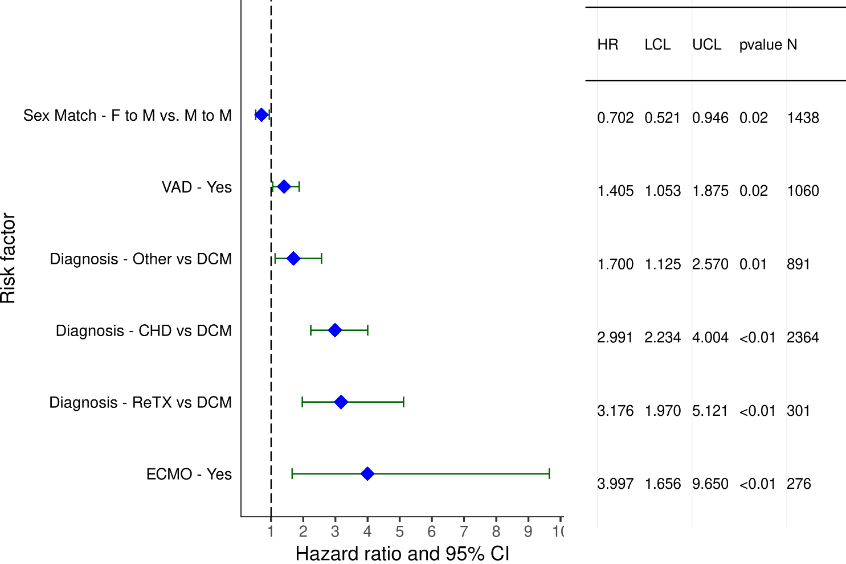
Pediatric Heart Transplants (1/2006-6/2017)
Statistically Significant Risk Factors For 1 Year Mortality with 95% Confidence Limits
2019
(N = 6,691)
JHLT. 2019 Oct; 38(10): 1015-1066
Notes:
Weight match = [(donor weight – recipient weight) / recipient weight] x 100
Height match = [(donor height – recipient height) / recipient height] x 100

Slide 216
Pediatric Heart Transplants (1/2006-6/2017)
Statistically Significant Risk Factors For 1 Year Mortality
Continuous Factors (see figures)
Ischemic time (hours) | Recipient eGFR (mL/min/1.73 m2)
Recipient bilirubin (mg/dl)
Note: Donor-recipient weight match was not statistically significant (p = 0.0955).
2019
JHLT. 2019 Oct; 38(10): 1015-1066
Notes:
Weight match = [(donor weight – recipient weight) / recipient weight] x 100
Height match = [(donor height – recipient height) / recipient height] x 100

Slide 217
Pediatric Heart Transplants (1/2006-6/2017)
Statistically Significant Risk Factors For 1 Year Mortality with 95% Confidence Limits
Ischemic time (hours)
p = 0.0098
2019
(N = 6,691)
JHLT. 2019 Oct; 38(10): 1015-1066
Notes:
Weight match = [(donor weight – recipient weight) / recipient weight] x 100
Height match = [(donor height – recipient height) / recipient height] x 100

Slide 218
Pediatric Heart Transplants (1/2006-6/2017)
Recipient eGFR (mL/min/1.73 m2)
Statistically Significant Risk Factors For 1 Year Mortality with 95% Confidence Limits
p < 0.0001
2019
(N = 6,691)
JHLT. 2019 Oct; 38(10): 1015-1066
Notes:
Weight match = [(donor weight – recipient weight) / recipient weight] x 100
Height match = [(donor height – recipient height) / recipient height] x 100

Slide 219
Pediatric Heart Transplants (1/2006-6/2017)
Statistically Significant Risk Factors For 1 Year Mortality with 95% Confidence Limits
Recipient bilirubin (mg/dl)
p = 0.0138
2019
(N = 6,691)
JHLT. 2019 Oct; 38(10): 1015-1066
Notes:
Weight match = [(donor weight – recipient weight) / recipient weight] x 100
Height match = [(donor height – recipient height) / recipient height] x 100

Slide 220
Pediatric Heart Transplants (1/2006-6/2017)
Donor-recipient weight match (%)
Risk Factors For 1 Year Mortality with 95% Confidence Limits
2019
(N = 6,691)
JHLT. 2019 Oct; 38(10): 1015-1066
Notes:
Weight match = [(donor weight – recipient weight) / recipient weight] x 100
Height match = [(donor height – recipient height) / recipient height] x 100

Slide 221
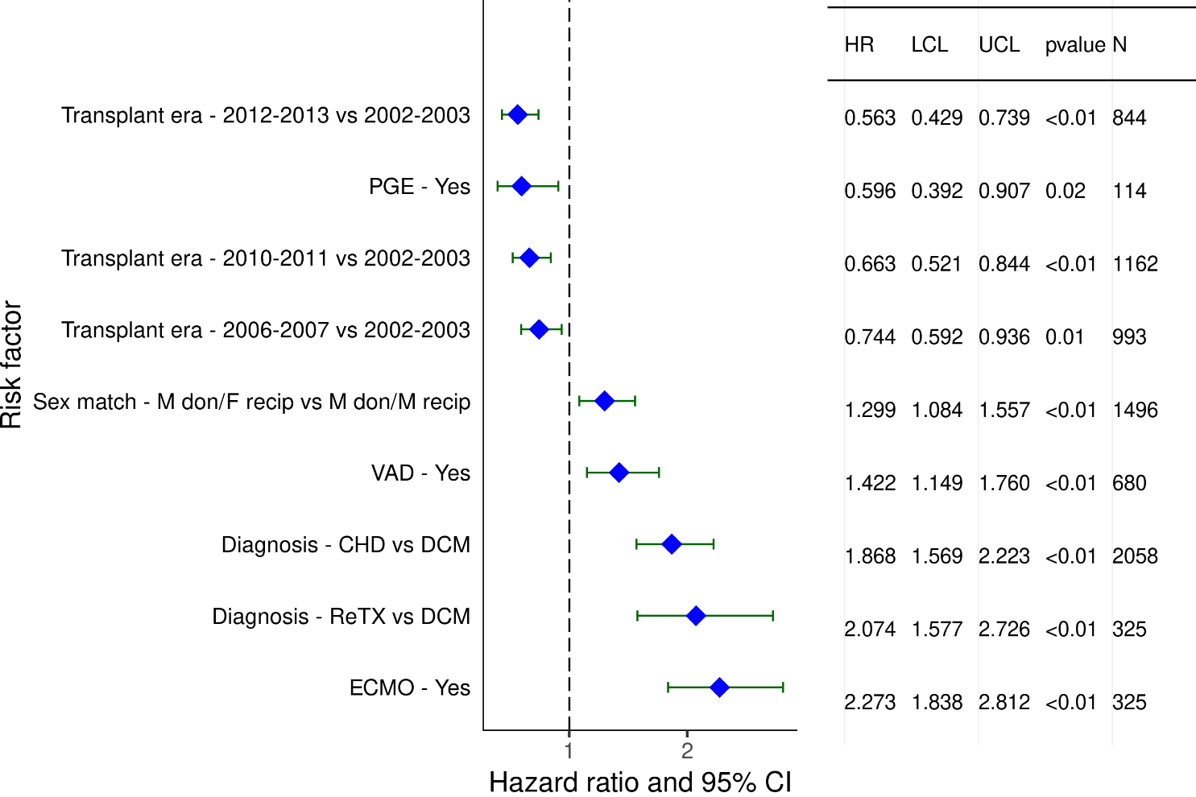
Pediatric Heart Transplants (1/2002-6/2013)
Statistically Significant Risk Factors For 5 Year Mortality with 95% Confidence Limits
2019
(N = 5,986)
JHLT. 2019 Oct; 38(10): 1015-1066
Notes:
Weight match = [(donor weight – recipient weight) / recipient weight] x 100
Height match = [(donor height – recipient height) / recipient height] x 100

Slide 222
Pediatric Heart Transplants (1/2002-6/2013)
Statistically Significant Risk Factors For 5 Year Mortality
Continuous Factors (see figures)
Recipient age (years) | Donor age (years)
Ischemic time (hours) | Recipient eGFR (mL/min/1.73 m2)
Note: Donor-recipient height match was not statistically significant (p-value = 0.2672).
2019
JHLT. 2019 Oct; 38(10): 1015-1066
Notes:
Weight match = [(donor weight – recipient weight) / recipient weight] x 100
Height match = [(donor height – recipient height) / recipient height] x 100

Slide 223
Pediatric Heart Transplants (1/2002-6/2013)
Statistically Significant Risk Factors For 5 Year Mortality with 95% Confidence Limits
Recipient age (years)
p < 0.0001
2019
(N = 5,986)
JHLT. 2019 Oct; 38(10): 1015-1066
Notes:
Weight match = [(donor weight – recipient weight) / recipient weight] x 100
Height match = [(donor height – recipient height) / recipient height] x 100

Slide 224
Pediatric Heart Transplants (1/2002-6/2013)
Statistically Significant Risk Factors For 5 Year Mortality with 95% Confidence Limits
Donor age (years)
p = 0.0057
2019
(N = 5,986)
JHLT. 2019 Oct; 38(10): 1015-1066
Notes:
Weight match = [(donor weight – recipient weight) / recipient weight] x 100
Height match = [(donor height – recipient height) / recipient height] x 100

Slide 225
Pediatric Heart Transplants (1/2002-6/2013)
Statistically Significant Risk Factors For 5 Year Mortality with 95% Confidence Limits
Ischemic time (hours)
p = 0.0033
2019
(N = 5,986)
JHLT. 2019 Oct; 38(10): 1015-1066
Notes:
Weight match = [(donor weight – recipient weight) / recipient weight] x 100
Height match = [(donor height – recipient height) / recipient height] x 100

Slide 226
Pediatric Heart Transplants (1/2002-6/2013)
Statistically Significant Risk Factors For 5 Year Mortality with 95% Confidence Limits
Recipient eGFR (mL/min/1.73 m2)
p < 0.0001
2019
(N = 5,986)
JHLT. 2019 Oct; 38(10): 1015-1066
Notes:
Weight match = [(donor weight – recipient weight) / recipient weight] x 100
Height match = [(donor height – recipient height) / recipient height] x 100

Slide 227
Pediatric Heart Transplants (1/2002-6/2018)
Donor-recipient height match (%)
Risk Factors For 5 Year Mortality with 95% Confidence Limits
2019
(N = 5,986)
JHLT. 2019 Oct; 38(10): 1015-1066
Notes:
Weight match = [(donor weight – recipient weight) / recipient weight] x 100
Height match = [(donor height – recipient height) / recipient height] x 100

