Slide 1

HEART TRANSPLANTATION
Adult Recipients
2019
JHLT. 2019 Oct; 38(10): 1015-1066

Slide 2
Table of Contents
Donor and recipient characteristics: slides 3-21
Immunosuppression: slides 22-32
Survival analyses: slides 33-60
Morbidity: slides 61-78
Multivariable analyses: slides 79-104
Focus theme: slides 105-187
  Donor-recipient size match (version 1): slides 105-146
    Select characteristics: slides 106-117
    Post-transplant outcomes: slides 118-125
    Multivariable analyses: slides 126-146
  Donor-recipient size match (version 2): slides 147-187
    Select characteristics: slides 148-159
    Post-transplant outcomes: slides 160-167
    Multivariable analyses: slides 168-187
2019
JHLT. 2019 Oct; 38(10): 1015-1066

Slide 3
Donor and Recipient Characteristics:
Diagnosis: slides 4-6, 11,17
Retransplants by year: slide 7
Recipient and donor characteristics: slides 8-21
2019
JHLT. 2019 Oct; 38(10): 1015-1066

Slide 4
Adult Heart Transplants
Diagnosis
1/1982 – 6/2018
1/2010 – 6/2018
2019
JHLT. 2019 Oct; 38(10): 1015-1066

Slide 5
Adult Heart Transplants
Diagnosis by Location
(Transplants: January 2010 – June 2018)
2019
JHLT. 2019 Oct; 38(10): 1015-1066

Slide 6
Adult Heart Transplants
Diagnosis by Age Group
(Transplants: January 2010 – June 2018)
2019
2019
JHLT. 2019 Oct; 38(10): 1015-1066
JHLT. 2019 Oct; 38(10): 1015-1066

Slide 7
Adult Heart Retransplants by Year of Retransplant
2019
JHLT. 2019 Oct; 38(10): 1015-1066

Slide 8
Adult Heart Transplants
Donor and Recipient Characteristics
 | 1992-2000 (N = 37,794) | 2001-2009 (N = 33,625) | 2010-6/2018 (N = 36,883) | pvalue
Recipient age (years) | 54.0 (28.0 - 65.0) | 54.0 (25.0 - 66.0) | 55.0 (25.0 - 68.0) | <0.0001
Donor age (years) | 31.0 (15.0 - 54.0) | 34.0 (16.0 - 56.0) | 35.0 (17.0 - 58.0) | <0.0001
Donor and recipient age difference (years) | -19.0 (-44.0 - 7.0) | -17.0 (-43.0 - 11.0) | -16.0 (-43.0 - 13.0) | <0.0001
Recipient weight (kg) | 75.3 (53.0 - 102.0) | 78.0 (53.5 - 107.0) | 80.1 (54.0 - 109.8) | <0.0001
Recipient height (cm) | 173.0 (157.0 - 188.0) | 174.0 (157.5 - 188.0) | 174.0 (157.0 - 188.0) | 0.0042
Recipient BMI | 25.0 (19.0 - 32.5) | 25.7 (19.3 - 34.0) | 26.5 (19.5 - 34.9) | <0.0001
Donor weight (kg) | 74.8 (52.0 - 102.1)¹ | 77.6 (55.0 - 110.0) | 80.0 (57.0 - 115.2) | <0.0001
Donor height (cm) | 175.0 (157.0 - 188.0) ¹ | 175.3 (159.0 - 190.0) | 175.0 (157.5 - 188.0) | <0.0001
Donor BMI | 24.2 (18.8 - 32.8) ¹ | 25.1 (19.6 - 35.2) | 26.0 (19.9 - 37.5) | <0.0001
Continuous factors are expressed as median (5th – 95th percentiles)
2019
¹ Based on 4/1994-2000 transplants.
JHLT. 2019 Oct; 38(10): 1015-1066
Notes:
Comparisons for categorical variables were made using the chi-square statistic. Multiple groups were compared using single p-value.
Comparisons for continuous variables were made using Kruskal-Wallis test.
A significant p-value means that at least one of the groups is different than the others but it doesn’t identify which group it is.

Slide 9
Adult Heart Transplants
Donor and Recipient Characteristics
 | 1992-2000 (N = 37,794) | 2001-2009 (N = 33,625) | 2010-6/2018 (N = 36,883) | pvalue
Donor/recipient sex (% male) | 68.5%/ 80.7% | 69.4%/ 77.6% | 67.9%/ 74.4% | 0.0001/ <0.0001
Female donor-to-male recipient | 21.30% | 17.80% | 16.10% | <0.0001
Male donor-to-female recipient | 9.20% | 9.70% | 9.70% | 0.0426
Donor/recipient diabetes mellitus | 1.5%¹/ 13.3%¹ | 2.3%/ 22.0% | 3.5%/ 26.9% | <0.0001/ <0.0001
Recipient history of prior dialysis | 3.00% | 4.10% | 4.80% | <0.0001
Donor/recipient cigarette history | 37.9%¹/- | 25.9%/48.9%² | 14.5%/ 44.9% | <0.0001/ <0.0001
Donor/recipient hypertension | 10.8%¹/ 34.6%¹ | 12.3%/ 40.8% | 15.4%/ 51.1% | <0.0001/ <0.0001
Recipient prior cardiac surgery | - | 41.5%² | 50.30% | <0.0001
Recipient previous malignancy | 3.7%¹ | 5.80% | 8.60% | <0.0001
Ischemic time (hours) | 2.9 (1.3 - 4.8) | 3.2 (1.6 - 5.0) | 3.2 (1.5 - 5.0) | <0.0001
(Cont’d)
Continuous factors are expressed as median (5th – 95th percentiles)
2019
¹ Based on 4/1994-2000 transplants.
² Based on 7/2004-2009 transplants.
JHLT. 2019 Oct; 38(10): 1015-1066
Notes:
Comparisons for categorical variables were made using the chi-square statistic. Multiple groups were compared using single p-value.
Comparisons for continuous variables were made using Kruskal-Wallis test.
A significant p-value means that at least one of the groups is different than the others but it doesn’t identify which group it is.

Slide 10
Adult Heart Transplants
Donor and Recipient Characteristics
 | 1992-2000 (N = 37,794) | 2001-2009 (N = 33,625) | 2010-6/2018 (N = 36,883) | pvalue
PRA > 10%¹ | 7.4% | 13.4% | 22.0% | <0.0001
PRA (%)¹ | 0.0 (0.0 - 21.0) | 0.0 (0.0 - 50.0) | 0.0 (0.0 - 71.0) | <0.0001
Creatinine at time of transplant (mg/dL) | 1.2 (0.7 - 2.4) | 1.2 (0.7 - 2.4) | 1.2 (0.7 - 2.3) | <0.0001
Pulmonary vascular resistance (Wood units) | 2.2 (0.2 - 6.2)² | 2.1 (0.0 - 5.7) | 2.0 (0.0 - 5.3) | <0.0001
HLA mismatches
0-2 | 4.3% | 4.0% | 3.9% | <0.0001
3-4 | 40.3% | 39.7% | 38.2%
5-6 | 55.4% | 56.3% | 57.9%
Continuous factors are expressed as median (5th – 95th percentiles)
(Cont’d)
¹ CPRA and PRA values were combined. If Class I and Class II PRA values were reported separately, the higher of the two values was used.
2019
² Based on 4/1994-2000 transplants.
JHLT. 2019 Oct; 38(10): 1015-1066
Notes:
Comparisons for categorical variables were made using the chi-square statistic. Multiple groups were compared using single p-value.
Comparisons for continuous variables were made using Kruskal-Wallis test.
A significant p-value means that at least one of the groups is different than the others but it doesn’t identify which group it is.

Slide 11
Adult Heart Transplants
Donor and Recipient Characteristics
 | 1992-2000 (N = 37,794) | 2001-2009 (N = 33,625) | 2010-6/2018 (N = 36,883) | pvalue
Diagnosis
CHD | 1.7% | 2.7% | 3.1% | <0.0001
HCM | 1.1% | 2.7% | 3.4%
ICM | 45.1% | 39.2% | 32.4%
NICM | 44.1% | 46.1% | 50.8%
RCM | 1.2% | 2.3% | 3.5%
Retransplant | 2.6% | 2.9% | 2.8%
VCM | 3.9% | 3.4% | 2.5%
Other | 0.3% | 0.6% | 1.5%
Donor cause of death
Head Trauma | 44.9% | 48.8% | 40.5% | <0.0001
Stroke | 28.2% | 26.4% | 19.9%
Anoxia | 3.8% | 7.7% | 21.5%
CNS tumor | 1.0% | 0.9% | 0.5%
Other | 22.0% | 16.2% | 17.7%
2019
(Cont’d)
JHLT. 2019 Oct; 38(10): 1015-1066
Notes:
Comparisons for categorical variables were made using the chi-square statistic. Multiple groups were compared using single p-value.
Comparisons for continuous variables were made using Kruskal-Wallis test.
A significant p-value means that at least one of the groups is different than the others but it doesn’t identify which group it is.

Slide 12
Adult Heart Transplants
Donor and Recipient Characteristics
 | 1992-2000 (N = 37,794) | 2001-2009 (N = 33,625) | 2010-6/2018 (N = 36,883) | pvalue
Pre-operative support (multiple items may be reported)
Hospitalized at time of transplant | 61.1% | 47.6% | 44.5% | <0.0001
On IV inotropes | 56.7%¹ | 49.0% | 39.1% | <0.0001
Ventilator | 3.3% | 3.3% | 1.7% | <0.0001
IABP | 6.4% | 7.1% | 7.3% | 0.0007
Mechanical circulatory support | - | 25.1%² | 45.1% | <0.0001
LVAD | - | 23.5%² | 42.9% | <0.0001
RVAD | - | 4.1%² | 2.9% | <0.0001
TAH | - | 0.6%² | 1.3% | <0.0001
ECMO | - | 1.0%² | 1.2% | 0.1662
(Cont’d)
¹ Based on 4/1994-2000 transplants.
² Based on 2005-2009 transplants.
2019
JHLT. 2019 Oct; 38(10): 1015-1066
Notes:
Comparisons for categorical variables were made using the chi-square statistic. Multiple groups were compared using single p-value.
Comparisons for continuous variables were made using Kruskal-Wallis test.
A significant p-value means that at least one of the groups is different than the others but it doesn’t identify which group it is.

Slide 13
Adult Heart Transplants
Donor and Recipient Age
(Transplants: January 2010 – June 2018)
2019
JHLT. 2019 Oct; 38(10): 1015-1066

Slide 14
Adult Heart Transplants
Donor and Recipient Sex by Location
(Transplants: January 2010 – June 2018)
Donor
Recipient
2019
JHLT. 2019 Oct; 38(10): 1015-1066

Slide 15
Adult Heart Transplants
% of Patients Bridged with Mechanical Circulatory Support*
(Transplants: January 2005 – December 2017)
2019
* LVAD, RVAD, TAH, ECMO
JHLT. 2019 Oct; 38(10): 1015-1066

Slide 16
Adult Heart Transplants
% of Patients Bridged with Mechanical Circulatory Support* by Year and Device Type
2019
* LVAD, RVAD, TAH, ECMO
JHLT. 2019 Oct; 38(10): 1015-1066

Slide 17
Adult Heart Transplants
Number and % of Combined Organ Transplants Reported by Year and Type of Transplant
2019
JHLT. 2019 Oct; 38(10): 1015-1066

Slide 18
Adult Heart Transplants
Recipient BMI Distribution by Location
(Transplants: January 2010 – June 2018)
2019
JHLT. 2019 Oct; 38(10): 1015-1066

Slide 19
Adult Heart Transplants
Recipient Diabetes Mellitus Distribution by Location
(Transplants: January 2010 – June 2018)
2019
JHLT. 2019 Oct; 38(10): 1015-1066

Slide 20
Adult Heart Transplants
Recipient Cigarette History by Location
(Transplants: January 2010 – June 2018)
2019
JHLT. 2019 Oct; 38(10): 1015-1066

Slide 21
Adult Heart Transplants
Ischemic Time Distribution by Location
(Transplants: January 2010 – June 2018)
2019
JHLT. 2019 Oct; 38(10): 1015-1066

Slide 22
Immunosuppression:
Induction: slides 23-25
Maintenance: slides 26-28
Rejection: slides 29-32
2019
JHLT. 2019 Oct; 38(10): 1015-1066

Slide 23
Adult Heart Transplants
Induction Immunosuppression
(Transplants: January 2010 – June 2018)
N = 20,088
2019
Analysis is limited to patients who were alive at the time of discharge.
JHLT. 2019 Oct; 38(10): 1015-1066

Slide 24
Adult Heart Transplants
Induction Immunosuppression by Location
(Transplants: January 2010 – June 2018)
2019
Analysis is limited to patients who were alive at the time of discharge.
JHLT. 2019 Oct; 38(10): 1015-1066

Slide 25
Adult Heart Transplants
Kaplan-Meier Survival by Induction Type
Conditional on Survival to 14 Days
(Transplants: January 2005 – June 2017)
No pairwise comparisons were significant at p < 0.05.
2019
JHLT. 2019 Oct; 38(10): 1015-1066
Notes:
Survival was calculated using the Kaplan-Meier method, which incorporates information from all transplants for whom any follow-up has been provided. Since many patients are still alive and some patients have been lost to follow-up, the survival rates are estimates rather than exact rates because the time of death is not known for all patients.
Survival rates were compared using the log-rank test statistic. Adjustments for multiple comparisons were done using Scheffe’s method.

Slide 26
Adult Heart Transplants
Maintenance Immunosuppression at Time of 1 Year
Follow-up
(Follow-ups: January 2010 – June 2018)
N = 17,490
2019
Analysis is limited to patients who were alive at the time of follow-up.
JHLT. 2019 Oct; 38(10): 1015-1066

Slide 27
Adult Heart Transplants
Maintenance Immunosuppression at Time of 1 Year Follow-up by Year
NOTE: Different patients are analyzed in each timeframe.
2019
Analysis is limited to patients who were alive at the time of follow-up.
JHLT. 2019 Oct; 38(10): 1015-1066
Notes:
This figure shows the maintenance immunosuppression reported as being provided at the time of the 1-year annual follow-up forms. As different patients were transplanted each year this figure does not represent changes in immunosuppression for individual patients but may represent changes in practice.

Slide 28
Adult Heart Transplants
Maintenance Immunosuppression Drug Combinations at
Time of 1 Year Follow-up
(Follow-ups: January 2010 – June 2018)
2019
Analysis is limited to patients who were alive at the time of follow-up.
JHLT. 2019 Oct; 38(10): 1015-1066

Slide 29
Adult Heart Transplants
% of Recipients Experiencing Treated Rejection Between Transplant Discharge and 1-Year Follow-Up by Transplant Era
p<0.0001
Treated rejection = Recipient was reported to (1) have at least one acute rejection episode that was treated with an anti-rejection agent; or (2) have been hospitalized for rejection.
2019
JHLT. 2019 Oct; 38(10): 1015-1066

Slide 30
Adult Heart Transplants
% of Recipients Experiencing Treated Rejection Between Transplant Discharge and 1-Year Follow-Up by Type of Induction
(Follow-ups: January 2005 – June 2018)
No Induction vs. Polyclonal: p = 0.0398; No Induction vs. IL-2R Antagonist: p = 0.0370;
Polyclonal vs. IL-2R Antagonist: p = 0.9999
Treated rejection = Recipient was reported to (1) have at least one acute rejection episode that was treated with an anti-rejection agent; or (2) have been hospitalized for rejection.
Analysis is limited to patients who were alive at the time of the follow-up.
2019
JHLT. 2019 Oct; 38(10): 1015-1066
Notes:
Comparisons were made using the chi-square statistic. Adjustments for multiple comparisons were done using Bonferroni method.

Slide 31
Adult Heart Transplants
% of Recipients Experiencing Treated Rejection Between Transplant Discharge and 1-Year Follow-Up by Maintenance
Immunosuppression
(Follow-ups: January 2005 – June 2018)
p<0.0001
Analysis is limited to patients who were alive at the time of the follow-up.
Treated rejection = Recipient was reported to (1) have at least one acute rejection episode that was treated with an anti-rejection agent; or (2) have been hospitalized for rejection.
2019
JHLT. 2019 Oct; 38(10): 1015-1066
Notes:
Comparisons were made using the chi-square statistic.

Slide 32
Adult Heart Transplants
Freedom from Hospitalization for Rejection by Era
(Transplants: January 1995 – June 2017)
All pairwise comparisons were statistically significant at p < 0.001.
2019
JHLT. 2019 Oct; 38(10): 1015-1066
Notes:
Freedom from hospitalization for rejection rates by era were computed using the Kaplan-Meier method.
Hospitalizations for rejections are reported on annual follow-ups; a date of diagnosis is not provided. For this figure the midpoint between the date of previous follow-up (when event had not occurred) and the date of follow-up when the event was reported was used as the date of occurrence. Patients were included in the analysis until an unknown response for the outcome of interest was reported. Therefore, the rates seen here may differ from those reported in the cumulative prevalence slide which is based on only those patients with known responses for each of the outcomes at all follow-up time points.
Rates were compared using the log-rank test statistic. Adjustments for multiple comparisons were done using Scheffe’s method.

Slide 33
Survival Analyses:
by era: slides 34-35, 47-51 and 57
by diagnosis: slides 36-38 and 47-51
by transplant type: slides 39-40 and 57
by age group: slides 41-42
by sex: slides 43-46
by PVR: slide 52
by recipient BMI: slide 53
by diabetes mellitus: slide 54
by cigarette history: slide 55
by mechanical circulatory support use: slides 56
by induction and immunosuppression: slides 25
cause of death: slides 58-60
2018
JHLT. 2019 Oct; 38(10): 1015-1066

Slide 34
Adult Heart Transplants
Kaplan-Meier Survival by Era
(Transplants: January 1982 – June 2017)
All pairwise comparisons were statistically significant at p < 0.0001.
Median survival (years):
1982-1991=8.6; 1992-2001=10.5; 2002-2009=12.5; 2010-6/2017=NA
2019
JHLT. 2019 Oct; 38(10): 1015-1066
Notes:
Survival was calculated using the Kaplan-Meier method, which incorporates information from all transplants for whom any follow-up has been provided. Since many patients are still alive and some patients have been lost to follow-up, the survival rates are estimates rather than exact rates because the time of death is not known for all patients. The median survival is the estimated time point at which 50% of all of the recipients have died.
Survival rates were compared using the log-rank test statistic. Adjustments for multiple comparisons were done using Scheffe’s method.

Slide 35
Adult Heart Transplants
Kaplan-Meier Survival by Era Conditional on Survival to 1
Year
(Transplants: January 1982 – June 2017)
All pairwise comparisons were statistically significant at p < 0.05 except 2002-2009 vs. 2010-6/2017.
Median survival (years):
1982-1991=11.9; 1992-2001=13.2; 2002-2009=14.8; 2010-6/2017=NA
2019
JHLT. 2019 Oct; 38(10): 1015-1066
Notes:
Survival was calculated using the Kaplan-Meier method, which incorporates information from all transplants for whom any follow-up has been provided. Since many patients are still alive and some patients have been lost to follow-up, the survival rates are estimates rather than exact rates because the time of death is not known for all patients. Conditional survival is shown in this figure; this is the survival following 1 year for all patients who survived to 1 year. The conditional median survival is the estimated time point at which 50% of the recipients who survive to at least 1 year have died.
Survival rates were compared using the log-rank test statistic. Adjustments for multiple comparisons were done using Scheffe’s method.

Slide 36
Adult Heart Transplants
Kaplan-Meier Survival Within 1 Year by Diagnosis
(Transplants: January 1982 – June 2017)
All pairwise comparisons were statistically significant at
p < 0.05 except CHD Vs. VCM
2019
JHLT. 2019 Oct; 38(10): 1015-1066
Notes:
Survival was calculated using the Kaplan-Meier method, which incorporates information from all transplants for whom any follow-up has been provided. Since many patients are still alive and some patients have been lost to follow-up, the survival rates are estimates rather than exact rates because the time of death is not known for all patients.
Survival rates were compared using the log-rank test statistic. Adjustments for multiple comparisons were done using Scheffe’s method.

Slide 37
Adult Heart Transplants
Kaplan-Meier Survival by Diagnosis
(Transplants: January 2005 – June 2017)
All pairwise comparisons were significant at p < 0.05 except:
CHD vs. ICM, NICM, and VCM;
ICM vs. VCM and Retransplant vs. VCM.
2019
JHLT. 2019 Oct; 38(10): 1015-1066
Notes:
Survival was calculated using the Kaplan-Meier method, which incorporates information from all transplants for whom any follow-up has been provided. Since many patients are still alive and some patients have been lost to follow-up, the survival rates are estimates rather than exact rates because the time of death is not known for all patients.
Survival rates were compared using the log-rank test statistic. Adjustments for multiple comparisons were done using Scheffe’s method. Results of log-rank test should be interpreted with caution when curves cross.

Slide 38
Adult Heart Transplants
Kaplan-Meier Survival by Diagnosis Conditional on Survival
to 1 Year
(Transplants: January 2005 – June 2017)
All pairwise comparisons were significant at p < 0.05 except
CHD vs. NICM and VCM;
ICM vs. Retransplant and NICM vs. VCM.
2019
JHLT. 2019 Oct; 38(10): 1015-1066
Notes:
Survival was calculated using the Kaplan-Meier method, which incorporates information from all transplants for whom any follow-up has been provided. Since many patients are still alive and some patients have been lost to follow-up, the survival rates are estimates rather than exact rates because the time of death is not known for all patients.
Survival rates were compared using the log-rank test statistic. Adjustments for multiple comparisons were done using Scheffe’s method. Results of log-rank test should be interpreted with caution when curves cross.
Conditional survival was performed by limiting the group of patients analyzed to those who have survived to at least 1 year. Thus it is possible to examine longer term survival after excluding early deaths.

Slide 39
Adult Heart Transplants
Kaplan-Meier Survival by Transplant Type
(Transplants: January 1992 – June 2017)
p<0.0001
Median survival (years): Primary=11.6; Retransplant=8.2
2019
JHLT. 2019 Oct; 38(10): 1015-1066
Notes:
Survival was calculated using the Kaplan-Meier method, which incorporates information from all transplants for whom any follow-up has been provided. Since many patients are still alive and some patients have been lost to follow-up, the survival rates are estimates rather than exact rates because the time of death is not known for all patients. The median survival is the estimated time point at which 50% of all of the recipients have died.
Survival rates were compared using the log-rank test statistic.

Slide 40
Adult Heart Transplants
Kaplan-Meier Survival by Transplant Type Conditional on
Survival to 1 Year
(Transplants: January 1992 – June 2017)
p<0.0001
Median survival (years): Primary=13.9; Retransplant=12.4
2019
JHLT. 2019 Oct; 38(10): 1015-1066
Notes:
Survival was calculated using the Kaplan-Meier method, which incorporates information from all transplants for whom any follow-up has been provided. Since many patients are still alive and some patients have been lost to follow-up, the survival rates are estimates rather than exact rates because the time of death is not known for all patients. Conditional survival is shown in this figure; this is the survival following 1 year for all patients who survived to 1 year. The conditional median survival is the estimated time point at which 50% of the recipients who survive to at least 1 year have died.
Survival rates were compared using the log-rank test statistic.

Slide 41
Adult Heart Transplants
Kaplan-Meier Survival by Recipient Age Group (Years)
(Transplants: January 2010 – June 2017)
All pairwise comparisons were significant at p < 0.05 except 18-39 vs. 40-59 and 60-69 vs 70+.
2019
JHLT. 2019 Oct; 38(10): 1015-1066
Notes:
Survival was calculated using the Kaplan-Meier method, which incorporates information from all transplants for whom any follow-up has been provided. Since many patients are still alive and some patients have been lost to follow-up, the survival rates are estimates rather than exact rates because the time of death is not known for all patients.
Survival rates were compared using the log-rank test statistic. Adjustments for multiple comparisons were done using Scheffe’s method. Results of log-rank test should be interpreted with caution when curves cross.

Slide 42
Adult Heart Transplants
Kaplan-Meier Survival by Donor Age Group (Years)
(Transplants: January 1992 – June 2017)
Median survival (years):
0-10=11.8; 11-39=12.2; 40-59=10.4; 60+=7.6
All pairwise comparisons were significant at p < 0.05 except 0-10 vs. 11-39 and 0-10 vs. 40-59.
2019
JHLT. 2019 Oct; 38(10): 1015-1066
Notes:
Survival was calculated using the Kaplan-Meier method, which incorporates information from all transplants for whom any follow-up has been provided. Since many patients are still alive and some patients have been lost to follow-up, the survival rates are estimates rather than exact rates because the time of death is not known for all patients. The median survival is the estimated time point at which 50% of all of the recipients have died.
Survival rates were compared using the log-rank test statistic. Adjustments for multiple comparisons were done using Scheffe’s method. Results of log-rank test should be interpreted with caution when curves cross.

Slide 43
Adult Heart Transplants
Kaplan-Meier Survival by Recipient Sex
(Transplants: January 1992 – June 2017)
p<0.0001
Median survival (years): Male=11.4; Female=12.2
2019
JHLT. 2019 Oct; 38(10): 1015-1066
Notes:
Survival was calculated using the Kaplan-Meier method, which incorporates information from all transplants for whom any follow-up has been provided. Since many patients are still alive and some patients have been lost to follow-up, the survival rates are estimates rather than exact rates because the time of death is not known for all patients. The median survival is the estimated time point at which 50% of all of the recipients have died.
Survival rates were compared using the log-rank test statistic.

Slide 44
Adult Heart Transplants
Kaplan-Meier Survival by Recipient Sex Conditional on
Survival to 1 Year
(Transplants: January 1992 – June 2017)
p<0.0001
Median survival (years): Male=13.6; Female=14.8
2019
JHLT. 2019 Oct; 38(10): 1015-1066
Notes:
Survival was calculated using the Kaplan-Meier method, which incorporates information from all transplants for whom any follow-up has been provided. Since many patients are still alive and some patients have been lost to follow-up, the survival rates are estimates rather than exact rates because the time of death is not known for all patients. Conditional survival is shown in this figure; this is the survival following 1 year for all patients who survived to 1 year. The conditional median survival is the estimated time point at which 50% of the recipients who survive to at least 1 year have died.
Survival rates were compared using the log-rank test statistic.

Slide 45
Adult Heart Transplants
Kaplan-Meier Survival by Donor/Recipient Sex
(Transplants: January 1992 – June 2017)
All pairwise comparisons were significant at p < 0.05 except Male/Female vs. Female/Female and Male/Male.
Median survival (years): Male/Male=11.7; Male/Female=12.0; Female/Male=10.5; Female/Female=12.4
2019
JHLT. 2019 Oct; 38(10): 1015-1066
Notes:
Survival was calculated using the Kaplan-Meier method, which incorporates information from all transplants for whom any follow-up has been provided. Since many patients are still alive and some patients have been lost to follow-up, the survival rates are estimates rather than exact rates because the time of death is not known for all patients. The median survival is the estimated time point at which 50% of all of the recipients have died.
Survival rates were compared using the log-rank test statistic. Adjustments for multiple comparisons were done using Scheffe’s method.

Slide 46
Adult Heart Transplants
Kaplan-Meier Survival by Donor/Recipient Sex Conditional on Survival to 1 Year
(Transplants: January 1992 – June 2017)
All pairwise comparisons were significant at p < 0.05 except Male/Female vs. Female/Female.
Median survival (years):
Male/Male=13.8; Male/Female=14.6; Female/Male=13.2; Female/Female=14.9
2019
JHLT. 2019 Oct; 38(10): 1015-1066
Notes:
Survival was calculated using the Kaplan-Meier method, which incorporates information from all transplants for whom any follow-up has been provided. Since many patients are still alive and some patients have been lost to follow-up, the survival rates are estimates rather than exact rates because the time of death is not known for all patients. Conditional survival is shown in this figure; this is the survival following 1 year for all patients who survived to 1 year. The conditional median survival is the estimated time point at which 50% of the recipients who survive to at least 1 year have died.
Survival rates were compared using the log-rank test statistic. Adjustments for multiple comparisons were done using Scheffe’s method.

Slide 47
Adult Heart Transplants
Diagnosis: CHD
Kaplan-Meier Survival by Era
(Transplants: January 1982 – June 2017)
No pairwise comparisons were significant at p < 0.05 except 1992-2001 vs. 2002-2009 and 2010-6/2017.
Median survival (years):
1982-1991=14.6; 1992-2001=13.0; 2002-2009=NA; 2010-6/2017=NA
2019
JHLT. 2019 Oct; 38(10): 1015-1066
Notes:
Survival was calculated using the Kaplan-Meier method, which incorporates information from all transplants for whom any follow-up has been provided. Since many patients are still alive and some patients have been lost to follow-up, the survival rates are estimates rather than exact rates because the time of death is not known for all patients. The median survival is the estimated time point at which 50% of all of the recipients have died.
Survival rates were compared using the log-rank test statistic. Adjustments for multiple comparisons were done using Scheffe’s method.

Slide 48
Adult Heart Transplants
Diagnosis: ICM
Kaplan-Meier Survival by Era
(Transplants: January 1982 – June 2017)
All pairwise comparisons were significant at p < 0.05 except 2002-2009 vs. 2010-6/2017.
Median survival (years):
1982-1991=8.2; 1992-2001=9.7; 2002-2009=10.7; 2010-6/2017=NA
2019
JHLT. 2019 Oct; 38(10): 1015-1066
Notes:
Survival was calculated using the Kaplan-Meier method, which incorporates information from all transplants for whom any follow-up has been provided. Since many patients are still alive and some patients have been lost to follow-up, the survival rates are estimates rather than exact rates because the time of death is not known for all patients. The median survival is the estimated time point at which 50% of all of the recipients have died.
Survival rates were compared using the log-rank test statistic. Adjustments for multiple comparisons were done using Scheffe’s method.

Slide 49
Adult Heart Transplants
Diagnosis: NICM
Kaplan-Meier Survival by Era
(Transplants: January 1982 – June 2017)
All pairwise comparisons were significant at p < 0.05.
Median survival (years):
1982-1991=10.0; 1992-2001=11.6; 2002-2009=13.7; 2010-6/2017=NA;
2019
JHLT. 2019 Oct; 38(10): 1015-1066
Notes:
Survival was calculated using the Kaplan-Meier method, which incorporates information from all transplants for whom any follow-up has been provided. Since many patients are still alive and some patients have been lost to follow-up, the survival rates are estimates rather than exact rates because the time of death is not known for all patients. The median survival is the estimated time point at which 50% of all of the recipients have died.
Survival rates were compared using the log-rank test statistic. Adjustments for multiple comparisons were done using Scheffe’s method.

Slide 50
Adult Heart Transplants
Diagnosis: Retransplant
Kaplan-Meier Survival by Era
(Transplants: January 1982 – June 2017)
Median survival (years):
1982-1991=1.0; 1992-2001=5.2; 2002-2009=9.4; 2010-6/2017=NA
All pairwise comparisons were significant at p < 0.05 except 2002-2009 vs. 2010-6/2017.
2019
JHLT. 2019 Oct; 38(10): 1015-1066
Notes:
Survival was calculated using the Kaplan-Meier method, which incorporates information from all transplants for whom any follow-up has been provided. Since many patients are still alive and some patients have been lost to follow-up, the survival rates are estimates rather than exact rates because the time of death is not known for all patients. The median survival is the estimated time point at which 50% of all of the recipients have died.
Survival rates were compared using the log-rank test statistic. Adjustments for multiple comparisons were done using Scheffe’s method.

Slide 51
Adult Heart Transplants
Diagnosis: VCM
Kaplan-Meier Survival by Era
(Transplants: January 1982 – June 2017)
All pairwise comparisons were significant at p < 0.05 except 2002-2009 vs. 1992-2001 and 2010-6/2017
Median survival (years):
1982-1991=9.4; 1992-2001=11.4; 2002-2009=12.3; 2010-6/2017=NA
2019
JHLT. 2019 Oct; 38(10): 1015-1066
Notes:
Survival was calculated using the Kaplan-Meier method, which incorporates information from all transplants for whom any follow-up has been provided. Since many patients are still alive and some patients have been lost to follow-up, the survival rates are estimates rather than exact rates because the time of death is not known for all patients. The median survival is the estimated time point at which 50% of all of the recipients have died.
Survival rates were compared using the log-rank test statistic. Adjustments for multiple comparisons were done using Scheffe’s method. Results of log-rank test should be interpreted with caution when curves cross.

Slide 52
Adult Heart Transplants
Kaplan-Meier Survival by PVR (Wood Units)
(Transplants: January 2005 – June 2017)
No pairwise comparisons were significant at p < 0.05.
2019
JHLT. 2019 Oct; 38(10): 1015-1066
Notes:
Survival was calculated using the Kaplan-Meier method, which incorporates information from all transplants for whom any follow-up has been provided. Since many patients are still alive and some patients have been lost to follow-up, the survival rates are estimates rather than exact rates because the time of death is not known for all patients.
Survival rates were compared using the log-rank test statistic. Adjustments for multiple comparisons were done using Scheffe’s method. Results of log-rank test should be interpreted with caution when curves cross.

Slide 53
Adult Heart Transplants
Kaplan-Meier Survival by Recipient BMI Group (kg/m²)
(Transplants: January 2010 – June 2017)
No pairwise comparisons were significant at p < 0.05
except 18.5-<25 vs. 30-<35, 18.5-<25 vs. 35+, and 25-<30 vs. 35+.
2019
JHLT. 2019 Oct; 38(10): 1015-1066
Notes:
Survival was calculated using the Kaplan-Meier method, which incorporates information from all transplants for whom any follow-up has been provided. Since many patients are still alive and some patients have been lost to follow-up, the survival rates are estimates rather than exact rates because the time of death is not known for all patients.
Survival rates were compared using the log-rank test statistic. Adjustments for multiple comparisons were done using Scheffe’s method. Results of log-rank test should be interpreted with caution when curves cross.

Slide 54
Adult Heart Transplants
Kaplan-Meier Survival by Recipient Diabetes Mellitus
(Transplants: January 2005 – June 2017)
p<0.0001
2019
JHLT. 2019 Oct; 38(10): 1015-1066
Notes:
Survival was calculated using the Kaplan-Meier method, which incorporates information from all transplants for whom any follow-up has been provided. Since many patients are still alive and some patients have been lost to follow-up, the survival rates are estimates rather than exact rates because the time of death is not known for all patients.
Survival rates were compared using the log-rank test statistic.

Slide 55
Adult Heart Transplants
Kaplan-Meier Survival by Recipient Cigarette History
(Transplants: January 2005 – June 2017)
p<0.0001
2019
JHLT. 2019 Oct; 38(10): 1015-1066
Notes:
Survival was calculated using the Kaplan-Meier method, which incorporates information from all transplants for whom any follow-up has been provided. Since many patients are still alive and some patients have been lost to follow-up, the survival rates are estimates rather than exact rates because the time of death is not known for all patients.
Survival rates were compared using the log-rank test statistic. Results of log-rank test should be interpreted with caution when curves cross.

Slide 56
Adult Heart Transplants
Kaplan-Meier Survival by Pre-Transplant Mechanical
Circulatory Support Use
(Transplants: January 2010 – June 2017)
No pairwise comparisons were significant at p < 0.05
except ECMO vs. LVAD Continuous and ECMO vs. No LVAD.
2019
JHLT. 2019 Oct; 38(10): 1015-1066
Notes:
Survival was calculated using the Kaplan-Meier method, which incorporates information from all transplants for whom any follow-up has been provided. Since many patients are still alive and some patients have been lost to follow-up, the survival rates are estimates rather than exact rates because the time of death is not known for all patients.
Survival rates were compared using the log-rank test statistic. Adjustments for multiple comparisons were done using Scheffe’s method. Results of log-rank test should be interpreted with caution when curves cross.

Slide 57
Adult Heart Retransplants
Kaplan-Meier 1 Year Survival
p<0.0001
Comparison of survival for interval ≤ 12 months vs. > 12 months:
Comparison of survival for interval ≤ 12 months vs. > 12 months for
2010-6/2017: p<0.0001
20,953
39,191
29,032
31,065
65
114
64
68
44
430
498
537
111
107
62
60
315
250
121
88
Time (Months) Between Previous and Current Transplant
2019
JHLT. 2019 Oct; 38(10): 1015-1066
Notes:
Survival was computed using the Kaplan-Meier method. Rates were compared using the log-rank test statistic. Numbers on the slide show total number of transplants for each era and transplant type.
Rates are shown only for groups with 10 or more patients at risk (alive with follow-up) at 1 year.

Slide 58
Adult Heart Transplants
Cause of Death
(Deaths: January 1995 – June 2018)
Cause of Death | 0-30 Days (N=6,871) | 31 Days - 1 Year (N=5,980) | >1-3 Years (N=4,211) | >3-5 Years (N=3,630) | >5-10 Years (N=9,441) | >10-15 Years (N=7,108) | >15 Years (N=5,695)
Cardiac Allograft Vasculopathy | 83 (1.2%) | 190 (3.2%) | 456 (10.8%) | 449 (12.4%) | 1,153 (12.2%) | 859 (12.1%) | 598 (10.5%)
Acute Rejection | 268 (3.9%) | 474 (7.9%) | 412 (9.8%) | 171 (4.7%) | 176 (1.9%) | 67 (0.9%) | 29 (0.5%)
PTLD | 2 (0.0%) | 57 (1.0%) | 94 (2.2%) | 105 (2.9%) | 305 (3.2%) | 189 (2.7%) | 121 (2.1%)
Malignancy (non-PTLD) | 4 (0.1%) | 137 (2.3%) | 517 (12.3%) | 712 (19.6%) | 2,081 (22.0%) | 1,525 (21.5%) | 1,103 (19.4%)
CMV | 3 (0.0%) | 51 (0.9%) | 19 (0.5%) | 5 (0.1%) | 8 (0.1%) | 6 (0.1%) | 2 (0.0%)
Infection, Non-CMV | 958 (13.9%) | 1,904 (31.8%) | 561 (13.3%) | 394 (10.9%) | 1,023 (10.8%) | 788 (11.1%) | 702 (12.3%)
Graft Failure | 2,716 (39.5%) | 1,052 (17.6%) | 1,112 (26.4%) | 884 (24.4%) | 1,838 (19.5%) | 1,231 (17.3%) | 944 (16.6%)
Technical | 494 (7.2%) | 94 (1.6%) | 30 (0.7%) | 28 (0.8%) | 93 (1.0%) | 85 (1.2%) | 73 (1.3%)
Multiple Organ Failure | 1,274 (18.5%) | 1,006 (16.8%) | 268 (6.4%) | 209 (5.8%) | 650 (6.9%) | 599 (8.4%) | 530 (9.3%)
Renal Failure | 32 (0.5%) | 53 (0.9%) | 56 (1.3%) | 113 (3.1%) | 512 (5.4%) | 569 (8.0%) | 562 (9.9%)
Pulmonary | 183 (2.7%) | 235 (3.9%) | 179 (4.3%) | 163 (4.5%) | 445 (4.7%) | 336 (4.7%) | 292 (5.1%)
Cerebrovascular | 538 (7.8%) | 332 (5.6%) | 158 (3.8%) | 119 (3.3%) | 446 (4.7%) | 387 (5.4%) | 319 (5.6%)
Other | 316 (4.6%) | 395 (6.6%) | 349 (8.3%) | 278 (7.7%) | 711 (7.5%) | 467 (6.6%) | 420 (7.4%)
Total Deaths (N) | 7,759 | 6,912 | 5,223 | 4,607 | 12,586 | 10,268 | 8,531
2019
Percentages represent % of deaths in the respective time period. Total number of deaths includes deaths with unknown causes.
JHLT. 2019 Oct; 38(10): 1015-1066
Notes:
Only known causes of death are included in the tabulation.

Slide 59
Adult Heart Transplants
Relative Incidence of Leading Causes of Death
(Deaths: January 2010 – June 2018)
2019
Since only leading causes of death are shown, the sum of percentages for each time period is less than 100%.
JHLT. 2019 Oct; 38(10): 1015-1066

Slide 60
Adult Heart Transplants
Cumulative Incidence of Leading Causes of Death
(Transplants: January 2010 – June 2017)
2019
JHLT. 2019 Oct; 38(10): 1015-1066
Notes:
Incidence was computed using a competing-risks extension of the Kaplan-Meier method.

Slide 61
Morbidity:
Length of stay: slides 62-63
Functional status: slide 64
Employment: slides 65
Hospitalization: slide 66
CAV: slides 67-72
Renal dysfunction: slides 67 and 73-74
Malignancy: slides 75-78
Other morbidities: slides 67
2018
JHLT. 2019 Oct; 38(10): 1015-1066

Slide 62
Adult Heart Transplants
Length of Stay by Era
(Transplants: January 2005 – 6/2018)
2019
JHLT. 2019 Oct; 38(10): 1015-1066

Slide 63
Adult Heart Transplants
Length of Stay by Location
(Transplants: January 2005 – 6/2018)
2019
JHLT. 2019 Oct; 38(10): 1015-1066

Slide 64
Adult Heart Transplants
Functional Status of Surviving Recipients by Karnofsky Score
(Follow-ups: January 2010 – June 2018)
2019
JHLT. 2019 Oct; 38(10): 1015-1066
Notes:
This figure shows the functional status reported on the 1-year, 3-year and 5-year annual follow-ups. Because all follow-ups between January 2010 and June 2018 were included, the bars do not include the same patients.

Slide 65
Adult Heart Transplants
Surviving Recipients Working Post-Transplant
Age at Follow-up: 25-60 Years
(Follow-ups: January 2005 – June 2018)
2019
JHLT. 2019 Oct; 38(10): 1015-1066
Notes:
This figure shows the employment status reported on annual follow-ups. Because all follow-ups between 2005 and June 2018 were included, the bars do not include the same patients.

Slide 66
Adult Heart Transplants
Rehospitalization Post Transplant of Surviving Recipients
(Follow-ups: January 2005 – June 2018)
2019
JHLT. 2019 Oct; 38(10): 1015-1066
Notes:
This figure shows the hospitalizations reported on the annual follow-ups, representing the hospitalizations between discharge and 1 year, between the 2-year and 3-year follow-up, and between the 4-year and 5-year follow-ups, respectively. Because all follow-ups between 2005 and June 2018 were included, the bars do not include the same patients.

Slide 67
Adult Heart Transplants
Cumulative Morbidity Rates in Survivors within 1, 5 and 10
Years Post Transplant
(Transplants: January 1995 – June 2017)
Outcome | Within 1 Year | Total N with known response | Within 5 Years | Total N with known response | Within 10 Years | Total N with known response
Severe Renal Dysfunction¹ | 6.7% | (N=39,544) | 15.7% | (N=22,462) | 22.3% | (N=9,195)
Creatinine > 2.5 mg/dl | 5.1% |  | 12.2% |  | 14.3%
Chronic Dialysis | 1.5% |  | 2.9% |  | 6.0%
Renal Transplant | 0.1% |  | 0.6% |  | 2.0%
Diabetes² | 20.0% | (N=39,834) | 33.8% | (N=22,720) | -
Cardiac Allograft Vasculopathy | 7.7% | (N=36,774) | 29.0% | (N=17,392) | 46.8% | (N=5,962)
2019
¹ Severe renal dysfunction = Creatinine > 2.5 mg/dl (221 μmol/L), dialysis, or renal transplant
² Data are not available 10 years post-transplant.
JHLT. 2019 Oct; 38(10): 1015-1066
Notes:
This table shows the percentage of patients experiencing various morbidities as reported within 1, 5 and 10 years following transplantation. The percentages are based on patients with known responses. To reduce bias, only patients with responses reported on every follow-up through the 5-year annual (or 10-year annual) follow-up were included in the 5-year (or 10-year) analysis. Because the outcomes are reported to be unknown at different rates the number with known responses for each outcome are also provided.

Slide 68
Adult Heart Transplants
Freedom from Cardiac Allograft Vasculopathy by Era
(Transplants: January 1995 – June 2017)
p<0.0001
2019
JHLT. 2019 Oct; 38(10): 1015-1066
Notes:
Freedom from CAV rates by era were computed using the Kaplan-Meier method.
The development of CAV is reported on annual follow-ups; a date of diagnosis is not provided. For this figure the midpoint between the date of previous follow-up (when event had not occurred) and the date of follow-up when the event was reported was used as the date of occurrence. Patients were included in the analysis until an unknown response for the outcome of interest was reported. Therefore, the rates seen here may differ from those reported in the cumulative prevalence slide which is based on only those patients with known responses for each of the outcomes at all follow-up time points.
Survival rates were compared using the log-rank test statistic.

Slide 69
Adult Heart Transplants
Freedom from Cardiac Allograft Vasculopathy by Ischemic
Time
(Transplants: January 1995 – June 2017)
No pairwise comparisons were significant at p < 0.05.
2019
JHLT. 2019 Oct; 38(10): 1015-1066
Notes:
Freedom from CAV rates were computed using the Kaplan-Meier method.
The development of CAV is reported on annual follow-ups; a date of diagnosis is not provided. For this figure the midpoint between the date of previous follow-up (when event had not occurred) and the date of follow-up when the event was reported was used as the date of occurrence. Patients were included in the analysis until an unknown response for the outcome of interest was reported. Therefore, the rates seen here may differ from those reported in the cumulative prevalence slide which is based on only those patients with known responses for each of the outcomes at all follow-up time points.
Survival rates were compared using the log-rank test statistic. Adjustments for multiple comparisons were done using Scheffe’s method.

Slide 70
Adult Heart Transplants
Freedom from Cardiac Allograft Vasculopathy by Sex
(Transplants: January 1995 – June 2017)
p<0.0001
2019
JHLT. 2019 Oct; 38(10): 1015-1066
Notes:
Freedom from CAV rates were computed using the Kaplan-Meier method.
The development of CAV is reported on annual follow-ups; a date of diagnosis is not provided. For this figure the midpoint between the date of previous follow-up (when event had not occurred) and the date of follow-up when the event was reported was used as the date of occurrence. Patients were included in the analysis until an unknown response for the outcome of interest was reported. Therefore, the rates seen here may differ from those reported in the cumulative prevalence slide which is based on only those patients with known responses for each of the outcomes at all follow-up time points.
Survival rates were compared using the log-rank test statistic.

Slide 71
Adult Heart Transplants
Survival After Report of CAV Within 3 Years of Transplant and Survival In Patients Without CAV*
(Transplants: January 1995 – June 2017)
p<0.0001
* Patient survival for those without CAV within 3 years after transplant was conditioned on survival to median time of CAV development ( days). Median time to CAV development is based on patients who developed CAV within 3 years of transplant.
2019
518
JHLT. 2019 Oct; 38(10): 1015-1066
Notes:
Survival following CAV and survival from the median time to CAV development were computed using the Kaplan-Meier method.
The development of CAV is reported on annual follow-ups; a date of diagnosis is not provided. For this figure the midpoint between the date of previous follow-up (when event had not occurred) and the date of follow-up when the event was reported was used as the date of occurrence.
Survival rates were compared using the log-rank test statistic.

Slide 72
Adult Heart Transplants
Survival After Report of CAV Within 3 Years of Transplant and Survival In Patients Without CAV* by Era
(Transplants: January 1995 – June 2017)
All pairwise comparisons within each CAV group and within each era were significant at p < 0.05.
* Patient survival for those without CAV within 3 years after transplant was conditioned on survival to median time of CAV development ( days). Median time to CAV development is based on patients who developed CAV within 3 years of transplant.
2019
518
JHLT. 2019 Oct; 38(10): 1015-1066
Notes:
Survival following CAV and survival from the median time to CAV development were computed using the Kaplan-Meier method.
The development of CAV is reported on annual follow-ups; a date of diagnosis is not provided. For this figure the midpoint between the date of previous follow-up (when event had not occurred) and the date of follow-up when the event was reported was used as the date of occurrence.
Survival rates were compared using the log-rank test statistic. Adjustments for multiple comparisons were done using Bonferroni method.

Slide 73
Adult Heart Transplants
Freedom from Severe Renal Dysfunction* by Era
(Transplants: January 1995 – June 2017)
p<0.0001
2019
* Severe renal dysfunction = Creatinine > 2.5 mg/dl (221 μmol/L), dialysis, or renal transplant
JHLT. 2019 Oct; 38(10): 1015-1066
Notes:
Freedom from Severe Renal Dysfunction rates by era were computed using the Kaplan-Meier method.
The development of severe renal dysfunction is reported on annual follow-ups; a date of diagnosis is not provided. For this figure the midpoint between the date of previous follow-up (when event had not occurred) and the date of follow-up when the event was reported was used as the date of occurrence. Patients were included in the analysis until an unknown response for the outcome of interest was reported. Therefore, the rates seen here may differ from those reported in the cumulative prevalence slide which is based on only those patients with known responses for each of the outcomes at all follow-up time points.
Survival rates were compared using the log-rank test statistic.

Slide 74
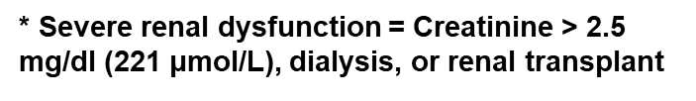
Adult Heart Transplants
Kaplan-Meier Survival by Severe Renal Dysfunction* Within 1st Year Conditional on Survival to 1 Year
(Transplants: January 1995 – June 2016)
p<0.0001
2019
JHLT. 2019 Oct; 38(10): 1015-1066
Notes:
Survival was calculated using the Kaplan-Meier method, which incorporates information from all transplants for whom any follow-up has been provided. Since many patients are still alive and some patients have been lost to follow-up, the survival rates are estimates rather than exact rates because the time of death is not known for all patients.
Survival rates were compared using the log-rank test statistic.

Slide 75
Adult Heart Transplants
Cumulative Morbidity Rates in Survivors
Post Transplant Malignancy
(Transplants: January 1995 – June 2017)
Malignancy/Type |  | 1-Year Survivors | 5-Year Survivors | 10-Year Survivors
No Malignancy |  | 38,866 (94.9%) | 20,974 (84%) | 8,466 (72.3%)
Malignancy (all types combined) |  | 2,068 (5.1%) | 3,997 (16%) | 3,238 (27.7%)
Malignancy Type* | Skin | 695 (1.7%) | 2,395 (9.6%) | 2,166 (18.5%)
 | Lymphoma | 190 (0.5%) | 262 (1%) | 200 (1.7%)
 | Other | 1,148 (2.8%) | 1,562 (6.3%) | 1,192 (10.2%)
 | Type Not Reported | 35 (0.1%) | 28 (0.1%) | 16 (0.1%)
“Other” includes: prostate (8,18,9), adenocarcinoma (5, 2, 1), lung (6, 4, 1), bladder (2, 2, 0), Kaposi's sarcoma (0, 1, 0), breast (1, 3, 1), cervical (2, 3, 2), colon (0,3, 2), and renal (2, 4, 1). Numbers in parentheses are those reported within 1 year, 5 years and 10 years, respectively.
* Recipients may have experienced more than one type of malignancy so the sum of individual malignancy types may be greater than the total number with malignancy.
2019
Skin malignancy includes melanoma and non-melanoma skin cancers.
JHLT. 2019 Oct; 38(10): 1015-1066
Notes:
This table shows the percentage of patients with malignancies reported within 1, 5 and 10 years following transplantation. The percentages are based on patients with known responses. To reduce bias, only patients with responses reported on every follow-up through the 5-year annual follow-up were included in the “5-Year Survivors” column. Similarly, only patients with responses reported on every follow-up through the 10-year annual follow-up were included in the “10-Year Survivors” column.

Slide 76
Adult Heart Transplants
Freedom from Malignancy by Type
(Transplants: January 1995 - June 2017)
2019
Skin malignancy includes melanoma and non-melanoma skin cancers.
JHLT. 2019 Oct; 38(10): 1015-1066
Notes:
Freedom from Malignancy rates were computed using the Kaplan-Meier method.
When available, diagnosis date is used. Otherwise the midpoint between the date of previous follow-up (when malignancy had not been reported) and the date of follow-up when the malignancy was reported was used as the date of occurrence. Patients were included in the analysis until an unknown response for malignancy was reported. Therefore, the rates seen here may differ from those reported in the cumulative prevalence slide which is based on only those patients with known responses for malignancy at all follow-up time points.

Slide 77
Adult Heart Transplants
Freedom from Malignancy by Era and Sex
(Transplants: January 1995 – June 2017)
All pairwise comparisons were significant at p < 0.05.
2019
JHLT. 2019 Oct; 38(10): 1015-1066
Notes:
Freedom from Malignancy rates were computed using the Kaplan-Meier method.
When available, diagnosis date is used. Otherwise the midpoint between the date of previous follow-up (when malignancy had not been reported) and the date of follow-up when the malignancy was reported was used as the date of occurrence. Patients were included in the analysis until an unknown response for malignancy was reported. Therefore, the rates seen here may differ from those reported in the cumulative prevalence slide which is based on only those patients with known responses for malignancy at all follow-up time points.
Survival rates were compared using the log-rank test statistic. Adjustments for multiple comparisons were done using Scheffe’s method.

Slide 78
Adult Heart Transplants
Survival After Report of Skin Malignancy or Lymphoma Within 3 Years of Transplant and Survival In Patients Without
Malignancy*
(Transplants: January 1995 – June 2017)
All pairwise comparisons were significant at p<0.0001.
* Patient survival for those without malignancy within 3 years after transplant was conditioned on survival to median time of malignancy development ( days). Median time to malignancy development is based on patients who developed malignancy within 3 years of transplant.
2019
359
JHLT. 2019 Oct; 38(10): 1015-1066
Notes:
Survival following malignancy and survival from the median time to malignancy development were computed using the Kaplan-Meier method.
When available, diagnosis date is used. Otherwise the midpoint between the date of previous follow-up (when event had not occurred) and the date of follow-up when the event was reported was used as the date of occurrence.
Survival rates were compared using the log-rank test statistic. Adjustments for multiple comparisons were done using Scheffe’s method.

Slide 79
Multivariable Analyses
Note: One- and five-year mortality models are included in the Focus theme section
2019
JHLT. 2019 Oct; 38(10): 1015-1066

Slide 80
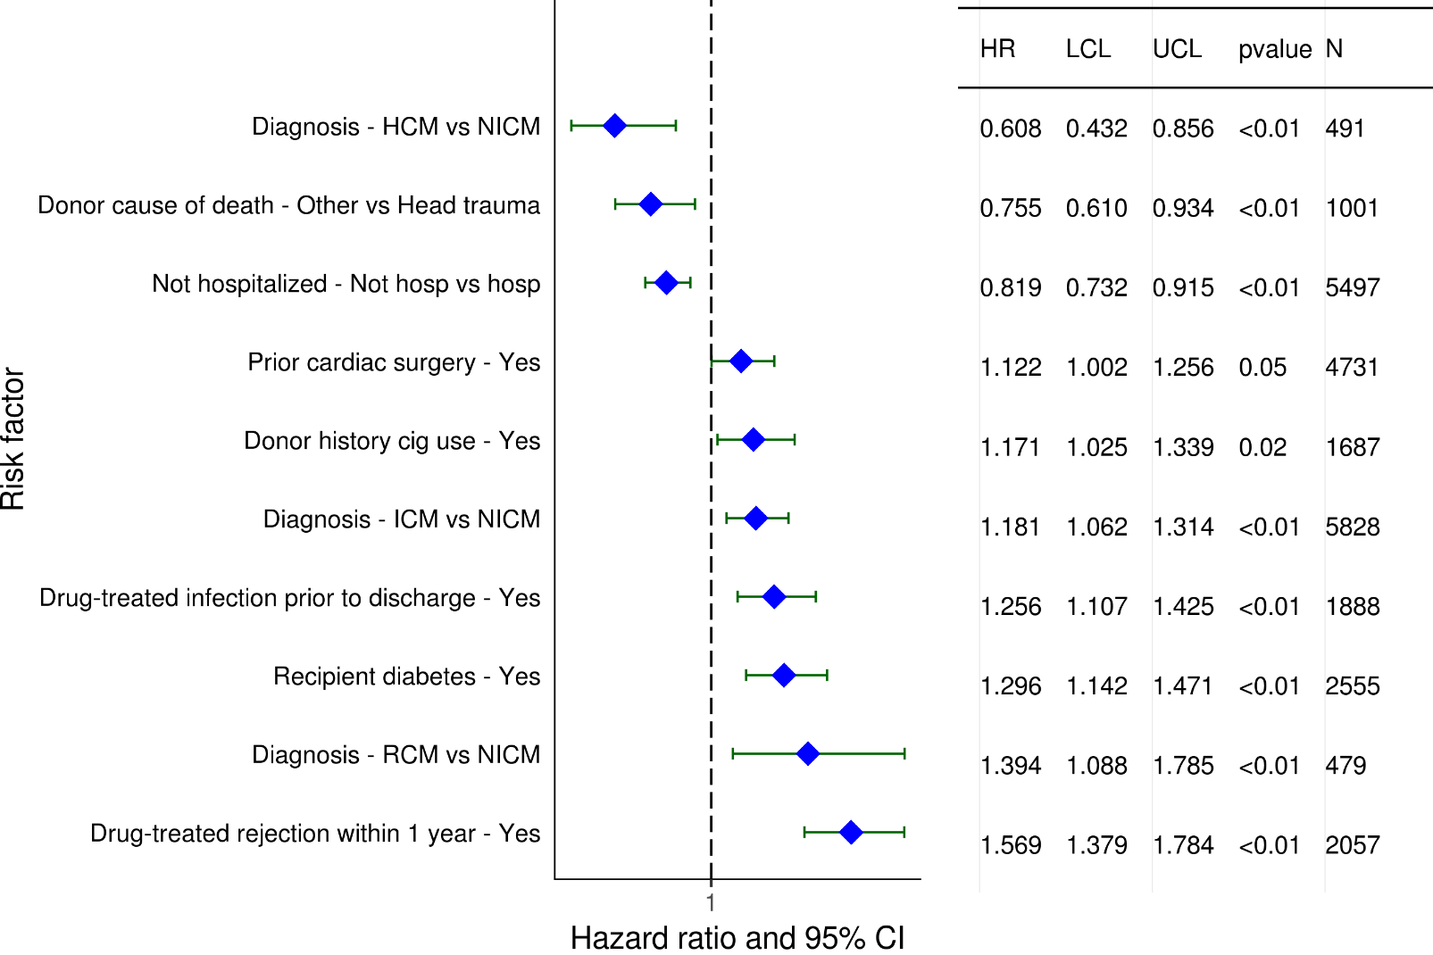
Adult Heart Transplants (2008-6/2013)
Risk Factors For 5 Year Mortality Conditional on Survival to 1 Year with 95% Confidence Limits
2019
(N = 17,019)
JHLT. 2019 Oct; 38(10): 1015-1066

Slide 81
Adult Heart Transplants (2008-6/2013)
Risk Factors For 5 Year Mortality Conditional on Survival to 1 Year
Continuous Factors (see figures)
Recipient age (years) | Donor age (years)
Recipient creatinine (mg/dL) | Recipient BMI (kg/m²)
Recipient transpulmonary gradient (mmHg)
2019
JHLT. 2019 Oct; 38(10): 1015-1066

Slide 82
Adult Heart Transplants (2008-6/2013)
Risk Factors For 5 Year Mortality Conditional on Survival to 1 Year with 95% Confidence Limits
Recipient age (years)
p < 0.0001
2019
(N = 17,019)
JHLT. 2019 Oct; 38(10): 1015-1066
Notes:
Multivariable analysis was performed using a proportional hazards model censoring all patients at 5 years. Continuous factors were fit using a restricted cubic spline.

Slide 83
Adult Heart Transplants (2008-6/2013)
Risk Factors For 5 Year Mortality Conditional on Survival to 1 Year with 95% Confidence Limits
Donor age (years)
p = 0.0010
2019
(N = 17,019)
JHLT. 2019 Oct; 38(10): 1015-1066
Notes:
Multivariable analysis was performed using a proportional hazards model censoring all patients at 5 years. Continuous factors were fit using a restricted cubic spline.

Slide 84
Adult Heart Transplants (2008-6/2013)
Risk Factors For 5 Year Mortality Conditional on Survival to 1 Year with 95% Confidence Limits
Recipient creatinine (mg/dL)
p < 0.0001
2019
(N = 17,019)
JHLT. 2019 Oct; 38(10): 1015-1066
Notes:
Multivariable analysis was performed using a proportional hazards model censoring all patients at 5 years. Continuous factors were fit using a restricted cubic spline.

Slide 85
Adult Heart Transplants (2008-6/2013)
Risk Factors For 5 Year Mortality Conditional on Survival to 1 Year with 95% Confidence Limits
Recipient BMI (kg/m²)
p = 0.0382
2019
(N = 17,019)
JHLT. 2019 Oct; 38(10): 1015-1066
Notes:
Multivariable analysis was performed using a proportional hazards model censoring all patients at 5 years. Continuous factors were fit using a restricted cubic spline.

Slide 86
Adult Heart Transplants (2008-6/2013)
Risk Factors For 5 Year Mortality Conditional on Survival to 1 Year with 95% Confidence Limits
Recipient transpulmonary gradient (TPG) (mm/Hg)
p = 0.0003
2019
(N = 17,019)
JHLT. 2019 Oct; 38(10): 1015-1066
Notes:
Multivariable analysis was performed using a proportional hazards model censoring all patients at 5 years. Continuous factors were fit using a restricted cubic spline.

Slide 87
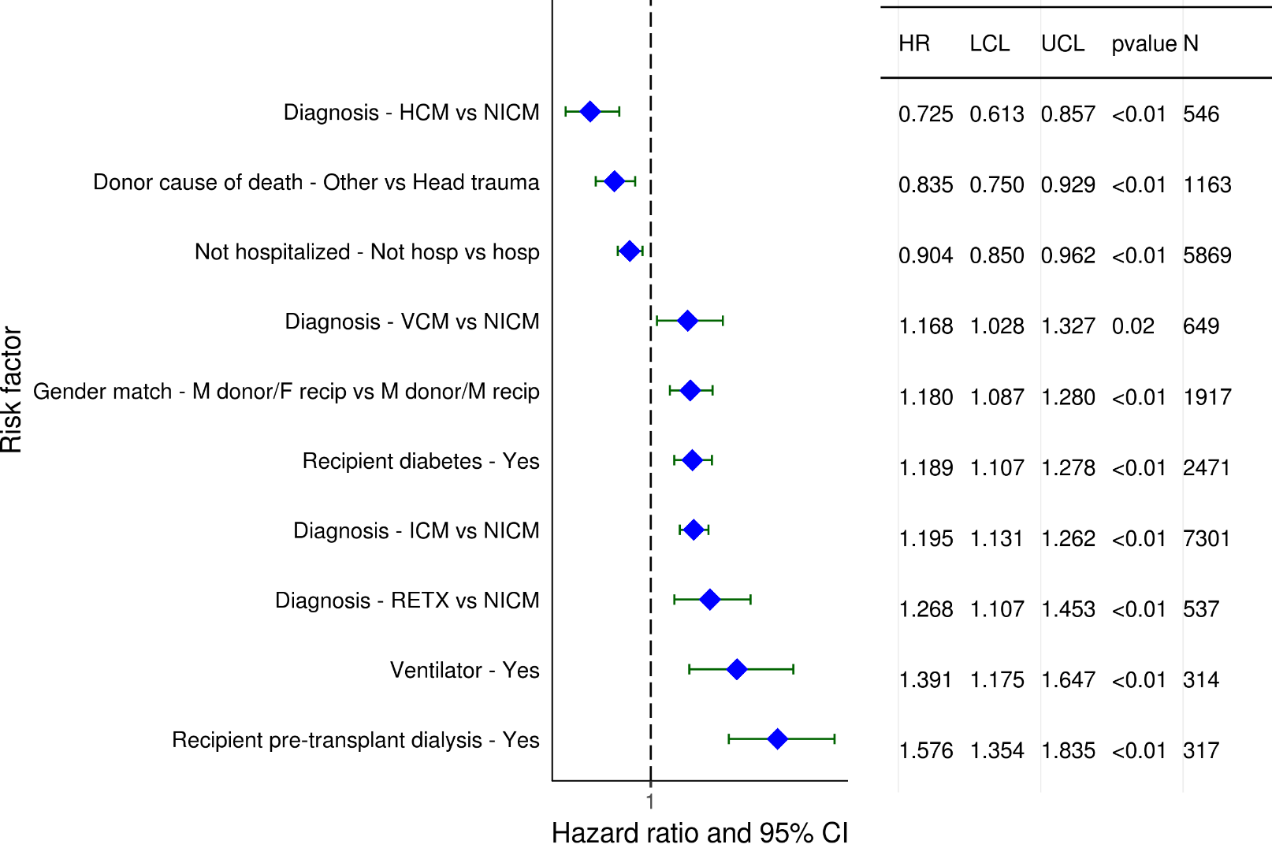
Adult Heart Transplants (2003-6/2008)
Statistically Significant Risk Factors For 10 Year Mortality with 95% Confidence Limits
2019
(N = 19,993)
JHLT. 2019 Oct; 38(10): 1015-1066

Slide 88
Adult Heart Transplants (2003-6/2008)
Statistically Significant Risk Factors For 10 Year Mortality
Continuous Factors (see figures)
Recipient age (years) | Donor age (years)
Recipient creatinine (mg/dL) | Ischemic time (hours)
Recipient BMI (kg/m2) | Transplant center volume within 3 yrs
Recipient PRA (%)
2019
JHLT. 2019 Oct; 38(10): 1015-1066

Slide 89
Adult Heart Transplants (2003-6/2008)
Statistically Significant Risk Factors For 10 Year Mortality with 95% Confidence Limits
Recipient age (years)
p < 0.0001
2019
(N = 19,993)
JHLT. 2019 Oct; 38(10): 1015-1066
Notes:
Multivariable analysis was performed using a proportional hazards model censoring all patients at 5 years. Continuous factors were fit using a restricted cubic spline.

Slide 90
Adult Heart Transplants (2003-6/2008)
Statistically Significant Risk Factors For 10 Year Mortality with 95% Confidence Limits
Donor age (years)
p < 0.0001
2019
(N = 19,993)
JHLT. 2019 Oct; 38(10): 1015-1066
Notes:
Multivariable analysis was performed using a proportional hazards model censoring all patients at 5 years. Continuous factors were fit using a restricted cubic spline.

Slide 91
Adult Heart Transplants (2003-6/2008)
Statistically Significant Risk Factors For 10 Year Mortality with 95% Confidence Limits
Recipient creatinine (mg/dL)
p < 0.0001
2019
(N = 19,993)
JHLT. 2019 Oct; 38(10): 1015-1066
Notes:
Multivariable analysis was performed using a proportional hazards model censoring all patients at 5 years. Continuous factors were fit using a restricted cubic spline.

Slide 92
Adult Heart Transplants (2003-6/2008)
Statistically Significant Risk Factors For 10 Year Mortality with 95% Confidence Limits
Ischemic time (hours)
p = 0.0213
2019
(N = 19,993)
JHLT. 2019 Oct; 38(10): 1015-1066
Notes:
Multivariable analysis was performed using a proportional hazards model censoring all patients at 5 years. Continuous factors were fit using a restricted cubic spline.

Slide 93
Adult Heart Transplants (2003-6/2008)
Statistically Significant Risk Factors For 10 Year Mortality with 95% Confidence Limits
Recipient BMI (kg/m²)
p = 0.0104
2019
(N = 19,993)
JHLT. 2019 Oct; 38(10): 1015-1066
Notes:
Multivariable analysis was performed using a proportional hazards model censoring all patients at 5 years. Continuous factors were fit using a restricted cubic spline.

Slide 94
Adult Heart Transplants (2003-6/2008)
Statistically Significant Risk Factors For 10 Year Mortality with 95% Confidence Limits
Transplant center volume within 3 yrs
p < 0.0001
2019
(N = 19,993)
JHLT. 2019 Oct; 38(10): 1015-1066
Notes:
Multivariable analysis was performed using a proportional hazards model censoring all patients at 5 years. Continuous factors were fit using a restricted cubic spline.

Slide 95
Adult Heart Transplants (2003-6/2008)
Statistically Significant Risk Factors For 10 Year Mortality with 95% Confidence Limits
Recipient PRA (%)
p = 0.0095
2019
(N = 19,993)
JHLT. 2019 Oct; 38(10): 1015-1066
Notes:
Multivariable analysis was performed using a proportional hazards model censoring all patients at 5 years. Continuous factors were fit using a restricted cubic spline.

Slide 96
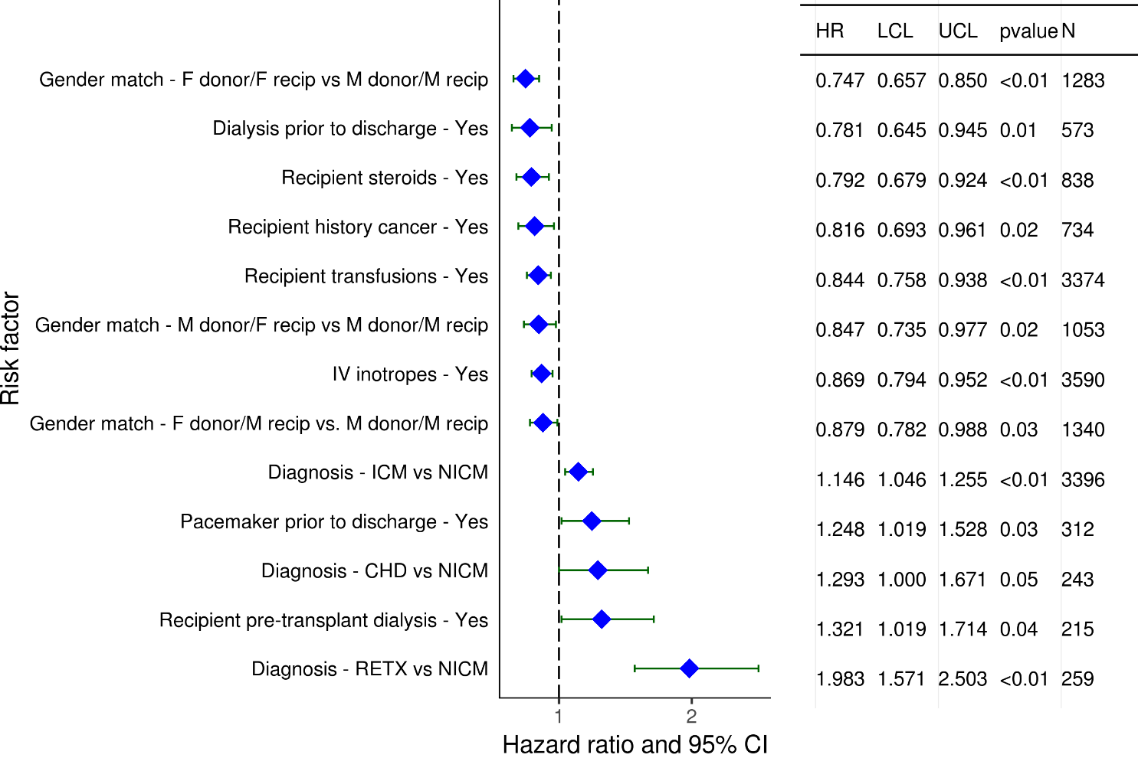
Adult Heart Transplants (2008-6/2013)
Statistically Significant Risk Factors for Development of CAV within
5 Years Conditional on Survival to Discharge with 95% Confidence Limits
2019
(N = 9,025)
JHLT. 2019 Oct; 38(10): 1015-1066

Slide 97
Adult Heart Transplants (2008-6/2013)
Statistically Significant Risk Factors for Development of CAV within
5 Years Conditional on Survival to Discharge
Continuous Factors (see figures)
Donor age (years) | Transplant center volume within 3 yrs
Recipient bilirubin (mg/dl)
2019
JHLT. 2019 Oct; 38(10): 1015-1066

Slide 98
Adult Heart Transplants (2008-6/2013)
Statistically Significant Risk Factors for Development of CAV within
5 Years Conditional on Survival to Discharge with 95% Confidence Limits
Donor age (years)
p < 0.0001
2019
(N = 9,025)
JHLT. 2019 Oct; 38(10): 1015-1066
Notes:
Multivariable analysis was performed using a proportional hazards model censoring all patients at 5 years. Continuous factors were fit using a restricted cubic spline.

Slide 99
Adult Heart Transplants (2008-6/2013)
Statistically Significant Risk Factors for Development of CAV within
5 Years Conditional on Survival to Discharge with 95% Confidence Limits
Transplant center volume within 3 yrs
p = 0.0057
2019
(N = 9,025)
JHLT. 2019 Oct; 38(10): 1015-1066
Notes:
Multivariable analysis was performed using a proportional hazards model censoring all patients at 5 years. Continuous factors were fit using a restricted cubic spline.

Slide 100
Adult Heart Transplants (2008-6/2013)
Statistically Significant Risk Factors for Development of CAV within 5 Years Conditional on Survival to Discharge with 95% Confidence Limits
Recipient bilirubin (mg/dl)
p = 0.0345
2019
(N = 9,025)
JHLT. 2019 Oct; 38(10): 1015-1066
Notes:
Multivariable analysis was performed using a proportional hazards model censoring all patients at 5 years. Continuous factors were fit using a restricted cubic spline.

Slide 101
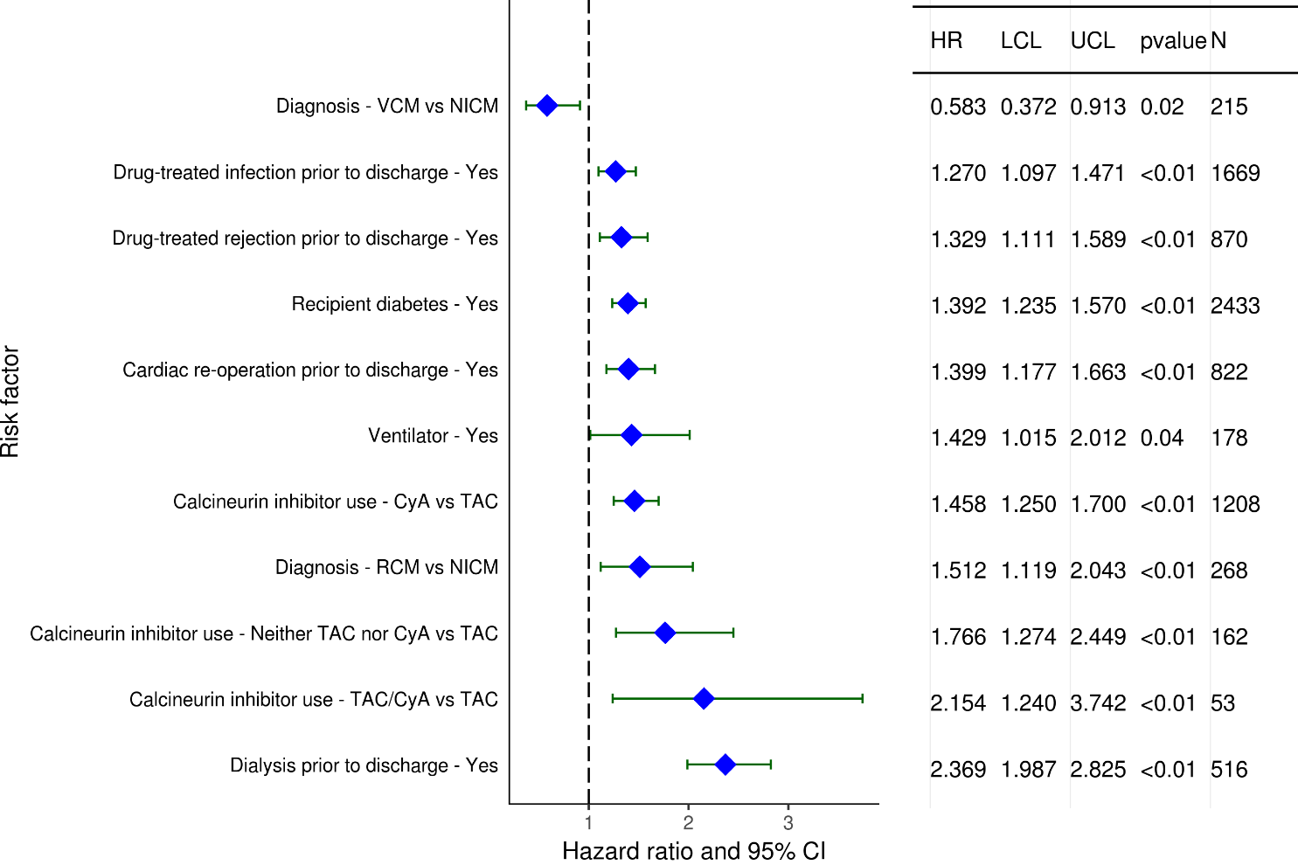
Adult Heart Transplants (2008-6/2013)
Statistically Significant Risk Factors for Development of Severe Renal Dysfunction within 5 Years with 95% Confidence Limits
Limited to Recipients without Severe Renal Dysfunction* Pre-Transplant
Conditional on Survival to Discharge
(N = 9,226)
2019
* Severe renal dysfunction = Creatinine > 2.5 mg/dl (221 μmol/L), dialysis, or renal transplant
JHLT. 2019 Oct; 38(10): 1015-1066

Slide 102
Adult Heart Transplants (2008-6/2013)
Statistically Significant Risk Factors for Development of Severe Renal Dysfunction within 5 Years
Limited to Recipients without Severe Renal Dysfunction Pre-Transplant
Conditional on Survival to Discharge
Continuous Factors (see figures)
Recipient creatinine (mg/dL) | Recipient bilirubin (mg/dl)
2019
JHLT. 2019 Oct; 38(10): 1015-1066

Slide 103
Adult Heart Transplants (2008-6/2013)
Statistically Significant Risk Factors for Development of Severe Renal Dysfunction within 5 Years with 95% Confidence Limits
Limited to Recipients without Severe Renal Dysfunction Pre-Transplant
Conditional on Survival to Discharge
Recipient creatinine (mg/dL)
p < 0.0001
2019
(N = 9,226)
JHLT. 2019 Oct; 38(10): 1015-1066
Notes:
Multivariable analysis was performed using a proportional hazards model censoring all patients at 5 years. Continuous factors were fit using a restricted cubic spline.

Slide 104
Adult Heart Transplants (2008-6/2013)
Statistically Significant Risk Factors for Development of Severe Renal Dysfunction within 5 Years with 95% Confidence Limits
Limited to Recipients without Severe Renal Dysfunction Pre-Transplant
Conditional on Survival to Discharge
Recipient bilirubin (mg/dl)
p < 0.0001
2019
(N = 9,226)
JHLT. 2019 Oct; 38(10): 1015-1066
Notes:
Multivariable analysis was performed using a proportional hazards model censoring all patients at 5 years. Continuous factors were fit using a restricted cubic spline.

Slide 105
Focus Theme:
Donor-Recipient Size Match
(Version 1)
For slides 106-147, predicted heart mass (PHM) match is used to measure size match and is calculated as:
[(donor PHM – recipient PHM) / donor PHM] x 100
2019
JHLT. 2019 Oct; 38(10): 1015-1066
Notes:
Predicted Heart Mass (PHM) is used for adult heart Focus analysis
PHM is calculated based on age, height, and weight –
PHM = LV mass + RV mass
LV mass = a x Height ^{0.54} (m) x Weight ^{0.61} (kg)
Where a = 6.82 for women
a = 8.25 for men
RV mass = a x Age ^{-0.32} (years) x Height ^{1.135} (m) x Weight ^{0.315} (kg)
where a = 10.59 for women
a = 11.25 for men
Version 1 -
PHM match is calculated as [(donor PHM – recipient PHM) / donor PHM] x 100.
Weight match is calculated as
[(donor weight – recipient weight) / donor weight] x 100.
Height match is calculated as
[(donor height – recipient height) / donor height] x 100.

Slide 106
Focus Theme -
Select Characteristics
2019
JHLT. 2019 Oct; 38(10): 1015-1066
Notes:
PHM match = [(donor PHM – recipient PHM) / donor PHM] x 100
Weight match = [(donor weight – recipient weight) / donor weight] x 100
Height match = [(donor height – recipient height) / donor height] x 100

Slide 107
Adult Heart Transplants
Distribution of Donor-Recipient Predicted Heart Mass (PHM) Match by Donor-Recipient Weight Match
(Transplants: January 2010 – June 2018)
PHM Match:
2019
JHLT. 2019 Oct; 38(10): 1015-1066
Notes:
PHM match = [(donor PHM – recipient PHM) / donor PHM] x 100
Weight match = [(donor weight – recipient weight) / donor weight] x 100
Height match = [(donor height – recipient height) / donor height] x 100

Slide 108
Adult Heart Transplants
Donor-Recipient Predicted Heart Mass (PHM) Match by Donor-Recipient Weight Match
(Transplants: January 2010 – June 2018)
2019
R = 0.74; p<0.0001
JHLT. 2019 Oct; 38(10): 1015-1066
Notes:
PHM match = [(donor PHM – recipient PHM) / donor PHM] x 100
Weight match = [(donor weight – recipient weight) / donor weight] x 100
Height match = [(donor height – recipient height) / donor height] x 100

Slide 109
Adult Heart Transplants
Donor-Recipient Predicted Heart Mass (PHM) Match by Donor-Recipient Height Match
(Transplants: January 2010 – June 2018)
2019
R = 0.58; p<0.0001
JHLT. 2019 Oct; 38(10): 1015-1066
Notes:
PHM match = [(donor PHM – recipient PHM) / donor PHM] x 100
Weight match = [(donor weight – recipient weight) / donor weight] x 100
Height match = [(donor height – recipient height) / donor height] x 100

Slide 110
Adult Heart Transplants
Donor-Recipient Predicted Heart Mass (PHM) Match and Recipient Age
(Transplants: January 2010 – June 2018)
2019
R =
-0.025, p<0.0001
JHLT. 2019 Oct; 38(10): 1015-1066
Notes:
PHM match = [(donor PHM – recipient PHM) / donor PHM] x 100
Weight match = [(donor weight – recipient weight) / donor weight] x 100
Height match = [(donor height – recipient height) / donor height] x 100

Slide 111
Adult Heart Transplants
Transplants with Donor-Recipient Predicted Heart Mass (PHM) Match of <-20% and >20% by Transplant Year
(Transplants: January 1992 – December 2017)
Year of Transplant
2019
JHLT. 2019 Oct; 38(10): 1015-1066
Notes:
PHM match = [(donor PHM – recipient PHM) / donor PHM] x 100
Weight match = [(donor weight – recipient weight) / donor weight] x 100
Height match = [(donor height – recipient height) / donor height] x 100

Slide 112
Adult Heart Transplants
Distribution of Donor-Recipient Predicted Heart Mass Match by Donor-Recipient Sex Match
(Transplants: January 2010 – June 2018)
2019
JHLT. 2019 Oct; 38(10): 1015-1066
Notes:
PHM match = [(donor PHM – recipient PHM) / donor PHM] x 100
Weight match = [(donor weight – recipient weight) / donor weight] x 100
Height match = [(donor height – recipient height) / donor height] x 100

Slide 113
Adult Heart Transplants
Distribution of Donor-Recipient Predicted Heart Mass Match by Recipient Age Group
(Transplants: January 2010 – June 2018)
2019
JHLT. 2019 Oct; 38(10): 1015-1066
Notes:
PHM match = [(donor PHM – recipient PHM) / donor PHM] x 100
Weight match = [(donor weight – recipient weight) / donor weight] x 100
Height match = [(donor height – recipient height) / donor height] x 100

Slide 114
Adult Heart Transplants
Distribution of Donor-Recipient Predicted Heart Mass Match by Ischemic Time
(Transplants: January 2010 – June 2018)
2019
JHLT. 2019 Oct; 38(10): 1015-1066
Notes:
PHM match = [(donor PHM – recipient PHM) / donor PHM] x 100
Weight match = [(donor weight – recipient weight) / donor weight] x 100
Height match = [(donor height – recipient height) / donor height] x 100

Slide 115
Adult Heart Transplants
Distribution of Donor-Recipient Predicted Heart Mass Match by Donor Age Group
(Transplants: January 2010 – June 2018)
2019
JHLT. 2019 Oct; 38(10): 1015-1066
Notes:
PHM match = [(donor PHM – recipient PHM) / donor PHM] x 100
Weight match = [(donor weight – recipient weight) / donor weight] x 100
Height match = [(donor height – recipient height) / donor height] x 100

Slide 116
Adult Heart Transplants
Distribution of Donor-Recipient Predicted Heart Mass Match by Recipient PVR
(Transplants: January 2010 – June 2018)
2019
JHLT. 2019 Oct; 38(10): 1015-1066
Notes:
PHM match = [(donor PHM – recipient PHM) / donor PHM] x 100
Weight match = [(donor weight – recipient weight) / donor weight] x 100
Height match = [(donor height – recipient height) / donor height] x 100

Slide 117
Adult Heart Transplants
Distribution of Donor-Recipient Predicted Heart Mass Match by Geographic Location
(Transplants: January 2010 – June 2018)
2019
JHLT. 2019 Oct; 38(10): 1015-1066
Notes:
PHM match = [(donor PHM – recipient PHM) / donor PHM] x 100
Weight match = [(donor weight – recipient weight) / donor weight] x 100
Height match = [(donor height – recipient height) / donor height] x 100

Slide 118
Focus Theme -
Post-transplant Outcomes
2019
JHLT. 2019 Oct; 38(10): 1015-1066
Notes:
PHM match = [(donor PHM – recipient PHM) / donor PHM] x 100
Weight match = [(donor weight – recipient weight) / donor weight] x 100
Height match = [(donor height – recipient height) / donor height] x 100

Slide 119
Adult Heart Transplants
% of Recipients Experiencing Treated Rejection Between Discharge and 1-Year Follow-Up by Donor-Recipient Predicted Heart Mass (PHM) Match
(Transplants: January 2012 – June 2017)
p = 0.0452
Treated rejection = Recipient was reported to (1) have at least one acute rejection episode that was treated with an anti-rejection agent; or (2) have been hospitalized for rejection.
2019
JHLT. 2019 Oct; 38(10): 1015-1066
Notes:
PHM match = [(donor PHM – recipient PHM) / donor PHM] x 100
Weight match = [(donor weight – recipient weight) / donor weight] x 100
Height match = [(donor height – recipient height) / donor height] x 100

Slide 120
Adult Heart Transplants
Kaplan-Meier Survival Within 1 Year by Donor-Recipient Height Match
(Transplants: January 2012 – June 2017)
No pairwise comparisons were significant at p < 0.05 except <-10% vs. >10%.
2019
JHLT. 2019 Oct; 38(10): 1015-1066
Notes:
PHM match = [(donor PHM – recipient PHM) / donor PHM] x 100
Weight match = [(donor weight – recipient weight) / donor weight] x 100
Height match = [(donor height – recipient height) / donor height] x 100
Survival was calculated using the Kaplan-Meier method, which incorporates information from all transplants for whom any follow-up has been provided. Since many patients are still alive and some patients have been lost to follow-up, the survival rates are estimates rather than exact rates because the time of death is not known for all patients.
Survival rates were compared using the log-rank test statistic. Adjustments for multiple comparisons were done using Scheffe’s method. Results of log-rank test should be interpreted with caution when curves cross.

Slide 121
Adult Heart Transplants
Kaplan-Meier Survival Within 5 Years by Donor-Recipient Height Match
(Transplants: January 2008 – June 2013)
2019
JHLT. 2019 Oct; 38(10): 1015-1066
Notes:
PHM match = [(donor PHM – recipient PHM) / donor PHM] x 100
Weight match = [(donor weight – recipient weight) / donor weight] x 100
Height match = [(donor height – recipient height) / donor height] x 100
Survival was calculated using the Kaplan-Meier method, which incorporates information from all transplants for whom any follow-up has been provided. Since many patients are still alive and some patients have been lost to follow-up, the survival rates are estimates rather than exact rates because the time of death is not known for all patients.
Survival rates were compared using the log-rank test statistic. Adjustments for multiple comparisons were done using Scheffe’s method. Results of log-rank test should be interpreted with caution when curves cross.

Slide 122
Adult Heart Transplants
Kaplan-Meier Survival Within 1 Year by Donor-Recipient Weight Match
(Transplants: January 2012 – June 2017)
p = 0.2607
2019
JHLT. 2019 Oct; 38(10): 1015-1066
Notes:
PHM match = [(donor PHM – recipient PHM) / donor PHM] x 100
Weight match = [(donor weight – recipient weight) / donor weight] x 100
Height match = [(donor height – recipient height) / donor height] x 100
Survival was calculated using the Kaplan-Meier method, which incorporates information from all transplants for whom any follow-up has been provided. Since many patients are still alive and some patients have been lost to follow-up, the survival rates are estimates rather than exact rates because the time of death is not known for all patients.
Survival rates were compared using the log-rank test statistic. Adjustments for multiple comparisons were done using Scheffe’s method. Results of log-rank test should be interpreted with caution when curves cross.

Slide 123
Adult Heart Transplants
Kaplan-Meier Survival Within 5 Years by Donor-Recipient Weight Match
(Transplants: January 2008 – June 2013)
p = 0.9542
2019
JHLT. 2019 Oct; 38(10): 1015-1066
Notes:
PHM match = [(donor PHM – recipient PHM) / donor PHM] x 100
Weight match = [(donor weight – recipient weight) / donor weight] x 100
Height match = [(donor height – recipient height) / donor height] x 100
Survival was calculated using the Kaplan-Meier method, which incorporates information from all transplants for whom any follow-up has been provided. Since many patients are still alive and some patients have been lost to follow-up, the survival rates are estimates rather than exact rates because the time of death is not known for all patients.
Survival rates were compared using the log-rank test statistic. Adjustments for multiple comparisons were done using Scheffe’s method. Results of log-rank test should be interpreted with caution when curves cross.

Slide 124
Adult Heart Transplants
Kaplan-Meier Survival Within 1 Year
By Donor-Recipient Predicted Heart Mass Match
(Transplants: January 2012 – June 2017)
No pairwise comparisons were significant at p < 0.05 except
<-30% vs. -20% - 20% and >20% - 30%
2019
JHLT. 2019 Oct; 38(10): 1015-1066
Notes:
PHM match = [(donor PHM – recipient PHM) / donor PHM] x 100
Weight match = [(donor weight – recipient weight) / donor weight] x 100
Height match = [(donor height – recipient height) / donor height] x 100
Survival was calculated using the Kaplan-Meier method, which incorporates information from all transplants for whom any follow-up has been provided. Since many patients are still alive and some patients have been lost to follow-up, the survival rates are estimates rather than exact rates because the time of death is not known for all patients.
Survival rates were compared using the log-rank test statistic. Adjustments for multiple comparisons were done using Scheffe’s method. Results of log-rank test should be interpreted with caution when curves cross.

Slide 125
Adult Heart Transplants
Kaplan-Meier Survival Within 5 Years by Donor-Recipient Predicted Heart Mass Match
(Transplants: January 2008 – June 2013)
No pairwise comparisons were significant at p < 0.05 except
-30% - <20% vs. >20% - 30% and -20% - 20%
<-30% vs. >20% - 30% and -20% - 20%
2019
JHLT. 2019 Oct; 38(10): 1015-1066
Notes:
PHM match = [(donor PHM – recipient PHM) / donor PHM] x 100
Weight match = [(donor weight – recipient weight) / donor weight] x 100
Height match = [(donor height – recipient height) / donor height] x 100
Survival was calculated using the Kaplan-Meier method, which incorporates information from all transplants for whom any follow-up has been provided. Since many patients are still alive and some patients have been lost to follow-up, the survival rates are estimates rather than exact rates because the time of death is not known for all patients.
Survival rates were compared using the log-rank test statistic. Adjustments for multiple comparisons were done using Scheffe’s method. Results of log-rank test should be interpreted with caution when curves cross.

Slide 126
Focus Theme -
Multivariable Analyses
2019
JHLT. 2019 Oct; 38(10): 1015-1066
Notes:
PHM match = [(donor PHM – recipient PHM) / donor PHM] x 100
Weight match = [(donor weight – recipient weight) / donor weight] x 100
Height match = [(donor height – recipient height) / donor height] x 100

Slide 127
Adult Heart Transplants (2012-6/2017)
Univariable Cox Model with Only Predicted Heart Match
Hazard Ratio for 1 Year Mortality with 95% Confidence Limits
Predicted heart mass match (%)
p < 0.0001
2019
(N = 23,202)
JHLT. 2019 Oct; 38(10): 1015-1066
Notes:
PHM match = [(donor PHM – recipient PHM) / donor PHM] x 100
Weight match = [(donor weight – recipient weight) / donor weight] x 100
Height match = [(donor height – recipient height) / donor height] x 100

Slide 128
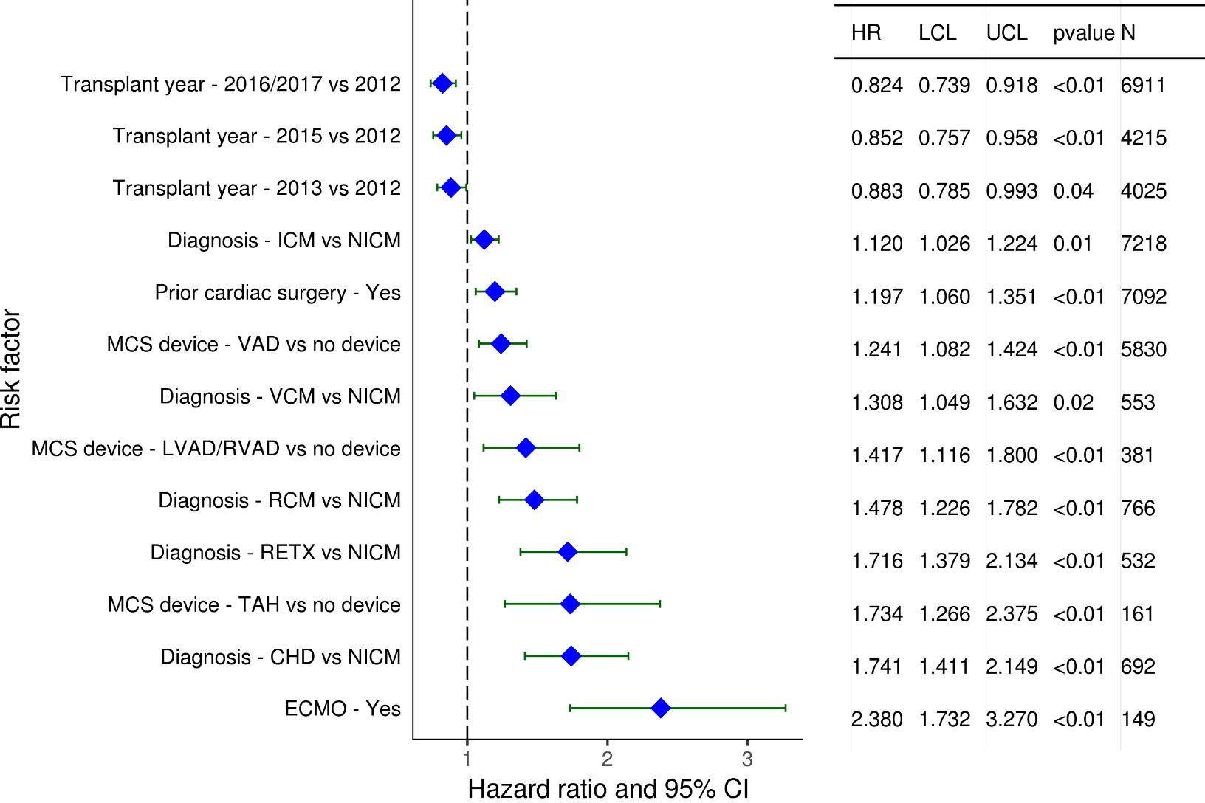
Adult Heart Transplants (2012-6/2017)
Statistically Significant Risk Factors For 1 Year Mortality with 95% Confidence Limits
2019
(N = 23,202)
JHLT. 2019 Oct; 38(10): 1015-1066
Notes:
PHM match = [(donor PHM – recipient PHM) / donor PHM] x 100
Weight match = [(donor weight – recipient weight) / donor weight] x 100
Height match = [(donor height – recipient height) / donor height] x 100

Slide 129
Adult Heart Transplants (2012-6/2017)
Statistically Significant Risk Factors For 1 Year Mortality
Continuous Factors (see figures)
Recipient age (years) | Donor age (years)
Recipient creatinine (mg/dL) | Ischemic time (hours)
Recipient BMI (kg/m2) | Recipient bilirubin (mg/dl)
Donor-recipient predicted heart mass match (%)
2019
JHLT. 2019 Oct; 38(10): 1015-1066
Notes:
PHM match = [(donor PHM – recipient PHM) / donor PHM] x 100
Weight match = [(donor weight – recipient weight) / donor weight] x 100
Height match = [(donor height – recipient height) / donor height] x 100

Slide 130
Adult Heart Transplants (2012-6/2017)
Statistically Significant Risk Factors For 1 Year Mortality with 95% Confidence Limits
Recipient age (years)
p < 0.0001
2019
(N = 23,202)
JHLT. 2019 Oct; 38(10): 1015-1066
Notes:
PHM match = [(donor PHM – recipient PHM) / donor PHM] x 100
Weight match = [(donor weight – recipient weight) / donor weight] x 100
Height match = [(donor height – recipient height) / donor height] x 100

Slide 131
Adult Heart Transplants (2012-6/2017)
Statistically Significant Risk Factors For 1 Year Mortality with 95% Confidence Limits
Donor age (years)
p < 0.0001
2019
(N = 23,202)
JHLT. 2019 Oct; 38(10): 1015-1066
Notes:
PHM match = [(donor PHM – recipient PHM) / donor PHM] x 100
Weight match = [(donor weight – recipient weight) / donor weight] x 100
Height match = [(donor height – recipient height) / donor height] x 100

Slide 132
Adult Heart Transplants (2012-6/2017)
Statistically Significant Risk Factors For 1 Year Mortality with 95% Confidence Limits
Recipient creatinine (mg/dL)
p < 0.0001
2019
(N = 23,202)
JHLT. 2019 Oct; 38(10): 1015-1066
Notes:
PHM match = [(donor PHM – recipient PHM) / donor PHM] x 100
Weight match = [(donor weight – recipient weight) / donor weight] x 100
Height match = [(donor height – recipient height) / donor height] x 100

Slide 133
Adult Heart Transplants (2012-6/2017)
Statistically Significant Risk Factors For 1 Year Mortality with 95% Confidence Limits
Ischemic time (hours)
p < 0.0001
2019
(N = 23,202)
JHLT. 2019 Oct; 38(10): 1015-1066
Notes:
PHM match = [(donor PHM – recipient PHM) / donor PHM] x 100
Weight match = [(donor weight – recipient weight) / donor weight] x 100
Height match = [(donor height – recipient height) / donor height] x 100

Slide 134
Adult Heart Transplants (2012-6/2017)
Statistically Significant Risk Factors For 1 Year Mortality with 95% Confidence Limits
Recipient BMI (kg/m2)
p = 0.0389
2019
(N = 23,202)
JHLT. 2019 Oct; 38(10): 1015-1066
Notes:
PHM match = [(donor PHM – recipient PHM) / donor PHM] x 100
Weight match = [(donor weight – recipient weight) / donor weight] x 100
Height match = [(donor height – recipient height) / donor height] x 100

Slide 135
Adult Heart Transplants (2012-6/2017)
Statistically Significant Risk Factors For 1 Year Mortality with 95% Confidence Limits
Recipient bilirubin (mg/dl)
p < 0.0001
2019
(N = 23,202)
JHLT. 2019 Oct; 38(10): 1015-1066
Notes:
PHM match = [(donor PHM – recipient PHM) / donor PHM] x 100
Weight match = [(donor weight – recipient weight) / donor weight] x 100
Height match = [(donor height – recipient height) / donor height] x 100

Slide 136
Adult Heart Transplants (2012-6/2017)
Statistically Significant Risk Factors For 1 Year Mortality with 95% Confidence Limits
Predicted heart mass match (%)
p = 0.0003
2019
(N = 23,202)
JHLT. 2019 Oct; 38(10): 1015-1066
Notes:
PHM match = [(donor PHM – recipient PHM) / donor PHM] x 100
Weight match = [(donor weight – recipient weight) / donor weight] x 100
Height match = [(donor height – recipient height) / donor height] x 100

Slide 137
Adult Heart Transplants (2008-6/2013)
Univariable Cox Model with Only Predicted Heart Match
Hazard Ratio for 5 Year Mortality with 95% Confidence Limits
Predicted heart mass match (%)
p < 0.0001
2019
(N = 20,820)
JHLT. 2019 Oct; 38(10): 1015-1066
Notes:
PHM match = [(donor PHM – recipient PHM) / donor PHM] x 100
Weight match = [(donor weight – recipient weight) / donor weight] x 100
Height match = [(donor height – recipient height) / donor height] x 100

Slide 138
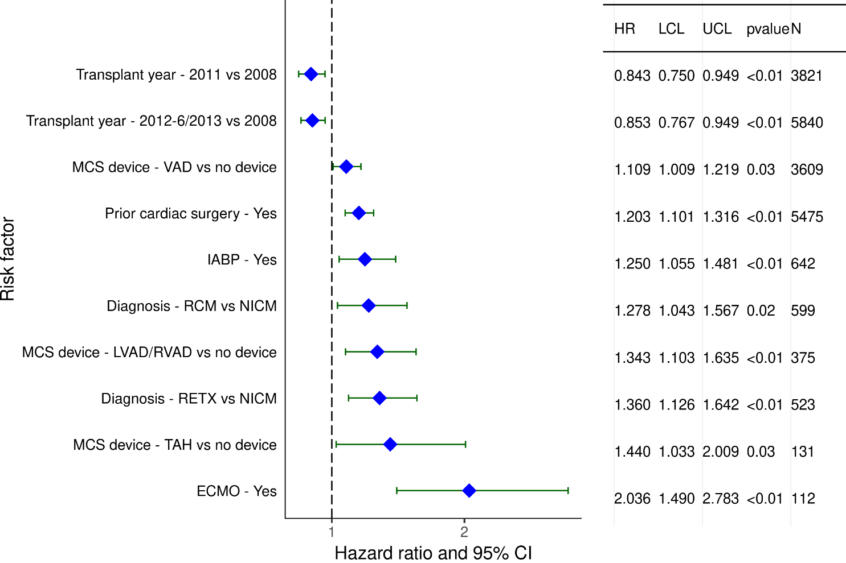
Adult Heart Transplants (2008-6/2013)
Statistically Significant Risk Factors For 5 Year Mortality with 95% Confidence Limits
2019
(N = 20,820)
JHLT. 2019 Oct; 38(10): 1015-1066
Notes:
PHM match = [(donor PHM – recipient PHM) / donor PHM] x 100
Weight match = [(donor weight – recipient weight) / donor weight] x 100
Height match = [(donor height – recipient height) / donor height] x 100

Slide 139
Adult Heart Transplants (2008-6/2013)
Statistically Significant Risk Factors For 5 Year Mortality
Continuous Factors (see figures)
Recipient age (years) | Donor age (years)
Recipient creatinine (mg/dL) | Ischemic time (hours)
Recipient BMI (kg/m2) | Recipient bilirubin (mg/dl)
Donor-recipient predicted heart mass match (%)
2019
JHLT. 2019 Oct; 38(10): 1015-1066
Notes:
PHM match = [(donor PHM – recipient PHM) / donor PHM] x 100
Weight match = [(donor weight – recipient weight) / donor weight] x 100
Height match = [(donor height – recipient height) / donor height] x 100

Slide 140
Adult Heart Transplants (2008-6/2013)
Statistically Significant Risk Factors For 5 Year Mortality with 95% Confidence Limits
Recipient age (years)
p < 0.0001
2019
(N = 20,820)
JHLT. 2019 Oct; 38(10): 1015-1066
Notes:
PHM match = [(donor PHM – recipient PHM) / donor PHM] x 100
Weight match = [(donor weight – recipient weight) / donor weight] x 100
Height match = [(donor height – recipient height) / donor height] x 100

Slide 141
Adult Heart Transplants (2008-6/2013)
Statistically Significant Risk Factors For 5 Year Mortality with 95% Confidence Limits
Donor age (years)
p < 0.0001
2019
(N = 20,820)
JHLT. 2019 Oct; 38(10): 1015-1066
Notes:
PHM match = [(donor PHM – recipient PHM) / donor PHM] x 100
Weight match = [(donor weight – recipient weight) / donor weight] x 100
Height match = [(donor height – recipient height) / donor height] x 100

Slide 142
Adult Heart Transplants (2008-6/2013)
Statistically Significant Risk Factors For 5 Year Mortality with 95% Confidence Limits
Recipient creatinine (mg/dL)
p < 0.0001
2019
(N = 20,820)
JHLT. 2019 Oct; 38(10): 1015-1066
Notes:
PHM match = [(donor PHM – recipient PHM) / donor PHM] x 100
Weight match = [(donor weight – recipient weight) / donor weight] x 100
Height match = [(donor height – recipient height) / donor height] x 100

Slide 143
Adult Heart Transplants (2008-6/2013)
Statistically Significant Risk Factors For 5 Year Mortality with 95% Confidence Limits
Ischemic time (hours)
p < 0.0001
2019
(N = 20,820)
JHLT. 2019 Oct; 38(10): 1015-1066
Notes:
PHM match = [(donor PHM – recipient PHM) / donor PHM] x 100
Weight match = [(donor weight – recipient weight) / donor weight] x 100
Height match = [(donor height – recipient height) / donor height] x 100

Slide 144
Adult Heart Transplants (2008-6/2013)
Statistically Significant Risk Factors For 5 Year Mortality with 95% Confidence Limits
Recipient BMI (kg/m2)
p = 0.0065
2019
(N = 20,820)
JHLT. 2019 Oct; 38(10): 1015-1066
Notes:
PHM match = [(donor PHM – recipient PHM) / donor PHM] x 100
Weight match = [(donor weight – recipient weight) / donor weight] x 100
Height match = [(donor height – recipient height) / donor height] x 100

Slide 145
Adult Heart Transplants (2008-6/2013)
Statistically Significant Risk Factors For 5 Year Mortality with 95% Confidence Limits
Recipient bilirubin (mg/dl)
p = 0.0408
2019
(N = 20,820)
JHLT. 2019 Oct; 38(10): 1015-1066
Notes:
PHM match = [(donor PHM – recipient PHM) / donor PHM] x 100
Weight match = [(donor weight – recipient weight) / donor weight] x 100
Height match = [(donor height – recipient height) / donor height] x 100

Slide 146
Adult Heart Transplants (2008-6/2013)
Statistically Significant Risk Factors For 5 Year Mortality with 95% Confidence Limits
Predicted heart mass match (%)
p < 0.0001
2019
(N = 20,820)
JHLT. 2019 Oct; 38(10): 1015-1066
Notes:
PHM match = [(donor PHM – recipient PHM) / donor PHM] x 100
Weight match = [(donor weight – recipient weight) / donor weight] x 100
Height match = [(donor height – recipient height) / donor height] x 100

Slide 147
Focus Theme:
Donor-Recipient Size Match
(Version 2)
For slides 148-187, predicted heart mass (PHM) match is used to measure size match and is calculated as:
[(donor PHM – recipient PHM) / recipient PHM] x 100
2019
JHLT. 2019 Oct; 38(10): 1015-1066
Notes:
Predicted Heart Mass (PHM) is used for adult heart Focus analysis
PHM is calculated based on age, height, and weight –
PHM = LV mass + RV mass
LV mass = a x Height ^{0.54} (m) x Weight ^{0.61} (kg)
Where a = 6.82 for women
a = 8.25 for men
RV mass = a x Age ^{-0.32} (years) x Height ^{1.135} (m) x Weight ^{0.315} (kg)
where a = 10.59 for women
a = 11.25 for men
Version 2 -
PHM match is calculated as [(donor PHM – recipient PHM) / recipient PHM] x 100.
Weight match is calculated as
[(donor weight – recipient weight) / recipient weight] x 100.
Height match is calculated as
[(donor height – recipient height) / recipient height] x 100.

Slide 148
Focus Theme -
Select Characteristics
2019
JHLT. 2019 Oct; 38(10): 1015-1066
Notes:
PHM match = [(donor PHM – recipient PHM) / donor PHM] x 100
Weight match = [(donor weight – recipient weight) / donor weight] x 100
Height match = [(donor height – recipient height) / donor height] x 100

Slide 149
Adult Heart Transplants
Distribution of Donor-Recipient Predicted Heart Mass (PHM) Match by Donor-Recipient Weight Match
(Transplants: January 2010 – June 2018)
PHM Match:
2019
JHLT. 2019 Oct; 38(10): 1015-1066
Notes:
PHM match = [(donor PHM – recipient PHM) / recipient PHM] x 100
Weight match = [(donor weight – recipient weight) / recipient weight] x 100
Height match = [(donor height – recipient height) / recipient height] x 100

Slide 150
Adult Heart Transplants
Donor-Recipient Predicted Heart Mass (PHM) Match by Donor-Recipient Weight Match
(Transplants: January 2010 – June 2018)
2019
R = 0.76, p<0.0001
JHLT. 2019 Oct; 38(10): 1015-1066
Notes:
PHM match = [(donor PHM – recipient PHM) / recipient PHM] x 100
Weight match = [(donor weight – recipient weight) / recipient weight] x 100
Height match = [(donor height – recipient height) / recipient height] x 100

Slide 151
Adult Heart Transplants
Donor-Recipient Predicted Heart Mass (PHM) Match by Donor-Recipient Height Match
(Transplants: January 2010 – June 2018)
2019
R = 0.58, p<0.0001
JHLT. 2019 Oct; 38(10): 1015-1066
Notes:
PHM match = [(donor PHM – recipient PHM) / recipient PHM] x 100
Weight match = [(donor weight – recipient weight) / recipient weight] x 100
Height match = [(donor height – recipient height) / recipient height] x 100

Slide 152
Adult Heart Transplants
Donor-Recipient Predicted Heart Mass (PHM) Match and Recipient Age
(Transplants: January 2010 – June 2018)
2019
R = -0.03, p<0.0001
JHLT. 2019 Oct; 38(10): 1015-1066
Notes:
PHM match = [(donor PHM – recipient PHM) / recipient PHM] x 100
Weight match = [(donor weight – recipient weight) / recipient weight] x 100
Height match = [(donor height – recipient height) / recipient height] x 100

Slide 153
Adult Heart Transplants
Transplants with Donor-Recipient Predicted Heart Mass (PHM) Match of <-20% and >20% by Transplant Year
(Transplants: January 1992 – December 2017)
Year of Transplant
2019
JHLT. 2019 Oct; 38(10): 1015-1066
Notes:
PHM match = [(donor PHM – recipient PHM) / recipient PHM] x 100
Weight match = [(donor weight – recipient weight) / recipient weight] x 100
Height match = [(donor height – recipient height) / recipient height] x 100

Slide 154
Adult Heart Transplants
Distribution of Donor-Recipient Predicted Heart Mass Match by Donor-Recipient Sex Combination
(Transplants: January 2010 – June 2018)
2019
JHLT. 2019 Oct; 38(10): 1015-1066
Notes:
PHM match = [(donor PHM – recipient PHM) / recipient PHM] x 100
Weight match = [(donor weight – recipient weight) / recipient weight] x 100
Height match = [(donor height – recipient height) / recipient height] x 100

Slide 155
Adult Heart Transplants
Distribution of Donor-Recipient Predicted Heart Mass Match by Recipient Age Group
(Transplants: January 2010 – June 2018)
2019
JHLT. 2019 Oct; 38(10): 1015-1066
Notes:
PHM match = [(donor PHM – recipient PHM) / recipient PHM] x 100
Weight match = [(donor weight – recipient weight) / recipient weight] x 100
Height match = [(donor height – recipient height) / recipient height] x 100

Slide 156
Adult Heart Transplants
Distribution of Donor-Recipient Predicted Heart Mass Match by Ischemic Time
(Transplants: January 2010 – June 2018)
2019
JHLT. 2019 Oct; 38(10): 1015-1066
Notes:
PHM match = [(donor PHM – recipient PHM) / recipient PHM] x 100
Weight match = [(donor weight – recipient weight) / recipient weight] x 100
Height match = [(donor height – recipient height) / recipient height] x 100

Slide 157
Adult Heart Transplants
Distribution of Donor-Recipient Predicted Heart Mass Match by Donor Age Group
(Transplants: January 2010 – June 2018)
2019
JHLT. 2019 Oct; 38(10): 1015-1066
Notes:
PHM match = [(donor PHM – recipient PHM) / recipient PHM] x 100
Weight match = [(donor weight – recipient weight) / recipient weight] x 100
Height match = [(donor height – recipient height) / recipient height] x 100

Slide 158
Adult Heart Transplants
Distribution of Donor-Recipient Predicted Heart Mass Match by Recipient PVR
(Transplants: January 2010 – June 2018)
2019
JHLT. 2019 Oct; 38(10): 1015-1066
Notes:
PHM match = [(donor PHM – recipient PHM) / recipient PHM] x 100
Weight match = [(donor weight – recipient weight) / recipient weight] x 100
Height match = [(donor height – recipient height) / recipient height] x 100

Slide 159
Adult Heart Transplants
Distribution of Donor-Recipient Predicted Heart Mass Match by Geographic Location
(Transplants: January 2010 – June 2018)
2019
JHLT. 2019 Oct; 38(10): 1015-1066
Notes:
PHM match = [(donor PHM – recipient PHM) / recipient PHM] x 100
Weight match = [(donor weight – recipient weight) / recipient weight] x 100
Height match = [(donor height – recipient height) / recipient height] x 100

Slide 160
Focus Theme -
Post-transplant Outcomes
2019
JHLT. 2019 Oct; 38(10): 1015-1066
Notes:
PHM match = [(donor PHM – recipient PHM) / recipient PHM] x 100
Weight match = [(donor weight – recipient weight) / recipient weight] x 100
Height match = [(donor height – recipient height) / recipient height] x 100

Slide 161
Adult Heart Transplants
% of Recipients Experiencing Treated Rejection Between Discharge and 1-Year Follow-Up by Donor-Recipient Predicted Heart Mass (PHM) Match
(Transplants: January 2012 – June 2017)
p = 0.0773
Treated rejection = Recipient was reported to (1) have at least one acute rejection episode that was treated with an anti-rejection agent; or (2) have been hospitalized for rejection.
2019
JHLT. 2019 Oct; 38(10): 1015-1066
Notes:
PHM match = [(donor PHM – recipient PHM) / recipient PHM] x 100
Weight match = [(donor weight – recipient weight) / recipient weight] x 100
Height match = [(donor height – recipient height) / recipient height] x 100

Slide 162
Adult Heart Transplants
Kaplan-Meier Survival Within 1 Year by Donor-Recipient Height Match
(Transplants: January 2012 – June 2017)
All pairwise comparisons significant at p <0.05 except <-10% vs. -10% - 10%
2019
JHLT. 2019 Oct; 38(10): 1015-1066
Notes:
PHM match = [(donor PHM – recipient PHM) / recipient PHM] x 100
Weight match = [(donor weight – recipient weight) / recipient weight] x 100
Height match = [(donor height – recipient height) / recipient height] x 100
Survival was calculated using the Kaplan-Meier method, which incorporates information from all transplants for whom any follow-up has been provided. Since many patients are still alive and some patients have been lost to follow-up, the survival rates are estimates rather than exact rates because the time of death is not known for all patients.
Survival rates were compared using the log-rank test statistic. Adjustments for multiple comparisons were done using Scheffe’s method. Results of log-rank test should be interpreted with caution when curves cross.

Slide 163
Adult Heart Transplants
Kaplan-Meier Survival Within 5 Years by Donor-Recipient Height Match
(Transplants: January 2008 – June 2013)
No pairwise comparisons significant at p <0.05
2019
JHLT. 2019 Oct; 38(10): 1015-1066
Notes:
PHM match = [(donor PHM – recipient PHM) / recipient PHM] x 100
Weight match = [(donor weight – recipient weight) / recipient weight] x 100
Height match = [(donor height – recipient height) / recipient height] x 100
Survival was calculated using the Kaplan-Meier method, which incorporates information from all transplants for whom any follow-up has been provided. Since many patients are still alive and some patients have been lost to follow-up, the survival rates are estimates rather than exact rates because the time of death is not known for all patients.
Survival rates were compared using the log-rank test statistic. Adjustments for multiple comparisons were done using Scheffe’s method. Results of log-rank test should be interpreted with caution when curves cross.

Slide 164
Adult Heart Transplants
Kaplan-Meier Survival Within 1 Year by Donor-Recipient Weight Match
(Transplants: January 2012 – June 2017)
p = 0.3484
2019
JHLT. 2019 Oct; 38(10): 1015-1066
Notes:
PHM match = [(donor PHM – recipient PHM) / recipient PHM] x 100
Weight match = [(donor weight – recipient weight) / recipient weight] x 100
Height match = [(donor height – recipient height) / recipient height] x 100
Survival was calculated using the Kaplan-Meier method, which incorporates information from all transplants for whom any follow-up has been provided. Since many patients are still alive and some patients have been lost to follow-up, the survival rates are estimates rather than exact rates because the time of death is not known for all patients.
Survival rates were compared using the log-rank test statistic. Adjustments for multiple comparisons were done using Scheffe’s method. Results of log-rank test should be interpreted with caution when curves cross.

Slide 165
Adult Heart Transplants
Kaplan-Meier Survival Within 5 Years by Donor-Recipient Weight Match
(Transplants: January 2008 – June 2013)
p = 0.7610
2019
JHLT. 2019 Oct; 38(10): 1015-1066
Notes:
PHM match = [(donor PHM – recipient PHM) / recipient PHM] x 100
Weight match = [(donor weight – recipient weight) / recipient weight] x 100
Height match = [(donor height – recipient height) / recipient height] x 100
Survival was calculated using the Kaplan-Meier method, which incorporates information from all transplants for whom any follow-up has been provided. Since many patients are still alive and some patients have been lost to follow-up, the survival rates are estimates rather than exact rates because the time of death is not known for all patients.
Survival rates were compared using the log-rank test statistic. Adjustments for multiple comparisons were done using Scheffe’s method. Results of log-rank test should be interpreted with caution when curves cross.

Slide 166
Adult Heart Transplants
Kaplan-Meier Survival Within 1 Year
By Donor-Recipient Predicted Heart Mass Match
(Transplants: January 2012 – June 2017)
No pairwise comparisons significant at p <0.05
2019
JHLT. 2019 Oct; 38(10): 1015-1066
Notes:
PHM match = [(donor PHM – recipient PHM) / recipient PHM] x 100
Weight match = [(donor weight – recipient weight) / recipient weight] x 100
Height match = [(donor height – recipient height) / recipient height] x 100
Survival was calculated using the Kaplan-Meier method, which incorporates information from all transplants for whom any follow-up has been provided. Since many patients are still alive and some patients have been lost to follow-up, the survival rates are estimates rather than exact rates because the time of death is not known for all patients.
Survival rates were compared using the log-rank test statistic. Adjustments for multiple comparisons were done using Scheffe’s method. Results of log-rank test should be interpreted with caution when curves cross.

Slide 167
Adult Heart Transplants
Kaplan-Meier Survival Within 5 Years by Donor-Recipient Predicted Heart Mass Match
(Transplants: January 2008 – June 2013)
All pairwise comparisons significant at p<0.05 except
-30% - <-20% vs. <-30% and >20% - 30%
-20% - 20% vs. >20% - 30% and >30%
>20% - 30% vs. >30%
2019
JHLT. 2019 Oct; 38(10): 1015-1066
Notes:
PHM match = [(donor PHM – recipient PHM) / recipient PHM] x 100
Weight match = [(donor weight – recipient weight) / recipient weight] x 100
Height match = [(donor height – recipient height) / recipient height] x 100
Survival was calculated using the Kaplan-Meier method, which incorporates information from all transplants for whom any follow-up has been provided. Since many patients are still alive and some patients have been lost to follow-up, the survival rates are estimates rather than exact rates because the time of death is not known for all patients.
Survival rates were compared using the log-rank test statistic. Adjustments for multiple comparisons were done using Scheffe’s method. Results of log-rank test should be interpreted with caution when curves cross.

Slide 168
Focus Theme -
Multivariable Analyses
2019
JHLT. 2019 Oct; 38(10): 1015-1066
Notes:
PHM match = [(donor PHM – recipient PHM) / recipient PHM] x 100
Weight match = [(donor weight – recipient weight) / recipient weight] x 100
Height match = [(donor height – recipient height) / recipient height] x 100

Slide 169
Adult Heart Transplants (2012-6/2017)
Univariable Cox Model with Only Predicted Heart Mass Match
Hazard Ratio for 1 Year Mortality with 95% Confidence Limits
Predicted heart mass match (%)
p = 0.0002
2019
(N = 23,202)
JHLT. 2019 Oct; 38(10): 1015-1066
Notes:
PHM match = [(donor PHM – recipient PHM) / recipient PHM] x 100
Weight match = [(donor weight – recipient weight) / recipient weight] x 100
Height match = [(donor height – recipient height) / recipient height] x 100

Slide 170
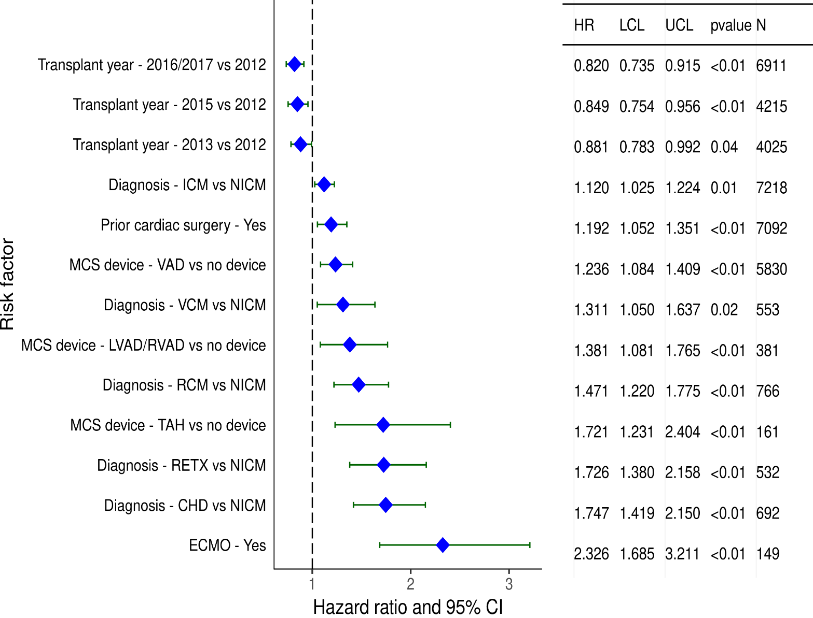
Adult Heart Transplants (2012-6/2017)
Statistically Significant Risk Factors For 1 Year Mortality with 95% Confidence Limits
2019
(N = 23,202)
JHLT. 2019 Oct; 38(10): 1015-1066
Notes:
PHM match = [(donor PHM – recipient PHM) / recipient PHM] x 100
Weight match = [(donor weight – recipient weight) / recipient weight] x 100
Height match = [(donor height – recipient height) / recipient height] x 100

Slide 171
Adult Heart Transplants (2012-6/2017)
Statistically Significant Risk Factors For 1 Year Mortality
Continuous Factors (see figures)
Recipient age (years) | Donor age (years)
Recipient creatinine (mg/dL) | Ischemic time (hours)
Recipient BMI (kg/m2) | Recipient bilirubin (mg/dl)
Donor-recipient predicted heart mass match (%)
2019
JHLT. 2019 Oct; 38(10): 1015-1066
Notes:
PHM match = [(donor PHM – recipient PHM) / recipient PHM] x 100
Weight match = [(donor weight – recipient weight) / recipient weight] x 100
Height match = [(donor height – recipient height) / recipient height] x 100

Slide 172
Adult Heart Transplants (2012-6/2017)
Statistically Significant Risk Factors For 1 Year Mortality with 95% Confidence Limits
Recipient age (years)
p < 0.0001
2019
(N = 23,202)
JHLT. 2019 Oct; 38(10): 1015-1066
Notes:
PHM match = [(donor PHM – recipient PHM) / recipient PHM] x 100
Weight match = [(donor weight – recipient weight) / recipient weight] x 100
Height match = [(donor height – recipient height) / recipient height] x 100

Slide 173
Adult Heart Transplants (2012-6/2017)
Statistically Significant Risk Factors For 1 Year Mortality with 95% Confidence Limits
Donor age (years)
p < 0.0001
2019
(N = 23,202)
JHLT. 2019 Oct; 38(10): 1015-1066
Notes:
PHM match = [(donor PHM – recipient PHM) / recipient PHM] x 100
Weight match = [(donor weight – recipient weight) / recipient weight] x 100
Height match = [(donor height – recipient height) / recipient height] x 100

Slide 174
Adult Heart Transplants (2012-6/2017)
Statistically Significant Risk Factors For 1 Year Mortality with 95% Confidence Limits
Recipient creatinine (mg/dL)
p < 0.0001
2019
(N = 23,202)
JHLT. 2019 Oct; 38(10): 1015-1066
Notes:
PHM match = [(donor PHM – recipient PHM) / recipient PHM] x 100
Weight match = [(donor weight – recipient weight) / recipient weight] x 100
Height match = [(donor height – recipient height) / recipient height] x 100

Slide 175
Adult Heart Transplants (2012-6/2017)
Statistically Significant Risk Factors For 1 Year Mortality with 95% Confidence Limits
Ischemic time (hours)
p < 0.0001
2019
(N = 23,202)
JHLT. 2019 Oct; 38(10): 1015-1066
Notes:
PHM match = [(donor PHM – recipient PHM) / recipient PHM] x 100
Weight match = [(donor weight – recipient weight) / recipient weight] x 100
Height match = [(donor height – recipient height) / recipient height] x 100

Slide 176
Adult Heart Transplants (2012-6/2017)
Statistically Significant Risk Factors For 1 Year Mortality with 95% Confidence Limits
Recipient BMI (kg/m2)
p = 0.0153
2019
(N = 23,202)
JHLT. 2019 Oct; 38(10): 1015-1066
Notes:
PHM match = [(donor PHM – recipient PHM) / recipient PHM] x 100
Weight match = [(donor weight – recipient weight) / recipient weight] x 100
Height match = [(donor height – recipient height) / recipient height] x 100

Slide 177
Adult Heart Transplants (2012-6/2017)
Statistically Significant Risk Factors For 1 Year Mortality with 95% Confidence Limits
Recipient bilirubin (mg/dl)
p < 0.0001
2019
(N = 23,202)
JHLT. 2019 Oct; 38(10): 1015-1066
Notes:
PHM match = [(donor PHM – recipient PHM) / recipient PHM] x 100
Weight match = [(donor weight – recipient weight) / recipient weight] x 100
Height match = [(donor height – recipient height) / recipient height] x 100

Slide 178
Adult Heart Transplants (2012-6/2017)
Statistically Significant Risk Factors For 1 Year Mortality with 95% Confidence Limits
Predicted heart mass match (%)
p = 0.0002
2019
(N = 23,202)
JHLT. 2019 Oct; 38(10): 1015-1066
Notes:
PHM match = [(donor PHM – recipient PHM) / recipient PHM] x 100
Weight match = [(donor weight – recipient weight) / recipient weight] x 100
Height match = [(donor height – recipient height) / recipient height] x 100

Slide 179
Adult Heart Transplants (2008-6/2013)
Univariable Cox Model with Only Predicted Heart Mass Match
Hazard Ratio for 5 Year Mortality with 95% Confidence Limits
Predicted heart mass match (%)
p = 0.0135
2019
(N = 20,820)
JHLT. 2019 Oct; 38(10): 1015-1066
Notes:
PHM match = [(donor PHM – recipient PHM) / recipient PHM] x 100
Weight match = [(donor weight – recipient weight) / recipient weight] x 100
Height match = [(donor height – recipient height) / recipient height] x 100

Slide 180
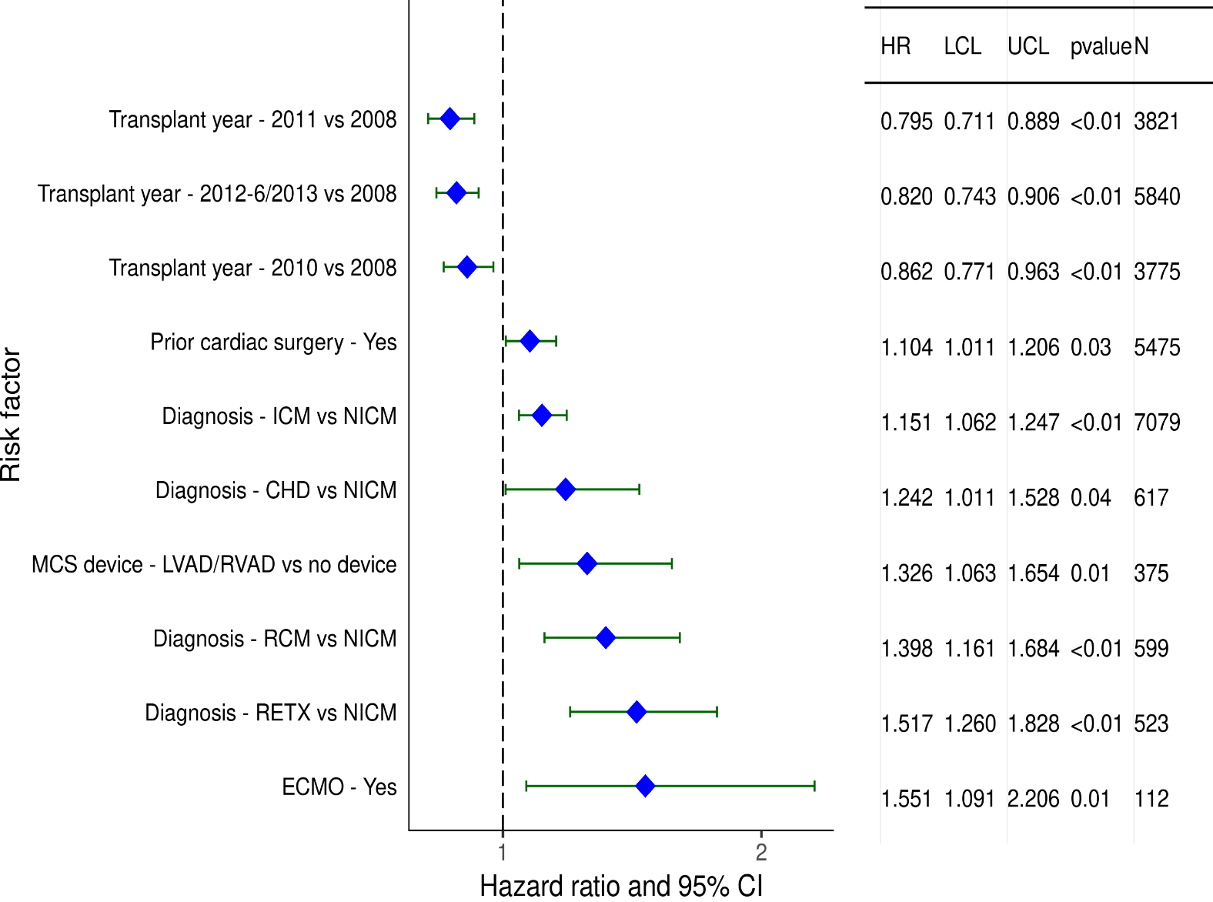
Adult Heart Transplants (2008-6/2013)
Statistically Significant Risk Factors For 5 Year Mortality with 95% Confidence Limits
2019
(N = 20,820)
JHLT. 2019 Oct; 38(10): 1015-1066
Notes:
PHM match = [(donor PHM – recipient PHM) / recipient PHM] x 100
Weight match = [(donor weight – recipient weight) / recipient weight] x 100
Height match = [(donor height – recipient height) / recipient height] x 100

Slide 181
Adult Heart Transplants (2008-6/2013)
Statistically Significant Risk Factors For 5 Year Mortality
Continuous Factors (see figures)
Recipient age (years) | Donor age (years)
Recipient creatinine (mg/dL) | Ischemic time (hours)
Recipient BMI (kg/m2)
Note: Predicted heart mass match was not significant in the multivariable model.
2019
JHLT. 2019 Oct; 38(10): 1015-1066
Notes:
PHM match = [(donor PHM – recipient PHM) / recipient PHM] x 100
Weight match = [(donor weight – recipient weight) / recipient weight] x 100
Height match = [(donor height – recipient height) / recipient height] x 100

Slide 182
Adult Heart Transplants (2008-6/2013)
Statistically Significant Risk Factors For 5 Year Mortality with 95% Confidence Limits
Recipient age (years)
p < 0.0001
2019
(N = 20,820)
JHLT. 2019 Oct; 38(10): 1015-1066
Notes:
PHM match = [(donor PHM – recipient PHM) / recipient PHM] x 100
Weight match = [(donor weight – recipient weight) / recipient weight] x 100
Height match = [(donor height – recipient height) / recipient height] x 100

Slide 183
Adult Heart Transplants (2008-6/2013)
Statistically Significant Risk Factors For 5 Year Mortality with 95% Confidence Limits
Donor age (years)
p < 0.0001
2019
(N = 20,820)
JHLT. 2019 Oct; 38(10): 1015-1066
Notes:
PHM match = [(donor PHM – recipient PHM) / recipient PHM] x 100
Weight match = [(donor weight – recipient weight) / recipient weight] x 100
Height match = [(donor height – recipient height) / recipient height] x 100

Slide 184
Adult Heart Transplants (2008-6/2013)
Statistically Significant Risk Factors For 5 Year Mortality with 95% Confidence Limits
Recipient creatinine (mg/dL)
p < 0.0001
2019
(N = 20,820)
JHLT. 2019 Oct; 38(10): 1015-1066
Notes:
PHM match = [(donor PHM – recipient PHM) / recipient PHM] x 100
Weight match = [(donor weight – recipient weight) / recipient weight] x 100
Height match = [(donor height – recipient height) / recipient height] x 100

Slide 185
Adult Heart Transplants (2008-6/2013)
Statistically Significant Risk Factors For 5 Year Mortality with 95% Confidence Limits
Ischemic time (hours)
p = 0.0092
2019
(N = 20,820)
JHLT. 2019 Oct; 38(10): 1015-1066
Notes:
PHM match = [(donor PHM – recipient PHM) / recipient PHM] x 100
Weight match = [(donor weight – recipient weight) / recipient weight] x 100
Height match = [(donor height – recipient height) / recipient height] x 100

Slide 186
Adult Heart Transplants (2008-6/2013)
Statistically Significant Risk Factors For 5 Year Mortality with 95% Confidence Limits
Recipient BMI (kg/m2)
p = 0.0035
2019
(N = 20,820)
JHLT. 2019 Oct; 38(10): 1015-1066
Notes:
PHM match = [(donor PHM – recipient PHM) / recipient PHM] x 100
Weight match = [(donor weight – recipient weight) / recipient weight] x 100
Height match = [(donor height – recipient height) / recipient height] x 100

Slide 187
Adult Heart Transplants (2008-6/2013)
Risk Factors For 5 Year Mortality with 95% Confidence Limits
Predicted heart mass match (%)
p = 0.1135
2019
(N = 20,820)
JHLT. 2019 Oct; 38(10): 1015-1066
Notes:
PHM match = [(donor PHM – recipient PHM) / recipient PHM] x 100
Weight match = [(donor weight – recipient weight) / recipient weight] x 100
Height match = [(donor height – recipient height) / recipient height] x 100

