Slide 1

HEART TRANSPLANTATION
Pediatric Recipients
2018
JHLT. 2018 Oct; 37(10): 1155-1206

Slide 2
Table of Contents
Donor, recipient and center characteristics: slides 3-29
Post-transplant – survival and other outcomes: slides 30-53
Induction and maintenance immunosuppression: slides 54-65
Rejection and post-transplant morbidities: slides 66-101
Retransplantation: slides 102-108
Multivariable analyses: slides 109-159
Focus theme: slides 160-177
2018
JHLT. 2018 Oct; 37(10): 1155-1206

Slide 3
Donor, Recipient and Center Characteristics
2018
JHLT. 2018 Oct; 37(10): 1155-1206

Slide 4
Pediatric Heart Transplants
Number of Centers Reporting Transplants
2018
JHLT. 2018 Oct; 37(10): 1155-1206

Slide 5
(Transplants: January 2004 – June 2017)
Pediatric Heart Transplants
Number of Centers by Center Volume
2018
JHLT. 2018 Oct; 37(10): 1155-1206

Slide 6
Pediatric Heart Transplants
Distribution of Transplants by Center Volume
(Transplants: January 2004 – June 2017)
2018
JHLT. 2018 Oct; 37(10): 1155-1206

Slide 7
Pediatric Heart Transplants
Recipient Age Distribution by Center Volume
(Transplants: January 2004 – June 2017)
Recipient Age (Years):
2018
JHLT. 2018 Oct; 37(10): 1155-1206

Slide 8
Pediatric Heart Transplants
Distribution of Transplants by Location and Average Center
Volume
(Transplants: January 2004 – June 2017)
2018
JHLT. 2018 Oct; 37(10): 1155-1206

Slide 9
Pediatric Heart Transplants
Recipient Age Distribution
(Transplants: January 2004 – June 2017)
2018
JHLT. 2018 Oct; 37(10): 1155-1206

Slide 10
Pediatric Heart Transplants
Recipient Age (in Years) Distribution by Year of Transplant
NOTE: This figure includes only the heart transplants that are reported to the ISHLT Transplant Registry. As such, this should not be construed as evidence that the number of hearts transplanted worldwide has increased and/or decreased in recent years.
2018
JHLT. 2018 Oct; 37(10): 1155-1206

Slide 11
Pediatric Heart Transplants
Recipient Age Distribution by Location
(Transplants: January 2004 – June 2017)
Recipient Age (Years):
2018
JHLT. 2018 Oct; 37(10): 1155-1206

Slide 12
Pediatric Heart Transplants
Donor Age Distribution
(Transplants: January 2004 – June 2017)
2018
JHLT. 2018 Oct; 37(10): 1155-1206
Notes:
NOTE: Transplants where donor age is unknown are excluded from this tabulation.

Slide 13
Pediatric Heart Transplants
Donor and Recipient Age
(Transplants: January 2004 – June 2017)
2018
JHLT. 2018 Oct; 37(10): 1155-1206

Slide 14
Pediatric Heart Transplants
Donor Age Distribution by Location
(Transplants: January 2004 – June 2017)
Donor Age (Years):
2018
JHLT. 2018 Oct; 37(10): 1155-1206
Notes:
NOTE: Transplants where donor age is unknown are excluded from this tabulation.

Slide 15
Pediatric Heart Transplants
Distribution of Transplants by Donor/Recipient Weight Ratio
(Transplants: January 2004 – June 2017)
2018
JHLT. 2018 Oct; 37(10): 1155-1206

Slide 16
Pediatric Heart Transplants
Recipient Diagnosis (Age: < 1 Year)
2009-6/2017
2018
JHLT. 2018 Oct; 37(10): 1155-1206
Notes:
NOTE: Transplants with unknown diagnoses are excluded from this tabulation

Slide 17
Pediatric Heart Transplants
Recipient Diagnosis (Age: 1-5 Years)
2009-6/2017
2018
JHLT. 2018 Oct; 37(10): 1155-1206
Notes:
NOTE: Transplants with unknown diagnoses are excluded from this tabulation

Slide 18
Pediatric Heart Transplants
Recipient Diagnosis (Age: 6-10 Years)
2009-6/2017
2018
JHLT. 2018 Oct; 37(10): 1155-1206
Notes:
NOTE: Transplants with unknown diagnoses are excluded from this tabulation

Slide 19
Pediatric Heart Transplants
Recipient Diagnosis (Age: 11-17 Years)
2009-6/2017
2018
JHLT. 2018 Oct; 37(10): 1155-1206
Notes:
NOTE: Transplants with unknown diagnoses are excluded from this tabulation

Slide 20
Pediatric Heart Transplants
Diagnosis Distribution by Location
(Transplants: January 2004 – June 2017)
2018
JHLT. 2018 Oct; 37(10): 1155-1206
Notes:
NOTE: Transplants with unknown diagnoses are excluded from this tabulation.

Slide 21
Pediatric Heart Transplants
% of Patients Bridged with Mechanical Circulatory Support*
by Year
(Transplants: January 2005 – December 2016
2018
* LVAD, RVAD, TAH, ECMO
JHLT. 2018 Oct; 37(10): 1155-1206

Slide 22
Pediatric Heart Transplants
% of Patients Bridged with Mechanical Circulatory Support*
(Transplants: January 2009 – June 2017)
2018
* LVAD, RVAD, TAH, ECMO
JHLT. 2018 Oct; 37(10): 1155-1206

Slide 23
Pediatric Heart Transplants
% of Patients Bridged with Mechanical Circulatory Support*
by Diagnosis
(Transplants: January 2009 – June 2017)
2018
* LVAD, RVAD, TAH, ECMO
JHLT. 2018 Oct; 37(10): 1155-1206

Slide 24
Pediatric Heart Transplants
% of Patients Bridged with Mechanical Circulatory Support*
by Age Group
(Transplants: January 2009 – June 2017)
2018
* LVAD, RVAD, TAH, ECMO
JHLT. 2018 Oct; 37(10): 1155-1206

Slide 25
Pediatric Heart Transplants
% of Patients Bridged with Mechanical Circulatory Support*
by Age Group and Diagnosis
(Transplants: January 2009 – June 2017)
<1 year
1-5 years
6-10 years
11-17 years
2018
* LVAD, RVAD, TAH, ECMO
JHLT. 2018 Oct; 37(10): 1155-1206

Slide 26
Pediatric Heart Transplants
PRA Distribution by Year
(Transplants: January 2005 – December 2016)
2018
CPRA and PRA values were combined. If Class I and Class II PRA values were reported separately, the higher of the two values was used.
JHLT. 2018 Oct; 37(10): 1155-1206

Slide 27
Pediatric Heart Transplants
PRA Distribution by Age Group
(Transplants: January 2009 – June 2017)
p<0.0001
2018
CPRA and PRA values were combined. If Class I and Class II PRA values were reported separately, the higher of the two values was used.
JHLT. 2018 Oct; 37(10): 1155-1206

Slide 28
Pediatric Heart Transplants
PRA Distribution by Diagnosis
(Transplants: January 2009 – June 2017)
p<0.0001
2018
CPRA and PRA values were combined. If Class I and Class II PRA values were reported separately, the higher of the two values was used.
JHLT. 2018 Oct; 37(10): 1155-1206

Slide 29
Pediatric Heart Transplants
PRA Distribution by Age Group and Diagnosis
(Transplants: January 2009 – June 2017)
<1 Year
1-5 Years
6-10 Years
11-17 Years
2018
CPRA and PRA values were combined. If Class I and Class II PRA values were reported separately, the higher of the two values was used.
JHLT. 2018 Oct; 37(10): 1155-1206

Slide 30
Post-Transplant:
Survival and Other Outcomes
2018
JHLT. 2018 Oct; 37(10): 1155-1206

Slide 31
Pediatric Heart Transplants
Kaplan-Meier Survival
(Transplants: January 1982 – June 2016)
No pair-wise comparisons were significant at p < 0.05 except 1-5 vs. 11-17 and 6-10 vs. 11-17.
Median survival (years): <1=22.3; 1-5=19.3; 6-10=14.6; 11-17=13.3
2018
JHLT. 2018 Oct; 37(10): 1155-1206
Notes:
Survival was calculated using the Kaplan-Meier method, which incorporates information from all transplants for whom any follow-up has been provided. Since many patients are still alive and some patients have been lost to follow-up, the survival rates are estimates rather than exact rates because the time of death is not known for all patients. The median survival is the estimated time point at which 50% of all of the recipients have died.
Survival rates were compared using the log-rank test statistic. Adjustments for multiple comparisons were done using Scheffe’s method. Results of log-rank test should be interpreted with caution when curves cross.

Slide 32
Pediatric Heart Transplants
Kaplan-Meier Survival Conditional on Survival to 1 Year
(Transplants: January 1982 – June 2016)
Median survival (years): <1=27.1; 1-5=22.1; 6-10=17.1; 11-17=16.4
All pair-wise comparisons were significant at p < 0.05 except <1 vs. 1-5.
2018
JHLT. 2018 Oct; 37(10): 1155-1206
Notes:
Survival was calculated using the Kaplan-Meier method, which incorporates information from all transplants for whom any follow-up has been provided. Since many patients are still alive and some patients have been lost to follow-up, the survival rates are estimates rather than exact rates because the time of death is not known for all patients. Conditional survival is shown in this figure; this is the survival following 1 year for all patients who survived to 1 year. The conditional median survival is the estimated time point at which 50% of the recipients who survive to at least 1 year have died. Because the decline in survival is greatest during the first year following transplantation, the conditional survival provides a more realistic expectation of survival time for recipients who survive the early post-transplant period.
Survival rates were compared using the log-rank test statistic. Adjustments for multiple comparisons were done using Scheffe’s method. Results of log-rank test should be interpreted with caution when curves cross.

Slide 33
Pediatric Heart Transplants
Kaplan-Meier Survival Conditional on Survival to 5 Years
(Transplants: January 1982 – June 2012)
All pair-wise comparisons were significant at p < 0.05 except 6-10 vs. 11-17.
2018
JHLT. 2018 Oct; 37(10): 1155-1206
Notes:
Survival was calculated using the Kaplan-Meier method, which incorporates information from all transplants for whom any follow-up has been provided. Since many patients are still alive and some patients have been lost to follow-up, the survival rates are estimates rather than exact rates because the time of death is not known for all patients. Conditional survival is shown in this figure; this is the survival following 5 years for all patients who survived to 5 years.
Survival rates were compared using the log-rank test statistic. Adjustments for multiple comparisons were done using Scheffe’s method. Results of log-rank test should be interpreted with caution when curves cross.

Slide 34
Pediatric Heart Transplants
Kaplan-Meier Survival Conditional on Survival to 10 Years
(Transplants: January 1982 – June 2007)
All pair-wise comparisons were significant at p < 0.05 except 1-5 vs. 11-17.
2018
JHLT. 2018 Oct; 37(10): 1155-1206
Notes:
Survival was calculated using the Kaplan-Meier method, which incorporates information from all transplants for whom any follow-up has been provided. Since many patients are still alive and some patients have been lost to follow-up, the survival rates are estimates rather than exact rates because the time of death is not known for all patients. Conditional survival is shown in this figure; this is the survival following 10 years for all patients who survived to 10 years.
Survival rates were compared using the log-rank test statistic. Adjustments for multiple comparisons were done using Scheffe’s method. Results of log-rank test should be interpreted with caution when curves cross.

Slide 35
Pediatric Heart Transplants
Kaplan-Meier Survival by Era
(Transplants: January 1982 – June 2016)
All p-values were significant at p < 0.05.
Median survival (years): 1982-1989= 9.7; 1990-2003=14.5; 2004-2008=NA; 2009-6/2016=NA
2018
JHLT. 2018 Oct; 37(10): 1155-1206
Notes:
Survival was calculated using the Kaplan-Meier method, which incorporates information from all transplants for whom any follow-up has been provided. Since many patients are still alive and some patients have been lost to follow-up, the survival rates are estimates rather than exact rates because the time of death is not known for all patients. The median survival is the estimated time point at which 50% of all of the recipients have died.
Survival rates were compared using the log-rank test statistic. Adjustments for multiple comparisons were done using Scheffe’s method.

Slide 36
Pediatric Heart Transplants
Conditional Kaplan-Meier Survival for Recent Era
(Transplants: January 2004 – June 2016)
All pair-wise comparisons with 11-17 were significant at p<0.05. No other pair-wise comparisons were significant at p<0.05.
2018
JHLT. 2018 Oct; 37(10): 1155-1206
Notes:
Survival was calculated using the Kaplan-Meier method, which incorporates information from all transplants for whom any follow-up has been provided. Since many patients are still alive and some patients have been lost to follow-up, the survival rates are estimates rather than exact rates because the time of death is not known for all patients. Conditional survival is shown in this figure; this is the survival following 1 year for all patients who survived to 1 year. Because the decline in survival is greatest during the first year following transplantation, the conditional survival provides a more realistic expectation of survival time for recipients who survive the early post-transplant period.
Survival rates were compared using the log-rank test statistic. Adjustments for multiple comparisons were done using Scheffe’s method. Results of log-rank test should be interpreted with caution when curves cross.

Slide 37
Pediatric Heart Transplants
Kaplan-Meier Survival by Era
Age: < 1 Year
(Transplants: January 1982 – June 2016)
All pair-wise comparisons were significant at p<0.05.
Median survival (years): 1982-1989=10.4.; 1990-2003=19.7; 2004-2008=NA; 2009-6/2016=NA
2018
JHLT. 2018 Oct; 37(10): 1155-1206
Notes:
Survival was calculated using the Kaplan-Meier method, which incorporates information from all transplants for whom any follow-up has been provided. Since many patients are still alive and some patients have been lost to follow-up, the survival rates are estimates rather than exact rates because the time of death is not known for all patients. The median survival is the estimated time point at which 50% of all of the recipients have died.
Survival rates were compared using the log-rank test statistic. Adjustments for multiple comparisons were done using Scheffe’s method.

Slide 38
Pediatric Heart Transplants
Kaplan-Meier Survival by Era
Age: 1-5 Years
(Transplants: January 1982 – June 2016)
All p-values significant at p<0.05 except 2004-2008 vs. 2009-6/2016.
Median survival (years): 1982-1989= 9.1.; 1990-2003=17.1; 2004-2008=NA; 2009-6/2016=NA
2018
JHLT. 2018 Oct; 37(10): 1155-1206
Notes:
Survival was calculated using the Kaplan-Meier method, which incorporates information from all transplants for whom any follow-up has been provided. Since many patients are still alive and some patients have been lost to follow-up, the survival rates are estimates rather than exact rates because the time of death is not known for all patients. The median survival is the estimated time point at which 50% of all of the recipients have died.
Survival rates were compared using the log-rank test statistic. Adjustments for multiple comparisons were done using Scheffe’s method.

Slide 39
Pediatric Heart Transplants
Kaplan-Meier Survival by Era
Age: 6-10 Years
(Transplants: January 1982 – June 2016)
All p-values significant at < 0.05 except 2004-2008 vs. 2009-6/2016.
Median survival (years): 1982-1989= 7.7.; 1990-2003=13.3; 2004-2008=NA; 2009-6/2016=NA
2018
JHLT. 2018 Oct; 37(10): 1155-1206
Notes:
Survival was calculated using the Kaplan-Meier method, which incorporates information from all transplants for whom any follow-up has been provided. Since many patients are still alive and some patients have been lost to follow-up, the survival rates are estimates rather than exact rates because the time of death is not known for all patients. The median survival is the estimated time point at which 50% of all of the recipients have died.
Survival rates were compared using the log-rank test statistic. Adjustments for multiple comparisons were done using Scheffe’s method.

Slide 40
Pediatric Heart Transplants
Kaplan-Meier Survival by Era
Age: 11-17 Years
(Transplants: January 1982 – June 2016)
Median survival (years): 1982-1989= 9.9.; 1990-2003=12.0; 2004-2008=NA; 2009-6/2016=NA
All other pair-wise comparisons were significant at p<0.05 except 2004-2008 vs. 2009-6/2016.
2018
JHLT. 2018 Oct; 37(10): 1155-1206
Notes:
Survival was calculated using the Kaplan-Meier method, which incorporates information from all transplants for whom any follow-up has been provided. Since many patients are still alive and some patients have been lost to follow-up, the survival rates are estimates rather than exact rates because the time of death is not known for all patients. The median survival is the estimated time point at which 50% of all of the recipients have died.
Survival rates were compared using the log-rank test statistic. Adjustments for multiple comparisons were done using Scheffe’s method. Results of log-rank test should be interpreted with caution when curves cross.

Slide 41
Pediatric Heart Transplants
Kaplan-Meier Survival by Recipient Gender
(Transplants: January 2004 – June 2016)
p = 0.1287
2018
JHLT. 2018 Oct; 37(10): 1155-1206
Notes:
Survival was calculated using the Kaplan-Meier method, which incorporates information from all transplants for whom any follow-up has been provided. Since many patients are still alive and some patients have been lost to follow-up, the survival rates are estimates rather than exact rates because the time of death is not known for all patients.
Survival rates were compared using the log-rank test statistic.

Slide 42
Pediatric Heart Transplants
Kaplan-Meier Survival by Donor/Recipient Gender
(Transplants: January 2004 – June 2016)
No pair-wise comparisons were significant at p<0.05.
2018
JHLT. 2018 Oct; 37(10): 1155-1206
Notes:
Survival was calculated using the Kaplan-Meier method, which incorporates information from all transplants for whom any follow-up has been provided. Since many patients are still alive and some patients have been lost to follow-up, the survival rates are estimates rather than exact rates because the time of death is not known for all patients.
Survival rates were compared using the log-rank test statistic. Adjustments for multiple comparisons were done using Scheffe’s method.

Slide 43
Pediatric Heart Transplants
Kaplan-Meier Survival by Diagnosis
Age: < 1 Year
(Transplants: January 2004 – June 2016)
p<0.0001
2018
JHLT. 2018 Oct; 37(10): 1155-1206
Notes:
Survival was calculated using the Kaplan-Meier method, which incorporates information from all transplants for whom any follow-up has been provided. Since many patients are still alive and some patients have been lost to follow-up, the survival rates are estimates rather than exact rates because the time of death is not known for all patients.
Survival rates were compared using the log-rank test statistic.

Slide 44
Pediatric Heart Transplants
Kaplan-Meier Survival by Diagnosis
Age: 1-5 Years
(Transplants: January 2004 – June 2016)
CHD vs. DCM: p=0.0004
CHD vs. Retransplant: p=0.1109
DCM vs. Retransplant: p=0.0001
2018
JHLT. 2018 Oct; 37(10): 1155-1206
Notes:
Survival was calculated using the Kaplan-Meier method, which incorporates information from all transplants for whom any follow-up has been provided. Since many patients are still alive and some patients have been lost to follow-up, the survival rates are estimates rather than exact rates because the time of death is not known for all patients.
Survival rates were compared using the log-rank test statistic. Adjustments for multiple comparisons were done using Scheffe’s method.

Slide 45
Pediatric Heart Transplants
Kaplan-Meier Survival by Diagnosis
Age: 6-10 Years
(Transplants: January 2004 – June 2016)
CHD vs. DCM: p=0.0745
CHD vs. Retransplant: p=0.9926
DCM vs. Retransplant: p=0.3577
2018
JHLT. 2018 Oct; 37(10): 1155-1206
Notes:
Survival was calculated using the Kaplan-Meier method, which incorporates information from all transplants for whom any follow-up has been provided. Since many patients are still alive and some patients have been lost to follow-up, the survival rates are estimates rather than exact rates because the time of death is not known for all patients.
Survival rates were compared using the log-rank test statistic. Adjustments for multiple comparisons were done using Scheffe’s method. Results of log-rank test should be interpreted with caution when curves cross.

Slide 46
Pediatric Heart Transplants
Kaplan-Meier Survival by Diagnosis
Age: 11-17 Years
(Transplants: January 2004 – June 2016)
CHD vs. DCM: p=0.0101
CHD vs. Retransplant: p=0.0754
DCM vs. Retransplant: p<0.0001
2018
JHLT. 2018 Oct; 37(10): 1155-1206
Notes:
Survival was calculated using the Kaplan-Meier method, which incorporates information from all transplants for whom any follow-up has been provided. Since many patients are still alive and some patients have been lost to follow-up, the survival rates are estimates rather than exact rates because the time of death is not known for all patients.
Survival rates were compared using the log-rank test statistic. Adjustments for multiple comparisons were done using Scheffe’s method. Results of log-rank test should be interpreted with caution when curves cross.

Slide 47
Pediatric Heart Transplants
Kaplan-Meier Survival by PRA
Diagnosis=CHD
(Transplants: January 2005 – June 2016)
0-9% vs. 10-39%: p=0.7843
0-9% vs. 40%+: p=0.0600
10-39% vs. 40%+: p=0.6234
2018
CPRA and PRA values were combined. If Class I and Class II PRA values were reported separately, the higher of the two values was used.
JHLT. 2018 Oct; 37(10): 1155-1206
Notes:
Survival was calculated using the Kaplan-Meier method, which incorporates information from all transplants for whom any follow-up has been provided. Since many patients are still alive and some patients have been lost to follow-up, the survival rates are estimates rather than exact rates because the time of death is not known for all patients.
Survival rates were compared using the log-rank test statistic. Adjustments for multiple comparisons were done using Scheffe’s method.

Slide 48
Pediatric Heart Transplants
Kaplan-Meier Survival by PRA
Diagnosis=DCM
(Transplants: January 2005 – June 2016)
0-9% vs. 10-39%: p=0.8637
0-9% vs. 40%+: p=0.8953
10-39% vs. 40%+: p=0.9989
2018
CPRA and PRA values were combined. If Class I and Class II PRA values were reported separately, the higher of the two values was used.
JHLT. 2018 Oct; 37(10): 1155-1206
Notes:
Survival was calculated using the Kaplan-Meier method, which incorporates information from all transplants for whom any follow-up has been provided. Since many patients are still alive and some patients have been lost to follow-up, the survival rates are estimates rather than exact rates because the time of death is not known for all patients.
Survival rates were compared using the log-rank test statistic. Adjustments for multiple comparisons were done using Scheffe’s method.

Slide 49
Pediatric Heart Transplants
Kaplan-Meier Survival by PRA
Diagnosis=Retransplant
(Transplants: January 2005 – June 2016)
0-9% vs. 10-39%: p=0.9666
0-9% vs. 40%+: p=0.7142
10-39% vs. 40%+: p=0.6525
2018
CPRA and PRA values were combined. If Class I and Class II PRA values were reported separately, the higher of the two values was used.
JHLT. 2018 Oct; 37(10): 1155-1206
Notes:
Survival was calculated using the Kaplan-Meier method, which incorporates information from all transplants for whom any follow-up has been provided. Since many patients are still alive and some patients have been lost to follow-up, the survival rates are estimates rather than exact rates because the time of death is not known for all patients.
Survival rates were compared using the log-rank test statistic. Adjustments for multiple comparisons were done using Scheffe’s method.

Slide 50
Pediatric Heart Transplants
Kaplan-Meier Patient vs. Graft Survival
(Transplants: January 2004 – June 2016)
p = 0.0001
2018
JHLT. 2018 Oct; 37(10): 1155-1206
Notes:
Survival was calculated using the Kaplan-Meier method, which incorporates information from all transplants for whom any follow-up has been provided. Since many patients are still alive and some patients have been lost to follow-up, the survival rates are estimates rather than exact rates because the time of death is not known for all patients.
Survival rates were compared using the log-rank test statistic.

Slide 51
Pediatric Heart Transplants
Kaplan-Meier Survival by Mechanical Circulatory Support
Usage*
(Transplants: January 2009 – June 2016)
ECMO, no VAD or TAH vs. VAD or TAH, no ECMO: p <0.0001 ECMO, no VAD or TAH vs. No ECMO/VAD/TAH: p<0.0001
VAD or TAH, no ECMO vs. No ECMO/VAD/TAH: p=0.9007
2018
* LVAD, RVAD, TAH, ECMO
JHLT. 2018 Oct; 37(10): 1155-1206
Notes:
Survival was calculated using the Kaplan-Meier method, which incorporates information from all transplants for whom any follow-up has been provided. Since many patients are still alive and some patients have been lost to follow-up, the survival rates are estimates rather than exact rates because the time of death is not known for all patients.
Survival rates were compared using the log-rank test statistic. Adjustments for multiple comparisons were done using Scheffe’s method. Results of log-rank test should be interpreted with caution when curves cross.

Slide 52
Pediatric Heart Transplants
Functional Status of Surviving Recipients
(Follow-ups: January 2009 – June 2017)
2018
JHLT. 2018 Oct; 37(10): 1155-1206
Notes:
Functional status is collected using Lansky score for pediatric recipients.
This figure shows the functional status reported on the 1-year, 2-year and 3-year annual follow-ups. Because all follow-ups between January 2009 and June 2017 were included, the bars do not include the same patients.

Slide 53
Pediatric Heart Transplants
Rehospitalization Post-transplant of Surviving Recipients
(Follow-ups: January 2009 – June 2017)
2018
JHLT. 2018 Oct; 37(10): 1155-1206
Notes:
This figure shows the hospitalizations reported on the 1-year, 3-year and 5-year annual follow-ups, representing the hospitalizations between discharge and 1 year, between the 2-year and 3-year follow-up, and between the 4-year and 5-year follow-up, respectively. Because all follow-ups between January 2009 and June 2017 were included, the bars do not include the same patients.

Slide 54
Induction and Maintenance Immunosuppression
2018
JHLT. 2018 Oct; 37(10): 1155-1206

Slide 55
Pediatric Heart Transplants
Induction Immunosuppression
(Transplants: January 2004 – June 2017)
N = 5,046
2018
Analysis is limited to patients who were alive at the time of the discharge.
JHLT. 2018 Oct; 37(10): 1155-1206

Slide 56
Pediatric Heart Transplants
Induction Immunosuppression by Era
(Transplants: January 2004 – June 2017)
All pair-wise comparisons between eras were significant at p < 0.05 except for IL-2R Antagonist.
2018
Analysis is limited to patients who were alive at the time of the discharge.
JHLT. 2018 Oct; 37(10): 1155-1206

Slide 57
Pediatric Heart Transplants
Kaplan-Meier Survival by Induction Group Conditional on
Survival to 14 Days
(Transplants: January 2004 – June 2016)
No pair-wise comparisons were significant at p<0.05.
2018
JHLT. 2018 Oct; 37(10): 1155-1206
Notes:
Survival was calculated using the Kaplan-Meier method, which incorporates information from all transplants for whom any follow-up has been provided. Since many patients are still alive and some patients have been lost to follow-up, the survival rates are estimates rather than exact rates because the time of death is not known for all patients.
Survival rates were compared using the log-rank test statistic. Adjustments for multiple comparisons were done using Scheffe’s method.

Slide 58
Pediatric Heart Transplants
Kaplan-Meier Survival by Induction and Treated Rejection Between Transplant Discharge and 1-Year Follow-up
Conditional on Survival to 1 Year
(1-Year Follow-ups: July 2004 – June 2016)
No pair-wise comparisons of survival by induction were significant at p < 0.05 within either rejection grouping.
Treated rejection = Recipient was reported to (1) have at least one acute rejection episode that was treated with an anti-rejection agent; or (2) have been hospitalized for rejection.
No rejection = Recipient had (i) no acute rejection episodes and (ii) was reported either as not hospitalized for rejection or did not receive anti-rejection agents.
2018
JHLT. 2018 Oct; 37(10): 1155-1206
Notes:
Because of a modification in the data collection, the analysis is limited to follow-ups occurring on or after July 2004.
Survival was calculated using the Kaplan-Meier method, which incorporates information from all transplants for whom any follow-up has been provided. Since many patients are still alive and some patients have been lost to follow-up, the survival rates are estimates rather than exact rates because the time of death is not known for all patients.
Survival rates were compared using the log-rank test statistic. Adjustments for multiple comparisons were done using Scheffe’s method.

Slide 59
Pediatric Heart Transplants
Maintenance Immunosuppression at Time of Transplant
Discharge by Era
(Transplants: January 2004 – June 2017)
2018
Analysis is limited to patients who were alive at the time of the discharge.
JHLT. 2018 Oct; 37(10): 1155-1206

Slide 60
Pediatric Heart Transplants
Maintenance Immunosuppression at Time of 1 Year Follow-up
(Follow-ups: January 2004 – June 2017)
N = 4,400
2018
Analysis is limited to patients who were alive at the time of the follow-up.
JHLT. 2018 Oct; 37(10): 1155-1206

Slide 61
Pediatric Heart Transplants
Maintenance Immunosuppression Drug Combinations at
Time of 1 Year Follow-up
(Follow-ups: January 2004 – June 2017)
2018
Analysis is limited to patients who were alive at the time of the follow-up.
JHLT. 2018 Oct; 37(10): 1155-1206

Slide 62
Pediatric Heart Transplants
Kaplan-Meier Survival Based on Prednisone Use
Conditional on Survival to 1 Year
(Transplants: January 2004 – June 2016)
p < 0.0001
2018
JHLT. 2018 Oct; 37(10): 1155-1206
Notes:
Survival was calculated using the Kaplan-Meier method, which incorporates information from all transplants for whom any follow-up has been provided. Since many patients are still alive and some patients have been lost to follow-up, the survival rates are estimates rather than exact rates because the time of death is not known for all patients. The cohorts were conditioned on survival to 1 year, so that prednisone use during the first year could be used as a stratification factor.
Survival rates were compared using the log-rank test statistic. A significant p-value means that at least one of the groups is different than the others but it doesn’t identify which group it is.

Slide 63
Pediatric Heart Transplants
Kaplan-Meier Survival by Calcineurin Inhibitor Use at
Discharge
(Transplants: January 2004 – June 2016)
Conditional on Survival to 14 Days
p = 0.6966
2018
JHLT. 2018 Oct; 37(10): 1155-1206
Notes:
Survival was calculated using the Kaplan-Meier method, which incorporates information from all transplants for whom any follow-up has been provided. Since many patients are still alive and some patients have been lost to follow-up, the survival rates are estimates rather than exact rates because the time of death is not known for all patients.
Survival rates were compared using the log-rank test statistic. Results of log-rank test should be interpreted with caution when curves cross.

Slide 64
Pediatric Heart Transplants
Kaplan-Meier Survival by Maintenance Immunosuppression
at Discharge
(Transplants: January 2004 – June 2016)
Conditional on Survival to 14 Days
No pair-wise comparisons were significant at p<0.05.
2018
JHLT. 2018 Oct; 37(10): 1155-1206
Notes:
Survival was calculated using the Kaplan-Meier method, which incorporates information from all transplants for whom any follow-up has been provided. Since many patients are still alive and some patients have been lost to follow-up, the survival rates are estimates rather than exact rates because the time of death is not known for all patients.
Survival rates were compared using the log-rank test statistic. Results of log-rank test should be interpreted with caution when curves cross. Adjustments for multiple comparisons were done using Scheffe’s method.

Slide 65
Pediatric Heart Transplants
Kaplan-Meier Survival by Calcineurin Inhibitor Use
Conditional on Survival to 1 Year
(Transplants: January 2004 – June 2016)
No pair-wise comparisons were significant at p<0.05 except Cyclosporine use at discharge and 1 year vs. Cyclosporine use at discharge/Tacrolimus at 1 year.
2018
JHLT. 2018 Oct; 37(10): 1155-1206
Notes:
Survival was calculated using the Kaplan-Meier method, which incorporates information from all transplants for whom any follow-up has been provided. Since many patients are still alive and some patients have been lost to follow-up, the survival rates are estimates rather than exact rates because the time of death is not known for all patients. The cohorts were conditioned on survival to 1 year, so that cyclosporine vs. tacrolimus use during the first year could be used as a stratification factor.
Survival rates were compared using the log-rank test statistic. A significant p-value means that at least one of the groups is different than the others but it doesn’t identify which group it is. Results of log-rank test should be interpreted with caution when curves cross.

Slide 66
Rejection and Post-Transplant Morbidities
2018
JHLT. 2018 Oct; 37(10): 1155-1206

Slide 67
Pediatric Heart Transplants
Kaplan-Meier Survival Based on Treated Rejection within 1st Year
Conditional on Survival to 1 Year
(1-Year Follow-ups: July 2004 – June 2016)
p < 0.0001
Treated rejection = Recipient was reported to (1) have at least one acute rejection episode that was treated with an anti-rejection agent; or (2) have been hospitalized for rejection.
No rejection = Recipient had (i) no acute rejection episodes and (ii) was reported either as not hospitalized for rejection or did not receive anti-rejection agents.
2018
JHLT. 2018 Oct; 37(10): 1155-1206
Notes:
Because of a modification in the data collection, the analysis is limited to follow-ups occurring on or after July 2004.
Survival was calculated using the Kaplan-Meier method, which incorporates information from all transplants for whom any follow-up has been provided. Since many patients are alive and some patients have been lost to follow-up, the survival rates are estimates rather than exact rates because the time of death is not known for all patients and may never occur for some patients. Conditional survival is shown in this figure; this is the survival rate following 1 year for all patients who survived to 1 year.
Survival rates were compared using the log-rank test statistic.

Slide 68
Pediatric Heart Transplants
Kaplan-Meier Survival Based on Treated Rejection within 1st Year
Age = < 1 Year
Conditional on Survival to 1 Year
(1-Year Follow-ups: July 2004 – June 2016)
p < 0.0001
Treated rejection = Recipient was reported to (1) have at least one acute rejection episode that was treated with an anti-rejection agent; or (2) have been hospitalized for rejection.
No rejection = Recipient had (i) no acute rejection episodes and (ii) was reported either as not hospitalized for rejection or did not receive anti-rejection agents.
2018
JHLT. 2018 Oct; 37(10): 1155-1206
Notes:
Because of a modification in the data collection, the analysis is limited to follow-ups occurring on or after July 2004.
Survival was calculated using the Kaplan-Meier method, which incorporates information from all transplants for whom any follow-up has been provided. Since many patients are alive and some patients have been lost to follow-up, the survival rates are estimates rather than exact rates because the time of death is not known for all patients and may never occur for some patients. Conditional survival is shown in this figure; this is the survival rate following 1 year for all patients who survived to 1 year.
Survival rates were compared using the log-rank test statistic.

Slide 69
Pediatric Heart Transplants
Kaplan-Meier Survival Based on Treated Rejection within 1st Year
Age = 1-5 Years
Conditional on Survival to 1 Year
(1-Year Follow-ups: July 2004 – June 2016)
p = 0.0028
Treated rejection = Recipient was reported to (1) have at least one acute rejection episode that was treated with an anti-rejection agent; or (2) have been hospitalized for rejection.
No rejection = Recipient had (i) no acute rejection episodes and (ii) was reported either as not hospitalized for rejection or did not receive anti-rejection agents.
2018
JHLT. 2018 Oct; 37(10): 1155-1206
Notes:
Because of a modification in the data collection, the analysis is limited to follow-ups occurring on or after July 2004.
Survival was calculated using the Kaplan-Meier method, which incorporates information from all transplants for whom any follow-up has been provided. Since many patients are alive and some patients have been lost to follow-up, the survival rates are estimates rather than exact rates because the time of death is not known for all patients and may never occur for some patients. Conditional survival is shown in this figure; this is the survival rate following 1 year for all patients who survived to 1 year.
Survival rates were compared using the log-rank test statistic.

Slide 70
Pediatric Heart Transplants
Kaplan-Meier Survival Based on Treated Rejection within 1st Year
Age = 6-10 Years
Conditional on Survival to 1 Year
(1-Year Follow-ups: July 2004 – June 2016)
p = 0.0459
Treated rejection = Recipient was reported to (1) have at least one acute rejection episode that was treated with an anti-rejection agent; or (2) have been hospitalized for rejection.
No rejection = Recipient had (i) no acute rejection episodes and (ii) was reported either as not hospitalized for rejection or did not receive anti-rejection agents.
2018
JHLT. 2018 Oct; 37(10): 1155-1206
Notes:
Because of a modification in the data collection, the analysis is limited to follow-ups occurring on or after July 2004.
Survival was calculated using the Kaplan-Meier method, which incorporates information from all transplants for whom any follow-up has been provided. Since many patients are alive and some patients have been lost to follow-up, the survival rates are estimates rather than exact rates because the time of death is not known for all patients and may never occur for some patients. Conditional survival is shown in this figure; this is the survival rate following 1 year for all patients who survived to 1 year.
Survival rates were compared using the log-rank test statistic. Results of log-rank test should be interpreted with caution when curves cross.

Slide 71
Pediatric Heart Transplants
Kaplan-Meier Survival Based on Treated Rejection within 1st Year
Age = 11-17 Years
Conditional on Survival to 1 Year
(1-Year Follow-ups: July 2004 – June 2016)
p < 0.0001
Treated rejection = Recipient was reported to (1) have at least one acute rejection episode that was treated with an anti-rejection agent; or (2) have been hospitalized for rejection.
No rejection = Recipient had (i) no acute rejection episodes and (ii) was reported either as not hospitalized for rejection or did not receive anti-rejection agents.
2018
JHLT. 2018 Oct; 37(10): 1155-1206
Notes:
Because of a modification in the data collection, the analysis is limited to follow-ups occurring on or after July 2004.
Survival was calculated using the Kaplan-Meier method, which incorporates information from all transplants for whom any follow-up has been provided. Since many patients are alive and some patients have been lost to follow-up, the survival rates are estimates rather than exact rates because the time of death is not known for all patients and may never occur for some patients. Conditional survival is shown in this figure; this is the survival rate following 1 year for all patients who survived to 1 year.
Survival rates were compared using the log-rank test statistic.

Slide 72
Pediatric Heart Transplants
Kaplan-Meier Survival Based on Treated Rejection within 1st Year
by Calcineurin Use at Discharge
Conditional on Survival to 1 Year
(1-Year Follow-ups: July 2004 – June 2016)
Pair-wise comparisons within each Calcineurin use group were significant and no pair-wise comparisons within rejection group were significant at p<0.05.
Treated rejection = Recipient was reported to (1) have at least one acute rejection episode that was treated with an anti-rejection agent; or (2) have been hospitalized for rejection.
No rejection = Recipient had (i) no acute rejection episodes and (ii) was reported either as not hospitalized for rejection or did not receive anti-rejection agents.
2018
JHLT. 2018 Oct; 37(10): 1155-1206
Notes:
Because of a modification in the data collection, the analysis is limited to follow-ups occurring on or after July 2004.
Survival was calculated using the Kaplan-Meier method, which incorporates information from all transplants for whom any follow-up has been provided. Since many patients are alive and some patients have been lost to follow-up, the survival rates are estimates rather than exact rates because the time of death is not known for all patients and may never occur for some patients. Conditional survival is shown in this figure; this is the survival rate following 1 year for all patients who survived to 1 year.
Survival rates were compared using the log-rank test statistic. Adjustments for multiple comparisons were done using Bonferroni method.

Slide 73
Pediatric Heart Transplants
Percentage Experiencing Treated Rejection between Discharge
and 1-Year Follow-Up by Era
(Follow-ups: July 2004 – June 2017)
All pair-wise comparisons were significant at p<0.05.
Analysis is limited to patients who were alive at the time of the follow-up.
Treated rejection = Recipient was reported to (1) have at least one acute rejection episode that was treated with an anti-rejection agent; or (2) have been hospitalized for rejection.
2018
JHLT. 2018 Oct; 37(10): 1155-1206
Notes:
Because of a modification in the data collection, the analysis is limited to follow-ups occurring on or after July 2004.
Comparisons were made using the chi-square statistic. Adjustments for multiple comparisons were done using Bonferroni method.

Slide 74
Pediatric Heart Transplants
Percentage Experiencing Treated Rejection between Discharge
and 1-Year Follow-Up by Induction
(Follow-ups: July 2004 – June 2017)
No pair-wise comparisons were significant at p<0.05.
Analysis is limited to patients who were alive at the time of the follow-up.
Treated rejection = Recipient was reported to (1) have at least one acute rejection episode that was treated with an anti-rejection agent; or (2) have been hospitalized for rejection.
2018
JHLT. 2018 Oct; 37(10): 1155-1206
Notes:
Because of a modification in the data collection, the analysis is limited to follow-ups occurring on or after July 2004.
Comparisons were made using the chi-square statistic. Adjustments for multiple comparisons were done using Bonferroni method.

Slide 75
Pediatric Heart Transplants
Percentage Experiencing Treated Rejection between Discharge and
1-Year Follow-Up by Induction Type
(Follow-ups: July 2004 – June 2017)
No pair-wise comparisons were significant at p<0.05.
Analysis is limited to patients who were alive at the time of the follow-up.
Treated rejection = Recipient was reported to (1) have at least one acute rejection episode that was treated with an anti-rejection agent; or (2) have been hospitalized for rejection.
2018
JHLT. 2018 Oct; 37(10): 1155-1206
Notes:
Because of a modification in the data collection, the analysis is limited to follow-ups occurring on or after July 2004.
Comparisons were made using the chi-square statistic. Adjustments for multiple comparisons were done using Bonferroni method.

Slide 76
Pediatric Heart Transplants
Percentage Experiencing Treated Rejection between Discharge and 1-Year Follow-Up by Maintenance Immunosuppression and
Induction
(Follow-ups: July 2004 – June 2017)
CyA + No Induction vs. TAC + No Induction (Overall and 6-10), CyA +No Induction vs. TAC + Induction (Overall), CyA + Induction vs. TAC + No Induction (Overall and 11-17) and CyA + Induction vs. TAC + Induction (Overall, <1 and 11-17) were significant at p < 0.05. No other pair-wise comparisons were significant at p < 0.05.
Analysis is limited to patients who were alive at the time of the follow-up.
Treated rejection = Recipient was reported to (1) have at least one acute rejection episode that was treated with an anti-rejection agent; or (2) have been hospitalized for rejection.
2018
JHLT. 2018 Oct; 37(10): 1155-1206
Notes:
Because of a modification in the data collection, the analysis is limited to follow-ups occurring on or after July 2004.
Comparisons were made using the chi-square statistic. Adjustments for multiple comparisons were done using Bonferroni method.

Slide 77
Pediatric Heart Transplants
Percentage Experiencing Treated Rejection between Discharge and 1-Year Follow-Up by Maintenance Immunosuppression
(Follow-ups: July 2004 – June 2017)
CyA + MMF/MPA vs. TAC + MMF/MPA for Overall, <1, and 11-17 years and CyA/AZA vs. TAC + MMF/MPA for 6-10 years were significant at p < 0.05. No other pair-wise comparisons were significant at p < 0.05.
Analysis is limited to patients who were alive at the time of the follow-up.
Treated rejection = Recipient was reported to (1) have at least one acute rejection episode that was treated with an anti-rejection agent; or (2) have been hospitalized for rejection.
2018
JHLT. 2018 Oct; 37(10): 1155-1206
Notes:
Because of a modification in the data collection, the analysis is limited to follow-ups occurring on or after July 2004.
Comparisons were made using the chi-square statistic. Adjustments for multiple comparisons were done using Bonferroni method.

Slide 78
Pediatric Heart Transplants
Percentage Experiencing Treated Rejection between Discharge and 1-Year Follow-Up by Calcineurin Inhibitor Use at Discharge
(Follow-ups: July 2004 – June 2017)
All pair-wise comparisons were significant at p<0.05.
Analysis is limited to patients who were alive at the time of the follow-up.
Treated rejection = Recipient was reported to (1) have at least one acute rejection episode that was treated with an anti-rejection agent; or (2) have been hospitalized for rejection.
2018
JHLT. 2018 Oct; 37(10): 1155-1206
Notes:
Because of a modification in the data collection, the analysis is limited to follow-ups occurring on or after July 2004.
Comparisons were made using the chi-square statistic. Adjustments for multiple comparisons were done using Bonferroni method.

Slide 79
Pediatric Heart Transplants
Freedom from Cardiac Allograft Vasculopathy
(Transplants: January 1994 – June 2016)
2018
JHLT. 2018 Oct; 37(10): 1155-1206
Notes:
Freedom from CAV was computed using the Kaplan-Meier method.
The development of CAV is reported on annual follow-ups; a date of diagnosis is not provided. For this figure the midpoint between the date of previous follow-up (when event had not occurred) and the date of follow-up when the event was reported was used as the date of occurrence. Patients were included in the analysis until an unknown response for the outcome of interest was reported. Therefore, the rates seen here may differ from those reported in the cumulative prevalence slide which is based on only those patients with known responses for each of the outcomes at all follow-up time points.

Slide 80
Pediatric Heart Transplants
Freedom from Cardiac Allograft Vasculopathy by Era
(Transplants: January 1994 – June 2016)
p = 0.0019
2018
JHLT. 2018 Oct; 37(10): 1155-1206
Notes:
Freedom from CAV rates by era were computed using the Kaplan-Meier method.
The development of CAV is reported on annual follow-ups; a date of diagnosis is not provided. For this figure the midpoint between the date of previous follow-up (when event had not occurred) and the date of follow-up when the event was reported was used as the date of occurrence. Patients were included in the analysis until an unknown response for the outcome of interest was reported. Therefore, the rates seen here may differ from those reported in the cumulative prevalence slide which is based on only those patients with known responses for each of the outcomes at all follow-up time points.
Survival rates were compared using the log-rank test statistic.

Slide 81
Pediatric Heart Transplants
Freedom from Cardiac Allograft Vasculopathy by Induction
(Transplants: January 1994 – June 2016)
p = 0.0211
2018
JHLT. 2018 Oct; 37(10): 1155-1206
Notes:
Freedom from CAV was computed using the Kaplan-Meier method.
The development of CAV is reported on annual follow-ups; a date of diagnosis is not provided. For this figure the midpoint between the date of previous follow-up (when event had not occurred) and the date of follow-up when the event was reported was used as the date of occurrence. Patients were included in the analysis until an unknown response for the outcome of interest was reported. Therefore, the rates seen here may differ from those reported in the cumulative prevalence slide which is based on only those patients with known responses for each of the outcomes at all follow-up time points.
Survival rates were compared using the log-rank test statistic.

Slide 82
Pediatric Heart Transplants
Freedom from Cardiac Allograft Vasculopathy by Calcineurin
Conditional on Survival to 1 Year
Inhibitor Use
(Transplants: January 2004 – June 2016)
p = 0.2102
2018
JHLT. 2018 Oct; 37(10): 1155-1206
Notes:
Freedom from CAV was computed using the Kaplan-Meier method.
The development of CAV is reported on annual follow-ups; a date of diagnosis is not provided. For this figure the midpoint between the date of previous follow-up (when event had not occurred) and the date of follow-up when the event was reported was used as the date of occurrence. Patients were included in the analysis until an unknown response for the outcome of interest was reported. Therefore, the rates seen here may differ from those reported in the cumulative prevalence slide which is based on only those patients with known responses for each of the outcomes at all follow-up time points.
Survival rates were compared using the log-rank test statistic. A significant p-value means that at least one of the groups is different than the others but it doesn’t identify which group it is. Results of log-rank test should be interpreted with caution when curves cross.

Slide 83
Pediatric Heart Transplants
Freedom from Cardiac Allograft Vasculopathy
by Age Group
(Transplants: January 2004 – June 2016)
p <0.0001
2018
JHLT. 2018 Oct; 37(10): 1155-1206
Notes:
Freedom from CAV was computed using the Kaplan-Meier method.
The development of CAV is reported on annual follow-ups; a date of diagnosis is not provided. For this figure the midpoint between the date of previous follow-up (when event had not occurred) and the date of follow-up when the event was reported was used as the date of occurrence. Patients were included in the analysis until an unknown response for the outcome of interest was reported. Therefore, the rates seen here may differ from those reported in the cumulative prevalence slide which is based on only those patients with known responses for each of the outcomes at all follow-up time points.
Survival rates were compared using the log-rank test statistic. A significant p-value means that at least one of the groups is different than the others but it doesn’t identify which group it is. Results of log-rank test should be interpreted with caution when curves cross.

Slide 84
Pediatric Heart Transplants
Freedom from Cardiac Allograft Vasculopathy
by Ischemic Time
(Transplants: January 2004 – June 2016)
p = 0.5691
2018
JHLT. 2018 Oct; 37(10): 1155-1206
Notes:
Freedom from CAV was computed using the Kaplan-Meier method.
The development of CAV is reported on annual follow-ups; a date of diagnosis is not provided. For this figure the midpoint between the date of previous follow-up (when event had not occurred) and the date of follow-up when the event was reported was used as the date of occurrence. Patients were included in the analysis until an unknown response for the outcome of interest was reported. Therefore, the rates seen here may differ from those reported in the cumulative prevalence slide which is based on only those patients with known responses for each of the outcomes at all follow-up time points.
Survival rates were compared using the log-rank test statistic. A significant p-value means that at least one of the groups is different than the others but it doesn’t identify which group it is. Results of log-rank test should be interpreted with caution when curves cross.

Slide 85
Pediatric Heart Transplants
Freedom from Cardiac Allograft Vasculopathy by Ischemic
Time and Recipient Age
(Transplants: January 2004 – June 2016)
<1 year: p=0.9825
1-10 years: p=0.9587 11-17 years: p=0.9541
2018
JHLT. 2018 Oct; 37(10): 1155-1206
Notes:
Freedom from CAV was computed using the Kaplan-Meier method.
The development of CAV is reported on annual follow-ups; a date of diagnosis is not provided. For this figure the midpoint between the date of previous follow-up (when event had not occurred) and the date of follow-up when the event was reported was used as the date of occurrence. Patients were included in the analysis until an unknown response for the outcome of interest was reported. Therefore, the rates seen here may differ from those reported in the cumulative prevalence slide which is based on only those patients with known responses for each of the outcomes at all follow-up time points.
Survival rates were compared using the log-rank test statistic. Adjustments for multiple comparisons were done using Scheffe’s method. Results of log-rank test should be interpreted with caution when curves cross.

Slide 86
Pediatric Heart Transplants
Graft Survival Following Report of Cardiac Allograft
Vasculopathy by Age Group
(Transplants: January 2004 – June 2016)
Age at transplant:
p = 0.2051
2018
JHLT. 2018 Oct; 37(10): 1155-1206
Notes:
Survival was computed using the Kaplan-Meier method.
The development of CAV is reported on annual follow-ups; a date of diagnosis is not provided. For this figure the midpoint between the date of previous follow-up (when event had not occurred) and the date of follow-up when the event was reported was used as the date of occurrence. Survival was computed from this time point.
Survival rates were compared using the log-rank test statistic. A significant p-value means that at least one of the groups is different than the others but it doesn’t identify which group it is. Results of log-rank test should be interpreted with caution when curves cross.

Slide 87
Pediatric Heart Transplants
Freedom from Severe Renal Dysfunction* by Age Group
(Transplants: January 2004 – June 2016)
All pair-wise comparisons were significant at p<0.05 except <1 vs. 1-5 and 6-10 vs. 11-17.
2018
JHLT. 2018 Oct; 37(10): 1155-1206
Notes:
Freedom from severe renal dysfunction rate was computed using the Kaplan-Meier method.
The development of severe renal dysfunction is reported on annual follow-ups; a date of diagnosis is not provided. For this figure the midpoint between the date of previous follow-up (when event had not occurred) and the date of follow-up when the event was reported was used as the date of occurrence. Patients were included in the analysis until an unknown response for the outcome of interest was reported. Therefore, the rates seen here may differ from those reported in the cumulative prevalence slide which is based on only those patients with known responses for each of the outcomes at all follow-up time points.
Survival rates were compared using the log-rank test statistic. Adjustments for multiple comparisons were done using Scheffe’s method. Results of log-rank test should be interpreted with caution when curves cross.

Slide 88
Pediatric Heart Transplants
Freedom from Severe Renal Dysfunction* by Calcineurin
Conditional on Survival to 1 Year
Inhibitor Use
(Transplants: January 2004 – June 2016)
p = 0.9257
2018
JHLT. 2018 Oct; 37(10): 1155-1206
Notes:
Freedom from severe renal dysfunction rate was computed using the Kaplan-Meier method.
The development of severe renal dysfunction is reported on annual follow-ups; a date of diagnosis is not provided. For this figure the midpoint between the date of previous follow-up (when event had not occurred) and the date of follow-up when the event was reported was used as the date of occurrence. Patients were included in the analysis until an unknown response for the outcome of interest was reported. Therefore, the rates seen here may differ from those reported in the cumulative prevalence slide which is based on only those patients with known responses for each of the outcomes at all follow-up time points.
Survival rates were compared using the log-rank test statistic. A significant p-value means that at least one of the groups is different than the others but it doesn’t identify which group it is. Results of log-rank test should be interpreted with caution when curves cross.

Slide 89
Pediatric Heart Transplants
Freedom from Renal Replacement Therapy by Age Group
(Transplants: January 1994 – June 2016)
All pair-wise comparisons were significant at <0.05 except <1 vs. 1-5 and 6-10 vs. 11-17.
2018
JHLT. 2018 Oct; 37(10): 1155-1206
Notes:
Freedom from renal replacement therapy rate was computed using the Kaplan-Meier method.
The development of renal replacement therapy is reported on annual follow-ups; a date of diagnosis is not provided. For this figure the midpoint between the date of previous follow-up (when event had not occurred) and the date of follow-up when the event was reported was used as the date of occurrence. Patients were included in the analysis until an unknown response for the outcome of interest was reported. Therefore, the rates seen here may differ from those reported in the cumulative prevalence slide which is based on only those patients with known responses for each of the outcomes at all follow-up time points.
Survival rates were compared using the log-rank test statistic. Adjustments for multiple comparisons were done using Scheffe’s method. Results of log-rank test should be interpreted with caution when curves cross.

Slide 90
Pediatric Heart Transplants
Post-Transplant Malignancy
Cumulative Morbidity Rates in Survivors
(Transplants: January 1994 – June 2016)
Malignancy/Type |  | 1-Year Survivors | 5-Year Survivors | 10-Year Survivors
No Malignancy |  | 6,273 (98.3%) | 3,642 (95.3%) | 1,602 (90.5%)
Malignancy (all types combined) |  | 107 (1.7%) | 180 (4.7%) | 169 (9.5%)
Malignancy Type* | Lymphoma | 99 | 171 | 156
 | Other | 8 | 12 | 16
 | Skin | 0 | 1 | 2
 | Type not reported | 0 | 0 | 1
*Recipients may have experienced more than one type of malignancy so sum of individual malignancy types may be greater than total number with malignancy.
2018
JHLT. 2018 Oct; 37(10): 1155-1206
Notes:
This table shows the percentage of patients with malignancies reported within 1, 5 and 10 years following transplantation. The percentages are based on patients with known responses. To reduce bias, only patients with responses reported on every follow-up through the 5-year annual follow-up were included in the “5-Year Survivors” column. Similarly, only patients with responses reported on every follow-up through the 10-year annual follow-up were included in the “10-Year Survivors” column.

Slide 91
Pediatric Heart Transplants
Post-Transplant Malignancy
Cumulative Morbidity Rates in Survivors
(Transplants: January 1994 – June 2016)
 | Malignancy | Recipient Age
 |  | <1 | 1-5 | 6-10 | 11-17
1-Year Survivors | No Malignancy | 1,698 (99.1%) | 1,448 (98.6%) | 919 (96.8%) | 2,208 (98.1%)
 | Malignancy* | 15 (0.9%) | 20 (1.4%) | 30 (3.2%) | 42 (1.9%)
5-Year Survivors | No Malignancy | 1,004 (95.3%) | 839 (93.0%) | 569 (95.8%) | 1,230 (96.6%)
 | Malignancy* | 49 (4.7%) | 63 (7.0%) | 25 (4.2%) | 43 (3.4%)
10-Year Survivors | No Malignancy | 501 (91.3%) | 390 (87.2%) | 256 (91.8%) | 455 (91.7%)
 | Malignancy* | 48 (8.7%) | 57 (12.8%) | 23 (8.2%) | 41 (8.3%)
2018
* All types combined
JHLT. 2018 Oct; 37(10): 1155-1206
Notes:
This table shows the percentage of patients with malignancies reported within 1, 5 and 10 years following transplantation. The percentages are based on patients with known responses. To reduce bias, only patients with responses reported on every follow-up through the 5-year annual follow-up were included in the “5-Year Survivors” rows. Similarly, only patients with responses reported on every follow-up through the 10-year annual follow-up were included in the “10-Year Survivors” rows.

Slide 92
Pediatric Heart Transplants
Freedom from Malignancy
(Transplants: January 1994 - June 2016)
2018
JHLT. 2018 Oct; 37(10): 1155-1206
Notes:
Freedom from malignancy rates were computed using the Kaplan-Meier method.
When available, diagnosis date is used. Otherwise the midpoint between the date of previous follow-up (when malignancy had not been reported) and the date of follow-up when the malignancy was reported was used as the date of occurrence. Patients were included in the analysis until an unknown response for malignancy was reported. Therefore, the rates seen here may differ from those reported in the cumulative prevalence slide which is based on only those patients with known responses for malignancy at all follow-up time points.

Slide 93
Pediatric Heart Transplants
Freedom from Malignancy by Maintenance Immunosuppression
Conditional on Survival to 1 year
Combinations
(Transplants: January 2004 – June 2016)
p = 0.1414
2018
JHLT. 2018 Oct; 37(10): 1155-1206
Notes:
Freedom from malignancy rates were computed using the Kaplan-Meier method.
When available, diagnosis date is used. Otherwise the midpoint between the date of previous follow-up (when malignancy had not been reported) and the date of follow-up when the malignancy was reported was used as the date of occurrence. Patients were included in the analysis until an unknown response for malignancy was reported. Therefore, the rates seen here may differ from those reported in the cumulative prevalence slide which is based on only those patients with known responses for malignancy at all follow-up time points.
Survival rates were compared using the log-rank test statistic. A significant p-value means that at least one of the groups is different than the others but it doesn’t identify which group it is.

Slide 94
Pediatric Heart Transplants
Freedom from Lymphoma by Induction
(Transplants: January 1994 – June 2016)
p = 0.1973
2018
JHLT. 2018 Oct; 37(10): 1155-1206
Notes:
Freedom from malignancy rates were computed using the Kaplan-Meier method.
When available, diagnosis date is used. Otherwise the midpoint between the date of previous follow-up (when malignancy had not been reported) and the date of follow-up when the malignancy was reported was used as the date of occurrence. Patients were included in the analysis until an unknown response for malignancy was reported. Therefore, the rates seen here may differ from those reported in the cumulative prevalence slide which is based on only those patients with known responses for malignancy at all follow-up time points.
Survival rates were compared using the log-rank test statistic.

Slide 95
Pediatric Heart Transplants
Relationship of Rejection and Cardiac Allograft Vasculopathy
(Transplants: January 2004 – June 2014)
Rejection During 1st Year | Reported CAV between 1st and 3rd years post-transplant
 | Yes | No | All
Yes | 54 (6.6%) | 766 (93.4%) | 820 (100%)
No | 71 (4.0%) | 1,705 (96.0%) | 1,776 (100%)
p = 0.0042
2018
JHLT. 2018 Oct; 37(10): 1155-1206
Notes:
Because of a modification in the data collection, the analysis is limited to transplants occurring on or after January 2004.
Percentages were compared using the chi-squared test statistic.

Slide 96
Pediatric Heart Transplants
Cause of Death
(Deaths: January 2004 – June 2017)
Cause of death | 0-30 Days (N = 303) | 31 Days - 1 Year (N = 359) | >1 Year - 3 Years (N = 290) | >3 Years - 5 Years (N = 239) | >5 Years - 10 Years (N = 436) | >10 Years (N = 532)
Cardiac allograft vasculopathy | 4 (1.3%) | 9 (2.5%) | 40 (13.8%) | 39 (16.3%) | 89 (20.4%) | 128 (24.1%)
Acute rejection | 17 (5.6%) | 57 (15.9%) | 49 (16.9%) | 34 (14.2%) | 43 (9.9%) | 25 (4.7%)
Lymphoma | 0 | 7 (1.9%) | 10 (3.4%) | 10 (4.2%) | 23 (5.3%) | 35 (6.6%)
Malignancy, other | 0 | 3 (0.8%) | 4 (1.4%) | 1 (0.4%) | 9 (2.1%) | 21 (3.9%)
CMV | 0 | 6 (1.7%) | 0 | 0 | 0 | 0
Infection, non-CMV | 21 (6.9%) | 49 (13.6%) | 17 (5.9%) | 14 (5.9%) | 21 (4.8%) | 34 (6.4%)
Graft failure | 120 (39.6%) | 80 (22.3%) | 116 (40.0%) | 89 (37.2%) | 180 (41.3%) | 173 (32.5%)
Technical | 24 (7.9%) | 2 (0.6%) | 0 | 1 (0.4%) | 4 (0.9%) | 6 (1.1%)
Other | 22 (7.3%) | 25 (7.0%) | 16 (5.5%) | 18 (7.5%) | 23 (5.3%) | 34 (6.4%)
Multiple organ failure | 38 (12.5%) | 70 (19.5%) | 15 (5.2%) | 11 (4.6%) | 19 (4.4%) | 31 (5.8%)
Renal failure | 0 | 7 (1.9%) | 4 (1.4%) | 4 (1.7%) | 3 (0.7%) | 18 (3.4%)
Pulmonary | 9 (3.0%) | 31 (8.6%) | 11 (3.8%) | 10 (4.2%) | 13 (3.0%) | 13 (2.4%)
Cerebrovascular | 48 (15.8%) | 13 (3.6%) | 8 (2.8%) | 8 (3.3%) | 9 (2.1%) | 14 (2.6%)
2018
JHLT. 2018 Oct; 37(10): 1155-1206
Notes:
Percentages were based only on known causes of death.

Slide 97
Pediatric Heart Transplants
Cause of Death for Age <1 Year
(Deaths: January 2004 – June 2017)
Cause of death | 0-30 Days (N = 85) | 31 Days - 1 Year (N = 134) | >1 Year - 3 Years (N = 73) | >3 Years - 5 Years (N = 46) | >5 Years - 10 Years (N = 54) | >10 Years (N = 89)
Cardiac allograft vasculopathy | 3 (3.5%) | 4 (3.0%) | 10 (13.7%) | 6 (13.0%) | 12 (22.2%) | 25 (28.1%)
Acute rejection | 6 (7.1%) | 11 (8.2%) | 12 (16.4%) | 2 (4.3%) | 1 (1.9%) | 4 (4.5%)
Lymphoma | 0 | 1 (0.7%) | 4 (5.5%) | 3 (6.5%) | 10 (18.5%) | 13 (14.6%)
Malignancy, other | 0 | 0 | 2 (2.7%) | 1 (2.2%) | 2 (3.7%) | 3 (3.4%)
CMV | 0 | 2 (1.5%) | 0 | 0 | 0 | 0
Infection, non-CMV | 6 (7.1%) | 14 (10.4%) | 5 (6.8%) | 4 (8.7%) | 4 (7.4%) | 8 (9.0%)
Graft failure | 37 (43.5%) | 31 (23.1%) | 24 (32.9%) | 17 (37.0%) | 18 (33.3%) | 24 (27.0%)
Technical | 6 (7.1%) | 0 | 0 | 0 | 1 (1.9%) | 1 (1.1%)
Other | 5 (5.9%) | 13 (9.7%) | 6 (8.2%) | 3 (6.5%) | 1 (1.9%) | 2 (2.2%)
Multiple organ failure | 12 (14.1%) | 30 (22.4%) | 4 (5.5%) | 3 (6.5%) | 1 (1.9%) | 7 (7.9%)
Renal failure | 0 | 7 (5.2%) | 1 (1.4%) | 1 (2.2%) | 0 | 1 (1.1%)
Pulmonary | 3 (3.5%) | 18 (13.4%) | 5 (6.8%) | 3 (6.5%) | 3 (5.6%) | 0
Cerebrovascular | 7 (8.2%) | 3 (2.2%) | 0 | 3 (6.5%) | 1 (1.9%) | 1 (1.1%)
2018
JHLT. 2018 Oct; 37(10): 1155-1206
Notes:
Percentages were based only on known causes of death.

Slide 98
Pediatric Heart Transplants
Cause of Death for Age 1-5 Years
(Deaths: January 2004 – June 2017)
Cause of death | 0-30 Days (N = 58) | 31 Days - 1 Year (N = 89) | >1 Year - 3 Years (N = 63) | >3 Years - 5 Years (N = 48) | >5 Years - 10 Years (N = 62) | >10 Years (N = 124)
Cardiac allograft vasculopathy | 0 | 1 (1.1%) | 10 (15.9%) | 9 (18.8%) | 12 (19.4%) | 27 (21.8%)
Acute rejection | 6 (10.3%) | 28 (31.5%) | 11 (17.5%) | 8 (16.7%) | 4 (6.5%) | 7 (5.6%)
Lymphoma | 0 | 1 (1.1%) | 1 (1.6%) | 4 (8.3%) | 5 (8.1%) | 10 (8.1%)
Malignancy, other | 0 | 1 (1.1%) | 1 (1.6%) | 0 | 3 (4.8%) | 5 (4.0%)
CMV | 0 | 1 (1.1%) | 0 | 0 | 0 | 0
Infection, non-CMV | 3 (5.2%) | 10 (11.2%) | 4 (6.3%) | 3 (6.3%) | 5 (8.1%) | 3 (2.4%)
Graft failure | 29 (50.0%) | 20 (22.5%) | 26 (41.3%) | 14 (29.2%) | 21 (33.9%) | 38 (30.6%)
Technical | 3 (5.2%) | 0 | 0 | 0 | 0 | 1 (0.8%)
Other | 1 (1.7%) | 2 (2.2%) | 1 (1.6%) | 5 (10.4%) | 2 (3.2%) | 9 (7.3%)
Multiple organ failure | 4 (6.9%) | 17 (19.1%) | 3 (4.8%) | 1 (2.1%) | 4 (6.5%) | 10 (8.1%)
Renal failure | 0 | 0 | 0 | 0 | 1 (1.6%) | 3 (2.4%)
Pulmonary | 4 (6.9%) | 3 (3.4%) | 1 (1.6%) | 4 (8.3%) | 2 (3.2%) | 5 (4.0%)
Cerebrovascular | 8 (13.8%) | 5 (5.6%) | 5 (7.9%) | 0 | 3 (4.8%) | 6 (4.8%)
2018
JHLT. 2018 Oct; 37(10): 1155-1206
Notes:
Percentages were based only on known causes of death.

Slide 99
Pediatric Heart Transplants
Cause of Death for Age 6-10 Years
(Deaths: January 2004 – June 2017)
Cause of death | 0-30 Days (N = 55) | 31 Days - 1 Year (N = 30) | >1 Year - 3 Years (N = 24) | >3 Years - 5 Years (N = 29) | >5 Years - 10 Years (N = 64) | >10 Years (N = 114)
Cardiac allograft vasculopathy | 1 (1.8%) | 0 | 5 (20.8%) | 4 (13.8%) | 12 (18.8%) | 25 (21.9%)
Acute rejection | 2 (3.6%) | 2 (6.7%) | 1 (4.2%) | 11 (37.9%) | 6 (9.4%) | 7 (6.1%)
Lymphoma | 0 | 1 (3.3%) | 2 (8.3%) | 0 | 5 (7.8%) | 5 (4.4%)
Malignancy, other | 0 | 0 | 0 | 0 | 3 (4.7%) | 3 (2.6%)
CMV | 0 | 3 (10.0%) | 0 | 0 | 0 | 0
Infection, non-CMV | 2 (3.6%) | 7 (23.3%) | 2 (8.3%) | 1 (3.4%) | 5 (7.8%) | 9 (7.9%)
Graft failure | 14 (25.5%) | 1 (3.3%) | 7 (29.2%) | 8 (27.6%) | 20 (31.3%) | 42 (36.8%)
Technical | 5 (9.1%) | 0 | 0 | 1 (3.4%) | 2 (3.1%) | 0
Other | 7 (12.7%) | 3 (10.0%) | 2 (8.3%) | 1 (3.4%) | 1 (1.6%) | 6 (5.3%)
Multiple organ failure | 10 (18.2%) | 8 (26.7%) | 1 (4.2%) | 0 | 5 (7.8%) | 5 (4.4%)
Renal failure | 0 | 0 | 2 (8.3%) | 0 | 1 (1.6%) | 6 (5.3%)
Pulmonary | 0 | 2 (6.7%) | 1 (4.2%) | 1 (3.4%) | 3 (4.7%) | 3 (2.6%)
Cerebrovascular | 14 (25.5%) | 3 (10.0%) | 1 (4.2%) | 2 (6.9%) | 1 (1.6%) | 3 (2.6%)
2018
JHLT. 2018 Oct; 37(10): 1155-1206
Notes:
Percentages were based only on known causes of death.

Slide 100
Pediatric Heart Transplants
Cause of Death for Age 11-17 Years
(Deaths: January 2004 – June 2017)
Cause of death | 0-30 Days (N = 105) | 31 Days - 1 Year (N = 106) | >1 Year - 3 Years (N = 130) | >3 Years - 5 Years (N = 116) | >5 Years - 10 Years (N = 256) | >10 Years (N = 205)
Cardiac allograft vasculopathy | 0 | 4 (3.8%) | 15 (11.5%) | 20 (17.2%) | 53 (20.7%) | 51 (24.9%)
Acute rejection | 3 (2.9%) | 16 (15.1%) | 25 (19.2%) | 13 (11.2%) | 32 (12.5%) | 7 (3.4%)
Lymphoma | 0 | 4 (3.8%) | 3 (2.3%) | 3 (2.6%) | 3 (1.2%) | 7 (3.4%)
Malignancy, other | 0 | 2 (1.9%) | 1 (0.8%) | 0 | 1 (0.4%) | 10 (4.9%)
CMV | 10 (9.5%) | 18 (17.0%) | 6 (4.6%) | 6 (5.2%) | 7 (2.7%) | 14 (6.8%)
Infection, non-CMV | 40 (38.1%) | 28 (26.4%) | 59 (45.4%) | 50 (43.1%) | 121 (47.3%) | 69 (33.7%)
Graft failure | 10 (9.5%) | 2 (1.9%) | 0 | 0 | 1 (0.4%) | 4 (2.0%)
Technical | 9 (8.6%) | 7 (6.6%) | 7 (5.4%) | 9 (7.8%) | 19 (7.4%) | 17 (8.3%)
Other | 12 (11.4%) | 15 (14.2%) | 7 (5.4%) | 7 (6.0%) | 9 (3.5%) | 9 (4.4%)
Multiple organ failure | 0 | 0 | 1 (0.8%) | 3 (2.6%) | 1 (0.4%) | 8 (3.9%)
Renal failure | 2 (1.9%) | 8 (7.5%) | 4 (3.1%) | 2 (1.7%) | 5 (2.0%) | 5 (2.4%)
Pulmonary | 19 (18.1%) | 2 (1.9%) | 2 (1.5%) | 3 (2.6%) | 4 (1.6%) | 4 (2.0%)
2018
JHLT. 2018 Oct; 37(10): 1155-1206
Notes:
Percentages were based only on known causes of death.

Slide 101
Pediatric Heart Transplants
Relative Incidence of Leading Causes of Death
(Deaths: January 2004 – June 2017)
2018
JHLT. 2018 Oct; 37(10): 1155-1206

Slide 102
Retransplantation
2018
JHLT. 2018 Oct; 37(10): 1155-1206

Slide 103
Pediatric Heart Retransplants by Year of Retransplant
2018
Only patients who were less than 18 years old at the time of retransplant are included.
JHLT. 2018 Oct; 37(10): 1155-1206

Slide 104
Pediatric Heart Retransplants by Inter-transplant Interval and Recipient Age
(Retransplants: January 1994 – June 2017)
2018
Only patients who were less than 18 years old at the time of retransplant are included. Analysis is based on the recipient age at the time of retransplant.
JHLT. 2018 Oct; 37(10): 1155-1206

Slide 105
Pediatric Heart Retransplants
Kaplan-Meier Survival Rates for Primary and Repeat
Transplants
(Transplants: January 1994 – June 2016)
p < 0.0001
2018
Only patients who were less than 18 years old at the time of retransplant are included.
JHLT. 2018 Oct; 37(10): 1155-1206
Notes:
Survival was calculated using the Kaplan-Meier method, which incorporates information from all transplants for whom any follow-up has been provided. Since many patients are still alive and some patients have been lost to follow-up, the survival rates are estimates rather than exact rates because the time of death is not known for all patients.
Survival rates were compared using the log-rank test statistic.

Slide 106
Pediatric Heart Retransplants
Kaplan-Meier Survival Rates by Inter-transplant Interval
(Transplants: January 1994 – June 2016)
Comparison of survival for retransplant groups: p < 0.0001
2018
Only patients who were less than 18 years old at the time of retransplant are included.
JHLT. 2018 Oct; 37(10): 1155-1206
Notes:
Survival was calculated using the Kaplan-Meier method, which incorporates information from all transplants for whom any follow-up has been provided. Since many patients are still alive and some patients have been lost to follow-up, the survival rates are estimates rather than exact rates because the time of death is not known for all patients.
Survival rates were compared using the log-rank test statistic. A significant p-value means that at least one of the groups is different than the others but it doesn’t identify which group it is. Results of log-rank test should be interpreted with caution when curves cross.

Slide 107
Pediatric Heart Retransplants
Kaplan-Meier Survival Rates by Retransplant Reason
(Transplants: January 1994 – June 2016)
No pair-wise comparisons were significant at p < 0.05 except CAV vs. Primary Failure.
2018
Only patients who were less than 18 years old at the time of retransplant are included.
JHLT. 2018 Oct; 37(10): 1155-1206
Notes:
Survival was calculated using the Kaplan-Meier method, which incorporates information from all transplants for whom any follow-up has been provided. Since many patients are still alive and some patients have been lost to follow-up, the survival rates are estimates rather than exact rates because the time of death is not known for all patients.
Survival rates were compared using the log-rank test statistic.

Slide 108
Pediatric Heart Transplants
Kaplan-Meier Survival Conditional on Survival to 1 Year for Primary and
Repeat Transplants
(Transplants: January 1994 – June 2016)
p < 0.0001
2018
Only patients who were less than 18 years old at the time of retransplant are included.
JHLT. 2018 Oct; 37(10): 1155-1206
Notes:
Survival was calculated using the Kaplan-Meier method, which incorporates information from all transplants for whom any follow-up has been provided. Since many patients are still alive and some patients have been lost to follow-up, the survival rates are estimates rather than exact rates because the time of death is not known for all patients. Conditional survival is shown in this figure; this is the survival following 1 year for all patients who survived to 1 year.
Survival rates were compared using the log-rank test statistic.

Slide 109
Multivariable Analyses
2018
JHLT. 2018 Oct; 37(10): 1155-1206

Slide 110
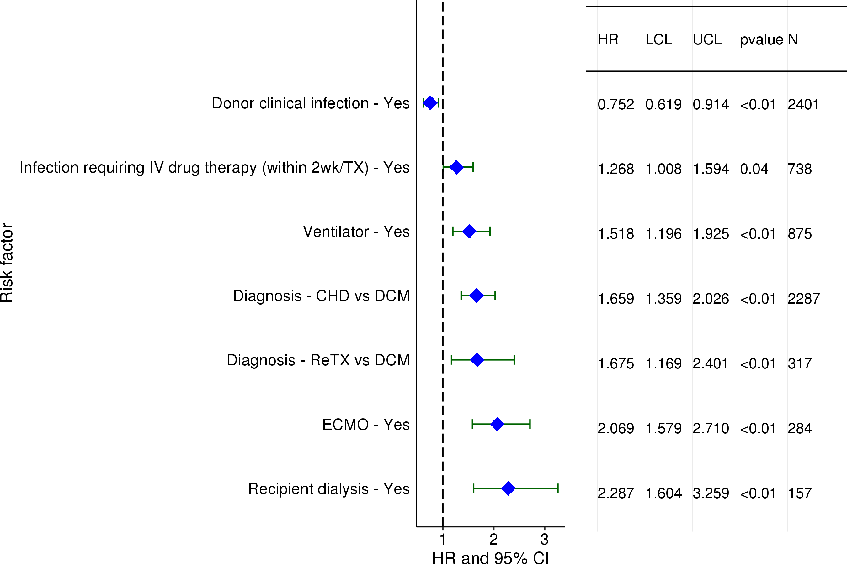
Pediatric Heart Transplants (1/2005-6/2016)
Statistically Significant Risk Factors For 1 Year Mortality with 95% Confidence Limits
2018
(N = 6,573)
JHLT. 2018 Oct; 37(10): 1155-1206

Slide 111
Pediatric Heart Transplants (1/2005-6/2016)
Statistically Significant Risk Factors For 1 Year Mortality
Continuous Factors (see figures)
Ischemic time | Recipient eGFR
Center volume: prev ped TXs within 1 yr | Recipient bilirubin
PRA | Recipient height percentile
Recipient weight percentile
2018
JHLT. 2018 Oct; 37(10): 1155-1206

Slide 112
Pediatric Heart Transplants (1/2005-6/2016)
Ischemic time
Risk Factors For 1 Year Mortality with 95% Confidence Limits
p < 0.0001
2018
(N = 6,573)
JHLT. 2018 Oct; 37(10): 1155-1206
Notes:
Multivariable analysis was performed using a proportional hazards model censoring all patients at 1 year. Continuous factors were fit using a restricted cubic spline.

Slide 113
Pediatric Heart Transplants (1/2005-6/2016)
Recipient eGFR
Risk Factors For 1 Year Mortality with 95% Confidence Limits
p < 0.0001
2018
(N = 6,573)
JHLT. 2018 Oct; 37(10): 1155-1206
Notes:
Multivariable analysis was performed using a proportional hazards model censoring all patients at 1 year. Continuous factors were fit using a restricted cubic spline.

Slide 114
Pediatric Heart Transplants (1/2005-6/2016)
Center volume: prev ped TXs within 1 yr
Risk Factors For 1 Year Mortality with 95% Confidence Limits
p < 0.0001
2018
(N = 6,573)
JHLT. 2018 Oct; 37(10): 1155-1206
Notes:
Multivariable analysis was performed using a proportional hazards model censoring all patients at 1 year. Continuous factors were fit using a restricted cubic spline.

Slide 115
Pediatric Heart Transplants (1/2005-6/2016)
Recipient bilirubin
Risk Factors For 1 Year Mortality with 95% Confidence Limits
p = 0.0214
2018
(N = 6,573)
JHLT. 2018 Oct; 37(10): 1155-1206
Notes:
Multivariable analysis was performed using a proportional hazards model censoring all patients at 1 year. Continuous factors were fit using a restricted cubic spline.

Slide 116
Pediatric Heart Transplants (1/2005-6/2016)
PRA
Risk Factors For 1 Year Mortality with 95% Confidence Limits
p = 0.0082
2018
(N = 6,573)
JHLT. 2018 Oct; 37(10): 1155-1206
Notes:
Multivariable analysis was performed using a proportional hazards model censoring all patients at 1 year. Continuous factors were fit using a restricted cubic spline.

Slide 117
Pediatric Heart Transplants (1/2005-6/2016)
Recipient height percentile
Risk Factors For 1 Year Mortality with 95% Confidence Limits
p < 0.0001
2018
(N = 6,573)
JHLT. 2018 Oct; 37(10): 1155-1206
Notes:
Multivariable analysis was performed using a proportional hazards model censoring all patients at 1 year. Continuous factors were fit using a restricted cubic spline.

Slide 118
Pediatric Heart Transplants (1/2005-6/2016)
Recipient weight percentile
Risk Factors For 1 Year Mortality with 95% Confidence Limits
p = 0.0051
2018
(N = 6,573)
JHLT. 2018 Oct; 37(10): 1155-1206
Notes:
Multivariable analysis was performed using a proportional hazards model censoring all patients at 1 year. Continuous factors were fit using a restricted cubic spline.

Slide 119
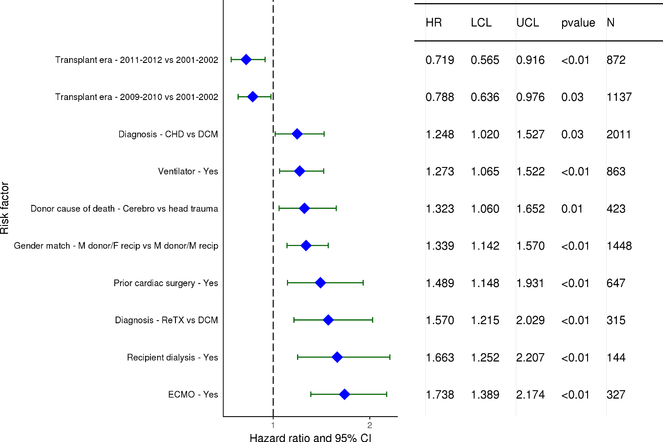
Pediatric Heart Transplants (1/2001-6/2012)
Statistically Significant Risk Factors For 5 Year Mortality with 95% Confidence Limits
2018
(N = 5,835)
JHLT. 2018 Oct; 37(10): 1155-1206

Slide 120
Pediatric Heart Transplants (1/2001-6/2012)
Statistically Significant Risk Factors For 5 Year Mortality
Continuous Factors (see figures)
Recipient age | Ischemic time
Recipient eGFR | Center volume: prev ped TXs within 1 yr
PRA | Recipient height percentile
Recipient weight percentile
2018
JHLT. 2018 Oct; 37(10): 1155-1206

Slide 121
Pediatric Heart Transplants (1/2001-6/2012)
Recipient age
Risk Factors For 5 Year Mortality with 95% Confidence Limits
p < 0.0001
2018
(N = 5,835)
JHLT. 2018 Oct; 37(10): 1155-1206
Notes:
Multivariable analysis was performed using a proportional hazards model censoring all patients at 5 years. Continuous factors were fit using a restricted cubic spline.

Slide 122
Pediatric Heart Transplants (1/2001-6/2012)
Ischemic time
Risk Factors For 5 Year Mortality with 95% Confidence Limits
p = 0.0003
2018
(N = 5,835)
JHLT. 2018 Oct; 37(10): 1155-1206
Notes:
Multivariable analysis was performed using a proportional hazards model censoring all patients at 5 years. Continuous factors were fit using a restricted cubic spline.

Slide 123
Pediatric Heart Transplants (1/2001-6/2012)
Recipient eGFR
Risk Factors For 5 Year Mortality with 95% Confidence Limits
p = 0.0346
2018
(N = 5,835)
JHLT. 2018 Oct; 37(10): 1155-1206
Notes:
Multivariable analysis was performed using a proportional hazards model censoring all patients at 5 years. Continuous factors were fit using a restricted cubic spline.

Slide 124
Pediatric Heart Transplants (1/2001-6/2012)
Center volume: prev ped TXs within 1 yr
Risk Factors For 5 Year Mortality with 95% Confidence Limits
p = 0.0001
2018
(N = 5,835)
JHLT. 2018 Oct; 37(10): 1155-1206
Notes:
Multivariable analysis was performed using a proportional hazards model censoring all patients at 5 years. Continuous factors were fit using a restricted cubic spline.

Slide 125
Pediatric Heart Transplants (1/2001-6/2012)
PRA
Risk Factors For 5 Year Mortality with 95% Confidence Limits
p = 0.0364
2018
(N = 5,835)
JHLT. 2018 Oct; 37(10): 1155-1206
Notes:
Multivariable analysis was performed using a proportional hazards model censoring all patients at 5 years. Continuous factors were fit using a restricted cubic spline.

Slide 126
Pediatric Heart Transplants (1/2001-6/2012)
Recipient height percentile
Risk Factors For 5 Year Mortality with 95% Confidence Limits
p < 0.0001
2018
(N = 5,835)
JHLT. 2018 Oct; 37(10): 1155-1206
Notes:
Multivariable analysis was performed using a proportional hazards model censoring all patients at 5 years. Continuous factors were fit using a restricted cubic spline.

Slide 127
Pediatric Heart Transplants (1/2001-6/2012)
Recipient weight percentile
Risk Factors For 5 Year Mortality with 95% Confidence Limits
p = 0.0428
2018
(N = 5,835)
JHLT. 2018 Oct; 37(10): 1155-1206
Notes:
Multivariable analysis was performed using a proportional hazards model censoring all patients at 5 years. Continuous factors were fit using a restricted cubic spline.

Slide 128
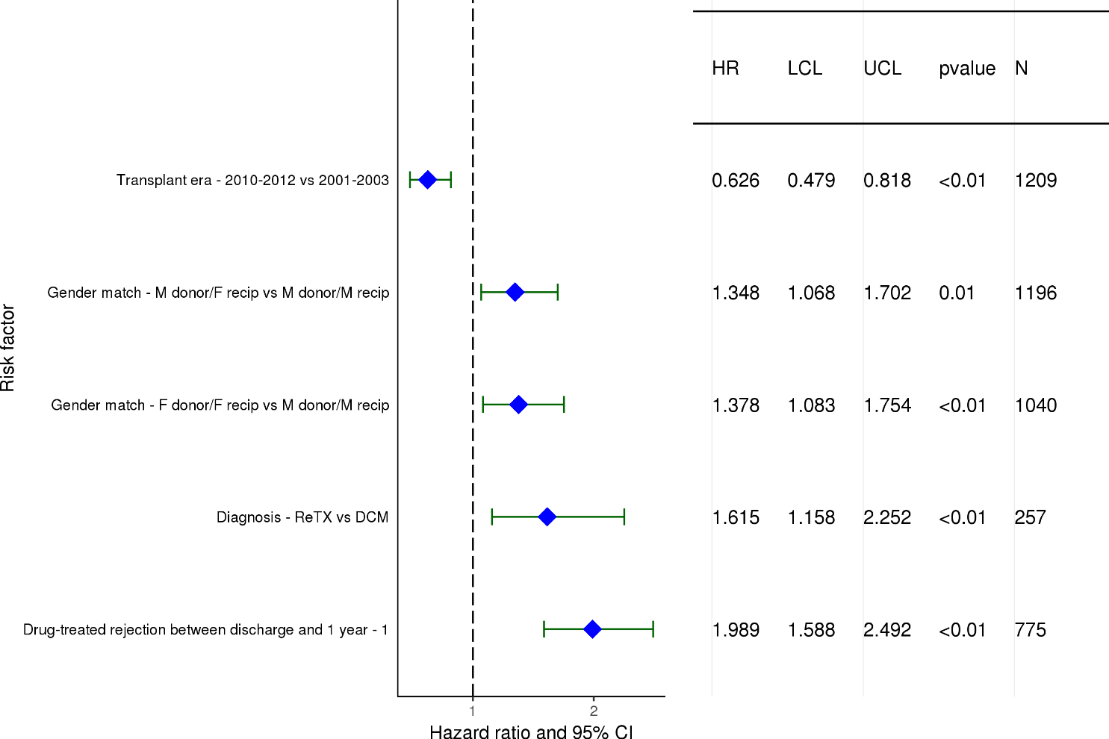
Pediatric Heart Transplants (1/2001-6/2012)
Pediatric Heart Transplants (1/2001-6/2012)
Statistically Significant Risk Factors For 5 Year Mortality Conditional on Survival to 1 Year with 95% Confidence Limits
2018
(N = 4,904)
JHLT. 2018 Oct; 37(10): 1155-1206

Slide 129
Pediatric Heart Transplants (1/2001-6/2012)
Statistically Significant Risk Factors For 5 Year Mortality Conditional on Survival to 1 Year
Continuous Factors (see figures)
Recipient age | PRA
Recipient weight percentile
2018
JHLT. 2018 Oct; 37(10): 1155-1206

Slide 130
Pediatric Heart Transplants (1/2001-6/2012)
Recipient age
Risk Factors For 5 Year Mortality Conditional on Survival to 1 Year with 95% Confidence Limits
p < 0.0001
2018
(N = 4,904)
JHLT. 2018 Oct; 37(10): 1155-1206
Notes:
Multivariable analysis was performed using a proportional hazards model censoring all patients at 5 years. Continuous factors were fit using a restricted cubic spline.

Slide 131
Pediatric Heart Transplants (1/2001-6/2012)
PRA
Risk Factors For 5 Year Mortality Conditional on Survival to 1 Year with 95% Confidence Limits
p = 0.0210
2018
(N = 4,904)
JHLT. 2018 Oct; 37(10): 1155-1206
Notes:
Multivariable analysis was performed using a proportional hazards model censoring all patients at 5 years. Continuous factors were fit using a restricted cubic spline.

Slide 132
Pediatric Heart Transplants (1/2001-6/2012)
Recipient weight percentile
Risk Factors For 5 Year Mortality Conditional on Survival to 1 Year
with 95% Confidence Limits
p = 0.0207
2018
(N = 4,904)
JHLT. 2018 Oct; 37(10): 1155-1206
Notes:
Multivariable analysis was performed using a proportional hazards model censoring all patients at 5 years. Continuous factors were fit using a restricted cubic spline.

Slide 133
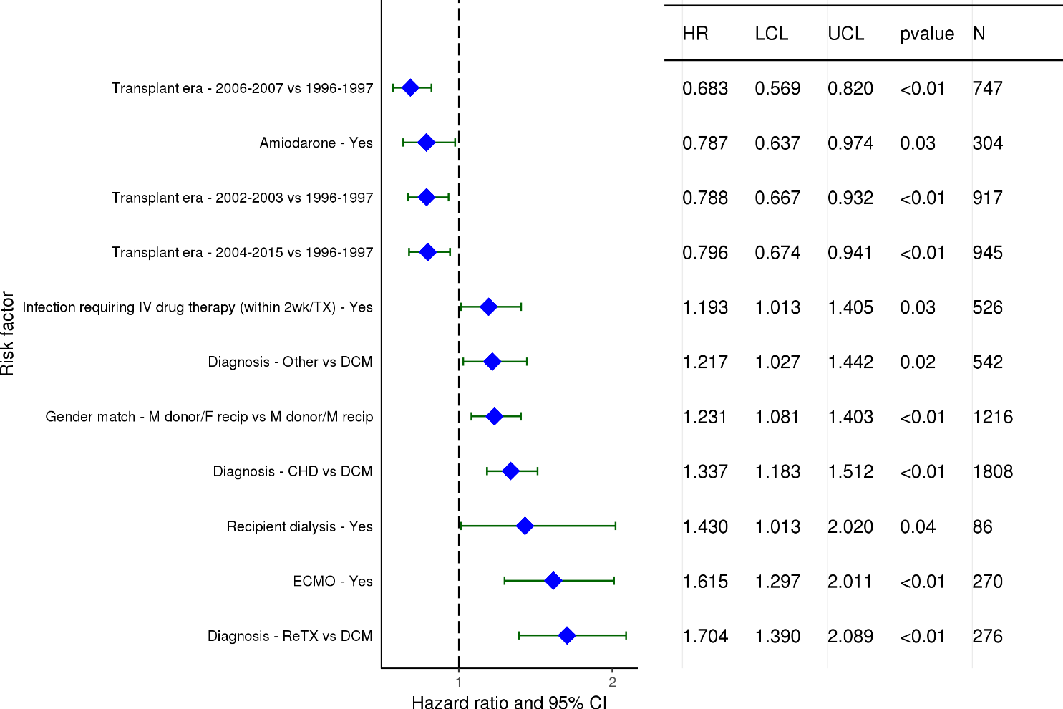
Pediatric Heart Transplants (1/1996-6/2007)
Statistically Significant Risk Factors For 10 Year Mortality with 95% Confidence Limits
2018
(N = 5,000)
JHLT. 2018 Oct; 37(10): 1155-1206

Slide 134
Pediatric Heart Transplants (1/1996-6/2007)
Statistically Significant Risk Factors For 10 Year Mortality
Continuous Factors (see figures)
Recipient age | Donor age
Center volume: prev ped TXs within 1 yr | PRA
Recipient height percentile
2018
JHLT. 2018 Oct; 37(10): 1155-1206

Slide 135
Pediatric Heart Transplants (1/1996-6/2007)
Recipient age
Risk Factors For 10 Year Mortality with 95% Confidence Limits
p < 0.0001
2018
(N = 5,000)
JHLT. 2018 Oct; 37(10): 1155-1206
Notes:
Multivariable analysis was performed using a proportional hazards model censoring all patients at 10 years. Continuous factors were fit using a restricted cubic spline.

Slide 136
Pediatric Heart Transplants (1/1996-6/2007)
Donor age
Risk Factors For 10 Year Mortality with 95% Confidence Limits
p = 0.0010
2018
(N = 5,000)
JHLT. 2018 Oct; 37(10): 1155-1206
Notes:
Multivariable analysis was performed using a proportional hazards model censoring all patients at 10 years. Continuous factors were fit using a restricted cubic spline.

Slide 137
Pediatric Heart Transplants (1/1996-6/2007)
Center volume: prev ped TXs within 1 yr
Risk Factors For 10 Year Mortality with 95% Confidence Limits
p = 0.0412
2018
(N = 5,000)
JHLT. 2018 Oct; 37(10): 1155-1206
Notes:
Multivariable analysis was performed using a proportional hazards model censoring all patients at 10 years. Continuous factors were fit using a restricted cubic spline.

Slide 138
Pediatric Heart Transplants (1/1996-6/2007)
PRA
Risk Factors For 10 Year Mortality with 95% Confidence Limits
p = 0.0019
2018
(N = 5,000)
JHLT. 2018 Oct; 37(10): 1155-1206
Notes:
Multivariable analysis was performed using a proportional hazards model censoring all patients at 10 years. Continuous factors were fit using a restricted cubic spline.

Slide 139
Pediatric Heart Transplants (1/1996-6/2007)
Recipient height percentile
Risk Factors For 10 Year Mortality with 95% Confidence Limits
p = 0.0196
2018
(N = 5,000)
JHLT. 2018 Oct; 37(10): 1155-1206
Notes:
Multivariable analysis was performed using a proportional hazards model censoring all patients at 10 years. Continuous factors were fit using a restricted cubic spline.

Slide 140
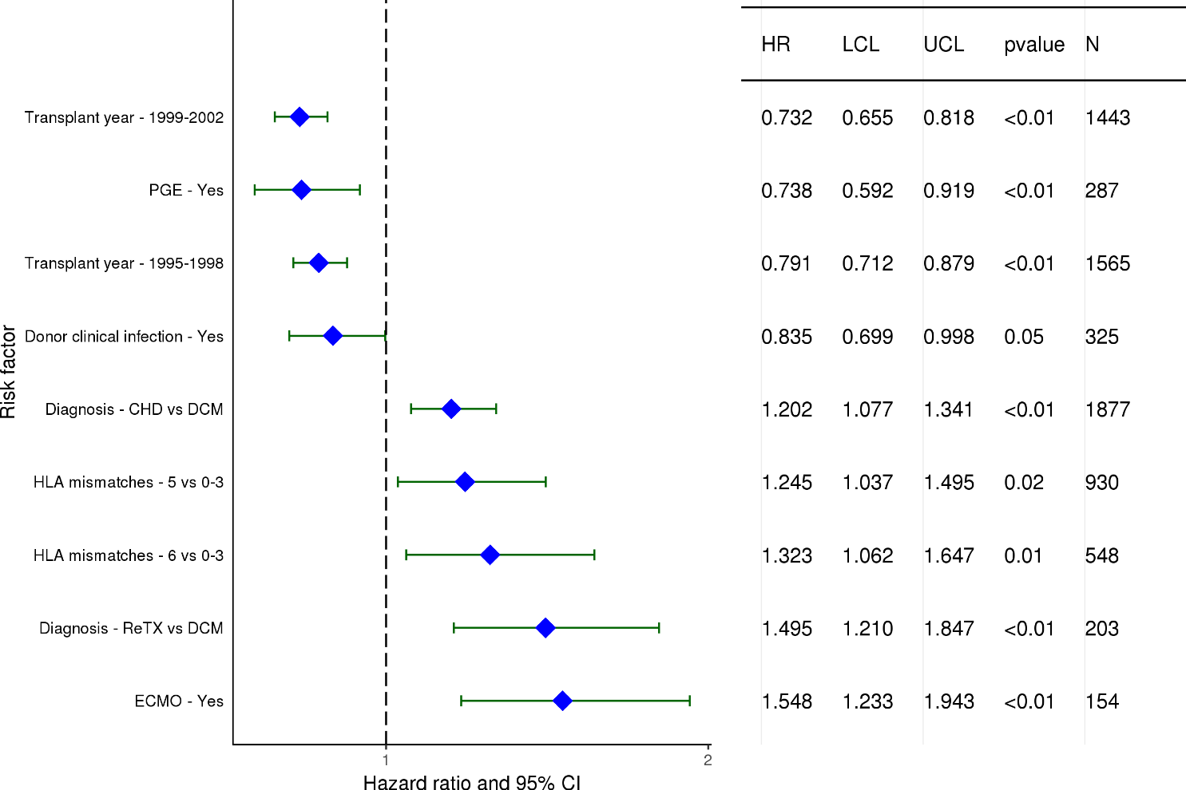
Pediatric Heart Transplants (1/1991-6/2002)
Statistically Significant Risk Factors For 15 Year Mortality with 95% Confidence Limits
2018
(N = 4,575)
JHLT. 2018 Oct; 37(10): 1155-1206

Slide 141
Pediatric Heart Transplants (1/1991-6/2002)
Statistically Significant Risk Factors For 15 Year Mortality
Continuous Factors (see figures)
Recipient age | Donor-recipient age difference
PRA | Recipient height percentile
Recipient weight percentile
2018
JHLT. 2018 Oct; 37(10): 1155-1206

Slide 142
Pediatric Heart Transplants (1/1991-6/2002)
Recipient age
Risk Factors For 15 Year Mortality with 95% Confidence Limits
p = 0.0055
2018
(N = 4,575)
JHLT. 2018 Oct; 37(10): 1155-1206
Notes:
Multivariable analysis was performed using a proportional hazards model censoring all patients at 15 years. Continuous factors were fit using a restricted cubic spline.

Slide 143
Pediatric Heart Transplants (1/1991-6/2002)
Donor-recipient age difference
Risk Factors For 15 Year Mortality with 95% Confidence Limits
p = 0.0124
2018
(N = 4,575)
JHLT. 2018 Oct; 37(10): 1155-1206
Notes:
Multivariable analysis was performed using a proportional hazards model censoring all patients at 15 years. Continuous factors were fit using a restricted cubic spline.

Slide 144
Pediatric Heart Transplants (1/1991-6/2002)
PRA
Risk Factors For 15 Year Mortality with 95% Confidence Limits
p = 0.0330
2018
(N = 4,575)
JHLT. 2018 Oct; 37(10): 1155-1206
Notes:
Multivariable analysis was performed using a proportional hazards model censoring all patients at 15 years. Continuous factors were fit using a restricted cubic spline.

Slide 145
Pediatric Heart Transplants (1/1991-6/2002)
Recipient height percentile
Risk Factors For 15 Year Mortality with 95% Confidence Limits
p = 0.0063
2018
(N = 4,575)
JHLT. 2018 Oct; 37(10): 1155-1206
Notes:
Multivariable analysis was performed using a proportional hazards model censoring all patients at 15 years. Continuous factors were fit using a restricted cubic spline.

Slide 146
Pediatric Heart Transplants (1/1991-6/2002)
Recipient weight percentile
Risk Factors For 15 Year Mortality with 95% Confidence Limits
p = 0.0378
2018
(N = 4,575)
JHLT. 2018 Oct; 37(10): 1155-1206
Notes:
Multivariable analysis was performed using a proportional hazards model censoring all patients at 15 years. Continuous factors were fit using a restricted cubic spline.

Slide 147
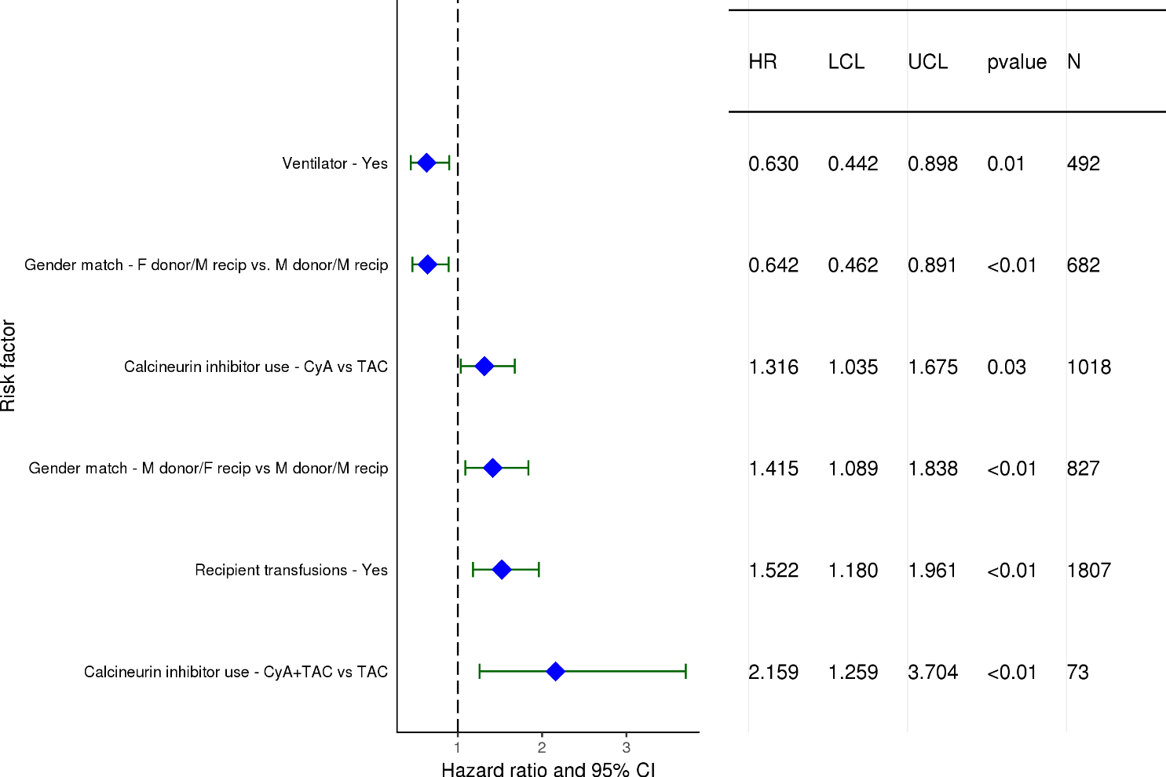
Pediatric Heart Transplants (1/2001-6/2012)
Statistically Significant Risk Factors for Developing CAV within 5 Years with 95% Confidence Limits
Conditional on Survival to Transplant Discharge
2018
(N = 3,142)
JHLT. 2018 Oct; 37(10): 1155-1206

Slide 148
Pediatric Heart Transplants (1/2001-6/2012)
Statistically Significant Risk Factors for Developing CAV within 5 Years
Conditional on Survival to Transplant Discharge
Continuous Factors (see figures)
Donor age | Recipient eGFR
PRA
2018
JHLT. 2018 Oct; 37(10): 1155-1206

Slide 149
Pediatric Heart Transplants (1/2001-6/2012)
Donor age
Conditional on Survival to Transplant Discharge
Risk Factors for Developing CAV within 5 Years with 95% Confidence Limits
p < 0.0001
2018
(N = 3,142)
JHLT. 2018 Oct; 37(10): 1155-1206
Notes:
Multivariable analysis was performed using a proportional hazards model censoring all patients at 5 years. Continuous factors were fit using a restricted cubic spline.

Slide 150
Pediatric Heart Transplants (1/2001-6/2012)
Risk Factors for Developing CAV within 5 Years with 95% Confidence Limits
Conditional on Survival to Transplant Discharge
Recipient eGFR
p = 0.0114
2018
(N = 3,142)
JHLT. 2018 Oct; 37(10): 1155-1206
Notes:
Multivariable analysis was performed using a proportional hazards model censoring all patients at 5 years. Continuous factors were fit using a restricted cubic spline.

Slide 151
Pediatric Heart Transplants (1/2001-6/2012)
PRA
Conditional on Survival to Transplant Discharge
Risk Factors for Developing CAV within 5 Years with 95% Confidence Limits
p = 0.0076
2018
(N = 3,142)
JHLT. 2018 Oct; 37(10): 1155-1206
Notes:
Multivariable analysis was performed using a proportional hazards model censoring all patients at 5 years. Continuous factors were fit using a restricted cubic spline.

Slide 152
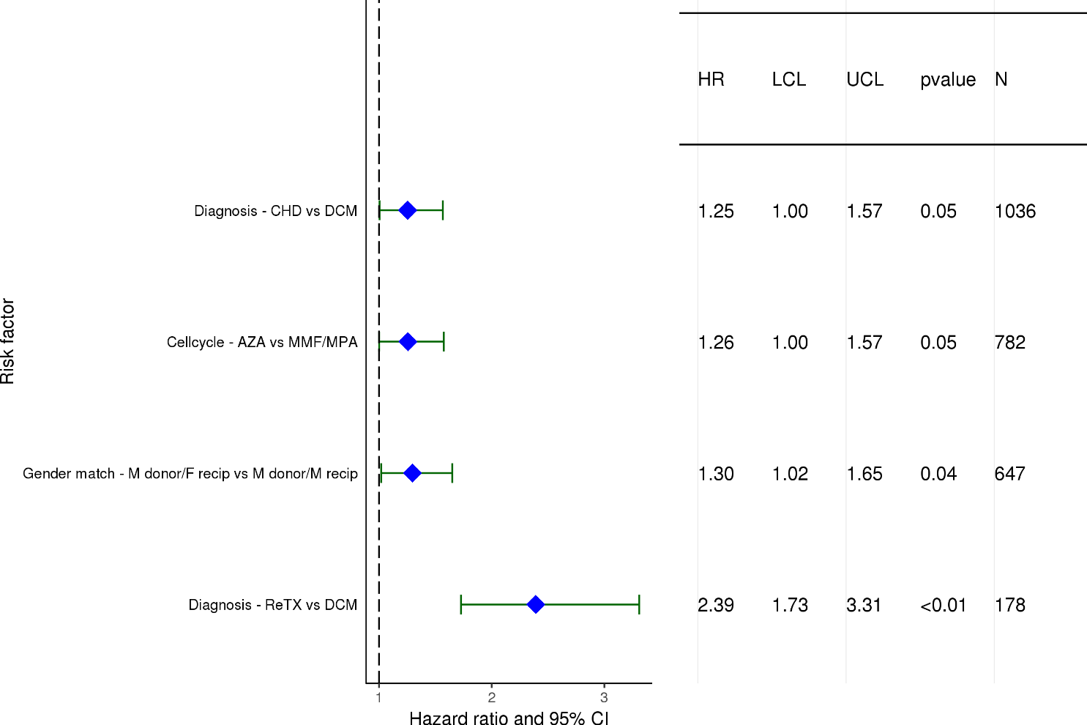
Pediatric Heart Transplants (1/1996-6/2007)
Statistically Significant Risk Factors for Developing CAV within 10 Years with 95% Confidence Limits
Conditional on Survival to Transplant Discharge
2018
(N = 2,565)
JHLT. 2018 Oct; 37(10): 1155-1206

Slide 153
Pediatric Heart Transplants (1/1996-6/2007)
Conditional on Survival to Transplant Discharge
Statistically Significant Risk Factors for Developing CAV within 10 Years
Continuous Factors (see figures)
Donor age
2018
JHLT. 2018 Oct; 37(10): 1155-1206

Slide 154
Pediatric Heart Transplants (1/1996-6/2007)
Donor age
Conditional on Survival to Transplant Discharge
Risk Factors for Developing CAV within 10 Years with 95% Confidence Limits
p < 0.0001
2018
(N = 2,565)
JHLT. 2018 Oct; 37(10): 1155-1206
Notes:
Multivariable analysis was performed using a proportional hazards model censoring all patients at 10 years. Continuous factors were fit using a restricted cubic spline.

Slide 155
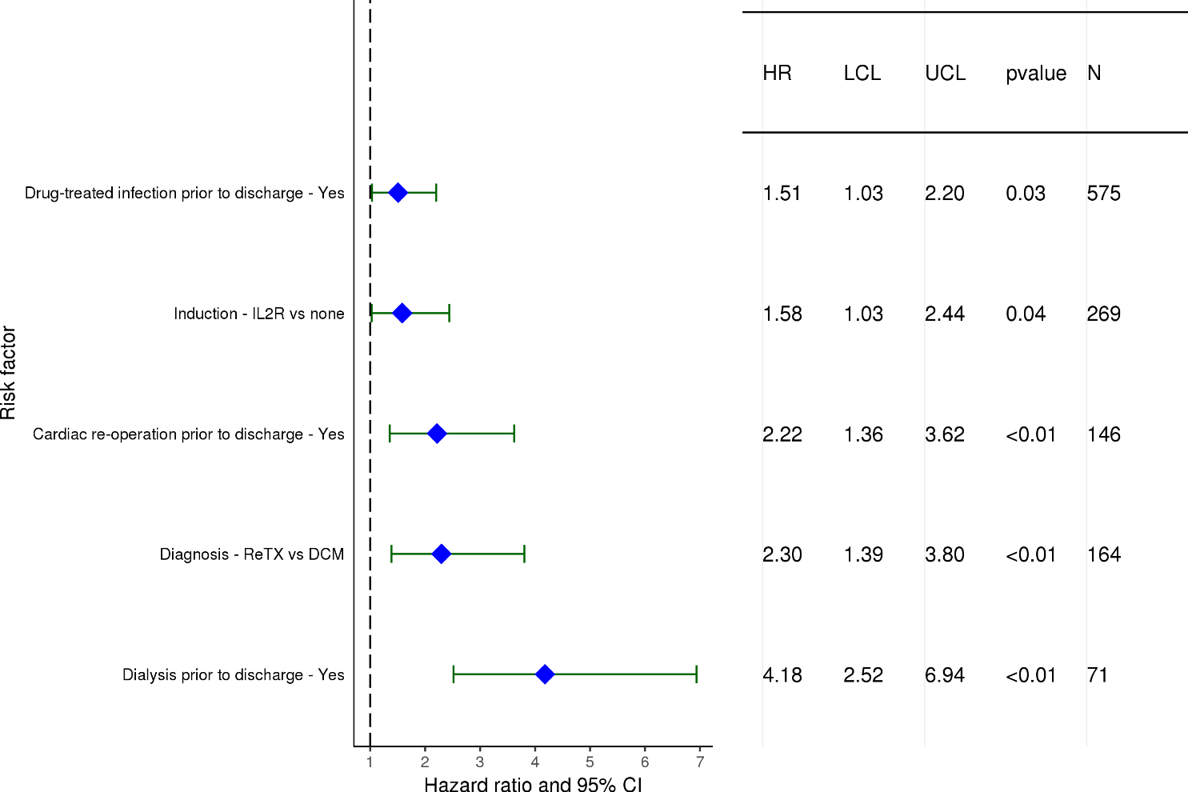
Pediatric Heart Transplants (1/1996-6/2007)
Statistically Significant Risk Factors for Developing Severe Renal Dysfunction within 10 Years with 95% Confidence Limits
Limited to Recipients without Severe Renal Dysfunction* Pre-Transplant
(N = 2,511)
2018
* Severe renal dysfunction = Creatinine > 2.5 mg/dl (221 μmol/L), dialysis or renal transplant
JHLT. 2018 Oct; 37(10): 1155-1206

Slide 156
Pediatric Heart Transplants (1/1996-6/2007)
Statistically Significant Risk Factors for Developing Severe Renal Dysfunction within 10 Years
Limited to Recipients without Severe Renal Dysfunction Pre-Transplant
Continuous Factors (see figures)
Recipient age | Recipient eGFR
Center volume: prev ped TXs within 1 yr
2018
JHLT. 2018 Oct; 37(10): 1155-1206

Slide 157
Pediatric Heart Transplants (1/1996-6/2007)
Risk Factors for Developing Severe Renal Dysfunction within 10 Years with 95% Confidence Limits
Recipient age
Limited to Recipients without Severe Renal Dysfunction Pre-Transplant
p < 0.0001
2018
(N = 2,511)
JHLT. 2018 Oct; 37(10): 1155-1206
Notes:
Multivariable analysis was performed using a proportional hazards model censoring all patients at 10 years. Continuous factors were fit using a restricted cubic spline.

Slide 158
Pediatric Heart Transplants (1/1996-6/2007)
Risk Factors for Developing Severe Renal Dysfunction within 10 Years with 95% Confidence Limits
Recipient eGFR
Limited to Recipients without Severe Renal Dysfunction Pre-Transplant
p = 0.0138
2018
(N = 2,511)
JHLT. 2018 Oct; 37(10): 1155-1206
Notes:
Multivariable analysis was performed using a proportional hazards model censoring all patients at 10 years. Continuous factors were fit using a restricted cubic spline.

Slide 159
Pediatric Heart Transplants (1/1996-6/2007)
Risk Factors for Developing Severe Renal Dysfunction within 10 Years with 95% Confidence Limits
Center volume: previous pediatric transplants within 1 year
Limited to Recipients without Severe Renal Dysfunction Pre-Transplant
p = 0.0118
2018
(N = 2,511)
JHLT. 2018 Oct; 37(10): 1155-1206
Notes:
Multivariable analysis was performed using a proportional hazards model censoring all patients at 10 years. Continuous factors were fit using a restricted cubic spline.

Slide 160
Focus Theme
2018
JHLT. 2018 Oct; 37(10): 1155-1206

Slide 161
Pediatric Heart Transplants
Number of Multiorgan Transplants by Type of Transplant
(Transplants: January 1990 – June 2017)
Primary transplants
Retransplants
2018
Heart-lung transplants are included in Lung slides.
JHLT. 2018 Oct; 37(10): 1155-1206

Slide 162
Pediatric Heart Transplants
Number and % of Multiorgan Transplants by Year and Type of Transplant
2018
Heart-lung transplants are included in Lung slides.
JHLT. 2018 Oct; 37(10): 1155-1206

Slide 163
Pediatric Heart Transplants
% of Multiorgan Transplants by Location
(Transplants: January 2006 – June 2017)
N = 30
2018
JHLT. 2018 Oct; 37(10): 1155-1206

Slide 164
Pediatric Heart Transplants
Donor and Recipient Characteristics
(Transplants: January 1995 – June 2017)
 | Multiorgan transplant (N = 55) | Heart alone transplant (N = 11,559) | p-value
Recipient age (years) | 14.0 (3.0 - 17.0) | 7.0 (0.0 - 17.0) | <0.0001
Donor age (years) | 16.0 (3.0 - 34.0) | 8.0 (0.0 - 39.0) | <0.0001
Recipient gender (% male) | 41.8% | 55.4% | 0.0434
Donor gender (% male) | 54.5% | 57.1% | 0.6994
Diagnosis
CHD | 27.3% | 36.7% | <0.0001
DCM | 27.3% | 46.0%
Retransplant | 32.7% | 5.0%
Other | 12.7% | 12.3%
Retransplant | 32.7% | 4.9% | <0.0001
Location
Europe | 18.2% | 26.9% | 0.0471
North America | 81.8% | 67.7%
Others | 0% | 5.4%
2018
Continuous factors are expressed as median (5th – 95th percentiles)
JHLT. 2018 Oct; 37(10): 1155-1206
Notes:
Comparisons for categorical variables were made using the chi-square statistic. When expected cell counts were small, Fisher’s exact test was used instead. Multiple groups were compared using single p-value.
Comparisons for continuous variables were made using Kruskal-Wallis test.
A significant p-value means that at least one of the groups is different than the others but it doesn’t identify which group it is.
For diagnosis tabulations, unknown diagnoses were excluded. Status of retransplant tabulation included transplants with unknown diagnosis. Therefore the percent of retransplants may be lower than the percent with diagnosis of retransplant.

Slide 165
Pediatric Heart Transplants
Donor and Recipient Characteristics
(Transplants: January 1995 – June 2017)
 | Multiorgan transplant (N = 55) | Heart alone transplant (N = 11,559) | p-value
Recipient hypertension | 27.5% | 14.1% | 0.0151
Donor hypertension | 2.2% | 1.7% | 0.5302
Recipient diabetes mellitus | 2.1% | 0.7% | 0.2709
Donor diabetes mellitus | 0% | 0.8% | 0.9999
Recipient history of prior dialysis | 46.7% | 3.0% | <0.0001
Recipient creatinine (mg/dl) | 1.5 (0.4 - 9.7) | 0.5 (0.2 - 1.3) | <0.0001
Recipient total bilirubin (mg/dl) | 0.8 (0.3 - 4.0) | 0.7 (0.2 - 4.5) | 0.4213
Ischemic time (hours) | 3.3 (1.3 - 6.1) | 3.6 (1.6 - 5.9) | 0.1014
Induction* | 70.7% | 58.5% | 0.1133
Multiorgan transplants with kidney | (N=43)
Dialysis | 61.8%
Continuous factors are expressed as median (5th – 95th percentiles)
2018
* Analysis is limited to patients who were alive at the time of the discharge.
JHLT. 2018 Oct; 37(10): 1155-1206
Notes:
Comparisons for categorical variables were made using the chi-square statistic. When expected cell counts were small, Fisher’s exact test was used instead. Multiple groups were compared using single p-value.
Comparisons for continuous variables were made using Kruskal-Wallis test.
A significant p-value means that at least one of the groups is different than the others but it doesn’t identify which group it is.

Slide 166
Pediatric Heart Transplants
Diagnosis of Multiorgan Transplants by Era
2018
JHLT. 2018 Oct; 37(10): 1155-1206

Slide 167
Pediatric Heart Transplants
% of Recipients Experiencing Treated Rejection within 1 Year
by Transplant Type
(Transplants: January 2004 – June 2016)
p = 0.0541
Analysis is limited to patients who were alive at the time of the follow-up.
Treated rejection = Recipient was reported to (1) have at least one acute rejection episode that was treated with an anti-rejection agent; or (2) have been hospitalized for rejection.
2018
JHLT. 2018 Oct; 37(10): 1155-1206
Notes:
Comparisons were made using the chi-square statistic.

Slide 168
Pediatric Heart Transplants
% of Recipients Experiencing Any Rejection within 1 year
by Transplant Type
(Transplants: January 2004 – June 2016)
p = 0.0585
Analysis is limited to patients who were alive at the time of the follow-up.
Any rejection = Recipient was reported to (1) have at least one acute rejection episode; or (2) have been hospitalized for rejection.
2018
JHLT. 2018 Oct; 37(10): 1155-1206
Notes:
Comparisons were made using the chi-square statistic.

Slide 169
Pediatric Heart Transplants
Kaplan-Meier Survival by Transplant Type
(Transplants: January 1990 – June 2016)
p = 0.8987
2018
JHLT. 2018 Oct; 37(10): 1155-1206
Notes:
Survival was calculated using the Kaplan-Meier method, which incorporates information from all transplants for whom any follow-up has been provided. Since many patients are still alive and some patients have been lost to follow-up, the survival rates are estimates rather than exact rates because the time of death is not known for all patients.
Survival rates were compared using the log-rank test statistic. Results of log-rank test should be interpreted with caution when curves cross.

Slide 170
Pediatric Heart Transplants
Freedom from Cardiac Allograft Vasculopathy by Transplant
Type
(Transplants: January 1994 – June 2016)
p = 0.7329
2018
JHLT. 2018 Oct; 37(10): 1155-1206
Notes:
Freedom from CAV rates by era were computed using the Kaplan-Meier method.
The development of CAV is reported on annual follow-ups; a date of diagnosis is not provided. For this figure the midpoint between the date of previous follow-up (when event had not occurred) and the date of follow-up when the event was reported was used as the date of occurrence. Patients were included in the analysis until an unknown response for the outcome of interest was reported. Therefore, the rates seen here may differ from those reported in the cumulative prevalence slide which is based on only those patients with known responses for each of the outcomes at all follow-up time points.
Survival rates were compared using the log-rank test statistic. Results of log-rank test should be interpreted with caution when curves cross.

Slide 171
Pediatric Heart Transplants
Length of Stay by Transplant Type
(Transplants: January 2000 – June 2017)
2018
JHLT. 2018 Oct; 37(10): 1155-1206

Slide 172
Pediatric Heart Transplants
Cumulative Morbidity Rates in Survivors within 1 year Post-Transplant
by Transplant Type
(Transplants: January 1994 – June 2016)
Outcome | Heart-kidney | Total N with known response | Heart alone | Total N with known response
Severe Renal Dysfunction¹ | 6.9% | (N=29) | 0.9% | (N=6,219)
Creatinine > 2.5 mg/dl | 0.0% |  | 0.6%
Chronic Dialysis | 6.9% |  | 0.3%
Renal Transplant | 0.0% |  | 0.0%
Diabetes | 6.9% | (N=29) | 2.8% | (N=6,235)
Cardiac Allograft Vasculopathy | 3.4% | (N=29) | 1.9% | (N=5,827)
2017
¹ Severe renal dysfunction = Creatinine > 2.5 mg/dl (221 μmol/L), dialysis or renal transplant
JHLT. 2018 Oct; 37(10): 1155-1206
Notes:
This table shows the percentage of patients experiencing various morbidities as reported within 1 year following transplantation. The percentages are based on patients with known responses. Because the outcomes are reported to be unknown at different rates the number with known responses for each outcome are also provided.

Slide 173
Pediatric Heart Transplants
Cumulative Morbidity Rates in Survivors within 5 years Post-Transplant
by Transplant Type
(Transplants: January 1994 – June 2012)
Outcome | Heart-kidney | Total N with known response | Heart alone | Total N with known response
Severe Renal Dysfunction¹ | 20.0% | (N=20) | 2.2% | (N=3,476)
Creatinine > 2.5 mg/dl | 10.0% |  | 1.6%
Chronic Dialysis | 10.0% |  | 0.4%
Renal Transplant | 0.0% |  | 0.3%
Diabetes | 4.8% | (N=21) | 5.2% | (N=3,489)
Cardiac Allograft Vasculopathy | 11.8% | (N=17) | 10.2% | (N=2,795)
2017
¹ Severe renal dysfunction = Creatinine > 2.5 mg/dl (221 μmol/L), dialysis or renal transplant
JHLT. 2018 Oct; 37(10): 1155-1206
Notes:
This table shows the percentage of patients experiencing various morbidities as reported within 5 years following transplantation. The percentages are based on patients with known responses. To reduce bias, only patients with responses reported on every follow-up through the 5-year annual follow-up were included in the 5-year analysis. Because the outcomes are reported to be unknown at different rates the number with known responses for each outcome are also provided.

Slide 174
Pediatric Heart Transplants
Maintenance Immunosuppression at Time of 1 Year Follow-up by Transplant Type
(Follow-ups: January 2004 – June 2017)
2018
Analysis is limited to patients who were alive at the time of the follow-up.
JHLT. 2018 Oct; 37(10): 1155-1206
Notes:
This figure shows the maintenance immunosuppression reported as being provided at the time of the 1-year annual follow-up forms. As different patients were transplanted each year this figure does not represent changes in immunosuppression for individual patients but may represent changes in practice.

Slide 175
Pediatric Heart Transplants
Maintenance Immunosuppression Drug Combinations at
Time of 1 Year Follow-up
(Follow-ups: January 2004 – June 2017)
2018
Analysis is limited to patients who were alive at the time of the follow-up.
JHLT. 2018 Oct; 37(10): 1155-1206

Slide 176
Pediatric Heart Transplants
Cause of Death Stratified by Transplant Type
(Deaths: January 1994 – June 2017)
Transplant Type | Cause of Death | <5 Years | >5 Years
Multiorgan transplant | CAV | 1 (11.1%) | 2 (22.2%)
 | Acute rejection | 1 (11.1%) | 1 (11.1%)
 | Malignancy | 0 | 0
 | Infection | 4 (44.4%) | 2 (22.2%)
 | Graft Failure | 2 (22.2%) | 2 (22.2%)
 | Multiple Organ Failure | 0 | 0
 | Pulmonary | 0 | 0
 | Cerebrovascular | 0 | 1 (11.1%)
 | All known causes | 9 | 9
Heart alone transplant | CAV | 209 (9.8%) | 313 (24.5%)
 | Acute rejection | 318 (14.9%) | 105 (8.2%)
 | Malignancy | 62 (2.9%) | 127 (9.9%)
 | Infection | 212 (9.9%) | 76 (5.9%)
 | Graft Failure | 700 (32.8%) | 425 (33.2%)
 | Multiple Organ Failure | 207 (9.7%) | 56 (4.4%)
 | Pulmonary | 103 (4.8%) | 34 (2.7%)
 | Cerebrovascular | 117 (5.5%) | 28 (2.2%)
 | All known causes | 2,136 | 1,279
2017
Only the most frequent causes of death are shown on the slide.
JHLT. 2018 Oct; 37(10): 1155-1206
Notes:
Only known causes of death are included in the tabulation.

Slide 177
Pediatric Heart Transplants
Cause of Death Stratified by Transplant Type
(Deaths: January 1994 – June 2017)
2018
Only the most frequent causes of death are shown on the slide.
JHLT. 2018 Oct; 37(10): 1155-1206

