Slide 1

LUNG TRANSPLANTATION
Adult Recipients
2018
JHLT. 2018 Oct; 37(10): 1155-1206

Slide 2
Table of Contents
Donor, recipient and center characteristics: slides 3-16
Post-transplant survival and rejection: slides 17-41
Functional and employment status and rehospitalization post transplant: slides 42-47
Induction and maintenance immunosuppression: slides 48-64
Post transplant morbidities: slides 65-85
Multivariable analyses: slides 86-134
Focus theme: slides 135-153
2018
JHLT. 2018 Oct; 37(10): 1155-1206

Slide 3
Donor, Recipient and Center Characteristics
2018
JHLT. 2018 Oct; 37(10): 1155-1206

Slide 4
Adult Lung Transplants
Number of Transplants by Year and Procedure Type
NOTE: This figure includes only the adult lung transplants that are reported to the ISHLT Transplant Registry. As such, this should not be construed as representing changes in the number of adult lung transplants performed worldwide.
2018
JHLT. 2018 Oct; 37(10): 1155-1206

Slide 5
Adult Lung Retransplants
Retransplants by Year and Location
2018
JHLT. 2018 Oct; 37(10): 1155-1206

Slide 6
Adult Lung Retransplants
Retransplants by Inter-transplant Interval
(Retransplants: January 1990 – June 2017)
2018
JHLT. 2018 Oct; 37(10): 1155-1206

Slide 7
Adult Lung Transplants
Average Center Volume by Location
(Transplants: January 2009 – June 2017)
2018
JHLT. 2018 Oct; 37(10): 1155-1206

Slide 8
Adult Lung Transplants
Diagnoses
(Transplants: January 1995 – June 2017)
Diagnosis | SLT (N=19,112) | BLT (N=39,813) | TOTAL (N=58,925)
COPD | 7,525 (39.4%) | 10,505 (26.4%) | 18,030 (30.6%)
IIP | 7,100 (37.1%) | 8,064 (20.3%) | 15,164 (25.7%)
CF | 225 (1.2%) | 8,871 (22.3%) | 9,096 (15.4%)
ILD-not IIP | 1,067 (5.6%) | 2,209 (5.5%) | 3,276 (5.6%)
A1ATD | 806 (4.2%) | 2,056 (5.2%) | 2,862 (4.9%)
Retransplant | 966 (5.1%) | 1,410 (3.5%) | 2,376 (4.0%)
IPAH | 93 (0.5%) | 1,609 (4.0%) | 1,702 (2.9%)
Non CF-bronchiectasis | 73 (0.4%) | 1,526 (3.8%) | 1,599 (2.7%)
Sarcoidosis | 328 (1.7%) | 1,126 (2.8%) | 1,454 (2.5%)
PH-not IPAH | 136 (0.7%) | 767 (1.9%) | 903 (1.5%)
LAM/tuberous sclerosis | 155 (0.8%) | 400 (1.0%) | 555 (0.9%)
OB | 76 (0.4%) | 431 (1.1%) | 507 (0.9%)
CTD | 154 (0.8%) | 349 (0.9%) | 503 (0.9%)
Cancer | 7 (0.0%) | 30 (0.1%) | 37 (0.1%)
Other | 401 (2.1%) | 460 (1.2%) | 861 (1.5%)
2018
JHLT. 2018 Oct; 37(10): 1155-1206
Notes:
Transplants with unknown diagnoses are excluded from this tabulation.

Slide 9
Adult Lung Transplants
Distribution of Procedure Type for Major Diagnoses by Year
Year of TX | A1ATD |  | COPD |  | CF |  | IIP |  | ILD-not IIP
 | Double (%) | Single (%) | Double (%) | Single (%) | Double (%) | Single (%) | Double (%) | Single (%) | Double (%) | Single (%)
2002 | 57.0 | 43.0 | 39.0 | 61.0 | 97.1 | 2.9 | 35.2 | 64.8 | 54.2 | 45.8
2003 | 66.4 | 33.6 | 43.1 | 56.9 | 96.4 | 3.6 | 42.6 | 57.4 | 43.3 | 56.7
2004 | 74.8 | 25.2 | 45.6 | 54.4 | 96.5 | 3.5 | 45.7 | 54.3 | 59.4 | 40.6
2005 | 76.9 | 23.1 | 49.4 | 50.6 | 97.5 | 2.5 | 46.6 | 53.4 | 57.4 | 42.6
2006 | 71.8 | 28.2 | 58.3 | 41.7 | 98.5 | 1.5 | 47.1 | 52.9 | 69.6 | 30.4
2007 | 82.5 | 17.5 | 63.4 | 36.6 | 97.9 | 2.1 | 49.1 | 50.9 | 64.8 | 35.2
2008 | 80.0 | 20.0 | 65.1 | 34.9 | 98.8 | 1.2 | 52.1 | 47.9 | 62.3 | 37.7
2009 | 87.2 | 12.8 | 66.4 | 33.6 | 99.6 | 0.4 | 51.9 | 48.1 | 64.7 | 35.3
2010 | 85.1 | 14.9 | 70.3 | 29.7 | 99.6 | 0.4 | 55.7 | 44.3 | 65.6 | 34.4
2011 | 89.9 | 10.1 | 73.2 | 26.8 | 98.8 | 1.2 | 54.4 | 45.6 | 70.3 | 29.7
2012 | 91.6 | 8.4 | 74.2 | 25.8 | 98.3 | 1.7 | 59.5 | 40.5 | 74.9 | 25.1
2013 | 91.2 | 8.8 | 76.5 | 23.5 | 98.9 | 1.1 | 58.8 | 41.2 | 70.8 | 29.2
2014 | 86.8 | 13.2 | 79.3 | 20.7 | 98.9 | 1.1 | 60.8 | 39.2 | 71.5 | 28.5
2015 | 93.8 | 6.3 | 77.1 | 22.9 | 98.3 | 1.7 | 62.6 | 37.4 | 76.5 | 23.5
2016 | 94.0 | 6.0 | 78.6 | 21.4 | 99.5 | 0.5 | 66.0 | 34.0 | 80.6 | 19.4
2018
JHLT. 2018 Oct; 37(10): 1155-1206

Slide 10
Adult Lung Transplants
Procedure Type within Indication, by Year
2018
JHLT. 2018 Oct; 37(10): 1155-1206

Slide 11
Adult Lung Transplants
Major Diagnoses by Year (%)
2018
JHLT. 2018 Oct; 37(10): 1155-1206

Slide 12
Adult Lung Transplants
Major Diagnoses by Year (Number)
2018
JHLT. 2018 Oct; 37(10): 1155-1206

Slide 13
Adult Lung Transplants
Diagnosis Distribution by Location
(Transplants: January 2004 – June 2017)
2018
JHLT. 2018 Oct; 37(10): 1155-1206
Notes:
Transplants with unknown diagnoses are excluded from this tabulation.

Slide 14
Adult Lung Transplants
Diagnosis Distribution by Location and Era
(Transplants: January 2004 – June 2017)
2018
JHLT. 2018 Oct; 37(10): 1155-1206
Notes:
Transplants with unknown diagnoses are excluded from this tabulation.

Slide 15
Adult Lung Transplants
Transplant Type Distribution by Recipient Age Group
(Transplants: January 1990 – June 2017)
2018
JHLT. 2018 Oct; 37(10): 1155-1206

Slide 16
Adult Lung Transplants
Transplant Type Distribution by Location
(Transplants: January 1990 – June 2017)
2018
JHLT. 2018 Oct; 37(10): 1155-1206

Slide 17
Post-Transplant Survival and Rejection
2018
JHLT. 2018 Oct; 37(10): 1155-1206

Slide 18
Adult Lung Transplants
Kaplan-Meier Survival by Procedure Type for Primary
Transplant Recipients
(Transplants: January 1990 – June 2016)
Median survival (years):
Double Lung = 7.6; Conditional = 10.0 Single Lung = 4.7; Conditional = 6.5
p<0.0001
2018
JHLT. 2018 Oct; 37(10): 1155-1206
Notes:
Survival was calculated using the Kaplan-Meier method, which incorporates information from all transplants for whom any follow-up has been provided. Since many patients are still alive and some patients have been lost to follow-up, the survival rates are estimates rather than exact rates because the time of death is not known for all patients.
The median survival is the estimated time point at which 50% of all of the recipients have died. The conditional median survival is the estimated time point at which 50% of the recipients who survive to at least 1 year have died. Because the decline in survival is greatest during the first year following transplantation, the conditional survival provides a more realistic expectation of survival time for recipients who survive the early post-transplant period.
Survival rates were compared using the log-rank test statistic.

Slide 19
Adult Lung Transplants
Kaplan-Meier Survival by Transplant Type
(Transplants: January 1990 – June 2016)
Median survival (years):
Primary: 6.2; Conditional = 8.3 Retransplant: 3.1; Conditional = 6.4
p<0.0001
2018
JHLT. 2018 Oct; 37(10): 1155-1206
Notes:
Survival was calculated using the Kaplan-Meier method, which incorporates information from all transplants for whom any follow-up has been provided. Since many patients are still alive and some patients have been lost to follow-up, the survival rates are estimates rather than exact rates because the time of death is not known for all patients.
The median survival is the estimated time point at which 50% of all of the recipients have died. The conditional median survival is the estimated time point at which 50% of the recipients who survive to at least 1 year have died. Because the decline in survival is greatest during the first year following transplantation, the conditional survival provides a more realistic expectation of survival time for recipients who survive the early post-transplant period.
Survival rates were compared using the log-rank test statistic. Adjustments for multiple comparisons were done using Scheffe’s method.

Slide 20
Adult Lung Transplants
Kaplan-Meier Survival by Era
(Transplants: January 1990 – June 2016)
Median survival (years):
1990-1998: 4.3; Conditional=7.1; 1999-2008: 6.1; Conditional=8.6; 2009-6/2016: 6.5; Conditional=NA
1990-1998 vs. 1999-2008: p<0.0001; 1990-1998 vs. 2009-6/2016: p<0.0001; 1999-2008 vs. 2009-6/2016: p<0.0001
2018
JHLT. 2018 Oct; 37(10): 1155-1206
Notes:
Survival was calculated using the Kaplan-Meier method, which incorporates information from all transplants for whom any follow-up has been provided. Since many patients are still alive and some patients have been lost to follow-up, the survival rates are estimates rather than exact rates because the time of death is not known for all patients.
The median survival is the estimated time point at which 50% of all of the recipients have died. The conditional median survival is the estimated time point at which 50% of the recipients who survive to at least 1 year have died. Because the decline in survival is greatest during the first year following transplantation, the conditional survival provides a more realistic expectation of survival time for recipients who survive the early post-transplant period.
Survival rates were compared using the log-rank test statistic. Adjustments for multiple comparisons were done using Scheffe’s method.

Slide 21
Adult Lung Transplants
Kaplan-Meier Survival by Era and Transplant Type
(Transplants: January 1990 – June 2016)
All pair-wise comparisons between transplant types within each era and between eras within each transplant type were significant at p < 0.05 except for
Retx: 1999-2008 vs. 2009-6/2016.
Median survival (years):
Primary: 1990-1998 = 4.4; 1999-2008 = 6.3; 2009-6/2016 = 6.7; Retx: 1990-1998 = 1.0; 1999-2008 = 3.4; 2009-6/2016 = 3.4
2018
JHLT. 2018 Oct; 37(10): 1155-1206
Notes:
Survival was calculated using the Kaplan-Meier method, which incorporates information from all transplants for whom any follow-up has been provided. Since many patients are still alive and some patients have been lost to follow-up, the survival rates are estimates rather than exact rates because the time of death is not known for all patients. The median survival is the estimated time point at which 50% of all of the recipients have died.
Survival rates were compared using the log-rank test statistic. Adjustments for multiple comparisons were done using Bonferroni method.

Slide 22
Adult Lung Transplants
Kaplan-Meier Survival Conditional on Survival to 1 Year
by Era and Transplant Type
(Transplants: January 1990 – June 2016)
No pair-wise comparisons between transplant types within each era and between eras within each transplant type were significant at p < 0.05 except for
1999-2008: Primary vs. Retx
2009-6/2016: Primary vs. Retx
Primary: 1990-1998 vs. 1999-2008
Primary: 1990-1998 vs. 2009-6/2015
Median survival (years):
Primary: 1990-1998 = 7.2; 1999-2008 = 8.7; 2009-6/2016 = NA; Retx: 1990-1998 = 6.1; 1999-2008 = 7.2; 2009-6/2016 = 5.4
2018
JHLT. 2018 Oct; 37(10): 1155-1206
Notes:
Survival was calculated using the Kaplan-Meier method, which incorporates information from all transplants for whom any follow-up has been provided. Since many patients are still alive and some patients have been lost to follow-up, the survival rates are estimates rather than exact rates because the time of death is not known for all patients. The median survival is the estimated time point at which 50% of all of the recipients have died.
Survival rates were compared using the log-rank test statistic. Adjustments for multiple comparisons were done using Bonferroni method.

Slide 23
Adult Lung Transplants
Kaplan-Meier Survival by Gender
(Transplants: January 1990 – June 2016)
p<0.0001
Median survival (years): Male=5.8; Female=6.4
2018
JHLT. 2018 Oct; 37(10): 1155-1206
Notes:
Survival was calculated using the Kaplan-Meier method, which incorporates information from all transplants for whom any follow-up has been provided. Since many patients are still alive and some patients have been lost to follow-up, the survival rates are estimates rather than exact rates because the time of death is not known for all patients. The median survival is the estimated time point at which 50% of all of the recipients have died.
Survival rates were compared using the log-rank test statistic.

Slide 24
Adult Lung Transplants
Kaplan-Meier Survival by Transplant Type and Gender
(Transplants: January 1990 – June 2016)
All pair-wise comparisons were significant at p < 0.05 except
Retx: Male vs. Female.
Median survival (years):
Primary: Male=5.9, Female=6.5; First Retx: Male=3.1, Female=3.0
2018
JHLT. 2018 Oct; 37(10): 1155-1206
Notes:
Survival was calculated using the Kaplan-Meier method, which incorporates information from all transplants for whom any follow-up has been provided. Since many patients are still alive and some patients have been lost to follow-up, the survival rates are estimates rather than exact rates because the time of death is not known for all patients. The median survival is the estimated time point at which 50% of all of the recipients have died.
Survival rates were compared using the log-rank test statistic. Adjustments for multiple comparisons were done using Scheffe’s method.

Slide 25
Adult Lung Transplants
Kaplan-Meier Survival by Major Diagnosis
(Transplants: January 1990 – June 2016)
Median survival (years):
A1ATD: 7.0; CF: 9.5; COPD: 5.9; IIP: 5.2; ILD-not IIP: 6.3; IPAH: 6.3.
All pair-wise comparisons were significant at p < 0.05 except A1ATD vs. ILD-non IIP, A1ATD vs. IPAH, COPD vs. ILD-non IIP and ILD-non IIP vs. IPAH.
2018
JHLT. 2018 Oct; 37(10): 1155-1206
Notes:
Survival was calculated using the Kaplan-Meier method, which incorporates information from all transplants for whom any follow-up has been provided. Since many patients are still alive and some patients have been lost to follow-up, the survival rates are estimates rather than exact rates because the time of death is not known for all patients. The median survival is the estimated time point at which 50% of all of the recipients have died.
Survival rates were compared using the log-rank test statistic. Adjustments for multiple comparisons were done using Scheffe’s method. Results of log-rank test should be interpreted with caution when curves cross. Only pair-wise comparisons statistically significant at p < 0.05 are shown on the slide.

Slide 26
Adult Lung Transplants
Kaplan-Meier Survival by Major Diagnosis Conditional on
Survival to 3 Months
(Transplants: January 1990 – June 2016)
All pair-wise comparisons were significant at p < 0.05 except A1ATD vs. ILD-non IIP, CF vs IPAH and COPD vs. IIP.
Median survival (years): A1ATD: 8.3; CF: 10.9; COPD: 6.5; IIP: 6.3; ILD-not IIP: 7.3; IPAH: 9.8
2018
JHLT. 2018 Oct; 37(10): 1155-1206
Notes:
Survival was calculated using the Kaplan-Meier method, which incorporates information from all transplants for whom any follow-up has been provided. Since many patients are still alive and some patients have been lost to follow-up, the survival rates are estimates rather than exact rates because the time of death is not known for all patients. This figure shows survival conditional on survival to 3 months. Therefore, only patients surviving to at least 3 months were included in the calculation. The conditional median survival is the estimated time point at which 50% of the recipients who survive to at least 3 months have died.
Survival rates were compared using the log-rank test statistic. Adjustments for multiple comparisons were done using Scheffe’s method.

Slide 27
Adult Lung Transplants
Kaplan-Meier Survival by Major Diagnosis Conditional on
Survival to 1 Year
(Transplants: January 1990 – June 2016)
All pair-wise comparisons were significant at p < 0.05 except A1ATD vs. ILD-non IIP, CF vs. IPAH and COPD vs. IIP.
Median survival (years): A1ATD: 9.2; CF: 12.2; COPD: 7.3; IIP: 7.2; ILD-not IIP: 8.2; IPAH: 10.9
2018
JHLT. 2018 Oct; 37(10): 1155-1206
Notes:
Survival was calculated using the Kaplan-Meier method, which incorporates information from all transplants for whom any follow-up has been provided. Since many patients are still alive and some patients have been lost to follow-up, the survival rates are estimates rather than exact rates because the time of death is not known for all patients. This figure shows survival conditional on survival to 12 months. Therefore, only patients surviving to at least 12 months were included in the calculation. The conditional median survival is the estimated time point at which 50% of the recipients who survive to at least 12 months have died.
Survival rates were compared using the log-rank test statistic. Adjustments for multiple comparisons were done using Scheffe’s method.

Slide 28
Adult Lung Transplants
Kaplan-Meier Survival by Procedure Type
Diagnosis: A1ATD
(Transplants: January 1990 – June 2016)
p<0.0001
2018
JHLT. 2018 Oct; 37(10): 1155-1206
Notes:
Survival was calculated using the Kaplan-Meier method, which incorporates information from all transplants for whom any follow-up has been provided. Since many patients are still alive and some patients have been lost to follow-up, the survival rates are estimates rather than exact rates because the time of death is not known for all patients.
Survival rates were compared using the log-rank test statistic.

Slide 29
Adult Lung Transplants
Kaplan-Meier Survival by Procedure Type
Diagnosis: COPD
(Transplants: January 1990 – June 2016)
p<0.0001
2018
JHLT. 2018 Oct; 37(10): 1155-1206
Notes:
Survival was calculated using the Kaplan-Meier method, which incorporates information from all transplants for whom any follow-up has been provided. Since many patients are still alive and some patients have been lost to follow-up, the survival rates are estimates rather than exact rates because the time of death is not known for all patients.
Survival rates were compared using the log-rank test statistic.

Slide 30
Adult Lung Transplants
Kaplan-Meier Survival by Procedure Type and Era
Diagnosis: COPD, Single Lung
(Transplants: January 1990 – June 2016)
1990-1998 vs. 1999-2008: p<0.0001 1990-1998 vs. 2009-6/2016: p<0.0001 1999-2008 vs. 2009-6/2016: p = 0.5866
2018
JHLT. 2018 Oct; 37(10): 1155-1206
Notes:
Survival was calculated using the Kaplan-Meier method, which incorporates information from all transplants for whom any follow-up has been provided. Since many patients are still alive and some patients have been lost to follow-up, the survival rates are estimates rather than exact rates because the time of death is not known for all patients.
Survival rates were compared using the log-rank test statistic. Adjustments for multiple comparisons were done using Scheffe’s method.

Slide 31
Adult Lung Transplants
Kaplan-Meier Survival by Procedure Type and Era
Diagnosis: COPD, Bilateral/Double Lung
(Transplants: January 1990 – June 2016)
1990-1998 vs. 1999-2008: p = 0.0141 1990-1998 vs. 2009-6/2016: p = 0.0029 1999-2008 vs. 2009-6/2016: p = 0.1071
2018
JHLT. 2018 Oct; 37(10): 1155-1206
Notes:
Survival was calculated using the Kaplan-Meier method, which incorporates information from all transplants for whom any follow-up has been provided. Since many patients are still alive and some patients have been lost to follow-up, the survival rates are estimates rather than exact rates because the time of death is not known for all patients.
Survival rates were compared using the log-rank test statistic. Adjustments for multiple comparisons were done using Scheffe’s method.

Slide 32
Adult Lung Transplants
Kaplan-Meier Survival by Procedure Type
Diagnosis: IIP
(Transplants: January 1990 – June 2016)
p<0.0001
2018
JHLT. 2018 Oct; 37(10): 1155-1206
Notes:
Survival was calculated using the Kaplan-Meier method, which incorporates information from all transplants for whom any follow-up has been provided. Since many patients are still alive and some patients have been lost to follow-up, the survival rates are estimates rather than exact rates because the time of death is not known for all patients.
Survival rates were compared using the log-rank test statistic.

Slide 33
Adult Lung Transplants
Kaplan-Meier Survival by Procedure Type and Era
Diagnosis: IIP, Single Lung
(Transplants: January 1990 – June 2016)
1990-1998 vs. 1999-2008: p = 0.0006 1990-1998 vs. 2009-6/2016: p<0.0001 1999-2008 vs. 2009-6/2016: p = 0.2919
2018
JHLT. 2018 Oct; 37(10): 1155-1206
Notes:
Survival was calculated using the Kaplan-Meier method, which incorporates information from all transplants for whom any follow-up has been provided. Since many patients are still alive and some patients have been lost to follow-up, the survival rates are estimates rather than exact rates because the time of death is not known for all patients.
Survival rates were compared using the log-rank test statistic. Adjustments for multiple comparisons were done using Scheffe’s method.

Slide 34
Adult Lung Transplants
Kaplan-Meier Survival by Procedure Type and Era
Diagnosis: IIP, Bilateral/Double Lung
(Transplants: January 1990 – June 2016)
1990-1998 vs. 1999-2008: p = 0.0001
1990-1998 vs. 2009-6/2016: p<0.0001
1999-2008 vs. 2009-6/2016: p = 0.1568
2018
JHLT. 2018 Oct; 37(10): 1155-1206
Notes:
Survival was calculated using the Kaplan-Meier method, which incorporates information from all transplants for whom any follow-up has been provided. Since many patients are still alive and some patients have been lost to follow-up, the survival rates are estimates rather than exact rates because the time of death is not known for all patients.
Survival rates were compared using the log-rank test statistic. Adjustments for multiple comparisons were done using Scheffe’s method.

Slide 35
Adult Lung Transplants
Kaplan-Meier Survival by Procedure Type
Diagnosis: ILD-not IIP
(Transplants: January 1990 – June 2016)
p<0.0001
2018
JHLT. 2018 Oct; 37(10): 1155-1206
Notes:
Survival was calculated using the Kaplan-Meier method, which incorporates information from all transplants for whom any follow-up has been provided. Since many patients are still alive and some patients have been lost to follow-up, the survival rates are estimates rather than exact rates because the time of death is not known for all patients.
Survival rates were compared using the log-rank test statistic.

Slide 36
Adult Lung Transplants
Kaplan-Meier Survival by Procedure Type and Era
Diagnosis: CF, Bilateral/Double Lung
(Transplants: January 1990 – June 2016)
1990-1998 vs. 1999-2008: p<0.0001 1990-1998 vs. 2009-6/2016: p<0.0001 1999-2008 vs. 2009-6/2016: p<0.0001
2018
JHLT. 2018 Oct; 37(10): 1155-1206
Notes:
Survival was calculated using the Kaplan-Meier method, which incorporates information from all transplants for whom any follow-up has been provided. Since many patients are still alive and some patients have been lost to follow-up, the survival rates are estimates rather than exact rates because the time of death is not known for all patients.
Survival rates were compared using the log-rank test statistic. Adjustments for multiple comparisons were done using Scheffe’s method.

Slide 37
Adult Lung Transplants
Percentage Experiencing Treated Rejection between Discharge
and 1-Year Follow-Up
(Follow-ups: July 2004 – June 2017)
No pair-wise comparisons were significant at < 0.05 except 18-34 vs. all other age groups.
Analysis is limited to patients who were alive at the time of the follow-up.
Treated rejection = Recipient was reported to (1) have at least one acute rejection episode that was treated with an anti-rejection agent; or (2) have been hospitalized for rejection.
2018
JHLT. 2018 Oct; 37(10): 1155-1206
Notes:
Comparisons were made using the chi-square statistic. Adjustments for multiple comparisons were done using Bonferroni method.
N represents those at risk for rejection.

Slide 38
Adult Lung Transplants
Percentage Experiencing Any Rejection between Discharge
and 1-Year Follow-Up
(Follow-ups: July 2004 – June 2017)
No pair-wise comparisons were significant at < 0.05 except 18-34 vs. all other age groups.
Analysis is limited to patients who were alive at the time of the follow-up.
No rejection = Recipient had (1) no acute rejection episodes and (2) was reported either as not hospitalized for rejection or did not receive anti-rejection agents.
2018
JHLT. 2018 Oct; 37(10): 1155-1206
Notes:
Comparisons were made using the chi-square statistic. Adjustments for multiple comparisons were done using Bonferroni method.
N represents those at risk for rejection.

Slide 39
Adult Lung Transplants
Percentage Experiencing Treated Rejection between Discharge
and 1-Year Follow-Up
(Follow-ups: July 2004 – June 2017)
No pair-wise comparisons were significant at < 0.05.
Analysis is limited to patients who were alive at the time of the follow-up
Treated rejection = Recipient was reported to (1) have at least one acute rejection episode that was treated with an anti-rejection agent; or (2) have been hospitalized for rejection.
2018
JHLT. 2018 Oct; 37(10): 1155-1206
Notes:
Comparisons were made using the chi-square statistic. Adjustments for multiple comparisons were done using Bonferroni method.
N represents those at risk for rejection.

Slide 40
Adult Lung Transplants
Percentage Experiencing Any Rejection between Discharge and
1-Year Follow-Up
(Follow-ups: July 2004 – June 2017)
No pair-wise comparisons were significant at < 0.05.
Analysis is limited to patients who were alive at the time of the follow-up
No rejection = Recipient had (1) no acute rejection episodes and (2) was reported either as not hospitalized for rejection or did not receive anti-rejection agents.
2018
JHLT. 2018 Oct; 37(10): 1155-1206
Notes:
Comparisons were made using the chi-square statistic. Adjustments for multiple comparisons were done using Bonferroni method.
N represents those at risk for rejection.

Slide 41
Adult Lung Transplants
Kaplan-Meier Survival by Donor/Recipient CMV Status
(Transplants: January 2004 – June 2016)
All pair-wise comparisons were significant at p < 0.05 except D(+)/R(+) vs. D(+)/R(-).
2018
JHLT. 2018 Oct; 37(10): 1155-1206
Notes:
Survival was calculated using the Kaplan-Meier method, which incorporates information from all transplants for whom any follow-up has been provided. Since many patients are still alive and some patients have been lost to follow-up, the survival rates are estimates rather than exact rates because the time of death is not known for all patients.
Survival rates were compared using the log-rank test statistic. Adjustments for multiple comparisons were done using Scheffe’s method.

Slide 42
Functional and Employment Status and Rehospitalization Post Transplant
2018
JHLT. 2018 Oct; 37(10): 1155-1206

Slide 43
Adult Lung Transplants
Length of Stay by Era
(Transplants: January 2005 – 6/2017)
2018
JHLT. 2018 Oct; 37(10): 1155-1206

Slide 44
Adult Lung Transplants
Length of Stay by Location
(Transplants: January 2005 – 6/2017)
2018
JHLT. 2018 Oct; 37(10): 1155-1206

Slide 45
Adult Lung Transplants
Functional Status of Surviving Recipients
(Follow-ups: January 2009 – June 2017)
2018
JHLT. 2018 Oct; 37(10): 1155-1206
Notes:
Functional status is collected using Karnofsky score for adult recipients and Lansky score for pediatric recipients.
This figure shows the functional status reported on the 1-year, 2-year and 3-year annual follow-ups. Because all follow-ups between January 2009 and June 2017 were included, the bars do not include the same patients.

Slide 46
Adult Lung Transplants
Surviving Recipients Working Post-Transplant
(Follow-ups: January 2009 – June 2017)
2018
JHLT. 2018 Oct; 37(10): 1155-1206
Notes:
This figure shows the employment status reported on annual follow-ups. Because all follow-ups between 2004 and June 2017 were included, the bars do not include the same patients.

Slide 47
Adult Lung Transplants
Rehospitalization Post Transplant of Surviving Recipients
(Follow-ups: January 2009 – June 2017)
2018
JHLT. 2018 Oct; 37(10): 1155-1206
Notes:
This figure shows the hospitalizations reported on the 1-year, 3-year, and 5-year follow-ups, representing the hospitalizations between discharge and 1 year, between the 2-year and 3-year follow-up, and between the 4-year and 5-year follow-up, respectively. Because all follow-ups between January 2009 and June 2017 were included, the bars do not include the same patients.

Slide 48
Induction and Maintenance Immunosuppression
2018
JHLT. 2018 Oct; 37(10): 1155-1206

Slide 49
Adult Lung Transplants
Induction Immunosuppression
Analysis limited to patients receiving prednisone
(Transplants: January 2004 – June 2017)
N = 21,977
2018
Analysis is limited to patients who were alive at the time of the discharge.
JHLT. 2018 Oct; 37(10): 1155-1206

Slide 50
Adult Lung Transplants
Induction Immunosuppression
Analysis limited to patients receiving prednisone
(Transplants: 2004, 2009, January 2017 – June 2017)
2018
Analysis is limited to patients who were alive at the time of the discharge.
JHLT. 2018 Oct; 37(10): 1155-1206

Slide 51
Adult Lung Transplants
Induction Immunosuppression
Analysis limited to patients receiving prednisone
(Transplants: January 2004 – December 2016)
2018
Analysis is limited to patients who were alive at the time of the discharge.
JHLT. 2018 Oct; 37(10): 1155-1206

Slide 52
Adult Lung Transplants
Survival by Induction Usage Conditional on Survival to 14
Days
(Transplants: April 1994 – June 2016)
p<0.0001
2018
JHLT. 2018 Oct; 37(10): 1155-1206
Notes:
Survival was calculated using the Kaplan-Meier method, which incorporates information from all transplants for whom any follow-up has been provided. Since many patients are still alive and some patients have been lost to follow-up, the survival rates are estimates rather than exact rates because the time of death is not known for all patients.
Survival rates were compared using the log-rank test statistic.

Slide 53
Adult Lung Transplants
Survival by Induction Usage Conditional on Survival to 14
Days
(Transplants: January 2004 – June 2016)
p<0.0001
2018
JHLT. 2018 Oct; 37(10): 1155-1206
Notes:
Survival was calculated using the Kaplan-Meier method, which incorporates information from all transplants for whom any follow-up has been provided. Since many patients are still alive and some patients have been lost to follow-up, the survival rates are estimates rather than exact rates because the time of death is not known for all patients.
Survival rates were compared using the log-rank test statistic.

Slide 54
Adult Lung Transplants
Maintenance Immunosuppression at Time of 1 Year Follow-up
Analysis limited to patients receiving prednisone
(Follow-ups: January 2004 – June 2017)
N = 18,007
2018
Analysis is limited to patients who were alive at the time of the follow-up.
JHLT. 2018 Oct; 37(10): 1155-1206

Slide 55
Adult Lung Transplants
Maintenance Immunosuppression at Time of 1 Year Follow-up
Analysis limited to patients receiving prednisone
(Follow-ups: January 2004 – June 2017)
Consecutive bars within each drug type represent follow-ups in years from 2002 through 6/2017
2018
Analysis is limited to patients who were alive at the time of the follow-up.
JHLT. 2018 Oct; 37(10): 1155-1206

Slide 56
Adult Lung Transplants
Maintenance Immunosuppression Drug Combinations at
Analysis limited to patients receiving prednisone
Time of 1 Year Follow-up
(Follow-ups: January 2004 – June 2017)
2018
Analysis is limited to patients who were alive at the time of the follow-up.
JHLT. 2018 Oct; 37(10): 1155-1206

Slide 57
Adult Lung Transplants
Kaplan-Meier Survival by Maintenance Immunosuppression Combinations
Analysis limited to patients receiving prednisone
Conditional on Survival to 1 Year
(Transplants: January 2004 – June 2016)
p = 0.0004
2018
JHLT. 2018 Oct; 37(10): 1155-1206
Notes:
Survival was calculated using the Kaplan-Meier method, which incorporates information from all transplants for whom any follow-up has been provided. Since many patients are still alive and some patients have been lost to follow-up, the survival rates are estimates rather than exact rates because the time of death is not known for all patients. The cohorts were conditioned on survival to 1 year, so that maintenance immunosuppression combinations use during the first year could be used as a stratification factor.
Survival rates were compared using the log-rank test statistic. A significant p-value means that at least one of the groups is different than the others but it doesn’t identify which group it is.

Slide 58
Adult Lung Transplants
Kaplan-Meier Survival by Maintenance Immunosuppression Combinations
Analysis limited to patients receiving prednisone
Diagnosis: COPD
Conditional on Survival to 1 Year
(Transplants: January 2004 – June 2016)
p = 0.0031
2018
JHLT. 2018 Oct; 37(10): 1155-1206
Notes:
Survival was calculated using the Kaplan-Meier method, which incorporates information from all transplants for whom any follow-up has been provided. Since many patients are still alive and some patients have been lost to follow-up, the survival rates are estimates rather than exact rates because the time of death is not known for all patients. The cohorts were conditioned on survival to 1 year, so that maintenance immunosuppression combinations use during the first year could be used as a stratification factor.
Survival rates were compared using the log-rank test statistic. A significant p-value means that at least one of the groups is different than the others but it doesn’t identify which group it is.

Slide 59
Adult Lung Transplants
Kaplan-Meier Survival by Maintenance Immunosuppression Combinations
Analysis limited to patients receiving prednisone
Diagnosis: IIP
Conditional on Survival to 1 Year
(Transplants: January 2004 – June 2016)
p = 0.0064
2018
JHLT. 2018 Oct; 37(10): 1155-1206
Notes:
Survival was calculated using the Kaplan-Meier method, which incorporates information from all transplants for whom any follow-up has been provided. Since many patients are still alive and some patients have been lost to follow-up, the survival rates are estimates rather than exact rates because the time of death is not known for all patients. The cohorts were conditioned on survival to 1 year, so that maintenance immunosuppression combinations use during the first year could be used as a stratification factor.
Survival rates were compared using the log-rank test statistic. A significant p-value means that at least one of the groups is different than the others but it doesn’t identify which group it is.

Slide 60
Adult Lung Transplants
Kaplan-Meier Survival by Maintenance Immunosuppression Combinations
Analysis limited to patients receiving prednisone
Diagnosis: CF
Conditional on Survival to 1 Year
(Transplants: January 2004 – June 2016)
p = 0.3702
2018
JHLT. 2018 Oct; 37(10): 1155-1206
Notes:
Survival was calculated using the Kaplan-Meier method, which incorporates information from all transplants for whom any follow-up has been provided. Since many patients are still alive and some patients have been lost to follow-up, the survival rates are estimates rather than exact rates because the time of death is not known for all patients. The cohorts were conditioned on survival to 1 year, so that maintenance immunosuppression combinations use during the first year could be used as a stratification factor.
Survival rates were compared using the log-rank test statistic. Results of log-rank test should be interpreted with caution when curves cross.

Slide 61
Adult Lung Transplants
Percentage Experiencing Treated Rejection between Discharge and 1-
Year Follow-Up by Type of Induction
(Follow-ups: July 2004 – June 2017)
No pair-wise comparisons were significant at p < 0.05 except all comparisons with IL-2R.
Analysis is limited to patients who were alive at the time of the follow-up.
Treated rejection = Recipient was reported to (1) have at least one acute rejection episode that was treated with an anti-rejection agent; or (2) have been hospitalized for rejection.
2018
JHLT. 2018 Oct; 37(10): 1155-1206
Notes:
Comparisons were made using the chi-square statistic. Adjustments for multiple comparisons were done using Bonferroni method.
N represents those at risk for rejection.

Slide 62
Adult Lung Transplants
Percentage Experiencing Any Rejection between Discharge and 1-Year
Follow-Up by Type of Induction
(Follow-ups: July 2004 – June 2017)
No pair-wise comparisons were significant at p < 0.05 except No induction vs. IL-2R.
Analysis is limited to patients who were alive at the time of the follow-up.
No rejection = Recipient had (1) no acute rejection episodes and (2) was reported either as not hospitalized for rejection or did not receive anti-rejection agents.
2018
JHLT. 2018 Oct; 37(10): 1155-1206
Notes:
Comparisons were made using the chi-square statistic. Adjustments for multiple comparisons were done using Bonferroni method.
N represents those at risk for rejection.

Slide 63
Adult Lung Transplants
Percentage Experiencing Treated Rejection between Discharge and 1-Year Follow-Up by Maintenance Immunosuppression
(Follow-ups: July 2004 – June 2017)
All pair-wise comparisons were significant at p < 0.05 except CyA + MMF/MPA vs. TAC + AZA.
Analysis is limited to patients who were alive at the time of the follow-up.
Treated rejection = Recipient was reported to (1) have at least one acute rejection episode that was treated with an anti-rejection agent; or (2) have been hospitalized for rejection.
2018
JHLT. 2018 Oct; 37(10): 1155-1206
Notes:
Comparisons were made using the chi-square statistic. Adjustments for multiple comparisons were done using Bonferroni method.
N represents those at risk for rejection.

Slide 64
Adult Lung Transplants
Percentage Experiencing Any Rejection between Discharge and 1-Year Follow-Up by Maintenance Immunosuppression
(Follow-ups: July 2004 – June 2017)
All pair-wise comparisons were significant at p < 0.05 except CyA + MMF/MPA vs. TAC + AZA.
Analysis is limited to patients who were alive at the time of the follow-up.
2018
No rejection = Recipient had (1) no acute rejection episodes and (2) was reported either as not hospitalized for rejection or did not receive anti-rejection agents.
JHLT. 2018 Oct; 37(10): 1155-1206
Notes:
Comparisons were made using the chi-square statistic. Adjustments for multiple comparisons were done using Bonferroni method.
N represents those at risk for rejection.

Slide 65
Post-Transplant Morbidities
2018
JHLT. 2018 Oct; 37(10): 1155-1206

Slide 66
Adult Lung Transplants
Cumulative Morbidity Rates in Survivors within 1 Year Post-
Transplant
(Transplants: January 1994 – June 2016)
Outcome | Transplants: January 1994 – December 2003 |  | Transplants: January 2004 – June 2016
 | Within 1 Year | Total number with known response | Within 1 Year | Total number with known response
Severe Renal Dysfunction* | 8.3% | (N = 6,517) | 4.8% | (N = 17,847)
Creatinine > 2.5 mg/dl (221 µmol/L) | 7.0% |  | 3.4%
Chronic Dialysis | 1.2% |  | 1.4%
Renal Transplant | 0.0% |  | 0.0%
Diabetes | 22.3% | (N = 6,562) | 18.9% | (N = 18,002)
Bronchiolitis Obliterans Syndrome | 8.3% | (N = 6,154) | 8.9% | (N = 17,036)
2018
* Severe renal dysfunction = Creatinine > 2.5 mg/dl (221 μmol/L), dialysis or renal transplant
JHLT. 2018 Oct; 37(10): 1155-1206
Notes:
This table shows the percentage of patients experiencing various morbidities as reported on the 1-year annual follow-up form. The percentages are based on patients with known responses. Because the outcomes are reported to be unknown at different rates the number with known responses for each outcome are also provided.

Slide 67
Adult Lung Transplants
Cumulative Morbidity Rates in Survivors within 1 Year Post-
Transplant by Transplant Type
(Transplants: January 1994 – June 2016)
Outcome | Primary |  | First Retransplant
 | Within 1 Year | Total number with known response | Within 1 Year | Total number with known response
Severe Renal Dysfunction* | 5.6% | (N = 23,564) | 8.4% | (N = 787)
Creatinine > 2.5 mg/dl (221 µmol/L) | 4.3% |  | 5.3%
Chronic Dialysis | 1.3% |  | 2.8%
Renal Transplant | 0.0% |  | 0.3%
Diabetes | 19.8% | (N = 23,761) | 17.6% | (N = 790)
Bronchiolitis Obliterans Syndrome | 8.6% | (N = 22,430) | 14.7% | (N = 748)
2018
* Severe renal dysfunction = Creatinine > 2.5 mg/dl (221 μmol/L), dialysis or renal transplant
JHLT. 2018 Oct; 37(10): 1155-1206
Notes:
This table shows the percentage of patients experiencing various morbidities as reported on the 1-year annual follow-up form. The percentages are based on patients with known responses. Because the outcomes are reported to be unknown at different rates the number with known responses for each outcome are also provided.

Slide 68
Adult Lung Transplants
Cumulative Morbidity Rates in Survivors within 1 and 5 Years
Post-Transplant
(Transplants: January 1994 – June 2016)
Outcome | Within 1 Year | Total number with known response | Within 5 Years | Total number with known response
Severe Renal Dysfunction* | 5.7% | (N = 24,364) | 16.3% | (N = 10,159)
Creatinine > 2.5 mg/dl (221 µmol/L) | 4.4% |  | 12.9%
Chronic Dialysis | 1.3% |  | 2.8%
Renal Transplant | 0.0% |  | 0.6%
Diabetes | 19.8% | (N = 24,564) | 34.4% | (N = 10,311)
Bronchiolitis Obliterans Syndrome | 8.8% | (N = 23,190) | 41.1% | (N = 8,803)
2018
* Severe renal dysfunction = Creatinine > 2.5 mg/dl (221 μmol/L), dialysis or renal transplant
JHLT. 2018 Oct; 37(10): 1155-1206
Notes:
This table shows the percentage of patients experiencing various morbidities as reported on the 1-year annual follow-up form and within 5 years following transplantation. The percentages are based on patients with known responses. To reduce bias, only patients with responses reported on every follow-up through the 5-year annual follow-up were included in the 5-year analysis. Because the outcomes are reported to be unknown at different rates the number with known responses for each outcome are also provided.

Slide 69
Adult Lung Retransplants
Cumulative Morbidity Rates in Survivors within 1 and 5 Years
Post First Retransplant
(Transplants: January 1994 – June 2016)
Outcome | Within 1 Year | Total number with known response | Within 5 Years | Total number with known response
Severe Renal Dysfunction* | 8.4% | (N = 787) | 20.9% | (N = 277)
Creatinine > 2.5 mg/dl (221 µmol/L) | 5.3% |  | 13.0%
Chronic Dialysis | 2.8% |  | 5.8%
Renal Transplant | 0.3% |  | 2.2%
Diabetes | 17.6% | (N = 790) | 31.6% | (N = 272)
Bronchiolitis Obliterans Syndrome | 14.7% | (N = 748) | 49.1% | (N = 228)
2018
* Severe renal dysfunction = Creatinine > 2.5 mg/dl (221 μmol/L), dialysis or renal transplant
JHLT. 2018 Oct; 37(10): 1155-1206
Notes:
This table shows the percentage of patients experiencing various morbidities as reported on the 1-year annual follow-up form and within 5 years following transplantation. The percentages are based on patients with known responses. To reduce bias, only patients with responses reported on every follow-up through the 5-year annual follow-up were included in the 5-year analysis. Because the outcomes are reported to be unknown at different rates the number with known responses for each outcome are also provided.

Slide 70
Adult Lung Transplants
Cumulative Morbidity Rates in Survivors within 10 Years
Post-Transplant
(Transplants: January 1994 – June 2007)
Outcome | Within 10 Years | Total number with known response
Severe Renal Dysfunction* | 25.0% | (N = 2,744)
Creatinine > 2.5 mg/dl (221 µmol/L) | 15.0%
Chronic Dialysis | 6.4%
Renal Transplant | 3.6%
Bronchiolitis Obliterans Syndrome | 65.8% | (N = 2,318)
2018
* Severe renal dysfunction = Creatinine > 2.5 mg/dl (221 μmol/L), dialysis or renal transplant
JHLT. 2018 Oct; 37(10): 1155-1206
Notes:
This table shows the percentage of patients experiencing various morbidities as reported within 10 years following transplantation. The percentages are based on patients with known responses. To reduce bias, only patients with responses reported on every follow-up through the 10-year annual follow-up were included. Because the outcomes are reported to be unknown at different rates the number with known responses for each outcome are also provided.

Slide 71
Adult Lung Transplants
Freedom from Bronchiolitis Obliterans Syndrome
Conditional on Survival to 14 days
(Transplants: January 1994 – June 2016)
2018
JHLT. 2018 Oct; 37(10): 1155-1206
Notes:
Freedom from Bronchiolitis Obliterans Syndrome rates were computed using the Kaplan-Meier method.
The development of bronchiolitis obliterans is reported on annual follow-ups; a date of diagnosis is not provided. For this figure the midpoint between the date of previous follow-up (when event had not occurred) and the date of follow-up when the event was reported was used as the date of occurrence. Patients were included in the analysis until an unknown response for bronchiolitis obliterans was reported. Therefore, the rates seen here may differ from those reported in the cumulative prevalence slide which is based on only those patients with known responses for bronchiolitis obliterans at all follow-up time points.

Slide 72
Adult Lung Transplants
Freedom from Bronchiolitis Obliterans Syndrome by Transplant Type
Conditional on Survival to 14 days
(Transplants: January 1994 – June 2016)
p<0.0001
2018
JHLT. 2018 Oct; 37(10): 1155-1206
Notes:
Freedom from Bronchiolitis Obliterans Syndrome rates were computed using the Kaplan-Meier method.
The development of bronchiolitis obliterans is reported on annual follow-ups; a date of diagnosis is not provided. For this figure the midpoint between the date of previous follow-up (when event had not occurred) and the date of follow-up when the event was reported was used as the date of occurrence. Patients were included in the analysis until an unknown response for bronchiolitis obliterans was reported. Therefore, the rates seen here may differ from those reported in the cumulative prevalence slide which is based on only those patients with known responses for bronchiolitis obliterans at all follow-up time points.
Rates were compared using the log-rank test statistic.

Slide 73
Adult Lung Transplants
Freedom from Bronchiolitis Obliterans Syndrome
by Diagnosis Conditional on Survival to 14 days
(Transplants: January 1994 – June 2016)
No pair-wise comparisons were significant at p < 0.05 except all comparisons with Retransplant and CF vs. COPD.
2018
JHLT. 2018 Oct; 37(10): 1155-1206
Notes:
Freedom from Bronchiolitis Obliterans Syndrome rates were computed using the Kaplan-Meier method.
The development of bronchiolitis obliterans is reported on annual follow-ups; a date of diagnosis is not provided. For this figure the midpoint between the date of previous follow-up (when event had not occurred) and the date of follow-up when the event was reported was used as the date of occurrence. Patients were included in the analysis until an unknown response for bronchiolitis obliterans was reported. Therefore, the rates seen here may differ from those reported in the cumulative prevalence slide which is based on only those patients with known responses for bronchiolitis obliterans at all follow-up time points.
Rates were compared using the log-rank test statistic. Adjustments for multiple comparisons were done using Scheffe’s method.

Slide 74
Adult Lung Transplants
Freedom from Bronchiolitis Obliterans Syndrome
by Induction Use Conditional on Survival to 14 days
(Transplants: January 1994 – June 2016)
p = 0.0046
2018
JHLT. 2018 Oct; 37(10): 1155-1206
Notes:
Freedom from Bronchiolitis Obliterans Syndrome rates were computed using the Kaplan-Meier method.
The development of bronchiolitis obliterans is reported on annual follow-ups; a date of diagnosis is not provided. For this figure the midpoint between the date of previous follow-up (when event had not occurred) and the date of follow-up when the event was reported was used as the date of occurrence. Patients were included in the analysis until an unknown response for bronchiolitis obliterans was reported. Therefore, the rates seen here may differ from those reported in the cumulative prevalence slide which is based on only those patients with known responses for bronchiolitis obliterans at all follow-up time points.
Rates were compared using the log-rank test statistic.

Slide 75
Adult Lung Transplants
Freedom from Bronchiolitis Obliterans Syndrome
by Induction Use Conditional on Survival to 1 Year
(Transplants: January 1994 – June 2016)
p = 0.0139
2018
JHLT. 2018 Oct; 37(10): 1155-1206
Notes:
Freedom from Bronchiolitis Obliterans Syndrome rates were computed using the Kaplan-Meier method.
The development of bronchiolitis obliterans is reported on annual follow-ups; a date of diagnosis is not provided. For this figure the midpoint between the date of previous follow-up (when event had not occurred) and the date of follow-up when the event was reported was used as the date of occurrence. Patients were included in the analysis until an unknown response for bronchiolitis obliterans was reported. Therefore, the rates seen here may differ from those reported in the cumulative prevalence slide which is based on only those patients with known responses for bronchiolitis obliterans at all follow-up time points.
Rates were compared using the log-rank test statistic.

Slide 76
Adult Lung Transplants
Freedom from Bronchiolitis Obliterans Syndrome
by Donor/Recipient CMV Status Conditional on Survival to 14
Days
(Transplants: January 1994 – June 2016)
No pair-wise comparisons were significant at p < 0.05.
2018
JHLT. 2018 Oct; 37(10): 1155-1206
Notes:
Freedom from Bronchiolitis Obliterans Syndrome rates were computed using the Kaplan-Meier method.
The development of bronchiolitis obliterans is reported on annual follow-ups; a date of diagnosis is not provided. For this figure the midpoint between the date of previous follow-up (when event had not occurred) and the date of follow-up when the event was reported was used as the date of occurrence. Patients were included in the analysis until an unknown response for bronchiolitis obliterans was reported. Therefore, the rates seen here may differ from those reported in the cumulative prevalence slide which is based on only those patients with known responses for bronchiolitis obliterans at all follow-up time points.
Rates were compared using the log-rank test statistic. Adjustments for multiple comparisons were done using Scheffe’s method.

Slide 77
Adult Lung Transplants
Freedom from Bronchiolitis Obliterans Syndrome
by Donor/Recipient CMV Status
Conditional on Survival to 1 Year
(Transplants: January 1994 – June 2016)
No pair-wise comparisons were significant at p < 0.05.
2018
JHLT. 2018 Oct; 37(10): 1155-1206
Notes:
Freedom from Bronchiolitis Obliterans Syndrome rates were computed using the Kaplan-Meier method.
The development of bronchiolitis obliterans is reported on annual follow-ups; a date of diagnosis is not provided. For this figure the midpoint between the date of previous follow-up (when event had not occurred) and the date of follow-up when the event was reported was used as the date of occurrence. Patients were included in the analysis until an unknown response for bronchiolitis obliterans was reported. Therefore, the rates seen here may differ from those reported in the cumulative prevalence slide which is based on only those patients with known responses for bronchiolitis obliterans at all follow-up time points.
Rates were compared using the log-rank test statistic. Adjustments for multiple comparisons were done using Scheffe’s method.

Slide 78
Adult Lung Transplants
Freedom from Severe Renal Dysfunction*
(Transplants: January 1994 – June 2016)
* Severe renal dysfunction = Creatinine > 2.5 mg/dl (221 μmol/L), dialysis or renal transplant
2018
JHLT. 2018 Oct; 37(10): 1155-1206
Notes:
Freedom from Freedom from Severe Renal Dysfunction rates were computed using the Kaplan-Meier method.
The development of severe renal dysfunction is reported on annual follow-ups; a date of diagnosis is not provided. For this figure the midpoint between the date of previous follow-up (when event had not occurred) and the date of follow-up when the event was reported was used as the date of occurrence. Patients were included in the analysis until an unknown response for severe renal dysfunction was reported. Therefore, the rates seen here may differ from those reported in the cumulative prevalence slide which is based on only those patients with known responses for severe renal dysfunction at all follow-up time points.

Slide 79
Adult Lung Transplants
Freedom from Severe Renal Dysfunction* Conditional on
Survival to 1 Year
(Transplants: January 1994 – June 2016)
* Severe renal dysfunction = Creatinine > 2.5 mg/dl (221 μmol/L), dialysis or renal transplant
2018
JHLT. 2018 Oct; 37(10): 1155-1206
Notes:
Freedom from Severe Renal Dysfunction rates were computed using the Kaplan-Meier method.
The development of severe renal dysfunction is reported on annual follow-ups; a date of diagnosis is not provided. For this figure the midpoint between the date of previous follow-up (when event had not occurred) and the date of follow-up when the event was reported was used as the date of occurrence. Patients were included in the analysis until an unknown response for severe renal dysfunction was reported. Therefore, the rates seen here may differ from those reported in the cumulative prevalence slide which is based on only those patients with known responses for severe renal dysfunction at all follow-up time points.

Slide 80
Adult Lung Transplants
Cumulative Post Transplant Malignancy Rates in Survivors
(Transplants: January 1994 – June 2016)
Malignancy/Type |  | 1-Year Survivors | 5-Year Survivors | 10-Year Survivors
No Malignancy |  | 23,654 (94.7%) | 8,756 (80.4%) | 2,297 (68.3%)
Malignancy (all types combined) |  | 1,311 (5.3%) | 2,134 (19.6%) | 1,066 (31.7%)
Malignancy Type* | Skin | 456 | 1508 | 809
 | Lymphoma | 250 | 163 | 76
 | Other | 575 | 583 | 286
 | Type Not Reported | 30 | 13 | 1
Other malignancies reported include: adenocarcinoma (2; 2; 1), bladder (2; 2; 1), lung (2; 2; 0), breast (1; 7; 3); prostate (0; 5; 2), cervical (1; 1; 0); and colon (0; 1; 0). Numbers in parentheses represent the number of reported cases within each time period.
* Recipients may have experienced more than one type of malignancy; therefore, the sum of individual malignancy types may be greater than the total number with malignancy.
2018
JHLT. 2018 Oct; 37(10): 1155-1206
Notes:
This table shows the percentage of patients with malignancies reported within 1 year, within 5 years and within 10 years following transplantation. The percentages are based on patients with known responses. To reduce bias, only patients with responses reported on every follow-up through the 5-year (10-year) annual follow-up were included in the “5-Year Survivors” (“10-Year Survivors”) column.

Slide 81
Adult Lung Transplants
Freedom from Malignancy
(Transplants: January 1994 - June 2016)
2018
JHLT. 2018 Oct; 37(10): 1155-1206
Notes:
Freedom from Malignancy rates were computed using the Kaplan-Meier method.
When available, diagnosis date is used. Otherwise the midpoint between the date of previous follow-up (when event had not occurred) and the date of follow-up when the event was reported was used as the date of occurrence. Patients were included in the analysis until an unknown response for malignancy was reported. Therefore, the rates seen here may differ from those reported in the cumulative prevalence slide which is based on only those patients with known responses for malignancy at all follow-up time points.

Slide 82
Adult Lung Transplants
Freedom from Malignancy Conditional on Survival to 1 Year
(Transplants: January 1994 - June 2016)
2018
JHLT. 2018 Oct; 37(10): 1155-1206
Notes:
Freedom from Malignancy rates were computed using the Kaplan-Meier method.
When available, diagnosis date is used. Otherwise the midpoint between the date of previous follow-up (when event had not occurred) and the date of follow-up when the event was reported was used as the date of occurrence. Patients were included in the analysis until an unknown response for malignancy was reported. Therefore, the rates seen here may differ from those reported in the cumulative prevalence slide which is based on only those patients with known responses for malignancy at all follow-up time points.

Slide 83
Adult Lung Transplants
Cause of Death
(Deaths: January 1990 – June 2017)
Cause of Death | 0-30 Days (N=3,707) | 31 Days - 1 Year (N=6,724) | >1 Year - 3 Years (N=6,619) | >3 Years - 5 Years (N=3,941) | >5 Years - 10 Years (N=4,992) | >10 Years (N=2,097)
OB/BOS | 11 (0.3%) | 309 (4.6%) | 1,729 (26.1%) | 1,176 (29.8%) | 1,234 (24.7%) | 464 (22.1%)
Acute Rejection | 118 (3.2%) | 119 (1.8%) | 102 (1.5%) | 24 (0.6%) | 23 (0.5%) | 4 (0.2%)
Lymphoma | 1 (0.0%) | 141 (2.1%) | 112 (1.7%) | 55 (1.4%) | 93 (1.9%) | 60 (2.9%)
Malignancy, Non-Lymphoma | 5 (0.1%) | 201 (3.0%) | 554 (8.4%) | 478 (12.1%) | 761 (15.2%) | 301 (14.4%)
CMV | 3 (0.1%) | 132 (2.0%) | 58 (0.9%) | 10 (0.3%) | 6 (0.1%) | 1 (0.0%)
Infection, Non-CMV | 693 (18.7%) | 2,313 (34.4%) | 1,374 (20.8%) | 694 (17.6%) | 835 (16.7%) | 344 (16.4%)
Graft Failure | 888 (24.0%) | 1,102 (16.4%) | 1,252 (18.9%) | 704 (17.9%) | 804 (16.1%) | 312 (14.9%)
Cardiovascular | 445 (12.0%) | 369 (5.5%) | 292 (4.4%) | 184 (4.7%) | 293 (5.9%) | 142 (6.8%)
Technical | 439 (11.8%) | 237 (3.5%) | 61 (0.9%) | 18 (0.5%) | 36 (0.7%) | 14 (0.7%)
Multiple Organ Failure | 471 (12.7%) | 817 (12.2%) | 338 (5.1%) | 158 (4.0%) | 233 (4.7%) | 109 (5.2%)
Other | 633 (17.1%) | 984 (14.6%) | 747 (11.3%) | 440 (11.2%) | 674 (13.5%) | 346 (16.5%)
2018
Percentages represent % of deaths in the respective time period.
JHLT. 2018 Oct; 37(10): 1155-1206
Notes:
Only known causes of death are included in the tabulation.

Slide 84
Adult Lung Retransplants
Cause of Death
(Deaths: January 1990 – June 2017)
Cause of Death | 0-30 Days (N=292) | 31 Days - 1 Year (N=398) | >1 Year - 3 Years (N=320) | >3 Years - 5 Years (N=140) | >5 Years - 10 Years (N=164) | >10 Years (N=42)
OB/BOS | 5 (1.7%) | 35 (8.8%) | 117 (36.6%) | 49 (35.0%) | 47 (28.7%) | 13 (31.0%)
Acute Rejection | 8 (2.7%) | 11 (2.8%) | 1 (0.3%) | 1 (0.7%) | 1 (0.6%) | 1 (2.4%)
Lymphoma | 0 | 5 (1.3%) | 3 (0.9%) | 3 (2.1%) | 3 (1.8%) | 0
Malignancy, Non-Lymphoma | 0 | 4 (1.0%) | 15 (4.7%) | 14 (10.0%) | 18 (11.0%) | 5 (11.9%)
CMV | 0 | 4 (1.0%) | 3 (0.9%) | 0 | 0 | 0
Infection, Non-CMV | 58 (19.9%) | 117 (29.4%) | 55 (17.2%) | 26 (18.6%) | 24 (14.6%) | 5 (11.9%)
Graft Failure | 70 (24.0%) | 73 (18.3%) | 68 (21.3%) | 27 (19.3%) | 28 (17.1%) | 4 (9.5%)
Cardiovascular | 27 (9.2%) | 22 (5.5%) | 14 (4.4%) | 5 (3.6%) | 7 (4.3%) | 2 (4.8%)
Technical | 41 (14.0%) | 12 (3.0%) | 3 (0.9%) | 1 (0.7%) | 1 (0.6%) | 1 (2.4%)
Multiple Organ Failure | 35 (12.0%) | 58 (14.6%) | 13 (4.1%) | 5 (3.6%) | 11 (6.7%) | 3 (7.1%)
Other | 48 (16.4%) | 57 (14.3%) | 28 (8.8%) | 9 (6.4%) | 24 (14.6%) | 8 (19.0%)
2018
Percentages represent % of deaths in the respective time period.
JHLT. 2018 Oct; 37(10): 1155-1206
Notes:
Only known causes of death are included in the tabulation.

Slide 85
Adult Lung Transplants
Relative Incidence of Leading Causes of Death
(Deaths: January 1990 – June 2017)
2018
JHLT. 2018 Oct; 37(10): 1155-1206
Notes:
Only known causes of death are included in the tabulation.

Slide 86
Multivariable Analyses
2018
JHLT. 2018 Oct; 37(10): 1155-1206

Slide 87
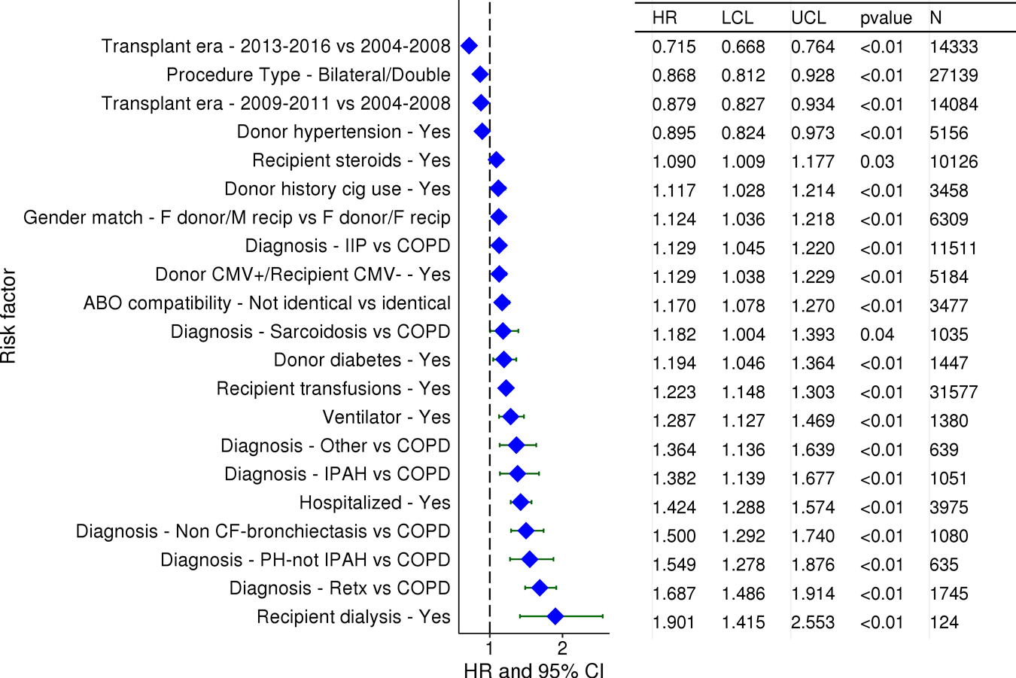

Adult Lung Transplants (2004-6/2016)
Statistically Significant Risk Factors For 1 Year Mortality with 95% Confidence Limits
2018
(N = 41,438)

Slide 88
Adult Lung Transplants (2004-6/2016)
Statistically Significant Risk Factors For 1 Year Mortality
Continuous Factors (see figures)
Recipient age | Donor age
Recipient creatinine | Recipient FVC% predicted
Transplant center volume | Ischemic time
Recipient bilirubin
2018

Slide 89
Adult Lung Transplants (2004-6/2016)
Recipient age
Risk Factors For 1 Year Mortality with 95% Confidence Limits
p < 0.0001
2018
(N = 41,438)
JHLT. 2018 Oct; 37(10): 1155-1206
Notes:
Multivariable analysis was performed using a proportional hazards model censoring all patients at 1 year. Continuous factors were fit using a restricted cubic spline.

Slide 90
Adult Lung Transplants (2004-6/2016)
Donor age
Risk Factors For 1 Year Mortality with 95% Confidence Limits
p < 0.0001
2018
(N = 41,438)
JHLT. 2018 Oct; 37(10): 1155-1206
Notes:
Multivariable analysis was performed using a proportional hazards model censoring all patients at 1 year. Continuous factors were fit using a restricted cubic spline.

Slide 91
Adult Lung Transplants (2004-6/2016)
Recipient creatinine
Risk Factors For 1 Year Mortality with 95% Confidence Limits
p < 0.0001
2018
(N = 41,438)
JHLT. 2018 Oct; 37(10): 1155-1206
Notes:
Multivariable analysis was performed using a proportional hazards model censoring all patients at 1 year. Continuous factors were fit using a restricted cubic spline.

Slide 92
Adult Lung Transplants (2004-6/2016)
Recipient FVC% predicted
Risk Factors For 1 Year Mortality with 95% Confidence Limits
p < 0.0001
2018
(N = 41,438)
JHLT. 2018 Oct; 37(10): 1155-1206
Notes:
Multivariable analysis was performed using a proportional hazards model censoring all patients at 1 year. Continuous factors were fit using a restricted cubic spline.

Slide 93
Adult Lung Transplants (2004-6/2016)
Transplant center volume
Risk Factors For 1 Year Mortality with 95% Confidence Limits
p < 0.0001
2018
(N = 41,438)
JHLT. 2018 Oct; 37(10): 1155-1206
Notes:
Multivariable analysis was performed using a proportional hazards model censoring all patients at 1 year. Continuous factors were fit using a restricted cubic spline.

Slide 94
Adult Lung Transplants (2004-6/2016)
Ischemic time
Risk Factors For 1 Year Mortality with 95% Confidence Limits
p = 0.0052
2018
(N = 41,438)
JHLT. 2018 Oct; 37(10): 1155-1206
Notes:
Multivariable analysis was performed using a proportional hazards model censoring all patients at 1 year. Continuous factors were fit using a restricted cubic spline.

Slide 95
Adult Lung Transplants (2004-6/2016)
Risk Factors For 1 Year Mortality with 95% Confidence Limits
Recipient bilirubin
p < 0.0001
2018
(N = 41,438)
JHLT. 2018 Oct; 37(10): 1155-1206
Notes:
Multivariable analysis was performed using a proportional hazards model censoring all patients at 1 year. Continuous factors were fit using a restricted cubic spline.

Slide 96
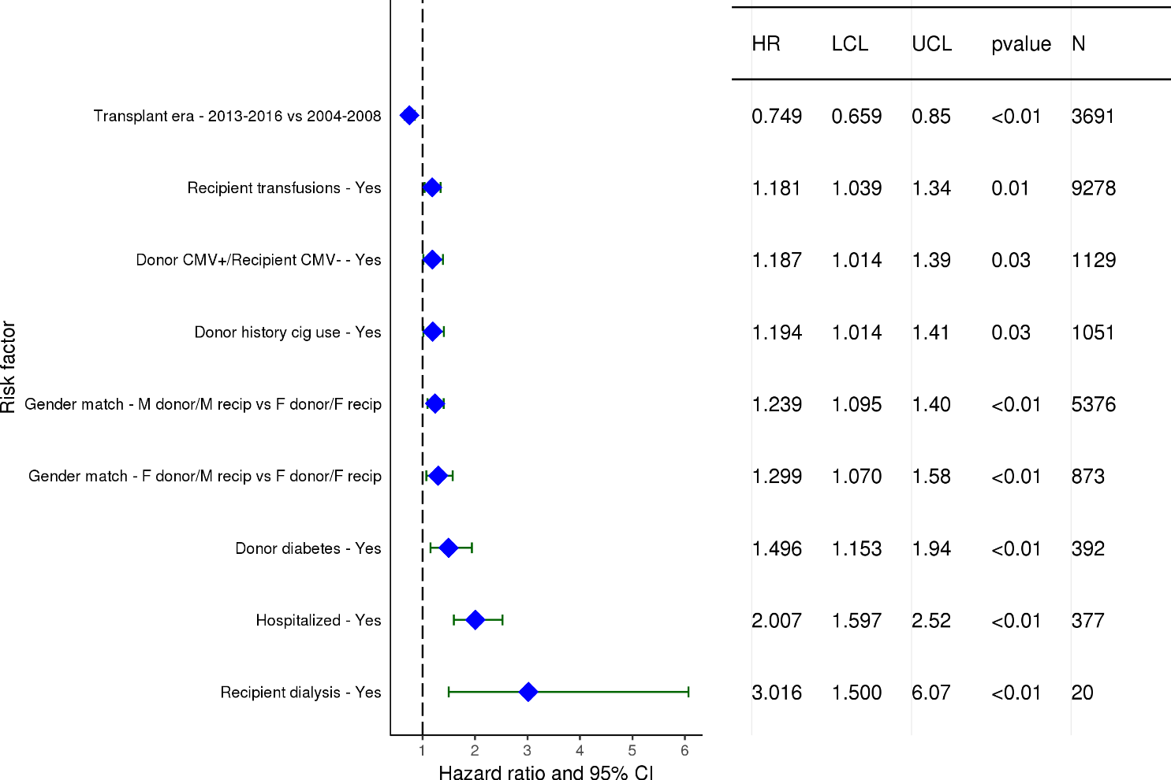
Adult Lung Transplants with COPD (2004-6/2016)
Statistically Significant Risk Factors For 1 Year Mortality with 95% Confidence Limits
2018
(N = 11,763)
JHLT. 2018 Oct; 37(10): 1155-1206

Slide 97
Adult Lung Transplants with COPD (2004-6/2016)
Statistically Significant Risk Factors For 1 Year Mortality
Continuous Factors (see figures)
Recipient age | Transplant center volume
Recipient bilirubin
2018
JHLT. 2018 Oct; 37(10): 1155-1206

Slide 98
Adult Lung Transplants with COPD (2004-6/2016)
Recipient age
Risk Factors For 1 Year Mortality with 95% Confidence Limits
p < 0.0001
2018
(N = 11,763)
JHLT. 2018 Oct; 37(10): 1155-1206
Notes:
Multivariable analysis was performed using a proportional hazards model censoring all patients at 1 year. Continuous factors were fit using a restricted cubic spline.

Slide 99
Adult Lung Transplants with COPD (2004-6/2016)
Transplant center volume
Risk Factors For 1 Year Mortality with 95% Confidence Limits
p < 0.0001
2018
(N = 11,763)
JHLT. 2018 Oct; 37(10): 1155-1206
Notes:
Multivariable analysis was performed using a proportional hazards model censoring all patients at 1 year. Continuous factors were fit using a restricted cubic spline.

Slide 100
Adult Lung Transplants with COPD (2004-6/2016)
Risk Factors For 1 Year Mortality with 95% Confidence Limits
Recipient bilirubin
p = 0.0188
2018
(N = 11,763)
JHLT. 2018 Oct; 37(10): 1155-1206
Notes:
Multivariable analysis was performed using a proportional hazards model censoring all patients at 1 year. Continuous factors were fit using a restricted cubic spline.

Slide 101
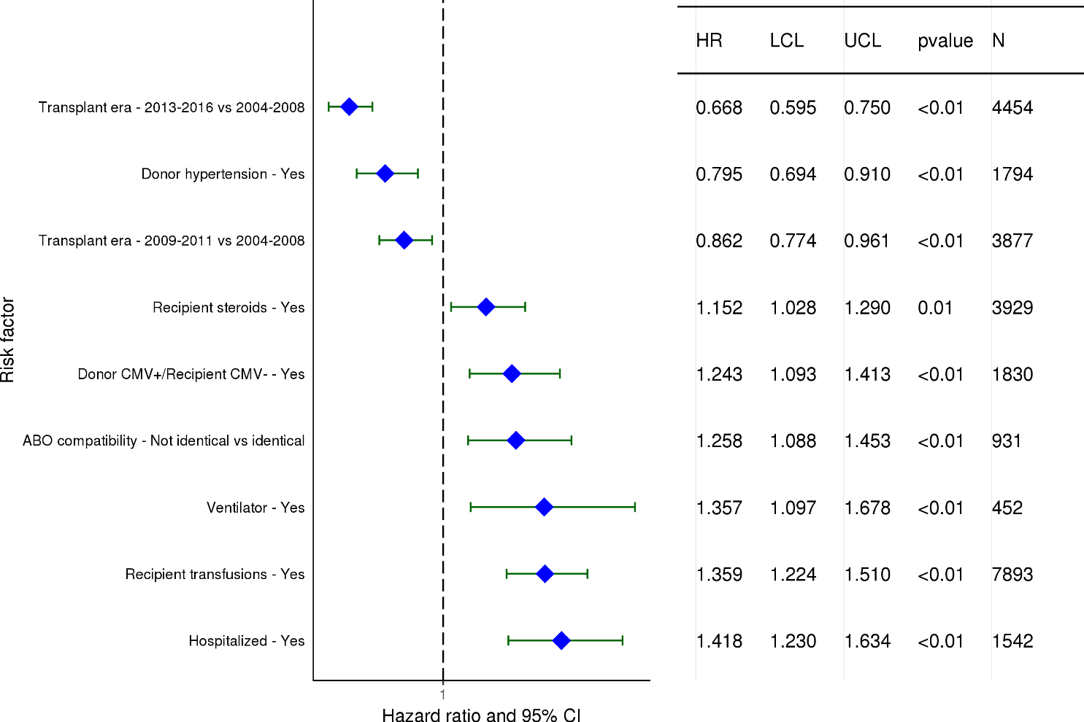
Adult Lung Transplants with IIP (2004-6/2016)
Statistically Significant Risk Factors For 1 Year Mortality with 95% Confidence Limits
2018
(N = 11,511)
JHLT. 2018 Oct; 37(10): 1155-1206

Slide 102
Adult Lung Transplants with IIP (2004-6/2016)
Statistically Significant Risk Factors For 1 Year Mortality
Continuous Factors (see figures)
Recipient age | Donor age
Recipient creatinine | Recipient BMI
Recipient FEV1% predicted | Transplant center volume
Recipient bilirubin
2018
JHLT. 2018 Oct; 37(10): 1155-1206

Slide 103
Adult Lung Transplants with IIP (2004-6/2016)
Recipient age
Risk Factors For 1 Year Mortality with 95% Confidence Limits
p < 0.0001
2018
(N = 11,511)
JHLT. 2018 Oct; 37(10): 1155-1206
Notes:
Multivariable analysis was performed using a proportional hazards model censoring all patients at 5 years. Continuous factors were fit using a restricted cubic spline.

Slide 104
Adult Lung Transplants with IIP (2004-6/2016)
Donor age
Risk Factors For 1 Year Mortality with 95% Confidence Limits
p < 0.0001
2018
(N = 11,511)
JHLT. 2018 Oct; 37(10): 1155-1206
Notes:
Multivariable analysis was performed using a proportional hazards model censoring all patients at 5 years. Continuous factors were fit using a restricted cubic spline.

Slide 105
Adult Lung Transplants with IIP (2004-6/2016)
Recipient creatinine
Risk Factors For 1 Year Mortality with 95% Confidence Limits
p = 0.0002
2018
(N = 11,511)
JHLT. 2018 Oct; 37(10): 1155-1206
Notes:
Multivariable analysis was performed using a proportional hazards model censoring all patients at 5 years. Continuous factors were fit using a restricted cubic spline.

Slide 106
Adult Lung Transplants with IIP (2004-6/2016)
Recipient BMI
Risk Factors For 1 Year Mortality with 95% Confidence Limits
p = 0.0017
2018
(N = 11,511)
JHLT. 2018 Oct; 37(10): 1155-1206
Notes:
Multivariable analysis was performed using a proportional hazards model censoring all patients at 5 years. Continuous factors were fit using a restricted cubic spline.

Slide 107
Adult Lung Transplants with IIP (2004-6/2016)
Recipient FEV1% predicted
Risk Factors For 1 Year Mortality with 95% Confidence Limits
p = 0.0085
2018
(N = 11,511)
JHLT. 2018 Oct; 37(10): 1155-1206
Notes:
Multivariable analysis was performed using a proportional hazards model censoring all patients at 5 years. Continuous factors were fit using a restricted cubic spline.

Slide 108
Adult Lung Transplants with IIP (2004-6/2016)
Transplant center volume
Risk Factors For 1 Year Mortality with 95% Confidence Limits
p < 0.0001
2018
(N = 11,511)
JHLT. 2018 Oct; 37(10): 1155-1206
Notes:
Multivariable analysis was performed using a proportional hazards model censoring all patients at 5 years. Continuous factors were fit using a restricted cubic spline.

Slide 109
Adult Lung Transplants with IIP (2004-6/2016)
Risk Factors For 1 Year Mortality with 95% Confidence Limits
Recipient bilirubin
p < 0.0001
2018
(N = 11,511)
JHLT. 2018 Oct; 37(10): 1155-1206
Notes:
Multivariable analysis was performed using a proportional hazards model censoring all patients at 5 years. Continuous factors were fit using a restricted cubic spline.

Slide 110
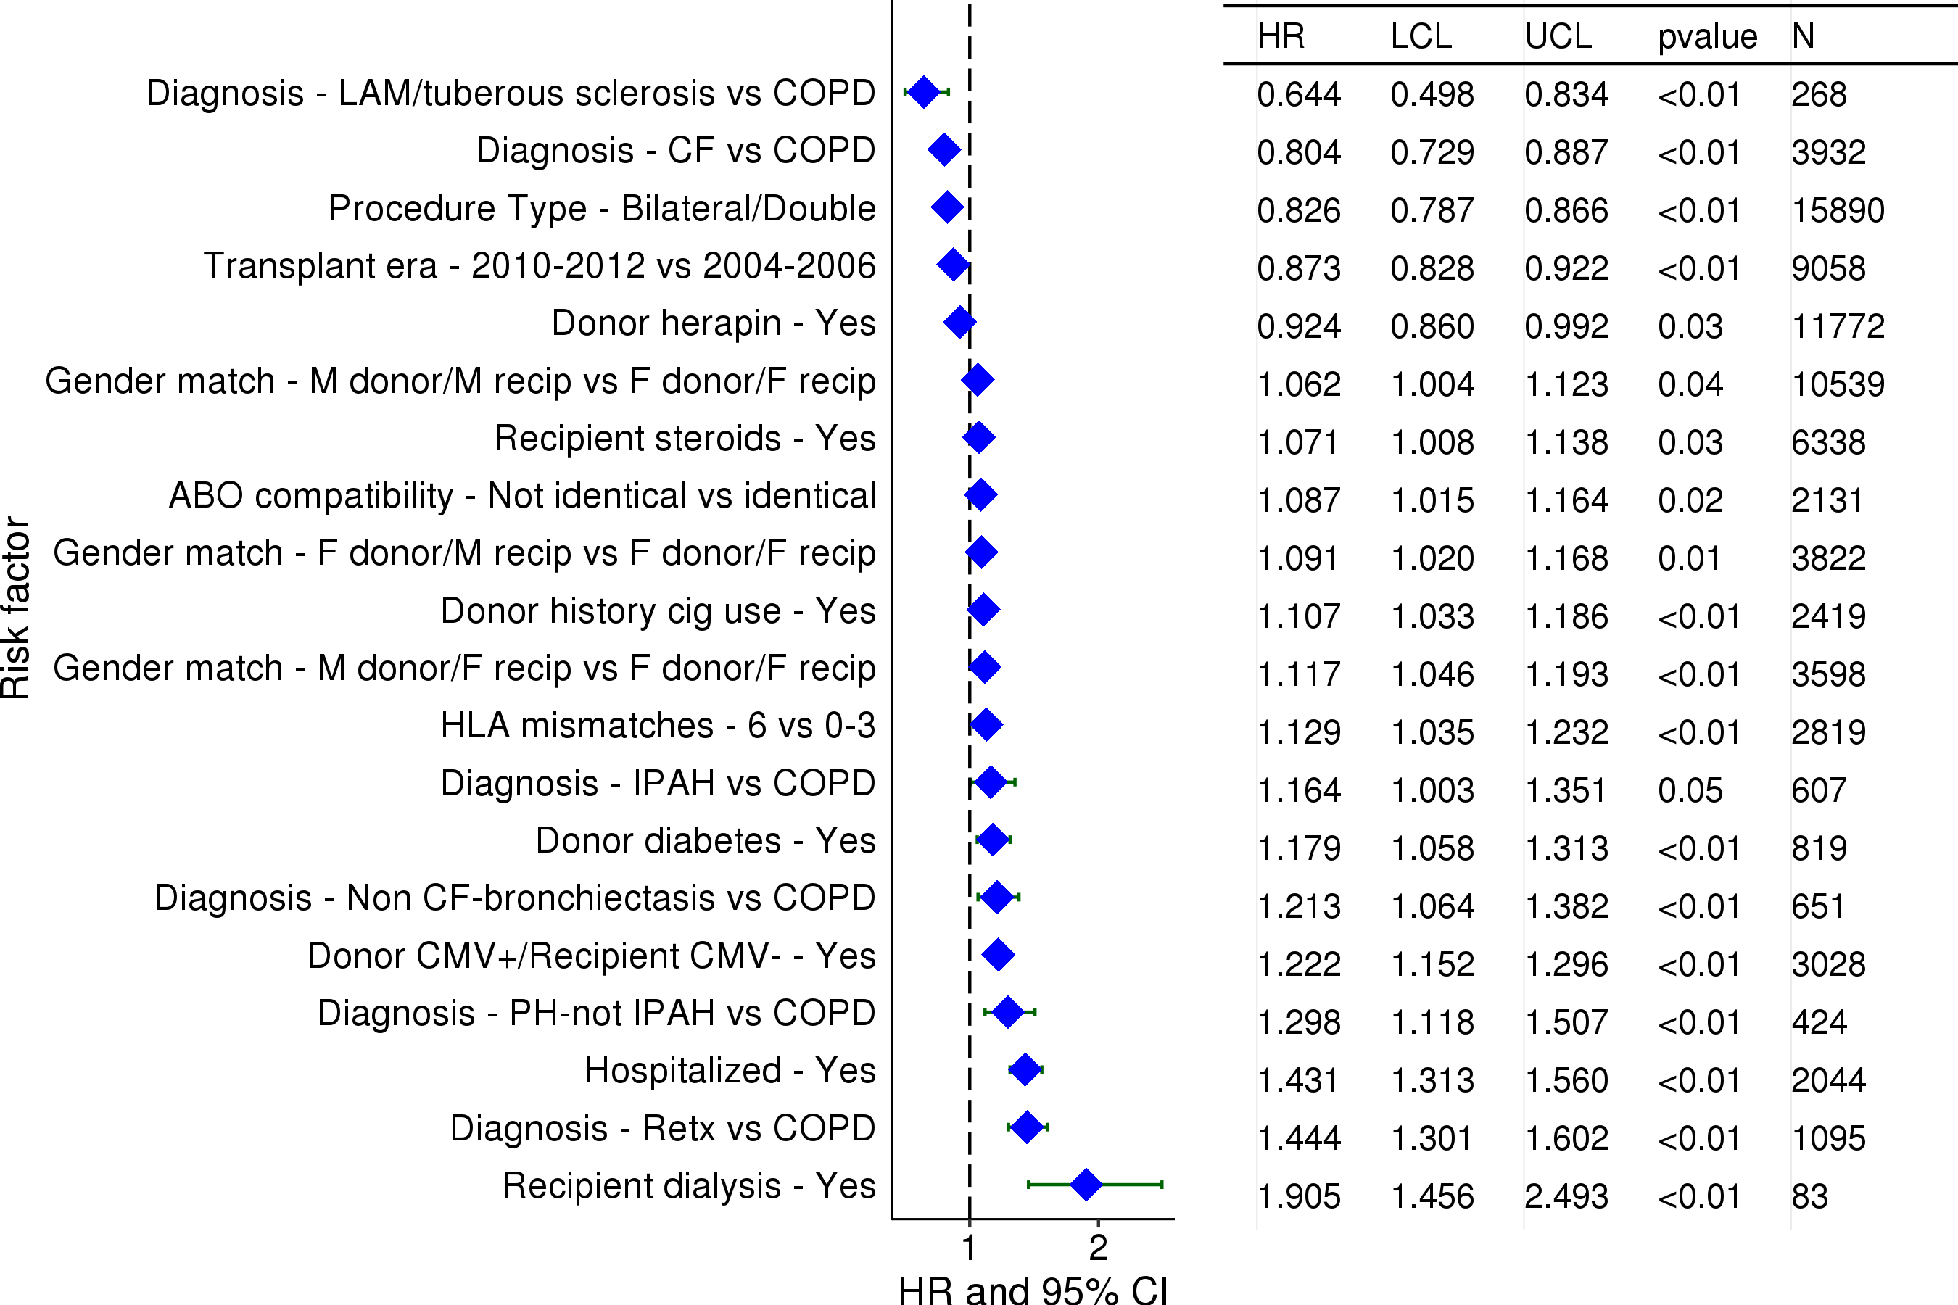
Adult Lung Transplants (2004-6/2012)
Statistically Significant Risk Factors For 5 Year Mortality with 95% Confidence Limits
2018
(N = 25,245)
JHLT. 2018 Oct; 37(10): 1155-1206

Slide 111
Adult Lung Transplants (2004-6/2012)
Statistically Significant Risk Factors For 5 Year Mortality
Continuous Factors (see figures)
Recipient age | Donor age
Recipient creatinine | Oxygen requirement
Recipient FVC% predicted | Transplant center volume
Recipient bilirubin | PRA
2018
JHLT. 2018 Oct; 37(10): 1155-1206

Slide 112
Adult Lung Transplants (2004-6/2012)
Recipient age
Risk Factors For 5 Year Mortality with 95% Confidence Limits
p < 0.0001
2018
(N = 25,245)
JHLT. 2018 Oct; 37(10): 1155-1206
Notes:
Multivariable analysis was performed using a proportional hazards model censoring all patients at 5 years. Continuous factors were fit using a restricted cubic spline.

Slide 113
Adult Lung Transplants (2004-6/2012)
Donor age
Risk Factors For 5 Year Mortality with 95% Confidence Limits
p < 0.0001
2018
(N = 25,245)
JHLT. 2018 Oct; 37(10): 1155-1206
Notes:
Multivariable analysis was performed using a proportional hazards model censoring all patients at 5 years. Continuous factors were fit using a restricted cubic spline.

Slide 114
Adult Lung Transplants (2004-6/2012)
Recipient creatinine
Risk Factors For 5 Year Mortality with 95% Confidence Limits
p < 0.0001
2018
(N = 25,245)
JHLT. 2018 Oct; 37(10): 1155-1206
Notes:
Multivariable analysis was performed using a proportional hazards model censoring all patients at 5 years. Continuous factors were fit using a restricted cubic spline.

Slide 115
Adult Lung Transplants (2004-6/2012)
Oxygen requirement
Risk Factors For 5 Year Mortality with 95% Confidence Limits
p = 0.0009
2018
(N = 25,245)
JHLT. 2018 Oct; 37(10): 1155-1206
Notes:
Multivariable analysis was performed using a proportional hazards model censoring all patients at 5 years. Continuous factors were fit using a restricted cubic spline.

Slide 116
Adult Lung Transplants (2004-6/2012)
Recipient FVC% predicted
Risk Factors For 5 Year Mortality with 95% Confidence Limits
p = 0.0067
2018
(N = 25,245)
JHLT. 2018 Oct; 37(10): 1155-1206
Notes:
Multivariable analysis was performed using a proportional hazards model censoring all patients at 5 years. Continuous factors were fit using a restricted cubic spline.

Slide 117
Adult Lung Transplants (2004-6/2012)
Transplant center volume
Risk Factors For 5 Year Mortality with 95% Confidence Limits
p < 0.0001
2018
(N = 25,245)
JHLT. 2018 Oct; 37(10): 1155-1206
Notes:
Multivariable analysis was performed using a proportional hazards model censoring all patients at 5 years. Continuous factors were fit using a restricted cubic spline.

Slide 118
Adult Lung Transplants (2004-6/2012)
Risk Factors For 5 Year Mortality with 95% Confidence Limits
Recipient bilirubin
p = 0.0073
2018
(N = 25,245)
JHLT. 2018 Oct; 37(10): 1155-1206
Notes:
Multivariable analysis was performed using a proportional hazards model censoring all patients at 5 years. Continuous factors were fit using a restricted cubic spline.

Slide 119
Adult Lung Transplants (2004-6/2012)
PRA
Risk Factors For 5 Year Mortality with 95% Confidence Limits
p = 0.0039
2018
(N = 25,245)
JHLT. 2018 Oct; 37(10): 1155-1206
Notes:
Multivariable analysis was performed using a proportional hazards model censoring all patients at 5 years. Continuous factors were fit using a restricted cubic spline.

Slide 120
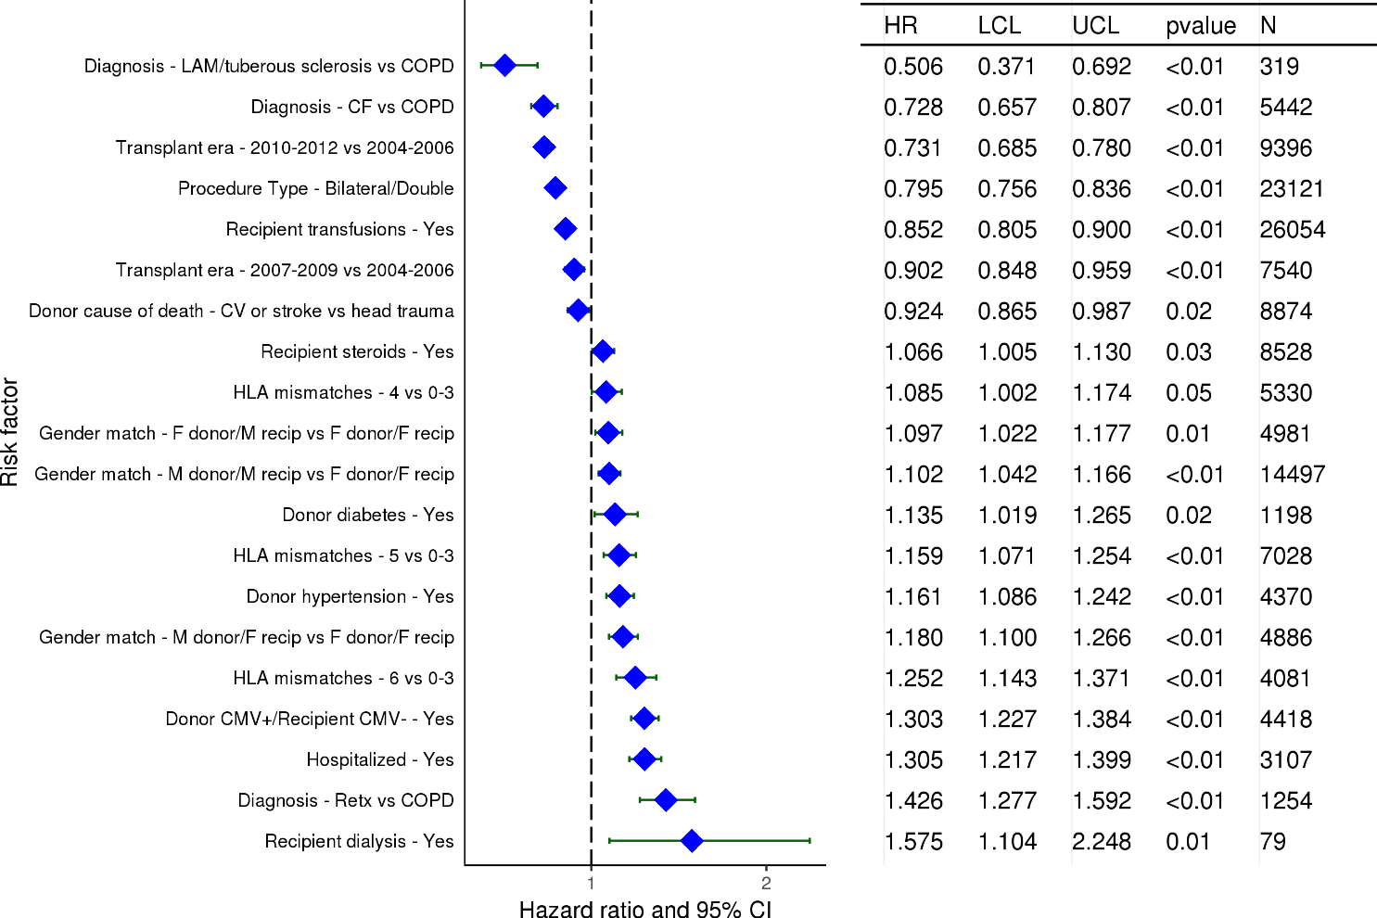
Adult Lung Transplants (2004-6/2012)
Statistically Significant Risk Factors For 5 Year Mortality Conditional on Survival to 1 Year with 95% Confidence Limits
2018
(N = 34,370)
JHLT. 2018 Oct; 37(10): 1155-1206

Slide 121
Adult Lung Transplants (2004-6/2012)
Statistically Significant Risk Factors For 5 Year Mortality Conditional on Survival to 1 Year
Continuous Factors (see figures)
Recipient age | Donor age
Donor to recipient BMI ratio | Transplant center volume
2018
JHLT. 2018 Oct; 37(10): 1155-1206

Slide 122
Adult Lung Transplants (2004-6/2012)
Risk Factors For 5 Year Mortality Conditional on Survival to 1 Year with 95% Confidence Limits
Recipient age
p < 0.0001
2018
(N = 34,370)
JHLT. 2018 Oct; 37(10): 1155-1206
Notes:
Multivariable analysis was performed using a proportional hazards model censoring all patients at 5 years. Continuous factors were fit using a restricted cubic spline.

Slide 123
Adult Lung Transplants (2004-6/2012)
Risk Factors For 5 Year Mortality Conditional on Survival to 1 Year with 95% Confidence Limits
Donor age
p = 0.0132
2018
(N = 34,370)
JHLT. 2018 Oct; 37(10): 1155-1206
Notes:
Multivariable analysis was performed using a proportional hazards model censoring all patients at 5 years. Continuous factors were fit using a restricted cubic spline.

Slide 124
Adult Lung Transplants (2004-6/2012)
Risk Factors For 5 Year Mortality Conditional on Survival to 1 Year with 95% Confidence Limits
Donor to recipient BMI ratio
p = 0.0386
2018
(N = 34,370)
JHLT. 2018 Oct; 37(10): 1155-1206
Notes:
Multivariable analysis was performed using a proportional hazards model censoring all patients at 5 years. Continuous factors were fit using a restricted cubic spline.

Slide 125
Adult Lung Transplants (2004-6/2012)
Risk Factors For 5 Year Mortality Conditional on Survival to 1 Year with 95% Confidence Limits
Transplant center volume
p < 0.0001
2018
(N = 34,370)
JHLT. 2018 Oct; 37(10): 1155-1206
Notes:
Multivariable analysis was performed using a proportional hazards model censoring all patients at 5 years. Continuous factors were fit using a restricted cubic spline.

Slide 126
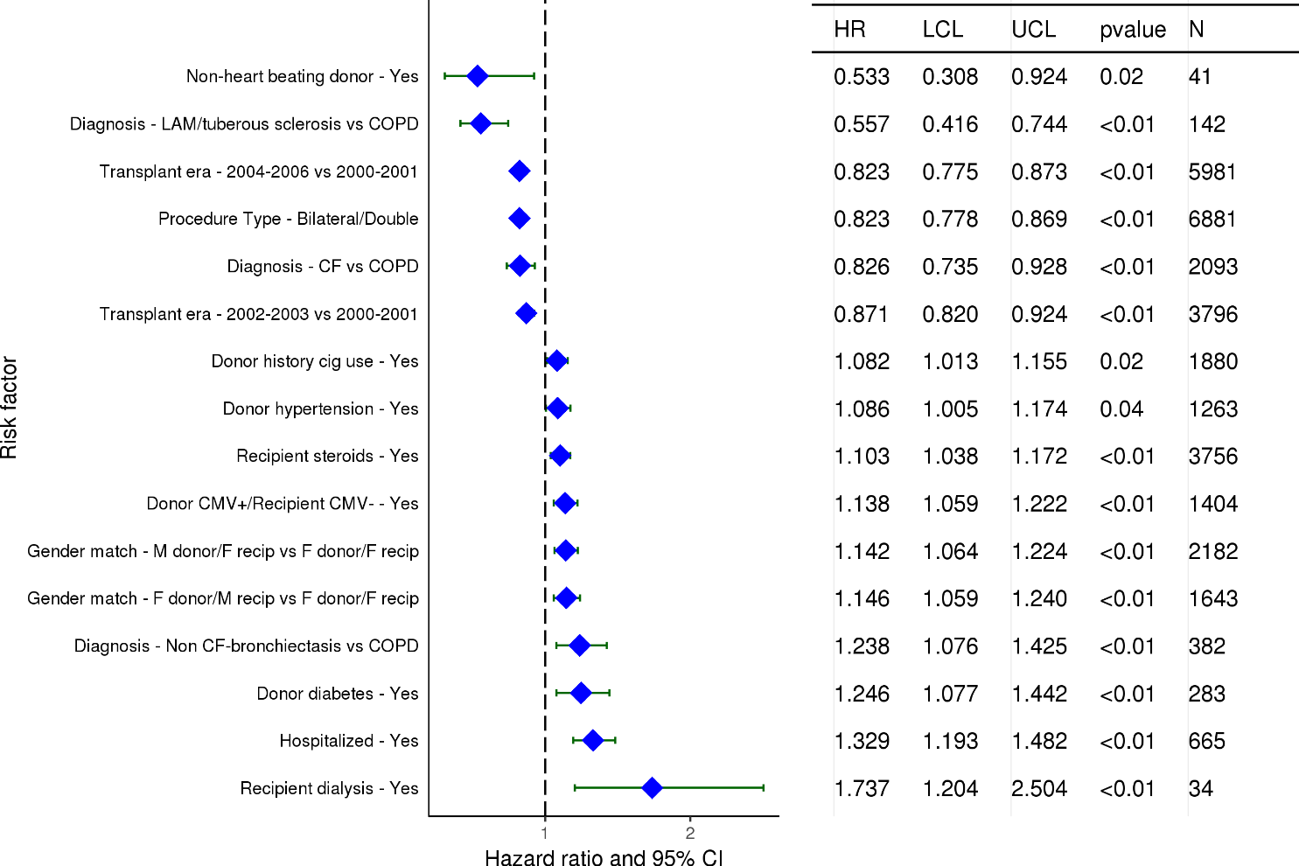
Adult Lung Transplants (2000-6/2006)
Statistically Significant Risk Factors For 10 Year Mortality with 95% Confidence Limits
2018
(N = 13,079)
JHLT. 2018 Oct; 37(10): 1155-1206

Slide 127
Adult Lung Transplants (2000-6/2006)
Statistically Significant Risk Factors For 10 Year Mortality
Continuous Factors (see figures)
Recipient age | Donor age
Recipient creatinine | Recipient BMI
Oxygen requirement | Transplant center volume
PRA
2018
JHLT. 2018 Oct; 37(10): 1155-1206

Slide 128
Adult Lung Transplants (2000-6/2006)
Recipient age
Risk Factors For 10 Year Mortality with 95% Confidence Limits
p < 0.0001
2018
(N = 13,079)
JHLT. 2018 Oct; 37(10): 1155-1206
Notes:
Multivariable analysis was performed using a proportional hazards model censoring all patients at 10 years. Continuous factors were fit using a restricted cubic spline.

Slide 129
Adult Lung Transplants (2000-6/2006)
Donor age
Risk Factors For 10 Year Mortality with 95% Confidence Limits
p = 0.0453
2018
(N = 13,079)
JHLT. 2018 Oct; 37(10): 1155-1206
Notes:
Multivariable analysis was performed using a proportional hazards model censoring all patients at 10 years. Continuous factors were fit using a restricted cubic spline.

Slide 130
Adult Lung Transplants (2000-6/2006)
Recipient creatinine
Risk Factors For 10 Year Mortality with 95% Confidence Limits
p = 0.0011
2018
(N = 13,079)
JHLT. 2018 Oct; 37(10): 1155-1206
Notes:
Multivariable analysis was performed using a proportional hazards model censoring all patients at 10 years. Continuous factors were fit using a restricted cubic spline.

Slide 131
Adult Lung Transplants (2000-6/2006)
Recipient BMI
Risk Factors For 10 Year Mortality with 95% Confidence Limits
p = 0.0078
2018
(N = 13,079)
JHLT. 2018 Oct; 37(10): 1155-1206
Notes:
Multivariable analysis was performed using a proportional hazards model censoring all patients at 10 years. Continuous factors were fit using a restricted cubic spline.

Slide 132
Adult Lung Transplants (2000-6/2006)
Oxygen requirement
Risk Factors For 10 Year Mortality with 95% Confidence Limits
p < 0.0001
2018
(N = 13,079)
JHLT. 2018 Oct; 37(10): 1155-1206
Notes:
Multivariable analysis was performed using a proportional hazards model censoring all patients at 10 years. Continuous factors were fit using a restricted cubic spline.

Slide 133
Adult Lung Transplants (2000-6/2006)
Transplant center volume
Risk Factors For 10 Year Mortality with 95% Confidence Limits
p = 0.0001
2018
(N = 13,079)
JHLT. 2018 Oct; 37(10): 1155-1206
Notes:
Multivariable analysis was performed using a proportional hazards model censoring all patients at 10 years. Continuous factors were fit using a restricted cubic spline.

Slide 134
Adult Lung Transplants (2000-6/2006)
PRA
Risk Factors For 10 Year Mortality with 95% Confidence Limits
p = 0.0040
2018
(N = 13,079)
JHLT. 2018 Oct; 37(10): 1155-1206
Notes:
Multivariable analysis was performed using a proportional hazards model censoring all patients at 10 years. Continuous factors were fit using a restricted cubic spline.

Slide 135
Focus Theme
2018
JHLT. 2018 Oct; 37(10): 1155-1206

Slide 136
Adult Lung Transplants
Number of Multiorgan Transplants Reported by Type of Transplant
(Transplants: January 1990 – June 2017)
Primary transplants
Retransplants
2018
Heart-lung alone and heart-lung with other organs are included in multiorgan transplants.
JHLT. 2018 Oct; 37(10): 1155-1206

Slide 137
Adult Lung Transplants
Number and % of Multiorgan Transplants Reported by Year and Type of Transplant
2018
Heart-lung alone and heart-lung with other organs are included in multiorgan transplants.
JHLT. 2018 Oct; 37(10): 1155-1206

Slide 138
Adult Lung Transplants
% of Multiorgan Transplants by Location
(Transplants: January 2004 – June 2017)
N = 107
2018
Heart-lung alone and heart-lung with other organs are excluded from multiorgan transplants.
JHLT. 2018 Oct; 37(10): 1155-1206

Slide 139
Adult Lung Transplants
Donor and Recipient Characteristics
(Transplants: January 2004 – June 2017)
 | Multiorgan transplant (N = 174) | Lung alone transplant (N = 45,667) | p-value
Recipient age (years) | 36.5 (20.0 - 62.0) | 56.0 (24.0 - 68.0) | <0.0001
Donor age (years) | 27.0 (16.0 - 59.0) | 40.0 (16.0 - 64.0) | <0.0001
Recipient gender (% male) | 66.1% | 57.5% | 0.0223
Donor gender (% male) | 63.2% | 56.2% | 0.0622
Diagnosis
A1ATD | 4.1% | 3.6% | <0.0001
CF | 47.4% | 14.9%
COPD | 2.3% | 28.5%
IIP | 15.2% | 28.7%
ILD-not IIP | 2.3% | 6.4%
IPAH | 2.9% | 2.6%
Non CF-bronchiectasis | 1.2% | 2.6%
PH-not IPAH | 5.3% | 1.5%
Retransplant | 15.8% | 4.2%
Sarcoidosis | 0.6% | 2.5%
Other | 2.9% | 4.4%
Continuous factors are expressed as median (5th – 95th percentiles)
2018
Heart-lung alone and heart-lung with other organs are excluded from multiorgan transplants.
JHLT. 2018 Oct; 37(10): 1155-1206
Notes:
Comparisons for categorical variables were made using the chi-square statistic. When expected cell counts were small, Fisher’s exact test was used instead. Multiple groups were compared using single p-value.
Comparisons for continuous variables were made using Kruskal-Wallis test.
A significant p-value means that at least one of the groups is different than the others but it doesn’t identify which group it is.
For diagnosis tabulations, unknown diagnoses were excluded. Status of retransplant tabulation included transplants with unknown diagnosis. Therefore the percent of retransplants may be lower than the percent with diagnosis of retransplant.

Slide 140
Adult Lung Transplants
Donor and Recipient Characteristics
(Transplants: January 2004 – June 2017)
 | Multiorgan transplant (N = 174) | Lung alone transplant (N = 45,667) | p-value
Retransplant | 15.5% | 4.2% | <0.0001
Location
Europe | 33.9% | 37.4% | 0.1184
North America | 61.5% | 54.8%
Others | 4.6% | 7.8%
Recipient hypertension | 30.9% | 25.3% | 0.2481
Donor hypertension | 13.3% | 22.5% | 0.0190
Recipient diabetes mellitus | 47.4% | 18.9% | <0.0001
Donor diabetes mellitus | 0.9% | 6.3% | 0.0177
2018
Heart-lung alone and heart-lung with other organs are excluded from multiorgan transplants.
JHLT. 2018 Oct; 37(10): 1155-1206
Notes:
Comparisons for categorical variables were made using the chi-square statistic. Multiple groups were compared using single p-value.
Comparisons for continuous variables were made using Kruskal-Wallis test.
A significant p-value means that at least one of the groups is different than the others but it doesn’t identify which group it is.
For diagnosis tabulations, unknown diagnoses were excluded. Status of retransplant tabulation included transplants with unknown diagnosis. Therefore the percent of retransplants may be lower than the percent with diagnosis of retransplant.

Slide 141
Adult Lung Transplants
Donor and Recipient Characteristics
(Transplants: January 2004 – June 2017)
 | Multiorgan transplant (N = 174) | Lung alone transplant (N = 45,667) | p-value
Recipient history of prior dialysis | 21.2% | 0.7% | <0.0001
Recipient creatinine (mg/dl) | 0.9 (0.4 - 4.4) | 0.8 (0.5 - 1.3) | 0.0050
Recipient total bilirubin (mg/dl) | 0.6 (0.2 - 4.2) | 0.5 (0.2 - 1.4) | <0.0001
Ischemic time (hours) | 4.9 (2.4 - 9.0) | 5.1 (2.6 - 8.5) | 0.0659
Induction* | 67.7% | 61.5% | 0.2152
Multiorgan transplants with kidney | (N=65)
Dialysis | 47.1%
Multiorgan transplants with liver | (N=108)
Creatinine (mg/dl) | 0.7 (0.3 - 1.5)
Bilirubin (mg/dl) | 1.0 (0.3 - 5.7)
Continuous factors are expressed as median (5th – 95th percentiles)
* Analysis is limited to patients who were alive at the time of the discharge and receiving prednisone.
2018
Heart-lung alone and heart-lung with other organs are excluded from multiorgan transplants.
JHLT. 2018 Oct; 37(10): 1155-1206
Notes:
Comparisons for categorical variables were made using the chi-square statistic. Multiple groups were compared using single p-value.
Comparisons for continuous variables were made using Kruskal-Wallis test.
A significant p-value means that at least one of the groups is different than the others but it doesn’t identify which group it is.

Slide 142
Adult Lung Transplants
Diagnosis of Multiorgan Transplants by Era
2018
Heart-lung alone and heart-lung with other organs are excluded from multiorgan transplants.
JHLT. 2018 Oct; 37(10): 1155-1206
Notes:
Transplants with unknown diagnoses are excluded from this tabulation.

Slide 143
Adult Lung Transplants
% of Recipients Experiencing Treated Rejection within 1 Year
by Transplant Type
(Transplants: January 2004 – June 2016)
All pair-wise comparisons were significant at p < 0.05 except lung alone vs. heart-lung alone.
Analysis is limited to patients who were alive at the time of the follow-up.
Heart-lung alone and heart-lung with other organs are excluded from multiorgan lung transplants.
Treated rejection = Recipient was reported to (1) have at least one acute rejection episode that was treated with an anti-rejection agent; or (2) have been hospitalized for rejection.
2018
JHLT. 2018 Oct; 37(10): 1155-1206
Notes:
Comparisons were made using the chi-square statistic.

Slide 144
Adult Lung Transplants
% of Recipients Experiencing Any Rejection within 1 year
by Transplant Type
(Transplants: January 2004 – June 2016)
All pair-wise comparisons were significant at p < 0.05 except lung alone vs. heart-lung alone.
Analysis is limited to patients who were alive at the time of the follow-up.
Heart-lung alone and heart-lung with other organs are excluded from multiorgan lung transplants.
Any rejection = Recipient was reported to (1) have at least one acute rejection episode; or (2) have been hospitalized for rejection.
2018
JHLT. 2018 Oct; 37(10): 1155-1206
Notes:
Comparisons were made using the chi-square statistic.

Slide 145
Adult Lung Transplants
Kaplan-Meier Survival by Transplant Type
(Transplants: January 1990 – June 2016)
No pair-wise comparisons were significant at p < 0.05 except lung alone vs. heart-lung alone.
2018
Heart-lung alone and heart-lung with other organs are excluded from multiorgan transplants.
JHLT. 2018 Oct; 37(10): 1155-1206
Notes:
Survival was calculated using the Kaplan-Meier method, which incorporates information from all transplants for whom any follow-up has been provided. Since many patients are still alive and some patients have been lost to follow-up, the survival rates are estimates rather than exact rates because the time of death is not known for all patients.
Survival rates were compared using the log-rank test statistic. Adjustments for multiple comparisons were done using Scheffe’s method. Results of log-rank test should be interpreted with caution when curves cross.

Slide 146
Adult Lung Transplants
Kaplan-Meier Survival of Multiorgan Transplant Recipients by Era
(Transplants: January 1990 – June 2016)
No pair-wise comparisons were significant at p < 0.05 except 1990-2004 heart-lung alone vs. 2005-6/2016 heart-lung alone and 1990-2004 heart-lung alone vs. 2005-6/2016 multiorgan lung transplant.
2018
Heart-lung alone and heart-lung with other organs are excluded from multiorgan lung transplants.
JHLT. 2018 Oct; 37(10): 1155-1206
Notes:
Survival was calculated using the Kaplan-Meier method, which incorporates information from all transplants for whom any follow-up has been provided. Since many patients are still alive and some patients have been lost to follow-up, the survival rates are estimates rather than exact rates because the time of death is not known for all patients. The median survival is the estimated time point at which 50% of all of the recipients have died.
Survival rates were compared using the log-rank test statistic. Adjustments for multiple comparisons were done using Scheffe’s method. Results of log-rank test should be interpreted with caution when curves cross.

Slide 147
Adult Lung Transplants
Freedom from Bronchiolitis Obliterans Syndrome by Transplant Type
Conditional on Survival to 14 days
(Transplants: January 1994 – June 2016)
All pair-wise comparisons were significant at p < 0.05 except multiorgan lung transplant vs. heart-lung alone transplant.
2018
Heart-lung alone and heart-lung with other organs are excluded from multiorgan lung transplants.
JHLT. 2018 Oct; 37(10): 1155-1206
Notes:
Freedom from Bronchiolitis Obliterans Syndrome rates were computed using the Kaplan-Meier method.
The development of bronchiolitis obliterans is reported on annual follow-ups; a date of diagnosis is not provided. For this figure the midpoint between the date of previous follow-up (when event had not occurred) and the date of follow-up when the event was reported was used as the date of occurrence. Patients were included in the analysis until an unknown response for bronchiolitis obliterans was reported. Therefore, the rates seen here may differ from those reported in the cumulative prevalence slide which is based on only those patients with known responses for bronchiolitis obliterans at all follow-up time points.
Rates were compared using the log-rank test statistic. Adjustments for multiple comparisons were done using Scheffe’s method.

Slide 148
Adult Lung Transplants
Length of Stay by Transplant Type
(Transplants: January 2000 – June 2017)
2018
JHLT. 2018 Oct; 37(10): 1155-1206

Slide 149
Adult Lung Transplants
Cumulative Morbidity Rates in Survivors within 1 year Post-Transplant
by Transplant Type
(Transplants: January 1994 – June 2016)
Outcome | Lung-liver | Total N with known response | Lung alone | Total N with known response
Severe Renal Dysfunction¹ | 4.0% | (N=50) | 5.7% | (N=24,284)
Creatinine > 2.5 mg/dl | 4.0% |  | 4.4%
Chronic Dialysis | 0.0% |  | 1.3%
Renal Transplant | 0.0% |  | 0.0%
Diabetes | 17.6% | (N=51) | 19.8% | (N=24,483)
Bronchiolitis Obliterans Syndrome | 2.1% | (N=48) | 8.8% | (N=23,115)
2018
¹ Severe renal dysfunction = Creatinine > 2.5 mg/dl (221 μmol/L), dialysis or renal transplant
JHLT. 2018 Oct; 37(10): 1155-1206
Notes:
This table shows the percentage of patients experiencing various morbidities as reported within 1 year following transplantation. The percentages are based on patients with known responses. Because the outcomes are reported to be unknown at different rates the number with known responses for each outcome are also provided.

Slide 150
Adult Lung Transplants
Cumulative Morbidity Rates in Survivors within 5 years Post-Transplant
by Transplant Type
(Transplants: January 1994 – June 2012)
Outcome | Lung-liver | Total N with known response | Lung alone | Total N with known response
Severe Renal Dysfunction¹ | 21.1% | (N=19) | 16.4% | (N=9,771)
Creatinine > 2.5 mg/dl | 10.5% |  | 13.0%
Chronic Dialysis | 10.5% |  | 2.8%
Renal Transplant | 0.0% |  | 0.6%
Diabetes | 27.8% | (N=18) | 35.1% | (N=9,917)
Bronchiolitis Obliterans Syndrome | 33.3% | (N=15) | 40.9% | (N=8,483)
2018
¹ Severe renal dysfunction = Creatinine > 2.5 mg/dl (221 μmol/L), dialysis or renal transplant
JHLT. 2018 Oct; 37(10): 1155-1206
Notes:
This table shows the percentage of patients experiencing various morbidities as reported within 5 years following transplantation. The percentages are based on patients with known responses. To reduce bias, only patients with responses reported on every follow-up through the 5-year annual follow-up were included in the 5-year analysis. Because the outcomes are reported to be unknown at different rates the number with known responses for each outcome are also provided.

Slide 151
Adult Lung Transplants
Maintenance Immunosuppression at Time of 1 Year Follow-up by Transplant Type
(Follow-ups: January 2004 – June 2017)
2018
Analysis is limited to patients who were alive at the time of the follow-up.
JHLT. 2018 Oct; 37(10): 1155-1206
Notes:
This figure shows the maintenance immunosuppression reported as being provided at the time of the 1-year annual follow-up forms. As different patients were transplanted each year this figure does not represent changes in immunosuppression for individual patients but may represent changes in practice.

Slide 152
Adult Lung Transplants
Maintenance Immunosuppression Drug Combinations at
Time of 1 Year Follow-up
(Follow-ups: January 2004 – June 2017)
2018
Analysis is limited to patients who were alive at the time of the follow-up.
JHLT. 2018 Oct; 37(10): 1155-1206

Slide 153
Adult Lung Transplants
Cause of Death Stratified by Transplant Type
(Deaths: January 1990 – June 2017)
Transplant Type | Cause of Death | 0-30 Days | 31 Days - 1 Year | >1 Year - 5 Years | >5 Years
Multiorgan lung transplant | OB/BOS | 0 | 0 | 1 (5.9%) | 1 (5.6%)
 | Acute Rejection | 0 | 0 | 0 | 1 (5.6%)
 | Malignancy | 0 | 2 (5.7%) | 2 (11.8%) | 4 (22.2%)
 | Infection | 5 (33.3%) | 11 (31.4%) | 5 (29.4%) | 1 (5.6%)
 | Graft Failure | 2 (13.3%) | 1 (2.9%) | 6 (35.3%) | 2 (11.1%)
 | Cardiovascular | 2 (13.3%) | 3 (8.6%) | 1 (5.9%) | 1 (5.6%)
 | Technical | 0 | 1 (2.9%) | 0 | 0
 | Multiple Organ Failure | 4 (26.7%) | 6 (17.1%) | 1 (5.9%) | 2 (11.1%)
 | All known causes | 15 | 35 | 17 | 18
Lung alone transplant | OB/BOS | 11 (0.3%) | 309 (4.6%) | 2,904 (27.5%) | 1,697 (24.0%)
 | Acute Rejection | 118 (3.2%) | 119 (1.8%) | 126 (1.2%) | 26 (0.4%)
 | Malignancy | 6 (0.2%) | 340 (5.1%) | 1,197 (11.4%) | 1,211 (17.1%)
 | Infection | 691 (18.7%) | 2,434 (36.4%) | 2,131 (20.2%) | 1,185 (16.8%)
 | Graft Failure | 886 (24.0%) | 1,101 (16.5%) | 1,950 (18.5%) | 1,114 (15.8%)
 | Cardiovascular | 443 (12.0%) | 366 (5.5%) | 475 (4.5%) | 434 (6.1%)
 | Technical | 439 (11.9%) | 236 (3.5%) | 79 (0.7%) | 50 (0.7%)
 | Multiple Organ Failure | 467 (12.6%) | 811 (12.1%) | 495 (4.7%) | 340 (4.8%)
 | All known causes | 3,692 | 6,689 | 10,543 | 7,071
Only the most frequent causes of death are shown on the slide.
2018
Heart-lung alone and heart-lung with other organs are excluded from multiorgan lung transplants.
JHLT. 2018 Oct; 37(10): 1155-1206
Notes:
Only known causes of death are included in the tabulation.

