Slide 1

HEART TRANSPLANTATION
Adult Recipients
2018
JHLT. 2018 Oct; 37(10): 1155-1206

Slide 2
Table of Contents
Donor and recipient characteristics: slides 3-26
Immunosuppression: slides 27-42
Survival analyses: slides 43-80
Morbidity: slides 81-107
Multivariable analyses: slides 108-171
Focus theme: slides 172-193
2018
JHLT. 2018 Oct; 37(10): 1155-1206

Slide 3
Donor and Recipient Characteristics:
Diagnosis: slides 4-6, 11, 21, 23 and 25
Retransplants by year: slide 7
Recipient and donor characteristics: slides 8-26
2018
JHLT. 2018 Oct; 37(10): 1155-1206

Slide 4
Adult Heart Transplants
Diagnosis
1/1982 – 6/2017
1/2009 – 6/2017
2018
JHLT. 2018 Oct; 37(10): 1155-1206

Slide 5
Adult Heart Transplants
Diagnosis by Location
(Transplants: January 2009 – June 2017)
2018
JHLT. 2018 Oct; 37(10): 1155-1206

Slide 6
Adult Heart Transplants
Diagnosis by Age Group
(Transplants: January 2009 – June 2017)
2018
JHLT. 2018 Oct; 37(10): 1155-1206

Slide 7
Adult Heart Retransplants by Year of Retransplant
2018
JHLT. 2018 Oct; 37(10): 1155-1206

Slide 8
Adult Heart Transplants
Donor and Recipient Characteristics
 | 1992-2003 (N = 48,776) | 2004-2008 (N = 18,785) | 2009-6/2017 (N = 35,703) | p-value
Recipient age (years) | 54.0 (28.0 - 65.0) | 53.0 (24.0 - 66.0) | 55.0 (25.0 - 68.0) | <0.0001
Donor age (years) | 32.0 (15.0 - 54.0) | 34.0 (16.0 - 56.0) | 35.0 (17.0 - 58.0) | <0.0001
Donor and recipient age difference (years) | -19.0 (-43.0 - 8.0) | -16.0 (-43.0 - 12.0) | -16.0 (-43.0 - 13.0) | <0.0001
Recipient weight (kg) | 76.0 (53.1 - 103.0) | 78.0 (53.5 - 107.5) | 80.0 (54.0 - 109.2) | <0.0001
Recipient height (cm) | 174.0 (157.0 - 188.0) | 175.0 (157.5 - 188.0) | 174.0 (157.5 - 188.0) | 0.0065
Recipient BMI | 25.1 (19.1 - 32.8) | 25.8 (19.3 - 34.2) | 26.4 (19.5 - 34.8) | <0.0001
Donor weight (kg) | 75.0 (53.0 - 104.0)¹ | 78.3 (56.0 - 110.0) | 80.0 (56.7 - 115.0) | <0.0001
Donor height (cm) | 175.0 (157.0 - 188.0)¹ | 175.3 (160.0 - 190.0) | 175.0 (157.5 - 188.0) | <0.0001
Donor BMI | 24.4 (19.0 - 33.3)¹ | 25.2 (19.8 - 35.4) | 25.9 (19.9 - 37.2) | <0.0001
Continuous factors are expressed as median (5th – 95th percentiles)
2018
¹ Based on 4/1994-2003 transplants.
JHLT. 2018 Oct; 37(10): 1155-1206
Notes:
Comparisons for categorical variables were made using the chi-square statistic. Multiple groups were compared using single p-value.
Comparisons for continuous variables were made using Kruskal-Wallis test.
A significant p-value means that at least one of the groups is different than the others but it doesn’t identify which group it is.

Slide 9
Adult Heart Transplants
Donor and Recipient Characteristics
 | 1992-2003 (N = 48,776) | 2004-2008 (N = 18,785) | 2009-6/2017 (N = 35,703) | p-value
Recipient/donor gender (% male) | 80.1%/ 68.6% | 77.4%/ 69.7% | 74.9%/ 68.0% | <0.0001/ 0.0003
Male recipient/female donor | 20.6% | 17.6% | 16.4% | <0.0001
Female recipient/male donor | 9.2% | 9.9% | 9.6% | 0.0141
Recipient/donor diabetes mellitus | 14.8%¹/ 1.6%¹ | 23.0%/ 2.5% | 26.5%/ 3.4% | <0.0001/ <0.0001
Recipient history of prior dialysis | 3.3%¹ | 4.2% | 4.7% | <0.0001
Recipient/donor cigarette history | -/ 36.2%¹ | 49.3%²/ 23.8% | 45.4%/ 15.2% | <0.0001/ <0.0001
Recipient/donor hypertension | 35.3%¹/ 11.0%¹ | 42.6%/ 12.4% | 50.8%/ 15.4% | <0.0001/ <0.0001
Recipient prior cardiac surgery | - | 40.0%² | 50.5% | <0.0001
Recipient previous malignancy | 3.9%¹ | 6.1% | 8.6% | <0.0001
Ischemic time (hours) | 3.0 (1.4 - 4.8) | 3.3 (1.6 - 5.1) | 3.2 (1.5 - 5.0) | <0.0001
Continuous factors are expressed as median (5th – 95th percentiles)
(Cont’d)
2018
¹ Based on 4/1994-2003 transplants.
² Based on 7/2004-2008 transplants.
JHLT. 2018 Oct; 37(10): 1155-1206
Notes:
Comparisons for categorical variables were made using the chi-square statistic. Multiple groups were compared using single p-value.
Comparisons for continuous variables were made using Kruskal-Wallis test.
A significant p-value means that at least one of the groups is different than the others but it doesn’t identify which group it is.

Slide 10
Adult Heart Transplants
Donor and Recipient Characteristics
 | 1992-2003 (N = 48,776) | 2004-2008 (N = 18,785) | 2009-6/2017 (N = 35,703) | p-value
PRA > 10%¹ | 7.7% | 15.1% | 21.1% | <0.0001
PRA (%)¹ | 0.0 (0.0 - 22.0) | 0.0 (0.0 - 55.0) | 0.0 (0.0 - 68.0) | <0.0001
Creatinine at time of transplant (mg/dL) | 1.2 (0.7 - 2.4) | 1.2 (0.7 - 2.4) | 1.2 (0.7 - 2.3) | <0.0001
Pulmonary vascular resistance (Wood units) | 2.1 (0.2 - 6.1)² | 2.1 (0.0 - 5.7) | 2.1 (0.0 - 5.4) | <0.0001
HLA mismatches
0-2 | 4.3% | 4.0% | 3.9% | <0.0001
3-4 | 40.3% | 39.5% | 38.3%
5-6 | 55.4% | 56.5% | 57.8%
Continuous factors are expressed as median (5th – 95th percentiles)
(Cont’d)
¹ CPRA and PRA values were combined. If Class I and Class II PRA values were reported separately, the higher of the two values was used.
2018
² Based on 4/1994-2003 transplants.
JHLT. 2018 Oct; 37(10): 1155-1206
Notes:
Comparisons for categorical variables were made using the chi-square statistic. Multiple groups were compared using single p-value.
Comparisons for continuous variables were made using Kruskal-Wallis test.
A significant p-value means that at least one of the groups is different than the others but it doesn’t identify which group it is.

Slide 11
Adult Heart Transplants
Donor and Recipient Characteristics
 | 1992-2003 (N = 48,776) | 2004-2008 (N = 18,785) | 2009-6/2017 (N = 35,703) | p-value
Diagnosis
CHD | 1.9% | 2.7% | 3.1% | <0.0001
HCM | 1.4% | 2.9% | 3.2%
ICM | 44.7% | 37.9% | 33.1%
NICM | 44.0% | 46.9% | 50.5%
RCM | 1.4% | 2.5% | 3.4%
Retransplant | 2.6% | 3.1% | 2.8%
VCM | 3.8% | 3.5% | 2.7%
Other | 0.3% | 0.6% | 1.3%
Donor cause of death
Head trauma | 46.4% | 48.2% | 40.8% | <0.0001
Stroke | 28.7% | 24.5% | 20.8%
Anoxia | 4.3% | 8.0% | 19.3%
CNS tumor | 1.0% | 0.8% | 0.5%
Other | 19.6% | 18.5% | 18.6%
2018
(Cont’d)
JHLT. 2018 Oct; 37(10): 1155-1206
Notes:
Comparisons for categorical variables were made using the chi-square statistic. Multiple groups were compared using single p-value.
Comparisons for continuous variables were made using Kruskal-Wallis test.
A significant p-value means that at least one of the groups is different than the others but it doesn’t identify which group it is.

Slide 12
Adult Heart Transplants
Donor and Recipient Characteristics
 | 1992-2003 (N = 48,776) | 2004-2008 (N = 18,785) | 2009-6/2017 (N = 35,703) | p-value
Pre-operative support (multiple items may be reported)
Hospitalized at time of transplant | 58.9% | 46.1% | 44.4% | <0.0001
On IV inotropes | 56.7%¹ | 45.6% | 39.7% | <0.0001
Ventilator | 3.4% | 3.0% | 1.9% | <0.0001
IABP | 6.6% | 7.1% | 7.0% | 0.1238
Mechanical circulatory support² | - | 23.0%² | 43.9% | <0.0001
LVAD | - | 21.4%² | 41.7% | <0.0001
RVAD | - | 4.4%² | 3.1% | <0.0001
TAH | - | 0.5%² | 1.3% | <0.0001
ECMO | - | 0.9%² | 1.1% | 0.1954
(Cont’d)
¹ Based on 4/1994-2003 transplants.
² Based on 2005-2008 transplants.
2018
JHLT. 2018 Oct; 37(10): 1155-1206
Notes:
Comparisons for categorical variables were made using the chi-square statistic. Multiple groups were compared using single p-value.
Comparisons for continuous variables were made using Kruskal-Wallis test.
A significant p-value means that at least one of the groups is different than the others but it doesn’t identify which group it is.

Slide 13
Adult Heart Transplants
Donor and Recipient Age
(Transplants: January 2009 – June 2017)
2018
JHLT. 2018 Oct; 37(10): 1155-1206

Slide 14
Adult Heart Transplants
Donor and Recipient Age
(Transplants: January 2009 – June 2017)
2018
JHLT. 2018 Oct; 37(10): 1155-1206

Slide 15
Adult Heart Transplants
Donor and Recipient Age
(Transplants: January 2009 – June 2017)
2018
R² =
0.02, p<0.0001
JHLT. 2018 Oct; 37(10): 1155-1206
Notes:
R² - squared Pearson correlation coefficient.

Slide 16
Adult Heart Transplants
Donor and Recipient Gender by Location
(Transplants: January 2009 – June 2017)
Donor
Recipient
2018
JHLT. 2018 Oct; 37(10): 1155-1206

Slide 17
Adult Heart Transplants
% of Patients Bridged with Mechanical Circulatory Support*
(Transplants: January 2005 – December 2016)
2018
* LVAD, RVAD, TAH, ECMO
JHLT. 2018 Oct; 37(10): 1155-1206

Slide 18
Adult Heart Transplants
% of Patients Bridged with Mechanical Circulatory Support* by Year and Device Type
2018
* LVAD, RVAD, TAH, ECMO
JHLT. 2018 Oct; 37(10): 1155-1206

Slide 19
Adult Heart Transplants
Number and % of Combined Organ Transplants Reported by Year and Type of Transplant
2018
JHLT. 2018 Oct; 37(10): 1155-1206

Slide 20
Adult Heart Transplants
Recipient BMI Distribution by Location
(Transplants: January 2009 – June 2017)
2018
JHLT. 2018 Oct; 37(10): 1155-1206

Slide 21
Adult Heart Transplants
Recipient BMI Distribution by Diagnosis
(Transplants: January 2009 – June 2017)
2018
JHLT. 2018 Oct; 37(10): 1155-1206

Slide 22
Adult Heart Transplants
Recipient Diabetes Mellitus Distribution by Location
(Transplants: January 2009 – June 2017)
2018
JHLT. 2018 Oct; 37(10): 1155-1206

Slide 23
Adult Heart Transplants
Recipient Diabetes Mellitus Distribution by Diagnosis
(Transplants: January 2009 – June 2017)
2018
JHLT. 2018 Oct; 37(10): 1155-1206

Slide 24
Adult Heart Transplants
Recipient Cigarette History by Location
(Transplants: January 2009 – June 2017)
2018
JHLT. 2018 Oct; 37(10): 1155-1206

Slide 25
Adult Heart Transplants
Recipient Cigarette History by Diagnosis
(Transplants: January 2009 – June 2017)
2018
JHLT. 2018 Oct; 37(10): 1155-1206

Slide 26
Adult Heart Transplants
Ischemic Time Distribution by Location
(Transplants: January 2009 – June 2017)
2018
JHLT. 2018 Oct; 37(10): 1155-1206

Slide 27
Immunosuppression:
Induction: slides 28-30 and 37-38
Maintenance: slides 31-34 and 39-40
Rejection: slides 35-42
2018
JHLT. 2018 Oct; 37(10): 1155-1206

Slide 28
Adult Heart Transplants
Induction Immunosuppression
(Transplants: January 2009 – June 2017)
N = 19,086
2018
Analysis is limited to patients who were alive at the time of the discharge.
JHLT. 2018 Oct; 37(10): 1155-1206

Slide 29
Adult Heart Transplants
Induction Immunosuppression by Location
(Transplants: January 2009 – June 2017)
2018
Analysis is limited to patients who were alive at the time of the discharge.
JHLT. 2018 Oct; 37(10): 1155-1206

Slide 30
Adult Heart Transplants
Kaplan-Meier Survival by Induction Type
Conditional on Survival to 14 Days
(Transplants: January 2004 – June 2016)
No pair-wise comparisons were significant at p < 0.05 except IL-2R antagonist vs. Polyclonal.
2018
JHLT. 2018 Oct; 37(10): 1155-1206
Notes:
Survival was calculated using the Kaplan-Meier method, which incorporates information from all transplants for whom any follow-up has been provided. Since many patients are still alive and some patients have been lost to follow-up, the survival rates are estimates rather than exact rates because the time of death is not known for all patients.
Survival rates were compared using the log-rank test statistic. Adjustments for multiple comparisons were done using Scheffe’s method.

Slide 31
Adult Heart Transplants
Maintenance Immunosuppression at Time of 1 Year
Follow-up
(Follow-ups: January 2009 – June 2017)
N = 16,411
2018
Analysis is limited to patients who were alive at the time of the follow-up.
JHLT. 2018 Oct; 37(10): 1155-1206

Slide 32
Adult Heart Transplants
Maintenance Immunosuppression at Time of 1 Year Follow-up by Year
NOTE: Different patients are analyzed in each timeframe.
2018
Analysis is limited to patients who were alive at the time of the follow-up.
JHLT. 2018 Oct; 37(10): 1155-1206
Notes:
This figure shows the maintenance immunosuppression reported as being provided at the time of the 1-year annual follow-up forms. As different patients were transplanted each year this figure does not represent changes in immunosuppression for individual patients but may represent changes in practice.

Slide 33
Adult Heart Transplants
Maintenance Immunosuppression Drug Combinations at
Time of 1 Year Follow-up
(Follow-ups: January 2009 – June 2017)
2018
Analysis is limited to patients who were alive at the time of the follow-up.
JHLT. 2018 Oct; 37(10): 1155-1206

Slide 34
Adult Heart Transplants
Kaplan-Meier Survival by Maintenance Immunosuppression
Conditional on Survival to 1 Year
at 1 year
(Transplants: January 2004 – June 2016)
p = 0.0639
2018
JHLT. 2018 Oct; 37(10): 1155-1206
Notes:
Survival was calculated using the Kaplan-Meier method, which incorporates information from all transplants for whom any follow-up has been provided. Since many patients are still alive and some patients have been lost to follow-up, the survival rates are estimates rather than exact rates because the time of death is not known for all patients.
Survival rates were compared using the log-rank test statistic.

Slide 35
Adult Heart Transplants
% of Recipients Experiencing Treated Rejection Between Transplant Discharge and 1-Year Follow-Up by Era
p<0.0001
Treated rejection = Recipient was reported to (1) have at least one acute rejection episode that was treated with an anti-rejection agent; or (2) have been hospitalized for rejection.
2018
JHLT. 2018 Oct; 37(10): 1155-1206

Slide 36
Adult Heart Transplants
% of Recipients Experiencing Any Rejection Between Transplant Discharge and 1-Year Follow-Up by Era
p<0.0001
Analysis is limited to patients who were alive at the time of the follow-up.
Any rejection = Recipient was reported to (1) have at least one acute rejection episode; or (2) have been hospitalized for rejection.
2018
JHLT. 2018 Oct; 37(10): 1155-1206

Slide 37
Adult Heart Transplants
% of Recipients Experiencing Treated Rejection Between Transplant Discharge and 1-Year Follow-Up by Type of Induction
(Follow-ups: January 2005 – June 2017)
No Induction vs. Polyclonal: p = 0.0303; No Induction vs. IL-2R Antagonist: p = 0.0154; Polyclonal vs. IL-2R Antagonist: p = 0.9999
Treated rejection = Recipient was reported to (1) have at least one acute rejection episode that was treated with an anti-rejection agent; or (2) have been hospitalized for rejection.
Analysis is limited to patients who were alive at the time of the follow-up.
2018
JHLT. 2018 Oct; 37(10): 1155-1206
Notes:
Comparisons were made using the chi-square statistic. Adjustments for multiple comparisons were done using Bonferroni method.

Slide 38
Adult Heart Transplants
% of Recipients Experiencing Any Rejection Between Transplant Discharge and 1-Year Follow-Up by Type of Induction
(Follow-ups: January 2005 – June 2017)
No Induction vs. Polyclonal: p = 0.0265; No Induction vs. IL-2R Antagonist: p<0.0001; Polyclonal vs. IL-2R Antagonist: p<0.0001
Analysis is limited to patients who were alive at the time of the follow-up.
Any rejection = Recipient was reported to (1) have at least one acute rejection episode; or (2) have been hospitalized for rejection.
2018
JHLT. 2018 Oct; 37(10): 1155-1206
Notes:
Comparisons were made using the chi-square statistic. Adjustments for multiple comparisons were done using Bonferroni method.

Slide 39
Adult Heart Transplants
% of Recipients Experiencing Treated Rejection Between Transplant Discharge and 1-Year Follow-Up by Maintenance
Immunosuppression
(Follow-ups: January 2005 – June 2017)
p<0.0001
Analysis is limited to patients who were alive at the time of the follow-up.
Treated rejection = Recipient was reported to (1) have at least one acute rejection episode that was treated with an anti-rejection agent; or (2) have been hospitalized for rejection.
2018
JHLT. 2018 Oct; 37(10): 1155-1206
Notes:
Comparisons were made using the chi-square statistic.

Slide 40
Adult Heart Transplants
% of Recipients Experiencing Any Rejection Between Transplant Discharge and 1-Year Follow-Up by Maintenance
Immunosuppression
(Follow-ups: January 2005 – June 2017)
p<0.0001
Analysis is limited to patients who were alive at the time of the follow-up.
Any rejection = Recipient was reported to (1) have at least one acute rejection episode; or (2) have been hospitalized for rejection.
2018
JHLT. 2018 Oct; 37(10): 1155-1206
Notes:
Comparisons were made using the chi-square statistic.

Slide 41
Adult Heart Transplants
Kaplan-Meier Survival by Treatment for Rejection Within 1st Year
Conditional on survival to 1 year
and Transplant Type
(1 Year Follow-ups: January 2005 – June 2016)
No pair-wise comparisons were significant at p < 0.05 except:
primary/no rejection vs. primary/treated rejection and retx/treated rejection,
primary/untreated rejection vs. primary/ treated rejection and retx/treated rejection.
Treated rejection = Recipient was reported to (1) have at least one acute rejection episode that was treated with an --rejection agent; or (2) have been hospitalized for rejection. No rejection = Recipient had (1) no acute rejection episodes and (2) was reported either as not hospitalized for rejection or did not receive anti-rejection agents.
2018
JHLT. 2018 Oct; 37(10): 1155-1206
Notes:
Survival was calculated using the Kaplan-Meier method, which incorporates information from all transplants for whom any follow-up has been provided. Since many patients are still alive and some patients have been lost to follow-up, the survival rates are estimates rather than exact rates because the time of death is not known for all patients.
Survival rates were compared using the log-rank test statistic. Adjustments for multiple comparisons were done using Scheffe’s method.

Slide 42
Adult Heart Transplants
Freedom from Hospitalization for Rejection by Era
(Transplants: January 1994 – June 2016)
All pair-wise comparisons were statistically significant at p < 0.0001.
2018
JHLT. 2018 Oct; 37(10): 1155-1206
Notes:
Freedom from hospitalization for rejection rates by era were computed using the Kaplan-Meier method.
Hospitalizations for rejections are reported on annual follow-ups; a date of diagnosis is not provided. For this figure the midpoint between the date of previous follow-up (when event had not occurred) and the date of follow-up when the event was reported was used as the date of occurrence. Patients were included in the analysis until an unknown response for the outcome of interest was reported. Therefore, the rates seen here may differ from those reported in the cumulative prevalence slide which is based on only those patients with known responses for each of the outcomes at all follow-up time points.
Rates were compared using the log-rank test statistic. Adjustments for multiple comparisons were done using Scheffe’s method.

Slide 43
Survival Analyses:
by era: slides 44-45, 61-65 and 73
by diagnosis: slides 46-51 and 61-65
by transplant type: slides 41, 52-53 and 73
by age group: slides 54-56
by gender: slides 57-60
by PVR: slide 66
by recipient BMI: slide 67
by diabetes mellitus: slide 68
by cigarette history: slide 69
by mechanical circulatory support use: slides 70-72
by employment status post transplant: slide 74
by induction and immunosuppression: slides 30 and 34
by treatment for rejection: slide 41
by PRA: slide 75
cause of death: slides 76-80
2018
JHLT. 2018 Oct; 37(10): 1155-1206

Slide 44
Adult Heart Transplants
Kaplan-Meier Survival by Era
(Transplants: January 1982 – June 2016)
All pair-wise comparisons were significant at p < 0.0001.
Median survival (years):
1982-1991=8.6; 1992-2001=10.5; 2002-2008=12.4; 2009-6/2016=NA
2018
JHLT. 2018 Oct; 37(10): 1155-1206
Notes:
Survival was calculated using the Kaplan-Meier method, which incorporates information from all transplants for whom any follow-up has been provided. Since many patients are still alive and some patients have been lost to follow-up, the survival rates are estimates rather than exact rates because the time of death is not known for all patients. The median survival is the estimated time point at which 50% of all of the recipients have died.
Survival rates were compared using the log-rank test statistic. Adjustments for multiple comparisons were done using Scheffe’s method.

Slide 45
Adult Heart Transplants
Kaplan-Meier Survival by Era Conditional on Survival to 1
Year
(Transplants: January 1982 – June 2016)
All pair-wise comparisons were significant at p < 0.05 except 2002-2008 vs. 2009-6/2016.
Median survival (years):
1982-1991=11.9; 1992-2001=13.2; 2002-2008=NA; 2009-6/2016=NA
2018
JHLT. 2018 Oct; 37(10): 1155-1206
Notes:
Survival was calculated using the Kaplan-Meier method, which incorporates information from all transplants for whom any follow-up has been provided. Since many patients are still alive and some patients have been lost to follow-up, the survival rates are estimates rather than exact rates because the time of death is not known for all patients. Conditional survival is shown in this figure; this is the survival following 1 year for all patients who survived to 1 year. The conditional median survival is the estimated time point at which 50% of the recipients who survive to at least 1 year have died.
Survival rates were compared using the log-rank test statistic. Adjustments for multiple comparisons were done using Scheffe’s method.

Slide 46
Adult Heart Transplants
Kaplan-Meier Survival Within 1 Year by Diagnosis
(Transplants: January 1982 – June 2016)
All pair-wise comparisons were significant at p < 0.05 except CHD vs. VCM.
2018
JHLT. 2018 Oct; 37(10): 1155-1206
Notes:
Survival was calculated using the Kaplan-Meier method, which incorporates information from all transplants for whom any follow-up has been provided. Since many patients are still alive and some patients have been lost to follow-up, the survival rates are estimates rather than exact rates because the time of death is not known for all patients.
Survival rates were compared using the log-rank test statistic. Adjustments for multiple comparisons were done using Scheffe’s method.

Slide 47
Adult Heart Transplants
Kaplan-Meier Survival by Diagnosis
(Transplants: January 1982 – June 2016)
Median survival (years):
CHD=15.0; ICM=9.7; NICM=12.0; Retransplant=6.6; VCM=11.2
All pair-wise comparisons were significant at p < 0.05 except CHD vs. NICM.
2018
JHLT. 2018 Oct; 37(10): 1155-1206
Notes:
Survival was calculated using the Kaplan-Meier method, which incorporates information from all transplants for whom any follow-up has been provided. Since many patients are still alive and some patients have been lost to follow-up, the survival rates are estimates rather than exact rates because the time of death is not known for all patients. The median survival is the estimated time point at which 50% of all of the recipients have died.
Survival rates were compared using the log-rank test statistic. Adjustments for multiple comparisons were done using Scheffe’s method. Results of log-rank test should be interpreted with caution when curves cross.

Slide 48
Adult Heart Transplants
Kaplan-Meier Survival by Diagnosis Conditional on Survival
to 1 Year
(Transplants: January 1982 – June 2016)
Median survival (years):
CHD=20.1; ICM=12.0; NICM=14.4; Retransplant=11.6; VCM=14.6
All pair-wise comparisons were significant at p < 0.05 except ICM vs. Retransplant and NICM vs. VCM.
2018
JHLT. 2018 Oct; 37(10): 1155-1206
Notes:
Survival was calculated using the Kaplan-Meier method, which incorporates information from all transplants for whom any follow-up has been provided. Since many patients are still alive and some patients have been lost to follow-up, the survival rates are estimates rather than exact rates because the time of death is not known for all patients. The median survival is the estimated time point at which 50% of all of the recipients have died.
Survival rates were compared using the log-rank test statistic. Adjustments for multiple comparisons were done using Scheffe’s method. Results of log-rank test should be interpreted with caution when curves cross.
Conditional survival was performed by limiting the group of patients analyzed to those who have survived to at least 1 year. Thus it is possible to examine longer term survival after excluding early deaths.

Slide 49
Adult Heart Transplants
Kaplan-Meier Survival Within 1 Year (Panel A), Overall (Panel B) and Conditional on Survival to 1 Year (Panel C) by Diagnosis
(Transplants: January 1982 – June 2016)
Panel A
Panel B
Panel C
All pair-wise comparisons were significant at p < 0.05 except CHD vs. NICM.
All pair-wise comparisons were significant at p < 0.05 except CHD vs. VCM.
All pair-wise comparisons were significant at p < 0.05 except ICM vs. Retransplant and NICM vs. VCM.
2018
JHLT. 2018 Oct; 37(10): 1155-1206
Notes:
Survival was calculated using the Kaplan-Meier method, which incorporates information from all transplants for whom any follow-up has been provided. Since many patients are still alive and some patients have been lost to follow-up, the survival rates are estimates rather than exact rates because the time of death is not known for all patients.
Survival rates were compared using the log-rank test statistic. Adjustments for multiple comparisons were done using Scheffe’s method.

Slide 50
Adult Heart Transplants
Kaplan-Meier Survival by Diagnosis
(Transplants: January 2004 – June 2016)
All pair-wise comparisons were significant at p < 0.05 except:
CHD vs. ICM, NICM, and VCM,
ICM vs. VCM and Retransplant vs. VCM.
2018
JHLT. 2018 Oct; 37(10): 1155-1206
Notes:
Survival was calculated using the Kaplan-Meier method, which incorporates information from all transplants for whom any follow-up has been provided. Since many patients are still alive and some patients have been lost to follow-up, the survival rates are estimates rather than exact rates because the time of death is not known for all patients.
Survival rates were compared using the log-rank test statistic. Adjustments for multiple comparisons were done using Scheffe’s method. Results of log-rank test should be interpreted with caution when curves cross.

Slide 51
Adult Heart Transplants
Kaplan-Meier Survival by Diagnosis Conditional on Survival
to 1 Year
(Transplants: January 2004 – June 2016)
All pair-wise comparisons were significant at p < 0.05 except CHD vs. VCM, ICM vs. Retransplant and NICM vs. Retransplant.
2018
JHLT. 2018 Oct; 37(10): 1155-1206
Notes:
Survival was calculated using the Kaplan-Meier method, which incorporates information from all transplants for whom any follow-up has been provided. Since many patients are still alive and some patients have been lost to follow-up, the survival rates are estimates rather than exact rates because the time of death is not known for all patients.
Survival rates were compared using the log-rank test statistic. Adjustments for multiple comparisons were done using Scheffe’s method. Results of log-rank test should be interpreted with caution when curves cross.
Conditional survival was performed by limiting the group of patients analyzed to those who have survived to at least 1 year. Thus it is possible to examine longer term survival after excluding early deaths.

Slide 52
Adult Heart Transplants
Kaplan-Meier Survival by Transplant Type
(Transplants: January 1982 – June 2016)
p<0.0001
Median survival (years): Primary=10.9; Retransplant=6.6
2018
JHLT. 2018 Oct; 37(10): 1155-1206
Notes:
Survival was calculated using the Kaplan-Meier method, which incorporates information from all transplants for whom any follow-up has been provided. Since many patients are still alive and some patients have been lost to follow-up, the survival rates are estimates rather than exact rates because the time of death is not known for all patients. The median survival is the estimated time point at which 50% of all of the recipients have died.
Survival rates were compared using the log-rank test statistic.

Slide 53
Adult Heart Transplants
Kaplan-Meier Survival by Transplant Type Conditional on
Survival to 1 Year
(Transplants: January 1982 – June 2016)
p<0.0001
Median survival (years): Primary=13.4; Retransplant=11.6
2018
JHLT. 2018 Oct; 37(10): 1155-1206
Notes:
Survival was calculated using the Kaplan-Meier method, which incorporates information from all transplants for whom any follow-up has been provided. Since many patients are still alive and some patients have been lost to follow-up, the survival rates are estimates rather than exact rates because the time of death is not known for all patients. Conditional survival is shown in this figure; this is the survival following 1 year for all patients who survived to 1 year. The conditional median survival is the estimated time point at which 50% of the recipients who survive to at least 1 year have died.
Survival rates were compared using the log-rank test statistic.

Slide 54
Adult Heart Transplants
Kaplan-Meier Survival by Recipient Age Group (Years)
(Transplants: January 1982 – June 2016)
Median survival (years): 18-39=13.3; 40-59=11.0; 60-69=9.4; 70+=8.5
All pair-wise comparisons were significant at p < 0.01.
2018
JHLT. 2018 Oct; 37(10): 1155-1206
Notes:
Survival was calculated using the Kaplan-Meier method, which incorporates information from all transplants for whom any follow-up has been provided. Since many patients are still alive and some patients have been lost to follow-up, the survival rates are estimates rather than exact rates because the time of death is not known for all patients. The median survival is the estimated time point at which 50% of all of the recipients have died.
Survival rates were compared using the log-rank test statistic. Adjustments for multiple comparisons were done using Scheffe’s method.

Slide 55
Adult Heart Transplants
Kaplan-Meier Survival by Recipient Age Group (Years)
(Transplants: January 2009 – June 2016)
All pair-wise comparisons were significant at p < 0.05 except 18-39 vs. 40-59 and 60-69 vs 70+.
2018
JHLT. 2018 Oct; 37(10): 1155-1206
Notes:
Survival was calculated using the Kaplan-Meier method, which incorporates information from all transplants for whom any follow-up has been provided. Since many patients are still alive and some patients have been lost to follow-up, the survival rates are estimates rather than exact rates because the time of death is not known for all patients.
Survival rates were compared using the log-rank test statistic. Adjustments for multiple comparisons were done using Scheffe’s method. Results of log-rank test should be interpreted with caution when curves cross.

Slide 56
Adult Heart Transplants
Kaplan-Meier Survival by Donor Age Group (Years)
(Transplants: January 1982 – June 2016)
Median survival (years):
0-10=10.4; 11-39=11.7; 40-59=9.9; 60+=7.4
All pair-wise comparisons were significant at p < 0.05 except 0-10 vs. 11-39 and 0-10 vs. 40-59.
2018
JHLT. 2018 Oct; 37(10): 1155-1206
Notes:
Survival was calculated using the Kaplan-Meier method, which incorporates information from all transplants for whom any follow-up has been provided. Since many patients are still alive and some patients have been lost to follow-up, the survival rates are estimates rather than exact rates because the time of death is not known for all patients. The median survival is the estimated time point at which 50% of all of the recipients have died.
Survival rates were compared using the log-rank test statistic. Adjustments for multiple comparisons were done using Scheffe’s method. Results of log-rank test should be interpreted with caution when curves cross.

Slide 57
Adult Heart Transplants
Kaplan-Meier Survival by Recipient Gender
(Transplants: January 1982 – June 2016)
p<0.0001
Median survival (years): Male=10.7; Female=11.7
2018
JHLT. 2018 Oct; 37(10): 1155-1206
Notes:
Survival was calculated using the Kaplan-Meier method, which incorporates information from all transplants for whom any follow-up has been provided. Since many patients are still alive and some patients have been lost to follow-up, the survival rates are estimates rather than exact rates because the time of death is not known for all patients. The median survival is the estimated time point at which 50% of all of the recipients have died.
Survival rates were compared using the log-rank test statistic.

Slide 58
Adult Heart Transplants
Kaplan-Meier Survival by Recipient Gender Conditional on
Survival to 1 Year
(Transplants: January 1982 – June 2016)
p<0.0001
Median survival (years): Male=13.1; Female=14.5
2018
JHLT. 2018 Oct; 37(10): 1155-1206
Notes:
Survival was calculated using the Kaplan-Meier method, which incorporates information from all transplants for whom any follow-up has been provided. Since many patients are still alive and some patients have been lost to follow-up, the survival rates are estimates rather than exact rates because the time of death is not known for all patients. Conditional survival is shown in this figure; this is the survival following 1 year for all patients who survived to 1 year. The conditional median survival is the estimated time point at which 50% of the recipients who survive to at least 1 year have died.
Survival rates were compared using the log-rank test statistic.

Slide 59
Adult Heart Transplants
Kaplan-Meier Survival by Donor/Recipient Gender
(Transplants: January 1982 – June 2016)
All pair-wise comparisons were significant at p < 0.05 except Male/Male vs. Male/Female and Male/Female vs. Female/Female.
Median survival (years): Male/Male=11.2; Male/Female=11.6; Female/Male=10.1; Female/Female=12.1
2018
JHLT. 2018 Oct; 37(10): 1155-1206
Notes:
Survival was calculated using the Kaplan-Meier method, which incorporates information from all transplants for whom any follow-up has been provided. Since many patients are still alive and some patients have been lost to follow-up, the survival rates are estimates rather than exact rates because the time of death is not known for all patients. The median survival is the estimated time point at which 50% of all of the recipients have died.
Survival rates were compared using the log-rank test statistic. Adjustments for multiple comparisons were done using Scheffe’s method.

Slide 60
Adult Heart Transplants
Kaplan-Meier Survival by Donor/Recipient Gender Conditional on Survival to 1 Year
(Transplants: January 1982 – June 2016)
All pair-wise comparisons were significant at p < 0.05 except Male/Female vs. Female/Female.
Median survival (years):
Male/Male=13.4; Male/Female=14.3; Female/Male=12.9; Female/Female=14.8
2018
JHLT. 2018 Oct; 37(10): 1155-1206
Notes:
Survival was calculated using the Kaplan-Meier method, which incorporates information from all transplants for whom any follow-up has been provided. Since many patients are still alive and some patients have been lost to follow-up, the survival rates are estimates rather than exact rates because the time of death is not known for all patients. Conditional survival is shown in this figure; this is the survival following 1 year for all patients who survived to 1 year. The conditional median survival is the estimated time point at which 50% of the recipients who survive to at least 1 year have died.
Survival rates were compared using the log-rank test statistic. Adjustments for multiple comparisons were done using Scheffe’s method.

Slide 61
Adult Heart Transplants
Diagnosis: CHD
Kaplan-Meier Survival by Era
(Transplants: January 1982 – June 2016)
No pair-wise comparisons were significant at p < 0.05 except 1992-2001 vs. 2002-2008 and 1992-2001 vs. 2009-6/2016.
Median survival (years):
1982-1991=14.4; 1992-2001=12.9; 2002-2008=NA; 2009-6/2016=NA
2018
JHLT. 2018 Oct; 37(10): 1155-1206
Notes:
Survival was calculated using the Kaplan-Meier method, which incorporates information from all transplants for whom any follow-up has been provided. Since many patients are still alive and some patients have been lost to follow-up, the survival rates are estimates rather than exact rates because the time of death is not known for all patients. The median survival is the estimated time point at which 50% of all of the recipients have died.
Survival rates were compared using the log-rank test statistic. Adjustments for multiple comparisons were done using Scheffe’s method.

Slide 62
Adult Heart Transplants
Diagnosis: ICM
Kaplan-Meier Survival by Era
(Transplants: January 1982 – June 2016)
All pair-wise comparisons were significant at p < 0.05 except 2002-2008 vs. 2009-6/2016.
Median survival (years):
1982-1991=8.1; 1992-2001=9.6; 2002-2008=10.7; 2009-6/2016=NA
2018
JHLT. 2018 Oct; 37(10): 1155-1206
Notes:
Survival was calculated using the Kaplan-Meier method, which incorporates information from all transplants for whom any follow-up has been provided. Since many patients are still alive and some patients have been lost to follow-up, the survival rates are estimates rather than exact rates because the time of death is not known for all patients. The median survival is the estimated time point at which 50% of all of the recipients have died.
Survival rates were compared using the log-rank test statistic. Adjustments for multiple comparisons were done using Scheffe’s method.

Slide 63
Adult Heart Transplants
Diagnosis: NICM
Kaplan-Meier Survival by Era
(Transplants: January 1982 – June 2016)
All comparisons were significant at p < 0.05.
Median survival (years):
1982-1991=9.9; 1992-2001=11.5; 2002-2008=13.6; 2009-6/2016=NA
2018
JHLT. 2018 Oct; 37(10): 1155-1206
Notes:
Survival was calculated using the Kaplan-Meier method, which incorporates information from all transplants for whom any follow-up has been provided. Since many patients are still alive and some patients have been lost to follow-up, the survival rates are estimates rather than exact rates because the time of death is not known for all patients. The median survival is the estimated time point at which 50% of all of the recipients have died.
Survival rates were compared using the log-rank test statistic. Adjustments for multiple comparisons were done using Scheffe’s method.

Slide 64
Adult Heart Transplants
Diagnosis: Retransplant
Kaplan-Meier Survival by Era
(Transplants: January 1982 – June 2016)
Median survival (years):
1982-1991=1.0; 1992-2001=5.2; 2002-2008=8.8; 2009-6/2016=NA
All comparisons were significant at p < 0.05.
2018
JHLT. 2018 Oct; 37(10): 1155-1206
Notes:
Survival was calculated using the Kaplan-Meier method, which incorporates information from all transplants for whom any follow-up has been provided. Since many patients are still alive and some patients have been lost to follow-up, the survival rates are estimates rather than exact rates because the time of death is not known for all patients. The median survival is the estimated time point at which 50% of all of the recipients have died.
Survival rates were compared using the log-rank test statistic. Adjustments for multiple comparisons were done using Scheffe’s method.

Slide 65
Adult Heart Transplants
Diagnosis: VCM
Kaplan-Meier Survival by Era
(Transplants: January 1982 – June 2016)
No pair-wise comparisons were significant at p < 0.05 except all comparisons with 1982-1991.
Median survival (years):
1982-1991=9.4; 1992-2001=11.4; 2002-2008=12.2; 2009-6/2016=NA
2018
JHLT. 2018 Oct; 37(10): 1155-1206
Notes:
Survival was calculated using the Kaplan-Meier method, which incorporates information from all transplants for whom any follow-up has been provided. Since many patients are still alive and some patients have been lost to follow-up, the survival rates are estimates rather than exact rates because the time of death is not known for all patients. The median survival is the estimated time point at which 50% of all of the recipients have died.
Survival rates were compared using the log-rank test statistic. Adjustments for multiple comparisons were done using Scheffe’s method. Results of log-rank test should be interpreted with caution when curves cross.

Slide 66
Adult Heart Transplants
Kaplan-Meier Survival by PVR
(Transplants: January 2004 – June 2016)
No pair-wise comparisons were significant at p < 0.05.
2018
JHLT. 2018 Oct; 37(10): 1155-1206
Notes:
Survival was calculated using the Kaplan-Meier method, which incorporates information from all transplants for whom any follow-up has been provided. Since many patients are still alive and some patients have been lost to follow-up, the survival rates are estimates rather than exact rates because the time of death is not known for all patients.
Survival rates were compared using the log-rank test statistic. Adjustments for multiple comparisons were done using Scheffe’s method. Results of log-rank test should be interpreted with caution when curves cross.

Slide 67
Adult Heart Transplants
Kaplan-Meier Survival by Recipient BMI Group
(Transplants: January 2009 – June 2016)
No pair-wise comparisons were significant at p < 0.05 except 18.5-<25 vs. 30-<35, 18.5-<25 vs. 35+ and 25-<30 vs. 35+.
2018
JHLT. 2018 Oct; 37(10): 1155-1206
Notes:
Survival was calculated using the Kaplan-Meier method, which incorporates information from all transplants for whom any follow-up has been provided. Since many patients are still alive and some patients have been lost to follow-up, the survival rates are estimates rather than exact rates because the time of death is not known for all patients.
Survival rates were compared using the log-rank test statistic. Adjustments for multiple comparisons were done using Scheffe’s method. Results of log-rank test should be interpreted with caution when curves cross.

Slide 68
Adult Heart Transplants
Kaplan-Meier Survival by Recipient Diabetes Mellitus
(Transplants: January 2004 – June 2016)
p<0.0001
2018
JHLT. 2018 Oct; 37(10): 1155-1206
Notes:
Survival was calculated using the Kaplan-Meier method, which incorporates information from all transplants for whom any follow-up has been provided. Since many patients are still alive and some patients have been lost to follow-up, the survival rates are estimates rather than exact rates because the time of death is not known for all patients.
Survival rates were compared using the log-rank test statistic.

Slide 69
Adult Heart Transplants
Kaplan-Meier Survival by Recipient Cigarette History
(Transplants: July 2004 – June 2016)
p<0.0001
2018
JHLT. 2018 Oct; 37(10): 1155-1206
Notes:
Survival was calculated using the Kaplan-Meier method, which incorporates information from all transplants for whom any follow-up has been provided. Since many patients are still alive and some patients have been lost to follow-up, the survival rates are estimates rather than exact rates because the time of death is not known for all patients.
Survival rates were compared using the log-rank test statistic. Results of log-rank test should be interpreted with caution when curves cross.

Slide 70
Adult Heart Transplants
Kaplan-Meier Survival by Pre-Transplant Mechanical
Circulatory Support Use
(Transplants: January 2005 – June 2016)
No pair-wise comparisons were significant at p < 0.05 except all comparisons with ECMO and Inotropes/No LVAD vs. Pulsatile flow.
2018
JHLT. 2018 Oct; 37(10): 1155-1206
Notes:
Survival was calculated using the Kaplan-Meier method, which incorporates information from all transplants for whom any follow-up has been provided. Since many patients are still alive and some patients have been lost to follow-up, the survival rates are estimates rather than exact rates because the time of death is not known for all patients.
Survival rates were compared using the log-rank test statistic. Adjustments for multiple comparisons were done using Scheffe’s method. Results of log-rank test should be interpreted with caution when curves cross.

Slide 71
Adult Heart Transplants
Kaplan-Meier Survival by Pre-Transplant Mechanical Circulatory Support Use Conditional on Survival to 6 Months
(Transplants: January 2005 – June 2016)
No pair-wise comparisons were significant at p < 0.05.
2018
JHLT. 2018 Oct; 37(10): 1155-1206
Notes:
Survival was calculated using the Kaplan-Meier method, which incorporates information from all transplants for whom any follow-up has been provided. Since many patients are still alive and some patients have been lost to follow-up, the survival rates are estimates rather than exact rates because the time of death is not known for all patients.
Survival rates were compared using the log-rank test statistic. Adjustments for multiple comparisons were done using Scheffe’s method. Results of log-rank test should be interpreted with caution when curves cross.

Slide 72
Adult Heart Transplants
Kaplan-Meier Survival by Pre-Transplant Mechanical
Circulatory Support Use
(Transplants: January 2009 – June 2016)
No pair-wise comparisons were significant at p < 0.05 except ECMO vs. LVAD Continuous and ECMO vs. No LVAD.
2018
JHLT. 2018 Oct; 37(10): 1155-1206
Notes:
Survival was calculated using the Kaplan-Meier method, which incorporates information from all transplants for whom any follow-up has been provided. Since many patients are still alive and some patients have been lost to follow-up, the survival rates are estimates rather than exact rates because the time of death is not known for all patients.
Survival rates were compared using the log-rank test statistic. Adjustments for multiple comparisons were done using Scheffe’s method. Results of log-rank test should be interpreted with caution when curves cross.

Slide 73
Adult Heart Retransplants
Kaplan-Meier 1 Year Survival
p<0.0001
Comparison of survival for interval ≤ 12 months vs. > 12 months:
Comparison of survival for interval ≤ 12 months vs. > 12 months for
2009-6/2016: p<0.0001
20,912
39,100
25,313
29,974
64
114
48
78
44
429
440
517
111
106
58
52
314
250
104
93
Time (Months) Between Previous and Current Transplant
2018
JHLT. 2018 Oct; 37(10): 1155-1206
Notes:
Survival was computed using the Kaplan-Meier method. Rates were compared using the log-rank test statistic. Numbers on the slide show total number of transplants for each era and transplant type.
Rates are shown only for groups with 10 or more patients at risk (alive with follow-up) at 1 year.

Slide 74
Adult Heart Transplants
Kaplan-Meier Survival by Employment Status at 1 Year
Conditional on Survival to 1 Year
(1 Year Follow-ups: January 2004 – June 2016)
p<0.0001
2018
JHLT. 2018 Oct; 37(10): 1155-1206
Notes:
Survival was calculated using the Kaplan-Meier method, which incorporates information from all transplants for whom any follow-up has been provided. Since many patients are still alive and some patients have been lost to follow-up, the survival rates are estimates rather than exact rates because the time of death is not known for all patients.
Survival rates were compared using the log-rank test statistic.

Slide 75
Adult Heart Transplants
Kaplan-Meier Survival by PRA Group
(Transplants: January 2009 – June 2016)
No pair-wise comparisons were significant at p < 0.05 except 0% vs. 10-39%.
2018
CPRA and PRA values were combined. If Class I and Class II PRA values were reported separately, the higher of the two values was used.
JHLT. 2018 Oct; 37(10): 1155-1206
Notes:
Survival was calculated using the Kaplan-Meier method, which incorporates information from all transplants for whom any follow-up has been provided. Since many patients are still alive and some patients have been lost to follow-up, the survival rates are estimates rather than exact rates because the time of death is not known for all patients.
Survival rates were compared using the log-rank test statistic. Adjustments for multiple comparisons were done using Scheffe’s method.

Slide 76
Adult Heart Transplants
Cause of Death
(Deaths: January 1994 – June 2017)
Cause of Death | 0-30 Days (N=7,048) | 31 Days - 1 Year (N=6,076) | >1-3 Years (N=4,298) | >3-5 Years (N=3,693) | >5-10 Years (N=9,428) | >10-15 Years (N=6,759) | >15 Years (N=5,176)
Cardiac Allograft Vasculopathy | 90 (1.3%) | 212 (3.5%) | 494 (11.5%) | 483 (13.1%) | 1,201 (12.7%) | 834 (12.3%) | 560 (10.8%)
Acute Rejection | 294 (4.2%) | 516 (8.5%) | 413 (9.6%) | 172 (4.7%) | 177 (1.9%) | 62 (0.9%) | 28 (0.5%)
Lymphoma | 2 (0.0%) | 64 (1.1%) | 104 (2.4%) | 115 (3.1%) | 312 (3.3%) | 183 (2.7%) | 109 (2.1%)
Malignancy, Other | 4 (0.1%) | 151 (2.5%) | 529 (12.3%) | 720 (19.5%) | 2,036 (21.6%) | 1,438 (21.3%) | 985 (19.0%)
CMV | 3 (0.0%) | 58 (1.0%) | 21 (0.5%) | 6 (0.2%) | 8 (0.1%) | 4 (0.1%) | 2 (0.0%)
Infection, Non-CMV | 981 (13.9%) | 1,928 (31.7%) | 574 (13.4%) | 389 (10.5%) | 1,006 (10.7%) | 736 (10.9%) | 638 (12.3%)
Graft Failure | 2,858 (40.6%) | 1,074 (17.7%) | 1,137 (26.5%) | 888 (24.0%) | 1,835 (19.5%) | 1,176 (17.4%) | 862 (16.7%)
Technical | 500 (7.1%) | 93 (1.5%) | 31 (0.7%) | 28 (0.8%) | 94 (1.0%) | 81 (1.2%) | 68 (1.3%)
Other | 312 (4.4%) | 401 (6.6%) | 338 (7.9%) | 281 (7.6%) | 719 (7.6%) | 449 (6.6%) | 381 (7.4%)
Multiple Organ Failure | 1,243 (17.6%) | 964 (15.9%) | 261 (6.1%) | 209 (5.7%) | 650 (6.9%) | 571 (8.4%) | 486 (9.4%)
Renal Failure | 30 (0.4%) | 53 (0.9%) | 57 (1.3%) | 114 (3.1%) | 516 (5.5%) | 538 (8.0%) | 509 (9.8%)
Pulmonary | 189 (2.7%) | 230 (3.8%) | 175 (4.1%) | 164 (4.4%) | 429 (4.6%) | 318 (4.7%) | 252 (4.9%)
Cerebrovascular | 542 (7.7%) | 332 (5.5%) | 164 (3.8%) | 124 (3.4%) | 445 (4.7%) | 369 (5.5%) | 296 (5.7%)
Total Deaths (N) | 8,121 | 6,979 | 5,276 | 4,647 | 12,489 | 9,763 | 7,735
2018
Percentages represent % of deaths in the respective time period. Total number of deaths includes deaths with unknown causes.
JHLT. 2018 Oct; 37(10): 1155-1206
Notes:
Only known causes of death are included in the tabulation.

Slide 77
Adult Heart Transplants
Relative Incidence of Leading Causes of Death
(Deaths: January 1994 – June 2017)
2018
Since only leading causes of death are shown, the sum of percentages for each time period is less than 100%.
JHLT. 2018 Oct; 37(10): 1155-1206

Slide 78
Adult Heart Transplants
Cumulative Incidence of Leading Causes of Death
(Transplants: January 1994 – June 2016)
2018
JHLT. 2018 Oct; 37(10): 1155-1206
Notes:
Incidence was computed using a competing-risks extension of the Kaplan-Meier method.

Slide 79
Adult Heart Transplants
Relative Incidence of Leading Causes of Death
(Deaths: January 2009 – June 2017)
2018
Since only leading causes of death are shown, the sum of percentages for each time period is less than 100%.
JHLT. 2018 Oct; 37(10): 1155-1206

Slide 80
Adult Heart Transplants
Cumulative Incidence of Leading Causes of Death
(Transplants: January 2009 – June 2016)
2018
JHLT. 2018 Oct; 37(10): 1155-1206
Notes:
Incidence was computed using a competing-risks extension of the Kaplan-Meier method.

Slide 81
Morbidity:
Length of stay: slides 82-83
Functional status: slide 84
Employment: slides 85-86
Hospitalization: slide 87
CAV: slides 88-94
Renal dysfunction: slides 88-89 and 95-97
Malignancy: slides 98-107
Other morbidities: slides 88-89
2018
JHLT. 2018 Oct; 37(10): 1155-1206

Slide 82
Adult Heart Transplants
Length of Stay by Era
(Transplants: January 2005 – 6/2017)
2018
JHLT. 2018 Oct; 37(10): 1155-1206

Slide 83
Adult Heart Transplants
Length of Stay by Location
(Transplants: January 2005 – 6/2017)
2018
JHLT. 2018 Oct; 37(10): 1155-1206

Slide 84
Adult Heart Transplants
Functional Status of Surviving Recipients by Karnofsky
Score
(Follow-ups: January 2009 – June 2017)
2018
JHLT. 2018 Oct; 37(10): 1155-1206
Notes:
This figure shows the functional status reported on the 1-year, 3-year and 5-year annual follow-ups. Because all follow-ups between January 2009 and June 2017 were included, the bars do not include the same patients.

Slide 85
Adult Heart Transplants
Surviving Recipients Working Post-Transplant
(Follow-ups: January 2004 – June 2017)
2018
JHLT. 2018 Oct; 37(10): 1155-1206
Notes:
This figure shows the employment status reported on annual follow-ups. Because all follow-ups between 2004 and June 2017 were included, the bars do not include the same patients.

Slide 86
Adult Heart Transplants
Surviving Recipients Working Post-Transplant
Age at Follow-up: 25-60 Years
(Follow-ups: January 2004 – June 2017)
2018
JHLT. 2018 Oct; 37(10): 1155-1206
Notes:
This figure shows the employment status reported on annual follow-ups. Because all follow-ups between 2004 and June 2017 were included, the bars do not include the same patients.

Slide 87
Adult Heart Transplants
Rehospitalization Post Transplant of Surviving Recipients
(Follow-ups: January 2004 – June 2017)
2018
JHLT. 2018 Oct; 37(10): 1155-1206
Notes:
This figure shows the hospitalizations reported on the annual follow-ups, representing the hospitalizations between discharge and 1 year, between the 2-year and 3-year follow-up, and between the 4-year and 5-year follow-ups, respectively. Because all follow-ups between 2004 and June 2017 were included, the bars do not include the same patients.

Slide 88
Adult Heart Transplants
Cumulative Morbidity Rates in Survivors within 1, 5 and 10
Years Post Transplant
(Transplants: January 1994 – June 2016)
Outcome | Within 1 Year | Total N with known response | Within 5 Years | Total N with known response | Within 10 Years | Total N with known response
Severe Renal Dysfunction¹ | 6.9% | (N=38,588) | 16.1% | (N=22,131) | 23.1% | (N=9,000)
Creatinine > 2.5 mg/dl | 5.4% |  | 12.7% |  | 15.1%
Chronic Dialysis | 1.4% |  | 2.9% |  | 6.0%
Renal Transplant | 0.1% |  | 0.6% |  | 2.0%
Diabetes² | 21.0% | (N=38,844) | 34.5% | (N=22,396) | -
Cardiac Allograft Vasculopathy | 7.6% | (N=35,766) | 29.2% | (N=16,921) | 47.2% | (N=5,787)
2018
¹ Severe renal dysfunction = Creatinine > 2.5 mg/dl (221 μmol/L), dialysis or renal transplant
² Data are not available 10 years post-transplant.
JHLT. 2018 Oct; 37(10): 1155-1206
Notes:
This table shows the percentage of patients experiencing various morbidities as reported within 1, 5 and 10 years following transplantation. The percentages are based on patients with known responses. To reduce bias, only patients with responses reported on every follow-up through the 5-year annual (or 10-year annual) follow-up were included in the 5-year (or 10-year) analysis. Because the outcomes are reported to be unknown at different rates the number with known responses for each outcome are also provided.

Slide 89
Adult Heart Transplants
Cumulative Morbidity Rates in Survivors within 1, 5 and 10
For the Same Patients
Years Post Transplant
(Transplants: January 1994 – June 2007)
Outcome | Within 1 Year | Total N with known response | Within 5 Years | Total N with known response | Within 10 Years | Total N with known response
Severe Renal Dysfunction¹ | 4.8% | (N=5,185) | 11.4% | (N=5,185) | 20.3% | (N=5,185)
Creatinine > 2.5 mg/dl | 4.2% |  | 9.7% |  | 13.5%
Chronic Dialysis | 0.5% |  | 1.4% |  | 5.0%
Renal Transplant | 0.1% |  | 0.4% |  | 1.8%
Cardiac Allograft Vasculopathy | 6.4% | (N=5,185) | 27.1% | (N=5,185) | 46.5% | (N=5,185)
¹ Severe renal dysfunction = Creatinine > 2.5 mg/dl (221 μmol/L), dialysis or renal transplant
Only patients with known responses reported on every annual follow-up through the 10-year follow-up were included.
2018
JHLT. 2018 Oct; 37(10): 1155-1206
Notes:
This table shows the percentage of patients experiencing various morbidities as reported within 1, 5 and 10 years following transplantation. The percentages are based on patients with known responses. To reduce bias, only patients with responses reported on every follow-up through 10-year annual follow-up were included in the analysis.

Slide 90
Adult Heart Transplants
Freedom from Cardiac Allograft Vasculopathy by Era
(Transplants: January 1994 – June 2016)
p<0.0001
2018
JHLT. 2018 Oct; 37(10): 1155-1206
Notes:
Freedom from CAV rates by era were computed using the Kaplan-Meier method.
The development of CAV is reported on annual follow-ups; a date of diagnosis is not provided. For this figure the midpoint between the date of previous follow-up (when event had not occurred) and the date of follow-up when the event was reported was used as the date of occurrence. Patients were included in the analysis until an unknown response for the outcome of interest was reported. Therefore, the rates seen here may differ from those reported in the cumulative prevalence slide which is based on only those patients with known responses for each of the outcomes at all follow-up time points.
Survival rates were compared using the log-rank test statistic.

Slide 91
Adult Heart Transplants
Freedom from Cardiac Allograft Vasculopathy by Ischemic
Time
(Transplants: January 1994 – June 2016)
No pairwise comparisons were significant at p < 0.05.
2018
JHLT. 2018 Oct; 37(10): 1155-1206
Notes:
Freedom from CAV rates were computed using the Kaplan-Meier method.
The development of CAV is reported on annual follow-ups; a date of diagnosis is not provided. For this figure the midpoint between the date of previous follow-up (when event had not occurred) and the date of follow-up when the event was reported was used as the date of occurrence. Patients were included in the analysis until an unknown response for the outcome of interest was reported. Therefore, the rates seen here may differ from those reported in the cumulative prevalence slide which is based on only those patients with known responses for each of the outcomes at all follow-up time points.
Survival rates were compared using the log-rank test statistic. Adjustments for multiple comparisons were done using Scheffe’s method.

Slide 92
Adult Heart Transplants
Freedom from Cardiac Allograft Vasculopathy by Gender
(Transplants: January 1994 – June 2016)
p<0.0001
2018
JHLT. 2018 Oct; 37(10): 1155-1206
Notes:
Freedom from CAV rates were computed using the Kaplan-Meier method.
The development of CAV is reported on annual follow-ups; a date of diagnosis is not provided. For this figure the midpoint between the date of previous follow-up (when event had not occurred) and the date of follow-up when the event was reported was used as the date of occurrence. Patients were included in the analysis until an unknown response for the outcome of interest was reported. Therefore, the rates seen here may differ from those reported in the cumulative prevalence slide which is based on only those patients with known responses for each of the outcomes at all follow-up time points.
Survival rates were compared using the log-rank test statistic.

Slide 93
Adult Heart Transplants
Survival After Report of CAV Within 3 Years of Transplant and Survival In Patients Without CAV*
(Transplants: January 1994 – June 2016)
p<0.0001
* Patient survival for those without CAV within 3 years after transplant was conditioned on survival to median time of CAV development ( days). Median time to CAV development is based on patients who developed CAV within 3 years of transplant.
2018
526
JHLT. 2018 Oct; 37(10): 1155-1206
Notes:
Survival following CAV and survival from the median time to CAV development were computed using the Kaplan-Meier method.
The development of CAV is reported on annual follow-ups; a date of diagnosis is not provided. For this figure the midpoint between the date of previous follow-up (when event had not occurred) and the date of follow-up when the event was reported was used as the date of occurrence.
Survival rates were compared using the log-rank test statistic.

Slide 94
Adult Heart Transplants
Survival After Report of CAV Within 3 Years of Transplant and Survival In Patients Without CAV* by Era
(Transplants: January 1994 – June 2016)
All pair-wise comparisons within each CAV group and within each era were significant at p < 0.05.
* Patient survival for those without CAV within 3 years after transplant was conditioned on survival to median time of CAV development ( days). Median time to CAV development is based on patients who developed CAV within 3 years of transplant.
2018
526
JHLT. 2018 Oct; 37(10): 1155-1206
Notes:
Survival following CAV and survival from the median time to CAV development were computed using the Kaplan-Meier method.
The development of CAV is reported on annual follow-ups; a date of diagnosis is not provided. For this figure the midpoint between the date of previous follow-up (when event had not occurred) and the date of follow-up when the event was reported was used as the date of occurrence.
Survival rates were compared using the log-rank test statistic. Adjustments for multiple comparisons were done using Bonferroni method.

Slide 95
Adult Heart Transplants
Freedom from Severe Renal Dysfunction* by Era
(Transplants: January 1994 – June 2016)
p<0.0001
* Severe renal dysfunction = Creatinine > 2.5 mg/dl (221 μmol/L), dialysis or renal transplant
2018
JHLT. 2018 Oct; 37(10): 1155-1206
Notes:
Freedom from Severe Renal Dysfunction rates by era were computed using the Kaplan-Meier method.
The development of severe renal dysfunction is reported on annual follow-ups; a date of diagnosis is not provided. For this figure the midpoint between the date of previous follow-up (when event had not occurred) and the date of follow-up when the event was reported was used as the date of occurrence. Patients were included in the analysis until an unknown response for the outcome of interest was reported. Therefore, the rates seen here may differ from those reported in the cumulative prevalence slide which is based on only those patients with known responses for each of the outcomes at all follow-up time points.
Survival rates were compared using the log-rank test statistic.

Slide 96
Adult Heart Transplants
Freedom from Severe Renal Dysfunction* by
Ischemic Time
(Transplants: January 1994 – June 2016)
No pairwise comparisons were significant at p < 0.05.
* Severe renal dysfunction = Creatinine > 2.5 mg/dl (221 μmol/L), dialysis or renal transplant
2018
JHLT. 2018 Oct; 37(10): 1155-1206
Notes:
Freedom from Severe Renal Dysfunction rates were computed using the Kaplan-Meier method.
The development of severe renal dysfunction is reported on annual follow-ups; a date of diagnosis is not provided. For this figure the midpoint between the date of previous follow-up (when event had not occurred) and the date of follow-up when the event was reported was used as the date of occurrence. Patients were included in the analysis until an unknown response for the outcome of interest was reported. Therefore, the rates seen here may differ from those reported in the cumulative prevalence slide which is based on only those patients with known responses for each of the outcomes at all follow-up time points.
Survival rates were compared using the log-rank test statistic. Adjustments for multiple comparisons were done using Scheffe’s method.

Slide 97
Adult Heart Transplants
Kaplan-Meier Survival by Severe Renal Dysfunction* Within 1st Year Conditional on Survival to 1 Year
(Transplants: January 1994 – June 2015)
p<0.0001
2018
JHLT. 2018 Oct; 37(10): 1155-1206
Notes:
Survival was calculated using the Kaplan-Meier method, which incorporates information from all transplants for whom any follow-up has been provided. Since many patients are still alive and some patients have been lost to follow-up, the survival rates are estimates rather than exact rates because the time of death is not known for all patients.
Survival rates were compared using the log-rank test statistic.

Slide 98
Adult Heart Transplants
Cumulative Morbidity Rates in Survivors
Post Transplant Malignancy
(Transplants: January 1994 – June 2016)
Malignancy/Type |  | 1-Year Survivors | 5-Year Survivors | 10-Year Survivors
No Malignancy |  | 37,928 (94.8%) | 20,922 (84.0%) | 8,451 (72.1%)
Malignancy (all types combined) |  | 2,062 (5.2%) | 3,981 (16.0%) | 3,277 (27.9%)
Malignancy Type* | Skin | 677 (1.7%) | 2,378 (9.5%) | 2,189 (18.7%)
 | Lymphoma | 203 (0.5%) | 279 (1.1%) | 211 (1.8%)
 | Other | 1,141 (2.9%) | 1,545 (6.2%) | 1,190 (10.1%)
 | Type Not Reported | 41 (0.1%) | 38 (0.2%) | 21 (0.2%)
“Other” includes: prostate (11, 31, 19), adenocarcinoma (7, 2, 1), lung (6, 5, 1), bladder (2, 3, 0), Kaposi's sarcoma (0, 2, 0), breast (1, 4, 2), cervical (2, 3, 2), colon (2, 4, 3), and renal (2, 6, 1). Numbers in parentheses are those reported within 1 year, 5 years and 10 years, respectively.
* Recipients may have experienced more than one type of malignancy so the sum of individual malignancy types may be greater than the total number with malignancy.
2018
Skin malignancy includes melanoma and non-melanoma skin cancers.
JHLT. 2018 Oct; 37(10): 1155-1206
Notes:
This table shows the percentage of patients with malignancies reported within 1, 5 and 10 years following transplantation. The percentages are based on patients with known responses. To reduce bias, only patients with responses reported on every follow-up through the 5-year annual follow-up were included in the “5-Year Survivors” column. Similarly, only patients with responses reported on every follow-up through the 10-year annual follow-up were included in the “10-Year Survivors” column.

Slide 99
Adult Heart Transplants
Freedom from Malignancy by Type
(Transplants: January 1994 - June 2016)
2018
Skin malignancy includes melanoma and non-melanoma skin cancers.
JHLT. 2018 Oct; 37(10): 1155-1206
Notes:
Freedom from Malignancy rates were computed using the Kaplan-Meier method.
When available, diagnosis date is used. Otherwise the midpoint between the date of previous follow-up (when malignancy had not been reported) and the date of follow-up when the malignancy was reported was used as the date of occurrence. Patients were included in the analysis until an unknown response for malignancy was reported. Therefore, the rates seen here may differ from those reported in the cumulative prevalence slide which is based on only those patients with known responses for malignancy at all follow-up time points.

Slide 100
Adult Heart Transplants
Freedom from Malignancy by Maintenance Immunosuppression Combinations at Discharge
Conditional on Survival to 14 days
(Transplants: January 2004 – June 2016)
All pairwise comparisons were significant at p < 0.05 except for Cyclosporine+MMF/MPA vs. Cyclosporine+AZA
2018
JHLT. 2018 Oct; 37(10): 1155-1206
Notes:
Freedom from Malignancy rates were computed using the Kaplan-Meier method.
When available, diagnosis date is used. Otherwise the midpoint between the date of previous follow-up (when malignancy had not been reported) and the date of follow-up when the malignancy was reported was used as the date of occurrence. Patients were included in the analysis until an unknown response for malignancy was reported. Therefore, the rates seen here may differ from those reported in the cumulative prevalence slide which is based on only those patients with known responses for malignancy at all follow-up time points.
Survival rates were compared using the log-rank test statistic. A significant p-value means that at least one of the groups is different than the others but it doesn’t identify which group it is.

Slide 101
Adult Heart Transplants
Freedom from Malignancy by Era
(Transplants: January 1994 – June 2016)
p<0.0001
2018
JHLT. 2018 Oct; 37(10): 1155-1206
Notes:
Freedom from Malignancy rates were computed using the Kaplan-Meier method.
When available, diagnosis date is used. Otherwise the midpoint between the date of previous follow-up (when malignancy had not been reported) and the date of follow-up when the malignancy was reported was used as the date of occurrence. Patients were included in the analysis until an unknown response for malignancy was reported. Therefore, the rates seen here may differ from those reported in the cumulative prevalence slide which is based on only those patients with known responses for malignancy at all follow-up time points.
Survival rates were compared using the log-rank test statistic.

Slide 102
Adult Heart Transplants
Freedom from Malignancy by Era and Gender
(Transplants: January 1994 – June 2016)
All pair-wise comparisons were significant at p < 0.05.
2018
JHLT. 2018 Oct; 37(10): 1155-1206
Notes:
Freedom from Malignancy rates were computed using the Kaplan-Meier method.
When available, diagnosis date is used. Otherwise the midpoint between the date of previous follow-up (when malignancy had not been reported) and the date of follow-up when the malignancy was reported was used as the date of occurrence. Patients were included in the analysis until an unknown response for malignancy was reported. Therefore, the rates seen here may differ from those reported in the cumulative prevalence slide which is based on only those patients with known responses for malignancy at all follow-up time points.
Survival rates were compared using the log-rank test statistic. Adjustments for multiple comparisons were done using Scheffe’s method.

Slide 103
Adult Heart Transplants
Freedom from Skin Malignancy by Era
(Transplants: January 1994 – June 2016)
p = 0.1921
2018
JHLT. 2018 Oct; 37(10): 1155-1206
Notes:
Freedom from Skin Malignancy rates were computed using the Kaplan-Meier method.
When available, diagnosis date is used. Otherwise the midpoint between the date of previous follow-up (when malignancy had not been reported) and the date of follow-up when the malignancy was reported was used as the date of occurrence. Patients were included in the analysis until an unknown response for malignancy was reported. Therefore, the rates seen here may differ from those reported in the cumulative prevalence slide which is based on only those patients with known responses for malignancy at all follow-up time points.
Survival rates were compared using the log-rank test statistic.

Slide 104
Adult Heart Transplants
Freedom from Lymphoma by Era
(Transplants: January 1994 – June 2016)
p<0.0001
2018
JHLT. 2018 Oct; 37(10): 1155-1206
Notes:
Freedom from Malignancy rates were computed using the Kaplan-Meier method.
When available, diagnosis date is used. Otherwise the midpoint between the date of previous follow-up (when malignancy had not been reported) and the date of follow-up when the malignancy was reported was used as the date of occurrence. Patients were included in the analysis until an unknown response for malignancy was reported. Therefore, the rates seen here may differ from those reported in the cumulative prevalence slide which is based on only those patients with known responses for malignancy at all follow-up time points.
Survival rates were compared using the log-rank test statistic.

Slide 105
Adult Heart Transplants
Freedom from Other* Malignancy by Era
(Transplants: January 1994 – June 2016)
p<0.0001
2018
* Other malignancy includes all types of malignancy except skin and lymphoma.
JHLT. 2018 Oct; 37(10): 1155-1206
Notes:
Freedom from Malignancy rates were computed using the Kaplan-Meier method.
When available, diagnosis date is used. Otherwise the midpoint between the date of previous follow-up (when malignancy had not been reported) and the date of follow-up when the malignancy was reported was used as the date of occurrence. Patients were included in the analysis until an unknown response for malignancy was reported. Therefore, the rates seen here may differ from those reported in the cumulative prevalence slide which is based on only those patients with known responses for malignancy at all follow-up time points.
Survival rates were compared using the log-rank test statistic.

Slide 106
Adult Heart Transplants
Survival After Report of Malignancy Within 3 Years of Transplant and Survival In Patients Without Malignancy*
(Transplants: January 1994 – June 2016)
p<0.0001
* Patient survival for those without malignancy within 3 years after transplant was conditioned on survival to median time of malignancy development ( days). Median time to malignancy development is based on patients who developed malignancy within 3 years of transplant.
2018
359
JHLT. 2018 Oct; 37(10): 1155-1206
Notes:
Survival following malignancy and survival from the median time to malignancy development were computed using the Kaplan-Meier method.
When available, diagnosis date is used. Otherwise the midpoint between the date of previous follow-up (when event had not occurred) and the date of follow-up when the event was reported was used as the date of occurrence.
Survival rates were compared using the log-rank test statistic.

Slide 107
Adult Heart Transplants
Survival After Report of Skin Malignancy or Lymphoma Within 3 Years of Transplant and Survival In Patients Without
Malignancy*
(Transplants: January 1994 – June 2016)
All pair-wise comparisons were significant at p<0.0001.
* Patient survival for those without malignancy within 3 years after transplant was conditioned on survival to median time of malignancy development ( days). Median time to malignancy development is based on patients who developed malignancy within 3 years of transplant.
2018
359
JHLT. 2018 Oct; 37(10): 1155-1206
Notes:
Survival following malignancy and survival from the median time to malignancy development were computed using the Kaplan-Meier method.
When available, diagnosis date is used. Otherwise the midpoint between the date of previous follow-up (when event had not occurred) and the date of follow-up when the event was reported was used as the date of occurrence.
Survival rates were compared using the log-rank test statistic. Adjustments for multiple comparisons were done using Scheffe’s method.

Slide 108
Multivariable analyses:
Mortality
  Within 1 year: slides 109-117
  Within 5 years: slides 118-126
  Within 5 years conditional on survival to 1 year: slides 127-132
  Within 10 years: slides 133-142
  Within 15 years: slides 143-153
  Within 20 years: slides 154-161
CAV within 5 years: slides 162-166
Severe renal dysfunction within 1 year: slides 167-171
2017
JHLT. 2018 Oct; 37(10): 1155-1206

Slide 109
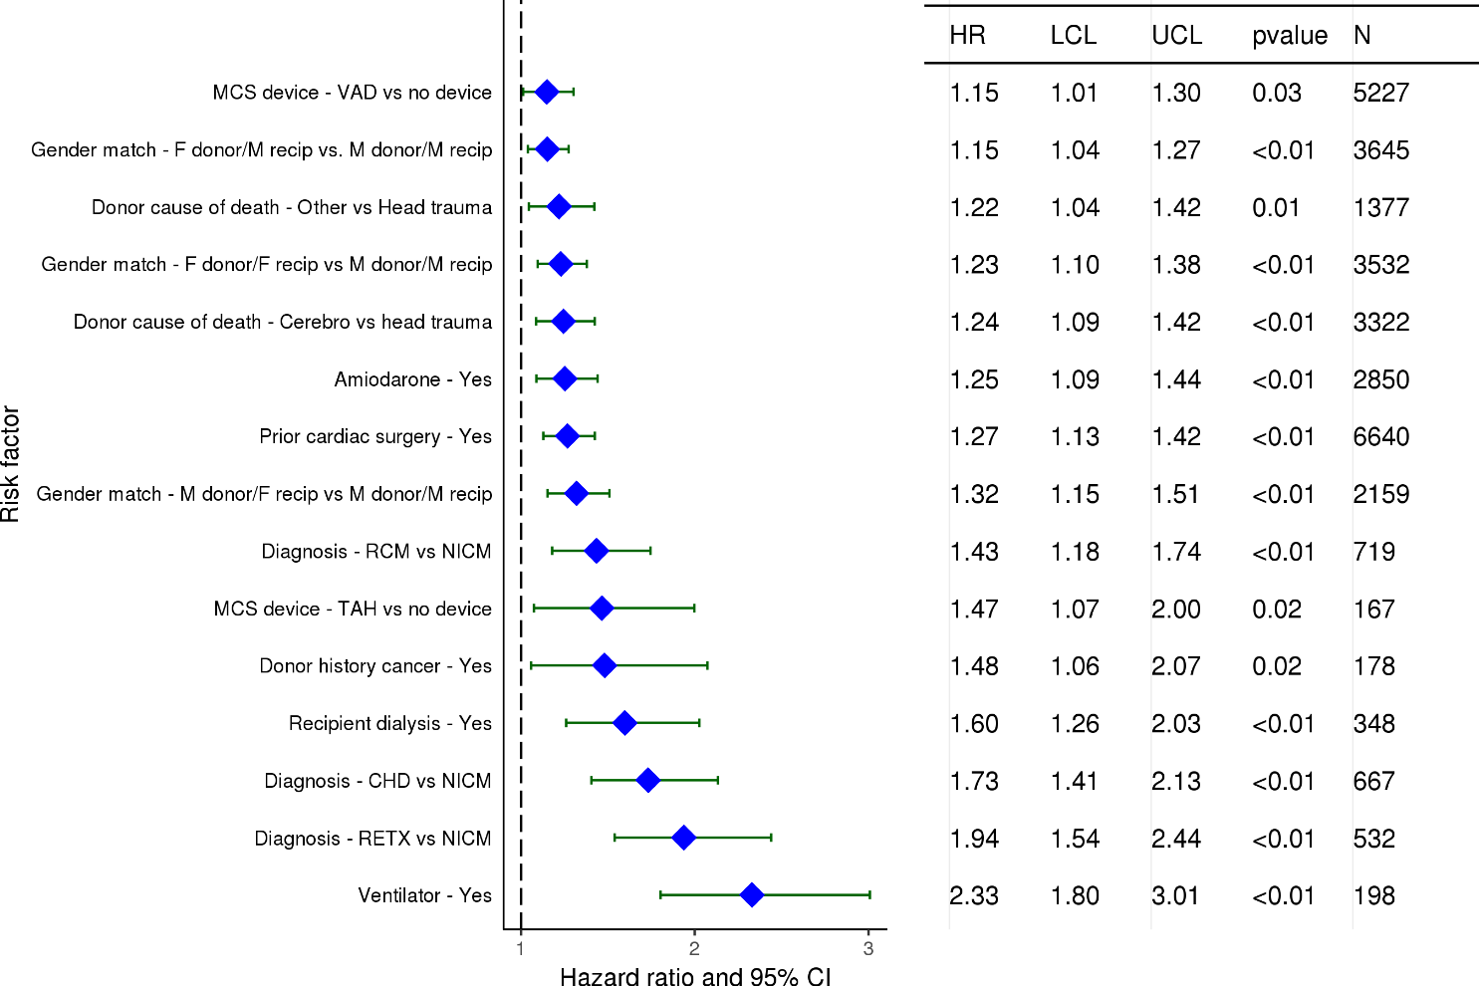
Adult Heart Transplants (2011-6/2016)
Statistically Significant Risk Factors For 1 Year Mortality with 95% Confidence Limits
2018
(N = 22,314)
JHLT. 2018 Oct; 37(10): 1155-1206

Slide 110
Adult Heart Transplants (2011-6/2016)
Statistically Significant Risk Factors For 1 Year Mortality
Continuous Factors (see figures)
Recipient age | Donor age
Recipient creatinine | Ischemic time
Donor BMI | Transplant center volume
Recipient bilirubin
2018
JHLT. 2018 Oct; 37(10): 1155-1206

Slide 111
Adult Heart Transplants (2011-6/2016)
Recipient age
Risk Factors For 1 Year Mortality with 95% Confidence Limits
p < 0.0001
2018
(N = 22,314)
JHLT. 2018 Oct; 37(10): 1155-1206
Notes:
Multivariable analysis was performed using a proportional hazards model censoring all patients at 1 year. Continuous factors were fit using a restricted cubic spline.

Slide 112
Adult Heart Transplants (2011-6/2016)
Donor age
Risk Factors For 1 Year Mortality with 95% Confidence Limits
p < 0.0001
2018
(N = 22,314)
JHLT. 2018 Oct; 37(10): 1155-1206
Notes:
Multivariable analysis was performed using a proportional hazards model censoring all patients at 1 year. Continuous factors were fit using a restricted cubic spline.

Slide 113
Adult Heart Transplants (2011-6/2016)
Recipient creatinine
Risk Factors For 1 Year Mortality with 95% Confidence Limits
p < 0.0001
2018
(N = 22,314)
JHLT. 2018 Oct; 37(10): 1155-1206
Notes:
Multivariable analysis was performed using a proportional hazards model censoring all patients at 1 year. Continuous factors were fit using a restricted cubic spline.

Slide 114
Adult Heart Transplants (2011-6/2016)
Ischemic time
Risk Factors For 1 Year Mortality with 95% Confidence Limits
p < 0.0001
2018
(N = 22,314)
JHLT. 2018 Oct; 37(10): 1155-1206
Notes:
Multivariable analysis was performed using a proportional hazards model censoring all patients at 1 year. Continuous factors were fit using a restricted cubic spline.

Slide 115
Adult Heart Transplants (2011-6/2016)
Donor BMI
Risk Factors For 1 Year Mortality with 95% Confidence Limits
p = 0.0045
2018
(N = 22,314)
JHLT. 2018 Oct; 37(10): 1155-1206
Notes:
Multivariable analysis was performed using a proportional hazards model censoring all patients at 1 year. Continuous factors were fit using a restricted cubic spline.

Slide 116
Adult Heart Transplants (2011-6/2016)
Transplant center volume
Risk Factors For 1 Year Mortality with 95% Confidence Limits
p < 0.0001
2018
(N = 22,314)
JHLT. 2018 Oct; 37(10): 1155-1206
Notes:
Multivariable analysis was performed using a proportional hazards model censoring all patients at 1 year. Continuous factors were fit using a restricted cubic spline.

Slide 117
Adult Heart Transplants (2011-6/2016)
Recipient bilirubin
Risk Factors For 1 Year Mortality with 95% Confidence Limits
p < 0.0001
2018
(N = 22,314)
JHLT. 2018 Oct; 37(10): 1155-1206
Notes:
Multivariable analysis was performed using a proportional hazards model censoring all patients at 1 year. Continuous factors were fit using a restricted cubic spline.

Slide 118
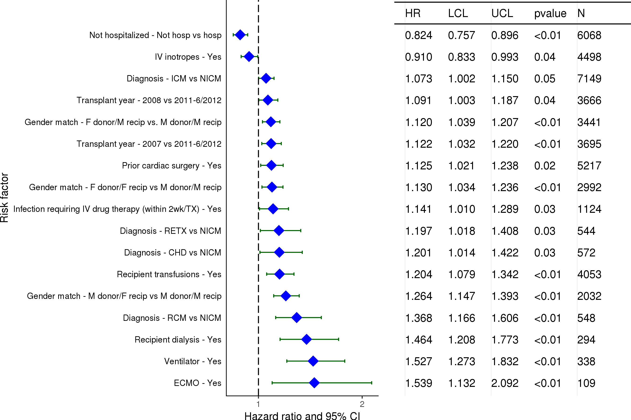
Adult Heart Transplants (2007-6/2012)
Statistically Significant Risk Factors For 5 Year Mortality with 95% Confidence Limits
2018
(N = 20,616)
JHLT. 2018 Oct; 37(10): 1155-1206

Slide 119
Adult Heart Transplants (2007-6/2012)
Statistically Significant Risk Factors For 5 Year Mortality
Continuous Factors (see figures)
Recipient age | Recipient BMI
Donor age | Transplant center volume
Recipient creatinine | Recipient bilirubin
Ischemic time
2018
JHLT. 2018 Oct; 37(10): 1155-1206

Slide 120
Adult Heart Transplants (2007-6/2012)
Recipient age
Risk Factors For 5 Year Mortality with 95% Confidence Limits
p < 0.0001
2018
(N = 20,616)
JHLT. 2018 Oct; 37(10): 1155-1206
Notes:
Multivariable analysis was performed using a proportional hazards model censoring all patients at 5 years. Continuous factors were fit using a restricted cubic spline.

Slide 121
Adult Heart Transplants (2007-6/2012)
Donor age
Risk Factors For 5 Year Mortality with 95% Confidence Limits
p < 0.0001
2018
(N = 20,616)
JHLT. 2018 Oct; 37(10): 1155-1206
Notes:
Multivariable analysis was performed using a proportional hazards model censoring all patients at 5 years. Continuous factors were fit using a restricted cubic spline.

Slide 122
Adult Heart Transplants (2007-6/2012)
Recipient creatinine
Risk Factors For 5 Year Mortality with 95% Confidence Limits
p < 0.0001
2018
(N = 20,616)
JHLT. 2018 Oct; 37(10): 1155-1206
Notes:
Multivariable analysis was performed using a proportional hazards model censoring all patients at 5 years. Continuous factors were fit using a restricted cubic spline.

Slide 123
Adult Heart Transplants (2007-6/2012)
Ischemic time
Risk Factors For 5 Year Mortality with 95% Confidence Limits
p < 0.0001
2018
(N = 20,616)
JHLT. 2018 Oct; 37(10): 1155-1206
Notes:
Multivariable analysis was performed using a proportional hazards model censoring all patients at 5 years. Continuous factors were fit using a restricted cubic spline.

Slide 124
Adult Heart Transplants (2007-6/2012)
Recipient BMI
Risk Factors For 5 Year Mortality with 95% Confidence Limits
p = 0.0026
2018
(N = 20,616)
JHLT. 2018 Oct; 37(10): 1155-1206
Notes:
Multivariable analysis was performed using a proportional hazards model censoring all patients at 5 years. Continuous factors were fit using a restricted cubic spline.

Slide 125
Adult Heart Transplants (2007-6/2012)
Transplant center volume
Risk Factors For 5 Year Mortality with 95% Confidence Limits
p < 0.0001
2018
(N = 20,616)
JHLT. 2018 Oct; 37(10): 1155-1206
Notes:
Multivariable analysis was performed using a proportional hazards model censoring all patients at 5 years. Continuous factors were fit using a restricted cubic spline.

Slide 126
Adult Heart Transplants (2007-6/2012)
Recipient bilirubin
Risk Factors For 5 Year Mortality with 95% Confidence Limits
p = 0.0195
2018
(N = 20,616)
JHLT. 2018 Oct; 37(10): 1155-1206
Notes:
Multivariable analysis was performed using a proportional hazards model censoring all patients at 5 years. Continuous factors were fit using a restricted cubic spline.

Slide 127
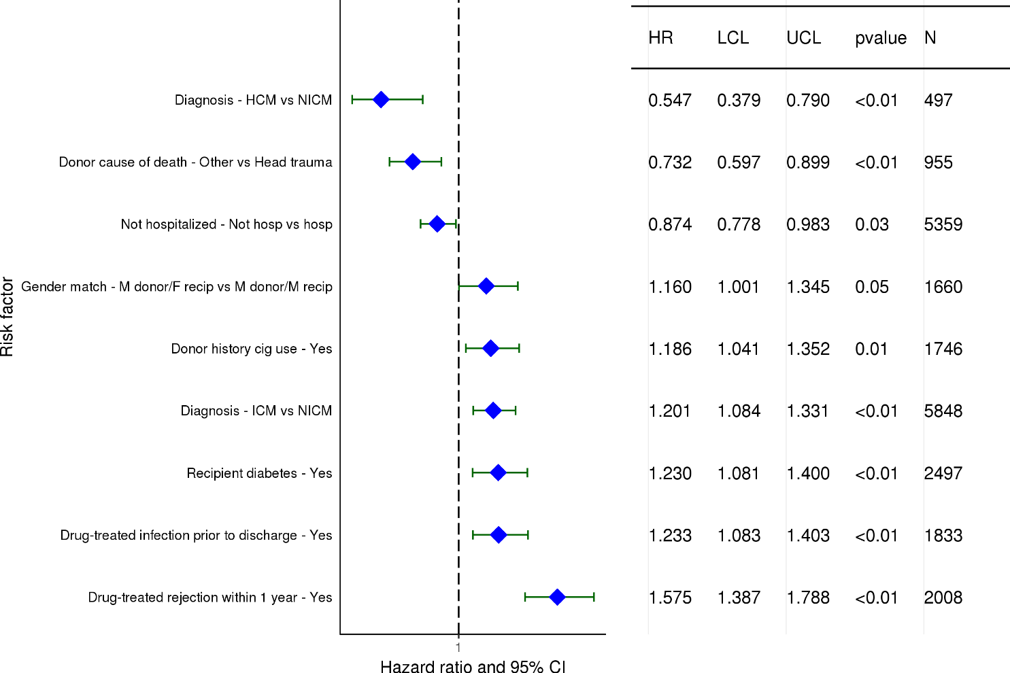
Adult Heart Transplants (2007-6/2012)
Statistically Significant Risk Factors For 5 Year Mortality Conditional on Survival to 1 Year with 95% Confidence Limits
2018
(N = 16,774)
JHLT. 2018 Oct; 37(10): 1155-1206

Slide 128
Adult Heart Transplants (2007-6/2012)
Statistically Significant Risk Factors For 5 Year Mortality Conditional on Survival to 1 Year
Continuous Factors (see figures)
Recipient age | Donor age
Recipient creatinine | Recipient BMI
2018
JHLT. 2018 Oct; 37(10): 1155-1206

Slide 129
Adult Heart Transplants (2007-6/2012)
Risk Factors For 5 Year Mortality Conditional on Survival to 1 Year with 95% Confidence Limits
Recipient age
p < 0.0001
2018
(N = 16,774)
JHLT. 2018 Oct; 37(10): 1155-1206
Notes:
Multivariable analysis was performed using a proportional hazards model censoring all patients at 5 years. Continuous factors were fit using a restricted cubic spline.

Slide 130
Adult Heart Transplants (2007-6/2012)
Risk Factors For 5 Year Mortality Conditional on Survival to 1 Year with 95% Confidence Limits
Donor age
p = 0.0064
2018
(N = 16,774)
JHLT. 2018 Oct; 37(10): 1155-1206
Notes:
Multivariable analysis was performed using a proportional hazards model censoring all patients at 5 years. Continuous factors were fit using a restricted cubic spline.

Slide 131
Adult Heart Transplants (2007-6/2012)
Risk Factors For 5 Year Mortality Conditional on Survival to 1 Year with 95% Confidence Limits
Recipient creatinine
p = 0.0019
2018
(N = 16,774)
JHLT. 2018 Oct; 37(10): 1155-1206
Notes:
Multivariable analysis was performed using a proportional hazards model censoring all patients at 5 years. Continuous factors were fit using a restricted cubic spline.

Slide 132
Adult Heart Transplants (2007-6/2012)
Risk Factors For 5 Year Mortality Conditional on Survival to 1 Year with 95% Confidence Limits
Recipient BMI
p = 0.0379
2018
(N = 16,774)
JHLT. 2018 Oct; 37(10): 1155-1206
Notes:
Multivariable analysis was performed using a proportional hazards model censoring all patients at 5 years. Continuous factors were fit using a restricted cubic spline.

Slide 133
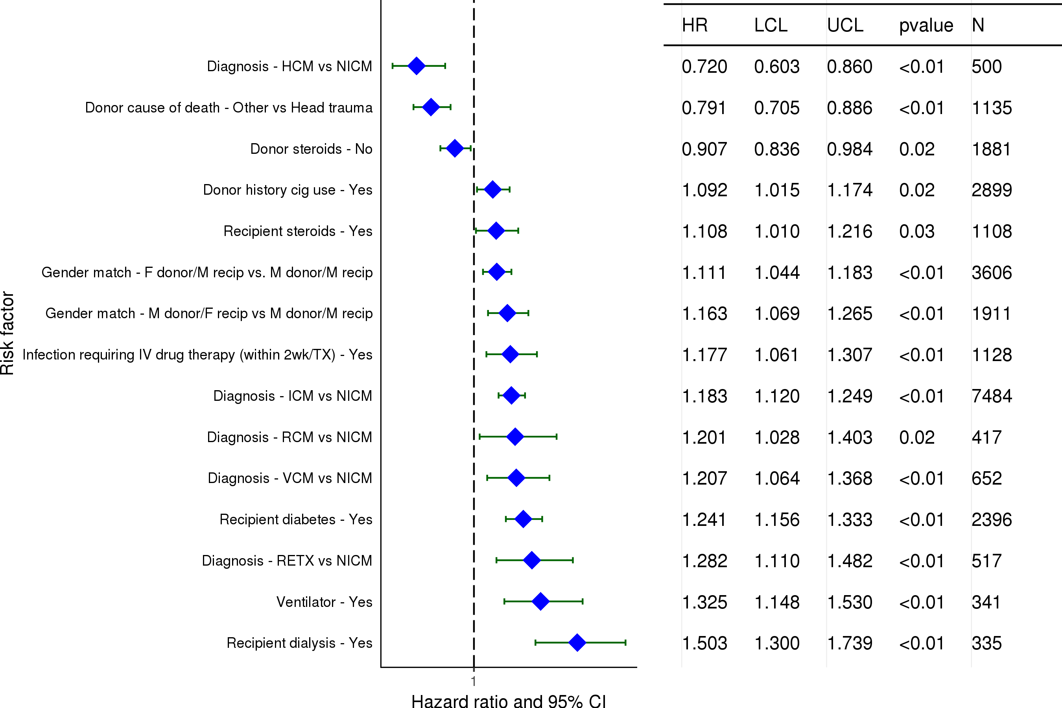
Adult Heart Transplants (2002-6/2007)
Statistically Significant Risk Factors For 10 Year Mortality with 95% Confidence Limits
2018
(N = 19,980)
JHLT. 2018 Oct; 37(10): 1155-1206

Slide 134
Adult Heart Transplants (2002-6/2007)
Statistically Significant Risk Factors For 10 Year Mortality
Continuous Factors (see figures)
Recipient age | Donor age
Recipient creatinine | Ischemic time
Recipient BMI | Transpulmonary gradient (TPG)
Transplant center volume | PRA (%)
2018
JHLT. 2018 Oct; 37(10): 1155-1206

Slide 135
Adult Heart Transplants (2002-6/2007)
Recipient age
Risk Factors For 10 Year Mortality with 95% Confidence Limits
p < 0.0001
2018
(N = 19,980)
JHLT. 2018 Oct; 37(10): 1155-1206
Notes:
Multivariable analysis was performed using a proportional hazards model censoring all patients at 10 years. Continuous factors were fit using a restricted cubic spline.

Slide 136
Adult Heart Transplants (2002-6/2007)
Donor age
Risk Factors For 10 Year Mortality with 95% Confidence Limits
p < 0.0001
2018
(N = 19,980)
JHLT. 2018 Oct; 37(10): 1155-1206
Notes:
Multivariable analysis was performed using a proportional hazards model censoring all patients at 10 years. Continuous factors were fit using a restricted cubic spline.

Slide 137
Adult Heart Transplants (2002-6/2007)
Recipient creatinine
Risk Factors For 10 Year Mortality with 95% Confidence Limits
p < 0.0001
2018
(N = 19,980)
JHLT. 2018 Oct; 37(10): 1155-1206
Notes:
Multivariable analysis was performed using a proportional hazards model censoring all patients at 10 years. Continuous factors were fit using a restricted cubic spline.

Slide 138
Adult Heart Transplants (2002-6/2007)
Ischemic time
Risk Factors For 10 Year Mortality with 95% Confidence Limits
p = 0.0004
2018
(N = 19,980)
JHLT. 2018 Oct; 37(10): 1155-1206
Notes:
Multivariable analysis was performed using a proportional hazards model censoring all patients at 10 years. Continuous factors were fit using a restricted cubic spline.

Slide 139
Adult Heart Transplants (2002-6/2007)
Recipient BMI
Risk Factors For 10 Year Mortality with 95% Confidence Limits
p = 0.0004
2018
(N = 19,980)
JHLT. 2018 Oct; 37(10): 1155-1206
Notes:
Multivariable analysis was performed using a proportional hazards model censoring all patients at 10 years. Continuous factors were fit using a restricted cubic spline.

Slide 140
Adult Heart Transplants (2002-6/2007)
Transpulmonary gradient (TPG)
Risk Factors For 10 Year Mortality with 95% Confidence Limits
p = 0.0429
2018
(N = 19,980)
JHLT. 2018 Oct; 37(10): 1155-1206
Notes:
Multivariable analysis was performed using a proportional hazards model censoring all patients at 10 years. Continuous factors were fit using a restricted cubic spline.

Slide 141
Adult Heart Transplants (2002-6/2007)
Transplant center volume
Risk Factors For 10 Year Mortality with 95% Confidence Limits
p < 0.0001
2018
(N = 19,980)
JHLT. 2018 Oct; 37(10): 1155-1206
Notes:
Multivariable analysis was performed using a proportional hazards model censoring all patients at 10 years. Continuous factors were fit using a restricted cubic spline.

Slide 142
Adult Heart Transplants (2002-6/2007)
PRA (%)
Risk Factors For 10 Year Mortality with 95% Confidence Limits
p = 0.0035
2018
(N = 19,980)
JHLT. 2018 Oct; 37(10): 1155-1206
Notes:
Multivariable analysis was performed using a proportional hazards model censoring all patients at 10 years. Continuous factors were fit using a restricted cubic spline.

Slide 143
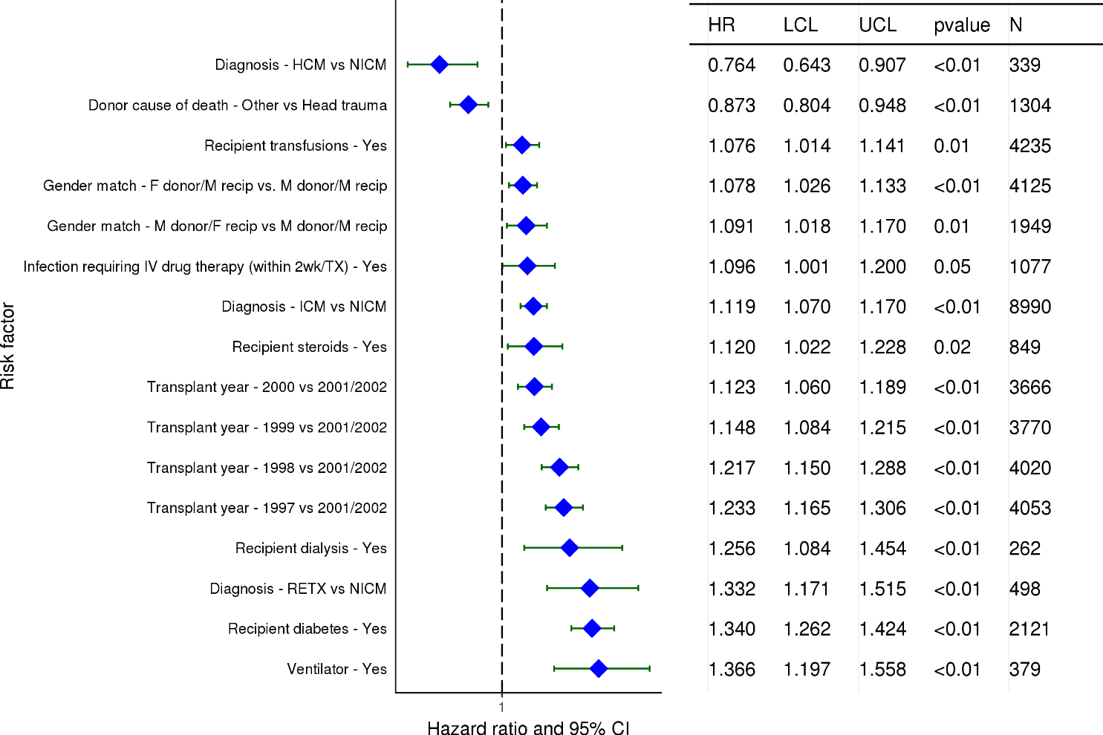
Adult Heart Transplants (1997-6/2002)
Statistically Significant Risk Factors For 15 Year Mortality with 95% Confidence Limits
2018
(N = 20,862)
JHLT. 2018 Oct; 37(10): 1155-1206

Slide 144
Adult Heart Transplants (1997-6/2002)
Statistically Significant Risk Factors For 15 Year Mortality
Continuous Factors (see figures)
Recipient age | Donor age
Recipient creatinine | Ischemic time
Recipient BMI | Donor BMI
Transplant center volume | Recipient bilirubin
PRA
2018
JHLT. 2018 Oct; 37(10): 1155-1206

Slide 145
Adult Heart Transplants (1997-6/2002)
Recipient age
Risk Factors For 15 Year Mortality with 95% Confidence Limits
p < 0.0001
2018
(N = 20,862)
JHLT. 2018 Oct; 37(10): 1155-1206
Notes:
Multivariable analysis was performed using a proportional hazards model censoring all patients at 15 years. Continuous factors were fit using a restricted cubic spline.

Slide 146
Adult Heart Transplants (1997-6/2002)
Donor age
Risk Factors For 15 Year Mortality with 95% Confidence Limits
p < 0.0001
2018
(N = 20,862)
JHLT. 2018 Oct; 37(10): 1155-1206
Notes:
Multivariable analysis was performed using a proportional hazards model censoring all patients at 15 years. Continuous factors were fit using a restricted cubic spline.

Slide 147
Adult Heart Transplants (1997-6/2002)
Recipient creatinine
Risk Factors For 15 Year Mortality with 95% Confidence Limits
p < 0.0001
2018
(N = 20,862)
JHLT. 2018 Oct; 37(10): 1155-1206
Notes:
Multivariable analysis was performed using a proportional hazards model censoring all patients at 15 years. Continuous factors were fit using a restricted cubic spline.

Slide 148
Adult Heart Transplants (1997-6/2002)
Ischemic time
Risk Factors For 15 Year Mortality with 95% Confidence Limits
p = 0.0157
2018
(N = 20,862)
JHLT. 2018 Oct; 37(10): 1155-1206
Notes:
Multivariable analysis was performed using a proportional hazards model censoring all patients at 15 years. Continuous factors were fit using a restricted cubic spline.

Slide 149
Adult Heart Transplants (1997-6/2002)
Recipient BMI
Risk Factors For 15 Year Mortality with 95% Confidence Limits
p < 0.0001
2018
(N = 20,862)
JHLT. 2018 Oct; 37(10): 1155-1206
Notes:
Multivariable analysis was performed using a proportional hazards model censoring all patients at 15 years. Continuous factors were fit using a restricted cubic spline.

Slide 150
Adult Heart Transplants (1997-6/2002)
Donor BMI
Risk Factors For 15 Year Mortality with 95% Confidence Limits
p = 0.0497
2018
(N = 20,862)
JHLT. 2018 Oct; 37(10): 1155-1206
Notes:
Multivariable analysis was performed using a proportional hazards model censoring all patients at 15 years. Continuous factors were fit using a restricted cubic spline.

Slide 151
Adult Heart Transplants (1997-6/2002)
Transplant center volume
Risk Factors For 15 Year Mortality with 95% Confidence Limits
p < 0.0001
2018
(N = 20,862)
JHLT. 2018 Oct; 37(10): 1155-1206
Notes:
Multivariable analysis was performed using a proportional hazards model censoring all patients at 15 years. Continuous factors were fit using a restricted cubic spline.

Slide 152
Adult Heart Transplants (1997-6/2002)
Recipient bilirubin
Risk Factors For 15 Year Mortality with 95% Confidence Limits
p = 0.0121
2018
(N = 20,862)
JHLT. 2018 Oct; 37(10): 1155-1206
Notes:
Multivariable analysis was performed using a proportional hazards model censoring all patients at 15 years. Continuous factors were fit using a restricted cubic spline.

Slide 153
Adult Heart Transplants (1997-6/2002)
PRA
Risk Factors For 15 Year Mortality with 95% Confidence Limits
p = 0.0002
2018
(N = 20,862)
JHLT. 2018 Oct; 37(10): 1155-1206
Notes:
Multivariable analysis was performed using a proportional hazards model censoring all patients at 15 years. Continuous factors were fit using a restricted cubic spline.

Slide 154
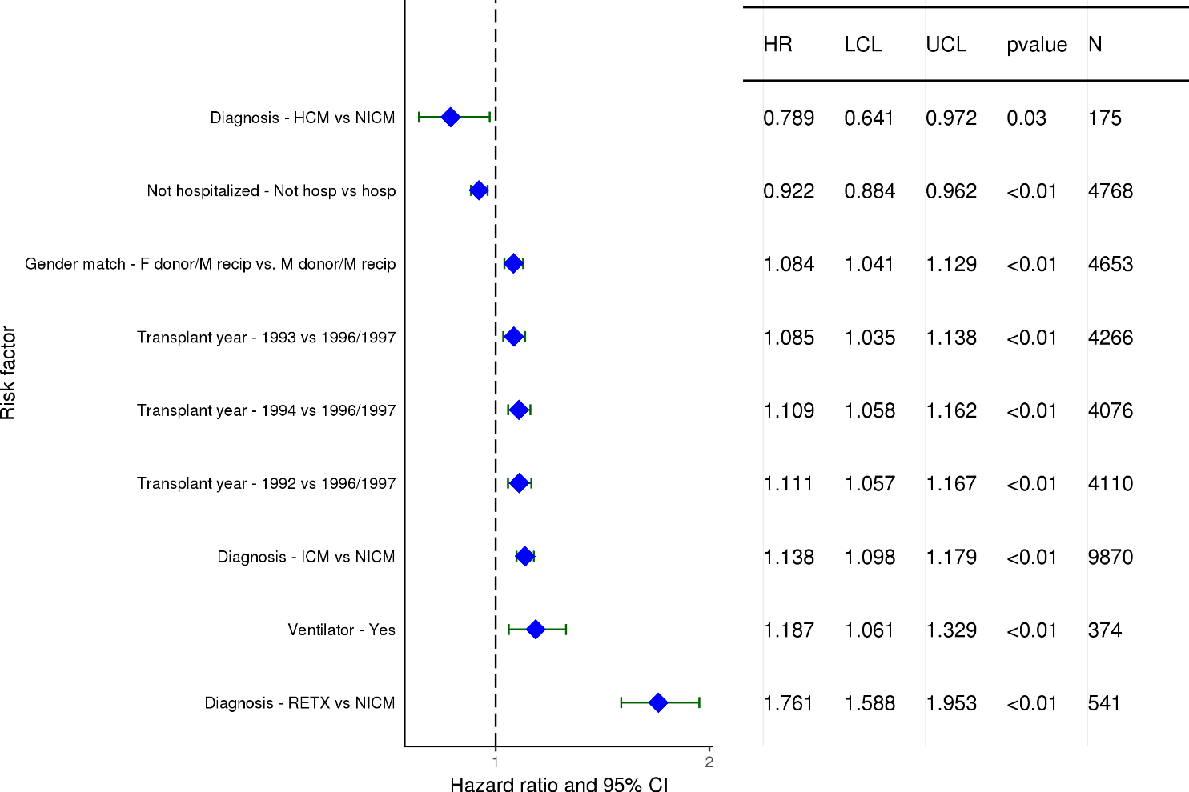
Adult Heart Transplants (1992-6/1997)
Statistically Significant Risk Factors For 20 Year Mortality with 95% Confidence Limits
2018
(N = 22,481)
JHLT. 2018 Oct; 37(10): 1155-1206

Slide 155
Adult Heart Transplants (1992-6/1997)
Statistically Significant Risk Factors For 20 Year Mortality
Continuous Factors (see figures)
Recipient age | Donor age
Ischemic time | Recipient BMI
Transplant center volume | PRA
2018
JHLT. 2018 Oct; 37(10): 1155-1206

Slide 156
Adult Heart Transplants (1992-6/1997)
Recipient age
Risk Factors For 20 Year Mortality with 95% Confidence Limits
p < 0.0001
2018
(N = 22,481)
JHLT. 2018 Oct; 37(10): 1155-1206
Notes:
Multivariable analysis was performed using a proportional hazards model censoring all patients at 20 years. Continuous factors were fit using a restricted cubic spline.

Slide 157
Adult Heart Transplants (1992-6/1997)
Donor age
Risk Factors For 20 Year Mortality with 95% Confidence Limits
p < 0.0001
2018
(N = 22,481)
JHLT. 2018 Oct; 37(10): 1155-1206
Notes:
Multivariable analysis was performed using a proportional hazards model censoring all patients at 20 years. Continuous factors were fit using a restricted cubic spline.

Slide 158
Adult Heart Transplants (1992-6/1997)
Ischemic time
Risk Factors For 20 Year Mortality with 95% Confidence Limits
p = 0.0047
2018
(N = 22,481)
JHLT. 2018 Oct; 37(10): 1155-1206
Notes:
Multivariable analysis was performed using a proportional hazards model censoring all patients at 20 years. Continuous factors were fit using a restricted cubic spline.

Slide 159
Adult Heart Transplants (1992-6/1997)
Recipient BMI
Risk Factors For 20 Year Mortality with 95% Confidence Limits
p < 0.0001
2018
(N = 22,481)
JHLT. 2018 Oct; 37(10): 1155-1206
Notes:
Multivariable analysis was performed using a proportional hazards model censoring all patients at 20 years. Continuous factors were fit using a restricted cubic spline.

Slide 160
Adult Heart Transplants (1992-6/1997)
Transplant center volume
Risk Factors For 20 Year Mortality with 95% Confidence Limits
p < 0.0001
2018
(N = 22,481)
JHLT. 2018 Oct; 37(10): 1155-1206
Notes:
Multivariable analysis was performed using a proportional hazards model censoring all patients at 20 years. Continuous factors were fit using a restricted cubic spline.

Slide 161
Adult Heart Transplants (1992-6/1997)
PRA
Risk Factors For 20 Year Mortality with 95% Confidence Limits
p = 0.0078
2018
(N = 22,481)
JHLT. 2018 Oct; 37(10): 1155-1206
Notes:
Multivariable analysis was performed using a proportional hazards model censoring all patients at 20 years. Continuous factors were fit using a restricted cubic spline.

Slide 162
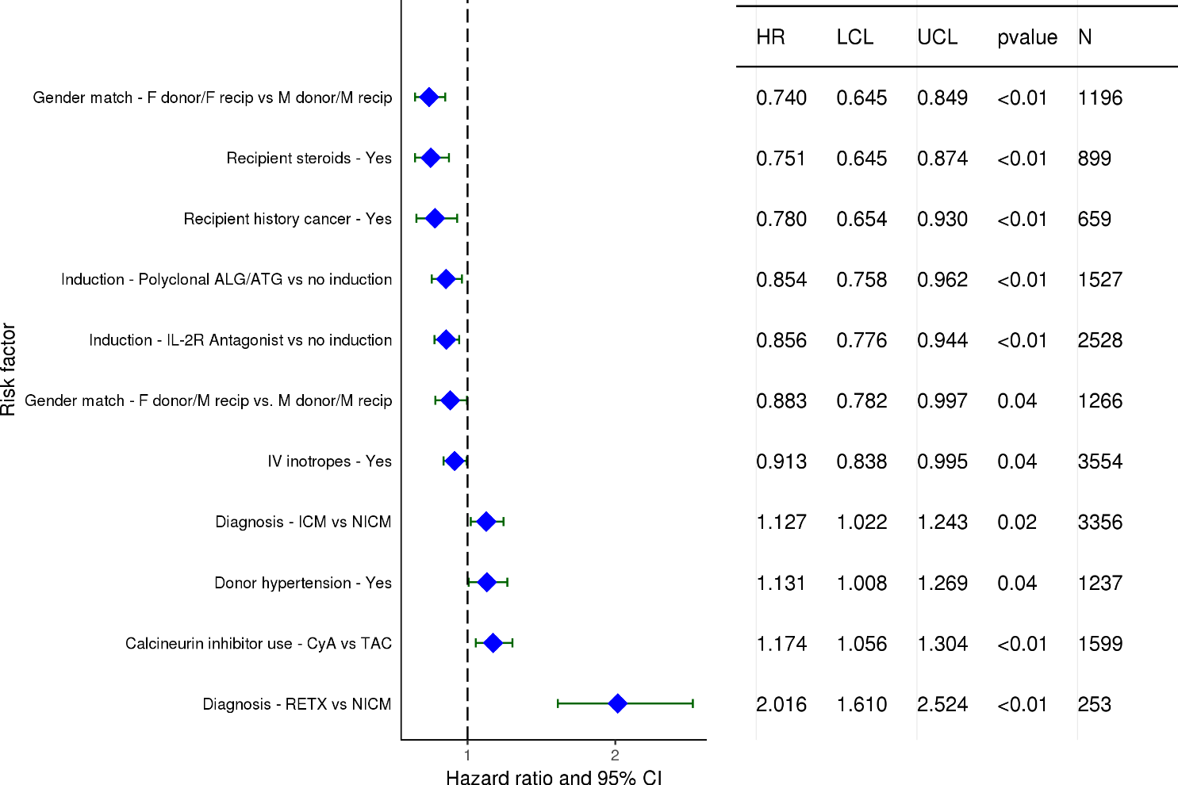
Adult Heart Transplants (2007-6/2012)
Statistically Significant Risk Factors for Development of CAV within 5 Years
Conditional on Survival to Transplant Discharge with 95% Confidence Limits
2018
(N = 8,718)
JHLT. 2018 Oct; 37(10): 1155-1206

Slide 163
Adult Heart Transplants (2007-6/2012)
Statistically Significant Risk Factors for Development of CAV within 5 Years
Conditional on Survival to Transplant Discharge
Continuous Factors (see figures)
Recipient age | Donor age
Recipient BMI
2018
JHLT. 2018 Oct; 37(10): 1155-1206

Slide 164
Adult Heart Transplants (2007-6/2012)
Risk Factors for Development of CAV within 5 Years
Conditional on Survival to Transplant Discharge with 95% Confidence Limits
Recipient age
p = 0.0454
2018
(N = 8,718)
JHLT. 2018 Oct; 37(10): 1155-1206
Notes:
Multivariable analysis was performed using a proportional hazards model censoring all patients at 5 years. Continuous factors were fit using a restricted cubic spline.

Slide 165
Adult Heart Transplants (2007-6/2012)
Risk Factors for Development of CAV within 5 Years
Conditional on Survival to Transplant Discharge with 95% Confidence Limits
Donor age
p < 0.0001
2018
(N = 8,718)
JHLT. 2018 Oct; 37(10): 1155-1206
Notes:
Multivariable analysis was performed using a proportional hazards model censoring all patients at 5 years. Continuous factors were fit using a restricted cubic spline.

Slide 166
Adult Heart Transplants (2007-6/2012)
Risk Factors for Development of CAV within 5 Years
Conditional on Survival to Transplant Discharge with 95% Confidence Limits
Recipient BMI
p = 0.0313
2018
(N = 8,718)
JHLT. 2018 Oct; 37(10): 1155-1206
Notes:
Multivariable analysis was performed using a proportional hazards model censoring all patients at 5 years. Continuous factors were fit using a restricted cubic spline.

Slide 167
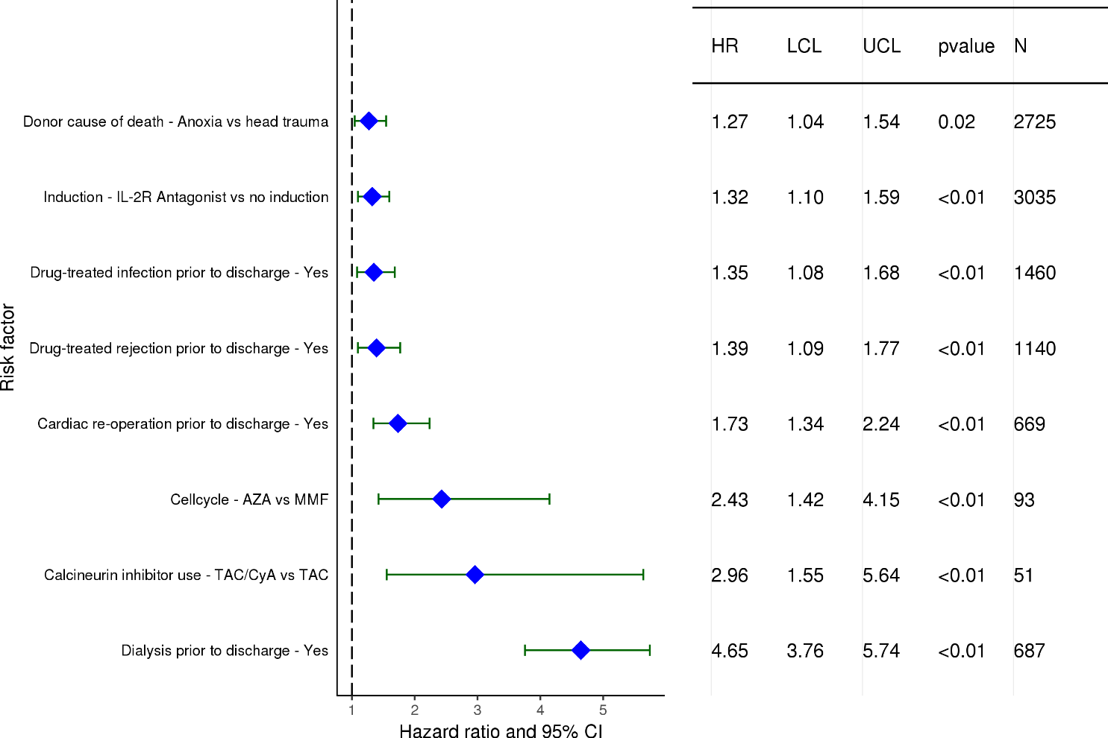
Adult Heart Transplants (2011-6/2016)
Statistically Significant Risk Factors for Development of Severe Renal Dysfunction within 1 Year with 95% Confidence Limits
Limited to Recipients without Severe Renal Dysfunction* Pre-Transplant
Conditional on Survival to Transplant Discharge
(N = 10,391)
2018
* Severe renal dysfunction = Creatinine > 2.5 mg/dl (221 μmol/L), dialysis or renal transplant
JHLT. 2018 Oct; 37(10): 1155-1206

Slide 168
Adult Heart Transplants (2011-6/2016)
Statistically Significant Risk Factors for Development of Severe Renal Dysfunction within 1 Year
Limited to Recipients without Severe Renal Dysfunction Pre-Transplant
Conditional on Survival to Transplant Discharge
Continuous Factors (see figures)
Donor age | Recipient creatinine
PVR
2018
JHLT. 2018 Oct; 37(10): 1155-1206

Slide 169
Adult Heart Transplants (2011-6/2016)
Risk Factors for Development of Severe Renal Dysfunction within 1 Year with 95% Confidence Limits
Limited to Recipients without Severe Renal Dysfunction Pre-Transplant
Conditional on Survival to Transplant Discharge
Donor age
p = 0.0029
2018
(N = 10,391)
JHLT. 2018 Oct; 37(10): 1155-1206
Notes:
Multivariable analysis was performed using a proportional hazards model censoring all patients at 1 year. Continuous factors were fit using a restricted cubic spline.

Slide 170
Adult Heart Transplants (2011-6/2016)
Risk Factors for Development of Severe Renal Dysfunction within 1 Year with 95% Confidence Limits
Limited to Recipients without Severe Renal Dysfunction Pre-Transplant
Conditional on Survival to Transplant Discharge
Recipient creatinine
p < 0.0001
2018
(N = 10,391)
JHLT. 2018 Oct; 37(10): 1155-1206
Notes:
Multivariable analysis was performed using a proportional hazards model censoring all patients at 1 year. Continuous factors were fit using a restricted cubic spline.

Slide 171
Adult Heart Transplants (2011-6/2016)
Risk Factors for Development of Severe Renal Dysfunction within 1 Year with 95% Confidence Limits
Limited to Recipients without Severe Renal Dysfunction Pre-Transplant
Conditional on Survival to Transplant Discharge
PVR
p = 0.0302
2018
(N = 10,391)
JHLT. 2018 Oct; 37(10): 1155-1206
Notes:
Multivariable analysis was performed using a proportional hazards model censoring all patients at 1 year. Continuous factors were fit using a restricted cubic spline.

Slide 172
Focus Theme
2018
JHLT. 2018 Oct; 37(10): 1155-1206

Slide 173
Adult Heart Transplants
Number of Multiorgan Transplants Reported by Type of Transplant
(Transplants: January 1990 – June 2017)
Primary transplants
Retransplants
2018
Heart-lung transplants are included in Lung slides.
JHLT. 2018 Oct; 37(10): 1155-1206

Slide 174
Adult Heart Transplants
Number and % of Multiorgan Transplants Reported by Year and Type of Transplant
2018
Heart-lung transplants are included in Lung slides.
JHLT. 2018 Oct; 37(10): 1155-1206

Slide 175
Adult Heart Transplants
Location by Transplant Type
(Transplants: January 2009 – June 2017)
2018
JHLT. 2018 Oct; 37(10): 1155-1206

Slide 176
Adult Heart Transplants
% of Multiorgan Transplants by Location
(Transplants: January 2009 – June 2017)
N = 983
N = 145
2018
JHLT. 2018 Oct; 37(10): 1155-1206

Slide 177
Adult Heart Transplants
Donor and Recipient Characteristics
(Transplants: January 2009 – June 2017)
 | Multiorgan transplant (N = 1,152) | Heart alone transplant (N = 34,551) | p-value
Recipient age (years) | 56.0 (30.0 - 68.0) | 55.0 (25.0 - 68.0) | 0.0106
Donor age (years) | 31.0 (17.0 - 53.0) | 35.0 (17.0 - 58.0) | <0.0001
Recipient gender (% male) | 78.0% | 74.7% | 0.0137
Donor gender (% male) | 71.3% | 67.9% | 0.0171
Diagnosis
CHD | 4.7% | 3.1% | <0.0001
HCM | 2.6% | 3.2%
ICM | 31.5% | 33.1%
NICM | 35.9% | 51.0%
RCM | 8.9% | 3.2%
Retransplant | 12.9% | 2.5%
VCM | 2.0% | 2.7%
Other | 1.4% | 1.2%
Continuous factors are expressed as median (5th – 95th percentiles)
2018
JHLT. 2018 Oct; 37(10): 1155-1206
Notes:
Comparisons for categorical variables were made using the chi-square statistic. Multiple groups were compared using single p-value.
Comparisons for continuous variables were made using Kruskal-Wallis test.
A significant p-value means that at least one of the groups is different than the others but it doesn’t identify which group it is.

Slide 178
Adult Heart Transplants
Donor and Recipient Characteristics
(Transplants: January 2009 – June 2017)
 | Multiorgan transplant (N = 1,152) | Heart alone transplant (N = 34,551) | p-value
Retransplant | 12.8% | 2.4% | <0.0001
Location
Europe | 12.6% | 37.5% | <0.0001
North America | 85.3% | 53.0%
Others | 2.1% | 9.5%
Recipient hypertension | 64.8% | 50.2% | <0.0001
Donor hypertension | 12.3% | 15.6% | 0.0052
Recipient diabetes mellitus | 37.0% | 26.1% | <0.0001
Donor diabetes mellitus | 2.4% | 3.5% | 0.0710
2018
JHLT. 2018 Oct; 37(10): 1155-1206
Notes:
Comparisons for categorical variables were made using the chi-square statistic. Multiple groups were compared using single p-value.
Comparisons for continuous variables were made using Kruskal-Wallis test.
A significant p-value means that at least one of the groups is different than the others but it doesn’t identify which group it is.

Slide 179
Adult Heart Transplants
Donor and Recipient Characteristics
(Transplants: January 2009 – June 2017)
 | Multiorgan transplant (N = 1,152) | Heart alone transplant (N = 34,551) | p-value
Recipient history of prior dialysis | 43.8% | 2.7% | <0.0001
Recipient creatinine (mg/dl) | 2.4 (0.8 - 8.4) | 1.2 (0.7 - 2.0) | <0.0001
Recipient total bilirubin (mg/dl) | 0.7 (0.3 - 2.8) | 0.8 (0.3 - 2.5) | 0.5010
Ischemic time (hours) | 3.0 (1.6 - 4.8) | 3.2 (1.5 - 5.0) | <0.0001
Induction* | 68.7% | 52.8% | <0.0001
Multiorgan transplants with kidney | N=976
Dialysis | 50.8%
Creatinine (no dialysis) (mg/dl) | 2.3 (1.0 - 4.0)
Multiorgan transplants with liver | N=185
Creatinine (mg/dl) | 1.2 (0.6 - 2.2)
Bilirubin (mg/dl) | 0.9 (0.4 - 3.9)
Continuous factors are expressed as median (5th – 95th percentiles)
2018
* Analysis is limited to patients who were alive at the time of the discharge.
JHLT. 2018 Oct; 37(10): 1155-1206
Notes:
Comparisons for categorical variables were made using the chi-square statistic. Multiple groups were compared using single p-value.
Comparisons for continuous variables were made using Kruskal-Wallis test.
A significant p-value means that at least one of the groups is different than the others but it doesn’t identify which group it is.

Slide 180
Adult Heart Transplants
Diagnosis of Multiorgan Transplants by Era
2018
JHLT. 2018 Oct; 37(10): 1155-1206

Slide 181
Adult Heart Transplants
% of Recipients Experiencing Treated Rejection within 1 Year
by Transplant Type
(Transplants: January 2004 – June 2016)
p<0.0001
Analysis is limited to patients who were alive at the time of the follow-up.
Treated rejection = Recipient was reported to (1) have at least one acute rejection episode that was treated with an anti-rejection agent; or (2) have been hospitalized for rejection.
2018
JHLT. 2018 Oct; 37(10): 1155-1206
Notes:
Comparisons were made using the chi-square statistic.

Slide 182
Adult Heart Transplants
% of Recipients Experiencing Any Rejection within 1 year
by Transplant Type
(Transplants: January 2004 – June 2016)
p<0.0001
Analysis is limited to patients who were alive at the time of the follow-up.
Any rejection = Recipient was reported to (1) have at least one acute rejection episode; or (2) have been hospitalized for rejection.
2018
JHLT. 2018 Oct; 37(10): 1155-1206
Notes:
Comparisons were made using the chi-square statistic.

Slide 183
Adult Heart Transplants
Kaplan-Meier Survival by Transplant Type
(Transplants: January 1990 – June 2016)
p = 0.0004
2018
JHLT. 2018 Oct; 37(10): 1155-1206
Notes:
Survival was calculated using the Kaplan-Meier method, which incorporates information from all transplants for whom any follow-up has been provided. Since many patients are still alive and some patients have been lost to follow-up, the survival rates are estimates rather than exact rates because the time of death is not known for all patients.
Survival rates were compared using the log-rank test statistic.

Slide 184
Adult Heart Transplants
Kaplan-Meier Survival of Multiorgan Transplant Recipients by Era
(Transplants: January 1990 – June 2016)
No pair-wise comparisons were significant at p < 0.05.
2018
JHLT. 2018 Oct; 37(10): 1155-1206
Notes:
Survival was calculated using the Kaplan-Meier method, which incorporates information from all transplants for whom any follow-up has been provided. Since many patients are still alive and some patients have been lost to follow-up, the survival rates are estimates rather than exact rates because the time of death is not known for all patients. The median survival is the estimated time point at which 50% of all of the recipients have died.
Survival rates were compared using the log-rank test statistic. Adjustments for multiple comparisons were done using Scheffe’s method.

Slide 185
Adult Heart Transplants
Freedom from Cardiac Allograft Vasculopathy by Transplant
Type
(Transplants: January 1994 – June 2016)
p = 0.0003
2018
JHLT. 2018 Oct; 37(10): 1155-1206
Notes:
Freedom from CAV rates by era were computed using the Kaplan-Meier method.
The development of CAV is reported on annual follow-ups; a date of diagnosis is not provided. For this figure the midpoint between the date of previous follow-up (when event had not occurred) and the date of follow-up when the event was reported was used as the date of occurrence. Patients were included in the analysis until an unknown response for the outcome of interest was reported. Therefore, the rates seen here may differ from those reported in the cumulative prevalence slide which is based on only those patients with known responses for each of the outcomes at all follow-up time points.
Survival rates were compared using the log-rank test statistic.

Slide 186
Adult Heart Transplants
Length of Stay by Transplant Type
(Transplants: January 2000 – June 2017)
2018
JHLT. 2018 Oct; 37(10): 1155-1206

Slide 187
Adult Heart Transplants
Cumulative Morbidity Rates in Survivors within 1 year Post-Transplant
by Transplant Type
(Transplants: January 1994 – June 2016)
Outcome | Heart-kidney | Total N with known response | Heart alone | Total N with known response
Severe Renal Dysfunction¹ | 7.6% | (N=976) | 6.8% | (N=37,423)
Creatinine > 2.5 mg/dl | 4.4% |  | 5.4%
Chronic Dialysis | 3.0% |  | 1.4%
Renal Transplant | 0.2% |  | 0.1%
Diabetes | 19.2% | (N=989) | 21.0% | (N=37,666)
Cardiac Allograft Vasculopathy | 6.5% | (N=920) | 7.6% | (N=34,668)
2018
¹ Severe renal dysfunction = Creatinine > 2.5 mg/dl (221 μmol/L), dialysis or renal transplant
JHLT. 2018 Oct; 37(10): 1155-1206
Notes:
This table shows the percentage of patients experiencing various morbidities as reported within 1 year following transplantation. The percentages are based on patients with known responses. Because the outcomes are reported to be unknown at different rates the number with known responses for each outcome are also provided.

Slide 188
Adult Heart Transplants
Cumulative Morbidity Rates in Survivors within 5 years Post-Transplant
by Transplant Type
(Transplants: January 1994 – June 2012)
Outcome | Heart-kidney | Total N with known response | Heart alone | Total N with known response
Severe Renal Dysfunction¹ | 16.2% | (N=488) | 16.2% | (N=21,529)
Creatinine > 2.5 mg/dl | 9.4% |  | 12.8%
Chronic Dialysis | 6.8% |  | 2.8%
Renal Transplant | 0.0% |  | 0.6%
Diabetes | 40.4% | (N=493) | 34.4% | (N=21,794)
Cardiac Allograft Vasculopathy | 24.3% | (N=379) | 29.3% | (N=16,460)
2018
¹ Severe renal dysfunction = Creatinine > 2.5 mg/dl (221 μmol/L), dialysis or renal transplant
JHLT. 2018 Oct; 37(10): 1155-1206
Notes:
This table shows the percentage of patients experiencing various morbidities as reported within 5 years following transplantation. The percentages are based on patients with known responses. To reduce bias, only patients with responses reported on every follow-up through the 5-year annual follow-up were included in the 5-year analysis. Because the outcomes are reported to be unknown at different rates the number with known responses for each outcome are also provided.

Slide 189
Adult Heart Transplants
Cumulative Morbidity Rates in Survivors within 10 years Post-Transplant
by Transplant Type
(Transplants: January 1994 – June 2007)
Outcome | Heart-kidney | Total N with known response | Heart alone | Total N with known response
Severe Renal Dysfunction¹ | 22.2% | (N=162) | 23.1% | (N=8,801)
Creatinine > 2.5 mg/dl | 10.5% |  | 15.2%
Chronic Dialysis | 9.9% |  | 5.9%
Renal Transplant | 1.9% |  | 2.0%
Cardiac Allograft Vasculopathy | 38.9% | (N=108) | 47.4% | (N=5,663)
2018
¹ Severe renal dysfunction = Creatinine > 2.5 mg/dl (221 μmol/L), dialysis or renal transplant
JHLT. 2018 Oct; 37(10): 1155-1206
Notes:
This table shows the percentage of patients experiencing various morbidities as reported within years following transplantation. The percentages are based on patients with known responses. To reduce bias, only patients with responses reported on every follow-up through the 10-year annual follow-up were included in the 0-year analysis. Because the outcomes are reported to be unknown at different rates the number with known responses for each outcome are also provided.

Slide 190
Adult Heart Transplants
Maintenance Immunosuppression at Time of 1 Year Follow-up by Transplant Type
(Follow-ups: January 2009 – 6/2017)
2018
Analysis is limited to patients who were alive at the time of the follow-up.
JHLT. 2018 Oct; 37(10): 1155-1206
Notes:
This figure shows the maintenance immunosuppression reported as being provided at the time of the 1-year annual follow-up forms. As different patients were transplanted each year this figure does not represent changes in immunosuppression for individual patients but may represent changes in practice.

Slide 191
Adult Heart Transplants
Maintenance Immunosuppression Drug Combinations at
Time of 1 Year Follow-up
(Follow-ups: January 2009 – June 2017)
2018
Analysis is limited to patients who were alive at the time of the follow-up.
JHLT. 2018 Oct; 37(10): 1155-1206

Slide 192
Adult Heart Transplants
Cause of Death Stratified by Transplant Type
(Deaths: January 1994 – June 2017)
Transplant Type | Cause of Death | 0-30 Days | 31 Days - 1 Year | >1 Year - 3 Years | >3 Years - 5 Years | >5 Years
Multiorgan transplant | CAV | 1 (0.9%) | 1 (0.6%) | 4 (7.1%) | 1 (2.2%) | 11 (5.8%)
 | Malignancy | 0 | 9 (5.8%) | 10 (17.9%) | 12 (26.1%) | 37 (19.4%)
 | Infection | 26 (22.6%) | 57 (36.8%) | 16 (28.6%) | 8 (17.4%) | 32 (16.8%)
 | Graft Failure | 32 (27.8%) | 21 (13.5%) | 8 (14.3%) | 5 (10.9%) | 25 (13.1%)
 | Multiple Organ Failure | 22 (19.1%) | 33 (21.3%) | 3 (5.4%) | 5 (10.9%) | 21 (11.0%)
 | Renal Failure | 0 | 3 (1.9%) | 3 (5.4%) | 0 | 15 (7.9%)
 | Pulmonary | 5 (4.3%) | 11 (7.1%) | 4 (7.1%) | 5 (10.9%) | 19 (9.9%)
 | Cerebrovascular | 10 (8.7%) | 6 (3.9%) | 0 | 4 (8.7%) | 10 (5.2%)
 | All known causes | 115 | 155 | 56 | 46 | 191
Heart alone transplant | CAV | 89 (1.3%) | 211 (3.6%) | 490 (11.6%) | 482 (13.2%) | 2,584 (12.2%)
 | Malignancy | 6 (0.1%) | 206 (3.5%) | 623 (14.7%) | 823 (22.6%) | 5,026 (23.7%)
 | Infection | 958 (13.8%) | 1,929 (32.6%) | 579 (13.6%) | 387 (10.6%) | 2,362 (11.2%)
 | Graft Failure | 2,826 (40.8%) | 1,053 (17.8%) | 1,129 (26.6%) | 883 (24.2%) | 3,848 (18.2%)
 | Multiple Organ Failure | 1,221 (17.6%) | 931 (15.7%) | 258 (6.1%) | 204 (5.6%) | 1,686 (8.0%)
 | Renal Failure | 30 (0.4%) | 50 (0.8%) | 54 (1.3%) | 114 (3.1%) | 1,548 (7.3%)
 | Pulmonary | 184 (2.7%) | 219 (3.7%) | 171 (4.0%) | 159 (4.4%) | 980 (4.6%)
 | Cerebrovascular | 532 (7.7%) | 326 (5.5%) | 164 (3.9%) | 120 (3.3%) | 1,100 (5.2%)
 | All known causes | 6,933 | 5,921 | 4,242 | 3,647 | 21,172
2018
Only the most frequent causes of death are shown on the slide.
JHLT. 2018 Oct; 37(10): 1155-1206
Notes:
Only known causes of death are included in the tabulation.

Slide 193
Adult Heart Transplants
Cause of Death Stratified by Transplant Type
(Deaths: January 1994 – June 2017)
2018
Only the most frequent causes of death are shown on the slide.
JHLT. 2018 Oct; 37(10): 1155-1206

