Slide 1

HEART TRANSPLANTATION
Pediatric Recipients
2017
JHLT. 2017 Oct; 36(10): 1037-1079

Slide 2
Table of Contents
Donor, recipient and center characteristics: slides 3-29
Post transplant – survival and other outcomes: slides 30-53
Induction and maintenance immunosuppression: slides 54-65
Rejection and post transplant morbidities: slides 66-101
Retransplantation: slides 102-108
Multivariable analyses: slides 109-183
Focus theme: slides 184-199
2017
JHLT. 2017 Oct; 36(10): 1037-1079

Slide 3
Donor, Recipient and Center Characteristics
2017
JHLT. 2017 Oct; 36(10): 1037-1079

Slide 4
Pediatric Heart Transplants
Number of Centers Reporting Transplants
2017
JHLT. 2017 Oct; 36(10): 1037-1079

Slide 5
(Transplants: January 2004 – June 2016)
Pediatric Heart Transplants
Number of Centers by Center Volume
2017
JHLT. 2017 Oct; 36(10): 1037-1079

Slide 6
Pediatric Heart Transplants
Distribution of Transplants by Center Volume
(Transplants: January 2004 – June 2016)
2017
JHLT. 2017 Oct; 36(10): 1037-1079

Slide 7
Pediatric Heart Transplants
Recipient Age Distribution by Center Volume
(Transplants: January 2004 – June 2016)
2017
JHLT. 2017 Oct; 36(10): 1037-1079

Slide 8
Pediatric Heart Transplants
Distribution of Transplants by Location and Average Center
Volume
(Transplants: January 2004 – June 2016)
2017
JHLT. 2017 Oct; 36(10): 1037-1079

Slide 9
Pediatric Heart Transplants
Recipient Age Distribution
(Transplants: January 2004 – June 2016)
2017
JHLT. 2017 Oct; 36(10): 1037-1079

Slide 10
Pediatric Heart Transplants
Recipient Age Distribution by Year of Transplant
NOTE: This figure includes only the heart transplants that are reported to the ISHLT Transplant Registry. As such, this should not be construed as evidence that the number of hearts transplanted worldwide has increased and/or decreased in recent years.
2017
JHLT. 2017 Oct; 36(10): 1037-1079

Slide 11
Pediatric Heart Transplants
Recipient Age Distribution by Location
(Transplants: January 2004 – June 2016)
2017
JHLT. 2017 Oct; 36(10): 1037-1079

Slide 12
Pediatric Heart Transplants
Donor Age Distribution
(Transplants: January 2004 – June 2016)
2017
JHLT. 2017 Oct; 36(10): 1037-1079
Notes:
NOTE: Transplants where donor age is unknown are excluded from this tabulation.

Slide 13
Pediatric Heart Transplants
Donor and Recipient Age
(Transplants: January 2004 – June 2016)
2017
JHLT. 2017 Oct; 36(10): 1037-1079

Slide 14
Pediatric Heart Transplants
Donor Age Distribution by Location
(Transplants: January 2004 – June 2016)
2017
JHLT. 2017 Oct; 36(10): 1037-1079
Notes:
NOTE: Transplants where donor age is unknown are excluded from this tabulation.

Slide 15
Pediatric Heart Transplants
Distribution of Transplants by Donor/Recipient Weight Ratio
(Transplants: January 2004 – June 2016)
2017
JHLT. 2017 Oct; 36(10): 1037-1079

Slide 16
Pediatric Heart Transplants
Recipient Diagnosis (Age: < 1 Year)
2009-6/2016
2017
JHLT. 2017 Oct; 36(10): 1037-1079
Notes:
NOTE: Transplants with unknown diagnoses are excluded from this tabulation

Slide 17
Pediatric Heart Transplants
Recipient Diagnosis (Age: 1-5 Years)
2009-6/2016
2017
JHLT. 2017 Oct; 36(10): 1037-1079
Notes:
NOTE: Transplants with unknown diagnoses are excluded from this tabulation

Slide 18
Pediatric Heart Transplants
Recipient Diagnosis (Age: 6-10 Years)
2009-6/2016
2017
JHLT. 2017 Oct; 36(10): 1037-1079
Notes:
NOTE: Transplants with unknown diagnoses are excluded from this tabulation

Slide 19
Pediatric Heart Transplants
Recipient Diagnosis (Age: 11-17 Years)
2009-6/2016
2017
JHLT. 2017 Oct; 36(10): 1037-1079
Notes:
NOTE: Transplants with unknown diagnoses are excluded from this tabulation

Slide 20
Pediatric Heart Transplants
Diagnosis Distribution by Location
(Transplants: January 2004 – June 2016)
2017
JHLT. 2017 Oct; 36(10): 1037-1079
Notes:
NOTE: Transplants with unknown diagnoses are excluded from this tabulation.

Slide 21
Pediatric Heart Transplants
% of Patients Bridged with Mechanical Circulatory Support*
by Year
(Transplants: January 2005 – December 2015)
2017
* LVAD, RVAD, TAH, ECMO
JHLT. 2017 Oct; 36(10): 1037-1079

Slide 22
Pediatric Heart Transplants
% of Patients Bridged with Mechanical Circulatory Support*
(Transplants: January 2009 – June 2016)
2017
* LVAD, RVAD, TAH, ECMO
JHLT. 2017 Oct; 36(10): 1037-1079

Slide 23
Pediatric Heart Transplants
% of Patients Bridged with Mechanical Circulatory Support*
by Diagnosis
(Transplants: January 2009 – June 2016)
2017
* LVAD, RVAD, TAH, ECMO
JHLT. 2017 Oct; 36(10): 1037-1079

Slide 24
Pediatric Heart Transplants
% of Patients Bridged with Mechanical Circulatory Support*
by Age Group
(Transplants: January 2009 – June 2016)
2017
* LVAD, RVAD, TAH, ECMO
JHLT. 2017 Oct; 36(10): 1037-1079

Slide 25
Pediatric Heart Transplants
% of Patients Bridged with Mechanical Circulatory Support*
by Age Group and Diagnosis
(Transplants: January 2009 – June 2016)
<1 year
1-5 years
6-10 years
11-17 years
2017
* LVAD, RVAD, TAH, ECMO
JHLT. 2017 Oct; 36(10): 1037-1079

Slide 26
Pediatric Heart Transplants
PRA Distribution by Year
(Transplants: January 2005 – December 2015)
2017
CPRA and PRA values were combined. If Class I and Class II PRA values were reported separately, the higher of the two values was used.
JHLT. 2017 Oct; 36(10): 1037-1079

Slide 27
Pediatric Heart Transplants
PRA Distribution by Age Group
(Transplants: January 2009 – June 2016)
p<0.0001
2017
CPRA and PRA values were combined. If Class I and Class II PRA values were reported separately, the higher of the two values was used.
JHLT. 2017 Oct; 36(10): 1037-1079

Slide 28
Pediatric Heart Transplants
PRA Distribution by Diagnosis
(Transplants: January 2009 – June 2016)
p<0.0001
2017
CPRA and PRA values were combined. If Class I and Class II PRA values were reported separately, the higher of the two values was used.
JHLT. 2017 Oct; 36(10): 1037-1079

Slide 29
Pediatric Heart Transplants
PRA Distribution by Age Group and Diagnosis
(Transplants: January 2009 – June 2016)
<1 Year
1-5 Years
6-10 Years
11-17 Years
2017
CPRA and PRA values were combined. If Class I and Class II PRA values were reported separately, the higher of the two values was used.
JHLT. 2017 Oct; 36(10): 1037-1079

Slide 30
Post Transplant:
Survival and Other Outcomes
2017
JHLT. 2017 Oct; 36(10): 1037-1079

Slide 31
Pediatric Heart Transplants
Kaplan-Meier Survival
(Transplants: January 1982 – June 2015)
No pair-wise comparisons were significant at p < 0.05 except 1-5 vs. 11-17 and 6-10 vs. 11-17.
Median survival (years): <1=22.3; 1-5=18.4; 6-10=14.4; 11-17=13.1
2017
JHLT. 2017 Oct; 36(10): 1037-1079
Notes:
Survival was calculated using the Kaplan-Meier method, which incorporates information from all transplants for whom any follow-up has been provided. Since many patients are still alive and some patients have been lost to follow-up, the survival rates are estimates rather than exact rates because the time of death is not known for all patients. The median survival is the estimated time point at which 50% of all of the recipients have died.
Survival rates were compared using the log-rank test statistic. Adjustments for multiple comparisons were done using Scheffe’s method. Results of log-rank test should be interpreted with caution when curves cross.

Slide 32
Pediatric Heart Transplants
Kaplan-Meier Survival Conditional on Survival to 1 Year
(Transplants: January 1982 – June 2015)
Median survival (years): <1=NA; 1-5=21.9; 6-10=16.9; 11-17=15.8
All pair-wise comparisons were significant at p < 0.05.
2017
JHLT. 2017 Oct; 36(10): 1037-1079
Notes:
Survival was calculated using the Kaplan-Meier method, which incorporates information from all transplants for whom any follow-up has been provided. Since many patients are still alive and some patients have been lost to follow-up, the survival rates are estimates rather than exact rates because the time of death is not known for all patients. Conditional survival is shown in this figure; this is the survival following 1 year for all patients who survived to 1 year. The conditional median survival is the estimated time point at which 50% of the recipients who survive to at least 1 year have died. Because the decline in survival is greatest during the first year following transplantation, the conditional survival provides a more realistic expectation of survival time for recipients who survive the early post-transplant period.
Survival rates were compared using the log-rank test statistic. Adjustments for multiple comparisons were done using Scheffe’s method. Results of log-rank test should be interpreted with caution when curves cross.

Slide 33
Pediatric Heart Transplants
Kaplan-Meier Survival Conditional on Survival to 5 Years
(Transplants: January 1982 – June 2011)
All pair-wise comparisons were significant at p < 0.05 except 6-10 vs. 11-17.
2017
JHLT. 2017 Oct; 36(10): 1037-1079
Notes:
Survival was calculated using the Kaplan-Meier method, which incorporates information from all transplants for whom any follow-up has been provided. Since many patients are still alive and some patients have been lost to follow-up, the survival rates are estimates rather than exact rates because the time of death is not known for all patients. Conditional survival is shown in this figure; this is the survival following 5 years for all patients who survived to 5 years.
Survival rates were compared using the log-rank test statistic. Adjustments for multiple comparisons were done using Scheffe’s method. Results of log-rank test should be interpreted with caution when curves cross.

Slide 34
Pediatric Heart Transplants
Kaplan-Meier Survival Conditional on Survival to 10 Years
(Transplants: January 1982 – June 2006)
All pair-wise comparisons were significant at p < 0.05 except 1-5 vs. 11-17.
2017
JHLT. 2017 Oct; 36(10): 1037-1079
Notes:
Survival was calculated using the Kaplan-Meier method, which incorporates information from all transplants for whom any follow-up has been provided. Since many patients are still alive and some patients have been lost to follow-up, the survival rates are estimates rather than exact rates because the time of death is not known for all patients. Conditional survival is shown in this figure; this is the survival following 10 years for all patients who survived to 10 years.
Survival rates were compared using the log-rank test statistic. Adjustments for multiple comparisons were done using Scheffe’s method. Results of log-rank test should be interpreted with caution when curves cross.

Slide 35
Pediatric Heart Transplants
Kaplan-Meier Survival by Era
(Transplants: January 1982 – June 2015)
All p-values were significant at p < 0.05.
Median survival (years):1982-1989= 9.8; 1990-2003=14.4; 2004-2008=NA; 2009-6/2015=NA
2017
JHLT. 2017 Oct; 36(10): 1037-1079
Notes:
Survival was calculated using the Kaplan-Meier method, which incorporates information from all transplants for whom any follow-up has been provided. Since many patients are still alive and some patients have been lost to follow-up, the survival rates are estimates rather than exact rates because the time of death is not known for all patients. The median survival is the estimated time point at which 50% of all of the recipients have died.
Survival rates were compared using the log-rank test statistic. Adjustments for multiple comparisons were done using Scheffe’s method.

Slide 36
Pediatric Heart Transplants
Conditional Kaplan-Meier Survival for Recent Era
(Transplants: January 2004 – June 2015)
All pair-wise comparisons with 11-17 were significant at p<0.05. No other pair-wise comparisons were significant at p<0.05.
2017
JHLT. 2017 Oct; 36(10): 1037-1079
Notes:
Survival was calculated using the Kaplan-Meier method, which incorporates information from all transplants for whom any follow-up has been provided. Since many patients are still alive and some patients have been lost to follow-up, the survival rates are estimates rather than exact rates because the time of death is not known for all patients. Conditional survival is shown in this figure; this is the survival following 1 year for all patients who survived to 1 year. Because the decline in survival is greatest during the first year following transplantation, the conditional survival provides a more realistic expectation of survival time for recipients who survive the early post-transplant period.
Survival rates were compared using the log-rank test statistic. Adjustments for multiple comparisons were done using Scheffe’s method. Results of log-rank test should be interpreted with caution when curves cross.

Slide 37
Pediatric Heart Transplants
Kaplan-Meier Survival by Era
Age: < 1 Year
(Transplants: January 1982 – June 2015)
All pair-wise comparisons were significant at p<0.05.
Median survival (years): 1982-1989=10.8; 1990-2003=20.3; 2004-2008=NA; 2009-6/2015=NA
2017
JHLT. 2017 Oct; 36(10): 1037-1079
Notes:
Survival was calculated using the Kaplan-Meier method, which incorporates information from all transplants for whom any follow-up has been provided. Since many patients are still alive and some patients have been lost to follow-up, the survival rates are estimates rather than exact rates because the time of death is not known for all patients. The median survival is the estimated time point at which 50% of all of the recipients have died.
Survival rates were compared using the log-rank test statistic. Adjustments for multiple comparisons were done using Scheffe’s method.

Slide 38
Pediatric Heart Transplants
Kaplan-Meier Survival by Era
Age: 1-5 Years
(Transplants: January 1982 – June 2015)
All p-values significant at p<0.05 except 2004-2008 vs. 2009-6/2015.
Median survival (years): 1982-1989= 9.1; 1990-2003=16.9; 2004-2008=NA; 2009-6/2015=NA
2017
JHLT. 2017 Oct; 36(10): 1037-1079
Notes:
Survival was calculated using the Kaplan-Meier method, which incorporates information from all transplants for whom any follow-up has been provided. Since many patients are still alive and some patients have been lost to follow-up, the survival rates are estimates rather than exact rates because the time of death is not known for all patients. The median survival is the estimated time point at which 50% of all of the recipients have died.
Survival rates were compared using the log-rank test statistic. Adjustments for multiple comparisons were done using Scheffe’s method.

Slide 39
Pediatric Heart Transplants
Kaplan-Meier Survival by Era
Age: 6-10 Years
(Transplants: January 1982 – June 2015)
All p-values significant at < 0.05 except 2004-2008 vs. 2009-6/2015.
Median survival (years): 1982-1989= 7.7; 1990-2003=13.3; 2004-2008=NA; 2009-6/2015=NA
2017
JHLT. 2017 Oct; 36(10): 1037-1079
Notes:
Survival was calculated using the Kaplan-Meier method, which incorporates information from all transplants for whom any follow-up has been provided. Since many patients are still alive and some patients have been lost to follow-up, the survival rates are estimates rather than exact rates because the time of death is not known for all patients. The median survival is the estimated time point at which 50% of all of the recipients have died.
Survival rates were compared using the log-rank test statistic. Adjustments for multiple comparisons were done using Scheffe’s method.

Slide 40
Pediatric Heart Transplants
Kaplan-Meier Survival by Era
Age: 11-17 Years
(Transplants: January 1982 – June 2015)
Median survival (years): 1982-1989= 9.9.; 1990-2003=12.0; 2004-2008=NA; 2009-6/2015=NA
All other pair-wise comparisons were significant at p<0.05 except 1982-1989 vs. 1990-2003 and 2004-2008 vs. 2009-6/2015.
2017
JHLT. 2017 Oct; 36(10): 1037-1079
Notes:
Survival was calculated using the Kaplan-Meier method, which incorporates information from all transplants for whom any follow-up has been provided. Since many patients are still alive and some patients have been lost to follow-up, the survival rates are estimates rather than exact rates because the time of death is not known for all patients. The median survival is the estimated time point at which 50% of all of the recipients have died.
Survival rates were compared using the log-rank test statistic. Adjustments for multiple comparisons were done using Scheffe’s method. Results of log-rank test should be interpreted with caution when curves cross.

Slide 41
Pediatric Heart Transplants
Kaplan-Meier Survival by Recipient Gender
(Transplants: January 2004 – June 2015)
p = 0.1114
2017
JHLT. 2017 Oct; 36(10): 1037-1079
Notes:
Survival was calculated using the Kaplan-Meier method, which incorporates information from all transplants for whom any follow-up has been provided. Since many patients are still alive and some patients have been lost to follow-up, the survival rates are estimates rather than exact rates because the time of death is not known for all patients.
Survival rates were compared using the log-rank test statistic.

Slide 42
Pediatric Heart Transplants
Kaplan-Meier Survival by Donor/Recipient Gender
(Transplants: January 2004 – June 2015)
No pair-wise comparisons were significant at p<0.05.
2017
JHLT. 2017 Oct; 36(10): 1037-1079
Notes:
Survival was calculated using the Kaplan-Meier method, which incorporates information from all transplants for whom any follow-up has been provided. Since many patients are still alive and some patients have been lost to follow-up, the survival rates are estimates rather than exact rates because the time of death is not known for all patients.
Survival rates were compared using the log-rank test statistic. Adjustments for multiple comparisons were done using Scheffe’s method.

Slide 43
Pediatric Heart Transplants
Kaplan-Meier Survival by Diagnosis
Age: < 1 Year
(Transplants: January 2004 – June 2015)
p<0.0001
2017
JHLT. 2017 Oct; 36(10): 1037-1079
Notes:
Survival was calculated using the Kaplan-Meier method, which incorporates information from all transplants for whom any follow-up has been provided. Since many patients are still alive and some patients have been lost to follow-up, the survival rates are estimates rather than exact rates because the time of death is not known for all patients.
Survival rates were compared using the log-rank test statistic.

Slide 44
Pediatric Heart Transplants
Kaplan-Meier Survival by Diagnosis
Age: 1-5 Years
(Transplants: January 2004 – June 2015)
CHD vs. DCM: p=0.0002
CHD vs. Retransplant: p=0.0809
DCM vs. Retransplant: p<0.0001
2017
JHLT. 2017 Oct; 36(10): 1037-1079
Notes:
Survival was calculated using the Kaplan-Meier method, which incorporates information from all transplants for whom any follow-up has been provided. Since many patients are still alive and some patients have been lost to follow-up, the survival rates are estimates rather than exact rates because the time of death is not known for all patients.
Survival rates were compared using the log-rank test statistic. Adjustments for multiple comparisons were done using Scheffe’s method.

Slide 45
Pediatric Heart Transplants
Kaplan-Meier Survival by Diagnosis
Age: 6-10 Years
(Transplants: January 2004 – June 2015)
CHD vs. DCM: p=0.0602
CHD vs. Retransplant: p=0.9987
DCM vs. Retransplant: p=0.4268
2017
JHLT. 2017 Oct; 36(10): 1037-1079
Notes:
Survival was calculated using the Kaplan-Meier method, which incorporates information from all transplants for whom any follow-up has been provided. Since many patients are still alive and some patients have been lost to follow-up, the survival rates are estimates rather than exact rates because the time of death is not known for all patients.
Survival rates were compared using the log-rank test statistic. Adjustments for multiple comparisons were done using Scheffe’s method. Results of log-rank test should be interpreted with caution when curves cross.

Slide 46
Pediatric Heart Transplants
Kaplan-Meier Survival by Diagnosis
Age: 11-17 Years
(Transplants: January 2004 – June 2015)
CHD vs. DCM: p=0.0118
CHD vs. Retransplant: p=0.0804
DCM vs. Retransplant: p<0.0001
2017
JHLT. 2017 Oct; 36(10): 1037-1079
Notes:
Survival was calculated using the Kaplan-Meier method, which incorporates information from all transplants for whom any follow-up has been provided. Since many patients are still alive and some patients have been lost to follow-up, the survival rates are estimates rather than exact rates because the time of death is not known for all patients.
Survival rates were compared using the log-rank test statistic. Adjustments for multiple comparisons were done using Scheffe’s method. Results of log-rank test should be interpreted with caution when curves cross.

Slide 47
Pediatric Heart Transplants
Kaplan-Meier Survival by PRA
Diagnosis=CHD
(Transplants: January 2005 – June 2015)
0-9% vs. 10-39%: p=0.9998
0-9% vs. 40%+: p=0.1426
10-39% vs. 40%+: p=0.4343
2017
CPRA and PRA values were combined. If Class I and Class II PRA values were reported separately, the higher of the two values was used.
JHLT. 2017 Oct; 36(10): 1037-1079
Notes:
Survival was calculated using the Kaplan-Meier method, which incorporates information from all transplants for whom any follow-up has been provided. Since many patients are still alive and some patients have been lost to follow-up, the survival rates are estimates rather than exact rates because the time of death is not known for all patients.
Survival rates were compared using the log-rank test statistic. Adjustments for multiple comparisons were done using Scheffe’s method.

Slide 48
Pediatric Heart Transplants
Kaplan-Meier Survival by PRA
Diagnosis=DCM
(Transplants: January 2005 – June 2015)
0-9% vs. 10-39%: p=0.8560
0-9% vs. 40%+: p=0.9588
10-39% vs. 40%+: p=0.9788
2017
CPRA and PRA values were combined. If Class I and Class II PRA values were reported separately, the higher of the two values was used.
JHLT. 2017 Oct; 36(10): 1037-1079
Notes:
Survival was calculated using the Kaplan-Meier method, which incorporates information from all transplants for whom any follow-up has been provided. Since many patients are still alive and some patients have been lost to follow-up, the survival rates are estimates rather than exact rates because the time of death is not known for all patients.
Survival rates were compared using the log-rank test statistic. Adjustments for multiple comparisons were done using Scheffe’s method.

Slide 49
Pediatric Heart Transplants
Kaplan-Meier Survival by PRA
Diagnosis=Retransplant
(Transplants: January 2005 – June 2015)
0-9% vs. 10-39%: p=0.8560
0-9% vs. 40%+: p=0.9588
10-39% vs. 40%+: p=0.9788
2017
CPRA and PRA values were combined. If Class I and Class II PRA values were reported separately, the higher of the two values was used.
JHLT. 2017 Oct; 36(10): 1037-1079
Notes:
Survival was calculated using the Kaplan-Meier method, which incorporates information from all transplants for whom any follow-up has been provided. Since many patients are still alive and some patients have been lost to follow-up, the survival rates are estimates rather than exact rates because the time of death is not known for all patients.
Survival rates were compared using the log-rank test statistic. Adjustments for multiple comparisons were done using Scheffe’s method.

Slide 50
Pediatric Heart Transplants
Kaplan-Meier Patient vs. Graft Survival
(Transplants: January 2004 – June 2015)
p = 0.0006
2017
JHLT. 2017 Oct; 36(10): 1037-1079
Notes:
Survival was calculated using the Kaplan-Meier method, which incorporates information from all transplants for whom any follow-up has been provided. Since many patients are still alive and some patients have been lost to follow-up, the survival rates are estimates rather than exact rates because the time of death is not known for all patients.
Survival rates were compared using the log-rank test statistic.

Slide 51
Pediatric Heart Transplants
Kaplan-Meier Survival by Mechanical Circulatory Support
Usage*
(Transplants: January 2009 – June 2015)
ECMO, no VAD or TAH vs. VAD or TAH, no ECMO: p <0.0001 ECMO, no VAD or TAH vs. No ECMO/VAD/TAH: p<0.0001
VAD or TAH, no ECMO vs. No ECMO/VAD/TAH: p=0.9476
2017
* LVAD, RVAD, TAH, ECMO
JHLT. 2017 Oct; 36(10): 1037-1079
Notes:
Survival was calculated using the Kaplan-Meier method, which incorporates information from all transplants for whom any follow-up has been provided. Since many patients are still alive and some patients have been lost to follow-up, the survival rates are estimates rather than exact rates because the time of death is not known for all patients.
Survival rates were compared using the log-rank test statistic. Adjustments for multiple comparisons were done using Scheffe’s method. Results of log-rank test should be interpreted with caution when curves cross.

Slide 52
Pediatric Heart Transplants
Functional Status of Surviving Recipients
(Follow-ups: January 2009 – June 2016)
2017
JHLT. 2017 Oct; 36(10): 1037-1079
Notes:
Functional status is collected using Lansky score for pediatric recipients.
This figure shows the functional status reported on the 1-year, 2-year and 3-year annual follow-ups. Because all follow-ups between January 2009 and June 2016 were included, the bars do not include the same patients.

Slide 53
Pediatric Heart Transplants
Rehospitalization Post-transplant of Surviving Recipients
(Follow-ups: January 2009 – June 2016)
2017
JHLT. 2017 Oct; 36(10): 1037-1079
Notes:
This figure shows the hospitalizations reported on the 1-year, 3-year and 5-year annual follow-ups, representing the hospitalizations between discharge and 1 year, between the 2-year and 3-year follow-up, and between the 4-year and 5-year follow-up, respectively. Because all follow-ups between January 2009 and June 2016 were included, the bars do not include the same patients.

Slide 54
Induction and Maintenance Immunosuppression
2017
JHLT. 2017 Oct; 36(10): 1037-1079

Slide 55
Pediatric Heart Transplants
Induction Immunosuppression
(Transplants: January 2004 – June 2016)
2017
Analysis is limited to patients who were alive at the time of the discharge.
JHLT. 2017 Oct; 36(10): 1037-1079

Slide 56
Pediatric Heart Transplants
Induction Immunosuppression by Era
(Transplants: January 2004 – June 2016)
All pair-wise comparisons between eras were significant at p < 0.05.
2017
Analysis is limited to patients who were alive at the time of the discharge.
JHLT. 2017 Oct; 36(10): 1037-1079

Slide 57
Pediatric Heart Transplants
Kaplan-Meier Survival by Induction Group Conditional on
Survival to 14 Days
(Transplants: January 2004 – June 2015)
No pair-wise comparisons were significant at p<0.05.
2017
JHLT. 2017 Oct; 36(10): 1037-1079
Notes:
Survival was calculated using the Kaplan-Meier method, which incorporates information from all transplants for whom any follow-up has been provided. Since many patients are still alive and some patients have been lost to follow-up, the survival rates are estimates rather than exact rates because the time of death is not known for all patients.
Survival rates were compared using the log-rank test statistic. Adjustments for multiple comparisons were done using Scheffe’s method.

Slide 58
Pediatric Heart Transplants
Kaplan-Meier Survival by Induction and Treated Rejection Between Transplant Discharge and 1-Year Follow-up
Conditional on Survival to 1 Year
(1-Year Follow-ups: July 2004 – June 2015)
No pair-wise comparisons of survival by induction were significant at p < 0.05 within either rejection grouping.
Treated rejection = Recipient was reported to (1) have at least one acute rejection episode that was treated with an anti-rejection agent; or (2) have been hospitalized for rejection.
No rejection = Recipient had (i) no acute rejection episodes and (ii) was reported either as not hospitalized for rejection or did not receive anti-rejection agents.
2017
JHLT. 2017 Oct; 36(10): 1037-1079
Notes:
Because of a modification in the data collection, the analysis is limited to follow-ups occurring on or after July 2004.
Survival was calculated using the Kaplan-Meier method, which incorporates information from all transplants for whom any follow-up has been provided. Since many patients are still alive and some patients have been lost to follow-up, the survival rates are estimates rather than exact rates because the time of death is not known for all patients.
Survival rates were compared using the log-rank test statistic. Adjustments for multiple comparisons were done using Scheffe’s method.

Slide 59
Pediatric Heart Transplants
Maintenance Immunosuppression at Time of Transplant
Discharge by Era
(Transplants: January 2004 – June 2016)
2017
Analysis is limited to patients who were alive at the time of the discharge.
JHLT. 2017 Oct; 36(10): 1037-1079

Slide 60
Pediatric Heart Transplants
Maintenance Immunosuppression at Time of 1 Year Follow-up
(Follow-ups: January 2004 – June 2016)
N = 3,767
2017
Analysis is limited to patients who were alive at the time of the follow-up
JHLT. 2017 Oct; 36(10): 1037-1079
Notes:
.

Slide 61
Pediatric Heart Transplants
Maintenance Immunosuppression Drug Combinations at
Time of 1 Year Follow-up
(Follow-ups: January 2004 – June 2016)
2017
Analysis is limited to patients who were alive at the time of the follow-up.
JHLT. 2017 Oct; 36(10): 1037-1079

Slide 62
Pediatric Heart Transplants
Kaplan-Meier Survival Based on Prednisone Use
Conditional on Survival to 1 Year
(Transplants: January 2004 – June 2015)
p < 0.0001
2017
JHLT. 2017 Oct; 36(10): 1037-1079
Notes:
Survival was calculated using the Kaplan-Meier method, which incorporates information from all transplants for whom any follow-up has been provided. Since many patients are still alive and some patients have been lost to follow-up, the survival rates are estimates rather than exact rates because the time of death is not known for all patients. The cohorts were conditioned on survival to 1 year, so that prednisone use during the first year could be used as a stratification factor.
Survival rates were compared using the log-rank test statistic. A significant p-value means that at least one of the groups is different than the others but it doesn’t identify which group it is.

Slide 63
Pediatric Heart Transplants
Kaplan-Meier Survival by Calcineurin Inhibitor Use at
Discharge
(Transplants: January 2004 – June 2015)
Conditional on Survival to 14 Days
p = 0.6350
2017
JHLT. 2017 Oct; 36(10): 1037-1079
Notes:
Survival was calculated using the Kaplan-Meier method, which incorporates information from all transplants for whom any follow-up has been provided. Since many patients are still alive and some patients have been lost to follow-up, the survival rates are estimates rather than exact rates because the time of death is not known for all patients.
Survival rates were compared using the log-rank test statistic. Results of log-rank test should be interpreted with caution when curves cross.

Slide 64
Pediatric Heart Transplants
Kaplan-Meier Survival by Maintenance Immunosuppression
at Discharge
(Transplants: January 2004 – June 2015)
Conditional on Survival to 14 Days
No pair-wise comparisons were significant at p<0.05.
2017
JHLT. 2017 Oct; 36(10): 1037-1079
Notes:
Survival was calculated using the Kaplan-Meier method, which incorporates information from all transplants for whom any follow-up has been provided. Since many patients are still alive and some patients have been lost to follow-up, the survival rates are estimates rather than exact rates because the time of death is not known for all patients.
Survival rates were compared using the log-rank test statistic. Results of log-rank test should be interpreted with caution when curves cross. Adjustments for multiple comparisons were done using Scheffe’s method.

Slide 65
Pediatric Heart Transplants
Kaplan-Meier Survival by Calcineurin Inhibitor Use
Conditional on Survival to 1 Year
(Transplants: January 2004 – June 2015)
No pair-wise comparisons were significant at p<0.05 except Cyclosporine use at discharge and 1 year vs. Cyclosporine use at discharge/Tacrolimus at 1 year.
2017
JHLT. 2017 Oct; 36(10): 1037-1079
Notes:
Survival was calculated using the Kaplan-Meier method, which incorporates information from all transplants for whom any follow-up has been provided. Since many patients are still alive and some patients have been lost to follow-up, the survival rates are estimates rather than exact rates because the time of death is not known for all patients. The cohorts were conditioned on survival to 1 year, so that cyclosporine vs. tacrolimus use during the first year could be used as a stratification factor.
Survival rates were compared using the log-rank test statistic. A significant p-value means that at least one of the groups is different than the others but it doesn’t identify which group it is. Results of log-rank test should be interpreted with caution when curves cross.

Slide 66
Rejection and Post Transplant Morbidities
2017
JHLT. 2017 Oct; 36(10): 1037-1079

Slide 67
Pediatric Heart Transplants
Kaplan-Meier Survival Based on Treated Rejection within 1st Year
Conditional on Survival to 1 Year
(1-Year Follow-ups: July 2004 – June 2015)
p < 0.0001
Treated rejection = Recipient was reported to (1) have at least one acute rejection episode that was treated with an anti-rejection agent; or (2) have been hospitalized for rejection.
No rejection = Recipient had (i) no acute rejection episodes and (ii) was reported either as not hospitalized for rejection or did not receive anti-rejection agents.
2017
JHLT. 2017 Oct; 36(10): 1037-1079
Notes:
Because of a modification in the data collection, the analysis is limited to follow-ups occurring on or after July 2004.
Survival was calculated using the Kaplan-Meier method, which incorporates information from all transplants for whom any follow-up has been provided. Since many patients are alive and some patients have been lost to follow-up, the survival rates are estimates rather than exact rates because the time of death is not known for all patients and may never occur for some patients. Conditional survival is shown in this figure; this is the survival rate following 1 year for all patients who survived to 1 year.
Survival rates were compared using the log-rank test statistic.

Slide 68
Pediatric Heart Transplants
Kaplan-Meier Survival Based on Treated Rejection within 1st Year
Age = < 1 Year
Conditional on Survival to 1 Year
(1-Year Follow-ups: July 2004 – June 2015)
p = 0.0001
Treated rejection = Recipient was reported to (1) have at least one acute rejection episode that was treated with an anti-rejection agent; or (2) have been hospitalized for rejection.
No rejection = Recipient had (i) no acute rejection episodes and (ii) was reported either as not hospitalized for rejection or did not receive anti-rejection agents.
2017
JHLT. 2017 Oct; 36(10): 1037-1079
Notes:
Because of a modification in the data collection, the analysis is limited to follow-ups occurring on or after July 2004.
Survival was calculated using the Kaplan-Meier method, which incorporates information from all transplants for whom any follow-up has been provided. Since many patients are alive and some patients have been lost to follow-up, the survival rates are estimates rather than exact rates because the time of death is not known for all patients and may never occur for some patients. Conditional survival is shown in this figure; this is the survival rate following 1 year for all patients who survived to 1 year.
Survival rates were compared using the log-rank test statistic.

Slide 69
Pediatric Heart Transplants
Kaplan-Meier Survival Based on Treated Rejection within 1st Year
Age = 1-5 Years
Conditional on Survival to 1 Year
(1-Year Follow-ups: July 2004 – June 2015)
p = 0.0058
Treated rejection = Recipient was reported to (1) have at least one acute rejection episode that was treated with an anti-rejection agent; or (2) have been hospitalized for rejection.
No rejection = Recipient had (i) no acute rejection episodes and (ii) was reported either as not hospitalized for rejection or did not receive anti-rejection agents.
2017
JHLT. 2017 Oct; 36(10): 1037-1079
Notes:
Because of a modification in the data collection, the analysis is limited to follow-ups occurring on or after July 2004.
Survival was calculated using the Kaplan-Meier method, which incorporates information from all transplants for whom any follow-up has been provided. Since many patients are alive and some patients have been lost to follow-up, the survival rates are estimates rather than exact rates because the time of death is not known for all patients and may never occur for some patients. Conditional survival is shown in this figure; this is the survival rate following 1 year for all patients who survived to 1 year.
Survival rates were compared using the log-rank test statistic.

Slide 70
Pediatric Heart Transplants
Kaplan-Meier Survival Based on Treated Rejection within 1st Year
Age = 6-10 Years
Conditional on Survival to 1 Year
(1-Year Follow-ups: July 2004 – June 2015)
p = 0.0752
Treated rejection = Recipient was reported to (1) have at least one acute rejection episode that was treated with an anti-rejection agent; or (2) have been hospitalized for rejection.
No rejection = Recipient had (i) no acute rejection episodes and (ii) was reported either as not hospitalized for rejection or did not receive anti-rejection agents.
2017
JHLT. 2017 Oct; 36(10): 1037-1079
Notes:
Because of a modification in the data collection, the analysis is limited to follow-ups occurring on or after July 2004.
Survival was calculated using the Kaplan-Meier method, which incorporates information from all transplants for whom any follow-up has been provided. Since many patients are alive and some patients have been lost to follow-up, the survival rates are estimates rather than exact rates because the time of death is not known for all patients and may never occur for some patients. Conditional survival is shown in this figure; this is the survival rate following 1 year for all patients who survived to 1 year.
Survival rates were compared using the log-rank test statistic. Results of log-rank test should be interpreted with caution when curves cross.

Slide 71
Pediatric Heart Transplants
Kaplan-Meier Survival Based on Treated Rejection within 1st Year
Age = 11-17 Years
Conditional on Survival to 1 Year
(1-Year Follow-ups: July 2004 – June 2015)
p < 0.0001
Treated rejection = Recipient was reported to (1) have at least one acute rejection episode that was treated with an anti-rejection agent; or (2) have been hospitalized for rejection.
No rejection = Recipient had (i) no acute rejection episodes and (ii) was reported either as not hospitalized for rejection or did not receive anti-rejection agents.
2017
JHLT. 2017 Oct; 36(10): 1037-1079
Notes:
Because of a modification in the data collection, the analysis is limited to follow-ups occurring on or after July 2004.
Survival was calculated using the Kaplan-Meier method, which incorporates information from all transplants for whom any follow-up has been provided. Since many patients are alive and some patients have been lost to follow-up, the survival rates are estimates rather than exact rates because the time of death is not known for all patients and may never occur for some patients. Conditional survival is shown in this figure; this is the survival rate following 1 year for all patients who survived to 1 year.
Survival rates were compared using the log-rank test statistic.

Slide 72
Pediatric Heart Transplants
Kaplan-Meier Survival Based on Treated Rejection within 1st Year
by Calcineurin Use at Discharge
Conditional on Survival to 1 Year
(1-Year Follow-ups: July 2004 – June 2015)
Pair-wise comparisons within each Calcineurin use group were significant and no pair-wise comparisons within rejection group were significant at p<0.05.
Treated rejection = Recipient was reported to (1) have at least one acute rejection episode that was treated with an anti-rejection agent; or (2) have been hospitalized for rejection.
No rejection = Recipient had (i) no acute rejection episodes and (ii) was reported either as not hospitalized for rejection or did not receive anti-rejection agents.
2017
JHLT. 2017 Oct; 36(10): 1037-1079
Notes:
Because of a modification in the data collection, the analysis is limited to follow-ups occurring on or after July 2004.
Survival was calculated using the Kaplan-Meier method, which incorporates information from all transplants for whom any follow-up has been provided. Since many patients are alive and some patients have been lost to follow-up, the survival rates are estimates rather than exact rates because the time of death is not known for all patients and may never occur for some patients. Conditional survival is shown in this figure; this is the survival rate following 1 year for all patients who survived to 1 year.
Survival rates were compared using the log-rank test statistic. Adjustments for multiple comparisons were done using Bonferroni method.

Slide 73
Pediatric Heart Transplants
Percentage Experiencing Treated Rejection between Discharge
and 1-Year Follow-Up by Era
(Follow-ups: July 2004 – June 2016)
All pair-wise comparisons were significant at p<0.05.
Analysis is limited to patients who were alive at the time of the follow-up.
Treated rejection = Recipient was reported to (1) have at least one acute rejection episode that was treated with an anti-rejection agent; or (2) have been hospitalized for rejection.
2017
JHLT. 2017 Oct; 36(10): 1037-1079
Notes:
Because of a modification in the data collection, the analysis is limited to follow-ups occurring on or after July 2004.
Comparisons were made using the chi-square statistic. Adjustments for multiple comparisons were done using Bonferroni method.

Slide 74
Pediatric Heart Transplants
Percentage Experiencing Treated Rejection between Discharge
and 1-Year Follow-Up by Induction
(Follow-ups: July 2004 – June 2016)
No pair-wise comparisons were significant at p<0.05.
Analysis is limited to patients who were alive at the time of the follow-up.
Treated rejection = Recipient was reported to (1) have at least one acute rejection episode that was treated with an anti-rejection agent; or (2) have been hospitalized for rejection.
2017
JHLT. 2017 Oct; 36(10): 1037-1079
Notes:
Because of a modification in the data collection, the analysis is limited to follow-ups occurring on or after July 2004.
Comparisons were made using the chi-square statistic. Adjustments for multiple comparisons were done using Bonferroni method.

Slide 75
Pediatric Heart Transplants
Percentage Experiencing Treated Rejection between Discharge and
1-Year Follow-Up by Induction Type
(Follow-ups: July 2004 – June 2016)
No pair-wise comparisons were significant at p<0.05.
Analysis is limited to patients who were alive at the time of the follow-up.
Treated rejection = Recipient was reported to (1) have at least one acute rejection episode that was treated with an anti-rejection agent; or (2) have been hospitalized for rejection.
2017
JHLT. 2017 Oct; 36(10): 1037-1079
Notes:
Because of a modification in the data collection, the analysis is limited to follow-ups occurring on or after July 2004.
Comparisons were made using the chi-square statistic. Adjustments for multiple comparisons were done using Bonferroni method.

Slide 76
Pediatric Heart Transplants
Percentage Experiencing Treated Rejection between Discharge and 1-Year Follow-Up by Maintenance Immunosuppression and
Induction
(Follow-ups: July 2004 – June 2016)
CyA + No Induction vs. TAC + No Induction (Overall), CyA +No Induction vs. TAC + Induction (Overall), CyA + Induction vs. TAC + No Induction (Overall and 11-17 years) and CyA + Induction vs. TAC + Induction (Overall and 11-17 years) were significant at p < 0.05. No other pair-wise comparisons were significant at p < 0.05.
Analysis is limited to patients who were alive at the time of the follow-up.
Treated rejection = Recipient was reported to (1) have at least one acute rejection episode that was treated with an anti-rejection agent; or (2) have been hospitalized for rejection.
2017
JHLT. 2017 Oct; 36(10): 1037-1079
Notes:
Because of a modification in the data collection, the analysis is limited to follow-ups occurring on or after July 2004.
Comparisons were made using the chi-square statistic. Adjustments for multiple comparisons were done using Bonferroni method.

Slide 77
Pediatric Heart Transplants
Percentage Experiencing Treated Rejection between Discharge and 1-Year Follow-Up by Maintenance Immunosuppression
(Follow-ups: July 2004 – June 2016)
CyA + MMF/MPA vs. TAC + MMF/MPA for Overall, <1, and 11-17 years were significant at p < 0.05. No other pair-wise comparisons were significant at p < 0.05.
Analysis is limited to patients who were alive at the time of the follow-up.
Treated rejection = Recipient was reported to (1) have at least one acute rejection episode that was treated with an anti-rejection agent; or (2) have been hospitalized for rejection.
2017
JHLT. 2017 Oct; 36(10): 1037-1079
Notes:
Because of a modification in the data collection, the analysis is limited to follow-ups occurring on or after July 2004.
Comparisons were made using the chi-square statistic. Adjustments for multiple comparisons were done using Bonferroni method.

Slide 78
Pediatric Heart Transplants
Percentage Experiencing Treated Rejection between Discharge and 1-Year Follow-Up by Calcineurin Inhibitor Use at Discharge
(Follow-ups: July 2004 – June 2016)
All pair-wise comparisons were significant at p<0.05.
Analysis is limited to patients who were alive at the time of the follow-up.
Treated rejection = Recipient was reported to (1) have at least one acute rejection episode that was treated with an anti-rejection agent; or (2) have been hospitalized for rejection.
2017
JHLT. 2017 Oct; 36(10): 1037-1079
Notes:
Because of a modification in the data collection, the analysis is limited to follow-ups occurring on or after July 2004.
Comparisons were made using the chi-square statistic. Adjustments for multiple comparisons were done using Bonferroni method.

Slide 79
Pediatric Heart Transplants
Freedom from Cardiac Allograft Vasculopathy
(Transplants: January 1994 – June 2015)
2017
JHLT. 2017 Oct; 36(10): 1037-1079
Notes:
Freedom from CAV was computed using the Kaplan-Meier method.
The development of CAV is reported on annual follow-ups; a date of diagnosis is not provided. For this figure the midpoint between the date of previous follow-up (when event had not occurred) and the date of follow-up when the event was reported was used as the date of occurrence. Patients were included in the analysis until an unknown response for the outcome of interest was reported. Therefore, the rates seen here may differ from those reported in the cumulative prevalence slide which is based on only those patients with known responses for each of the outcomes at all follow-up time points.

Slide 80
Pediatric Heart Transplants
Freedom from Cardiac Allograft Vasculopathy by Era
(Transplants: January 1994 – June 2015)
p = 0.0086
2017
JHLT. 2017 Oct; 36(10): 1037-1079
Notes:
Freedom from CAV rates by era were computed using the Kaplan-Meier method.
The development of CAV is reported on annual follow-ups; a date of diagnosis is not provided. For this figure the midpoint between the date of previous follow-up (when event had not occurred) and the date of follow-up when the event was reported was used as the date of occurrence. Patients were included in the analysis until an unknown response for the outcome of interest was reported. Therefore, the rates seen here may differ from those reported in the cumulative prevalence slide which is based on only those patients with known responses for each of the outcomes at all follow-up time points.
Survival rates were compared using the log-rank test statistic.

Slide 81
Pediatric Heart Transplants
Freedom from Cardiac Allograft Vasculopathy by Induction
(Transplants: January 1994 – June 2015)
p = 0.0273
2017
JHLT. 2017 Oct; 36(10): 1037-1079
Notes:
Freedom from CAV was computed using the Kaplan-Meier method.
The development of CAV is reported on annual follow-ups; a date of diagnosis is not provided. For this figure the midpoint between the date of previous follow-up (when event had not occurred) and the date of follow-up when the event was reported was used as the date of occurrence. Patients were included in the analysis until an unknown response for the outcome of interest was reported. Therefore, the rates seen here may differ from those reported in the cumulative prevalence slide which is based on only those patients with known responses for each of the outcomes at all follow-up time points.
Survival rates were compared using the log-rank test statistic.

Slide 82
Pediatric Heart Transplants
Freedom from Cardiac Allograft Vasculopathy by Calcineurin
Conditional on Survival to 1 Year
Inhibitor Use
(Transplants: January 2004 – June 2015)
p = 0.1344
2017
JHLT. 2017 Oct; 36(10): 1037-1079
Notes:
Freedom from CAV was computed using the Kaplan-Meier method.
The development of CAV is reported on annual follow-ups; a date of diagnosis is not provided. For this figure the midpoint between the date of previous follow-up (when event had not occurred) and the date of follow-up when the event was reported was used as the date of occurrence. Patients were included in the analysis until an unknown response for the outcome of interest was reported. Therefore, the rates seen here may differ from those reported in the cumulative prevalence slide which is based on only those patients with known responses for each of the outcomes at all follow-up time points.
Survival rates were compared using the log-rank test statistic. A significant p-value means that at least one of the groups is different than the others but it doesn’t identify which group it is. Results of log-rank test should be interpreted with caution when curves cross.

Slide 83
Pediatric Heart Transplants
Freedom from Cardiac Allograft Vasculopathy
by Age Group
(Transplants: January 2004 – June 2015)
p <0.0001
2017
JHLT. 2017 Oct; 36(10): 1037-1079
Notes:
Freedom from CAV was computed using the Kaplan-Meier method.
The development of CAV is reported on annual follow-ups; a date of diagnosis is not provided. For this figure the midpoint between the date of previous follow-up (when event had not occurred) and the date of follow-up when the event was reported was used as the date of occurrence. Patients were included in the analysis until an unknown response for the outcome of interest was reported. Therefore, the rates seen here may differ from those reported in the cumulative prevalence slide which is based on only those patients with known responses for each of the outcomes at all follow-up time points.
Survival rates were compared using the log-rank test statistic. A significant p-value means that at least one of the groups is different than the others but it doesn’t identify which group it is. Results of log-rank test should be interpreted with caution when curves cross.

Slide 84
Pediatric Heart Transplants
Freedom from Cardiac Allograft Vasculopathy
by Ischemic Time
(Transplants: January 2004 – June 2015)
p = 0.4832
2017
JHLT. 2017 Oct; 36(10): 1037-1079
Notes:
Freedom from CAV was computed using the Kaplan-Meier method.
The development of CAV is reported on annual follow-ups; a date of diagnosis is not provided. For this figure the midpoint between the date of previous follow-up (when event had not occurred) and the date of follow-up when the event was reported was used as the date of occurrence. Patients were included in the analysis until an unknown response for the outcome of interest was reported. Therefore, the rates seen here may differ from those reported in the cumulative prevalence slide which is based on only those patients with known responses for each of the outcomes at all follow-up time points.
Survival rates were compared using the log-rank test statistic. A significant p-value means that at least one of the groups is different than the others but it doesn’t identify which group it is. Results of log-rank test should be interpreted with caution when curves cross.

Slide 85
Pediatric Heart Transplants
Freedom from Cardiac Allograft Vasculopathy by Ischemic
Time and Recipient Age
(Transplants: January 2004 – June 2015)
<1 year: p=0.9841
1-10 years: p=0.9978 11-17 years: p=0.9166
2017
JHLT. 2017 Oct; 36(10): 1037-1079
Notes:
Freedom from CAV was computed using the Kaplan-Meier method.
The development of CAV is reported on annual follow-ups; a date of diagnosis is not provided. For this figure the midpoint between the date of previous follow-up (when event had not occurred) and the date of follow-up when the event was reported was used as the date of occurrence. Patients were included in the analysis until an unknown response for the outcome of interest was reported. Therefore, the rates seen here may differ from those reported in the cumulative prevalence slide which is based on only those patients with known responses for each of the outcomes at all follow-up time points.
Survival rates were compared using the log-rank test statistic. Adjustments for multiple comparisons were done using Scheffe’s method. Results of log-rank test should be interpreted with caution when curves cross.

Slide 86
Pediatric Heart Transplants
Graft Survival Following Report of Cardiac Allograft
Vasculopathy by Age Group
(Transplants: January 2004 – June 2015)
Age at transplant:
p = 0.0458
2017
JHLT. 2017 Oct; 36(10): 1037-1079
Notes:
Survival was computed using the Kaplan-Meier method.
The development of CAV is reported on annual follow-ups; a date of diagnosis is not provided. For this figure the midpoint between the date of previous follow-up (when event had not occurred) and the date of follow-up when the event was reported was used as the date of occurrence. Survival was computed from this time point.
Survival rates were compared using the log-rank test statistic. A significant p-value means that at least one of the groups is different than the others but it doesn’t identify which group it is. Results of log-rank test should be interpreted with caution when curves cross.

Slide 87
Pediatric Heart Transplants
Freedom from Severe Renal Dysfunction* by Age Group
(Transplants: January 2004 – June 2015)
All pair-wise comparisons were significant at p<0.05 except <1 vs. 1-5 and 6-10 vs. 11-17.
2017
JHLT. 2017 Oct; 36(10): 1037-1079
Notes:
Freedom from severe renal dysfunction rate was computed using the Kaplan-Meier method.
The development of severe renal dysfunction is reported on annual follow-ups; a date of diagnosis is not provided. For this figure the midpoint between the date of previous follow-up (when event had not occurred) and the date of follow-up when the event was reported was used as the date of occurrence. Patients were included in the analysis until an unknown response for the outcome of interest was reported. Therefore, the rates seen here may differ from those reported in the cumulative prevalence slide which is based on only those patients with known responses for each of the outcomes at all follow-up time points.
Survival rates were compared using the log-rank test statistic. Adjustments for multiple comparisons were done using Scheffe’s method. Results of log-rank test should be interpreted with caution when curves cross.

Slide 88
Pediatric Heart Transplants
Freedom from Severe Renal Dysfunction* by Calcineurin
Conditional on Survival to 1 Year
Inhibitor Use
(Transplants: January 2004 – June 2015)
p = 0.7031
2017
JHLT. 2017 Oct; 36(10): 1037-1079
Notes:
Freedom from severe renal dysfunction rate was computed using the Kaplan-Meier method.
The development of severe renal dysfunction is reported on annual follow-ups; a date of diagnosis is not provided. For this figure the midpoint between the date of previous follow-up (when event had not occurred) and the date of follow-up when the event was reported was used as the date of occurrence. Patients were included in the analysis until an unknown response for the outcome of interest was reported. Therefore, the rates seen here may differ from those reported in the cumulative prevalence slide which is based on only those patients with known responses for each of the outcomes at all follow-up time points.
Survival rates were compared using the log-rank test statistic. A significant p-value means that at least one of the groups is different than the others but it doesn’t identify which group it is. Results of log-rank test should be interpreted with caution when curves cross.

Slide 89
Pediatric Heart Transplants
Freedom from Renal Replacement Therapy by Age Group
(Transplants: January 1994 – June 2015)
No pair-wise comparisons were significant at <0.05 except <1 vs. 11-17, 1-5 vs. 6-10 and 1-5 vs. 11-17.
2017
JHLT. 2017 Oct; 36(10): 1037-1079
Notes:
Freedom from renal replacement therapy rate was computed using the Kaplan-Meier method.
The development of renal replacement therapy is reported on annual follow-ups; a date of diagnosis is not provided. For this figure the midpoint between the date of previous follow-up (when event had not occurred) and the date of follow-up when the event was reported was used as the date of occurrence. Patients were included in the analysis until an unknown response for the outcome of interest was reported. Therefore, the rates seen here may differ from those reported in the cumulative prevalence slide which is based on only those patients with known responses for each of the outcomes at all follow-up time points.
Survival rates were compared using the log-rank test statistic. Adjustments for multiple comparisons were done using Scheffe’s method. Results of log-rank test should be interpreted with caution when curves cross.

Slide 90
Pediatric Heart Transplants
Post Transplant Malignancy
Cumulative Morbidity Rates in Survivors
(Transplants: January 1994 – June 2015)
Malignancy/Type |  | 1-Year Survivors | 5-Year Survivors | 10-Year Survivors
No Malignancy |  | 5,851 (98.3%) | 3,369 (95.3%) | 1,451 (90.2%)
Malignancy (all types combined) |  | 101 (1.7%) | 167 (4.7%) | 157 (9.8%)
Malignancy Type* | Lymphoma | 93 | 159 | 148
 | Other | 8 | 11 | 13
 | Skin | 0 | 1 | 2
*Recipients may have experienced more than one type of malignancy so sum of individual malignancy types may be greater than total number with malignancy.
2017
JHLT. 2017 Oct; 36(10): 1037-1079
Notes:
This table shows the percentage of patients with malignancies reported within 1, 5 and 10 years following transplantation. The percentages are based on patients with known responses. To reduce bias, only patients with responses reported on every follow-up through the 5-year annual follow-up were included in the “5-Year Survivors” column. Similarly, only patients with responses reported on every follow-up through the 10-year annual follow-up were included in the “10-Year Survivors” column.

Slide 91
Pediatric Heart Transplants
Post Transplant Malignancy
Cumulative Morbidity Rates in Survivors
(Transplants: January 1994 – June 2015)
 | Malignancy | Recipient Age
 |  | <1 | 1-5 | 6-10 | 11-17
1-Year Survivors | No Malignancy | 1,585 (99.2%) | 1,347 (98.5%) | 848 (96.7%) | 2,071 (98.2%)
 | Malignancy* | 13 (0.8%) | 20 (1.5%) | 29 (3.3%) | 39 (1.8%)
5-Year Survivors | No Malignancy | 934 (95.5%) | 774 (93%) | 527 (95.5%) | 1,134 (96.6%)
 | Malignancy* | 44 (4.5%) | 58 (7.0%) | 25 (4.5%) | 40 (3.4%)
10-Year Survivors | No Malignancy | 462 (90.6%) | 351 (86.7%) | 225 (91.5%) | 413 (92.4%)
 | Malignancy* | 48 (9.4%) | 54 (13.3%) | 21 (8.5%) | 34 (7.6%)
2017
* All types combined
JHLT. 2017 Oct; 36(10): 1037-1079
Notes:
This table shows the percentage of patients with malignancies reported within 1, 5 and 10 years following transplantation. The percentages are based on patients with known responses. To reduce bias, only patients with responses reported on every follow-up through the 5-year annual follow-up were included in the “5-Year Survivors” rows. Similarly, only patients with responses reported on every follow-up through the 10-year annual follow-up were included in the “10-Year Survivors” rows.

Slide 92
Pediatric Heart Transplants
Freedom from Malignancy
(Transplants: January 1994 - June 2015)
2017
JHLT. 2017 Oct; 36(10): 1037-1079
Notes:
Freedom from malignancy rates were computed using the Kaplan-Meier method.
When available, diagnosis date is used. Otherwise the midpoint between the date of previous follow-up (when malignancy had not been reported) and the date of follow-up when the malignancy was reported was used as the date of occurrence. Patients were included in the analysis until an unknown response for malignancy was reported. Therefore, the rates seen here may differ from those reported in the cumulative prevalence slide which is based on only those patients with known responses for malignancy at all follow-up time points.

Slide 93
Pediatric Heart Transplants
Freedom from Malignancy by Maintenance Immunosuppression
Conditional on Survival to 1 year
Combinations
(Transplants: January 2004 – June 2015)
p = 0.0866
2017
JHLT. 2017 Oct; 36(10): 1037-1079
Notes:
Freedom from malignancy rates were computed using the Kaplan-Meier method.
When available, diagnosis date is used. Otherwise the midpoint between the date of previous follow-up (when malignancy had not been reported) and the date of follow-up when the malignancy was reported was used as the date of occurrence. Patients were included in the analysis until an unknown response for malignancy was reported. Therefore, the rates seen here may differ from those reported in the cumulative prevalence slide which is based on only those patients with known responses for malignancy at all follow-up time points.
Survival rates were compared using the log-rank test statistic. A significant p-value means that at least one of the groups is different than the others but it doesn’t identify which group it is.

Slide 94
Pediatric Heart Transplants
Freedom from Lymphoma by Induction
(Transplants: January 1994 – June 2015)
p = 0.1699
2017
JHLT. 2017 Oct; 36(10): 1037-1079
Notes:
Freedom from malignancy rates were computed using the Kaplan-Meier method.
When available, diagnosis date is used. Otherwise the midpoint between the date of previous follow-up (when malignancy had not been reported) and the date of follow-up when the malignancy was reported was used as the date of occurrence. Patients were included in the analysis until an unknown response for malignancy was reported. Therefore, the rates seen here may differ from those reported in the cumulative prevalence slide which is based on only those patients with known responses for malignancy at all follow-up time points.
Survival rates were compared using the log-rank test statistic.

Slide 95
Pediatric Heart Transplants
Relationship of Rejection and Cardiac Allograft Vasculopathy
(Transplants: January 2004 – June 2013)
Rejection During 1st Year | Reported CAV between 1st and 3rd years post-transplant
 | Yes | No | All
Yes | 49 (6.6%) | 689 (93.4%) | 738 (100%)
No | 64 (4.1%) | 1,487 (95.9%) | 1,551 (100%)
p = 0.0095
2017
JHLT. 2017 Oct; 36(10): 1037-1079
Notes:
Because of a modification in the data collection, the analysis is limited to follow-ups occurring on or after July 2004.
Percentages were compared using the chi-squared test statistic.

Slide 96
Pediatric Heart Transplants
Cause of Death
(Deaths: January 2004 – June 2016)
CAUSE OF DEATH | 0-30 Days (N = 285) | 31 Days - 1 Year (N = 328) | >1 Year - 3 Years (N = 266) | >3 Years - 5 Years (N = 226) | >5 Years - 10 Years (N = 402) | >10 Years (N = 467)
CARDIAC ALLOGRAFT VASCULOPATHY | 4 (1.4%) | 9 (2.7%) | 38 (14.3%) | 38 (16.8%) | 82 (20.4%) | 112 (24.0%)
ACUTE REJECTION | 17 (6.0%) | 51 (15.5%) | 45 (16.9%) | 33 (14.6%) | 42 (10.4%) | 23 (4.9%)
LYMPHOMA | 0 | 5 (1.5%) | 9 (3.4%) | 10 (4.4%) | 22 (5.5%) | 28 (6.0%)
MALIGNANCY, OTHER | 0 | 3 (0.9%) | 4 (1.5%) | 1 (0.4%) | 8 (2.0%) | 18 (3.9%)
CMV | 0 | 6 (1.8%) | 0 | 0 | 0 | 0
INFECTION, NON-CMV | 18 (6.3%) | 40 (12.2%) | 15 (5.6%) | 13 (5.8%) | 21 (5.2%) | 29 (6.2%)
GRAFT FAILURE | 112 (39.3%) | 69 (21.0%) | 108 (40.6%) | 85 (37.6%) | 166 (41.3%) | 157 (33.6%)
TECHNICAL | 23 (8.1%) | 2 (0.6%) | 0 | 1 (0.4%) | 4 (1.0%) | 5 (1.1%)
OTHER | 22 (7.7%) | 25 (7.6%) | 15 (5.6%) | 15 (6.6%) | 20 (5.0%) | 28 (6.0%)
MULTIPLE ORGAN FAILURE | 35 (12.3%) | 68 (20.7%) | 13 (4.9%) | 10 (4.4%) | 15 (3.7%) | 27 (5.8%)
RENAL FAILURE | 0 | 6 (1.8%) | 1 (0.4%) | 4 (1.8%) | 2 (0.5%) | 15 (3.2%)
PULMONARY | 9 (3.2%) | 31 (9.5%) | 11 (4.1%) | 9 (4.0%) | 11 (2.7%) | 12 (2.6%)
CEREBROVASCULAR | 45 (15.8%) | 13 (4.0%) | 7 (2.6%) | 7 (3.1%) | 9 (2.2%) | 13 (2.8%)
2017
JHLT. 2017 Oct; 36(10): 1037-1079
Notes:
Percentages were based only on known causes of death.

Slide 97
Pediatric Heart Transplants
Cause of Death for Age <1 Year
(Deaths: January 2004 – June 2016)
CAUSE OF DEATH | 0-30 Days (N = 81) | 31 Days - 1 Year (N = 126) | >1 Year - 3 Years (N = 65) | >3 Years - 5 Years (N = 45) | >5 Years - 10 Years (N = 53) | >10 Years (N = 66)
CARDIAC ALLOGRAFT VASCULOPATHY | 3 (3.7%) | 4 (3.2%) | 10 (15.4%) | 6 (13.3%) | 12 (22.6%) | 17 (25.8%)
ACUTE REJECTION | 6 (7.4%) | 10 (7.9%) | 10 (15.4%) | 2 (4.4%) | 1 (1.9%) | 3 (4.5%)
LYMPHOMA | 0 | 0 | 3 (4.6%) | 3 (6.7%) | 9 (17.0%) | 9 (13.6%)
MALIGNANCY, OTHER | 0 | 0 | 2 (3.1%) | 1 (2.2%) | 2 (3.8%) | 2 (3.0%)
CMV | 0 | 2 (1.6%) | 0 | 0 | 0 | 0
INFECTION, NON-CMV | 5 (6.2%) | 13 (10.3%) | 4 (6.2%) | 3 (6.7%) | 4 (7.5%) | 7 (10.6%)
GRAFT FAILURE | 35 (43.2%) | 27 (21.4%) | 21 (32.3%) | 17 (37.8%) | 18 (34.0%) | 17 (25.8%)
TECHNICAL | 6 (7.4%) | 0 | 0 | 0 | 1 (1.9%) | 1 (1.5%)
OTHER | 5 (6.2%) | 13 (10.3%) | 5 (7.7%) | 3 (6.7%) | 1 (1.9%) | 2 (3.0%)
MULTIPLE ORGAN FAILURE | 12 (14.8%) | 30 (23.8%) | 4 (6.2%) | 3 (6.7%) | 1 (1.9%) | 6 (9.1%)
RENAL FAILURE | 0 | 6 (4.8%) | 1 (1.5%) | 1 (2.2%) | 0 | 1 (1.5%)
PULMONARY | 3 (3.7%) | 18 (14.3%) | 5 (7.7%) | 3 (6.7%) | 3 (5.7%) | 0
CEREBROVASCULAR | 6 (7.4%) | 3 (2.4%) | 0 | 3 (6.7%) | 1 (1.9%) | 1 (1.5%)
2017
JHLT. 2017 Oct; 36(10): 1037-1079
Notes:
Percentages were based only on known causes of death.

Slide 98
Pediatric Heart Transplants
Cause of Death for Age 1-5 Years
(Deaths: January 2004 – June 2016)
CAUSE OF DEATH | 0-30 Days (N = 51) | 31 Days - 1 Year (N = 83) | >1 Year - 3 Years (N = 59) | >3 Years - 5 Years (N = 46) | >5 Years - 10 Years (N = 57) | >10 Years (N = 115)
CARDIAC ALLOGRAFT VASCULOPATHY | 0 | 1 (1.2%) | 9 (15.3%) | 9 (19.6%) | 11 (19.3%) | 26 (22.6%)
ACUTE REJECTION | 6 (11.8%) | 26 (31.3%) | 10 (16.9%) | 7 (15.2%) | 4 (7.0%) | 7 (6.1%)
LYMPHOMA | 0 | 1 (1.2%) | 1 (1.7%) | 4 (8.7%) | 5 (8.8%) | 9 (7.8%)
MALIGNANCY, OTHER | 0 | 1 (1.2%) | 1 (1.7%) | 0 | 2 (3.5%) | 4 (3.5%)
CMV | 0 | 1 (1.2%) | 0 | 0 | 0 | 0
INFECTION, NON-CMV | 2 (3.9%) | 8 (9.6%) | 4 (6.8%) | 3 (6.5%) | 5 (8.8%) | 3 (2.6%)
GRAFT FAILURE | 26 (51.0%) | 19 (22.9%) | 25 (42.4%) | 13 (28.3%) | 21 (36.8%) | 36 (31.3%)
TECHNICAL | 3 (5.9%) | 0 | 0 | 0 | 0 | 1 (0.9%)
OTHER | 1 (2.0%) | 2 (2.4%) | 1 (1.7%) | 5 (10.9%) | 1 (1.8%) | 7 (6.1%)
MULTIPLE ORGAN FAILURE | 3 (5.9%) | 16 (19.3%) | 2 (3.4%) | 1 (2.2%) | 2 (3.5%) | 9 (7.8%)
RENAL FAILURE | 0 | 0 | 0 | 0 | 1 (1.8%) | 3 (2.6%)
PULMONARY | 4 (7.8%) | 3 (3.6%) | 1 (1.7%) | 4 (8.7%) | 2 (3.5%) | 4 (3.5%)
CEREBROVASCULAR | 6 (11.8%) | 5 (6.0%) | 5 (8.5%) | 0 | 3 (5.3%) | 6 (5.2%)
2017
JHLT. 2017 Oct; 36(10): 1037-1079
Notes:
Percentages were based only on known causes of death.

Slide 99
Pediatric Heart Transplants
Cause of Death for Age 6-10 Years
(Deaths: January 2004 – June 2016)
CAUSE OF DEATH | 0-30 Days (N = 52) | 31 Days - 1 Year (N = 26) | >1 Year - 3 Years (N = 21) | >3 Years - 5 Years (N = 27) | >5 Years - 10 Years (N = 53) | >10 Years (N = 102)
CARDIAC ALLOGRAFT VASCULOPATHY | 1 (1.9%) | 0 | 5 (23.8%) | 4 (14.8%) | 11 (20.8%) | 23 (22.5%)
ACUTE REJECTION | 2 (3.8%) | 2 (7.7%) | 1 (4.8%) | 11 (40.7%) | 5 (9.4%) | 6 (5.9%)
LYMPHOMA | 0 | 1 (3.8%) | 2 (9.5%) | 0 | 5 (9.4%) | 5 (4.9%)
MALIGNANCY, OTHER | 0 | 0 | 0 | 0 | 3 (5.7%) | 2 (2.0%)
CMV | 0 | 3 (11.5%) | 0 | 0 | 0 | 0
INFECTION, NON-CMV | 1 (1.9%) | 4 (15.4%) | 2 (9.5%) | 1 (3.7%) | 4 (7.5%) | 7 (6.9%)
GRAFT FAILURE | 14 (26.9%) | 1 (3.8%) | 7 (33.3%) | 8 (29.6%) | 17 (32.1%) | 39 (38.2%)
TECHNICAL | 4 (7.7%) | 0 | 0 | 1 (3.7%) | 2 (3.8%) | 0
OTHER | 7 (13.5%) | 3 (11.5%) | 2 (9.5%) | 0 | 0 | 4 (3.9%)
MULTIPLE ORGAN FAILURE | 9 (17.3%) | 7 (26.9%) | 1 (4.8%) | 0 | 3 (5.7%) | 5 (4.9%)
RENAL FAILURE | 0 | 0 | 0 | 0 | 0 | 5 (4.9%)
PULMONARY | 0 | 2 (7.7%) | 1 (4.8%) | 1 (3.7%) | 2 (3.8%) | 3 (2.9%)
CEREBROVASCULAR | 14 (26.9%) | 3 (11.5%) | 0 | 1 (3.7%) | 1 (1.9%) | 3 (2.9%)
2017
JHLT. 2017 Oct; 36(10): 1037-1079
Notes:
Percentages were based only on known causes of death.

Slide 100
Pediatric Heart Transplants
Cause of Death for Age 11-17 Years
(Deaths: January 2004 – June 2016)
CAUSE OF DEATH | 0-30 Days (N = 101) | 31 Days - 1 Year (N = 93) | >1 Year - 3 Years (N = 121) | >3 Years - 5 Years (N = 108) | >5 Years - 10 Years (N = 239) | >10 Years (N = 184)
CARDIAC ALLOGRAFT VASCULOPATHY | 0 | 4 (4.3%) | 14 (11.6%) | 19 (17.6%) | 48 (20.1%) | 46 (25.0%)
ACUTE REJECTION | 3 (3.0%) | 13 (14.0%) | 24 (19.8%) | 13 (12.0%) | 32 (13.4%) | 7 (3.8%)
LYMPHOMA | 0 | 3 (3.2%) | 3 (2.5%) | 3 (2.8%) | 3 (1.3%) | 5 (2.7%)
MALIGNANCY, OTHER | 0 | 2 (2.2%) | 1 (0.8%) | 0 | 1 (0.4%) | 10 (5.4%)
INFECTION, NON-CMV | 10 (9.9%) | 15 (16.1%) | 5 (4.1%) | 6 (5.6%) | 8 (3.3%) | 12 (6.5%)
GRAFT FAILURE | 37 (36.6%) | 22 (23.7%) | 55 (45.5%) | 47 (43.5%) | 110 (46.0%) | 65 (35.3%)
TECHNICAL | 10 (9.9%) | 2 (2.2%) | 0 | 0 | 1 (0.4%) | 3 (1.6%)
OTHER | 9 (8.9%) | 7 (7.5%) | 7 (5.8%) | 7 (6.5%) | 18 (7.5%) | 15 (8.2%)
MULTIPLE ORGAN FAILURE | 11 (10.9%) | 15 (16.1%) | 6 (5.0%) | 6 (5.6%) | 9 (3.8%) | 7 (3.8%)
RENAL FAILURE | 0 | 0 | 0 | 3 (2.8%) | 1 (0.4%) | 6 (3.3%)
PULMONARY | 2 (2.0%) | 8 (8.6%) | 4 (3.3%) | 1 (0.9%) | 4 (1.7%) | 5 (2.7%)
CEREBROVASCULAR | 19 (18.8%) | 2 (2.2%) | 2 (1.7%) | 3 (2.8%) | 4 (1.7%) | 3 (1.6%)
2017
JHLT. 2017 Oct; 36(10): 1037-1079
Notes:
Percentages were based only on known causes of death.

Slide 101
Pediatric Heart Transplants
Relative Incidence of Leading Causes of Death
(Deaths: January 2004 – June 2016)
2017
JHLT. 2017 Oct; 36(10): 1037-1079

Slide 102
Retransplantation
2017
JHLT. 2017 Oct; 36(10): 1037-1079

Slide 103
Pediatric Heart Retransplants by Year of Retransplant
2017
Only patients who were less than 18 years old at the time of retransplant are included.
JHLT. 2017 Oct; 36(10): 1037-1079

Slide 104
Pediatric Heart Retransplants by Inter-transplant Interval and Recipient Age
(Retransplants: January 1994 – June 2016)
2017
Only patients who were less than 18 years old at the time of retransplant are included. Analysis is based on the recipient age at the time of retransplant.
JHLT. 2017 Oct; 36(10): 1037-1079

Slide 105
Pediatric Heart Retransplants
Kaplan-Meier Survival Rates for Primary and Repeat
Transplants
(Transplants: January 1994 – June 2015)
p < 0.0001
2017
Only patients who were less than 18 years old at the time of retransplant are included.
JHLT. 2017 Oct; 36(10): 1037-1079
Notes:
Survival was calculated using the Kaplan-Meier method, which incorporates information from all transplants for whom any follow-up has been provided. Since many patients are still alive and some patients have been lost to follow-up, the survival rates are estimates rather than exact rates because the time of death is not known for all patients.
Survival rates were compared using the log-rank test statistic.

Slide 106
Pediatric Heart Retransplants
Kaplan-Meier Survival Rates by Inter-transplant Interval
(Transplants: January 1994 – June 2015)
Comparison of survival for retransplant groups: p < 0.0001
2017
Only patients who were less than 18 years old at the time of retransplant are included.
JHLT. 2017 Oct; 36(10): 1037-1079
Notes:
Survival was calculated using the Kaplan-Meier method, which incorporates information from all transplants for whom any follow-up has been provided. Since many patients are still alive and some patients have been lost to follow-up, the survival rates are estimates rather than exact rates because the time of death is not known for all patients.
Survival rates were compared using the log-rank test statistic. A significant p-value means that at least one of the groups is different than the others but it doesn’t identify which group it is. Results of log-rank test should be interpreted with caution when curves cross.

Slide 107
Pediatric Heart Retransplants
Kaplan-Meier Survival Rates by Retransplant Reason
(Transplants: January 1994 – June 2015)
No pair-wise comparisons were significant at p < 0.05 except Coronary Artery Disease vs. Primary Failure
2017
Only patients who were less than 18 years old at the time of retransplant are included.
JHLT. 2017 Oct; 36(10): 1037-1079
Notes:
Survival was calculated using the Kaplan-Meier method, which incorporates information from all transplants for whom any follow-up has been provided. Since many patients are still alive and some patients have been lost to follow-up, the survival rates are estimates rather than exact rates because the time of death is not known for all patients.
Survival rates were compared using the log-rank test statistic.

Slide 108
Pediatric Heart Transplants
Kaplan-Meier Survival Conditional on Survival to 1 Year for Primary and
Repeat Transplants
(Transplants: January 1994 – June 2015)
p < 0.0001
2017
Only patients who were less than 18 years old at the time of retransplant are included.
JHLT. 2017 Oct; 36(10): 1037-1079
Notes:
Survival was calculated using the Kaplan-Meier method, which incorporates information from all transplants for whom any follow-up has been provided. Since many patients are still alive and some patients have been lost to follow-up, the survival rates are estimates rather than exact rates because the time of death is not known for all patients. Conditional survival is shown in this figure; this is the survival following 1 year for all patients who survived to 1 year.
Survival rates were compared using the log-rank test statistic.

Slide 109
Multivariable Analyses
2017
JHLT. 2017 Oct; 36(10): 1037-1079

Slide 110
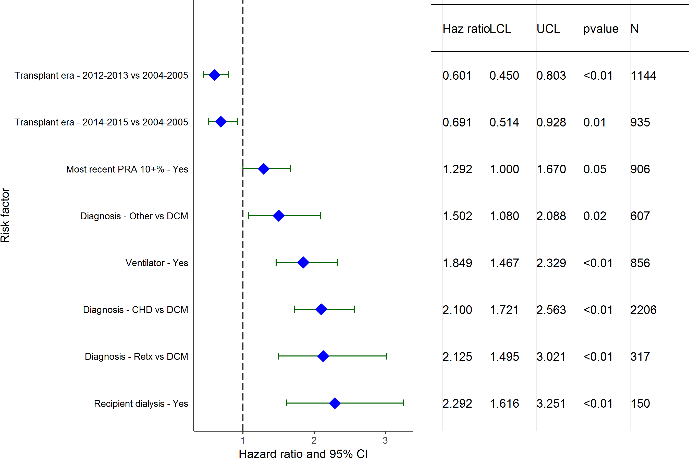
Pediatric Heart Transplants (1/2004-6/2015)
Statistically Significant Risk Factors For 1 Year Mortality with 95% Confidence Limits
2017
(N = 6,327)
JHLT. 2017 Oct; 36(10): 1037-1079

Slide 111
Pediatric Heart Transplants (1/2004-6/2015)
Statistically Significant Risk Factors For 1 Year Mortality
Continuous Factors (see figures)
Ischemic time | Recipient BMI
Donor BSA | Height difference
Estimated GFR | Center volume: prev ped TXs within 1 yr
Total bilirubin
2017
JHLT. 2017 Oct; 36(10): 1037-1079

Slide 112
Pediatric Heart Transplants (1/2004-6/2015)
Ischemic time
Risk Factors For 1 Year Mortality with 95% Confidence Limits
p = 0.0003
2017
(N = 6,327)
JHLT. 2017 Oct; 36(10): 1037-1079
Notes:
Multivariable analysis was performed using a proportional hazards model censoring all patients at 1 year. Continuous factors were fit using a restricted cubic spline.

Slide 113
Pediatric Heart Transplants (1/2004-6/2015)
Recipient BMI
Risk Factors For 1 Year Mortality with 95% Confidence Limits
p = 0.0072
2017
(N = 6,327)
JHLT. 2017 Oct; 36(10): 1037-1079
Notes:
Multivariable analysis was performed using a proportional hazards model censoring all patients at 1 year. Continuous factors were fit using a restricted cubic spline.

Slide 114
Pediatric Heart Transplants (1/2004-6/2015)
Donor BSA
Risk Factors For 1 Year Mortality with 95% Confidence Limits
p = 0.0038
2017
(N = 6,327)
JHLT. 2017 Oct; 36(10): 1037-1079
Notes:
Multivariable analysis was performed using a proportional hazards model censoring all patients at 1 year. Continuous factors were fit using a restricted cubic spline.

Slide 115
Pediatric Heart Transplants (1/2004-6/2015)
Height difference
Risk Factors For 1 Year Mortality with 95% Confidence Limits
p = 0.0119
2017
(N = 6,327)
JHLT. 2017 Oct; 36(10): 1037-1079
Notes:
Multivariable analysis was performed using a proportional hazards model censoring all patients at 1 year. Continuous factors were fit using a restricted cubic spline.

Slide 116
Pediatric Heart Transplants (1/2004-6/2015)
Estimated GFR
Risk Factors For 1 Year Mortality with 95% Confidence Limits
p = 0.0117
2017
(N = 6,327)
JHLT. 2017 Oct; 36(10): 1037-1079
Notes:
Multivariable analysis was performed using a proportional hazards model censoring all patients at 1 year. Continuous factors were fit using a restricted cubic spline.

Slide 117
Pediatric Heart Transplants (1/2004-6/2015)
Center volume: prev ped TXs within 1 yr
Risk Factors For 1 Year Mortality with 95% Confidence Limits
p = 0.0004
2017
(N = 6,327)
JHLT. 2017 Oct; 36(10): 1037-1079
Notes:
Multivariable analysis was performed using a proportional hazards model censoring all patients at 1 year. Continuous factors were fit using a restricted cubic spline.

Slide 118
Pediatric Heart Transplants (1/2004-6/2015)
Total bilirubin
Risk Factors For 1 Year Mortality with 95% Confidence Limits
p = 0.0170
2017
(N = 6,327)
JHLT. 2017 Oct; 36(10): 1037-1079
Notes:
Multivariable analysis was performed using a proportional hazards model censoring all patients at 1 year. Continuous factors were fit using a restricted cubic spline.

Slide 119
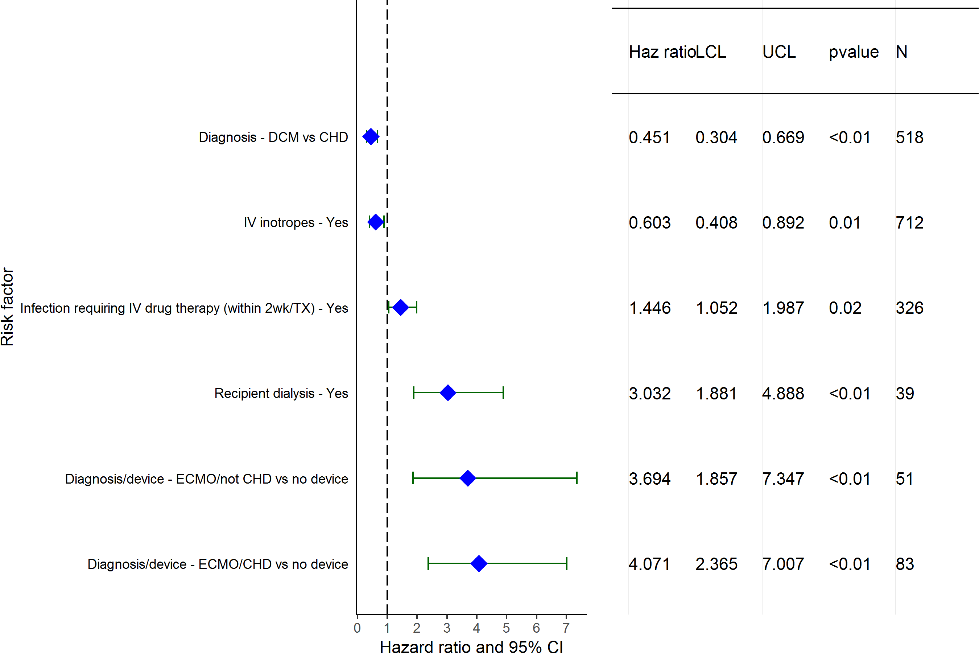
Pediatric Heart Transplants (1/2004-6/2015)
Statistically Significant Risk Factors For 1 Year Mortality with 95% Confidence Limits
Age = <1 Year
2017
(N = 1,463)
JHLT. 2017 Oct; 36(10): 1037-1079

Slide 120
Pediatric Heart Transplants (1/2004-6/2015)
Age = <1 Year
Statistically Significant Risk Factors For 1 Year Mortality
Continuous Factors (see figures)
Recipient creatinine | Ischemic time
Recipient height | Recipient BSA
2017
JHLT. 2017 Oct; 36(10): 1037-1079

Slide 121
Pediatric Heart Transplants (1/2004-6/2015)
Recipient creatinine
Age = <1 Year
Risk Factors For 1 Year Mortality with 95% Confidence Limits
p = 0.0009
2017
(N = 1,463)
JHLT. 2017 Oct; 36(10): 1037-1079
Notes:
Multivariable analysis was performed using a proportional hazards model censoring all patients at 1 year. Continuous factors were fit using a restricted cubic spline.

Slide 122
Pediatric Heart Transplants (1/2004-6/2015)
Ischemic time
Age = <1 Year
Risk Factors For 1 Year Mortality with 95% Confidence Limits
p = 0.0104
2017
(N = 1,463)
JHLT. 2017 Oct; 36(10): 1037-1079
Notes:
Multivariable analysis was performed using a proportional hazards model censoring all patients at 1 year. Continuous factors were fit using a restricted cubic spline.

Slide 123
Pediatric Heart Transplants (1/2004-6/2015)
Recipient height
Age = <1 Year
Risk Factors For 1 Year Mortality with 95% Confidence Limits
p = 0.0128
2017
(N = 1,463)
JHLT. 2017 Oct; 36(10): 1037-1079
Notes:
Multivariable analysis was performed using a proportional hazards model censoring all patients at 1 year. Continuous factors were fit using a restricted cubic spline.

Slide 124
Pediatric Heart Transplants (1/2004-6/2015)
Recipient BSA
Age = <1 Year
Risk Factors For 1 Year Mortality with 95% Confidence Limits
p = 0.0235
2017
(N = 1,463)
JHLT. 2017 Oct; 36(10): 1037-1079
Notes:
Multivariable analysis was performed using a proportional hazards model censoring all patients at 1 year. Continuous factors were fit using a restricted cubic spline.

Slide 125
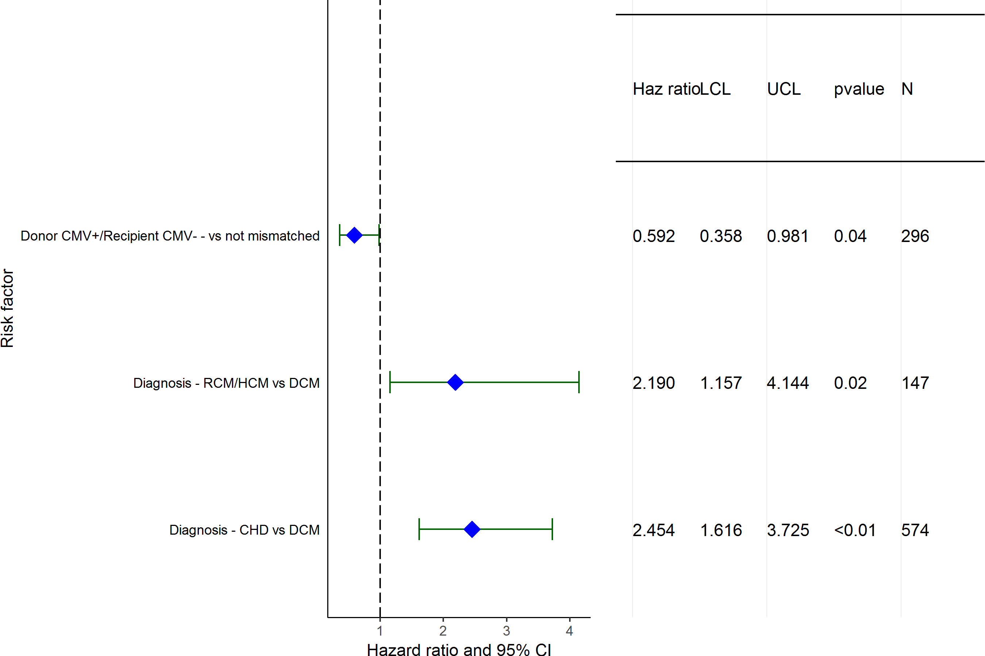
Pediatric Heart Transplants (1/2004-6/2015)
Statistically Significant Risk Factors For 1 Year Mortality with 95% Confidence Limits
Age = 1-5 Years
2017
(N = 1,460)
JHLT. 2017 Oct; 36(10): 1037-1079

Slide 126
Pediatric Heart Transplants (1/2004-6/2015)
Age = 1-5 Years
Statistically Significant Risk Factors For 1 Year Mortality
Continuous Factors (see figures)
Recipient height | Height ratio
Estimated GFR | Center volume: prev ped TXs within 1 yr
2017
JHLT. 2017 Oct; 36(10): 1037-1079

Slide 127
Pediatric Heart Transplants (1/2004-6/2015)
Recipient height
Age = 1-5 Years
Risk Factors For 1 Year Mortality with 95% Confidence Limits
p = 0.0165
2017
(N = 1,460)
JHLT. 2017 Oct; 36(10): 1037-1079
Notes:
Multivariable analysis was performed using a proportional hazards model censoring all patients at 1 year. Continuous factors were fit using a restricted cubic spline.

Slide 128
Pediatric Heart Transplants (1/2004-6/2015)
Height ratio
Age = 1-5 Years
Risk Factors For 1 Year Mortality with 95% Confidence Limits
p = 0.0306
2017
(N = 1,460)
JHLT. 2017 Oct; 36(10): 1037-1079
Notes:
Multivariable analysis was performed using a proportional hazards model censoring all patients at 1 year. Continuous factors were fit using a restricted cubic spline.

Slide 129
Pediatric Heart Transplants (1/2004-6/2015)
Estimated GFR
Age = 1-5 Years
Risk Factors For 1 Year Mortality with 95% Confidence Limits
p = 0.0008
2017
(N = 1,460)
JHLT. 2017 Oct; 36(10): 1037-1079
Notes:
Multivariable analysis was performed using a proportional hazards model censoring all patients at 1 year. Continuous factors were fit using a restricted cubic spline.

Slide 130
Pediatric Heart Transplants (1/2004-6/2015)
Center volume: prev ped TXs within 1 yr
Age = 1-5 Years
Risk Factors For 1 Year Mortality with 95% Confidence Limits
p = 0.0208
2017
(N = 1,460)
JHLT. 2017 Oct; 36(10): 1037-1079
Notes:
Multivariable analysis was performed using a proportional hazards model censoring all patients at 1 year. Continuous factors were fit using a restricted cubic spline.

Slide 131
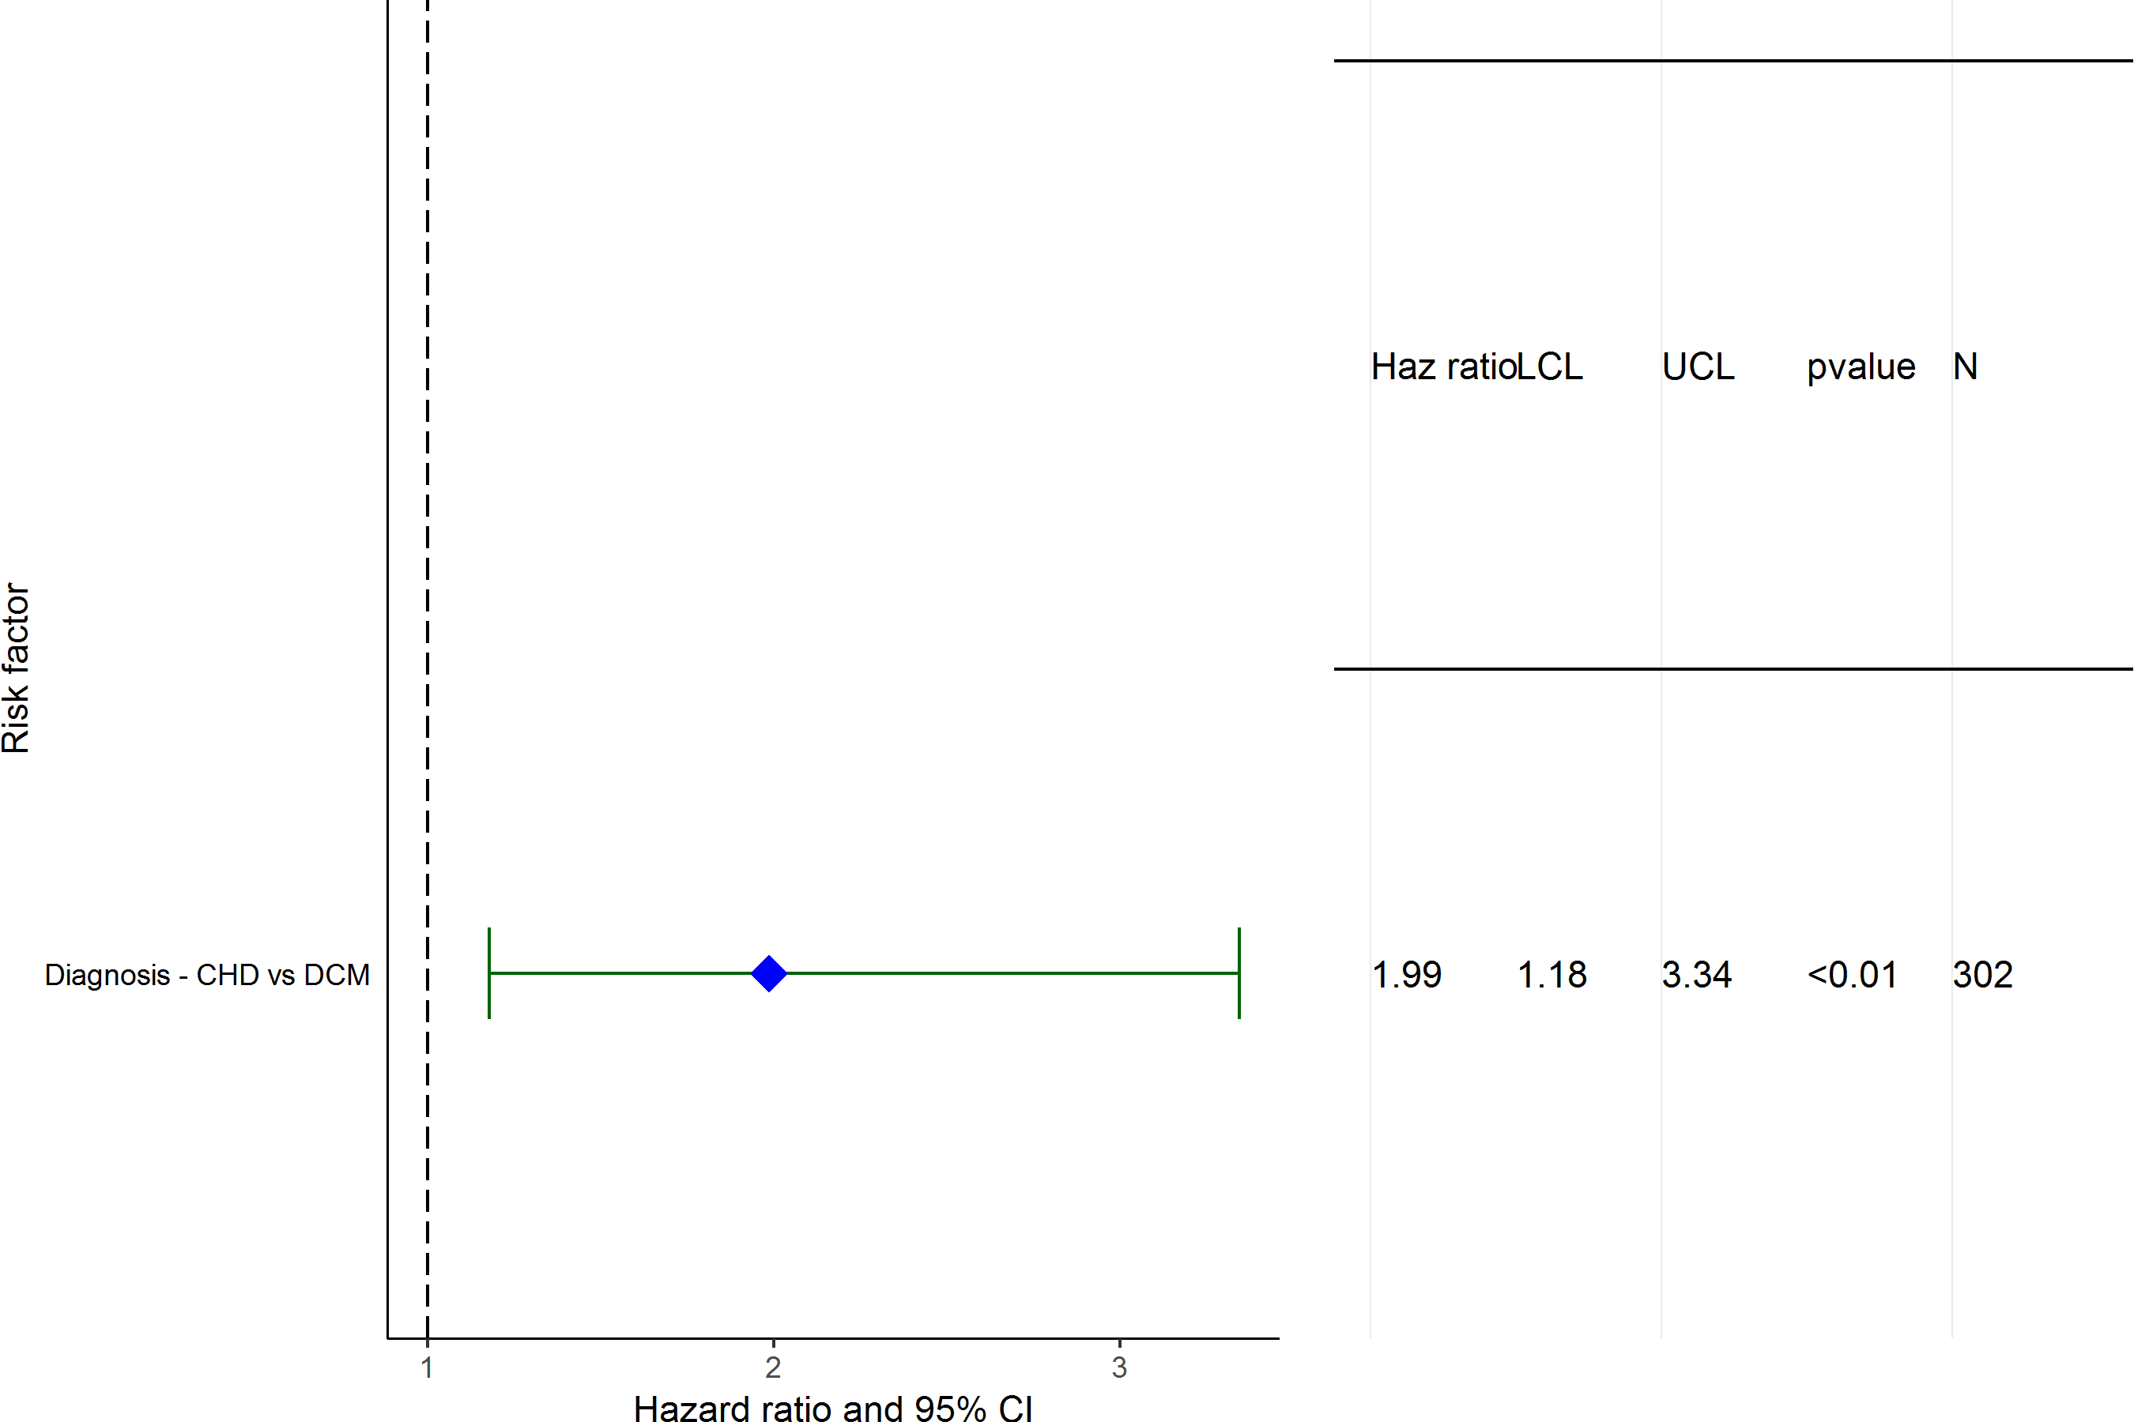
Pediatric Heart Transplants (1/2004-6/2015)
Statistically Significant Risk Factors For 1 Year Mortality with 95% Confidence Limits
Age = 6-10 Years
2017
(N = 952)
JHLT. 2017 Oct; 36(10): 1037-1079

Slide 132
Pediatric Heart Transplants (1/2004-6/2015)
Age = 6-10 Years
Statistically Significant Risk Factors For 1 Year Mortality
Continuous Factors (see figures)
Donor age | Recipient height
BSA ratio | Height difference
Estimated GFR | Center volume: prev ped TXs within 1 yr
2017
JHLT. 2017 Oct; 36(10): 1037-1079

Slide 133
Pediatric Heart Transplants (1/2004-6/2015)
Donor age
Age = 6-10 Years
Risk Factors For 1 Year Mortality with 95% Confidence Limits
p = 0.0443
2017
(N = 952)
JHLT. 2017 Oct; 36(10): 1037-1079
Notes:
Multivariable analysis was performed using a proportional hazards model censoring all patients at 1 year. Continuous factors were fit using a restricted cubic spline.

Slide 134
Pediatric Heart Transplants (1/2004-6/2015)
Recipient height
Age = 6-10 Years
Risk Factors For 1 Year Mortality with 95% Confidence Limits
p = 0.0160
2017
(N = 952)
JHLT. 2017 Oct; 36(10): 1037-1079
Notes:
Multivariable analysis was performed using a proportional hazards model censoring all patients at 1 year. Continuous factors were fit using a restricted cubic spline.

Slide 135
Pediatric Heart Transplants (1/2004-6/2015)
BSA ratio
Age = 6-10 Years
Risk Factors For 1 Year Mortality with 95% Confidence Limits
p = 0.0484
2017
(N = 952)
JHLT. 2017 Oct; 36(10): 1037-1079
Notes:
Multivariable analysis was performed using a proportional hazards model censoring all patients at 1 year. Continuous factors were fit using a restricted cubic spline.

Slide 136
Pediatric Heart Transplants (1/2004-6/2015)
Height difference
Age = 6-10 Years
Risk Factors For 1 Year Mortality with 95% Confidence Limits
p = 0.0083
2017
(N = 952)
JHLT. 2017 Oct; 36(10): 1037-1079
Notes:
Multivariable analysis was performed using a proportional hazards model censoring all patients at 1 year. Continuous factors were fit using a restricted cubic spline.

Slide 137
Pediatric Heart Transplants (1/2004-6/2015)
Estimated GFR
Age = 6-10 Years
Risk Factors For 1 Year Mortality with 95% Confidence Limits
p = 0.0152
2017
(N = 952)
JHLT. 2017 Oct; 36(10): 1037-1079
Notes:
Multivariable analysis was performed using a proportional hazards model censoring all patients at 1 year. Continuous factors were fit using a restricted cubic spline.

Slide 138
Pediatric Heart Transplants (1/2004-6/2015)
Center volume: prev ped TXs within 1 yr
Age = 6-10 Years
Risk Factors For 1 Year Mortality with 95% Confidence Limits
p = 0.0397
2017
(N = 952)
JHLT. 2017 Oct; 36(10): 1037-1079
Notes:
Multivariable analysis was performed using a proportional hazards model censoring all patients at 1 year. Continuous factors were fit using a restricted cubic spline.

Slide 139
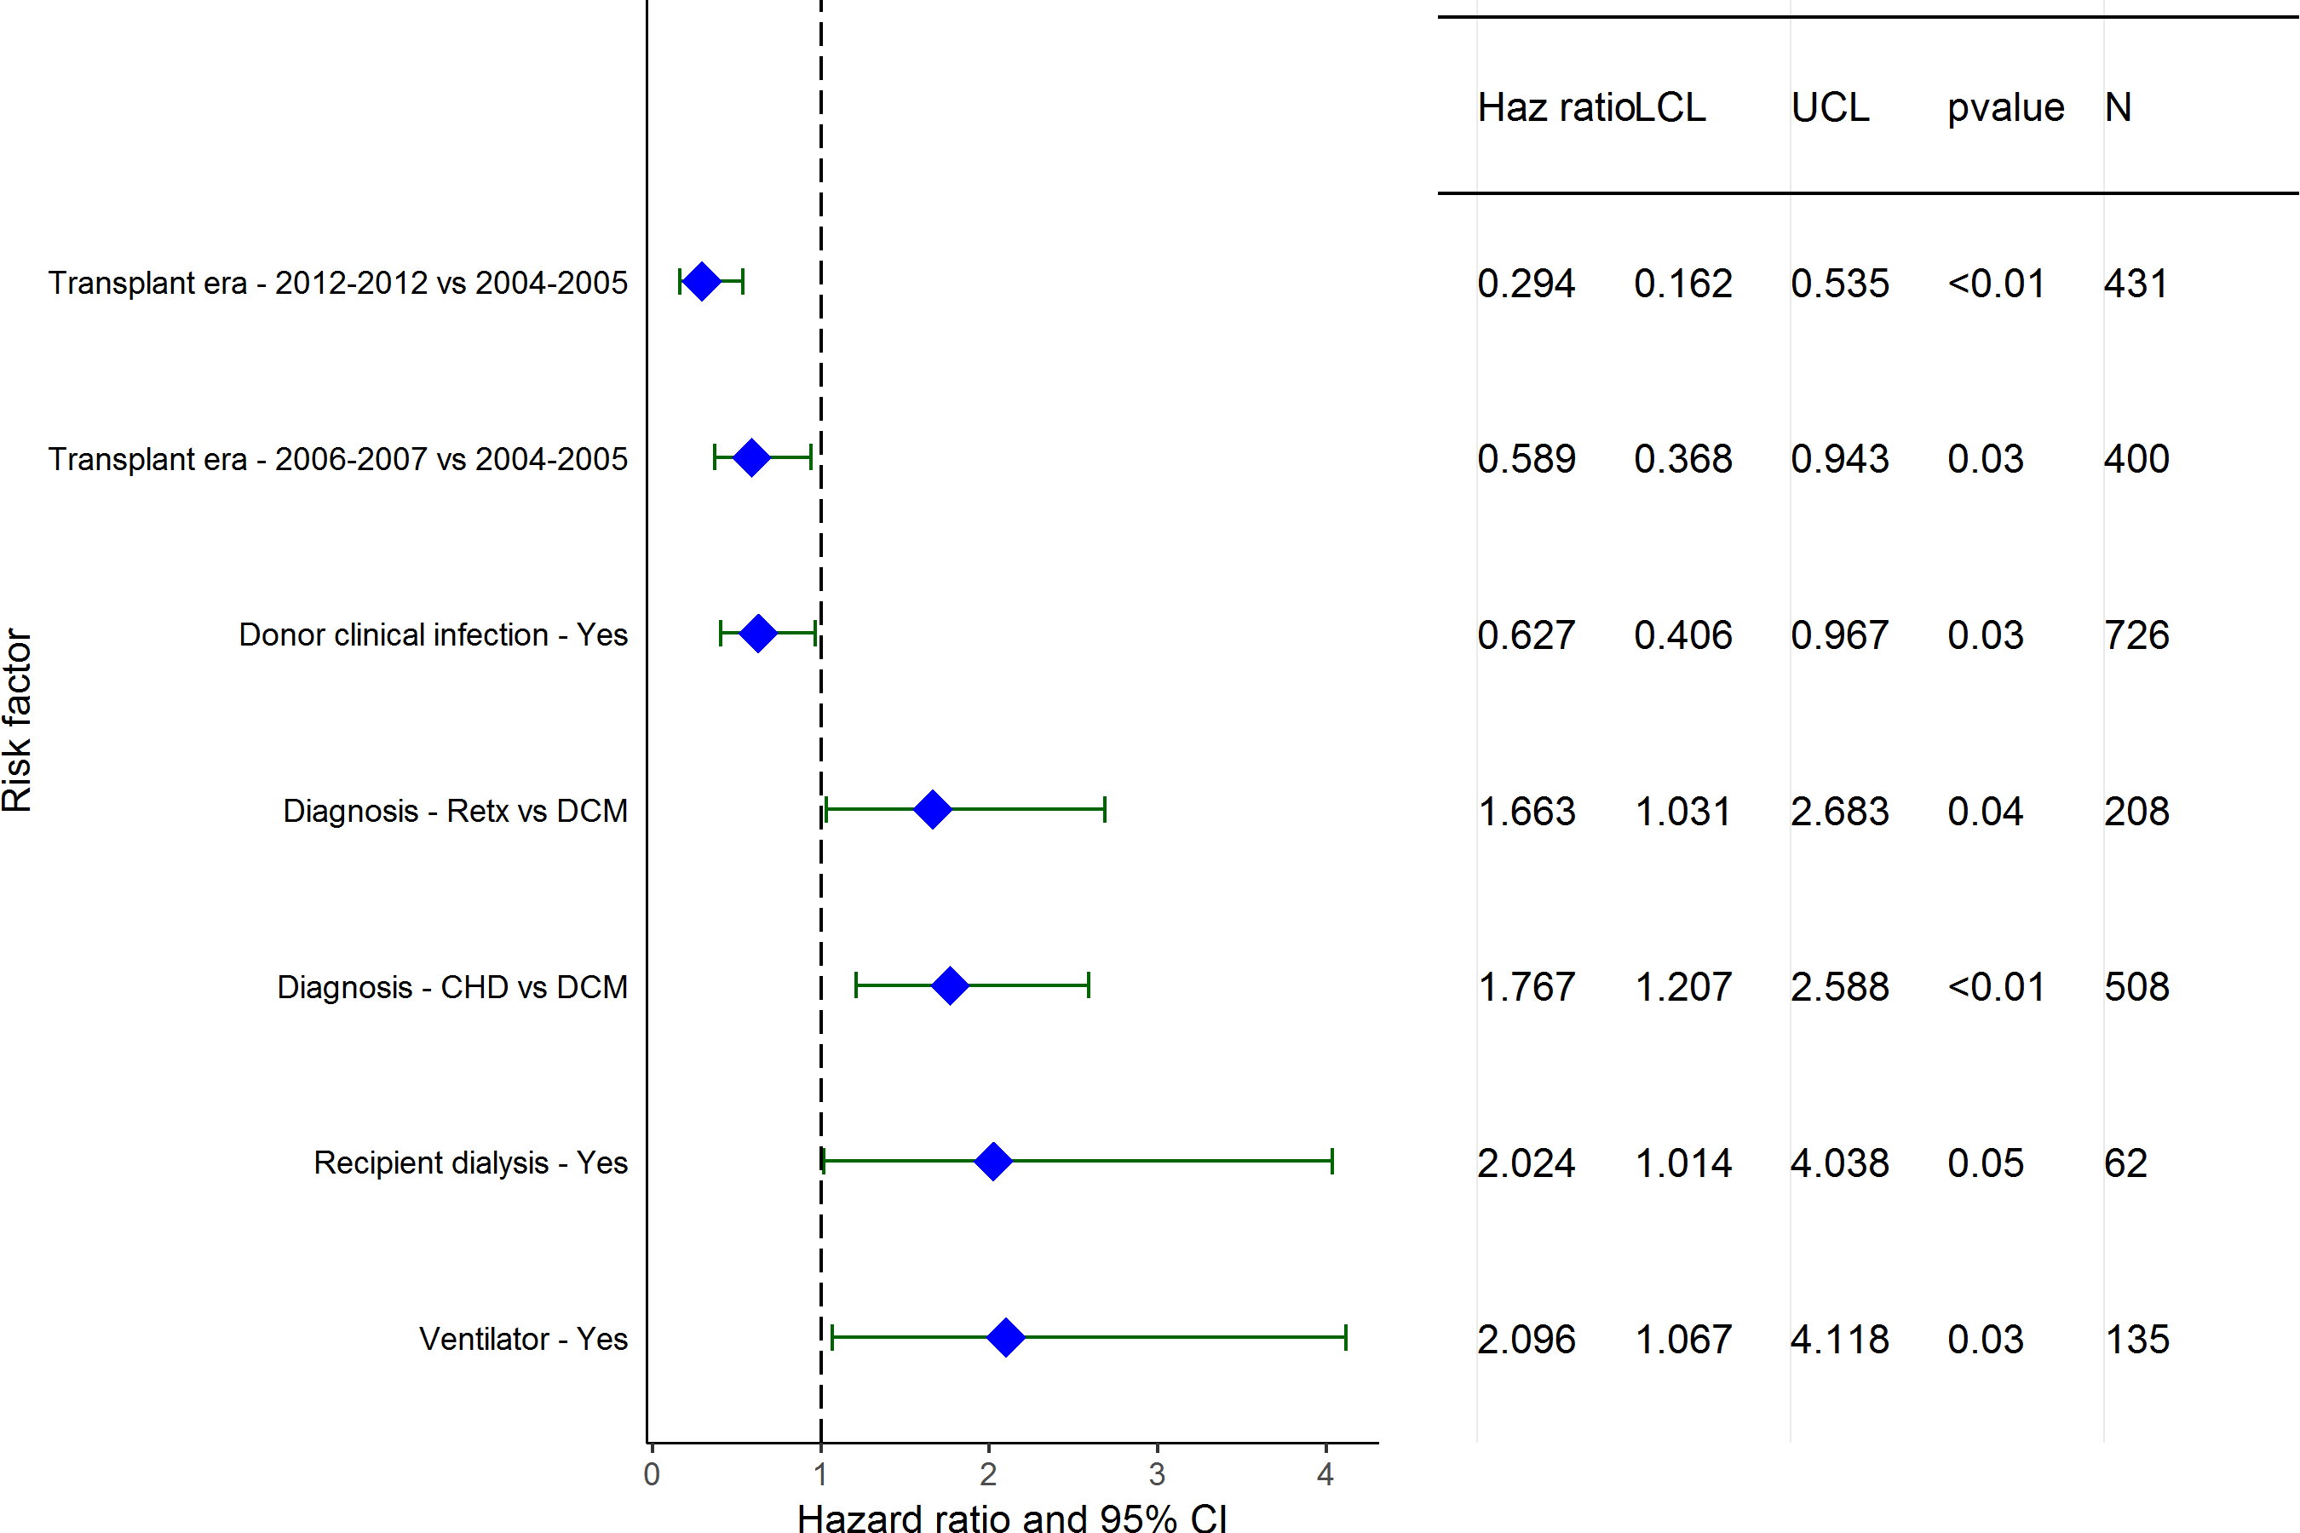
Pediatric Heart Transplants (1/2004-6/2015)
Statistically Significant Risk Factors For 1 Year Mortality with 95% Confidence Limits
Age = 11-17 Years
2017
(N = 2,452)
JHLT. 2017 Oct; 36(10): 1037-1079

Slide 140
Pediatric Heart Transplants (1/2004-6/2015)
Age = 11-17 Years
Statistically Significant Risk Factors For 1 Year Mortality
Continuous Factors (see figures)
PCW | Most recent PRA
PA mean
2017
JHLT. 2017 Oct; 36(10): 1037-1079

Slide 141
Pediatric Heart Transplants (1/2004-6/2015)
PCW
Age = 11-17 Years
Risk Factors For 1 Year Mortality with 95% Confidence Limits
p = 0.0004
2017
(N = 2,452)
JHLT. 2017 Oct; 36(10): 1037-1079
Notes:
Multivariable analysis was performed using a proportional hazards model censoring all patients at 1 year. Continuous factors were fit using a restricted cubic spline.

Slide 142
Pediatric Heart Transplants (1/2004-6/2015)
Most recent PRA
Age = 11-17 Years
Risk Factors For 1 Year Mortality with 95% Confidence Limits
p = 0.0149
2017
(N = 2,452)
JHLT. 2017 Oct; 36(10): 1037-1079
Notes:
Multivariable analysis was performed using a proportional hazards model censoring all patients at 1 year. Continuous factors were fit using a restricted cubic spline.

Slide 143
Pediatric Heart Transplants (1/2004-6/2015)
PA mean
Age = 11-17 Years
Risk Factors For 1 Year Mortality with 95% Confidence Limits
p = 0.0008
2017
(N = 2,452)
JHLT. 2017 Oct; 36(10): 1037-1079
Notes:
Multivariable analysis was performed using a proportional hazards model censoring all patients at 1 year. Continuous factors were fit using a restricted cubic spline.

Slide 144
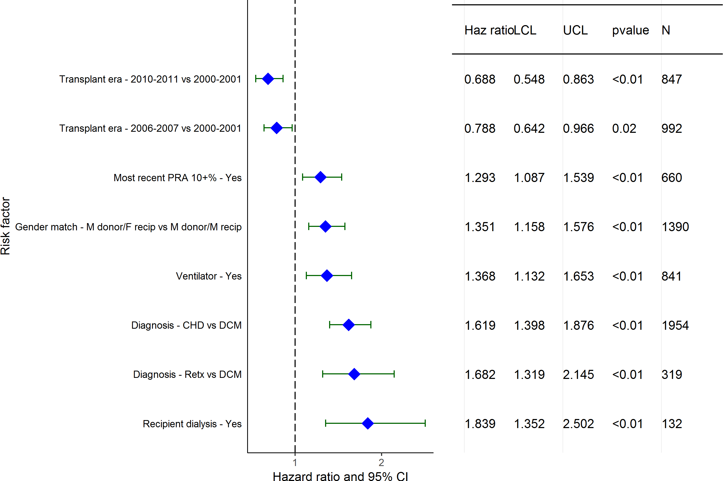
Pediatric Heart Transplants (1/2001-6/2011)
Statistically Significant Risk Factors For 5 Year Mortality with 95% Confidence Limits
2017
(N = 5,651)
JHLT. 2017 Oct; 36(10): 1037-1079

Slide 145
Pediatric Heart Transplants (1/2001-6/2011)
Statistically Significant Risk Factors For 5 Year Mortality
Continuous Factors (see figures)
Recipient age | Donor age
Ischemic time | Recipient weight (kg)
Estimated GFR | Center volume: prev ped TXs within 1 yr
2017
JHLT. 2017 Oct; 36(10): 1037-1079

Slide 146
Pediatric Heart Transplants (1/2001-6/2011)
Recipient age
Risk Factors For 5 Year Mortality with 95% Confidence Limits
p = 0.0002
2017
(N = 5,651)
JHLT. 2017 Oct; 36(10): 1037-1079
Notes:
Multivariable analysis was performed using a proportional hazards model censoring all patients at 5 years. Continuous factors were fit using a restricted cubic spline.

Slide 147
Pediatric Heart Transplants (1/2001-6/2011)
Donor age
Risk Factors For 5 Year Mortality with 95% Confidence Limits
p = 0.0434
2017
(N = 5,651)
JHLT. 2017 Oct; 36(10): 1037-1079
Notes:
Multivariable analysis was performed using a proportional hazards model censoring all patients at 5 years. Continuous factors were fit using a restricted cubic spline.

Slide 148
Pediatric Heart Transplants (1/2001-6/2011)
Ischemic time
Risk Factors For 5 Year Mortality with 95% Confidence Limits
p = 0.0048
2017
(N = 5,651)
JHLT. 2017 Oct; 36(10): 1037-1079
Notes:
Multivariable analysis was performed using a proportional hazards model censoring all patients at 5 years. Continuous factors were fit using a restricted cubic spline.

Slide 149
Pediatric Heart Transplants (1/2001-6/2011)
Recipient weight (kg)
Risk Factors For 5 Year Mortality with 95% Confidence Limits
p = 0.0403
2017
(N = 5,651)
JHLT. 2017 Oct; 36(10): 1037-1079
Notes:
Multivariable analysis was performed using a proportional hazards model censoring all patients at 5 years. Continuous factors were fit using a restricted cubic spline.

Slide 150
Pediatric Heart Transplants (1/2001-6/2011)
Estimated GFR
Risk Factors For 5 Year Mortality with 95% Confidence Limits
p = 0.0006
2017
(N = 5,651)
JHLT. 2017 Oct; 36(10): 1037-1079
Notes:
Multivariable analysis was performed using a proportional hazards model censoring all patients at 5 years. Continuous factors were fit using a restricted cubic spline.

Slide 151
Pediatric Heart Transplants (1/2001-6/2011)
Center volume: prev ped TXs within 1 yr
Risk Factors For 5 Year Mortality with 95% Confidence Limits
p = 0.0026
2017
(N = 5,651)
JHLT. 2017 Oct; 36(10): 1037-1079
Notes:
Multivariable analysis was performed using a proportional hazards model censoring all patients at 5 years. Continuous factors were fit using a restricted cubic spline.

Slide 152
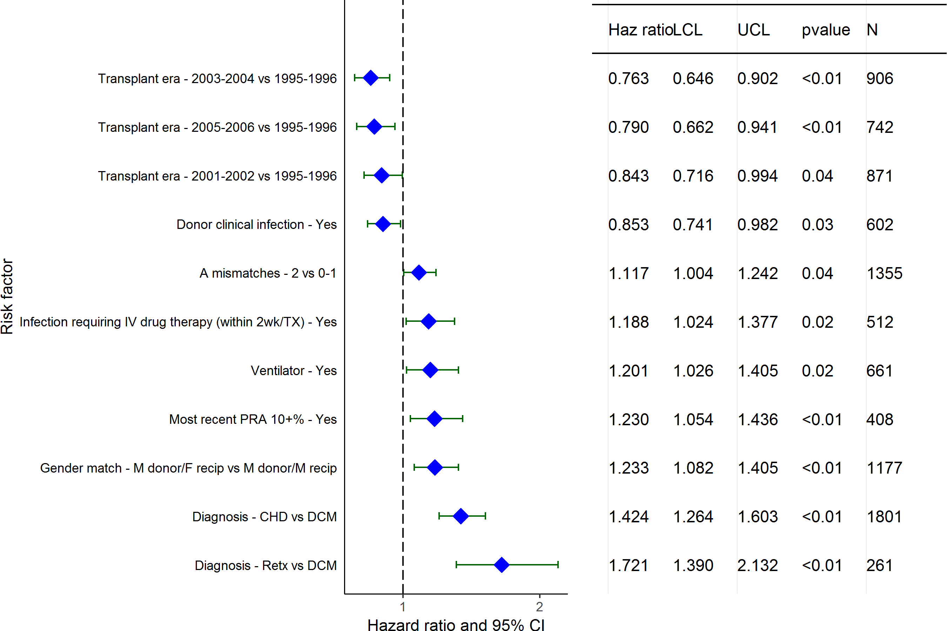
Pediatric Heart Transplants (1/1996-6/2006)
Statistically Significant Risk Factors For 10 Year Mortality with 95% Confidence Limits
2017
(N = 4,878)
JHLT. 2017 Oct; 36(10): 1037-1079

Slide 153
Pediatric Heart Transplants (1/1996-6/2006)
Statistically Significant Risk Factors For 10 Year Mortality
Continuous Factors (see figures)
Recipient age | Donor age
Recipient height | Estimated GFR
Transplant center volume
2017
JHLT. 2017 Oct; 36(10): 1037-1079

Slide 154
Pediatric Heart Transplants (1/1996-6/2006)
Recipient age
Risk Factors For 10 Year Mortality with 95% Confidence Limits
p = 0.0010
2017
(N = 4,878)
JHLT. 2017 Oct; 36(10): 1037-1079
Notes:
Multivariable analysis was performed using a proportional hazards model censoring all patients at 10 years. Continuous factors were fit using a restricted cubic spline.

Slide 155
Pediatric Heart Transplants (1/1996-6/2006)
Donor age
Risk Factors For 10 Year Mortality with 95% Confidence Limits
p = 0.0006
2017
(N = 4,878)
JHLT. 2017 Oct; 36(10): 1037-1079
Notes:
Multivariable analysis was performed using a proportional hazards model censoring all patients at 10 years. Continuous factors were fit using a restricted cubic spline.

Slide 156
Pediatric Heart Transplants (1/1996-6/2006)
Recipient height
Risk Factors For 10 Year Mortality with 95% Confidence Limits
p = 0.0023
2017
(N = 4,878)
JHLT. 2017 Oct; 36(10): 1037-1079
Notes:
Multivariable analysis was performed using a proportional hazards model censoring all patients at 10 years. Continuous factors were fit using a restricted cubic spline.

Slide 157
Pediatric Heart Transplants (1/1996-6/2006)
Estimated GFR
Risk Factors For 10 Year Mortality with 95% Confidence Limits
p = 0.0143
2017
(N = 4,878)
JHLT. 2017 Oct; 36(10): 1037-1079
Notes:
Multivariable analysis was performed using a proportional hazards model censoring all patients at 10 years. Continuous factors were fit using a restricted cubic spline.

Slide 158
Pediatric Heart Transplants (1/1996-6/2006)
Transplant center volume
Risk Factors For 10 Year Mortality with 95% Confidence Limits
p = 0.0084
2017
(N = 4,878)
JHLT. 2017 Oct; 36(10): 1037-1079
Notes:
Multivariable analysis was performed using a proportional hazards model censoring all patients at 10 years. Continuous factors were fit using a restricted cubic spline.

Slide 159
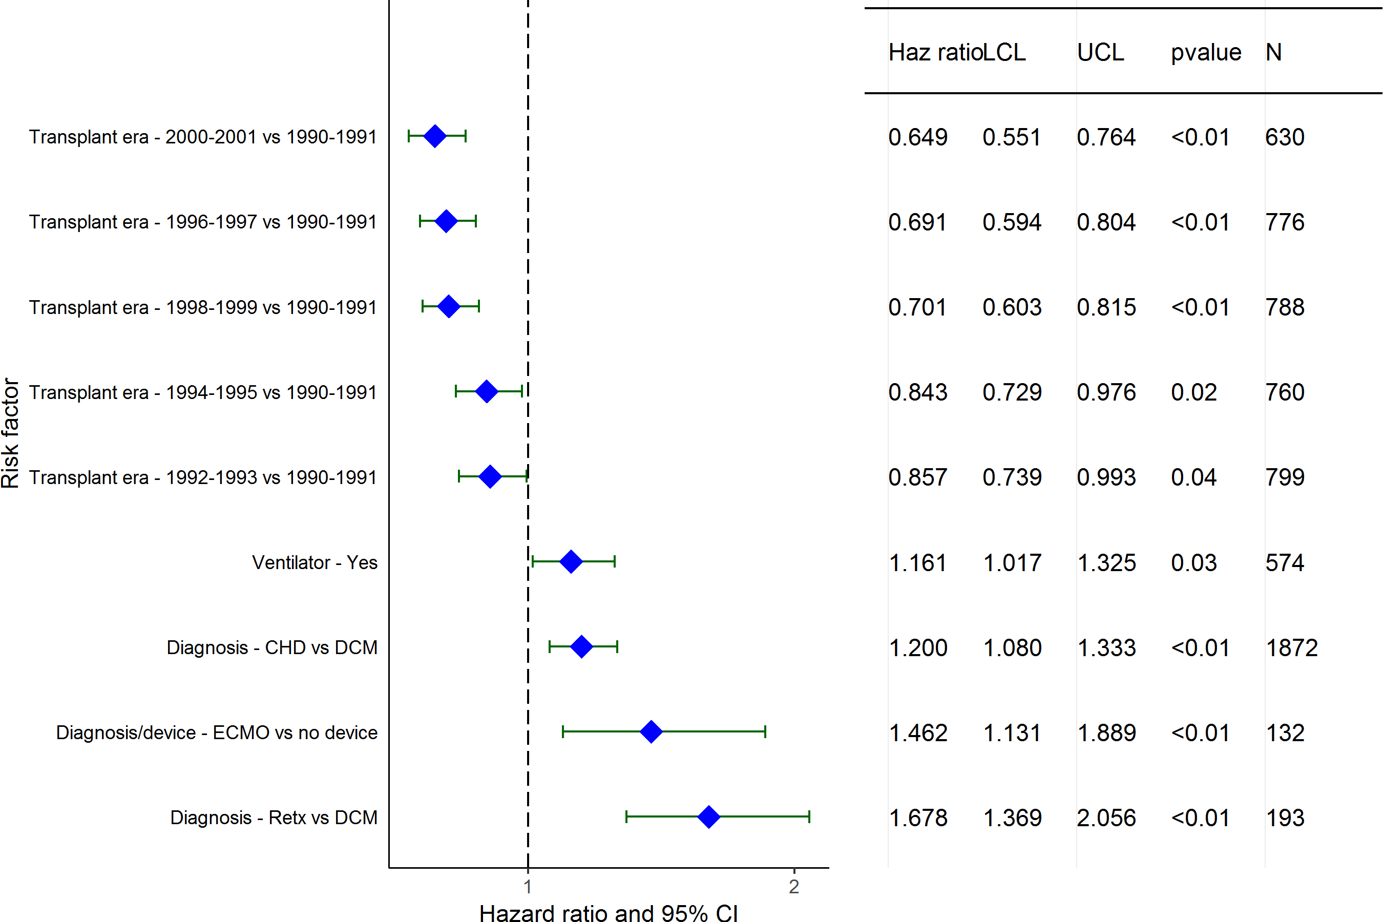
Pediatric Heart Transplants (1990-6/2001)
Statistically Significant Risk Factors For 15 Year Mortality with 95% Confidence Limits
2017
(N = 4,493)
JHLT. 2017 Oct; 36(10): 1037-1079

Slide 160
Pediatric Heart Transplants (1990-6/2001)
Statistically Significant Risk Factors For 15 Year Mortality
Continuous Factors (see figures)
Donor age | Donor weight (kg)
Donor BMI | Center volume: prev ped TXs within 1 yr
2017
JHLT. 2017 Oct; 36(10): 1037-1079

Slide 161
Pediatric Heart Transplants (1990-6/2001)
Donor age
Risk Factors For 15 Year Mortality with 95% Confidence Limits
p = 0.0137
2017
(N = 4,493)
JHLT. 2017 Oct; 36(10): 1037-1079
Notes:
Multivariable analysis was performed using a proportional hazards model censoring all patients at 15 years. Continuous factors were fit using a restricted cubic spline.
Analyses were limited to transplants having essentially complete information regarding risk factors.

Slide 162
Pediatric Heart Transplants (1990-6/2001)
Donor weight (kg)
Risk Factors For 15 Year Mortality with 95% Confidence Limits
p = 0.0016
2017
(N = 4,493)
JHLT. 2017 Oct; 36(10): 1037-1079
Notes:
Multivariable analysis was performed using a proportional hazards model censoring all patients at 15 years. Continuous factors were fit using a restricted cubic spline.
Analyses were limited to transplants having essentially complete information regarding risk factors.

Slide 163
Pediatric Heart Transplants (1990-6/2001)
Donor BMI
Risk Factors For 15 Year Mortality with 95% Confidence Limits
p = 0.0038
2017
(N = 4,493)
JHLT. 2017 Oct; 36(10): 1037-1079
Notes:
Multivariable analysis was performed using a proportional hazards model censoring all patients at 15 years. Continuous factors were fit using a restricted cubic spline.
Analyses were limited to transplants having essentially complete information regarding risk factors.

Slide 164
Pediatric Heart Transplants (1990-6/2001)
Center volume: prev ped TXs within 1 yr
Risk Factors For 15 Year Mortality with 95% Confidence Limits
p = 0.0236
2017
(N = 4,493)
JHLT. 2017 Oct; 36(10): 1037-1079
Notes:
Multivariable analysis was performed using a proportional hazards model censoring all patients at 15 years. Continuous factors were fit using a restricted cubic spline.
Analyses were limited to transplants having essentially complete information regarding risk factors.

Slide 165
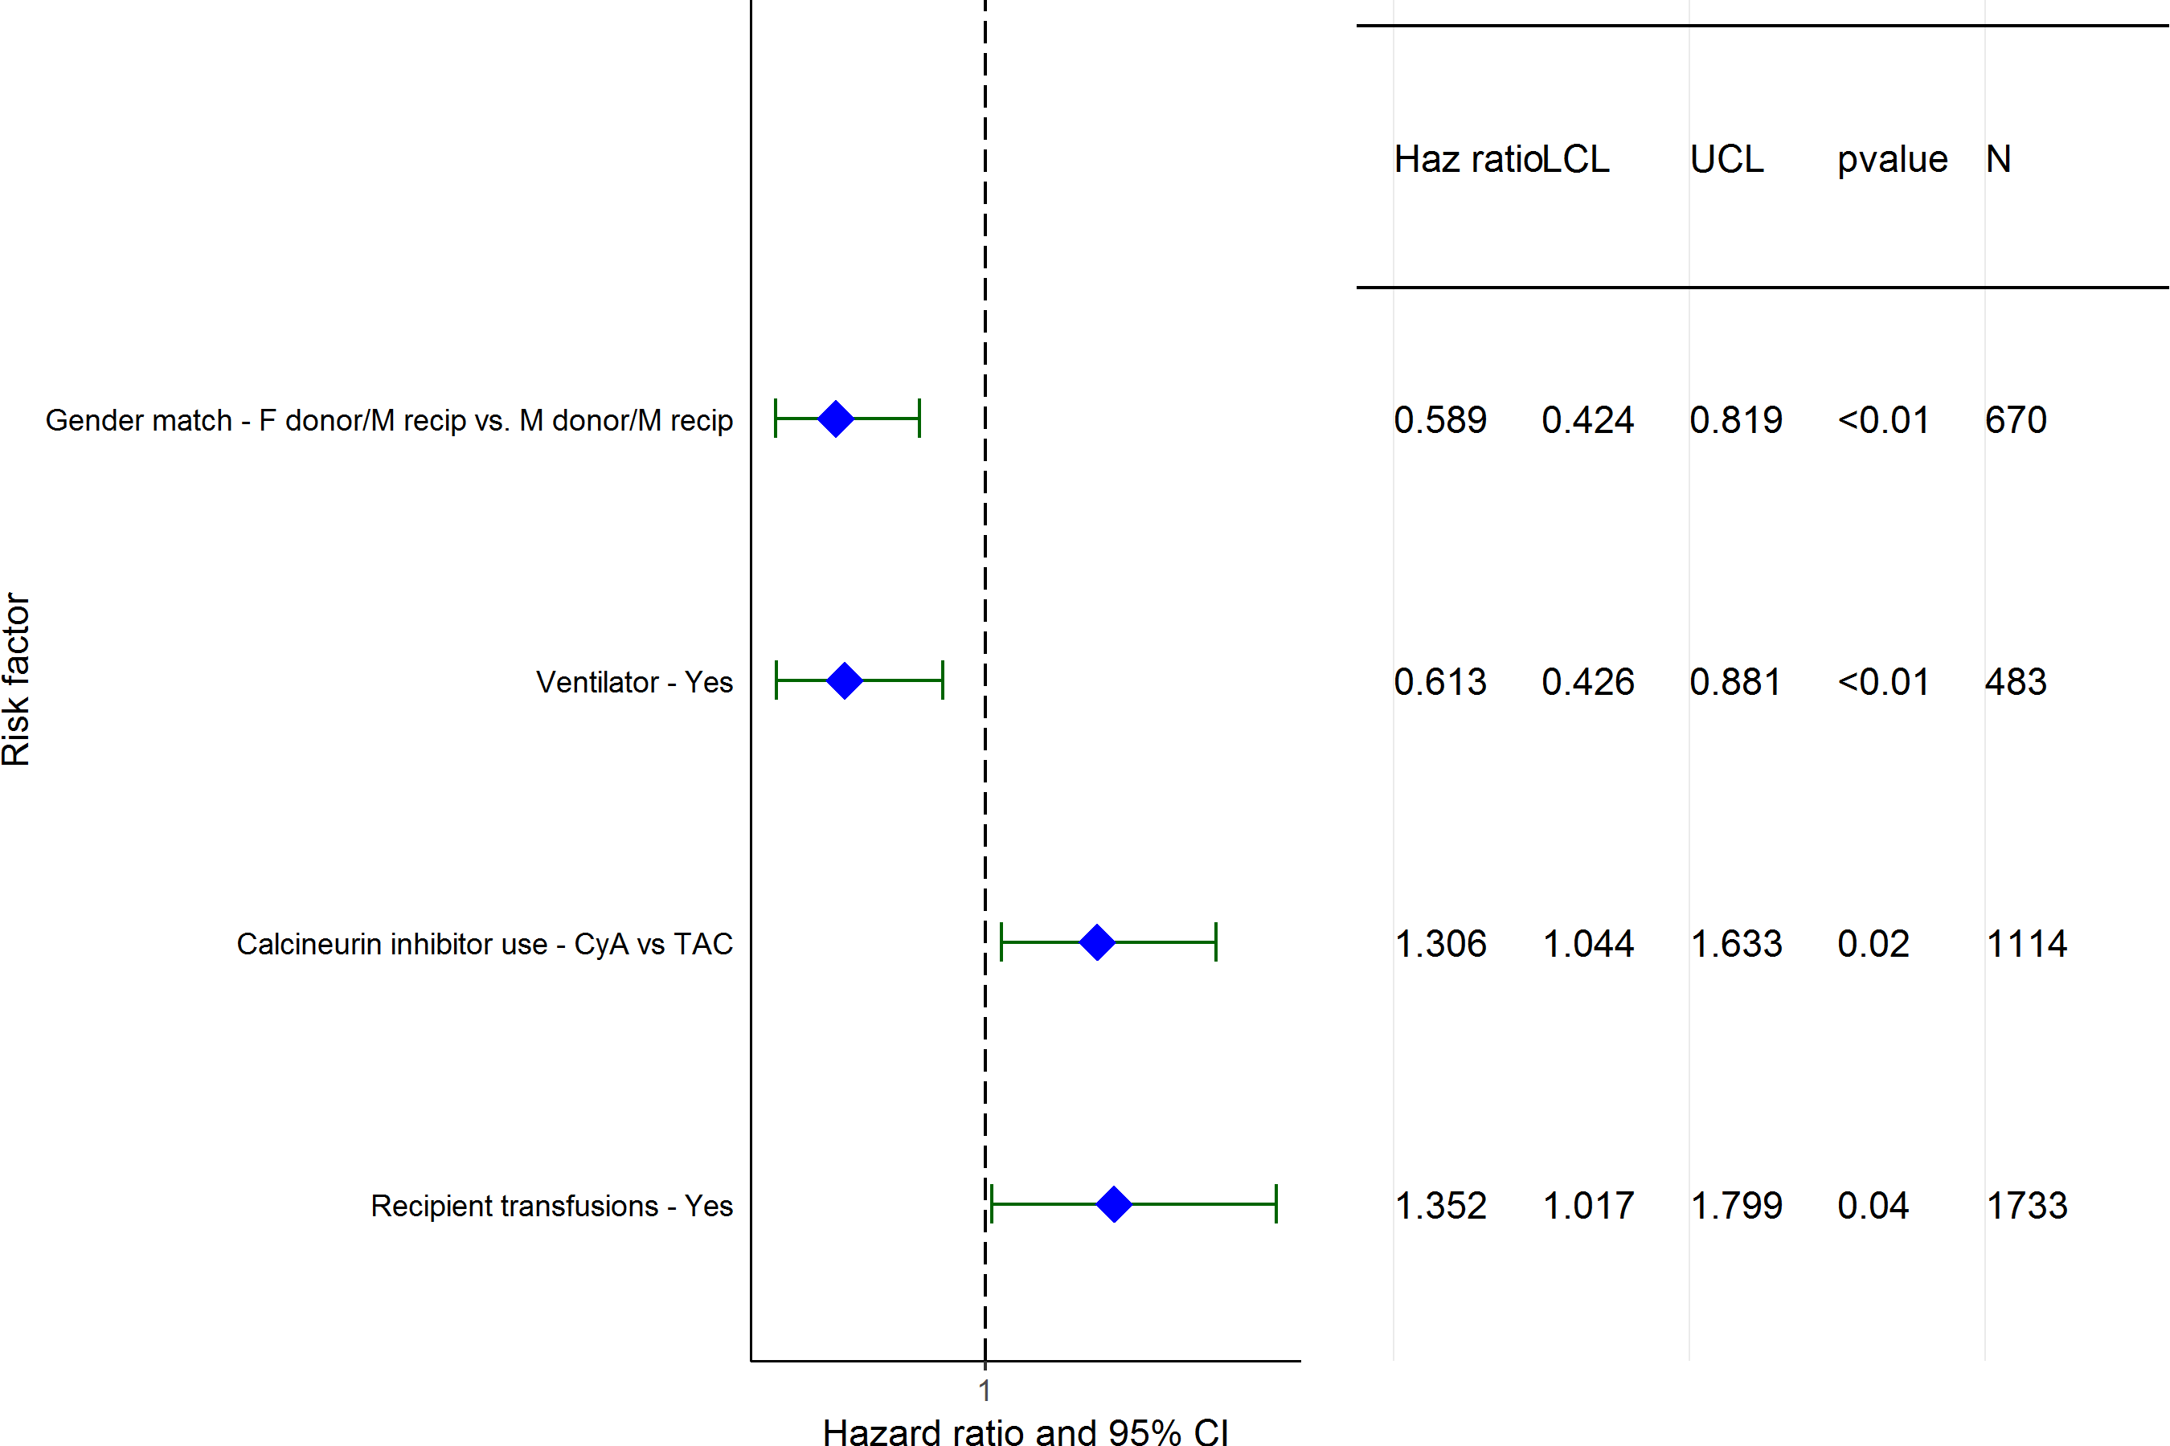
Pediatric Heart Transplants (1/2000-6/2011)
Conditional on Survival to Transplant Discharge
Statistically Significant Risk Factors for Developing CAV within 5 Years
with 95% Confidence Limits
2017
(N = 3,044)
JHLT. 2017 Oct; 36(10): 1037-1079

Slide 166
Pediatric Heart Transplants (1/2000-6/2011)
Conditional on Survival to Transplant Discharge
Statistically Significant Risk Factors for Developing CAV within 5 Years
Continuous Factors (see figures)
Donor age | Transplant center volume
2017
JHLT. 2017 Oct; 36(10): 1037-1079

Slide 167
Pediatric Heart Transplants (1/2000-6/2011)
Donor age
Conditional on Survival to Transplant Discharge
Risk Factors for Developing CAV within 5 Years with 95% Confidence Limits
p < 0.0001
2017
(N = 3,044)
JHLT. 2017 Oct; 36(10): 1037-1079
Notes:
Multivariable analysis was performed using a proportional hazards model censoring all patients at 5 years. Continuous factors were fit using a restricted cubic spline.

Slide 168
Pediatric Heart Transplants (1/2000-6/2011)
Transplant center volume
Conditional on Survival to Transplant Discharge
Risk Factors for Developing CAV within 5 Years with 95% Confidence Limits
p = 0.0312
2017
(N = 3,044)
JHLT. 2017 Oct; 36(10): 1037-1079
Notes:
Multivariable analysis was performed using a proportional hazards model censoring all patients at 5 years. Continuous factors were fit using a restricted cubic spline.

Slide 169
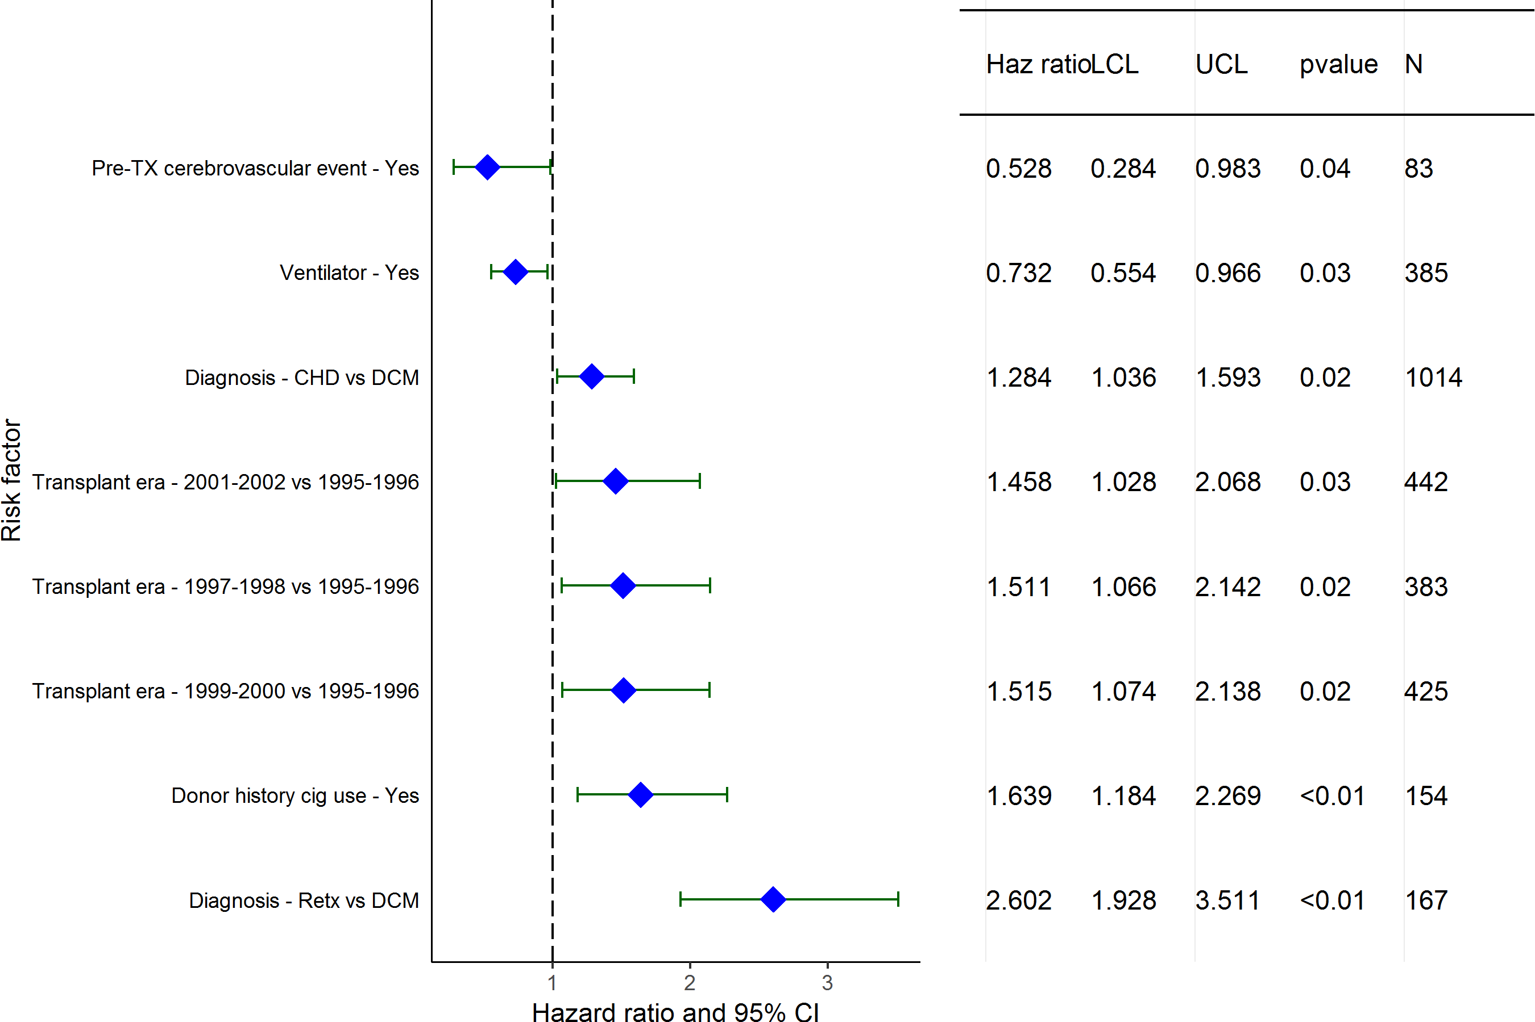
Pediatric Heart Transplants (1/1995-6/2006)
Conditional on Survival to Transplant Discharge
Statistically Significant Risk Factors for Developing CAV within 10 Years
with 95% Confidence Limits
2017
(N = 2,456)
JHLT. 2017 Oct; 36(10): 1037-1079

Slide 170
Pediatric Heart Transplants (1/1995-6/2006)
Conditional on Survival to Transplant Discharge
Statistically Significant Risk Factors for Developing CAV within 10 Years
Continuous Factors (see figures)
Donor age | BMI ratio
Donor BSA | Transplant center volume
2017
JHLT. 2017 Oct; 36(10): 1037-1079

Slide 171
Pediatric Heart Transplants (1/1995-6/2006)
Donor age
Conditional on Survival to Transplant Discharge
Risk Factors for Developing CAV within 10 Years with 95% Confidence Limits
p = 0.0105
2017
(N = 2,456)
JHLT. 2017 Oct; 36(10): 1037-1079
Notes:
Multivariable analysis was performed using a proportional hazards model censoring all patients at 5 years. Continuous factors were fit using a restricted cubic spline.

Slide 172
Pediatric Heart Transplants (1/1995-6/2006)
BMI ratio
Conditional on Survival to Transplant Discharge
Risk Factors for Developing CAV within 10 Years with 95% Confidence Limits
p = 0.0115
2017
(N = 2,456)
JHLT. 2017 Oct; 36(10): 1037-1079
Notes:
Multivariable analysis was performed using a proportional hazards model censoring all patients at 5 years. Continuous factors were fit using a restricted cubic spline.

Slide 173
Pediatric Heart Transplants (1/1995-6/2006)
Donor BSA
Conditional on Survival to Transplant Discharge
Risk Factors for Developing CAV within 10 Years with 95% Confidence Limits
p = 0.0021
2017
(N = 2,456)
JHLT. 2017 Oct; 36(10): 1037-1079
Notes:
Multivariable analysis was performed using a proportional hazards model censoring all patients at 5 years. Continuous factors were fit using a restricted cubic spline.

Slide 174
Pediatric Heart Transplants (1/1995-6/2006)
Transplant center volume
Conditional on Survival to Transplant Discharge
Risk Factors for Developing CAV within 10 Years with 95% Confidence Limits
p < 0.0001
2017
(N = 2,456)
JHLT. 2017 Oct; 36(10): 1037-1079
Notes:
Multivariable analysis was performed using a proportional hazards model censoring all patients at 5 years. Continuous factors were fit using a restricted cubic spline.

Slide 175
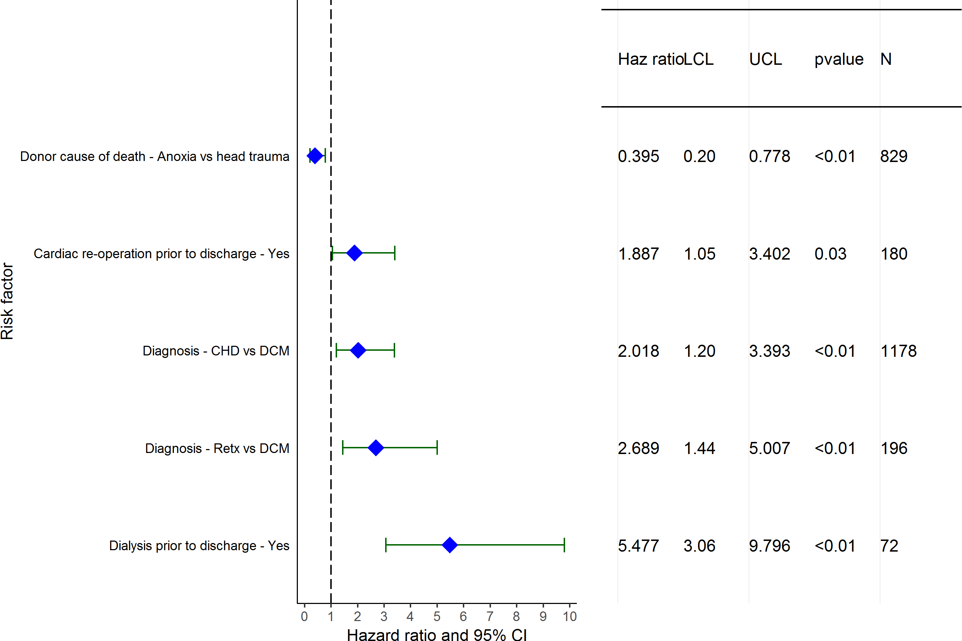
Pediatric Heart Transplants (1/2000-6/2011)
Limited to Recipients without Severe Renal Dysfunction* Pre-Transplant
Statistically Significant Risk Factors for Developing Renal Dysfunction
within 5 Years with 95% Confidence Limits
2017
(N = 2,983)
JHLT. 2017 Oct; 36(10): 1037-1079

Slide 176
Pediatric Heart Transplants (1/2000-6/2011)
Statistically Significant Risk Factors for Developing Renal Dysfunction within 5 Years
Limited to Recipients without Severe Renal Dysfunction* Pre-Transplant
Continuous Factors (see figures)
Donor height | Donor BSA
2017
JHLT. 2017 Oct; 36(10): 1037-1079

Slide 177
Pediatric Heart Transplants (1/2000-6/2011)
Donor height
Limited to Recipients without Severe Renal Dysfunction* Pre-Transplant
Risk Factors for Developing Renal Dysfunction within 5 Years with 95% Confidence Limits
p = 0.0306
2017
(N = 2,983)
JHLT. 2017 Oct; 36(10): 1037-1079
Notes:
Multivariable analysis was performed using a proportional hazards model censoring all patients at 5 years. Continuous factors were fit using a restricted cubic spline.

Slide 178
Pediatric Heart Transplants (1/2000-6/2011)
Donor BSA
Limited to Recipients without Severe Renal Dysfunction* Pre-Transplant
Risk Factors for Developing Renal Dysfunction within 5 Years with 95% Confidence Limits
p = 0.0079
2017
(N = 2,983)
JHLT. 2017 Oct; 36(10): 1037-1079
Notes:
Multivariable analysis was performed using a proportional hazards model censoring all patients at 5 years. Continuous factors were fit using a restricted cubic spline.

Slide 179
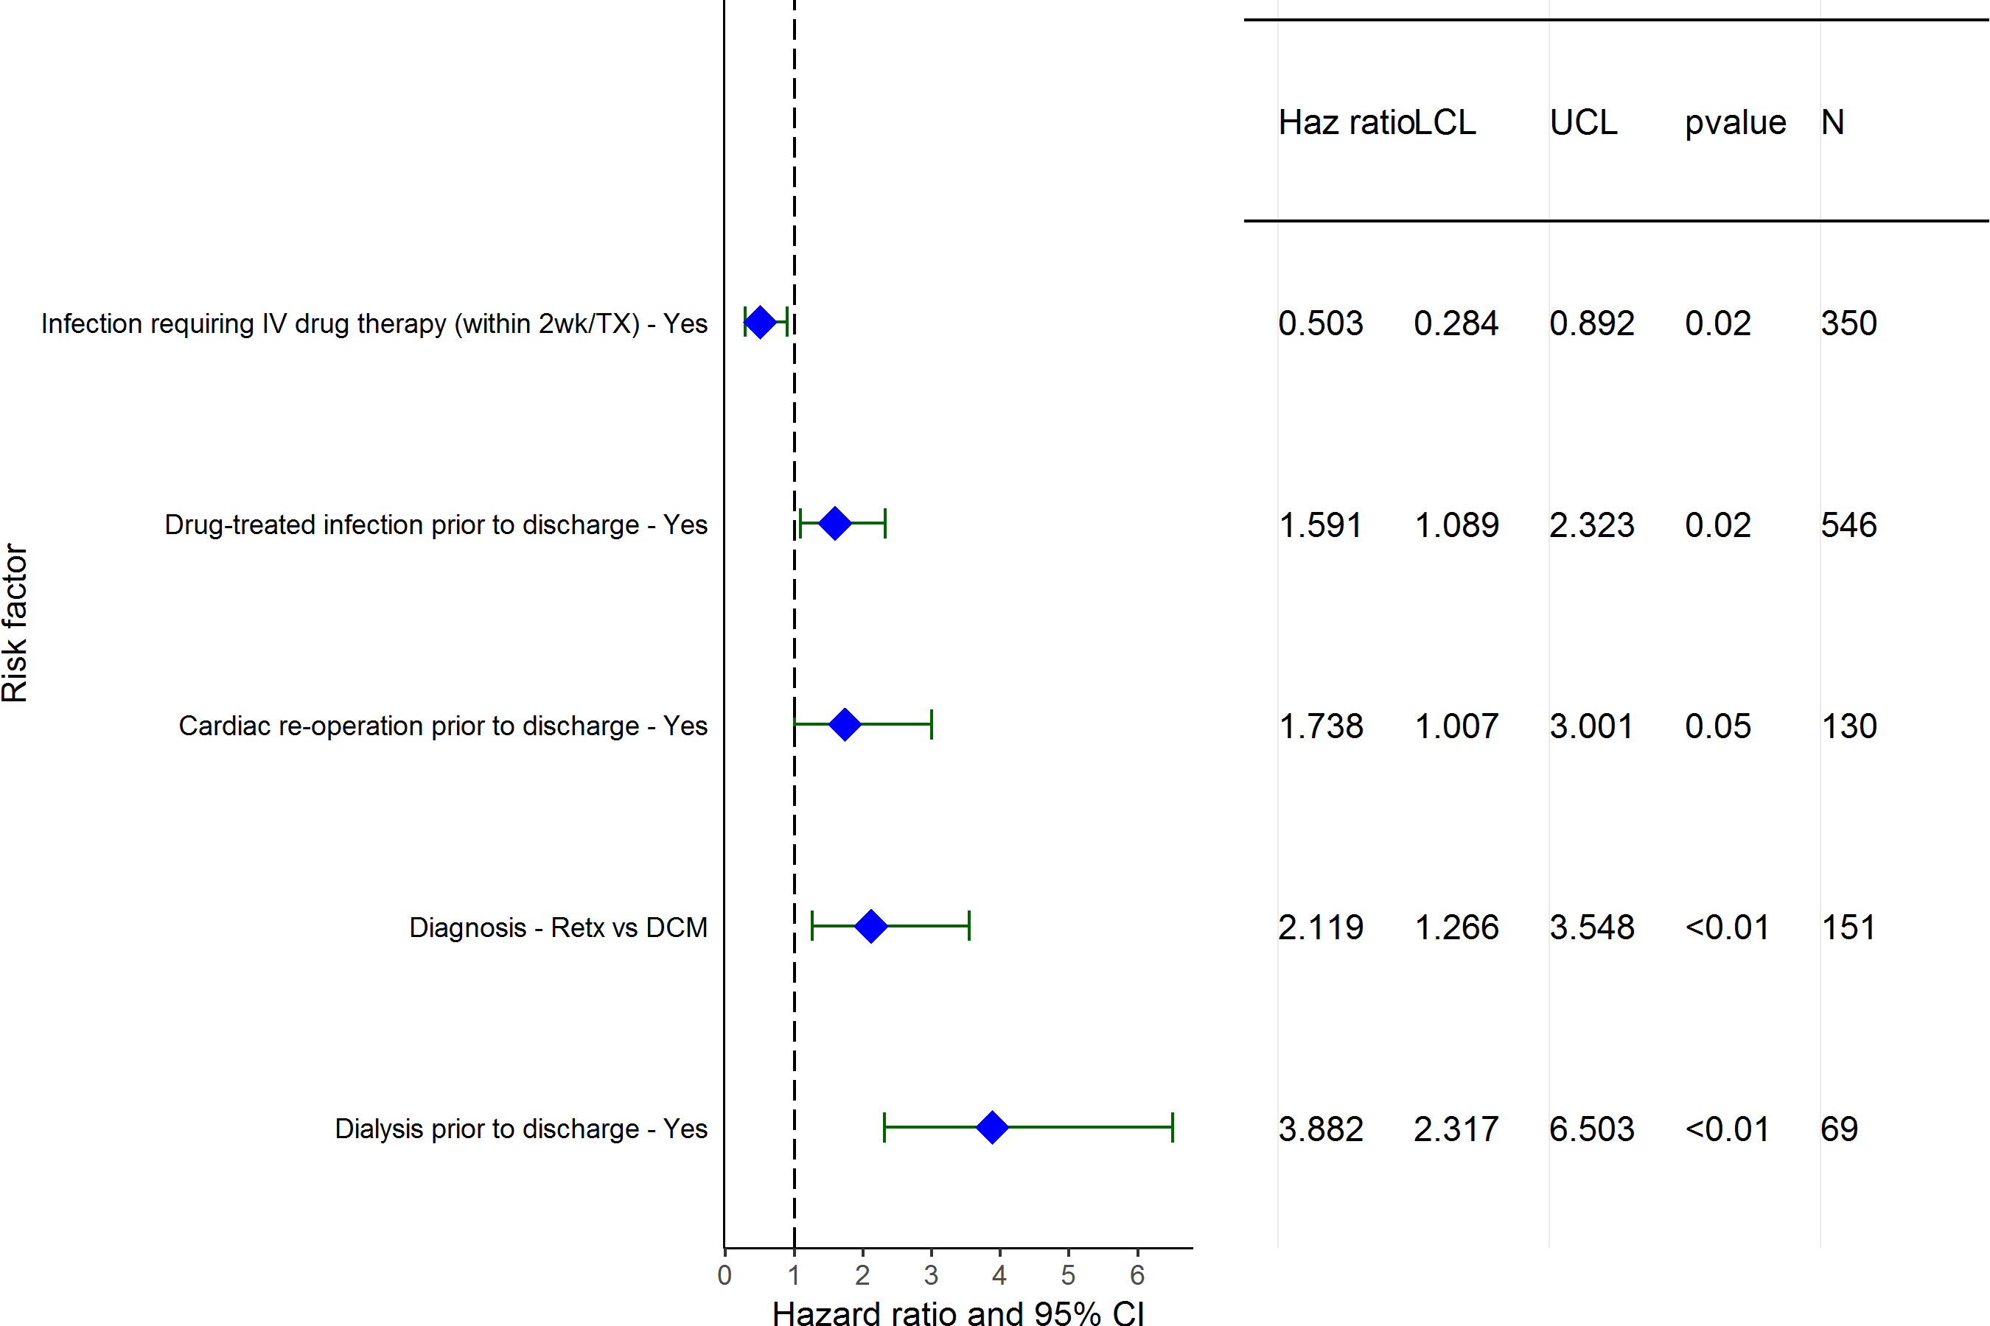
Pediatric Heart Transplants (1/1995-6/2006)
Limited to Recipients without Severe Renal Dysfunction* Pre-Transplant
Statistically Significant Risk Factors for Developing Renal Dysfunction within 10 Years with 95% Confidence Limits
2017
(N = 2,427)
JHLT. 2017 Oct; 36(10): 1037-1079

Slide 180
Pediatric Heart Transplants (1/1995-6/2006)
Statistically Significant Risk Factors for Developing Renal Dysfunction within 10 Years
Limited to Recipients without Severe Renal Dysfunction* Pre-Transplant
Continuous Factors (see figures)
Recipient weight (kg) | Estimated GFR
Center volume: prev ped TXs within 1 yr
2017
JHLT. 2017 Oct; 36(10): 1037-1079

Slide 181
Pediatric Heart Transplants (1/1995-6/2006)
Recipient weight (kg)
Limited to Recipients without Severe Renal Dysfunction* Pre-Transplant
Risk Factors for Developing Renal Dysfunction within 10 Years with 95% Confidence Limits
p < 0.0001
2017
(N = 2,427)
JHLT. 2017 Oct; 36(10): 1037-1079
Notes:
Multivariable analysis was performed using a proportional hazards model censoring all patients at 5 years. Continuous factors were fit using a restricted cubic spline.

Slide 182
Pediatric Heart Transplants (1/1995-6/2006)
Estimated GFR
Limited to Recipients without Severe Renal Dysfunction* Pre-Transplant
Risk Factors for Developing Renal Dysfunction within 10 Years with 95% Confidence Limits
p = 0.0100
2017
(N = 2,427)
JHLT. 2017 Oct; 36(10): 1037-1079
Notes:
Multivariable analysis was performed using a proportional hazards model censoring all patients at 10 years. Continuous factors were fit using a restricted cubic spline.

Slide 183
Pediatric Heart Transplants (1/1995-6/2006)
Center volume: prev ped TXs within 1 yr
Limited to Recipients without Severe Renal Dysfunction* Pre-Transplant
Risk Factors for Developing Renal Dysfunction within 10 Years with 95% Confidence Limits
p = 0.0243
2017
(N = 2,427)
JHLT. 2017 Oct; 36(10): 1037-1079
Notes:
Multivariable analysis was performed using a proportional hazards model censoring all patients at 10 years. Continuous factors were fit using a restricted cubic spline.

Slide 184
Focus Theme
2017
JHLT. 2017 Oct; 36(10): 1037-1079

Slide 185
Pediatric Heart Transplants
Ischemic Time Distribution by Diagnosis
(Transplants: January 2004 – June 2016)
2017
p < 0.0001
JHLT. 2017 Oct; 36(10): 1037-1079

Slide 186
Pediatric Heart Transplants
Ischemic Time Distribution by Recipient Age
(Transplants: January 2004 – June 2016)
2017
p < 0.0001
JHLT. 2017 Oct; 36(10): 1037-1079

Slide 187
Pediatric Heart Transplants
Ischemic Time Distribution by Mechanical Circulatory Support*
(Transplants: January 2004 – June 2016)
2017
* LVAD, RVAD, TAH, ECMO
p = 0.0552
JHLT. 2017 Oct; 36(10): 1037-1079

Slide 188
Pediatric Heart Transplants
Ischemic Time Distribution by Donor Age
(Transplants: January 2004 – June 2016)
2017
p < 0.0001
JHLT. 2017 Oct; 36(10): 1037-1079

Slide 189
Pediatric Heart Transplants
Ischemic Time Distribution by Donor Cause of Death
(Transplants: January 2004 – June 2016)
2017
p < 0.0001
JHLT. 2017 Oct; 36(10): 1037-1079

Slide 190
Pediatric Heart Transplants
Ischemic Time Distribution by Year of Transplant
2017
JHLT. 2017 Oct; 36(10): 1037-1079

Slide 191
Pediatric Heart Transplants
Ischemic Time Distribution by Location
(Transplants: January 2004 – June 2016)
2017
p < 0.0001
JHLT. 2017 Oct; 36(10): 1037-1079

Slide 192
Pediatric Heart Transplants
Ischemic Time Distribution by Center Volume
(Transplants: January 2004 – June 2016)
2017
p < 0.0001
JHLT. 2017 Oct; 36(10): 1037-1079

Slide 193
Pediatric Heart Transplants
Kaplan-Meier Survival Within 30 Days by Ischemic Time
(Transplants: January 2004 – June 2015)
All pair-wise comparisons were significant at p < 0.05 except 0-<2 vs. 2-<4 hours
2017
JHLT. 2017 Oct; 36(10): 1037-1079
Notes:
Survival was calculated using the Kaplan-Meier method, which incorporates information from all transplants for whom any follow-up has been provided. Since many patients are still alive and some patients have been lost to follow-up, the survival rates are estimates rather than exact rates because the time of death is not known for all patients.
Survival rates were compared using the log-rank test statistic. Adjustments for multiple comparisons were done using Scheffe’s method. Results of log-rank test should be interpreted with caution when curves cross.

Slide 194
Pediatric Heart Transplants
Kaplan-Meier Survival by Ischemic Time
(Transplants: January 2004 – June 2015)
No pair-wise comparisons were significant at p < 0.05 except 2-<4 vs. 4+ hours
2017
JHLT. 2017 Oct; 36(10): 1037-1079
Notes:
Survival was calculated using the Kaplan-Meier method, which incorporates information from all transplants for whom any follow-up has been provided. Since many patients are still alive and some patients have been lost to follow-up, the survival rates are estimates rather than exact rates because the time of death is not known for all patients.
Survival rates were compared using the log-rank test statistic. Adjustments for multiple comparisons were done using Scheffe’s method. Results of log-rank test should be interpreted with caution when curves cross.

Slide 195
Pediatric Heart Transplants
Kaplan-Meier Survival by Ischemic Time
Diagnosis = CHD
(Transplants: January 2004 – June 2015)
No pair-wise comparisons were significant at p < 0.05.
2017
JHLT. 2017 Oct; 36(10): 1037-1079
Notes:
Survival was calculated using the Kaplan-Meier method, which incorporates information from all transplants for whom any follow-up has been provided. Since many patients are still alive and some patients have been lost to follow-up, the survival rates are estimates rather than exact rates because the time of death is not known for all patients.
Survival rates were compared using the log-rank test statistic. Adjustments for multiple comparisons were done using Scheffe’s method. Results of log-rank test should be interpreted with caution when curves cross.

Slide 196
Pediatric Heart Transplants
Percentage Experiencing Treated Rejection between Discharge and 1-Year Follow-Up by Ischemic Time
(Transplants: January 2004 – June 2015)
No pair-wise comparisons were significant at p < 0.05.
Analysis is limited to patients who were alive at the time of the follow-up.
Treated rejection = Recipient was reported to (1) have at least one acute rejection episode that was treated with an anti-rejection agent; or (2) have been hospitalized for rejection.
2017
JHLT. 2017 Oct; 36(10): 1037-1079
Notes:
Comparisons were made using the chi-square statistic. Adjustments for multiple comparisons were done using Bonferroni method.

Slide 197
Pediatric Heart Transplants
Freedom from Cardiac Allograft Vasculopathy
by Ischemic Time
(Transplants: January 2004 – June 2015)
No pair-wise comparisons were significant at p < 0.05.
2017
JHLT. 2017 Oct; 36(10): 1037-1079
Notes:
Freedom from CAV was computed using the Kaplan-Meier method.
The development of CAV is reported on annual follow-ups; a date of diagnosis is not provided. For this figure the midpoint between the date of previous follow-up (when event had not occurred) and the date of follow-up when the event was reported was used as the date of occurrence. Patients were included in the analysis until an unknown response for the outcome of interest was reported. Therefore, the rates seen here may differ from those reported in the cumulative prevalence slide which is based on only those patients with known responses for each of the outcomes at all follow-up time points.
Survival rates were compared using the log-rank test statistic. A significant p-value means that at least one of the groups is different than the others but it doesn’t identify which group it is. Results of log-rank test should be interpreted with caution when curves cross.

Slide 198
Pediatric Heart Transplants
Freedom from Severe Renal Dysfunction* by Ischemic Time
(Transplants: January 2004 – June 2015)
No pair-wise comparisons were significant at p < 0.05.
2017
JHLT. 2017 Oct; 36(10): 1037-1079
Notes:
Freedom from severe renal dysfunction rate was computed using the Kaplan-Meier method.
The development of severe renal dysfunction is reported on annual follow-ups; a date of diagnosis is not provided. For this figure the midpoint between the date of previous follow-up (when event had not occurred) and the date of follow-up when the event was reported was used as the date of occurrence. Patients were included in the analysis until an unknown response for the outcome of interest was reported. Therefore, the rates seen here may differ from those reported in the cumulative prevalence slide which is based on only those patients with known responses for each of the outcomes at all follow-up time points.
Survival rates were compared using the log-rank test statistic. Adjustments for multiple comparisons were done using Scheffe’s method. Results of log-rank test should be interpreted with caution when curves cross.

Slide 199
Pediatric Heart Transplants
Length of Stay Distribution by Ischemic Time
(Transplants: January 2004 – June 2015)
2017
JHLT. 2017 Oct; 36(10): 1037-1079

