Slide 1

LUNG TRANSPLANTATION
Pediatric Recipients
2016
JHLT. 2016 Oct; 35(10): 1149-1205
Notes:
Analysis excludes living donor transplants unless specifically stated otherwise.

Slide 2
Table of Contents
Donor, recipient and center characteristics: slides 3-22
Post transplant – survival and other outcomes: slides 23-43
Induction and maintenance immunosuppression: slides 44-50
Post transplant morbidities: slides 51-69
Multivariable analyses: slides 70-79
2016
JHLT. 2016 Oct; 35(10): 1149-1205

Slide 3
Donor, Recipient and Center Characteristics
2016
JHLT. 2016 Oct; 35(10): 1149-1205
Notes:
Analysis excludes living donor transplants unless specifically stated otherwise.

Slide 4
Pediatric Lung Transplants
Recipient Age Distribution – Number
(Transplants: January 1988 – June 2015)
2016
Analysis includes deceased and living donor transplants.
JHLT. 2016 Oct; 35(10): 1149-1205

Slide 5
Pediatric Lung Transplants
Recipient Age Distribution – Percentage
(Transplants: January 1988 – June 2015)
2016
Analysis includes deceased and living donor transplants.
JHLT. 2016 Oct; 35(10): 1149-1205

Slide 6
Pediatric Lung Transplants
Donor Type Distribution by Transplant Year
(Transplants: January 1986 - December 2014)
NOTE: This figure includes only the lung transplants that are reported to the ISHLT Transplant Registry. As such, the presented data may not reflect the changes in the number of lung transplants performed worldwide.
2016
Analysis includes deceased and living donor transplants.
JHLT. 2016 Oct; 35(10): 1149-1205

Slide 7
Pediatric Lung Transplants
Donor Type Distribution by Recipient Age Group Within Era
(Transplants: January 1988 – June 2015)
2008-6/2015
2016
Analysis includes deceased and living donor transplants.
JHLT. 2016 Oct; 35(10): 1149-1205

Slide 8
Pediatric Lung Transplants
Donor Age Distribution
(Transplants: January 1988 – June 2015)
2016
JHLT. 2016 Oct; 35(10): 1149-1205
Notes:
Transplants with unknown donor ages are excluded from this tabulation.

Slide 9
Pediatric Lung Transplants
Donor and Recipient Age
(Transplants: January 2008 – June 2015)
2016
JHLT. 2016 Oct; 35(10): 1149-1205

Slide 10
Pediatric Lung Transplants
Recipient Age Distribution by Year of Transplant
NOTE: This figure includes only the pediatric lung transplants that are reported to the ISHLT Transplant Registry. Therefore, these numbers should not be interpreted as the rate of change in pediatric lung procedures performed worldwide.
2016
Analysis includes deceased and living donor transplants.
JHLT. 2016 Oct; 35(10): 1149-1205

Slide 11
Pediatric Lung Retransplants by Year of Retransplant
2016
Only patients who were less than 18 years old at the time of retransplant are included.
JHLT. 2016 Oct; 35(10): 1149-1205

Slide 12
Pediatric Lung Transplants
Number of Centers Reporting Transplants by Location
(Transplants: January 1986 – December 2014)
2016
Analysis includes deceased and living donor transplants.
JHLT. 2016 Oct; 35(10): 1149-1205

Slide 13
Pediatric Lung Transplants
Number of Centers Reporting Transplants by Pediatric Center Volume
2016
Analysis includes deceased and living donor transplants.
JHLT. 2016 Oct; 35(10): 1149-1205

Slide 14
Pediatric Lung Transplants
Number of Transplants by Pediatric Center Volume
2016
Analysis includes deceased and living donor transplants.
JHLT. 2016 Oct; 35(10): 1149-1205

Slide 15
Pediatric Lung Transplants
Indications by Age Group
(Transplants: January 2000 – June 2015)
Diagnosis | < 1 |  | 1-5 |  | 6-10 |  | 11-17
Cystic Fibrosis | 0 |  | 4 | 4.0% | 108 | 50.0% | 780 | 67.8%
Bronchiectasis | 0 |  | 0 |  | 0 |  | 19 | 1.7%
ILD | 5 | 8.8% | 9 | 9.1% | 7 | 3.2% | 35 | 3.0%
ILD Other Specify Cause | 6 | 10.5% | 9 | 9.1% | 21 | 9.7% | 43 | 3.7%
Pulmonary Hypertension/Pulmonary Arterial Hypertension | 7 | 12.3% | 27 | 27.3% | 22 | 10.2% | 89 | 7.7%
PH Eisenmenger’s Syndrome | 0 |  | 1 | 1.0% | 1 | 0.5% | 6 | 0.5%
PHT Other | 14 | 24.6% | 18 | 18.2% | 8 | 3.7% | 18 | 1.6%
Obliterative Bronchiolitis (non-Retransplant) | 0 |  | 8 | 8.1% | 27 | 12.5% | 53 | 4.6%
Bronchopulmonary Dysplasia | 4 | 7.0% | 3 | 3.0% | 3 | 1.4% | 3 | 0.3%
ABCA3 Transporter Mutation | 4 | 7.0% | 4 | 4.0% | 1 | 0.5% | 1 | 0.1%
Surfactant Protein B Deficiency | 12 | 21.1% | 4 | 4.0% | 1 | 0.5% | 0
Surfactant Protein C Deficiency | 0 |  | 1 | 1.0% | 0 |  | 1 | 0.1%
Retransplant (Obliterative Bronchiolitis) | 0 |  | 4 | 4.0% | 5 | 2.3% | 37 | 3.2%
Retransplant (not Obliterative Bronchiolitis) | 0 |  | 3 | 3.0% | 5 | 2.3% | 40 | 3.5%
COPD, with or without A1ATD | 2 | 3.5% | 1 | 1.0% | 1 | 0.5% | 7 | 0.6%
Other | 3 | 5.3% | 3 | 3.0% | 6 | 2.8% | 19 | 1.7%
2016
Analysis includes deceased and living donor transplants.
JHLT. 2016 Oct; 35(10): 1149-1205
Notes:
Transplants with unknown diagnoses are excluded from this tabulation.

Slide 16
Pediatric Lung Transplants
Diagnosis Distribution by Gender
(Transplants: January 2008 – June 2015)
2016
NOTE: Unknown diagnoses were excluded from this tabulation. Analysis includes deceased and living donor transplants.
JHLT. 2016 Oct; 35(10): 1149-1205

Slide 17
Pediatric Lung Transplants
Diagnosis Distribution by Location
(Transplants: January 2008 – June 2015)
Total number of transplants reported:
Europe = 383, North America = 400, Other = 78
2016
NOTE: Unknown diagnoses were excluded from this tabulation. Analysis includes deceased and living donor transplants.
JHLT. 2016 Oct; 35(10): 1149-1205

Slide 18
Pediatric Lung Transplants
Age Distribution by Diagnosis
(Transplants: January 2008 – June 2015)
2016
NOTE: Unknown diagnoses were excluded from this tabulation. Analysis includes deceased and living donor transplants.
JHLT. 2016 Oct; 35(10): 1149-1205

Slide 19
Pediatric Lung Transplants
Diagnosis Distribution by Era
(Transplants: January 1988 – June 2015)
2016
NOTE: Unknown diagnoses were excluded from this tabulation. Analysis includes deceased and living donor transplants.
JHLT. 2016 Oct; 35(10): 1149-1205

Slide 20
Pediatric Lung Transplants
Age Distribution by Era and Diagnosis
(Transplants: January 2000 – June 2015)
CF
ILD
ILD Other
OB (non-Retx)
PHT Other
PH/ PAH
Other
2016
NOTE: Unknown diagnoses were excluded from this tabulation. Analysis includes deceased and living donor transplants.
JHLT. 2016 Oct; 35(10): 1149-1205

Slide 21
Pediatric Lung Transplants
Age Distribution by Location
(Transplants: January 2008 – June 2015)
2016
Analysis includes deceased and living donor transplants.
JHLT. 2016 Oct; 35(10): 1149-1205

Slide 22
Pediatric Lung Transplants
Donor Age Distribution by Location
(Transplants: January 2008 – June 2015)
NOTE: Transplants with unknown donor age and living donor transplants were excluded from this tabulation.
2016
Total number of transplants reported:
Europe = 383, North America = 400, Other = 78
JHLT. 2016 Oct; 35(10): 1149-1205

Slide 23
Post Transplant:
Survival and Other Outcomes
2016
JHLT. 2016 Oct; 35(10): 1149-1205
Notes:
Analysis excludes living donor transplants unless specifically stated otherwise.

Slide 24
Lung Transplants
Kaplan-Meier Survival by Recipient Age Group
(Transplants: January 1990 – June 2014)
p = 0.1299
Median survival (years): Adult = 5.7; Pediatric= 5.4
2016
JHLT. 2016 Oct; 35(10): 1149-1205
Notes:
Survival was calculated using the Kaplan-Meier method, which incorporates information from all transplants for whom any follow-up has been provided. Since many patients are still alive and some patients have been lost to follow-up, the survival rates are estimates rather than exact rates because the time of death is not known for all patients. The median survival is the estimated time point at which 50% of all of the recipients have died. Survival rates were compared using the log-rank test statistic. Results of log-rank test should be interpreted with caution when curves cross.

Slide 25
Lung Transplants
Kaplan-Meier Survival by Recipient Age Group and Procedure
(Transplants: January 1990 – June 2014)
Adult, Single vs. Adult, Bilateral/Double: p<0.0001
Adult, Single vs. Pediatric: p<0.0001
Adult, Bilateral/Double vs. Pediatric: p = 0.0009
Median survival (years): Adult, Single=4.5;
Adult, Bilateral/Double=7.1;
Adult, Pediatric=5.4
2016
JHLT. 2016 Oct; 35(10): 1149-1205
Notes:
Survival was calculated using the Kaplan-Meier method, which incorporates information from all transplants for whom any follow-up has been provided. Since many patients are still alive and some patients have been lost to follow-up, the survival rates are estimates rather than exact rates because the time of death is not known for all patients. The median survival is the estimated time point at which 50% of all of the recipients have died.
Survival rates were compared using the log-rank test statistic. Adjustments for multiple comparisons were done using Scheffe’s method. Results of log-rank test should be interpreted with caution when curves cross.

Slide 26
Pediatric Lung Transplants
Kaplan-Meier Survival by Procedure Type
(Transplants: January 1990 – June 2014)
p<0.0001
Median survival (years):
Single Lung=2.2; Bilateral/Double=5.6
2016
JHLT. 2016 Oct; 35(10): 1149-1205
Notes:
Survival was calculated using the Kaplan-Meier method, which incorporates information from all transplants for whom any follow-up has been provided. Since many patients are still alive and some patients have been lost to follow-up, the survival rates are estimates rather than exact rates because the time of death is not known for all patients. The median survival is the estimated time point at which 50% of all of the recipients have died.
Survival rates were compared using the log-rank test statistic.

Slide 27
Pediatric Lung Transplants
Kaplan-Meier Survival by Diagnosis
(Transplants: January 1990 – June 2014)
No pair-wise comparisons were significant at p < 0.05.
Median survival (years): CF=5.3; ILD=4.5; ILD Other=5.7; OB (non-Retx)=NA; PHT Other=3.5; PH/PAH=8.6
2016
JHLT. 2016 Oct; 35(10): 1149-1205
Notes:
Survival was calculated using the Kaplan-Meier method, which incorporates information from all transplants for whom any follow-up has been provided. Since many patients are still alive and some patients have been lost to follow-up, the survival rates are estimates rather than exact rates because the time of death is not known for all patients. The median survival is the estimated time point at which 50% of all of the recipients have died.
Survival rates were compared using the log-rank test statistic. Results of log-rank test should be interpreted with caution when curves cross.

Slide 28
Pediatric Lung Transplants
Conditional Kaplan-Meier Survival by Diagnosis
(Transplants: January 1990 – June 2014)
Median survival (years): CF=8.0; ILD=NA; ILD Other=7.3; OB (non-Retx)=NA; PHT Other=7.4; PH/PAH=NA
No pair-wise comparisons were significant at p < 0.05.
2016
JHLT. 2016 Oct; 35(10): 1149-1205
Notes:
Survival was calculated using the Kaplan-Meier method, which incorporates information from all transplants for whom any follow-up has been provided. Since many patients are still alive and some patients have been lost to follow-up, the survival rates are estimates rather than exact rates because the time of death is not known for all patients.
This figure shows survival conditional on survival to 1 year. Therefore, only patients surviving to at least 1 year were included in the calculation. The conditional median survival is the estimated time point at which 50% of the recipients who survive to at least 1 year have died.
Survival rates were compared using the log-rank test statistic. Results of log-rank test should be interpreted with caution when curves cross.

Slide 29
Pediatric Lung Transplants
Kaplan-Meier Survival by Recipient Age Group
(Transplants: January 1990 – June 2014)
No pair-wise comparisons were significant at p<0.05.
Median survival (years):
< 1 = 6.4; 1-5 = 7.2; 6-10 = 6.7; 11-17 = 4.9
2016
JHLT. 2016 Oct; 35(10): 1149-1205
Notes:
Survival was calculated using the Kaplan-Meier method, which incorporates information from all transplants for whom any follow-up has been provided. Since many patients are still alive and some patients have been lost to follow-up, the survival rates are estimates rather than exact rates because the time of death is not known for all patients. The median survival is the estimated time point at which 50% of all of the recipients have died.
Survival rates were compared using the log-rank test statistic. Adjustments for multiple comparisons were done using Scheffe’s method. Results of log-rank test should be interpreted with caution when curves cross. With only small number of transplants available for analysis in the tail, the p-value may be affected by the outcomes of just a few transplants.

Slide 30
Pediatric Lung Transplants
Conditional Kaplan-Meier Survival by Recipient Age Group
(Transplants: January 1990 – June 2014)
No pair-wise comparisons were significant at p<0.05.
Median survival (years):
< 1 = 9.2; 1-5 = NA; 6-10 = 10.0; 11-17 = 8.0
2016
JHLT. 2016 Oct; 35(10): 1149-1205
Notes:
Survival was calculated using the Kaplan-Meier method, which incorporates information from all transplants for whom any follow-up has been provided. Since many patients are still alive and some patients have been lost to follow-up, the survival rates are estimates rather than exact rates because the time of death is not known for all patients.
This figure shows survival conditional on survival to 1 year. Therefore, only patients surviving to at least 1 year were included in the calculation. The conditional median survival is the estimated time point at which 50% of the recipients who survive to at least 1 year have died. Because the decline in survival is greatest during the first year following transplantation, the conditional survival provides a more realistic expectation of survival time for recipients who survive the early post-transplant period.
Survival rates were compared using the log-rank test statistic. Adjustments for multiple comparisons were done using Scheffe’s method. Results of log-rank test should be interpreted with caution when curves cross. With only small number of transplants available for analysis in the tail, the p-value may be affected by the outcomes of just a few transplants.

Slide 31
Pediatric Lung Transplants
Kaplan-Meier Survival by Gender
(Transplants: January 1990 – June 2014)
p = 0.0205
Median survival (years):
Male=5.9; Female=4.9
2016
Median recipient age (years):
Male=13.0; Female=14.0
JHLT. 2016 Oct; 35(10): 1149-1205
Notes:
Survival was calculated using the Kaplan-Meier method, which incorporates information from all transplants for whom any follow-up has been provided. Since many patients are still alive and some patients have been lost to follow-up, the survival rates are estimates rather than exact rates because the time of death is not known for all patients. The median survival is the estimated time point at which 50% of all of the recipients have died.
Survival rates were compared using the log-rank test statistic. Results of log-rank test should be interpreted with caution when curves cross.

Slide 32
Pediatric Lung Transplants
Kaplan-Meier Survival by Donor/Recipient Gender
(Transplants: January 1990 – June 2014)
No pair-wise comparisons were significant at p<0.05 except Male/Male vs. Male/Female
Median survival (years):
Male/Male: 6.3; Male/Female: 4.4; Female/Male: 5.5; Female/Female: 5.6
2016
JHLT. 2016 Oct; 35(10): 1149-1205
Notes:
Survival was calculated using the Kaplan-Meier method, which incorporates information from all transplants for whom any follow-up has been provided. Since many patients are still alive and some patients have been lost to follow-up, the survival rates are estimates rather than exact rates because the time of death is not known for all patients. The median survival is the estimated time point at which 50% of all of the recipients have died.
Survival rates were compared using the log-rank test statistic. Adjustments for multiple comparisons were done using Scheffe’s method.

Slide 33
Pediatric Lung Transplants
Kaplan-Meier Survival by Era
(Transplants: January 1988 – June 2014)
Median survival (years):
Unconditional: 1988-1999=3.3; 2000-2007=5.8; 2008-6/2014=NA Conditional: 1988-1999=7.1; 2000-2007=8.8; 2008-6/2014=NA
1988-1999 vs. 2000-2007: p = 0.0007
1988-1999 vs. 2008-6/2014: p<0.0001
2000-2007 vs. 2008-6/2014: p = 0.4806
2016
JHLT. 2016 Oct; 35(10): 1149-1205
Notes:
Survival was calculated using the Kaplan-Meier method, which incorporates information from all transplants for whom any follow-up has been provided. Since many patients are still alive and some patients have been lost to follow-up, the survival rates are estimates rather than exact rates because the time of death is not known for all patients.
The median survival is the estimated time point at which 50% of all of the recipients have died. The conditional median survival is the estimated time point at which 5% of the recipients who survive to at least 1 year have died. Because the decline in survival is greatest during the first year following transplantation, the conditional survival provides a more realistic expectation of survival time for recipients who survive the early post-transplant period.
Survival rates were compared using the log-rank test statistic. Adjustments for multiple comparisons were done using Scheffe’s method.

Slide 34
Pediatric Lung Transplants
Kaplan-Meier Survival by Donor Age,
Recipients Age 11-17 Years
(Transplants: January 1990 – June 2014)
Median survival (years):
0-10=5.7; 11-17=4.8; 18-34=4.7;35-49=5.6; 50+=3.9
No pair-wise comparisons were significant at p<0.05.
2016
JHLT. 2016 Oct; 35(10): 1149-1205
Notes:
Survival was calculated using the Kaplan-Meier method, which incorporates information from all transplants for whom any follow-up has been provided. Since many patients are still alive and some patients have been lost to follow-up, the survival rates are estimates rather than exact rates because the time of death is not known for all patients. The median survival is the estimated time point at which 50% of all of the recipients have died.
Survival rates were compared using the log-rank test statistic. Adjustments for multiple comparisons were done using Scheffe’s method. Results of log-rank test should be interpreted with caution when curves cross.

Slide 35
Pediatric Lung Transplants
Kaplan-Meier Survival by Donor Type for Recipients Age 11-17 Years
(Transplants: January 1990 – June 2014)
Median survival (years): Deceased = 4.9 Living = 3.8
p = 0.1019
2016
JHLT. 2016 Oct; 35(10): 1149-1205
Notes:
Survival was calculated using the Kaplan-Meier method, which incorporates information from all transplants for whom any follow-up has been provided. Since many patients are still alive and some patients have been lost to follow-up, the survival rates are estimates rather than exact rates because the time of death is not known for all patients. The median survival is the estimated time point at which 50% of all of the recipients have died.
Survival rates were compared using the log-rank test statistic.

Slide 36
Pediatric Lung Transplants
Kaplan-Meier Survival by Stages of Chronic Kidney Disease* at
Time of Transplant
(Transplants: January 1990 – June 2014)
Median survival (years):
1: 5.8; 2: 3.9; 3: 4.0
No pair-wise comparisons were significant at p < 0.05.
* Stages of CKD:
1: eGFR ≥90; 2: eGFR=60-89; 3: eGFR=30-59
2016
JHLT. 2016 Oct; 35(10): 1149-1205
Notes:
Survival was calculated using the Kaplan-Meier method, which incorporates information from all transplants for whom any follow-up has been provided. Since many patients are still alive and some patients have been lost to follow-up, the survival rates are estimates rather than exact rates because the time of death is not known for all patients.
The median survival is the estimated time point at which 50% of all of the recipients have died.
Survival rates were compared using the log-rank test statistic. Adjustments for multiple comparisons were done using Scheffe’s method.

Slide 37
Pediatric Lung Transplants
Kaplan-Meier Survival Donor/Recipient Height Difference (%*)
(Transplants: January 1990 – June 2014)
No pair-wise comparisons were significant at p < 0.05.
2016
* Computed as
(donor – recipient height)*100%/recipient height
JHLT. 2016 Oct; 35(10): 1149-1205
Notes:
Survival was calculated using the Kaplan-Meier method, which incorporates information from all transplants for whom any follow-up has been provided. Since many patients are still alive and some patients have been lost to follow-up, the survival rates are estimates rather than exact rates because the time of death is not known for all patients.
Survival rates were compared using the log-rank test statistic. Adjustments for multiple comparisons were done using Scheffe’s method. Results of log-rank test should be interpreted with caution when curves cross.

Slide 38
Pediatric Lung Transplants
Kaplan-Meier Survival Donor - Recipient Height Difference (cm)
(Transplants: January 1990 – June 2014)
No pair-wise comparisons were significant at p < 0.05.
2016
JHLT. 2016 Oct; 35(10): 1149-1205
Notes:
Survival was calculated using the Kaplan-Meier method, which incorporates information from all transplants for whom any follow-up has been provided. Since many patients are still alive and some patients have been lost to follow-up, the survival rates are estimates rather than exact rates because the time of death is not known for all patients.
Survival rates were compared using the log-rank test statistic. Adjustments for multiple comparisons were done using Scheffe’s method. Results of log-rank test should be interpreted with caution when curves cross.

Slide 39
Pediatric Lung Retransplants
(Retransplants: January 2000 – June 2015)
2016
Analysis includes deceased and living donor transplants.
JHLT. 2016 Oct; 35(10): 1149-1205

Slide 40
Pediatric Lung Transplants
Kaplan-Meier Survival by Transplant Type
(Transplants: January 2000 – June 2015)
p = 0.0006
2016
JHLT. 2016 Oct; 35(10): 1149-1205
Notes:
Survival was calculated using the Kaplan-Meier method, which incorporates information from all retransplants for whom any follow-up has been provided. Since many patients are still alive and some patients have been lost to follow-up, the survival rates are estimates rather than exact rates because the time of death is not known for all patients.
Survival rates were compared using the log-rank test statistic.

Slide 41
Pediatric Lung Transplants
Functional Status of Surviving Recipients
(Follow-ups: January 2008 – June 2015)
2016
JHLT. 2016 Oct; 35(10): 1149-1205
Notes:
Functional status is collected using Karnofsky score for adult recipients and Lansky score for pediatric recipients.
This figure shows the functional status reported on the 1-year, 2-year and 3-year annual follow-ups. Because all follow-ups between January 2008 and June 2015 were included, the bars do not include the same patients.

Slide 42
Pediatric Lung Transplants
Rehospitalization Post-Transplant of Surviving Recipients
(Follow-ups: January 2008 – June 2015)
2016
JHLT. 2016 Oct; 35(10): 1149-1205
Notes:
This figure shows the hospitalizations reported on the 1-year, 3-year and 5-year annual follow-ups, representing the hospitalizations between discharge and 1 year, between the 2-year and 3-year follow-up and between the 4-year and 5-year follow-up, respectively. Because all follow-ups between 2008 and June 2015 were included, the bars do not include the same patients.

Slide 43
Pediatric Lung Transplants
Rehospitalization Post-Transplant of Surviving Recipients
(Follow-ups: January 2008 – June 2015)
2016
JHLT. 2016 Oct; 35(10): 1149-1205
Notes:
This figure shows the hospitalizations reported between discharge and 1 year, between the 1-year and 3-year follow-up, and between the 3-year and 5-year follow-up, respectively. Because all follow-ups between 2008 and June 2015 were included, the bars do not include the same patients.

Slide 44
Induction and Maintenance Immunosuppression
2016
JHLT. 2016 Oct; 35(10): 1149-1205
Notes:
Analysis excludes living donor transplants unless specifically stated otherwise.

Slide 45
Pediatric Lung Transplants
Induction Immunosuppression
(Transplants: January 2008 – June 2015)
2016
Analysis is limited to patients who were alive at the time of the discharge.
JHLT. 2016 Oct; 35(10): 1149-1205

Slide 46
Pediatric Lung Transplants
Induction Immunosuppression
(Transplants: January 2001 – June 2015)
2016
Analysis is limited to patients who were alive at the time of the discharge.
JHLT. 2016 Oct; 35(10): 1149-1205

Slide 47
Pediatric Lung Transplants
Kaplan-Meier Survival Stratified by Induction Use
(Transplants: January 2008 – June 2014)
p = 0.7345
2016
JHLT. 2016 Oct; 35(10): 1149-1205
Notes:
Survival was calculated using the Kaplan-Meier method, which incorporates information from all transplants for whom any follow-up has been provided. Since many patients are still alive and some patients have been lost to follow-up, the survival rates are estimates rather than exact rates because the time of death is not know for all patients.
Survival rates were compared using the log-rank test statistic.

Slide 48
Pediatric Lung Transplants
Maintenance Immunosuppression at Time of Follow-up
(Follow-ups: January 2008 – June 2015)
2016
Analysis is limited to patients who were alive at the time of the follow-up.
JHLT. 2016 Oct; 35(10): 1149-1205
Notes:
This figure shows the maintenance immunosuppression reported as being provided at the time of the 1-year and 5-year annual follow-up forms. To provide a snapshot of current practice, only follow-ups occurring between January 2008 and June 2015 were included. Therefore, this figure does not represent changes in practice between the 1-year follow-up and 5-year follow-up on a cohort of patients. The patients in the 1-year tabulation are not the same patients as in the 5-year tabulation.

Slide 49
Pediatric Lung Transplants
Maintenance Immunosuppression at Time of Follow-up
(Follow-ups: January 2008 – June 2015)
1 Year Follow-up (N=325)
5 Year Follow-up (N=160)
NOTE: No patients were on both calcineurin inhibitors at different points during the 1-year, and two patients were on neither drug during the 1-year. In the 5-year tabulations, 1 patient was reported to be on both drugs during the year and none were reported to be on neither drug.
2016
Analysis is limited to patients who were alive at the time of the follow-up.
JHLT. 2016 Oct; 35(10): 1149-1205
Notes:
This figure shows the maintenance immunosuppression reported as being provided at the time of the 1-year and 5-year annual follow-up forms. To provide a snapshot of current practice, only follow-ups occurring between January 2008 and June 2015 were included. Therefore, this figure does not represent changes in practice between the 1-year follow-up and 5-year follow-up on a cohort of patients. The patients in the 1-year tabulation are not the same patients as in the 5-year tabulation.

Slide 50
Pediatric Lung Transplants
Maintenance Immunosuppression Drug Combinations at Time of Follow-up
(Follow-ups: January 2008 – June 2015)
NOTE: Different patients are analyzed in Year 1 and Year 5.
2016
Analysis is limited to patients who were alive at the time of the follow-up.
JHLT. 2016 Oct; 35(10): 1149-1205
Notes:
This figure shows the maintenance immunosuppression reported as being provided at the time of the 1-year and 5-year annual follow-up forms. To provide a snapshot of current practice, only follow-ups occurring between January 2008 and June 2015 were included. Therefore, this figure does not represent changes in practice between the 1-year follow-up and 5-year follow-up on a cohort of patients. The patients in the 1-year tabulation are not the same patients as in the 5-year tabulation.

Slide 51
Post Transplant Morbidities
2016
JHLT. 2016 Oct; 35(10): 1149-1205
Notes:
Analysis excludes living donor transplants unless specifically stated otherwise.

Slide 52
Pediatric Lung Transplants
Cumulative Morbidity Rates in Survivors within 1, 5 and 7 Years Post Transplant
(Transplants: January 1994 – June 2014)
Outcome | Within 1 Year | Total N with known response | Within 5 Years | Total N with known response | Within 7 Years | Total N with known response
Hypertension* | 42.4% | (N = 780) | 69.3% | (N = 270) | –
Renal Dysfunction | 9.5% | (N = 813) | 29.5% | (N = 292) | 41.7% | (N = 168)
Abnormal Creatinine ≤ 2.5 mg/dl | 6.4% |  | 22.6% |  | 31.0%
Creatinine > 2.5 mg/dl | 2.1% |  | 4.5% |  | 6.5%
Chronic Dialysis | 0.7% |  | 1.7% |  | 1.8%
Renal Transplant | 0.2% |  | 0.7% |  | 2.4%
Hyperlipidemia* | 5.1% | (N = 791) | 18.0% | (N = 272) | –
Diabetes* | 21.1% | (N = 829) | 31.3% | (N = 316) | –
Bronchiolitis Obliterans Syndrome | 11.2% | (N = 771) | 37.4% | (N = 243) | 45.7% | (N = 129)
2016
* Data are not available 7 years post-transplant.
JHLT. 2016 Oct; 35(10): 1149-1205
Notes:
This table shows the percentage of patients experiencing various morbidities as reported within 1, 5 and 7 years following transplantation. The percentages are based on patients with known responses. To reduce bias, only patients with responses reported on every follow-up through the 5-year annual (or 7-year annual) follow-up were included in the 5-year (or 7-year) analysis. Because the outcomes are reported to be unknown at different rates the number with known responses for each outcome are also provided.

Slide 53
Pediatric Lung Transplants
Cumulative Morbidity Rates in Survivors within 1 Year Post-Transplant by Induction Use
(Transplants: January 2000 – June 2014)
Outcome | Induction |  | No Induction
 | Within 1 Year | Total number with known response | Within 1 Year | Total number with known response
Hypertension | 46.4% | (N = 345) | 44.2% | (N = 190)
Renal Dysfunction | 9.7% | (N = 359) | 7.8% | (N = 205)
Abnormal Creatinine ≤ 2.5 mg/dl | 7.5% |  | 6.8%
Creatinine > 2.5 mg/dl | 1.9% |  | 0.5%
Chronic Dialysis | 0.3% |  | 0.0%
Renal Transplant | 0.0% |  | 0.5%
Hyperlipidemia | 4.9% | (N = 346) | 10.5% | (N = 191)
Diabetes | 19.1% | (N = 371) | 24.0% | (N = 208)
Bronchiolitis Obliterans Syndrome | 10.2% | (N = 352) | 8.6% | (N = 197)
2016
JHLT. 2016 Oct; 35(10): 1149-1205
Notes:
This table shows the percentage of patients experiencing various morbidities as reported on the 1-year annual follow-up form. The percentages are based on patients with known responses. Because the outcomes are reported to be unknown at different rates the number with known responses for each outcome are also provided.

Slide 54
Pediatric Lung Transplants
Cumulative Morbidity Rates in Survivors within 5 Years Post-Transplant by Induction Use
(Transplants: January 2000 – June 2010)
Outcome | Induction |  | No Induction
 | Within 5 Years | Total number with known response | Within 5 Years | Total number with known response
Hypertension | 71.4% | (N = 98) | 63.6% | (N = 66)
Renal Dysfunction | 28.8% | (N = 111) | 29.3% | (N = 75)
Abnormal Creatinine ≤ 2.5 mg/dl | 25.2% |  | 22.7%
Creatinine > 2.5 mg/dl | 3.6% |  | 2.7%
Chronic Dialysis | 0.0% |  | 2.7%
Renal Transplant | 0.0% |  | 1.3%
Hyperlipidemia | 24.2% | (N = 95) | 24.6% | (N = 65)
Diabetes | 31.4% | (N = 118) | 35.0% | (N = 80)
Bronchiolitis Obliterans Syndrome | 34.0% | (N = 97) | 45.2% | (N = 62)
2016
JHLT. 2016 Oct; 35(10): 1149-1205
Notes:
This table shows the percentage of patients experiencing various morbidities as reported within 5 years following transplantation. The percentages are based on patients with known responses. To reduce bias, only patients with responses reported on every follow-up through the 5-year annual follow-up were included. Because the outcomes are reported to be unknown at different rates the number with known responses for each outcome are also provided.

Slide 55
Pediatric Lung Transplants
Bronchiolitis Obliterans Syndrome-Free Survival
(Transplants: January 1994 – June 2014)
2016
JHLT. 2016 Oct; 35(10): 1149-1205
Notes:
Bronchiolitis obliterans syndrome-free survival rates were computed using the Kaplan-Meier method.
The development of bronchiolitis obliterans is reported on annual follow-ups; a date of diagnosis is not provided. For this figure the midpoint between the date of previous follow-up (when event had not occurred) and the date of follow-up when the event was reported was used as the date of occurrence.
Patients were included in the analysis until an unknown response for bronchiolitis obliterans was reported. Therefore, the rates seen here may differ from those reported in the cumulative prevalence slide which is based on only those patients with known responses for bronchiolitis obliterans at all follow-up time points.

Slide 56
Pediatric Lung Transplants
Bronchiolitis Obliterans Syndrome-Free Survival by Era
(Transplants: January 1994 – June 2014)
p = 0.2213
2016
JHLT. 2016 Oct; 35(10): 1149-1205
Notes:
Bronchiolitis obliterans syndrome-free survival rates were computed using the Kaplan-Meier method.
The development of bronchiolitis obliterans is reported on annual follow-ups; a date of diagnosis is not provided. For this figure the midpoint between the date of previous follow-up (when event had not occurred) and the date of follow-up when the event was reported was used as the date of occurrence.
Patients were included in the analysis until an unknown response for bronchiolitis obliterans was reported. Therefore, the rates seen here may differ from those reported in the cumulative prevalence slide which is based on only those patients with known responses for bronchiolitis obliterans at all follow-up time points.
Rates were compared using the log-rank test statistic.

Slide 57
Pediatric Lung Transplants
Bronchiolitis Obliterans Syndrome-Free Survival by Age Group
(Transplants: January 1994 – June 2014)
No pair-wise comparisons were significant at p<0.05.
2016
JHLT. 2016 Oct; 35(10): 1149-1205
Notes:
Bronchiolitis obliterans syndrome-free survival rates were computed using the Kaplan-Meier method.
The development of bronchiolitis obliterans is reported on annual follow-ups; a date of diagnosis is not provided. For this figure the midpoint between the date of previous follow-up (when event had not occurred) and the date of follow-up when the event was reported was used as the date of occurrence. Patients were included in the analysis until an unknown response for bronchiolitis obliterans was reported. Therefore, the rates seen here may differ from those reported in the cumulative prevalence slide which is based on only those patients with known responses for bronchiolitis obliterans at all follow-up time points.
Rates were compared using the log-rank test statistic. Adjustments for multiple comparisons were done using Scheffe’s method.

Slide 58
Pediatric Lung Transplants
Bronchiolitis Obliterans Syndrome-Free Survival by Diagnosis
(Transplants: January 1994 – June 2014)
No pair-wise comparisons were significant at p < 0.05
2016
JHLT. 2016 Oct; 35(10): 1149-1205
Notes:
Bronchiolitis obliterans syndrome-free survival rates were computed using the Kaplan-Meier method.
The development of bronchiolitis obliterans is reported on annual follow-ups; a date of diagnosis is not provided. For this figure the midpoint between the date of previous follow-up (when event had not occurred) and the date of follow-up when the event was reported was used as the date of occurrence. Patients were included in the analysis until an unknown response for bronchiolitis obliterans was reported. Therefore, the rates seen here may differ from those reported in the cumulative prevalence slide which is based on only those patients with known responses for bronchiolitis obliterans at all follow-up time points.
Rates were compared using the log-rank test statistic.

Slide 59
Pediatric Lung Transplants
Bronchiolitis Obliterans Syndrome-Free Survival by Induction Use
(Transplants: January 1994 – June 2014)
p = 0.3014
2016
JHLT. 2016 Oct; 35(10): 1149-1205
Notes:
Bronchiolitis obliterans syndrome-free survival rates were computed using the Kaplan-Meier method.
The development of bronchiolitis obliterans is reported on annual follow-ups; a date of diagnosis is not provided. For this figure the midpoint between the date of previous follow-up (when event had not occurred) and the date of follow-up when the event was reported was used as the date of occurrence. Patients were included in the analysis until an unknown response for bronchiolitis obliterans was reported. Therefore, the rates seen here may differ from those reported in the cumulative prevalence slide which is based on only those patients with known responses for bronchiolitis obliterans at all follow-up time points.
Rates were compared using the log-rank test statistic.

Slide 60
Pediatric Lung Transplants
Severe Renal Dysfunction*-Free Survival
(Transplants: January 1994 – June 2014)
2016
JHLT. 2016 Oct; 35(10): 1149-1205
Notes:
Severe renal dysfunction-free survival rates were computed using the Kaplan-Meier method.
The development of severe renal dysfunction is reported on annual follow-ups; a date of diagnosis is not provided. For this figure the midpoint between the date of previous follow-up (when event had not occurred) and the date of follow-up when the event was reported was used as the date of occurrence. Patients were included in the analysis until an unknown response for severe renal dysfunction was reported. Therefore, the rates seen here may differ from those reported in the cumulative prevalence slide which is based on only those patients with known responses for severe renal dysfunction at all follow-up time points

Slide 61
Pediatric Lung Transplants
Severe Renal Dysfunction*-Free Survival by Era
(Transplants: January 1994 – June 2014)
p = 0.0049
2016
JHLT. 2016 Oct; 35(10): 1149-1205
Notes:
Severe renal dysfunction-free survival rates were computed using the Kaplan-Meier method.
The development of severe renal dysfunction is reported on annual follow-ups; a date of diagnosis is not provided. For this figure the midpoint between the date of previous follow-up (when event had not occurred) and the date of follow-up when the event was reported was used as the date of occurrence. Patients were included in the analysis until an unknown response for severe renal dysfunction was reported. Therefore, the rates seen here may differ from those reported in the cumulative prevalence slide which is based on only those patients with known responses for severe renal dysfunction at all follow-up time points
Rates were compared using the log-rank test statistic.

Slide 62
Pediatric Lung Transplants
Cumulative Post-Transplant Malignancy Rates in Survivors
(Transplants: January 1994 – June 2014)
Malignancy/Type |  | 1-Year Survivors | 5-Year Survivors | 7-Year Survivors
No Malignancy |  | 748 (94.8%) | 277 (90.2%) | 167 (89.8%)
Malignancy (all types combined) |  | 41 (5.2%) | 30 (9.8%) | 19 (10.2%)
Malignancy Type* | Lymphoma | 38 | 29 | 19
 | Other | 2 | 1 | 0
 | Skin | 1 | 0 | 0
 | Type Not Reported | 0 | 1 | 0
“Other” includes liver and primitive neuroectodermal tumor.
* Recipients may have experienced more than one type of malignancy so the sum of
individual malignancy types may be greater than the total number with malignancy.
2016
JHLT. 2016 Oct; 35(10): 1149-1205
Notes:
This table shows the percentage of patients with malignancies reported within 1, within 5 years and within 7 years following transplantation. The percentages are based on patients with known responses. To reduce bias, only patients with responses reported on every follow-up through the 5-year (or 7-year) annual follow-up were included in the “5-Year Survivors” (or “7-Year Survivors”) column.

Slide 63
Pediatric Lung Transplants
Malignancy-Free Survival
(Transplants: January 1994 – June 2014)
2016
JHLT. 2016 Oct; 35(10): 1149-1205
Notes:
Malignancy-free survival rates were computed using the Kaplan-Meier method.
When available, diagnosis date is used. Otherwise the midpoint between the date of previous follow-up (when event had not occurred) and the date of follow-up when the event was reported was used as the date of occurrence. Patients were included in the analysis until an unknown response for malignancy was reported. Therefore, the rates seen here may differ from those reported in the cumulative prevalence slide which is based on only those patients with known responses for malignancy at all follow-up time points.

Slide 64
Pediatric Lung Transplants
Malignancy-Free Survival by Age Group
(Transplants: April 1994 – June 2014)
No pair-wise comparisons were significant at p<0.05.
2016
JHLT. 2016 Oct; 35(10): 1149-1205
Notes:
Malignancy-free survival rates were computed using the Kaplan-Meier method.
When available, diagnosis date is used. Otherwise the midpoint between the date of previous follow-up (when event had not occurred) and the date of follow-up when the event was reported was used as the date of occurrence. Patients were included in the analysis until an unknown response for malignancy was reported. Therefore, the rates seen here may differ from those reported in the cumulative prevalence slide which is based on only those patients with known responses for malignancy at all follow-up time points.
Rates were compared using the log-rank test statistic. Adjustments for multiple comparisons were done using Scheffe’s method. Results of log-rank test should be interpreted with caution when curves cross.

Slide 65
Pediatric Lung Transplants
Malignancy-Free Survival by Induction Use
(Transplants: January 2000 – June 2014)
p = 0.8219
2016
JHLT. 2016 Oct; 35(10): 1149-1205
Notes:
Malignancy-free survival rates were computed using the Kaplan-Meier method.
When available, diagnosis date is used. Otherwise the midpoint between the date of previous follow-up (when event had not occurred) and the date of follow-up when the event was reported was used as the date of occurrence. Patients were included in the analysis until an unknown response for malignancy was reported. Therefore, the rates seen here may differ from those reported in the cumulative prevalence slide which is based on only those patients with known responses for malignancy at all follow-up time points.
Rates were compared using the log-rank test statistic. Results of log-rank test should be interpreted with caution when curves cross.

Slide 66
Pediatric Lung Transplants
Cause of Death
(Deaths: January 1990 – June 2015)
CAUSE OF DEATH | 0-30 Days (N = 151) | 31 Days - 1 Year (N = 212) | >1 Year - 3 Years (N = 266) | >3 Years - 5 Years (N = 128) | >5 Years (N = 140)
OB/BOS | 0 | 24 (11.3%) | 96 (36.1%) | 49 (38.3%) | 65 (46.4%)
ACUTE REJECTION | 3 (2.0%) | 5 (2.4%) | 6 (2.3%) | 3 (2.3%) | 1 (0.7%)
LYMPHOMA | 0 | 9 (4.2%) | 7 (2.6%) | 3 (2.3%) | 5 (3.6%)
MALIGNANCY, NON-LYMPHOMA | 0 | 3 (1.4%) | 1 (0.4%) | 1 (0.8%) | 7 (5.0%)
CMV | 0 | 6 (2.8%) | 0 | 0 | 0
INFECTION, NON-CMV | 23 (15.2%) | 66 (31.1%) | 43 (16.2%) | 22 (17.2%) | 10 (7.1%)
GRAFT FAILURE | 44 (29.1%) | 41 (19.3%) | 70 (26.3%) | 29 (22.7%) | 31 (22.1%)
CARDIOVASCULAR | 22 (14.6%) | 9 (4.2%) | 4 (1.5%) | 1 (0.8%) | 1 (0.7%)
TECHNICAL | 22 (14.6%) | 5 (2.4%) | 6 (2.3%) | 3 (2.3%) | 2 (1.4%)
MULTIPLE ORGAN FAILURE | 16 (10.6%) | 25 (11.8%) | 14 (5.3%) | 5 (3.9%) | 9 (6.4%)
OTHER | 21 (13.9%) | 19 (9.0%) | 19 (7.1%) | 12 (9.4%) | 9 (6.4%)
2016
JHLT. 2016 Oct; 35(10): 1149-1205
Notes:
Only known causes of death are included in the tabulation.

Slide 67
Pediatric Lung Transplants
Cause of Death
(Deaths: January 1990 – June 2015)
Diagnosis = Cystic Fibrosis
CAUSE OF DEATH | 0-30 Days (N=55) | 31 Days - 1 Year (N=114) | >1 Year - 3 Years (N=164) | >3 Years - 5 Years (N=79) | >5 Years - 10 Years (N=78)
OB/BOS | 0 | 15 (13.2%) | 64 (39.0%) | 35 (44.3%) | 35 (44.9%)
ACUTE REJECTION | 0 | 2 (1.8%) | 5 (3.0%) | 1 (1.3%) | 0
LYMPHOMA | 0 | 3 (2.6%) | 5 (3.0%) | 2 (2.5%) | 2 (2.6%)
MALIGNANCY, OTHER | 0 | 3 (2.6%) | 0 | 0 | 4 (5.1%)
CMV | 0 | 3 (2.6%) | 0 | 0 | 0
INFECTION, NON-CMV | 11 (20.0%) | 37 (32.5%) | 25 (15.2%) | 15 (19.0%) | 8 (10.3%)
GRAFT FAILURE | 17 (30.9%) | 21 (18.4%) | 41 (25.0%) | 16 (20.3%) | 16 (20.5%)
CARDIOVASCULAR | 4 (7.3%) | 5 (4.4%) | 1 (0.6%) | 0 | 1 (1.3%)
TECHNICAL | 4 (7.3%) | 4 (3.5%) | 4 (2.4%) | 2 (2.5%) | 1 (1.3%)
MULTIPLE ORGAN FAILURE | 6 (10.9%) | 13 (11.4%) | 9 (5.5%) | 1 (1.3%) | 7 (9.0%)
OTHER | 13 (23.6%) | 8 (7.0%) | 10 (6.1%) | 7 (8.9%) | 4 (5.1%)
2016
JHLT. 2016 Oct; 35(10): 1149-1205
Notes:
Only known causes of death are included in the tabulation.

Slide 68
Pediatric Lung Transplants
Cause of Death
(Deaths: January 2000 – June 2015)
CAUSE OF DEATH | 0-30 Days (N = 85) | 31 Days - 1 Year (N = 135) | >1 Year - 3 Years (N = 203) | >3 Years - 5 Years (N = 109) | >5 Years (N = 133)
OB/BOS | 0 | 14 (10.4%) | 70 (34.5%) | 41 (37.6%) | 61 (45.9%)
ACUTE REJECTION | 3 (3.5%) | 3 (2.2%) | 6 (3.0%) | 2 (1.8%) | 1 (0.8%)
LYMPHOMA | 0 | 3 (2.2%) | 3 (1.5%) | 3 (2.8%) | 5 (3.8%)
MALIGNANCY, NON-LYMPHOMA | 0 | 3 (2.2%) | 1 (0.5%) | 1 (0.9%) | 7 (5.3%)
CMV | 0 | 2 (1.5%) | 0 | 0 | 0
INFECTION, NON-CMV | 14 (16.5%) | 37 (27.4%) | 31 (15.3%) | 17 (15.6%) | 9 (6.8%)
GRAFT FAILURE | 12 (14.1%) | 30 (22.2%) | 60 (29.6%) | 26 (23.9%) | 30 (22.6%)
CARDIOVASCULAR | 14 (16.5%) | 7 (5.2%) | 3 (1.5%) | 1 (0.9%) | 1 (0.8%)
TECHNICAL | 15 (17.6%) | 3 (2.2%) | 3 (1.5%) | 3 (2.8%) | 2 (1.5%)
MULTIPLE ORGAN FAILURE | 14 (16.5%) | 21 (15.6%) | 12 (5.9%) | 5 (4.6%) | 8 (6.0%)
OTHER | 13 (15.3%) | 12 (8.9%) | 14 (6.9%) | 10 (9.2%) | 9 (6.8%)
2016
JHLT. 2016 Oct; 35(10): 1149-1205
Notes:
Only known causes of death are included in the tabulation.

Slide 69
Pediatric Lung Transplants
Relative Incidence of Leading Causes of Death
(Deaths: January 2000 – June 2015)
2016
JHLT. 2016 Oct; 35(10): 1149-1205
Notes:
Only known causes of death are included in the tabulation.

Slide 70
Multivariable Analyses
2016
JHLT. 2016 Oct; 35(10): 1149-1205
Notes:
Analysis excludes living donor transplants unless specifically stated otherwise.

Slide 71
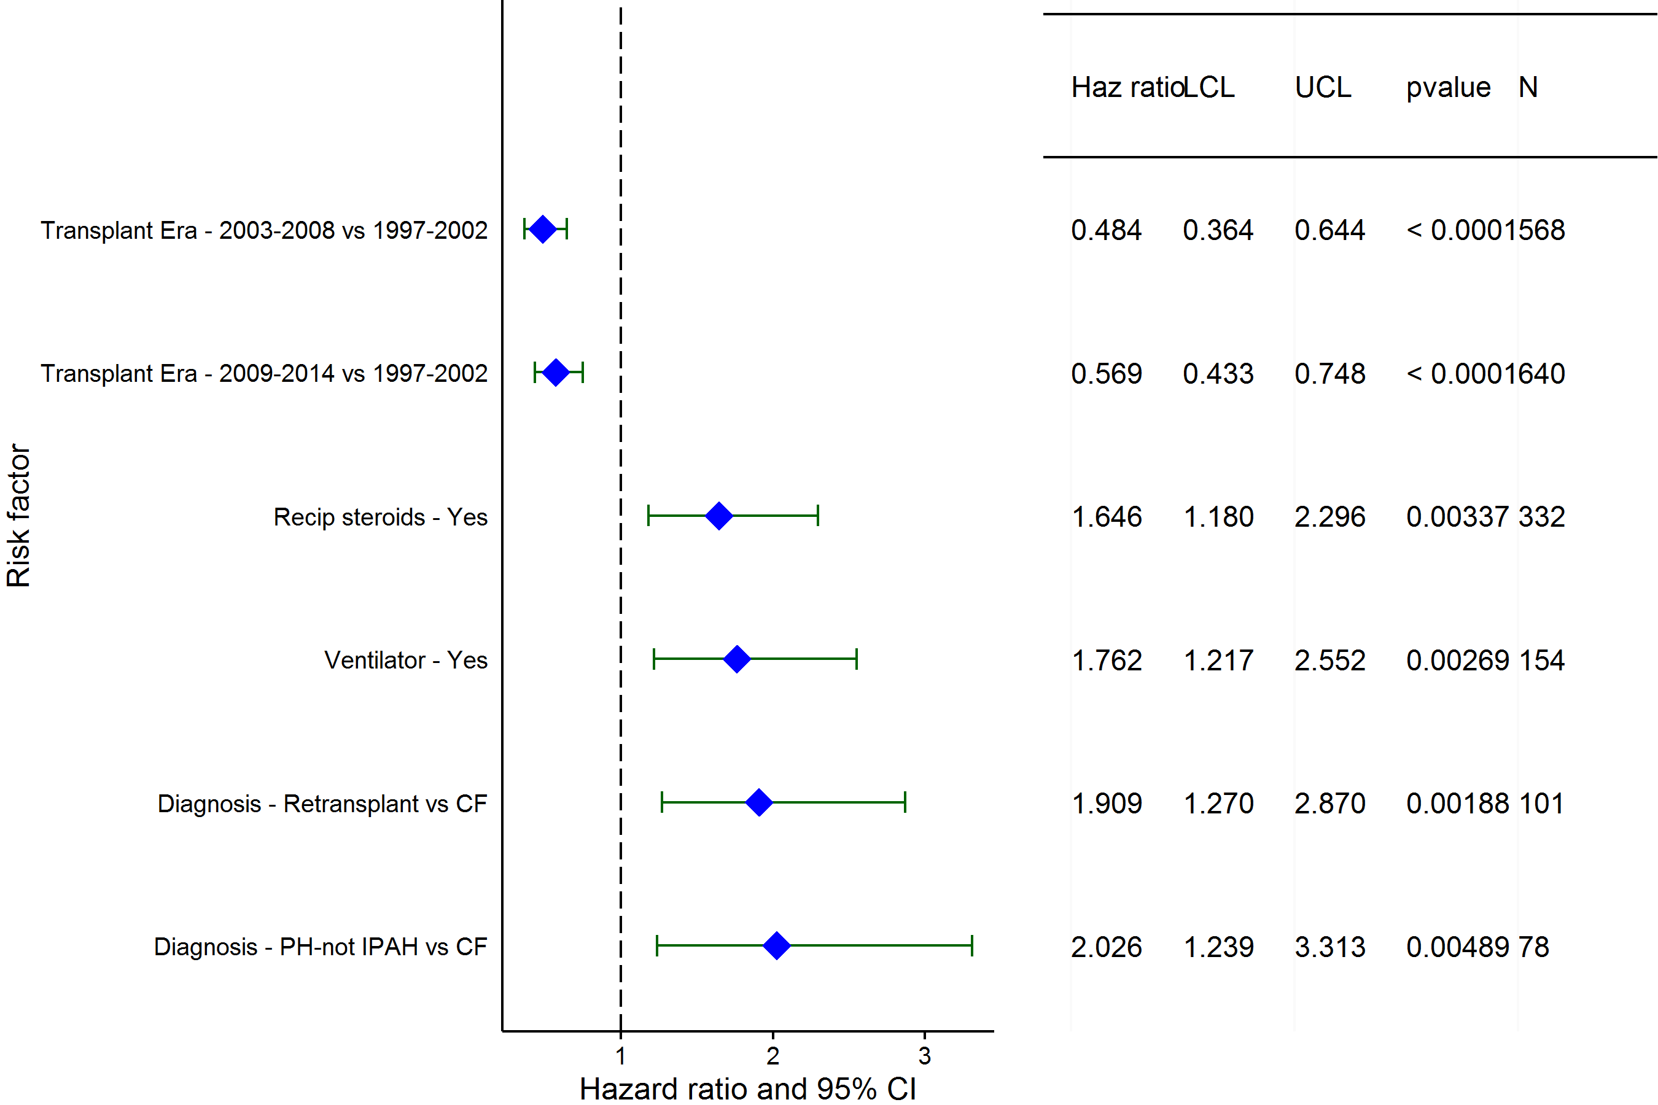
Pediatric Lung Transplants (1997-6/2014)
Risk Factors For 1 Year Mortality/Graft Failure with 95% Confidence Limits
2016
(N = 1,626)
JHLT. 2016 Oct; 35(10): 1149-1205

Slide 72
Pediatric Lung Transplants (1997-6/2014)
Risk Factors For 1 Year Mortality/Graft Failure
Continuous Factors (see figures)
Recipient age | Transplant center volume (Pediatric)
2016
JHLT. 2016 Oct; 35(10): 1149-1205

Slide 73
Pediatric Lung Transplants (1997-6/2014)
Risk Factors For 1 Year Mortality/Graft Failure with 95% Confidence Limits
Recipient age
p = 0.0414
2016
(N = 1,626)
JHLT. 2016 Oct; 35(10): 1149-1205
Notes:
Multivariable analysis was performed using a proportional hazards model censoring all patients at 1 year. Continuous factors were fit using a restricted cubic spline.

Slide 74
Pediatric Lung Transplants (1997-6/2014)
Risk Factors For 1 Year Mortality/Graft Failure with 95% Confidence Limits
Transplant center volume (Pediatric)
p = 0.0147
2016
(N = 1,626)
JHLT. 2016 Oct; 35(10): 1149-1205
Notes:
Multivariable analysis was performed using a proportional hazards model censoring all patients at 1 years. Continuous factors were fit using a restricted cubic spline.

Slide 75
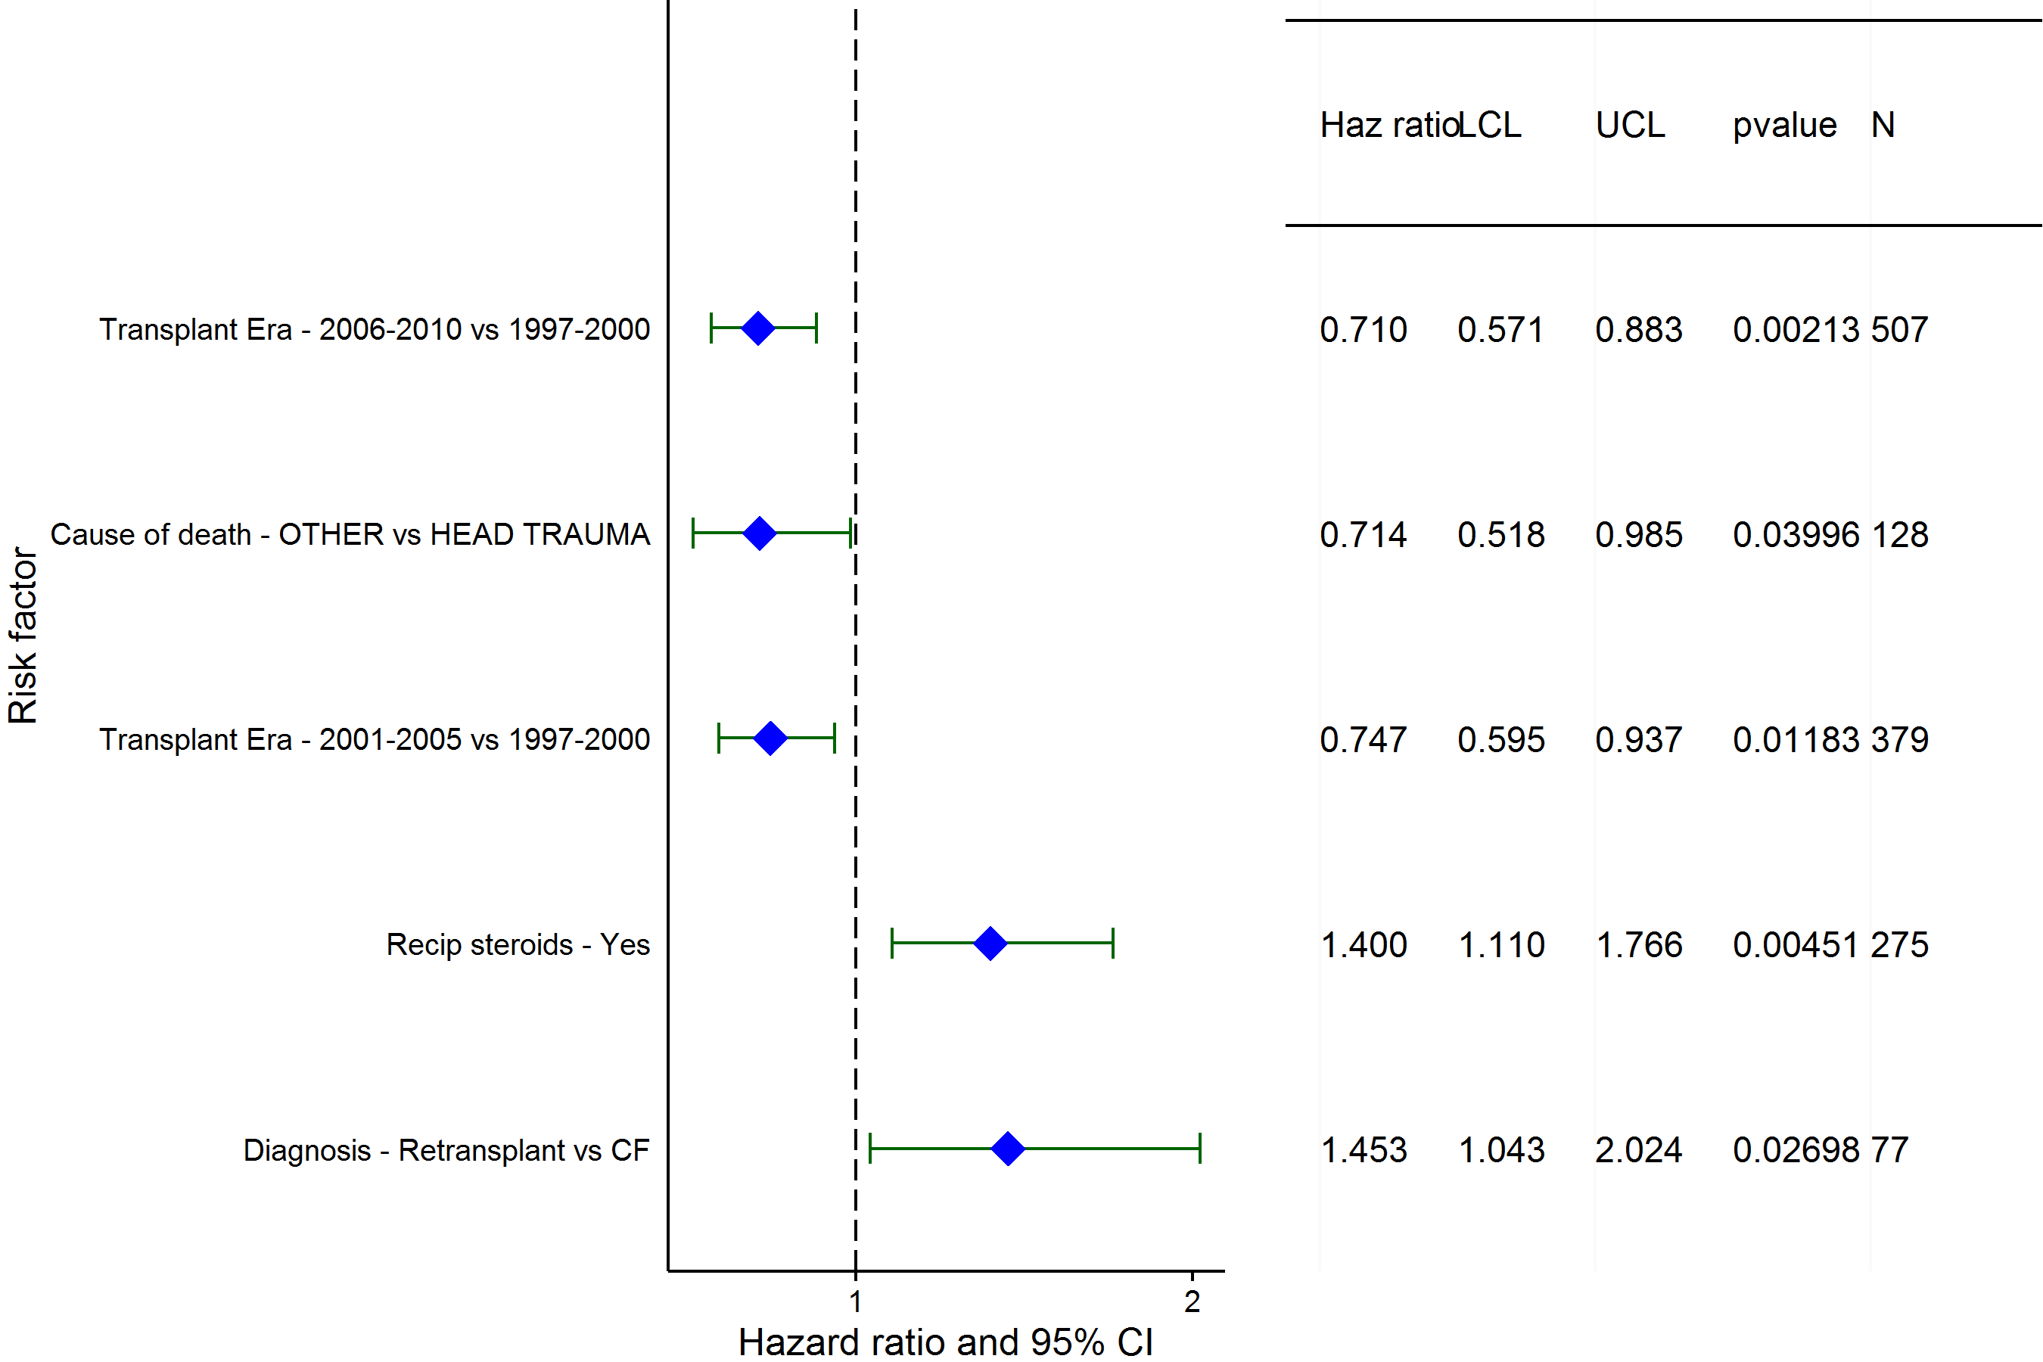
Pediatric Lung Transplants (1997-6/2010)
Risk Factors For 5 Year Mortality/Graft Failure with 95% Confidence Limits
2016
(N = 1,176)
JHLT. 2016 Oct; 35(10): 1149-1205

Slide 76
Pediatric Lung Transplants (1997-6/2010)
Risk Factors For 5 Year Mortality/Graft Failure
Continuous Factors (see figures)
Transplant center volume (Pediatric)
2016
JHLT. 2016 Oct; 35(10): 1149-1205

Slide 77
Pediatric Lung Transplants (1997-6/2010)
Risk Factors For 5 Year Mortality/Graft Failure with 95% Confidence Limits
Transplant center volume (Pediatric)
p = 0.0300
2016
(N = 1,176)
JHLT. 2016 Oct; 35(10): 1149-1205
Notes:
Multivariable analysis was performed using a proportional hazards model censoring all patients at 5 years. Continuous factors were fit using a restricted cubic spline.

Slide 78
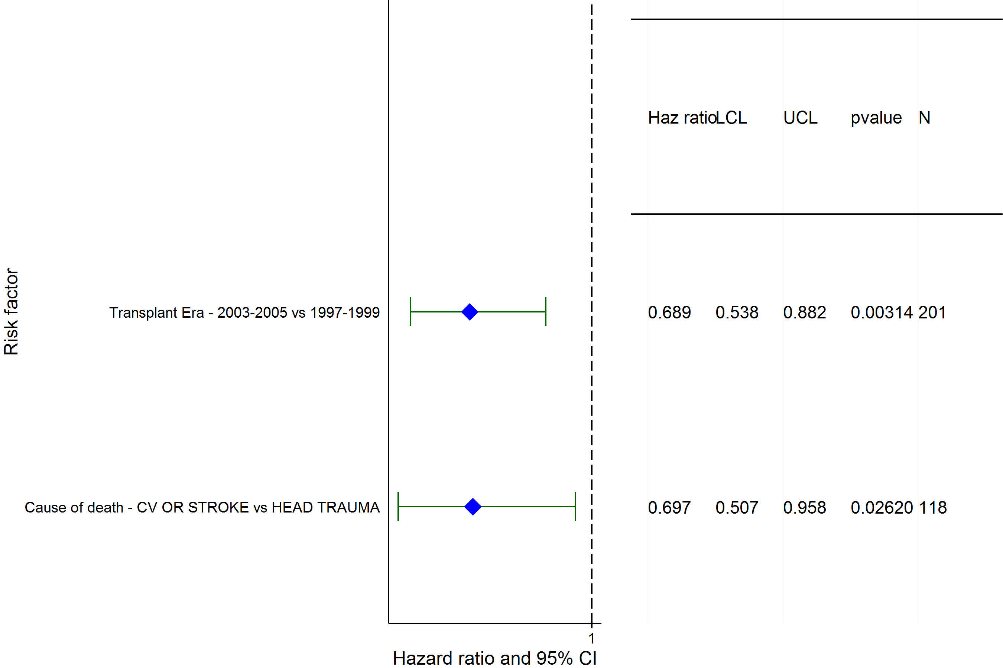
Pediatric Lung Transplants (1997-6/2005)
Risk Factors For 10 Year Mortality/Graft Failure with 95% Confidence Limits
2016
(N = 619)
JHLT. 2016 Oct; 35(10): 1149-1205

Slide 79
Pediatric Lung Transplants (1997-6/2005)
Risk Factors For 10 Year Mortality/Graft Failure
Continuous Factors (see figures)
None
2016
JHLT. 2016 Oct; 35(10): 1149-1205

