Slide 1

HEART TRANSPLANTATION
Pediatric Recipients
2016
JHLT. 2016 Oct; 35(10): 1149-1205

Slide 2
Table of Contents
Donor, recipient and center characteristics: slides 3-26
Post transplant – survival and other outcomes: slides 27-47
Induction and maintenance immunosuppression: slides 48-61
Rejection and post transplant morbidities: slides 62-99
Retransplantation: slides 100-106
Multivariable analyses: slides 107-164
Focus theme: slides 165-178
2016
JHLT. 2016 Oct; 35(10): 1149-1205

Slide 3
Donor, Recipient and Center Characteristics
2016
JHLT. 2016 Oct; 35(10): 1149-1205

Slide 4
Pediatric Heart Transplants
Number of Centers Reporting Transplants
2016
JHLT. 2016 Oct; 35(10): 1149-1205

Slide 5
(Transplants: January 2004 – June 2015)
Pediatric Heart Transplants
Number of Centers by Center Volume
2016
JHLT. 2016 Oct; 35(10): 1149-1205

Slide 6
Pediatric Heart Transplants
Distribution of Transplants by Center Volume
(Transplants: January 2004 – June 2015)
2016
JHLT. 2016 Oct; 35(10): 1149-1205

Slide 7
Pediatric Heart Transplants
Recipient Age Distribution by Center Volume
(Transplants: January 2004 – June 2015)
2016
JHLT. 2016 Oct; 35(10): 1149-1205

Slide 8
Pediatric Heart Transplants
Distribution of Transplants by Location and Average Center
Volume
(Transplants: January 2004 – June 2015)
2016
JHLT. 2016 Oct; 35(10): 1149-1205

Slide 9
Pediatric Heart Transplants
Recipient Age Distribution
(Transplants: January 2004 – June 2015)
2016
JHLT. 2016 Oct; 35(10): 1149-1205

Slide 10
Pediatric Heart Transplants
Recipient Age Distribution by Year of Transplant
NOTE: This figure includes only the heart transplants that are reported to the ISHLT Transplant Registry. As such, this should not be construed as evidence that the number of hearts transplanted worldwide has increased and/or decreased in recent years.
2016
JHLT. 2016 Oct; 35(10): 1149-1205

Slide 11
Pediatric Heart Transplants
Recipient Age Distribution by Location
(Transplants: January 2004 – June 2015)
2016
JHLT. 2016 Oct; 35(10): 1149-1205

Slide 12
Pediatric Heart Transplants
Donor Age Distribution
(Transplants: January 2004 – June 2015)
2016
JHLT. 2016 Oct; 35(10): 1149-1205
Notes:
NOTE: Transplants where donor age is unknown are excluded from this tabulation.

Slide 13
Pediatric Heart Transplants
Donor and Recipient Age
(Transplants: January 2004 – June 2015)
2016
JHLT. 2016 Oct; 35(10): 1149-1205

Slide 14
Pediatric Heart Transplants
Donor Age Distribution by Location
(Transplants: January 2004 – June 2015)
2016
JHLT. 2016 Oct; 35(10): 1149-1205
Notes:
NOTE: Transplants where donor age is unknown are excluded from this tabulation.

Slide 15
Pediatric Heart Transplants
Distribution of Transplants by Donor/Recipient Weight Ratio
(Transplants: January 2004 – June 2015)
2016
JHLT. 2016 Oct; 35(10): 1149-1205

Slide 16
Pediatric Heart Transplants
Recipient Diagnosis (Age: < 1 Year)
2009-6/2015
2016
JHLT. 2016 Oct; 35(10): 1149-1205
Notes:
NOTE: Transplants with unknown diagnoses are excluded from this tabulation

Slide 17
Pediatric Heart Transplants
Recipient Diagnosis (Age: 1-5 Years)
2009-6/2015
2016
JHLT. 2016 Oct; 35(10): 1149-1205
Notes:
NOTE: Transplants with unknown diagnoses are excluded from this tabulation

Slide 18
Pediatric Heart Transplants
Recipient Diagnosis (Age: 6-10 Years)
2009-6/2015
2016
JHLT. 2016 Oct; 35(10): 1149-1205
Notes:
NOTE: Transplants with unknown diagnoses are excluded from this tabulation

Slide 19
Pediatric Heart Transplants
Recipient Diagnosis (Age: 11-17 Years)
2009-6/2015
2016
JHLT. 2016 Oct; 35(10): 1149-1205
Notes:
NOTE: Transplants with unknown diagnoses are excluded from this tabulation

Slide 20
Pediatric Heart Transplants
Diagnosis Distribution by Location
(Transplants: January 2004 – June 2015)
2016
JHLT. 2016 Oct; 35(10): 1149-1205
Notes:
NOTE: Transplants with unknown diagnoses are excluded from this tabulation.

Slide 21
Pediatric Heart Transplants
% of Patients Bridged with Mechanical Circulatory Support*
by Year
(Transplants: January 2005 – December 2014)
2016
* LVAD, RVAD, TAH, ECMO
JHLT. 2016 Oct; 35(10): 1149-1205

Slide 22
Pediatric Heart Transplants
% of Patients Bridged with Mechanical Circulatory Support*
(Transplants: January 2009 – June 2015)
2016
* LVAD, RVAD, TAH, ECMO
JHLT. 2016 Oct; 35(10): 1149-1205

Slide 23
Pediatric Heart Transplants
% of Patients Bridged with Mechanical Circulatory Support*
by Diagnosis
(Transplants: January 2009 – June 2015)
2016
* LVAD, RVAD, TAH, ECMO
JHLT. 2016 Oct; 35(10): 1149-1205

Slide 24
Pediatric Heart Transplants
% of Patients Bridged with Mechanical Circulatory Support*
by Age Group
(Transplants: January 2009 – June 2015)
2016
* LVAD, RVAD, TAH, ECMO
JHLT. 2016 Oct; 35(10): 1149-1205

Slide 25
Pediatric Heart Transplants
PRA Distribution by Year
(Transplants: January 2005 – December 2014)
2016
If Class I and Class II values were reported separately, the higher of the two values was used.
JHLT. 2016 Oct; 35(10): 1149-1205

Slide 26
Pediatric Heart Transplants
PRA Distribution by Age Group
(Transplants: January 2009 – June 2015)
p<0.0001
2016
If Class I and Class II values were reported separately, the higher of the two values was used.
JHLT. 2016 Oct; 35(10): 1149-1205

Slide 27
Post Transplant:
Survival and Other Outcomes
2016
JHLT. 2016 Oct; 35(10): 1149-1205

Slide 28
Pediatric Heart Transplants
Kaplan-Meier Survival
(Transplants: January 1982 – June 2014)
1-5 vs. 11-17: p = 0.0001
6-10 vs. 11-17: p = 0.0312
No other pair-wise comparisons were significant at p < 0.05.
Median survival (years): <1=20.7; 1-5=18.2; 6-10=14.0; 11-17=12.7
2016
JHLT. 2016 Oct; 35(10): 1149-1205
Notes:
Survival was calculated using the Kaplan-Meier method, which incorporates information from all transplants for whom any follow-up has been provided. Since many patients are still alive and some patients have been lost to follow-up, the survival rates are estimates rather than exact rates because the time of death is not known for all patients. The median survival is the estimated time point at which 50% of all of the recipients have died.
Survival rates were compared using the log-rank test statistic. Adjustments for multiple comparisons were done using Scheffe’s method. Results of log-rank test should be interpreted with caution when curves cross.

Slide 29
Pediatric Heart Transplants
Kaplan-Meier Survival Conditional on Survival to 1 Year
(Transplants: January 1982 – June 2014)
Median survival (years): <1=NA; 1-5=21.5; 6-10=16.5; 11-17=15.7
All pair-wise comparisons were significant at p < 0.05.
2016
JHLT. 2016 Oct; 35(10): 1149-1205
Notes:
Survival was calculated using the Kaplan-Meier method, which incorporates information from all transplants for whom any follow-up has been provided. Since many patients are still alive and some patients have been lost to follow-up, the survival rates are estimates rather than exact rates because the time of death is not known for all patients. Conditional survival is shown in this figure; this is the survival following 1 year for all patients who survived to 1 year. The conditional median survival is the estimated time point at which 50% of the recipients who survive to at least 1 year have died. Because the decline in survival is greatest during the first year following transplantation, the conditional survival provides a more realistic expectation of survival time for recipients who survive the early post-transplant period.
Survival rates were compared using the log-rank test statistic. Adjustments for multiple comparisons were done using Scheffe’s method. Results of log-rank test should be interpreted with caution when curves cross.

Slide 30
Pediatric Heart Transplants
Kaplan-Meier Survival Conditional on Survival to 5 Years
(Transplants: January 1982 – June 2010)
All pair-wise comparisons were significant at p < 0.05 except 6-10 vs. 11-17.
2016
JHLT. 2016 Oct; 35(10): 1149-1205
Notes:
Survival was calculated using the Kaplan-Meier method, which incorporates information from all transplants for whom any follow-up has been provided. Since many patients are still alive and some patients have been lost to follow-up, the survival rates are estimates rather than exact rates because the time of death is not known for all patients. Conditional survival is shown in this figure; this is the survival following 5 years for all patients who survived to 5 years.
Survival rates were compared using the log-rank test statistic. Adjustments for multiple comparisons were done using Scheffe’s method. Results of log-rank test should be interpreted with caution when curves cross.

Slide 31
Pediatric Heart Transplants
Kaplan-Meier Survival Conditional on Survival to 10 Years
(Transplants: January 1982 – June 2005)
All pair-wise comparisons were significant at p < 0.05 except 1-5 vs. 11-17.
2016
JHLT. 2016 Oct; 35(10): 1149-1205
Notes:
Survival was calculated using the Kaplan-Meier method, which incorporates information from all transplants for whom any follow-up has been provided. Since many patients are still alive and some patients have been lost to follow-up, the survival rates are estimates rather than exact rates because the time of death is not known for all patients. Conditional survival is shown in this figure; this is the survival following 10 years for all patients who survived to 10 years.
Survival rates were compared using the log-rank test statistic. Adjustments for multiple comparisons were done using Scheffe’s method. Results of log-rank test should be interpreted with caution when curves cross.

Slide 32
Pediatric Heart Transplants
Kaplan-Meier Survival by Era
(Transplants: January 1982 – June 2014)
All p-values significant at p < 0.05
Median survival (years): 1982-1989= 9.8; 1990-2003=14.5; 2004-2008=NA; 2009-6/2014=NA
2016
JHLT. 2016 Oct; 35(10): 1149-1205
Notes:
Survival was calculated using the Kaplan-Meier method, which incorporates information from all transplants for whom any follow-up has been provided. Since many patients are still alive and some patients have been lost to follow-up, the survival rates are estimates rather than exact rates because the time of death is not known for all patients. The median survival is the estimated time point at which 50% of all of the recipients have died.
Survival rates were compared using the log-rank test statistic. Adjustments for multiple comparisons were done using Scheffe’s method.

Slide 33
Pediatric Heart Transplants
Conditional Kaplan-Meier Survival for Recent Era
(Transplants:January 2004 – June 2014)
All pair-wise comparisons with 11-17 were significant at p<0.05. No other pair-wise comparisons were significant at p<0.05.
2016
JHLT. 2016 Oct; 35(10): 1149-1205
Notes:
Survival was calculated using the Kaplan-Meier method, which incorporates information from all transplants for whom any follow-up has been provided. Since many patients are still alive and some patients have been lost to follow-up, the survival rates are estimates rather than exact rates because the time of death is not known for all patients. Conditional survival is shown in this figure; this is the survival following 1 year for all patients who survived to 1 year. Because the decline in survival is greatest during the first year following transplantation, the conditional survival provides a more realistic expectation of survival time for recipients who survive the early post-transplant period.
Survival rates were compared using the log-rank test statistic. Adjustments for multiple comparisons were done using Scheffe’s method. Results of log-rank test should be interpreted with caution when curves cross.

Slide 34
Pediatric Heart Transplants
Kaplan-Meier Survival by Era
Age: < 1 Year
(Transplants: January 1982 – June 2014)
All pair-wise comparisons were significant at p<0.05.
Median survival (years): 1982-1989=10.8.; 1990-2003=20.0; 2004-2008=NA; 2009-6/2014=NA
2016
JHLT. 2016 Oct; 35(10): 1149-1205
Notes:
Survival was calculated using the Kaplan-Meier method, which incorporates information from all transplants for whom any follow-up has been provided. Since many patients are still alive and some patients have been lost to follow-up, the survival rates are estimates rather than exact rates because the time of death is not known for all patients. The median survival is the estimated time point at which 50% of all of the recipients have died.
Survival rates were compared using the log-rank test statistic. Adjustments for multiple comparisons were done using Scheffe’s method.

Slide 35
Pediatric Heart Transplants
Kaplan-Meier Survival by Era
Age: 1-5 Years
(Transplants: January 1982 – June 2014)
All p-values significant at p<0.05 except 2004-2008 vs. 2009-6/2014.
Median survival (years): 1982-1989= 9.1.; 1990-2003=16.9; 2004-2008=NA; 2009-6/2014=NA
2016
JHLT. 2016 Oct; 35(10): 1149-1205
Notes:
Survival was calculated using the Kaplan-Meier method, which incorporates information from all transplants for whom any follow-up has been provided. Since many patients are still alive and some patients have been lost to follow-up, the survival rates are estimates rather than exact rates because the time of death is not known for all patients. The median survival is the estimated time point at which 50% of all of the recipients have died.
Survival rates were compared using the log-rank test statistic. Adjustments for multiple comparisons were done using Scheffe’s method.

Slide 36
Pediatric Heart Transplants
Kaplan-Meier Survival by Era
Age: 6-10 Years
(Transplants: January 1982 – June 2014)
All p-values significant at < 0.05 except 2004-2008 vs. 2009-6/2014.
Median survival (years): 1982-1989= 7.7.; 1990-2003=13.2; 2004-2008=NA; 2009-6/2014=NA
2016
JHLT. 2016 Oct; 35(10): 1149-1205
Notes:
Survival was calculated using the Kaplan-Meier method, which incorporates information from all transplants for whom any follow-up has been provided. Since many patients are still alive and some patients have been lost to follow-up, the survival rates are estimates rather than exact rates because the time of death is not known for all patients. The median survival is the estimated time point at which 50% of all of the recipients have died.
Survival rates were compared using the log-rank test statistic. Adjustments for multiple comparisons were done using Scheffe’s method.

Slide 37
Pediatric Heart Transplants
Kaplan-Meier Survival by Era
Age: 11-17 Years
(Transplants: January 1982 – June 2014)
Median survival (years): 1982-1989= 9.9.; 1990-2003=11.9; 2004-2008=NA; 2009-6/2014=NA
All other pair-wise comparisons were significant at p<0.05 except 1990-2003 vs. 2004-2008 and 2004-2008 vs. 2009-6/2014.
2016
JHLT. 2016 Oct; 35(10): 1149-1205
Notes:
Survival was calculated using the Kaplan-Meier method, which incorporates information from all transplants for whom any follow-up has been provided. Since many patients are still alive and some patients have been lost to follow-up, the survival rates are estimates rather than exact rates because the time of death is not known for all patients. The median survival is the estimated time point at which 50% of all of the recipients have died.
Survival rates were compared using the log-rank test statistic. Adjustments for multiple comparisons were done using Scheffe’s method. Results of log-rank test should be interpreted with caution when curves cross.

Slide 38
Pediatric Heart Transplants
Kaplan-Meier Survival by Recipient Gender
(Transplants: January 2004 – June 2014)
p = 0.0358
2016
JHLT. 2016 Oct; 35(10): 1149-1205
Notes:
Survival was calculated using the Kaplan-Meier method, which incorporates information from all transplants for whom any follow-up has been provided. Since many patients are still alive and some patients have been lost to follow-up, the survival rates are estimates rather than exact rates because the time of death is not known for all patients.
Survival rates were compared using the log-rank test statistic.

Slide 39
Pediatric Heart Transplants
Kaplan-Meier Survival by Donor/Recipient Gender
(Transplants: January 2004 – June 2014)
No pair-wise comparisons were significant at p<0.05.
2016
JHLT. 2016 Oct; 35(10): 1149-1205
Notes:
Survival was calculated using the Kaplan-Meier method, which incorporates information from all transplants for whom any follow-up has been provided. Since many patients are still alive and some patients have been lost to follow-up, the survival rates are estimates rather than exact rates because the time of death is not known for all patients.
Survival rates were compared using the log-rank test statistic. Adjustments for multiple comparisons were done using Scheffe’s method.

Slide 40
Pediatric Heart Transplants
Kaplan-Meier Survival by Diagnosis
Age: < 1 Year
(Transplants: January 2004 – June 2014)
p<0.0001
2016
JHLT. 2016 Oct; 35(10): 1149-1205
Notes:
Survival was calculated using the Kaplan-Meier method, which incorporates information from all transplants for whom any follow-up has been provided. Since many patients are still alive and some patients have been lost to follow-up, the survival rates are estimates rather than exact rates because the time of death is not known for all patients.
Survival rates were compared using the log-rank test statistic.

Slide 41
Pediatric Heart Transplants
Kaplan-Meier Survival by Diagnosis
Age: 1-5 Years
(Transplants: January 2004 – June 2014)
CHD vs. DCM: p < 0.0001
CHD vs. Retransplant: p = 0.2494
DCM vs. Retransplant: p = 0.0002
2016
JHLT. 2016 Oct; 35(10): 1149-1205
Notes:
Survival was calculated using the Kaplan-Meier method, which incorporates information from all transplants for whom any follow-up has been provided. Since many patients are still alive and some patients have been lost to follow-up, the survival rates are estimates rather than exact rates because the time of death is not known for all patients.
Survival rates were compared using the log-rank test statistic. Adjustments for multiple comparisons were done using Scheffe’s method.

Slide 42
Pediatric Heart Transplants
Kaplan-Meier Survival by Diagnosis
Age: 6-10 Years
(Transplants: January 2004 – June 2014)
CHD vs. DCM: p = 0.0894
CHD vs. Retransplant: p = 0.8955
DCM vs. Retransplant: p = 0.7803
2016
JHLT. 2016 Oct; 35(10): 1149-1205
Notes:
Survival was calculated using the Kaplan-Meier method, which incorporates information from all transplants for whom any follow-up has been provided. Since many patients are still alive and some patients have been lost to follow-up, the survival rates are estimates rather than exact rates because the time of death is not known for all patients.
Survival rates were compared using the log-rank test statistic. Adjustments for multiple comparisons were done using Scheffe’s method. Results of log-rank test should be interpreted with caution when curves cross.

Slide 43
Pediatric Heart Transplants
Kaplan-Meier Survival by Diagnosis
Age: 11-17 Years
(Transplants: January 2004 – June 2014)
CHD vs. DCM: p = 0.0304
CHD vs. Retransplant: p = 0.0632
DCM vs. Retransplant: p < 0.0001
2016
JHLT. 2016 Oct; 35(10): 1149-1205
Notes:
Survival was calculated using the Kaplan-Meier method, which incorporates information from all transplants for whom any follow-up has been provided. Since many patients are still alive and some patients have been lost to follow-up, the survival rates are estimates rather than exact rates because the time of death is not known for all patients.
Survival rates were compared using the log-rank test statistic. Adjustments for multiple comparisons were done using Scheffe’s method. Results of log-rank test should be interpreted with caution when curves cross.

Slide 44
Pediatric Heart Transplants
Kaplan-Meier Patient vs. Graft Survival
(Transplants: January 2004 – June 2014)
p = 0.0041
2016
JHLT. 2016 Oct; 35(10): 1149-1205
Notes:
Survival was calculated using the Kaplan-Meier method, which incorporates information from all transplants for whom any follow-up has been provided. Since many patients are still alive and some patients have been lost to follow-up, the survival rates are estimates rather than exact rates because the time of death is not known for all patients.
Survival rates were compared using the log-rank test statistic.

Slide 45
Pediatric Heart Transplants
Kaplan-Meier Survival by Mechanical Circulatory Support
Usage*
(Transplants: January 2009 – June 2014)
All pair-wise comparisons were significant at p < 0.05 except No ECMO/VAD/TAH vs. VAD or TAH, no ECMO.
2016
* LVAD, RVAD, TAH, ECMO
JHLT. 2016 Oct; 35(10): 1149-1205
Notes:
Survival was calculated using the Kaplan-Meier method, which incorporates information from all transplants for whom any follow-up has been provided. Since many patients are still alive and some patients have been lost to follow-up, the survival rates are estimates rather than exact rates because the time of death is not known for all patients.
Survival rates were compared using the log-rank test statistic. Adjustments for multiple comparisons were done using Scheffe’s method. Results of log-rank test should be interpreted with caution when curves cross.

Slide 46
Pediatric Heart Transplants
Functional Status of Surviving Recipients
(Follow-ups: January 2009 – June 2015)
2016
JHLT. 2016 Oct; 35(10): 1149-1205
Notes:
Functional status is collected using Lansky score for pediatric recipients.
This figure shows the functional status reported on the 1-year, 2-year and 3-year annual follow-ups. Because all follow-ups between January 2009 and June 2015 were included, the bars do not include the same patients.

Slide 47
Pediatric Heart Transplants
Rehospitalization Post-transplant of Surviving Recipients
(Follow-ups: January 2009 – June 2015)
2016
JHLT. 2016 Oct; 35(10): 1149-1205
Notes:
This figure shows the hospitalizations reported on the 1-year, 3-year and 5-year annual follow-ups, representing the hospitalizations between discharge and 1 year, between the 2-year and 3-year follow-up, and between the 4-year and 5-year follow-up, respectively. Because all follow-ups between January 2009 and June 2015 were included, the bars do not include the same patients.

Slide 48
Induction and Maintenance Immunosuppression
2016
JHLT. 2016 Oct; 35(10): 1149-1205

Slide 49
Pediatric Heart Transplants
Induction Immunosuppression
(Transplants: January 2004 – June 2015)
2016
Analysis is limited to patients who were alive at the time of the discharge.
JHLT. 2016 Oct; 35(10): 1149-1205

Slide 50
Pediatric Heart Transplants
Induction Immunosuppression by Era
(Transplants: January 2004 – June 2015)
All pair-wise comparisons between eras were significant at p < 0.05.
2016
Analysis is limited to patients who were alive at the time of the discharge.
JHLT. 2016 Oct; 35(10): 1149-1205

Slide 51
Pediatric Heart Transplants
Kaplan-Meier Survival by Induction Group Conditional on
Survival to 14 Days
(Transplants: January 2004 – June 2014)
No pair-wise comparisons were significant at p<0.05.
2016
JHLT. 2016 Oct; 35(10): 1149-1205
Notes:
Survival was calculated using the Kaplan-Meier method, which incorporates information from all transplants for whom any follow-up has been provided. Since many patients are still alive and some patients have been lost to follow-up, the survival rates are estimates rather than exact rates because the time of death is not known for all patients.
Survival rates were compared using the log-rank test statistic. Adjustments for multiple comparisons were done using Scheffe’s method.

Slide 52
Pediatric Heart Transplants
Kaplan-Meier Survival by Induction and Treated Rejection Between Transplant Discharge and 1-Year Follow-up
Conditional on Survival to 1 Year
(1-Year Follow-ups: July 2004 – June 2014)
No pair-wise comparisons of survival by induction were significant at p < 0.05 within either rejection grouping.
Treated rejection = Recipient was reported to (1) have at least one acute rejection episode that was treated with an anti-rejection agent; or (2) have been hospitalized for rejection.
No rejection = Recipient had (i) no acute rejection episodes and (ii) was reported either as not hospitalized for rejection or did not receive anti-rejection agents.
2016
JHLT. 2016 Oct; 35(10): 1149-1205
Notes:
Because of a modification in the data collection, the analysis is limited to follow-ups occurring on or after July 2004.
Survival was calculated using the Kaplan-Meier method, which incorporates information from all transplants for whom any follow-up has been provided. Since many patients are still alive and some patients have been lost to follow-up, the survival rates are estimates rather than exact rates because the time of death is not known for all patients.
Survival rates were compared using the log-rank test statistic. Adjustments for multiple comparisons were done using Scheffe’s method.

Slide 53
Pediatric Heart Transplants
Maintenance Immunosuppression at Time of Transplant
Discharge by Era
(Transplants: January 2004 – June 2015)
2016
Analysis is limited to patients who were alive at the time of the discharge.
JHLT. 2016 Oct; 35(10): 1149-1205

Slide 54
Pediatric Heart Transplants
Maintenance Immunosuppression at Time of Follow-up
(Follow-ups: January 2004 – June 2015)
2016
Analysis is limited to patients who were alive at the time of the follow-up
JHLT. 2016 Oct; 35(10): 1149-1205
Notes:
This figure shows the maintenance immunosuppression reported as being provided at the time of the 1-year and 5-year annual follow-up forms. To provide a snapshot of current practice, only follow-ups occurring between January 2004 and June 2015 were included. Therefore, this figure does not represent changes in practice between the 1-year follow-up and 5-year follow-up on a cohort of patients. The patients in the 1-year tabulation are not the same patients as in the 5-year tabulation.

Slide 55
Pediatric Heart Transplants
Maintenance Immunosuppression at Time of Follow-up
for Same Patients at Each Time Point
(Follow-ups: January 2004 – June 2015)
2016
Analysis is limited to patients who were alive at the time of the follow-up.
JHLT. 2016 Oct; 35(10): 1149-1205
Notes:
This figure shows the maintenance immunosuppression reported as being provided at the time of the 1-year and 5-year annual follow-up forms for the same patients based on follow-ups between January 2004 and June 2015.

Slide 56
Pediatric Heart Transplants
Maintenance Immunosuppression Drug Combinations at
Time of Follow-up
(Follow-ups: January 2004 – June 2015)
NOTE: Different patients are analyzed in Year 1 and Year 5.
2016
Analysis is limited to patients who were alive at the time of the follow-up.
JHLT. 2016 Oct; 35(10): 1149-1205
Notes:
This figure shows the maintenance immunosuppression reported as being provided at the time of the 1-year and 5-year annual follow-up forms for the same patients based on follow-ups between January 2004 and June 2015.

Slide 57
Pediatric Heart Transplants
Kaplan-Meier Survival Based on Prednisone Use
Conditional on Survival to 1 Year
(Transplants: January 2004 – June 2014)
p < 0.0001
2016
JHLT. 2016 Oct; 35(10): 1149-1205
Notes:
Survival was calculated using the Kaplan-Meier method, which incorporates information from all transplants for whom any follow-up has been provided. Since many patients are still alive and some patients have been lost to follow-up, the survival rates are estimates rather than exact rates because the time of death is not known for all patients. The cohorts were conditioned on survival to 1 year, so that prednisone use during the first year could be used as a stratification factor.
Survival rates were compared using the log-rank test statistic. A significant p-value means that at least one of the groups is different than the others but it doesn’t identify which group it is.

Slide 58
Pediatric Heart Transplants
Kaplan-Meier Survival by Calcineurin Inhibitor Use at
Discharge
(Transplants: January 2004 – June 2014)
Conditional on Survival to 14 Days
p = 0.9804
2016
JHLT. 2016 Oct; 35(10): 1149-1205
Notes:
Survival was calculated using the Kaplan-Meier method, which incorporates information from all transplants for whom any follow-up has been provided. Since many patients are still alive and some patients have been lost to follow-up, the survival rates are estimates rather than exact rates because the time of death is not known for all patients.
Survival rates were compared using the log-rank test statistic. Results of log-rank test should be interpreted with caution when curves cross.

Slide 59
Pediatric Heart Transplants
Kaplan-Meier Survival by Maintenance Immunosuppression
at Discharge
(Transplants: January 2004 – June 2014)
Conditional on Survival to 14 Days
No pair-wise comparisons were significant at p<0.05.
2016
JHLT. 2016 Oct; 35(10): 1149-1205
Notes:
Survival was calculated using the Kaplan-Meier method, which incorporates information from all transplants for whom any follow-up has been provided. Since many patients are still alive and some patients have been lost to follow-up, the survival rates are estimates rather than exact rates because the time of death is not known for all patients.
Survival rates were compared using the log-rank test statistic. Results of log-rank test should be interpreted with caution when curves cross. Adjustments for multiple comparisons were done using Scheffe’s method.

Slide 60
Pediatric Heart Transplants
Kaplan-Meier Survival by Calcineurin Inhibitor Use
Conditional on Survival to 1 Year
(Transplants: January 2004 – June 2014)
No pair-wise comparisons were significant at p<0.05 except Cyclosporine use at discharge and 1 year vs. Cyclosporine use at discharge/Tacrolimus at 1 year.
2016
JHLT. 2016 Oct; 35(10): 1149-1205
Notes:
Survival was calculated using the Kaplan-Meier method, which incorporates information from all transplants for whom any follow-up has been provided. Since many patients are still alive and some patients have been lost to follow-up, the survival rates are estimates rather than exact rates because the time of death is not known for all patients. The cohorts were conditioned on survival to 1 year, so that cyclosporine vs. tacrolimus use during the first year could be used as a stratification factor.
Survival rates were compared using the log-rank test statistic. A significant p-value means that at least one of the groups is different than the others but it doesn’t identify which group it is. Results of log-rank test should be interpreted with caution when curves cross.

Slide 61
Pediatric Heart Transplants
Kaplan-Meier Survival by Calcineurin Inhibitor Use
Conditional on Survival to 5 Years
(Transplants: January 2004 – June 2009)
No pair-wise comparisons were significant at p<0.05 except Cyclosporine at discharge and 5 years vs. Cyclosporine at discharge/TAC at 5 years.
2016
JHLT. 2016 Oct; 35(10): 1149-1205
Notes:
Survival was calculated using the Kaplan-Meier method, which incorporates information from all transplants for whom any follow-up has been provided. Since many patients are still alive and some patients have been lost to follow-up, the survival rates are estimates rather than exact rates because the time of death is not known for all patients.
Survival rates were compared using the log-rank test statistic. Adjustments for multiple comparisons were done using Scheffe’s method. Results of log-rank test should be interpreted with caution when curves cross.

Slide 62
Rejection and Post Transplant Morbidities
2016
JHLT. 2016 Oct; 35(10): 1149-1205

Slide 63
Pediatric Heart Transplants
Kaplan-Meier Survival Based on Treated Rejection within 1st Year
Conditional on survival to 1 year
(1-Year Follow-ups: July 2004 – June 2014)
p < 0.0001
Treated rejection = Recipient was reported to (1) have at least one acute rejection episode that was treated with an anti-rejection agent; or (2) have been hospitalized for rejection.
No rejection = Recipient had (i) no acute rejection episodes and (ii) was reported either as not hospitalized for rejection or did not receive anti-rejection agents.
2016
JHLT. 2016 Oct; 35(10): 1149-1205
Notes:
Because of a modification in the data collection, the analysis is limited to follow-ups occurring on or after July 2004.
Survival was calculated using the Kaplan-Meier method, which incorporates information from all transplants for whom any follow-up has been provided. Since many patients are alive and some patients have been lost to follow-up, the survival rates are estimates rather than exact rates because the time of death is not known for all patients and may never occur for some patients. Conditional survival is shown in this figure; this is the survival rate following 1 year for all patients who survived to 1 year.
Survival rates were compared using the log-rank test statistic.

Slide 64
Pediatric Heart Transplants
Kaplan-Meier Survival Based on Treated Rejection within 1st Year
Age = < 1 Year
Conditional on survival to 1 year
(1-Year Follow-ups: July 2004 – June 2014)
p = 0.0101
Treated rejection = Recipient was reported to (1) have at least one acute rejection episode that was treated with an anti-rejection agent; or (2) have been hospitalized for rejection.
No rejection = Recipient had (i) no acute rejection episodes and (ii) was reported either as not hospitalized for rejection or did not receive anti-rejection agents.
2016
JHLT. 2016 Oct; 35(10): 1149-1205
Notes:
Because of a modification in the data collection, the analysis is limited to follow-ups occurring on or after July 2004.
Survival was calculated using the Kaplan-Meier method, which incorporates information from all transplants for whom any follow-up has been provided. Since many patients are alive and some patients have been lost to follow-up, the survival rates are estimates rather than exact rates because the time of death is not known for all patients and may never occur for some patients. Conditional survival is shown in this figure; this is the survival rate following 1 year for all patients who survived to 1 year.
Survival rates were compared using the log-rank test statistic.

Slide 65
Pediatric Heart Transplants
Kaplan-Meier Survival Based on Treated Rejection within 1st Year
Age = 1-5 Years
Conditional on survival to 1 year
(1-Year Follow-ups: July 2004 – June 2014)
p = 0.0368
Treated rejection = Recipient was reported to (1) have at least one acute rejection episode that was treated with an anti-rejection agent; or (2) have been hospitalized for rejection.
No rejection = Recipient had (i) no acute rejection episodes and (ii) was reported either as not hospitalized for rejection or did not receive anti-rejection agents.
2016
JHLT. 2016 Oct; 35(10): 1149-1205
Notes:
Because of a modification in the data collection, the analysis is limited to follow-ups occurring on or after July 2004.
Survival was calculated using the Kaplan-Meier method, which incorporates information from all transplants for whom any follow-up has been provided. Since many patients are alive and some patients have been lost to follow-up, the survival rates are estimates rather than exact rates because the time of death is not known for all patients and may never occur for some patients. Conditional survival is shown in this figure; this is the survival rate following 1 year for all patients who survived to 1 year.
Survival rates were compared using the log-rank test statistic.

Slide 66
Pediatric Heart Transplants
Kaplan-Meier Survival Based on Treated Rejection within 1st Year
Age = 6-10 Years
Conditional on survival to 1 year
(1-Year Follow-ups: July 2004 – June 2014)
p = 0.1050
Treated rejection = Recipient was reported to (1) have at least one acute rejection episode that was treated with an anti-rejection agent; or (2) have been hospitalized for rejection.
No rejection = Recipient had (i) no acute rejection episodes and (ii) was reported either as not hospitalized for rejection or did not receive anti-rejection agents.
2016
JHLT. 2016 Oct; 35(10): 1149-1205
Notes:
Because of a modification in the data collection, the analysis is limited to follow-ups occurring on or after July 2004.
Survival was calculated using the Kaplan-Meier method, which incorporates information from all transplants for whom any follow-up has been provided. Since many patients are alive and some patients have been lost to follow-up, the survival rates are estimates rather than exact rates because the time of death is not known for all patients and may never occur for some patients. Conditional survival is shown in this figure; this is the survival rate following 1 year for all patients who survived to 1 year.
Survival rates were compared using the log-rank test statistic. Results of log-rank test should be interpreted with caution when curves cross.

Slide 67
Pediatric Heart Transplants
Kaplan-Meier Survival Based on Treated Rejection within 1st Year
Age = 11-17 Years
Conditional on survival to 1 year
(1-Year Follow-ups: July 2004 – June 2014)
p = 0.0009
Treated rejection = Recipient was reported to (1) have at least one acute rejection episode that was treated with an anti-rejection agent; or (2) have been hospitalized for rejection.
No rejection = Recipient had (i) no acute rejection episodes and (ii) was reported either as not hospitalized for rejection or did not receive anti-rejection agents.
2016
JHLT. 2016 Oct; 35(10): 1149-1205
Notes:
Because of a modification in the data collection, the analysis is limited to follow-ups occurring on or after July 2004.
Survival was calculated using the Kaplan-Meier method, which incorporates information from all transplants for whom any follow-up has been provided. Since many patients are alive and some patients have been lost to follow-up, the survival rates are estimates rather than exact rates because the time of death is not known for all patients and may never occur for some patients. Conditional survival is shown in this figure; this is the survival rate following 1 year for all patients who survived to 1 year.
Survival rates were compared using the log-rank test statistic.

Slide 68
Pediatric Heart Transplants
Kaplan-Meier Survival Based on Treated Rejection within 1st Year
by Calcineurin Use at Discharge
Conditional on survival to 1 year
(1-Year Follow-ups: July 2004 – June 2014)
TAC: Rejection vs. no rejection p<0.0001
No other pair-wise comparisons within rejection or Calcineurin group were significant at p<0.05.
Treated rejection = Recipient was reported to (1) have at least one acute rejection episode that was treated with an anti-rejection agent; or (2) have been hospitalized for rejection.
No rejection = Recipient had (i) no acute rejection episodes and (ii) was reported either as not hospitalized for rejection or did not receive anti-rejection agents.
2016
JHLT. 2016 Oct; 35(10): 1149-1205
Notes:
Because of a modification in the data collection, the analysis is limited to follow-ups occurring on or after July 2004.
Survival was calculated using the Kaplan-Meier method, which incorporates information from all transplants for whom any follow-up has been provided. Since many patients are alive and some patients have been lost to follow-up, the survival rates are estimates rather than exact rates because the time of death is not known for all patients and may never occur for some patients. Conditional survival is shown in this figure; this is the survival rate following 1 year for all patients who survived to 1 year.
Survival rates were compared using the log-rank test statistic. Adjustments for multiple comparisons were done using Bonferroni method.

Slide 69
Pediatric Heart Transplants
Percentage Experiencing Treated Rejection between Discharge
and 1-Year Follow-Up by Era
(Follow-ups: July 2004 – June 2015)
All pair-wise comparisons were significant at p<0.05.
Analysis is limited to patients who were alive at the time of the follow-up.
Treated rejection = Recipient was reported to (1) have at least one acute rejection episode that was treated with an anti-rejection agent; or (2) have been hospitalized for rejection.
2016
JHLT. 2016 Oct; 35(10): 1149-1205
Notes:
Because of a modification in the data collection, the analysis is limited to follow-ups occurring on or after July 2004.
Comparisons were made using the chi-square statistic. Adjustments for multiple comparisons were done using Bonferroni method.

Slide 70
Pediatric Heart Transplants
Percentage Experiencing Treated Rejection between Discharge
and 1-Year Follow-Up by Induction
(Follow-ups: July 2004 – June 2015)
No pair-wise comparisons were significant at p<0.05.
Analysis is limited to patients who were alive at the time of the follow-up.
Treated rejection = Recipient was reported to (1) have at least one acute rejection episode that was treated with an anti-rejection agent; or (2) have been hospitalized for rejection.
2016
JHLT. 2016 Oct; 35(10): 1149-1205
Notes:
Because of a modification in the data collection, the analysis is limited to follow-ups occurring on or after July 2004.
Comparisons were made using the chi-square statistic. Adjustments for multiple comparisons were done using Bonferroni method.

Slide 71
Pediatric Heart Transplants
Percentage Experiencing Treated Rejection between Discharge and 1-
1-Year Follow-Up by Induction Type
(Follow-ups: July 2004 – June 2015)
No pair-wise comparisons were significant at p<0.05.
Analysis is limited to patients who were alive at the time of the follow-up.
Treated rejection = Recipient was reported to (1) have at least one acute rejection episode that was treated with an anti-rejection agent; or (2) have been hospitalized for rejection.
2016
JHLT. 2016 Oct; 35(10): 1149-1205
Notes:
Because of a modification in the data collection, the analysis is limited to follow-ups occurring on or after July 2004.
Comparisons were made using the chi-square statistic. Adjustments for multiple comparisons were done using Bonferroni method.

Slide 72
Pediatric Heart Transplants
Percentage Experiencing Treated Rejection between Discharge and 1-Year Follow-Up by Maintenance Immunosuppression and
Induction
(Follow-ups: July 2004 – June 2015)
CyA + No Induction vs. TAC + No Induction (Overall), CyA + Induction vs. TAC + No Induction (Overall and 11-17 years) and CyA + Induction vs. TAC + Induction (Overall and 11-17 years) were significant at p < 0.05. No other pair-wise comparisons were significant at p < 0.05.
Analysis is limited to patients who were alive at the time of the follow-up.
Treated rejection = Recipient was reported to (1) have at least one acute rejection episode that was treated with an anti-rejection agent; or (2) have been hospitalized for rejection.
2016
JHLT. 2016 Oct; 35(10): 1149-1205
Notes:
Because of a modification in the data collection, the analysis is limited to follow-ups occurring on or after July 2004.
Comparisons were made using the chi-square statistic. Adjustments for multiple comparisons were done using Bonferroni method.

Slide 73
Pediatric Heart Transplants
Percentage Experiencing Treated Rejection between Discharge and 1-Year Follow-Up by Maintenance Immunosuppression
(Follow-ups: July 2004 – June 2015)
CyA + MMF/MPA vs. TAC + MMF/MPA for Overall, <1, and 11-17 years were significant at p < 0.05. No other pair-wise comparisons were significant at p < 0.05.
Analysis is limited to patients who were alive at the time of the follow-up.
Treated rejection = Recipient was reported to (1) have at least one acute rejection episode that was treated with an anti-rejection agent; or (2) have been hospitalized for rejection.
2016
JHLT. 2016 Oct; 35(10): 1149-1205
Notes:
Because of a modification in the data collection, the analysis is limited to follow-ups occurring on or after July 2004.
Comparisons were made using the chi-square statistic. Adjustments for multiple comparisons were done using Bonferroni method.

Slide 74
Pediatric Heart Transplants
Percentage Experiencing Treated Rejection between Discharge and 1-Year Follow-Up by Calcineurin Inhibitor Use at Discharge
(Follow-ups: July 2004 – June 2015)
All pair-wise comparisons were significant at p<0.05 except Cyclosporine vs. Tacrolimus for 1-5 years.
Analysis is limited to patients who were alive at the time of the follow-up.
Treated rejection = Recipient was reported to (1) have at least one acute rejection episode that was treated with an anti-rejection agent; or (2) have been hospitalized for rejection.
2016
JHLT. 2016 Oct; 35(10): 1149-1205
Notes:
Because of a modification in the data collection, the analysis is limited to follow-ups occurring on or after July 2004.
Comparisons were made using the chi-square statistic. Adjustments for multiple comparisons were done using Bonferroni method.

Slide 75
Pediatric Heart Transplants
Coronary Artery Vasculopathy-Free Survival
(Transplants: January 1994 – June 2014)
2016
JHLT. 2016 Oct; 35(10): 1149-1205
Notes:
CAV-free survival was computed using the Kaplan-Meier method.
The development of CAV is reported on annual follow-ups; a date of diagnosis is not provided. For this figure the midpoint between the date of previous follow-up (when event had not occurred) and the date of follow-up when the event was reported was used as the date of occurrence. Patients were included in the analysis until an unknown response for the outcome of interest was reported. Therefore, the rates seen here may differ from those reported in the cumulative prevalence slide which is based on only those patients with known responses for each of the outcomes at all follow-up time points.

Slide 76
Pediatric Heart Transplants
Cardiac Allograft Vasculopathy-Free Survival by Era
(Transplants: January 1994 – June 2014)
p = 0.0176
2016
JHLT. 2016 Oct; 35(10): 1149-1205
Notes:
CAV-free survival rates by era were computed using the Kaplan-Meier method.
The development of CAV is reported on annual follow-ups; a date of diagnosis is not provided. For this figure the midpoint between the date of previous follow-up (when event had not occurred) and the date of follow-up when the event was reported was used as the date of occurrence. Patients were included in the analysis until an unknown response for the outcome of interest was reported. Therefore, the rates seen here may differ from those reported in the cumulative prevalence slide which is based on only those patients with known responses for each of the outcomes at all follow-up time points.
Survival rates were compared using the log-rank test statistic.

Slide 77
Pediatric Heart Transplants
Coronary Artery Vasculopathy-Free Survival by Induction
(Transplants: January 1994 – June 2014)
p = 0.0235
2016
JHLT. 2016 Oct; 35(10): 1149-1205
Notes:
CAV-free survival was computed using the Kaplan-Meier method.
The development of CAV is reported on annual follow-ups; a date of diagnosis is not provided. For this figure the midpoint between the date of previous follow-up (when event had not occurred) and the date of follow-up when the event was reported was used as the date of occurrence. Patients were included in the analysis until an unknown response for the outcome of interest was reported. Therefore, the rates seen here may differ from those reported in the cumulative prevalence slide which is based on only those patients with known responses for each of the outcomes at all follow-up time points.
Survival rates were compared using the log-rank test statistic.

Slide 78
Pediatric Heart Transplants
Coronary Artery Vasculopathy-Free Survival by Calcineurin
Conditional on Survival to 1 Year
Inhibitor Use
(Transplants: January 2004 – June 2014)
p = 0.0814
2016
JHLT. 2016 Oct; 35(10): 1149-1205
Notes:
CAV-free survival was computed using the Kaplan-Meier method.
The development of CAV is reported on annual follow-ups; a date of diagnosis is not provided. For this figure the midpoint between the date of previous follow-up (when event had not occurred) and the date of follow-up when the event was reported was used as the date of occurrence. Patients were included in the analysis until an unknown response for the outcome of interest was reported. Therefore, the rates seen here may differ from those reported in the cumulative prevalence slide which is based on only those patients with known responses for each of the outcomes at all follow-up time points.
Survival rates were compared using the log-rank test statistic. A significant p-value means that at least one of the groups is different than the others but it doesn’t identify which group it is. Results of log-rank test should be interpreted with caution when curves cross.

Slide 79
Pediatric Heart Transplants
Coronary Artery Vasculopathy-Free Survival
by Age Group
(Transplants: January 2004 – June 2014)
p <0.0001
2016
JHLT. 2016 Oct; 35(10): 1149-1205
Notes:
CAV-free survival was computed using the Kaplan-Meier method.
The development of CAV is reported on annual follow-ups; a date of diagnosis is not provided. For this figure the midpoint between the date of previous follow-up (when event had not occurred) and the date of follow-up when the event was reported was used as the date of occurrence. Patients were included in the analysis until an unknown response for the outcome of interest was reported. Therefore, the rates seen here may differ from those reported in the cumulative prevalence slide which is based on only those patients with known responses for each of the outcomes at all follow-up time points.
Survival rates were compared using the log-rank test statistic. A significant p-value means that at least one of the groups is different than the others but it doesn’t identify which group it is. Results of log-rank test should be interpreted with caution when curves cross.

Slide 80
Pediatric Heart Transplants
Coronary Artery Vasculopathy-Free Survival
by Ischemia Time
(Transplants: January 2004 – June 2014)
p = 0.4976
2016
JHLT. 2016 Oct; 35(10): 1149-1205
Notes:
CAV-free survival was computed using the Kaplan-Meier method.
The development of CAV is reported on annual follow-ups; a date of diagnosis is not provided. For this figure the midpoint between the date of previous follow-up (when event had not occurred) and the date of follow-up when the event was reported was used as the date of occurrence. Patients were included in the analysis until an unknown response for the outcome of interest was reported. Therefore, the rates seen here may differ from those reported in the cumulative prevalence slide which is based on only those patients with known responses for each of the outcomes at all follow-up time points.
Survival rates were compared using the log-rank test statistic. A significant p-value means that at least one of the groups is different than the others but it doesn’t identify which group it is. Results of log-rank test should be interpreted with caution when curves cross.

Slide 81
Pediatric Heart Transplants
Coronary Artery Vasculopathy-Free Survival
by Ischemia Time and Recipient Age
(Transplants: 2004 – June 2014)
<1 year: p=0.9872
1-10 years: p=0.8234
11-17 years: p=0.9128
2016
JHLT. 2016 Oct; 35(10): 1149-1205
Notes:
CAV-free survival was computed using the Kaplan-Meier method.
The development of CAV is reported on annual follow-ups; a date of diagnosis is not provided. For this figure the midpoint between the date of previous follow-up (when event had not occurred) and the date of follow-up when the event was reported was used as the date of occurrence. Patients were included in the analysis until an unknown response for the outcome of interest was reported. Therefore, the rates seen here may differ from those reported in the cumulative prevalence slide which is based on only those patients with known responses for each of the outcomes at all follow-up time points.
Survival rates were compared using the log-rank test statistic. Adjustments for multiple comparisons were done using Scheffe’s method. Results of log-rank test should be interpreted with caution when curves cross.

Slide 82
Pediatric Heart Transplants
Graft Survival Following Report of Coronary Artery
Vasculopathy by Age Group
(Transplants: 2004 – June 2014)
Age at transplant:
p = 0.0041
2016
JHLT. 2016 Oct; 35(10): 1149-1205
Notes:
Survival was computed using the Kaplan-Meier method.
The development of CAV is reported on annual follow-ups; a date of diagnosis is not provided. For this figure the midpoint between the date of previous follow-up (when event had not occurred) and the date of follow-up when the event was reported was used as the date of occurrence. Survival was computed from this time point.
Survival rates were compared using the log-rank test statistic. A significant p-value means that at least one of the groups is different than the others but it doesn’t identify which group it is. Results of log-rank test should be interpreted with caution when curves cross.

Slide 83
Pediatric Heart Transplants
Severe Renal Dysfunction*-Free Survival by Age Group
(Transplants: 2004 – June 2014)
All pair-wise comparisons were significant at p<0.05 except <1 vs. 1-5 and 6-10 vs. 11-17.
2016
JHLT. 2016 Oct; 35(10): 1149-1205
Notes:
Severe renal dysfunction-free survival rate was computed using the Kaplan-Meier method.
The development of severe renal dysfunction is reported on annual follow-ups; a date of diagnosis is not provided. For this figure the midpoint between the date of previous follow-up (when event had not occurred) and the date of follow-up when the event was reported was used as the date of occurrence. Patients were included in the analysis until an unknown response for the outcome of interest was reported. Therefore, the rates seen here may differ from those reported in the cumulative prevalence slide which is based on only those patients with known responses for each of the outcomes at all follow-up time points.
Survival rates were compared using the log-rank test statistic. Adjustments for multiple comparisons were done using Scheffe’s method. Results of log-rank test should be interpreted with caution when curves cross.

Slide 84
Pediatric Heart Transplants
Severe Renal Dysfunction*-Free Survival by Calcineurin
Conditional on Survival to 1 Year
Inhibitor Use
(Transplants: 2004 – June 2014)
p = 0.7479
2016
JHLT. 2016 Oct; 35(10): 1149-1205
Notes:
Severe renal dysfunction-free survival rate was computed using the Kaplan-Meier method.
The development of severe renal dysfunction is reported on annual follow-ups; a date of diagnosis is not provided. For this figure the midpoint between the date of previous follow-up (when event had not occurred) and the date of follow-up when the event was reported was used as the date of occurrence. Patients were included in the analysis until an unknown response for the outcome of interest was reported. Therefore, the rates seen here may differ from those reported in the cumulative prevalence slide which is based on only those patients with known responses for each of the outcomes at all follow-up time points.
Survival rates were compared using the log-rank test statistic. A significant p-value means that at least one of the groups is different than the others but it doesn’t identify which group it is. Results of log-rank test should be interpreted with caution when curves cross.

Slide 85
Pediatric Heart Transplants
Renal Replacement Therapy-Free Survival by Age Group
(Transplants: January 1994 – June 2014)
<1 vs. 6-10: p=0.0396
<1 vs. 11-17: p=0.0094
1-5 vs. 11-17: p=0.0032
No other pair-wise comparisons were significant at <0.05.
2016
JHLT. 2016 Oct; 35(10): 1149-1205
Notes:
Renal replacement therapy-free survival rate was computed using the Kaplan-Meier method.
The development of renal replacement therapy is reported on annual follow-ups; a date of diagnosis is not provided. For this figure the midpoint between the date of previous follow-up (when event had not occurred) and the date of follow-up when the event was reported was used as the date of occurrence. Patients were included in the analysis until an unknown response for the outcome of interest was reported. Therefore, the rates seen here may differ from those reported in the cumulative prevalence slide which is based on only those patients with known responses for each of the outcomes at all follow-up time points.
Survival rates were compared using the log-rank test statistic. Adjustments for multiple comparisons were done using Scheffe’s method. Results of log-rank test should be interpreted with caution when curves cross.

Slide 86
Pediatric Heart Transplants
Post Transplant Malignancy
Cumulative Morbidity Rates in Survivors
(Transplants: January 1994 – June 2014)
Malignancy/Type |  | 1-Year Survivors | 5-Year Survivors | 10-Year Survivors
No Malignancy |  | 5,451 (98.4%) | 3,072 (95.3%) | 1,281 (90.5%)
Malignancy (all types combined) |  | 88 (1.6%) | 151 (4.7%) | 134 (9.5%)
Malignancy Type* | Lymphoma | 80 | 143 | 128
 | Other | 8 | 10 | 9
 | Skin | 0 | 1 | 2
 | Type Not Reported | 0 | 0 | 0
*Recipients may have experienced more than one type of malignancy so sum of individual malignancy types may be greater than total number with malignancy.
2016
JHLT. 2016 Oct; 35(10): 1149-1205
Notes:
This table shows the percentage of patients with malignancies reported within 1, 5 and 10 years following transplantation. The percentages are based on patients with known responses. To reduce bias, only patients with responses reported on every follow-up through the 5-year annual follow-up were included in the “5-Year Survivors” column. Similarly, only patients with responses reported on every follow-up through the 10-year annual follow-up were included in the “10-Year Survivors” column.

Slide 87
Pediatric Heart Transplants
Post Transplant Malignancy
Cumulative Morbidity Rates in Survivors
(Transplants: January 1994 – June 2014)
 | Malignancy | Recipient Age
 |  | <1 | 1-5 | 6-10 | 11-17
1-Year Survivors | No Malignancy | 1,473 (99.1%) | 1,259 (98.7%) | 793 (97.1%) | 1,926 (98.3%)
 | Malignancy* | 13 (0.9%) | 17 (1.3%) | 24 (2.9%) | 34 (1.7%)
5-Year Survivors | No Malignancy | 851 (95.4%) | 706 (93.1%) | 488 (95.9%) | 1,027 (96.5%)
 | Malignancy* | 41 (4.6%) | 52 (6.9%) | 21 (4.1%) | 37 (3.5%)
10-Year Survivors | No Malignancy | 409 (90.9%) | 317 (88.3%) | 199 (90.9%) | 356 (92%)
 | Malignancy* | 41 (9.1%) | 42 (11.7%) | 20 (9.1%) | 31 (8%)
2016
* All types combined
JHLT. 2016 Oct; 35(10): 1149-1205
Notes:
This table shows the percentage of patients with malignancies reported within 1, 5 and 10 years following transplantation. The percentages are based on patients with known responses. To reduce bias, only patients with responses reported on every follow-up through the 5-year annual follow-up were included in the “5-Year Survivors” rows. Similarly, only patients with responses reported on every follow-up through the 10-year annual follow-up were included in the “10-Year Survivors” rows.

Slide 88
Pediatric Heart Transplants
Malignancy-Free Survival
(Transplants: January 1994 - June 2014)
2016
JHLT. 2016 Oct; 35(10): 1149-1205
Notes:
Malignancy-free survival rates were computed using the Kaplan-Meier method.
When available, diagnosis date is used. Otherwise the midpoint between the date of previous follow-up (when malignancy had not been reported) and the date of follow-up when the malignancy was reported was used as the date of occurrence. Patients were included in the analysis until an unknown response for malignancy was reported. Therefore, the rates seen here may differ from those reported in the cumulative prevalence slide which is based on only those patients with known responses for malignancy at all follow-up time points.

Slide 89
Pediatric Heart Transplants
Malignancy-Free Survival by Maintenance Immunosuppression
Conditional on Survival to 1 year
Combinations
(Transplants: January 2004 – June 2014)
p = 0.1737
2016
JHLT. 2016 Oct; 35(10): 1149-1205
Notes:
Malignancy-free survival rates were computed using the Kaplan-Meier method.
When available, diagnosis date is used. Otherwise the midpoint between the date of previous follow-up (when malignancy had not been reported) and the date of follow-up when the malignancy was reported was used as the date of occurrence. Patients were included in the analysis until an unknown response for malignancy was reported. Therefore, the rates seen here may differ from those reported in the cumulative prevalence slide which is based on only those patients with known responses for malignancy at all follow-up time points.
Survival rates were compared using the log-rank test statistic. A significant p-value means that at least one of the groups is different than the others but it doesn’t identify which group it is.

Slide 90
Pediatric Heart Transplants
Lymphoma-Free Survival by Induction
(Transplants: January 1994 – June 2014)
p = 0.2031
2016
JHLT. 2016 Oct; 35(10): 1149-1205
Notes:
Malignancy-free survival rates were computed using the Kaplan-Meier method.
When available, diagnosis date is used. Otherwise the midpoint between the date of previous follow-up (when malignancy had not been reported) and the date of follow-up when the malignancy was reported was used as the date of occurrence. Patients were included in the analysis until an unknown response for malignancy was reported. Therefore, the rates seen here may differ from those reported in the cumulative prevalence slide which is based on only those patients with known responses for malignancy at all follow-up time points.
Survival rates were compared using the log-rank test statistic.

Slide 91
Pediatric Heart Transplants
Incidence of Hypertension between 1 and 3 Years
(Transplants: January 2004 – June 2012)
Maintenance Immunosuppression at discharge and 1 year | % HTN reported between 1 and 3 years |  | P-value
 | For Patients on drug | For Patients not on drug
Azathioprine | 16.8 | 24.5 | 0.0803
Cyclosporine | 23.5 | 22.2 | 0.6910
MMF/MPA | 24.2 | 19.5 | 0.2687
Prednisone | 26.9 | 18.9 | 0.0104
Sirolimus/Everolimus | 28.6 | 23 | 0.6005
Tacrolimus | 22.5 | 24.2 | 0.6066
2016
Only patients without hypertension reported by 1 year were analyzed.
JHLT. 2016 Oct; 35(10): 1149-1205
Notes:
Percentages were compared using the chi-squared test statistic.

Slide 92
Pediatric Heart Transplants
Incidence of Hypertension between 3 and 5 Years
(Transplants: January 2004 – June 2010)
Maintenance Immunosuppression at discharge and 1 year | % HTN reported between 3 and 5 years |  | P-value
 | For Patients on drug | For Patients not on drug
Azathioprine | 12.1 | 16.2 | 0.4065
Cyclosporine | 12.8 | 14.1 | 0.7482
MMF/MPA | 12.9 | 19.7 | 0.1539
Prednisone | 18.1 | 8.2 | 0.0079
Sirolimus/Everolimus | 20.0 | 13.9 | 0.6375
Tacrolimus | 15.0 | 12.6 | 0.5310
2016
Only patients without hypertension reported by 3 years were analyzed.
JHLT. 2016 Oct; 35(10): 1149-1205
Notes:
Percentages were compared using the chi-squared test statistic.

Slide 93
Pediatric Heart Transplants
Relationship of Rejection and Coronary Artery Vasculopathy
(Transplants: January 2004 – June 2014)
Rejection During 1st Year | Reported CAV between 1st and 3rd years post-transplant
 | Yes | No | All
Yes | 45 (7.1%) | 593 (92.9%) | 638 (100%)
No | 57 (4.3%) | 1,260 (95.7%) | 1,317 (100%)
p = 0.0111
2016
JHLT. 2016 Oct; 35(10): 1149-1205
Notes:
Because of a modification in the data collection, the analysis is limited to follow-ups occurring on or after July 2004.
Percentages were compared using the chi-squared test statistic.

Slide 94
Pediatric Heart Transplants
Cause of Death
(Deaths: January 2004 – June 2015)
CAUSE OF DEATH | 0-30 Days (N = 256) | 31 Days - 1 Year (N = 297) | >1 Year - 3 Years (N = 236) | >3 Years - 5 Years (N = 204) | >5 Years - 10 Years (N = 366) | >10 Years (N = 408)
CORONARY ARTERY VASCULOPATHY | 4 (1.6%) | 9 (3.0%) | 33 (14.0%) | 36 (17.6%) | 75 (20.5%) | 99 (24.3%)
ACUTE REJECTION | 17 (6.6%) | 45 (15.2%) | 42 (17.8%) | 30 (14.7%) | 39 (10.7%) | 21 (5.1%)
LYMPHOMA | 0 | 5 (1.7%) | 9 (3.8%) | 9 (4.4%) | 22 (6.0%) | 26 (6.4%)
MALIGNANCY, OTHER | 0 | 3 (1.0%) | 3 (1.3%) | 1 (0.5%) | 7 (1.9%) | 17 (4.2%)
CMV | 0 | 6 (2.0%) | 0 | 0 | 0 | 0
INFECTION, NON-CMV | 16 (6.3%) | 37 (12.5%) | 14 (5.9%) | 12 (5.9%) | 20 (5.5%) | 24 (5.9%)
GRAFT FAILURE | 98 (38.3%) | 61 (20.5%) | 89 (37.7%) | 76 (37.3%) | 145 (39.6%) | 135 (33.1%)
TECHNICAL | 20 (7.8%) | 2 (0.7%) | 0 | 1 (0.5%) | 4 (1.1%) | 5 (1.2%)
OTHER | 23 (9.0%) | 21 (7.1%) | 15 (6.4%) | 14 (6.9%) | 19 (5.2%) | 24 (5.9%)
MULTIPLE ORGAN FAILURE | 30 (11.7%) | 64 (21.5%) | 13 (5.5%) | 8 (3.9%) | 14 (3.8%) | 25 (6.1%)
RENAL FAILURE | 1 (0.4%) | 4 (1.3%) | 1 (0.4%) | 1 (0.5%) | 1 (0.3%) | 12 (2.9%)
PULMONARY | 10 (3.9%) | 29 (9.8%) | 11 (4.7%) | 9 (4.4%) | 11 (3.0%) | 7 (1.7%)
CEREBROVASCULAR | 37 (14.5%) | 11 (3.7%) | 6 (2.5%) | 7 (3.4%) | 9 (2.5%) | 13 (3.2%)
2016
JHLT. 2016 Oct; 35(10): 1149-1205
Notes:
Percentages were based only on known causes of death.

Slide 95
Pediatric Heart Transplants
Cause of Death for Age <1 Year
(Deaths: January 2004 – June 2015)
CAUSE OF DEATH | 0-30 Days (N = 77) | 31 Days - 1 Year (N = 117) | >1 Year - 3 Years (N = 59) | >3 Years - 5 Years (N = 39) | >5 Years - 10 Years (N = 51) | >10 Years (N = 63)
CORONARY ARTERY VASCULOPATHY | 3 (3.9%) | 4 (3.4%) | 8 (13.6%) | 4 (10.3%) | 12 (23.5%) | 17 (27.0%)
ACUTE REJECTION | 6 (7.8%) | 10 (8.5%) | 10 (16.9%) | 2 (5.1%) | 1 (2.0%) | 3 (4.8%)
LYMPHOMA | 0 | 0 | 3 (5.1%) | 3 (7.7%) | 9 (17.6%) | 9 (14.3%)
MALIGNANCY, OTHER | 0 | 0 | 1 (1.7%) | 1 (2.6%) | 2 (3.9%) | 2 (3.2%)
CMV | 0 | 2 (1.7%) | 0 | 0 | 0 | 0
INFECTION, NON-CMV | 5 (6.5%) | 13 (11.1%) | 4 (6.8%) | 3 (7.7%) | 4 (7.8%) | 6 (9.5%)
GRAFT FAILURE | 32 (41.6%) | 25 (21.4%) | 18 (30.5%) | 14 (35.9%) | 17 (33.3%) | 16 (25.4%)
TECHNICAL | 6 (7.8%) | 0 | 0 | 0 | 1 (2.0%) | 1 (1.6%)
OTHER | 5 (6.5%) | 12 (10.3%) | 5 (8.5%) | 3 (7.7%) | 0 | 2 (3.2%)
MULTIPLE ORGAN FAILURE | 10 (13.0%) | 27 (23.1%) | 4 (6.8%) | 3 (7.7%) | 1 (2.0%) | 5 (7.9%)
RENAL FAILURE | 1 (1.3%) | 4 (3.4%) | 1 (1.7%) | 0 | 0 | 1 (1.6%)
PULMONARY | 3 (3.9%) | 17 (14.5%) | 5 (8.5%) | 3 (7.7%) | 3 (5.9%) | 0
CEREBROVASCULAR | 6 (7.8%) | 3 (2.6%) | 0 | 3 (7.7%) | 1 (2.0%) | 1 (1.6%)
2016
JHLT. 2016 Oct; 35(10): 1149-1205
Notes:
Percentages were based only on known causes of death.

Slide 96
Pediatric Heart Transplants
Cause of Death for Age 1-5 Years
(Deaths: January 2004 – June 2015)
CAUSE OF DEATH | 0-30 Days (N = 44) | 31 Days - 1 Year (N = 70) | >1 Year - 3 Years (N = 51) | >3 Years - 5 Years (N = 44) | >5 Years - 10 Years (N = 49) | >10 Years (N = 104)
CORONARY ARTERY VASCULOPATHY | 0 | 1 (1.4%) | 8 (15.7%) | 9 (20.5%) | 10 (20.4%) | 22 (21.2%)
ACUTE REJECTION | 6 (13.6%) | 20 (28.6%) | 9 (17.6%) | 7 (15.9%) | 4 (8.2%) | 8 (7.7%)
LYMPHOMA | 0 | 1 (1.4%) | 1 (2.0%) | 3 (6.8%) | 5 (10.2%) | 8 (7.7%)
MALIGNANCY, OTHER | 0 | 1 (1.4%) | 1 (2.0%) | 0 | 1 (2.0%) | 4 (3.8%)
CMV | 0 | 1 (1.4%) | 0 | 0 | 0 | 0
INFECTION, NON-CMV | 1 (2.3%) | 6 (8.6%) | 3 (5.9%) | 2 (4.5%) | 5 (10.2%) | 3 (2.9%)
GRAFT FAILURE | 21 (47.7%) | 16 (22.9%) | 21 (41.2%) | 13 (29.5%) | 16 (32.7%) | 31 (29.8%)
TECHNICAL | 3 (6.8%) | 0 | 0 | 0 | 0 | 1 (1.0%)
OTHER | 1 (2.3%) | 1 (1.4%) | 1 (2.0%) | 5 (11.4%) | 1 (2.0%) | 7 (6.7%)
MULTIPLE ORGAN FAILURE | 3 (6.8%) | 16 (22.9%) | 2 (3.9%) | 1 (2.3%) | 2 (4.1%) | 9 (8.7%)
RENAL FAILURE | 0 | 0 | 0 | 0 | 0 | 3 (2.9%)
PULMONARY | 4 (9.1%) | 3 (4.3%) | 1 (2.0%) | 4 (9.1%) | 2 (4.1%) | 2 (1.9%)
CEREBROVASCULAR | 5 (11.4%) | 4 (5.7%) | 4 (7.8%) | 0 | 3 (6.1%) | 6 (5.8%)
2016
JHLT. 2016 Oct; 35(10): 1149-1205
Notes:
Percentages were based only on known causes of death.

Slide 97
Pediatric Heart Transplants
Cause of Death for Age 6-10 Years
(Deaths: January 2004 – June 2015)
CAUSE OF DEATH | 0-30 Days (N = 47) | 31 Days - 1 Year (N = 22) | >1 Year - 3 Years (N = 19) | >3 Years - 5 Years (N = 25) | >5 Years - 10 Years (N = 48) | >10 Years (N = 88)
CORONARY ARTERY VASCULOPATHY | 1 (2.1%) | 0 | 4 (21.1%) | 4 (16.0%) | 11 (22.9%) | 20 (22.7%)
ACUTE REJECTION | 2 (4.3%) | 2 (9.1%) | 1 (5.3%) | 9 (36.0%) | 5 (10.4%) | 3 (3.4%)
LYMPHOMA | 0 | 1 (4.5%) | 2 (10.5%) | 0 | 5 (10.4%) | 5 (5.7%)
MALIGNANCY, OTHER | 0 | 0 | 0 | 0 | 3 (6.3%) | 1 (1.1%)
CMV | 0 | 3 (13.6%) | 0 | 0 | 0 | 0
INFECTION, NON-CMV | 2 (4.3%) | 4 (18.2%) | 2 (10.5%) | 1 (4.0%) | 3 (6.3%) | 4 (4.5%)
GRAFT FAILURE | 11 (23.4%) | 1 (4.5%) | 6 (31.6%) | 8 (32.0%) | 13 (27.1%) | 36 (40.9%)
TECHNICAL | 3 (6.4%) | 0 | 0 | 1 (4.0%) | 2 (4.2%) | 0
OTHER | 7 (14.9%) | 2 (9.1%) | 2 (10.5%) | 0 | 0 | 4 (4.5%)
MULTIPLE ORGAN FAILURE | 8 (17.0%) | 6 (27.3%) | 1 (5.3%) | 0 | 3 (6.3%) | 5 (5.7%)
RENAL FAILURE | 0 | 0 | 0 | 0 | 0 | 5 (5.7%)
PULMONARY | 0 | 1 (4.5%) | 1 (5.3%) | 1 (4.0%) | 2 (4.2%) | 2 (2.3%)
CEREBROVASCULAR | 13 (27.7%) | 2 (9.1%) | 0 | 1 (4.0%) | 1 (2.1%) | 3 (3.4%)
2016
JHLT. 2016 Oct; 35(10): 1149-1205
Notes:
Percentages were based only on known causes of death.

Slide 98
Pediatric Heart Transplants
Cause of Death for Age 11-17 Years
(Deaths: January 2004 – June 2015)
CAUSE OF DEATH | 0-30 Days (N = 88) | 31 Days - 1 Year (N = 88) | >1 Year - 3 Years (N = 107) | >3 Years - 5 Years (N = 96) | >5 Years - 10 Years (N = 218) | >10 Years (N = 153)
CORONARY ARTERY VASCULOPATHY | 0 | 4 (4.5%) | 13 (12.1%) | 19 (19.8%) | 42 (19.3%) | 40 (26.1%)
ACUTE REJECTION | 3 (3.4%) | 13 (14.8%) | 22 (20.6%) | 12 (12.5%) | 29 (13.3%) | 7 (4.6%)
LYMPHOMA | 0 | 3 (3.4%) | 3 (2.8%) | 3 (3.1%) | 3 (1.4%) | 4 (2.6%)
MALIGNANCY, OTHER | 0 | 2 (2.3%) | 1 (0.9%) | 0 | 1 (0.5%) | 10 (6.5%)
INFECTION, NON-CMV | 8 (9.1%) | 14 (15.9%) | 5 (4.7%) | 6 (6.3%) | 8 (3.7%) | 11 (7.2%)
GRAFT FAILURE | 34 (38.6%) | 19 (21.6%) | 44 (41.1%) | 41 (42.7%) | 99 (45.4%) | 52 (34.0%)
TECHNICAL | 8 (9.1%) | 2 (2.3%) | 0 | 0 | 1 (0.5%) | 3 (2.0%)
OTHER | 10 (11.4%) | 6 (6.8%) | 7 (6.5%) | 6 (6.3%) | 18 (8.3%) | 11 (7.2%)
MULTIPLE ORGAN FAILURE | 9 (10.2%) | 15 (17.0%) | 6 (5.6%) | 4 (4.2%) | 8 (3.7%) | 6 (3.9%)
RENAL FAILURE | 0 | 0 | 0 | 1 (1.0%) | 1 (0.5%) | 3 (2.0%)
PULMONARY | 3 (3.4%) | 8 (9.1%) | 4 (3.7%) | 1 (1.0%) | 4 (1.8%) | 3 (2.0%)
CEREBROVASCULAR | 13 (14.8%) | 2 (2.3%) | 2 (1.9%) | 3 (3.1%) | 4 (1.8%) | 3 (2.0%)
2016
JHLT. 2016 Oct; 35(10): 1149-1205
Notes:
Percentages were based only on known causes of death.

Slide 99
Pediatric Heart Transplants
Relative Incidence of Leading Causes of Death
(Deaths: January 2004 – June 2015)
2016
JHLT. 2016 Oct; 35(10): 1149-1205

Slide 100
Retransplantation
2016
JHLT. 2016 Oct; 35(10): 1149-1205

Slide 101
Pediatric Heart Retransplants by Year of Retransplant
2016
Only patients who were less than 18 years old at the time of retransplant are included.
JHLT. 2016 Oct; 35(10): 1149-1205

Slide 102
Pediatric Heart Retransplants by Inter-transplant Interval and Recipient Age
(Retransplants: January 1994 – June 2015)
2016
Only patients who were less than 18 years old at the time of retransplant are included. Analysis is based on the recipient age at the time of retransplant.
JHLT. 2016 Oct; 35(10): 1149-1205

Slide 103
Pediatric Heart Retransplants
Kaplan-Meier Survival Rates for Primary and Repeat
Transplants
(Transplants: January 1994 – June 2014)
p < 0.0001
2016
Only patients who were less than 18 years old at the time of retransplant are included.
JHLT. 2016 Oct; 35(10): 1149-1205
Notes:
Survival was calculated using the Kaplan-Meier method, which incorporates information from all transplants for whom any follow-up has been provided. Since many patients are still alive and some patients have been lost to follow-up, the survival rates are estimates rather than exact rates because the time of death is not known for all patients.
Survival rates were compared using the log-rank test statistic.

Slide 104
Pediatric Heart Retransplants
Kaplan-Meier Survival Rates by Inter-transplant Interval
(Transplants: January 1994 – June 2014)
Comparison of survival for retransplant groups: p < 0.0001
2016
Only patients who were less than 18 years old at the time of retransplant are included.
JHLT. 2016 Oct; 35(10): 1149-1205
Notes:
Survival was calculated using the Kaplan-Meier method, which incorporates information from all transplants for whom any follow-up has been provided. Since many patients are still alive and some patients have been lost to follow-up, the survival rates are estimates rather than exact rates because the time of death is not known for all patients.
Survival rates were compared using the log-rank test statistic. A significant p-value means that at least one of the groups is different than the others but it doesn’t identify which group it is. Results of log-rank test should be interpreted with caution when curves cross.

Slide 105
Pediatric Heart Retransplants
Kaplan-Meier Survival Rates by Retransplant Reason
(Transplants: January 1994 – June 2014)
No pair-wise comparisons were significant at p < 0.05 except Coronary Artery Disease vs. Primary Failure
2016
Only patients who were less than 18 years old at the time of retransplant are included.
JHLT. 2016 Oct; 35(10): 1149-1205
Notes:
Survival was calculated using the Kaplan-Meier method, which incorporates information from all transplants for whom any follow-up has been provided. Since many patients are still alive and some patients have been lost to follow-up, the survival rates are estimates rather than exact rates because the time of death is not known for all patients.
Survival rates were compared using the log-rank test statistic.

Slide 106
Pediatric Heart Transplants
Kaplan-Meier Survival Conditional on Survival to 1 Year for Primary and
Repeat Transplants
(Transplants: January 1994 – June 2014)
p < 0.0001
2016
Only patients who were less than 18 years old at the time of retransplant are included.
JHLT. 2016 Oct; 35(10): 1149-1205
Notes:
Survival was calculated using the Kaplan-Meier method, which incorporates information from all transplants for whom any follow-up has been provided. Since many patients are still alive and some patients have been lost to follow-up, the survival rates are estimates rather than exact rates because the time of death is not known for all patients. Conditional survival is shown in this figure; this is the survival following 1 year for all patients who survived to 1 year.
Survival rates were compared using the log-rank test statistic.

Slide 107
Multivariable Analyses
2016
JHLT. 2016 Oct; 35(10): 1149-1205

Slide 108
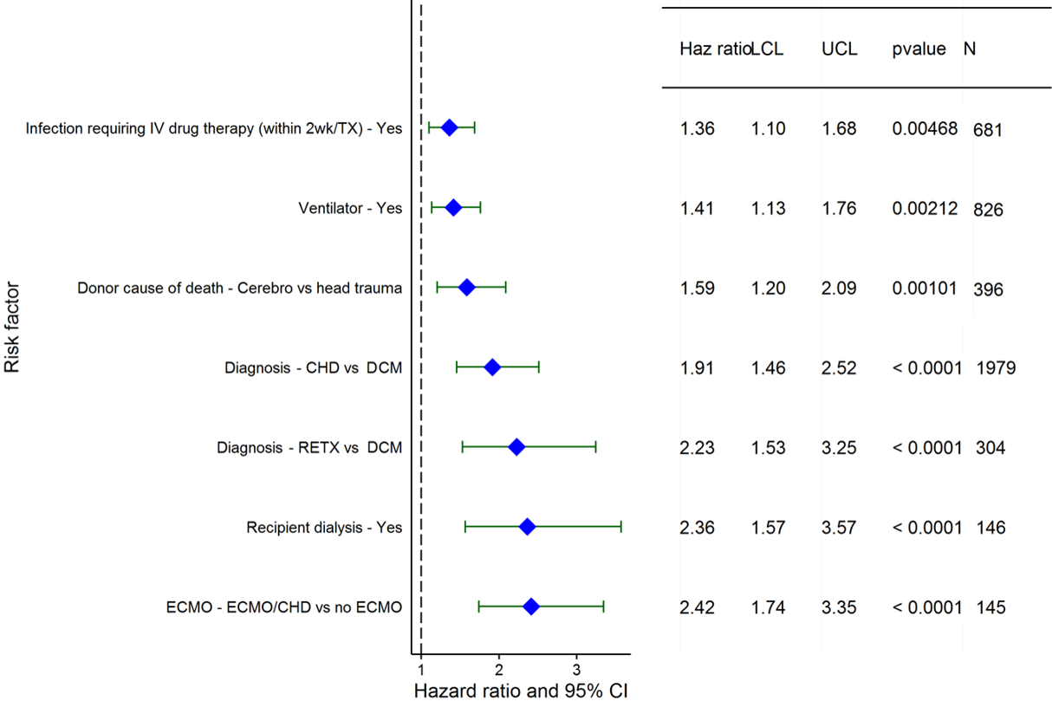
Pediatric Heart Transplants (2003-2013)
Risk Factors For 1 Year Mortality with 95% Confidence Limits
2016
(N = 5,646)
JHLT. 2016 Oct; 35(10): 1149-1205

Slide 109
Pediatric Heart Transplants (2003-2013)
Risk Factors For 1 Year Mortality
Continuous Factors (see figures)
Ischemia time | Donor weight
Estimated GFR | Pediatric center volume
2016
JHLT. 2016 Oct; 35(10): 1149-1205

Slide 110
Pediatric Heart Transplants (2003-2013)
Ischemia time
Risk Factors For 1 Year Mortality with 95% Confidence Limits
p < 0.0001
2016
(N = 5,646)
JHLT. 2016 Oct; 35(10): 1149-1205
Notes:
Multivariable analysis was performed using a proportional hazards model censoring all patients at 1 year. Continuous factors were fit using a restricted cubic spline.

Slide 111
Pediatric Heart Transplants (2003-2013)
Donor weight
Risk Factors For 1 Year Mortality with 95% Confidence Limits
p < 0.0001
2016
(N = 5,646)
JHLT. 2016 Oct; 35(10): 1149-1205
Notes:
Multivariable analysis was performed using a proportional hazards model censoring all patients at 1 year. Continuous factors were fit using a restricted cubic spline.

Slide 112
Pediatric Heart Transplants (2003-2013)
Estimated GFR
Risk Factors For 1 Year Mortality with 95% Confidence Limits
p = 0.0016
2016
(N = 5,646)
JHLT. 2016 Oct; 35(10): 1149-1205
Notes:
Multivariable analysis was performed using a proportional hazards model censoring all patients at 1 year. Continuous factors were fit using a restricted cubic spline.

Slide 113
Pediatric Heart Transplants (2003-2013)
Center volume of pediatric transplants
Risk Factors For 1 Year Mortality with 95% Confidence Limits
p < 0.0001
2016
(N = 5,646)
JHLT. 2016 Oct; 35(10): 1149-1205
Notes:
Multivariable analysis was performed using a proportional hazards model censoring all patients at 1 year. Continuous factors were fit using a restricted cubic spline.

Slide 114
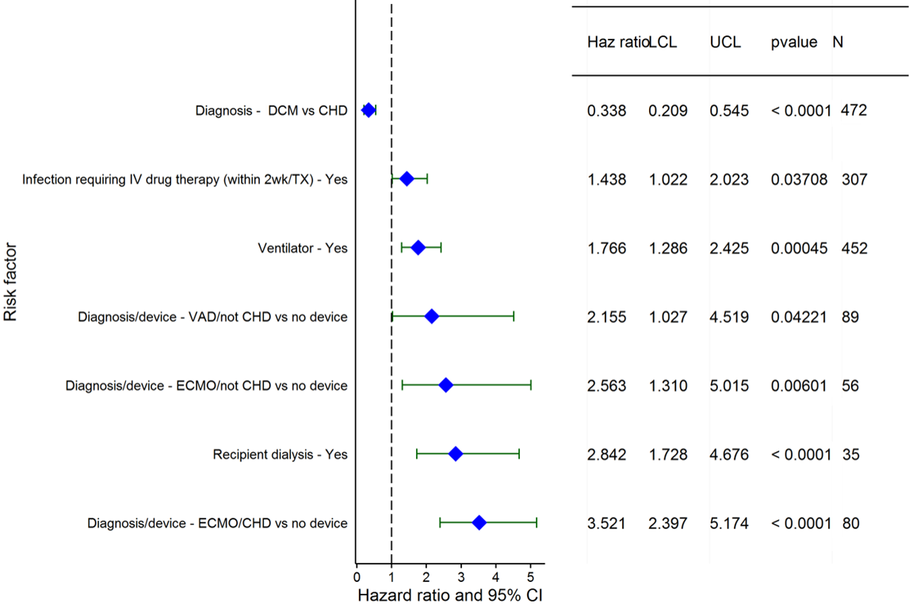
Pediatric Heart Transplants (2003-2013)
Age = <1 Year
Risk Factors For 1 Year Mortality with 95% Confidence Limits
2016
(N = 1,333)
JHLT. 2016 Oct; 35(10): 1149-1205

Slide 115
Pediatric Heart Transplants (2003-2013)
Age = <1 Year
Risk Factors For 1 Year Mortality
Continuous Factors (see figures)
Estimated GFR | Center volume of pediatric transplants
2016
JHLT. 2016 Oct; 35(10): 1149-1205

Slide 116
Pediatric Heart Transplants (2003-2013)
Estimated GFR
Age = <1 Year
Risk Factors For 1 Year Mortality with 95% Confidence Limits
p = 0.0008
2016
(N = 1,333)
JHLT. 2016 Oct; 35(10): 1149-1205
Notes:
Multivariable analysis was performed using a proportional hazards model censoring all patients at 1 year. Continuous factors were fit using a restricted cubic spline.

Slide 117
Pediatric Heart Transplants (2003-2013)
Center volume of pediatric transplants
Age = <1 Year
Risk Factors For 1 Year Mortality with 95% Confidence Limits
p = 0.0364
2016
(N = 1,333)
JHLT. 2016 Oct; 35(10): 1149-1205
Notes:
Multivariable analysis was performed using a proportional hazards model censoring all patients at 1 year. Continuous factors were fit using a restricted cubic spline.

Slide 118
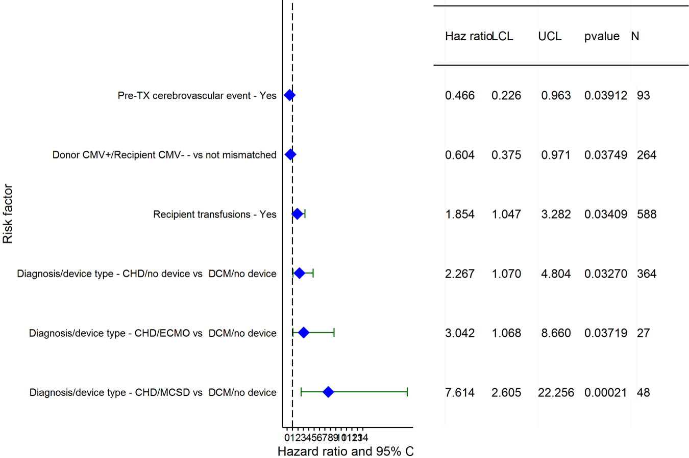
Pediatric Heart Transplants (2003-2013)
Age = 1-5 Years
Risk Factors For 1 Year Mortality with 95% Confidence Limits
2016
(N = 1,265)
JHLT. 2016 Oct; 35(10): 1149-1205

Slide 119
Pediatric Heart Transplants (2003-2013)
Age = 1-5 Years
Risk Factors For 1 Year Mortality
Continuous Factors (see figures)
BMI ratio | Estimated GFR
2016
JHLT. 2016 Oct; 35(10): 1149-1205

Slide 120
Pediatric Heart Transplants (2003-2013)
BMI ratio
Age = 1-5 Years
Risk Factors For 1 Year Mortality with 95% Confidence Limits
p = 0.0410
2016
(N = 1,265)
JHLT. 2016 Oct; 35(10): 1149-1205
Notes:
Multivariable analysis was performed using a proportional hazards model censoring all patients at 1 year. Continuous factors were fit using a restricted cubic spline.

Slide 121
Pediatric Heart Transplants (2003-2013)
mL/min/1.73 m²
Estimated GFR
Age = 1-5 Years
Risk Factors For 1 Year Mortality with 95% Confidence Limits
p = 0.0002
2016
(N = 1,265)
JHLT. 2016 Oct; 35(10): 1149-1205
Notes:
Multivariable analysis was performed using a proportional hazards model censoring all patients at 1 year. Continuous factors were fit using a restricted cubic spline.

Slide 122
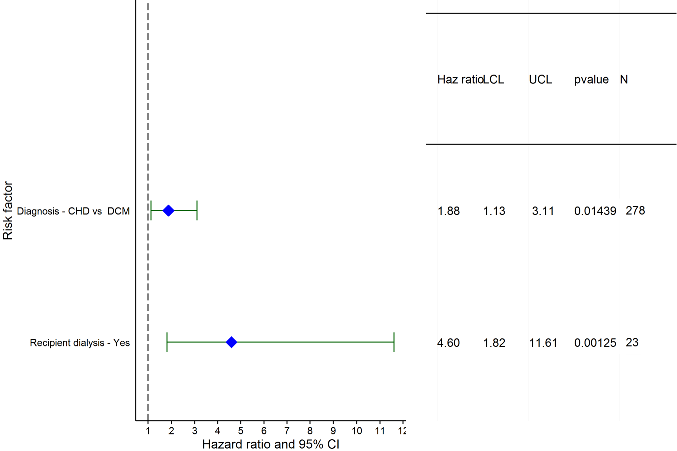
Pediatric Heart Transplants (2003-2013)
Age = 6-10 Years
Risk Factors For 1 Year Mortality with 95% Confidence Limits
2016
(N = 862)
JHLT. 2016 Oct; 35(10): 1149-1205

Slide 123
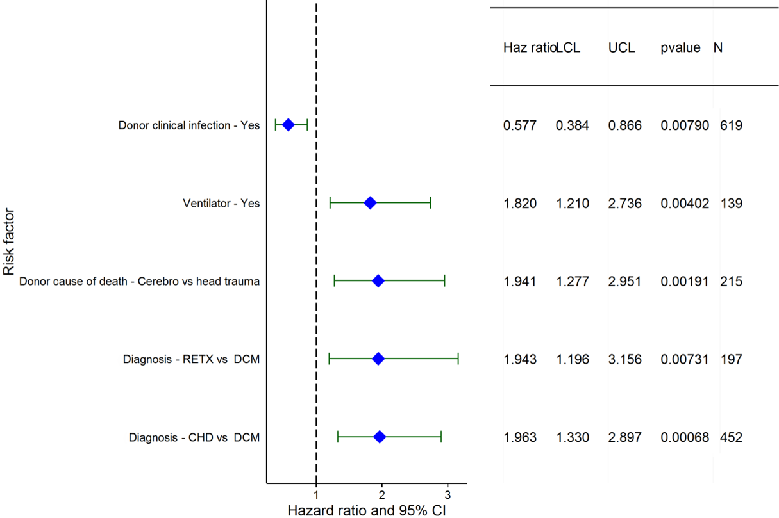
Pediatric Heart Transplants (2003-2013)
Age = 11-17 Years
Risk Factors For 1 Year Mortality with 95% Confidence Limits
2016
(N = 2,186)
JHLT. 2016 Oct; 35(10): 1149-1205

Slide 124
Pediatric Heart Transplants (2003-2013)
Age = 11-17 Years
Risk Factors For 1 Year Mortality
Continuous Factors (see figures)
Ischemia time | Pediatric center volume
2016
JHLT. 2016 Oct; 35(10): 1149-1205

Slide 125
Pediatric Heart Transplants (2003-2013)
Ischemia time
Age = 11-17 Years
Risk Factors For 1 Year Mortality with 95% Confidence Limits
p = 0.0447
2016
(N = 2,186)
JHLT. 2016 Oct; 35(10): 1149-1205
Notes:
Multivariable analysis was performed using a proportional hazards model censoring all patients at 1 year. Continuous factors were fit using a restricted cubic spline.

Slide 126
Pediatric Heart Transplants (2003-2013)
Center volume of pediatric transplants
Age = 11-17 Years
Risk Factors For 1 Year Mortality with 95% Confidence Limits
p = 0.0089
2016
(N = 2,186)
JHLT. 2016 Oct; 35(10): 1149-1205
Notes:
Multivariable analysis was performed using a proportional hazards model censoring all patients at 1 year. Continuous factors were fit using a restricted cubic spline.

Slide 127
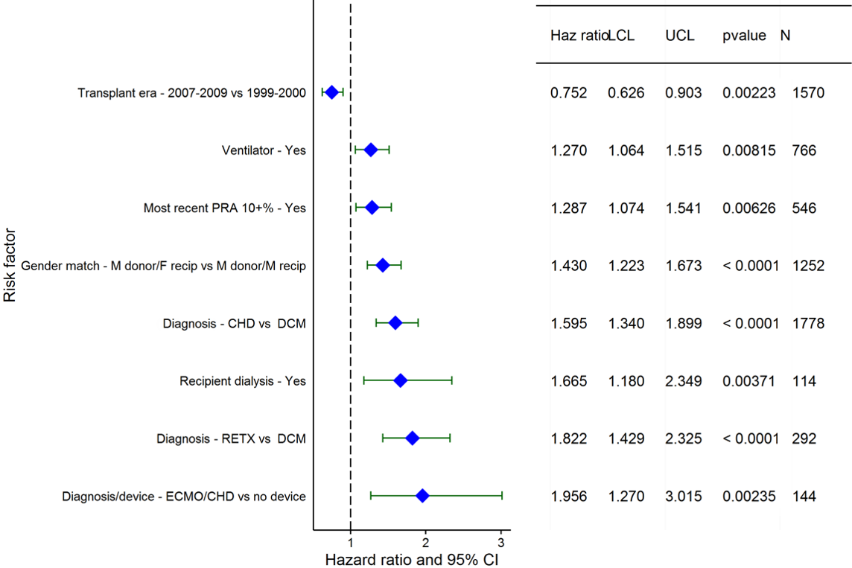
Pediatric Heart Transplants (1999-2009)
Risk Factors For 5 Year Mortality with 95% Confidence Limits
2016
(N = 5,035)
JHLT. 2016 Oct; 35(10): 1149-1205

Slide 128
Pediatric Heart Transplants (1999-2009)
Risk Factors For 5 Year Mortality
Continuous Factors (see figures)
Recipient age | Donor age
Ischemia time | Recipient weight
Estimated GFR | Pediatric center volume
2016
JHLT. 2016 Oct; 35(10): 1149-1205

Slide 129
Pediatric Heart Transplants (1999-2009)
Recipient age
Risk Factors For 5 Year Mortality with 95% Confidence Limits
p = 0.0041
2016
(N = 5,035)
JHLT. 2016 Oct; 35(10): 1149-1205
Notes:
Multivariable analysis was performed using a proportional hazards model censoring all patients at 5 years. Continuous factors were fit using a restricted cubic spline.

Slide 130
Pediatric Heart Transplants (1999-2009)
Donor age
Risk Factors For 5 Year Mortality with 95% Confidence Limits
p = 0.0030
2016
(N = 5,035)
JHLT. 2016 Oct; 35(10): 1149-1205
Notes:
Multivariable analysis was performed using a proportional hazards model censoring all patients at 5 years. Continuous factors were fit using a restricted cubic spline.

Slide 131
Pediatric Heart Transplants (1999-2009)
Ischemia time
Risk Factors For 5 Year Mortality with 95% Confidence Limits
p = 0.0057
2016
(N = 5,035)
JHLT. 2016 Oct; 35(10): 1149-1205
Notes:
Multivariable analysis was performed using a proportional hazards model censoring all patients at 5 years. Continuous factors were fit using a restricted cubic spline.

Slide 132
Pediatric Heart Transplants (1999-2009)
Recipient weight
Risk Factors For 5 Year Mortality with 95% Confidence Limits
p = 0.0259
2016
(N = 5,035)
JHLT. 2016 Oct; 35(10): 1149-1205
Notes:
Multivariable analysis was performed using a proportional hazards model censoring all patients at 5 years. Continuous factors were fit using a restricted cubic spline.

Slide 133
Pediatric Heart Transplants (1999-2009)
Estimated GFR
Risk Factors For 5 Year Mortality with 95% Confidence Limits
p = 0.0160
2016
(N = 5,035)
JHLT. 2016 Oct; 35(10): 1149-1205
Notes:
Multivariable analysis was performed using a proportional hazards model censoring all patients at 5 years. Continuous factors were fit using a restricted cubic spline.

Slide 134
Pediatric Heart Transplants (1999-2009)
Center volume of pediatric transplants
Risk Factors For 5 Year Mortality with 95% Confidence Limits
p = 0.0088
2016
(N = 5,035)
JHLT. 2016 Oct; 35(10): 1149-1205
Notes:
Multivariable analysis was performed using a proportional hazards model censoring all patients at 5 years. Continuous factors were fit using a restricted cubic spline.

Slide 135
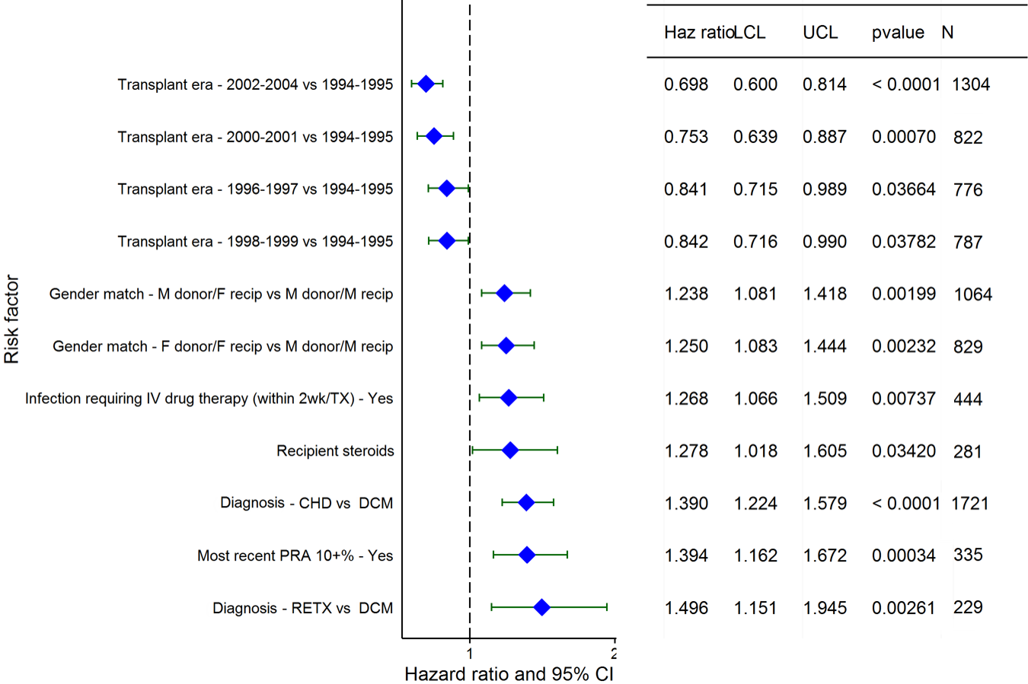
Pediatric Heart Transplants (1994-2004)
Risk Factors For 10 Year Mortality with 95% Confidence Limits
2016
(N = 4,449)
JHLT. 2016 Oct; 35(10): 1149-1205

Slide 136
Pediatric Heart Transplants (1994-2004)
Risk Factors For 10 Year Mortality
Continuous Factors (see figures)
Recipient age | Donor age
Estimated GFR | Pediatric center volume
Total bilirubin
2016
JHLT. 2016 Oct; 35(10): 1149-1205

Slide 137
Pediatric Heart Transplants (1994-2004)
Recipient age
Risk Factors For 10 Year Mortality with 95% Confidence Limits
p = 0.0017
2016
(N = 4,449)
JHLT. 2016 Oct; 35(10): 1149-1205
Notes:
Multivariable analysis was performed using a proportional hazards model censoring all patients at 10 years. Continuous factors were fit using a restricted cubic spline.

Slide 138
Pediatric Heart Transplants (1994-2004)
Donor age
Risk Factors For 10 Year Mortality with 95% Confidence Limits
p = 0.0104
2016
(N = 4,449)
JHLT. 2016 Oct; 35(10): 1149-1205
Notes:
Multivariable analysis was performed using a proportional hazards model censoring all patients at 10 years. Continuous factors were fit using a restricted cubic spline.

Slide 139
Pediatric Heart Transplants (1994-2004)
Estimated GFR
Risk Factors For 10 Year Mortality with 95% Confidence Limits
p = 0.0492
2016
(N = 4,449)
JHLT. 2016 Oct; 35(10): 1149-1205
Notes:
Multivariable analysis was performed using a proportional hazards model censoring all patients at 10 years. Continuous factors were fit using a restricted cubic spline.

Slide 140
Pediatric Heart Transplants (1994-2004)
Center volume of pediatric transplants
Risk Factors For 10 Year Mortality with 95% Confidence Limits
p = 0.0246
2016
(N = 4,449)
JHLT. 2016 Oct; 35(10): 1149-1205
Notes:
Multivariable analysis was performed using a proportional hazards model censoring all patients at 10 years. Continuous factors were fit using a restricted cubic spline.

Slide 141
Pediatric Heart Transplants (1994-2004)
Total bilirubin
Risk Factors For 10 Year Mortality with 95% Confidence Limits
p = 0.0360
2016
(N = 4,449)
JHLT. 2016 Oct; 35(10): 1149-1205
Notes:
Multivariable analysis was performed using a proportional hazards model censoring all patients at 10 years. Continuous factors were fit using a restricted cubic spline.

Slide 142
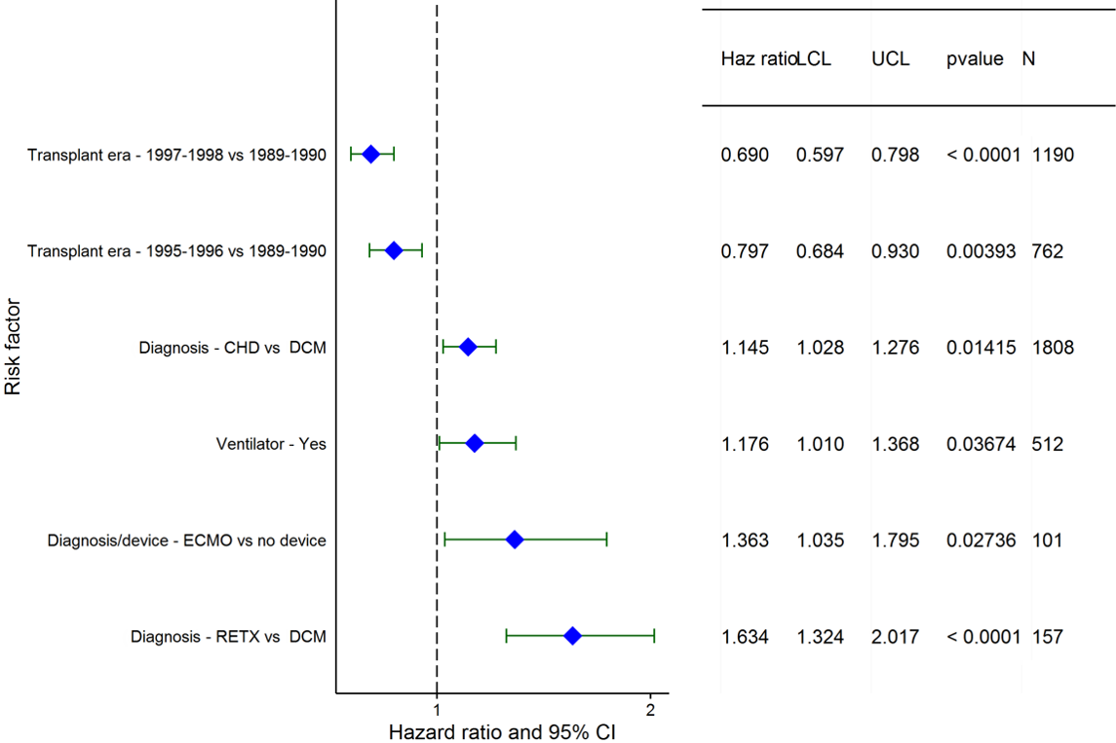
Pediatric Heart Transplants (1989-1999)
Risk Factors For 15 Year Mortality with 95% Confidence Limits
2016
(N = 4,141)
JHLT. 2016 Oct; 35(10): 1149-1205

Slide 143
Pediatric Heart Transplants (1989-1999)
Risk Factors For 15 Year Mortality
Continuous Factors (see figures)
Recipient weight | BSA ratio
Center volume of pediatric transplants
2016
JHLT. 2016 Oct; 35(10): 1149-1205

Slide 144
Pediatric Heart Transplants (1989-1999)
Recipient weight (kg)
Risk Factors For 15 Year Mortality with 95% Confidence Limits
p = 0.0002
2016
(N = 4,141)
JHLT. 2016 Oct; 35(10): 1149-1205
Notes:
Multivariable analysis was performed using a proportional hazards model censoring all patients at 15 years. Continuous factors were fit using a restricted cubic spline.

Slide 145
Pediatric Heart Transplants (1989-1999)
Ratio of Donor BSA to Recipient BSA
Risk Factors For 15 Year Mortality with 95% Confidence Limits
p = 0.0177
2016
(N = 4,141)
JHLT. 2016 Oct; 35(10): 1149-1205
Notes:
Multivariable analysis was performed using a proportional hazards model censoring all patients at 15 years. Continuous factors were fit using a restricted cubic spline.

Slide 146
Pediatric Heart Transplants (1989-1999)
Center volume of pediatric transplants
Risk Factors For 15 Year Mortality with 95% Confidence Limits
p = 0.0300
2016
(N = 4,141)
JHLT. 2016 Oct; 35(10): 1149-1205
Notes:
Multivariable analysis was performed using a proportional hazards model censoring all patients at 15 years. Continuous factors were fit using a restricted cubic spline.

Slide 147
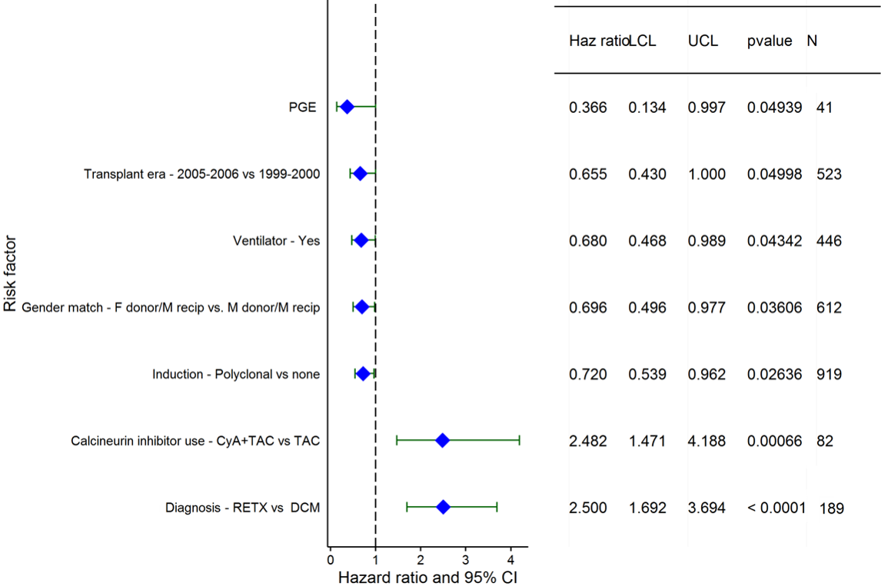
Pediatric Heart Transplants (1999-2009)
Conditional on Survival to Transplant Discharge
Risk Factors for Developing CAV within 5 Years
2016
(N = 2,769)
JHLT. 2016 Oct; 35(10): 1149-1205

Slide 148
Pediatric Heart Transplants (1999-2009)
Conditional on Survival to Transplant Discharge
Risk Factors for Developing CAV within 5 Years
Continuous Factors (see figures)
Donor age | Recipient BSA
Transplant center volume (pediatric and adult)
2016
JHLT. 2016 Oct; 35(10): 1149-1205

Slide 149
Pediatric Heart Transplants (1999-2009)
Donor age
Conditional on Survival to Transplant Discharge
Risk Factors for Developing CAV within 5 Years
p < 0.0001
2016
(N = 2,769)
JHLT. 2016 Oct; 35(10): 1149-1205
Notes:
Multivariable analysis was performed using a proportional hazards model censoring all patients at 5 years. Continuous factors were fit using a restricted cubic spline.

Slide 150
Pediatric Heart Transplants (1999-2009)
Recipient BSA
Conditional on Survival to Transplant Discharge
Risk Factors for Developing CAV within 5 Years
p = 0.0009
2016
(N = 2,769)
JHLT. 2016 Oct; 35(10): 1149-1205
Notes:
Multivariable analysis was performed using a proportional hazards model censoring all patients at 5 years. Continuous factors were fit using a restricted cubic spline.

Slide 151
Pediatric Heart Transplants (1999-2009)
Transplant center volume (pediatric and adult)
Conditional on Survival to Transplant Discharge
Risk Factors for Developing CAV within 5 Years
p = 0.0050
2016
(N = 2,769)
JHLT. 2016 Oct; 35(10): 1149-1205
Notes:
Multivariable analysis was performed using a proportional hazards model censoring all patients at 5 years. Continuous factors were fit using a restricted cubic spline.

Slide 152
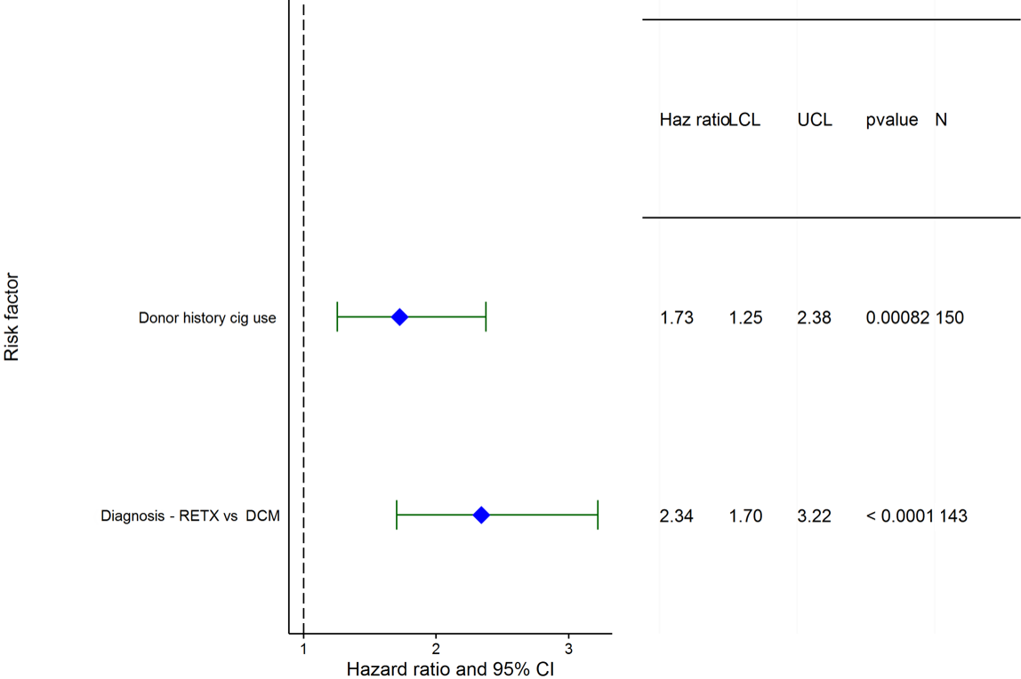
Pediatric Heart Transplants (1994-2004)
Conditional on Survival to Transplant Discharge
Risk Factors for Developing CAV within 10 Years
2016
(N = 2,245)
JHLT. 2016 Oct; 35(10): 1149-1205

Slide 153
Pediatric Heart Transplants (1994-2004)
Conditional on Survival to Transplant Discharge
Risk Factors for Developing CAV within 10 Years
Continuous Factors (see figures)
Recipient age | Donor weight
BMI ratio | Transplant center volume (pediatric and adult)
2016
JHLT. 2016 Oct; 35(10): 1149-1205

Slide 154
Pediatric Heart Transplants (1994-2004)
Recipient age
Conditional on Survival to Transplant Discharge
Risk Factors for Developing CAV within 10 Years
p = 0.0407
2016
(N = 2,245)
JHLT. 2016 Oct; 35(10): 1149-1205
Notes:
Multivariable analysis was performed using a proportional hazards model censoring all patients at 10 years. Continuous factors were fit using a restricted cubic spline.

Slide 155
Pediatric Heart Transplants (1994-2004)
Donor weight
Conditional on Survival to Transplant Discharge
Risk Factors for Developing CAV within 10 Years
p = 0.0011
2016
(N = 2,245)
JHLT. 2016 Oct; 35(10): 1149-1205
Notes:
Multivariable analysis was performed using a proportional hazards model censoring all patients at 10 years. Continuous factors were fit using a restricted cubic spline.

Slide 156
Pediatric Heart Transplants (1994-2004)
Ratio of Donor BMI to Recipient BMI
Conditional on Survival to Transplant Discharge
Risk Factors for Developing CAV within 10 Years
p = 0.0146
2016
(N = 2,245)
JHLT. 2016 Oct; 35(10): 1149-1205
Notes:
Multivariable analysis was performed using a proportional hazards model censoring all patients at 10 years. Continuous factors were fit using a restricted cubic spline.

Slide 157
Pediatric Heart Transplants (1994-2004)
Transplant center volume (pediatric and adult)
Conditional on Survival to Transplant Discharge
Risk Factors for Developing CAV within 10 Years
p = 0.0002
2016
(N = 2,245)
JHLT. 2016 Oct; 35(10): 1149-1205
Notes:
Multivariable analysis was performed using a proportional hazards model censoring all patients at 10 years. Continuous factors were fit using a restricted cubic spline.

Slide 158
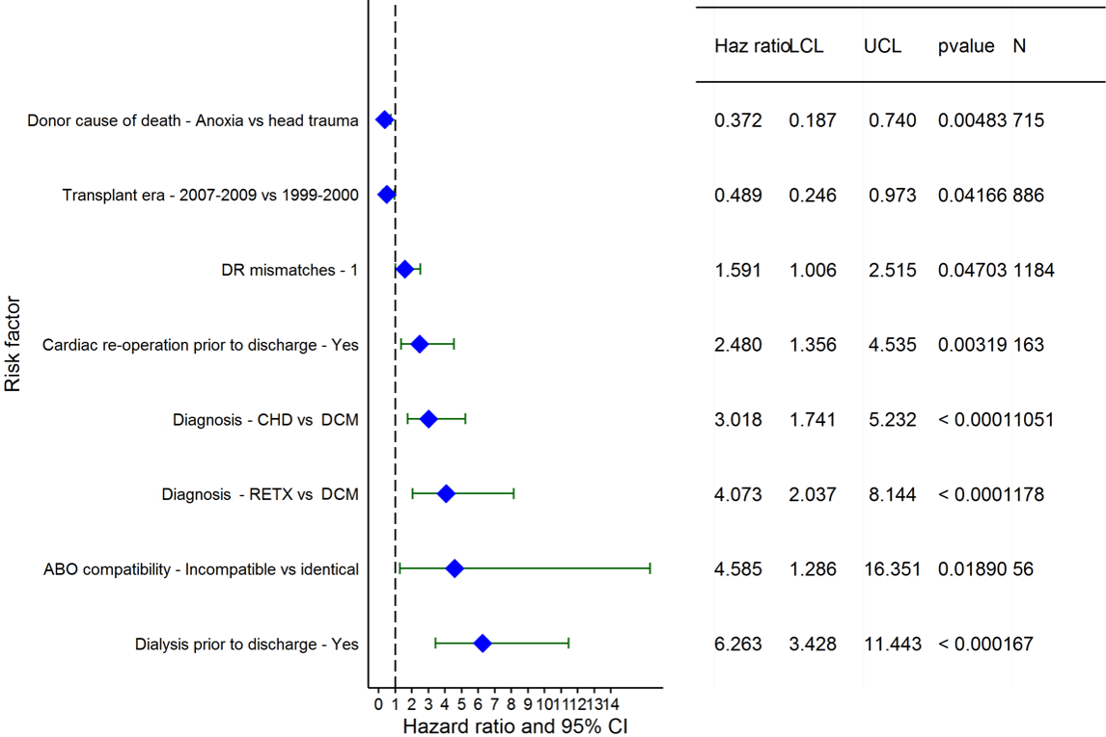
Pediatric Heart Transplants (1999-2009)
Risk Factors for Developing Renal Dysfunction within 5 Years
Limited to Recipients without Severe Renal Dysfunction* Pre-Transplant Conditional on Survival to Transplant Discharge
2016
(N = 2,691)
JHLT. 2016 Oct; 35(10): 1149-1205
*Severe renal dysfunction = creatinine > 2.5 mg/dl or dialysis

Slide 159
Pediatric Heart Transplants (1999-2009)
Risk Factors for Developing Renal Dysfunction within 5 Years
Limited to Recipients without Severe Renal Dysfunction* Pre-Transplant Conditional on Survival to Transplant Discharge
Continuous Factors (see figures)
Donor BSA
2016
JHLT. 2016 Oct; 35(10): 1149-1205
*Severe renal dysfunction = creatinine > 2.5 mg/dl or dialysis

Slide 160
Pediatric Heart Transplants (1999-2009)
Risk Factors for Developing Renal Dysfunction within 5 Years
Donor BSA
Limited to Recipients without Severe Renal Dysfunction* Pre-Transplant Conditional on Survival to Transplant Discharge
p = 0.0025
2016
(N = 2,691)
JHLT. 2016 Oct; 35(10): 1149-1205
*Severe renal dysfunction = creatinine > 2.5 mg/dl or dialysis
Notes:
Multivariable analysis was performed using a proportional hazards model censoring all patients at 5 years. Continuous factors were fit using a restricted cubic spline.

Slide 161
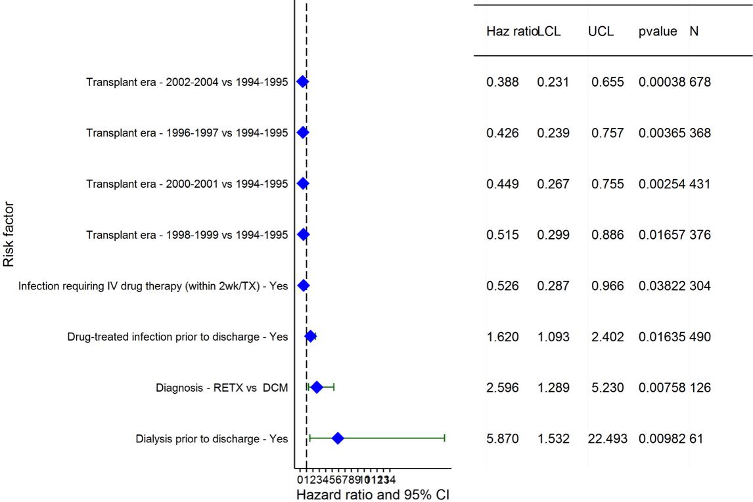
Pediatric Heart Transplants (1994-2004)
Risk Factors for Developing Renal Dysfunction within 10 Years
Limited to Recipients without Severe Renal Dysfunction* Pre-Transplant Conditional on Survival to Transplant Discharge
2016
(N = 2,222)
JHLT. 2016 Oct; 35(10): 1149-1205
*Severe renal dysfunction = creatinine > 2.5 mg/dl or dialysis

Slide 162
Pediatric Heart Transplants (1994-2004)
Risk Factors for Developing Renal Dysfunction within 10 Years
Limited to Recipients without Severe Renal Dysfunction* Pre-Transplant Conditional on Survival to Transplant Discharge
Continuous Factors (see figures)
Recipient BSA | Center volume of pediatric transplants
2016
JHLT. 2016 Oct; 35(10): 1149-1205
*Severe renal dysfunction = creatinine > 2.5 mg/dl or dialysis

Slide 163
Pediatric Heart Transplants (1994-2004)
Risk Factors for Developing Renal Dysfunction within 10 Years
Recipient BSA
Limited to Recipients without Severe Renal Dysfunction* Pre-Transplant Conditional on Survival to Transplant Discharge
p < 0.0001
2016
(N = 2,222)
JHLT. 2016 Oct; 35(10): 1149-1205
*Severe renal dysfunction = creatinine > 2.5 mg/dl or dialysis
Notes:
Multivariable analysis was performed using a proportional hazards model censoring all patients at 10 years. Continuous factors were fit using a restricted cubic spline.

Slide 164
Pediatric Heart Transplants (1994-2004)
Risk Factors for Developing Renal Dysfunction within 10 Years
Center volume of pediatric transplants
Limited to Recipients without Severe Renal Dysfunction* Pre-Transplant Conditional on Survival to Transplant Discharge
p = 0.0121
2016
(N = 2,222)
JHLT. 2016 Oct; 35(10): 1149-1205
*Severe renal dysfunction = creatinine > 2.5 mg/dl or dialysis
Notes:
Multivariable analysis was performed using a proportional hazards model censoring all patients at 10 years. Continuous factors were fit using a restricted cubic spline.

Slide 165
Focus Theme
2016
JHLT. 2016 Oct; 35(10): 1149-1205

Slide 166
Pediatric Heart Transplants
Diagnosis Distribution by Era
2016
JHLT. 2016 Oct; 35(10): 1149-1205
Notes:
NOTE: Transplants with unknown diagnoses are excluded from this tabulation.

Slide 167
Pediatric Heart Transplants
Diagnosis Distribution by Age Group
(Transplants: January 2009 – June 2015)
2016
JHLT. 2016 Oct; 35(10): 1149-1205
Notes:
NOTE: Transplants with unknown diagnoses are excluded from this tabulation.

Slide 168
Pediatric Heart Transplants
Diagnosis Distribution by Gender
(Transplants: January 2009 – June 2015)
2016
JHLT. 2016 Oct; 35(10): 1149-1205
Notes:
NOTE: Transplants with unknown diagnoses are excluded from this tabulation.

Slide 169
Pediatric Heart Transplants
Kaplan-Meier Survival by Diagnosis
(Transplants: January 2004 – June 2014)
All pair-wise comparisons were significant at p < 0.05.
2016
JHLT. 2016 Oct; 35(10): 1149-1205
Notes:
Survival was calculated using the Kaplan-Meier method, which incorporates information from all transplants for whom any follow-up has been provided. Since many patients are still alive and some patients have been lost to follow-up, the survival rates are estimates rather than exact rates because the time of death is not known for all patients.
Survival rates were compared using the log-rank test statistic. Adjustments for multiple comparisons were done using Scheffe’s method. Results of log-rank test should be interpreted with caution when curves cross.

Slide 170
Pediatric Heart Transplants
Percentage Experiencing Treated Rejection between Discharge and 1-Year Follow-Up by Diagnosis
(Follow-ups: July 2004 – June 2015)
No pair-wise comparisons were significant at p < 0.05 except all comparisons with Retransplant.
Analysis is limited to patients who were alive at the time of the follow-up.
Treated rejection = Recipient was reported to (1) have at least one acute rejection episode that was treated with an anti-rejection agent; or (2) have been hospitalized for rejection.
2016
JHLT. 2016 Oct; 35(10): 1149-1205
Notes:
Because of a modification in the data collection, the analysis is limited to follow-ups occurring on or after July 2004.
Comparisons were made using the chi-square statistic. Adjustments for multiple comparisons were done using Bonferroni method.

Slide 171
Pediatric Heart Transplants
Coronary Artery Vasculopathy-Free Survival
by Diagnosis
(Transplants: January 2004 – June 2014)
No pair-wise comparisons were significant at p < 0.05 except all comparisons with Retransplant.
2016
JHLT. 2016 Oct; 35(10): 1149-1205
Notes:
CAV-free survival was computed using the Kaplan-Meier method.
The development of CAV is reported on annual follow-ups; a date of diagnosis is not provided. For this figure the midpoint between the date of previous follow-up (when event had not occurred) and the date of follow-up when the event was reported was used as the date of occurrence. Patients were included in the analysis until an unknown response for the outcome of interest was reported. Therefore, the rates seen here may differ from those reported in the cumulative prevalence slide which is based on only those patients with known responses for each of the outcomes at all follow-up time points.
Survival rates were compared using the log-rank test statistic. A significant p-value means that at least one of the groups is different than the others but it doesn’t identify which group it is. Results of log-rank test should be interpreted with caution when curves cross.

Slide 172
Pediatric Heart Transplants
Severe Renal Dysfunction*-Free Survival by Diagnosis
(Transplants: January 2004 – June 2014)
No pair-wise comparisons were significant at p < 0.05 except all comparisons with Retransplant.
2016
JHLT. 2016 Oct; 35(10): 1149-1205
Notes:
Severe renal dysfunction-free survival rate was computed using the Kaplan-Meier method.
The development of severe renal dysfunction is reported on annual follow-ups; a date of diagnosis is not provided. For this figure the midpoint between the date of previous follow-up (when event had not occurred) and the date of follow-up when the event was reported was used as the date of occurrence. Patients were included in the analysis until an unknown response for the outcome of interest was reported. Therefore, the rates seen here may differ from those reported in the cumulative prevalence slide which is based on only those patients with known responses for each of the outcomes at all follow-up time points.
Survival rates were compared using the log-rank test statistic. Adjustments for multiple comparisons were done using Scheffe’s method. Results of log-rank test should be interpreted with caution when curves cross.

Slide 173
Pediatric Heart Transplants
Induction Immunosuppression by Diagnosis
(Transplants: January 2004 – June 2015)
2016
Analysis is limited to patients who were alive at the time of the discharge.
JHLT. 2016 Oct; 35(10): 1149-1205

Slide 174
Pediatric Heart Transplants
Maintenance Immunosuppression at Time of 1 Year
Follow-up by Diagnosis
(Follow-ups: January 2009 – June 2015)
2016
Analysis is limited to patients who were alive at the time of the follow-up.
JHLT. 2016 Oct; 35(10): 1149-1205
Notes:
This figure shows the maintenance immunosuppression reported as being provided at the time of the 1-year annual follow-up forms.

Slide 175
Pediatric Heart Transplants
Cause of Death for CHD Diagnosis
(Deaths: January 2004 – June 2015)
CAUSE OF DEATH | 0-30 Days (N = 133) | 31 Days – 1 Year (N = 164) | >1 Year - 3 Years (N = 92) | >3 Years - 5 Years (N = 73) | >5 Years - 10 Years (N = 103) | >10 Years (N = 146)
CORONARY ARTERY VASCULOPATHY | 4 (3.0%) | 5 (3.0%) | 15 (16.3%) | 13 (17.8%) | 23 (22.3%) | 35 (24.0%)
ACUTE REJECTION | 12 (9.0%) | 20 (12.2%) | 13 (14.1%) | 10 (13.7%) | 8 (7.8%) | 8 (5.5%)
LYMPHOMA | 0 | 3 (1.8%) | 5 (5.4%) | 3 (4.1%) | 8 (7.8%) | 13 (8.9%)
MALIGNANCY, OTHER | 0 | 0 | 0 | 0 | 2 (1.9%) | 3 (2.1%)
CMV | 0 | 4 (2.4%) | 0 | 0 | 0 | 0
INFECTION, NON-CMV | 6 (4.5%) | 22 (13.4%) | 9 (9.8%) | 3 (4.1%) | 5 (4.9%) | 6 (4.1%)
GRAFT FAILURE | 49 (36.8%) | 28 (17.1%) | 33 (35.9%) | 26 (35.6%) | 39 (37.9%) | 44 (30.1%)
TECHNICAL | 12 (9.0%) | 1 (0.6%) | 0 | 0 | 2 (1.9%) | 3 (2.1%)
OTHER | 13 (9.8%) | 12 (7.3%) | 6 (6.5%) | 5 (6.8%) | 3 (2.9%) | 8 (5.5%)
MULTIPLE ORGAN FAILURE | 14 (10.5%) | 42 (25.6%) | 2 (2.2%) | 3 (4.1%) | 4 (3.9%) | 12 (8.2%)
RENAL FAILURE | 0 | 3 (1.8%) | 0 | 1 (1.4%) | 0 | 3 (2.1%)
PULMONARY | 6 (4.5%) | 19 (11.6%) | 6 (6.5%) | 6 (8.2%) | 5 (4.9%) | 3 (2.1%)
CEREBROVASCULAR | 17 (12.8%) | 5 (3.0%) | 3 (3.3%) | 3 (4.1%) | 4 (3.9%) | 8 (5.5%)
2016
JHLT. 2016 Oct; 35(10): 1149-1205
Notes:
Percentages were based only on known causes of death.

Slide 176
Pediatric Heart Transplants
Cause of Death for DCM Diagnosis
(Deaths: January 2004 – June 2015)
CAUSE OF DEATH | 0-30 Days (N = 74) | 31 Days – 1 Year (N = 85) | >1 Year – 3 Years (N = 104) | >3 Years - 5 Years (N = 89) | >5 Years - 10 Years (N = 181) | >10 Years (N = 196)
CORONARY ARTERY VASCULOPATHY | 0 | 3 (3.5%) | 15 (14.4%) | 13 (14.6%) | 32 (17.7%) | 50 (25.5%)
ACUTE REJECTION | 2 (2.7%) | 21 (24.7%) | 20 (19.2%) | 12 (13.5%) | 24 (13.3%) | 11 (5.6%)
LYMPHOMA | 0 | 0 | 1 (1.0%) | 3 (3.4%) | 12 (6.6%) | 10 (5.1%)
MALIGNANCY, OTHER | 0 | 3 (3.5%) | 2 (1.9%) | 1 (1.1%) | 2 (1.1%) | 10 (5.1%)
CMV | 0 | 2 (2.4%) | 0 | 0 | 0 | 0
INFECTION, NON-CMV | 5 (6.8%) | 9 (10.6%) | 5 (4.8%) | 4 (4.5%) | 9 (5.0%) | 12 (6.1%)
GRAFT FAILURE | 33 (44.6%) | 21 (24.7%) | 43 (41.3%) | 38 (42.7%) | 78 (43.1%) | 64 (32.7%)
TECHNICAL | 3 (4.1%) | 0 | 0 | 1 (1.1%) | 1 (0.6%) | 2 (1.0%)
OTHER | 7 (9.5%) | 7 (8.2%) | 7 (6.7%) | 6 (6.7%) | 12 (6.6%) | 14 (7.1%)
MULTIPLE ORGAN FAILURE | 12 (16.2%) | 12 (14.1%) | 6 (5.8%) | 4 (4.5%) | 4 (2.2%) | 8 (4.1%)
RENAL FAILURE | 0 | 1 (1.2%) | 0 | 0 | 1 (0.6%) | 8 (4.1%)
PULMONARY | 1 (1.4%) | 2 (2.4%) | 3 (2.9%) | 3 (3.4%) | 3 (1.7%) | 2 (1.0%)
CEREBROVASCULAR | 11 (14.9%) | 4 (4.7%) | 2 (1.9%) | 4 (4.5%) | 3 (1.7%) | 5 (2.6%)
2016
JHLT. 2016 Oct; 35(10): 1149-1205
Notes:
Percentages were based only on known causes of death.

Slide 177
Pediatric Heart Transplants
Cause of Death for Retransplant Diagnosis
(Deaths: January 2004 – June 2015)
CAUSE OF DEATH | 0-30 Days (N = 17) | 31 Days – 1 Year (N = 21) | >1 Year – 3 Years (N = 19) | >3 Years - 5 Years (N = 23) | >5 Years - 10 Years (N = 35) | >10 Years (N = 17)
CORONARY ARTERY VASCULOPATHY | 0 | 1 (4.8%) | 1 (5.3%) | 4 (17.4%) | 9 (25.7%) | 2 (11.8%)
ACUTE REJECTION | 0 | 1 (4.8%) | 5 (26.3%) | 5 (21.7%) | 3 (8.6%) | 0
LYMPHOMA | 0 | 1 (4.8%) | 2 (10.5%) | 1 (4.3%) | 1 (2.9%) | 1 (5.9%)
MALIGNANCY, OTHER | 0 | 0 | 0 | 0 | 2 (5.7%) | 1 (5.9%)
INFECTION, NON-CMV | 2 (11.8%) | 4 (19.0%) | 0 | 4 (17.4%) | 1 (2.9%) | 2 (11.8%)
GRAFT FAILURE | 5 (29.4%) | 3 (14.3%) | 6 (31.6%) | 6 (26.1%) | 13 (37.1%) | 7 (41.2%)
TECHNICAL | 4 (23.5%) | 0 | 0 | 0 | 1 (2.9%) | 0
OTHER | 0 | 2 (9.5%) | 1 (5.3%) | 2 (8.7%) | 0 | 1 (5.9%)
MULTIPLE ORGAN FAILURE | 2 (11.8%) | 6 (28.6%) | 3 (15.8%) | 1 (4.3%) | 2 (5.7%) | 1 (5.9%)
RENAL FAILURE | 0 | 0 | 0 | 0 | 0 | 1 (5.9%)
PULMONARY | 2 (11.8%) | 2 (9.5%) | 0 | 0 | 1 (2.9%) | 1 (5.9%)
CEREBROVASCULAR | 2 (11.8%) | 1 (4.8%) | 1 (5.3%) | 0 | 2 (5.7%) | 0
2016
JHLT. 2016 Oct; 35(10): 1149-1205
Notes:
Percentages were based only on known causes of death.

Slide 178
Pediatric Heart Transplants
Cause of Death for Other Diagnosis
(Deaths: January 2004 – June 2015)
CAUSE OF DEATH | 0-30 Days (N = 27) | 31 Days – 1 Year (N = 26) | >1 Year – 3 Years (N = 21) | >3 Years - 5 Years (N = 16) | >5 Years - 10 Years (N = 36) | >10 Years (N = 29)
CORONARY ARTERY VASCULOPATHY | 0 | 0 | 3 (14.3%) | 5 (31.3%) | 10 (27.8%) | 9 (31.0%)
ACUTE REJECTION | 3 (11.1%) | 3 (11.5%) | 4 (19.0%) | 3 (18.8%) | 3 (8.3%) | 0
LYMPHOMA | 0 | 1 (3.8%) | 1 (4.8%) | 2 (12.5%) | 1 (2.8%) | 1 (3.4%)
MALIGNANCY, OTHER | 0 | 0 | 1 (4.8%) | 0 | 0 | 0
INFECTION, NON-CMV | 2 (7.4%) | 2 (7.7%) | 0 | 1 (6.3%) | 4 (11.1%) | 2 (6.9%)
GRAFT FAILURE | 8 (29.6%) | 8 (30.8%) | 6 (28.6%) | 4 (25.0%) | 9 (25.0%) | 12 (41.4%)
TECHNICAL | 1 (3.7%) | 1 (3.8%) | 0 | 0 | 0 | 0
OTHER | 3 (11.1%) | 0 | 1 (4.8%) | 1 (6.3%) | 3 (8.3%) | 1 (3.4%)
MULTIPLE ORGAN FAILURE | 2 (7.4%) | 4 (15.4%) | 2 (9.5%) | 0 | 4 (11.1%) | 3 (10.3%)
RENAL FAILURE | 1 (3.7%) | 0 | 1 (4.8%) | 0 | 0 | 0
PULMONARY | 1 (3.7%) | 6 (23.1%) | 2 (9.5%) | 0 | 2 (5.6%) | 1 (3.4%)
CEREBROVASCULAR | 6 (22.2%) | 1 (3.8%) | 0 | 0 | 0 | 0
2016
JHLT. 2016 Oct; 35(10): 1149-1205
Notes:
Percentages were based only on known causes of death.

