Slide 1

HEART TRANSPLANTATION
Adult Recipients
2016
JHLT. 2016 Oct; 35(10): 1149-1205

Slide 2
Table of Contents
Donor and recipient characteristics: slides 3-26
Immunosuppression: slides 27-42
Survival analyses: slides 43-81
Morbidity: slides 82-106
Multivariable analyses: slides 107-175
Focus theme: slides 176-206
2016
JHLT. 2016 Oct; 35(10): 1149-1205

Slide 3
Donor and Recipient Characteristics:
Diagnosis: slides 4-6, 11, 21, 23 and 25
Retransplants by year: slide 7
Recipient and donor characteristics: slides 8-26
2016
JHLT. 2016 Oct; 35(10): 1149-1205

Slide 4
Adult Heart Transplants
Diagnosis
1/1982 – 6/2015
1/2009 – 6/2015
2016
JHLT. 2016 Oct; 35(10): 1149-1205

Slide 5
Adult Heart Transplants
Diagnosis by Location
(Transplants: January 2009 – June 2015)
2016
JHLT. 2016 Oct; 35(10): 1149-1205

Slide 6
Adult Heart Transplants
Diagnosis by Age Group
(Transplants: January 2009 – June 2015)
2016
JHLT. 2016 Oct; 35(10): 1149-1205

Slide 7
Adult Heart Retransplants by Year of Retransplant
2016
JHLT. 2016 Oct; 35(10): 1149-1205

Slide 8
Adult Heart Transplants
Donor and Recipient Characteristics
 | 1992-2003 (N = 48,388) | 2004-2008 (N = 17,666) | 2009-6/2015 (N = 24,474) | p-value
Recipient age (years) | 54.0 (28.0 - 65.0) | 53.0 (24.0 - 66.0) | 54.0 (25.0 - 68.0) | <0.0001
Donor age (years) | 32.0 (15.0 - 54.0) | 34.0 (16.0 - 56.0) | 35.0 (17.0 - 57.0) | <0.0001
Donor and recipient age difference (years) | -19.0 (-43.0 - 8.0) | -16.0 (-43.0 - 12.0) | -16.0 (-43.0 - 12.0) | <0.0001
Recipient weight (kg) | 76.0 (53.1 - 103.0) | 78.0 (53.5 - 107.5) | 80.0 (54.0 - 108.9) | <0.0001
Recipient height (cm) | 174.0 (157.0 - 188.0) | 175.0 (157.5 - 188.0) | 174.5 (157.5 - 188.0) | 0.0091
Recipient BMI | 25.1 (19.1 - 32.8) | 25.8 (19.3 - 34.2) | 26.3 (19.5 - 34.8) | <0.0001
Donor weight (kg) | 75.0 (53.0 - 104.0)¹ | 78.3 (56.0 - 110.0) | 80.0 (56.7 - 114.0) | <0.0001
Donor height (cm) | 175.0 (157.0 - 188.0)¹ | 175.3 (160.0 - 190.0) | 175.0 (157.5 - 189.0) | <0.0001
Donor BMI | 24.4 (19.0 - 33.3)¹ | 25.2 (19.8 - 35.4) | 25.8 (19.9 - 37.0) | <0.0001
Continuous factors are expressed as median (5th – 95th percentiles)
2016
¹ Based on 4/1994-2003 transplants.
JHLT. 2016 Oct; 35(10): 1149-1205
Notes:
Comparisons for categorical variables were made using the chi-square statistic. Multiple groups were compared using single p-value.
Comparisons for continuous variables were made using Kruskal-Wallis test.
A significant p-value means that at least one of the groups is different than the others but it doesn’t identify which group it is.

Slide 9
Adult Heart Transplants
Donor and Recipient Characteristics
 | 1992-2003 (N = 48,388) | 2004-2008 (N = 17,666) | 2009-6/2015 (N = 24,474) | p-value
Recipient/donor gender (% male) | 80.1%/ 68.6% | 77.3%/ 70.2% | 74.9%/ 68.3% | <0.0001/ 0.0001
Male recipient/ female donor | 20.7% | 17.2% | 16.4% | <0.0001
Female recipient/ male donor | 9.2% | 10.1% | 9.9% | 0.0005
Recipient/donor diabetes mellitus | 14.8%¹/ 1.6%¹ | 23.0%/ 2.5% | 26.0%/ 3.4% | <0.0001/ <0.0001
Recipient prior history of dialysis | 3.3%¹ | 4.1% | 4.6% | <0.0001
Recipient amiodarone use | 24.1%¹ | 28.8% | 33.8% | <0.0001
Recipient/donor cigarette history | - / 36.2%¹ | 49.3%²/ 23.8% | 45.7%/ 15.9% | <0.0001/ <0.0001
Recipient/donor hypertension | 35.2%¹/ 11.0%¹ | 42.6%/ 12.4% | 51.1%/ 15.2% | <0.0001/ <0.0001
Recipient prior cardiac surgery | - | 40.0%² | 50.3% | <0.0001
Recipient peripheral vascular disease | 3.6%¹ | 3.1% | 3.1% | 0.0103
Recipient previous malignancy | 3.9%¹ | 6.0% | 8.2% | <0.0001
Recipient COPD | 3.3%¹ | 3.6% | 5.1% | <0.0001
Ischemic time (hours) | 3.0 (1.4 - 4.9) | 3.3 (1.6 - 5.1) | 3.2 (1.5 - 5.1) | <0.0001
Continuous factors are expressed as median (5th – 95th percentiles)
(Cont’d)
2016
¹ Based on 4/1994-2003 transplants.
² Based on 7/2004-2008 transplants.
JHLT. 2016 Oct; 35(10): 1149-1205
Notes:
Comparisons for categorical variables were made using the chi-square statistic. Multiple groups were compared using single p-value.
Comparisons for continuous variables were made using Kruskal-Wallis test.
A significant p-value means that at least one of the groups is different than the others but it doesn’t identify which group it is.

Slide 10
Adult Heart Transplants
Donor and Recipient Characteristics
 | 1992-2003 (N = 48,388) | 2004-2008 (N = 17,666) | 2009-6/2015 (N = 24,474) | p-value
Most recent PRA > 10%¹
Overall | 7.7% | 11.5%² | 13.5%³ | <0.0001
Class I | - | 12.5%⁴ | 15.8%⁵ | <0.0001
Class II | - | 8.5%⁴ | 11.5%⁵ | <0.0001
Creatinine at time of transplant (mg/dL) | 1.2 (0.7 - 2.4) | 1.2 (0.7 - 2.4) | 1.2 (0.7 - 2.3) | <0.0001
Pulmonary vascular resistance (Wood units) | 2.1 (0.2 - 6.1)⁶ | 2.1 (0.0 - 5.7) | 2.1 (0.0 - 5.5) | <0.0001
HLA Mismatches
0-2 | 4.3% | 4.0% | 3.9% | 0.0001
3-4 | 40.4% | 39.7% | 38.4%
5-6 | 55.2% | 56.3% | 57.7%
Continuous factors are expressed as median (5th – 95th percentiles)
(Cont’d)
¹ PRA was collected as a single percentage outside of US. Until mid-2004 PRA was collected in US as a single percentage. After this date, PRA was collected separately for Class I and Class II.
² Based on US 1/2004-6/2004 transplants and non-US 2004-2008 transplants.
³ Based on non-US transplants.
⁴ Based on US 7/2004-2008 transplants.
⁵ Based on US transplants.
⁶ Based on 4/1994-2003 transplants.
2016
JHLT. 2016 Oct; 35(10): 1149-1205
Notes:
Comparisons for categorical variables were made using the chi-square statistic. Multiple groups were compared using single p-value.
Comparisons for continuous variables were made using Kruskal-Wallis test.
A significant p-value means that at least one of the groups is different than the others but it doesn’t identify which group it is.

Slide 11
Adult Heart Transplants
Donor and Recipient Characteristics
 | 1992-2003 (N = 48,388) | 2004-2008 (N = 17,666) | 2009-6/2015 (N = 24,474) | p-value
Diagnosis
CHD | 1.9% | 2.7% | 3.2% | <0.0001
HCM | 1.3% | 2.8% | 3.0%
ICM | 44.8% | 38.2% | 34.6%
NICM | 44.1% | 46.8% | 49.2%
RCM | 1.3% | 2.3% | 3.3%
Retransplant | 2.6% | 3.2% | 3.0%
VCM | 3.7% | 3.3% | 2.7%
Other | 0.3% | 0.6% | 1.1%
Donor cause of death
Head trauma | 47.5% | 49.1% | 42.1% | <0.0001
Stroke | 29.5% | 25.6% | 22.6%
Anoxia | 4.4% | 8.3% | 16.8%
CNS tumor | 1.0% | 0.8% | 0.5%
Other | 17.6% | 16.2% | 17.9%
2016
(Cont’d)
JHLT. 2016 Oct; 35(10): 1149-1205
Notes:
Comparisons for categorical variables were made using the chi-square statistic. Multiple groups were compared using single p-value.
Comparisons for continuous variables were made using Kruskal-Wallis test.
A significant p-value means that at least one of the groups is different than the others but it doesn’t identify which group it is.

Slide 12
Adult Heart Transplants
Donor and Recipient Characteristics
 | 1992-2003 (N = 48,388) | 2004-2008 (N = 17,666) | 2009-6/2015 (N = 24,474) | p-value
Pre-operative support (multiple items may be reported)
Hospitalized at time of transplant | 59.0% | 46.4% | 44.1% | <0.0001
On IV inotropes | 54.6%¹ | 44.6% | 39.4% | <0.0001
Ventilator | 3.3% | 3.0% | 2.1% | <0.0001
IABP | 6.4% | 7.0% | 6.4% | 0.1497
Mechanical circulatory support | 22.2%² | 26.0% | 44.7% | <0.0001
LVAD | 20.1%² | 22.2% | 38.1% | <0.0001
RVAD | - | 4.4%³ | 3.2% | <0.0001
TAH | 0.5%² | 0.5% | 1.4% | <0.0001
ECMO | 0.3%⁴ | 0.9% | 1.3% | <0.0001
(Cont’d)
¹ Based on 4/1994-2003 transplants.
² Based on 11/1999-2003 transplants.
³ Based on 2005-2008 transplants.
⁴ Based on 5/1995-2008 transplants.
2016
JHLT. 2016 Oct; 35(10): 1149-1205
Notes:
Comparisons for categorical variables were made using the chi-square statistic. Multiple groups were compared using single p-value.
Comparisons for continuous variables were made using Kruskal-Wallis test.
A significant p-value means that at least one of the groups is different than the others but it doesn’t identify which group it is.

Slide 13
Adult Heart Transplants
Donor and Recipient Age
(Transplants: January 2009 – June 2015)
2016
JHLT. 2016 Oct; 35(10): 1149-1205

Slide 14
Adult Heart Transplants
Donor and Recipient Age
(Transplants: January 2009 – June 2015)
2016
JHLT. 2016 Oct; 35(10): 1149-1205

Slide 15
Adult Heart Transplants
Donor and Recipient Age
(Transplants: January 2009 – June 2015)
2016
R² =
0.01, p<0.0001
JHLT. 2016 Oct; 35(10): 1149-1205
Notes:
R² - squared Pearson correlation coefficient.

Slide 16
Adult Heart Transplants
Donor and Recipient Gender by Location
(Transplants: January 2009 – June 2015)
Donor
Recipient
2016
JHLT. 2016 Oct; 35(10): 1149-1205

Slide 17
Adult Heart Transplants
% of Patients Bridged with Mechanical Circulatory Support*
(Transplants: January 2000 – December 2014)
2016
* LVAD, RVAD, TAH, ECMO
JHLT. 2016 Oct; 35(10): 1149-1205

Slide 18
Adult Heart Transplants
% of Patients Bridged with Mechanical Circulatory Support* by Year and Device Type
2016
* LVAD, RVAD, TAH, ECMO
JHLT. 2016 Oct; 35(10): 1149-1205

Slide 19
Adult Heart Transplants
Number and % of Combined Organ Transplants Reported by Year and Type of Transplant
2016
JHLT. 2016 Oct; 35(10): 1149-1205

Slide 20
Adult Heart Transplants
Recipient BMI Distribution by Location
(Transplants: January 2009 – June 2015)
2016
JHLT. 2016 Oct; 35(10): 1149-1205

Slide 21
Adult Heart Transplants
Recipient BMI Distribution by Diagnosis
(Transplants: January 2009 – June 2015)
2016
JHLT. 2016 Oct; 35(10): 1149-1205

Slide 22
Adult Heart Transplants
Recipient Diabetes Mellitus Distribution by Location
(Transplants: January 2009 – June 2015)
2016
JHLT. 2016 Oct; 35(10): 1149-1205

Slide 23
Adult Heart Transplants
Recipient Diabetes Mellitus Distribution by Diagnosis
(Transplants: January 2009 – June 2015)
2016
JHLT. 2016 Oct; 35(10): 1149-1205

Slide 24
Adult Heart Transplants
Recipient Cigarette History by Location
(Transplants: January 2009 – June 2015)
2016
JHLT. 2016 Oct; 35(10): 1149-1205

Slide 25
Adult Heart Transplants
Recipient Cigarette and COPD History by Diagnosis
(Transplants: January 2009 – June 2015)
2016
JHLT. 2016 Oct; 35(10): 1149-1205

Slide 26
Adult Heart Transplants
Ischemic Time Distribution by Location
(Transplants: January 2009 – June 2015)
2016
JHLT. 2016 Oct; 35(10): 1149-1205

Slide 27
Immunosuppression:
Induction: slides 28-30 and 37-38
Maintenance: slides 31-34 and 39-40
Rejection: slides 35-42
2016
JHLT. 2016 Oct; 35(10): 1149-1205

Slide 28
Adult Heart Transplants
Induction Immunosuppression
(Transplants: January 2009 – June 2015)
2016
Analysis is limited to patients who were alive at the time of the discharge.
JHLT. 2016 Oct; 35(10): 1149-1205

Slide 29
Adult Heart Transplants
Induction Immunosuppression by Location
(Transplants: January 2009 – June 2015)
2016
Analysis is limited to patients who were alive at the time of the discharge.
JHLT. 2016 Oct; 35(10): 1149-1205

Slide 30
Adult Heart Transplants
Kaplan-Meier Survival by Induction Type
Conditional on Survival to 14 Days
(Transplants: January 2004 – June 2014)
No pair-wise comparisons were significant at p < 0.05.
2016
JHLT. 2016 Oct; 35(10): 1149-1205
Notes:
Survival was calculated using the Kaplan-Meier method, which incorporates information from all transplants for whom any follow-up has been provided. Since many patients are still alive and some patients have been lost to follow-up, the survival rates are estimates rather than exact rates because the time of death is not known for all patients.
Survival rates were compared using the log-rank test statistic. Adjustments for multiple comparisons were done using Scheffe’s method.

Slide 31
Adult Heart Transplants
Maintenance Immunosuppression at Time of Follow-up
(Follow-ups: January 2009 – June 2015)
2016
Analysis is limited to patients who were alive at the time of the follow-up.
JHLT. 2016 Oct; 35(10): 1149-1205
Notes:
This figure shows the maintenance immunosuppression reported as being provided at the time of the 1-year and 5-year annual follow-up forms. To provide a snapshot of current practice, only follow-ups occurring between January 2009 and June 2015 were included. Therefore, this figure does not represent changes in practice between the 1-year follow-up and 5-year follow-up on a cohort of patients. The patients in the 1-year tabulation are not the same patients as in the 5-year tabulation.

Slide 32
Adult Heart Transplants
Maintenance Immunosuppression at Time of 1 Year Follow-up by Year
NOTE: Different patients are analyzed in each timeframe.
2016
Analysis is limited to patients who were alive at the time of the follow-up.
JHLT. 2016 Oct; 35(10): 1149-1205
Notes:
This figure shows the maintenance immunosuppression reported as being provided at the time of the 1-year annual follow-up forms. As different patients were transplanted each year this figure does not represent changes in immunosuppression for individual patients but may represent changes in practice.

Slide 33
Adult Heart Transplants
Maintenance Immunosuppression Drug Combinations at
For the Same Patients at Year 1 and 5
Time of Follow-up
(Follow-ups: January 2004 – June 2015)
2016
Analysis is limited to patients who were alive at the time of the follow-up.
JHLT. 2016 Oct; 35(10): 1149-1205
Notes:
This figure shows the maintenance immunosuppression reported as being provided at the time of the 1-year and 5-year annual follow-up forms for the same patients based on follow-ups occurring between January 2004 and June 2015.

Slide 34
Adult Heart Transplants
Kaplan-Meier Survival by Maintenance Immunosuppression
Conditional on Survival to 1 Year
at 1 year
(Transplants: January 2004 – June 2014)
p = 0.2394
2016
JHLT. 2016 Oct; 35(10): 1149-1205
Notes:
Survival was calculated using the Kaplan-Meier method, which incorporates information from all transplants for whom any follow-up has been provided. Since many patients are still alive and some patients have been lost to follow-up, the survival rates are estimates rather than exact rates because the time of death is not known for all patients.
Survival rates were compared using the log-rank test statistic.

Slide 35
Adult Heart Transplants
% of Recipients Experiencing Treated Rejection Between Transplant Discharge and 1-Year Follow-Up by Era
p<0.0001
Treated rejection = Recipient was reported to (1) have at least one acute rejection episode that was treated with an anti-rejection agent; or (2) have been hospitalized for rejection.
2016
JHLT. 2016 Oct; 35(10): 1149-1205

Slide 36
Adult Heart Transplants
% of Recipients Experiencing Any Rejection Between Transplant Discharge and 1-Year Follow-Up by Era
p<0.0001
Analysis is limited to patients who were alive at the time of the follow-up.
Any rejection = Recipient was reported to (1) have at least one acute rejection episode; or (2) have been hospitalized for rejection.
2016
JHLT. 2016 Oct; 35(10): 1149-1205

Slide 37
Adult Heart Transplants
% of Recipients Experiencing Treated Rejection Between Transplant Discharge and 1-Year Follow-Up by Type of Induction
(Follow-ups: January 2005 – June 2015)
No Induction vs. Polyclonal: p = 0.0036; No Induction vs. IL-2R Antagonist: p = 0.0171; Polyclonal vs. IL-2R Antagonist:
p = 0.9999
Treated rejection = Recipient was reported to (1) have at least one acute rejection episode that was treated with an anti-rejection agent; or (2) have been hospitalized for rejection.
Analysis is limited to patients who were alive at the time of the follow-up.
2016
JHLT. 2016 Oct; 35(10): 1149-1205
Notes:
Comparisons were made using the chi-square statistic. Adjustments for multiple comparisons were done using Bonferroni method.

Slide 38
Adult Heart Transplants
% of Recipients Experiencing Any Rejection Between Transplant Discharge and 1-Year Follow-Up by Type of Induction
(Follow-ups: January 2005 – June 2015)
No Induction vs. Polyclonal: p = 0.0177; No Induction vs. IL-2R Antagonist: p<0.0001; Polyclonal vs. IL-2R Antagonist: p = 0.0009
Analysis is limited to patients who were alive at the time of the follow-up.
Any rejection = Recipient was reported to (1) have at least one acute rejection episode; or (2) have been hospitalized for rejection.
2016
JHLT. 2016 Oct; 35(10): 1149-1205
Notes:
Comparisons were made using the chi-square statistic. Adjustments for multiple comparisons were done using Bonferroni method.

Slide 39
Adult Heart Transplants
% of Recipients Experiencing Treated Rejection Between Transplant Discharge and 1-Year Follow-Up by Maintenance
Immunosuppression
(Follow-ups: January 2005 – June 2015)
p<0.0001
Analysis is limited to patients who were alive at the time of the follow-up.
Treated rejection = Recipient was reported to (1) have at least one acute rejection episode that was treated with an anti-rejection agent; or (2) have been hospitalized for rejection.
2016
JHLT. 2016 Oct; 35(10): 1149-1205
Notes:
Comparisons were made using the chi-square statistic.

Slide 40
Adult Heart Transplants
% of Recipients Experiencing Any Rejection Between Transplant Discharge and 1-Year Follow-Up by Maintenance
Immunosuppression
(Follow-ups: January 2005 – June 2015)
p<0.0001
Analysis is limited to patients who were alive at the time of the follow-up.
Any rejection = Recipient was reported to (1) have at least one acute rejection episode; or (2) have been hospitalized for rejection.
2016
JHLT. 2016 Oct; 35(10): 1149-1205
Notes:
Comparisons were made using the chi-square statistic.

Slide 41
Adult Heart Transplants
Kaplan-Meier Survival by Treatment for Rejection Within 1st Year
Conditional on survival to 1 year
and Transplant Type
(1 Year Follow-ups: January 2005 – June 2014)
No pair-wise comparisons were significant at p < 0.05 except:
primary/no rejection vs. primary/treated rejection and retx/treated rejection,
primary/untreated rejection vs. primary/ treated rejection and retx/treated rejection
Treated rejection = Recipient was reported to (1) have at least one acute rejection episode that was treated with an anti-rejection agent; or (2) have been hospitalized for rejection. No rejection = Recipient had (1) no acute rejection episodes and (2) was reported either as not hospitalized for rejection or did not receive anti-rejection agents.
2016
JHLT. 2016 Oct; 35(10): 1149-1205
Notes:
Survival was calculated using the Kaplan-Meier method, which incorporates information from all transplants for whom any follow-up has been provided. Since many patients are still alive and some patients have been lost to follow-up, the survival rates are estimates rather than exact rates because the time of death is not known for all patients.
Survival rates were compared using the log-rank test statistic. Adjustments for multiple comparisons were done using Scheffe’s method.

Slide 42
Adult Heart Transplants
Hospitalization for Rejection-Free Survival by Era
(Transplants: January 1994 – June 2014)
All pair-wise comparisons were statistically significant at p < 0.01.
2016
JHLT. 2016 Oct; 35(10): 1149-1205
Notes:
Hospitalization for rejection-free survival rates by era were computed using the Kaplan-Meier method.
Hospitalizations for rejections are reported on annual follow-ups; a date of diagnosis is not provided. For this figure the midpoint between the date of previous follow-up (when event had not occurred) and the date of follow-up when the event was reported was used as the date of occurrence. Patients were included in the analysis until an unknown response for the outcome of interest was reported. Therefore, the rates seen here may differ from those reported in the cumulative prevalence slide which is based on only those patients with known responses for each of the outcomes at all follow-up time points.
Rates were compared using the log-rank test statistic. Adjustments for multiple comparisons were done using Scheffe’s method.

Slide 43
Survival Analyses:
by era: slides 44-45, 61-65 and 74
by diagnosis: slides 46-51 and 61-65
by transplant type: slides 41, 52-53 and 74
by age group: slides 54-56
by gender: slides 57-60
by PVR: slide 66
by BMI: slide 67
by diabetes mellitus: slide 68
by cigarette history: slide 69
by COPD history: slide 70
by mechanical circulatory support use: slides 71-73
by employment status post transplant: slide 75
by induction and immunosuppression: slides 30 and 34
by treatment for rejection: slide 41
by PRA: slide 76
Cause of death: slides 77-81
2016
JHLT. 2016 Oct; 35(10): 1149-1205

Slide 44
Adult Heart Transplants
Kaplan-Meier Survival by Era
(Transplants: January 1982 – June 2014)
All pair-wise comparisons were significant at p < 0.05.
Median survival (years):
1982-1991=8.5; 1992-2001=10.4; 2002-2008=11.9; 2009-6/2014=NA
2016
JHLT. 2016 Oct; 35(10): 1149-1205
Notes:
Survival was calculated using the Kaplan-Meier method, which incorporates information from all transplants for whom any follow-up has been provided. Since many patients are still alive and some patients have been lost to follow-up, the survival rates are estimates rather than exact rates because the time of death is not known for all patients. The median survival is the estimated time point at which 50% of all of the recipients have died.
Survival rates were compared using the log-rank test statistic. Adjustments for multiple comparisons were done using Scheffe’s method.

Slide 45
Adult Heart Transplants
Kaplan-Meier Survival by Era Conditional on Survival to 1
Year
(Transplants: January 1982 – June 2014)
All pair-wise comparisons were significant at p < 0.05 except 1992-2001 vs. 2009-6/2014 and 2002-2008 vs. 2009-6/2014.
Median survival (years):
1982-1991=11.8; 1992-2001=13.2; 2002-2008=NA; 2009-6/2014=NA
2016
JHLT. 2016 Oct; 35(10): 1149-1205
Notes:
Survival was calculated using the Kaplan-Meier method, which incorporates information from all transplants for whom any follow-up has been provided. Since many patients are still alive and some patients have been lost to follow-up, the survival rates are estimates rather than exact rates because the time of death is not known for all patients. Conditional survival is shown in this figure; this is the survival following 1 year for all patients who survived to 1 year. The conditional median survival is the estimated time point at which 50% of the recipients who survive to at least 1 year have died.
Survival rates were compared using the log-rank test statistic. Adjustments for multiple comparisons were done using Scheffe’s method.

Slide 46
Adult Heart Transplants
Kaplan-Meier Survival Within 1 Year by Diagnosis
(Transplants: January 1982 – June 2014)
All pair-wise comparisons were significant at p < 0.01 except CHD vs. VCM.
2016
JHLT. 2016 Oct; 35(10): 1149-1205
Notes:
Survival was calculated using the Kaplan-Meier method, which incorporates information from all transplants for whom any follow-up has been provided. Since many patients are still alive and some patients have been lost to follow-up, the survival rates are estimates rather than exact rates because the time of death is not known for all patients.
Survival rates were compared using the log-rank test statistic. Adjustments for multiple comparisons were done using Scheffe’s method.

Slide 47
Adult Heart Transplants
Kaplan-Meier Survival by Diagnosis
(Transplants: January 1982 – June 2014)
Median survival (years):
CHD=14.8; ICM=9.5; NICM=11.7; Retransplant=6.2; VCM=10.8
All pair-wise comparisons were significant at p < 0.05 except CHD vs. NICM.
2016
JHLT. 2016 Oct; 35(10): 1149-1205
Notes:
Survival was calculated using the Kaplan-Meier method, which incorporates information from all transplants for whom any follow-up has been provided. Since many patients are still alive and some patients have been lost to follow-up, the survival rates are estimates rather than exact rates because the time of death is not known for all patients. The median survival is the estimated time point at which 50% of all of the recipients have died.
Survival rates were compared using the log-rank test statistic. Adjustments for multiple comparisons were done using Scheffe’s method. Results of log-rank test should be interpreted with caution when curves cross.

Slide 48
Adult Heart Transplants
Kaplan-Meier Survival by Diagnosis Conditional on Survival
to 1 Year
(Transplants: January 1982 – June 2014)
Median survival (years):
CHD=20.5; ICM=11.8; NICM=14.1; Retransplant=11.2; VCM=14.3
All pair-wise comparisons were significant at p < 0.0001 except ICM vs. Retransplant and NICM vs. VCM.
2016
JHLT. 2016 Oct; 35(10): 1149-1205
Notes:
Survival was calculated using the Kaplan-Meier method, which incorporates information from all transplants for whom any follow-up has been provided. Since many patients are still alive and some patients have been lost to follow-up, the survival rates are estimates rather than exact rates because the time of death is not known for all patients. The median survival is the estimated time point at which 50% of all of the recipients have died.
Survival rates were compared using the log-rank test statistic. Adjustments for multiple comparisons were done using Scheffe’s method. Results of log-rank test should be interpreted with caution when curves cross.
Conditional survival was performed by limiting the group of patients analyzed to those who have survived to at least 1 year. Thus it is possible to examine longer term survival after excluding early deaths.

Slide 49
Adult Heart Transplants
Kaplan-Meier Survival Within 1 Year (Panel A), Overall (Panel B) and Conditional on Survival to 1 Year (Panel C) by Diagnosis
(Transplants: January 1982 – June 2014)
Panel A
Panel B
Panel C
All pair-wise comparisons were significant at p < 0.05 except CHD vs. NICM.
All pair-wise comparisons were significant at p < 0.0001 except ICM vs. Retransplant and NICM vs. VCM.
All pair-wise comparisons were significant at p < 0.01 except CHD vs. VCM.
2016
JHLT. 2016 Oct; 35(10): 1149-1205
Notes:
Survival was calculated using the Kaplan-Meier method, which incorporates information from all transplants for whom any follow-up has been provided. Since many patients are still alive and some patients have been lost to follow-up, the survival rates are estimates rather than exact rates because the time of death is not known for all patients.
Survival rates were compared using the log-rank test statistic. Adjustments for multiple comparisons were done using Scheffe’s method.

Slide 50
Adult Heart Transplants
Kaplan-Meier Survival by Diagnosis
(Transplants: January 2004 – June 2014)
All pair-wise comparisons were significant at p < 0.05 except CHD vs. ICM, CHD vs. VCM, ICM vs. VCM and Retransplant vs. VCM.
2016
JHLT. 2016 Oct; 35(10): 1149-1205
Notes:
Survival was calculated using the Kaplan-Meier method, which incorporates information from all transplants for whom any follow-up has been provided. Since many patients are still alive and some patients have been lost to follow-up, the survival rates are estimates rather than exact rates because the time of death is not known for all patients.
Survival rates were compared using the log-rank test statistic. Adjustments for multiple comparisons were done using Scheffe’s method. Results of log-rank test should be interpreted with caution when curves cross.

Slide 51
Adult Heart Transplants
Kaplan-Meier Survival by Diagnosis Conditional on Survival
to 1 Year
(Transplants: January 2004 – June 2014)
No pair-wise comparisons were significant at p < 0.05 except CHD vs. ICM, CHD vs. Retransplant, ICM vs. NICM and NICM vs. Retransplant.
2016
JHLT. 2016 Oct; 35(10): 1149-1205
Notes:
Survival was calculated using the Kaplan-Meier method, which incorporates information from all transplants for whom any follow-up has been provided. Since many patients are still alive and some patients have been lost to follow-up, the survival rates are estimates rather than exact rates because the time of death is not known for all patients.
Survival rates were compared using the log-rank test statistic. Adjustments for multiple comparisons were done using Scheffe’s method. Results of log-rank test should be interpreted with caution when curves cross.
Conditional survival was performed by limiting the group of patients analyzed to those who have survived to at least 1 year. Thus it is possible to examine longer term survival after excluding early deaths.

Slide 52
Adult Heart Transplants
Kaplan-Meier Survival by Transplant Type
(Transplants: January 1982 – June 2014)
p<0.0001
Median survival (years): Primary=10.6; Retransplant=6.2
2016
JHLT. 2016 Oct; 35(10): 1149-1205
Notes:
Survival was calculated using the Kaplan-Meier method, which incorporates information from all transplants for whom any follow-up has been provided. Since many patients are still alive and some patients have been lost to follow-up, the survival rates are estimates rather than exact rates because the time of death is not known for all patients. The median survival is the estimated time point at which 50% of all of the recipients have died.
Survival rates were compared using the log-rank test statistic.

Slide 53
Adult Heart Transplants
Kaplan-Meier Survival by Transplant Type Conditional on
Survival to 1 Year
(Transplants: January 1982 – June 2014)
p<0.0001
Median survival (years): Primary=13.1; Retransplant=11.2
2016
JHLT. 2016 Oct; 35(10): 1149-1205
Notes:
Survival was calculated using the Kaplan-Meier method, which incorporates information from all transplants for whom any follow-up has been provided. Since many patients are still alive and some patients have been lost to follow-up, the survival rates are estimates rather than exact rates because the time of death is not known for all patients. Conditional survival is shown in this figure; this is the survival following 1 year for all patients who survived to 1 year. The conditional median survival is the estimated time point at which 50% of the recipients who survive to at least 1 year have died.
Survival rates were compared using the log-rank test statistic.

Slide 54
Adult Heart Transplants
Kaplan-Meier Survival by Age Group
(Transplants: January 1982 – June 2014)
Median survival (years):
18-39=12.6; 40-59=10.7; 60-69=9.1; 70+=8.3
All pair-wise comparisons were significant at p < 0.05.
2016
JHLT. 2016 Oct; 35(10): 1149-1205
Notes:
Survival was calculated using the Kaplan-Meier method, which incorporates information from all transplants for whom any follow-up has been provided. Since many patients are still alive and some patients have been lost to follow-up, the survival rates are estimates rather than exact rates because the time of death is not known for all patients. The median survival is the estimated time point at which 50% of all of the recipients have died.
Survival rates were compared using the log-rank test statistic. Adjustments for multiple comparisons were done using Scheffe’s method.

Slide 55
Adult Heart Transplants
Kaplan-Meier Survival by Age Group
(Transplants: January 2009 – June 2014)
No pair-wise comparisons were significant at p < 0.05 except 18-39 vs. 60-69 and 40-59 vs. 60-69.
2016
JHLT. 2016 Oct; 35(10): 1149-1205
Notes:
Survival was calculated using the Kaplan-Meier method, which incorporates information from all transplants for whom any follow-up has been provided. Since many patients are still alive and some patients have been lost to follow-up, the survival rates are estimates rather than exact rates because the time of death is not known for all patients.
Survival rates were compared using the log-rank test statistic. Adjustments for multiple comparisons were done using Scheffe’s method. Results of log-rank test should be interpreted with caution when curves cross.

Slide 56
Adult Heart Transplants
Kaplan-Meier Survival by Donor Age Group
(Transplants: January 1982 – June 2014)
Median survival (years):
0-10=10.8; 11-39=11.3; 40-59=9.5; 60+=6.8
All pair-wise comparisons were significant at p < 0.05 except 0-10 vs. 11-39.
2016
JHLT. 2016 Oct; 35(10): 1149-1205
Notes:
Survival was calculated using the Kaplan-Meier method, which incorporates information from all transplants for whom any follow-up has been provided. Since many patients are still alive and some patients have been lost to follow-up, the survival rates are estimates rather than exact rates because the time of death is not known for all patients. The median survival is the estimated time point at which 50% of all of the recipients have died.
Survival rates were compared using the log-rank test statistic. Adjustments for multiple comparisons were done using Scheffe’s method. Results of log-rank test should be interpreted with caution when curves cross.

Slide 57
Adult Heart Transplants
Kaplan-Meier Survival by Recipient Gender
(Transplants: January 1982 – June 2014)
p<0.0001
Median survival (years): Male=10.3; Female=11.2
2016
JHLT. 2016 Oct; 35(10): 1149-1205
Notes:
Survival was calculated using the Kaplan-Meier method, which incorporates information from all transplants for whom any follow-up has been provided. Since many patients are still alive and some patients have been lost to follow-up, the survival rates are estimates rather than exact rates because the time of death is not known for all patients. The median survival is the estimated time point at which 50% of all of the recipients have died.
Survival rates were compared using the log-rank test statistic.

Slide 58
Adult Heart Transplants
Kaplan-Meier Survival by Recipient Gender Conditional on
Survival to 1 Year
(Transplants: January 1982 – June 2014)
p<0.0001
Median survival (years): Male=12.8; Female=14.1
2016
JHLT. 2016 Oct; 35(10): 1149-1205
Notes:
Survival was calculated using the Kaplan-Meier method, which incorporates information from all transplants for whom any follow-up has been provided. Since many patients are still alive and some patients have been lost to follow-up, the survival rates are estimates rather than exact rates because the time of death is not known for all patients. Conditional survival is shown in this figure; this is the survival following 1 year for all patients who survived to 1 year. The conditional median survival is the estimated time point at which 50% of the recipients who survive to at least 1 year have died.
Survival rates were compared using the log-rank test statistic.

Slide 59
Adult Heart Transplants
Kaplan-Meier Survival by Donor/Recipient Gender
(Transplants: January 1982 – June 2014)
All pair-wise comparisons were significant at p < 0.05 except Male/Male vs. Male/Female and Male/Female vs. Female/Female.
Median survival (years): Male/Male=10.9; Male/Female=11.1; Female/Male=9.7; Female/Female=11.6
2016
JHLT. 2016 Oct; 35(10): 1149-1205
Notes:
Survival was calculated using the Kaplan-Meier method, which incorporates information from all transplants for whom any follow-up has been provided. Since many patients are still alive and some patients have been lost to follow-up, the survival rates are estimates rather than exact rates because the time of death is not known for all patients. The median survival is the estimated time point at which 50% of all of the recipients have died.
Survival rates were compared using the log-rank test statistic. Adjustments for multiple comparisons were done using Scheffe’s method.

Slide 60
Adult Heart Transplants
Kaplan-Meier Survival by Donor/Recipient Gender Conditional on Survival to 1 Year
(Transplants: January 1982 – June 2014)
All pair-wise comparisons were significant at p < 0.05 except Male/Female vs. Female/Female.
Median survival (years):
Male/Male=13.1; Male/Female=13.9; Female/Male=12.6; Female/Female=14.4
2016
JHLT. 2016 Oct; 35(10): 1149-1205
Notes:
Survival was calculated using the Kaplan-Meier method, which incorporates information from all transplants for whom any follow-up has been provided. Since many patients are still alive and some patients have been lost to follow-up, the survival rates are estimates rather than exact rates because the time of death is not known for all patients. Conditional survival is shown in this figure; this is the survival following 1 year for all patients who survived to 1 year. The conditional median survival is the estimated time point at which 50% of the recipients who survive to at least 1 year have died.
Survival rates were compared using the log-rank test statistic. Adjustments for multiple comparisons were done using Scheffe’s method.

Slide 61
Adult Heart Transplants
Diagnosis: CHD
Kaplan-Meier Survival by Era
(Transplants: January 1982 – June 2014)
No pair-wise comparisons were significant at p < 0.05.
Median survival (years):
1982-1991=13.7; 1992-2001=13.1; 2002-2008=NA; 2009-6/2014=NA
2016
JHLT. 2016 Oct; 35(10): 1149-1205
Notes:
Survival was calculated using the Kaplan-Meier method, which incorporates information from all transplants for whom any follow-up has been provided. Since many patients are still alive and some patients have been lost to follow-up, the survival rates are estimates rather than exact rates because the time of death is not known for all patients. The median survival is the estimated time point at which 50% of all of the recipients have died.
Survival rates were compared using the log-rank test statistic. Adjustments for multiple comparisons were done using Scheffe’s method.

Slide 62
Adult Heart Transplants
Diagnosis: ICM
Kaplan-Meier Survival by Era
(Transplants: January 1982 – June 2014)
All pair-wise comparisons were significant at p < 0.05 except 2002-2008 vs. 2009-6/2014.
Median survival (years):
1982-1991=8.1; 1992-2001=9.6; 2002-2008=10.4; 2009-6/2014=NA
2016
JHLT. 2016 Oct; 35(10): 1149-1205
Notes:
Survival was calculated using the Kaplan-Meier method, which incorporates information from all transplants for whom any follow-up has been provided. Since many patients are still alive and some patients have been lost to follow-up, the survival rates are estimates rather than exact rates because the time of death is not known for all patients. The median survival is the estimated time point at which 50% of all of the recipients have died.
Survival rates were compared using the log-rank test statistic. Adjustments for multiple comparisons were done using Scheffe’s method.

Slide 63
Adult Heart Transplants
Diagnosis: NICM
Kaplan-Meier Survival by Era
(Transplants: January 1982 – June 2014)
All comparisons were significant at p < 0.05 except 2002-2008 vs. 2009-6/2014.
Median survival (years):
1982-1991=9.8; 1992-2001=11.5; 2002-2008=NA; 2009-6/2014=NA
2016
JHLT. 2016 Oct; 35(10): 1149-1205
Notes:
Survival was calculated using the Kaplan-Meier method, which incorporates information from all transplants for whom any follow-up has been provided. Since many patients are still alive and some patients have been lost to follow-up, the survival rates are estimates rather than exact rates because the time of death is not known for all patients. The median survival is the estimated time point at which 50% of all of the recipients have died.
Survival rates were compared using the log-rank test statistic. Adjustments for multiple comparisons were done using Scheffe’s method.

Slide 64
Adult Heart Transplants
Diagnosis: Retransplant
Kaplan-Meier Survival by Era
(Transplants: January 1982 – June 2014)
Median survival (years):
1982-1991=1.3; 1992-2001=5.2; 2002-2008=8.8; 2009-6/2014=NA
All comparisons were significant at p < 0.05 except 2002-2008 vs. 2009-6/2014.
2016
JHLT. 2016 Oct; 35(10): 1149-1205
Notes:
Survival was calculated using the Kaplan-Meier method, which incorporates information from all transplants for whom any follow-up has been provided. Since many patients are still alive and some patients have been lost to follow-up, the survival rates are estimates rather than exact rates because the time of death is not known for all patients. The median survival is the estimated time point at which 50% of all of the recipients have died.
Survival rates were compared using the log-rank test statistic. Adjustments for multiple comparisons were done using Scheffe’s method.

Slide 65
Adult Heart Transplants
Diagnosis: VCM
Kaplan-Meier Survival by Era
(Transplants: January 1982 – June 2014)
No pair-wise comparisons were significant at p < 0.05 except 1982-1991 vs. 1992-2001 and 1982-1991 vs. 2009-6/2014.
Median survival (years):
1982-1991=9.1; 1992-2001=11.3; 2002-2008=10.8; 2009-6/2014=NA
2016
JHLT. 2016 Oct; 35(10): 1149-1205
Notes:
Survival was calculated using the Kaplan-Meier method, which incorporates information from all transplants for whom any follow-up has been provided. Since many patients are still alive and some patients have been lost to follow-up, the survival rates are estimates rather than exact rates because the time of death is not known for all patients. The median survival is the estimated time point at which 50% of all of the recipients have died.
Survival rates were compared using the log-rank test statistic. Adjustments for multiple comparisons were done using Scheffe’s method. Results of log-rank test should be interpreted with caution when curves cross.

Slide 66
Adult Heart Transplants
Kaplan-Meier Survival by PVR
(Transplants: January 2004 – June 2014)
No pair-wise comparisons were significant at p < 0.05.
2016
JHLT. 2016 Oct; 35(10): 1149-1205
Notes:
Survival was calculated using the Kaplan-Meier method, which incorporates information from all transplants for whom any follow-up has been provided. Since many patients are still alive and some patients have been lost to follow-up, the survival rates are estimates rather than exact rates because the time of death is not known for all patients.
Survival rates were compared using the log-rank test statistic. Adjustments for multiple comparisons were done using Scheffe’s method. Results of log-rank test should be interpreted with caution when curves cross.

Slide 67
Adult Heart Transplants
Kaplan-Meier Survival by BMI Group
(Transplants: January 2009 – June 2014)
No pair-wise comparisons were significant at p < 0.05.
2016
JHLT. 2016 Oct; 35(10): 1149-1205
Notes:
Survival was calculated using the Kaplan-Meier method, which incorporates information from all transplants for whom any follow-up has been provided. Since many patients are still alive and some patients have been lost to follow-up, the survival rates are estimates rather than exact rates because the time of death is not known for all patients.
Survival rates were compared using the log-rank test statistic. Adjustments for multiple comparisons were done using Scheffe’s method. Results of log-rank test should be interpreted with caution when curves cross.

Slide 68
Adult Heart Transplants
Kaplan-Meier Survival by Recipient Diabetes Mellitus
(Transplants: January 2004 – June 2014)
p<0.0001
2016
JHLT. 2016 Oct; 35(10): 1149-1205
Notes:
Survival was calculated using the Kaplan-Meier method, which incorporates information from all transplants for whom any follow-up has been provided. Since many patients are still alive and some patients have been lost to follow-up, the survival rates are estimates rather than exact rates because the time of death is not known for all patients.
Survival rates were compared using the log-rank test statistic.

Slide 69
Adult Heart Transplants
Kaplan-Meier Survival by Recipient Cigarette History
(Transplants: July 2004 – June 2014)
p<0.0001
2016
JHLT. 2016 Oct; 35(10): 1149-1205
Notes:
Survival was calculated using the Kaplan-Meier method, which incorporates information from all transplants for whom any follow-up has been provided. Since many patients are still alive and some patients have been lost to follow-up, the survival rates are estimates rather than exact rates because the time of death is not known for all patients.
Survival rates were compared using the log-rank test statistic. Results of log-rank test should be interpreted with caution when curves cross.

Slide 70
Adult Heart Transplants
Kaplan-Meier Survival by Recipient COPD History
(Transplants: January 2004 – June 2014)
p = 0.0267
2016
JHLT. 2016 Oct; 35(10): 1149-1205
Notes:
Survival was calculated using the Kaplan-Meier method, which incorporates information from all transplants for whom any follow-up has been provided. Since many patients are still alive and some patients have been lost to follow-up, the survival rates are estimates rather than exact rates because the time of death is not known for all patients.
Survival rates were compared using the log-rank test statistic. Results of log-rank test should be interpreted with caution when curves cross.

Slide 71
Adult Heart Transplants
Kaplan-Meier Survival by Pre-Transplant Mechanical
Circulatory Support Use
(Transplants: January 1999 – June 2014)
No pair-wise comparisons were significant at p < 0.05 except all comparisons with ECMO.
2016
JHLT. 2016 Oct; 35(10): 1149-1205
Notes:
Survival was calculated using the Kaplan-Meier method, which incorporates information from all transplants for whom any follow-up has been provided. Since many patients are still alive and some patients have been lost to follow-up, the survival rates are estimates rather than exact rates because the time of death is not known for all patients.
Survival rates were compared using the log-rank test statistic. Adjustments for multiple comparisons were done using Scheffe’s method. Results of log-rank test should be interpreted with caution when curves cross.

Slide 72
Adult Heart Transplants
Kaplan-Meier Survival by Pre-Transplant Mechanical Circulatory Support Use Conditional on Survival to 6 Months
(Transplants: January 1999 – June 2014)
No pair-wise comparisons were significant at p < 0.05.
2016
JHLT. 2016 Oct; 35(10): 1149-1205
Notes:
Survival was calculated using the Kaplan-Meier method, which incorporates information from all transplants for whom any follow-up has been provided. Since many patients are still alive and some patients have been lost to follow-up, the survival rates are estimates rather than exact rates because the time of death is not known for all patients.
Survival rates were compared using the log-rank test statistic. Adjustments for multiple comparisons were done using Scheffe’s method. Results of log-rank test should be interpreted with caution when curves cross.

Slide 73
Adult Heart Transplants
Kaplan-Meier Survival by Pre-Transplant Mechanical
Circulatory Support Use
(Transplants: January 2009 – June 2014)
No pair-wise comparisons were significant at p < 0.05 except all comparisons with ECMO.
2016
JHLT. 2016 Oct; 35(10): 1149-1205
Notes:
Survival was calculated using the Kaplan-Meier method, which incorporates information from all transplants for whom any follow-up has been provided. Since many patients are still alive and some patients have been lost to follow-up, the survival rates are estimates rather than exact rates because the time of death is not known for all patients.
Survival rates were compared using the log-rank test statistic. Adjustments for multiple comparisons were done using Scheffe’s method. Results of log-rank test should be interpreted with caution when curves cross.

Slide 74
Adult Heart Retransplants
Kaplan-Meier 1 Year Survival
p<0.0001
Comparison of survival for interval ≤ 12 months vs. > 12 months:
Comparison of survival for interval ≤ 12 months vs. > 12 months for
2009-6/2014: p<0.0001
20,819
38,925
23,745
19,970
64
113
48
56
44
423
439
375
109
105
56
41
306
237
93
64
Time (Months) Between Previous and Current Transplant
2016
JHLT. 2016 Oct; 35(10): 1149-1205
Notes:
Survival was computed using the Kaplan-Meier method. Rates were compared using the log-rank test statistic. Numbers on the slide show total number of transplants for each era and transplant type.
Rates are shown only for groups with 10 or more patients at risk (alive with follow-up) at 1 year.

Slide 75
Adult Heart Transplants
Kaplan-Meier Survival by Employment Status at 1 Year
Conditional on Survival to 1 Year
(1 Year Follow-ups: January 2004 – June 2014)
p<0.0001
2016
JHLT. 2016 Oct; 35(10): 1149-1205
Notes:
Survival was calculated using the Kaplan-Meier method, which incorporates information from all transplants for whom any follow-up has been provided. Since many patients are still alive and some patients have been lost to follow-up, the survival rates are estimates rather than exact rates because the time of death is not known for all patients.
Survival rates were compared using the log-rank test statistic.

Slide 76
Adult Heart Transplants
Kaplan-Meier Survival by PRA Group
(Transplants: January 2009 – June 2014)
No pair-wise comparisons were significant at p < 0.05.
2016
If Class I and Class II values were reported separately, the greater of the two values was used.
JHLT. 2016 Oct; 35(10): 1149-1205
Notes:
Survival was calculated using the Kaplan-Meier method, which incorporates information from all transplants for whom any follow-up has been provided. Since many patients are still alive and some patients have been lost to follow-up, the survival rates are estimates rather than exact rates because the time of death is not known for all patients.
Survival rates were compared using the log-rank test statistic. Adjustments for multiple comparisons were done using Scheffe’s method.

Slide 77
Adult Heart Transplants
Cause of Death
(Deaths: January 1994 – June 2015)
Cause of Death | 0-30 Days (N=6,238) | 31 Days - 1 Year (N=5,370) | >1-3 Years (N=3,861) | >3-5 Years (N=3,347) | >5-10 Years (N=8,557) | >10-15 Years (N=5,997) | >15 Years (N=4,053)
Cardiac Allograft Vasculopathy | 84 (1.3%) | 187 (3.5%) | 456 (11.8%) | 448 (13.4%) | 1,125 (13.1%) | 768 (12.8%) | 442 (10.9%)
Acute Rejection | 272 (4.4%) | 500 (9.3%) | 393 (10.2%) | 164 (4.9%) | 167 (2.0%) | 56 (0.9%) | 25 (0.6%)
Lymphoma | 2 (0.0%) | 59 (1.1%) | 92 (2.4%) | 110 (3.3%) | 298 (3.5%) | 169 (2.8%) | 95 (2.3%)
Malignancy, Other | 3 (0.0%) | 127 (2.4%) | 466 (12.1%) | 644 (19.2%) | 1,821 (21.3%) | 1,264 (21.1%) | 769 (19.0%)
CMV | 3 (0.0%) | 55 (1.0%) | 19 (0.5%) | 6 (0.2%) | 7 (0.1%) | 4 (0.1%) | 0
Infection, Non-CMV | 835 (13.4%) | 1,671 (31.1%) | 500 (13.0%) | 344 (10.3%) | 909 (10.6%) | 651 (10.9%) | 489 (12.1%)
Graft Failure | 2,510 (40.2%) | 927 (17.3%) | 1012 (26.2%) | 781 (23.3%) | 1,622 (19.0%) | 1,043 (17.4%) | 703 (17.3%)
Technical | 456 (7.3%) | 84 (1.6%) | 28 (0.7%) | 27 (0.8%) | 92 (1.1%) | 73 (1.2%) | 49 (1.2%)
Other | 272 (4.4%) | 365 (6.8%) | 304 (7.9%) | 256 (7.6%) | 670 (7.8%) | 393 (6.6%) | 305 (7.5%)
Multiple Organ Failure | 1,110 (17.8%) | 856 (15.9%) | 229 (5.9%) | 197 (5.9%) | 592 (6.9%) | 502 (8.4%) | 383 (9.4%)
Renal Failure | 29 (0.5%) | 50 (0.9%) | 53 (1.4%) | 105 (3.1%) | 470 (5.5%) | 486 (8.1%) | 394 (9.7%)
Pulmonary | 181 (2.9%) | 206 (3.8%) | 158 (4.1%) | 150 (4.5%) | 381 (4.5%) | 266 (4.4%) | 180 (4.4%)
Cerebrovascular | 481 (7.7%) | 283 (5.3%) | 151 (3.9%) | 115 (3.4%) | 403 (4.7%) | 322 (5.4%) | 219 (5.4%)
Total Deaths (N) | 7,189 | 6,194 | 4,754 | 4,227 | 11,349 | 8,708 | 6,068
2016
Percentages represent % of deaths in the respective time period. Total number of deaths includes deaths with unknown causes.
JHLT. 2016 Oct; 35(10): 1149-1205
Notes:
Only known causes of death are included in the tabulation.

Slide 78
Adult Heart Transplants
Relative Incidence of Leading Causes of Death
(Deaths: January 1994 – June 2015)
2016
Since only leading causes of death are shown, the sum of percentages for each time period is less than 100%.
JHLT. 2016 Oct; 35(10): 1149-1205

Slide 79
Adult Heart Transplants
Cumulative Incidence of Leading Causes of Death
(Transplants: January 1994 – June 2014)
2016
JHLT. 2016 Oct; 35(10): 1149-1205
Notes:
Incidence was computed using a competing-risks extension of the Kaplan-Meier method.

Slide 80
Adult Heart Transplants
Relative Incidence of Leading Causes of Death
(Deaths: January 2009 – June 2015)
2016
Since only leading causes of death are shown, the sum of percentages for each time period is less than 100%.
JHLT. 2016 Oct; 35(10): 1149-1205

Slide 81
Adult Heart Transplants
Cumulative Incidence of Leading Causes of Death
(Transplants: January 2009 – June 2014)
2016
JHLT. 2016 Oct; 35(10): 1149-1205
Notes:
Incidence was computed using a competing-risks extension of the Kaplan-Meier method.

Slide 82
Morbidity:
Functional status: slide 83
Employment: slides 84-85
Hospitalization: slide 86
CAV: slides 87-93
Renal dysfunction: slides 87-88 and 94-96
Malignancy: slides 97-106
Other morbidities: slides 87-88
2016
JHLT. 2016 Oct; 35(10): 1149-1205

Slide 83
Adult Heart Transplants
Functional Status of Surviving Recipients by Karnofsky
Score
(Follow-ups: January 2009 – June 2015)
2016
JHLT. 2016 Oct; 35(10): 1149-1205
Notes:
This figure shows the functional status reported on the 1-year, 3-year and 5-year annual follow-ups. Because all follow-ups between January 2009 and June 2015 were included, the bars do not include the same patients.

Slide 84
Adult Heart Transplants
Employment Status of Surviving Recipients
(Follow-ups: January 2004 – June 2015)
2016
JHLT. 2016 Oct; 35(10): 1149-1205
Notes:
This figure shows the employment status reported on annual follow-ups. Because all follow-ups between 2004 and June 2015 were included, the bars do not include the same patients.

Slide 85
Adult Heart Transplants
Employment Status of Surviving Recipients
Age at Follow-up: 25-60 Years
(Follow-ups: January 2004 – June 2015)
2016
JHLT. 2016 Oct; 35(10): 1149-1205
Notes:
This figure shows the employment status reported on annual follow-ups. Because all follow-ups between 2004 and June 2015 were included, the bars do not include the same patients.

Slide 86
Adult Heart Transplants
Rehospitalization Post Transplant of Surviving Recipients
(Follow-ups: January 2004 – June 2015)
2016
JHLT. 2016 Oct; 35(10): 1149-1205
Notes:
This figure shows the hospitalizations reported on the annual follow-ups, representing the hospitalizations between discharge and 1 year, between the 2-year and 3-year follow-up, and between the 4-year and 5-year follow-ups, respectively. Because all follow-ups between 2004 and June 2015 were included, the bars do not include the same patients.

Slide 87
Adult Heart Transplants
Cumulative Morbidity Rates in Survivors within 1, 5 and 10
Years Post Transplant
(Transplants: January 1994 – June 2014)
Outcome | Within 1 Year | Total N with known response | Within 5 Years | Total N with known response | Within 10 Years | Total N with known response
Hypertension* | 70.8% | (N=31,161) | 90.9% | (N=15,499) | -
Renal Dysfunction | 25.4% | (N=34,723) | 50.9% | (N=19,546) | 68.0% | (N=8,142)
Abnormal Creatinine ≤ 2.5 mg/dl | 17.3% |  | 32.8% |  | 39.5%
Creatinine > 2.5 mg/dl | 6.1% |  | 13.7% |  | 18.6%
Chronic Dialysis | 1.7% |  | 3.0% |  | 6.2%
Renal Transplant | 0.3% |  | 1.3% |  | 3.7%
Hyperlipidemia* | 59.9% | (N=32,371) | 87.6% | (N=17,082) | -
Diabetes* | 23.3% | (N=35,391) | 36.6% | (N=19,975) | -
Cardiac Allograft Vasculopathy | 7.8% | (N=32,292) | 29.4% | (N=14,808) | 47.6% | (N=4,944)
2016
* Data are not available 10 years post-transplant.
JHLT. 2016 Oct; 35(10): 1149-1205
Notes:
This table shows the percentage of patients experiencing various morbidities as reported within 1, 5 and 10 years following transplantation. The percentages are based on patients with known responses. To reduce bias, only patients with responses reported on every follow-up through the 5-year annual (or 10-year annual) follow-up were included in the 5-year (or 10-year) analysis. Because the outcomes are reported to be unknown at different rates the number with known responses for each outcome are also provided.

Slide 88
Adult Heart Transplants
Cumulative Morbidity Rates in Survivors within 1, 5 and 10
For the Same Patients
Years Post Transplant
(Transplants: January 1994 – June 2005)
Outcome | Within 1 Year | Total N with known response | Within 5 Years | Total N with known response | Within 10 Years | Total N with known response
Renal Dysfunction | 22.7% | (N=4,464) | 48.8% | (N=4,464) | 65.1% | (N=4,464)
Abnormal Creatinine ≤ 2.5 mg/dl | 17.0% |  | 35.0% |  | 40.9%
Creatinine > 2.5 mg/dl | 5.0% |  | 11.6% |  | 16.3%
Chronic Dialysis | 0.4% |  | 1.1% |  | 4.5%
Renal Transplant | 0.4% |  | 1.1% |  | 3.3%
Cardiac Allograft Vasculopathy | 6.4% | (N=4,464) | 27.4% | (N=4,464) | 47.4% | (N=4,464)
2016
Only patients with known responses reported on every annual follow-up through the 10-year follow-up were included.
JHLT. 2016 Oct; 35(10): 1149-1205
Notes:
This table shows the percentage of patients experiencing various morbidities as reported within 1, 5 and 10 years following transplantation. The percentages are based on patients with known responses. To reduce bias, only patients with responses reported on every follow-up through 10-year annual follow-up were included in the analysis.

Slide 89
Adult Heart Transplants
Cardiac Allograft Vasculopathy-Free Survival by Era
(Transplants: January 1994 – June 2014)
p<0.0001
2016
JHLT. 2016 Oct; 35(10): 1149-1205
Notes:
CAV-free survival rates by era were computed using the Kaplan-Meier method.
The development of CAV is reported on annual follow-ups; a date of diagnosis is not provided. For this figure the midpoint between the date of previous follow-up (when event had not occurred) and the date of follow-up when the event was reported was used as the date of occurrence. Patients were included in the analysis until an unknown response for the outcome of interest was reported. Therefore, the rates seen here may differ from those reported in the cumulative prevalence slide which is based on only those patients with known responses for each of the outcomes at all follow-up time points.
Survival rates were compared using the log-rank test statistic.

Slide 90
Adult Heart Transplants
Cardiac Allograft Vasculopathy-Free Survival by Ischemia
Time
(Transplants: January 1994 – June 2014)
No pairwise comparisons were significant at p < 0.05.
2016
JHLT. 2016 Oct; 35(10): 1149-1205
Notes:
CAV-free survival rates were computed using the Kaplan-Meier method.
The development of CAV is reported on annual follow-ups; a date of diagnosis is not provided. For this figure the midpoint between the date of previous follow-up (when event had not occurred) and the date of follow-up when the event was reported was used as the date of occurrence. Patients were included in the analysis until an unknown response for the outcome of interest was reported. Therefore, the rates seen here may differ from those reported in the cumulative prevalence slide which is based on only those patients with known responses for each of the outcomes at all follow-up time points.
Survival rates were compared using the log-rank test statistic. Adjustments for multiple comparisons were done using Scheffe’s method.

Slide 91
Adult Heart Transplants
Cardiac Allograft Vasculopathy-Free Survival by Gender
(Transplants: January 1994 – June 2014)
p<0.0001
2016
JHLT. 2016 Oct; 35(10): 1149-1205
Notes:
CAV-free survival rates were computed using the Kaplan-Meier method.
The development of CAV is reported on annual follow-ups; a date of diagnosis is not provided. For this figure the midpoint between the date of previous follow-up (when event had not occurred) and the date of follow-up when the event was reported was used as the date of occurrence. Patients were included in the analysis until an unknown response for the outcome of interest was reported. Therefore, the rates seen here may differ from those reported in the cumulative prevalence slide which is based on only those patients with known responses for each of the outcomes at all follow-up time points.
Survival rates were compared using the log-rank test statistic.

Slide 92
Adult Heart Transplants
Survival After Report of CAV Within 3 Years of Transplant and Survival In Patients Without CAV*
(Transplants: January 1994 – June 2014)
p<0.0001
* Patient survival for those without CAV within 3 years after transplant was conditioned on survival to median time of CAV development ( days). Median time to CAV development is based on patients who developed CAV within 3 years of transplant.
2016
527
JHLT. 2016 Oct; 35(10): 1149-1205
Notes:
Survival following CAV and survival from the median time to CAV development were computed using the Kaplan-Meier method.
The development of CAV is reported on annual follow-ups; a date of diagnosis is not provided. For this figure the midpoint between the date of previous follow-up (when event had not occurred) and the date of follow-up when the event was reported was used as the date of occurrence.
Survival rates were compared using the log-rank test statistic.

Slide 93
Adult Heart Transplants
Survival After Report of CAV Within 3 Years of Transplant and Survival In Patients Without CAV* by Era
(Transplants: January 1994 – June 2014)
All pair-wise comparisons within each CAV group and within each era were significant at p < 0.05.
* Patient survival for those without CAV within 3 years after transplant was conditioned on survival to median time of CAV development ( days). Median time to CAV development is based on patients who developed CAV within 3 years of transplant.
2016
527
JHLT. 2016 Oct; 35(10): 1149-1205
Notes:
Survival following CAV and survival from the median time to CAV development were computed using the Kaplan-Meier method.
The development of CAV is reported on annual follow-ups; a date of diagnosis is not provided. For this figure the midpoint between the date of previous follow-up (when event had not occurred) and the date of follow-up when the event was reported was used as the date of occurrence.
Survival rates were compared using the log-rank test statistic. Adjustments for multiple comparisons were done using Bonferroni method.

Slide 94
Adult Heart Transplants
Severe Renal Dysfunction*-Free Survival by Era
(Transplants: January 1994 – June 2014)
p<0.0001
* Severe renal dysfunction = Creatinine > 2.5 mg/dl (221 μmol/L), dialysis or renal transplant
2016
JHLT. 2016 Oct; 35(10): 1149-1205
Notes:
Severe renal dysfunction-free survival rates by era were computed using the Kaplan-Meier method.
The development of severe renal dysfunction is reported on annual follow-ups; a date of diagnosis is not provided. For this figure the midpoint between the date of previous follow-up (when event had not occurred) and the date of follow-up when the event was reported was used as the date of occurrence. Patients were included in the analysis until an unknown response for the outcome of interest was reported. Therefore, the rates seen here may differ from those reported in the cumulative prevalence slide which is based on only those patients with known responses for each of the outcomes at all follow-up time points.
Survival rates were compared using the log-rank test statistic.

Slide 95
Adult Heart Transplants
Severe Renal Dysfunction*-Free Survival by
Ischemia Time
(Transplants: January 1994 – June 2014)
No pairwise comparisons were significant at p < 0.05.
* Severe renal dysfunction = Creatinine > 2.5 mg/dl (221 μmol/L), dialysis or renal transplant
2016
JHLT. 2016 Oct; 35(10): 1149-1205
Notes:
Severe renal dysfunction-free survival rates were computed using the Kaplan-Meier method.
The development of severe renal dysfunction is reported on annual follow-ups; a date of diagnosis is not provided. For this figure the midpoint between the date of previous follow-up (when event had not occurred) and the date of follow-up when the event was reported was used as the date of occurrence. Patients were included in the analysis until an unknown response for the outcome of interest was reported. Therefore, the rates seen here may differ from those reported in the cumulative prevalence slide which is based on only those patients with known responses for each of the outcomes at all follow-up time points.
Survival rates were compared using the log-rank test statistic. Adjustments for multiple comparisons were done using Scheffe’s method.

Slide 96
Adult Heart Transplants
Kaplan-Meier Survival by Severe Renal Dysfunction* Within 1st Year Conditional on Survival to 1 Year
(Transplants: January 1994 – June 2013)
p<0.0001
2016
JHLT. 2016 Oct; 35(10): 1149-1205
Notes:
Survival was calculated using the Kaplan-Meier method, which incorporates information from all transplants for whom any follow-up has been provided. Since many patients are still alive and some patients have been lost to follow-up, the survival rates are estimates rather than exact rates because the time of death is not known for all patients.
Survival rates were compared using the log-rank test statistic.

Slide 97
Adult Heart Transplants
Cumulative Morbidity Rates in Survivors
Post Transplant Malignancy
(Transplants: January 1994 – June 2014)
Malignancy/Type |  | 1-Year Survivors | 5-Year Survivors | 10-Year Survivors
No Malignancy |  | 33,561 (94.9%) | 18,347 (84.3%) | 7,099 (72.6%)
Malignancy (all types combined) |  | 1,815 (5.1%) | 3,428 (15.7%) | 2,676 (27.4%)
Malignancy Type* | Skin | 597 (1.7%) | 2,035 (9.3%) | 1,772 (18.1%)
 | Lymphoma | 190 (0.5%) | 243 (1.1%) | 181 (1.9%)
 | Other | 989 (2.8%) | 1,339 (6.1%) | 977 (10%)
 | Type Not Reported | 39 (0.1%) | 37 (0.2%) | 16 (0.2%)
“Other” includes: prostate (11, 31, 19), adenocarcinoma (7, 2, 1), lung (6, 5, 1), bladder (2, 3, 0), Kaposi's sarcoma (0, 2, 0), breast (1, 4, 2), cervical (2, 3, 2), colon (2, 4, 3), and renal (2, 6, 1). Numbers in parentheses are those reported within 1 year, 5 years and 10 years, respectively.
* Recipients may have experienced more than one type of malignancy so the sum of individual malignancy types may be greater than the total number with malignancy.
2016
JHLT. 2016 Oct; 35(10): 1149-1205
Notes:
This table shows the percentage of patients with malignancies reported within 1, 5 and 10 years following transplantation. The percentages are based on patients with known responses. To reduce bias, only patients with responses reported on every follow-up through the 5-year annual follow-up were included in the “5-Year Survivors” column. Similarly, only patients with responses reported on every follow-up through the 10-year annual follow-up were included in the “10-Year Survivors” column.

Slide 98
Adult Heart Transplants
Malignancy-Free Survival by Type
(Transplants: January 1994 - June 2014)
2016
JHLT. 2016 Oct; 35(10): 1149-1205
Notes:
Malignancy-free survival rates were computed using the Kaplan-Meier method.
When available, diagnosis date is used. Otherwise the midpoint between the date of previous follow-up (when malignancy had not been reported) and the date of follow-up when the malignancy was reported was used as the date of occurrence. Patients were included in the analysis until an unknown response for malignancy was reported. Therefore, the rates seen here may differ from those reported in the cumulative prevalence slide which is based on only those patients with known responses for malignancy at all follow-up time points.

Slide 99
Adult Heart Transplants
Malignancy-Free Survival by Maintenance Immunosuppression Combinations at Discharge
Conditional on Survival to 14 days
(Transplants: January 2004 – June 2014)
No pairwise comparisons were significant at p < 0.05 except for Tacrolimus+MMF/MPA vs. Cyclosporine+MMF/MPA
2016
JHLT. 2016 Oct; 35(10): 1149-1205
Notes:
Malignancy-free survival rates were computed using the Kaplan-Meier method.
When available, diagnosis date is used. Otherwise the midpoint between the date of previous follow-up (when malignancy had not been reported) and the date of follow-up when the malignancy was reported was used as the date of occurrence. Patients were included in the analysis until an unknown response for malignancy was reported. Therefore, the rates seen here may differ from those reported in the cumulative prevalence slide which is based on only those patients with known responses for malignancy at all follow-up time points.
Survival rates were compared using the log-rank test statistic. A significant p-value means that at least one of the groups is different than the others but it doesn’t identify which group it is.

Slide 100
Adult Heart Transplants
Malignancy-Free Survival by Era
(Transplants: January 1994 – June 2014)
p<0.0001
2016
JHLT. 2016 Oct; 35(10): 1149-1205
Notes:
Malignancy-free survival rates were computed using the Kaplan-Meier method.
When available, diagnosis date is used. Otherwise the midpoint between the date of previous follow-up (when malignancy had not been reported) and the date of follow-up when the malignancy was reported was used as the date of occurrence. Patients were included in the analysis until an unknown response for malignancy was reported. Therefore, the rates seen here may differ from those reported in the cumulative prevalence slide which is based on only those patients with known responses for malignancy at all follow-up time points.
Survival rates were compared using the log-rank test statistic.

Slide 101
Adult Heart Transplants
Malignancy-Free Survival by Era and Gender
(Transplants: January 1994 – June 2014)
All pair-wise comparisons were significant at p < 0.05 except Female: 1994-2003 vs. 2004-6/2014
2016
JHLT. 2016 Oct; 35(10): 1149-1205
Notes:
Malignancy-free survival rates were computed using the Kaplan-Meier method.
When available, diagnosis date is used. Otherwise the midpoint between the date of previous follow-up (when malignancy had not been reported) and the date of follow-up when the malignancy was reported was used as the date of occurrence. Patients were included in the analysis until an unknown response for malignancy was reported. Therefore, the rates seen here may differ from those reported in the cumulative prevalence slide which is based on only those patients with known responses for malignancy at all follow-up time points.
Survival rates were compared using the log-rank test statistic. Adjustments for multiple comparisons were done using Scheffe’s method.

Slide 102
Adult Heart Transplants
Skin Malignancy-Free Survival by Era
(Transplants: January 1994 – June 2014)
p = 0.0258
2016
JHLT. 2016 Oct; 35(10): 1149-1205
Notes:
Malignancy-free survival rates were computed using the Kaplan-Meier method.
When available, diagnosis date is used. Otherwise the midpoint between the date of previous follow-up (when malignancy had not been reported) and the date of follow-up when the malignancy was reported was used as the date of occurrence. Patients were included in the analysis until an unknown response for malignancy was reported. Therefore, the rates seen here may differ from those reported in the cumulative prevalence slide which is based on only those patients with known responses for malignancy at all follow-up time points.
Survival rates were compared using the log-rank test statistic.

Slide 103
Adult Heart Transplants
Lymphoma-Free Survival by Era
(Transplants: January 1994 – June 2014)
p<0.0001
2016
JHLT. 2016 Oct; 35(10): 1149-1205
Notes:
Malignancy-free survival rates were computed using the Kaplan-Meier method.
When available, diagnosis date is used. Otherwise the midpoint between the date of previous follow-up (when malignancy had not been reported) and the date of follow-up when the malignancy was reported was used as the date of occurrence. Patients were included in the analysis until an unknown response for malignancy was reported. Therefore, the rates seen here may differ from those reported in the cumulative prevalence slide which is based on only those patients with known responses for malignancy at all follow-up time points.
Survival rates were compared using the log-rank test statistic.

Slide 104
Adult Heart Transplants
Other* Malignancy-Free Survival by Era
(Transplants: January 1994 – June 2014)
p<0.0001
2016
* Other malignancy includes all types of malignancy except skin and lymphoma.
JHLT. 2016 Oct; 35(10): 1149-1205
Notes:
Malignancy-free survival rates were computed using the Kaplan-Meier method.
When available, diagnosis date is used. Otherwise the midpoint between the date of previous follow-up (when malignancy had not been reported) and the date of follow-up when the malignancy was reported was used as the date of occurrence. Patients were included in the analysis until an unknown response for malignancy was reported. Therefore, the rates seen here may differ from those reported in the cumulative prevalence slide which is based on only those patients with known responses for malignancy at all follow-up time points.
Survival rates were compared using the log-rank test statistic.

Slide 105
Adult Heart Transplants
Survival After Report of Malignancy Within 3 Years of Transplant and Survival In Patients Without Malignancy*
(Transplants: January 1994 – June 2014)
p<0.0001
* Patient survival for those without malignancy within 3 years after transplant was conditioned on survival to median time of malignancy development ( days). Median time to malignancy development is based on patients who developed malignancy within 3 years of transplant.
2016
355
JHLT. 2016 Oct; 35(10): 1149-1205
Notes:
Survival following malignancy and survival from the median time to malignancy development were computed using the Kaplan-Meier method.
When available, diagnosis date is used. Otherwise the midpoint between the date of previous follow-up (when event had not occurred) and the date of follow-up when the event was reported was used as the date of occurrence.
Survival rates were compared using the log-rank test statistic.

Slide 106
Adult Heart Transplants
Survival After Report of Skin Malignancy or Lymphoma Within 3 Years of Transplant and Survival In Patients Without
Malignancy*
(Transplants: January 1994 – June 2014)
All pair-wise comparisons were significant at p < 0.0001.
* Patient survival for those without malignancy within 3 years after transplant was conditioned on survival to median time of malignancy development ( days). Median time to malignancy development is based on patients who developed malignancy within 3 years of transplant.
2016
355
JHLT. 2016 Oct; 35(10): 1149-1205
Notes:
Survival following malignancy and survival from the median time to malignancy development were computed using the Kaplan-Meier method.
When available, diagnosis date is used. Otherwise the midpoint between the date of previous follow-up (when event had not occurred) and the date of follow-up when the event was reported was used as the date of occurrence.
Survival rates were compared using the log-rank test statistic. Adjustments for multiple comparisons were done using Scheffe’s method.

Slide 107
Multivariable analyses:
Mortality
  Within 1 year: slides 108-117
  Within 5 years: slides 118-130
  Within 5 years conditional on survival to 1 year: slides 131-136
  Within 10 years: slides 137-145
  Within 15 years: slides 146-156
  Within 20 years: slides 157-164
CAV within 5 years: slides 165-171
Severe renal dysfunction within 1 year: slides 172-175
2016
JHLT. 2016 Oct; 35(10): 1149-1205

Slide 108
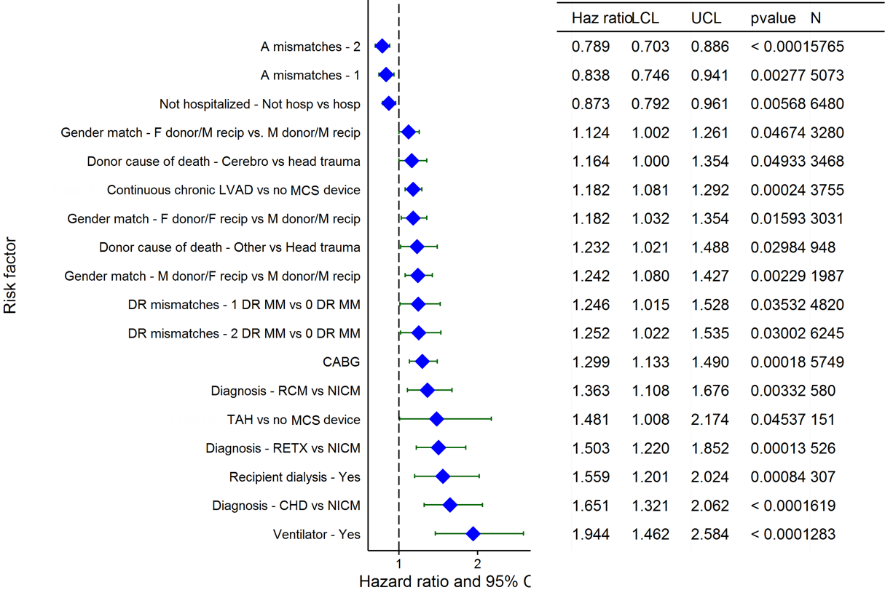
Adult Heart Transplants (2009-6/2014)
Risk Factors For 1 Year Mortality with 95% Confidence Limits
Mechanical Circulatory Support (MCS) includes LVAD, RVAD, TAH and ECMO
2016
(N = 19,948)
JHLT. 2016 Oct; 35(10): 1149-1205

Slide 109
Adult Heart Transplants (2009-6/2014)
Risk Factors For 1 Year Mortality
Continuous Factors (see figures)
Recipient age | Donor age
Recipient creatinine | Ischemia time
Donor height | Recipient BSA
Transplant center volume | Recipient total bilirubin
2016
JHLT. 2016 Oct; 35(10): 1149-1205

Slide 110
Adult Heart Transplants (2009-6/2014)
Recipient age
Risk Factors For 1 Year Mortality with 95% Confidence Limits
p < 0.0001
2016
(N = 19,948)
JHLT. 2016 Oct; 35(10): 1149-1205
Notes:
Multivariable analysis was performed using a proportional hazards model censoring all patients at 1 year. Continuous factors were fit using a restricted cubic spline.

Slide 111
Adult Heart Transplants (2009-6/2014)
Donor age
Risk Factors For 1 Year Mortality with 95% Confidence Limits
p < 0.0001
2016
(N = 19,948)
JHLT. 2016 Oct; 35(10): 1149-1205
Notes:
Multivariable analysis was performed using a proportional hazards model censoring all patients at 1 year. Continuous factors were fit using a restricted cubic spline.

Slide 112
Adult Heart Transplants (2009-6/2014)
Recipient creatinine
Risk Factors For 1 Year Mortality with 95% Confidence Limits
p < 0.0001
2016
(N = 19,948)
JHLT. 2016 Oct; 35(10): 1149-1205
Notes:
Multivariable analysis was performed using a proportional hazards model censoring all patients at 1 year. Continuous factors were fit using a restricted cubic spline.

Slide 113
Adult Heart Transplants (2009-6/2014)
Ischemia time
Risk Factors For 1 Year Mortality with 95% Confidence Limits
p < 0.0001
2016
(N = 19,948)
JHLT. 2016 Oct; 35(10): 1149-1205
Notes:
Multivariable analysis was performed using a proportional hazards model censoring all patients at 1 year. Continuous factors were fit using a restricted cubic spline.

Slide 114
Adult Heart Transplants (2009-6/2014)
Donor height
Risk Factors For 1 Year Mortality with 95% Confidence Limits
p = 0.0105
2016
(N = 19,948)
JHLT. 2016 Oct; 35(10): 1149-1205
Notes:
Multivariable analysis was performed using a proportional hazards model censoring all patients at 1 year. Continuous factors were fit using a restricted cubic spline.

Slide 115
Adult Heart Transplants (2009-6/2014)
Recipient BSA
Risk Factors For 1 Year Mortality with 95% Confidence Limits
p = 0.0017
2016
(N = 19,948)
JHLT. 2016 Oct; 35(10): 1149-1205
Notes:
Multivariable analysis was performed using a proportional hazards model censoring all patients at 1 year. Continuous factors were fit using a restricted cubic spline.

Slide 116
Adult Heart Transplants (2009-6/2014)
Transplant center volume
Risk Factors For 1 Year Mortality with 95% Confidence Limits
p < 0.0001
2016
(N = 19,948)
JHLT. 2016 Oct; 35(10): 1149-1205
Notes:
Multivariable analysis was performed using a proportional hazards model censoring all patients at 1 year. Continuous factors were fit using a restricted cubic spline.

Slide 117
Adult Heart Transplants (2009-6/2014)
Total bilirubin
Risk Factors For 1 Year Mortality with 95% Confidence Limits
p = 0.0028
2016
(N = 19,948)
JHLT. 2016 Oct; 35(10): 1149-1205
Notes:
Multivariable analysis was performed using a proportional hazards model censoring all patients at 1 year. Continuous factors were fit using a restricted cubic spline.

Slide 118
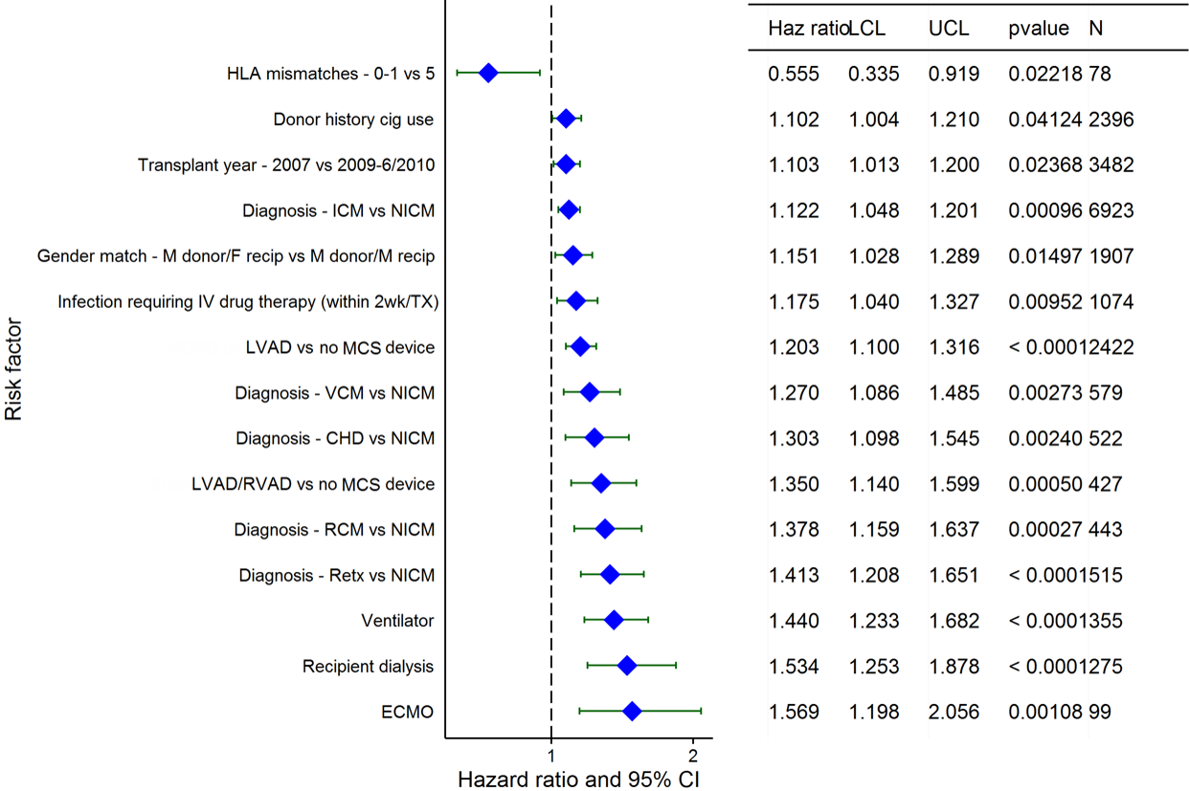
Adult Heart Transplants (2005-6/2010)
Risk Factors For 5 Year Mortality with 95% Confidence Limits
Mechanical Circulatory Support (MCS) includes LVAD, RVAD, TAH and ECMO
2016
(N = 19,066)
JHLT. 2016 Oct; 35(10): 1149-1205

Slide 119
Adult Heart Transplants (2005-6/2010)
Risk Factors For 5 Year Mortality
Continuous Factors (see figures)
Recipient age | Donor age
Recipient creatinine | Ischemia time
Most recent class I PRA | Donor BMI
BMI difference | PA systolic
Transplant center volume | Total bilirubin
Cardiac index
2016
JHLT. 2016 Oct; 35(10): 1149-1205

Slide 120
Adult Heart Transplants (2005-6/2010)
Recipient age
Risk Factors For 5 Year Mortality with 95% Confidence Limits
p < 0.0001
2016
(N = 19,066)
JHLT. 2016 Oct; 35(10): 1149-1205
Notes:
Multivariable analysis was performed using a proportional hazards model censoring all patients at 5 years. Continuous factors were fit using a restricted cubic spline.

Slide 121
Adult Heart Transplants (2005-6/2010)
Donor age
Risk Factors For 5 Year Mortality with 95% Confidence Limits
p < 0.0001
2016
(N = 19,066)
JHLT. 2016 Oct; 35(10): 1149-1205
Notes:
Multivariable analysis was performed using a proportional hazards model censoring all patients at 5 years. Continuous factors were fit using a restricted cubic spline.

Slide 122
Adult Heart Transplants (2005-6/2010)
Recipient creatinine
Risk Factors For 5 Year Mortality with 95% Confidence Limits
p < 0.0001
2016
(N = 19,066)
JHLT. 2016 Oct; 35(10): 1149-1205
Notes:
Multivariable analysis was performed using a proportional hazards model censoring all patients at 5 years. Continuous factors were fit using a restricted cubic spline.

Slide 123
Adult Heart Transplants (2005-6/2010)
Ischemia time
Risk Factors For 5 Year Mortality with 95% Confidence Limits
p < 0.0001
2016
(N = 19,066)
JHLT. 2016 Oct; 35(10): 1149-1205
Notes:
Multivariable analysis was performed using a proportional hazards model censoring all patients at 5 years. Continuous factors were fit using a restricted cubic spline.

Slide 124
Adult Heart Transplants (2005-6/2010)
Most recent class I PRA
Risk Factors For 5 Year Mortality with 95% Confidence Limits
p = 0.0099
2016
(N = 19,066)
JHLT. 2016 Oct; 35(10): 1149-1205
Notes:
Multivariable analysis was performed using a proportional hazards model censoring all patients at 5 years. Continuous factors were fit using a restricted cubic spline.

Slide 125
Adult Heart Transplants (2005-6/2010)
Donor BMI
Risk Factors For 5 Year Mortality with 95% Confidence Limits
p = 0.0160
2016
(N = 19,066)
JHLT. 2016 Oct; 35(10): 1149-1205
Notes:
Multivariable analysis was performed using a proportional hazards model censoring all patients at 5 years. Continuous factors were fit using a restricted cubic spline.

Slide 126
Adult Heart Transplants (2005-6/2010)
BMI difference
Risk Factors For 5 Year Mortality with 95% Confidence Limits
p < 0.0001
2016
(N = 19,066)
JHLT. 2016 Oct; 35(10): 1149-1205
Notes:
Multivariable analysis was performed using a proportional hazards model censoring all patients at 5 years. Continuous factors were fit using a restricted cubic spline.

Slide 127
Adult Heart Transplants (2005-6/2010)
PA systolic
Risk Factors For 5 Year Mortality with 95% Confidence Limits
p < 0.0001
2015
2016
(N = 19,066)
JHLT. 2016 Oct; 35(10): 1149-1205
Notes:
Multivariable analysis was performed using a proportional hazards model censoring all patients at 5 years. Continuous factors were fit using a restricted cubic spline.

Slide 128
Adult Heart Transplants (2005-6/2010)
Transplant center volume
Risk Factors For 5 Year Mortality with 95% Confidence Limits
p < 0.0001
2016
(N = 19,066)
JHLT. 2016 Oct; 35(10): 1149-1205
Notes:
Multivariable analysis was performed using a proportional hazards model censoring all patients at 5 years. Continuous factors were fit using a restricted cubic spline.

Slide 129
Adult Heart Transplants (2005-6/2010)
Total bilirubin
Risk Factors For 5 Year Mortality with 95% Confidence Limits
p = 0.0030
2016
(N = 19,066)
JHLT. 2016 Oct; 35(10): 1149-1205
Notes:
Multivariable analysis was performed using a proportional hazards model censoring all patients at 5 years. Continuous factors were fit using a restricted cubic spline.

Slide 130
Adult Heart Transplants (2005-6/2010)
Cardiac index
Risk Factors For 5 Year Mortality with 95% Confidence Limits
p = 0.0010
2016
(N = 19,066)
JHLT. 2016 Oct; 35(10): 1149-1205
Notes:
Multivariable analysis was performed using a proportional hazards model censoring all patients at 5 years. Continuous factors were fit using a restricted cubic spline.

Slide 131
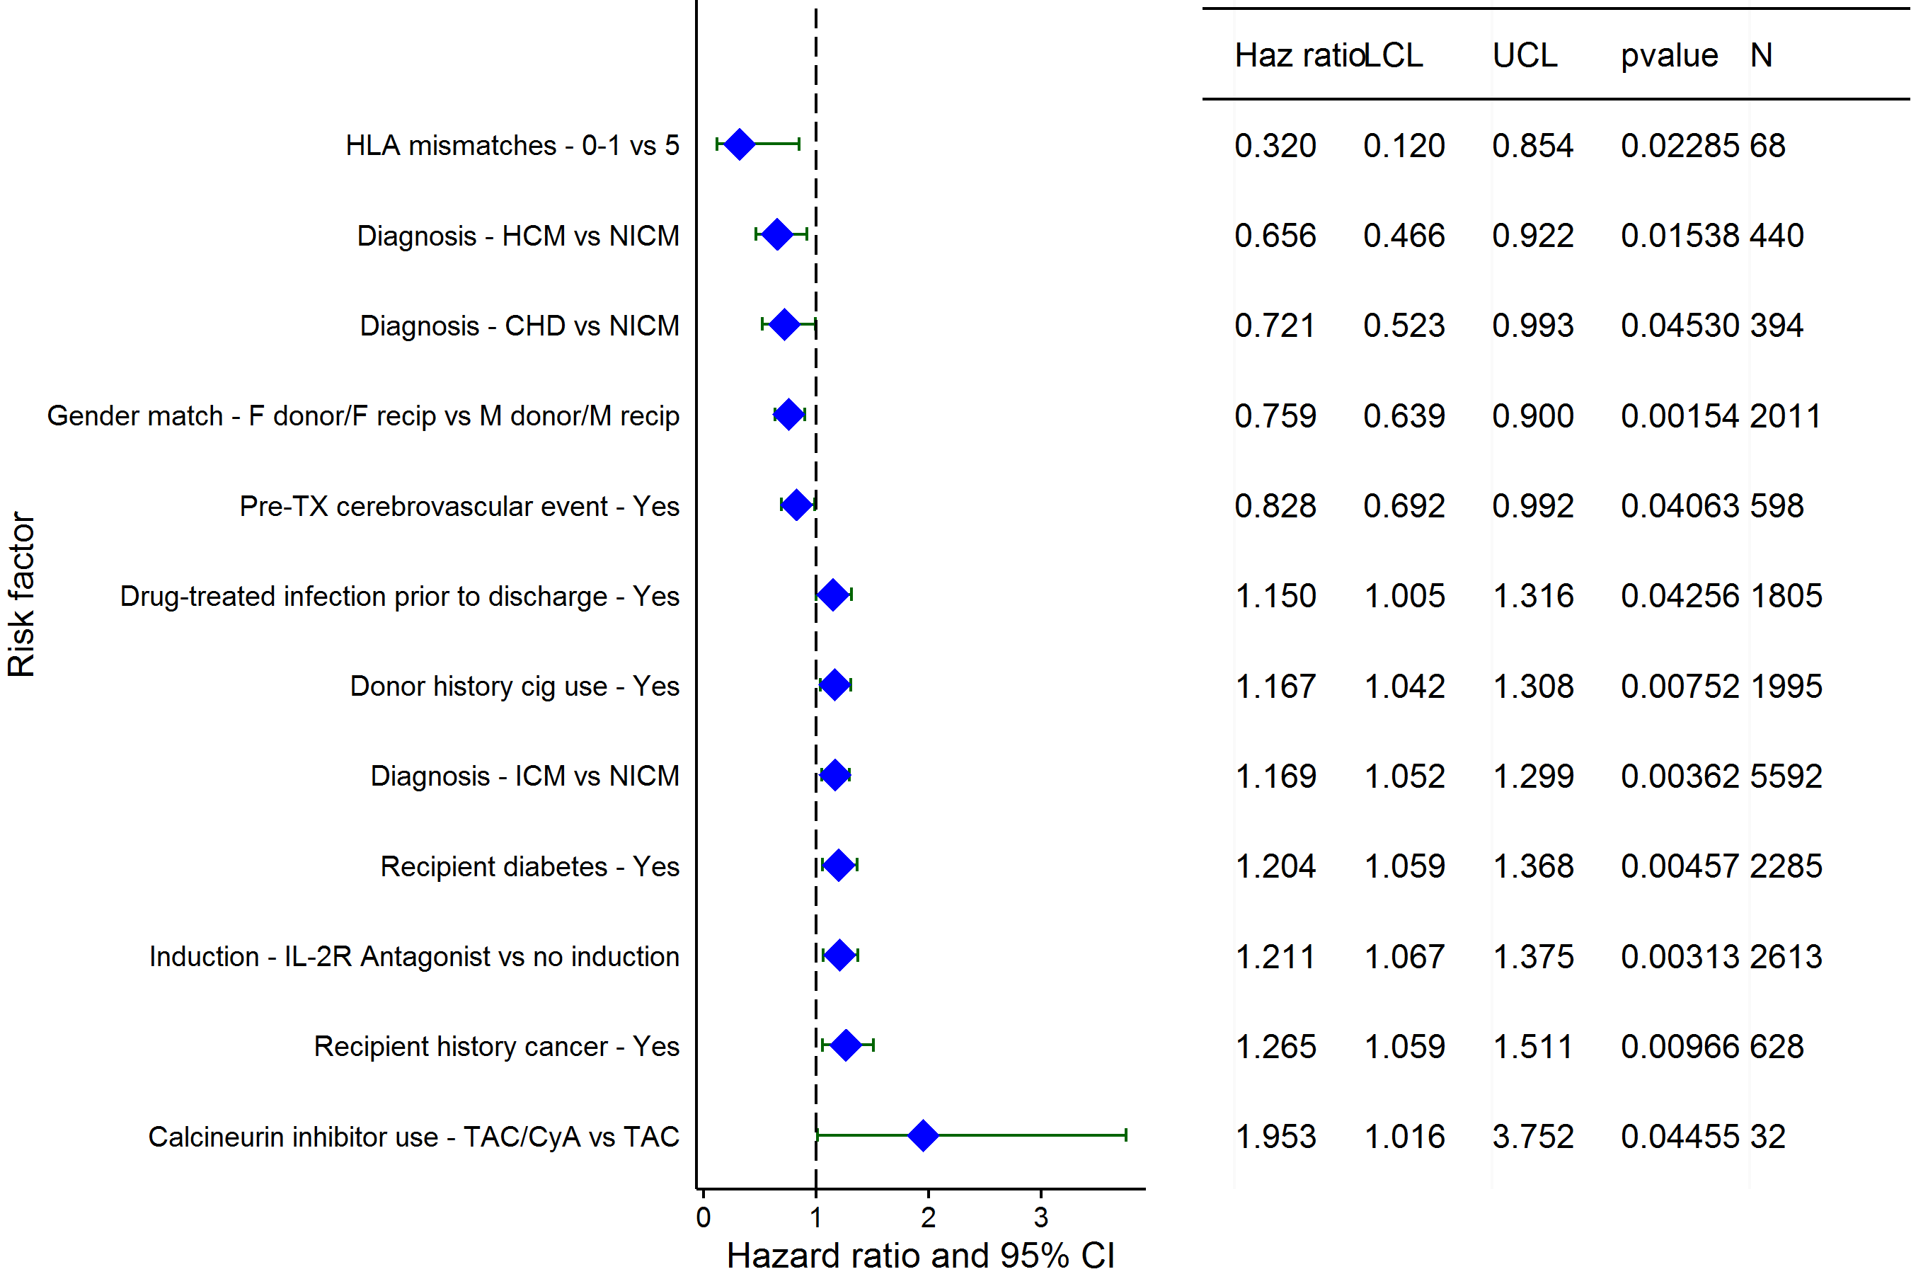
Adult Heart Transplants (2005-6/2010)
Risk Factors For 5 Year Mortality Conditional on Survival to 1 Year with 95% Confidence Limits
2016
(N = 15,330)
JHLT. 2016 Oct; 35(10): 1149-1205

Slide 132
Adult Heart Transplants (2005-6/2010)
Risk Factors For 5 Year Mortality Conditional on Survival to 1 Year
Continuous Factors (see figures)
Recipient age | Donor age
Recipient height | Recipient BMI
2016
JHLT. 2016 Oct; 35(10): 1149-1205

Slide 133
Adult Heart Transplants (2005-6/2010)
Risk Factors For 5 Year Mortality Conditional on Survival to 1 Year with 95% Confidence Limits
Recipient age
p < 0.0001
2016
(N = 19,066)
JHLT. 2016 Oct; 35(10): 1149-1205
Notes:
Multivariable analysis was performed using a proportional hazards model censoring all patients at 5 years. Continuous factors were fit using a restricted cubic spline.

Slide 134
Adult Heart Transplants (2005-6/2010)
Risk Factors For 5 Year Mortality Conditional on Survival to 1 Year with 95% Confidence Limits
Donor age
p = 0.0128
2016
(N = 15,330)
JHLT. 2016 Oct; 35(10): 1149-1205
Notes:
Multivariable analysis was performed using a proportional hazards model censoring all patients at 5 years. Continuous factors were fit using a restricted cubic spline.

Slide 135
Adult Heart Transplants (2005-6/2010)
Risk Factors For 5 Year Mortality Conditional on Survival to 1 Year with 95% Confidence Limits
Recipient height
p = 0.0402
2016
(N = 15,330)
JHLT. 2015 Oct; 34(10): 1244-1254
JHLT. 2016 Oct; 35(10): 1149-1205
Notes:
Multivariable analysis was performed using a proportional hazards model censoring all patients at 5 years. Continuous factors were fit using a restricted cubic spline.

Slide 136
Adult Heart Transplants (2005-6/2010)
Risk Factors For 5 Year Mortality Conditional on Survival to 1 Year with 95% Confidence Limits
Recipient BMI
p = 0.0039
2016
(N = 15,330)
JHLT. 2016 Oct; 35(10): 1149-1205
Notes:
Multivariable analysis was performed using a proportional hazards model censoring all patients at 5 years. Continuous factors were fit using a restricted cubic spline.

Slide 137
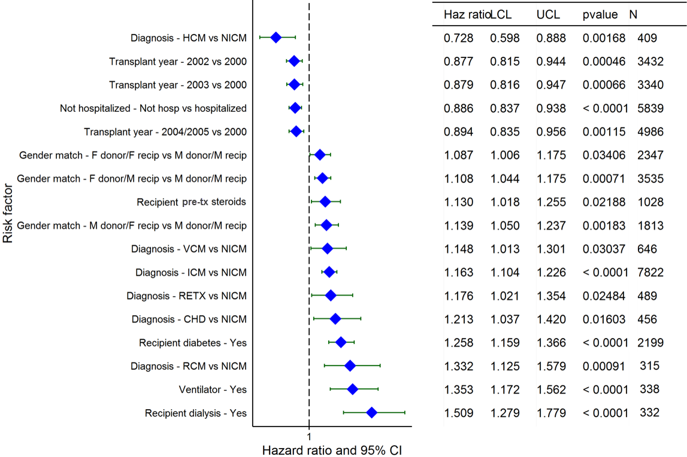
Adult Heart Transplants (2000-6/2005)
Risk Factors For 10 Year Mortality with 95% Confidence Limits
2016
(N = 19,004)
JHLT. 2016 Oct; 35(10): 1149-1205

Slide 138
Adult Heart Transplants (2000-6/2005)
Recipient age
Risk Factors For 10 Year Mortality
Continuous Factors (see figures)
Recipient age | Donor age
Recipient creatinine | Ischemia time
Recipient BMI | Transplant center volume
Most recent PRA
2016
JHLT. 2016 Oct; 35(10): 1149-1205

Slide 139
Adult Heart Transplants (2000-6/2005)
Recipient age
Risk Factors For 10 Year Mortality with 95% Confidence Limits
p < 0.0001
2016
(N = 19,004)
JHLT. 2016 Oct; 35(10): 1149-1205
Notes:
Multivariable analysis was performed using a proportional hazards model censoring all patients at 10 years. Continuous factors were fit using a restricted cubic spline.

Slide 140
Adult Heart Transplants (2000-6/2005)
Donor age
Risk Factors For 10 Year Mortality with 95% Confidence Limits
p < 0.0001
2016
(N = 19,004)
JHLT. 2016 Oct; 35(10): 1149-1205
Notes:
Multivariable analysis was performed using a proportional hazards model censoring all patients at 10 years. Continuous factors were fit using a restricted cubic spline.

Slide 141
Adult Heart Transplants (2000-6/2005)
Recipient creatinine
Risk Factors For 10 Year Mortality with 95% Confidence Limits
p < 0.0001
2016
(N = 19,004)
JHLT. 2016 Oct; 35(10): 1149-1205
Notes:
Multivariable analysis was performed using a proportional hazards model censoring all patients at 10 years. Continuous factors were fit using a restricted cubic spline.

Slide 142
Adult Heart Transplants (2000-6/2005)
Ischemia time
Risk Factors For 10 Year Mortality with 95% Confidence Limits
p = 0.0023
2016
(N = 19,004)
JHLT. 2016 Oct; 35(10): 1149-1205
Notes:
Multivariable analysis was performed using a proportional hazards model censoring all patients at 10 years. Continuous factors were fit using a restricted cubic spline.

Slide 143
Adult Heart Transplants (2000-6/2005)
Recipient BMI
Risk Factors For 10 Year Mortality with 95% Confidence Limits
p = 0.0015
2016
(N = 19,004)
JHLT. 2016 Oct; 35(10): 1149-1205
Notes:
Multivariable analysis was performed using a proportional hazards model censoring all patients at 10 years. Continuous factors were fit using a restricted cubic spline.

Slide 144
Adult Heart Transplants (2000-6/2005)
Transplant center volume
Risk Factors For 10 Year Mortality with 95% Confidence Limits
p < 0.0001
2016
(N = 19,004)
JHLT. 2016 Oct; 35(10): 1149-1205
Notes:
Multivariable analysis was performed using a proportional hazards model censoring all patients at 10 years. Continuous factors were fit using a restricted cubic spline.

Slide 145
Adult Heart Transplants (2000-6/2005)
Most recent PRA
Risk Factors For 10 Year Mortality with 95% Confidence Limits
p = 0.0003
2016
(N = 19,004)
JHLT. 2016 Oct; 35(10): 1149-1205
Notes:
Multivariable analysis was performed using a proportional hazards model censoring all patients at 10 years. Continuous factors were fit using a restricted cubic spline.

Slide 146
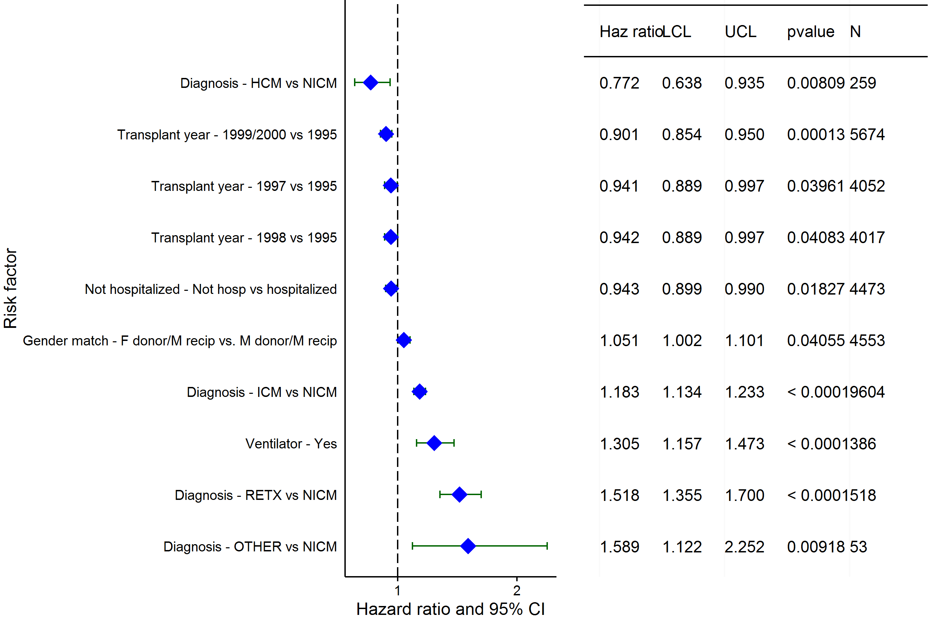
Adult Heart Transplants (1995-6/2000)
Risk Factors For 15 Year Mortality with 95% Confidence Limits
2016
(N = 21,657)
JHLT. 2016 Oct; 35(10): 1149-1205

Slide 147
Adult Heart Transplants (1995-6/2000)
Risk Factors For 15 Year Mortality
Continuous Factors (see figures)
Recipient age | Donor age
Recipient creatinine | Ischemia time
Recipient height | Recipient weight
BSA ratio | Transplant center volume
Most recent PRA
2016
JHLT. 2016 Oct; 35(10): 1149-1205

Slide 148
Adult Heart Transplants (1995-6/2000)
Recipient age
Risk Factors For 15 Year Mortality with 95% Confidence Limits
p < 0.0001
2016
(N = 21,657)
JHLT. 2016 Oct; 35(10): 1149-1205
Notes:
Multivariable analysis was performed using a proportional hazards model censoring all patients at 15 years. Continuous factors were fit using a restricted cubic spline.

Slide 149
Adult Heart Transplants (1995-6/2000)
Donor age
Risk Factors For 15 Year Mortality with 95% Confidence Limits
p < 0.0001
2016
(N = 21,657)
JHLT. 2016 Oct; 35(10): 1149-1205
Notes:
Multivariable analysis was performed using a proportional hazards model censoring all patients at 15 years. Continuous factors were fit using a restricted cubic spline.

Slide 150
Adult Heart Transplants (1995-6/2000)
Recipient creatinine
Risk Factors For 15 Year Mortality with 95% Confidence Limits
p < 0.0001
2016
(N = 21,657)
JHLT. 2016 Oct; 35(10): 1149-1205
Notes:
Multivariable analysis was performed using a proportional hazards model censoring all patients at 15 years. Continuous factors were fit using a restricted cubic spline.

Slide 151
Adult Heart Transplants (1995-6/2000)
Ischemia time
Risk Factors For 15 Year Mortality with 95% Confidence Limits
p = 0.0009
2016
(N = 21,657)
JHLT. 2016 Oct; 35(10): 1149-1205
Notes:
Multivariable analysis was performed using a proportional hazards model censoring all patients at 15 years. Continuous factors were fit using a restricted cubic spline.

Slide 152
Adult Heart Transplants (1995-6/2000)
Recipient height
Risk Factors For 15 Year Mortality with 95% Confidence Limits
p = 0.0024
2016
(N = 21,657)
JHLT. 2016 Oct; 35(10): 1149-1205
Notes:
Multivariable analysis was performed using a proportional hazards model censoring all patients at 15 years. Continuous factors were fit using a restricted cubic spline.

Slide 153
Adult Heart Transplants (1995-6/2000)
Recipient weight
Risk Factors For 15 Year Mortality with 95% Confidence Limits
p < 0.0001
2016
(N = 21,657)
JHLT. 2016 Oct; 35(10): 1149-1205
Notes:
Multivariable analysis was performed using a proportional hazards model censoring all patients at 15 years. Continuous factors were fit using a restricted cubic spline.

Slide 154
Adult Heart Transplants (1995-6/2000)
Ratio of Donor BSA to Recipient BSA
Risk Factors For 15 Year Mortality with 95% Confidence Limits
p = 0.0237
2016
(N = 21,657)
JHLT. 2016 Oct; 35(10): 1149-1205
Notes:
Multivariable analysis was performed using a proportional hazards model censoring all patients at 15 years. Continuous factors were fit using a restricted cubic spline.

Slide 155
Adult Heart Transplants (1995-6/2000)
Transplant center volume
Risk Factors For 15 Year Mortality with 95% Confidence Limits
p < 0.0001
2016
(N = 21,657)
JHLT. 2016 Oct; 35(10): 1149-1205
Notes:
Multivariable analysis was performed using a proportional hazards model censoring all patients at 15 years. Continuous factors were fit using a restricted cubic spline.

Slide 156
Adult Heart Transplants (1995-6/2000)
Most recent PRA
Risk Factors For 15 Year Mortality with 95% Confidence Limits
p = 0.0022
2016
(N = 21,657)
JHLT. 2016 Oct; 35(10): 1149-1205
Notes:
Multivariable analysis was performed using a proportional hazards model censoring all patients at 15 years. Continuous factors were fit using a restricted cubic spline.

Slide 157
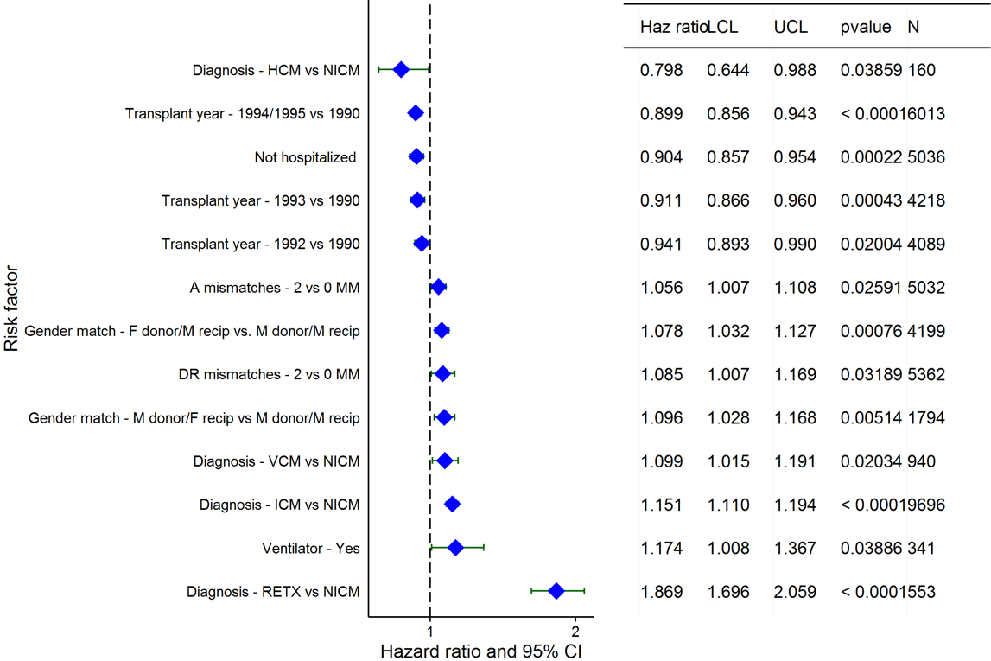
Adult Heart Transplants (1990-6/1995)
Risk Factors For 20 Year Mortality with 95% Confidence Limits
2016
(N = 22,325)
JHLT. 2016 Oct; 35(10): 1149-1205

Slide 158
Adult Heart Transplants (1990-6/1995)
Risk Factors For 20 Year Mortality
Continuous Factors (see figures)
Recipient age | Donor age
Ischemia time | Donor weight
Recipient weight | Transplant center volume
2016
JHLT. 2016 Oct; 35(10): 1149-1205

Slide 159
Adult Heart Transplants (1990-6/1995)
Recipient age
Risk Factors For 20 Year Mortality with 95% Confidence Limits
p < 0.0001
2016
(N = 22,325)
JHLT. 2016 Oct; 35(10): 1149-1205
Notes:
Multivariable analysis was performed using a proportional hazards model censoring all patients at 20 years. Continuous factors were fit using a restricted cubic spline.

Slide 160
Adult Heart Transplants (1990-6/1995)
Donor age
Risk Factors For 20 Year Mortality with 95% Confidence Limits
p < 0.0001
2016
(N = 22,325)
JHLT. 2016 Oct; 35(10): 1149-1205
Notes:
Multivariable analysis was performed using a proportional hazards model censoring all patients at 20 years. Continuous factors were fit using a restricted cubic spline.

Slide 161
Adult Heart Transplants (1990-6/1995)
Ischemia time
Risk Factors For 20 Year Mortality with 95% Confidence Limits
p = 0.0059
2016
(N = 22,325)
JHLT. 2016 Oct; 35(10): 1149-1205
Notes:
Multivariable analysis was performed using a proportional hazards model censoring all patients at 20 years. Continuous factors were fit using a restricted cubic spline.

Slide 162
Adult Heart Transplants (1990-6/1995)
Donor weight
Risk Factors For 20 Year Mortality with 95% Confidence Limits
p = 0.0193
2016
(N = 22,325)
JHLT. 2016 Oct; 35(10): 1149-1205
Notes:
Multivariable analysis was performed using a proportional hazards model censoring all patients at 20 years. Continuous factors were fit using a restricted cubic spline.

Slide 163
Adult Heart Transplants (1990-6/1995)
Recipient weight
Risk Factors For 20 Year Mortality with 95% Confidence Limits
p = 0.0002
2016
(N = 22,325)
JHLT. 2016 Oct; 35(10): 1149-1205
Notes:
Multivariable analysis was performed using a proportional hazards model censoring all patients at 20 years. Continuous factors were fit using a restricted cubic spline.

Slide 164
Adult Heart Transplants (1990-6/1995)
Transplant center volume
Risk Factors For 20 Year Mortality with 95% Confidence Limits
p < 0.0001
2016
(N = 22,325)
JHLT. 2016 Oct; 35(10): 1149-1205
Notes:
Multivariable analysis was performed using a proportional hazards model censoring all patients at 20 years. Continuous factors were fit using a restricted cubic spline.

Slide 165
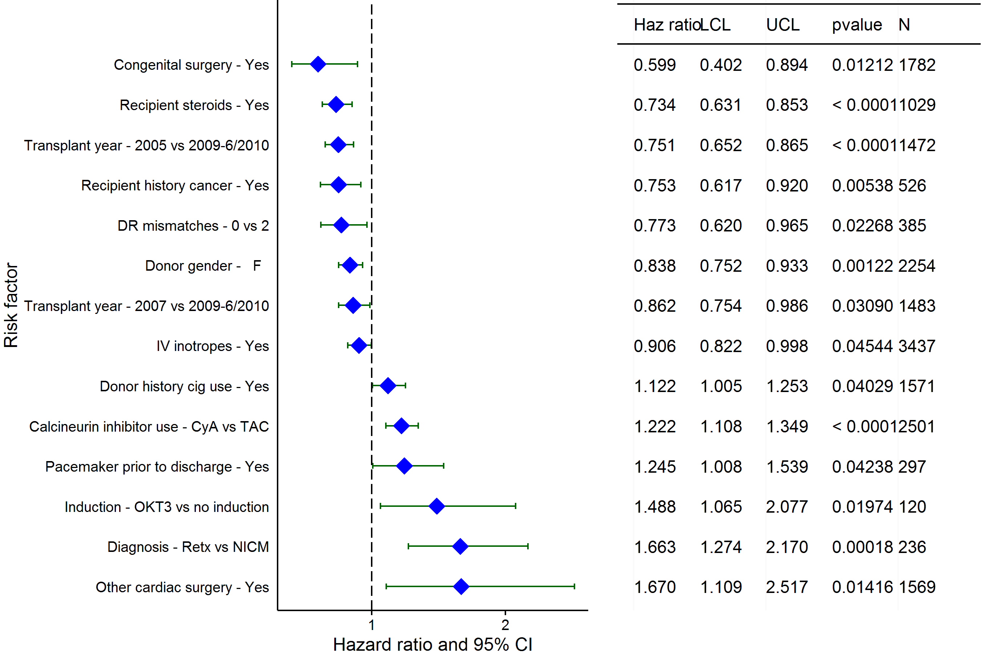
Adult Heart Transplants (2005-6/2010)
Risk Factors for Development of CAV within 5 Years with 95% Confidence Limits Conditional on Survival to Transplant Discharge
2016
(N = 8,289)
JHLT. 2016 Oct; 35(10): 1149-1205

Slide 166
Adult Heart Transplants (2005-6/2010)
Risk Factors for Development of CAV within 5 Years
Conditional on Survival to Transplant Discharge
Risk Factors for Development of CAV within 5 Years with 95% Confidence Limits Conditional on Survival to Transplant Discharge
Continuous Factors (see figures)
Donor age | Recipient BMI
Donor BMI | Donor/recipient age %
PA systolic | Transplant center volume
2016
JHLT. 2016 Oct; 35(10): 1149-1205

Slide 167
Adult Heart Transplants (2005-6/2010)
Risk Factors for Development of CAV within 5 Years with 95% Confidence Limits Conditional on Survival to Transplant Discharge
Donor age
p < 0.0001
2016
(N = 8,289)
JHLT. 2016 Oct; 35(10): 1149-1205
Notes:
Multivariable analysis was performed using a proportional hazards model censoring all patients at 5 years. Continuous factors were fit using a restricted cubic spline.

Slide 168
Adult Heart Transplants (2005-6/2010)
Risk Factors for Development of CAV within 5 Years with 95% Confidence Limits Conditional on Survival to Transplant Discharge
Recipient BMI
p = 0.0094
2016
(N = 8,289)
JHLT. 2016 Oct; 35(10): 1149-1205
Notes:
Multivariable analysis was performed using a proportional hazards model censoring all patients at 5 years. Continuous factors were fit using a restricted cubic spline.

Slide 169
Adult Heart Transplants (2005-6/2010)
Risk Factors for Development of CAV within 5 Years with 95% Confidence Limits Conditional on Survival to Transplant Discharge
Donor BMI
p = 0.0465
2016
(N = 8,289)
JHLT. 2016 Oct; 35(10): 1149-1205
Notes:
Multivariable analysis was performed using a proportional hazards model censoring all patients at 5 years. Continuous factors were fit using a restricted cubic spline.

Slide 170
Adult Heart Transplants (2005-6/2010)
PA systolic
Risk Factors for Development of CAV within 5 Years with 95% Confidence Limits Conditional on Survival to Transplant Discharge
p < 0.0001
2016
(N = 8,289)
JHLT. 2016 Oct; 35(10): 1149-1205
Notes:
Multivariable analysis was performed using a proportional hazards model censoring all patients at 5 years. Continuous factors were fit using a restricted cubic spline.

Slide 171
Adult Heart Transplants (2005-6/2010)
Transplant center volume
Risk Factors for Development of CAV within 5 Years with 95% Confidence Limits Conditional on Survival to Transplant Discharge
p = 0.0099
2016
(N = 8,289)
JHLT. 2016 Oct; 35(10): 1149-1205
Notes:
Multivariable analysis was performed using a proportional hazards model censoring all patients at 5 years. Continuous factors were fit using a restricted cubic spline.

Slide 172
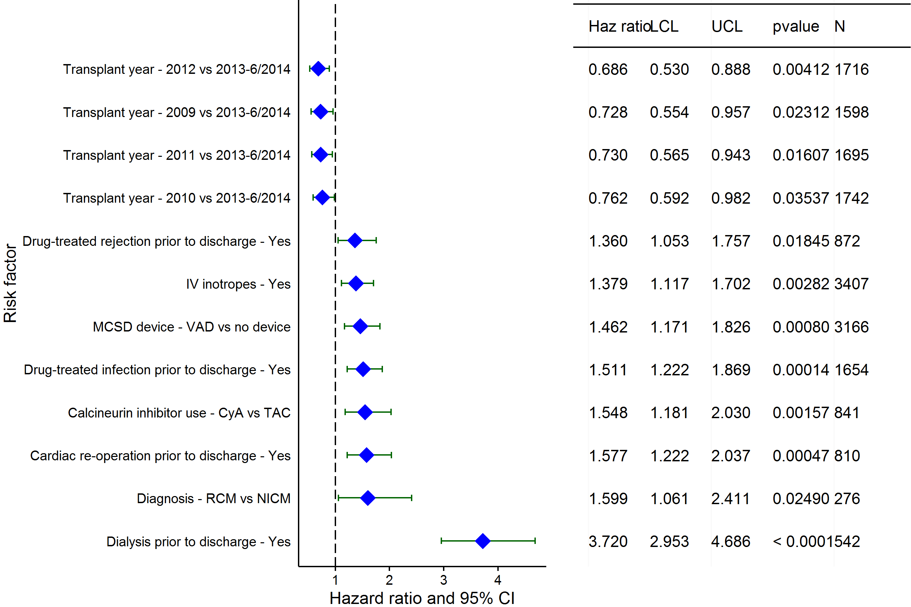
Adult Heart Transplants (2009-6/2014)
Risk Factors for Development of Renal Dysfunction within 1 Year
Limited to Recipients without Severe Renal Dysfunction* Pre-Transplant
Conditional on Survival to Transplant Discharge
2016
(N = 8,906)
JHLT. 2016 Oct; 35(10): 1149-1205

Slide 173
Adult Heart Transplants (2009-6/2014)
Risk Factors for Development of Renal Dysfunction within 1 Year
Limited to Recipients without Severe Renal Dysfunction* Pre-Transplant
Conditional on Survival to Transplant Discharge
Continuous Factors (see figures)
Recipient age | Recipient creatinine
2016
JHLT. 2016 Oct; 35(10): 1149-1205

Slide 174
Adult Heart Transplants (2009-6/2014)
Risk Factors for Development of Renal Dysfunction within 1 Year
Limited to Recipients without Severe Renal Dysfunction* Pre-Transplant
Conditional on Survival to Transplant Discharge
Recipient age
p = 0.0071
2016
(N = 8,906)
JHLT. 2016 Oct; 35(10): 1149-1205
Notes:
Multivariable analysis was performed using a proportional hazards model censoring all patients at 5 years. Continuous factors were fit using a restricted cubic spline.

Slide 175
Adult Heart Transplants (2009-6/2014)
Adult Heart Transplants (2009-6/2014)
Risk Factors for Development of Renal Dysfunction within 1 Year
Limited to Recipients without Severe Renal Dysfunction* Pre-Transplant
Conditional on Survival to Transplant Discharge
Recipient creatinine
p < 0.0001
2016
(N = 8,906)
JHLT. 2016 Oct; 35(10): 1149-1205
Notes:
Multivariable analysis was performed using a proportional hazards model censoring all patients at 5 years. Continuous factors were fit using a restricted cubic spline.

Slide 176
Focus Theme
2016
JHLT. 2016 Oct; 35(10): 1149-1205

Slide 177
Adult Heart Transplants
Diagnosis by Gender
(Transplants: January 2009 – June 2015)
2016
JHLT. 2016 Oct; 35(10): 1149-1205

Slide 178
Adult Heart Transplants
Diagnosis by Era and Location
Europe
North America
Other
2016
JHLT. 2016 Oct; 35(10): 1149-1205

Slide 179
Adult Heart Transplants
Age Group by Diagnosis
(Transplants: January 2009 – June 2015)
2016
JHLT. 2016 Oct; 35(10): 1149-1205

Slide 180
Adult Heart Transplants
Donor Age Group by Diagnosis
(Transplants: January 2009 – June 2015)
2016
JHLT. 2016 Oct; 35(10): 1149-1205

Slide 181
Adult Heart Transplants
% of Patients Bridged with Mechanical Circulatory Support*
by Diagnosis and Era
2016
* LVAD, RVAD, TAH, ECMO
JHLT. 2016 Oct; 35(10): 1149-1205

Slide 182
Adult Heart Transplants
Recipient Prior Cardiac Surgery Distribution by Diagnosis
(Transplants: January 2009 – June 2015)
2016
JHLT. 2016 Oct; 35(10): 1149-1205

Slide 183
Adult Heart Transplants
% of Recipients Hospitalized at Time of Transplant by Diagnosis
(Transplants: January 2009 – June 2015)
2016
JHLT. 2016 Oct; 35(10): 1149-1205

Slide 184
Adult Heart Transplants
Kaplan-Meier Graft Survival by Diagnosis
(Transplants: January 2004 – June 2014)
All pair-wise comparisons were significant at p < 0.05 except CHD vs. ICM, CHD vs. VCM, ICM vs. VCM and Retransplant vs. VCM
2016
JHLT. 2016 Oct; 35(10): 1149-1205
Notes:
Survival was calculated using the Kaplan-Meier method, which incorporates information from all transplants for whom any follow-up has been provided. Since many patients are still alive and some patients have been lost to follow-up, the survival rates are estimates rather than exact rates because the time of death is not known for all patients.
Survival rates were compared using the log-rank test statistic. Adjustments for multiple comparisons were done using Scheffe’s method. Results of log-rank test should be interpreted with caution when curves cross.

Slide 185
Adult Heart Transplants
Cause of Death
(Deaths: January 1994 – June 2015)
Deaths Within 0-30 Days Post Transplant
Cause of Death | CHD (N=263) | HCM (N=137) | ICM (N=2,601) | NICM (N=2,248) | RCM (N=148) | Retransplant (N=304) | VCM (N=289)
Cardiac Allograft Vasculopathy | 2 (0.8%) | 4 (2.9%) | 34 (1.3%) | 29 (1.3%) | 3 (2.0%) | 5 (1.6%) | 3 (1.0%)
Acute Rejection | 10 (3.8%) | 5 (3.6%) | 112 (4.3%) | 111 (4.9%) | 6 (4.1%) | 16 (5.3%) | 8 (2.8%)
Lymphoma | 0 | 0 | 1 (0.0%) | 1 (0.0%) | 0 | 0 | 0
Malignancy, Other | 0 | 0 | 0 | 1 (0.0%) | 0 | 1 (0.3%) | 0
CMV | 0 | 0 | 3 (0.1%) | 0 | 0 | 0 | 0
Infection, Non-CMV | 22 (8.4%) | 21 (15.3%) | 362 (13.9%) | 283 (12.6%) | 27 (18.2%) | 42 (13.8%) | 46 (15.9%)
Graft Failure | 91 (34.6%) | 53 (38.7%) | 1,045 (40.2%) | 955 (42.5%) | 46 (31.1%) | 110 (36.2%) | 118 (40.8%)
Technical | 33 (12.5%) | 10 (7.3%) | 195 (7.5%) | 126 (5.6%) | 10 (6.8%) | 29 (9.5%) | 31 (10.7%)
Other | 12 (4.6%) | 8 (5.8%) | 128 (4.9%) | 91 (4.0%) | 10 (6.8%) | 8 (2.6%) | 7 (2.4%)
Multiple Organ Failure | 57 (21.7%) | 21 (15.3%) | 440 (16.9%) | 394 (17.5%) | 29 (19.6%) | 60 (19.7%) | 54 (18.7%)
Renal Failure | 2 (0.8%) | 2 (1.5%) | 16 (0.6%) | 5 (0.2%) | 0 | 1 (0.3%) | 1 (0.3%)
Pulmonary | 8 (3.0%) | 4 (2.9%) | 85 (3.3%) | 59 (2.6%) | 2 (1.4%) | 8 (2.6%) | 10 (3.5%)
Cerebrovascular | 26 (9.9%) | 9 (6.6%) | 180 (6.9%) | 193 (8.6%) | 15 (10.1%) | 24 (7.9%) | 11 (3.8%)
Total Deaths (N) | 295 | 159 | 2,889 | 2,662 | 162 | 341 | 326
2016
Percentages represent % of deaths in the respective time period. Total number of deaths includes deaths with unknown causes.
JHLT. 2016 Oct; 35(10): 1149-1205
Notes:
Only known causes of death are included in the tabulation.

Slide 186
Adult Heart Transplants
Cause of Death
(Deaths: January 1994 – June 2015)
Deaths Within 31 Days - 1 Year Post Transplant
Cause of Death | CHD (N=115) | HCM (N=93) | ICM (N=2,186) | NICM (N=2,225) | RCM (N=143) | Retransplant (N=196) | VCM (N=198)
Cardiac Allograft Vasculopathy | 5 (4.3%) | 6 (6.5%) | 71 (3.2%) | 86 (3.9%) | 1 (0.7%) | 8 (4.1%) | 6 (3.0%)
Acute Rejection | 13 (11.3%) | 10 (10.8%) | 166 (7.6%) | 266 (12.0%) | 6 (4.2%) | 9 (4.6%) | 19 (9.6%)
Lymphoma | 2 (1.7%) | 1 (1.1%) | 19 (0.9%) | 30 (1.3%) | 2 (1.4%) | 3 (1.5%) | 1 (0.5%)
Malignancy, Other | 1 (0.9%) | 2 (2.2%) | 57 (2.6%) | 42 (1.9%) | 2 (1.4%) | 1 (0.5%) | 5 (2.5%)
CMV | 2 (1.7%) | 4 (4.3%) | 30 (1.4%) | 16 (0.7%) | 1 (0.7%) | 0 | 1 (0.5%)
Infection, Non-CMV | 29 (25.2%) | 29 (31.2%) | 760 (34.8%) | 642 (28.9%) | 47 (32.9%) | 49 (25.0%) | 66 (33.3%)
Graft Failure | 11 (9.6%) | 11 (11.8%) | 324 (14.8%) | 447 (20.1%) | 17 (11.9%) | 43 (21.9%) | 32 (16.2%)
Technical | 3 (2.6%) | 0 | 24 (1.1%) | 47 (2.1%) | 2 (1.4%) | 0 | 5 (2.5%)
Other | 10 (8.7%) | 5 (5.4%) | 152 (7.0%) | 127 (5.7%) | 18 (12.6%) | 22 (11.2%) | 12 (6.1%)
Multiple Organ Failure | 21 (18.3%) | 20 (21.5%) | 332 (15.2%) | 325 (14.6%) | 32 (22.4%) | 44 (22.4%) | 32 (16.2%)
Renal Failure | 1 (0.9%) | 2 (2.2%) | 19 (0.9%) | 17 (0.8%) | 5 (3.5%) | 4 (2.0%) | 1 (0.5%)
Pulmonary | 4 (3.5%) | 0 | 114 (5.2%) | 62 (2.8%) | 8 (5.6%) | 8 (4.1%) | 7 (3.5%)
Cerebrovascular | 13 (11.3%) | 3 (3.2%) | 118 (5.4%) | 118 (5.3%) | 2 (1.4%) | 5 (2.6%) | 11 (5.6%)
Total Deaths (N) | 127 | 103 | 2,482 | 2,596 | 159 | 225 | 224
2016
Percentages represent % of deaths in the respective time period. Total number of deaths includes deaths with unknown causes.
JHLT. 2016 Oct; 35(10): 1149-1205
Notes:
Only known causes of death are included in the tabulation.

Slide 187
Adult Heart Transplants
Cause of Death
(Deaths: January 1994 – June 2015)
Deaths Within >1-3 Years Post Transplant
Cause of Death | CHD (N=70) | HCM (N=40) | ICM (N=1,689) | NICM (N=1,639) | RCM (N=81) | Retransplant (N=131) | VCM (N=112)
Cardiac Allograft Vasculopathy | 9 (12.9%) | 3 (7.5%) | 183 (10.8%) | 209 (12.8%) | 6 (7.4%) | 23 (17.6%) | 14 (12.5%)
Acute Rejection | 11 (15.7%) | 6 (15.0%) | 121 (7.2%) | 212 (12.9%) | 4 (4.9%) | 14 (10.7%) | 14 (12.5%)
Lymphoma | 1 (1.4%) | 3 (7.5%) | 43 (2.5%) | 33 (2.0%) | 1 (1.2%) | 2 (1.5%) | 6 (5.4%)
Malignancy, Other | 0 | 3 (7.5%) | 247 (14.6%) | 168 (10.3%) | 4 (4.9%) | 12 (9.2%) | 18 (16.1%)
CMV | 0 | 0 | 11 (0.7%) | 6 (0.4%) | 1 (1.2%) | 1 (0.8%) | 0
Infection, Non-CMV | 7 (10.0%) | 2 (5.0%) | 250 (14.8%) | 185 (11.3%) | 14 (17.3%) | 13 (9.9%) | 14 (12.5%)
Graft Failure | 23 (32.9%) | 14 (35.0%) | 384 (22.7%) | 480 (29.3%) | 20 (24.7%) | 37 (28.2%) | 28 (25.0%)
Technical | 1 (1.4%) | 0 | 17 (1.0%) | 5 (0.3%) | 1 (1.2%) | 1 (0.8%) | 2 (1.8%)
Other | 8 (11.4%) | 4 (10.0%) | 126 (7.5%) | 126 (7.7%) | 14 (17.3%) | 12 (9.2%) | 4 (3.6%)
Multiple Organ Failure | 6 (8.6%) | 2 (5.0%) | 113 (6.7%) | 80 (4.9%) | 9 (11.1%) | 9 (6.9%) | 5 (4.5%)
Renal Failure | 0 | 0 | 28 (1.7%) | 18 (1.1%) | 2 (2.5%) | 1 (0.8%) | 4 (3.6%)
Pulmonary | 4 (5.7%) | 2 (5.0%) | 85 (5.0%) | 58 (3.5%) | 3 (3.7%) | 1 (0.8%) | 3 (2.7%)
Cerebrovascular | 0 | 1 (2.5%) | 81 (4.8%) | 59 (3.6%) | 2 (2.5%) | 5 (3.8%) | 0
Total Deaths (N) | 84 | 56 | 2,035 | 2,038 | 102 | 159 | 135
2016
Percentages represent % of deaths in the respective time period. Total number of deaths includes deaths with unknown causes.
JHLT. 2016 Oct; 35(10): 1149-1205
Notes:
Only known causes of death are included in the tabulation.

Slide 188
Adult Heart Transplants
Cause of Death
(Deaths: January 1994 – June 2015)
Deaths Within >3-5 Years Post Transplant
Cause of Death | CHD (N=52) | HCM (N=23) | ICM (N=1,534) | NICM (N=1,405) | RCM (N=56) | Retransplant (N=93) | VCM (N=91)
Cardiac Allograft Vasculopathy | 10 (19.2%) | 2 (8.7%) | 201 (13.1%) | 199 (14.2%) | 2 (3.6%) | 15 (16.1%) | 8 (8.8%)
Acute Rejection | 3 (5.8%) | 2 (8.7%) | 50 (3.3%) | 89 (6.3%) | 1 (1.8%) | 5 (5.4%) | 8 (8.8%)
Lymphoma | 2 (3.8%) | 0 | 55 (3.6%) | 37 (2.6%) | 1 (1.8%) | 4 (4.3%) | 5 (5.5%)
Malignancy, Other | 3 (5.8%) | 3 (13.0%) | 354 (23.1%) | 243 (17.3%) | 6 (10.7%) | 5 (5.4%) | 13 (14.3%)
CMV | 0 | 0 | 1 (0.1%) | 4 (0.3%) | 0 | 0 | 0
Infection, Non-CMV | 8 (15.4%) | 1 (4.3%) | 153 (10.0%) | 139 (9.9%) | 13 (23.2%) | 12 (12.9%) | 14 (15.4%)
Graft Failure | 15 (28.8%) | 8 (34.8%) | 302 (19.7%) | 383 (27.3%) | 9 (16.1%) | 19 (20.4%) | 19 (20.9%)
Technical | 2 (3.8%) | 0 | 10 (0.7%) | 8 (0.6%) | 0 | 4 (4.3%) | 2 (2.2%)
Other | 1 (1.9%) | 4 (17.4%) | 109 (7.1%) | 106 (7.5%) | 12 (21.4%) | 4 (4.3%) | 12 (13.2%)
Multiple Organ Failure | 4 (7.7%) | 1 (4.3%) | 97 (6.3%) | 70 (5.0%) | 7 (12.5%) | 7 (7.5%) | 6 (6.6%)
Renal Failure | 1 (1.9%) | 1 (4.3%) | 50 (3.3%) | 40 (2.8%) | 0 | 6 (6.5%) | 2 (2.2%)
Pulmonary | 2 (3.8%) | 1 (4.3%) | 89 (5.8%) | 44 (3.1%) | 5 (8.9%) | 7 (7.5%) | 2 (2.2%)
Cerebrovascular | 1 (1.9%) | 0 | 63 (4.1%) | 43 (3.1%) | 0 | 5 (5.4%) | 0
Total Deaths (N) | 67 | 31 | 1,889 | 1,792 | 69 | 119 | 119
2016
Percentages represent % of deaths in the respective time period. Total number of deaths includes deaths with unknown causes.
JHLT. 2016 Oct; 35(10): 1149-1205
Notes:
Only known causes of death are included in the tabulation.

Slide 189
Adult Heart Transplants
Cause of Death
(Deaths: January 1994 – June 2015)
Deaths Within >5-10 Years Post Transplant
Cause of Death | CHD (N=77) | HCM (N=55) | ICM (N=4,361) | NICM (N=3,205) | RCM (N=78) | Retransplant (N=216) | VCM (N=255)
Cardiac Allograft Vasculopathy | 8 (10.4%) | 4 (7.3%) | 552 (12.7%) | 441 (13.8%) | 6 (7.7%) | 33 (15.3%) | 43 (16.9%)
Acute Rejection | 3 (3.9%) | 1 (1.8%) | 52 (1.2%) | 95 (3.0%) | 0 | 2 (0.9%) | 6 (2.4%)
Lymphoma | 0 | 4 (7.3%) | 152 (3.5%) | 111 (3.5%) | 4 (5.1%) | 7 (3.2%) | 10 (3.9%)
Malignancy, Other | 12 (15.6%) | 7 (12.7%) | 1,026 (23.5%) | 616 (19.2%) | 14 (17.9%) | 28 (13.0%) | 54 (21.2%)
CMV | 0 | 0 | 3 (0.1%) | 2 (0.1%) | 0 | 0 | 1 (0.4%)
Infection, Non-CMV | 6 (7.8%) | 9 (16.4%) | 481 (11.0%) | 329 (10.3%) | 8 (10.3%) | 16 (7.4%) | 26 (10.2%)
Graft Failure | 31 (40.3%) | 19 (34.5%) | 679 (15.6%) | 715 (22.3%) | 20 (25.6%) | 58 (26.9%) | 32 (12.5%)
Technical | 0 | 2 (3.6%) | 42 (1.0%) | 36 (1.1%) | 0 | 3 (1.4%) | 1 (0.4%)
Other | 3 (3.9%) | 2 (3.6%) | 334 (7.7%) | 257 (8.0%) | 9 (11.5%) | 16 (7.4%) | 25 (9.8%)
Multiple Organ Failure | 6 (7.8%) | 4 (7.3%) | 295 (6.8%) | 218 (6.8%) | 8 (10.3%) | 20 (9.3%) | 24 (9.4%)
Renal Failure | 1 (1.3%) | 2 (3.6%) | 291 (6.7%) | 135 (4.2%) | 3 (3.8%) | 9 (4.2%) | 13 (5.1%)
Pulmonary | 3 (3.9%) | 0 | 239 (5.5%) | 110 (3.4%) | 4 (5.1%) | 12 (5.6%) | 6 (2.4%)
Cerebrovascular | 4 (5.2%) | 1 (1.8%) | 215 (4.9%) | 140 (4.4%) | 2 (2.6%) | 12 (5.6%) | 14 (5.5%)
Total Deaths (N) | 105 | 77 | 5,774 | 4,280 | 107 | 276 | 327
2016
Percentages represent % of deaths in the respective time period. Total number of deaths includes deaths with unknown causes.
JHLT. 2016 Oct; 35(10): 1149-1205
Notes:
Only known causes of death are included in the tabulation.

Slide 190
Adult Heart Transplants
Cause of Death
(Deaths: January 1994 – June 2015)
Deaths Within >10-15 Years Post Transplant
Cause of Death | CHD (N=50) | HCM (N=40) | ICM (N=2,966) | NICM (N=2,370) | RCM (N=39) | Retransplant (N=87) | VCM (N=227)
Cardiac Allograft Vasculopathy | 8 (16.0%) | 9 (22.5%) | 363 (12.2%) | 313 (13.2%) | 1 (2.6%) | 10 (11.5%) | 30 (13.2%)
Acute Rejection | 0 | 1 (2.5%) | 14 (0.5%) | 30 (1.3%) | 1 (2.6%) | 2 (2.3%) | 4 (1.8%)
Lymphoma | 1 (2.0%) | 0 | 78 (2.6%) | 76 (3.2%) | 1 (2.6%) | 2 (2.3%) | 6 (2.6%)
Malignancy, Other | 7 (14.0%) | 8 (20.0%) | 702 (23.7%) | 452 (19.1%) | 8 (20.5%) | 12 (13.8%) | 35 (15.4%)
CMV | 0 | 0 | 2 (0.1%) | 2 (0.1%) | 0 | 0 | 0
Infection, Non-CMV | 4 (8.0%) | 3 (7.5%) | 340 (11.5%) | 235 (9.9%) | 3 (7.7%) | 15 (17.2%) | 32 (14.1%)
Graft Failure | 12 (24.0%) | 10 (25.0%) | 419 (14.1%) | 483 (20.4%) | 9 (23.1%) | 19 (21.8%) | 42 (18.5%)
Technical | 1 (2.0%) | 1 (2.5%) | 25 (0.8%) | 34 (1.4%) | 0 | 1 (1.1%) | 4 (1.8%)
Other | 6 (12.0%) | 5 (12.5%) | 204 (6.9%) | 152 (6.4%) | 3 (7.7%) | 3 (3.4%) | 11 (4.8%)
Multiple Organ Failure | 3 (6.0%) | 2 (5.0%) | 250 (8.4%) | 190 (8.0%) | 8 (20.5%) | 8 (9.2%) | 23 (10.1%)
Renal Failure | 4 (8.0%) | 0 | 262 (8.8%) | 174 (7.3%) | 1 (2.6%) | 6 (6.9%) | 20 (8.8%)
Pulmonary | 1 (2.0%) | 0 | 149 (5.0%) | 99 (4.2%) | 3 (7.7%) | 3 (3.4%) | 7 (3.1%)
Cerebrovascular | 3 (6.0%) | 1 (2.5%) | 158 (5.3%) | 130 (5.5%) | 1 (2.6%) | 6 (6.9%) | 13 (5.7%)
Total Deaths (N) | 69 | 53 | 4,301 | 3,446 | 62 | 138 | 320
2016
Percentages represent % of deaths in the respective time period. Total number of deaths includes deaths with unknown causes.
JHLT. 2016 Oct; 35(10): 1149-1205
Notes:
Only known causes of death are included in the tabulation.

Slide 191
Adult Heart Transplants
Cause of Death
(Deaths: January 1994 – June 2015)
Deaths Within >15 Years Post Transplant
Cause of Death | CHD (N=45) | HCM (N=23) | ICM (N=1,793) | NICM (N=1,738) | RCM (N=21) | Retransplant (N=52) | VCM (N=190)
Cardiac Allograft Vasculopathy | 5 (11.1%) | 4 (17.4%) | 186 (10.4%) | 199 (11.4%) | 2 (9.5%) | 9 (17.3%) | 24 (12.6%)
Acute Rejection | 0 | 0 | 4 (0.2%) | 19 (1.1%) | 0 | 0 | 1 (0.5%)
Lymphoma | 3 (6.7%) | 1 (4.3%) | 41 (2.3%) | 37 (2.1%) | 1 (4.8%) | 1 (1.9%) | 7 (3.7%)
Malignancy, Other | 10 (22.2%) | 6 (26.1%) | 363 (20.2%) | 316 (18.2%) | 2 (9.5%) | 4 (7.7%) | 31 (16.3%)
Infection, Non-CMV | 5 (11.1%) | 0 | 237 (13.2%) | 190 (10.9%) | 3 (14.3%) | 5 (9.6%) | 26 (13.7%)
Graft Failure | 5 (11.1%) | 6 (26.1%) | 253 (14.1%) | 346 (19.9%) | 2 (9.5%) | 12 (23.1%) | 30 (15.8%)
Technical | 1 (2.2%) | 0 | 19 (1.1%) | 21 (1.2%) | 0 | 0 | 5 (2.6%)
Other | 5 (11.1%) | 2 (8.7%) | 143 (8.0%) | 122 (7.0%) | 2 (9.5%) | 2 (3.8%) | 17 (8.9%)
Multiple Organ Failure | 4 (8.9%) | 1 (4.3%) | 152 (8.5%) | 175 (10.1%) | 4 (19.0%) | 6 (11.5%) | 17 (8.9%)
Renal Failure | 5 (11.1%) | 3 (13.0%) | 216 (12.0%) | 140 (8.1%) | 3 (14.3%) | 5 (9.6%) | 13 (6.8%)
Pulmonary | 2 (4.4%) | 0 | 91 (5.1%) | 74 (4.3%) | 2 (9.5%) | 0 | 5 (2.6%)
Cerebrovascular | 0 | 0 | 88 (4.9%) | 99 (5.7%) | 0 | 8 (15.4%) | 14 (7.4%)
Total Deaths (N) | 67 | 31 | 2,689 | 2,635 | 29 | 79 | 258
2016
Percentages represent % of deaths in the respective time period. Total number of deaths includes deaths with unknown causes.
JHLT. 2016 Oct; 35(10): 1149-1205
Notes:
Only known causes of death are included in the tabulation.

Slide 192
Adult Heart Transplants
Relative Incidence of Leading Causes of Death for ICM Diagnosis
(Deaths: January 2009 – June 2015)
2016
Since only leading causes of death are shown, the sum of percentages for each time period is less than 100%.
JHLT. 2016 Oct; 35(10): 1149-1205

Slide 193
Adult Heart Transplants
Relative Incidence of Leading Causes of Death for NICM Diagnosis
(Deaths: January 2009 – June 2015)
2016
Since only leading causes of death are shown, the sum of percentages for each time period is less than 100%.
JHLT. 2016 Oct; 35(10): 1149-1205

Slide 194
Adult Heart Transplants
Cumulative Incidence of Leading Causes of Death for CHD
Diagnosis
(Transplants: January 2009 – June 2014)
2016
JHLT. 2016 Oct; 35(10): 1149-1205
Notes:
Incidence was computed using a competing-risks extension of the Kaplan-Meier method.

Slide 195
Adult Heart Transplants
Cumulative Incidence of Leading Causes of Death for HCM
Diagnosis
(Transplants: January 2009 – June 2014)
2016
JHLT. 2016 Oct; 35(10): 1149-1205
Notes:
Incidence was computed using a competing-risks extension of the Kaplan-Meier method.

Slide 196
Adult Heart Transplants
Cumulative Incidence of Leading Causes of Death for ICM
Diagnosis
(Transplants: January 2009 – June 2014)
2016
JHLT. 2016 Oct; 35(10): 1149-1205
Notes:
Incidence was computed using a competing-risks extension of the Kaplan-Meier method.

Slide 197
Adult Heart Transplants
Cumulative Incidence of Leading Causes of Death for NICM
Diagnosis
(Transplants: January 2009 – June 2014)
2016
JHLT. 2016 Oct; 35(10): 1149-1205
Notes:
Incidence was computed using a competing-risks extension of the Kaplan-Meier method.

Slide 198
Adult Heart Transplants
Cumulative Incidence of Leading Causes of Death for RCM
Diagnosis
(Transplants: January 2009 – June 2014)
2016
JHLT. 2016 Oct; 35(10): 1149-1205
Notes:
Incidence was computed using a competing-risks extension of the Kaplan-Meier method.

Slide 199
Adult Heart Transplants
Cumulative Incidence of Leading Causes of Death for
Retransplant Diagnosis
(Transplants: January 2009 – June 2014)
2016
JHLT. 2016 Oct; 35(10): 1149-1205
Notes:
Incidence was computed using a competing-risks extension of the Kaplan-Meier method.

Slide 200
Adult Heart Transplants
Cumulative Incidence of Leading Causes of Death for VCM
Diagnosis
(Transplants: January 2009 – June 2014)
2016
JHLT. 2016 Oct; 35(10): 1149-1205
Notes:
Incidence was computed using a competing-risks extension of the Kaplan-Meier method.

Slide 201
Adult Heart Transplants
Rehospitalization Up to 1 Year Post Transplant of Surviving Recipients by Diagnosis
(Follow-ups: January 2004 – June 2015)
2016
JHLT. 2016 Oct; 35(10): 1149-1205
Notes:
This figure shows the hospitalizations reported on the annual follow-ups, representing the hospitalizations between discharge and 1 year.

Slide 202
Adult Heart Transplants
Induction Immunosuppression by Diagnosis
(Transplants: January 2009 – June 2015)
2016
Analysis is limited to patients who were alive at the time of the discharge.
JHLT. 2016 Oct; 35(10): 1149-1205

Slide 203
Adult Heart Transplants
Maintenance Immunosuppression at Time of 1 Year
Follow-up by Diagnosis
(Follow-ups: January 2009 – June 2015)
2016
Analysis is limited to patients who were alive at the time of the follow-up.
JHLT. 2016 Oct; 35(10): 1149-1205
Notes:
This figure shows the maintenance immunosuppression reported as being provided at the time of the 1-year annual follow-up forms.

Slide 204
Adult Heart Transplants
Percentage Experiencing Treated Rejection between Discharge and 1-Year Follow-Up by Diagnosis
(Follow-ups: January 2005 – June 2015)
No pair-wise comparisons were significant at p < 0.05 except ICM vs. NICM and ICM vs. Retransplant
Analysis is limited to patients who were alive at the time of the follow-up.
Treated rejection = Recipient was reported to (1) have at least one acute rejection episode that was treated with an anti-rejection agent; or (2) have been hospitalized for rejection.
2016
JHLT. 2016 Oct; 35(10): 1149-1205
Notes:
Because of a modification in the data collection, the analysis is limited to follow-ups occurring on or after July 2004.
Comparisons were made using the chi-square statistic. Adjustments for multiple comparisons were done using Bonferroni method.

Slide 205
Adult Heart Transplants
Coronary Artery Vasculopathy-Free Survival
by Diagnosis
(Transplants: January 1994 – June 2014)
CHD vs. ICM, ICM vs. NICM and all pair-wise comparisons with Retransplant were significant at p < 0.05 except ICM vs. Retransplant. No other pair-wise comparisons were significant at p <0.05.
2016
JHLT. 2016 Oct; 35(10): 1149-1205
Notes:
CAV-free survival was computed using the Kaplan-Meier method.
The development of CAV is reported on annual follow-ups; a date of diagnosis is not provided. For this figure the midpoint between the date of previous follow-up (when event had not occurred) and the date of follow-up when the event was reported was used as the date of occurrence. Patients were included in the analysis until an unknown response for the outcome of interest was reported. Therefore, the rates seen here may differ from those reported in the cumulative prevalence slide which is based on only those patients with known responses for each of the outcomes at all follow-up time points.
Survival rates were compared using the log-rank test statistic. Adjustments for multiple comparisons were done using Scheffe’s method. Results of log-rank test should be interpreted with caution when curves cross.

Slide 206
Adult Heart Transplants
Severe Renal Dysfunction*-Free Survival by Diagnosis
(Transplants: January 1994 – June 2014)
All pair-wise comparisons were significant at p < 0.05 except NICM vs. VCM.
2016
JHLT. 2016 Oct; 35(10): 1149-1205
Notes:
Severe renal dysfunction-free survival rate was computed using the Kaplan-Meier method.
The development of severe renal dysfunction is reported on annual follow-ups; a date of diagnosis is not provided. For this figure the midpoint between the date of previous follow-up (when event had not occurred) and the date of follow-up when the event was reported was used as the date of occurrence. Patients were included in the analysis until an unknown response for the outcome of interest was reported. Therefore, the rates seen here may differ from those reported in the cumulative prevalence slide which is based on only those patients with known responses for each of the outcomes at all follow-up time points.
Survival rates were compared using the log-rank test statistic. Adjustments for multiple comparisons were done using Scheffe’s method. Results of log-rank test should be interpreted with caution when curves cross.

