Slide 1

LUNG TRANSPLANTATION
Pediatric Recipients
2015
JHLT. 2015 Oct; 34(10): 1255-1263
Notes:
Analysis excludes living donor transplants unless specifically stated otherwise.

Slide 2
Table of Contents
Donor, recipient and center characteristics: slides 3-18
Post transplant – survival and other outcomes: slides 19-33
Induction and maintenance immunosuppression: slides 34-40
Post transplant morbidities: slides 41-58
Multivariable analyses: slides 59-69
Early Graft Failure (EGF): slides 70-86
2015
JHLT. 2015 Oct; 34(10): 1255-1263
JHLT. 2014 Oct; 33(10): 1025-1033

Slide 3
Donor, Recipient and Center Characteristics
2015
JHLT. 2015 Oct; 34(10): 1255-1263
JHLT. 2014 Oct; 33(10): 1025-1033
Notes:
Analysis excludes living donor transplants unless specifically stated otherwise.

Slide 4
Pediatric Lung Transplants
Recipient Age Distribution – Number
(Transplants: January 1988 – June 2014)
2015
Analysis includes deceased and living donor transplants.
JHLT. 2015 Oct; 34(10): 1255-1263
JHLT. 2014 Oct; 33(10): 1025-1033

Slide 5
Pediatric Lung Transplants
Recipient Age Distribution – Percentage
(Transplants: January 1988 – June 2014)
2015
Analysis includes deceased and living donor transplants.
JHLT. 2015 Oct; 34(10): 1255-1263
JHLT. 2014 Oct; 33(10): 1025-1033

Slide 6
Pediatric Lung Transplants
Donor Type Distribution by Transplant Year
(Transplants: January 1986 – December 2013)
NOTE: This figure includes only the lung transplants that are reported to the ISHLT Transplant Registry. As such, the presented data may not reflect the changes in the number of lung transplants performed worldwide.
2015
Analysis includes deceased and living donor transplants.
JHLT. 2015 Oct; 34(10): 1255-1263
JHLT. 2014 Oct; 33(10): 1025-1033

Slide 7
Pediatric Lung Transplants
Donor Type Distribution by Recipient Age Group Within Era
(Transplants: January 1988 – June 2014)
2015
Analysis includes deceased and living donor transplants.
JHLT. 2015 Oct; 34(10): 1255-1263
JHLT. 2014 Oct; 33(10): 1025-1033

Slide 8
Pediatric Lung Transplants
Donor Age Distribution
(Transplants: January 1988 – June 2014)
2015
JHLT. 2015 Oct; 34(10): 1255-1263
JHLT. 2014 Oct; 33(10): 1025-1033
Notes:
Transplants with unknown donor ages are excluded from this tabulation.

Slide 9
Pediatric Lung Transplants
Donor and Recipient Age (Transplants: January 2008 – June 2014)
2015
JHLT. 2015 Oct; 34(10): 1255-1263
JHLT. 2014 Oct; 33(10): 1025-1033

Slide 10
Pediatric Lung Transplants
Recipient Age Distribution by Year of Transplant
NOTE: This figure includes only the pediatric lung transplants that are reported to the ISHLT Transplant Registry. Therefore, these numbers should not be interpreted as the rate of change in pediatric lung procedures performed worldwide.
2015
Analysis includes deceased and living donor transplants.
JHLT. 2015 Oct; 34(10): 1255-1263
JHLT. 2014 Oct; 33(10): 1025-1033

Slide 11
Pediatric Lung Retransplants by Year of Retransplant
2015
Only patients who were less than 18 years old at the time of retransplant are included.
JHLT. 2015 Oct; 34(10): 1255-1263
JHLT. 2014 Oct; 33(10): 1025-1033

Slide 12
Pediatric Lung Transplants
Number of Centers Reporting Transplants by Location
(Transplants: January 1986 – December 2013)
2015
Analysis includes deceased and living donor transplants.
JHLT. 2015 Oct; 34(10): 1255-1263
JHLT. 2014 Oct; 33(10): 1025-1033

Slide 13
Pediatric Lung Transplants
Number of Centers Reporting Transplants by Pediatric Center Volume
2015
Analysis includes deceased and living donor transplants.
JHLT. 2015 Oct; 34(10): 1255-1263
JHLT. 2014 Oct; 33(10): 1025-1033

Slide 14
Pediatric Lung Transplants
Number of Transplants by Pediatric Center Volume
2015
Analysis includes deceased and living donor transplants.
JHLT. 2015 Oct; 34(10): 1255-1263
JHLT. 2014 Oct; 33(10): 1025-1033

Slide 15
Pediatric Lung Transplants
Indications by Age Group (Transplants: January 2000 – June 2014)
Diagnosis | < 1 Year |  | 1-5 Years |  | 6-10 Years |  | 11-17 Years
Cystic Fibrosis | 0 |  | 5 | 5.7% | 99 | 50.5% | 726 | 69.1%
Idiopathic Pulmonary Arterial Hypertension | 7 | 13.0% | 19 | 21.8% | 20 | 10.2% | 83 | 7.9%
Retransplant: Obliterative Bronchiolitis | 0 |  | 4 | 4.6% | 6 | 3.1% | 33 | 3.1%
Congenital Heart Disease | 8 | 14.8% | 7 | 8.0% | 3 | 1.5% | 8 | 0.8%
Idiopathic Pulmonary Fibrosis | 4 | 7.4% | 11 | 12.6% | 8 | 4.1% | 29 | 2.8%
Obliterative Bronchiolitis, Not Retx | 0 |  | 8 | 9.2% | 21 | 10.7% | 48 | 4.6%
Retransplant, Not OB | 0 |  | 4 | 4.6% | 3 | 1.5% | 24 | 2.3%
Interstitial Pneumonitis | 0 |  | 2 | 2.3% | 2 | 1.0% | 1 | 0.1%
Pulmonary Vascular Disease | 2 | 3.7% | 5 | 5.7% | 2 | 1.0% | 1 | 0.1%
Eisenmenger’s Syndrome | 0 |  | 1 | 1.1% | 1 | 0.5% | 4 | 0.4%
Pulmonary Fibrosis, Other | 7 | 13.0% | 10 | 11.5% | 15 | 7.7% | 28 | 2.7%
Surfactant Protein B Deficiency | 11 | 20.4% | 4 | 4.6% | 0 |  | 0
COPD/Emphysema | 0 |  | 0 |  | 1 | 0.5% | 6 | 0.6%
Bronchopulmonary Dysplasia | 4 | 7.4% | 2 | 2.3% | 3 | 1.5% | 3 | 0.3%
Bronchiectasis | 0 |  | 0 |  | 0 |  | 14 | 1.3%
Other | 11 | 20.4% | 5 | 5.7% | 12 | 6.1% | 43 | 4.1%
2015
Analysis includes deceased and living donor transplants. For some retransplants, a diagnosis other than retransplant is reported, so the total percentage of retransplants may be greater.
JHLT. 2015 Oct; 34(10): 1255-1263
JHLT. 2014 Oct; 33(10): 1025-1033
Notes:
Transplants with unknown diagnoses are excluded from this tabulation.

Slide 16
Pediatric Lung Transplants
Age Distribution by Location
(Transplants: January 2008 – June 2014)
2015
Analysis includes deceased and living donor transplants.
JHLT. 2015 Oct; 34(10): 1255-1263
JHLT. 2014 Oct; 33(10): 1025-1033

Slide 17
Pediatric Lung Transplants
Diagnosis Distribution by Location
(Transplants: January 2008 – June 2014)
For some retransplants, a diagnosis other than retransplant is reported, so the total percentage of retransplants may be greater.
Total number of transplants reported:
Europe = 324, North America = 353, Other = 53
2015
NOTE: Unknown diagnoses were excluded from this tabulation. Analysis includes deceased and living donor transplants.
JHLT. 2015 Oct; 34(10): 1255-1263
JHLT. 2014 Oct; 33(10): 1025-1033

Slide 18
Pediatric Lung Transplants
Donor Age Distribution by Location
(Transplants: January 2008 – June 2014)
NOTE: Transplants with unknown donor age and living donor transplants were excluded from this tabulation.
2015
Total number of transplants reported:
Europe = 324, North America = 353, Other = 53
JHLT. 2015 Oct; 34(10): 1255-1263
JHLT. 2014 Oct; 33(10): 1025-1033

Slide 19
Post Transplant:
Survival and Other Outcomes
2015
JHLT. 2015 Oct; 34(10): 1255-1263
JHLT. 2014 Oct; 33(10): 1025-1033
Notes:
Analysis excludes living donor transplants unless specifically stated otherwise.

Slide 20
Lung Transplants
Kaplan-Meier Survival by Recipient Age Group
(Transplants: January 1990 – June 2013)
p = 0.1448
2015
JHLT. 2015 Oct; 34(10): 1255-1263
JHLT. 2014 Oct; 33(10): 1025-1033
Notes:
Survival was calculated using the Kaplan-Meier method, which incorporates information from all transplants for whom any follow-up has been provided. Since many patients are still alive and some patients have been lost to follow-up, the survival rates are estimates rather than exact rates because the time of death is not known for all patients. The median survival is the estimated time point at which 50% of all of the recipients have died. Survival rates were compared using the log-rank test statistic. Results of log-rank test should be interpreted with caution when curves cross.

Slide 21
Lung Transplants
Kaplan-Meier Survival by Recipient Age Group and Procedure Type (Transplants: January 1990 – June 2013)
Adult, Bilateral/Double vs. Adult, Single: p<0.0001
Adult, Bilateral/Double vs. Pediatric: p=0.0013
Adult, Single vs. Pediatric: p<0.0001
2015
JHLT. 2015 Oct; 34(10): 1255-1263
JHLT. 2014 Oct; 33(10): 1025-1033
Notes:
Survival was calculated using the Kaplan-Meier method, which incorporates information from all transplants for whom any follow-up has been provided. Since many patients are still alive and some patients have been lost to follow-up, the survival rates are estimates rather than exact rates because the time of death is not known for all patients. The median survival is the estimated time point at which 50% of all of the recipients have died.
Survival rates were compared using the log-rank test statistic. Adjustments for multiple comparisons were done using Scheffe’s method. Results of log-rank test should be interpreted with caution when curves cross.

Slide 22
Pediatric Lung Transplants
Kaplan-Meier Survival by Procedure Type
(Transplants: January 1990 – June 2013)
p<0.0001
2015
JHLT. 2015 Oct; 34(10): 1255-1263
JHLT. 2014 Oct; 33(10): 1025-1033
Notes:
Survival was calculated using the Kaplan-Meier method, which incorporates information from all transplants for whom any follow-up has been provided. Since many patients are still alive and some patients have been lost to follow-up, the survival rates are estimates rather than exact rates because the time of death is not known for all patients. The median survival is the estimated time point at which 50% of all of the recipients have died.
Survival rates were compared using the log-rank test statistic.

Slide 23
Pediatric Lung Transplants
Kaplan-Meier Survival by Diagnosis
(Transplants: January 1990 – June 2013)
p=0.6278
2015
JHLT. 2015 Oct; 34(10): 1255-1263
JHLT. 2014 Oct; 33(10): 1025-1033
Notes:
Survival was calculated using the Kaplan-Meier method, which incorporates information from all transplants for whom any follow-up has been provided. Since many patients are still alive and some patients have been lost to follow-up, the survival rates are estimates rather than exact rates because the time of death is not known for all patients. The median survival is the estimated time point at which 50% of all of the recipients have died.
Survival rates were compared using the log-rank test statistic. Results of log-rank test should be interpreted with caution when curves cross.

Slide 24
Pediatric Lung Transplants
Kaplan-Meier Survival by Recipient Age Group
(Transplants: January 1990 – June 2013)
Pair-wise comparisons were not significant at p<0.05.
N at risk = 13
2015
JHLT. 2015 Oct; 34(10): 1255-1263
JHLT. 2014 Oct; 33(10): 1025-1033
Notes:
Survival was calculated using the Kaplan-Meier method, which incorporates information from all transplants for whom any follow-up has been provided. Since many patients are still alive and some patients have been lost to follow-up, the survival rates are estimates rather than exact rates because the time of death is not known for all patients. The median survival is the estimated time point at which 50% of all of the recipients have died.
Survival rates were compared using the log-rank test statistic. Adjustments for multiple comparisons were done using Scheffe’s method. Results of log-rank test should be interpreted with caution when curves cross. With only small number of transplants available for analysis in the tail, the p-value may be affected by the outcomes of just a few transplants.

Slide 25
Pediatric Lung Transplants
Conditional Kaplan-Meier Survival by Recipient Age Group
(Transplants: January 1990 – June 2013)
Pair-wise comparisons were not significant at p<0.05.
N at risk = 13
2015
JHLT. 2015 Oct; 34(10): 1255-1263
JHLT. 2014 Oct; 33(10): 1025-1033
Notes:
Survival was calculated using the Kaplan-Meier method, which incorporates information from all transplants for whom any follow-up has been provided. Since many patients are still alive and some patients have been lost to follow-up, the survival rates are estimates rather than exact rates because the time of death is not known for all patients.
This figure shows survival conditional on survival to 1 year. Therefore, only patients surviving to at least 1 year were included in the calculation. The conditional median survival is the estimated time point at which 50% of the recipients who survive to at least 1 year have died. Because the decline in survival is greatest during the first year following transplantation, the conditional survival provides a more realistic expectation of survival time for recipients who survive the early post-transplant period.
Survival rates were compared using the log-rank test statistic. Adjustments for multiple comparisons were done using Scheffe’s method. Results of log-rank test should be interpreted with caution when curves cross. With only small number of transplants available for analysis in the tail, the p-value may be affected by the outcomes of just a few transplants.

Slide 26
Pediatric Lung Transplants
Kaplan-Meier Survival by Era
(Transplants: January 1988 – June 2013)
1988-1999 vs. 2000-2007: p=0.0004
1988-1999 vs. 2008-6/2013: p<0.0001
2000-2007 vs. 2008-6/2013: p=0.5546
N at risk = 13
2015
JHLT. 2015 Oct; 34(10): 1255-1263
JHLT. 2014 Oct; 33(10): 1025-1033
Notes:
Survival was calculated using the Kaplan-Meier method, which incorporates information from all transplants for whom any follow-up has been provided. Since many patients are still alive and some patients have been lost to follow-up, the survival rates are estimates rather than exact rates because the time of death is not known for all patients.
The median survival is the estimated time point at which 50% of all of the recipients have died. The conditional median survival is the estimated time point at which 5% of the recipients who survive to at least 1 year have died. Because the decline in survival is greatest during the first year following transplantation, the conditional survival provides a more realistic expectation of survival time for recipients who survive the early post-transplant period.
Survival rates were compared using the log-rank test statistic. Adjustments for multiple comparisons were done using Scheffe’s method.

Slide 27
Pediatric Lung Transplants
Kaplan-Meier Survival by Donor Age for Recipients Age 11-17 Years (Transplants: January 1990 – June 2013)
N at risk = 10
N at risk = 10
N at risk = 11
2015
JHLT. 2015 Oct; 34(10): 1255-1263
JHLT. 2014 Oct; 33(10): 1025-1033
Notes:
Survival was calculated using the Kaplan-Meier method, which incorporates information from all transplants for whom any follow-up has been provided. Since many patients are still alive and some patients have been lost to follow-up, the survival rates are estimates rather than exact rates because the time of death is not known for all patients. The median survival is the estimated time point at which 50% of all of the recipients have died.
Survival rates were compared using the log-rank test statistic. Adjustments for multiple comparisons were done using Scheffe’s method. Results of log-rank test should be interpreted with caution when curves cross.

Slide 28
Pediatric Lung Transplants
Kaplan-Meier Survival by Donor Type for Recipients Age 11-17 Years (Transplants: January 1990 – June 2013)
p = 0.1515
2015
JHLT. 2015 Oct; 34(10): 1255-1263
JHLT. 2014 Oct; 33(10): 1025-1033
Notes:
Survival was calculated using the Kaplan-Meier method, which incorporates information from all transplants for whom any follow-up has been provided. Since many patients are still alive and some patients have been lost to follow-up, the survival rates are estimates rather than exact rates because the time of death is not known for all patients. The median survival is the estimated time point at which 50% of all of the recipients have died.
Survival rates were compared using the log-rank test statistic.

Slide 29
Pediatric Lung Retransplants
(Retransplants: January 2000 – June 2014)
2015
Analysis includes deceased and living donor transplants.
JHLT. 2015 Oct; 34(10): 1255-1263
JHLT. 2014 Oct; 33(10): 1025-1033

Slide 30
Pediatric Lung Transplants
Kaplan-Meier Survival by Transplant Type
(Transplants: January 2000 – June 2013)
p<0.0001
N at risk = 50
2015
JHLT. 2015 Oct; 34(10): 1255-1263
JHLT. 2014 Oct; 33(10): 1025-1033
Notes:
Survival was calculated using the Kaplan-Meier method, which incorporates information from all retransplants for whom any follow-up has been provided. Since many patients are still alive and some patients have been lost to follow-up, the survival rates are estimates rather than exact rates because the time of death is not known for all patients.
Survival rates were compared using the log-rank test statistic.

Slide 31
Pediatric Lung Transplants
Functional Status of Surviving Recipients
(Follow-ups: January 2008 – June 2014)
2015
JHLT. 2015 Oct; 34(10): 1255-1263
JHLT. 2014 Oct; 33(10): 1025-1033
Notes:
Functional status is collected using Karnofsky score for adult recipients and Lansky score for pediatric recipients.
This figure shows the functional status reported on the 1-year, 2-year and 3-year annual follow-ups. Because all follow-ups between 2008 and June 2014 were included, the bars do not include the same patients.

Slide 32
Pediatric Lung Transplants
Rehospitalization Post-transplant of Surviving Recipients
(Follow-ups: January 2008 – June 2014)
2015
JHLT. 2015 Oct; 34(10): 1255-1263
JHLT. 2014 Oct; 33(10): 1025-1033
Notes:
This figure shows the hospitalizations reported on the 1-year, 3-year and 5-year annual follow-ups, representing the hospitalizations between discharge and 1 year, between the 2-year and 3-year follow-up and between the 4-year and 5-year follow-up, respectively. Because all follow-ups between 2008 and June 2014 were included, the bars do not include the same patients.

Slide 33
Pediatric Lung Transplants
Rehospitalization Post-transplant of Surviving Recipients
(Follow-ups: January 2008 – June 2014)
2015
JHLT. 2015 Oct; 34(10): 1255-1263
JHLT. 2014 Oct; 33(10): 1025-1033
Notes:
This figure shows the hospitalizations reported between discharge and 1 year, between the 1-year and 3-year follow-up, and between the 3-year and 5-year follow-up, respectively. Because all follow-ups between 2008 and June 2014 were included, the bars do not include the same patients.

Slide 34
Induction and Maintenance Immunosuppression
2015
JHLT. 2015 Oct; 34(10): 1255-1263
JHLT. 2014 Oct; 33(10): 1025-1033
Notes:
Analysis excludes living donor transplants unless specifically stated otherwise.

Slide 35
Pediatric Lung Transplants
Induction Immunosuppression
(Transplants: January 2008 – June 2014)
2015
Analysis is limited to patients who were alive at the time of the discharge.
JHLT. 2015 Oct; 34(10): 1255-1263
JHLT. 2014 Oct; 33(10): 1025-1033

Slide 36
Pediatric Lung Transplants
Induction Immunosuppression
(Transplants: January 2001 – June 2014)
2015
Analysis is limited to patients who were alive at the time of the discharge.
JHLT. 2015 Oct; 34(10): 1255-1263
JHLT. 2014 Oct; 33(10): 1025-1033

Slide 37
Pediatric Lung Transplants
Kaplan-Meier Survival Stratified by Induction Use
(Transplants: January 2008 – June 2013)
p=0.9444
2015
JHLT. 2015 Oct; 34(10): 1255-1263
JHLT. 2014 Oct; 33(10): 1025-1033
Notes:
Survival was calculated using the Kaplan-Meier method, which incorporates information from all transplants for whom any follow-up has been provided. Since many patients are still alive and some patients have been lost to follow-up, the survival rates are estimates rather than exact rates because the time of death is not know for all patients.
Survival rates were compared using the log-rank test statistic.

Slide 38
Pediatric Lung Transplants
Maintenance Immunosuppression at Time of Follow-up
(Follow-ups: January 2008 – June 2014)
2015
Analysis is limited to patients who were alive at the time of the follow-up.
JHLT. 2015 Oct; 34(10): 1255-1263
JHLT. 2014 Oct; 33(10): 1025-1033
Notes:
This figure shows the maintenance immunosuppression reported as being provided at the time of the 1-year and 5-year annual follow-up forms. To provide a snapshot of current practice, only follow-ups occurring between January 2008 and June 2014 were included. Therefore, this figure does not represent changes in practice between the 1-year follow-up and 5-year follow-up on a cohort of patients. The patients in the 1-year tabulation are not the same patients as in the 5-year tabulation.

Slide 39
Pediatric Lung Transplants
Maintenance Immunosuppression at Time of Follow-up
(Follow-ups: January 2008 – June 2014)
NOTE: No patients were on both calcineurin inhibitors at different points during the 1-year, and two patients were on neither drug during the 1-year. In the 5-year tabulations, 1 patient was reported to be on both drugs during the year and none were reported to be on neither drug.
2015
Analysis is limited to patients who were alive at the time of the follow-up.
JHLT. 2015 Oct; 34(10): 1255-1263
JHLT. 2014 Oct; 33(10): 1025-1033
Notes:
This figure shows the maintenance immunosuppression reported as being provided at the time of the 1-year and 5-year annual follow-up forms. To provide a snapshot of current practice, only follow-ups occurring between January 2008 and June 2014 were included. Therefore, this figure does not represent changes in practice between the 1-year follow-up and 5-year follow-up on a cohort of patients. The patients in the 1-year tabulation are not the same patients as in the 5-year tabulation.

Slide 40
Pediatric Lung Transplants
Maintenance Immunosuppression Drug Combinations at Time of Follow-up (Follow-ups: January 2008 – June 2014)
NOTE: Different patients are analyzed in Year 1 and Year 5.
2015
Analysis is limited to patients who were alive at the time of the follow-up.
JHLT. 2015 Oct; 34(10): 1255-1263
JHLT. 2014 Oct; 33(10): 1025-1033
Notes:
This figure shows the maintenance immunosuppression reported as being provided at the time of the 1-year and 5-year annual follow-up forms. To provide a snapshot of current practice, only follow-ups occurring between January 2008 and June 2014 were included. Therefore, this figure does not represent changes in practice between the 1-year follow-up and 5-year follow-up on a cohort of patients. The patients in the 1-year tabulation are not the same patients as in the 5-year tabulation.

Slide 41
Post Transplant Morbidities
2015
JHLT. 2015 Oct; 34(10): 1255-1263
JHLT. 2014 Oct; 33(10): 1025-1033
Notes:
Analysis excludes living donor transplants unless specifically stated otherwise.

Slide 42
Pediatric Lung Transplants
Cumulative Morbidity Rates in Survivors within 1, 5 and 7 Years Post Transplant (Follow-ups: April 1994 – June 2014)
Outcome | Within 1 Year | Total N with known response | Within 5 Years | Total N with known response | Within 7 Years | Total N with known response
Hypertension* | 41.4% | (N = 765) | 67.7% | (N = 229) | –
Renal Dysfunction | 9.4% | (N = 795) | 29.6% | (N = 247) | 42.8% | (N = 138)
Abnormal Creatinine ≤ 2.5 mg/dl | 6.5% |  | 23.1% |  | 32.6%
Creatinine > 2.5 mg/dl | 1.9% |  | 4.0% |  | 6.5%
Chronic Dialysis | 0.8% |  | 1.6% |  | 0.7%
Renal Transplant | 0.3% |  | 0.8% |  | 2.9%
Hyperlipidemia* | 5.1% | (N = 781) | 17.7% | (N = 231) | –
Diabetes* | 21.3% | (N = 797) | 35.2% | (N = 250) | –
Bronchiolitis Obliterans Syndrome | 12.2% | (N = 739) | 35.9% | (N = 192) | 41.9% | (N = 93)
2015
* Data are not available 7 years post-transplant.
JHLT. 2014 Oct; 33(10): 996-1008
JHLT. 2015 Oct; 34(10): 1255-1263
Notes:
This table shows the percentage of patients experiencing various morbidities as reported within 1, 5 and 7 years following transplantation. The percentages are based on patients with known responses. To reduce bias, only patients with responses reported on every follow-up through the 5-year annual (or 7-year annual) follow-up were included in the 5-year (or 7-year) analysis. Because the outcomes are reported to be unknown at different rates the number with known responses for each outcome are also provided.

Slide 43
Pediatric Lung Transplants
Cumulative Morbidity Rates in Survivors within 1 Year Post-Transplant by Induction Use (Transplants: January 2000 – June 2013)
Outcome | Induction |  | No Induction
 | Within 1 Year | Total number with known response | Within 1 Year | Total number with known response
Hypertension | 44.5% | (N = 344) | 43.3% | (N = 194)
Renal Dysfunction | 11.2% | (N = 357) | 10.0% | (N = 210)
Abnormal Creatinine ≤ 2.5 mg/dl | 8.7% |  | 6.7%
Creatinine > 2.5 mg/dl | 2.0% |  | 1.9%
Chronic Dialysis | 0.6% |  | 1.0%
Renal Transplant | 0% |  | 0.5%
Hyperlipidemia | 5.1% | (N = 350) | 10.2% | (N = 196)
Diabetes | 20.7% | (N = 358) | 25.6% | (N = 211)
Bronchiolitis Obliterans Syndrome | 11.5% | (N = 338) | 9.2% | (N = 195)
2015
JHLT. 2015 Oct; 34(10): 1255-1263
JHLT. 2014 Oct; 33(10): 1025-1033
Notes:
This table shows the percentage of patients experiencing various morbidities as reported on the 1-year annual follow-up form. The percentages are based on patients with known responses. Because the outcomes are reported to be unknown at different rates the number with known responses for each outcome are also provided.

Slide 44
Pediatric Lung Transplants
Cumulative Morbidity Rates in Survivors within 5 Years Post-Transplant by Induction Use (Transplants: January 2000 – June 2009)
Outcome | Induction |  | No Induction
 | Within 5 Years | Total number with known response | Within 5 Years | Total number with known response
Hypertension | 73.4% | (N = 79) | 60.3% | (N = 68)
Renal Dysfunction | 29.5% | (N = 88) | 32.0% | (N = 75)
Abnormal Creatinine ≤ 2.5 mg/dl | 28.4% |  | 26.7%
Creatinine > 2.5 mg/dl | 1.1% |  | 1.3%
Chronic Dialysis | 0% |  | 4.0%
Renal Transplant | 0% |  | 0%
Hyperlipidemia | 28.8% | (N = 80) | 21.2% | (N = 66)
Diabetes | 37.8% | (N = 90) | 38.2% | (N = 76)
Bronchiolitis Obliterans Syndrome | 29.7% | (N = 74) | 47.5% | (N = 59)
2015
JHLT. 2015 Oct; 34(10): 1255-1263
JHLT. 2014 Oct; 33(10): 1025-1033
Notes:
This table shows the percentage of patients experiencing various morbidities as reported within 5 years following transplantation. The percentages are based on patients with known responses. To reduce bias, only patients with responses reported on every follow-up through the 5-year annual follow-up were included. Because the outcomes are reported to be unknown at different rates the number with known responses for each outcome are also provided.

Slide 45
Pediatric Lung Transplants
Freedom from Bronchiolitis Obliterans Syndrome
(Follow-ups: April 1994 – June 2014)
2015
JHLT. 2015 Oct; 34(10): 1255-1263
JHLT. 2014 Oct; 33(10): 1025-1033
Notes:
Freedom from bronchiolitis obliterans rates were computed using the Kaplan-Meier method.
The development of bronchiolitis obliterans is reported on annual follow-ups; a date of diagnosis is not provided. For this figure the midpoint between the date of previous follow-up (when event had not occurred) and the date of follow-up when the event was reported was used as the date of occurrence.
Patients were included in the analysis until an unknown response for bronchiolitis obliterans was reported. Therefore, the rates seen here may differ from those reported in the cumulative prevalence slide which is based on only those patients with known responses for bronchiolitis obliterans at all follow-up time points.

Slide 46
Pediatric Lung Transplants
Freedom from Bronchiolitis Obliterans Syndrome by Era
(Transplants: April 1994 – June 2013)
2015
JHLT. 2015 Oct; 34(10): 1255-1263
JHLT. 2014 Oct; 33(10): 1025-1033
Notes:
Freedom from bronchiolitis obliterans rates were computed using the Kaplan-Meier method.
The development of bronchiolitis obliterans is reported on annual follow-ups; a date of diagnosis is not provided. For this figure the midpoint between the date of previous follow-up (when event had not occurred) and the date of follow-up when the event was reported was used as the date of occurrence.
Patients were included in the analysis until an unknown response for bronchiolitis obliterans was reported. Therefore, the rates seen here may differ from those reported in the cumulative prevalence slide which is based on only those patients with known responses for bronchiolitis obliterans at all follow-up time points.
Freedom from bronchiolitis obliterans were compared using the log-rank test statistic.

Slide 47
Pediatric Lung Transplants
Freedom from Bronchiolitis Obliterans Syndrome by Age Group (Follow-ups: April 1994 – June 2014)
No pair-wise comparisons were significant at p<0.05.
2015
JHLT. 2015 Oct; 34(10): 1255-1263
JHLT. 2014 Oct; 33(10): 1025-1033
Notes:
Freedom from bronchiolitis obliterans rates were computed using the Kaplan-Meier method.
The development of bronchiolitis obliterans is reported on annual follow-ups; a date of diagnosis is not provided. For this figure the midpoint between the date of previous follow-up (when event had not occurred) and the date of follow-up when the event was reported was used as the date of occurrence. Patients were included in the analysis until an unknown response for bronchiolitis obliterans was reported. Therefore, the rates seen here may differ from those reported in the cumulative prevalence slide which is based on only those patients with known responses for bronchiolitis obliterans at all follow-up time points.
Freedom from bronchiolitis obliterans were compared using the log-rank test statistic. Adjustments for multiple comparisons were done using Scheffe’s method.

Slide 48
Pediatric Lung Transplants
Freedom from Bronchiolitis Obliterans Syndrome by Diagnosis (Follow-ups: April 1994 – June 2014)
p = 0.0428
2015
JHLT. 2015 Oct; 34(10): 1255-1263
JHLT. 2014 Oct; 33(10): 1025-1033
Notes:
Freedom from bronchiolitis obliterans rates were computed using the Kaplan-Meier method.
The development of bronchiolitis obliterans is reported on annual follow-ups; a date of diagnosis is not provided. For this figure the midpoint between the date of previous follow-up (when event had not occurred) and the date of follow-up when the event was reported was used as the date of occurrence. Patients were included in the analysis until an unknown response for bronchiolitis obliterans was reported. Therefore, the rates seen here may differ from those reported in the cumulative prevalence slide which is based on only those patients with known responses for bronchiolitis obliterans at all follow-up time points.
Freedom from bronchiolitis obliterans were compared using the log-rank test statistic.

Slide 49
Pediatric Lung Transplants
Freedom from Bronchiolitis Obliterans Syndrome by Induction Use (Follow-ups: April 1994 – June 2014)
p=0.1733
2015
JHLT. 2015 Oct; 34(10): 1255-1263
JHLT. 2014 Oct; 33(10): 1025-1033
Notes:
Freedom from bronchiolitis obliterans rates were computed using the Kaplan-Meier method.
The development of bronchiolitis obliterans is reported on annual follow-ups; a date of diagnosis is not provided. For this figure the midpoint between the date of previous follow-up (when event had not occurred) and the date of follow-up when the event was reported was used as the date of occurrence. Patients were included in the analysis until an unknown response for bronchiolitis obliterans was reported. Therefore, the rates seen here may differ from those reported in the cumulative prevalence slide which is based on only those patients with known responses for bronchiolitis obliterans at all follow-up time points.
Rates were compared using the log-rank test statistic.

Slide 50
Pediatric Lung Transplants
Freedom from Severe Renal Dysfunction*
(Follow-ups: April 1994 – June 2014)
2015
JHLT. 2015 Oct; 34(10): 1255-1263
JHLT. 2014 Oct; 33(10): 1025-1033
Notes:
Freedom from severe renal dysfunction rates were computed using the Kaplan-Meier method.
The development of severe renal dysfunction is reported on annual follow-ups; a date of diagnosis is not provided. For this figure the midpoint between the date of previous follow-up (when event had not occurred) and the date of follow-up when the event was reported was used as the date of occurrence. Patients were included in the analysis until an unknown response for severe renal dysfunction was reported. Therefore, the rates seen here may differ from those reported in the cumulative prevalence slide which is based on only those patients with known responses for severe renal dysfunction at all follow-up time points

Slide 51
Pediatric Lung Transplants
Freedom from Severe Renal Dysfunction* by Era
(Transplants: April 1994 – June 2013)
p = 0.0176
2015
JHLT. 2015 Oct; 34(10): 1255-1263
JHLT. 2014 Oct; 33(10): 1025-1033
Notes:
Freedom from severe renal dysfunction rates were computed using the Kaplan-Meier method.
The development of severe renal dysfunction is reported on annual follow-ups; a date of diagnosis is not provided. For this figure the midpoint between the date of previous follow-up (when event had not occurred) and the date of follow-up when the event was reported was used as the date of occurrence. Patients were included in the analysis until an unknown response for severe renal dysfunction was reported. Therefore, the rates seen here may differ from those reported in the cumulative prevalence slide which is based on only those patients with known responses for severe renal dysfunction at all follow-up time points
Rates were compared using the log-rank test statistic.

Slide 52
Pediatric Lung Transplants
Cumulative Post-Transplant Malignancy Rates in Survivors
(Follow-ups: April 1994 – June 2014)
Malignancy/Type |  | 1-Year Survivors | 5-Year Survivors | 7-Year Survivors
No Malignancy |  | 770 (95.1%) | 231 (89.5%) | 132 (91%)
Malignancy (all types combined) |  | 40 (4.9%) | 27 (10.5%) | 13 (9%)
Malignancy Type* | Lymphoma | 38 | 26 | 13
 | Other | 2 | 1 | 0
 | Type Not Reported | 0 | 1 | 0
“Other” includes liver and primitive neuroectodermal tumor.
* Recipients may have experienced more than one type of malignancy so the sum of
individual malignancy types may be greater than the total number with malignancy.
2015
JHLT. 2015 Oct; 34(10): 1255-1263
JHLT. 2014 Oct; 33(10): 1025-1033
Notes:
This table shows the percentage of patients with malignancies reported within 1, within 5 years and within 7 years following transplantation. The percentages are based on patients with known responses. To reduce bias, only patients with responses reported on every follow-up through the 5-year (or 7-year) annual follow-up were included in the “5-Year Survivors” (or “7-Year Survivors”) column.

Slide 53
Pediatric Lung Transplants
Freedom from Malignancy (Follow-ups: April 1994 – June 2014)
2015
JHLT. 2015 Oct; 34(10): 1255-1263
JHLT. 2014 Oct; 33(10): 1025-1033
Notes:
Freedom from malignancy rates were computed using the Kaplan-Meier method.
The development of malignancy is reported on annual follow-ups; a date of diagnosis is not provided. For this figure the midpoint between the date of previous follow-up (when event had not occurred) and the date of follow-up when the event was reported was used as the date of occurrence. Patients were included in the analysis until an unknown response for malignancy was reported. Therefore, the rates seen here may differ from those reported in the cumulative prevalence slide which is based on only those patients with known responses for malignancy at all follow-up time points.

Slide 54
Pediatric Lung Transplants
Freedom from Malignancy by Age Group
(Follow-ups: April 1994 – June 2014)
No pair-wise comparisons were significant at p<0.05.
2015
JHLT. 2015 Oct; 34(10): 1255-1263
JHLT. 2014 Oct; 33(10): 1025-1033
Notes:
Freedom from malignancy rates were computed using the Kaplan-Meier method.
The development of malignancy is reported on annual follow-ups; a date of diagnosis is not provided. For this figure the midpoint between the date of previous follow-up (when event had not occurred) and the date of follow-up when the event was reported was used as the date of occurrence. Patients were included in the analysis until an unknown response for malignancy was reported. Therefore, the rates seen here may differ from those reported in the cumulative prevalence slide which is based on only those patients with known responses for malignancy at all follow-up time points.
Freedom from malignancy rates were compared using the log-rank test statistic. Adjustments for multiple comparisons were done using Scheffe’s method. Results of log-rank test should be interpreted with caution when curves cross.

Slide 55
Pediatric Lung Transplants
Freedom from Malignancy by Induction Use
(Transplants: January 2000 – June 2013)
p = 0.9405
2015
JHLT. 2015 Oct; 34(10): 1255-1263
JHLT. 2014 Oct; 33(10): 1025-1033
Notes:
Freedom from malignancy rates were computed using the Kaplan-Meier method.
The development of malignancy is reported on annual follow-ups; a date of diagnosis is not provided. For this figure the midpoint between the date of previous follow-up (when event had not occurred) and the date of follow-up when the event was reported was used as the date of occurrence. Patients were included in the analysis until an unknown response for malignancy was reported. Therefore, the rates seen here may differ from those reported in the cumulative prevalence slide which is based on only those patients with known responses for malignancy at all follow-up time points.
Rates were compared using the log-rank test statistic. Results of log-rank test should be interpreted with caution when curves cross.

Slide 56
Pediatric Lung Transplants
Cause of Death (Deaths: January 1990 – June 2014)
CAUSE OF DEATH | 0-30 Days (N=142) | 31 Days - 1 Year (N=196) | >1 Year - 3 Years (N=246) | >3 Years - 5 Years (N=119) | >5 Years (N=128)
BRONCHIOLITIS | 0 | 24 (12.2%) | 91 (37.0%) | 47 (39.5%) | 59 (46.1%)
ACUTE REJECTION | 3 (2.1%) | 4 (2.0%) | 5 (2.0%) | 3 (2.5%) | 0
LYMPHOMA | 0 | 9 (4.6%) | 7 (2.8%) | 4 (3.4%) | 5 (3.9%)
MALIGNANCY, NON-LYMPHOMA | 0 | 2 (1.0%) | 1 (0.4%) | 0 | 6 (4.7%)
CMV | 0 | 5 (2.6%) | 0 | 0 | 0
INFECTION, NON-CMV | 22 (15.5%) | 63 (32.1%) | 37 (15.0%) | 21 (17.6%) | 9 (7.0%)
GRAFT FAILURE | 41 (28.9%) | 36 (18.4%) | 62 (25.2%) | 27 (22.7%) | 29 (22.7%)
CARDIOVASCULAR | 21 (14.8%) | 8 (4.1%) | 4 (1.6%) | 1 (0.8%) | 1 (0.8%)
TECHNICAL | 17 (12.0%) | 5 (2.6%) | 6 (2.4%) | 3 (2.5%) | 2 (1.6%)
MULTIPLE ORGAN FAILURE | 15 (10.6%) | 23 (11.7%) | 13 (5.3%) | 4 (3.4%) | 8 (6.3%)
OTHER | 23 (16.2%) | 17 (8.7%) | 20 (8.1%) | 9 (7.6%) | 9 (7.0%)
2015
JHLT. 2015 Oct; 34(10): 1255-1263
JHLT. 2014 Oct; 33(10): 1025-1033
Notes:
Only known causes of death are included in the tabulation.

Slide 57
Pediatric Lung Transplants
Cause of Death (Deaths: January 2000 – June 2014)
CAUSE OF DEATH | 0-30 Days (N=76) | 31 Days - 1 Year (N=120) | >1 Year - 3 Years (N=182) | >3 Years - 5 Years (N=100) | >5 Years (N=121)
BRONCHIOLITIS | 0 | 14 (11.7%) | 65 (35.7%) | 39 (39.0%) | 55 (45.5%)
ACUTE REJECTION | 3 (3.9%) | 2 (1.7%) | 5 (2.7%) | 2 (2.0%) | 0
LYMPHOMA | 0 | 3 (2.5%) | 3 (1.6%) | 4 (4.0%) | 5 (4.1%)
MALIGNANCY, NON-LYMPHOMA | 0 | 2 (1.7%) | 1 (0.5%) | 0 | 6 (5.0%)
CMV | 0 | 2 (1.7%) | 0 | 0 | 0
INFECTION, NON-CMV | 13 (17.1%) | 34 (28.3%) | 25 (13.7%) | 16 (16.0%) | 8 (6.6%)
GRAFT FAILURE | 10 (13.2%) | 25 (20.8%) | 51 (28.0%) | 24 (24.0%) | 28 (23.1%)
CARDIOVASCULAR | 13 (17.1%) | 6 (5.0%) | 3 (1.6%) | 1 (1.0%) | 1 (0.8%)
TECHNICAL | 10 (13.2%) | 3 (2.5%) | 3 (1.6%) | 3 (3.0%) | 2 (1.7%)
MULTIPLE ORGAN FAILURE | 13 (17.1%) | 19 (15.8%) | 11 (6.0%) | 4 (4.0%) | 7 (5.8%)
OTHER | 14 (18.4%) | 10 (8.3%) | 15 (8.2%) | 7 (7.0%) | 9 (7.4%)
2015
JHLT. 2015 Oct; 34(10): 1255-1263
JHLT. 2014 Oct; 33(10): 1025-1033
Notes:
Only known causes of death are included in the tabulation.

Slide 58
Pediatric Lung Transplants
Relative Incidence of Leading Causes of Death
(Deaths: January 2000 – June 2014)
2015
JHLT. 2015 Oct; 34(10): 1255-1263
JHLT. 2014 Oct; 33(10): 1025-1033
Notes:
Only known causes of death are included in the tabulation.

Slide 59
Multivariable Analyses
2015
JHLT. 2015 Oct; 34(10): 1255-1263
JHLT. 2014 Oct; 33(10): 1025-1033
Notes:
Analysis excludes living donor transplants unless specifically stated otherwise.

Slide 60
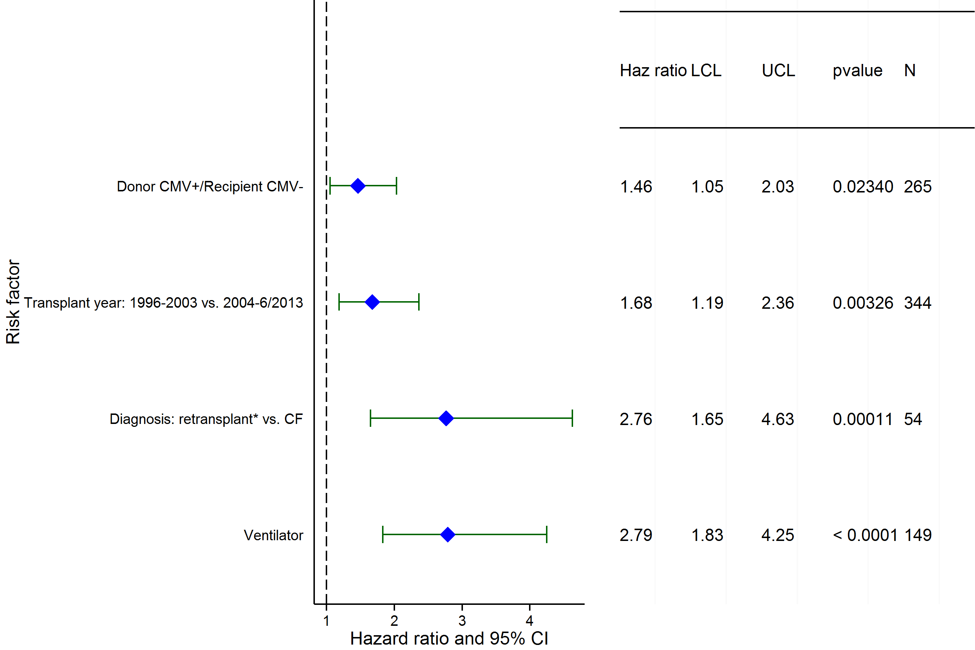
Pediatric Lung Transplants (January 1996 – June 2013)
Risk Factors For 1 Year Mortality/Graft Failure
(N = 841)
2015
* Retransplant includes those with a retransplant diagnosis or a previous transplant was reported.
JHLT. 2015 Oct; 34(10): 1255-1263
JHLT. 2014 Oct; 33(10): 1025-1033
Notes:
Multivariable analysis was performed using a proportional hazards model censoring all patients at 1 year. Continuous factors were fit using a restricted cubic spline.
Analyses were limited to transplants having essentially complete information regarding risk factors.

Slide 61
Pediatric Lung Transplants (January 1996 – June 2013)
Risk Factors For 1 Year Mortality/Graft Failure
Continuous Factors (see figure)
Recipient age
2015
(N = 841)
JHLT. 2015 Oct; 34(10): 1255-1263
JHLT. 2014 Oct; 33(10): 1025-1033
Notes:
Multivariable analysis was performed using a proportional hazards model censoring all patients at 1 year. Continuous factors were fit using a restricted cubic spline.
Analyses were limited to transplants having essentially complete information regarding risk factors.

Slide 62
Pediatric Lung Transplants (January 1996 – June 2013)
Risk Factors For 1 Year Mortality/Graft Failure
Recipient Age
p = 0.0409
2015
(N = 841)
JHLT. 2015 Oct; 34(10): 1255-1263
JHLT. 2014 Oct; 33(10): 1025-1033
Notes:
Multivariable analysis was performed using a proportional hazards model censoring all patients at 1 year. Continuous factors were fit using a restricted cubic spline.
Analyses were limited to transplants having essentially complete information regarding risk factors.

Slide 63
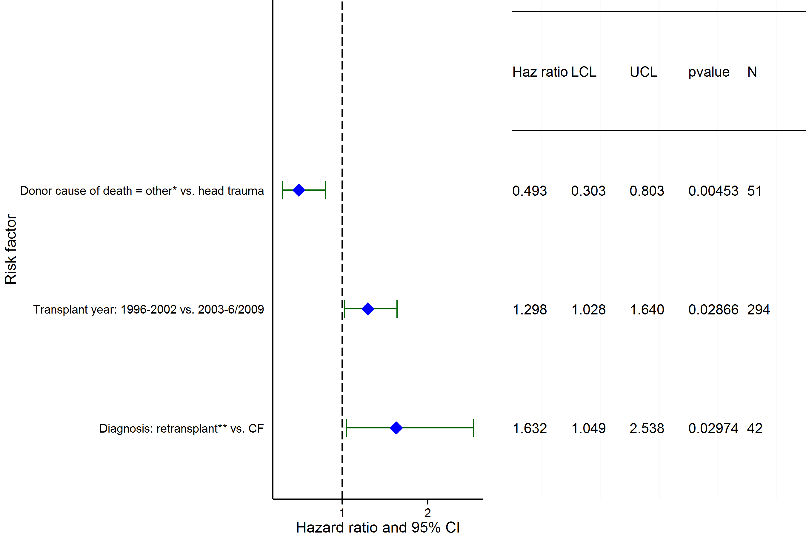
Pediatric Lung Transplants (1996-6/2009)
Risk Factors For 5 Year Mortality/Graft Failure with 95% Confidence Limits
(N = 636)
2015
* Other = All causes of death other than anoxia, stroke and head trauma
** Retransplant includes those with a retransplant diagnosis or a previous transplant was reported.
JHLT. 2015 Oct; 34(10): 1255-1263
Notes:
Multivariable analysis was performed using a proportional hazards model censoring all patients at 5 years. Continuous factors were fit using a restricted cubic spline.
Analyses were limited to transplants having essentially complete information regarding risk factors.

Slide 64
Pediatric Lung Transplants (1996-6/2009)
Risk Factors For 5 Year Mortality/Graft Failure
Continuous Factors (see figures)
Recipient age | Donor BMI/recipient BMI
2015
JHLT. 2015 Oct; 34(10): 1255-1263
Notes:
Multivariable analysis was performed using a proportional hazards model censoring all patients at 5 years. Continuous factors were fit using a restricted cubic spline.
Analyses were limited to transplants having essentially complete information regarding risk factors.

Slide 65
Pediatric Lung Transplants (1996-6/2009)
Risk Factors For 5 Year Mortality/Graft Failure with 95% Confidence Limits
Recipient age
Hazard Ratio of 5 Year Mortality/Graft Failure
p = 0.0090
2015
(N = 636)
JHLT. 2015 Oct; 34(10): 1255-1263
Notes:
Multivariable analysis was performed using a proportional hazards model censoring all patients at 5 years. Continuous factors were fit using a restricted cubic spline.
Analyses were limited to transplants having essentially complete information regarding risk factors.

Slide 66
Pediatric Lung Transplants (1996-6/2009)
Risk Factors For 5 Year Mortality/Graft Failure with 95% Confidence Limits
Donor BMI/recipient BMI
Hazard Ratio of 5 Year Mortality/Graft Failure
p = 0.0366
2015
(N = 636)
JHLT. 2015 Oct; 34(10): 1255-1263
Notes:
Multivariable analysis was performed using a proportional hazards model censoring all patients at 5 years. Continuous factors were fit using a restricted cubic spline.
Analyses were limited to transplants having essentially complete information regarding risk factors.

Slide 67
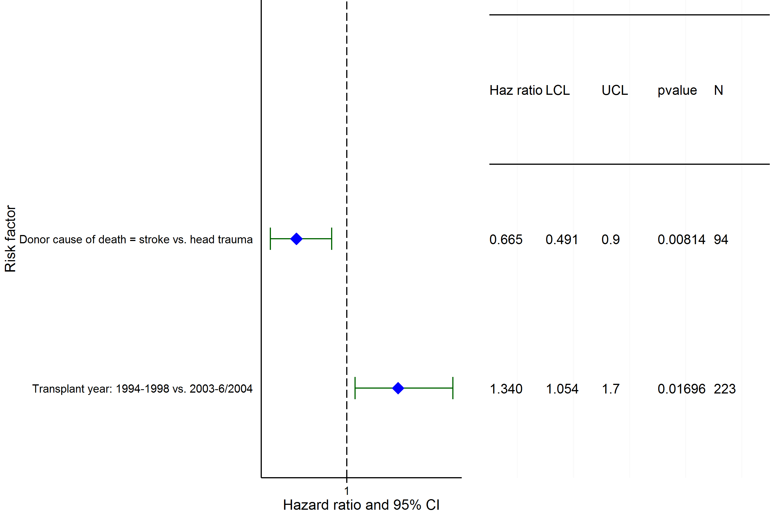
Pediatric Lung Transplants (1994-6/2004)
Risk Factors For 10 Year Mortality/Graft Failure
2015
(N = 449)
JHLT. 2015 Oct; 34(10): 1255-1263
JHLT. 2014 Oct; 33(10): 1025-1033
Notes:
Multivariable analysis was performed using a proportional hazards model censoring all patients at 10 years. Continuous factors were fit using a restricted cubic spline.
Analyses were limited to transplants having essentially complete information regarding risk factors.

Slide 68
Pediatric Lung Transplants (1994-6/2004)
Risk Factors For 10 Year Mortality/Graft Failure
Continuous Factors (see figures)
Recipient age
2015
JHLT. 2015 Oct; 34(10): 1255-1263
Notes:
Multivariable analysis was performed using a proportional hazards model censoring all patients at 10 years. Continuous factors were fit using a restricted cubic spline.
Analyses were limited to transplants having essentially complete information regarding risk factors.

Slide 69
Pediatric Lung Transplants (1994-6/2004)
Risk Factors For 5 Year Mortality/Graft Failure with 95% Confidence Limits
Recipient age
Hazard Ratio of 10 Year Mortality/Graft Failure
p = 0.0363
2015
(N = 449)
JHLT. 2015 Oct; 34(10): 1255-1263
Notes:
Multivariable analysis was performed using a proportional hazards model censoring all patients at 10 years. Continuous factors were fit using a restricted cubic spline.
Analyses were limited to transplants having essentially complete information regarding risk factors.

Slide 70
Early Graft Failure (EGF)
2015
JHLT. 2015 Oct; 34(10): 1255-1263

Slide 71
Pediatric Lung Transplants
Cumulative Incidence of EGF by Transplant Type
(Transplants: January 2005 – December 2013)
p = 0.0010
2015
JHLT. 2015 Oct; 34(10): 1255-1263
JHLT. 2014 Oct; 33(10): 1009-1024
Notes:
Only transplants with known EGF status are included in the tabulation. Incidence was computed using a competing-risks extension of the Kaplan-Meier method.

Slide 72
Pediatric Lung Transplants
% with EGF by EGF Type and Year for Primary Transplants
2015
JHLT. 2015 Oct; 34(10): 1255-1263
JHLT. 2014 Oct; 33(10): 1009-1024
Notes:
Only transplants with known EGF status are included in the tabulation. Percentage with EGF was computed using a competing-risks extension of the Kaplan-Meier method.

Slide 73
Pediatric Lung Transplants
Cumulative Incidence of EGF by Era
(Transplants: January 2005 – December 2013)
2015
JHLT. 2015 Oct; 34(10): 1255-1263
JHLT. 2014 Oct; 33(10): 1009-1024
Notes:
Only transplants with known EGF status are included in the tabulation. Incidence was computed using a competing-risks extension of the Kaplan-Meier method.

Slide 74
Pediatric Lung Transplants
Cumulative Incidence of EGF by Diagnosis
(Primary Transplants: January 2005 – December 2013)
2015
JHLT. 2015 Oct; 34(10): 1255-1263
JHLT. 2014 Oct; 33(10): 1009-1024
Notes:
Only transplants with known EGF status are included in the tabulation. Incidence was computed using a competing-risks extension of the Kaplan-Meier method.

Slide 75
Pediatric Lung Transplants
Cumulative Incidence of EGF by Diagnosis and Era
(Primary Transplants: January 2005 – December 2013)
2015
JHLT. 2015 Oct; 34(10): 1255-1263
JHLT. 2014 Oct; 33(10): 1009-1024
Notes:
Only transplants with known EGF status are included in the tabulation. Incidence was computed using a competing-risks extension of the Kaplan-Meier method.

Slide 76
Pediatric Lung Transplants
% with EGF by EGF Type and Age Group
(Primary Transplants: January 2005 – December 2013)
2015
JHLT. 2015 Oct; 34(10): 1255-1263
JHLT. 2014 Oct; 33(10): 1009-1024
Notes:
Only transplants with known EGF status are included in the tabulation. Percentage with EGF was computed using a competing-risks extension of the Kaplan-Meier method.
Comparisons were made using Fisher's exact test. Adjustments for multiple comparisons were done using Bonferroni method.

Slide 77
Pediatric Lung Transplants
% with EGF by EGF Type, Gender and Diagnosis
(Primary Transplants: January 2005 – December 2013)
No comparisons of % with EGF within each diagnosis were significant at p < 0.05.
2015
JHLT. 2015 Oct; 34(10): 1255-1263
JHLT. 2014 Oct; 33(10): 1009-1024
Notes:
Only transplants with known EGF status are included in the tabulation. Percentage with EGF was computed using a competing-risks extension of the Kaplan-Meier method.
Comparisons were made using Fisher's exact test. Adjustments for multiple comparisons were done using Bonferroni method.

Slide 78
Pediatric Lung Transplants
Cumulative Incidence of EGF by Donor Gender
(Primary Transplants: January 2005 – December 2013)
2015
JHLT. 2015 Oct; 34(10): 1255-1263
JHLT. 2014 Oct; 33(10): 1009-1024
Notes:
Only transplants with known EGF status are included in the tabulation. Incidence was computed using a competing-risks extension of the Kaplan-Meier method.

Slide 79
Pediatric Lung Transplants
Cumulative Incidence of EGF by Donor Age Group
(Transplants: January 2005 – December 2013)
2015
JHLT. 2015 Oct; 34(10): 1255-1263
JHLT. 2014 Oct; 33(10): 1009-1024
Notes:
Only transplants with known EGF status are included in the tabulation. Incidence was computed using a competing-risks extension of the Kaplan-Meier method.

Slide 80
Pediatric Lung Transplants
% with EGF by Location and Era for Primary Transplants
No pair-wise comparisons between eras within each location and between locations within each era were significant at p < 0.05.
Europe
North America
Other*
2015
JHLT. 2015 Oct; 34(10): 1255-1263
JHLT. 2014 Oct; 33(10): 1009-1024
Notes:
Only transplants with known EGF status are included in the tabulation. Percentage with EGF was computed using a competing-risks extension of the Kaplan-Meier method.
Comparisons were made using Fisher's exact test. Adjustments for multiple comparisons were done using Bonferroni method.

Slide 81
Pediatric Lung Transplants
% with EGF and non-EGF Early Failures by Location and Era for Primary Transplants
No pair-wise comparisons of % with EGF or comparisons of % with non-EGF early failures between eras within each location and between locations within each era were significant at p < 0.05.
Europe
North America
Other
2015
* non-EGF early failures include non-EGF retransplants and deaths within 30 days
JHLT. 2015 Oct; 34(10): 1255-1263
JHLT. 2014 Oct; 33(10): 1009-1024
Notes:
Only transplants with known EGF status are included in the tabulation. Percentage with EGF was computed using a competing-risks extension of the Kaplan-Meier method.
Comparisons were made using Fisher's exact test. Adjustments for multiple comparisons were done using Bonferroni method.

Slide 82
Pediatric Lung Transplants
% with EGF by EGF Type and Center Volume
(Primary Transplants: January 2005 – December 2013)
2015
JHLT. 2015 Oct; 34(10): 1255-1263
JHLT. 2014 Oct; 33(10): 1009-1024
Notes:
Only transplants with known EGF status are included in the tabulation. Percentage with EGF was computed using a competing-risks extension of the Kaplan-Meier method.
Comparisons were made using Fisher's exact test. Adjustments for multiple comparisons were done using Bonferroni method.

Slide 83
Pediatric Lung Transplants
Cumulative Incidence of EGF by Ischemic Time
(Transplants: January 2005 – December 2013)
2015
None of the patients in 2-<4 hours group (N=56) had EGF
JHLT. 2015 Oct; 34(10): 1255-1263
JHLT. 2014 Oct; 33(10): 1009-1024
Notes:
Only transplants with known EGF status are included in the tabulation. Incidence was computed using a competing-risks extension of the Kaplan-Meier method.

Slide 84
Pediatric Lung Transplants
Cumulative Incidence of EGF by Donor/Recipient BMI Ratio
(Transplants: January 2005 – December 2013)
2015
JHLT. 2015 Oct; 34(10): 1255-1263
JHLT. 2014 Oct; 33(10): 1009-1024
Notes:
Only transplants with known EGF status are included in the tabulation. Incidence was computed using a competing-risks extension of the Kaplan-Meier method.

Slide 85
Pediatric Lung Transplants
Cumulative Incidence of EGF by Donor Cause of Death
(Transplants: January 2005 – December 2013)
No pair-wise comparisons of % with EGF were significant at p < 0.05.
2015
JHLT. 2015 Oct; 34(10): 1255-1263
JHLT. 2014 Oct; 33(10): 1009-1024
Notes:
Only transplants with known EGF status are included in the tabulation. Incidence was computed using a competing-risks extension of the Kaplan-Meier method.

Slide 86
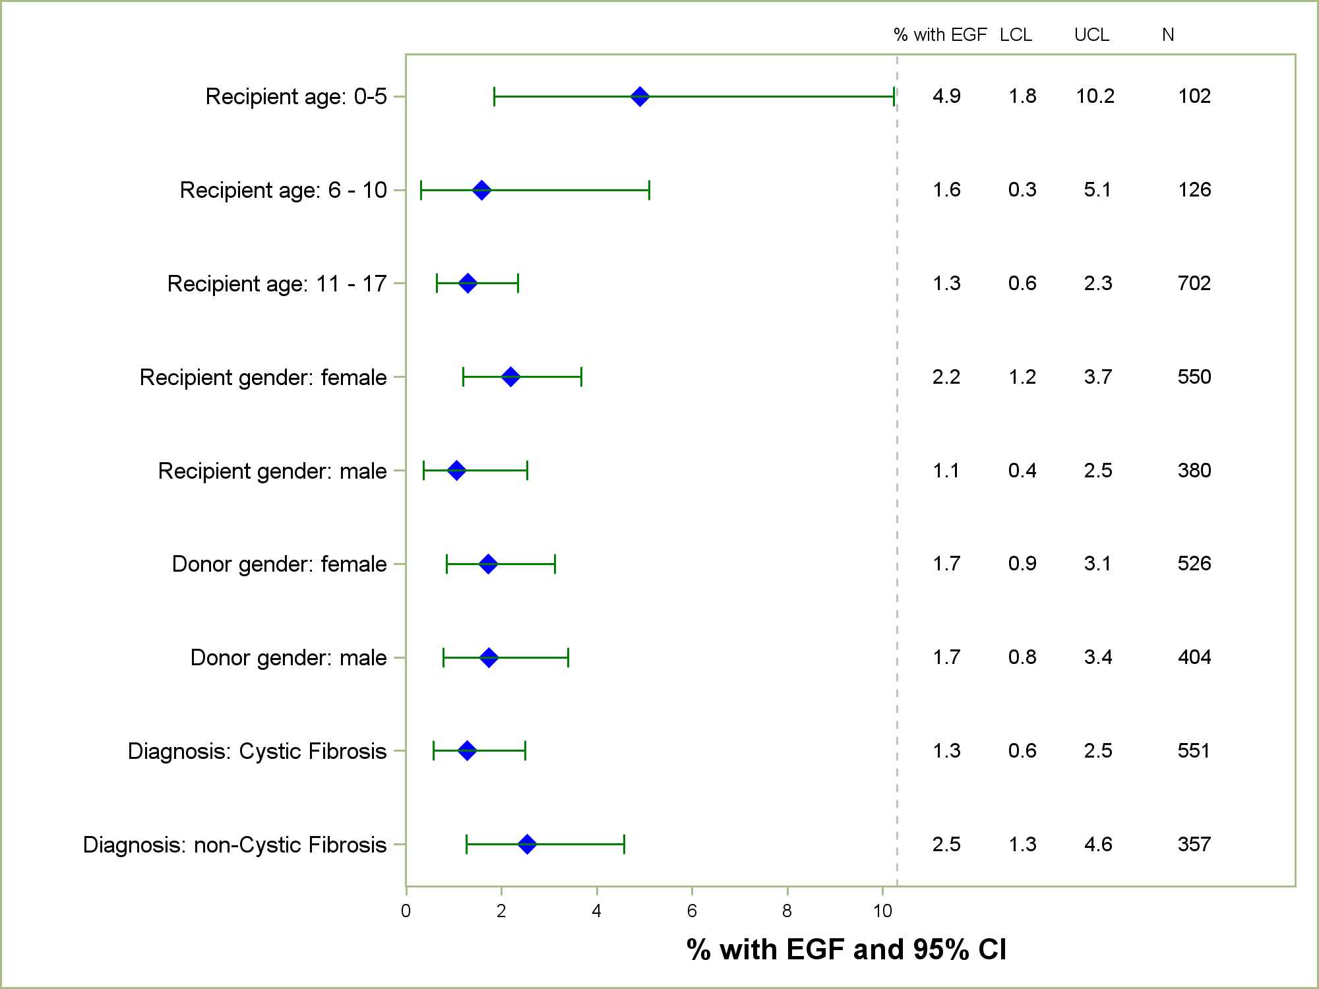
Pediatric Lung Transplants
% with EGF by Donor and Recipient Characteristics
(Primary Transplants: January 2005 – December 2013)
2015
JHLT. 2015 Oct; 34(10): 1255-1263
Notes:
Only transplants with known EGF status are included in the tabulation. Percentage with EGF was computed using a competing-risks extension of the Kaplan-Meier method.

