Slide 1

HEART TRANSPLANTATION
Pediatric Recipients
2015
JHLT. 2015 Oct; 34(10): 1233-1243

Slide 2
Table of Contents
Donor, recipient and center characteristics: slides 3-25
Post transplant – survival and other outcomes: slides 26-46
Induction and maintenance immunosuppression: slides 47-60
Rejection and post transplant morbidities: slides 61-98
Retransplantation: slides 99-105
Multivariable analyses: slides 106-170
Early Graft Failure (EGF): slides 171-192
2015
JHLT. 2014 Oct; 33(10): 985-995
JHLT. 2015 Oct; 34(10): 1233-1243

Slide 3
Donor, Recipient and Center Characteristics
2015
JHLT. 2014 Oct; 33(10): 985-995
JHLT. 2015 Oct; 34(10): 1233-1243

Slide 4
Pediatric Heart Transplants
Number of Centers Reporting Transplants
2015
JHLT. 2014 Oct; 33(10): 985-995
JHLT. 2015 Oct; 34(10): 1233-1243

Slide 5
Pediatric Heart Transplants
Number of Centers by Center Volume
(Transplants: January 2004 – June 2014)
2015
JHLT. 2014 Oct; 33(10): 985-995
JHLT. 2015 Oct; 34(10): 1233-1243

Slide 6
Pediatric Heart Transplants
Distribution of Transplants by Center Volume
(Transplants: January 2004 – June 2014)
2015
JHLT. 2014 Oct; 33(10): 985-995
JHLT. 2015 Oct; 34(10): 1233-1243

Slide 7
Pediatric Heart Transplants
Recipient Age Distribution by Center Volume
(Transplants: January 2004 – June 2014)
2015
JHLT. 2014 Oct; 33(10): 985-995
JHLT. 2015 Oct; 34(10): 1233-1243

Slide 8
Pediatric Heart Transplants
Distribution of Transplants by Location and Average Center Volume (Transplants: January 2004 – June 2014)
2015
JHLT. 2014 Oct; 33(10): 985-995
JHLT. 2015 Oct; 34(10): 1233-1243

Slide 9
Pediatric Heart Transplants
Recipient Age Distribution (Transplants: January 2004 – June 2014)
2015
JHLT. 2014 Oct; 33(10): 985-995
JHLT. 2015 Oct; 34(10): 1233-1243

Slide 10
Pediatric Heart Transplants
Recipient Age Distribution by Year of Transplant
NOTE: This figure includes only the heart transplants that are reported to the ISHLT Transplant Registry. As such, this should not be construed as evidence that the number of hearts transplanted worldwide has increased and/or decreased in recent years.
2015
JHLT. 2014 Oct; 33(10): 985-995
JHLT. 2015 Oct; 34(10): 1233-1243

Slide 11
Pediatric Heart Transplants
Recipient Age Distribution by Location
(Transplants: January 2004 – June 2014)
2015
JHLT. 2014 Oct; 33(10): 985-995
JHLT. 2015 Oct; 34(10): 1233-1243

Slide 12
Pediatric Heart Transplants
Donor Age Distribution (Transplants: January 2004 – June 2014)
2015
JHLT. 2014 Oct; 33(10): 985-995
JHLT. 2015 Oct; 34(10): 1233-1243
Notes:
NOTE: Transplants where donor age is unknown are excluded from this tabulation.

Slide 13
Pediatric Heart Transplants
Donor and Recipient Age
(Transplants: January 2004 – June 2014)
2015
JHLT. 2014 Oct; 33(10): 985-995
JHLT. 2015 Oct; 34(10): 1233-1243

Slide 14
Pediatric Heart Transplants
Donor Age Distribution by Location
(Transplants: January 2004 – June 2014)
2015
JHLT. 2014 Oct; 33(10): 985-995
JHLT. 2015 Oct; 34(10): 1233-1243
Notes:
NOTE: Transplants where donor age is unknown are excluded from this tabulation.

Slide 15
Pediatric Heart Transplants
Distribution of Transplants by Donor/Recipient Weight Ratio
(Transplants: January 2004 – June 2014)
2015
JHLT. 2014 Oct; 33(10): 985-995
JHLT. 2015 Oct; 34(10): 1233-1243

Slide 16
Pediatric Heart Transplants
Recipient Diagnosis (Age: < 1 Year)
2015
For some retransplants, a diagnosis other than retransplant is reported, so the total percentage of retransplants may be greater.
JHLT. 2014 Oct; 33(10): 985-995
JHLT. 2015 Oct; 34(10): 1233-1243
Notes:
NOTE: Transplants with unknown diagnoses are excluded from this tabulation

Slide 17
Pediatric Heart Transplants
Recipient Diagnosis (Age: 1-5 Years)
2015
For some retransplants, a diagnosis other than retransplant is reported, so the total percentage of retransplants may be greater.
JHLT. 2014 Oct; 33(10): 985-995
JHLT. 2015 Oct; 34(10): 1233-1243
Notes:
NOTE: Transplants with unknown diagnoses are excluded from this tabulation

Slide 18
Pediatric Heart Transplants
Recipient Diagnosis (Age: 6-10 Years)
2015
For some retransplants, a diagnosis other than retransplant is reported, so the total percentage of retransplants may be greater.
JHLT. 2014 Oct; 33(10): 985-995
JHLT. 2015 Oct; 34(10): 1233-1243
Notes:
NOTE: Transplants with unknown diagnoses are excluded from this tabulation

Slide 19
Pediatric Heart Transplants
Recipient Diagnosis (Age: 11-17 Years)
2015
For some retransplants, a diagnosis other than retransplant is reported, so the total percentage of retransplants may be greater.
JHLT. 2014 Oct; 33(10): 985-995
JHLT. 2015 Oct; 34(10): 1233-1243
Notes:
NOTE: Transplants with unknown diagnoses are excluded from this tabulation

Slide 20
Pediatric Heart Transplants
Diagnosis Distribution by Location
(Transplants: January 2004 – June 2014)
2015
For some retransplants, a diagnosis other than retransplant is reported, so the total percentage of retransplants may be greater.
JHLT. 2014 Oct; 33(10): 985-995
JHLT. 2015 Oct; 34(10): 1233-1243
Notes:
NOTE: Transplants with unknown diagnoses are excluded from this tabulation.

Slide 21
Pediatric Heart Transplants
% of Patients Bridged with Mechanical Circulatory Support* by Year (Transplants: January 2005 – December 2013)
2015
* LVAD, RVAD, TAH, ECMO
JHLT. 2014 Oct; 33(10): 985-995
JHLT. 2015 Oct; 34(10): 1233-1243

Slide 22
Pediatric Heart Transplants
% of Patients Bridged with Mechanical Circulatory Support*
(Transplants: January 2009 – June 2014)
2015
* LVAD, RVAD, TAH, ECMO
JHLT. 2014 Oct; 33(10): 985-995
JHLT. 2015 Oct; 34(10): 1233-1243

Slide 23
Pediatric Heart Transplants
% of Patients Bridged with Mechanical Circulatory Support* by Age Group (Transplants: January 2009 – June 2014)
2015
* LVAD, RVAD, TAH, ECMO
JHLT. 2014 Oct; 33(10): 985-995
JHLT. 2015 Oct; 34(10): 1233-1243

Slide 24
Pediatric Heart Transplants
PRA Distribution by Year
(Transplants: January 2005 – December 2013)
2015
If Class I and Class II values were reported separately, the higher of the two values was used.
JHLT. 2014 Oct; 33(10): 985-995
JHLT. 2015 Oct; 34(10): 1233-1243

Slide 25
Pediatric Heart Transplants
PRA Distribution by Age Group
(Transplants: January 2009 – June 2014)
p<0.0001
2015
If Class I and Class II values were reported separately, the higher of the two values was used.
JHLT. 2014 Oct; 33(10): 985-995
JHLT. 2015 Oct; 34(10): 1233-1243

Slide 26
Post Transplant:
Survival and Other Outcomes
2015
JHLT. 2014 Oct; 33(10): 985-995
JHLT. 2015 Oct; 34(10): 1233-1243

Slide 27
Pediatric Heart Transplants
Kaplan-Meier Survival (Transplants: January 1982 – June 2013)
1-5 vs. 11-17: p = 0.0009
6-10 vs. 11-17: p = 0.0235
No other pair-wise comparisons were significant at p < 0.05.
2015
JHLT. 2014 Oct; 33(10): 985-995
JHLT. 2015 Oct; 34(10): 1233-1243
Notes:
Survival was calculated using the Kaplan-Meier method, which incorporates information from all transplants for whom any follow-up has been provided. Since many patients are still alive and some patients have been lost to follow-up, the survival rates are estimates rather than exact rates because the time of death is not known for all patients. The median survival is the estimated time point at which 50% of all of the recipients have died.
Survival rates were compared using the log-rank test statistic. Adjustments for multiple comparisons were done using Scheffe’s method. Results of log-rank test should be interpreted with caution when curves cross.

Slide 28
Pediatric Heart Transplants
Kaplan-Meier Survival Conditional on Survival to 1 Year (Transplants: January 1982 – June 2013)
All pair-wise comparisons were significant at p < 0.05 except <1 vs. 1-5.
2015
JHLT. 2014 Oct; 33(10): 985-995
JHLT. 2015 Oct; 34(10): 1233-1243
Notes:
Survival was calculated using the Kaplan-Meier method, which incorporates information from all transplants for whom any follow-up has been provided. Since many patients are still alive and some patients have been lost to follow-up, the survival rates are estimates rather than exact rates because the time of death is not known for all patients. Conditional survival is shown in this figure; this is the survival following 1 year for all patients who survived to 1 year. The conditional median survival is the estimated time point at which 50% of the recipients who survive to at least 1 year have died. Because the decline in survival is greatest during the first year following transplantation, the conditional survival provides a more realistic expectation of survival time for recipients who survive the early post-transplant period.
Survival rates were compared using the log-rank test statistic. Adjustments for multiple comparisons were done using Scheffe’s method. Results of log-rank test should be interpreted with caution when curves cross.

Slide 29
Pediatric Heart Transplants
Kaplan-Meier Survival Conditional on Survival to 5 Years (Transplants: January 1982 – June 2009)
All pair-wise comparisons were significant at p < 0.05 except 6-10 vs. 11-17.
2015
JHLT. 2014 Oct; 33(10): 985-995
JHLT. 2015 Oct; 34(10): 1233-1243
Notes:
Survival was calculated using the Kaplan-Meier method, which incorporates information from all transplants for whom any follow-up has been provided. Since many patients are still alive and some patients have been lost to follow-up, the survival rates are estimates rather than exact rates because the time of death is not known for all patients. Conditional survival is shown in this figure; this is the survival following 5 years for all patients who survived to 5 years.
Survival rates were compared using the log-rank test statistic. Adjustments for multiple comparisons were done using Scheffe’s method. Results of log-rank test should be interpreted with caution when curves cross.

Slide 30
Pediatric Heart Transplants
Kaplan-Meier Survival Conditional on Survival to 10 Years (Transplants: January 1982 – June 2004)
All pair-wise comparisons with <1 were significant at p<0.0001.
1-5 vs. 6-10 was significant at p<0.05 (p=0.0013). No other pair-wise comparisons were significant at p<0.05.
2015
JHLT. 2014 Oct; 33(10): 985-995
JHLT. 2015 Oct; 34(10): 1233-1243
Notes:
Survival was calculated using the Kaplan-Meier method, which incorporates information from all transplants for whom any follow-up has been provided. Since many patients are still alive and some patients have been lost to follow-up, the survival rates are estimates rather than exact rates because the time of death is not known for all patients. Conditional survival is shown in this figure; this is the survival following 10 years for all patients who survived to 10 years.
Survival rates were compared using the log-rank test statistic. Adjustments for multiple comparisons were done using Scheffe’s method. Results of log-rank test should be interpreted with caution when curves cross.

Slide 31
Pediatric Heart Transplants
Kaplan-Meier Survival by Era
(Transplants: January 1982 – June 2013)
All p-values significant at p < 0.05
2015
JHLT. 2014 Oct; 33(10): 985-995
JHLT. 2015 Oct; 34(10): 1233-1243
Notes:
Survival was calculated using the Kaplan-Meier method, which incorporates information from all transplants for whom any follow-up has been provided. Since many patients are still alive and some patients have been lost to follow-up, the survival rates are estimates rather than exact rates because the time of death is not known for all patients. The median survival is the estimated time point at which 50% of all of the recipients have died.
Survival rates were compared using the log-rank test statistic. Adjustments for multiple comparisons were done using Scheffe’s method.

Slide 32
Pediatric Heart Transplants
Conditional Kaplan-Meier Survival for Recent Era
(Transplants: January 2004 – June 2013)
All pair-wise comparisons with 11-17 were significant at p<0.05. No other pair-wise comparisons were significant at p<0.05.
2015
JHLT. 2014 Oct; 33(10): 985-995
JHLT. 2015 Oct; 34(10): 1233-1243
Notes:
Survival was calculated using the Kaplan-Meier method, which incorporates information from all transplants for whom any follow-up has been provided. Since many patients are still alive and some patients have been lost to follow-up, the survival rates are estimates rather than exact rates because the time of death is not known for all patients. Conditional survival is shown in this figure; this is the survival following 1 year for all patients who survived to 1 year. Because the decline in survival is greatest during the first year following transplantation, the conditional survival provides a more realistic expectation of survival time for recipients who survive the early post-transplant period.
Survival rates were compared using the log-rank test statistic. Adjustments for multiple comparisons were done using Scheffe’s method. Results of log-rank test should be interpreted with caution when curves cross.

Slide 33
Pediatric Heart Transplants
Kaplan-Meier Survival by Era
Age: < 1 Year (Transplants: January 1982 – June 2013)
All pair-wise comparisons were significant at p<0.05 except 2004-2008 vs. 2009-6/2013.
Median survival (years): 1982-1989=12.0; 1990-2003=20.0; 2004-2008=NA; 2009-6/2013=NA
2015
JHLT. 2014 Oct; 33(10): 985-995
JHLT. 2015 Oct; 34(10): 1233-1243
Notes:
Survival was calculated using the Kaplan-Meier method, which incorporates information from all transplants for whom any follow-up has been provided. Since many patients are still alive and some patients have been lost to follow-up, the survival rates are estimates rather than exact rates because the time of death is not known for all patients. The median survival is the estimated time point at which 50% of all of the recipients have died.
Survival rates were compared using the log-rank test statistic. Adjustments for multiple comparisons were done using Scheffe’s method.

Slide 34
Pediatric Heart Transplants
Kaplan-Meier Survival by Era
Age: 1-5 Years (Transplants: January 1982 – June 2013)
All p-values significant at p<0.05 except 2004-2008 vs. 2009-6/2013 (p=0.9469).
Median survival (years): 1982-1989=9.1; 1990-2003=16.8; 2004-2008=NA; 2009-6/2013=NA
2015
JHLT. 2014 Oct; 33(10): 985-995
JHLT. 2015 Oct; 34(10): 1233-1243
Notes:
Survival was calculated using the Kaplan-Meier method, which incorporates information from all transplants for whom any follow-up has been provided. Since many patients are still alive and some patients have been lost to follow-up, the survival rates are estimates rather than exact rates because the time of death is not known for all patients. The median survival is the estimated time point at which 50% of all of the recipients have died.
Survival rates were compared using the log-rank test statistic. Adjustments for multiple comparisons were done using Scheffe’s method.

Slide 35
Pediatric Heart Transplants
Kaplan-Meier Survival by Era
Age: 6-10 Years (Transplants: January 1982 – June 2013)
All p-values significant at < 0.05 except 2004-2008 vs. 2009-6/2013 (p=0.9986).
Median survival (years): 1982-1989 = 9.4; 1990-2003 = 13.3; 2004-2008 = NA; 2009-6/2013 = NA
2015
JHLT. 2014 Oct; 33(10): 985-995
JHLT. 2015 Oct; 34(10): 1233-1243
Notes:
Survival was calculated using the Kaplan-Meier method, which incorporates information from all transplants for whom any follow-up has been provided. Since many patients are still alive and some patients have been lost to follow-up, the survival rates are estimates rather than exact rates because the time of death is not known for all patients. The median survival is the estimated time point at which 50% of all of the recipients have died.
Survival rates were compared using the log-rank test statistic. Adjustments for multiple comparisons were done using Scheffe’s method.

Slide 36
Pediatric Heart Transplants
Kaplan-Meier Survival by Era
Age: 11-17 Years (Transplants: January 1982 – June 2013)
Median survival (years): 1982-1989=9.9; 1990-2003=11.8; 2004-2008=NA; 2009-6/2013=NA
1982-1989 vs. 2004-2008: p=0.0001
1982-1989 vs. 2009-6/2013: p<0.0001
1990-2003 vs. 2009-6/2013: p<0.0001
No other pair-wise comparisons were significant at p<0.05.
2015
JHLT. 2014 Oct; 33(10): 985-995
JHLT. 2015 Oct; 34(10): 1233-1243
Notes:
Survival was calculated using the Kaplan-Meier method, which incorporates information from all transplants for whom any follow-up has been provided. Since many patients are still alive and some patients have been lost to follow-up, the survival rates are estimates rather than exact rates because the time of death is not known for all patients. The median survival is the estimated time point at which 50% of all of the recipients have died.
Survival rates were compared using the log-rank test statistic. Adjustments for multiple comparisons were done using Scheffe’s method. Results of log-rank test should be interpreted with caution when curves cross.

Slide 37
Pediatric Heart Transplants
Kaplan-Meier Survival by Recipient Gender
(Transplants: January 2004 – June 2013)
p = 0.0731
2015
JHLT. 2014 Oct; 33(10): 985-995
JHLT. 2015 Oct; 34(10): 1233-1243
Notes:
Survival was calculated using the Kaplan-Meier method, which incorporates information from all transplants for whom any follow-up has been provided. Since many patients are still alive and some patients have been lost to follow-up, the survival rates are estimates rather than exact rates because the time of death is not known for all patients.
Survival rates were compared using the log-rank test statistic.

Slide 38
Pediatric Heart Transplants
Kaplan-Meier Survival by Donor/Recipient Gender
(Transplants: January 2004 – June 2013)
No pair-wise comparisons were significant at p<0.05.
2015
JHLT. 2014 Oct; 33(10): 985-995
JHLT. 2015 Oct; 34(10): 1233-1243
Notes:
Survival was calculated using the Kaplan-Meier method, which incorporates information from all transplants for whom any follow-up has been provided. Since many patients are still alive and some patients have been lost to follow-up, the survival rates are estimates rather than exact rates because the time of death is not known for all patients.
Survival rates were compared using the log-rank test statistic. Adjustments for multiple comparisons were done using Scheffe’s method.

Slide 39
Pediatric Heart Transplants
Kaplan-Meier Survival by Diagnosis
Age: < 1 Year (Transplants: January 2004 – June 2013)
p<0.0001
2015
JHLT. 2014 Oct; 33(10): 985-995
JHLT. 2015 Oct; 34(10): 1233-1243
Notes:
Survival was calculated using the Kaplan-Meier method, which incorporates information from all transplants for whom any follow-up has been provided. Since many patients are still alive and some patients have been lost to follow-up, the survival rates are estimates rather than exact rates because the time of death is not known for all patients.
Survival rates were compared using the log-rank test statistic.

Slide 40
Pediatric Heart Transplants
Kaplan-Meier Survival by Diagnosis
Age: 1-5 Years (Transplants: January 2004 – June 2013)
Congenital vs. Cardiomyopathy: p = 0.0002
Congenital vs. Retransplant: p = 0.0785
Cardiomyopathy vs. Retransplant: p < 0.0001
2015
For some retransplants, a diagnosis other than retransplant is reported, so the total number of retransplants may be greater.
JHLT. 2014 Oct; 33(10): 985-995
JHLT. 2015 Oct; 34(10): 1233-1243
Notes:
Survival was calculated using the Kaplan-Meier method, which incorporates information from all transplants for whom any follow-up has been provided. Since many patients are still alive and some patients have been lost to follow-up, the survival rates are estimates rather than exact rates because the time of death is not known for all patients.
Survival rates were compared using the log-rank test statistic. Adjustments for multiple comparisons were done using Scheffe’s method.

Slide 41
Pediatric Heart Transplants
Kaplan-Meier Survival by Diagnosis
Age: 6-10 Years (Transplants: January 2004 – June 2013)
Congenital vs. Cardiomyopathy: p = 0.027
Congenital vs. Retransplant: p = 0.9682
Cardiomyopathy vs. Retransplant: p = 0.4603
2015
For some retransplants, a diagnosis other than retransplant is reported, so the total number of retransplants may be greater.
JHLT. 2014 Oct; 33(10): 985-995
JHLT. 2015 Oct; 34(10): 1233-1243
Notes:
Survival was calculated using the Kaplan-Meier method, which incorporates information from all transplants for whom any follow-up has been provided. Since many patients are still alive and some patients have been lost to follow-up, the survival rates are estimates rather than exact rates because the time of death is not known for all patients.
Survival rates were compared using the log-rank test statistic. Adjustments for multiple comparisons were done using Scheffe’s method. Results of log-rank test should be interpreted with caution when curves cross.

Slide 42
Pediatric Heart Transplants
Kaplan-Meier Survival by Diagnosis
Age: 11-17 Years (Transplants: January 2004 – June 2013)
Congenital vs. Cardiomyopathy: p = 0.001
Congenital vs. Retransplant: p = 0.1611
Cardiomyopathy vs. Retransplant: p<0.0001
2015
For some retransplants, a diagnosis other than retransplant is reported, so the total number of retransplants may be greater.
JHLT. 2014 Oct; 33(10): 985-995
JHLT. 2015 Oct; 34(10): 1233-1243
Notes:
Survival was calculated using the Kaplan-Meier method, which incorporates information from all transplants for whom any follow-up has been provided. Since many patients are still alive and some patients have been lost to follow-up, the survival rates are estimates rather than exact rates because the time of death is not known for all patients.
Survival rates were compared using the log-rank test statistic. Adjustments for multiple comparisons were done using Scheffe’s method. Results of log-rank test should be interpreted with caution when curves cross.

Slide 43
Pediatric Heart Transplants
Kaplan-Meier Patient vs. Graft Survival
(Transplants: January 2004 – June 2013)
p = 0.0124
2015
JHLT. 2014 Oct; 33(10): 985-995
JHLT. 2015 Oct; 34(10): 1233-1243
Notes:
Survival was calculated using the Kaplan-Meier method, which incorporates information from all transplants for whom any follow-up has been provided. Since many patients are still alive and some patients have been lost to follow-up, the survival rates are estimates rather than exact rates because the time of death is not known for all patients.
Survival rates were compared using the log-rank test statistic.

Slide 44
Pediatric Heart Transplants
Kaplan-Meier Survival by Mechanical Circulatory Support Usage* (Transplants: January 2009 – June 2013)
All pair-wise comparisons were significant at p < 0.0001 except No ECMO/VAD/TAH vs. VAD or TAH, no ECMO (p=0.9999).
2015
* LVAD, RVAD, TAH, ECMO
JHLT. 2014 Oct; 33(10): 985-995
JHLT. 2015 Oct; 34(10): 1233-1243
Notes:
Survival was calculated using the Kaplan-Meier method, which incorporates information from all transplants for whom any follow-up has been provided. Since many patients are still alive and some patients have been lost to follow-up, the survival rates are estimates rather than exact rates because the time of death is not known for all patients.
Survival rates were compared using the log-rank test statistic. Adjustments for multiple comparisons were done using Scheffe’s method. Results of log-rank test should be interpreted with caution when curves cross.

Slide 45
Pediatric Heart Transplants
Functional Status of Surviving Recipients
(Follow-ups: January 2009 – June 2014)
2015
JHLT. 2014 Oct; 33(10): 985-995
JHLT. 2015 Oct; 34(10): 1233-1243
Notes:
Functional status is collected using Lansky score for pediatric recipients.
This figure shows the functional status reported on the 1-year, 2-year and 3-year annual follow-ups. Because all follow-ups between March 2005 and June 2014 were included, the bars do not include the same patients.

Slide 46
Pediatric Heart Transplants
Rehospitalization Post-transplant of Surviving Recipients
(Follow-ups: January 2009 – June 2014)
2015
JHLT. 2014 Oct; 33(10): 985-995
JHLT. 2015 Oct; 34(10): 1233-1243
Notes:
This figure shows the hospitalizations reported on the 1-year, 3-year and 5-year annual follow-ups, representing the hospitalizations between discharge and 1 year, between the 2-year and 3-year follow-up, and between the 4-year and 5-year follow-up, respectively. Because all follow-ups between January 2000 and June 2014 were included, the bars do not include the same patients.

Slide 47
Induction and Maintenance Immunosuppression
2015
JHLT. 2014 Oct; 33(10): 985-995
JHLT. 2015 Oct; 34(10): 1233-1243

Slide 48
Pediatric Heart Transplants
Induction Immunosuppression
(Transplants: January 2004 – June 2014)
2015
Analysis is limited to patients who were alive at the time of the discharge.
JHLT. 2014 Oct; 33(10): 985-995
JHLT. 2015 Oct; 34(10): 1233-1243

Slide 49
Pediatric Heart Transplants
Induction Immunosuppression by Era
(Transplants: January 2004 – June 2014)
2015
Analysis is limited to patients who were alive at the time of the discharge.
JHLT. 2014 Oct; 33(10): 985-995
JHLT. 2015 Oct; 34(10): 1233-1243

Slide 50
Pediatric Heart Transplants
Kaplan-Meier Survival by Induction Group Conditional on Survival to 14 Days (Transplants: January 2004 – June 2013)
2015
JHLT. 2014 Oct; 33(10): 985-995
JHLT. 2015 Oct; 34(10): 1233-1243
Notes:
Survival was calculated using the Kaplan-Meier method, which incorporates information from all transplants for whom any follow-up has been provided. Since many patients are still alive and some patients have been lost to follow-up, the survival rates are estimates rather than exact rates because the time of death is not known for all patients.
Survival rates were compared using the log-rank test statistic. Adjustments for multiple comparisons were done using Scheffe’s method.

Slide 51
Pediatric Heart Transplants
Kaplan-Meier Survival by Induction and Treated Rejection Between Transplant Discharge and 1-Year Follow-up
Conditional on Survival to 1 Year (1-Year Follow-ups: July 2004 – June 2013)
Treated rejection = Recipient was reported to (1) have at least one acute rejection episode that was treated with an anti-rejection agent; or (2) have been hospitalized for rejection.
No rejection = Recipient had (i) no acute rejection episodes and (ii) was reported either as not hospitalized for rejection or did not receive anti-rejection agents.
2015
JHLT. 2014 Oct; 33(10): 985-995
JHLT. 2015 Oct; 34(10): 1233-1243
Notes:
Because of a modification in the data collection, the analysis is limited to follow-ups occurring on or after July 2004.
Survival was calculated using the Kaplan-Meier method, which incorporates information from all transplants for whom any follow-up has been provided. Since many patients are still alive and some patients have been lost to follow-up, the survival rates are estimates rather than exact rates because the time of death is not known for all patients.
Survival rates were compared using the log-rank test statistic. Adjustments for multiple comparisons were done using Scheffe’s method.

Slide 52
Pediatric Heart Transplants
Maintenance Immunosuppression at Time of Transplant Discharge by Era (Transplants: January 2004 – June 2014)
2015
Analysis is limited to patients who were alive at the time of the discharge.
JHLT. 2014 Oct; 33(10): 985-995
JHLT. 2015 Oct; 34(10): 1233-1243

Slide 53
Pediatric Heart Transplants
Maintenance Immunosuppression at Time of Follow-up
(Follow-ups: January 2004 – June 2014)
2015
Analysis is limited to patients who were alive at the time of the follow-up
JHLT. 2014 Oct; 33(10): 985-995
JHLT. 2015 Oct; 34(10): 1233-1243
Notes:
This figure shows the maintenance immunosuppression reported as being provided at the time of the 1-year and 5-year annual follow-up forms. To provide a snapshot of current practice, only follow-ups occurring between January 2004 and June 2014 were included. Therefore, this figure does not represent changes in practice between the 1-year follow-up and 5-year follow-up on a cohort of patients. The patients in the 1-year tabulation are not the same patients as in the 5-year tabulation.

Slide 54
Pediatric Heart Transplants
Maintenance Immunosuppression at Time of Follow-up for Same Patients at Each Time Point
(Follow-ups: January 2004 – June 2014)
2015
Analysis is limited to patients who were alive at the time of the follow-up.
JHLT. 2014 Oct; 33(10): 985-995
JHLT. 2015 Oct; 34(10): 1233-1243
Notes:
This figure shows the maintenance immunosuppression reported as being provided at the time of the 1-year and 5-year annual follow-up forms for the same patients based on follow-ups between January 2004 and June 2014.

Slide 55
Pediatric Heart Transplants
Maintenance Immunosuppression Drug Combinations at Time of Follow-up (Follow-ups: January 2004 – June 2014)
NOTE: Different patients are analyzed in Year 1 and Year 5.
2015
Analysis is limited to patients who were alive at the time of the follow-up.
JHLT. 2014 Oct; 33(10): 985-995
JHLT. 2015 Oct; 34(10): 1233-1243
Notes:
This figure shows the maintenance immunosuppression reported as being provided at the time of the 1-year and 5-year annual follow-up forms for the same patients based on follow-ups between January 2004 and June 2014.

Slide 56
Pediatric Heart Transplants
Kaplan-Meier Survival Based on Prednisone Use
Conditional on Survival to 1 Year (Transplants: January 2004 – June 2013)
2015
JHLT. 2014 Oct; 33(10): 985-995
JHLT. 2015 Oct; 34(10): 1233-1243
Notes:
Survival was calculated using the Kaplan-Meier method, which incorporates information from all transplants for whom any follow-up has been provided. Since many patients are still alive and some patients have been lost to follow-up, the survival rates are estimates rather than exact rates because the time of death is not known for all patients. The cohorts were conditioned on survival to 1 year, so that prednisone use during the first year could be used as a stratification factor.
Survival rates were compared using the log-rank test statistic. A significant p-value means that at least one of the groups is different than the others but it doesn’t identify which group it is.

Slide 57
Pediatric Heart Transplants
Kaplan-Meier Survival by Calcineurin Inhibitor Use at Discharge (Transplants: January 2004 – June 2013)
Conditional on Survival to 14 Days
2015
JHLT. 2014 Oct; 33(10): 985-995
JHLT. 2015 Oct; 34(10): 1233-1243
Notes:
Survival was calculated using the Kaplan-Meier method, which incorporates information from all transplants for whom any follow-up has been provided. Since many patients are still alive and some patients have been lost to follow-up, the survival rates are estimates rather than exact rates because the time of death is not known for all patients.
Survival rates were compared using the log-rank test statistic. Results of log-rank test should be interpreted with caution when curves cross.

Slide 58
Pediatric Heart Transplants
Kaplan-Meier Survival by Maintenance Immunosuppression at Discharge (Transplants: January 2004 – June 2013)
Conditional on Survival to 14 Days
2015
JHLT. 2014 Oct; 33(10): 985-995
JHLT. 2015 Oct; 34(10): 1233-1243
Notes:
Survival was calculated using the Kaplan-Meier method, which incorporates information from all transplants for whom any follow-up has been provided. Since many patients are still alive and some patients have been lost to follow-up, the survival rates are estimates rather than exact rates because the time of death is not known for all patients.
Survival rates were compared using the log-rank test statistic. Results of log-rank test should be interpreted with caution when curves cross. Adjustments for multiple comparisons were done using Scheffe’s method.

Slide 59
Pediatric Heart Transplants
Kaplan-Meier Survival by Calcineurin Inhibitor Use
Conditional on Survival to 1 Year (Transplants: January 2004 – June 2013)
No pair-wise comparisons were significant at p<0.05.
2015
JHLT. 2014 Oct; 33(10): 985-995
JHLT. 2015 Oct; 34(10): 1233-1243
Notes:
Survival was calculated using the Kaplan-Meier method, which incorporates information from all transplants for whom any follow-up has been provided. Since many patients are still alive and some patients have been lost to follow-up, the survival rates are estimates rather than exact rates because the time of death is not known for all patients. The cohorts were conditioned on survival to 1 year, so that cyclosporine vs. tacrolimus use during the first year could be used as a stratification factor.
Survival rates were compared using the log-rank test statistic. A significant p-value means that at least one of the groups is different than the others but it doesn’t identify which group it is. Results of log-rank test should be interpreted with caution when curves cross.

Slide 60
Pediatric Heart Transplants
Kaplan-Meier Survival by Calcineurin Inhibitor Use
(Transplants: January 2004 – June 2008)
Conditional on Survival to 5 Years
2015
JHLT. 2014 Oct; 33(10): 985-995
JHLT. 2015 Oct; 34(10): 1233-1243
Notes:
Survival was calculated using the Kaplan-Meier method, which incorporates information from all transplants for whom any follow-up has been provided. Since many patients are still alive and some patients have been lost to follow-up, the survival rates are estimates rather than exact rates because the time of death is not known for all patients.
Survival rates were compared using the log-rank test statistic. Adjustments for multiple comparisons were done using Scheffe’s method. Results of log-rank test should be interpreted with caution when curves cross.

Slide 61
Rejection and Post Transplant Morbidities
2015
JHLT. 2014 Oct; 33(10): 985-995
JHLT. 2015 Oct; 34(10): 1233-1243

Slide 62
Pediatric Heart Transplants
Kaplan-Meier Survival Based on Treated Rejection within 1st Year
Conditional on survival to 1 year (1-Year Follow-ups: July 2004 – June 2013)
Treated rejection = Recipient was reported to (1) have at least one acute rejection episode that was treated with an anti-rejection agent; or (2) have been hospitalized for rejection.
No rejection = Recipient had (i) no acute rejection episodes and (ii) was reported either as not hospitalized for rejection or did not receive anti-rejection agents.
2015
JHLT. 2014 Oct; 33(10): 985-995
JHLT. 2015 Oct; 34(10): 1233-1243
Notes:
Because of a modification in the data collection, the analysis is limited to follow-ups occurring on or after July 2004.
Survival was calculated using the Kaplan-Meier method, which incorporates information from all transplants for whom any follow-up has been provided. Since many patients are alive and some patients have been lost to follow-up, the survival rates are estimates rather than exact rates because the time of death is not known for all patients and may never occur for some patients. Conditional survival is shown in this figure; this is the survival rate following 1 year for all patients who survived to 1 year.
Survival rates were compared using the log-rank test statistic.

Slide 63
Pediatric Heart Transplants
Kaplan-Meier Survival Based on Treated Rejection within 1st Year
Conditional on survival to 1 year (1-Year Follow-ups: July 2004 – June 2013)
Age = < 1 Year
Treated rejection = Recipient was reported to (1) have at least one acute rejection episode that was treated with an anti-rejection agent; or (2) have been hospitalized for rejection.
No rejection = Recipient had (i) no acute rejection episodes and (ii) was reported either as not hospitalized for rejection or did not receive anti-rejection agents.
2015
JHLT. 2014 Oct; 33(10): 985-995
JHLT. 2015 Oct; 34(10): 1233-1243
Notes:
Because of a modification in the data collection, the analysis is limited to follow-ups occurring on or after July 2004.
Survival was calculated using the Kaplan-Meier method, which incorporates information from all transplants for whom any follow-up has been provided. Since many patients are alive and some patients have been lost to follow-up, the survival rates are estimates rather than exact rates because the time of death is not known for all patients and may never occur for some patients. Conditional survival is shown in this figure; this is the survival rate following 1 year for all patients who survived to 1 year.
Survival rates were compared using the log-rank test statistic.

Slide 64
Pediatric Heart Transplants
Kaplan-Meier Survival Based on Treated Rejection within 1st Year
Conditional on survival to 1 year (1-Year Follow-ups: July 2004 – June 2013)
Age = 1-5 Years
Treated rejection = Recipient was reported to (1) have at least one acute rejection episode that was treated with an anti-rejection agent; or (2) have been hospitalized for rejection.
No rejection = Recipient had (i) no acute rejection episodes and (ii) was reported either as not hospitalized for rejection or did not receive anti-rejection agents.
2015
JHLT. 2014 Oct; 33(10): 985-995
JHLT. 2015 Oct; 34(10): 1233-1243
Notes:
Because of a modification in the data collection, the analysis is limited to follow-ups occurring on or after July 2004.
Survival was calculated using the Kaplan-Meier method, which incorporates information from all transplants for whom any follow-up has been provided. Since many patients are alive and some patients have been lost to follow-up, the survival rates are estimates rather than exact rates because the time of death is not known for all patients and may never occur for some patients. Conditional survival is shown in this figure; this is the survival rate following 1 year for all patients who survived to 1 year.
Survival rates were compared using the log-rank test statistic.

Slide 65
Pediatric Heart Transplants
Kaplan-Meier Survival Based on Treated Rejection within 1st Year
Conditional on survival to 1 year (1-Year Follow-ups: July 2004 – June 2013)
Age = 6-10 Years
Treated rejection = Recipient was reported to (1) have at least one acute rejection episode that was treated with an anti-rejection agent; or (2) have been hospitalized for rejection.
No rejection = Recipient had (i) no acute rejection episodes and (ii) was reported either as not hospitalized for rejection or did not receive anti-rejection agents.
2015
JHLT. 2014 Oct; 33(10): 985-995
JHLT. 2015 Oct; 34(10): 1233-1243
Notes:
Because of a modification in the data collection, the analysis is limited to follow-ups occurring on or after July 2004.
Survival was calculated using the Kaplan-Meier method, which incorporates information from all transplants for whom any follow-up has been provided. Since many patients are alive and some patients have been lost to follow-up, the survival rates are estimates rather than exact rates because the time of death is not known for all patients and may never occur for some patients. Conditional survival is shown in this figure; this is the survival rate following 1 year for all patients who survived to 1 year.
Survival rates were compared using the log-rank test statistic. Results of log-rank test should be interpreted with caution when curves cross.

Slide 66
Pediatric Heart Transplants
Kaplan-Meier Survival Based on Treated Rejection within 1st Year
Conditional on survival to 1 year (1-Year Follow-ups: July 2004 – June 2013)
Age = 11-17 Years
Treated rejection = Recipient was reported to (1) have at least one acute rejection episode that was treated with an anti-rejection agent; or (2) have been hospitalized for rejection.
No rejection = Recipient had (i) no acute rejection episodes and (ii) was reported either as not hospitalized for rejection or did not receive anti-rejection agents.
2015
JHLT. 2014 Oct; 33(10): 985-995
JHLT. 2015 Oct; 34(10): 1233-1243
Notes:
Because of a modification in the data collection, the analysis is limited to follow-ups occurring on or after July 2004.
Survival was calculated using the Kaplan-Meier method, which incorporates information from all transplants for whom any follow-up has been provided. Since many patients are alive and some patients have been lost to follow-up, the survival rates are estimates rather than exact rates because the time of death is not known for all patients and may never occur for some patients. Conditional survival is shown in this figure; this is the survival rate following 1 year for all patients who survived to 1 year.
Survival rates were compared using the log-rank test statistic.

Slide 67
Pediatric Heart Transplants
Kaplan-Meier Survival Based on Treated Rejection within 1st Year by Calcineurin Use at Discharge
Conditional on survival to 1 year (1-Year Follow-ups: July 2004 – June 2013)
Treated rejection = Recipient was reported to (1) have at least one acute rejection episode that was treated with an anti-rejection agent; or (2) have been hospitalized for rejection.
No rejection = Recipient had (i) no acute rejection episodes and (ii) was reported either as not hospitalized for rejection or did not receive anti-rejection agents.
2015
JHLT. 2014 Oct; 33(10): 985-995
JHLT. 2015 Oct; 34(10): 1233-1243
Notes:
Because of a modification in the data collection, the analysis is limited to follow-ups occurring on or after July 2004.
Survival was calculated using the Kaplan-Meier method, which incorporates information from all transplants for whom any follow-up has been provided. Since many patients are alive and some patients have been lost to follow-up, the survival rates are estimates rather than exact rates because the time of death is not known for all patients and may never occur for some patients. Conditional survival is shown in this figure; this is the survival rate following 1 year for all patients who survived to 1 year.
Survival rates were compared using the log-rank test statistic. Adjustments for multiple comparisons were done using Bonferroni method.

Slide 68
Pediatric Heart Transplants
Percentage Experiencing Treated Rejection between Discharge and 1-Year Follow-Up by Era (Follow-ups: July 2004 – June 2014)
All pair-wise comparisons were significant at p<0.05.
Analysis is limited to patients who were alive at the time of the follow-up.
Treated rejection = Recipient was reported to (1) have at least one acute rejection episode that was treated with an anti-rejection agent; or (2) have been hospitalized for rejection.
2015
JHLT. 2014 Oct; 33(10): 985-995
JHLT. 2015 Oct; 34(10): 1233-1243
Notes:
Because of a modification in the data collection, the analysis is limited to follow-ups occurring on or after July 2004.
Comparisons were made using the chi-square statistic. Adjustments for multiple comparisons were done using Bonferroni method.

Slide 69
Pediatric Heart Transplants
Percentage Experiencing Treated Rejection between Discharge and 1-Year Follow-Up by Induction (Follow-ups: July 2004 – June 2014)
No pair-wise comparisons were significant at p<0.05.
Analysis is limited to patients who were alive at the time of the follow-up.
Treated rejection = Recipient was reported to (1) have at least one acute rejection episode that was treated with an anti-rejection agent; or (2) have been hospitalized for rejection.
2015
JHLT. 2014 Oct; 33(10): 985-995
JHLT. 2015 Oct; 34(10): 1233-1243
Notes:
Because of a modification in the data collection, the analysis is limited to follow-ups occurring on or after July 2004.
Comparisons were made using the chi-square statistic. Adjustments for multiple comparisons were done using Bonferroni method.

Slide 70
Pediatric Heart Transplants
Percentage Experiencing Treated Rejection between Discharge and 1-Year Follow-Up by Induction Type (Follow-ups: July 2004 – June 2014)
No pair-wise comparisons were significant at p<0.05.
Analysis is limited to patients who were alive at the time of the follow-up.
Treated rejection = Recipient was reported to (1) have at least one acute rejection episode that was treated with an anti-rejection agent; or (2) have been hospitalized for rejection.
2015
JHLT. 2014 Oct; 33(10): 985-995
JHLT. 2015 Oct; 34(10): 1233-1243
Notes:
Because of a modification in the data collection, the analysis is limited to follow-ups occurring on or after July 2004.
Comparisons were made using the chi-square statistic. Adjustments for multiple comparisons were done using Bonferroni method.

Slide 71
Pediatric Heart Transplants
Percentage Experiencing Treated Rejection between Discharge and 1-Year Follow-Up by Maintenance Immunosuppression and Induction (Follow-ups: July 2004 – June 2014)
Analysis is limited to patients who were alive at the time of the follow-up.
Treated rejection = Recipient was reported to (1) have at least one acute rejection episode that was treated with an anti-rejection agent; or (2) have been hospitalized for rejection.
2015
JHLT. 2014 Oct; 33(10): 985-995
JHLT. 2015 Oct; 34(10): 1233-1243
Notes:
Because of a modification in the data collection, the analysis is limited to follow-ups occurring on or after July 2004.
Comparisons were made using the chi-square statistic. Adjustments for multiple comparisons were done using Bonferroni method.

Slide 72
Pediatric Heart Transplants
Percentage Experiencing Treated Rejection between Discharge and 1-Year Follow-Up by Maintenance Immunosuppression
(Follow-ups: July 2004 – June 2014)
Analysis is limited to patients who were alive at the time of the follow-up.
Treated rejection = Recipient was reported to (1) have at least one acute rejection episode that was treated with an anti-rejection agent; or (2) have been hospitalized for rejection.
2015
JHLT. 2014 Oct; 33(10): 985-995
JHLT. 2015 Oct; 34(10): 1233-1243
Notes:
Because of a modification in the data collection, the analysis is limited to follow-ups occurring on or after July 2004.
Comparisons were made using the chi-square statistic. Adjustments for multiple comparisons were done using Bonferroni method.

Slide 73
Pediatric Heart Transplants
Percentage Experiencing Treated Rejection between Discharge and 1-Year Follow-Up by Calcineurin Inhibitor Use at Discharge
(Follow-ups: July 2004 – June 2014)
Analysis is limited to patients who were alive at the time of the follow-up.
Treated rejection = Recipient was reported to (1) have at least one acute rejection episode that was treated with an anti-rejection agent; or (2) have been hospitalized for rejection.
2015
JHLT. 2014 Oct; 33(10): 985-995
JHLT. 2015 Oct; 34(10): 1233-1243
Notes:
Because of a modification in the data collection, the analysis is limited to follow-ups occurring on or after July 2004.
Comparisons were made using the chi-square statistic. Adjustments for multiple comparisons were done using Bonferroni method.

Slide 74
Pediatric Heart Transplants
Freedom from Coronary Artery Vasculopathy
(Follow-ups: April 1994 – June 2014)
2015
JHLT. 2014 Oct; 33(10): 985-995
JHLT. 2015 Oct; 34(10): 1233-1243
Notes:
Freedom from CAV was computed using the Kaplan-Meier method.
The development of CAV is reported on annual follow-ups; a date of diagnosis is not provided. For this figure the midpoint between the date of previous follow-up (when event had not occurred) and the date of follow-up when the event was reported was used as the date of occurrence. Patients were included in the analysis until an unknown response for the outcome of interest was reported. Therefore, the rates seen here may differ from those reported in the cumulative prevalence slide which is based on only those patients with known responses for each of the outcomes at all follow-up time points.

Slide 75
Pediatric Heart Transplants
Freedom from Cardiac Allograft Vasculopathy by Era
(Transplants: April 1994 – June 2013)
p = 0.0288
2015
JHLT. 2015 Oct; 34(10): 1233-1243
Notes:
Freedom from CAV rates by era were computed using the Kaplan-Meier method.
The development of CAV is reported on annual follow-ups; a date of diagnosis is not provided. For this figure the midpoint between the date of previous follow-up (when event had not occurred) and the date of follow-up when the event was reported was used as the date of occurrence. Patients were included in the analysis until an unknown response for the outcome of interest was reported. Therefore, the rates seen here may differ from those reported in the cumulative prevalence slide which is based on only those patients with known responses for each of the outcomes at all follow-up time points.
Survival rates were compared using the log-rank test statistic.

Slide 76
Pediatric Heart Transplants
Freedom from Coronary Artery Vasculopathy by Induction (Follow-ups: April 1994 – June 2014)
2015
JHLT. 2014 Oct; 33(10): 985-995
JHLT. 2015 Oct; 34(10): 1233-1243
Notes:
Freedom from CAV was computed using the Kaplan-Meier method.
The development of CAV is reported on annual follow-ups; a date of diagnosis is not provided. For this figure the midpoint between the date of previous follow-up (when event had not occurred) and the date of follow-up when the event was reported was used as the date of occurrence. Patients were included in the analysis until an unknown response for the outcome of interest was reported. Therefore, the rates seen here may differ from those reported in the cumulative prevalence slide which is based on only those patients with known responses for each of the outcomes at all follow-up time points.
Freedom from CAV rates were compared using the log-rank test statistic.

Slide 77
Pediatric Heart Transplants
Freedom from Coronary Artery Vasculopathy by Calcineurin Inhibitor Use (Follow-ups: 2004 – June 2014)
Conditional on Survival to 1 Year
2015
JHLT. 2014 Oct; 33(10): 985-995
JHLT. 2015 Oct; 34(10): 1233-1243
Notes:
Freedom from CAV was computed using the Kaplan-Meier method.
The development of CAV is reported on annual follow-ups; a date of diagnosis is not provided. For this figure the midpoint between the date of previous follow-up (when event had not occurred) and the date of follow-up when the event was reported was used as the date of occurrence. Patients were included in the analysis until an unknown response for the outcome of interest was reported. Therefore, the rates seen here may differ from those reported in the cumulative prevalence slide which is based on only those patients with known responses for each of the outcomes at all follow-up time points.
Freedom from CAV rates were compared using the log-rank test statistic. A significant p-value means that at least one of the groups is different than the others but it doesn’t identify which group it is. Results of log-rank test should be interpreted with caution when curves cross.

Slide 78
Pediatric Heart Transplants
Freedom from Coronary Artery Vasculopathy by Age Group (Follow-ups: 2004 – June 2014)
2015
JHLT. 2014 Oct; 33(10): 985-995
JHLT. 2015 Oct; 34(10): 1233-1243
Notes:
Freedom from CAV was computed using the Kaplan-Meier method.
The development of CAV is reported on annual follow-ups; a date of diagnosis is not provided. For this figure the midpoint between the date of previous follow-up (when event had not occurred) and the date of follow-up when the event was reported was used as the date of occurrence. Patients were included in the analysis until an unknown response for the outcome of interest was reported. Therefore, the rates seen here may differ from those reported in the cumulative prevalence slide which is based on only those patients with known responses for each of the outcomes at all follow-up time points.
Freedom from CAV rates were compared using the log-rank test statistic. A significant p-value means that at least one of the groups is different than the others but it doesn’t identify which group it is. Results of log-rank test should be interpreted with caution when curves cross.

Slide 79
Pediatric Heart Transplants
Freedom from Coronary Artery Vasculopathy by Ischemia Time (Follow-ups: 2004 – June 2014)
2015
JHLT. 2014 Oct; 33(10): 985-995
JHLT. 2015 Oct; 34(10): 1233-1243
Notes:
Freedom from CAV was computed using the Kaplan-Meier method.
The development of CAV is reported on annual follow-ups; a date of diagnosis is not provided. For this figure the midpoint between the date of previous follow-up (when event had not occurred) and the date of follow-up when the event was reported was used as the date of occurrence. Patients were included in the analysis until an unknown response for the outcome of interest was reported. Therefore, the rates seen here may differ from those reported in the cumulative prevalence slide which is based on only those patients with known responses for each of the outcomes at all follow-up time points.
Freedom from CAV rates were compared using the log-rank test statistic. A significant p-value means that at least one of the groups is different than the others but it doesn’t identify which group it is. Results of log-rank test should be interpreted with caution when curves cross.

Slide 80
Pediatric Heart Transplants
Freedom from Coronary Artery Vasculopathy by Ischemia Time and Recipient Age (Follow-ups: 2004 – June 2014)
2015
JHLT. 2014 Oct; 33(10): 985-995
JHLT. 2015 Oct; 34(10): 1233-1243
Notes:
Freedom from CAV was computed using the Kaplan-Meier method.
The development of CAV is reported on annual follow-ups; a date of diagnosis is not provided. For this figure the midpoint between the date of previous follow-up (when event had not occurred) and the date of follow-up when the event was reported was used as the date of occurrence. Patients were included in the analysis until an unknown response for the outcome of interest was reported. Therefore, the rates seen here may differ from those reported in the cumulative prevalence slide which is based on only those patients with known responses for each of the outcomes at all follow-up time points.
Freedom from CAV rates were compared using the log-rank test statistic. Adjustments for multiple comparisons were done using Scheffe’s method. Results of log-rank test should be interpreted with caution when curves cross.

Slide 81
Pediatric Heart Transplants
Graft Survival Following Report of Coronary Artery Vasculopathy by Age Group (Follow-ups: 2004 – June 2014)
2015
JHLT. 2014 Oct; 33(10): 985-995
JHLT. 2015 Oct; 34(10): 1233-1243
Notes:
Survival was computed using the Kaplan-Meier method.
The development of CAV is reported on annual follow-ups; a date of diagnosis is not provided. For this figure the midpoint between the date of previous follow-up (when event had not occurred) and the date of follow-up when the event was reported was used as the date of occurrence. Survival was computed from this time point.
Survival rates were compared using the log-rank test statistic. A significant p-value means that at least one of the groups is different than the others but it doesn’t identify which group it is. Results of log-rank test should be interpreted with caution when curves cross.

Slide 82
Pediatric Heart Transplants
Freedom from Severe Renal Dysfunction* by Age Group
(Follow-ups: 2004 – June 2014)
2015
JHLT. 2014 Oct; 33(10): 985-995
JHLT. 2015 Oct; 34(10): 1233-1243
Notes:
Freedom from severe renal dysfunction rate was computed using the Kaplan-Meier method.
The development of severe renal dysfunction is reported on annual follow-ups; a date of diagnosis is not provided. For this figure the midpoint between the date of previous follow-up (when event had not occurred) and the date of follow-up when the event was reported was used as the date of occurrence. Patients were included in the analysis until an unknown response for the outcome of interest was reported. Therefore, the rates seen here may differ from those reported in the cumulative prevalence slide which is based on only those patients with known responses for each of the outcomes at all follow-up time points.
Freedom from severe renal dysfunction rates were compared using the log-rank test statistic. Adjustments for multiple comparisons were done using Scheffe’s method. Results of log-rank test should be interpreted with caution when curves cross.

Slide 83
Pediatric Heart Transplants
Freedom from Severe Renal Dysfunction* by Calcineurin Inhibitor Use (Follow-ups: 2004 – June 2014)
Conditional on Survival to 1 Year
2015
JHLT. 2014 Oct; 33(10): 985-995
JHLT. 2015 Oct; 34(10): 1233-1243
Notes:
Freedom from severe renal dysfunction rate was computed using the Kaplan-Meier method.
The development of severe renal dysfunction is reported on annual follow-ups; a date of diagnosis is not provided. For this figure the midpoint between the date of previous follow-up (when event had not occurred) and the date of follow-up when the event was reported was used as the date of occurrence. Patients were included in the analysis until an unknown response for the outcome of interest was reported. Therefore, the rates seen here may differ from those reported in the cumulative prevalence slide which is based on only those patients with known responses for each of the outcomes at all follow-up time points.
Freedom from severe renal dysfunction rates were compared using the log-rank test statistic. A significant p-value means that at least one of the groups is different than the others but it doesn’t identify which group it is. Results of log-rank test should be interpreted with caution when curves cross.

Slide 84
Pediatric Heart Transplants
Freedom from Renal Replacement Therapy by Age Group (Follow-ups: April 1994 – June 2014)
1-5 vs. 6-10: p=0.0016
1-5 vs. 11-17: p=0.0018
No other pair-wise comparisons were significant at <0.05.
2015
JHLT. 2014 Oct; 33(10): 985-995
JHLT. 2015 Oct; 34(10): 1233-1243
Notes:
Freedom from renal replacement therapy rate was computed using the Kaplan-Meier method.
The development of renal replacement therapy is reported on annual follow-ups; a date of diagnosis is not provided. For this figure the midpoint between the date of previous follow-up (when event had not occurred) and the date of follow-up when the event was reported was used as the date of occurrence. Patients were included in the analysis until an unknown response for the outcome of interest was reported. Therefore, the rates seen here may differ from those reported in the cumulative prevalence slide which is based on only those patients with known responses for each of the outcomes at all follow-up time points.
Freedom from renal replacement therapy rates were compared using the log-rank test statistic. Adjustments for multiple comparisons were done using Scheffe’s method. Results of log-rank test should be interpreted with caution when curves cross.

Slide 85
Pediatric Heart Transplants
Post Transplant Malignancy (Follow-ups: April 1994 – June 2014)
Cumulative Morbidity Rates in Survivors
Malignancy/Type |  | 1-Year Survivors | 5-Year Survivors | 10-Year Survivors
No Malignancy |  | 5,372 (98.4%) | 2,570 (95.3%) | 867 (90.3%)
Malignancy (all types combined) |  | 86 (1.6%) | 126 (4.7%) | 93 (9.7%)
Malignancy Type* | Lymphoma | 79 | 118 | 89
 | Other | 6 | 9 | 6
 | Skin | 0 | 1 | 1
 | Type Not Reported | 1 | 0 | 0
*Recipients may have experienced more than one type of malignancy so sum of individual malignancy types may be greater than total number with malignancy.
2015
JHLT. 2014 Oct; 33(10): 985-995
JHLT. 2015 Oct; 34(10): 1233-1243
Notes:
This table shows the percentage of patients with malignancies reported within 1, 5 and 10 years following transplantation. The percentages are based on patients with known responses. To reduce bias, only patients with responses reported on every follow-up through the 5-year annual follow-up were included in the “5-Year Survivors” column. Similarly, only patients with responses reported on every follow-up through the 10-year annual follow-up were included in the “10-Year Survivors” column.

Slide 86
Pediatric Heart Transplants
Post Transplant Malignancy (Follow-ups: April 1994 – June 2014)
Cumulative Morbidity Rates in Survivors
 | Malignancy/Type | Recipient Age
 |  | <1 | 1-5 | 6-10 | 11-17
1-Year Survivors | No Malignancy | 1,444 (99%) | 1,244 (98.7%) | 773 (97.2%) | 1,906 (98.3%)
 | Malignancy* | 14 (1%) | 17 (1.3%) | 22 (2.8%) | 33 (1.7%)
5-Year Survivors | No Malignancy | 704 (95.5%) | 604 (93.2%) | 417 (95.4%) | 844 (96.7%)
 | Malignancy* | 33 (4.5%) | 44 (6.8%) | 20 (4.6%) | 29 (3.3%)
10-Year Survivors | No Malignancy | 292 (91%) | 216 (88.5%) | 131 (91%) | 227 (90.8%)
 | Malignancy* | 29 (9%) | 28 (11.5%) | 13 (9%) | 23 (9.2%)
2015
* All types combined
JHLT. 2014 Oct; 33(10): 985-995
JHLT. 2015 Oct; 34(10): 1233-1243
Notes:
This table shows the percentage of patients with malignancies reported within 1, 5 and 10 years following transplantation. The percentages are based on patients with known responses. To reduce bias, only patients with responses reported on every follow-up through the 5-year annual follow-up were included in the “5-Year Survivors” rows. Similarly, only patients with responses reported on every follow-up through the 10-year annual follow-up were included in the “10-Year Survivors” rows.

Slide 87
Pediatric Heart Transplants
Freedom from Malignancy (Follow-ups: April 1994 – June 2014)
2015
JHLT. 2014 Oct; 33(10): 985-995
JHLT. 2015 Oct; 34(10): 1233-1243
Notes:
Freedom from malignancy rates were computed using the Kaplan-Meier method.
The development of malignancy is reported on annual follow-ups; a date of diagnosis is not provided. For this figure the midpoint between the date of previous follow-up (when malignancy had not been reported) and the date of follow-up when the malignancy was reported was used as the date of occurrence. Patients were included in the analysis until an unknown response for malignancy was reported. Therefore, the rates seen here may differ from those reported in the cumulative prevalence slide which is based on only those patients with known responses for malignancy at all follow-up time points.

Slide 88
Pediatric Heart Transplants
Freedom from Malignancy by Maintenance Immunosuppression Combinations (Follow-ups: January 2004 – June 2014)
Conditional on Survival to 1 year
p = 0.5222
2015
JHLT. 2014 Oct; 33(10): 985-995
JHLT. 2015 Oct; 34(10): 1233-1243
Notes:
Freedom from malignancy rates were computed using the Kaplan-Meier method.
The development of malignancy is reported on annual follow-ups; a date of diagnosis is not provided. For this figure the midpoint between the date of previous follow-up (when malignancy had not been reported) and the date of follow-up when the malignancy was reported was used as the date of occurrence. Patients were included in the analysis until an unknown response for malignancy was reported. Therefore, the rates seen here may differ from those reported in the cumulative prevalence slide which is based on only those patients with known responses for malignancy at all follow-up time points.
Freedom from malignancy rates were compared using the log-rank test statistic. A significant p-value means that at least one of the groups is different than the others but it doesn’t identify which group it is.

Slide 89
Pediatric Heart Transplants
Freedom from Lymphoma by Induction
(Follow-ups: April 1994 – June 2014)
p = 0.3713
2015
JHLT. 2014 Oct; 33(10): 985-995
JHLT. 2015 Oct; 34(10): 1233-1243
Notes:
Freedom from malignancy rates were computed using the Kaplan-Meier method.
The development of malignancy is reported on annual follow-ups; a date of diagnosis is not provided. For this figure the midpoint between the date of previous follow-up (when malignancy had not been reported) and the date of follow-up when the malignancy was reported was used as the date of occurrence. Patients were included in the analysis until an unknown response for malignancy was reported. Therefore, the rates seen here may differ from those reported in the cumulative prevalence slide which is based on only those patients with known responses for malignancy at all follow-up time points.
Freedom from malignancy rates were compared using the log-rank test statistic.

Slide 90
Pediatric Heart Transplants
Incidence of Hypertension between 1 and 3 Years
(Transplants: January 2004 – June 2011)
Maintenance Immunosuppression at discharge and 1 year | % HTN reported between 1 and 3 years |  | P-value
 | For Patients on drug | For Patients not on drug
Azathioprine | 17.6 | 24.6 | 0.1214
Cyclosporine | 23.0 | 22.3 | 0.8330
MMF/MPA | 24.2 | 19.7 | 0.2922
Prednisone | 26.6 | 20.4 | 0.0615
Sirolimus/Everolimus | 30.0 | 23.2 | 0.4349
Tacrolimus | 22.5 | 24.1 | 0.6488
2015
Only patients without hypertension reported by 1 year were analyzed.
JHLT. 2014 Oct; 33(10): 985-995
JHLT. 2015 Oct; 34(10): 1233-1243
Notes:
Percentages were compared using the chi-squared test statistic.

Slide 91
Pediatric Heart Transplants
Incidence of Hypertension between 3 and 5 Years
(Transplants: January 2004 – June 2009)
Maintenance Immunosuppression at discharge and 1 year | % HTN reported between 3 and 5 years |  | P-value
 | For Patients on drug | For Patients not on drug
Azathioprine | 12.5 | 16.2 | 0.4813
Cyclosporine | 12.6 | 14.3 | 0.6803
MMF/MPA | 13.2 | 18.6 | 0.2846
Prednisone | 17.6 | 9.4 | 0.0418
Sirolimus/Everolimus | 25.0 | 13.8 | 0.3138
Tacrolimus | 15.3 | 13.6 | 0.6778
2015
Only patients without hypertension reported by 3 years were analyzed.
JHLT. 2014 Oct; 33(10): 985-995
JHLT. 2015 Oct; 34(10): 1233-1243
Notes:
Percentages were compared using the chi-squared test statistic.

Slide 92
Pediatric Heart Transplants
Relationship of Rejection and Coronary Artery Vasculopathy
(Follow-ups: July 2004 – June 2014)
Rejection During 1st Year | Reported CAV between 1st and 3rd years post-transplant
 | Yes | No | All
Yes | 39 7.1% | 514 92.9% | 553 100%
No | 44 4.0% | 1,051 96.0% | 1,095 100%
p = 0.0078
2015
JHLT. 2014 Oct; 33(10): 985-995
JHLT. 2015 Oct; 34(10): 1233-1243
Notes:
Because of a modification in the data collection, the analysis is limited to follow-ups occurring on or after July 2004.
Percentages were compared using the chi-squared test statistic.

Slide 93
Pediatric Heart Transplants
Cause of Death (Deaths: January 2004 – June 2014)
CAUSE OF DEATH | 0-30 Days (N = 232) | 31 Days - 1 Year (N = 261) | >1 Year - 3 Years (N = 220) | >3 Years - 5 Years (N = 183) | >5 Years - 10 Years (N = 333) | >10 Years (N = 347)
CORONARY ARTERY VASCULOPATHY | 4 (1.7%) | 8 (3.1%) | 32 (14.5%) | 31 (16.9%) | 66 (19.8%) | 87 (25.1%)
ACUTE REJECTION | 17 (7.3%) | 43 (16.5%) | 40 (18.2%) | 28 (15.3%) | 39 (11.7%) | 16 (4.6%)
LYMPHOMA | 0 | 3 (1.1%) | 8 (3.6%) | 7 (3.8%) | 18 (5.4%) | 19 (5.5%)
MALIGNANCY, OTHER | 0 | 3 (1.1%) | 3 (1.4%) | 1 (0.5%) | 5 (1.5%) | 11 (3.2%)
CMV | 0 | 6 (2.3%) | 0 | 0 | 0 | 0
INFECTION, NON-CMV | 15 (6.5%) | 27 (10.3%) | 13 (5.9%) | 10 (5.5%) | 18 (5.4%) | 20 (5.8%)
GRAFT FAILURE | 84 (36.2%) | 54 (20.7%) | 80 (36.4%) | 69 (37.7%) | 135 (40.5%) | 118 (34.0%)
TECHNICAL | 18 (7.8%) | 2 (0.8%) | 0 | 1 (0.5%) | 4 (1.2%) | 5 (1.4%)
OTHER | 23 (9.9%) | 19 (7.3%) | 14 (6.4%) | 12 (6.6%) | 18 (5.4%) | 20 (5.8%)
MULTIPLE ORGAN FAILURE | 26 (11.2%) | 56 (21.5%) | 13 (5.9%) | 7 (3.8%) | 12 (3.6%) | 23 (6.6%)
RENAL FAILURE | 0 | 4 (1.5%) | 1 (0.5%) | 1 (0.5%) | 1 (0.3%) | 11 (3.2%)
PULMONARY | 10 (4.3%) | 26 (10.0%) | 11 (5.0%) | 9 (4.9%) | 10 (3.0%) | 7 (2.0%)
CEREBROVASCULAR | 35 (15.1%) | 10 (3.8%) | 5 (2.3%) | 7 (3.8%) | 7 (2.1%) | 10 (2.9%)
2015
JHLT. 2014 Oct; 33(10): 985-995
JHLT. 2015 Oct; 34(10): 1233-1243
Notes:
Percentages were based only on known causes of death.

Slide 94
Pediatric Heart Transplants
Cause of Death for Age <1 Year (Deaths: January 2004 – June 2014)
CAUSE OF DEATH | 0-30 Days (N = 72) | 31 Days - 1 Year (N = 102) | >1 Year - 3 Years (N = 58) | >3 Years - 5 Years (N = 38) | >5 Years - 10 Years (N = 45) | >10 Years (N = 50)
CORONARY ARTERY VASCULOPATHY | 3 (4.2%) | 3 (2.9%) | 8 (13.8%) | 4 (10.5%) | 12 (26.7%) | 16 (32.0%)
ACUTE REJECTION | 6 (8.3%) | 10 (9.8%) | 10 (17.2%) | 2 (5.3%) | 1 (2.2%) | 2 (4.0%)
LYMPHOMA | 0 | 0 | 3 (5.2%) | 3 (7.9%) | 6 (13.3%) | 6 (12.0%)
MALIGNANCY, OTHER | 0 | 0 | 1 (1.7%) | 1 (2.6%) | 1 (2.2%) | 0
CMV | 0 | 2 (2.0%) | 0 | 0 | 0 | 0
INFECTION, NON-CMV | 5 (6.9%) | 9 (8.8%) | 3 (5.2%) | 3 (7.9%) | 4 (8.9%) | 4 (8.0%)
GRAFT FAILURE | 31 (43.1%) | 21 (20.6%) | 18 (31.0%) | 13 (34.2%) | 16 (35.6%) | 14 (28.0%)
TECHNICAL | 5 (6.9%) | 0 | 0 | 0 | 1 (2.2%) | 1 (2.0%)
OTHER | 4 (5.6%) | 12 (11.8%) | 5 (8.6%) | 3 (7.9%) | 0 | 0
MULTIPLE ORGAN FAILURE | 9 (12.5%) | 23 (22.5%) | 4 (6.9%) | 3 (7.9%) | 1 (2.2%) | 5 (10.0%)
RENAL FAILURE | 0 | 4 (3.9%) | 1 (1.7%) | 0 | 0 | 1 (2.0%)
PULMONARY | 3 (4.2%) | 15 (14.7%) | 5 (8.6%) | 3 (7.9%) | 3 (6.7%)
CEREBROVASCULAR | 6 (8.3%) | 3 (2.9%) | 0 | 3 (7.9%) | 0 | 1 (2.0%)
2015
JHLT. 2014 Oct; 33(10): 985-995
JHLT. 2015 Oct; 34(10): 1233-1243
Notes:
Percentages were based only on known causes of death.

Slide 95
Pediatric Heart Transplants
Cause of Death for Age 1-5 Years (Deaths: January 2004 – June 2014)
CAUSE OF DEATH | 0-30 Days (N = 42) | 31 Days - 1 Year (N = 62) | >1 Year - 3 Years (N = 45) | >3 Years - 5 Years (N = 39) | >5 Years - 10 Years (N = 46) | >10 Years (N = 84)
CORONARY ARTERY VASCULOPATHY | 0 | 1 (1.6%) | 8 (17.8%) | 7 (17.9%) | 10 (21.7%) | 20 (23.8%)
ACUTE REJECTION | 6 (14.3%) | 19 (30.6%) | 9 (20.0%) | 7 (17.9%) | 4 (8.7%) | 6 (7.1%)
LYMPHOMA | 0 |  | 1 (2.2%) | 3 (7.7%) | 5 (10.9%) | 5 (6.0%)
MALIGNANCY, OTHER | 0 | 1 (1.6%) | 1 (2.2%) | 0 | 0 | 2 (2.4%)
CMV | 0 | 1 (1.6%) | 0 | 0 | 0 | 0
INFECTION, NON-CMV | 1 (2.4%) | 4 (6.5%) | 3 (6.7%) | 2 (5.1%) | 4 (8.7%) | 3 (3.6%)
GRAFT FAILURE | 19 (45.2%) | 15 (24.2%) | 15 (33.3%) | 11 (28.2%) | 15 (32.6%) | 25 (29.8%)
TECHNICAL | 3 (7.1%) | 0 | 0 | 0 | 0 | 1 (1.2%)
OTHER | 1 (2.4%) | 1 (1.6%) | 1 (2.2%) | 4 (10.3%) | 1 (2.2%) | 6 (7.1%)
MULTIPLE ORGAN FAILURE | 3 (7.1%) | 15 (24.2%) | 2 (4.4%) | 1 (2.6%) | 2 (4.3%) | 8 (9.5%)
RENAL FAILURE | 0 | 0 | 0 | 0 | 0 | 2 (2.4%)
PULMONARY | 4 (9.5%) | 2 (3.2%) | 1 (2.2%) | 4 (10.3%) | 2 (4.3%) | 2 (2.4%)
CEREBROVASCULAR | 5 (11.9%) | 3 (4.8%) | 4 (8.9%) | 0 | 3 (6.5%) | 4 (4.8%)
2015
JHLT. 2014 Oct; 33(10): 985-995
JHLT. 2015 Oct; 34(10): 1233-1243
Notes:
Percentages were based only on known causes of death.

Slide 96
Pediatric Heart Transplants
Cause of Death for Age 6-10 Years (Deaths: January 2004 – June 2014)
CAUSE OF DEATH | 0-30 Days (N = 41) | 31 Days - 1 Year (N = 18) | >1 Year - 3 Years (N = 16) | >3 Years - 5 Years (N = 24) | >5 Years - 10 Years (N = 43) | >10 Years (N = 72)
CORONARY ARTERY VASCULOPATHY | 1 (2.4%) | 0 | 4 (25.0%) | 4 (16.7%) | 10 (23.3%) | 16 (22.2%)
ACUTE REJECTION | 2 (4.9%) | 2 (11.1%) |  | 9 (37.5%) | 5 (11.6%) | 1 (1.4%)
LYMPHOMA | 0 | 1 (5.6%) | 2 (12.5%) | 0 | 4 (9.3%) | 4 (5.6%)
MALIGNANCY, OTHER | 0 | 0 | 0 | 0 | 3 (7.0%) | 1 (1.4%)
CMV | 0 | 3 (16.7%) | 0 | 0 | 0 | 0
INFECTION, NON-CMV | 2 (4.9%) | 3 (16.7%) | 2 (12.5%) | 1 (4.2%) | 3 (7.0%) | 3 (4.2%)
GRAFT FAILURE | 7 (17.1%) | 1 (5.6%) | 5 (31.3%) | 7 (29.2%) | 12 (27.9%) | 30 (41.7%)
TECHNICAL | 3 (7.3%) | 0 | 0 | 1 (4.2%) | 2 (4.7%)
OTHER | 8 (19.5%) | 1 (5.6%) | 1 (6.3%) | 0 | 0 | 3 (4.2%)
MULTIPLE ORGAN FAILURE | 7 (17.1%) | 4 (22.2%) | 1 (6.3%) | 0 | 2 (4.7%) | 5 (6.9%)
RENAL FAILURE | 0 | 0 | 0 | 0 | 0 | 5 (6.9%)
PULMONARY | 0 | 1 (5.6%) | 1 (6.3%) | 1 (4.2%) | 1 (2.3%) | 2 (2.8%)
CEREBROVASCULAR | 11 (26.8%) | 2 (11.1%) | 0 | 1 (4.2%) | 1 (2.3%) | 2 (2.8%)
2015
JHLT. 2014 Oct; 33(10): 985-995
JHLT. 2015 Oct; 34(10): 1233-1243
Notes:
Percentages were based only on known causes of death.

Slide 97
Pediatric Heart Transplants
Cause of Death for Age 11-17 Years (Deaths: January 2004 – June 2014)
CAUSE OF DEATH | 0-30 Days (N = 77) | 31 Days - 1 Year (N = 79) | >1 Year - 3 Years (N = 101) | >3 Years - 5 Years (N = 82) | >5 Years - 10 Years (N = 199) | >10 Years (N = 140)
CORONARY ARTERY VASCULOPATHY | 0 | 4 (5.1%) | 12 (11.9%) | 16 (19.5%) | 34 (17.1%) | 35 (25.0%)
ACUTE REJECTION | 3 (3.9%) | 12 (15.2%) | 21 (20.8%) | 10 (12.2%) | 29 (14.6%) | 7 (5.0%)
LYMPHOMA | 0 | 2 (2.5%) | 2 (2.0%) | 1 (1.2%) | 3 (1.5%) | 4 (2.9%)
MALIGNANCY, OTHER | 0 | 2 (2.5%) | 1 (1.0%) | 0 | 1 (0.5%) | 8 (5.7%)
CMV | 7 (9.1%) | 11 (13.9%) | 5 (5.0%) | 4 (4.9%) | 7 (3.5%) | 10 (7.1%)
INFECTION, NON-CMV | 27 (35.1%) | 17 (21.5%) | 42 (41.6%) | 38 (46.3%) | 92 (46.2%) | 48 (34.3%)
GRAFT FAILURE | 7 (9.1%) | 2 (2.5%) | 0 | 0 | 1 (0.5%) | 3 (2.1%)
TECHNICAL | 10 (13.0%) | 5 (6.3%) | 7 (6.9%) | 5 (6.1%) | 17 (8.5%) | 11 (7.9%)
OTHER | 7 (9.1%) | 14 (17.7%) | 6 (5.9%) | 3 (3.7%) | 7 (3.5%) | 5 (3.6%)
MULTIPLE ORGAN FAILURE | 0 | 0 | 0 | 1 (1.2%) | 1 (0.5%) | 3 (2.1%)
RENAL FAILURE | 3 (3.9%) | 8 (10.1%) | 4 (4.0%) | 1 (1.2%) | 4 (2.0%) | 3 (2.1%)
PULMONARY | 13 (16.9%) | 2 (2.5%) | 1 (1.0%) | 3 (3.7%) | 3 (1.5%) | 3 (2.1%)
CEREBROVASCULAR | 0 | 4 (5.1%) | 12 (11.9%) | 16 (19.5%) | 34 (17.1%) | 35 (25.0%)
2015
JHLT. 2014 Oct; 33(10): 985-995
JHLT. 2015 Oct; 34(10): 1233-1243
Notes:
Percentages were based only on known causes of death.

Slide 98
Pediatric Heart Transplants
Relative Incidence of Leading Causes of Death
(Deaths: January 2004 – June 2014)
2015
JHLT. 2014 Oct; 33(10): 985-995
JHLT. 2015 Oct; 34(10): 1233-1243

Slide 99
Retransplantation
2015
JHLT. 2014 Oct; 33(10): 985-995
JHLT. 2015 Oct; 34(10): 1233-1243

Slide 100
Pediatric Heart Retransplants by Year of Retransplant
2015
Only patients who were less than 18 years old at the time of retransplant are included.
JHLT. 2014 Oct; 33(10): 985-995
JHLT. 2015 Oct; 34(10): 1233-1243

Slide 101
Pediatric Heart Retransplants by Inter-transplant Interval and Recipient Age
(Retransplants: January 1994 – June 2014)
2015
Only patients who were less than 18 years old at the time of retransplant are included. Analysis is based on the recipient age at the time of retransplant.
JHLT. 2014 Oct; 33(10): 985-995
JHLT. 2015 Oct; 34(10): 1233-1243

Slide 102
Pediatric Heart Retransplants
Kaplan-Meier Survival Rates for Primary and Repeat Transplants (Transplants: January 1994 – June 2013)
p < 0.0001
2015
Only patients who were less than 18 years old at the time of retransplant are included.
JHLT. 2014 Oct; 33(10): 985-995
JHLT. 2015 Oct; 34(10): 1233-1243
Notes:
Survival was calculated using the Kaplan-Meier method, which incorporates information from all transplants for whom any follow-up has been provided. Since many patients are still alive and some patients have been lost to follow-up, the survival rates are estimates rather than exact rates because the time of death is not known for all patients.
Survival rates were compared using the log-rank test statistic.

Slide 103
Pediatric Heart Retransplants
Kaplan-Meier Survival Rates by Inter-transplant Interval (Transplants: January 1994 – June 2013)
Comparison of survival for retransplant groups: p<0.0001.
2015
Only patients who were less than 18 years old at the time of retransplant are included.
JHLT. 2014 Oct; 33(10): 985-995
JHLT. 2015 Oct; 34(10): 1233-1243
Notes:
Survival was calculated using the Kaplan-Meier method, which incorporates information from all transplants for whom any follow-up has been provided. Since many patients are still alive and some patients have been lost to follow-up, the survival rates are estimates rather than exact rates because the time of death is not known for all patients.
Survival rates were compared using the log-rank test statistic. A significant p-value means that at least one of the groups is different than the others but it doesn’t identify which group it is. Results of log-rank test should be interpreted with caution when curves cross.

Slide 104
Pediatric Heart Retransplants
Kaplan-Meier Survival Rates by Retransplant Reason
(Retransplants: January 1994 – June 2013)
2015
Only patients who were less than 18 years old at the time of retransplant are included.
JHLT. 2014 Oct; 33(10): 985-995
JHLT. 2015 Oct; 34(10): 1233-1243
Notes:
Survival was calculated using the Kaplan-Meier method, which incorporates information from all transplants for whom any follow-up has been provided. Since many patients are still alive and some patients have been lost to follow-up, the survival rates are estimates rather than exact rates because the time of death is not known for all patients.
Survival rates were compared using the log-rank test statistic.

Slide 105
Pediatric Heart Transplants
Kaplan-Meier Survival Conditional on Survival to 1 Year for Primary and Repeat Transplants (Transplants: January 1994 – June 2013)
p < 0.0001
2015
Only patients who were less than 18 years old at the time of retransplant are included.
JHLT. 2014 Oct; 33(10): 985-995
JHLT. 2015 Oct; 34(10): 1233-1243
Notes:
Survival was calculated using the Kaplan-Meier method, which incorporates information from all transplants for whom any follow-up has been provided. Since many patients are still alive and some patients have been lost to follow-up, the survival rates are estimates rather than exact rates because the time of death is not known for all patients. Conditional survival is shown in this figure; this is the survival following 1 year for all patients who survived to 1 year.
Survival rates were compared using the log-rank test statistic.

Slide 106
Multivariable Analyses
2015
JHLT. 2015 Oct; 34(10): 1233-1243

Slide 107
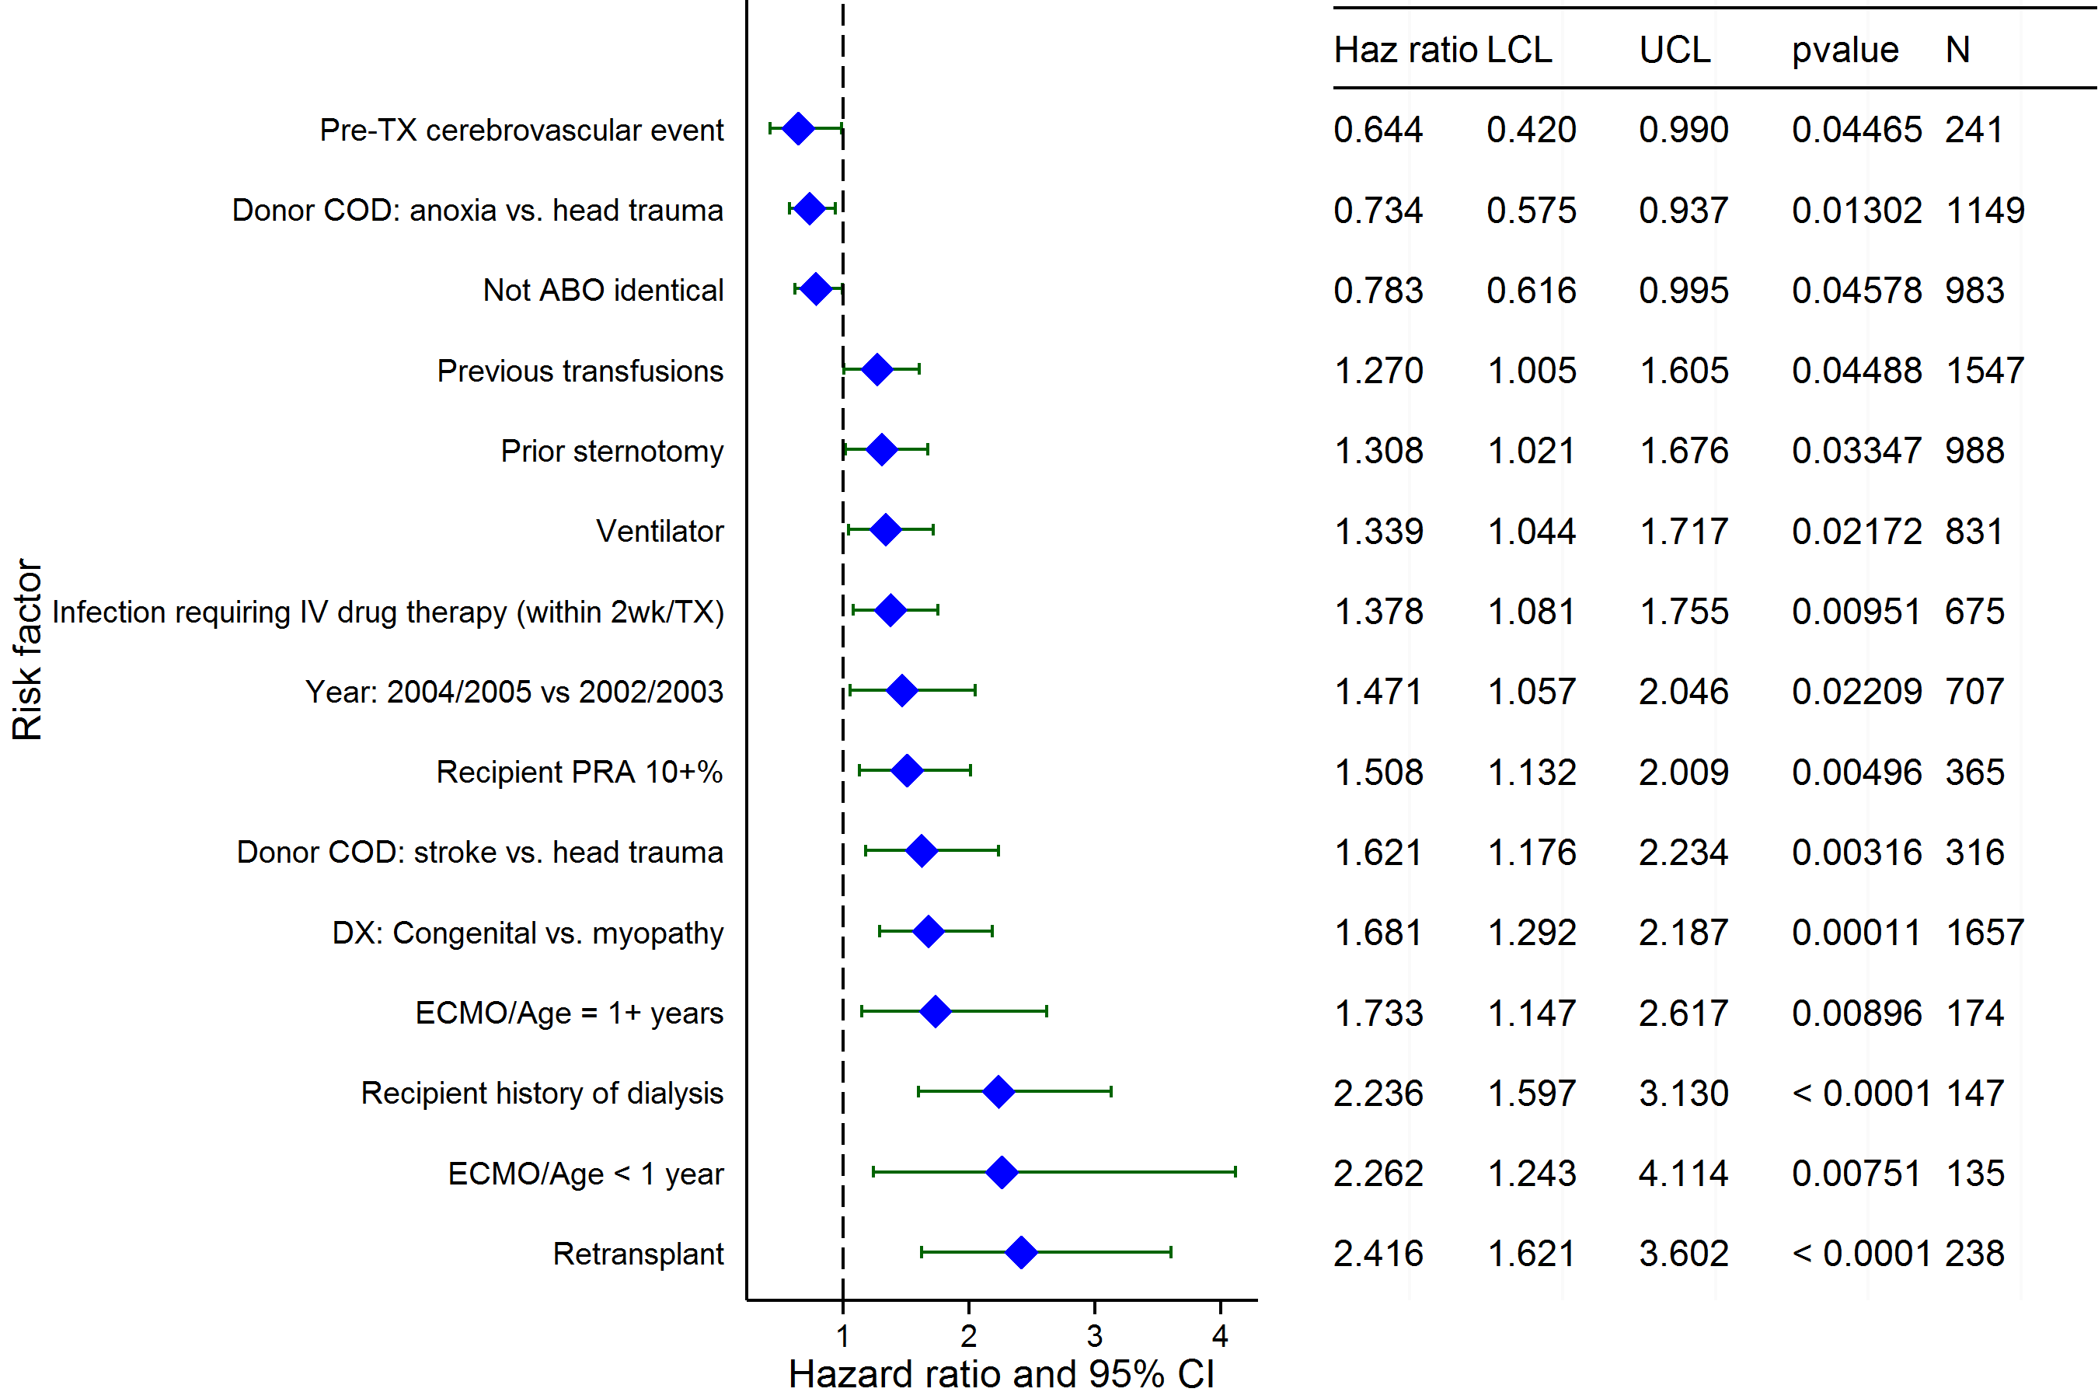
Pediatric Heart Transplants (2002-2012)
Risk Factors for 1 Year Mortality with 95% Confidence Limits
2015
(N = 4,158)
JHLT. 2015 Oct; 34(10): 1233-1243

Slide 108
Pediatric Heart Transplants (2002-2012)
Risk Factors for 1 Year Mortality
Continuous Factors (see figures)
Recipient Age | Donor Age
Recipient pre-transplant creatinine | Ischemia time
Recipient height | Donor/recip weight ratio
Center volume of pediatric transplants
2015
JHLT. 2015 Oct; 34(10): 1233-1243

Slide 109
Pediatric Heart Transplants (2002-2012)
Recipient Age
Risk Factors for 1 Year Mortality with 95% Confidence Limits
p = 0.0024
2015
(N = 4,158)
JHLT. 2015 Oct; 34(10): 1233-1243
Notes:
Multivariable analysis was performed using a proportional hazards model censoring all patients at 1 year. Continuous factors were fit using a restricted cubic spline.
Analyses were limited to transplants having essentially complete information regarding risk factors.

Slide 110
Pediatric Heart Transplants (2002-2012)
Donor Age
Risk Factors for 1 Year Mortality with 95% Confidence Limits
p = 0.0047
2015
(N = 4,158)
JHLT. 2015 Oct; 34(10): 1233-1243
Notes:
Multivariable analysis was performed using a proportional hazards model censoring all patients at 1 year. Continuous factors were fit using a restricted cubic spline.
Analyses were limited to transplants having essentially complete information regarding risk factors.

Slide 111
Pediatric Heart Transplants (2002-2012)
Recipient pre-transplant creatinine
Risk Factors for 1 Year Mortality with 95% Confidence Limits
p = 0.0148
2015
(N = 4,158)
JHLT. 2015 Oct; 34(10): 1233-1243
Notes:
Multivariable analysis was performed using a proportional hazards model censoring all patients at 1 year. Continuous factors were fit using a restricted cubic spline.
Analyses were limited to transplants having essentially complete information regarding risk factors.

Slide 112
Pediatric Heart Transplants (2002-2012)
Ischemia time
Risk Factors for 1 Year Mortality with 95% Confidence Limits
p < 0.0001
2015
(N = 4,158)
JHLT. 2015 Oct; 34(10): 1233-1243
Notes:
Multivariable analysis was performed using a proportional hazards model censoring all patients at 1 year. Continuous factors were fit using a restricted cubic spline.
Analyses were limited to transplants having essentially complete information regarding risk factors.

Slide 113
Pediatric Heart Transplants (2002-2012)
Recipient height
Risk Factors for 1 Year Mortality with 95% Confidence Limits
p < 0.0001
2015
(N = 4,158)
JHLT. 2015 Oct; 34(10): 1233-1243
Notes:
Multivariable analysis was performed using a proportional hazards model censoring all patients at 1 year. Continuous factors were fit using a restricted cubic spline.
Analyses were limited to transplants having essentially complete information regarding risk factors.

Slide 114
Pediatric Heart Transplants (2002-2012)
Donor/recip weight ratio
Risk Factors for 1 Year Mortality with 95% Confidence Limits
p = 0.0001
2015
(N = 4,158)
JHLT. 2015 Oct; 34(10): 1233-1243
Notes:
Multivariable analysis was performed using a proportional hazards model censoring all patients at 1 year. Continuous factors were fit using a restricted cubic spline.
Analyses were limited to transplants having essentially complete information regarding risk factors.

Slide 115
Pediatric Heart Transplants (2002-2012)
Center volume of pediatric transplants
Risk Factors for 1 Year Mortality with 95% Confidence Limits
p = 0.0119
2015
(N = 4,158)
JHLT. 2015 Oct; 34(10): 1233-1243
Notes:
Multivariable analysis was performed using a proportional hazards model censoring all patients at 1 year. Continuous factors were fit using a restricted cubic spline.
Analyses were limited to transplants having essentially complete information regarding risk factors.

Slide 116
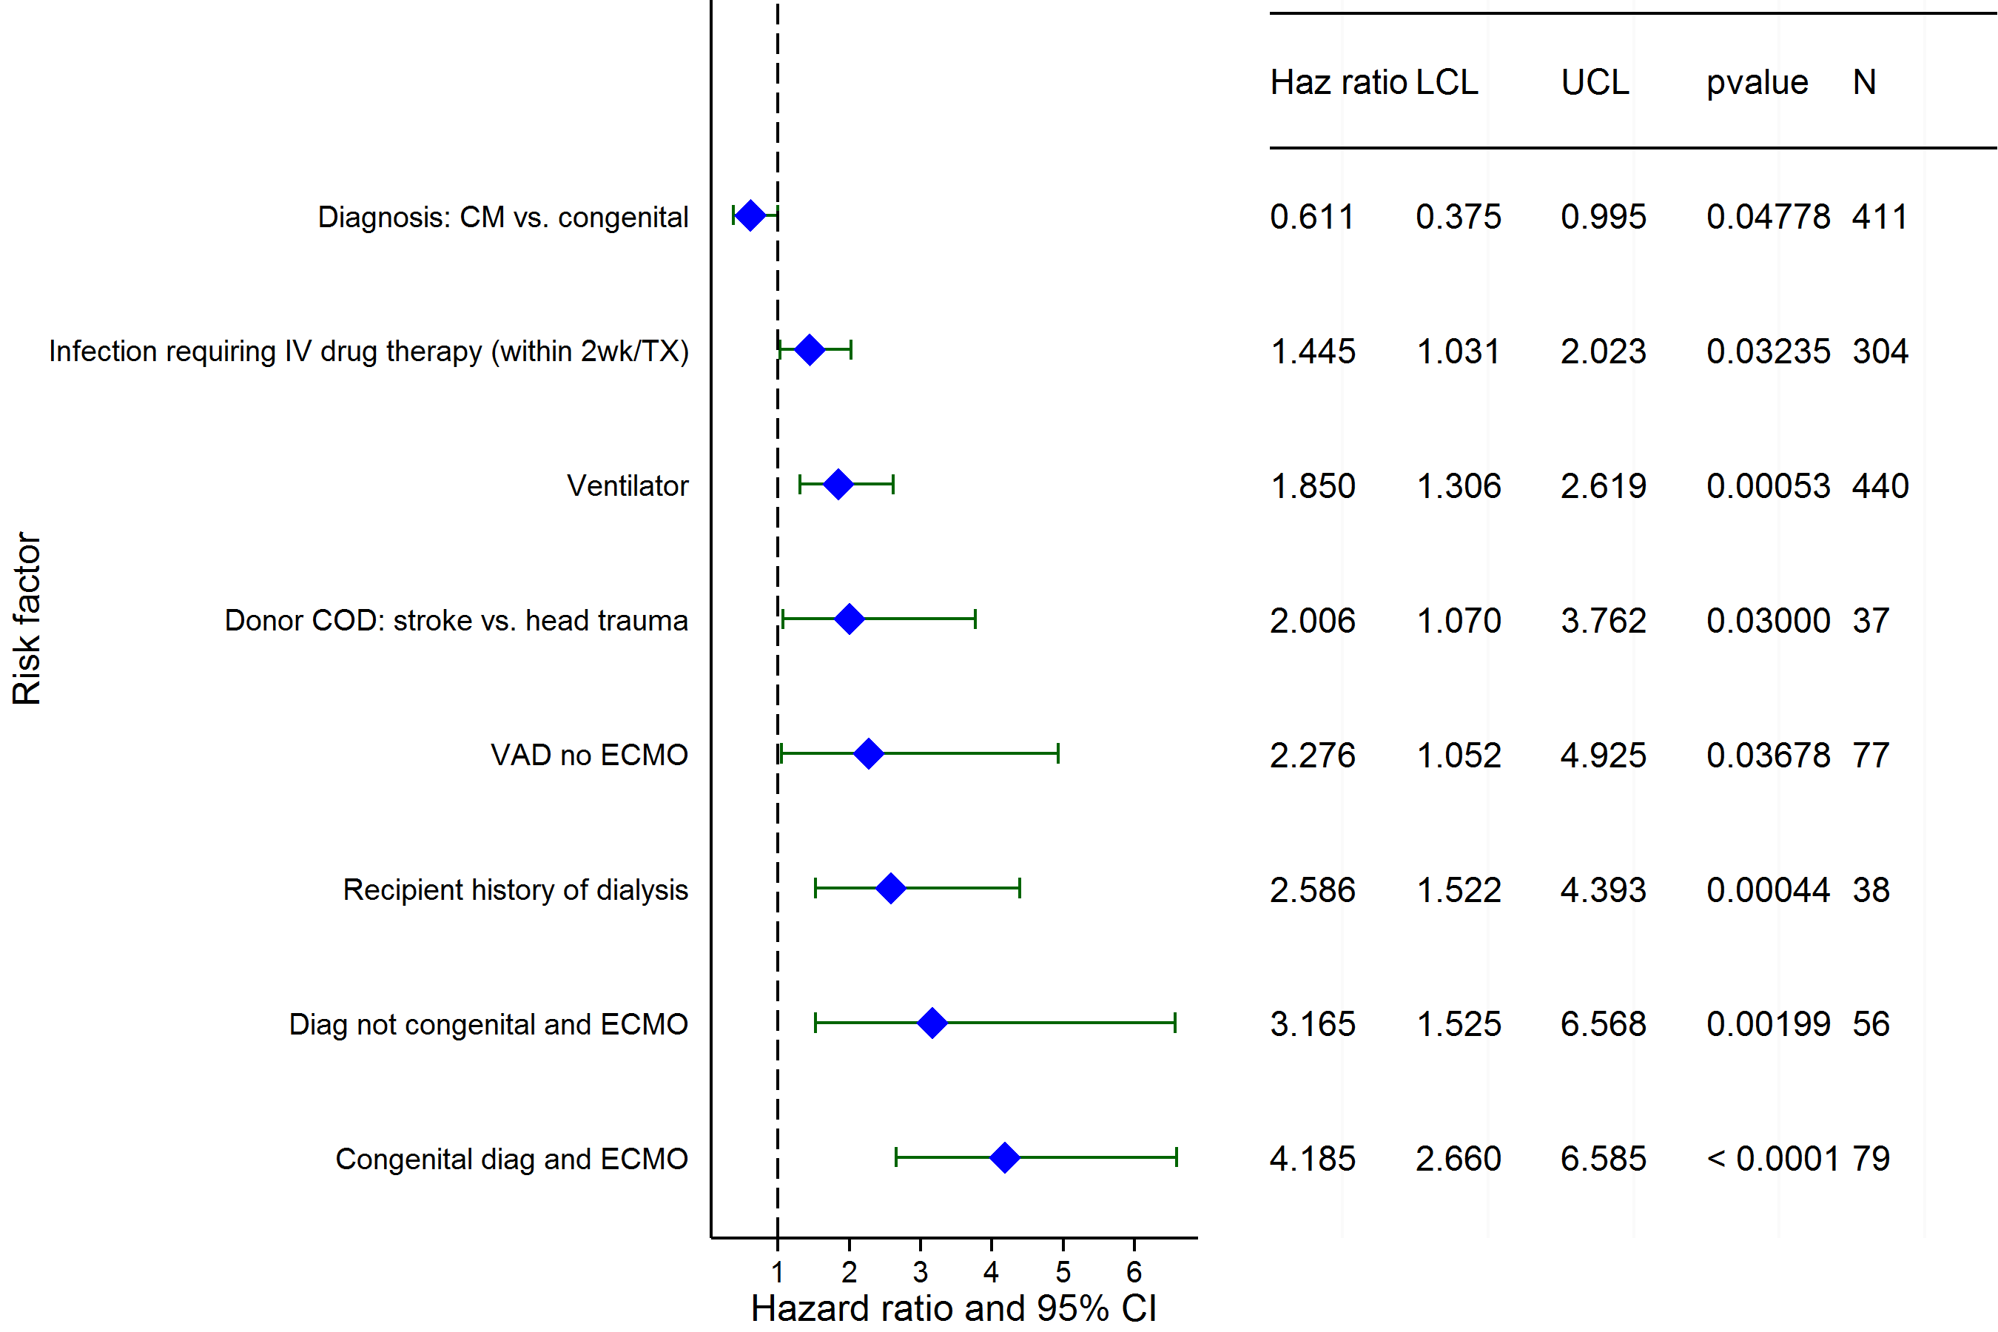
Pediatric Heart Transplants (2002-2012)
Age = <1 Year
Risk Factors for 1 Year Mortality with 95% Confidence Limits
2015
(N = 1,130)
JHLT. 2015 Oct; 34(10): 1233-1243

Slide 117
Pediatric Heart Transplants (2002-2012)
Age = <1 Year
Risk Factors for 1 Year Mortality
Continuous Factors (see figures)
Recipient Age | Recipient pre-transplant creatinine
Recipient BSA | Center volume of pediatric transplants
2015
JHLT. 2015 Oct; 34(10): 1233-1243

Slide 118
Pediatric Heart Transplants (2002-2012)
Recipient Age
Age = <1 Year
Risk Factors for 1 Year Mortality with 95% Confidence Limits
p = 0.0006
2015
(N = 1,130)
JHLT. 2015 Oct; 34(10): 1233-1243
Notes:
Multivariable analysis was performed using a proportional hazards model censoring all patients at 1 year. Continuous factors were fit using a restricted cubic spline.
Analyses were limited to transplants having essentially complete information regarding risk factors.

Slide 119
Pediatric Heart Transplants (2002-2012)
Recipient pre-transplant creatinine
Age = <1 Year
Risk Factors for 1 Year Mortality with 95% Confidence Limits
p < 0.0001
2015
(N = 1,130)
JHLT. 2015 Oct; 34(10): 1233-1243
Notes:
Multivariable analysis was performed using a proportional hazards model censoring all patients at 1 year. Continuous factors were fit using a restricted cubic spline.
Analyses were limited to transplants having essentially complete information regarding risk factors.

Slide 120
Pediatric Heart Transplants (2002-2012)
Recipient BSA
Age = <1 Year
Risk Factors for 1 Year Mortality with 95% Confidence Limits
p < 0.0001
2015
(N = 1,130)
JHLT. 2015 Oct; 34(10): 1233-1243
Notes:
Multivariable analysis was performed using a proportional hazards model censoring all patients at 5 years. Continuous factors were fit using a restricted cubic spline.
Analyses were limited to transplants having essentially complete information regarding risk factors.

Slide 121
Pediatric Heart Transplants (2002-2012)
Center volume of pediatric transplants
Age = <1 Year
Risk Factors for 1 Year Mortality with 95% Confidence Limits
p = 0.0004
2015
(N = 1,130)
JHLT. 2015 Oct; 34(10): 1233-1243
Notes:
Multivariable analysis was performed using a proportional hazards model censoring all patients at 1 year. Continuous factors were fit using a restricted cubic spline.
Analyses were limited to transplants having essentially complete information regarding risk factors.

Slide 122
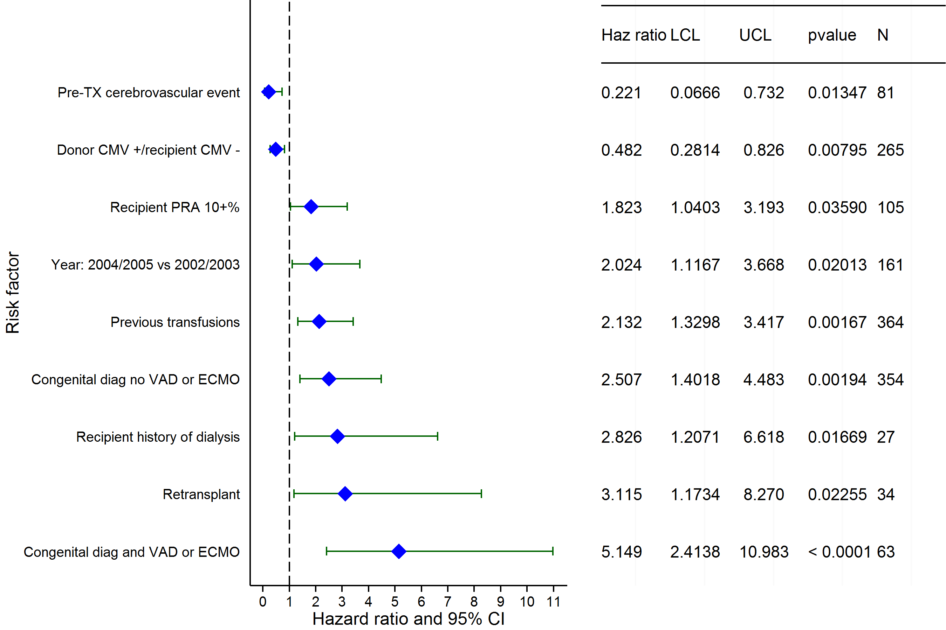
Pediatric Heart Transplants (2002-2012)
Age = 1-5 Years
Risk Factors for 1 Year Mortality with 95% Confidence Limits
2015
(N = 981)
JHLT. 2015 Oct; 34(10): 1233-1243

Slide 123
Pediatric Heart Transplants (2002-2012)
Age = 1-5 Years
Risk Factors for 1 Year Mortality
Continuous Factors (see figures)
Donor Age | Recipient pre-transplant creatinine
Recipient height | Donor BSA/recipient BSA
Ratio of pediatric transplant volume to total transplant volume | Center volume of pediatric transplants
Center volume of pediatric transplants
2015
JHLT. 2015 Oct; 34(10): 1233-1243

Slide 124
Pediatric Heart Transplants (2002-2012)
Donor Age
Age = 1-5 Years
Risk Factors for 1 Year Mortality with 95% Confidence Limits
p = 0.0010
2015
(N = 981)
JHLT. 2015 Oct; 34(10): 1233-1243
Notes:
Multivariable analysis was performed using a proportional hazards model censoring all patients at 1 year. Continuous factors were fit using a restricted cubic spline.
Analyses were limited to transplants having essentially complete information regarding risk factors.

Slide 125
Pediatric Heart Transplants (2002-2012)
Recipient pre-transplant creatinine
Age = 1-5 Years
Risk Factors for 1 Year Mortality with 95% Confidence Limits
p = 0.0078
2015
(N = 981)
JHLT. 2015 Oct; 34(10): 1233-1243
Notes:
Multivariable analysis was performed using a proportional hazards model censoring all patients at 1 year. Continuous factors were fit using a restricted cubic spline.
Analyses were limited to transplants having essentially complete information regarding risk factors.

Slide 126
Pediatric Heart Transplants (2002-2012)
Recipient height
Age = 1-5 Years
Risk Factors for 1 Year Mortality with 95% Confidence Limits
p = 0.0003
2015
(N = 981)
JHLT. 2015 Oct; 34(10): 1233-1243
Notes:
Multivariable analysis was performed using a proportional hazards model censoring all patients at 1 year. Continuous factors were fit using a restricted cubic spline.
Analyses were limited to transplants having essentially complete information regarding risk factors.

Slide 127
Pediatric Heart Transplants (2002-2012)
Donor BSA/recipient BSA
Age = 1-5 Years
Risk Factors for 1 Year Mortality with 95% Confidence Limits
p = 0.0018
2015
(N = 981)
JHLT. 2015 Oct; 34(10): 1233-1243
Notes:
Multivariable analysis was performed using a proportional hazards model censoring all patients at 1 year. Continuous factors were fit using a restricted cubic spline.
Analyses were limited to transplants having essentially complete information regarding risk factors.

Slide 128
Pediatric Heart Transplants (2002-2012)
Ratio of pediatric transplant volume to total transplant volume
Age = 1-5 Years
Risk Factors for 1 Year Mortality with 95% Confidence Limits
p = 0.0042
2015
(N = 981)
JHLT. 2015 Oct; 34(10): 1233-1243
Notes:
Multivariable analysis was performed using a proportional hazards model censoring all patients at 1 year. Continuous factors were fit using a restricted cubic spline.
Analyses were limited to transplants having essentially complete information regarding risk factors.

Slide 129
Pediatric Heart Transplants (2002-2012)
Center volume of pediatric transplants
Age = 1-5 Years
Risk Factors for 1 Year Mortality with 95% Confidence Limits
p = 0.0389
2015
(N = 981)
JHLT. 2015 Oct; 34(10): 1233-1243
Notes:
Multivariable analysis was performed using a proportional hazards model censoring all patients at 1 year. Continuous factors were fit using a restricted cubic spline.
Analyses were limited to transplants having essentially complete information regarding risk factors.

Slide 130
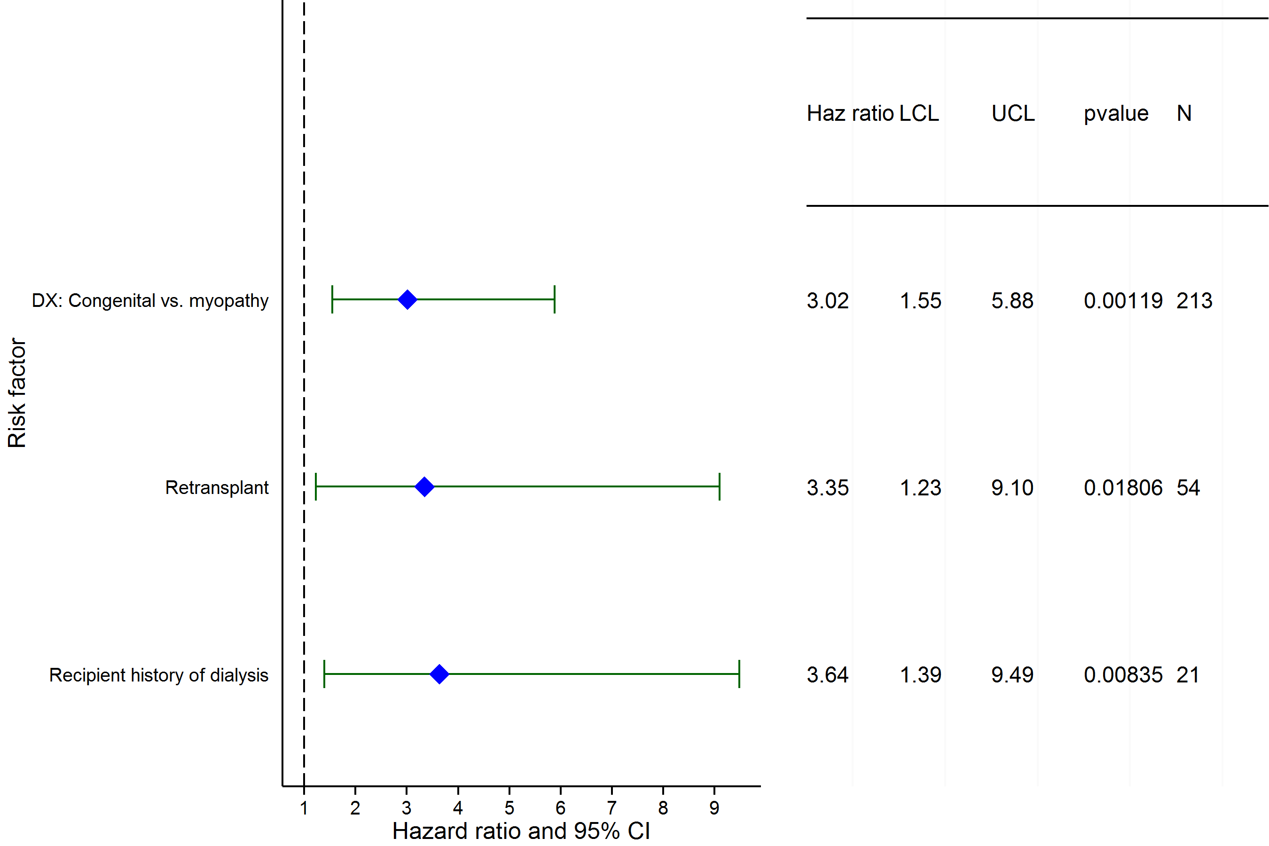
Pediatric Heart Transplants (2002-2012)
Age = 6-10 Years
Risk Factors for 1 Year Mortality with 95% Confidence Limits
2015
(N = 607)
JHLT. 2015 Oct; 34(10): 1233-1243

Slide 131
Pediatric Heart Transplants (2002-2012)
Age = 6-10 Years
Risk Factors for 1 Year Mortality
Continuous Factors (see figures)
Recipient pre-transplant bilirubin
2015
JHLT. 2015 Oct; 34(10): 1233-1243

Slide 132
Pediatric Heart Transplants (2002-2012)
Recipient pre-transplant bilirubin
Age = 6-10 Years
Risk Factors for 1 Year Mortality with 95% Confidence Limits
p = 0.0014
2015
(N = 607)
JHLT. 2015 Oct; 34(10): 1233-1243
Notes:
Multivariable analysis was performed using a proportional hazards model censoring all patients at 1 year. Continuous factors were fit using a restricted cubic spline.
Analyses were limited to transplants having essentially complete information regarding risk factors.

Slide 133
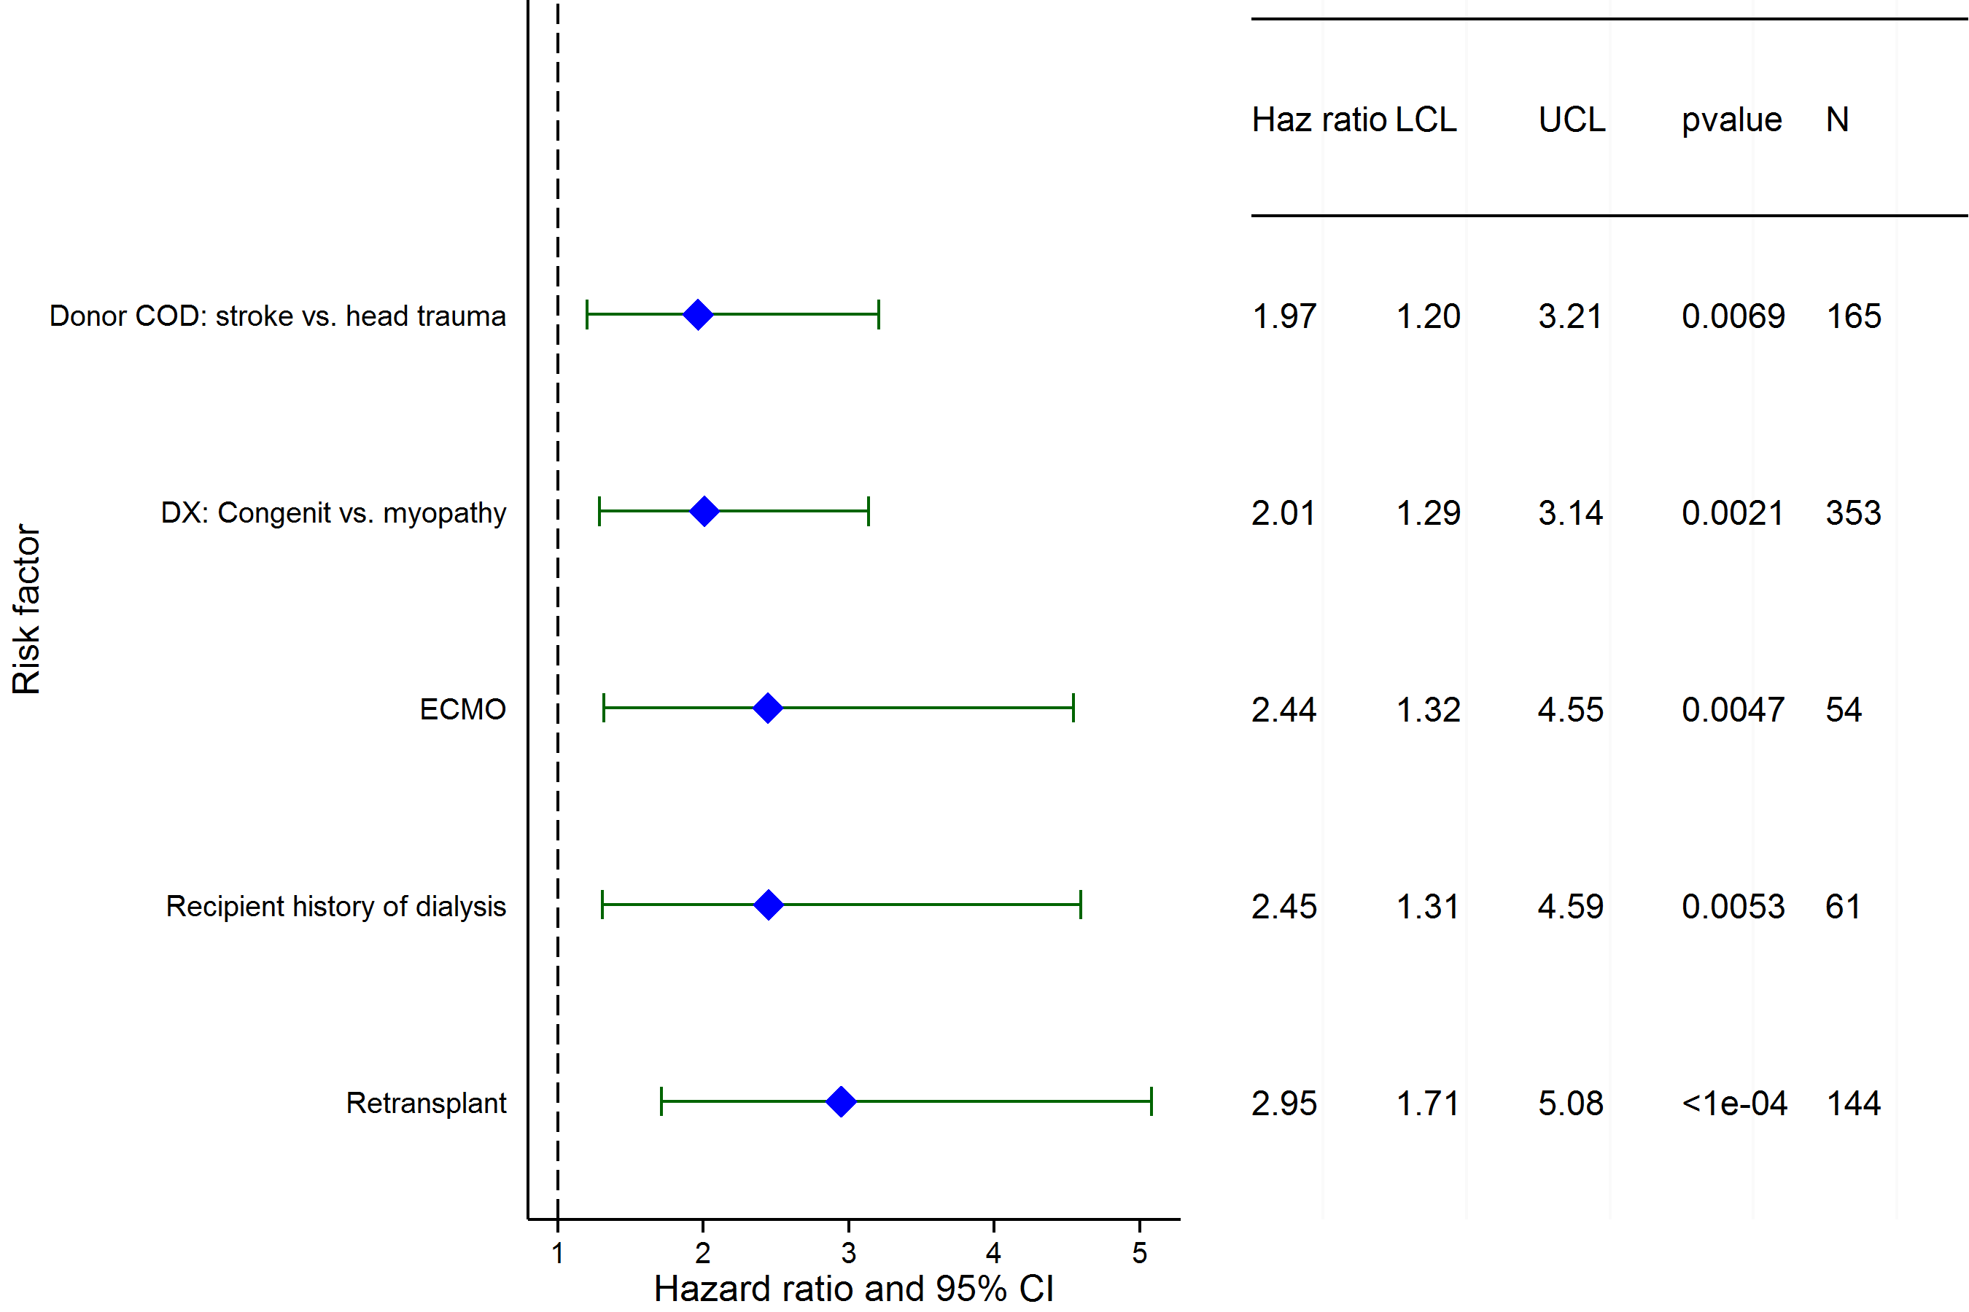
Pediatric Heart Transplants (2002-2012)
Age = 11-17 Years
Risk Factors for 1 Year Mortality with 95% Confidence Limits
2015
(N = 1,438)
JHLT. 2015 Oct; 34(10): 1233-1243

Slide 134
Pediatric Heart Transplants (2002-2012)
Age = 11-17 Years
Risk Factors for 1 Year Mortality
Continuous Factors (see figures)
Ischemia time | Ratio of pediatric transplant volume to total transplant volume
2015
JHLT. 2015 Oct; 34(10): 1233-1243

Slide 135
Pediatric Heart Transplants (2002-2012)
Ischemia time
Age = 11-17 Years
Risk Factors for 1 Year Mortality with 95% Confidence Limits
p = 0.0122
2015
(N = 1,438)
JHLT. 2015 Oct; 34(10): 1233-1243
Notes:
Multivariable analysis was performed using a proportional hazards model censoring all patients at 1 year. Continuous factors were fit using a restricted cubic spline.
Analyses were limited to transplants having essentially complete information regarding risk factors.

Slide 136
Pediatric Heart Transplants (2002-2012)
Ratio of pediatric transplant volume to total transplant volume
Age = 11-17 Years
Risk Factors for 1 Year Mortality with 95% Confidence Limits
p = 0.0234
2015
(N = 1,438)
JHLT. 2015 Oct; 34(10): 1233-1243
Notes:
Multivariable analysis was performed using a proportional hazards model censoring all patients at 1 year. Continuous factors were fit using a restricted cubic spline.
Analyses were limited to transplants having essentially complete information regarding risk factors.

Slide 137
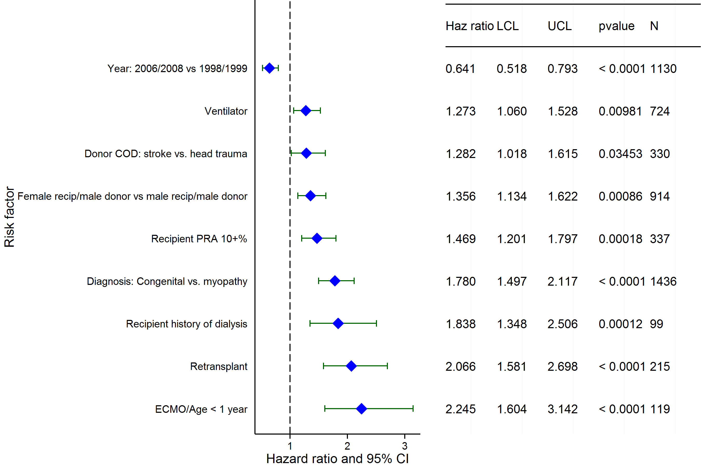
Pediatric Heart Transplants (1998-2008)
Risk Factors for 5 Year Mortality with 95% Confidence Limits
2015
(N = 3,598)
JHLT. 2015 Oct; 34(10): 1233-1243

Slide 138
Pediatric Heart Transplants (1998-2008)
Risk Factors for 5 Year Mortality
Continuous Factors (see figures)
Recipient Age | Donor Age
Ischemia time | Recipient BMI
2015
JHLT. 2015 Oct; 34(10): 1233-1243

Slide 139
Pediatric Heart Transplants (1998-2008)
Recipient Age
Risk Factors for 5 Year Mortality with 95% Confidence Limits
p < 0.0001
2015
(N = 3,598)
JHLT. 2015 Oct; 34(10): 1233-1243
Notes:
Multivariable analysis was performed using a proportional hazards model censoring all patients at 5 years. Continuous factors were fit using a restricted cubic spline.
Analyses were limited to transplants having essentially complete information regarding risk factors.

Slide 140
Pediatric Heart Transplants (1998-2008)
Donor Age
Risk Factors for 5 Year Mortality with 95% Confidence Limits
p = 0.0313
2015
(N = 3,598)
JHLT. 2015 Oct; 34(10): 1233-1243
Notes:
Multivariable analysis was performed using a proportional hazards model censoring all patients at 5 years. Continuous factors were fit using a restricted cubic spline.
Analyses were limited to transplants having essentially complete information regarding risk factors.

Slide 141
Pediatric Heart Transplants (1998-2008)
Ischemia time
Risk Factors for 5 Year Mortality with 95% Confidence Limits
p = 0.0198
2015
(N = 3,598)
JHLT. 2015 Oct; 34(10): 1233-1243
Notes:
Multivariable analysis was performed using a proportional hazards model censoring all patients at 5 years. Continuous factors were fit using a restricted cubic spline.
Analyses were limited to transplants having essentially complete information regarding risk factors.

Slide 142
Pediatric Heart Transplants (1998-2008)
Recipient BMI
Risk Factors for 5 Year Mortality with 95% Confidence Limits
p = 0.0079
2015
(N = 3,598)
JHLT. 2015 Oct; 34(10): 1233-1243
Notes:
Multivariable analysis was performed using a proportional hazards model censoring all patients at 5 years. Continuous factors were fit using a restricted cubic spline.
Analyses were limited to transplants having essentially complete information regarding risk factors.

Slide 143
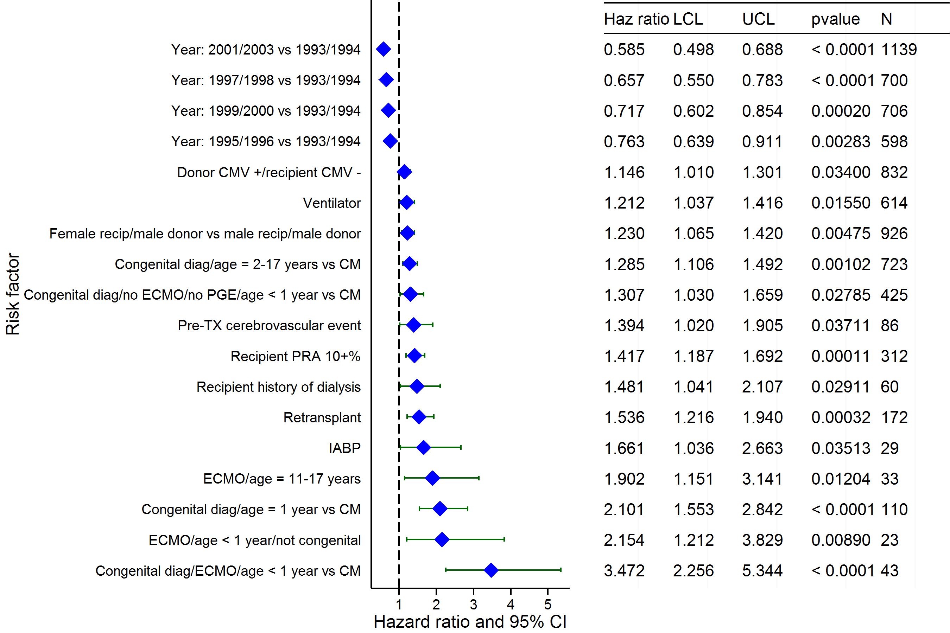
Pediatric Heart Transplants (1993-2003)
Risk Factors for 10 Year Mortality with 95% Confidence Limits
2015
(N = 3,767)
JHLT. 2015 Oct; 34(10): 1233-1243

Slide 144
Pediatric Heart Transplants (1993-2003)
Risk Factors for 10 Year Mortality
Continuous Factors (see figures)
Recipient Age | Recipient height
Recipient BMI | Ratio of pediatric transplant volume to total transplant volume
Estimated GFR
2015
JHLT. 2015 Oct; 34(10): 1233-1243

Slide 145
Pediatric Heart Transplants (1993-2003)
Recipient Age
Risk Factors for 10 Year Mortality with 95% Confidence Limits
p = 0.0115
2015
(N = 3,767)
JHLT. 2015 Oct; 34(10): 1233-1243
Notes:
Multivariable analysis was performed using a proportional hazards model censoring all patients at 10 years. Continuous factors were fit using a restricted cubic spline.
Analyses were limited to transplants having essentially complete information regarding risk factors.

Slide 146
Pediatric Heart Transplants (1993-2003)
Recipient height
Risk Factors for 10 Year Mortality with 95% Confidence Limits
p = 0.0380
2015
(N = 3,767)
JHLT. 2015 Oct; 34(10): 1233-1243
Notes:
Multivariable analysis was performed using a proportional hazards model censoring all patients at 10 years. Continuous factors were fit using a restricted cubic spline.
Analyses were limited to transplants having essentially complete information regarding risk factors.

Slide 147
Pediatric Heart Transplants (1993-2003)
Recipient BMI
Risk Factors for 10 Year Mortality with 95% Confidence Limits
p = 0.0035
2015
(N = 3,767)
JHLT. 2015 Oct; 34(10): 1233-1243
Notes:
Multivariable analysis was performed using a proportional hazards model censoring all patients at 10 years. Continuous factors were fit using a restricted cubic spline.
Analyses were limited to transplants having essentially complete information regarding risk factors.

Slide 148
Pediatric Heart Transplants (1993-2003)
Ratio of pediatric transplant volume to total transplant volume
Risk Factors for 10 Year Mortality with 95% Confidence Limits
p = 0.0008
2015
(N = 3,767)
JHLT. 2015 Oct; 34(10): 1233-1243
Notes:
Multivariable analysis was performed using a proportional hazards model censoring all patients at 10 years. Continuous factors were fit using a restricted cubic spline.
Analyses were limited to transplants having essentially complete information regarding risk factors.

Slide 149
Pediatric Heart Transplants (1993-2003)
Estimated GFR
Risk Factors for 10 Year Mortality with 95% Confidence Limits
p < 0.0001
2015
(N = 3,767)
JHLT. 2015 Oct; 34(10): 1233-1243
Notes:
Multivariable analysis was performed using a proportional hazards model censoring all patients at 10 years. Continuous factors were fit using a restricted cubic spline.
Analyses were limited to transplants having essentially complete information regarding risk factors.

Slide 150
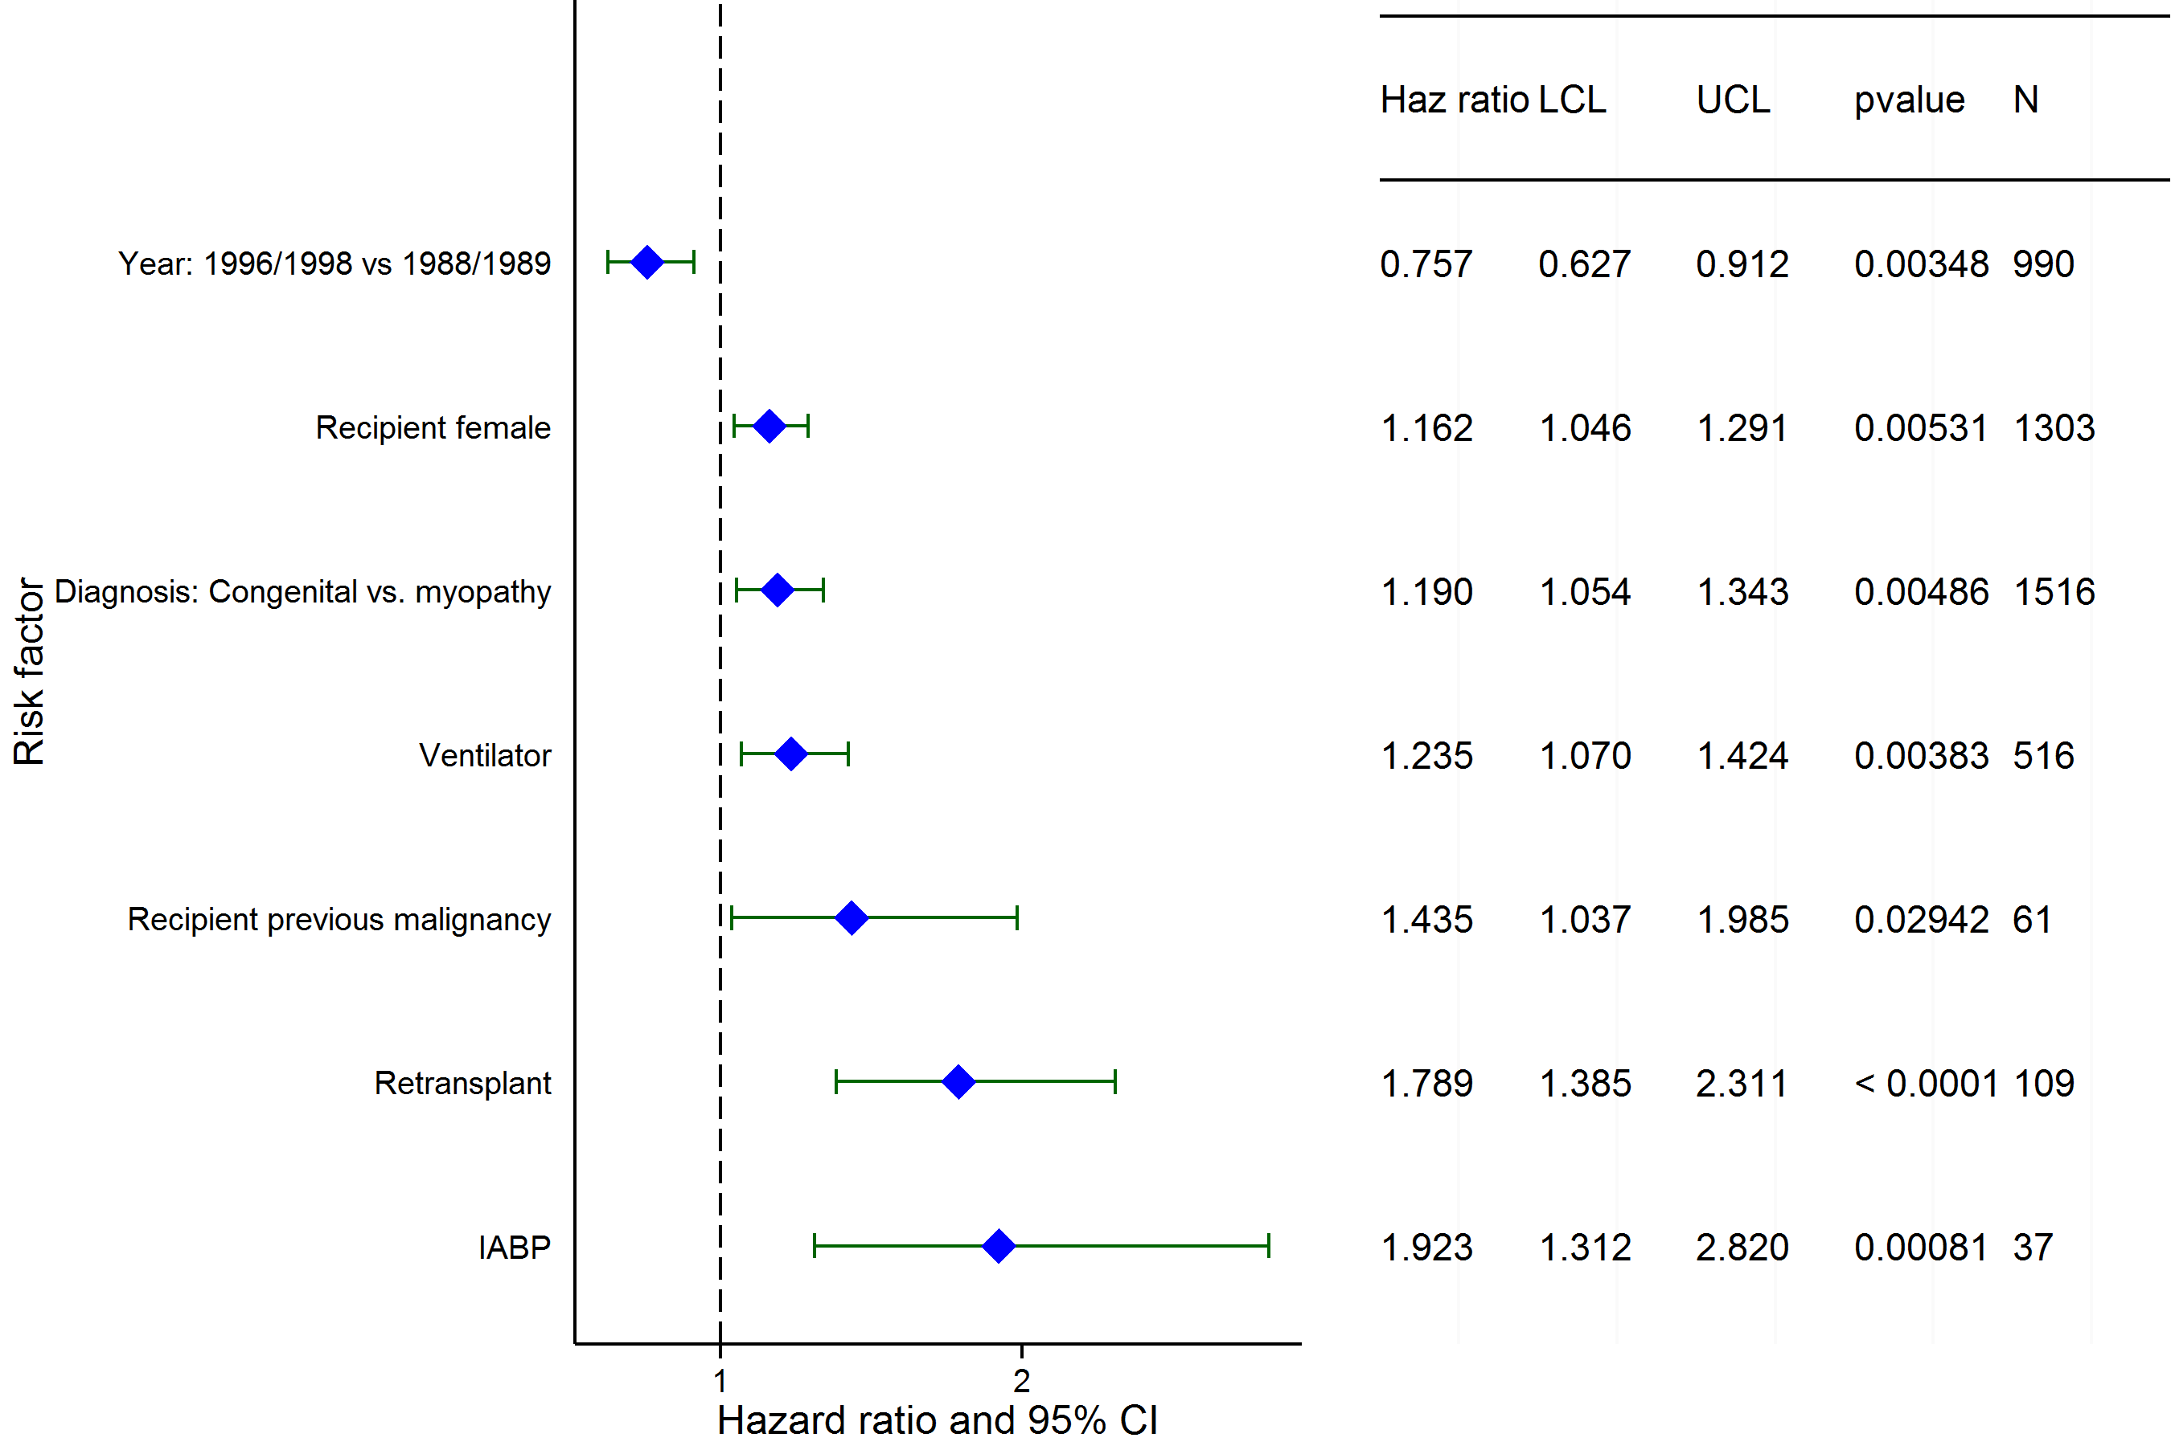
Pediatric Heart Transplants (1988-1998)
Risk Factors for 15 Year Mortality with 95% Confidence Limits
2015
(N = 3,079)
JHLT. 2015 Oct; 34(10): 1233-1243

Slide 151
Pediatric Heart Transplants (1988-1998)
Risk Factors for 15 Year Mortality
Continuous Factors (see figures)
Donor Age | Center volume of pediatric transplants
2015
JHLT. 2015 Oct; 34(10): 1233-1243

Slide 152
Pediatric Heart Transplants (1988-1998)
Donor Age
Risk Factors for 15 Year Mortality with 95% Confidence Limits
p = 0.0423
2015
(N = 3,079)
JHLT. 2015 Oct; 34(10): 1233-1243
Notes:
Multivariable analysis was performed using a proportional hazards model censoring all patients at 15 years. Continuous factors were fit using a restricted cubic spline.
Analyses were limited to transplants having essentially complete information regarding risk factors.

Slide 153
Pediatric Heart Transplants (1988-1998)
Center volume of pediatric transplants
Risk Factors for 15 Year Mortality with 95% Confidence Limits
p = 0.0016
2015
(N = 3,079)
JHLT. 2015 Oct; 34(10): 1233-1243
Notes:
Multivariable analysis was performed using a proportional hazards model censoring all patients at 15 years. Continuous factors were fit using a restricted cubic spline.
Analyses were limited to transplants having essentially complete information regarding risk factors.

Slide 154
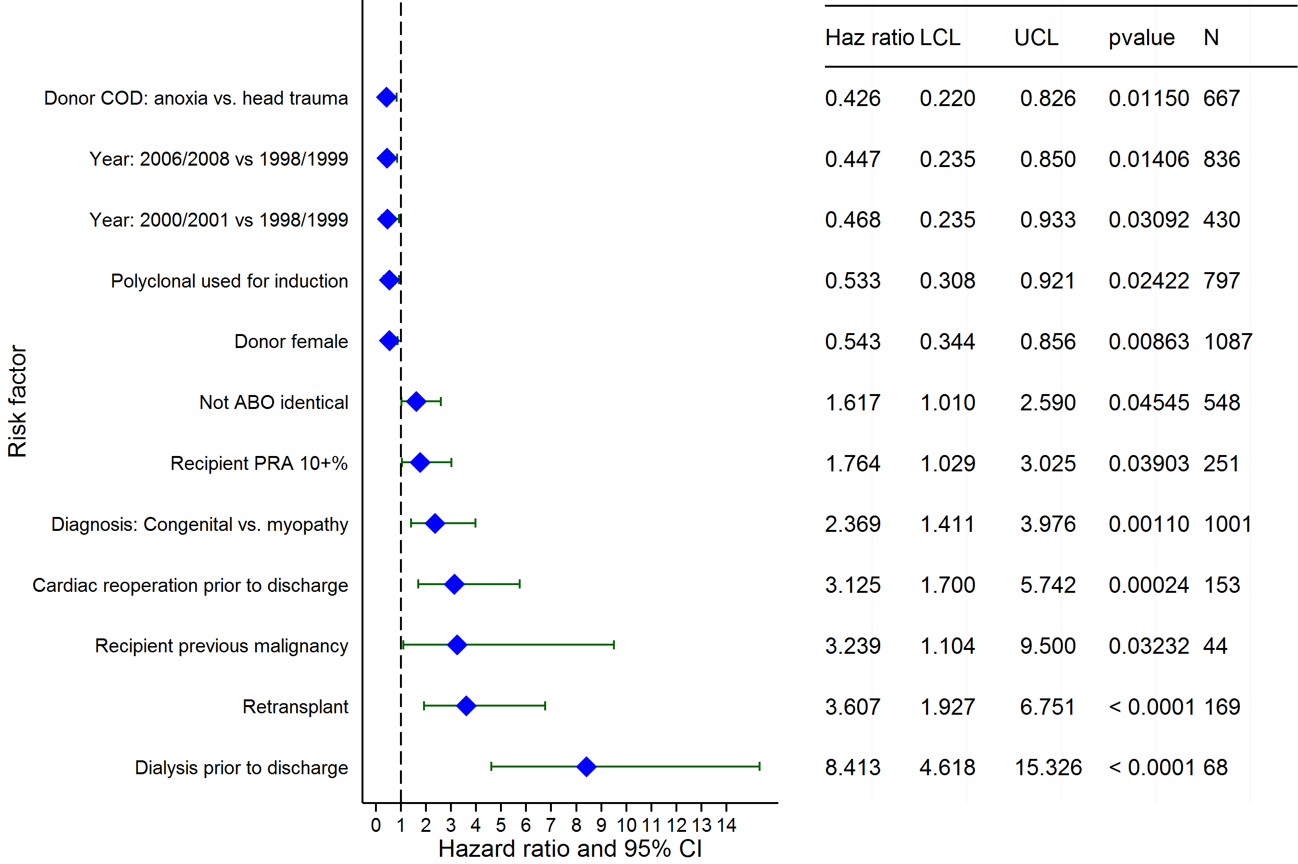
Pediatric Heart Transplants (1998-2008)
Risk Factors for Developing Severe Renal Dysfunction within 5 Years
Limited to Recipients without Severe Renal Dysfunction* Pre-Transplant
Conditional on Survival to Transplant Discharge
2015
(N = 2,562)
JHLT. 2015 Oct; 34(10): 1233-1243
*Severe renal dysfunction = creatinine > 2.5 mg/dl or dialysis

Slide 155
Pediatric Heart Transplants (1998-2008)
Risk Factors for Developing Severe Renal Dysfunction within 5 Years
Limited to Recipients without Severe Renal Dysfunction* Pre-Transplant
Conditional on Survival to Transplant Discharge
Continuous Factors (see figures)
Ischemia time | Donor weight
2015
JHLT. 2015 Oct; 34(10): 1233-1243
*Severe renal dysfunction = creatinine > 2.5 mg/dl or dialysis

Slide 156
Pediatric Heart Transplants (1998-2008)
Ischemia time
Risk Factors for Developing Severe Renal Dysfunction within 5 Years
Limited to Recipients without Severe Renal Dysfunction* Pre-Transplant
Conditional on Survival to Transplant Discharge
p = 0.0022
2015
(N = 2,562)
JHLT. 2015 Oct; 34(10): 1233-1243
*Severe renal dysfunction = creatinine > 2.5 mg/dl or dialysis
Notes:
Multivariable analysis was performed using a proportional hazards model censoring all patients at 5 years. Continuous factors were fit using a restricted cubic spline.
Analyses were limited to transplants having essentially complete information regarding risk factors.

Slide 157
Pediatric Heart Transplants (1998-2008)
Donor weight
Risk Factors for Developing Severe Renal Dysfunction within 5 Years
Limited to Recipients without Severe Renal Dysfunction* Pre-Transplant
Conditional on Survival to Transplant Discharge
p < 0.0001
2015
(N = 2,562)
JHLT. 2015 Oct; 34(10): 1233-1243
*Severe renal dysfunction = creatinine > 2.5 mg/dl or dialysis
Notes:
Multivariable analysis was performed using a proportional hazards model censoring all patients at 5 years. Continuous factors were fit using a restricted cubic spline.
Analyses were limited to transplants having essentially complete information regarding risk factors.

Slide 158
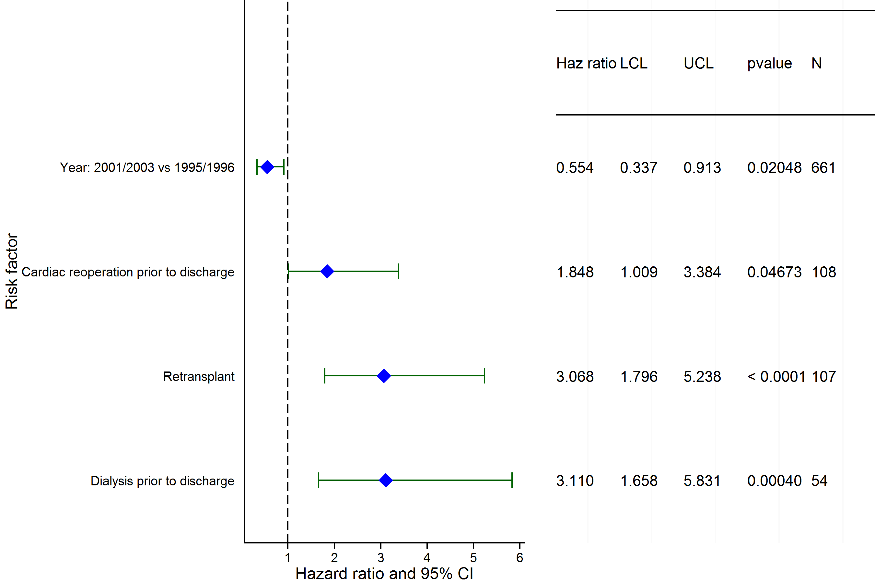
Pediatric Heart Transplants (1995-2003)
Risk Factors for Developing Severe Renal Dysfunction within 10 Years
Limited to Recipients without Severe Renal Dysfunction* Pre-Transplant
Conditional on Survival to Transplant Discharge
2015
(N = 1,787)
JHLT. 2015 Oct; 34(10): 1233-1243
*Severe renal dysfunction = creatinine > 2.5 mg/dl or dialysis

Slide 159
Pediatric Heart Transplants (1995-2003)
Risk Factors for Developing Severe Renal Dysfunction within 10 Years
Limited to Recipients without Severe Renal Dysfunction* Pre-Transplant
Conditional on Survival to Transplant Discharge
Continuous Factors (see figures)
Transplant program volume (pediatric and adult) | Recipient BSA
Ratio of pediatric transplant volume to total transplant volume
2015
JHLT. 2015 Oct; 34(10): 1233-1243
*Severe renal dysfunction = creatinine > 2.5 mg/dl or dialysis

Slide 160
Pediatric Heart Transplants (1995-2003)
Risk Factors for Developing Severe Renal Dysfunction within 10 Years
Limited to Recipients without Severe Renal Dysfunction* Pre-Transplant
Recipient BSA
Conditional on Survival to Transplant Discharge
p < 0.0001
2015
(N = 1,787)
JHLT. 2015 Oct; 34(10): 1233-1243
*Severe renal dysfunction = creatinine > 2.5 mg/dl or dialysis
Notes:
Multivariable analysis was performed using a proportional hazards model censoring all patients at 5 years. Continuous factors were fit using a restricted cubic spline.
Analyses were limited to transplants having essentially complete information regarding risk factors.

Slide 161
Pediatric Heart Transplants (1995-2003)
Conditional on Survival to Transplant Discharge
Transplant program volume (pediatric and adult)
Risk Factors for Developing Severe Renal Dysfunction within 10 Years
Limited to Recipients without Severe Renal Dysfunction* Pre-Transplant
p = 0.0204
2015
(N = 1,787)
JHLT. 2015 Oct; 34(10): 1233-1243
*Severe renal dysfunction = creatinine > 2.5 mg/dl or dialysis
Notes:
Multivariable analysis was performed using a proportional hazards model censoring all patients at 5 years. Continuous factors were fit using a restricted cubic spline.
Analyses were limited to transplants having essentially complete information regarding risk factors.

Slide 162
Pediatric Heart Transplants (1995-2003)
Risk Factors for Developing Severe Renal Dysfunction within 10 Years
Limited to Recipients without Severe Renal Dysfunction* Pre-Transplant
Ratio of pediatric transplant volume to total transplant volume
Conditional on Survival to Transplant Discharge
p = 0.0002
2015
(N = 1,787)
JHLT. 2015 Oct; 34(10): 1233-1243
*Severe renal dysfunction = creatinine > 2.5 mg/dl or dialysis
Notes:
Multivariable analysis was performed using a proportional hazards model censoring all patients at 5 years. Continuous factors were fit using a restricted cubic spline.
Analyses were limited to transplants having essentially complete information regarding risk factors.

Slide 163
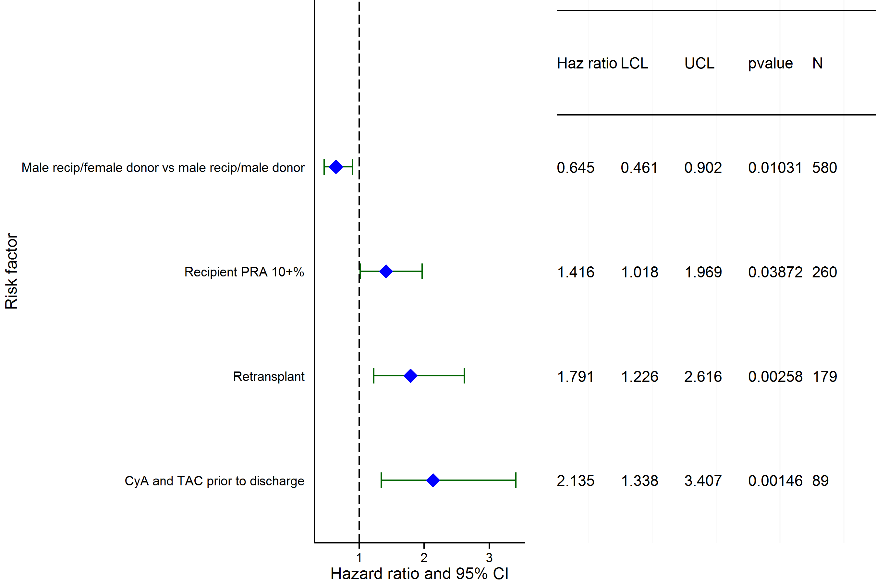
Pediatric Heart Transplants (1998-2008)
Conditional on Survival to Transplant Discharge
Risk Factors for Developing CAV within 5 Years
2015
(N = 2,547)
JHLT. 2015 Oct; 34(10): 1233-1243

Slide 164
Pediatric Heart Transplants (1998-2008)
Conditional on Survival to Transplant Discharge
Risk Factors for Developing CAV within 5 Years
Continuous Factors (see figures)
Donor Age | Transplant program volume (pediatric and adult)
2015
JHLT. 2015 Oct; 34(10): 1233-1243

Slide 165
Pediatric Heart Transplants (1998-2008)
Donor Age
Conditional on Survival to Transplant Discharge
Risk Factors for Developing CAV within 5 Years
p < 0.0001
2015
(N = 2,547)
JHLT. 2015 Oct; 34(10): 1233-1243
Notes:
Multivariable analysis was performed using a proportional hazards model censoring all patients at 5 years. Continuous factors were fit using a restricted cubic spline.
Analyses were limited to transplants having essentially complete information regarding risk factors.

Slide 166
Pediatric Heart Transplants (1998-2008)
Transplant program volume (pediatric and adult)
Conditional on Survival to Transplant Discharge
Risk Factors for Developing CAV within 5 Years
p = 0.0129
2015
(N = 2,547)
JHLT. 2015 Oct; 34(10): 1233-1243
Notes:
Multivariable analysis was performed using a proportional hazards model censoring all patients at 5 years. Continuous factors were fit using a restricted cubic spline.
Analyses were limited to transplants having essentially complete information regarding risk factors.

Slide 167
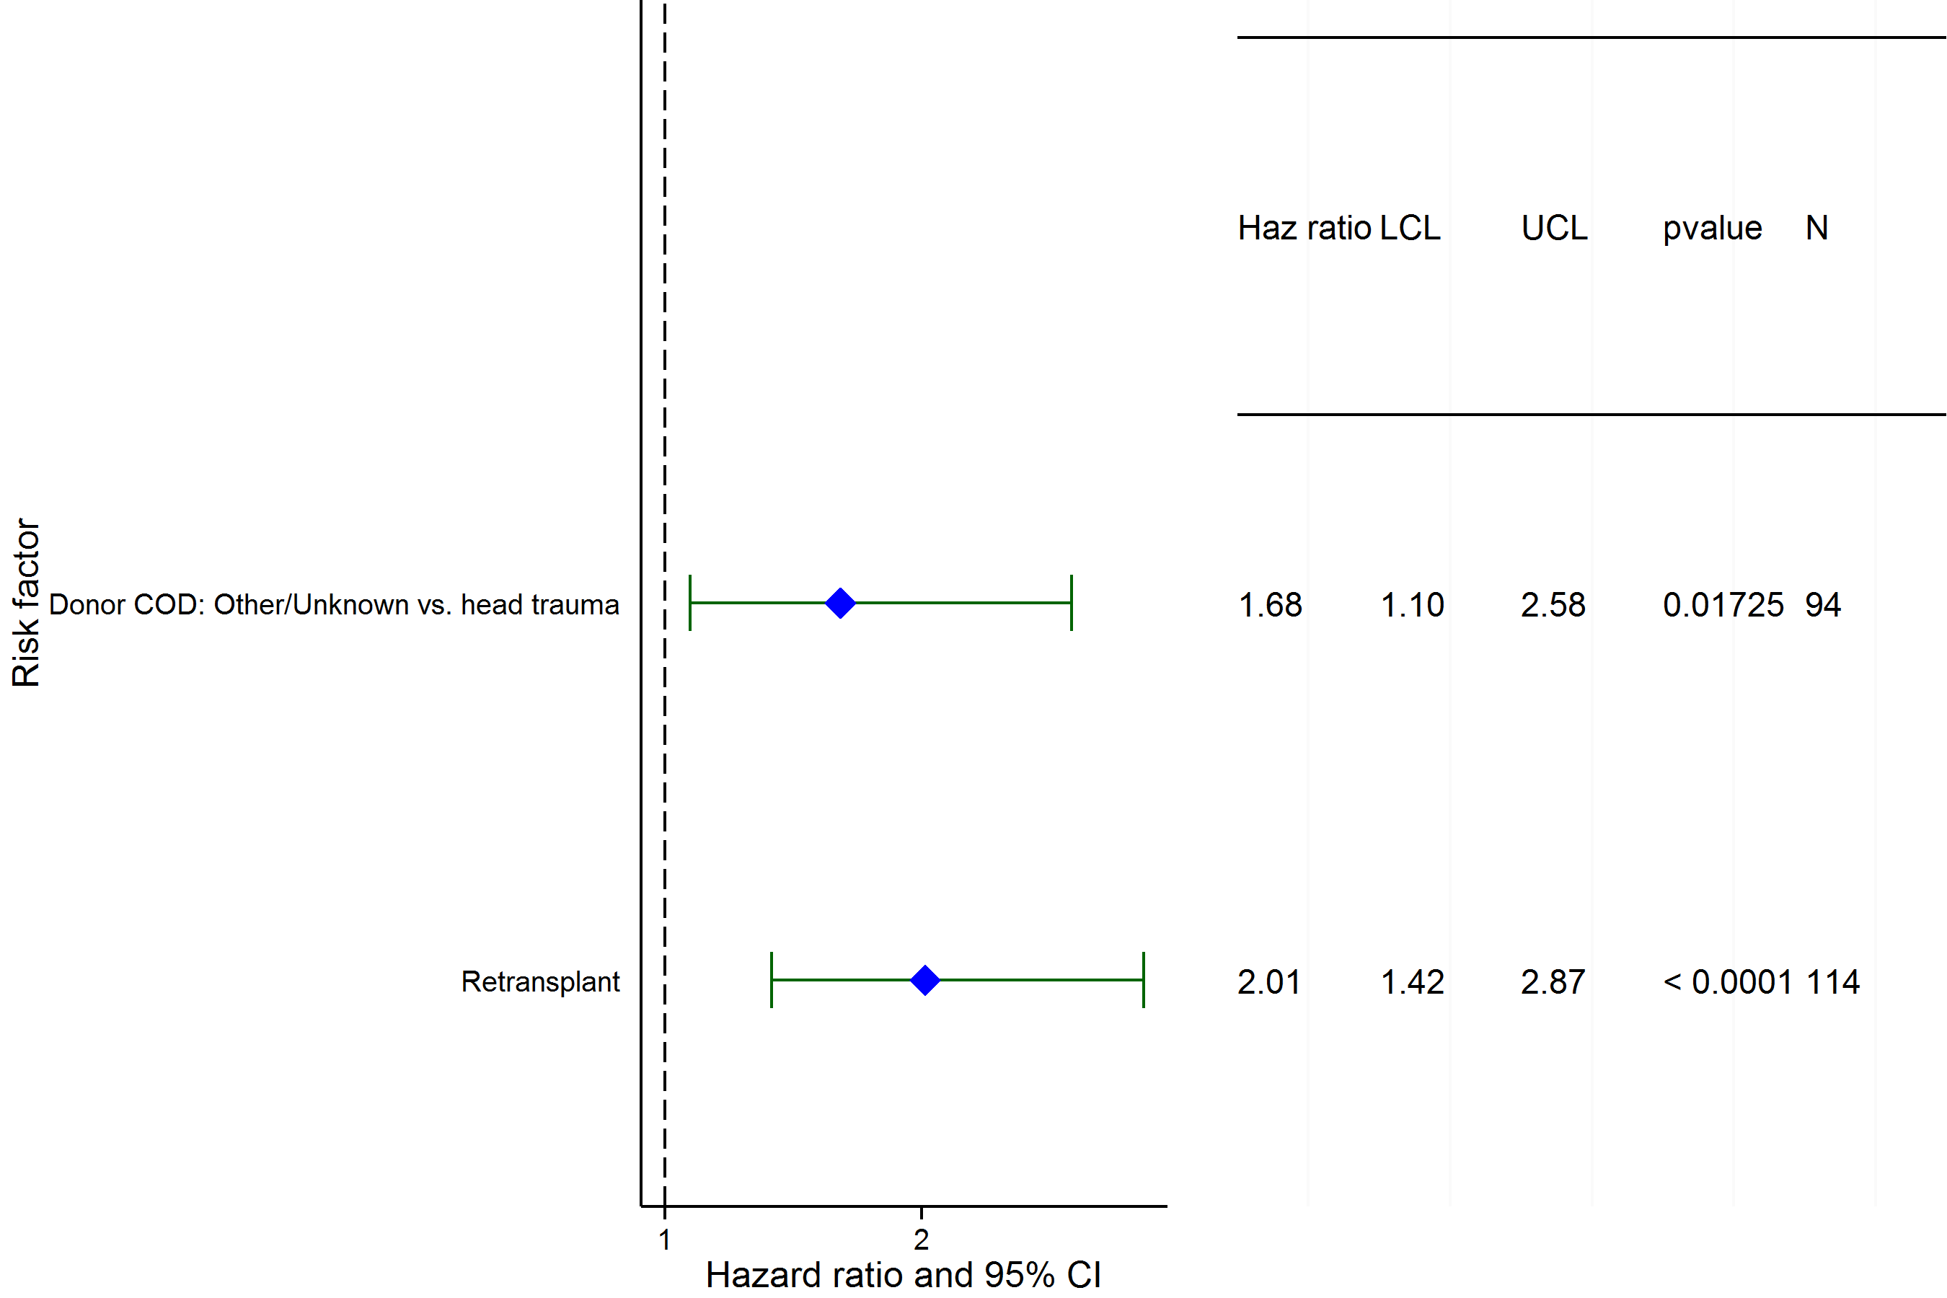
Pediatric Heart Transplants (1993-2003)
Conditional on Survival to Transplant Discharge
Risk Factors for Developing CAV within 10 Years
2015
(N = 1,731)
JHLT. 2015 Oct; 34(10): 1233-1243

Slide 168
Pediatric Heart Transplants (1993-2003)
Conditional on Survival to Transplant Discharge
Risk Factors for Developing CAV within 10 Years
Continuous Factors (see figures)
Recipient weight | Total program volume (pediatric and adult)
2015
JHLT. 2015 Oct; 34(10): 1233-1243

Slide 169
Pediatric Heart Transplants (1993-2003)
Recipient weight
Conditional on Survival to Transplant Discharge
Risk Factors for Developing CAV within 10 Years
p < 0.0001
2015
(N = 1,731)
JHLT. 2015 Oct; 34(10): 1233-1243
Notes:
Multivariable analysis was performed using a proportional hazards model censoring all patients at 10 years. Continuous factors were fit using a restricted cubic spline.
Analyses were limited to transplants having essentially complete information regarding risk factors.

Slide 170
Pediatric Heart Transplants (1993-2003)
Total program volume (pediatric and adult)
Conditional on Survival to Transplant Discharge
Risk Factors for Developing CAV within 10 Years
p = 0.0430
2015
(N = 1,731)
JHLT. 2015 Oct; 34(10): 1233-1243
Notes:
Multivariable analysis was performed using a proportional hazards model censoring all patients at 10 years. Continuous factors were fit using a restricted cubic spline.
Analyses were limited to transplants having essentially complete information regarding risk factors.

Slide 171
Early Graft Failure (EGF)
2015
JHLT. 2015 Oct; 34(10): 1233-1243

Slide 172
Pediatric Heart Transplants
Cumulative Incidence of EGF by Transplant Type
(Transplants: January 2005 – December 2013)
p = 0.2346
2015
JHLT. 2015 Oct; 34(10): 1233-1243
JHLT. 2014 Oct; 33(10): 1009-1024
Notes:
Only transplants with known EGF status are included in the tabulation. Incidence was computed using a competing-risks extension of the Kaplan-Meier method.

Slide 173
Pediatric Heart Transplants
% with EGF by EGF Type and Year for Primary Transplants
2015
JHLT. 2015 Oct; 34(10): 1233-1243
JHLT. 2014 Oct; 33(10): 1009-1024
Notes:
Only transplants with known EGF status are included in the tabulation. Percentage with EGF was computed using a competing-risks extension of the Kaplan-Meier method.

Slide 174
Pediatric Heart Transplants
Cumulative Incidence of EGF by Era
(Transplants: January 2005 – December 2013)
2015
JHLT. 2015 Oct; 34(10): 1233-1243
JHLT. 2014 Oct; 33(10): 1009-1024
Notes:
Only transplants with known EGF status are included in the tabulation. Incidence was computed using a competing-risks extension of the Kaplan-Meier method.

Slide 175
Pediatric Heart Transplants
Cumulative Incidence of EGF by Diagnosis
(Primary Transplants: January 2005 – December 2013)
2015
JHLT. 2015 Oct; 34(10): 1233-1243
JHLT. 2014 Oct; 33(10): 1009-1024
Notes:
Only transplants with known EGF status are included in the tabulation. Incidence was computed using a competing-risks extension of the Kaplan-Meier method.

Slide 176
Pediatric Heart Transplants
Cumulative Incidence of EGF by Diagnosis and Era
(Primary Transplants: January 2005 – December 2013)
2015
JHLT. 2015 Oct; 34(10): 1233-1243
JHLT. 2014 Oct; 33(10): 1009-1024
Notes:
Only transplants with known EGF status are included in the tabulation. Incidence was computed using a competing-risks extension of the Kaplan-Meier method.

Slide 177
Pediatric Heart Transplants
% with EGF by EGF Type and Age Group
(Primary Transplants: January 2005 – December 2013)
No pair-wise comparisons of % with EGF were significant at p < 0.05.
2015
JHLT. 2015 Oct; 34(10): 1233-1243
JHLT. 2014 Oct; 33(10): 1009-1024
Notes:
Only transplants with known EGF status are included in the tabulation. Percentage with EGF was computed using a competing-risks extension of the Kaplan-Meier method.
Comparisons were made using the chi-square statistic. Adjustments for multiple comparisons were done using Bonferroni method.

Slide 178
Pediatric Heart Transplants
% with EGF by EGF Type, Gender and Diagnosis
(Primary Transplants: January 2005 – December 2013)
Congenital
Cardiomyopathy
2015
JHLT. 2015 Oct; 34(10): 1233-1243
JHLT. 2014 Oct; 33(10): 1009-1024
Notes:
Only transplants with known EGF status are included in the tabulation. Percentage with EGF was computed using a competing-risks extension of the Kaplan-Meier method.
Comparisons were made using the chi-square statistic. Adjustments for multiple comparisons were done using Bonferroni method.

Slide 179
Pediatric Heart Transplants
Cumulative Incidence of EGF by Donor Gender
(Primary Transplants: January 2005 – December 2013)
p = 0.1922
2015
JHLT. 2015 Oct; 34(10): 1233-1243
JHLT. 2014 Oct; 33(10): 1009-1024
Notes:
Only transplants with known EGF status are included in the tabulation. Incidence was computed using a competing-risks extension of the Kaplan-Meier method.

Slide 180
Pediatric Heart Transplants
Cumulative Incidence of EGF by Donor Age Group
(Transplants: January 2005 – December 2013)
No pair-wise comparisons were significant at p < 0.05 except <1 vs. 1-10, <1 vs. 11-17 and 11-17 vs. 35-49.
2015
JHLT. 2015 Oct; 34(10): 1233-1243
JHLT. 2014 Oct; 33(10): 1009-1024
Notes:
Only transplants with known EGF status are included in the tabulation. Incidence was computed using a competing-risks extension of the Kaplan-Meier method.

Slide 181
Pediatric Heart Transplants
Cumulative Incidence of EGF by Mechanical Circulatory Support* (Transplants: January 2005 – December 2013)
* LVAD, RVAD, TAH, ECMO
Transplant recipients with not reported MSC status (N=1,393) and those with ECMO + VAD reported (N=44) were excluded.
2015
JHLT. 2015 Oct; 34(10): 1233-1243
JHLT. 2014 Oct; 33(10): 1009-1024
Notes:
Only transplants with known EGF status are included in the tabulation. Incidence was computed using a competing-risks extension of the Kaplan-Meier method.

Slide 182
Pediatric Heart Transplants
% with EGF by Location and Era for Primary Transplants
Europe
North America
Other
2015
JHLT. 2015 Oct; 34(10): 1233-1243
JHLT. 2014 Oct; 33(10): 1009-1024
Notes:
Only transplants with known EGF status are included in the tabulation. Percentage with EGF was computed using a competing-risks extension of the Kaplan-Meier method.
Comparisons were made using the chi-square statistic or Fisher's exact test. Adjustments for multiple comparisons were done using Bonferroni method.

Slide 183
Pediatric Heart Transplants
% with EGF and non-EGF Early Failures by Location and Era for Primary Transplants
No pair-wise comparisons of % with EGF and % with non-EGF early failures between eras within each location and between locations within each era were significant at p < 0.05.
Europe
North America
Other
2015
* non-EGF early failures include non-EGF retransplants and deaths within 30 days
JHLT. 2015 Oct; 34(10): 1233-1243
JHLT. 2014 Oct; 33(10): 1009-1024
Notes:
Only transplants with known EGF status are included in the tabulation. Percentage with EGF was computed using a competing-risks extension of the Kaplan-Meier method.
Comparisons were made using the chi-square statistic or Fisher's exact test. Adjustments for multiple comparisons were done using Bonferroni method.

Slide 184
Pediatric Heart Transplants
% with EGF by EGF Type and Center Volume
(Primary Transplants: January 2005 – December 2013)
2015
JHLT. 2015 Oct; 34(10): 1233-1243
JHLT. 2014 Oct; 33(10): 1009-1024
Notes:
Only transplants with known EGF status are included in the tabulation. Percentage with EGF was computed using a competing-risks extension of the Kaplan-Meier method.
Comparisons were made using the chi-square statistic. Adjustments for multiple comparisons were done using Bonferroni method.

Slide 185
Pediatric Heart Transplants
% with EGF by EGF Type and PRA
(Primary Transplants: January 2005 – December 2013)
2015
If Class I and Class II values were reported separately, the higher of the two values was used.
JHLT. 2015 Oct; 34(10): 1233-1243
JHLT. 2014 Oct; 33(10): 1009-1024
Notes:
Only transplants with known EGF status are included in the tabulation. Percentage with EGF was computed using a competing-risks extension of the Kaplan-Meier method.
Comparisons were made using the chi-square statistic or Fisher's exact test. Adjustments for multiple comparisons were done using Bonferroni method.

Slide 186
Pediatric Heart Transplants
Cumulative Incidence of EGF by Ischemic Time
(Transplants: January 2005 – December 2013)
2015
JHLT. 2015 Oct; 34(10): 1233-1243
JHLT. 2014 Oct; 33(10): 1009-1024
Notes:
Only transplants with known EGF status are included in the tabulation. Incidence was computed using a competing-risks extension of the Kaplan-Meier method.

Slide 187
Pediatric Heart Transplants
Cumulative Incidence of EGF by Donor/Recipient BMI Ratio
(Transplants: January 2005 – December 2013)
2015
JHLT. 2015 Oct; 34(10): 1233-1243
JHLT. 2014 Oct; 33(10): 1009-1024
Notes:
Only transplants with known EGF status are included in the tabulation. Incidence was computed using a competing-risks extension of the Kaplan-Meier method.

Slide 188
Pediatric Heart Transplants
Cumulative Incidence of EGF by Donor Cause of Death
(Transplants: January 2005 – December 2013)
2015
JHLT. 2015 Oct; 34(10): 1233-1243
JHLT. 2014 Oct; 33(10): 1009-1024
Notes:
Only transplants with known EGF status are included in the tabulation. Incidence was computed using a competing-risks extension of the Kaplan-Meier method.

Slide 189
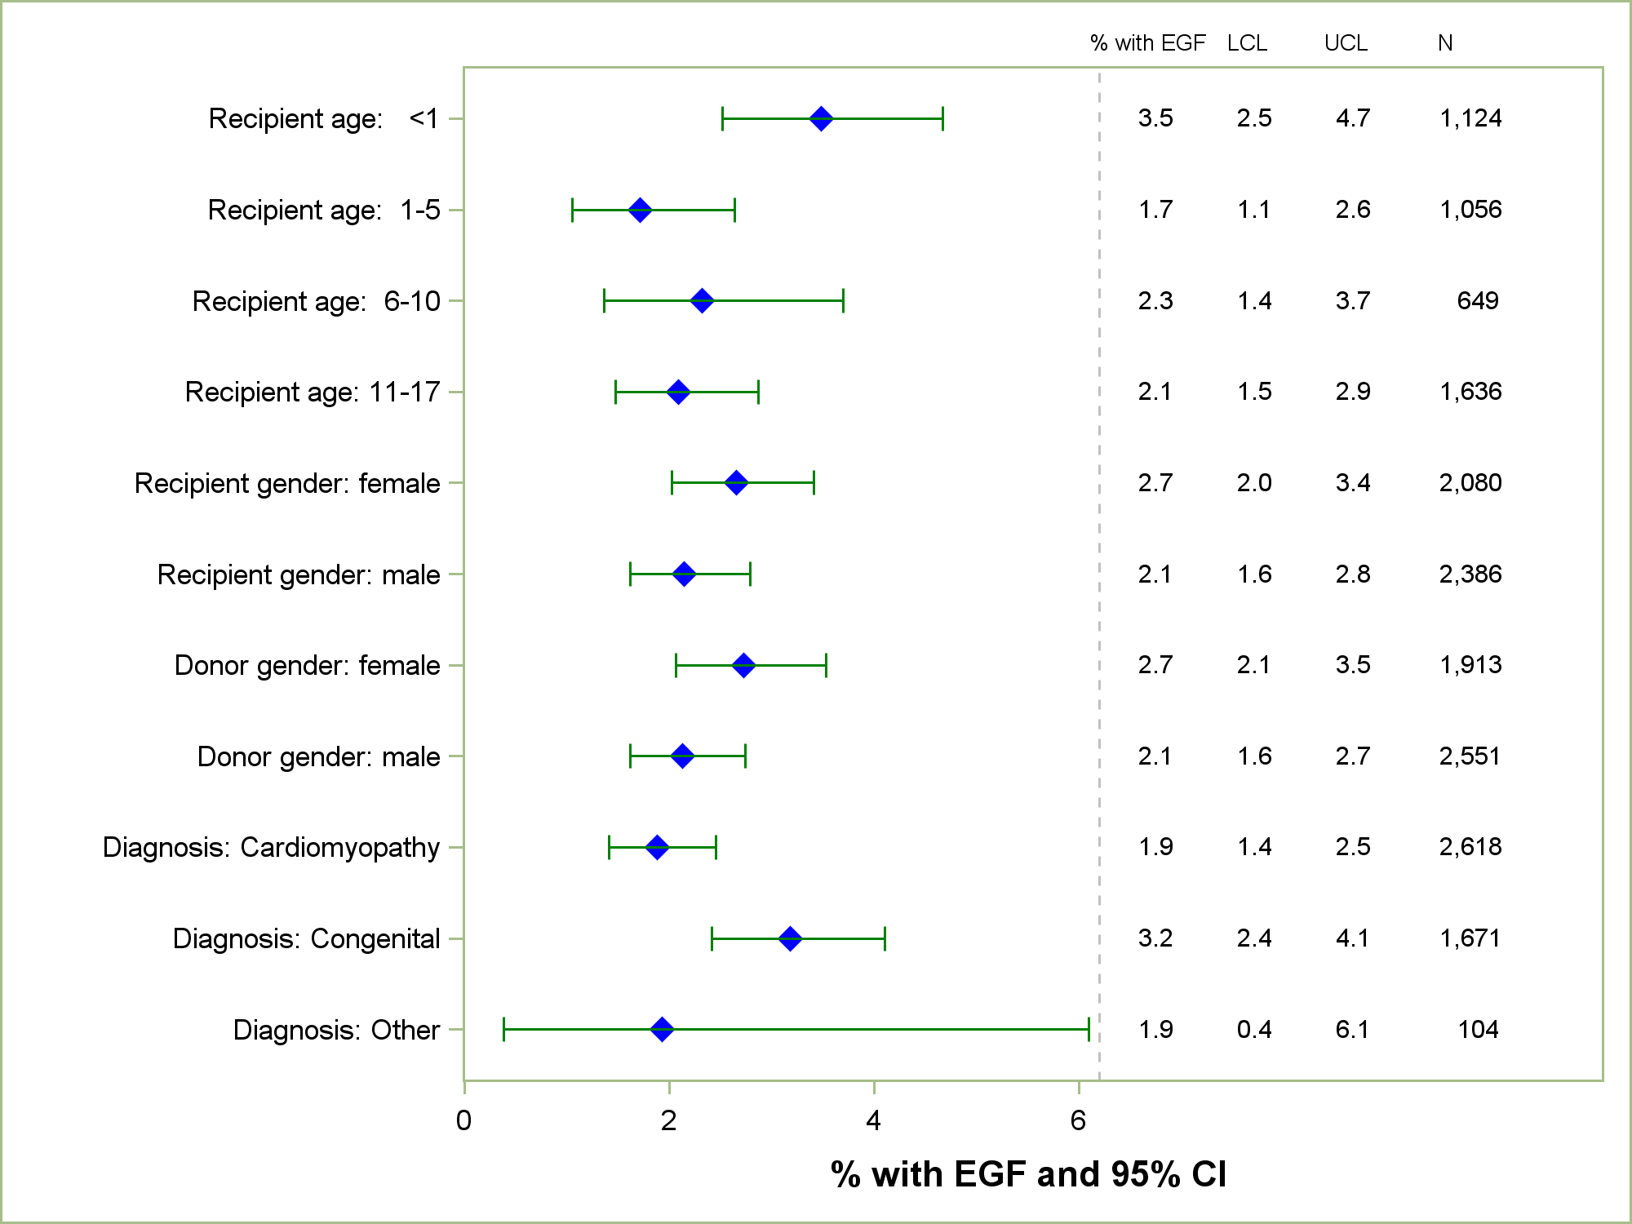
Pediatric Heart Transplants
% with EGF by Donor and Recipient Characteristics
(Primary Transplants: January 2005 – December 2013)
2015
JHLT. 2015 Oct; 34(10): 1233-1243
Notes:
Only transplants with known EGF status are included in the tabulation. Percentage with EGF was computed using a competing-risks extension of the Kaplan-Meier method.

Slide 190
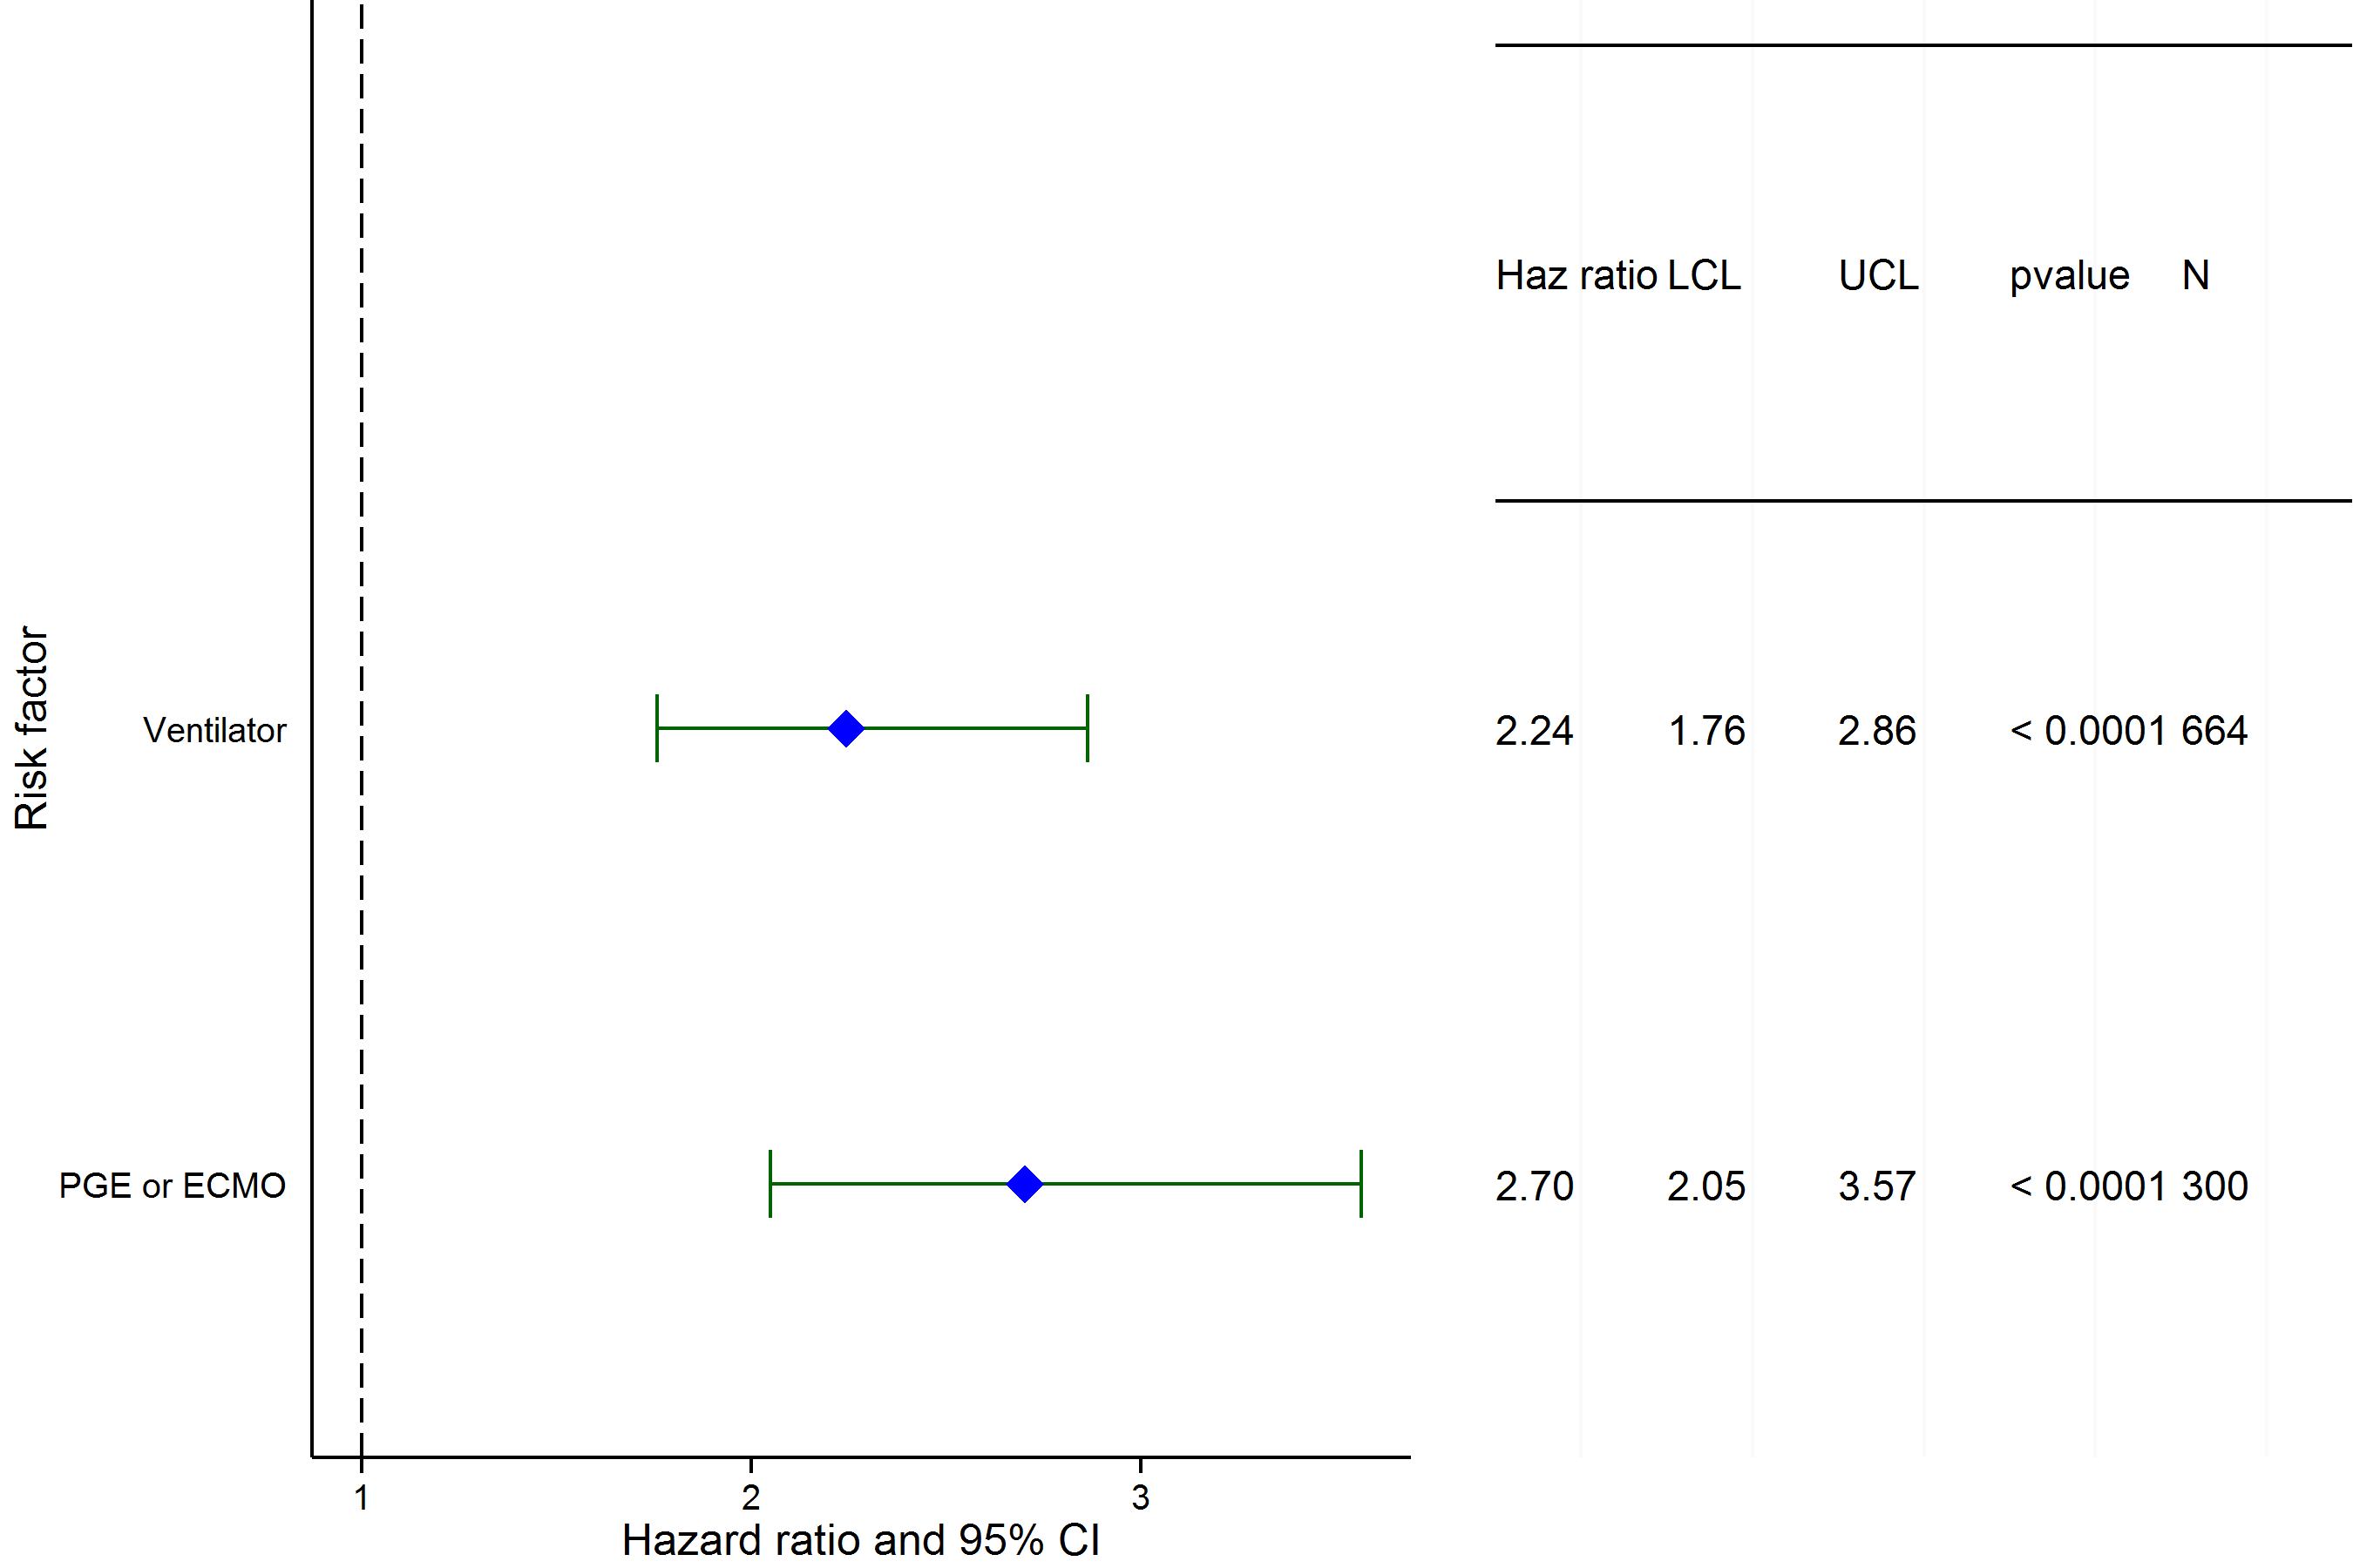
Pediatric Heart Transplants (2005-6/2013)
Risk Factors for EGF in 30 Days with 95% Confidence Limits
2015
(N = 3,394)
JHLT. 2015 Oct; 34(10): 1233-1243
Notes:
Multivariable analysis was performed using a proportional hazards model censoring all patients at 30 days. Continuous factors were fit using a restricted cubic spline.
Analyses were limited to transplants having essentially complete information regarding risk factors.

Slide 191
Pediatric Heart Transplants (2005-6/2013)
Risk Factors For EGF Within 30 Days
Continuous Factors (see figures)
Ischemia time
2015
JHLT. 2015 Oct; 34(10): 1233-1243

Slide 192
Pediatric Heart Transplants (2005-6/2013)
Ischemia time
Risk Factors for EGF in 30 Days with 95% Confidence Limits
p < 0.0001
2015
(N = 3,394)
JHLT. 2015 Oct; 34(10): 1233-1243
Notes:
Multivariable analysis was performed using a proportional hazards model censoring all patients at 30 days. Continuous factors were fit using a restricted cubic spline.
Analyses were limited to transplants having essentially complete information regarding risk factors.

