Slide 1

LUNG TRANSPLANTATION
Adult Recipients
2015
JHLT. 2015 Oct; 34(10): 1264-1277

Slide 2
Table of Contents
Donor, recipient and center characteristics: slides 3-18
Post transplant survival and rejection: slides 19-48
Functional and employment status and rehospitalization post transplant: slides 49-52
Induction and maintenance immunosuppression: slides 53-71
Post transplant morbidities: slides 72-94
Multivariable analyses: slides 95-160
Early Graft Failure (EGF): slides 161-186
2015
JHLT. 2015 Oct; 34(10): 1264-1277
JHLT. 2014 Oct; 33(10): 1009-1024

Slide 3
Donor, Recipient and Center Characteristics
2015
JHLT. 2015 Oct; 34(10): 1264-1277
JHLT. 2014 Oct; 33(10): 1009-1024

Slide 4
Adult Lung Transplants
Number of Transplants by Year and Procedure Type
NOTE: This figure includes only the adult lung transplants that are reported to the ISHLT Transplant Registry. As such, this should not be construed as representing changes in the number of adult lung transplants performed worldwide.
2015
JHLT. 2015 Oct; 34(10): 1264-1277
JHLT. 2014 Oct; 33(10): 1009-1024

Slide 5
Adult Lung Retransplants
Retransplants by Year and Location
2015
JHLT. 2015 Oct; 34(10): 1264-1277
JHLT. 2014 Oct; 33(10): 1009-1024

Slide 6
Adult Lung Retransplants
Retransplants by Inter-transplant Interval
(Retransplants: January 1990 – June 2014)
2015
JHLT. 2015 Oct; 34(10): 1264-1277
JHLT. 2014 Oct; 33(10): 1009-1024

Slide 7
Adult Lung Transplants Average Center Volume by Location (Transplants: January 2009 – June 2014)
2015
JHLT. 2015 Oct; 34(10): 1264-1277

Slide 8
Adult Lung Transplants
Indications (Transplants: January 1995 – June 2014)
Diagnosis | SLT (N=16,226) | BLT (N=29,457) | TOTAL (N=45,683)
COPD/Emphysema | 6,826 (42.1%) | 7,856 (26.7%) | 14,682 (32.1%)
Idiopathic Pulmonary Fibrosis | 5,561 (34.3%) | 5,442 (18.5%) | 11,003 (24.1%)
Cystic Fibrosis | 228 (1.4%) | 7,191 (24.4%) | 7,419 (16.2%)
Alpha-1 | 792 (4.9%) | 1,667 (5.7%) | 2,459 (5.4%)
Idiopathic Pulmonary Arterial Hypertension | 91 (0.6%) | 1,250 (4.2%) | 1,341 (2.9%)
Pulmonary Fibrosis, Other | 758 (4.7%) | 1,125 (3.8%) | 1,883 (4.1%)
Bronchiectasis | 65 (0.4%) | 1,167 (4.0%) | 1,232 (2.7%)
Sarcoidosis | 301 (1.9%) | 857 (2.9%) | 1,158 (2.5%)
Retransplant: Obliterative Bronchiolitis | 338 (2.1%) | 440 (1.5%) | 778 (1.7%)
Connective Tissue Disease | 200 (1.2%) | 481 (1.6%) | 681 (1.5%)
Obliterative Bronchiolitis (Not Retransplant) | 110 (0.7%) | 381 (1.3%) | 491 (1.1%)
LAM | 142 (0.9%) | 330 (1.1%) | 472 (1.0%)
Retransplant: Not Obliterative Bronchiolitis | 210 (1.3%) | 246 (0.8%) | 456 (1.0%)
Congenital Heart Disease | 93 (0.6%) | 333 (1.1%) | 426 (0.9%)
Cancer | 7 (0.0%) | 30 (0.1%) | 37 (0.1%)
Other | 504 (3.1%) | 661 (2.2%) | 1,165 (2.6%)
2015
For some retransplants, a diagnosis other than retransplant was reported, so the total number and percentage of retransplants may be greater.
JHLT. 2015 Oct; 34(10): 1264-1277
JHLT. 2014 Oct; 33(10): 1009-1024
Notes:
Transplants with unknown diagnoses are excluded from this tabulation.

Slide 9
Adult Lung Transplants
Distribution of Procedure Type for Major Indications by Year
Year of TX | Alpha-1 |  | COPD |  | Cystic Fibrosis |  | IPF |  | IPAH
 | Double | Single | Double | Single | Double | Single | Double | Single | Double | Single
1999 | 46.6 | 53.4 | 28 | 72 | 91.7 | 8.3 | 23.9 | 76.1 | 86.4 | 13.6
2000 | 57.9 | 42.1 | 29.2 | 70.8 | 93.9 | 6.1 | 31.6 | 68.4 | 92.9 | 7.1
2001 | 60.1 | 39.9 | 30 | 70 | 93.8 | 6.2 | 31.8 | 68.2 | 89.8 | 10.2
2002 | 56.6 | 43.4 | 38.9 | 61.1 | 96.2 | 3.8 | 36.2 | 63.8 | 87.9 | 12.1
2003 | 65.7 | 34.3 | 43 | 57 | 95.6 | 4.4 | 42.4 | 57.6 | 95.5 | 4.5
2004 | 73.4 | 26.6 | 45.8 | 54.2 | 96.3 | 3.7 | 45.2 | 54.8 | 94.4 | 5.6
2005 | 77 | 23 | 49.1 | 50.9 | 97.3 | 2.7 | 46.7 | 53.3 | 92.4 | 7.6
2006 | 71.8 | 28.2 | 58.4 | 41.6 | 98.5 | 1.5 | 48.2 | 51.8 | 100 | 0
2007 | 81.7 | 18.3 | 63.4 | 36.6 | 97.6 | 2.4 | 49.5 | 50.5 | 94.7 | 5.3
2008 | 80.2 | 19.8 | 65.4 | 34.6 | 98.6 | 1.4 | 52.7 | 47.3 | 94.1 | 5.9
2009 | 87.3 | 12.7 | 66.3 | 33.7 | 99.6 | 0.4 | 52.6 | 47.4 | 97.3 | 2.7
2010 | 86 | 14 | 70.3 | 29.7 | 99.4 | 0.6 | 56.1 | 43.9 | 95.8 | 4.2
2011 | 87.6 | 12.4 | 73 | 27 | 98.6 | 1.4 | 54.9 | 45.1 | 96.8 | 3.2
2012 | 91.5 | 8.5 | 74.3 | 25.7 | 98.4 | 1.6 | 60.3 | 39.7 | 95.1 | 4.9
2013 | 88.3 | 11.7 | 76.3 | 23.7 | 99.1 | 0.9 | 60.2 | 39.8 | 99 | 1
2015
JHLT. 2015 Oct; 34(10): 1264-1277
JHLT. 2014 Oct; 33(10): 1009-1024

Slide 10
Adult Lung Transplants
Procedure Type within Indication, by Year
2015
JHLT. 2015 Oct; 34(10): 1264-1277
JHLT. 2014 Oct; 33(10): 1009-1024

Slide 11
Adult Lung Transplants
Diagnosis Distribution by Procedure Type
(Transplants: January 1995 – June 2014)
2015
For some retransplants, a diagnosis other than retransplant was reported, so the total percentage of retransplants may be greater.
JHLT. 2015 Oct; 34(10): 1264-1277
JHLT. 2014 Oct; 33(10): 1009-1024
Notes:
Transplants with unknown procedure types and diagnoses are excluded from this tabulation.

Slide 12
Adult Lung Transplants
Major Indications by Year (%)
2015
For some retransplants, a diagnosis other than retransplant was reported, so the total percentage of retransplants may be greater.
JHLT. 2015 Oct; 34(10): 1264-1277
JHLT. 2014 Oct; 33(10): 1009-1024

Slide 13
Adult Lung Transplants
Major Indications by Year (Number)
2015
For some retransplants, a diagnosis other than retransplant was reported, so the total percentage of retransplants may be greater.
JHLT. 2015 Oct; 34(10): 1264-1277
JHLT. 2014 Oct; 33(10): 1009-1024

Slide 14
Adult Lung Transplants
Diagnosis Distribution by Location
(Transplants: January 2004 – June 2014)
2015
For some retransplants, a diagnosis other than retransplant was reported, so the total percentage of retransplants may be greater.
JHLT. 2015 Oct; 34(10): 1264-1277
JHLT. 2014 Oct; 33(10): 1009-1024
Notes:
Transplants with unknown diagnoses are excluded from this tabulation.

Slide 15
Adult Lung Transplants
Diagnosis Distribution by Location and Era
(Transplants: January 2004 – June 2014)
2015
For some retransplants, a diagnosis other than retransplant was reported, so the total percentage of retransplants may be greater.
JHLT. 2015 Oct; 34(10): 1264-1277
JHLT. 2014 Oct; 33(10): 1009-1024
Notes:
Transplants with unknown diagnoses are excluded from this tabulation.

Slide 16
Adult Lung Transplants
Transplant Type Distribution by Recipient Age Group
(Transplants: January 1990 – June 2014)
2015
JHLT. 2015 Oct; 34(10): 1264-1277
JHLT. 2014 Oct; 33(10): 1009-1024

Slide 17
Adult Lung Transplants
Transplant Type Distribution by Diagnosis
(Transplants: January 1990 – June 2014)
2015
JHLT. 2015 Oct; 34(10): 1264-1277
JHLT. 2014 Oct; 33(10): 1009-1024

Slide 18
Adult Lung Transplants
Transplant Type Distribution by Location
(Transplants: January 1990 – June 2014)
2015
JHLT. 2015 Oct; 34(10): 1264-1277
JHLT. 2014 Oct; 33(10): 1009-1024

Slide 19
Post Transplant Survival and Rejection
2015
JHLT. 2015 Oct; 34(10): 1264-1277
JHLT. 2014 Oct; 33(10): 1009-1024

Slide 20
Adult Lung Transplants
Kaplan-Meier Survival by Procedure Type for Primary Transplant Recipients (Transplants: January 1990 – June 2013)
p < 0.0001
2015
JHLT. 2015 Oct; 34(10): 1264-1277
JHLT. 2014 Oct; 33(10): 1009-1024
Notes:
Survival was calculated using the Kaplan-Meier method, which incorporates information from all transplants for whom any follow-up has been provided. Since many patients are still alive and some patients have been lost to follow-up, the survival rates are estimates rather than exact rates because the time of death is not known for all patients.
The median survival is the estimated time point at which 50% of all of the recipients have died. The conditional median survival is the estimated time point at which 50% of the recipients who survive to at least 1 year have died. Because the decline in survival is greatest during the first year following transplantation, the conditional survival provides a more realistic expectation of survival time for recipients who survive the early post-transplant period.
Survival rates were compared using the log-rank test statistic.

Slide 21
Adult Lung Transplants
Kaplan-Meier Survival by Transplant Type
(Transplants: January 1990 – June 2013)
p < 0.0001
2015
JHLT. 2015 Oct; 34(10): 1264-1277
JHLT. 2014 Oct; 33(10): 1009-1024
Notes:
Survival was calculated using the Kaplan-Meier method, which incorporates information from all transplants for whom any follow-up has been provided. Since many patients are still alive and some patients have been lost to follow-up, the survival rates are estimates rather than exact rates because the time of death is not known for all patients.
The median survival is the estimated time point at which 50% of all of the recipients have died. The conditional median survival is the estimated time point at which 50% of the recipients who survive to at least 1 year have died. Because the decline in survival is greatest during the first year following transplantation, the conditional survival provides a more realistic expectation of survival time for recipients who survive the early post-transplant period.
Survival rates were compared using the log-rank test statistic. Adjustments for multiple comparisons were done using Scheffe’s method.

Slide 22
Adult Lung Transplants
Kaplan-Meier Survival by Era
(Transplants: January 1990 – June 2013)
All pair-wise comparisons were significant at p <0.001 except 1999-2008 vs. 2009-6/2013 (p=0.1211)
2015
JHLT. 2015 Oct; 34(10): 1264-1277
JHLT. 2014 Oct; 33(10): 1009-1024
Notes:
Survival was calculated using the Kaplan-Meier method, which incorporates information from all transplants for whom any follow-up has been provided. Since many patients are still alive and some patients have been lost to follow-up, the survival rates are estimates rather than exact rates because the time of death is not known for all patients.
The median survival is the estimated time point at which 50% of all of the recipients have died. The conditional median survival is the estimated time point at which 50% of the recipients who survive to at least 1 year have died. Because the decline in survival is greatest during the first year following transplantation, the conditional survival provides a more realistic expectation of survival time for recipients who survive the early post-transplant period.
Survival rates were compared using the log-rank test statistic. Adjustments for multiple comparisons were done using Scheffe’s method.

Slide 23
Adult Lung Transplants
Kaplan-Meier Survival by Era and Transplant Type
(Transplants: January 1990 – June 2013)
All pair-wise comparisons between transplant types within each era and between eras within each transplant type were significant at p < 0.05 except for
Primary: 1999-2008 vs. 2009-6/2013
Retx: 1999-2008 vs. 2009-6/2013
2015
JHLT. 2015 Oct; 34(10): 1264-1277
JHLT. 2014 Oct; 33(10): 1009-1024
Notes:
Survival was calculated using the Kaplan-Meier method, which incorporates information from all transplants for whom any follow-up has been provided. Since many patients are still alive and some patients have been lost to follow-up, the survival rates are estimates rather than exact rates because the time of death is not known for all patients. The median survival is the estimated time point at which 50% of all of the recipients have died.
Survival rates were compared using the log-rank test statistic. Adjustments for multiple comparisons were done using Bonferroni method.

Slide 24
Adult Lung Transplants
Kaplan-Meier Survival Conditional on Survival to 1 Year by Era and Transplant Type
(Transplants: January 1990 – June 2013)
All pair-wise comparisons between transplant types within each era and between eras within each transplant type were significant at p < 0.05 except for
1990-1998: Primary vs. Retransplant
Primary: 1990-1998 vs. 2009-6/2013
Retx: 1990-1998 vs. 1999-2008
2015
JHLT. 2015 Oct; 34(10): 1264-1277
JHLT. 2014 Oct; 33(10): 1009-1024
Notes:
Survival was calculated using the Kaplan-Meier method, which incorporates information from all transplants for whom any follow-up has been provided. Since many patients are still alive and some patients have been lost to follow-up, the survival rates are estimates rather than exact rates because the time of death is not known for all patients. The median survival is the estimated time point at which 50% of all of the recipients have died.
Survival rates were compared using the log-rank test statistic. Adjustments for multiple comparisons were done using Bonferroni method.

Slide 25
Adult Lung Transplants
Kaplan-Meier Survival by Gender
(Transplants: January 1990 – June 2013)
p < 0.0001
N at risk = 21
N at risk = 15
2015
JHLT. 2015 Oct; 34(10): 1264-1277
JHLT. 2014 Oct; 33(10): 1009-1024
Notes:
Survival was calculated using the Kaplan-Meier method, which incorporates information from all transplants for whom any follow-up has been provided. Since many patients are still alive and some patients have been lost to follow-up, the survival rates are estimates rather than exact rates because the time of death is not known for all patients. The median survival is the estimated time point at which 50% of all of the recipients have died.
Survival rates were compared using the log-rank test statistic.

Slide 26
Adult Lung Transplants
Kaplan-Meier Survival by Transplant Type and Gender
(Transplants: January 1990 – June 2013)
All pair-wise comparisons were significant at p < 0.05 except
Retx: Male vs. Female
2015
JHLT. 2015 Oct; 34(10): 1264-1277
JHLT. 2014 Oct; 33(10): 1009-1024
Notes:
Survival was calculated using the Kaplan-Meier method, which incorporates information from all transplants for whom any follow-up has been provided. Since many patients are still alive and some patients have been lost to follow-up, the survival rates are estimates rather than exact rates because the time of death is not known for all patients. The median survival is the estimated time point at which 50% of all of the recipients have died.
Survival rates were compared using the log-rank test statistic. Adjustments for multiple comparisons were done using Scheffe’s method.

Slide 27
Adult Lung Transplants
Kaplan-Meier Survival by Diagnosis
(Transplants: January 1990 – June 2013)
All pair-wise comparisons were significant at p < 0.05 except
Alpha-1 vs. IPAH, Alpha-1 vs. Sarcoidosis, COPD vs. IPAH, COPD vs. Sarcoidosis, IPAH vs. Sarcoidosis
2015
JHLT. 2015 Oct; 34(10): 1264-1277
JHLT. 2014 Oct; 33(10): 1009-1024
Notes:
Survival was calculated using the Kaplan-Meier method, which incorporates information from all transplants for whom any follow-up has been provided. Since many patients are still alive and some patients have been lost to follow-up, the survival rates are estimates rather than exact rates because the time of death is not known for all patients. The median survival is the estimated time point at which 50% of all of the recipients have died.
Survival rates were compared using the log-rank test statistic. Adjustments for multiple comparisons were done using Scheffe’s method. Results of log-rank test should be interpreted with caution when curves cross. Only pair-wise comparisons statistically significant at p < 0.05 are shown on the slide.

Slide 28
Adult Lung Transplants
Kaplan-Meier Survival by Diagnosis for Primary Transplants
(Transplants: January 1990 – June 2013)
All pair-wise comparisons were significant at p < 0.05 except
Alpha-1 vs. IPAH, Alpha-1 vs. Sarcoidosis, COPD vs. IPAH, COPD vs. Sarcoidosis, IPAH vs. Sarcoidosis
2015
JHLT. 2015 Oct; 34(10): 1264-1277
JHLT. 2014 Oct; 33(10): 1009-1024
Notes:
Survival was calculated using the Kaplan-Meier method, which incorporates information from all transplants for whom any follow-up has been provided. Since many patients are still alive and some patients have been lost to follow-up, the survival rates are estimates rather than exact rates because the time of death is not known for all patients. The median survival is the estimated time point at which 50% of all of the recipients have died.
Survival rates were compared using the log-rank test statistic. Adjustments for multiple comparisons were done using Scheffe’s method. Results of log-rank test should be interpreted with caution when curves cross. Only pair-wise comparisons statistically significant at p < 0.05 are shown on the slide.

Slide 29
Adult Lung Transplants
Kaplan-Meier Survival by Transplant Type and Diagnosis
(Transplants: January 1990 – June 2013)
All pair-wise comparisons between transplant types within each diagnosis and between diagnoses for primary transplants were significant at p < 0.05. No pair-wise comparisons between diagnoses for first retransplant were significant at p < 0.05.
2015
JHLT. 2015 Oct; 34(10): 1264-1277
JHLT. 2014 Oct; 33(10): 1009-1024
Notes:
Survival was calculated using the Kaplan-Meier method, which incorporates information from all transplants for whom any follow-up has been provided. Since many patients are still alive and some patients have been lost to follow-up, the survival rates are estimates rather than exact rates because the time of death is not known for all patients. The median survival is the estimated time point at which 50% of all of the recipients have died.
Survival rates were compared using the log-rank test statistic. Adjustments for multiple comparisons were done using Bonferroni method.

Slide 30
Adult Lung Transplants
Kaplan-Meier Survival by Diagnosis Conditional on
Survival to 3 Months (Transplants: January 1990 – June 2013)
All pair-wise comparisons were significant at p < 0.05 except Alpha-1 vs. Sarcoidosis, COPD vs. IPF, CF vs. IPAH, and IPAH vs. Sarcoidosis
2015
JHLT. 2015 Oct; 34(10): 1264-1277
JHLT. 2014 Oct; 33(10): 1009-1024
Notes:
Survival was calculated using the Kaplan-Meier method, which incorporates information from all transplants for whom any follow-up has been provided. Since many patients are still alive and some patients have been lost to follow-up, the survival rates are estimates rather than exact rates because the time of death is not known for all patients. This figure shows survival conditional on survival to 3 months. Therefore, only patients surviving to at least 3 months were included in the calculation. The conditional median survival is the estimated time point at which 50% of the recipients who survive to at least 3 months have died.
Survival rates were compared using the log-rank test statistic. Adjustments for multiple comparisons were done using Scheffe’s method.

Slide 31
Adult Lung Transplants
Kaplan-Meier Survival by Diagnosis Conditional on
Survival to 3 Months for Primary Transplants
(Transplants: January 1990 – June 2013)
All pair-wise comparisons were significant at p < 0.05 except Alpha-1 vs. Sarcoidosis, COPD vs. IPF, CF vs. IPAH, and IPAH vs. Sarcoidosis
2015
JHLT. 2015 Oct; 34(10): 1264-1277
JHLT. 2014 Oct; 33(10): 1009-1024
Notes:
Survival was calculated using the Kaplan-Meier method, which incorporates information from all transplants for whom any follow-up has been provided. Since many patients are still alive and some patients have been lost to follow-up, the survival rates are estimates rather than exact rates because the time of death is not known for all patients. This figure shows survival conditional on survival to 3 months. Therefore, only patients surviving to at least 3 months were included in the calculation. The conditional median survival is the estimated time point at which 50% of the recipients who survive to at least 3 months have died.
Survival rates were compared using the log-rank test statistic. Adjustments for multiple comparisons were done using Scheffe’s method.

Slide 32
Adult Lung Transplants
Kaplan-Meier Survival by Transplant Type and Diagnosis Conditional on Survival to 3 Months (Transplants: January 1990 – June 2013)
No pair-wise comparisons between transplant types within each diagnosis except CF and between diagnoses for retransplants were significant at p < 0.05. All pair-wise comparisons between diagnoses for primary transplants were significant at p <0.05.
2015
JHLT. 2015 Oct; 34(10): 1264-1277
JHLT. 2014 Oct; 33(10): 1009-1024
Notes:
Survival was calculated using the Kaplan-Meier method, which incorporates information from all transplants for whom any follow-up has been provided. Since many patients are still alive and some patients have been lost to follow-up, the survival rates are estimates rather than exact rates because the time of death is not known for all patients. This figure shows survival conditional on survival to 3 months. Therefore, only patients surviving to at least 3 months were included in the calculation. The conditional median survival is the estimated time point at which 50% of the recipients who survive to at least 3 months have died.
Survival rates were compared using the log-rank test statistic. Adjustments for multiple comparisons were done using Bonferroni method.

Slide 33
Adult Lung Transplants
Kaplan-Meier Survival by Diagnosis Conditional on
Survival to 1 Year (Transplants: January 1990 – June 2013)
All pair-wise comparisons were significant at p < 0.05 except Alpha-1 vs. Sarcoidosis, COPD vs. IPF, CF vs. IPAH, CF vs. Sarcoidosis, and IPAH vs. Sarcoidosis
2015
JHLT. 2015 Oct; 34(10): 1264-1277
JHLT. 2014 Oct; 33(10): 1009-1024
Notes:
Survival was calculated using the Kaplan-Meier method, which incorporates information from all transplants for whom any follow-up has been provided. Since many patients are still alive and some patients have been lost to follow-up, the survival rates are estimates rather than exact rates because the time of death is not known for all patients. This figure shows survival conditional on survival to 12 months. Therefore, only patients surviving to at least 12 months were included in the calculation. The conditional median survival is the estimated time point at which 50% of the recipients who survive to at least 12 months have died.
Survival rates were compared using the log-rank test statistic. Adjustments for multiple comparisons were done using Scheffe’s method.

Slide 34
Adult Lung Transplants
Kaplan-Meier Survival by Diagnosis Conditional on
Survival to 1 Year for Primary Transplants
(Transplants: January 1990 – June 2013)
All pair-wise comparisons were significant at p < 0.05 except Alpha-1 vs. Sarcoidosis, COPD vs. IPF, CF vs. IPAH, CF vs. Sarcoidosis, and IPAH vs. Sarcoidosis
2015
JHLT. 2015 Oct; 34(10): 1264-1277
JHLT. 2014 Oct; 33(10): 1009-1024
Notes:
Survival was calculated using the Kaplan-Meier method, which incorporates information from all transplants for whom any follow-up has been provided. Since many patients are still alive and some patients have been lost to follow-up, the survival rates are estimates rather than exact rates because the time of death is not known for all patients. This figure shows survival conditional on survival to 12 months. Therefore, only patients surviving to at least 12 months were included in the calculation. The conditional median survival is the estimated time point at which 50% of the recipients who survive to at least 12 months have died.
Survival rates were compared using the log-rank test statistic. Adjustments for multiple comparisons were done using Scheffe’s method.

Slide 35
Adult Lung Transplants
Kaplan-Meier Survival by Procedure Type
(Transplants: January 1990 – June 2013)
Diagnosis: Alpha-1 Antitrypsin Deficiency
p < 0.0001
2015
JHLT. 2015 Oct; 34(10): 1264-1277
JHLT. 2014 Oct; 33(10): 1009-1024
Notes:
Survival was calculated using the Kaplan-Meier method, which incorporates information from all transplants for whom any follow-up has been provided. Since many patients are still alive and some patients have been lost to follow-up, the survival rates are estimates rather than exact rates because the time of death is not known for all patients.
Survival rates were compared using the log-rank test statistic.

Slide 36
Adult Lung Transplants
Kaplan-Meier Survival by Procedure Type
(Transplants: January 1990 – June 2013)
Diagnosis: COPD/Emphysema
p < 0.0001
2015
JHLT. 2015 Oct; 34(10): 1264-1277
JHLT. 2014 Oct; 33(10): 1009-1024
Notes:
Survival was calculated using the Kaplan-Meier method, which incorporates information from all transplants for whom any follow-up has been provided. Since many patients are still alive and some patients have been lost to follow-up, the survival rates are estimates rather than exact rates because the time of death is not known for all patients.
Survival rates were compared using the log-rank test statistic.

Slide 37
Adult Lung Transplants
Kaplan-Meier Survival by Procedure Type and Era
(Transplants: January 1990 – June 2013)
Diagnosis: COPD/Emphysema, Single Lung
1990-1998 vs. 1999-2008: p < 0.0001
1990-1998 vs. 2009-6/2013: p = 0.0016
1999-2008 vs. 2009-6/2013: p = 0.9893
2015
JHLT. 2015 Oct; 34(10): 1264-1277
JHLT. 2014 Oct; 33(10): 1009-1024
Notes:
Survival was calculated using the Kaplan-Meier method, which incorporates information from all transplants for whom any follow-up has been provided. Since many patients are still alive and some patients have been lost to follow-up, the survival rates are estimates rather than exact rates because the time of death is not known for all patients.
Survival rates were compared using the log-rank test statistic. Adjustments for multiple comparisons were done using Scheffe’s method.

Slide 38
Adult Lung Transplants
Kaplan-Meier Survival by Procedure Type and Era
(Transplants: January 1990 – June 2013)
Diagnosis: COPD/Emphysema, Bilateral/Double Lung
1990-1998 vs. 1999-2008: p = 0.0015
1990-1998 vs. 2009-6/2013: p = 0.0016
1999-2008 vs. 2009-6/2013: p = 0.2610
2015
JHLT. 2015 Oct; 34(10): 1264-1277
JHLT. 2014 Oct; 33(10): 1009-1024
Notes:
Survival was calculated using the Kaplan-Meier method, which incorporates information from all transplants for whom any follow-up has been provided. Since many patients are still alive and some patients have been lost to follow-up, the survival rates are estimates rather than exact rates because the time of death is not known for all patients.
Survival rates were compared using the log-rank test statistic. Adjustments for multiple comparisons were done using Scheffe’s method.

Slide 39
Adult Lung Transplants
Kaplan-Meier Survival by Procedure Type
(Transplants: January 1990 – June 2013)
Diagnosis: Idiopathic Pulmonary Fibrosis
p < 0.0001
2015
JHLT. 2015 Oct; 34(10): 1264-1277
JHLT. 2014 Oct; 33(10): 1009-1024
Notes:
Survival was calculated using the Kaplan-Meier method, which incorporates information from all transplants for whom any follow-up has been provided. Since many patients are still alive and some patients have been lost to follow-up, the survival rates are estimates rather than exact rates because the time of death is not known for all patients.
Survival rates were compared using the log-rank test statistic.

Slide 40
Adult Lung Transplants
Kaplan-Meier Survival by Procedure Type and Era
(Transplants: January 1990 – June 2013)
Diagnosis: Idiopathic Pulmonary Fibrosis, Single Lung
1990-1998 vs. 1999-2008: p = 0.0002
1990-1998 vs. 2009-6/2013: p = 0.0150
1999-2008 vs. 2009-6/2013: p = 0.7233
2015
JHLT. 2015 Oct; 34(10): 1264-1277
JHLT. 2014 Oct; 33(10): 1009-1024
Notes:
Survival was calculated using the Kaplan-Meier method, which incorporates information from all transplants for whom any follow-up has been provided. Since many patients are still alive and some patients have been lost to follow-up, the survival rates are estimates rather than exact rates because the time of death is not known for all patients.
Survival rates were compared using the log-rank test statistic. Adjustments for multiple comparisons were done using Scheffe’s method.

Slide 41
Adult Lung Transplants
Kaplan-Meier Survival by Procedure Type and Era
(Transplants: January 1990 – June 2013)
Diagnosis: Idiopathic Pulmonary Fibrosis, Bilateral/Double Lung
1990-1998 vs. 1999-2008: p < 0.0001
1990-1998 vs. 2009-6/2013: p < 0.0001
1999-2008 vs. 2009-6/2013: p = 0.3977
2015
JHLT. 2015 Oct; 34(10): 1264-1277
JHLT. 2014 Oct; 33(10): 1009-1024
Notes:
Survival was calculated using the Kaplan-Meier method, which incorporates information from all transplants for whom any follow-up has been provided. Since many patients are still alive and some patients have been lost to follow-up, the survival rates are estimates rather than exact rates because the time of death is not known for all patients.
Survival rates were compared using the log-rank test statistic. Adjustments for multiple comparisons were done using Scheffe’s method.

Slide 42
Adult Lung Transplants
Kaplan-Meier Survival by Procedure Type
(Transplants: January 1990 – June 2013)
Diagnosis: Idiopathic Arterial Pulmonary Hypertension
p < 0.0001
2015
JHLT. 2015 Oct; 34(10): 1264-1277
JHLT. 2014 Oct; 33(10): 1009-1024
Notes:
Survival was calculated using the Kaplan-Meier method, which incorporates information from all transplants for whom any follow-up has been provided. Since many patients are still alive and some patients have been lost to follow-up, the survival rates are estimates rather than exact rates because the time of death is not known for all patients.
Survival rates were compared using the log-rank test statistic.

Slide 43
Adult Lung Transplants
Kaplan-Meier Survival by Procedure Type and Era
(Transplants: January 1990 – June 2013)
Diagnosis: Cystic Fibrosis, Bilateral/Double Lung
1990-1998 vs. 1999-2008: p < 0.0001
1990-1998 vs. 2009-6/2013: p < 0.0001
1999-2008 vs. 2009-6/2013: p = 0.0818
2015
JHLT. 2015 Oct; 34(10): 1264-1277
JHLT. 2014 Oct; 33(10): 1009-1024
Notes:
Survival was calculated using the Kaplan-Meier method, which incorporates information from all transplants for whom any follow-up has been provided. Since many patients are still alive and some patients have been lost to follow-up, the survival rates are estimates rather than exact rates because the time of death is not known for all patients.
Survival rates were compared using the log-rank test statistic. Adjustments for multiple comparisons were done using Scheffe’s method.

Slide 44
Adult Lung Transplants
Percentage Experiencing Treated Rejection between Discharge and 1-Year Follow-Up (Follow-ups: July 2004 – June 2014)
No pair-wise comparisons were significant at < 0.05 except 18-34 vs. 35-49, 18-34 vs. 50-59, and 18-34 vs. 60-65
Analysis is limited to patients who were alive at the time of the follow-up.
Treated rejection = Recipient was reported to (1) have at least one acute rejection episode that was treated with an anti-rejection agent; or (2) have been hospitalized for rejection.
2015
JHLT. 2015 Oct; 34(10): 1264-1277
JHLT. 2014 Oct; 33(10): 1009-1024
Notes:
Comparisons were made using the chi-square statistic. Adjustments for multiple comparisons were done using Bonferroni method.
N represents those at risk for rejection.

Slide 45
Adult Lung Transplants
Percentage Experiencing Any Rejection between Discharge and 1-Year Follow-Up (Follow-ups: July 2004 – June 2014)
No pair-wise comparisons were significant at < 0.05 except 18-34 vs. 35-49, 18-34 vs. 50-59, and 18-34 vs. 60-65
Analysis is limited to patients who were alive at the time of the follow-up.
No rejection = Recipient had (1) no acute rejection episodes and (2) was reported either as not hospitalized for rejection or did not receive anti-rejection agents.
2015
JHLT. 2015 Oct; 34(10): 1264-1277
JHLT. 2014 Oct; 33(10): 1009-1024
Notes:
Comparisons were made using the chi-square statistic. Adjustments for multiple comparisons were done using Bonferroni method.
N represents those at risk for rejection.

Slide 46
Adult Lung Transplants
Percentage Experiencing Treated Rejection between Discharge and 1-Year Follow-Up (Follow-ups: July 2004 – June 2014)
No pair-wise comparisons were significant at < 0.05
Analysis is limited to patients who were alive at the time of the follow-up
Treated rejection = Recipient was reported to (1) have at least one acute rejection episode that was treated with an anti-rejection agent; or (2) have been hospitalized for rejection.
2015
JHLT. 2015 Oct; 34(10): 1264-1277
JHLT. 2014 Oct; 33(10): 1009-1024
Notes:
Comparisons were made using the chi-square statistic. Adjustments for multiple comparisons were done using Bonferroni method.
N represents those at risk for rejection.

Slide 47
Adult Lung Transplants
Percentage Experiencing Any Rejection between Discharge and 1-Year Follow-Up (Follow-ups: July 2004 – June 2014)
No pair-wise comparisons were significant at < 0.05
Analysis is limited to patients who were alive at the time of the follow-up
No rejection = Recipient had (1) no acute rejection episodes and (2) was reported either as not hospitalized for rejection or did not receive anti-rejection agents.
2015
JHLT. 2015 Oct; 34(10): 1264-1277
JHLT. 2014 Oct; 33(10): 1009-1024
Notes:
Comparisons were made using the chi-square statistic. Adjustments for multiple comparisons were done using Bonferroni method.
N represents those at risk for rejection.

Slide 48
Adult Lung Transplants
Kaplan-Meier Survival by Donor/Recipient CMV Status
(Transplants: January 2004 – June 2013)
All pair-wise comparisons were significant at p < 0.05 except D(+)/R(+) vs. D(+)/R(-) and D(-)/R(+) vs. D(-)/R(-)
2015
JHLT. 2015 Oct; 34(10): 1264-1277
JHLT. 2014 Oct; 33(10): 1009-1024
Notes:
Survival was calculated using the Kaplan-Meier method, which incorporates information from all transplants for whom any follow-up has been provided. Since many patients are still alive and some patients have been lost to follow-up, the survival rates are estimates rather than exact rates because the time of death is not known for all patients.
Survival rates were compared using the log-rank test statistic. Adjustments for multiple comparisons were done using Scheffe’s method.

Slide 49
Functional and Employment Status and Rehospitalization Post Transplant
2015
JHLT. 2015 Oct; 34(10): 1264-1277
JHLT. 2014 Oct; 33(10): 1009-1024

Slide 50
Adult Lung Transplants
Functional Status of Surviving Recipients
(Follow-ups: January 2009 – June 2014)
2015
JHLT. 2015 Oct; 34(10): 1264-1277
JHLT. 2014 Oct; 33(10): 1009-1024
Notes:
Functional status is collected using Karnofsky score for adult recipients and Lansky score for pediatric recipients.
This figure shows the functional status reported on the 1-year, 2-year and 3-year annual follow-ups. Because all follow-ups between January 2009 and June 2014 were included, the bars do not include the same patients.

Slide 51
Adult Lung Transplants
Employment Status of Surviving Recipients
(Follow-ups: January 2009 – June 2014)
2015
JHLT. 2015 Oct; 34(10): 1264-1277
JHLT. 2014 Oct; 33(10): 1009-1024
Notes:
This figure shows the employment status reported on the 1-year, 3-year and 5-year annual follow-ups. Because all follow-ups between January 2009 and June 2014 were included, the bars do not include the same patients.

Slide 52
Adult Lung Transplants
Rehospitalization Post Transplant of Surviving Recipients
(Follow-ups: January 2009 – June 2014)
2015
JHLT. 2015 Oct; 34(10): 1264-1277
JHLT. 2014 Oct; 33(10): 1009-1024
Notes:
This figure shows the hospitalizations reported on the 1-year, 3-year, and 5-year follow-ups, representing the hospitalizations between discharge and 1 year, between the 2-year and 3-year follow-up, and between the 4-year and 5-year follow-up, respectively. Because all follow-ups between January 2009 and June 2014 were included, the bars do not include the same patients.

Slide 53
Induction and Maintenance Immunosuppression
2015
JHLT. 2015 Oct; 34(10): 1264-1277
JHLT. 2014 Oct; 33(10): 1009-1024

Slide 54
Adult Lung Transplants
Induction Immunosuppression
Analysis limited to patients receiving prednisone
(Transplants: January 2004 – June 2014)
2015
Analysis is limited to patients who were alive at the time of the discharge.
JHLT. 2015 Oct; 34(10): 1264-1277
JHLT. 2014 Oct; 33(10): 1009-1024

Slide 55
Adult Lung Transplants
Induction Immunosuppression
Analysis limited to patients receiving prednisone
(Transplants: 2004, 2009 and January 2014 – June 2014)
2015
Analysis is limited to patients who were alive at the time of the discharge.
JHLT. 2015 Oct; 34(10): 1264-1277
JHLT. 2014 Oct; 33(10): 1009-1024

Slide 56
Adult Lung Transplants
Induction Immunosuppression
Analysis limited to patients receiving prednisone
(Transplants: January 2004 – December 2013)
2015
Analysis is limited to patients who were alive at the time of the discharge.
JHLT. 2015 Oct; 34(10): 1264-1277
JHLT. 2014 Oct; 33(10): 1009-1024

Slide 57
Adult Lung Transplants
Survival by Induction Usage Conditional on Survival to 14 Days (Transplants: April 1994 – June 2013)
p < 0.0001
2015
JHLT. 2015 Oct; 34(10): 1264-1277
JHLT. 2014 Oct; 33(10): 1009-1024
Notes:
Survival was calculated using the Kaplan-Meier method, which incorporates information from all transplants for whom any follow-up has been provided. Since many patients are still alive and some patients have been lost to follow-up, the survival rates are estimates rather than exact rates because the time of death is not known for all patients.
Survival rates were compared using the log-rank test statistic.

Slide 58
Adult Lung Transplants
Survival by Induction Usage Conditional on Survival to 14 Days (Transplants: January 2004 – June 2013)
p < 0.0001
2015
JHLT. 2015 Oct; 34(10): 1264-1277
JHLT. 2014 Oct; 33(10): 1009-1024
Notes:
Survival was calculated using the Kaplan-Meier method, which incorporates information from all transplants for whom any follow-up has been provided. Since many patients are still alive and some patients have been lost to follow-up, the survival rates are estimates rather than exact rates because the time of death is not known for all patients.
Survival rates were compared using the log-rank test statistic.

Slide 59
Adult Lung Transplants
Maintenance Immunosuppression at Time of Follow-up
Analysis limited to patients receiving prednisone
(Follow-ups: January 2004 – June 2014)
2015
Analysis is limited to patients who were alive at the time of the follow-up.
JHLT. 2015 Oct; 34(10): 1264-1277
JHLT. 2014 Oct; 33(10): 1009-1024
Notes:
This figure shows the maintenance immunosuppression reported as being provided at the time of the 1-year and 5-year annual follow-up forms. To provide a snapshot of current practice, only follow-ups occurring between January 2004 and June 2014 were included. Therefore, this figure does not represent changes in practice between the 1-year follow-up and 5-year follow-up on a cohort of patients. The patients in the 1-year tabulation are not the same patients as in the 5-year tabulation.

Slide 60
Adult Lung Transplants
Maintenance Immunosuppression at Time of Follow-up
Analysis limited to patients receiving prednisone
(Follow-ups: January 2004 – June 2014)
NOTE: Different patients are analyzed in Year 1 and Year 5
2015
Analysis is limited to patients who were alive at the time of the discharge.
JHLT. 2015 Oct; 34(10): 1264-1277
JHLT. 2014 Oct; 33(10): 1009-1024
Notes:
This figure shows the maintenance immunosuppression reported as being provided at the time of the 1-year and 5-year annual follow-up forms. To provide a snapshot of current practice, only follow-ups occurring between January 2004 and June 2014 were included. Therefore, this figure does not represent changes in practice between the 1-year follow-up and 5-year follow-up on a cohort of patients. The patients in the 1-year tabulation are not the same patients as in the 5-year tabulation.

Slide 61
Adult Lung Transplants
Maintenance Immunosuppression at Time of 1 Year Follow-up
Analysis limited to patients receiving prednisone
(Follow-ups: 2004, 2009 and July 2013 – June 2014)
NOTE: Different patients are analyzed in each time frame
2015
Analysis is limited to patients who were alive at the time of the follow-up.
JHLT. 2015 Oct; 34(10): 1264-1277
JHLT. 2014 Oct; 33(10): 1009-1024
Notes:
This figure shows the maintenance immunosuppression reported as being provided at the time of the 1-year annual follow-up forms. As different patients were transplanted each year this figure does not represent changes in immunosuppression for individual patients but may represent changes in practice.

Slide 62
Adult Lung Transplants
Maintenance Immunosuppression at Time of Follow-up
Analysis limited to patients receiving prednisone
(Follow-ups: January 2004 – June 2014)
2015
Analysis is limited to patients who were alive at the time of the follow-up.
JHLT. 2015 Oct; 34(10): 1264-1277
JHLT. 2014 Oct; 33(10): 1009-1024
Notes:
This figure shows the maintenance immunosuppression reported as being provided at the time of the 1-year and 5-year annual follow-up forms. To provide a snapshot of current practice, only follow-ups occurring between January 2004 and June 2014 were included. Therefore, this figure does not represent changes in practice between the 1-year follow-up and 5-year follow-up on a cohort of patients. The patients in the 1-year tabulation are not the same patients as in the 5-year tabulation.

Slide 63
Adult Lung Transplants
Maintenance Immunosuppression Drug Combinations at Time of Follow-up (Follow-ups: January 2004 – June 2014)
Analysis limited to patients receiving prednisone
NOTE: Different patients are analyzed in Year 1 and Year 5
2015
Analysis is limited to patients who were alive at the time of the follow-up.
JHLT. 2015 Oct; 34(10): 1264-1277
JHLT. 2014 Oct; 33(10): 1009-1024
Notes:
This figure shows the maintenance immunosuppression reported as being provided at the time of the 1-year and 5-year annual follow-up forms. To provide a snapshot of current practice, only follow-ups occurring between January 2004 and June 2014 were included. Therefore, this figure does not represent changes in practice between the 1-year follow-up and 5-year follow-up on a cohort of patients. The patients in the 1-year tabulation are not the same patients as in the 5-year tabulation.

Slide 64
Adult Lung Transplants
Kaplan-Meier Survival by Maintenance Immunosuppression Combinations Conditional on Survival to 1 Year (Transplants: January 2004 – June 2013)
Analysis limited to patients receiving prednisone
p < 0.0001
2015
JHLT. 2015 Oct; 34(10): 1264-1277
JHLT. 2014 Oct; 33(10): 1009-1024
Notes:
Survival was calculated using the Kaplan-Meier method, which incorporates information from all transplants for whom any follow-up has been provided. Since many patients are still alive and some patients have been lost to follow-up, the survival rates are estimates rather than exact rates because the time of death is not known for all patients. The cohorts were conditioned on survival to 1 year, so that maintenance immunosuppression combinations use during the first year could be used as a stratification factor.
Survival rates were compared using the log-rank test statistic. A significant p-value means that at least one of the groups is different than the others but it doesn’t identify which group it is.

Slide 65
Adult Lung Transplants
Kaplan-Meier Survival by Maintenance Immunosuppression Combinations Conditional on Survival to 1 Year (Transplants: January 2004 – June 2013)
Analysis limited to patients receiving prednisone
Diagnosis: COPD/Emphysema
p = 0.0020
2015
JHLT. 2015 Oct; 34(10): 1264-1277
JHLT. 2014 Oct; 33(10): 1009-1024
Notes:
Survival was calculated using the Kaplan-Meier method, which incorporates information from all transplants for whom any follow-up has been provided. Since many patients are still alive and some patients have been lost to follow-up, the survival rates are estimates rather than exact rates because the time of death is not known for all patients. The cohorts were conditioned on survival to 1 year, so that maintenance immunosuppression combinations use during the first year could be used as a stratification factor.
Survival rates were compared using the log-rank test statistic. A significant p-value means that at least one of the groups is different than the others but it doesn’t identify which group it is.

Slide 66
Adult Lung Transplants
Kaplan-Meier Survival by Maintenance Immunosuppression Combinations Conditional on Survival to 1 Year (Transplants: January 2004 – June 2013)
Analysis limited to patients receiving prednisone
Diagnosis: Idiopathic Pulmonary Fibrosis
p = 0.0302
2015
JHLT. 2015 Oct; 34(10): 1264-1277
JHLT. 2014 Oct; 33(10): 1009-1024
Notes:
Survival was calculated using the Kaplan-Meier method, which incorporates information from all transplants for whom any follow-up has been provided. Since many patients are still alive and some patients have been lost to follow-up, the survival rates are estimates rather than exact rates because the time of death is not known for all patients. The cohorts were conditioned on survival to 1 year, so that maintenance immunosuppression combinations use during the first year could be used as a stratification factor.
Survival rates were compared using the log-rank test statistic. A significant p-value means that at least one of the groups is different than the others but it doesn’t identify which group it is.

Slide 67
Adult Lung Transplants
Kaplan-Meier Survival by Maintenance Immunosuppression Combinations Conditional on Survival to 1 Year (Transplants: January 2004 – June 2013)
Analysis limited to patients receiving prednisone
Diagnosis: Cystic Fibrosis
p = 0.9803
2015
JHLT. 2015 Oct; 34(10): 1264-1277
JHLT. 2014 Oct; 33(10): 1009-1024
Notes:
Survival was calculated using the Kaplan-Meier method, which incorporates information from all transplants for whom any follow-up has been provided. Since many patients are still alive and some patients have been lost to follow-up, the survival rates are estimates rather than exact rates because the time of death is not known for all patients. The cohorts were conditioned on survival to 1 year, so that maintenance immunosuppression combinations use during the first year could be used as a stratification factor.
Survival rates were compared using the log-rank test statistic. Results of log-rank test should be interpreted with caution when curves cross.

Slide 68
Adult Lung Transplants
Percentage Experiencing Treated Rejection between Discharge and 1-Year Follow-Up by Type of Induction (Follow-ups: July 2004 – June 2014)
No pair-wise comparisons were significant at p < 0.05 except No induction vs. IL-2R and IL-2R vs. Alemtuzumab
Analysis is limited to patients who were alive at the time of the follow-up.
Treated rejection = Recipient was reported to (1) have at least one acute rejection episode that was treated with an anti-rejection agent; or (2) have been hospitalized for rejection.
2015
JHLT. 2015 Oct; 34(10): 1264-1277
JHLT. 2014 Oct; 33(10): 1009-1024
Notes:
Comparisons were made using the chi-square statistic. Adjustments for multiple comparisons were done using Bonferroni method.
N represents those at risk for rejection.

Slide 69
Adult Lung Transplants
Percentage Experiencing Any Rejection between Discharge and 1-Year Follow-Up by Type of Induction (Follow-ups: July 2004 – June 2014)
No pair-wise comparisons were significant at p < 0.05 except No induction vs. IL-2R and IL-2R vs. Alemtuzumab
Analysis is limited to patients who were alive at the time of the follow-up.
No rejection = Recipient had (1) no acute rejection episodes and (2) was reported either as not hospitalized for rejection or did not receive anti-rejection agents.
2015
JHLT. 2015 Oct; 34(10): 1264-1277
JHLT. 2014 Oct; 33(10): 1009-1024
Notes:
Comparisons were made using the chi-square statistic. Adjustments for multiple comparisons were done using Bonferroni method.
N represents those at risk for rejection.

Slide 70
Adult Lung Transplants
Percentage Experiencing Treated Rejection between Discharge and 1-Year Follow-Up by Maintenance Immunosuppression
(Follow-ups: July 2004 – June 2014)
Analysis is limited to patients who were alive at the time of the follow-up.
Treated rejection = Recipient was reported to (1) have at least one acute rejection episode that was treated with an anti-rejection agent; or (2) have been hospitalized for rejection.
2015
JHLT. 2015 Oct; 34(10): 1264-1277
JHLT. 2014 Oct; 33(10): 1009-1024
Notes:
Comparisons were made using the chi-square statistic. Adjustments for multiple comparisons were done using Bonferroni method.
N represents those at risk for rejection.

Slide 71
Adult Lung Transplants
Percentage Experiencing Any Rejection between Discharge and 1-Year Follow-Up by Maintenance Immunosuppression
(Follow-ups: July 2004 – June 2014)
Analysis is limited to patients who were alive at the time of the follow-up.
2015
No rejection = Recipient had (1) no acute rejection episodes and (2) was reported either as not hospitalized for rejection or did not receive anti-rejection agents.
JHLT. 2015 Oct; 34(10): 1264-1277
JHLT. 2014 Oct; 33(10): 1009-1024
Notes:
Comparisons were made using the chi-square statistic. Adjustments for multiple comparisons were done using Bonferroni method.
N represents those at risk for rejection.

Slide 72
Post Transplant Morbidities
2015
JHLT. 2015 Oct; 34(10): 1264-1277
JHLT. 2014 Oct; 33(10): 1009-1024

Slide 73
Adult Lung Transplants
Cumulative Morbidity Rates in Survivors within 1 Year Post Transplant (Follow-ups: April 1994 – June 2014)
Outcome | Follow-ups: April 1994 – December 2003 |  | Follow-ups: January 2004 – June 2014
 | Within 1 Year | Total number with known response | Within 1 Year | Total number with known response
Hypertension | 50.9% | (N=6,403) | 52.1% | (N=11,410)
Renal Dysfunction | 26.0% | (N=6,437) | 20.9% | (N=14,114)
Abnormal Creatinine ≤ 2.5 mg/dl | 16.0% |  | 15.5%
Creatinine > 2.5 mg/dl | 8.1% |  | 3.7%
Chronic Dialysis | 1.9% |  | 1.6%
Renal Transplant | 0.0% |  | 0.1%
Hyperlipidemia | 17.0% | (N=6,729) | 31.5% | (N=11,781)
Diabetes | 20.6% | (N=6,403) | 24.2% | (N=14,099)
Bronchiolitis Obliterans Syndrome | 9.2% | (N=6,010) | 9.3% | (N=13,338)
2015
JHLT. 2015 Oct; 34(10): 1264-1277
JHLT. 2014 Oct; 33(10): 1009-1024
Notes:
This table shows the percentage of patients experiencing various morbidities as reported on the 1-year annual follow-up form. The percentages are based on patients with known responses. Because the outcomes are reported to be unknown at different rates the number with known responses for each outcome are also provided.

Slide 74
Adult Lung Transplants
Cumulative Morbidity Rates in Survivors within 1 Year Post Transplant by Transplant Type (Follow-ups: April 1994 – June 2014)
Outcome | Primary |  | First Retransplant
 | Within 1 Year | Total number with known response | Within 1 Year | Total number with known response
Hypertension | 51.5% | (N=17,225) | 57.4% | (N=580)
Renal Dysfunction | 22.4% | (N=19,858) | 26.5% | (N=684)
Abnormal Creatinine ≤ 2.5 mg/dl | 15.6% |  | 16.1%
Creatinine > 2.5 mg/dl | 5.0% |  | 6.6%
Chronic Dialysis | 1.7% |  | 3.1%
Renal Transplant | 0.1% |  | 0.7%
Hyperlipidemia | 26.2% | (N=17,894) | 26.3% | (N=608)
Diabetes | 23.1% | (N=19,812) | 21.3% | (N=681)
Bronchiolitis Obliterans Syndrome | 9.0% | (N=18,700) | 16.4% | (N=639)
2015
JHLT. 2015 Oct; 34(10): 1264-1277
JHLT. 2014 Oct; 33(10): 1009-1024
Notes:
This table shows the percentage of patients experiencing various morbidities as reported on the 1-year annual follow-up form. The percentages are based on patients with known responses. Because the outcomes are reported to be unknown at different rates the number with known responses for each outcome are also provided.

Slide 75
Adult Lung Transplants
Cumulative Morbidity Rates in Survivors within 1 and 5 Years
Post Transplant (Follow-ups: April 1994 – June 2014)
Outcome | Within 1 Year | Total number with known response | Within 5 Years | Total number with known response
Hypertension | 51.7% | (N=17,813) | 80.7% | (N=5,293)
Renal Dysfunction | 22.5% | (N=20,551) | 53.3% | (N=7,056)
Abnormal Creatinine ≤ 2.5 mg/dl | 15.7% |  | 35.3%
Creatinine > 2.5 mg/dl | 5.0% |  | 14.3%
Chronic Dialysis | 1.7% |  | 3.0%
Renal Transplant | 0.1% |  | 0.8%
Hyperlipidemia | 26.2% | (N=18,510) | 57.9% | (N=5,643)
Diabetes | 23.0% | (N=20,502) | 39.5% | (N=6,941)
Bronchiolitis Obliterans Syndrome | 9.3% | (N=19,348) | 41.1% | (N=5,987)
2015
JHLT. 2015 Oct; 34(10): 1264-1277
JHLT. 2014 Oct; 33(10): 1009-1024
Notes:
This table shows the percentage of patients experiencing various morbidities as reported on the 1-year annual follow-up form and within 5 years following transplantation. The percentages are based on patients with known responses. To reduce bias, only patients with responses reported on every follow-up through the 5-year annual follow-up were included in the 5-year analysis. Because the outcomes are reported to be unknown at different rates the number with known responses for each outcome are also provided.

Slide 76
Adult Lung Retransplants
Cumulative Morbidity Rates in Survivors within 1 and 5 Years
Post First Retransplant (Follow-ups: April 1994 – June 2014)
Outcome | Within 1 Year | Total number with known response | Within 5 Years | Total number with known response
Hypertension | 57.4% | (N=580) | 80.4% | (N=97)
Renal Dysfunction | 26.5% | (N=684) | 62.2% | (N=172)
Abnormal Creatinine ≤ 2.5 mg/dl | 16.1% |  | 36.0%
Creatinine > 2.5 mg/dl | 6.6% |  | 15.7%
Chronic Dialysis | 3.1% |  | 7.0%
Renal Transplant | 0.7% |  | 3.5%
Hyperlipidemia | 26.3% | (N=608) | 54.1% | (N=111)
Diabetes | 21.3% | (N=681) | 38.7% | (N=163)
Bronchiolitis Obliterans Syndrome | 16.4% | (N=639) | 53.3% | (N=137)
2015
JHLT. 2015 Oct; 34(10): 1264-1277
JHLT. 2014 Oct; 33(10): 1009-1024
Notes:
This table shows the percentage of patients experiencing various morbidities as reported on the 1-year annual follow-up form and within 5 years following transplantation. The percentages are based on patients with known responses. To reduce bias, only patients with responses reported on every follow-up through the 5-year annual follow-up were included in the 5-year analysis. Because the outcomes are reported to be unknown at different rates the number with known responses for each outcome are also provided.

Slide 77
Adult Lung Transplants
Cumulative Morbidity Rates in Survivors within 10 Years Post-Transplant (Follow-ups: April 1994 – June 2014)
Outcome | Within 10 Years | Total number with known response
Renal Dysfunction | 71.9% | (N=1,515)
Abnormal Creatinine ≤ 2.5 mg/dl | 41.4%
Creatinine > 2.5 mg/dl | 18.7%
Chronic Dialysis | 7.3%
Renal Transplant | 4.6%
Bronchiolitis Obliterans Syndrome | 64.6% | (N=1,150)
2015
JHLT. 2015 Oct; 34(10): 1264-1277
JHLT. 2014 Oct; 33(10): 1009-1024
Notes:
This table shows the percentage of patients experiencing various morbidities as reported within 10 years following transplantation. The percentages are based on patients with known responses. To reduce bias, only patients with responses reported on every follow-up through the 10-year annual follow-up were included. Because the outcomes are reported to be unknown at different rates the number with known responses for each outcome are also provided.

Slide 78
Adult Lung Transplants
Freedom from Bronchiolitis Obliterans Syndrome
Conditional on Survival to 14 days (Follow-ups: April 1994 – June 2014)
2015
JHLT. 2015 Oct; 34(10): 1264-1277
JHLT. 2014 Oct; 33(10): 1009-1024
Notes:
Freedom from bronchiolitis obliterans rates were computed using the Kaplan-Meier method.
The development of bronchiolitis obliterans is reported on annual follow-ups; a date of diagnosis is not provided. For this figure the midpoint between the date of previous follow-up (when event had not occurred) and the date of follow-up when the event was reported was used as the date of occurrence. Patients were included in the analysis until an unknown response for bronchiolitis obliterans was reported. Therefore, the rates seen here may differ from those reported in the cumulative prevalence slide which is based on only those patients with known responses for bronchiolitis obliterans at all follow-up time points.

Slide 79
Adult Lung Transplants
Freedom from Bronchiolitis Obliterans Syndrome by Transplant Type Conditional on Survival to 14 days (Follow-ups: April 1994 – June 2014)
p < 0.0001
2015
JHLT. 2015 Oct; 34(10): 1264-1277
JHLT. 2014 Oct; 33(10): 1009-1024
Notes:
Freedom from bronchiolitis obliterans rates were computed using the Kaplan-Meier method.
The development of bronchiolitis obliterans is reported on annual follow-ups; a date of diagnosis is not provided. For this figure the midpoint between the date of previous follow-up (when event had not occurred) and the date of follow-up when the event was reported was used as the date of occurrence. Patients were included in the analysis until an unknown response for bronchiolitis obliterans was reported. Therefore, the rates seen here may differ from those reported in the cumulative prevalence slide which is based on only those patients with known responses for bronchiolitis obliterans at all follow-up time points.
Rates were compared using the log-rank test statistic.

Slide 80
Adult Lung Transplants
Freedom from Bronchiolitis Obliterans Syndrome by Diagnosis Conditional on Survival to 14 days
(Follow-ups: April 1994 – June 2014)
No pair-wise comparisons were significant at p < 0.05 except COPD vs. CF
2015
JHLT. 2015 Oct; 34(10): 1264-1277
JHLT. 2014 Oct; 33(10): 1009-1024
Notes:
Freedom from bronchiolitis obliterans rates were computed using the Kaplan-Meier method.
The development of bronchiolitis obliterans is reported on annual follow-ups; a date of diagnosis is not provided. For this figure the midpoint between the date of previous follow-up (when event had not occurred) and the date of follow-up when the event was reported was used as the date of occurrence. Patients were included in the analysis until an unknown response for bronchiolitis obliterans was reported. Therefore, the rates seen here may differ from those reported in the cumulative prevalence slide which is based on only those patients with known responses for bronchiolitis obliterans at all follow-up time points.
Rates were compared using the log-rank test statistic. Adjustments for multiple comparisons were done using Scheffe’s method.

Slide 81
Adult Lung Transplants
Freedom from Bronchiolitis Obliterans Syndrome by Induction Use Conditional on Survival to 14 days
(Follow-ups: April 1994 – June 2014)
p = 0.0002
2015
JHLT. 2015 Oct; 34(10): 1264-1277
JHLT. 2014 Oct; 33(10): 1009-1024
Notes:
Freedom from bronchiolitis obliterans rates were computed using the Kaplan-Meier method.
The development of bronchiolitis obliterans is reported on annual follow-ups; a date of diagnosis is not provided. For this figure the midpoint between the date of previous follow-up (when event had not occurred) and the date of follow-up when the event was reported was used as the date of occurrence. Patients were included in the analysis until an unknown response for bronchiolitis obliterans was reported. Therefore, the rates seen here may differ from those reported in the cumulative prevalence slide which is based on only those patients with known responses for bronchiolitis obliterans at all follow-up time points.
Rates were compared using the log-rank test statistic.

Slide 82
Adult Lung Transplants
Freedom from Bronchiolitis Obliterans Syndrome by Induction Use Conditional on Survival to 1 Year
(Follow-ups: April 1994 – June 2014)
p = 0.0005
2015
JHLT. 2015 Oct; 34(10): 1264-1277
JHLT. 2014 Oct; 33(10): 1009-1024
Notes:
Freedom from bronchiolitis obliterans rates were computed using the Kaplan-Meier method.
The development of bronchiolitis obliterans is reported on annual follow-ups; a date of diagnosis is not providedFor this figure the midpoint between the date of previous follow-up (when event had not occurred) and the date of follow-up when the event was reported was used as the date of occurrence. Patients were included in the analysis until an unknown response for bronchiolitis obliterans was reported. Therefore, the rates seen here may differ from those reported in the cumulative prevalence slide which is based on only those patients with known responses for bronchiolitis obliterans at all follow-up time points.
Rates were compared using the log-rank test statistic.

Slide 83
Adult Lung Transplants
Freedom from Bronchiolitis Obliterans Syndrome by Donor/Recipient CMV Status Conditional on Survival to 14 Days (Follow-ups: April 1994 – June 2014)
N at risk = 10
No pair-wise comparisons were significant at p < 0.05 except D(+)/R(-) vs. D(+)/R(+): p = 0.0208
N at risk = 14
2015
JHLT. 2015 Oct; 34(10): 1264-1277
JHLT. 2014 Oct; 33(10): 1009-1024
Notes:
Freedom from bronchiolitis obliterans rates were computed using the Kaplan-Meier method.
The development of bronchiolitis obliterans is reported on annual follow-ups; a date of diagnosis is not provided. For this figure the midpoint between the date of previous follow-up (when event had not occurred) and the date of follow-up when the event was reported was used as the date of occurrence. Patients were included in the analysis until an unknown response for bronchiolitis obliterans was reported. Therefore, the rates seen here may differ from those reported in the cumulative prevalence slide which is based on only those patients with known responses for bronchiolitis obliterans at all follow-up time points.
Rates were compared using the log-rank test statistic. Adjustments for multiple comparisons were done using Scheffe’s method.

Slide 84
Adult Lung Transplants
Freedom from Bronchiolitis Obliterans Syndrome by Donor/Recipient CMV Status
Conditional on Survival to 1 Year (Follow-ups: April 1994 – June 2014)
No pair-wise comparisons were significant at p < 0.05
N at risk = 10
N at risk = 14
2015
JHLT. 2015 Oct; 34(10): 1264-1277
JHLT. 2014 Oct; 33(10): 1009-1024
Notes:
Freedom from bronchiolitis obliterans rates were computed using the Kaplan-Meier method.
The development of bronchiolitis obliterans is reported on annual follow-ups; a date of diagnosis is not provided. For this figure the midpoint between the date of previous follow-up (when event had not occurred) and the date of follow-up when the event was reported was used as the date of occurrence. Patients were included in the analysis until an unknown response for bronchiolitis obliterans was reported. Therefore, the rates seen here may differ from those reported in the cumulative prevalence slide which is based on only those patients with known responses for bronchiolitis obliterans at all follow-up time points.
Rates were compared using the log-rank test statistic. Adjustments for multiple comparisons were done using Scheffe’s method.

Slide 85
Adult Lung Transplants
Freedom from Severe Renal Dysfunction*
(Follow-ups: April 1994 – June 2014)
* Severe renal dysfunction = Creatinine > 2.5 mg/dl (221 μmol/L), dialysis or renal transplant
2015
JHLT. 2015 Oct; 34(10): 1264-1277
JHLT. 2014 Oct; 33(10): 1009-1024
Notes:
Freedom from severe renal dysfunction rates were computed using the Kaplan-Meier method.
The development of severe renal dysfunction is reported on annual follow-ups; a date of diagnosis is not provided. For this figure the midpoint between the date of previous follow-up (when event had not occurred) and the date of follow-up when the event was reported was used as the date of occurrence. Patients were included in the analysis until an unknown response for severe renal dysfunction was reported. Therefore, the rates seen here may differ from those reported in the cumulative prevalence slide which is based on only those patients with known responses for severe renal dysfunction at all follow-up time points.

Slide 86
Adult Lung Transplants
Freedom from Severe Renal Dysfunction* Conditional on Survival to 1 Year (Follow-ups: April 1994 – June 2014)
* Severe renal dysfunction = Creatinine > 2.5 mg/dl (221 μmol/L), dialysis or renal transplant
2015
JHLT. 2015 Oct; 34(10): 1264-1277
JHLT. 2014 Oct; 33(10): 1009-1024
Notes:
Freedom from severe renal dysfunction rates were computed using the Kaplan-Meier method.
The development of severe renal dysfunction is reported on annual follow-ups; a date of diagnosis is not provided. For this figure the midpoint between the date of previous follow-up (when event had not occurred) and the date of follow-up when the event was reported was used as the date of occurrence. Patients were included in the analysis until an unknown response for severe renal dysfunction was reported. Therefore, the rates seen here may differ from those reported in the cumulative prevalence slide which is based on only those patients with known responses for severe renal dysfunction at all follow-up time points.

Slide 87
Adult Lung Transplants
Cumulative Post Transplant Malignancy Rates in Survivors(Follow-ups: April 1994 – June 2014)
Malignancy/Type |  | 1-Year Survivors | 5-Year Survivors | 10-Year Survivors
No Malignancy |  | 20,260 (96.3%) | 6,191 (83.4%) | 1,222 (70.9%)
Malignancy (all types combined) |  | 780 (3.7%) | 1,234 (16.6%) | 501 (29.1%)
Malignancy Type* | Skin | 279 | 882 | 359
 | Lymphoma | 272 | 111 | 47
 | Other | 200 | 294 | 139
 | Type Not Reported | 29 | 10 | 2
Other malignancies reported include: adenocarcinoma (2; 2; 1), bladder (2; 1; 0), lung (2; 4; 0), breast (1; 5; 2); prostate (0; 5; 1), cervical (1; 1; 0); liver (1; 1; 1); and colon (1; 1; 0). Numbers in parentheses represent the number of reported cases within each time period.
* Recipients may have experienced more than one type of malignancy; therefore, the sum of individual malignancy types may be greater than the total number with malignancy.
2015
JHLT. 2015 Oct; 34(10): 1264-1277
JHLT. 2014 Oct; 33(10): 1009-1024
Notes:
This table shows the percentage of patients with malignancies reported within 1 year, within 5 years and within 10 years following transplantation. The percentages are based on patients with known responses. To reduce bias, only patients with responses reported on every follow-up through the 5-year (10-year) annual follow-up were included in the “5-Year Survivors” (“10-Year Survivors”) column.

Slide 88
Adult Lung Transplants
Freedom from Malignancy (Follow-ups: April 1994 – June 2014)
2015
JHLT. 2015 Oct; 34(10): 1264-1277
JHLT. 2014 Oct; 33(10): 1009-1024
Notes:
Freedom from malignancy rates were computed using the Kaplan-Meier method.
The development of malignancy is reported on annual follow-ups; a date of diagnosis is not provided. For this figure the midpoint between the date of previous follow-up (when event had not occurred) and the date of follow-up when the event was reported was used as the date of occurrence. Patients were included in the analysis until an unknown response for malignancy was reported. Therefore, the rates seen here may differ from those reported in the cumulative prevalence slide which is based on only those patients with known responses for malignancy at all follow-up time points.

Slide 89
Adult Lung Transplants
Freedom from Malignancy Conditional on Survival to 1 Year
(Follow-ups: April 1994 – June 2014)
2015
JHLT. 2015 Oct; 34(10): 1264-1277
JHLT. 2014 Oct; 33(10): 1009-1024
Notes:
Freedom from malignancy rates were computed using the Kaplan-Meier method.
The development of malignancy is reported on annual follow-ups; a date of diagnosis is not provided. For this figure the midpoint between the date of previous follow-up (when event had not occurred) and the date of follow-up when the event was reported was used as the date of occurrence. Patients were included in the analysis until an unknown response for malignancy was reported. Therefore, the rates seen here may differ from those reported in the cumulative prevalence slide which is based on only those patients with known responses for malignancy at all follow-up time points.

Slide 90
Adult Lung Transplants
Cause of Death (Deaths: January 1990 – June 2014)
Cause of Death | 0-30 Days (N=3,224) | 31 Days - 1 Year (N=5,578) | >1 Year - 3 Years (N=5,256) | >3 Years - 5 Years (N=3,015) | >5 Years - 10 Years (N=3,655) | >10 Years (N=1,294)
Bronchiolitis | 9 (0.3%) | 256 (4.6%) | 1,378 (26.2%) | 892 (29.6%) | 914 (25.0%) | 274 (21.2%)
Acute Rejection | 115 (3.6%) | 102 (1.8%) | 83 (1.6%) | 18 (0.6%) | 20 (0.5%) | 2 (0.2%)
Lymphoma | 1 (0.0%) | 120 (2.2%) | 96 (1.8%) | 46 (1.5%) | 64 (1.8%) | 38 (2.9%)
Malignancy, Non-Lymphoma | 6 (0.2%) | 159 (2.9%) | 418 (8.0%) | 339 (11.2%) | 514 (14.1%) | 174 (13.4%)
CMV | 3 (0.1%) | 122 (2.2%) | 50 (1.0%) | 7 (0.2%) | 4 (0.1%) | 1 (0.1%)
Infection, Non-CMV | 623 (19.3%) | 1,964 (35.2%) | 1,122 (21.3%) | 548 (18.2%) | 655 (17.9%) | 211 (16.3%)
Graft Failure | 783 (24.3%) | 928 (16.6%) | 985 (18.7%) | 532 (17.6%) | 615 (16.8%) | 206 (15.9%)
Cardiovascular | 370 (11.5%) | 295 (5.3%) | 232 (4.4%) | 152 (5.0%) | 201 (5.5%) | 95 (7.3%)
Technical | 363 (11.3%) | 201 (3.6%) | 48 (0.9%) | 14 (0.5%) | 29 (0.8%) | 10 (0.8%)
Other | 951 (29.5%) | 1,431 (25.7%) | 844 (16.1%) | 467 (15.5%) | 639 (17.5%) | 283 (21.9%)
2015
Percentages represent % of deaths in the respective time period.
JHLT. 2015 Oct; 34(10): 1264-1277
JHLT. 2014 Oct; 33(10): 1009-1024
Notes:
Only known causes of death are included in the tabulation.

Slide 91
Adult Lung Retransplants
Cause of Death (Deaths: January 1990 – June 2014)
Cause of Death | 0-30 Days (N=253) | 31 Days - 1 Year (N=334) | >1 Year - 3 Years (N=242) | >3 Years - 5 Years (N=94) | >5 Years - 10 Years (N=107) | >10 Years (N=24)
Bronchiolitis | 5 (2.0%) | 29 (8.7%) | 93 (38.4%) | 38 (40.4%) | 28 (26.2%) | 7 (29.2%)
Acute Rejection | 8 (3.2%) | 8 (2.4%) | 0 | 0 | 0 | 0
Lymphoma | 0 | 4 (1.2%) | 4 (1.7%) | 2 (2.1%) | 3 (2.8%) | 0
Malignancy, Non-Lymphoma | 0 | 3 (0.9%) | 12 (5.0%) | 6 (6.4%) | 11 (10.3%) | 3 (12.5%)
CMV | 0 | 4 (1.2%) | 3 (1.2%) | 0 | 0 | 0
Infection, Non-CMV | 51 (20.2%) | 107 (32.0%) | 40 (16.5%) | 19 (20.2%) | 18 (16.8%) | 2 (8.3%)
Graft Failure | 62 (24.5%) | 59 (17.7%) | 48 (19.8%) | 15 (16.0%) | 21 (19.6%) | 3 (12.5%)
Cardiovascular | 23 (9.1%) | 17 (5.1%) | 10 (4.1%) | 2 (2.1%) | 3 (2.8%) | 1 (4.2%)
Technical | 37 (14.6%) | 10 (3.0%) | 2 (0.8%) | 0 | 1 (0.9%) | 1 (4.2%)
Other | 67 (26.5%) | 93 (27.8%) | 30 (12.4%) | 12 (12.8%) | 22 (20.6%) | 7 (29.2%)
2015
Percentages represent % of deaths in the respective time period.
JHLT. 2015 Oct; 34(10): 1264-1277
JHLT. 2014 Oct; 33(10): 1009-1024
Notes:
Only known causes of death are included in the tabulation.

Slide 92
Adult Lung Transplants
Cause of Death Stratified by Transplant Type
(Deaths: January 1990 – June 2014)
Transplant Type | Cause of Death | 0-30 Days | 31 Days - 1 Year | >1 Year - 3 Years | >3 Years - 5 Years | >5 Years
Primary | Bronchiolitis | 4 (0.1%) | 227 (4.3%) | 1,285 (25.6%) | 854 (29.2%) | 1,153 (23.9%)
 | Malignancy | 7 (0.2%) | 272 (5.2%) | 498 (9.9%) | 377 (12.9%) | 773 (16.0%)
 | Infection | 575 (19.4%) | 1,975 (37.7%) | 1,129 (22.5%) | 536 (18.3%) | 851 (17.7%)
 | Graft Failure | 721 (24.3%) | 869 (16.6%) | 937 (18.7%) | 517 (17.7%) | 797 (16.5%)
 | Cardiovascular | 347 (11.7%) | 278 (5.3%) | 222 (4.4%) | 150 (5.1%) | 292 (6.1%)
 | Technical | 326 (11.0%) | 191 (3.6%) | 46 (0.9%) | 14 (0.5%) | 37 (0.8%)
 | All known causes | 2,971 | 5,244 | 5,014 | 2,921 | 4,818
Retransplant | Bronchiolitis | 5 (2.0%) | 29 (8.7%) | 93 (38.4%) | 38 (40.4%) | 35 (26.7%)
 | Malignancy | 0 | 7 (2.1%) | 16 (6.6%) | 8 (8.5%) | 17 (13.0%)
 | Infection | 51 (20.2%) | 111 (33.2%) | 43 (17.8%) | 19 (20.2%) | 20 (15.3%)
 | Graft Failure | 62 (24.5%) | 59 (17.7%) | 48 (19.8%) | 15 (16.0%) | 24 (18.3%)
 | Cardiovascular | 23 (9.1%) | 17 (5.1%) | 10 (4.1%) | 2 (2.1%) | 4 (3.1%)
 | Technical | 37 (14.6%) | 10 (3.0%) | 2 (0.8%) | 0 | 2 (1.5%)
 | All known causes | 253 | 334 | 242 | 94 | 131
2015
Acute rejection and other causes of death are not shown on the slide.
JHLT. 2015 Oct; 34(10): 1264-1277
JHLT. 2014 Oct; 33(10): 1009-1024
Notes:
Only known causes of death are included in the tabulation.

Slide 93
Adult Lung Transplants
Relative Incidence of Leading Causes of Death
(Deaths: January 1990 – June 2014)
2015
JHLT. 2015 Oct; 34(10): 1264-1277
JHLT. 2014 Oct; 33(10): 1009-1024
Notes:
Only known causes of death are included in the tabulation.

Slide 94
Adult Lung Retransplants
Relative Incidence of Leading Causes of Death
(Deaths: January 1990 – June 2014)
2015
JHLT. 2015 Oct; 34(10): 1264-1277
JHLT. 2014 Oct; 33(10): 1009-1024
Notes:
Only known causes of death are included in the tabulation.

Slide 95
Multivariable Analyses
2015
JHLT. 2015 Oct; 34(10): 1264-1277

Slide 96
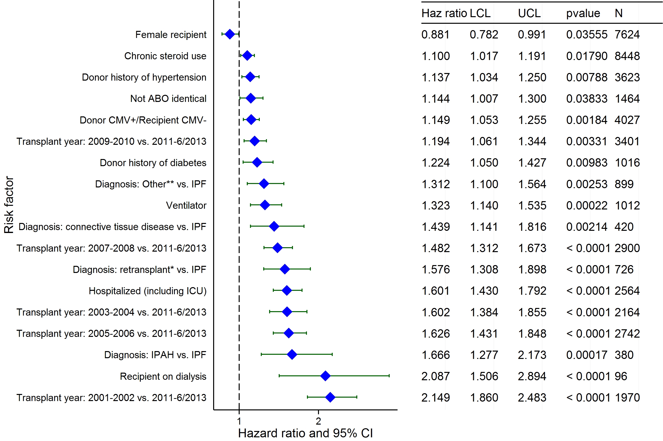
Adult Lung Transplants (2001-6/2013)
Risk Factors For 1 Year Mortality with 95% Confidence Limits
(N = 17,755)
* Retransplant includes those with a retransplant diagnosis or a previous transplant reported.
** Other = All diagnoses other than COPD, IPAH, IPF, cystic fibrosis, sarcoidosis, pulmonary fibrosis, bronchiectasis, alpha-1 antitrypsin deficiency, retransplant , LAM and Connective Tissue Disease.
2015
JHLT. 2015 Oct; 34(10): 1264-1277
Notes:
Multivariable analysis was performed using a proportional hazards model censoring all patients at 1 year. Continuous factors were fit using a restricted cubic spline.
Analyses were limited to transplants having essentially complete information regarding risk factors.

Slide 97
Adult Lung Transplants (2001-6/2013)
Risk Factors For 1 Year Mortality
Continuous Factors (see figures)
Recipient age | Recipient creatinine
Ischemia time | Recipient cardiac output
Bilirubin | Donor height
Transplant center volume | Recipient oxygen required at rest
Recipient FVC % predicted
2015
JHLT. 2015 Oct; 34(10): 1264-1277
Notes:
Multivariable analysis was performed using a proportional hazards model censoring all patients at 1 year. Continuous factors were fit using a restricted cubic spline.
Analyses were limited to transplants having essentially complete information regarding risk factors.

Slide 98
Adult Lung Transplants (2001-6/2013)
Recipient age
Risk Factors For 1 Year Mortality with 95% Confidence Limits
p < 0.0001
2015
(N = 17,755)
JHLT. 2015 Oct; 34(10): 1264-1277
Notes:
Multivariable analysis was performed using a proportional hazards model censoring all patients at 1 year. Continuous factors were fit using a restricted cubic spline.
Analyses were limited to transplants having essentially complete information regarding risk factors.

Slide 99
Adult Lung Transplants (2001-6/2013)
Recipient creatinine
Risk Factors For 1 Year Mortality with 95% Confidence Limits
p = 0.0007
2015
(N = 17,755)
JHLT. 2015 Oct; 34(10): 1264-1277
Notes:
Multivariable analysis was performed using a proportional hazards model censoring all patients at 1 year. Continuous factors were fit using a restricted cubic spline.
Analyses were limited to transplants having essentially complete information regarding risk factors.

Slide 100
Adult Lung Transplants (2001-6/2013)
Ischemia time
Risk Factors For 1 Year Mortality with 95% Confidence Limits
p = 0.0204
2015
(N = 17,755)
JHLT. 2015 Oct; 34(10): 1264-1277
Notes:
Multivariable analysis was performed using a proportional hazards model censoring all patients at 1 year. Continuous factors were fit using a restricted cubic spline.
Analyses were limited to transplants having essentially complete information regarding risk factors.

Slide 101
Adult Lung Transplants (2001-6/2013)
Recipient cardiac output
Risk Factors For 1 Year Mortality with 95% Confidence Limits
p = 0.0008
2015
(N = 17,755)
JHLT. 2015 Oct; 34(10): 1264-1277
Notes:
Multivariable analysis was performed using a proportional hazards model censoring all patients at 1 year. Continuous factors were fit using a restricted cubic spline.
Analyses were limited to transplants having essentially complete information regarding risk factors.

Slide 102
Adult Lung Transplants (2001-6/2013)
Bilirubin
Risk Factors For 1 Year Mortality with 95% Confidence Limits
p < 0.0001
2015
(N = 17,755)
JHLT. 2015 Oct; 34(10): 1264-1277
Notes:
Multivariable analysis was performed using a proportional hazards model censoring all patients at 1 year. Continuous factors were fit using a restricted cubic spline.
Analyses were limited to transplants having essentially complete information regarding risk factors.

Slide 103
Adult Lung Transplants (2001-6/2013)
Donor height
Risk Factors For 1 Year Mortality with 95% Confidence Limits
p = 0.0043
2015
(N = 17,755)
JHLT. 2015 Oct; 34(10): 1264-1277
Notes:
Multivariable analysis was performed using a proportional hazards model censoring all patients at 1 year. Continuous factors were fit using a restricted cubic spline.
Analyses were limited to transplants having essentially complete information regarding risk factors.

Slide 104
Adult Lung Transplants (2001-6/2013)
Transplant center volume
Risk Factors For 1 Year Mortality with 95% Confidence Limits
p < 0.0001
2015
(N = 17,755)
JHLT. 2015 Oct; 34(10): 1264-1277
Notes:
Multivariable analysis was performed using a proportional hazards model censoring all patients at 1 year. Continuous factors were fit using a restricted cubic spline.
Analyses were limited to transplants having essentially complete information regarding risk factors.

Slide 105
Adult Lung Transplants (2001-6/2013)
Recipient oxygen required at rest
Risk Factors For 1 Year Mortality with 95% Confidence Limits
p < 0.0001
2015
(N = 17,755)
JHLT. 2015 Oct; 34(10): 1264-1277
Notes:
Multivariable analysis was performed using a proportional hazards model censoring all patients at 1 year. Continuous factors were fit using a restricted cubic spline.
Analyses were limited to transplants having essentially complete information regarding risk factors.

Slide 106
Adult Lung Transplants (2001-6/2013)
Recipient FVC % predicted
Risk Factors For 1 Year Mortality with 95% Confidence Limits
p = 0.0021
2015
(N = 17,755)
JHLT. 2015 Oct; 34(10): 1264-1277
Notes:
Multivariable analysis was performed using a proportional hazards model censoring all patients at 1 year. Continuous factors were fit using a restricted cubic spline.
Analyses were limited to transplants having essentially complete information regarding risk factors.

Slide 107
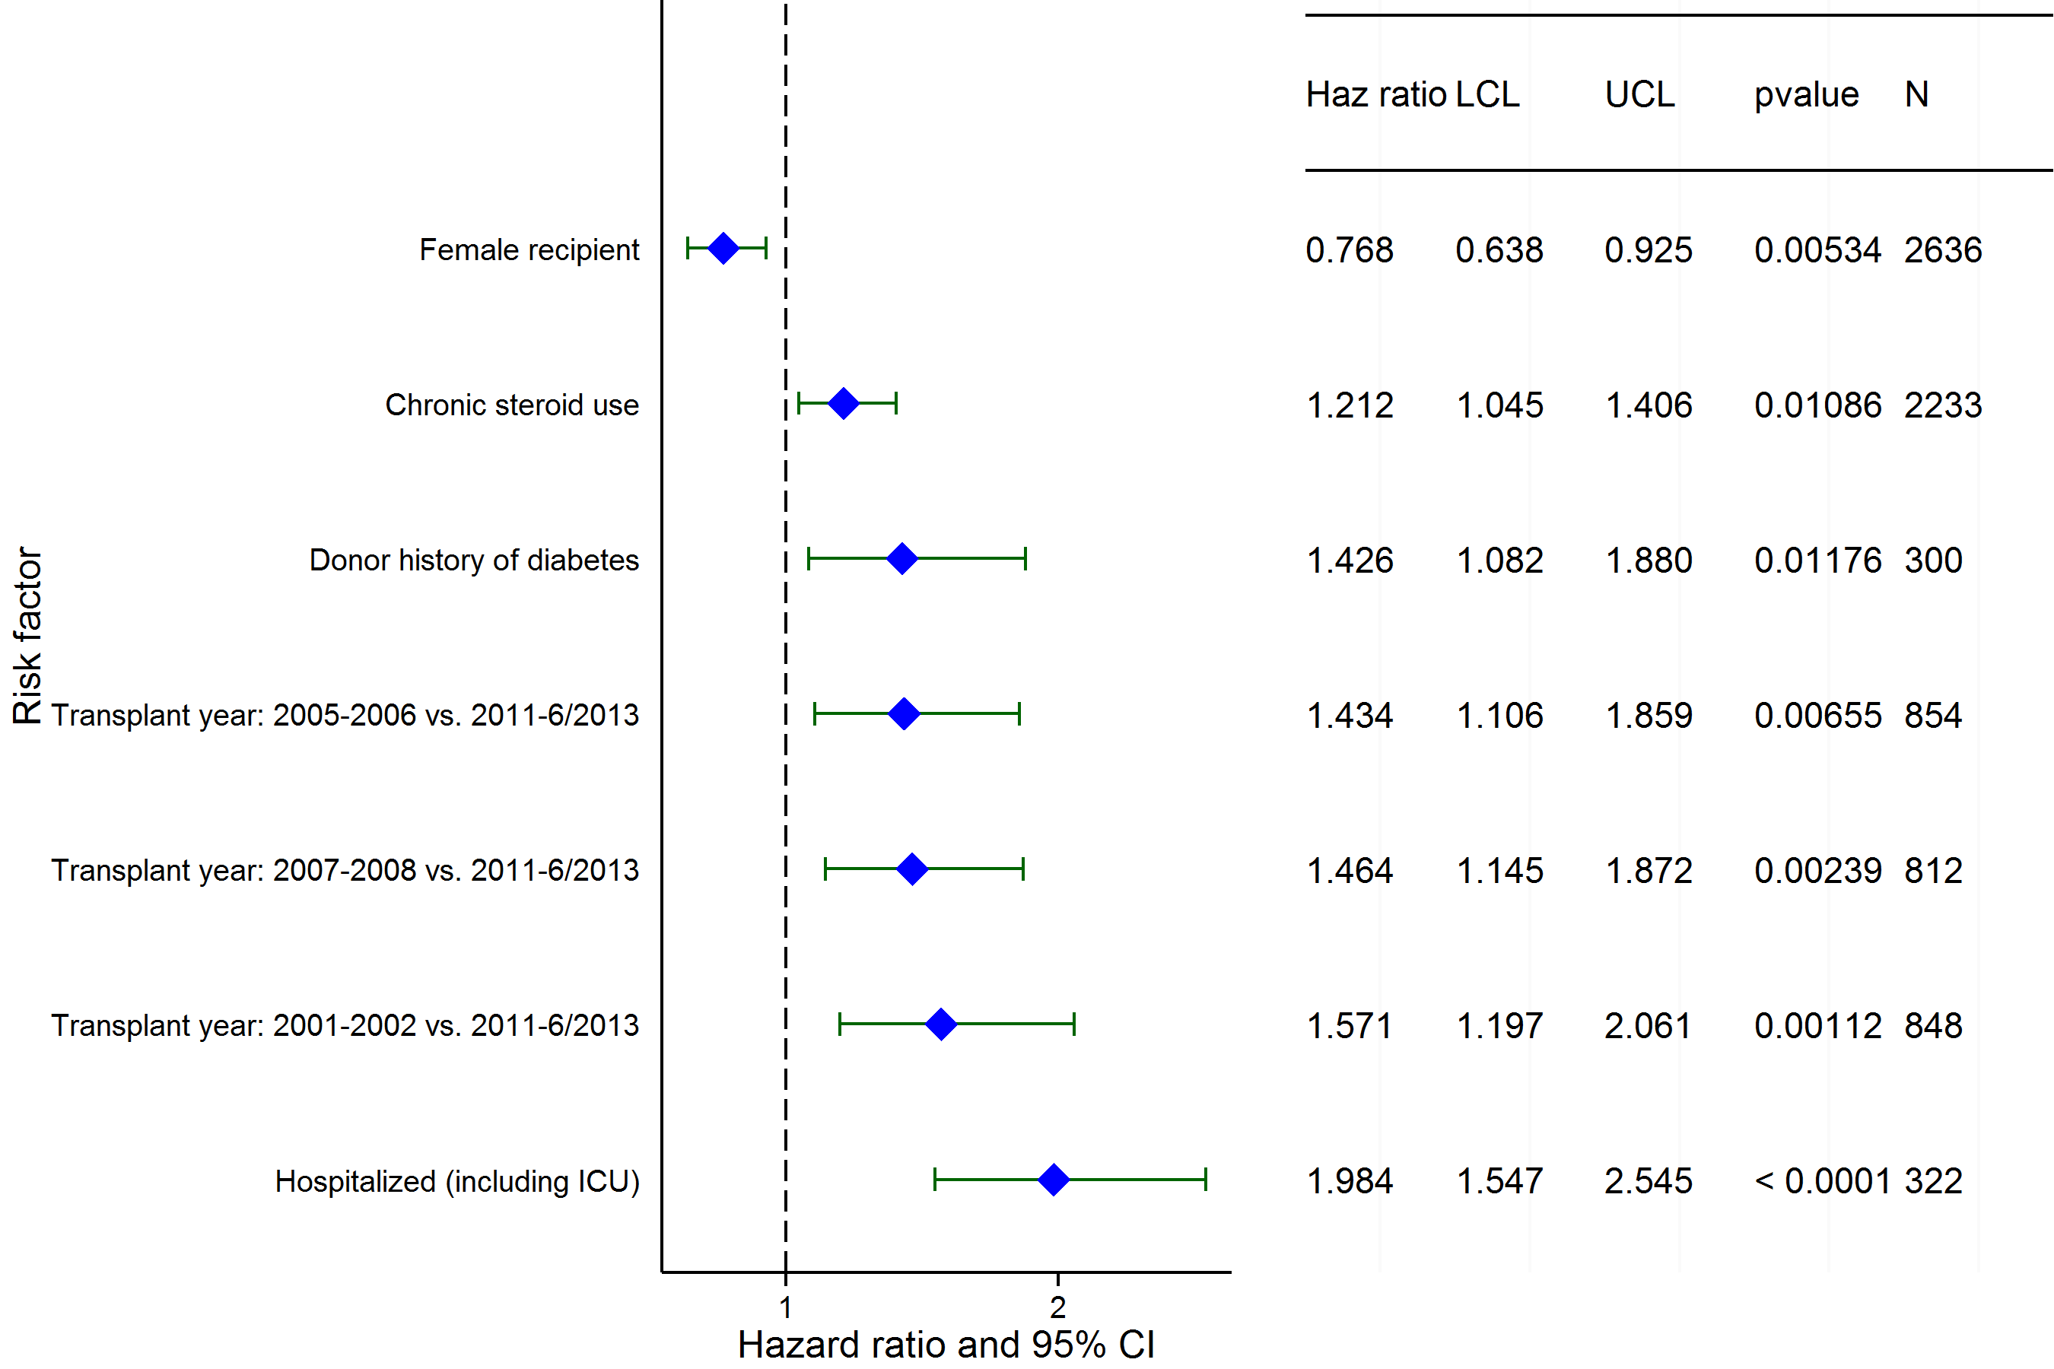
Adult Lung Transplants (2001-6/2013)
Diagnosis = COPD/Emphysema
Risk Factors For 1 Year Mortality with 95% Confidence Limits
2015
(N = 5,284)
JHLT. 2015 Oct; 34(10): 1264-1277
Notes:
NOTE: A separate model was fit for recipients with a diagnosis of COPD/emphysema.
Multivariable analysis was performed using a proportional hazards model censoring all patients at 1 year. Continuous factors were fit using a restricted cubic spline.
Analyses were limited to transplants having essentially complete information regarding risk factors.

Slide 108
Adult Lung Transplants (2001-6/2013)
Diagnosis = COPD/Emphysema
Risk Factors For 1 Year Mortality
Continuous Factors (see figures)
Recipient age | Recipient cardiac output
Transplant center volume | Recipient oxygen required at rest
2015
JHLT. 2015 Oct; 34(10): 1264-1277
Notes:
NOTE: A separate model was fit for recipients with a diagnosis of COPD/emphysema.
Multivariable analysis was performed using a proportional hazards model censoring all patients at 1 year. Continuous factors were fit using a restricted cubic spline.
Analyses were limited to transplants having essentially complete information regarding risk factors.

Slide 109
Adult Lung Transplants (2001-6/2013)
Risk Factors For 1 Year Mortality with 95% Confidence Limits
Recipient age
Diagnosis = COPD/Emphysema
p < 0.0001
2015
(N = 5,284)
JHLT. 2015 Oct; 34(10): 1264-1277
Notes:
NOTE: A separate model was fit for recipients with a diagnosis of COPD/emphysema.
Multivariable analysis was performed using a proportional hazards model censoring all patients at 1 year. Continuous factors were fit using a restricted cubic spline.
Analyses were limited to transplants having essentially complete information regarding risk factors.

Slide 110
Adult Lung Transplants (2001-6/2013)
Diagnosis = COPD/Emphysema
Risk Factors For 1 Year Mortality with 95% Confidence Limits
Recipient cardiac output
p = 0.0008
2015
(N = 5,284)
JHLT. 2015 Oct; 34(10): 1264-1277
Notes:
NOTE: A separate model was fit for recipients with a diagnosis of COPD/emphysema.
Multivariable analysis was performed using a proportional hazards model censoring all patients at 1 year. Continuous factors were fit using a restricted cubic spline.
Analyses were limited to transplants having essentially complete information regarding risk factors.

Slide 111
Adult Lung Transplants (2001-6/2013)
Transplant center volume
Diagnosis = COPD/Emphysema
Risk Factors For 1 Year Mortality with 95% Confidence Limits
p = 0.0009
2015
(N = 5,284)
JHLT. 2015 Oct; 34(10): 1264-1277
Notes:
NOTE: A separate model was fit for recipients with a diagnosis of COPD/emphysema.
Multivariable analysis was performed using a proportional hazards model censoring all patients at 1 year. Continuous factors were fit using a restricted cubic spline.
Analyses were limited to transplants having essentially complete information regarding risk factors.

Slide 112
Adult Lung Transplants (2001-6/2013)
Recipient oxygen required at rest
Diagnosis = COPD/Emphysema
Risk Factors For 1 Year Mortality with 95% Confidence Limits
p = 0.0373
2015
(N = 5,284)
JHLT. 2015 Oct; 34(10): 1264-1277
Notes:
NOTE: A separate model was fit for recipients with a diagnosis of COPD/emphysema.
Multivariable analysis was performed using a proportional hazards model censoring all patients at 1 year. Continuous factors were fit using a restricted cubic spline.
Analyses were limited to transplants having essentially complete information regarding risk factors.

Slide 113
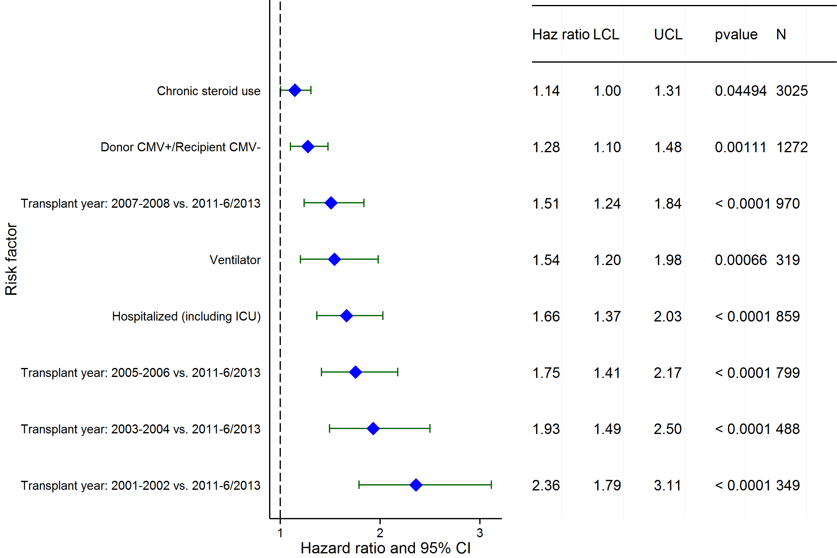
Adult Lung Transplants (2001-6/2013)
Diagnosis = IPF
Risk Factors For 1 Year Mortality with 95% Confidence Limits
2015
(N = 5,590)
JHLT. 2015 Oct; 34(10): 1264-1277
Notes:
NOTE: A separate model was fit for recipients with a diagnosis of IPF.
Multivariable analysis was performed using a proportional hazards model censoring all patients at 1 year. Continuous factors were fit using a restricted cubic spline.
Analyses were limited to transplants having essentially complete information regarding risk factors.

Slide 114
Adult Lung Transplants (2001-6/2013)
Diagnosis = IPF
Risk Factors For 1 Year Mortality
Continuous Factors (see figures)
Recipient age | Donor age
Recipient creatinine | Ischemia time
Bilirubin | Donor height
Transplant center volume | Recipient oxygen required at rest
Recipient FEV1 (% predicted)
2015
JHLT. 2015 Oct; 34(10): 1264-1277
Notes:
NOTE: A separate model was fit for recipients with a diagnosis of IPF.
Multivariable analysis was performed using a proportional hazards model censoring all patients at 1 year. Continuous factors were fit using a restricted cubic spline.
Analyses were limited to transplants having essentially complete information regarding risk factors.

Slide 115
Adult Lung Transplants (2001-6/2013)
Recipient age
Diagnosis = IPF
Risk Factors For 1 Year Mortality with 95% Confidence Limits
p < 0.0001
2015
(N = 5,590)
JHLT. 2015 Oct; 34(10): 1264-1277
Notes:
NOTE: A separate model was fit for recipients with a diagnosis of IPF.
Multivariable analysis was performed using a proportional hazards model censoring all patients at 1 year. Continuous factors were fit using a restricted cubic spline.
Analyses were limited to transplants having essentially complete information regarding risk factors.

Slide 116
Adult Lung Transplants (2001-6/2013)
Donor age
Diagnosis = IPF
Risk Factors For 1 Year Mortality with 95% Confidence Limits
p = 0.0339
2015
(N = 5,590)
JHLT. 2015 Oct; 34(10): 1264-1277
Notes:
NOTE: A separate model was fit for recipients with a diagnosis of IPF.
Multivariable analysis was performed using a proportional hazards model censoring all patients at 1 year. Continuous factors were fit using a restricted cubic spline.
Analyses were limited to transplants having essentially complete information regarding risk factors.

Slide 117
Adult Lung Transplants (2001-6/2013)
Recipient creatinine
Diagnosis = IPF
Risk Factors For 1 Year Mortality with 95% Confidence Limits
p = 0.0092
2015
(N = 5,590)
JHLT. 2015 Oct; 34(10): 1264-1277
Notes:
NOTE: A separate model was fit for recipients with a diagnosis of IPF.
Multivariable analysis was performed using a proportional hazards model censoring all patients at 1 year. Continuous factors were fit using a restricted cubic spline.
Analyses were limited to transplants having essentially complete information regarding risk factors.

Slide 118
Adult Lung Transplants (2001-6/2013)
Ischemia time
Diagnosis = IPF
Risk Factors For 1 Year Mortality with 95% Confidence Limits
p = 0.0272
2015
(N = 5,590)
JHLT. 2015 Oct; 34(10): 1264-1277
Notes:
NOTE: A separate model was fit for recipients with a diagnosis of IPF.
Multivariable analysis was performed using a proportional hazards model censoring all patients at 1 year. Continuous factors were fit using a restricted cubic spline.
Analyses were limited to transplants having essentially complete information regarding risk factors.

Slide 119
Adult Lung Transplants (2001-6/2013)
Bilirubin
Diagnosis = IPF
Risk Factors For 1 Year Mortality with 95% Confidence Limits
p < 0.0001
2015
(N = 5,590)
JHLT. 2015 Oct; 34(10): 1264-1277
Notes:
NOTE: A separate model was fit for recipients with a diagnosis of IPF.
Multivariable analysis was performed using a proportional hazards model censoring all patients at 1 year. Continuous factors were fit using a restricted cubic spline.
Analyses were limited to transplants having essentially complete information regarding risk factors.

Slide 120
Adult Lung Transplants (2001-6/2013)
Donor height
Diagnosis = IPF
Risk Factors For 1 Year Mortality with 95% Confidence Limits
p = 0.0004
2015
(N = 5,590)
JHLT. 2015 Oct; 34(10): 1264-1277
Notes:
NOTE: A separate model was fit for recipients with a diagnosis of IPF.
Multivariable analysis was performed using a proportional hazards model censoring all patients at 1 year. Continuous factors were fit using a restricted cubic spline.
Analyses were limited to transplants having essentially complete information regarding risk factors.

Slide 121
Adult Lung Transplants (2001-6/2013)
Transplant center volume
Diagnosis = IPF
Risk Factors For 1 Year Mortality with 95% Confidence Limits
p < 0.0001
2015
(N = 5,590)
JHLT. 2015 Oct; 34(10): 1264-1277
Notes:
NOTE: A separate model was fit for recipients with a diagnosis of IPF.
Multivariable analysis was performed using a proportional hazards model censoring all patients at 1 year. Continuous factors were fit using a restricted cubic spline.
Analyses were limited to transplants having essentially complete information regarding risk factors.

Slide 122
Adult Lung Transplants (2001-6/2013)
Recipient oxygen required at rest
Diagnosis = IPF
Risk Factors For 1 Year Mortality with 95% Confidence Limits
p < 0.0001
2015
(N = 5,590)
JHLT. 2015 Oct; 34(10): 1264-1277
Notes:
NOTE: A separate model was fit for recipients with a diagnosis of IPF.
Multivariable analysis was performed using a proportional hazards model censoring all patients at 1 year. Continuous factors were fit using a restricted cubic spline.
Analyses were limited to transplants having essentially complete information regarding risk factors.

Slide 123
Adult Lung Transplants (2001-6/2013)
Recipient FEV1 (% predicted)
Diagnosis = IPF
Risk Factors For 1 Year Mortality with 95% Confidence Limits
p = 0.0037
2015
(N = 5,590)
JHLT. 2015 Oct; 34(10): 1264-1277
Notes:
NOTE: A separate model was fit for recipients with a diagnosis of IPF.
Multivariable analysis was performed using a proportional hazards model censoring all patients at 1 year. Continuous factors were fit using a restricted cubic spline.
Analyses were limited to transplants having essentially complete information regarding risk factors.

Slide 124
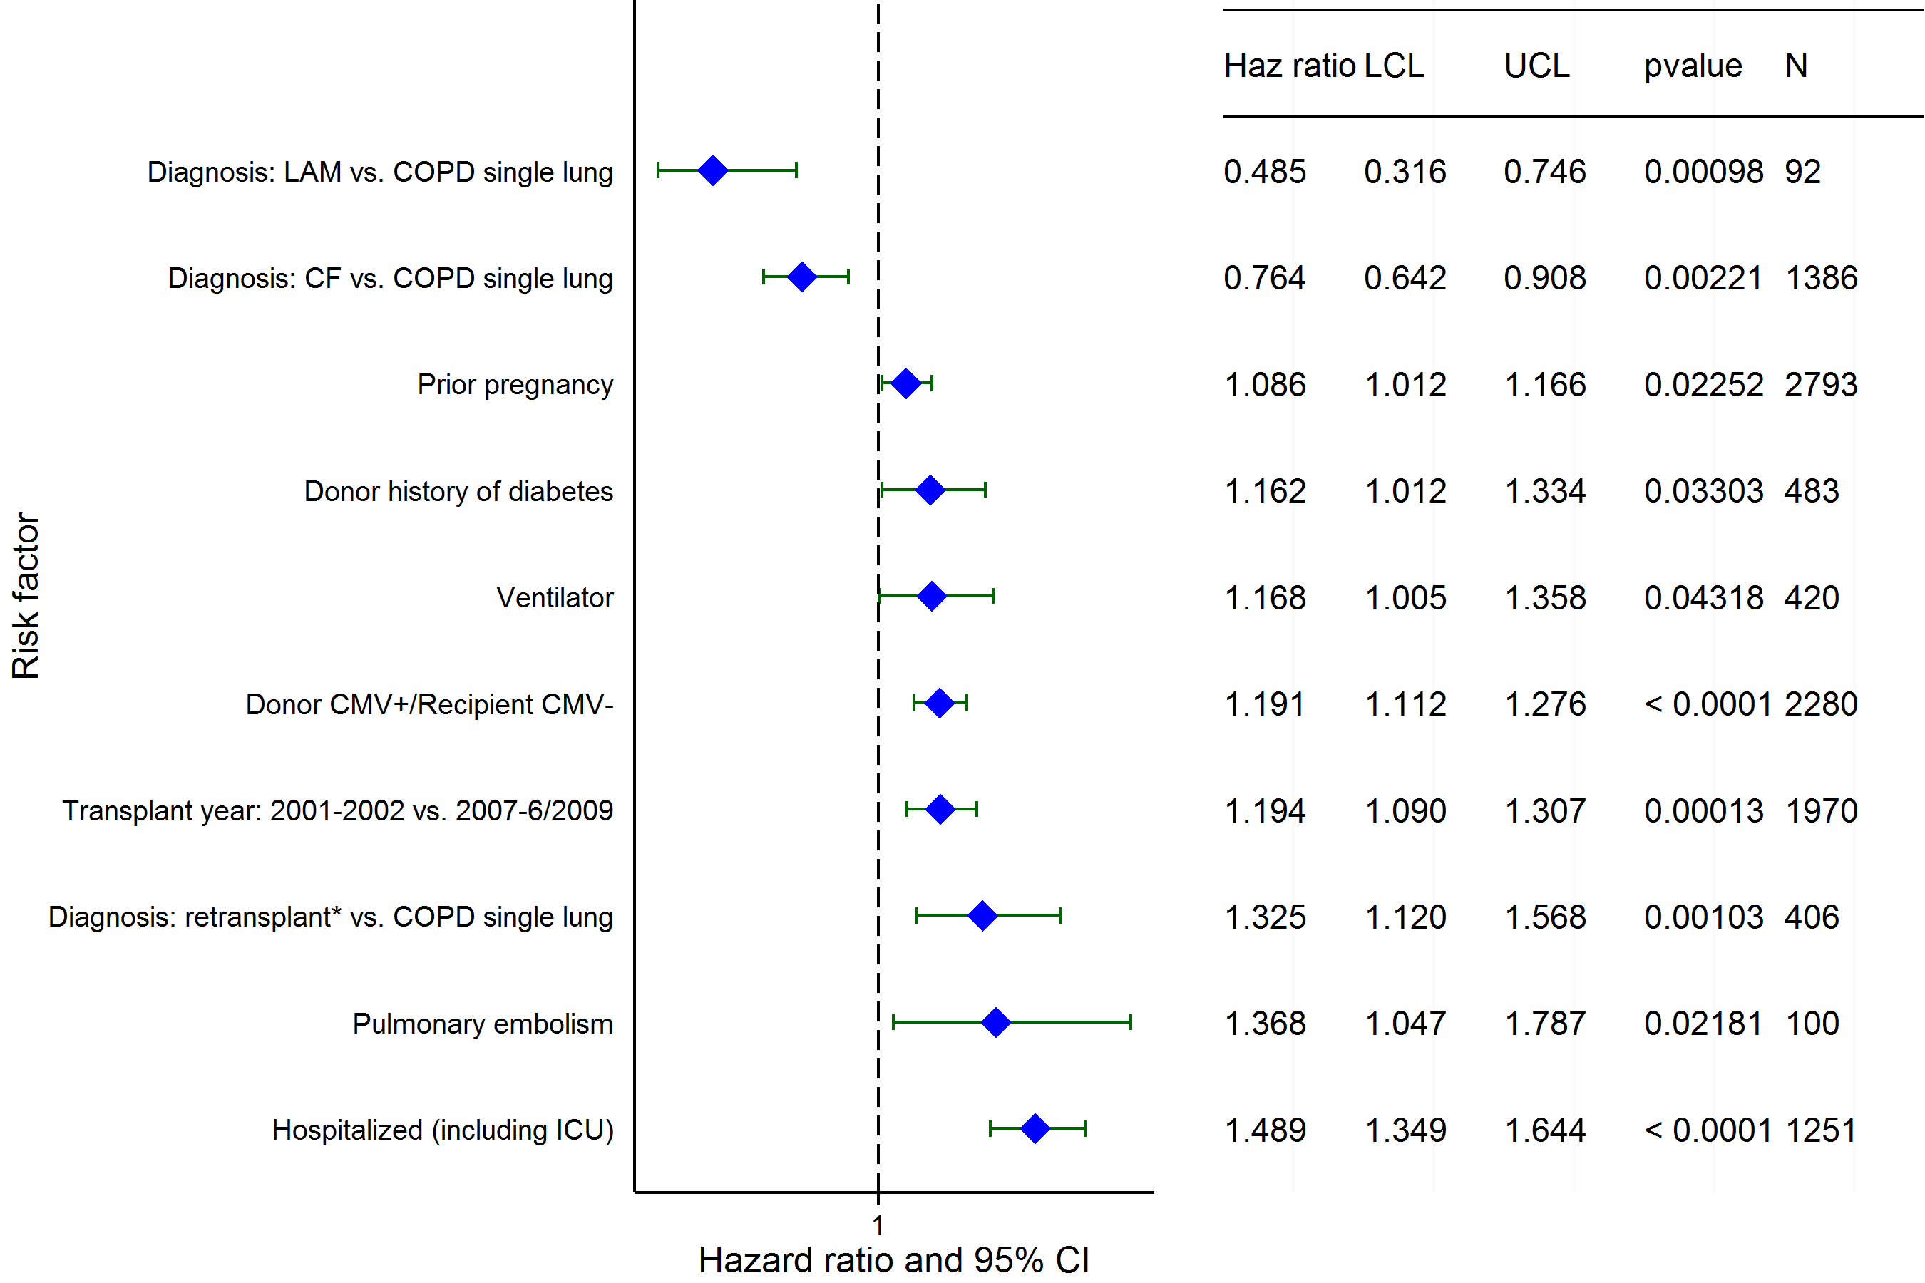
Adult Lung Transplants (2001-6/2009)
Risk Factors For 5 Year Mortality with 95% Confidence Limits
2015
(N = 10,584)
* Retransplant includes those with a retransplant diagnosis or a previous transplant was reported
JHLT. 2015 Oct; 34(10): 1264-1277
Notes:
Multivariable analysis was performed using a proportional hazards model censoring all patients at 5 years. Continuous factors were fit using a restricted cubic spline.
Analyses were limited to transplants having essentially complete information regarding risk factors.

Slide 125
Adult Lung Transplants (2001-6/2009)
Risk Factors For 5 Year Mortality
Continuous Factors (see figures)
Recipient age | Recipient creatinine
Recipient cardiac output | Bilirubin
Transplant center volume | Height difference
Recipient oxygen required at rest
2015
JHLT. 2015 Oct; 34(10): 1264-1277
Notes:
Multivariable analysis was performed using a proportional hazards model censoring all patients at 5 years. Continuous factors were fit using a restricted cubic spline.
Analyses were limited to transplants having essentially complete information regarding risk factors.

Slide 126
Adult Lung Transplants (2001-6/2009)
Recipient age
Risk Factors For 5 Year Mortality with 95% Confidence Limits
p < 0.0001
2015
(N = 10,584)
JHLT. 2015 Oct; 34(10): 1264-1277
Notes:
Multivariable analysis was performed using a proportional hazards model censoring all patients at 5 years. Continuous factors were fit using a restricted cubic spline.
Analyses were limited to transplants having essentially complete information regarding risk factors.

Slide 127
Adult Lung Transplants (2001-6/2009)
Recipient creatinine
Risk Factors For 5 Year Mortality with 95% Confidence Limits
p = 0.0003
2015
(N = 10,584)
JHLT. 2015 Oct; 34(10): 1264-1277
Notes:
Multivariable analysis was performed using a proportional hazards model censoring all patients at 5 years. Continuous factors were fit using a restricted cubic spline.
Analyses were limited to transplants having essentially complete information regarding risk factors.

Slide 128
Adult Lung Transplants (2001-6/2009)
Recipient cardiac output
Risk Factors For 5 Year Mortality with 95% Confidence Limits
p = 0.0003
2015
(N = 10,584)
JHLT. 2015 Oct; 34(10): 1264-1277
Notes:
Multivariable analysis was performed using a proportional hazards model censoring all patients at 5 years. Continuous factors were fit using a restricted cubic spline.
Analyses were limited to transplants having essentially complete information regarding risk factors.

Slide 129
Adult Lung Transplants (2001-6/2009)
Bilirubin
Risk Factors For 5 Year Mortality with 95% Confidence Limits
p = 0.0199
2015
(N = 10,584)
JHLT. 2015 Oct; 34(10): 1264-1277
Notes:
Multivariable analysis was performed using a proportional hazards model censoring all patients at 5 years. Continuous factors were fit using a restricted cubic spline.
Analyses were limited to transplants having essentially complete information regarding risk factors.

Slide 130
Adult Lung Transplants (2001-6/2009)
Transplant center volume
Risk Factors For 5 Year Mortality with 95% Confidence Limits
p < 0.0001
2015
(N = 10,584)
JHLT. 2015 Oct; 34(10): 1264-1277
Notes:
Multivariable analysis was performed using a proportional hazards model censoring all patients at 5 years. Continuous factors were fit using a restricted cubic spline.
Analyses were limited to transplants having essentially complete information regarding risk factors.

Slide 131
Adult Lung Transplants (2001-6/2009)
Height difference
Risk Factors For 5 Year Mortality with 95% Confidence Limits
p = 0.0120
2015
(N = 10,584)
JHLT. 2015 Oct; 34(10): 1264-1277
Notes:
Multivariable analysis was performed using a proportional hazards model censoring all patients at 5 years. Continuous factors were fit using a restricted cubic spline.
Analyses were limited to transplants having essentially complete information regarding risk factors.

Slide 132
Adult Lung Transplants (2001-6/2009)
Recipient oxygen required at rest
Risk Factors For 5 Year Mortality with 95% Confidence Limits
p = 0.0003
2015
(N = 10,584)
JHLT. 2015 Oct; 34(10): 1264-1277
Notes:
Multivariable analysis was performed using a proportional hazards model censoring all patients at 5 years. Continuous factors were fit using a restricted cubic spline.
Analyses were limited to transplants having essentially complete information regarding risk factors.

Slide 133
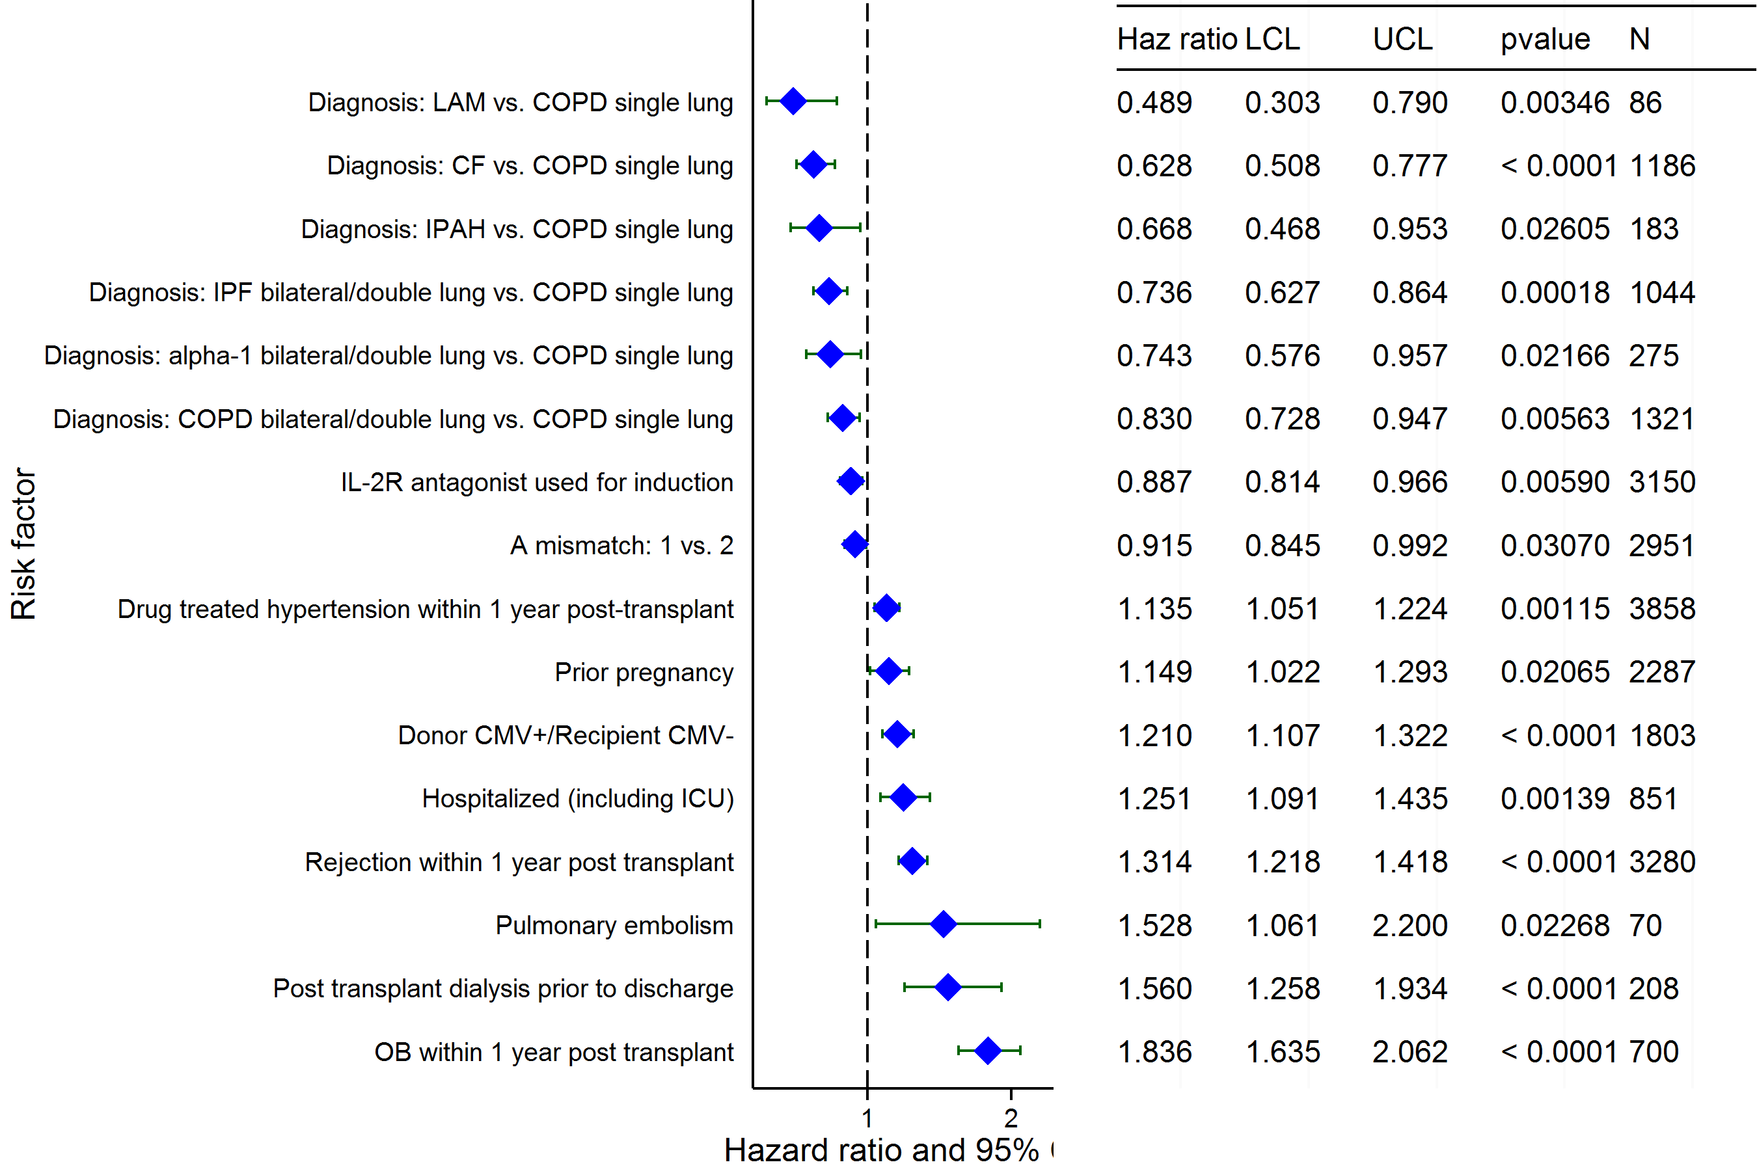
Adult Lung Transplants (2001-6/2009)
Conditional on Survival to 1 Year
Risk Factors For 5 Year Mortality with 95% Confidence Limits
2015
(N = 8,539)
JHLT. 2015 Oct; 34(10): 1264-1277
Notes:
Multivariable analysis was performed using a proportional hazards model censoring all patients at 5 years. Continuous factors were fit using a restricted cubic spline.
Analyses were limited to transplants having essentially complete information regarding risk factors.

Slide 134
Adult Lung Transplants (2001-6/2009)
Conditional on Survival to 1 Year
Risk Factors For 5 Year Mortality
Continuous Factors (see figures)
Recipient age | Recipient cardiac output
Transplant center volume | Recipient PVR
BMI difference | Recipient oxygen required at rest
2015
JHLT. 2015 Oct; 34(10): 1264-1277
Notes:
Multivariable analysis was performed using a proportional hazards model censoring all patients at 5 years. Continuous factors were fit using a restricted cubic spline.
Analyses were limited to transplants having essentially complete information regarding risk factors.

Slide 135
Adult Lung Transplants (2001-6/2009)
Recipient age
Conditional on Survival to 1 Year
Risk Factors For 5 Year Mortality with 95% Confidence Limits
p < 0.0001
2015
(N = 8,539)
JHLT. 2015 Oct; 34(10): 1264-1277
Notes:
Multivariable analysis was performed using a proportional hazards model censoring all patients at 5 years. Continuous factors were fit using a restricted cubic spline.
Analyses were limited to transplants having essentially complete information regarding risk factors.

Slide 136
Adult Lung Transplants (2001-6/2009)
Recipient cardiac output
Conditional on Survival to 1 Year
Risk Factors For 5 Year Mortality with 95% Confidence Limits
p = 0.0137
2015
(N = 8,539)
JHLT. 2015 Oct; 34(10): 1264-1277
Notes:
Multivariable analysis was performed using a proportional hazards model censoring all patients at 5 years. Continuous factors were fit using a restricted cubic spline.
Analyses were limited to transplants having essentially complete information regarding risk factors.

Slide 137
Adult Lung Transplants (2001-6/2009)
Transplant center volume
Conditional on Survival to 1 Year
Risk Factors For 5 Year Mortality with 95% Confidence Limits
p = 0.0002
2015
(N = 8,539)
JHLT. 2015 Oct; 34(10): 1264-1277
Notes:
Multivariable analysis was performed using a proportional hazards model censoring all patients at 5 years. Continuous factors were fit using a restricted cubic spline.
Analyses were limited to transplants having essentially complete information regarding risk factors.

Slide 138
Adult Lung Transplants (2001-6/2009)
Conditional on Survival to 1 Year
Risk Factors For 5 Year Mortality with 95% Confidence Limits
Recipient PVR
p = 0.0462
2015
(N = 8,539)
JHLT. 2015 Oct; 34(10): 1264-1277
Notes:
Multivariable analysis was performed using a proportional hazards model censoring all patients at 5 years. Continuous factors were fit using a restricted cubic spline.
Analyses were limited to transplants having essentially complete information regarding risk factors.

Slide 139
Conditional on Survival to 1 Year
Risk Factors For 5 Year Mortality with 95% Confidence Limits
Adult Lung Transplants (2001-6/2009)
BMI difference
p = 0.0078
2015
(N = 8,539)
JHLT. 2015 Oct; 34(10): 1264-1277
Notes:
Multivariable analysis was performed using a proportional hazards model censoring all patients at 5 years. Continuous factors were fit using a restricted cubic spline.
Analyses were limited to transplants having essentially complete information regarding risk factors.

Slide 140
Adult Lung Transplants (2001-6/2009)
Recipient oxygen required at rest
Conditional on Survival to 1 Year
Risk Factors For 5 Year Mortality with 95% Confidence Limits
p = 0.0384
2015
(N = 8,539)
JHLT. 2015 Oct; 34(10): 1264-1277
Notes:
Multivariable analysis was performed using a proportional hazards model censoring all patients at 5 years. Continuous factors were fit using a restricted cubic spline.
Analyses were limited to transplants having essentially complete information regarding risk factors.

Slide 141
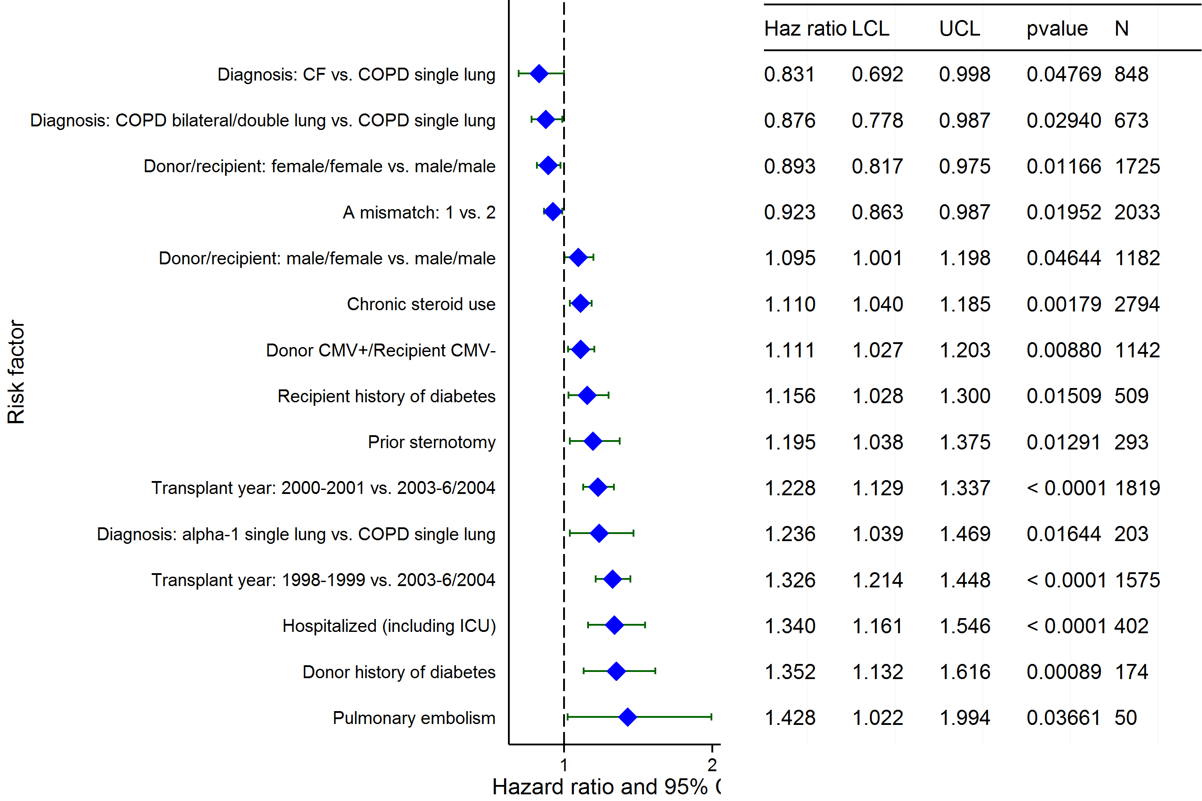
Adult Lung Transplants (1998-6/2004)
Risk Factors For 10 Year Mortality with 95% Confidence Limits
2015
(N = 5,958)
JHLT. 2015 Oct; 34(10): 1264-1277
Notes:
Multivariable analysis was performed using a proportional hazards model censoring all patients at 10 years. Continuous factors were fit using a restricted cubic spline.
Analyses were limited to transplants having essentially complete information regarding risk factors.

Slide 142
Adult Lung Transplants (1998-6/2004)
Risk Factors For 10 Year Mortality
Continuous Factors (see figures)
Recipient age | Donor age
Recipient creatinine | Recipient cardiac output
Transplant center volume | BMI difference
Recipient oxygen required at rest
2015
JHLT. 2015 Oct; 34(10): 1264-1277
Notes:
Multivariable analysis was performed using a proportional hazards model censoring all patients at 10 years. Continuous factors were fit using a restricted cubic spline.
Analyses were limited to transplants having essentially complete information regarding risk factors.

Slide 143
Adult Lung Transplants (1998-6/2004)
Recipient age
Risk Factors For 10 Year Mortality with 95% Confidence Limits
p < 0.0001
2015
(N = 5,958)
JHLT. 2015 Oct; 34(10): 1264-1277
Notes:
Multivariable analysis was performed using a proportional hazards model censoring all patients at 10 years. Continuous factors were fit using a restricted cubic spline.
Analyses were limited to transplants having essentially complete information regarding risk factors.

Slide 144
Adult Lung Transplants (1998-6/2004)
Donor age
Risk Factors For 10 Year Mortality with 95% Confidence Limits
p = 0.0080
2015
(N = 5,958)
JHLT. 2015 Oct; 34(10): 1264-1277
Notes:
Multivariable analysis was performed using a proportional hazards model censoring all patients at 10 years. Continuous factors were fit using a restricted cubic spline.
Analyses were limited to transplants having essentially complete information regarding risk factors.

Slide 145
Adult Lung Transplants (1998-6/2004)
Recipient creatinine
Risk Factors For 10 Year Mortality with 95% Confidence Limits
p = 0.0234
2015
(N = 5,958)
JHLT. 2015 Oct; 34(10): 1264-1277
Notes:
Multivariable analysis was performed using a proportional hazards model censoring all patients at 10 years. Continuous factors were fit using a restricted cubic spline.
Analyses were limited to transplants having essentially complete information regarding risk factors.

Slide 146
Adult Lung Transplants (1998-6/2004)
Recipient cardiac output
Risk Factors For 10 Year Mortality with 95% Confidence Limits
p = 0.0060
2015
(N = 5,958)
JHLT. 2015 Oct; 34(10): 1264-1277
Notes:
Multivariable analysis was performed using a proportional hazards model censoring all patients at 10 years. Continuous factors were fit using a restricted cubic spline.
Analyses were limited to transplants having essentially complete information regarding risk factors.

Slide 147
Adult Lung Transplants (1998-6/2004)
Transplant center volume
Risk Factors For 10 Year Mortality with 95% Confidence Limits
p < 0.0001
2015
(N = 5,958)
JHLT. 2015 Oct; 34(10): 1264-1277
Notes:
Multivariable analysis was performed using a proportional hazards model censoring all patients at 10 years. Continuous factors were fit using a restricted cubic spline.
Analyses were limited to transplants having essentially complete information regarding risk factors.

Slide 148
Adult Lung Transplants (1998-6/2004)
BMI difference
Risk Factors For 10 Year Mortality with 95% Confidence Limits
p = 0.0003
2015
(N = 5,958)
JHLT. 2015 Oct; 34(10): 1264-1277
Notes:
Multivariable analysis was performed using a proportional hazards model censoring all patients at 10 years. Continuous factors were fit using a restricted cubic spline.
Analyses were limited to transplants having essentially complete information regarding risk factors.

Slide 149
Adult Lung Transplants (1998-6/2004)
Recipient oxygen required at rest
Risk Factors For 10 Year Mortality with 95% Confidence Limits
p = 0.0017
2015
(N = 5,958)
JHLT. 2015 Oct; 34(10): 1264-1277
Notes:
Multivariable analysis was performed using a proportional hazards model censoring all patients at 10 years. Continuous factors were fit using a restricted cubic spline.
Analyses were limited to transplants having essentially complete information regarding risk factors.

Slide 150
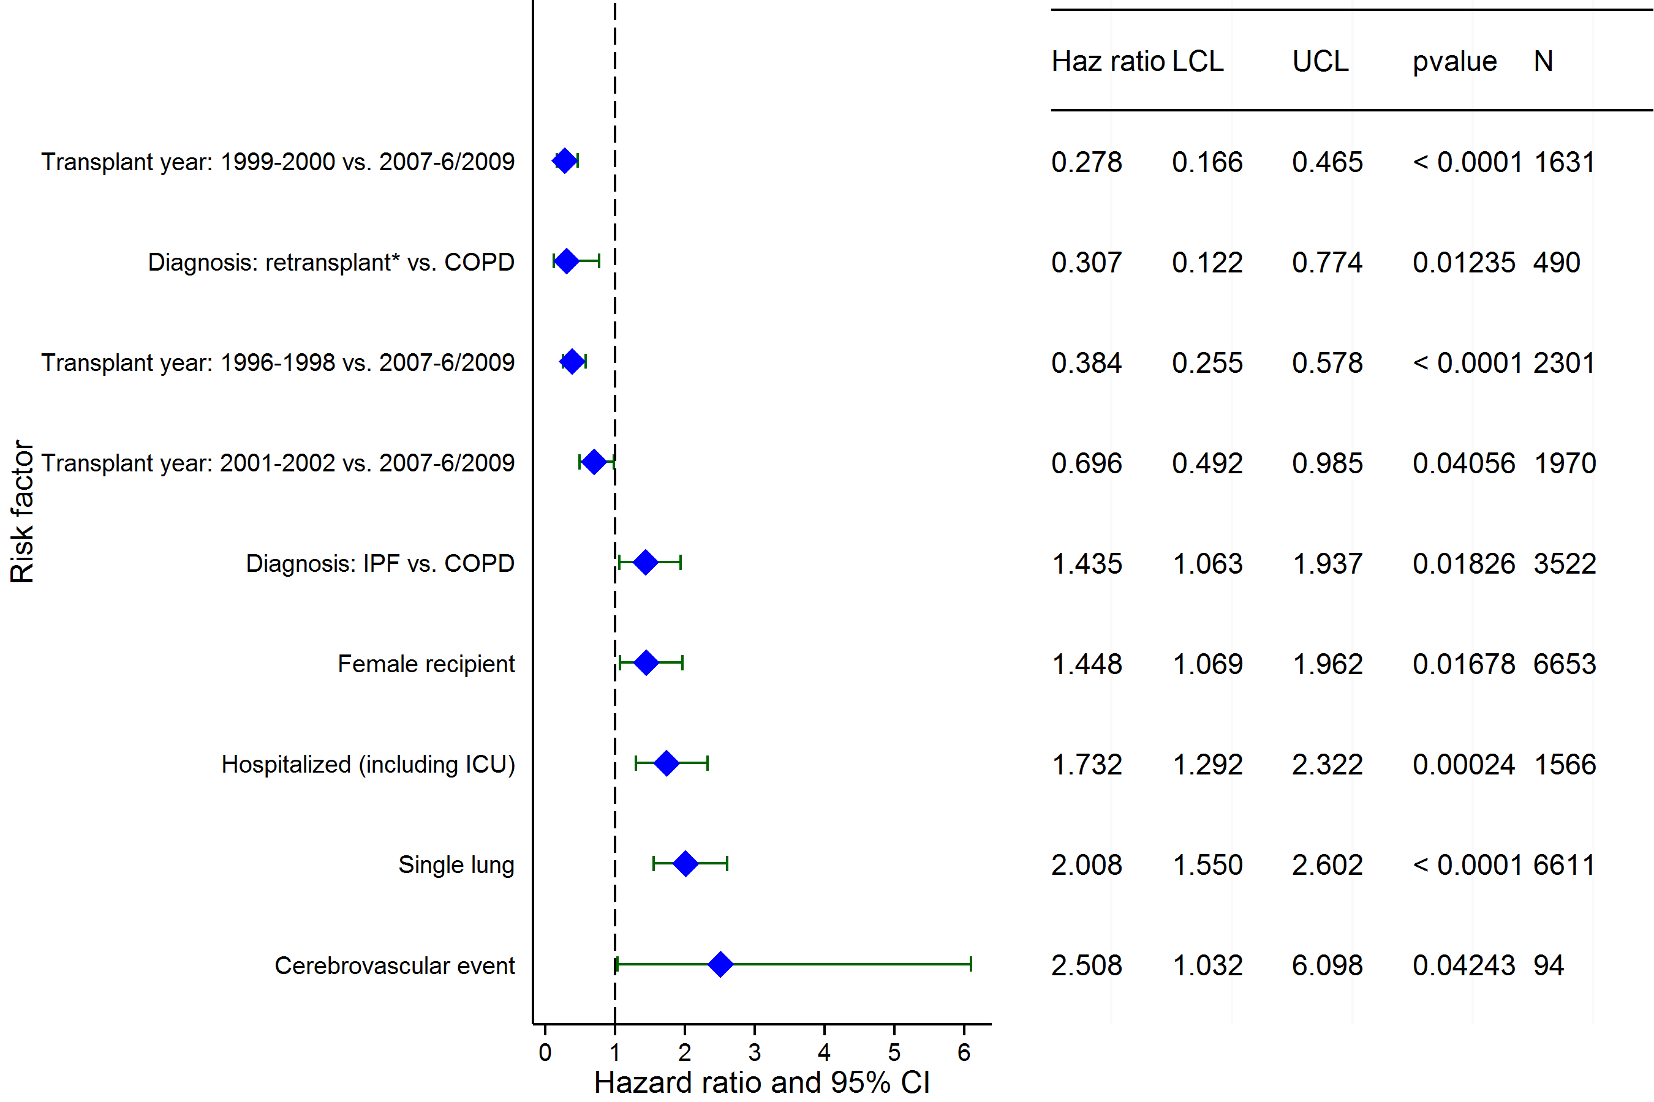
Adult Lung Transplants (1996-6/2009)
Risk Factors For Retransplantation within 5 Years with 95% Confidence Limits
(N = 14,516)
2015
* Retransplant includes those with a retransplant diagnosis or a previous transplant was reported
JHLT. 2015 Oct; 34(10): 1264-1277

Slide 151
Adult Lung Transplants (1996-6/2009)
Risk Factors For Retransplantation within 5 Years
Continuous Factors (see figures)
Recipient age | Donor age
Donor height | Height difference
Recipient oxygen required at rest
2015
JHLT. 2015 Oct; 34(10): 1264-1277
Notes:
Multivariable analysis was performed using a proportional hazards model censoring all patients at 5 years. Continuous factors were fit using a restricted cubic spline.
Analyses were limited to transplants having essentially complete information regarding risk factors.

Slide 152
Adult Lung Transplants (1996-6/2009)
Risk Factors For Retransplantation within 5 Years with 95% Confidence Limits
Recipient age
p < 0.0001
2015
(N = 14,516)
JHLT. 2015 Oct; 34(10): 1264-1277
Notes:
Multivariable analysis was performed using a proportional hazards model censoring all patients at 5 years. Continuous factors were fit using a restricted cubic spline.
Analyses were limited to transplants having essentially complete information regarding risk factors.

Slide 153
Adult Lung Transplants (1996-6/2009)
Risk Factors For Retransplantation within 5 Years with 95% Confidence Limits
Donor age
p = 0.0439
2015
(N = 14,516)
JHLT. 2015 Oct; 34(10): 1264-1277
Notes:
Multivariable analysis was performed using a proportional hazards model censoring all patients at 5 years. Continuous factors were fit using a restricted cubic spline.
Analyses were limited to transplants having essentially complete information regarding risk factors.

Slide 154
Adult Lung Transplants (1996-6/2009)
Risk Factors For Retransplantation within 5 Years with 95% Confidence Limits
Donor height
p = 0.0011
2015
(N = 14,516)
JHLT. 2015 Oct; 34(10): 1264-1277
Notes:
Multivariable analysis was performed using a proportional hazards model censoring all patients at 5 years. Continuous factors were fit using a restricted cubic spline.
Analyses were limited to transplants having essentially complete information regarding risk factors.

Slide 155
Adult Lung Transplants (1996-6/2009)
Risk Factors For Retransplantation within 5 Years with 95% Confidence Limits
Height difference
p < 0.0001
2015
(N = 14,516)
JHLT. 2015 Oct; 34(10): 1264-1277
Notes:
Multivariable analysis was performed using a proportional hazards model censoring all patients at 5 years. Continuous factors were fit using a restricted cubic spline.
Analyses were limited to transplants having essentially complete information regarding risk factors.

Slide 156
Adult Lung Transplants (1996-6/2009)
Risk Factors For Retransplantation within 5 Years with 95% Confidence Limits
Recipient oxygen required at rest
p = 0.0358
2015
(N = 14,516)
JHLT. 2015 Oct; 34(10): 1264-1277
Notes:
Multivariable analysis was performed using a proportional hazards model censoring all patients at 5 years. Continuous factors were fit using a restricted cubic spline.
Analyses were limited to transplants having essentially complete information regarding risk factors.

Slide 157
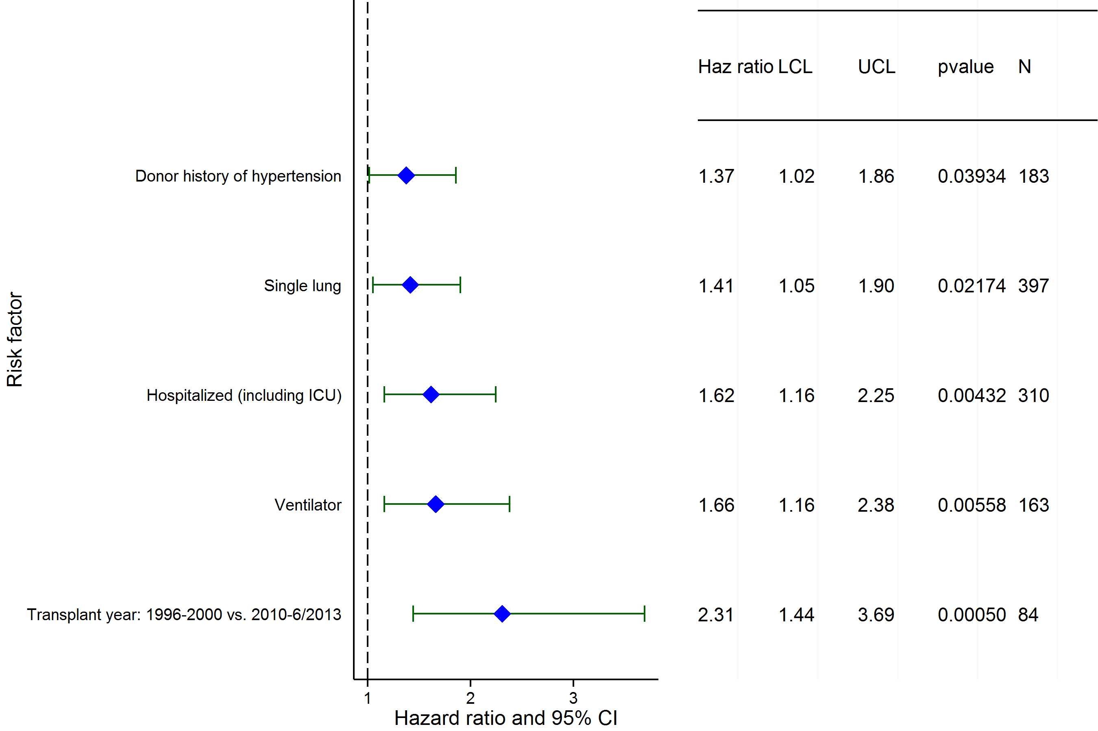
Adult Lung Transplants (1996-6/2013)
Retransplant recipients
Risk Factors For 1 Year Mortality with 95% Confidence Limits
2015
(N = 810)
JHLT. 2015 Oct; 34(10): 1264-1277

Slide 158
Adult Lung Transplants (1996-6/2013)
Retransplant recipients
Risk Factors For 1 Year Mortality
Continuous Factors (see figures)
Recipient creatinine | Transplant center volume
2015
JHLT. 2015 Oct; 34(10): 1264-1277

Slide 159
Adult Lung Transplants (1996-6/2013)
Recipient creatinine
Retransplant recipients
Risk Factors For 1 Year Mortality with 95% Confidence Limits
p = 0.0269
2015
(N = 810)
JHLT. 2015 Oct; 34(10): 1264-1277
Notes:
Multivariable analysis was performed using a proportional hazards model censoring all patients at 5 years. Continuous factors were fit using a restricted cubic spline.
Analyses were limited to transplants having essentially complete information regarding risk factors.

Slide 160
Adult Lung Transplants (1996-6/2013)
Transplant center volume
Retransplant recipients
Risk Factors For 1 Year Mortality with 95% Confidence Limits
p = 0.0159
2015
(N = 810)
JHLT. 2015 Oct; 34(10): 1264-1277
Notes:
Multivariable analysis was performed using a proportional hazards model censoring all patients at 5 years. Continuous factors were fit using a restricted cubic spline.
Analyses were limited to transplants having essentially complete information regarding risk factors.

Slide 161
Early Graft Failure (EGF)
2015
JHLT. 2015 Oct; 34(10): 1264-1277

Slide 162
Adult Lung Transplants
Cumulative Incidence of EGF by Transplant Type
(Transplants: January 2005 – December 2013)
2015
JHLT. 2015 Oct; 34(10): 1264-1277
JHLT. 2014 Oct; 33(10): 1009-1024
Notes:
Only transplants with known EGF status are included in the tabulation. Incidence was computed using a competing-risks extension of the Kaplan-Meier method.

Slide 163
Adult Lung Transplants
% with EGF by EGF Type and Year for Primary Transplants
2015
JHLT. 2015 Oct; 34(10): 1264-1277
JHLT. 2014 Oct; 33(10): 1009-1024
Notes:
Only transplants with known EGF status are included in the tabulation. Percentage with EGF was computed using a competing-risks extension of the Kaplan-Meier method.

Slide 164
Adult Lung Transplants
% with EGF by EGF Type and Year for First Retransplants
2015
JHLT. 2015 Oct; 34(10): 1264-1277
JHLT. 2014 Oct; 33(10): 1009-1024
Notes:
Only transplants with known EGF status are included in the tabulation. Percentage with EGF was computed using a competing-risks extension of the Kaplan-Meier method.

Slide 165
Adult Lung Transplants
Cumulative Incidence of EGF by Era
(Transplants: January 2005 – December 2013)
2015
JHLT. 2015 Oct; 34(10): 1264-1277
JHLT. 2014 Oct; 33(10): 1009-1024
Notes:
Only transplants with known EGF status are included in the tabulation. Incidence was computed using a competing-risks extension of the Kaplan-Meier method.

Slide 166
Adult Lung Transplants
Cumulative Incidence of EGF by Diagnosis
(Primary Transplants: January 2005 – December 2013)
2015
JHLT. 2015 Oct; 34(10): 1264-1277
JHLT. 2014 Oct; 33(10): 1009-1024
Notes:
Only transplants with known EGF status are included in the tabulation. Incidence was computed using a competing-risks extension of the Kaplan-Meier method.

Slide 167
Adult Lung Transplants
Cumulative Incidence of EGF by Diagnosis and Era
(Primary Transplants: January 2005 – December 2013)
2015
JHLT. 2015 Oct; 34(10): 1264-1277
JHLT. 2014 Oct; 33(10): 1009-1024
Notes:
Only transplants with known EGF status are included in the tabulation. Incidence was computed using a competing-risks extension of the Kaplan-Meier method.

Slide 168
Adult Lung Transplants
% with EGF by EGF Type, Procedure Type and Diagnosis (Primary Transplants: January 2005 – December 2013)
2015
* Ns represent the total number of single and bilateral/double transplants for each diagnosis
JHLT. 2015 Oct; 34(10): 1264-1277
JHLT. 2014 Oct; 33(10): 1009-1024
Notes:
Only transplants with known EGF status, diagnosis and procedure type are included in the tabulation. Percentage with EGF was computed using a competing-risks extension of the Kaplan-Meier method.
Comparisons were made using the chi-square statistic or Fisher's exact test. Adjustments for multiple comparisons were done using Bonferroni method.

Slide 169
Adult Lung Transplants
% with EGF by EGF Type and Age Group
(Primary Transplants: January 2005 – December 2013)
No pair-wise comparisons of % with EGF were significant at p < 0.05.
2015
JHLT. 2015 Oct; 34(10): 1264-1277
JHLT. 2014 Oct; 33(10): 1009-1024
Notes:
Only transplants with known EGF status are included in the tabulation. Percentage with EGF was computed using a competing-risks extension of the Kaplan-Meier method.
Comparisons were made using the chi-square statistic. Adjustments for multiple comparisons were done using Bonferroni method.

Slide 170
Adult Lung Transplants
% with EGF by EGF Type, Gender and Diagnosis
(Primary Transplants: January 2005 – December 2013)
2015
* Ns represent the total number of female and male recipients for each diagnosis
JHLT. 2015 Oct; 34(10): 1264-1277
JHLT. 2014 Oct; 33(10): 1009-1024
Notes:
Only transplants with known EGF status, diagnosis and gender are included in the tabulation. Percentage with EGF was computed using a competing-risks extension of the Kaplan-Meier method.
Comparisons were made using the chi-square statistic. Adjustments for multiple comparisons were done using Bonferroni method.

Slide 171
Adult Lung Transplants
Cumulative Incidence of EGF by Donor Gender
(Primary Transplants: January 2005 – December 2013)
p = 0.0006
2015
JHLT. 2015 Oct; 34(10): 1264-1277
JHLT. 2014 Oct; 33(10): 1009-1024
Notes:
Only transplants with known EGF status are included in the tabulation. Incidence was computed using a competing-risks extension of the Kaplan-Meier method.

Slide 172
Adult Lung Transplants
Cumulative Incidence of EGF by Donor Age Group
(Transplants: January 2005 – December 2013)
2015
JHLT. 2015 Oct; 34(10): 1264-1277
JHLT. 2014 Oct; 33(10): 1009-1024
Notes:
Only transplants with known EGF status are included in the tabulation. Incidence was computed using a competing-risks extension of the Kaplan-Meier method.

Slide 173
Adult Lung Transplants
% with EGF by Location and Era for Primary Transplants
No pair-wise comparisons between eras within each location and between locations within each era were significant at p < 0.05 except all pair-wise comparisons with North America within each era.
Europe
North America
Other
2015
JHLT. 2015 Oct; 34(10): 1264-1277
JHLT. 2014 Oct; 33(10): 1009-1024
Notes:
Only transplants with known EGF status are included in the tabulation. Percentage with EGF was computed using a competing-risks extension of the Kaplan-Meier method.
Comparisons were made using the chi-square statistic. Adjustments for multiple comparisons were done using Bonferroni method.

Slide 174
Adult Lung Transplants
% with EGF and non-EGF Early Failures by Location and Era for Primary Transplants
Europe
North America
Other
No pair-wise comparisons between eras within each location and between locations within each era were significant at p < 0.05 except:
% with EGF – all pair-wise comparisons with North America within each era
% with non-EGF early failures – all pair-wise comparisons with North America within each era
2015
* non-EGF early failures include non-EGF retransplants and deaths within 30 days
JHLT. 2015 Oct; 34(10): 1264-1277
JHLT. 2014 Oct; 33(10): 1009-1024
Notes:
Only transplants with known EGF status are included in the tabulation. Percentage with EGF was computed using a competing-risks extension of the Kaplan-Meier method.

Slide 175
Adult Lung Transplants
% with EGF by EGF Type and Center Volume
(Primary Transplants: January 2005 – December 2013)
All pair-wise comparisons of % with EGF with 30-39 and 50+ groups were significant at p < 0.05 except 1-4 vs. 30-39, 1-4 vs. 50+, 10-19 vs. 30-39, and 30-39 vs. 50+. No other pair-wise comparisons of % with EGF were significant.
2015
JHLT. 2015 Oct; 34(10): 1264-1277
JHLT. 2014 Oct; 33(10): 1009-1024
Notes:
Only transplants with known EGF status are included in the tabulation. Percentage with EGF was computed using a competing-risks extension of the Kaplan-Meier method.
Comparisons were made using the chi-square statistic or Fisher's exact test. Adjustments for multiple comparisons were done using Bonferroni method.

Slide 176
Adult Lung Transplants
% with EGF by EGF Type and PRA
(Primary Transplants: January 2005 – December 2013)
No pair-wise comparisons of % with EGF were significant at p < 0.05 except 0% vs. Not reported.
2015
If Class I and Class II values were reported separately, the higher of the two values was used.
JHLT. 2015 Oct; 34(10): 1264-1277
JHLT. 2014 Oct; 33(10): 1009-1024
Notes:
Only transplants with known EGF status are included in the tabulation. Percentage with EGF was computed using a competing-risks extension of the Kaplan-Meier method.
Comparisons were made using the chi-square statistic or Fisher's exact test. Adjustments for multiple comparisons were done using Bonferroni method.

Slide 177
Adult Lung Transplants
Cumulative Incidence of EGF by Ischemic Time
(Transplants: January 2005 – December 2013)
2015
JHLT. 2015 Oct; 34(10): 1264-1277
JHLT. 2014 Oct; 33(10): 1009-1024
Notes:
Only transplants with known EGF status are included in the tabulation. Incidence was computed using a competing-risks extension of the Kaplan-Meier method.

Slide 178
Adult Lung Transplants
Cumulative Incidence of EGF by Donor/Recipient BMI Ratio
(Transplants: January 2005 – December 2013)
No pair-wise comparisons were significant at p < 0.05 except < 0.85 vs. 1.15+.
2015
JHLT. 2015 Oct; 34(10): 1264-1277
JHLT. 2014 Oct; 33(10): 1009-1024
Notes:
Only transplants with known EGF status are included in the tabulation. Incidence was computed using a competing-risks extension of the Kaplan-Meier method.

Slide 179
Adult Lung Transplants
Cumulative Incidence of EGF by Donor Cause of Death
(Transplants: January 2005 – December 2013)
No pair-wise comparisons were significant at p < 0.05.
2015
JHLT. 2015 Oct; 34(10): 1264-1277
JHLT. 2014 Oct; 33(10): 1009-1024
Notes:
Only transplants with known EGF status are included in the tabulation. Incidence was computed using a competing-risks extension of the Kaplan-Meier method.

Slide 180
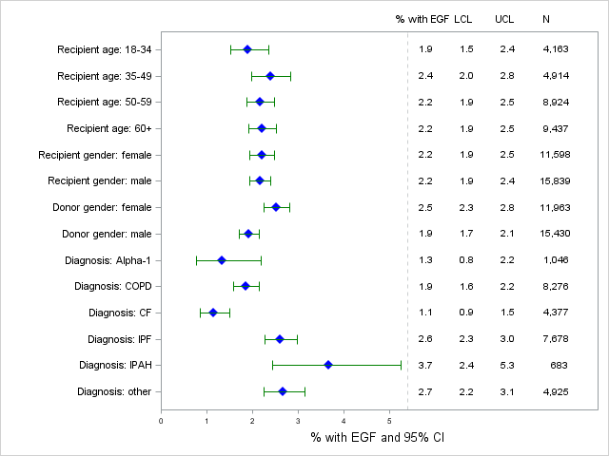
Adult Lung Transplants
% with EGF by Donor and Recipient Characteristics
(Primary Transplants: January 2005 – December 2013)
2015
JHLT. 2015 Oct; 34(10): 1264-1277
JHLT. 2014 Oct; 33(10): 1009-1024
Notes:
Only transplants with known EGF status are included in the tabulation. Percentage with EGF was computed using a competing-risks extension of the Kaplan-Meier method.

Slide 181
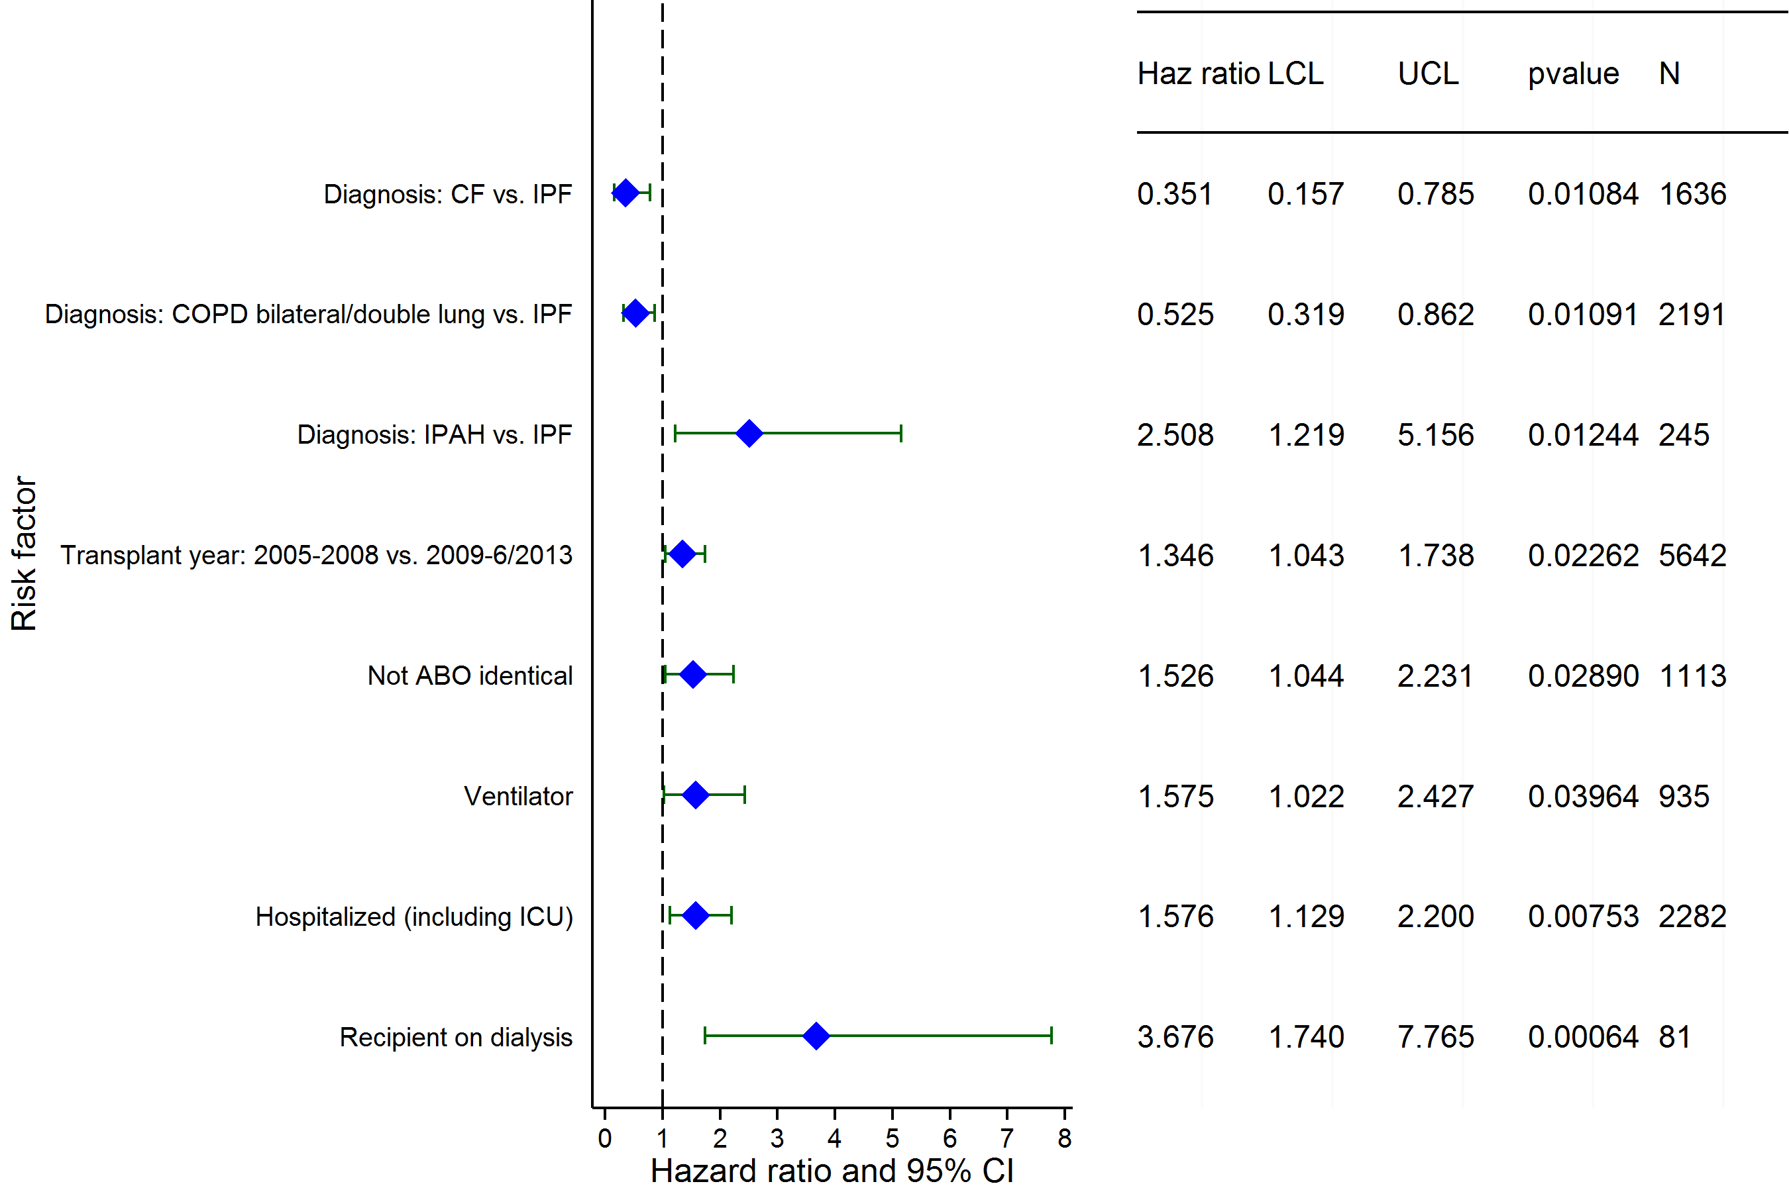
Adult Lung Transplants (2005-6/2013)
Risk Factors for EGF within 30 days with 95% CL
(N = 13,621)
2015
JHLT. 2015 Oct; 34(10): 1264-1277

Slide 182
Adult Lung Transplants (2005-6/2013)
Risk Factors for EGF within 30 days
Continuous Factors (see figures)
Donor age | Transplant center volume
Recipient weight | Recipient FEV1 (% predicted)
2015
JHLT. 2015 Oct; 34(10): 1264-1277

Slide 183
Adult Lung Transplants (2005-6/2013)
Donor Age
Risk Factors for EGF within 30 days with 95% CL
p = 0.0484
2015
(N = 16,627)
JHLT. 2015 Oct; 34(10): 1264-1277
Notes:
Multivariable analysis was performed using a proportional hazards model censoring all patients at 30 days. Continuous factors were fit using a restricted cubic spline.
Analyses were limited to transplants having essentially complete information regarding risk factors.

Slide 184
Adult Lung Transplants (2005-6/2013)
Recipient weight
Risk Factors for EGF within 30 days with 95% CL
p = 0.0047
2015
(N = 16,627)
JHLT. 2015 Oct; 34(10): 1264-1277
Notes:
Multivariable analysis was performed using a proportional hazards model censoring all patients at 30 days. Continuous factors were fit using a restricted cubic spline.
Analyses were limited to transplants having essentially complete information regarding risk factors.

Slide 185
Adult Lung Transplants (2005-6/2013)
Transplant center volume
Risk Factors for EGF within 30 days with 95% CL
p = 0.0025
2015
(N = 16,627)
JHLT. 2015 Oct; 34(10): 1264-1277
Notes:
Multivariable analysis was performed using a proportional hazards model censoring all patients at 30 days. Continuous factors were fit using a restricted cubic spline.
Analyses were limited to transplants having essentially complete information regarding risk factors.

Slide 186
Adult Lung Transplants (2005-6/2013)
Risk Factors for EGF within 30 days with 95% CL
Recipient FEV1 (% predicted)
p = 0.0426
2015
(N = 17,755)
JHLT. 2015 Oct; 34(10): 1264-1277
Notes:
Multivariable analysis was performed using a proportional hazards model censoring all patients at 30 days. Continuous factors were fit using a restricted cubic spline.
Analyses were limited to transplants having essentially complete information regarding risk factors.

