Slide 1

HEART TRANSPLANTATION
Adult Recipients
2015
JHLT. 2015 Oct; 34(10): 1244-1254

Slide 2
Table of Contents
Donor and recipient characteristics: slides 3-27
Immunosuppression: slides 28-43
Survival analyses: slides 44-82
Morbidity: slides 83-107
Multivariable analyses: slides 108-170
Early Graft Failure (EGF): slides 171-200
2015
JHLT. 2014 Oct; 33(10): 996-1008
JHLT. 2015 Oct; 34(10): 1244-1254

Slide 3
Donor and Recipient Characteristics:
Diagnosis: slides 4-6, 11, 22, 24 and 26
Retransplants by year: slide 7
Recipient and donor characteristics: slides 8-27
2015
JHLT. 2014 Oct; 33(10): 996-1008
JHLT. 2015 Oct; 34(10): 1244-1254

Slide 4
Adult Heart Transplants
Diagnosis
2015
For some retransplants a diagnosis other than retransplant was reported, so the total percentage of retransplants may be greater.
JHLT. 2014 Oct; 33(10): 996-1008
JHLT. 2015 Oct; 34(10): 1244-1254

Slide 5
Adult Heart Transplants
Diagnosis by Location
(Transplants: January 2009 – June 2014)
2015
For some retransplants a diagnosis other than retransplant was reported, so the total percentage of retransplants may be greater.
JHLT. 2014 Oct; 33(10): 996-1008
JHLT. 2015 Oct; 34(10): 1244-1254

Slide 6
Adult Heart Transplants
Diagnosis by Age Group
(Transplants: January 2009 – June 2014)
2015
For some retransplants a diagnosis other than retransplant was reported, so the total percentage of retransplants may be greater.
JHLT. 2014 Oct; 33(10): 996-1008
JHLT. 2015 Oct; 34(10): 1244-1254

Slide 7
Adult Heart Retransplants by Year of Retransplant
2015
JHLT. 2014 Oct; 33(10): 996-1008
JHLT. 2015 Oct; 34(10): 1244-1254

Slide 8
Adult Heart Transplants
Donor and Recipient Characteristics
 | 1992-2003 (N=48,061) | 2004-2008 (N=17,366) | 2009-6/2014 (N=19,770) | p-value
Recipient age (years) | 54.0 (28.0 - 65.0) | 53.0 (24.0 - 66.0) | 54.0 (25.0 - 68.0) | <0.0001
Donor age (years) | 32.0 (15.0 - 54.0) | 34.0 (16.0 - 56.0) | 35.0 (17.0 - 57.0) | <0.0001
Donor and recipient age difference (years) | -19.0 (-43.0 - 8.0) | -16.0 (-43.0 - 12.0) | -16.0 (-43.0 - 12.0) | <0.0001
Recipient weight (kg) | 76.0 (52.0 - 103.0) | 78.0 (53.0 - 108.9) | 79.8 (53.5 - 110.7) | <0.0001
Recipient height (cm) | 174.0 (157.0 - 188.0) | 174.0 (157.5 - 188.0) | 175.0 (157.0 - 188.0) | 0.0649
Recipient BMI | 23.1 (19.5 - 32.1) | 24.0 (19.6 - 33.6) | 24.6 (19.8 - 34.4) | <0.0001
Donor weight (kg) | 75.0 (53.0 - 104.8)¹ | 78.2 (56.0 - 110.2) | 80.0 (56.7 - 114.0) | <0.0001
Donor height (cm) | 175.0 (155.0 - 188.0)¹ | 175.3 (159.0 - 190.0) | 175.0 (157.5 - 189.0) | <0.0001
Donor BMI | 24.4 (18.9 - 33.3)¹ | 25.2 (19.8 - 35.4) | 25.7 (19.9 - 36.8) | <0.0001
Continuous factors are expressed as median (5th – 95th percentiles)
2015
¹ Based on 4/1994-2003 transplants.
JHLT. 2014 Oct; 33(10): 996-1008
JHLT. 2015 Oct; 34(10): 1244-1254
Notes:
Comparisons for categorical variables were made using the chi-square statistic. Multiple groups were compared using single p-value.
Comparisons for continuous variables were made using Kruskal-Wallis test.
A significant p-value means that at least one of the groups is different than the others but it doesn’t identify which group it is.

Slide 9
Adult Heart Transplants
Donor and Recipient Characteristics
 | 1992-2003 (N=48,061) | 2004-2008 (N=17,366) | 2009-6/2014 (N=19,770) | p-value
Recipient/donor gender (% male) | 80.1% / 68.5% | 77.3% / 70.1% | 74.9% / 68.2% | <0.0001 / 0.0001
Male recipient/ female donor | 20.7% | 17.3% | 16.6% | <0.0001
Female recipient/ male donor | 9.2% | 10.1% | 9.8% | 0.0007
Recipient/donor diabetes mellitus | 14.8%¹ / 1.6%¹ | 23.0% / 2.5% | 25.9% / 3.4% | <0.0001 / <0.0001
Recipient prior history of dialysis | 3.3%¹ | 4.1% | 4.4% | <0.0001
Recipient amiodarone use | 24.2%¹ | 28.8% | 33.2% | <0.0001
Recipient/donor cigarette history | – / 36.2%¹ | 49.3%² / 23.7% | 46.0% / 16.0% | <0.0001 / <0.0001
Recipient/donor hypertension | 35.3%¹ / 11.0%¹ | 42.6% / 12.3% | 50.5% / 15.1% | <0.0001 / <0.0001
Recipient prior cardiac surgery | – | 40.0%² | 49.6% | <0.0001
Recipient peripheral vascular disease | 3.6%¹ | 3.1% | 3.1% | 0.0159
Recipient previous malignancy | 3.4%¹ | 5.4% | 7.6% | <0.0001
Recipient COPD | 3.3%¹ | 3.6% | 4.9% | <0.0001
Ischemic time (hours) | 3.0 (1.4 - 4.9) | 3.3 (1.6 - 5.1) | 3.3 (1.6 - 5.1) | <0.0001
Continuous factors are expressed as median (5th – 95th percentiles)
(Cont’d)
2015
¹ Based on 4/1994-2003 transplants.
² Based on 7/2004-2008 transplants.
JHLT. 2014 Oct; 33(10): 996-1008
JHLT. 2015 Oct; 34(10): 1244-1254
Notes:
Comparisons for categorical variables were made using the chi-square statistic. Multiple groups were compared using single p-value.
Comparisons for continuous variables were made using Kruskal-Wallis test.
A significant p-value means that at least one of the groups is different than the others but it doesn’t identify which group it is.

Slide 10
Adult Heart Transplants
Donor and Recipient Characteristics
 | 1992-2003 (N=48,061) | 2004-2008 (N=17,366) | 2009-6/2014 (N=19,770) | p-value
Most recent PRA > 10%¹
Overall | 7.7% | 11.4%² | 13.5%³ | <0.0001
Class I | - | 12.5%⁴ | 16.0%⁵ | <0.0001
Class II | - | 8.5%⁴ | 11.6%⁵ | <0.0001
Creatinine at time of transplant (mg/dL) | 1.2 (0.7 - 2.4) | 1.2 (0.7 - 2.4) | 1.2 (0.7 - 2.3) | <0.0001
Pulmonary vascular resistance (Wood units) | 2.1 (0.5 - 6.0)⁶ | 2.1 (0.4 - 5.6) | 2.1 (0.4 - 5.3) | <0.0001
HLA Mismatches
0-2 | 4.4% | 4.0% | 3.8% | <0.0001
3-4 | 40.4% | 39.6% | 38.4%
5-6 | 55.2% | 56.4% | 57.8%
Continuous factors are expressed as median (5th – 95th percentiles)
(Cont’d)
¹ PRA was collected as a single percentage outside of US. Until mid-2004 PRA was collected in US as a single percentage. After this date, PRA was collected separately for Class I and Class II.
² Based on US 1/2004-6/2004 transplants and non-US 2004-2008 transplants.
³ Based on non-US transplants.
⁴ Based on US 7/2004-2008 transplants.
⁵ Based on US transplants.
⁶ Based on 4/1994-2003 transplants.
2015
JHLT. 2014 Oct; 33(10): 996-1008
JHLT. 2015 Oct; 34(10): 1244-1254
Notes:
Comparisons for categorical variables were made using the chi-square statistic. Multiple groups were compared using single p-value.
Comparisons for continuous variables were made using Kruskal-Wallis test.
A significant p-value means that at least one of the groups is different than the others but it doesn’t identify which group it is.

Slide 11
Adult Heart Transplants
Donor and Recipient Characteristics
 | 1992-2003 (N=48,061) | 2004-2008 (N=17,366) | 2009-6/2014 (N=19,770) | p-value
Retransplant¹ | 2.4% | 3.1% | 3.0% | < 0.0001
Diagnosis
Cardiomyopathy | 46.8% | 52.1% | 55.6% | <0.0001
Coronary artery disease | 45.4% | 38.8% | 35.1%
Valvular | 3.8% | 3.3% | 2.8%
Retransplant¹ | 1.9% | 2.5% | 2.6%
Congenital | 2.0% | 2.7% | 3.3%
Other causes | 0.2% | 0.4% | 0.6%
Donor cause of death
Head trauma | 47.5% | 49.2% | 42.9% | <0.0001
Stroke | 29.5% | 25.5% | 23.2%
Anoxia | 4.4% | 8.3% | 15.9%
CNS tumor | 1.0% | 0.8% | 0.6%
Other | 17.5% | 16.2% | 17.4%
2015
(Cont’d)
¹ For some retransplants a diagnosis other than retransplant was reported, so the total percentage of retransplants may be greater.
JHLT. 2014 Oct; 33(10): 996-1008
JHLT. 2015 Oct; 34(10): 1244-1254
Notes:
Comparisons for categorical variables were made using the chi-square statistic. Multiple groups were compared using single p-value.
Comparisons for continuous variables were made using Kruskal-Wallis test.
A significant p-value means that at least one of the groups is different than the others but it doesn’t identify which group it is.

Slide 12
Adult Heart Transplants
Donor and Recipient Characteristics
 | 1992-2003 (N=48,061) | 2004-2008 (N=17,366) | 2009-6/2014 (N=19,770) | p-value
Pre-operative support (multiple items may be reported)
Hospitalized at time of transplant | 58.9% | 46.2% | 43.8% | <0.0001
On IV inotropes | 54.4%¹ | 44.6% | 39.9% | <0.0001
Ventilator | 3.3% | 3.0% | 2.3% | <0.0001
IABP | 6.5% | 7.0% | 6.2% | 0.0865
Mechanical circulatory support | 22.2%² | 26.0% | 43.0% | <0.0001
LVAD | 13.2%² | 21.8% | 36.6% | <0.0001
RVAD | - | 4.4%³ | 3.2% | <0.0001
TAH | 0.0%² | 0.5% | 1.4% | <0.0001
ECMO | 0.3%⁴ | 0.9% | 1.2% | <0.0001
(Cont’d)
¹ Based on 4/1994-2003 transplants.
² Based on 11/1999-2003 transplants.
³ Based on 2005-2008 transplants.
⁴ Based on 5/1995-2008 transplants.
2015
JHLT. 2014 Oct; 33(10): 996-1008
JHLT. 2015 Oct; 34(10): 1244-1254
Notes:
Comparisons for categorical variables were made using the chi-square statistic. Multiple groups were compared using single p-value.
Comparisons for continuous variables were made using Kruskal-Wallis test.
A significant p-value means that at least one of the groups is different than the others but it doesn’t identify which group it is.

Slide 13
Adult Heart Transplants
Donor and Recipient Age
(Transplants: January 2009 – June 2014)
2015
JHLT. 2014 Oct; 33(10): 996-1008
JHLT. 2015 Oct; 34(10): 1244-1254

Slide 14
Adult Heart Transplants
Donor and Recipient Age
(Transplants: January 2009 – June 2014)
2015
JHLT. 2014 Oct; 33(10): 996-1008
JHLT. 2015 Oct; 34(10): 1244-1254

Slide 15
Adult Heart Transplants
Donor and Recipient Age (Transplants: January 2009 – June 2014)
2015
R² = 0.01, p < 0.0001
JHLT. 2014 Oct; 33(10): 996-1008
JHLT. 2015 Oct; 34(10): 1244-1254
Notes:
R² - squared Pearson correlation coefficient.

Slide 16
Adult Heart Transplants
Recipient Gender by Location
(Transplants: January 2009 – June 2014)
2015
JHLT. 2014 Oct; 33(10): 996-1008
JHLT. 2015 Oct; 34(10): 1244-1254

Slide 17
Adult Heart Transplants
Donor Gender by Location
(Transplants: January 2009 – June 2014)
2015
JHLT. 2014 Oct; 33(10): 996-1008
JHLT. 2015 Oct; 34(10): 1244-1254

Slide 18
Adult Heart Transplants
% of Patients Bridged with Mechanical Circulatory Support* (Transplants: January 2000 – December 2013)
2015
* LVAD, RVAD, TAH, ECMO
JHLT. 2014 Oct; 33(10): 996-1008
JHLT. 2015 Oct; 34(10): 1244-1254

Slide 19
Adult Heart Transplants
% of Patients Bridged with Mechanical Circulatory Support* by Year and Device Type
2015
* LVAD, RVAD, TAH, ECMO
JHLT. 2014 Oct; 33(10): 996-1008
JHLT. 2015 Oct; 34(10): 1244-1254

Slide 20
Adult Heart Transplants
Number and % of Combined Organ Transplants Reported by Year and Type of Transplant
2015
JHLT. 2014 Oct; 33(10): 996-1008
JHLT. 2015 Oct; 34(10): 1244-1254

Slide 21
Adult Heart Transplants
Recipient BMI Distribution by Location
(Transplants: January 2009 – June 2014)
2015
JHLT. 2014 Oct; 33(10): 996-1008
JHLT. 2015 Oct; 34(10): 1244-1254

Slide 22
Adult Heart Transplants
Recipient BMI Distribution by Diagnosis
(Transplants: January 2009 – June 2014)
2015
For some retransplants, a diagnosis other than retransplant was reported, so the total percentage of retransplants may be greater.
JHLT. 2014 Oct; 33(10): 996-1008
JHLT. 2015 Oct; 34(10): 1244-1254

Slide 23
Adult Heart Transplants
Recipient Diabetes Mellitus Distribution by Location
(Transplants: January 2009 – June 2014)
2015
JHLT. 2014 Oct; 33(10): 996-1008
JHLT. 2015 Oct; 34(10): 1244-1254

Slide 24
Adult Heart Transplants
Recipient Diabetes Mellitus Distribution by Diagnosis
(Transplants: January 2009 – June 2014)
2015
For some retransplants, a diagnosis other than retransplant was reported, so the total percentage of retransplants may be greater.
JHLT. 2014 Oct; 33(10): 996-1008
JHLT. 2015 Oct; 34(10): 1244-1254

Slide 25
Adult Heart Transplants
Recipient Cigarette History by Location
(Transplants: January 2009 – June 2014)
2015
JHLT. 2014 Oct; 33(10): 996-1008
JHLT. 2015 Oct; 34(10): 1244-1254

Slide 26
Adult Heart Transplants
Recipient Cigarette and COPD History by Diagnosis
(Transplants: January 2009 – June 2014)
2015
JHLT. 2014 Oct; 33(10): 996-1008
JHLT. 2015 Oct; 34(10): 1244-1254

Slide 27
Adult Heart Transplants
Ischemic Time Distribution by Location
(Transplants: January 2009 – June 2014)
2015
JHLT. 2014 Oct; 33(10): 996-1008
JHLT. 2015 Oct; 34(10): 1244-1254

Slide 28
Immunosuppression:
Induction: slides 29-31 and 38-39
Maintenance: slides 32-35 and 40-41
Rejection: slides 36-43
2015
JHLT. 2014 Oct; 33(10): 996-1008
JHLT. 2015 Oct; 34(10): 1244-1254

Slide 29
Adult Heart Transplants
Induction Immunosuppression
(Transplants: January 2009 – June 2014)
2015
Analysis is limited to patients who were alive at the time of the discharge.
JHLT. 2014 Oct; 33(10): 996-1008
JHLT. 2015 Oct; 34(10): 1244-1254

Slide 30
Adult Heart Transplants
Induction Immunosuppression by Location
(Transplants: January 2009 – June 2014)
2015
Analysis is limited to patients who were alive at the time of the discharge.
JHLT. 2015 Oct; 34(10): 1244-1254

Slide 31
Adult Heart Transplants
Kaplan-Meier Survival by Induction Type
Conditional on Survival to 14 Days
(Transplants: January 2004 – June 2013)
No pair-wise comparisons were significant at p < 0.05.
2015
JHLT. 2014 Oct; 33(10): 996-1008
JHLT. 2015 Oct; 34(10): 1244-1254
Notes:
Survival was calculated using the Kaplan-Meier method, which incorporates information from all transplants for whom any follow-up has been provided. Since many patients are still alive and some patients have been lost to follow-up, the survival rates are estimates rather than exact rates because the time of death is not known for all patients.
Survival rates were compared using the log-rank test statistic. Adjustments for multiple comparisons were done using Scheffe’s method.

Slide 32
Adult Heart Transplants
Maintenance Immunosuppression at Time of Follow-up (Follow-ups: January 2009 – June 2014)
2015
Analysis is limited to patients who were alive at the time of the follow-up.
JHLT. 2014 Oct; 33(10): 996-1008
JHLT. 2015 Oct; 34(10): 1244-1254
Notes:
This figure shows the maintenance immunosuppression reported as being provided at the time of the 1-year and 5-year annual follow-up forms. To provide a snapshot of current practice, only follow-ups occurring between January 2009 and June 2014 were included. Therefore, this figure does not represent changes in practice between the 1-year follow-up and 5-year follow-up on a cohort of patients. The patients in the 1-year tabulation are not the same patients as in the 5-year tabulation.

Slide 33
Adult Heart Transplants
Maintenance Immunosuppression at Time of 1 Year Follow-up by Year
NOTE: Different patients are analyzed in each timeframe.
2015
Analysis is limited to patients who were alive at the time of the follow-up.
JHLT. 2014 Oct; 33(10): 996-1008
JHLT. 2015 Oct; 34(10): 1244-1254
Notes:
This figure shows the maintenance immunosuppression reported as being provided at the time of the 1-year annual follow-up forms. As different patients were transplanted each year this figure does not represent changes in immunosuppression for individual patients but may represent changes in practice.

Slide 34
Adult Heart Transplants
Maintenance Immunosuppression Drug Combinations at Time of Follow-up (Follow-ups: January 2004 – June 2014)
For the Same Patients at Year 1 and 5
2015
Analysis is limited to patients who were alive at the time of the follow-up.
JHLT. 2014 Oct; 33(10): 996-1008
JHLT. 2015 Oct; 34(10): 1244-1254
Notes:
This figure shows the maintenance immunosuppression reported as being provided at the time of the 1-year and 5-year annual follow-up forms for the same patients based on follow-ups occurring between January 2004 and June 2014.

Slide 35
Adult Heart Transplants
Kaplan-Meier Survival by Maintenance Immunosuppression at 1 year (Transplants: January 2004 – June 2013)
Conditional on Survival to 1 Year
p = 0.2789
2015
JHLT. 2014 Oct; 33(10): 996-1008
JHLT. 2015 Oct; 34(10): 1244-1254
Notes:
Survival was calculated using the Kaplan-Meier method, which incorporates information from all transplants for whom any follow-up has been provided. Since many patients are still alive and some patients have been lost to follow-up, the survival rates are estimates rather than exact rates because the time of death is not known for all patients.
Survival rates were compared using the log-rank test statistic.

Slide 36
Adult Heart Transplants
% of Recipients Experiencing Treated Rejection Between Transplant Discharge and 1-Year Follow-Up by Era and Transplant Type
p < 0.0001
Treated rejection = Recipient was reported to (1) have at least one acute rejection episode that was treated with an anti-rejection agent; or (2) have been hospitalized for rejection.
2015
JHLT. 2014 Oct; 33(10): 996-1008
JHLT. 2015 Oct; 34(10): 1244-1254

Slide 37
Adult Heart Transplants
% of Recipients Experiencing Any Rejection Between Transplant Discharge and 1-Year Follow-Up by Era and Transplant Type
Analysis is limited to patients who were alive at the time of the follow-up.
Treated rejection = Recipient was reported to (1) have at least one acute rejection episode that was treated with an anti-rejection agent; or (2) have been hospitalized for rejection.
2015
JHLT. 2014 Oct; 33(10): 996-1008
JHLT. 2015 Oct; 34(10): 1244-1254

Slide 38
Adult Heart Transplants
% of Recipients Experiencing Treated Rejection Between Transplant Discharge and 1-Year Follow-Up by Type of Induction
(Follow-ups: January 2005 – June 2014)
Treated rejection = Recipient was reported to (1) have at least one acute rejection episode that was treated with an anti-rejection agent; or (2) have been hospitalized for rejection.
Analysis is limited to patients who were alive at the time of the follow-up.
2015
JHLT. 2014 Oct; 33(10): 996-1008
JHLT. 2015 Oct; 34(10): 1244-1254
Notes:
Comparisons were made using the chi-square statistic. Adjustments for multiple comparisons were done using Bonferroni method.

Slide 39
Adult Heart Transplants
% of Recipients Experiencing Any Rejection Between Transplant Discharge and 1-Year Follow-Up by Type of Induction
(Follow-ups: January 2005 – June 2014)
Analysis is limited to patients who were alive at the time of the follow-up.
Any rejection = Recipient was reported to (1) have at least one acute rejection episode; or (2) have been hospitalized for rejection.
2015
JHLT. 2014 Oct; 33(10): 996-1008
JHLT. 2015 Oct; 34(10): 1244-1254
Notes:
Comparisons were made using the chi-square statistic. Adjustments for multiple comparisons were done using Bonferroni method.

Slide 40
Adult Heart Transplants
% of Recipients Experiencing Treated Rejection Between Transplant Discharge and 1-Year Follow-Up by Maintenance Immunosuppression (Follow-ups: January 2005 – June 2014)
Analysis is limited to patients who were alive at the time of the follow-up.
Treated rejection = Recipient was reported to (1) have at least one acute rejection episode that was treated with an anti-rejection agent; or (2) have been hospitalized for rejection.
2015
JHLT. 2014 Oct; 33(10): 996-1008
JHLT. 2015 Oct; 34(10): 1244-1254
Notes:
Comparisons were made using the chi-square statistic.

Slide 41
Adult Heart Transplants
% of Recipients Experiencing Any Rejection Between Transplant Discharge and 1-Year Follow-Up by Maintenance Immunosuppression (Follow-ups: January 2005 – June 2014)
p < 0.0001
Analysis is limited to patients who were alive at the time of the follow-up.
Any rejection = Recipient was reported to (1) have at least one acute rejection episode; or (2) have been hospitalized for rejection.
2015
JHLT. 2014 Oct; 33(10): 996-1008
JHLT. 2015 Oct; 34(10): 1244-1254
Notes:
Comparisons were made using the chi-square statistic.

Slide 42
Adult Heart Transplants
Kaplan-Meier Survival by Treatment for Rejection Within 1st Year and Transplant Type (1 Year Follow-ups: January 2005 – June 2013)
Conditional on survival to 1 year
No pair-wise comparisons were significant at p < 0.05 except:
primary/no rejection vs. primary/treated rejection and retx/treated rejection,
primary/untreated rejection vs. primary/ treated rejection
Treated rejection = Recipient was reported to (1) have at least one acute rejection episode that was treated with an anti-rejection agent; or (2) have been hospitalized for rejection. No rejection = Recipient had (1) no acute rejection episodes and (2) was reported either as not hospitalized for rejection or did not receive anti-rejection agents.
2015
JHLT. 2014 Oct; 33(10): 996-1008
JHLT. 2015 Oct; 34(10): 1244-1254
Notes:
Survival was calculated using the Kaplan-Meier method, which incorporates information from all transplants for whom any follow-up has been provided. Since many patients are still alive and some patients have been lost to follow-up, the survival rates are estimates rather than exact rates because the time of death is not known for all patients.
Survival rates were compared using the log-rank test statistic. Adjustments for multiple comparisons were done using Scheffe’s method.

Slide 43
Adult Heart Transplants
Freedom from Hospitalization for Rejection by Era
(Transplants: April 1994 – June 2013)
All pair-wise comparisons were statistically significant at p < 0.01.
2015
JHLT. 2014 Oct; 33(10): 996-1008
JHLT. 2015 Oct; 34(10): 1244-1254
Notes:
Freedom from hospitalization for rejection rates by era were computed using the Kaplan-Meier method.
Hospitalizations for rejections are reported on annual follow-ups; a date of diagnosis is not provided. For this figure the midpoint between the date of previous follow-up (when event had not occurred) and the date of follow-up when the event was reported was used as the date of occurrence. Patients were included in the analysis until an unknown response for the outcome of interest was reported. Therefore, the rates seen here may differ from those reported in the cumulative prevalence slide which is based on only those patients with known responses for each of the outcomes at all follow-up time points.
Rates were compared using the log-rank test statistic. Adjustments for multiple comparisons were done using Scheffe’s method.

Slide 44
Survival Analyses:
by era: slides 45-46, 62-66 and 75
by diagnosis: slides 47-52 and 62-66
by transplant type: slides 53-54 and 75
by age group: slides 55-57
by gender: slides 58-61
by PVR: slide 67
by BMI: slide 68
by diabetes mellitus: slide 69
by cigarette history: slide 70
by COPD history: slide 71
by VAD usage: slides 72-74
by employment status post transplant: slide 76
by induction and immunosuppression: slides 31 and 35
by PRA: slide 77
Cause of death: slides 78-82
2015
JHLT. 2014 Oct; 33(10): 996-1008
JHLT. 2015 Oct; 34(10): 1244-1254

Slide 45
Adult Heart Transplants
Kaplan-Meier Survival by Era
(Transplants: January 1982 – June 2013)
All pair-wise comparisons were significant at p < 0.05.
2015
JHLT. 2014 Oct; 33(10): 996-1008
JHLT. 2015 Oct; 34(10): 1244-1254
Notes:
Survival was calculated using the Kaplan-Meier method, which incorporates information from all transplants for whom any follow-up has been provided. Since many patients are still alive and some patients have been lost to follow-up, the survival rates are estimates rather than exact rates because the time of death is not known for all patients. The median survival is the estimated time point at which 50% of all of the recipients have died.
Survival rates were compared using the log-rank test statistic. Adjustments for multiple comparisons were done using Scheffe’s method.

Slide 46
Adult Heart Transplants
Kaplan-Meier Survival by Era Conditional on Survival to 1 Year (Transplants: January 1982 – June 2013)
All pair-wise comparisons were significant at p < 0.05 except 1992-2001 vs. 2009-6/2013.
2015
JHLT. 2014 Oct; 33(10): 996-1008
JHLT. 2015 Oct; 34(10): 1244-1254
Notes:
Survival was calculated using the Kaplan-Meier method, which incorporates information from all transplants for whom any follow-up has been provided. Since many patients are still alive and some patients have been lost to follow-up, the survival rates are estimates rather than exact rates because the time of death is not known for all patients. Conditional survival is shown in this figure; this is the survival following 1 year for all patients who survived to 1 year. The conditional median survival is the estimated time point at which 50% of the recipients who survive to at least 1 year have died.
Survival rates were compared using the log-rank test statistic. Adjustments for multiple comparisons were done using Scheffe’s method.

Slide 47
Adult Heart Transplants
Kaplan-Meier Survival Within 1 Year by Diagnosis
(Transplants: January 1982 – June 2013)
All pair-wise comparisons were significant at p < 0.01 except congenital vs. valvular.
For some retransplants, a diagnosis other than retransplant is reported, so the total number of retransplants may be greater.
2015
JHLT. 2014 Oct; 33(10): 996-1008
JHLT. 2015 Oct; 34(10): 1244-1254
Notes:
Survival was calculated using the Kaplan-Meier method, which incorporates information from all transplants for whom any follow-up has been provided. Since many patients are still alive and some patients have been lost to follow-up, the survival rates are estimates rather than exact rates because the time of death is not known for all patients.
Survival rates were compared using the log-rank test statistic. Adjustments for multiple comparisons were done using Scheffe’s method.

Slide 48
Adult Heart Transplants
Kaplan-Meier Survival by Diagnosis
(Transplants: January 1982 – June 2013)
Median survival (years):
Cardiomyopathy=11.6; CAD=9.4; Congenital=14.6; Retransplant=6.7; Valvular=10.8
All pair-wise comparisons were significant at p < 0.0001 except cardiomyopathy vs. congenital.
For some retransplants, a diagnosis other than retransplant is reported, so the total number of retransplants may be greater.
2015
JHLT. 2014 Oct; 33(10): 996-1008
JHLT. 2015 Oct; 34(10): 1244-1254
Notes:
Survival was calculated using the Kaplan-Meier method, which incorporates information from all transplants for whom any follow-up has been provided. Since many patients are still alive and some patients have been lost to follow-up, the survival rates are estimates rather than exact rates because the time of death is not known for all patients. The median survival is the estimated time point at which 50% of all of the recipients have died.
Survival rates were compared using the log-rank test statistic. Adjustments for multiple comparisons were done using Scheffe’s method. Results of log-rank test should be interpreted with caution when curves cross.

Slide 49
Adult Heart Transplants
Kaplan-Meier Survival by Diagnosis Conditional on Survival to 1 Year (Transplants: January 1982 – June 2013)
Median survival (years):
Cardiomyopathy=14.1; CAD=11.7; Congenital=20.2; Retransplant=11.0; Valvular=14.3
All pair-wise comparisons were significant at p < 0.0001 except cardiomyopathy vs. valvular and CAD vs. retransplant.
For some retransplants, a diagnosis other than retransplant is reported, so the total number of retransplants may be greater.
2015
JHLT. 2014 Oct; 33(10): 996-1008
JHLT. 2015 Oct; 34(10): 1244-1254
Notes:
Survival was calculated using the Kaplan-Meier method, which incorporates information from all transplants for whom any follow-up has been provided. Since many patients are still alive and some patients have been lost to follow-up, the survival rates are estimates rather than exact rates because the time of death is not known for all patients. The median survival is the estimated time point at which 50% of all of the recipients have died.
Survival rates were compared using the log-rank test statistic. Adjustments for multiple comparisons were done using Scheffe’s method. Results of log-rank test should be interpreted with caution when curves cross.
Conditional survival was performed by limiting the group of patients analyzed to those who have survived to at least 1 year. Thus it is possible to examine longer term survival after excluding early deaths.

Slide 50
Adult Heart Transplants
Kaplan-Meier Survival Within 1 Year (Panel A), Overall (Panel B) and Conditional on Survival to 1 Year (Panel C) by Diagnosis (Transplants: January 1982 – June 2013)
Panel A
Panel B
Panel C
All pair-wise comparisons were significant at p < 0.0001 except cardiomyopathy vs. congenital.
All pair-wise comparisons were significant at p < 0.0001 except cardiomyopathy vs. valvular and CAD vs. retransplant.
All pair-wise comparisons were significant at p < 0.01 except congenital vs. valvular.
2015
For some retransplants, a diagnosis other than retransplant is reported, so the total number of retransplants may be greater.
JHLT. 2014 Oct; 33(10): 996-1008
JHLT. 2015 Oct; 34(10): 1244-1254
Notes:
Survival was calculated using the Kaplan-Meier method, which incorporates information from all transplants for whom any follow-up has been provided. Since many patients are still alive and some patients have been lost to follow-up, the survival rates are estimates rather than exact rates because the time of death is not known for all patients.
Survival rates were compared using the log-rank test statistic. Adjustments for multiple comparisons were done using Scheffe’s method.

Slide 51
Adult Heart Transplants
Kaplan-Meier Survival by Diagnosis
(Transplants: January 2004 – June 2013)
All pair-wise comparisons with cardiomyopathy were significant at p < 0.05 except cardiomyopathy vs. congenital. CAD vs. retransplant was significant at p < 0.05. No other pair-wise comparisons were significant at p < 0.05.
For some retransplants, a diagnosis other than retransplant is reported, so the total number of retransplants may be greater.
2015
JHLT. 2014 Oct; 33(10): 996-1008
JHLT. 2015 Oct; 34(10): 1244-1254
Notes:
Survival was calculated using the Kaplan-Meier method, which incorporates information from all transplants for whom any follow-up has been provided. Since many patients are still alive and some patients have been lost to follow-up, the survival rates are estimates rather than exact rates because the time of death is not known for all patients.
Survival rates were compared using the log-rank test statistic. Adjustments for multiple comparisons were done using Scheffe’s method. Results of log-rank test should be interpreted with caution when curves cross.

Slide 52
Adult Heart Transplants
Kaplan-Meier Survival by Diagnosis Conditional on Survival to 1 Year (Transplants: January 2004 – June 2013)
No pair-wise comparisons were significant at p < 0.05 except cardiomyopathy vs. CAD, cardiomyopathy vs. retransplant, CAD vs. congenital and congenital vs. retransplant
For some retransplants, a diagnosis other than retransplant is reported, so the total number of retransplants may be greater.
2015
JHLT. 2014 Oct; 33(10): 996-1008
JHLT. 2015 Oct; 34(10): 1244-1254
Notes:
Survival was calculated using the Kaplan-Meier method, which incorporates information from all transplants for whom any follow-up has been provided. Since many patients are still alive and some patients have been lost to follow-up, the survival rates are estimates rather than exact rates because the time of death is not known for all patients.
Survival rates were compared using the log-rank test statistic. Adjustments for multiple comparisons were done using Scheffe’s method. Results of log-rank test should be interpreted with caution when curves cross.
Conditional survival was performed by limiting the group of patients analyzed to those who have survived to at least 1 year. Thus it is possible to examine longer term survival after excluding early deaths.

Slide 53
Adult Heart Transplants
Kaplan-Meier Survival by Transplant Type
(Transplants: January 1982 – June 2013)
p < 0.0001
2015
JHLT. 2014 Oct; 33(10): 996-1008
JHLT. 2015 Oct; 34(10): 1244-1254
Notes:
Survival was calculated using the Kaplan-Meier method, which incorporates information from all transplants for whom any follow-up has been provided. Since many patients are still alive and some patients have been lost to follow-up, the survival rates are estimates rather than exact rates because the time of death is not known for all patients. The median survival is the estimated time point at which 50% of all of the recipients have died.
Survival rates were compared using the log-rank test statistic.

Slide 54
Adult Heart Transplants
Kaplan-Meier Survival by Transplant Type Conditional on Survival to 1 Year (Transplants: January 1982 – June 2013)
p < 0.0001
2015
JHLT. 2014 Oct; 33(10): 996-1008
JHLT. 2015 Oct; 34(10): 1244-1254
Notes:
Survival was calculated using the Kaplan-Meier method, which incorporates information from all transplants for whom any follow-up has been provided. Since many patients are still alive and some patients have been lost to follow-up, the survival rates are estimates rather than exact rates because the time of death is not known for all patients. Conditional survival is shown in this figure; this is the survival following 1 year for all patients who survived to 1 year. The conditional median survival is the estimated time point at which 50% of the recipients who survive to at least 1 year have died.
Survival rates were compared using the log-rank test statistic.

Slide 55
Adult Heart Transplants
Kaplan-Meier Survival by Age Group
(Transplants: January 1982 – June 2013)
All pair-wise comparisons were significant at p < 0.05.
2015
JHLT. 2014 Oct; 33(10): 996-1008
JHLT. 2015 Oct; 34(10): 1244-1254
Notes:
Survival was calculated using the Kaplan-Meier method, which incorporates information from all transplants for whom any follow-up has been provided. Since many patients are still alive and some patients have been lost to follow-up, the survival rates are estimates rather than exact rates because the time of death is not known for all patients. The median survival is the estimated time point at which 50% of all of the recipients have died.
Survival rates were compared using the log-rank test statistic. Adjustments for multiple comparisons were done using Scheffe’s method.

Slide 56
Adult Heart Transplants
Kaplan-Meier Survival by Age Group
(Transplants: January 2009 – June 2013)
No pair-wise comparisons were significant at p < 0.05 except
18-39 vs. 60-69 and 40-59 vs. 60-69.
2015
JHLT. 2014 Oct; 33(10): 996-1008
JHLT. 2015 Oct; 34(10): 1244-1254
Notes:
Survival was calculated using the Kaplan-Meier method, which incorporates information from all transplants for whom any follow-up has been provided. Since many patients are still alive and some patients have been lost to follow-up, the survival rates are estimates rather than exact rates because the time of death is not known for all patients.
Survival rates were compared using the log-rank test statistic. Adjustments for multiple comparisons were done using Scheffe’s method. Results of log-rank test should be interpreted with caution when curves cross.

Slide 57
Adult Heart Transplants
Kaplan-Meier Survival by Donor Age Group
(Transplants: January 1982 – June 2013)
All pair-wise comparisons were significant at p < 0.05 except 0-10 vs. 11-39 and 0-10 vs. 40-59.
2015
JHLT. 2014 Oct; 33(10): 996-1008
JHLT. 2015 Oct; 34(10): 1244-1254
Notes:
Survival was calculated using the Kaplan-Meier method, which incorporates information from all transplants for whom any follow-up has been provided. Since many patients are still alive and some patients have been lost to follow-up, the survival rates are estimates rather than exact rates because the time of death is not known for all patients. The median survival is the estimated time point at which 50% of all of the recipients have died.
Survival rates were compared using the log-rank test statistic. Adjustments for multiple comparisons were done using Scheffe’s method. Results of log-rank test should be interpreted with caution when curves cross.

Slide 58
Adult Heart Transplants
Kaplan-Meier Survival by Recipient Gender
(Transplants: January 1982 – June 2013)
p < 0.0001
2015
JHLT. 2014 Oct; 33(10): 996-1008
JHLT. 2015 Oct; 34(10): 1244-1254
Notes:
Survival was calculated using the Kaplan-Meier method, which incorporates information from all transplants for whom any follow-up has been provided. Since many patients are still alive and some patients have been lost to follow-up, the survival rates are estimates rather than exact rates because the time of death is not known for all patients. The median survival is the estimated time point at which 50% of all of the recipients have died.
Survival rates were compared using the log-rank test statistic.

Slide 59
Adult Heart Transplants
Kaplan-Meier Survival by Recipient Gender Conditional on Survival to 1 Year (Transplants: January 1982 – June 2013)
p < 0.0001
2015
JHLT. 2014 Oct; 33(10): 996-1008
JHLT. 2015 Oct; 34(10): 1244-1254
Notes:
Survival was calculated using the Kaplan-Meier method, which incorporates information from all transplants for whom any follow-up has been provided. Since many patients are still alive and some patients have been lost to follow-up, the survival rates are estimates rather than exact rates because the time of death is not known for all patients. Conditional survival is shown in this figure; this is the survival following 1 year for all patients who survived to 1 year. The conditional median survival is the estimated time point at which 50% of the recipients who survive to at least 1 year have died.
Survival rates were compared using the log-rank test statistic.

Slide 60
Adult Heart Transplants
Kaplan-Meier Survival by Donor/Recipient Gender
(Transplants: January 1982 – June 2013)
All pair-wise comparisons with Female/Male were significant at p < 0.0001. No other pair-wise comparisons were significant at p < 0.05.
2015
JHLT. 2014 Oct; 33(10): 996-1008
JHLT. 2015 Oct; 34(10): 1244-1254
Notes:
Survival was calculated using the Kaplan-Meier method, which incorporates information from all transplants for whom any follow-up has been provided. Since many patients are still alive and some patients have been lost to follow-up, the survival rates are estimates rather than exact rates because the time of death is not known for all patients. The median survival is the estimated time point at which 50% of all of the recipients have died.
Survival rates were compared using the log-rank test statistic. Adjustments for multiple comparisons were done using Scheffe’s method.

Slide 61
Adult Heart Transplants
Kaplan-Meier Survival by Donor/Recipient Gender Conditional on Survival to 1 Year
(Transplants: January 1982 – June 2013)
All pair-wise comparisons were significant at p < 0.05 except Male/Female vs. Female/Female.
2015
JHLT. 2014 Oct; 33(10): 996-1008
JHLT. 2015 Oct; 34(10): 1244-1254
Notes:
Survival was calculated using the Kaplan-Meier method, which incorporates information from all transplants for whom any follow-up has been provided. Since many patients are still alive and some patients have been lost to follow-up, the survival rates are estimates rather than exact rates because the time of death is not known for all patients. Conditional survival is shown in this figure; this is the survival following 1 year for all patients who survived to 1 year. The conditional median survival is the estimated time point at which 50% of the recipients who survive to at least 1 year have died.
Survival rates were compared using the log-rank test statistic. Adjustments for multiple comparisons were done using Scheffe’s method.

Slide 62
Adult Heart Transplants
Kaplan-Meier Survival by Era (Transplants: January 1982 – June 2013)
Diagnosis: Cardiomyopathy
All comparisons were significant at p < 0.05 except 2002-2008 vs. 2009-6/2013.
2015
JHLT. 2014 Oct; 33(10): 996-1008
JHLT. 2015 Oct; 34(10): 1244-1254
Notes:
Survival was calculated using the Kaplan-Meier method, which incorporates information from all transplants for whom any follow-up has been provided. Since many patients are still alive and some patients have been lost to follow-up, the survival rates are estimates rather than exact rates because the time of death is not known for all patients. The median survival is the estimated time point at which 50% of all of the recipients have died.
Survival rates were compared using the log-rank test statistic. Adjustments for multiple comparisons were done using Scheffe’s method.

Slide 63
Adult Heart Transplants
Kaplan-Meier Survival by Era (Transplants: January 1982 – June 2013)
Diagnosis: Coronary Artery Disease
2015
JHLT. 2014 Oct; 33(10): 996-1008
JHLT. 2015 Oct; 34(10): 1244-1254
Notes:
Survival was calculated using the Kaplan-Meier method, which incorporates information from all transplants for whom any follow-up has been provided. Since many patients are still alive and some patients have been lost to follow-up, the survival rates are estimates rather than exact rates because the time of death is not known for all patients. The median survival is the estimated time point at which 50% of all of the recipients have died.
Survival rates were compared using the log-rank test statistic. Adjustments for multiple comparisons were done using Scheffe’s method.

Slide 64
Adult Heart Transplants
Kaplan-Meier Survival by Era (Transplants: January 1982 – June 2013)
Diagnosis: Congenital
No pair-wise comparisons were significant at p < 0.05.
2015
JHLT. 2014 Oct; 33(10): 996-1008
JHLT. 2015 Oct; 34(10): 1244-1254
Notes:
Survival was calculated using the Kaplan-Meier method, which incorporates information from all transplants for whom any follow-up has been provided. Since many patients are still alive and some patients have been lost to follow-up, the survival rates are estimates rather than exact rates because the time of death is not known for all patients. The median survival is the estimated time point at which 50% of all of the recipients have died.
Survival rates were compared using the log-rank test statistic. Adjustments for multiple comparisons were done using Scheffe’s method.

Slide 65
Adult Heart Transplants
Kaplan-Meier Survival by Era (Transplants: January 1982 – June 2013)
Diagnosis: Retransplant
2015
For some retransplants, a diagnosis other than retransplant was reported, so the total number of retransplants may be greater.
JHLT. 2014 Oct; 33(10): 996-1008
JHLT. 2015 Oct; 34(10): 1244-1254
Notes:
Survival was calculated using the Kaplan-Meier method, which incorporates information from all transplants for whom any follow-up has been provided. Since many patients are still alive and some patients have been lost to follow-up, the survival rates are estimates rather than exact rates because the time of death is not known for all patients. The median survival is the estimated time point at which 50% of all of the recipients have died.
Survival rates were compared using the log-rank test statistic. Adjustments for multiple comparisons were done using Scheffe’s method.

Slide 66
Adult Heart Transplants
Kaplan-Meier Survival by Era (Transplants: January 1982 – June 2013)
Diagnosis: Valvular
No pair-wise comparisons were significant at p < 0.05 except 1982-1991 vs. 2009-6/2013.
2015
JHLT. 2014 Oct; 33(10): 996-1008
JHLT. 2015 Oct; 34(10): 1244-1254
Notes:
Survival was calculated using the Kaplan-Meier method, which incorporates information from all transplants for whom any follow-up has been provided. Since many patients are still alive and some patients have been lost to follow-up, the survival rates are estimates rather than exact rates because the time of death is not known for all patients. The median survival is the estimated time point at which 50% of all of the recipients have died.
Survival rates were compared using the log-rank test statistic. Adjustments for multiple comparisons were done using Scheffe’s method. Results of log-rank test should be interpreted with caution when curves cross.

Slide 67
Adult Heart Transplants
Kaplan-Meier Survival by PVR
(Transplants: January 2004 – June 2013)
No pair-wise comparisons were significant at p < 0.05.
2015
JHLT. 2014 Oct; 33(10): 996-1008
JHLT. 2015 Oct; 34(10): 1244-1254
Notes:
Survival was calculated using the Kaplan-Meier method, which incorporates information from all transplants for whom any follow-up has been provided. Since many patients are still alive and some patients have been lost to follow-up, the survival rates are estimates rather than exact rates because the time of death is not known for all patients.
Survival rates were compared using the log-rank test statistic. Adjustments for multiple comparisons were done using Scheffe’s method. Results of log-rank test should be interpreted with caution when curves cross.

Slide 68
Adult Heart Transplants
Kaplan-Meier Survival by BMI Group
(Transplants: January 2009 – June 2013)
No pair-wise comparisons were significant at p < 0.05 except 18.5 - <25 vs. 25 - <30.
2015
JHLT. 2014 Oct; 33(10): 996-1008
JHLT. 2015 Oct; 34(10): 1244-1254
Notes:
Survival was calculated using the Kaplan-Meier method, which incorporates information from all transplants for whom any follow-up has been provided. Since many patients are still alive and some patients have been lost to follow-up, the survival rates are estimates rather than exact rates because the time of death is not known for all patients.
Survival rates were compared using the log-rank test statistic. Adjustments for multiple comparisons were done using Scheffe’s method. Results of log-rank test should be interpreted with caution when curves cross.

Slide 69
Adult Heart Transplants
Kaplan-Meier Survival by Recipient Diabetes Mellitus
(Transplants: January 2004 – June 2013)
p < 0.0001
2015
JHLT. 2014 Oct; 33(10): 996-1008
JHLT. 2015 Oct; 34(10): 1244-1254
Notes:
Survival was calculated using the Kaplan-Meier method, which incorporates information from all transplants for whom any follow-up has been provided. Since many patients are still alive and some patients have been lost to follow-up, the survival rates are estimates rather than exact rates because the time of death is not known for all patients.
Survival rates were compared using the log-rank test statistic.

Slide 70
Adult Heart Transplants
Kaplan-Meier Survival by Recipient Cigarette History
(Transplants: July 2004 – June 2013)
p = 0.0002
2015
JHLT. 2014 Oct; 33(10): 996-1008
JHLT. 2015 Oct; 34(10): 1244-1254
Notes:
Survival was calculated using the Kaplan-Meier method, which incorporates information from all transplants for whom any follow-up has been provided. Since many patients are still alive and some patients have been lost to follow-up, the survival rates are estimates rather than exact rates because the time of death is not known for all patients.
Survival rates were compared using the log-rank test statistic. Results of log-rank test should be interpreted with caution when curves cross.

Slide 71
Adult Heart Transplants
Kaplan-Meier Survival by Recipient COPD History
(Transplants: January 2004 – June 2013)
p = 0.1272
2015
JHLT. 2014 Oct; 33(10): 996-1008
JHLT. 2015 Oct; 34(10): 1244-1254
Notes:
Survival was calculated using the Kaplan-Meier method, which incorporates information from all transplants for whom any follow-up has been provided. Since many patients are still alive and some patients have been lost to follow-up, the survival rates are estimates rather than exact rates because the time of death is not known for all patients.
Survival rates were compared using the log-rank test statistic. Results of log-rank test should be interpreted with caution when curves cross.

Slide 72
Adult Heart Transplants
Kaplan-Meier Survival by VAD usage
(Transplants: January 1999 – June 2013)
All pair-wise comparisons with ECMO were significant at
p < 0.05. Continuous flow vs. Pulsatile flow and No LVAD / Inotropes vs. Pulsatile flow were significant at p < 0.05. No other pair-wise comparisons were significant at p < 0.05.
2015
JHLT. 2014 Oct; 33(10): 996-1008
JHLT. 2015 Oct; 34(10): 1244-1254
Notes:
Survival was calculated using the Kaplan-Meier method, which incorporates information from all transplants for whom any follow-up has been provided. Since many patients are still alive and some patients have been lost to follow-up, the survival rates are estimates rather than exact rates because the time of death is not known for all patients.
Survival rates were compared using the log-rank test statistic. Adjustments for multiple comparisons were done using Scheffe’s method. Results of log-rank test should be interpreted with caution when curves cross.

Slide 73
Adult Heart Transplants
Kaplan-Meier Survival by VAD usage Conditional on Survival to 6 Months (Transplants: January 1999 – June 2013)
No pair-wise comparisons were significant at p < 0.05.
2015
JHLT. 2014 Oct; 33(10): 996-1008
JHLT. 2015 Oct; 34(10): 1244-1254
Notes:
Survival was calculated using the Kaplan-Meier method, which incorporates information from all transplants for whom any follow-up has been provided. Since many patients are still alive and some patients have been lost to follow-up, the survival rates are estimates rather than exact rates because the time of death is not known for all patients.
Survival rates were compared using the log-rank test statistic. Adjustments for multiple comparisons were done using Scheffe’s method. Results of log-rank test should be interpreted with caution when curves cross.

Slide 74
Adult Heart Transplants
Kaplan-Meier Survival by VAD usage
(Transplants: January 2009 – June 2013)
All pair-wise comparisons with ECMO were significant at p < 0.05. No other pair-wise comparisons were significant at p < 0.05.
2015
JHLT. 2014 Oct; 33(10): 996-1008
JHLT. 2015 Oct; 34(10): 1244-1254
Notes:
Survival was calculated using the Kaplan-Meier method, which incorporates information from all transplants for whom any follow-up has been provided. Since many patients are still alive and some patients have been lost to follow-up, the survival rates are estimates rather than exact rates because the time of death is not known for all patients.
Survival rates were compared using the log-rank test statistic. Adjustments for multiple comparisons were done using Scheffe’s method. Results of log-rank test should be interpreted with caution when curves cross.

Slide 75
Adult Heart Retransplants
1 Year Survival
Comparison of survival for interval ≤ 12 months vs. > 12 months: p < 0.0001
Comparison of survival for interval ≤ 12 months vs. > 12 months for 2009-6/2013: p < 0.0001
20,665
38,427
23,307
15,730
61
113
48
45
38
417
437
295
107
105
54
26
308
239
92
50
Time (Months) Between Previous and Current Transplant
2015
JHLT. 2014 Oct; 33(10): 996-1008
JHLT. 2015 Oct; 34(10): 1244-1254
Notes:
Survival was computed using the Kaplan-Meier method. Rates were compared using the log-rank test statistic. Numbers on the slide show total number of transplants for each era and transplant type.
Rates are shown only for groups with 10 or more patients at risk (alive with follow-up) at 1 year.

Slide 76
Adult Heart Transplants
Kaplan-Meier Survival by Employment Status at 1 Year
Conditional on Survival to 1 Year
(1 Year Follow-ups: January 2004 – June 2013)
p < 0.0001
2015
JHLT. 2014 Oct; 33(10): 996-1008
JHLT. 2015 Oct; 34(10): 1244-1254
Notes:
Survival was calculated using the Kaplan-Meier method, which incorporates information from all transplants for whom any follow-up has been provided. Since many patients are still alive and some patients have been lost to follow-up, the survival rates are estimates rather than exact rates because the time of death is not known for all patients.
Survival rates were compared using the log-rank test statistic.

Slide 77
Adult Heart Transplants
Kaplan-Meier Survival by PRA Group
(Transplants: January 2009 – June 2013)
No pair-wise comparisons were significant at p < 0.05.
2015
If Class I and Class II values were reported separately, the greater of the two values was used.
JHLT. 2014 Oct; 33(10): 996-1008
JHLT. 2015 Oct; 34(10): 1244-1254
Notes:
Survival was calculated using the Kaplan-Meier method, which incorporates information from all transplants for whom any follow-up has been provided. Since many patients are still alive and some patients have been lost to follow-up, the survival rates are estimates rather than exact rates because the time of death is not known for all patients.
Survival rates were compared using the log-rank test statistic. Adjustments for multiple comparisons were done using Scheffe’s method.

Slide 78
Adult Heart Transplants
Cause of Death (Deaths: January 1994 – June 2014)
Cause of Death | 0-30 Days (N=5,888) | 31 Days–1 Yr (N=5,053) | >1–3 Years (N=3,686) | >3–5 Years (N=3,215) | >5–10 Years (N=8,114) | >10–15 Years (N=5,576) | >15 Years (N=3,504)
Cardiac Allograft Vasculopathy | 82 (1.4%) | 183 (3.6%) | 444 (12.0%) | 439 (13.7%) | 1,091 (13.4%) | 739 (13.3%) | 409 (11.7%)
Acute Rejection | 265 (4.5%) | 484 (9.6%) | 384 (10.4%) | 159 (4.9%) | 160 (2.0%) | 52 (0.9%) | 23 (0.7%)
Lymphoma | 2 (0.0%) | 59 (1.2%) | 88 (2.4%) | 105 (3.3%) | 292 (3.6%) | 162 (2.9%) | 84 (2.4%)
Malignancy, Other | 3 (0.1%) | 121 (2.4%) | 445 (12.1%) | 617 (19.2%) | 1,716 (21.1%) | 1,177 (21.1%) | 667 (19.0%)
CMV | 3 (0.1%) | 52 (1.0%) | 18 (0.5%) | 6 (0.2%) | 7 (0.1%) | 4 (0.1%) | 0
Infection, Non-CMV | 772 (13.1%) | 1,551 (30.7%) | 460 (12.5%) | 331 (10.3%) | 863 (10.6%) | 581 (10.4%) | 403 (11.5%)
Graft Failure | 2,276 (38.7%) | 863 (17.1%) | 961 (26.1%) | 736 (22.9%) | 1,508 (18.6%) | 967 (17.3%) | 592 (16.9%)
Technical | 436 (7.4%) | 76 (1.5%) | 26 (0.7%) | 28 (0.9%) | 90 (1.1%) | 67 (1.2%) | 48 (1.4%)
Other | 341 (5.8%) | 357 (7.1%) | 291 (7.9%) | 247 (7.7%) | 647 (8.0%) | 366 (6.6%) | 261 (7.4%)
Multiple Organ Failure | 1,060 (18.0%) | 793 (15.7%) | 220 (6.0%) | 195 (6.1%) | 550 (6.8%) | 464 (8.3%) | 335 (9.6%)
Renal Failure | 29 (0.5%) | 49 (1.0%) | 53 (1.4%) | 98 (3.0%) | 458 (5.6%) | 463 (8.3%) | 335 (9.6%)
Pulmonary | 177 (3.0%) | 198 (3.9%) | 149 (4.0%) | 144 (4.5%) | 356 (4.4%) | 242 (4.3%) | 156 (4.5%)
Cerebrovascular | 442 (7.5%) | 267 (5.3%) | 147 (4.0%) | 110 (3.4%) | 376 (4.6%) | 292 (5.2%) | 191 (5.5%)
Total Deaths (N) | 6,651 | 5,768 | 4,476 | 4,003 | 10,633 | 7,968 | 5,174
2015
Percentages represent % of deaths in the respective time period. Total number of deaths includes deaths with unknown causes.
JHLT. 2014 Oct; 33(10): 996-1008
JHLT. 2015 Oct; 34(10): 1244-1254
Notes:
Only known causes of death are included in the tabulation.

Slide 79
Adult Heart Transplants
Relative Incidence of Leading Causes of Death
(Deaths: January 1994 – June 2014)
2015
Since only leading causes of death are shown, the sum of percentages for each time period is less than 100%.
JHLT. 2014 Oct; 33(10): 996-1008
JHLT. 2015 Oct; 34(10): 1244-1254

Slide 80
Adult Heart Transplants
Cumulative Incidence of Leading Causes of Death
(Transplants: January 1994 – June 2013)
2015
JHLT. 2014 Oct; 33(10): 996-1008
JHLT. 2015 Oct; 34(10): 1244-1254
Notes:
Incidence was computed using a competing-risks extension of the Kaplan-Meier method.

Slide 81
Adult Heart Transplants
Relative Incidence of Leading Causes of Death
(Deaths: January 2009 – June 2014)
2015
Since only leading causes of death are shown, the sum of percentages for each time period is less than 100%.
JHLT. 2014 Oct; 33(10): 996-1008
JHLT. 2015 Oct; 34(10): 1244-1254

Slide 82
Adult Heart Transplants
Cumulative Incidence of Leading Causes of Death
(Transplants: January 2009 – June 2013)
2015
JHLT. 2014 Oct; 33(10): 996-1008
JHLT. 2015 Oct; 34(10): 1244-1254
Notes:
Incidence was computed using a competing-risks extension of the Kaplan-Meier method.

Slide 83
Morbidity:
Functional status: slide 84
Employment: slides 85-86
Hospitalization: slide 87
CAV: slides 88-94
Renal dysfunction: slides 88-89 and 95-97
Malignancy: slides 98-107
Other morbidities: slides 88-89
2015
JHLT. 2014 Oct; 33(10): 996-1008
JHLT. 2015 Oct; 34(10): 1244-1254

Slide 84
Adult Heart Transplants
Functional Status of Surviving Recipients by Karnofsky Score (Follow-ups: January 2009 – June 2014)
2015
JHLT. 2014 Oct; 33(10): 996-1008
JHLT. 2015 Oct; 34(10): 1244-1254
Notes:
This figure shows the functional status reported on the 1-year, 3-year and 5-year annual follow-ups. Because all follow-ups between January 2009 and June 2014 were included, the bars do not include the same patients.

Slide 85
Adult Heart Transplants
Employment Status of Surviving Recipients
(Follow-ups: January 2004 – June 2014)
2015
JHLT. 2014 Oct; 33(10): 996-1008
JHLT. 2015 Oct; 34(10): 1244-1254
Notes:
This figure shows the employment status reported on annual follow-ups. Because all follow-ups between 2004 and June 2014 were included, the bars do not include the same patients.

Slide 86
Adult Heart Transplants
Employment Status of Surviving Recipients
Age at Follow-up: 25-60 Years
(Follow-ups: January 2004 – June 2014)
2015
JHLT. 2014 Oct; 33(10): 996-1008
JHLT. 2015 Oct; 34(10): 1244-1254
Notes:
This figure shows the employment status reported on annual follow-ups. Because all follow-ups between 2004 and June 2014 were included, the bars do not include the same patients.

Slide 87
Adult Heart Transplants
Rehospitalization Post Transplant of Surviving Recipients
(Follow-ups: January 2004 – June 2014)
2015
JHLT. 2014 Oct; 33(10): 996-1008
JHLT. 2015 Oct; 34(10): 1244-1254
Notes:
This figure shows the hospitalizations reported on the annual follow-ups, representing the hospitalizations between discharge and 1 year, between the 2-year and 3-year follow-up, and between the 4-year and 5-year follow-ups, respectively. Because all follow-ups between 2004 and June 2014 were included, the bars do not include the same patients.

Slide 88
Adult Heart Transplants
Cumulative Morbidity Rates in Survivors within 1, 5 and 10 Years Post Transplant (Follow-ups: January 1995 – June 2014)
Outcome | Within 1 Year | Total N with known response | Within 5 Years | Total N with known response | Within 10 Years | Total N with known response
Hypertension* | 71.2% | (N=29,710) | 91.1% | (N=13,640) | –
Renal Dysfunction | 25.4% | (N=33,020) | 50.9% | (N=16,957) | 67.5% | (N=5,918)
Abnormal Creatinine ≤ 2.5 mg/dl | 17.5% |  | 32.7% |  | 38.7%
Creatinine > 2.5 mg/dl | 6.1% |  | 14.2% |  | 19.3%
Chronic Dialysis | 1.6% |  | 2.8% |  | 5.9%
Renal Transplant | 0.3% |  | 1.2% |  | 3.6%
Hyperlipidemia* | 59.9% | (N=30,927) | 87.1% | (N=14,991) | –
Diabetes* | 24.1% | (N=33,036) | 36.8% | (N=16,624) | –
Cardiac Allograft Vasculopathy | 7.7% | (N=30,073) | 30.0% | (N=12,445) | 49.7% | (N=3,460)
2015
* Data are not available 10 years post-transplant.
JHLT. 2014 Oct; 33(10): 996-1008
JHLT. 2015 Oct; 34(10): 1244-1254
Notes:
This table shows the percentage of patients experiencing various morbidities as reported within 1, 5 and 10 years following transplantation. The percentages are based on patients with known responses. To reduce bias, only patients with responses reported on every follow-up through the 5-year annual (or 10-year annual) follow-up were included in the 5-year (or 10-year) analysis. Because the outcomes are reported to be unknown at different rates the number with known responses for each outcome are also provided.

Slide 89
Adult Heart Transplants
Cumulative Morbidity Rates in Survivors within 1, 5 and 10 Years Post Transplant (Transplants: January 1995 – June 2004)
For the Same Patients
Outcome | Within 1 Year | Total N with known response | Within 5 Years | Total N with known response | Within 10 Years | Total N with known response
Renal Dysfunction | 23.8% | (N=2,870) | 49.2% | (N=2,870) | 64.7% | (N=2,870)
Abnormal Creatinine ≤ 2.5 mg/dl | 17.7% |  | 35.3% |  | 40.2%
Creatinine > 2.5 mg/dl | 5.5% |  | 11.8% |  | 16.7%
Chronic Dialysis | 0.3% |  | 1.0% |  | 4.4%
Renal Transplant | 0.3% |  | 1.1% |  | 3.4%
Cardiac Allograft Vasculopathy | 7.2% | (N=2,870) | 29.9% | (N=2,870) | 49.0% | (N=2,870)
2015
Only patients with known responses reported on every annual follow-up through the 10-year follow-up were included.
JHLT. 2014 Oct; 33(10): 996-1008
JHLT. 2015 Oct; 34(10): 1244-1254
Notes:
This table shows the percentage of patients experiencing various morbidities as reported within 1, 5 and 10 years following transplantation. The percentages are based on patients with known responses. To reduce bias, only patients with responses reported on every follow-up through 10-year annual follow-up were included in the analysis.

Slide 90
Adult Heart Transplants
Freedom from Cardiac Allograft Vasculopathy by Era
(Transplants: April 1994 – June 2013)
p < 0.0001
2015
JHLT. 2015 Oct; 34(10): 1244-1254
Notes:
Freedom from CAV rates by era were computed using the Kaplan-Meier method.
The development of CAV is reported on annual follow-ups; a date of diagnosis is not provided. For this figure the midpoint between the date of previous follow-up (when event had not occurred) and the date of follow-up when the event was reported was used as the date of occurrence. Patients were included in the analysis until an unknown response for the outcome of interest was reported. Therefore, the rates seen here may differ from those reported in the cumulative prevalence slide which is based on only those patients with known responses for each of the outcomes at all follow-up time points.
Survival rates were compared using the log-rank test statistic.

Slide 91
Adult Heart Transplants
Freedom from Cardiac Allograft Vasculopathy by Ischemia Time (Transplants: April 1994 – June 2013)
No pairwise comparisons were significant at p < 0.05.
2015
JHLT. 2015 Oct; 34(10): 1244-1254
Notes:
Freedom from CAV rates were computed using the Kaplan-Meier method.
The development of CAV is reported on annual follow-ups; a date of diagnosis is not provided. For this figure the midpoint between the date of previous follow-up (when event had not occurred) and the date of follow-up when the event was reported was used as the date of occurrence. Patients were included in the analysis until an unknown response for the outcome of interest was reported. Therefore, the rates seen here may differ from those reported in the cumulative prevalence slide which is based on only those patients with known responses for each of the outcomes at all follow-up time points.
Survival rates were compared using the log-rank test statistic. Adjustments for multiple comparisons were done using Scheffe’s method.

Slide 92
Adult Heart Transplants
Freedom from Cardiac Allograft Vasculopathy by Gender (Transplants: April 1994 – June 2013)
p < 0.0001
2015
JHLT. 2015 Oct; 34(10): 1244-1254
Notes:
Freedom from CAV rates were computed using the Kaplan-Meier method.
The development of CAV is reported on annual follow-ups; a date of diagnosis is not provided. For this figure the midpoint between the date of previous follow-up (when event had not occurred) and the date of follow-up when the event was reported was used as the date of occurrence. Patients were included in the analysis until an unknown response for the outcome of interest was reported. Therefore, the rates seen here may differ from those reported in the cumulative prevalence slide which is based on only those patients with known responses for each of the outcomes at all follow-up time points.
Survival rates were compared using the log-rank test statistic.

Slide 93
Adult Heart Transplants
Survival After Report of CAV Within 3 Years of Transplant and Survival In Patients Without CAV*
(Transplants: April 1994 – June 2013)
p < 0.0001
* Patient survival for those without CAV within 3 years after transplant was conditioned on survival to median time of CAV development (518 days). Median time to CAV development is based on patients who developed CAV within 3 years of transplant.
2015
JHLT. 2015 Oct; 34(10): 1244-1254
Notes:
Survival following CAV and survival from the median time to CAV development were computed using the Kaplan-Meier method.
The development of CAV is reported on annual follow-ups; a date of diagnosis is not provided. For this figure the midpoint between the date of previous follow-up (when event had not occurred) and the date of follow-up when the event was reported was used as the date of occurrence.
Survival rates were compared using the log-rank test statistic.

Slide 94
Adult Heart Transplants
Survival After Report of CAV Within 3 Years of Transplant and Survival In Patients Without CAV* by Era
(Transplants: April 1994 – June 2013)
All pair-wise comparisons within each CAV group and within each era were significant at p < 0.05 except:
No CAV: 4/1994-2003 vs. 2004-6/2013.
* Patient survival for those without CAV within 3 years after transplant was conditioned on survival to median time of CAV development (518 days). Median time to CAV development is based on patients who developed CAV within 3 years of transplant.
2015
JHLT. 2014 Oct; 33(10): 996-1008
JHLT. 2015 Oct; 34(10): 1244-1254
Notes:
Survival following CAV and survival from the median time to CAV development were computed using the Kaplan-Meier method.
The development of CAV is reported on annual follow-ups; a date of diagnosis is not provided. For this figure the midpoint between the date of previous follow-up (when event had not occurred) and the date of follow-up when the event was reported was used as the date of occurrence.
Survival rates were compared using the log-rank test statistic. Adjustments for multiple comparisons were done using Bonferroni method.

Slide 95
Adult Heart Transplants
Freedom from Severe Renal Dysfunction by Era*
(Transplants: April 1994 – June 2013)
p < 0.0001
* Severe renal dysfunction = Creatinine > 2.5 mg/dl (221 μmol/L), dialysis or renal transplant
2015
JHLT. 2015 Oct; 34(10): 1244-1254
Notes:
Freedom from severe renal dysfunction rates by era were computed using the Kaplan-Meier method.
The development of severe renal dysfunction is reported on annual follow-ups; a date of diagnosis is not provided. For this figure the midpoint between the date of previous follow-up (when event had not occurred) and the date of follow-up when the event was reported was used as the date of occurrence. Patients were included in the analysis until an unknown response for the outcome of interest was reported. Therefore, the rates seen here may differ from those reported in the cumulative prevalence slide which is based on only those patients with known responses for each of the outcomes at all follow-up time points.
Survival rates were compared using the log-rank test statistic.

Slide 96
Adult Heart Transplants
Freedom from Severe Renal Dysfunction* Stratified by Ischemia Time (Transplants: April 1994 – June 2013)
No pairwise comparisons were significant at p < 0.05.
* Severe renal dysfunction = Creatinine > 2.5 mg/dl (221 μmol/L), dialysis or renal transplant
2015
JHLT. 2015 Oct; 34(10): 1244-1254
Notes:
Freedom from severe renal dysfunction rates were computed using the Kaplan-Meier method.
The development of severe renal dysfunction is reported on annual follow-ups; a date of diagnosis is not provided. For this figure the midpoint between the date of previous follow-up (when event had not occurred) and the date of follow-up when the event was reported was used as the date of occurrence. Patients were included in the analysis until an unknown response for the outcome of interest was reported. Therefore, the rates seen here may differ from those reported in the cumulative prevalence slide which is based on only those patients with known responses for each of the outcomes at all follow-up time points.
Survival rates were compared using the log-rank test statistic. Adjustments for multiple comparisons were done using Scheffe’s method.

Slide 97
Adult Heart Transplants
Kaplan-Meier Survival by Renal Dysfunction Within 1st Year
Conditional on Survival to 1 Year
(1 year follow-ups: April 1994 – June 2013)
p < 0.0001
2015
JHLT. 2015 Oct; 34(10): 1244-1254
Notes:
Survival was calculated using the Kaplan-Meier method, which incorporates information from all transplants for whom any follow-up has been provided. Since many patients are still alive and some patients have been lost to follow-up, the survival rates are estimates rather than exact rates because the time of death is not known for all patients.
Survival rates were compared using the log-rank test statistic.

Slide 98
Adult Heart Transplants
Post Transplant Malignancy (Follow-ups: April 1994 – June 2014)
Cumulative Morbidity Rates in Survivors
Malignancy/Type |  | 1-Year Survivors | 5-Year Survivors | 10-Year Survivors
No Malignancy |  | 34,582 (97.4%) | 15,788 (85.7%) | 4,949 (72.3%)
Malignancy (all types combined) |  | 926 (2.6%) | 2,633 (14.3%) | 1,899 (27.7%)
Malignancy Type* | Skin | 465 (1.3%) | 1,758 (9.5%) | 1,336 (19.5%)
 | Lymphoma | 187 (0.5%) | 194 (1.1%) | 114 (1.7%)
 | Other | 212 (0.6%) | 766 (4.2%) | 609 (8.9%)
 | Type Not Reported | 62 (0.2%) | 53 (0.3%) | 23 (0.3%)
“Other” includes: prostate (11, 35, 21), adenocarcinoma (7, 7, 4), lung (6, 4, 1), bladder (4, 5, 4), Kaposi's sarcoma (0, 3, 1), breast (2, 7, 2), cervical (2, 5, 2), colon (2, 4, 2), and renal (2, 7, 2). Numbers in parentheses are those reported within 1 year, 5 years and 10 years, respectively.
* Recipients may have experienced more than one type of malignancy so the sum of individual malignancy types may be greater than the total number with malignancy.
2015
JHLT. 2015 Oct; 34(10): 1244-1254
Notes:
This table shows the percentage of patients with malignancies reported within 1, 5 and 10 years following transplantation. The percentages are based on patients with known responses. To reduce bias, only patients with responses reported on every follow-up through the 5-year annual follow-up were included in the “5-Year Survivors” column. Similarly, only patients with responses reported on every follow-up through the 10-year annual follow-up were included in the “10-Year Survivors” column.

Slide 99
Adult Heart Transplants
Freedom from Malignancy by Type
(Follow-ups: April 1994 – June 2014)
2015
JHLT. 2015 Oct; 34(10): 1244-1254
Notes:
Freedom from malignancy rates were computed using the Kaplan-Meier method.
The development of malignancy is reported on annual follow-ups; a date of diagnosis is not provided. For this figure the midpoint between the date of previous follow-up (when malignancy had not been reported) and the date of follow-up when the malignancy was reported was used as the date of occurrence. Patients were included in the analysis until an unknown response for malignancy was reported. Therefore, the rates seen here may differ from those reported in the cumulative prevalence slide which is based on only those patients with known responses for malignancy at all follow-up time points.

Slide 100
Adult Heart Transplants
Freedom from Malignancy by Maintenance Immunosuppression Combinations at Discharge
Conditional on Survival to 14 days (Transplants: January 2004 – June 2013)
No pairwise comparisons were significant at p < 0.05 except for TAC+MMF vs. CyA+MMF
2015
JHLT. 2015 Oct; 34(10): 1244-1254
Notes:
Freedom from malignancy rates were computed using the Kaplan-Meier method.
The development of malignancy is reported on annual follow-ups; a date of diagnosis is not provided. For this figure the midpoint between the date of previous follow-up (when malignancy had not been reported) and the date of follow-up when the malignancy was reported was used as the date of occurrence. Patients were included in the analysis until an unknown response for malignancy was reported. Therefore, the rates seen here may differ from those reported in the cumulative prevalence slide which is based on only those patients with known responses for malignancy at all follow-up time points.
Freedom from malignancy rates were compared using the log-rank test statistic. A significant p-value means that at least one of the groups is different than the others but it doesn’t identify which group it is.

Slide 101
Adult Heart Transplants
Freedom from Malignancy by Era
(Transplants: April 1994 – June 2013)
p = 0.0065
2015
JHLT. 2015 Oct; 34(10): 1244-1254
Notes:
Freedom from malignancy rates were computed using the Kaplan-Meier method.
The development of malignancy is reported on annual follow-ups; a date of diagnosis is not provided. For this figure the midpoint between the date of previous follow-up (when malignancy had not been reported) and the date of follow-up when the malignancy was reported was used as the date of occurrence. Patients were included in the analysis until an unknown response for malignancy was reported. Therefore, the rates seen here may differ from those reported in the cumulative prevalence slide which is based on only those patients with known responses for malignancy at all follow-up time points.
Freedom from malignancy rates were compared using the log-rank test statistic.

Slide 102
Adult Heart Transplants
Freedom from Malignancy by Era and Gender
(Transplants: April 1994 – June 2013)
All pair-wise comparisons were significant at p < 0.05 except Female: 4/1994-2003 vs. 2004-06/2013 and Male: 4/1994-2003 vs. 2004-06/2013.
2015
JHLT. 2014 Oct; 33(10): 996-1008
JHLT. 2015 Oct; 34(10): 1244-1254
Notes:
Freedom from malignancy rates were computed using the Kaplan-Meier method.
The development of malignancy is reported on annual follow-ups; a date of diagnosis is not provided. For this figure the midpoint between the date of previous follow-up (when malignancy had not been reported) and the date of follow-up when the malignancy was reported was used as the date of occurrence. Patients were included in the analysis until an unknown response for malignancy was reported. Therefore, the rates seen here may differ from those reported in the cumulative prevalence slide which is based on only those patients with known responses for malignancy at all follow-up time points.
Freedom from malignancy rates were compared using the log-rank test statistic. Adjustments for multiple comparisons were done using Scheffe’s method.

Slide 103
Adult Heart Transplants
Freedom from Skin Malignancy by Era
(Transplants: April 1994 – June 2013)
p = 0.0255
2015
JHLT. 2015 Oct; 34(10): 1244-1254
Notes:
Freedom from malignancy rates were computed using the Kaplan-Meier method.
The development of malignancy is reported on annual follow-ups; a date of diagnosis is not provided. For this figure the midpoint between the date of previous follow-up (when malignancy had not been reported) and the date of follow-up when the malignancy was reported was used as the date of occurrence. Patients were included in the analysis until an unknown response for malignancy was reported. Therefore, the rates seen here may differ from those reported in the cumulative prevalence slide which is based on only those patients with known responses for malignancy at all follow-up time points.
Freedom from malignancy rates were compared using the log-rank test statistic.

Slide 104
Adult Heart Transplants
Freedom from Lymphoma by Era
(Transplants: April 1994 – June 2013)
p = 0.0002
2015
JHLT. 2015 Oct; 34(10): 1244-1254
Notes:
Freedom from malignancy rates were computed using the Kaplan-Meier method.
The development of malignancy is reported on annual follow-ups; a date of diagnosis is not provided. For this figure the midpoint between the date of previous follow-up (when malignancy had not been reported) and the date of follow-up when the malignancy was reported was used as the date of occurrence. Patients were included in the analysis until an unknown response for malignancy was reported. Therefore, the rates seen here may differ from those reported in the cumulative prevalence slide which is based on only those patients with known responses for malignancy at all follow-up time points.
Freedom from malignancy rates were compared using the log-rank test statistic.

Slide 105
Adult Heart Transplants
Freedom from Other* Malignancy by Era
(Transplants: April 1994 – June 2013)
p < 0.0001
2015
* Other malignancy includes all types of malignancy except skin and lymphoma.
JHLT. 2015 Oct; 34(10): 1244-1254
Notes:
Freedom from malignancy rates were computed using the Kaplan-Meier method.
The development of malignancy is reported on annual follow-ups; a date of diagnosis is not provided. For this figure the midpoint between the date of previous follow-up (when malignancy had not been reported) and the date of follow-up when the malignancy was reported was used as the date of occurrence. Patients were included in the analysis until an unknown response for malignancy was reported. Therefore, the rates seen here may differ from those reported in the cumulative prevalence slide which is based on only those patients with known responses for malignancy at all follow-up time points.
Freedom from malignancy rates were compared using the log-rank test statistic.

Slide 106
Adult Heart Transplants
Survival After Report of Malignancy Within 3 Years of Transplant and Survival In Patients Without Malignancy* (Transplants: April 1994 – June 2013)
p < 0.0001
* Patient survival for those without malignancy within 3 years after transplant was conditioned on survival to median time of malignancy development (545 days). Median time to malignancy development is based on patients who developed malignancy within 3 years of transplant.
2015
JHLT. 2014 Oct; 33(10): 996-1008
JHLT. 2015 Oct; 34(10): 1244-1254
Notes:
Survival following malignancy and survival from the median time to malignancy development were computed using the Kaplan-Meier method.
The development of malignancy is reported on annual follow-ups; a date of diagnosis is not provided. For this figure the midpoint between the date of previous follow-up (when event had not occurred) and the date of follow-up when the event was reported was used as the date of occurrence.
Survival rates were compared using the log-rank test statistic.

Slide 107
Adult Heart Transplants
Survival After Report of Skin Malignancy or Lymphoma Within 3 Years of Transplant and Survival In Patients Without Malignancy* (Transplants: April 1994 – June 2013)
All pair-wise comparisons were significant at p < 0.0001.
* Patient survival for those without malignancy within 3 years after transplant was conditioned on survival to median time of malignancy development (545 days). Median time to malignancy development is based on patients who developed malignancy within 3 years of transplant.
2015
JHLT. 2014 Oct; 33(10): 996-1008
JHLT. 2015 Oct; 34(10): 1244-1254
Notes:
Survival following malignancy and survival from the median time to malignancy development were computed using the Kaplan-Meier method.
The development of malignancy is reported on annual follow-ups; a date of diagnosis is not provided. For this figure the midpoint between the date of previous follow-up (when event had not occurred) and the date of follow-up when the event was reported was used as the date of occurrence.
Survival rates were compared using the log-rank test statistic. Adjustments for multiple comparisons were done using Scheffe’s method.

Slide 108
Multivariable analyses:
Mortality
  Within 1 year: slides 109-119
  Within 5 years: slides 120-131
  Within 5 years conditional on survival to 1 year: slides 132-138
  Within 10 years: slides 139-148
  Within 15 years: slides 149-157
  Within 20 years: slides 158-163
CAV within 5 years: slides 164-166
Severe renal dysfunction within 1 year: slides 167-170
2015
JHLT. 2015 Oct; 34(10): 1244-1254

Slide 109
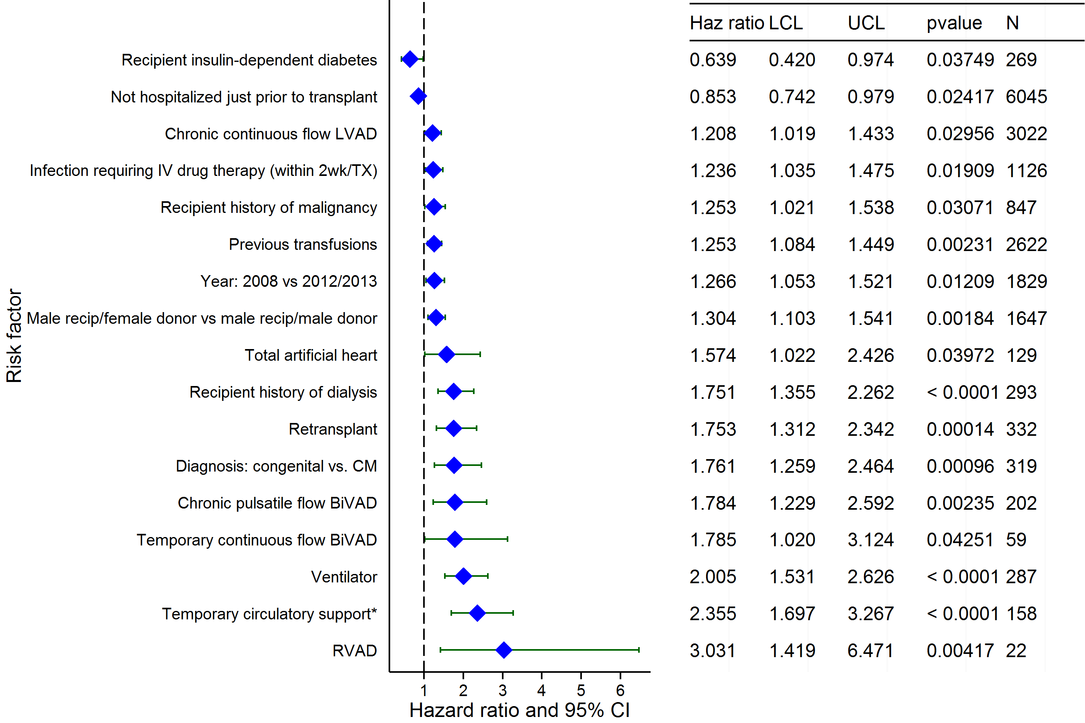
Adult Heart Transplants (2008-6/2013)
Risk Factors For 1 Year Mortality with 95% Confidence Limits
2015
(N = 10,904)
JHLT. 2015 Oct; 34(10): 1244-1254

Slide 110
Adult Heart Transplants (2008-6/2013)
Risk Factors For 1 Year Mortality
Continuous Factors (see figures)
Recipient Age | Donor Age
Recipient pre-transplant creatinine | Ischemia time
Recipient pre-transplant bilirubin | Recipient height
Recipient weight | Transplant center volume
Recipient pulmonary artery systolic pressure
2015
JHLT. 2015 Oct; 34(10): 1244-1254

Slide 111
Adult Heart Transplants (2008-6/2013)
Recipient Age
Risk Factors For 1 Year Mortality with 95% Confidence Limits
p < 0.0001
2015
(N = 10,904)
JHLT. 2015 Oct; 34(10): 1244-1254
Notes:
Multivariable analysis was performed using a proportional hazards model censoring all patients at 1 year. Continuous factors were fit using a restricted cubic spline.
Analyses were limited to transplants having essentially complete information regarding risk factors.

Slide 112
Adult Heart Transplants (2008-6/2013)
Donor Age
Risk Factors For 1 Year Mortality with 95% Confidence Limits
p < 0.0001
2015
(N = 10,904)
JHLT. 2015 Oct; 34(10): 1244-1254
Notes:
Multivariable analysis was performed using a proportional hazards model censoring all patients at 1 year. Continuous factors were fit using a restricted cubic spline.
Analyses were limited to transplants having essentially complete information regarding risk factors.

Slide 113
Adult Heart Transplants (2008-6/2013)
Recipient pre-transplant creatinine
Risk Factors For 1 Year Mortality with 95% Confidence Limits
p < 0.0001
2015
(N = 10,904)
JHLT. 2015 Oct; 34(10): 1244-1254
Notes:
Multivariable analysis was performed using a proportional hazards model censoring all patients at 1 year. Continuous factors were fit using a restricted cubic spline.
Analyses were limited to transplants having essentially complete information regarding risk factors.

Slide 114
Adult Heart Transplants (2008-6/2013)
Ischemia time
Risk Factors For 1 Year Mortality with 95% Confidence Limits
p = 0.0007
2015
(N = 10,904)
JHLT. 2015 Oct; 34(10): 1244-1254
Notes:
Multivariable analysis was performed using a proportional hazards model censoring all patients at 1 year. Continuous factors were fit using a restricted cubic spline.
Analyses were limited to transplants having essentially complete information regarding risk factors.

Slide 115
Adult Heart Transplants (2008-6/2013)
Recipient pre-transplant bilirubin
Risk Factors For 1 Year Mortality with 95% Confidence Limits
p < 0.0001
2015
(N = 10,904)
JHLT. 2015 Oct; 34(10): 1244-1254
Notes:
Multivariable analysis was performed using a proportional hazards model censoring all patients at 1 year. Continuous factors were fit using a restricted cubic spline.
Analyses were limited to transplants having essentially complete information regarding risk factors.

Slide 116
Adult Heart Transplants (2008-6/2013)
Recipient height
Risk Factors For 1 Year Mortality with 95% Confidence Limits
p < 0.0001
2015
(N = 10,904)
JHLT. 2015 Oct; 34(10): 1244-1254
Notes:
Multivariable analysis was performed using a proportional hazards model censoring all patients at 1 year. Continuous factors were fit using a restricted cubic spline.
Analyses were limited to transplants having essentially complete information regarding risk factors.

Slide 117
Adult Heart Transplants (2008-6/2013)
Recipient weight
Risk Factors For 1 Year Mortality with 95% Confidence Limits
p = 0.0111
2015
(N = 10,904)
JHLT. 2015 Oct; 34(10): 1244-1254
Notes:
Multivariable analysis was performed using a proportional hazards model censoring all patients at 1 year. Continuous factors were fit using a restricted cubic spline.
Analyses were limited to transplants having essentially complete information regarding risk factors.

Slide 118
Adult Heart Transplants (2008-6/2013)
Transplant center volume
Risk Factors For 1 Year Mortality with 95% Confidence Limits
p < 0.0001
2015
(N = 10,904)
JHLT. 2015 Oct; 34(10): 1244-1254
Notes:
Multivariable analysis was performed using a proportional hazards model censoring all patients at 1 year. Continuous factors were fit using a restricted cubic spline.
Analyses were limited to transplants having essentially complete information regarding risk factors.

Slide 119
Adult Heart Transplants (2008-6/2013)
Recipient pulmonary artery systolic pressure
Risk Factors For 1 Year Mortality with 95% Confidence Limits
p = 0.0110
2015
(N = 10,904)
JHLT. 2015 Oct; 34(10): 1244-1254
Notes:
Multivariable analysis was performed using a proportional hazards model censoring all patients at 1 year. Continuous factors were fit using a restricted cubic spline.
Analyses were limited to transplants having essentially complete information regarding risk factors.

Slide 120
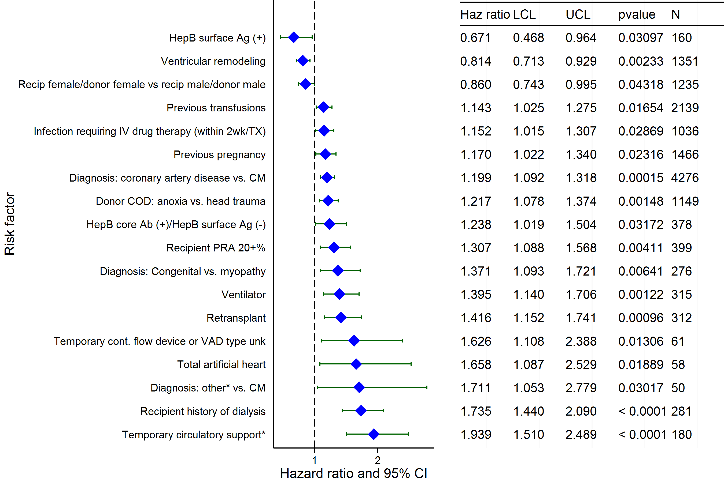
Adult Heart Transplants (2004-6/2009)
Risk Factors For 5 Year Mortality with 95% Confidence Limits
2015
(N = 10,272)
JHLT. 2015 Oct; 34(10): 1244-1254

Slide 121
Adult Heart Transplants (2004-6/2009)
Risk Factors For 5 Year Mortality
Continuous Factors (see figures)
Recipient Age | Donor Age
Recipient pre-transplant creatinine | Ischemia time
Recipient pre-transplant bilirubin | Recipient height
Transplant center volume | Recipient BMI
Recipient transpulmonary gradient | Recipient pulmonary artery systolic pressure
2015
JHLT. 2015 Oct; 34(10): 1244-1254

Slide 122
Adult Heart Transplants (2004-6/2009)
Recipient Age
Risk Factors For 5 Year Mortality with 95% Confidence Limits
p < 0.0001
2015
(N = 10,272)
JHLT. 2015 Oct; 34(10): 1244-1254
Notes:
Multivariable analysis was performed using a proportional hazards model censoring all patients at 5 years. Continuous factors were fit using a restricted cubic spline.
Analyses were limited to transplants having essentially complete information regarding risk factors.

Slide 123
Adult Heart Transplants (2004-6/2009)
Donor Age
Risk Factors For 5 Year Mortality with 95% Confidence Limits
p < 0.0001
2015
(N = 10,272)
JHLT. 2015 Oct; 34(10): 1244-1254
Notes:
Multivariable analysis was performed using a proportional hazards model censoring all patients at 5 years. Continuous factors were fit using a restricted cubic spline.
Analyses were limited to transplants having essentially complete information regarding risk factors.

Slide 124
Adult Heart Transplants (2004-6/2009)
Recipient pre-transplant creatinine
Risk Factors For 5 Year Mortality with 95% Confidence Limits
p < 0.0001
2015
(N = 10,272)
JHLT. 2015 Oct; 34(10): 1244-1254
Notes:
Multivariable analysis was performed using a proportional hazards model censoring all patients at 5 years. Continuous factors were fit using a restricted cubic spline.
Analyses were limited to transplants having essentially complete information regarding risk factors.

Slide 125
Adult Heart Transplants (2004-6/2009)
Ischemia time
Risk Factors For 5 Year Mortality with 95% Confidence Limits
p < 0.0001
2015
(N = 10,272)
JHLT. 2015 Oct; 34(10): 1244-1254
Notes:
Multivariable analysis was performed using a proportional hazards model censoring all patients at 5 years. Continuous factors were fit using a restricted cubic spline.
Analyses were limited to transplants having essentially complete information regarding risk factors.

Slide 126
Adult Heart Transplants (2004-6/2009)
Recipient pre-transplant bilirubin
Risk Factors For 5 Year Mortality with 95% Confidence Limits
p = 0.0080
2015
(N = 10,272)
JHLT. 2015 Oct; 34(10): 1244-1254
Notes:
Multivariable analysis was performed using a proportional hazards model censoring all patients at 5 years. Continuous factors were fit using a restricted cubic spline.
Analyses were limited to transplants having essentially complete information regarding risk factors.

Slide 127
Adult Heart Transplants (2004-6/2009)
Recipient height
Risk Factors For 5 Year Mortality with 95% Confidence Limits
p < 0.0001
2015
(N = 10,272)
JHLT. 2015 Oct; 34(10): 1244-1254
Notes:
Multivariable analysis was performed using a proportional hazards model censoring all patients at 5 years. Continuous factors were fit using a restricted cubic spline.
Analyses were limited to transplants having essentially complete information regarding risk factors.

Slide 128
Adult Heart Transplants (2004-6/2009)
Transplant center volume
Risk Factors For 5 Year Mortality with 95% Confidence Limits
p = 0.0290
2015
(N = 10,272)
JHLT. 2015 Oct; 34(10): 1244-1254
Notes:
Multivariable analysis was performed using a proportional hazards model censoring all patients at 5 years. Continuous factors were fit using a restricted cubic spline.
Analyses were limited to transplants having essentially complete information regarding risk factors.

Slide 129
Adult Heart Transplants (2004-6/2009)
Recipient BMI
Risk Factors For 5 Year Mortality with 95% Confidence Limits
p = 0.0060
2015
(N = 10,272)
JHLT. 2015 Oct; 34(10): 1244-1254
Notes:
Multivariable analysis was performed using a proportional hazards model censoring all patients at 5 years. Continuous factors were fit using a restricted cubic spline.
Analyses were limited to transplants having essentially complete information regarding risk factors.

Slide 130
Adult Heart Transplants (2004-6/2009)
Recipient transpulmonary gradient
Risk Factors For 5 Year Mortality with 95% Confidence Limits
p = 0.0449
2015
(N = 10,272)
JHLT. 2015 Oct; 34(10): 1244-1254
Notes:
Multivariable analysis was performed using a proportional hazards model censoring all patients at 5 years. Continuous factors were fit using a restricted cubic spline.
Analyses were limited to transplants having essentially complete information regarding risk factors.

Slide 131
Adult Heart Transplants (2004-6/2009)
Recipient pulmonary artery systolic pressure
Risk Factors For 5 Year Mortality with 95% Confidence Limits
p = 0.0180
2015
(N = 10,272)
JHLT. 2015 Oct; 34(10): 1244-1254
Notes:
Multivariable analysis was performed using a proportional hazards model censoring all patients at 5 years. Continuous factors were fit using a restricted cubic spline.
Analyses were limited to transplants having essentially complete information regarding risk factors.

Slide 132
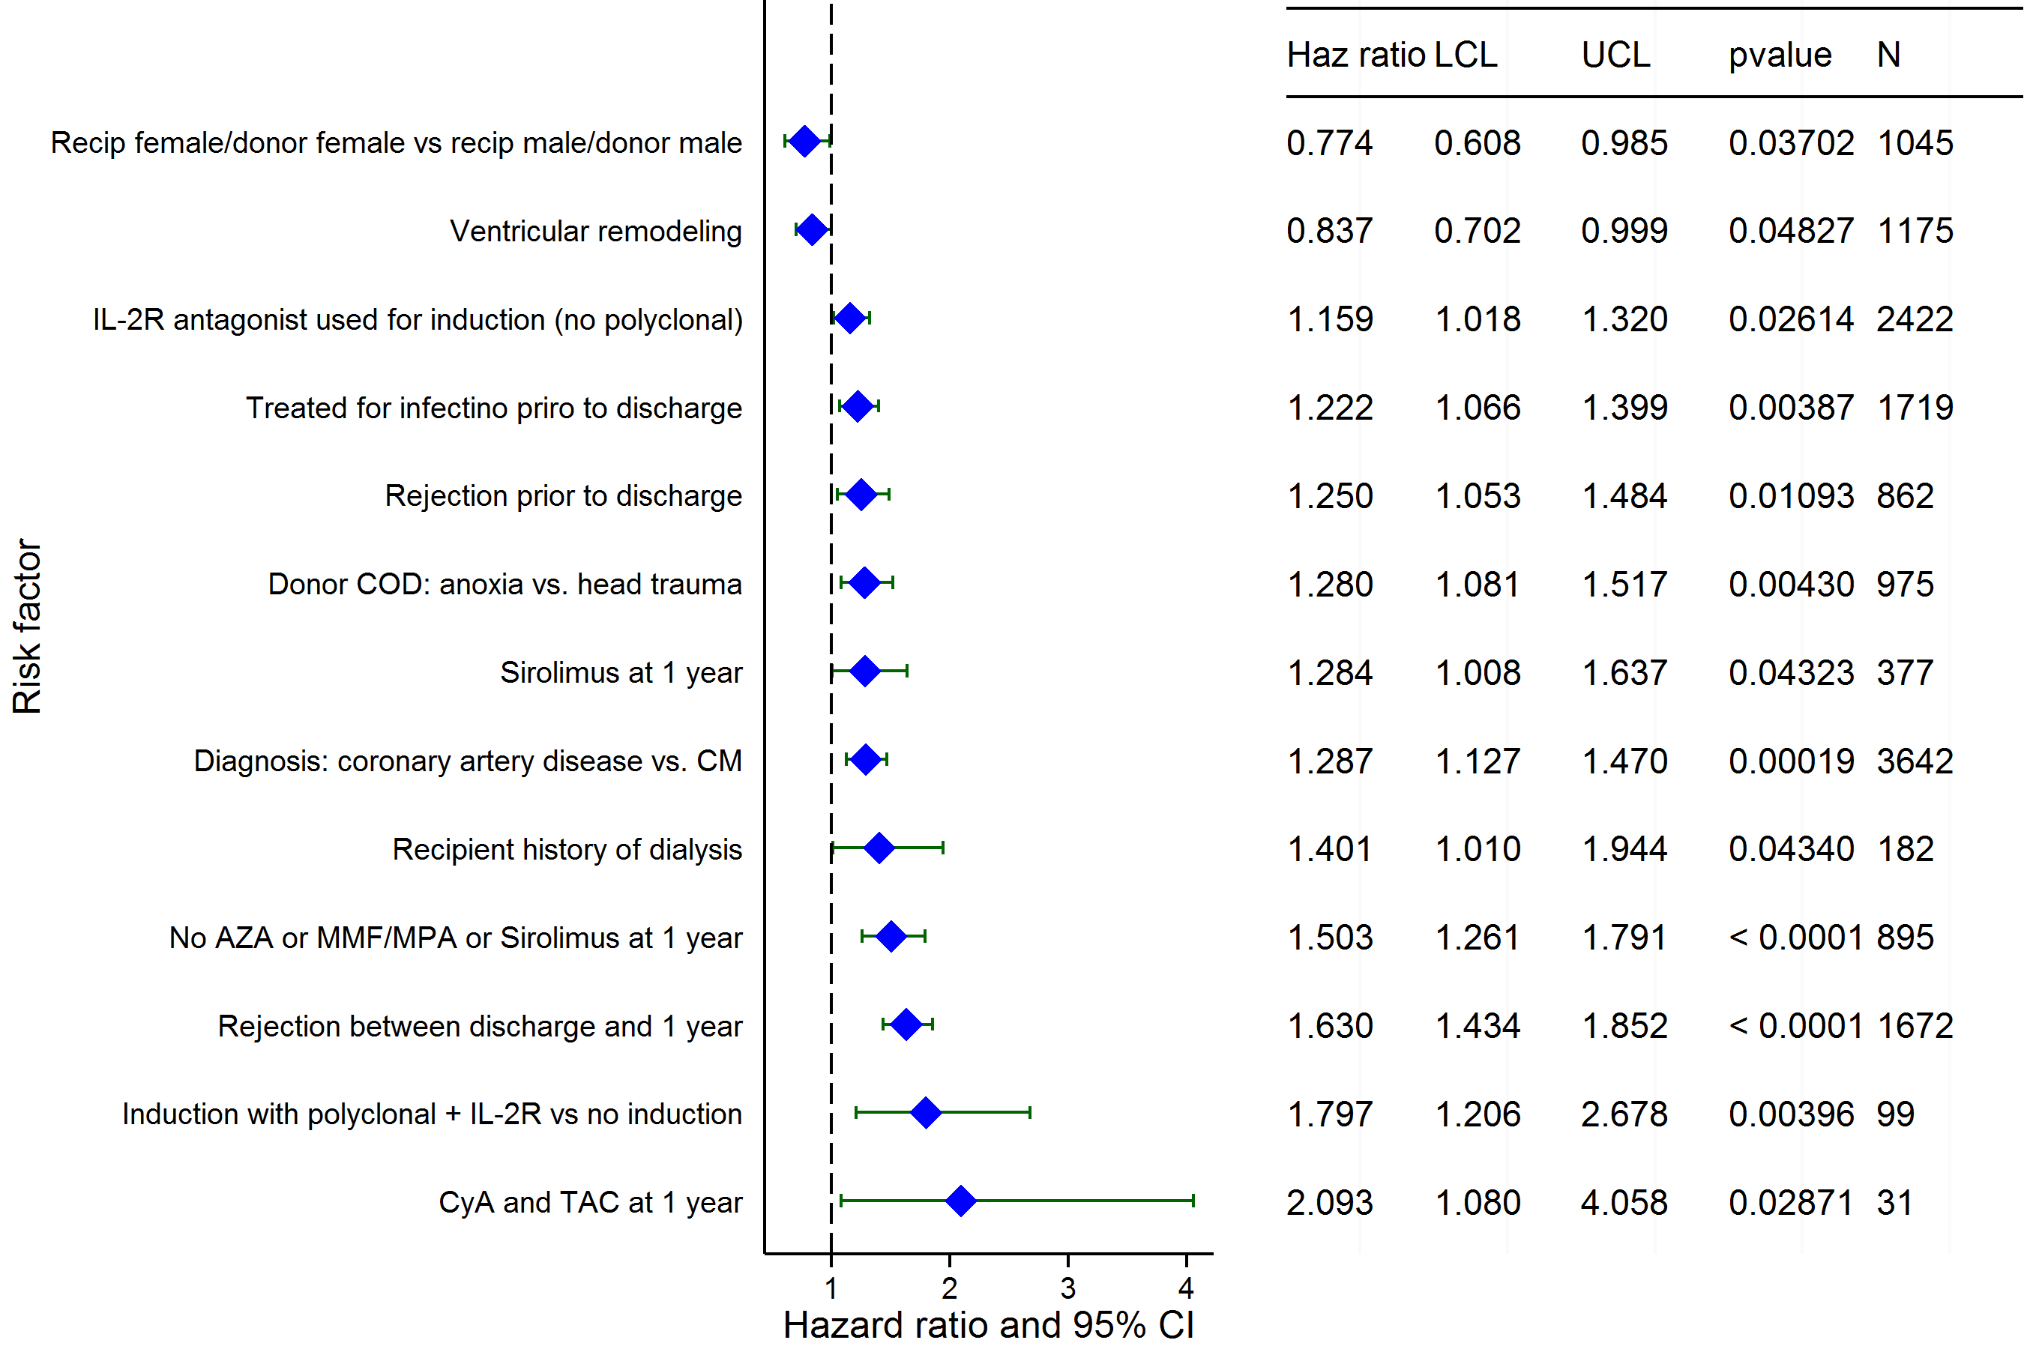
Adult Heart Transplants (2004-6/2009)
Risk Factors For 5 Year Mortality Conditional on Survival to 1 Year with 95% Confidence Limits
2015
(N = 8,786)
JHLT. 2015 Oct; 34(10): 1244-1254

Slide 133
Adult Heart Transplants (2004-6/2009)
Risk Factors For 5 Year Mortality Conditional on Survival to 1 Year
Continuous Factors (see figures)
Recipient Age | Recipient pre-transplant creatinine
Pulmonary capillary wedge pressure | Recipient height
Donor age - recipient age
2015
JHLT. 2015 Oct; 34(10): 1244-1254

Slide 134
Adult Heart Transplants (2004-6/2009)
Risk Factors For 5 Year Mortality Conditional on Survival to 1 Year with 95% Confidence Limits
Recipient Age
p = 0.0110
2015
(N = 8,786)
JHLT. 2015 Oct; 34(10): 1244-1254
Notes:
Multivariable analysis was performed using a proportional hazards model censoring all patients at 5 years. Continuous factors were fit using a restricted cubic spline.
Analyses were limited to transplants having essentially complete information regarding risk factors.

Slide 135
Adult Heart Transplants (2004-6/2009)
Risk Factors For 5 Year Mortality Conditional on Survival to 1 Year with 95% Confidence Limits
Donor age - recipient age
p = 0.0004
2015
(N = 8,786)
JHLT. 2015 Oct; 34(10): 1244-1254
Notes:
Multivariable analysis was performed using a proportional hazards model censoring all patients at 5 years. Continuous factors were fit using a restricted cubic spline.
Analyses were limited to transplants having essentially complete information regarding risk factors.

Slide 136
Adult Heart Transplants (2004-6/2009)
Risk Factors For 5 Year Mortality Conditional on Survival to 1 Year with 95% Confidence Limits
Recipient pre-transplant creatinine
p = 0.0172
2015
(N = 8,786)
JHLT. 2015 Oct; 34(10): 1244-1254
Notes:
Multivariable analysis was performed using a proportional hazards model censoring all patients at 5 years. Continuous factors were fit using a restricted cubic spline.
Analyses were limited to transplants having essentially complete information regarding risk factors.

Slide 137
Adult Heart Transplants (2004-6/2009)
Risk Factors For 5 Year Mortality Conditional on Survival to 1 Year with 95% Confidence Limits
Pulmonary Capillary Wedge Pressure
p = 0.0493
2015
(N = 8,786)
JHLT. 2015 Oct; 34(10): 1244-1254
Notes:
Multivariable analysis was performed using a proportional hazards model censoring all patients at 5 years. Continuous factors were fit using a restricted cubic spline.
Analyses were limited to transplants having essentially complete information regarding risk factors.

Slide 138
Adult Heart Transplants (2004-6/2009)
Risk Factors For 5 Year Mortality Conditional on Survival to 1 Year with 95% Confidence Limits
Recipient height
p = 0.0026
2015
(N = 8,786)
JHLT. 2015 Oct; 34(10): 1244-1254
Notes:
Multivariable analysis was performed using a proportional hazards model censoring all patients at 5 years. Continuous factors were fit using a restricted cubic spline.
Analyses were limited to transplants having essentially complete information regarding risk factors.

Slide 139
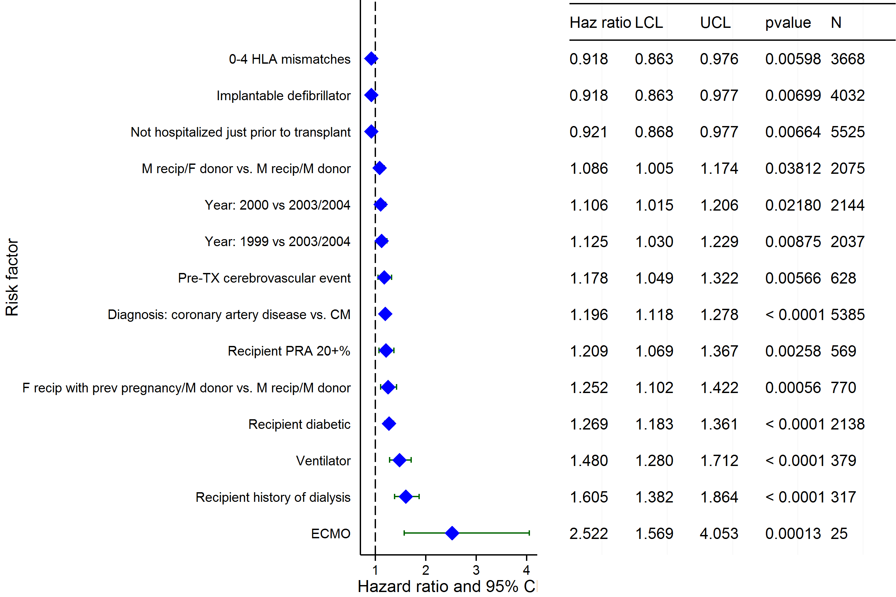
Adult Heart Transplants (1999-6/2004)
Risk Factors For 10 Year Mortality with 95% Conf. Limits
2015
(N = 11,427)
JHLT. 2015 Oct; 34(10): 1244-1254

Slide 140
Adult Heart Transplants (1999-6/2004)
Risk Factors For 10 Year Mortality
Continuous Factors (see figures)
Recipient Age | Donor Age
Recipient pre-transplant creatinine | Ischemia time
Recipient pre-transplant bilirubin | Recipient weight
Transplant center volume | Recipient BMI
2015
JHLT. 2015 Oct; 34(10): 1244-1254

Slide 141
Adult Heart Transplants (1999-6/2004)
Recipient Age
Risk Factors For 10 Year Mortality with 95% Conf. Limits
p < 0.0001
2015
(N = 11,427)
JHLT. 2015 Oct; 34(10): 1244-1254
Notes:
Multivariable analysis was performed using a proportional hazards model censoring all patients at 10 years. Continuous factors were fit using a restricted cubic spline.
Analyses were limited to transplants having essentially complete information regarding risk factors.

Slide 142
Adult Heart Transplants (1999-6/2004)
Donor Age
Risk Factors For 10 Year Mortality with 95% Conf. Limits
p < 0.0001
2015
(N = 11,427)
JHLT. 2015 Oct; 34(10): 1244-1254
Notes:
Multivariable analysis was performed using a proportional hazards model censoring all patients at 10 years. Continuous factors were fit using a restricted cubic spline.
Analyses were limited to transplants having essentially complete information regarding risk factors.

Slide 143
Adult Heart Transplants (1999-6/2004)
Recipient pre-transplant creatinine
Risk Factors For 10 Year Mortality with 95% Conf. Limits
p < 0.0001
2015
(N = 11,427)
JHLT. 2015 Oct; 34(10): 1244-1254
Notes:
Multivariable analysis was performed using a proportional hazards model censoring all patients at 10 years. Continuous factors were fit using a restricted cubic spline.
Analyses were limited to transplants having essentially complete information regarding risk factors.

Slide 144
Adult Heart Transplants (1999-6/2004)
Ischemia time
Risk Factors For 10 Year Mortality with 95% Conf. Limits
p = 0.0037
2015
(N = 11,427)
JHLT. 2015 Oct; 34(10): 1244-1254
Notes:
Multivariable analysis was performed using a proportional hazards model censoring all patients at 10 years. Continuous factors were fit using a restricted cubic spline.
Analyses were limited to transplants having essentially complete information regarding risk factors.

Slide 145
Adult Heart Transplants (1999-6/2004)
Recipient pre-transplant bilirubin
Risk Factors For 10 Year Mortality with 95% Conf. Limits
p < 0.0001
2015
(N = 11,427)
JHLT. 2015 Oct; 34(10): 1244-1254
Notes:
Multivariable analysis was performed using a proportional hazards model censoring all patients at 10 years. Continuous factors were fit using a restricted cubic spline.
Analyses were limited to transplants having essentially complete information regarding risk factors.

Slide 146
Adult Heart Transplants (1999-6/2004)
Recipient weight
Risk Factors For 10 Year Mortality with 95% Conf. Limits
p = 0.0002
2015
(N = 11,427)
JHLT. 2015 Oct; 34(10): 1244-1254
Notes:
Multivariable analysis was performed using a proportional hazards model censoring all patients at 10 years. Continuous factors were fit using a restricted cubic spline.
Analyses were limited to transplants having essentially complete information regarding risk factors.

Slide 147
Adult Heart Transplants (1999-6/2004)
Transplant center volume
Risk Factors For 10 Year Mortality with 95% Conf. Limits
p < 0.0001
2015
(N = 11,427)
JHLT. 2015 Oct; 34(10): 1244-1254
Notes:
Multivariable analysis was performed using a proportional hazards model censoring all patients at 10 years. Continuous factors were fit using a restricted cubic spline.
Analyses were limited to transplants having essentially complete information regarding risk factors.

Slide 148
Adult Heart Transplants (1999-6/2004)
Recipient BMI
Risk Factors For 10 Year Mortality with 95% Conf. Limits
p < 0.0001
2015
(N = 11,427)
JHLT. 2015 Oct; 34(10): 1244-1254
Notes:
Multivariable analysis was performed using a proportional hazards model censoring all patients at 10 years. Continuous factors were fit using a restricted cubic spline.
Analyses were limited to transplants having essentially complete information regarding risk factors.

Slide 149
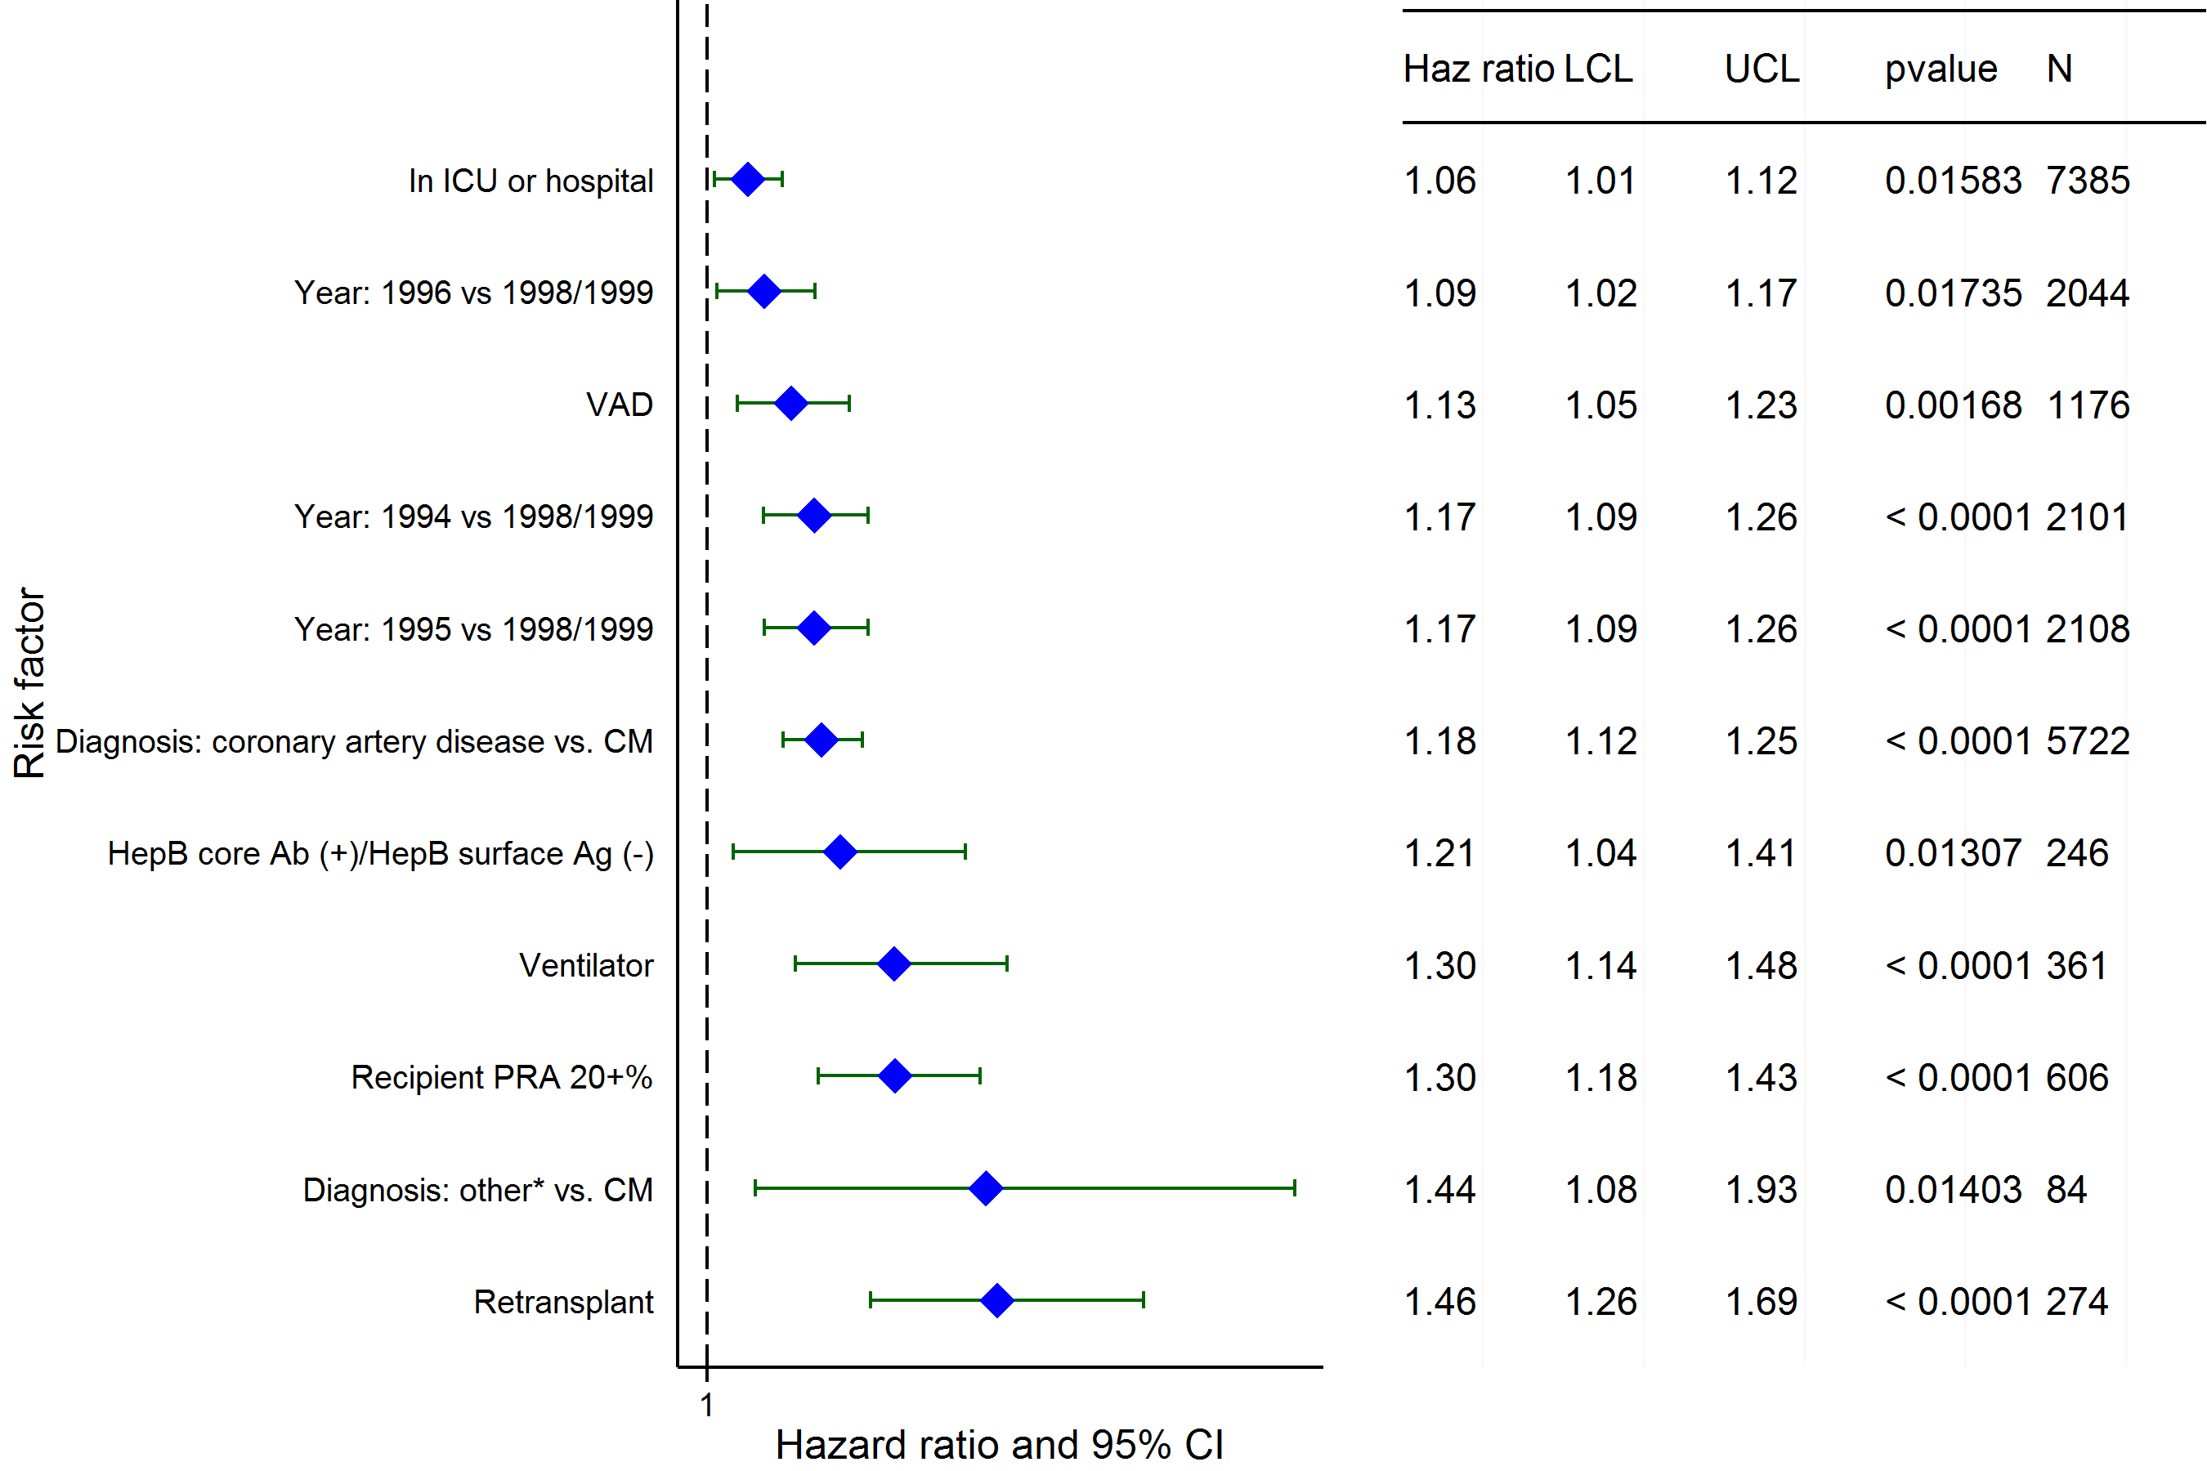
Adult Heart Transplants (1994-6/1999)
Risk Factors For 15 Year Mortality with 95% Conf. Limits
2015
(N = 11,388)
JHLT. 2015 Oct; 34(10): 1244-1254

Slide 150
Adult Heart Transplants (1994-6/1999)
Risk Factors For 15 Year Mortality
Continuous Factors (see figures)
Recipient Age | Recipient pre-transplant creatinine
Ischemia time | Recipient weight
Transplant center volume | Recipient BSA
Donor age - recipient age
2015
JHLT. 2015 Oct; 34(10): 1244-1254

Slide 151
Adult Heart Transplants (1994-6/1999)
Recipient Age
Risk Factors For 15 Year Mortality with 95% Conf. Limits
p < 0.0001
2015
(N = 11,388)
JHLT. 2015 Oct; 34(10): 1244-1254
Notes:
Multivariable analysis was performed using a proportional hazards model censoring all patients at 15 years. Continuous factors were fit using a restricted cubic spline.
Analyses were limited to transplants having essentially complete information regarding risk factors.

Slide 152
Adult Heart Transplants (1994-6/1999)
Recipient pre-transplant creatinine
Risk Factors For 15 Year Mortality with 95% Conf. Limits
p < 0.0001
2015
(N = 11,388)
JHLT. 2015 Oct; 34(10): 1244-1254
Notes:
Multivariable analysis was performed using a proportional hazards model censoring all patients at 15 years. Continuous factors were fit using a restricted cubic spline.
Analyses were limited to transplants having essentially complete information regarding risk factors.

Slide 153
Adult Heart Transplants (1994-6/1999)
Ischemia time
Risk Factors For 15 Year Mortality with 95% Conf. Limits
p = 0.0017
2015
(N = 11,388)
JHLT. 2015 Oct; 34(10): 1244-1254
Notes:
Multivariable analysis was performed using a proportional hazards model censoring all patients at 15 years. Continuous factors were fit using a restricted cubic spline.
Analyses were limited to transplants having essentially complete information regarding risk factors.

Slide 154
Adult Heart Transplants (1994-6/1999)
Recipient weight
Risk Factors For 15 Year Mortality with 95% Conf. Limits
p < 0.0001
2015
(N = 11,388)
JHLT. 2015 Oct; 34(10): 1244-1254
Notes:
Multivariable analysis was performed using a proportional hazards model censoring all patients at 15 years. Continuous factors were fit using a restricted cubic spline.
Analyses were limited to transplants having essentially complete information regarding risk factors.

Slide 155
Adult Heart Transplants (1994-6/1999)
Transplant center volume
Risk Factors For 15 Year Mortality with 95% Conf. Limits
p < 0.0001
2015
(N = 11,388)
JHLT. 2015 Oct; 34(10): 1244-1254
Notes:
Multivariable analysis was performed using a proportional hazards model censoring all patients at 15 years. Continuous factors were fit using a restricted cubic spline.
Analyses were limited to transplants having essentially complete information regarding risk factors.

Slide 156
Adult Heart Transplants (1994-6/1999)
Recipient BSA
Risk Factors For 15 Year Mortality with 95% Conf. Limits
p = 0.0006
2015
(N = 11,388)
JHLT. 2015 Oct; 34(10): 1244-1254
Notes:
Multivariable analysis was performed using a proportional hazards model censoring all patients at 15 years. Continuous factors were fit using a restricted cubic spline.
Analyses were limited to transplants having essentially complete information regarding risk factors.

Slide 157
Adult Heart Transplants (1994-6/1999)
Donor age - recipient age
Risk Factors For 15 Year Mortality with 95% Conf. Limits
p < 0.0001
2015
(N = 11,388)
JHLT. 2015 Oct; 34(10): 1244-1254
Notes:
Multivariable analysis was performed using a proportional hazards model censoring all patients at 15 years. Continuous factors were fit using a restricted cubic spline.
Analyses were limited to transplants having essentially complete information regarding risk factors.

Slide 158
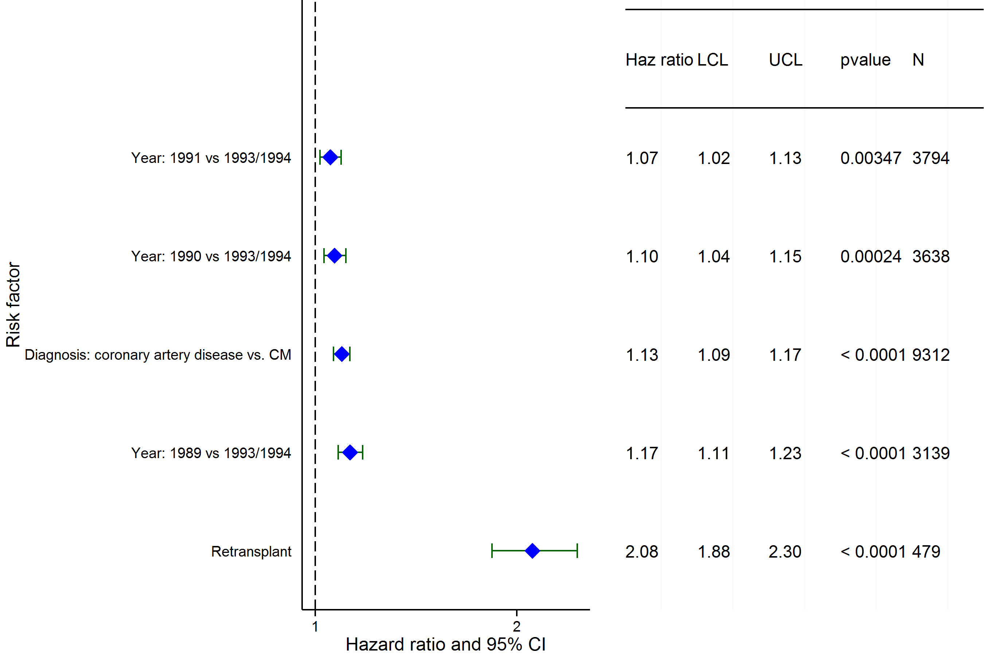
Adult Heart Transplants (1989-6/1994)
Risk Factors For 20 Year Mortality with 95% Conf. Limits
2015
(N = 20,137)
JHLT. 2015 Oct; 34(10): 1244-1254

Slide 159
Adult Heart Transplants (1989-6/1994)
Risk Factors For 20 Year Mortality
Continuous Factors (see figures)
Recipient Age | Ischemia time
Transplant center volume | Donor age - recipient age
2015
JHLT. 2015 Oct; 34(10): 1244-1254

Slide 160
Adult Heart Transplants (1989-6/1994)
Recipient Age
Risk Factors For 20 Year Mortality with 95% Conf. Limits
p < 0.0001
2015
(N = 20,137)
JHLT. 2015 Oct; 34(10): 1244-1254
Notes:
Multivariable analysis was performed using a proportional hazards model censoring all patients at 20 years. Continuous factors were fit using a restricted cubic spline.
Analyses were limited to transplants having essentially complete information regarding risk factors.

Slide 161
Adult Heart Transplants (1989-6/1994)
Ischemia time
Risk Factors For 20 Year Mortality with 95% Conf. Limits
p = 0.0015
2015
(N = 20,137)
JHLT. 2015 Oct; 34(10): 1244-1254
Notes:
Multivariable analysis was performed using a proportional hazards model censoring all patients at 20 years. Continuous factors were fit using a restricted cubic spline.
Analyses were limited to transplants having essentially complete information regarding risk factors.

Slide 162
Adult Heart Transplants (1989-6/1994)
Transplant center volume
Risk Factors For 20 Year Mortality with 95% Conf. Limits
p < 0.0001
2015
(N = 20,137)
JHLT. 2015 Oct; 34(10): 1244-1254
Notes:
Multivariable analysis was performed using a proportional hazards model censoring all patients at 20 years. Continuous factors were fit using a restricted cubic spline.
Analyses were limited to transplants having essentially complete information regarding risk factors.

Slide 163
Adult Heart Transplants (1989-6/1994)
Donor age - recipient age
Risk Factors For 20 Year Mortality with 95% Conf. Limits
p < 0.0001
2015
(N = 20,137)
JHLT. 2015 Oct; 34(10): 1244-1254
Notes:
Multivariable analysis was performed using a proportional hazards model censoring all patients at 20 years. Continuous factors were fit using a restricted cubic spline.
Analyses were limited to transplants having essentially complete information regarding risk factors.

Slide 164
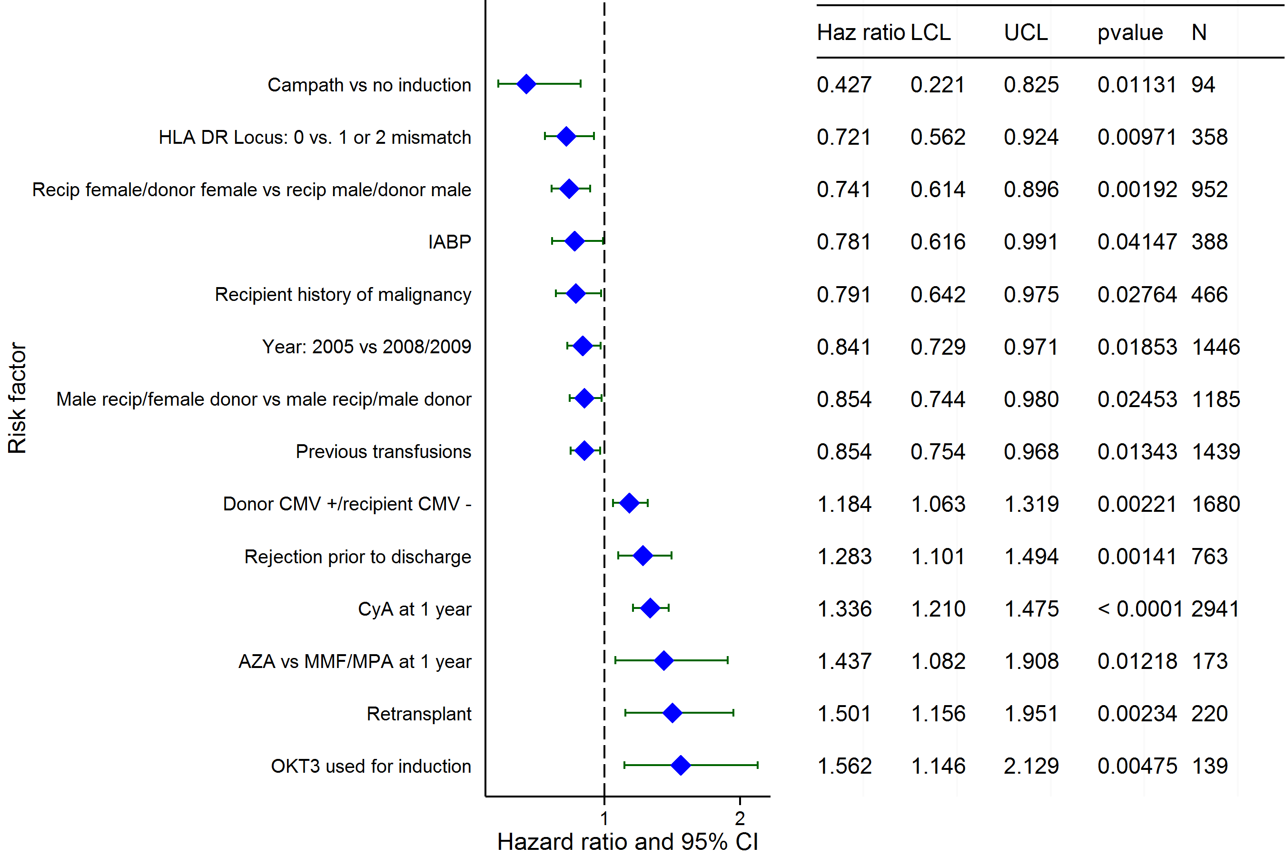
Adult Heart Transplants (2004-6/2009)
Risk Factors for Development of CAV within 5 Years with 95% Confidence Limits Conditional on Survival to Discharge
2015
(N = 7,914)
JHLT. 2015 Oct; 34(10): 1244-1254

Slide 165
Adult Heart Transplants (2004-6/2009)
Risk Factors for Development of CAV within 5 Years
Continuous Factors (see figures)
Donor Age
2015
JHLT. 2015 Oct; 34(10): 1244-1254

Slide 166
Adult Heart Transplants (2004-6/2009)
Risk Factors for Development of CAV within 5 Years with 95% Confidence Limits Conditional on Survival to Discharge
Donor Age
p < 0.0001
2015
(N = 7,914)
JHLT. 2015 Oct; 34(10): 1244-1254
Notes:
Multivariable analysis was performed using a proportional hazards model censoring all patients at 5 years. Continuous factors were fit using a restricted cubic spline.
Analyses were limited to transplants having essentially complete information regarding risk factors.

Slide 167
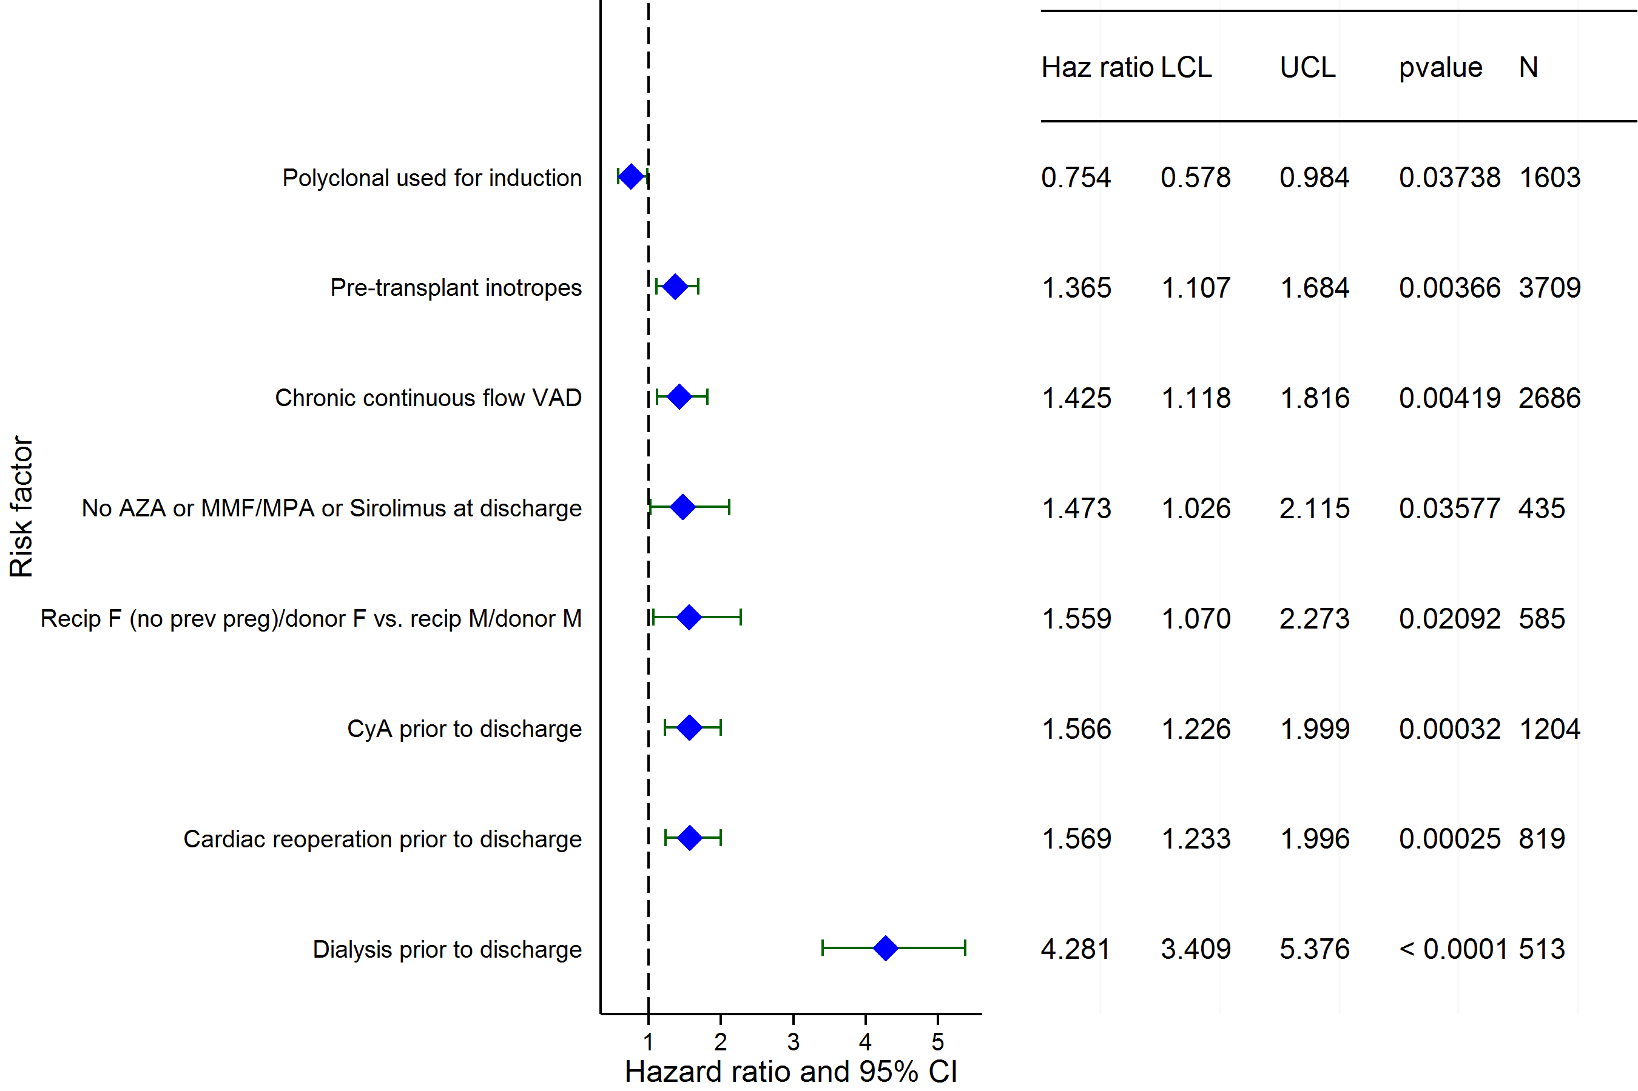
Adult Heart Transplants (2008-6/2013)
Risk Factors for Development of Renal Dysfunction within 1 Year
Limited to Recipients without Severe Renal Dysfunction* Pre-Transplant
Conditional on Survival to Transplant Discharge
2015
(N = 9,208)
JHLT. 2015 Oct; 34(10): 1244-1254

Slide 168
Adult Heart Transplants (2008-6/2013)
Risk Factors for Development of Renal Dysfunction within 1 Year
Continuous Factors (see figures)
Recipient Age | Recipient pre-transplant creatinine
2015
JHLT. 2015 Oct; 34(10): 1244-1254

Slide 169
Adult Heart Transplants (2008-6/2013)
Risk Factors for Development of Renal Dysfunction within 1 Year
Limited to Recipients without Severe Renal Dysfunction* Pre-Transplant
Conditional on Survival to Transplant Discharge
Recipient Age
pval = 0.0335
2015
(N = 9,208)
JHLT. 2015 Oct; 34(10): 1244-1254
Notes:
Multivariable analysis was performed using a proportional hazards model censoring all patients at 5 years. Continuous factors were fit using a restricted cubic spline.
Analyses were limited to transplants having essentially complete information regarding risk factors.

Slide 170
Adult Heart Transplants (2008-6/2013)
Risk Factors for Development of Renal Dysfunction within 1 Year
Limited to Recipients without Severe Renal Dysfunction* Pre-Transplant
Conditional on Survival to Transplant Discharge
Recipient pre-transplant creatinine
p < 0.0001
2015
(N = 9,208)
JHLT. 2015 Oct; 34(10): 1244-1254
Notes:
Multivariable analysis was performed using a proportional hazards model censoring all patients at 5 years. Continuous factors were fit using a restricted cubic spline.
Analyses were limited to transplants having essentially complete information regarding risk factors.

Slide 171
Early Graft Failure (EGF):
EGF by various donor, recipient and transplant characteristics: slides 172-190
Multivariable analysis for EGF within 30 days: slides 191-200
2015
JHLT. 2014 Oct; 33(10): 996-1008
JHLT. 2015 Oct; 34(10): 1244-1254

Slide 172
Adult Heart Transplants
Cumulative Incidence of EGF by Transplant Type
(Transplants: January 2005 – December 2013)
p = 0.2851
2015
JHLT. 2015 Oct; 34(10): 1244-1254
JHLT. 2014 Oct; 33(10): 1009-1024
Notes:
Only transplants with known EGF status are included in the tabulation. Incidence was computed using a competing-risks extension of the Kaplan-Meier method.

Slide 173
Adult Heart Transplants
% with EGF by EGF Type and Year for Primary Transplants
2015
JHLT. 2015 Oct; 34(10): 1244-1254
JHLT. 2014 Oct; 33(10): 1009-1024
Notes:
Only transplants with known EGF status are included in the tabulation. Percentage with EGF was computed using a competing-risks extension of the Kaplan-Meier method.

Slide 174
Adult Heart Transplants
% with EGF by EGF Type and Year for First Retransplants
2015
JHLT. 2015 Oct; 34(10): 1244-1254
JHLT. 2014 Oct; 33(10): 1009-1024
Notes:
Only transplants with known EGF status are included in the tabulation. Percentage with EGF was computed using a competing-risks extension of the Kaplan-Meier method.

Slide 175
Adult Heart Transplants
Cumulative Incidence of EGF by Era
(Transplants: January 2005 – December 2013)
p < 0.0001
2015
JHLT. 2015 Oct; 34(10): 1244-1254
JHLT. 2014 Oct; 33(10): 1009-1024
Notes:
Only transplants with known EGF status are included in the tabulation. Incidence was computed using a competing-risks extension of the Kaplan-Meier method.

Slide 176
Adult Heart Transplants
Cumulative Incidence of EGF by Diagnosis
(Primary Transplants: January 2005 – December 2013)
No pair-wise comparisons were significant at p < 0.05 except Cardiomyopathy vs. Congenital, Cardiomyopathy vs. Valvular and CAD vs. Congenital
2015
JHLT. 2015 Oct; 34(10): 1244-1254
JHLT. 2014 Oct; 33(10): 1009-1024
Notes:
Only transplants with known EGF status are included in the tabulation. Incidence was computed using a competing-risks extension of the Kaplan-Meier method.

Slide 177
Adult Heart Transplants
Cumulative Incidence of EGF by Diagnosis and Era
(Primary Transplants: January 2005 – December 2013)
All pair-wise comparisons between eras within each diagnosis were significant at p < 0.05. No pair-wise comparisons between diagnoses within each era were significant at p < 0.05.
2015
JHLT. 2015 Oct; 34(10): 1244-1254
JHLT. 2014 Oct; 33(10): 1009-1024
Notes:
Only transplants with known EGF status are included in the tabulation. Incidence was computed using a competing-risks extension of the Kaplan-Meier method.

Slide 178
Adult Heart Transplants
% with EGF by EGF Type and Age Group
(Primary Transplants: January 2005 – December 2013)
2015
JHLT. 2015 Oct; 34(10): 1244-1254
JHLT. 2014 Oct; 33(10): 1009-1024
Notes:
Only transplants with known EGF status are included in the tabulation. Percentage with EGF was computed using a competing-risks extension of the Kaplan-Meier method.
Comparisons were made using the chi-square statistic. Adjustments for multiple comparisons were done using Bonferroni method.

Slide 179
Adult Heart Transplants
% with EGF by EGF Type, Gender and Diagnosis
(Primary Transplants: January 2005 – December 2013)
Myopathy
(N*=4,959/11,680)
CAD
(N=1,454/9,872)
Congenital
(N=359/586)
Valvular
(N=259/660)
Valvular
(N=60/134)
2015
* Ns represent the total number of female and male recipients for each diagnosis.
JHLT. 2015 Oct; 34(10): 1244-1254
JHLT. 2014 Oct; 33(10): 1009-1024
Notes:
Only transplants with known EGF status are included in the tabulation. Percentage with EGF was computed using a competing-risks extension of the Kaplan-Meier method.
Comparisons were made using the chi-square statistic or Fisher's exact test. Adjustments for multiple comparisons were done using Bonferroni method.

Slide 180
Adult Heart Transplants
Cumulative Incidence of EGF by Donor Gender
(Primary Transplants: January 2005 – December 2013)
2015
JHLT. 2015 Oct; 34(10): 1244-1254
JHLT. 2014 Oct; 33(10): 1009-1024
Notes:
Only transplants with known EGF status are included in the tabulation. Incidence was computed using a competing-risks extension of the Kaplan-Meier method.

Slide 181
Adult Heart Transplants
Cumulative Incidence of EGF by Donor Age Group
(Transplants: January 2005 – December 2013)
All pair-wise comparisons were significant at p < 0.001.
2015
JHLT. 2015 Oct; 34(10): 1244-1254
JHLT. 2014 Oct; 33(10): 1009-1024
Notes:
Only transplants with known EGF status are included in the tabulation. Incidence was computed using a competing-risks extension of the Kaplan-Meier method.

Slide 182
Adult Heart Transplants
Cumulative Incidence of EGF by Mechanical Circulatory Support* (Transplants: January 2005 – December 2013)
* LVAD, RVAD, TAH, ECMO
Only transplants with known MSC status are included in the tabulation. MSC status was not reported for N=14,080 recipients.
2015
JHLT. 2015 Oct; 34(10): 1244-1254
JHLT. 2014 Oct; 33(10): 1009-1024
Notes:
Only transplants with known EGF status are included in the tabulation. Incidence was computed using a competing-risks extension of the Kaplan-Meier method.

Slide 183
Adult Heart Transplants
% with EGF by Location and Era for Primary Transplants
No pair-wise comparisons between eras within each location and between locations within each era were significant at p < 0.05 except all pair-wise comparisons with North America
Europe
North America
Other
2015
JHLT. 2015 Oct; 34(10): 1244-1254
JHLT. 2014 Oct; 33(10): 1009-1024
Notes:
Only transplants with known EGF status are included in the tabulation. Percentage with EGF was computed using a competing-risks extension of the Kaplan-Meier method.
Comparisons were made using the chi-square statistic. Adjustments for multiple comparisons were done using Bonferroni method.

Slide 184
Adult Heart Transplants
% with EGF and non-EGF Early Failures by Location and Era for Primary Transplants
Europe
North America
Other
No pair-wise comparisons between eras within each location and between locations within each era were significant at p < 0.05 except:
% with EGF – all pair-wise comparisons with North America
% with non-EGF early failures – all pair-wise comparisons with North America within each era
2015
* non-EGF early failures include non-EGF retransplants and deaths within 30 days
JHLT. 2015 Oct; 34(10): 1244-1254
JHLT. 2014 Oct; 33(10): 1009-1024
Notes:
Only transplants with known EGF status are included in the tabulation. Percentage with EGF was computed using a competing-risks extension of the Kaplan-Meier method.
Comparisons were made using the chi-square statistic. Adjustments for multiple comparisons were done using Bonferroni method.

Slide 185
Adult Heart Transplants
% with EGF by EGF Type and Center Volume
(Primary Transplants: January 2005 – December 2013)
2015
JHLT. 2015 Oct; 34(10): 1244-1254
JHLT. 2014 Oct; 33(10): 1009-1024
Notes:
Only transplants with known EGF status are included in the tabulation. Percentage with EGF was computed using a competing-risks extension of the Kaplan-Meier method.
Comparisons were made using the chi-square statistic. Adjustments for multiple comparisons were done using Bonferroni method.

Slide 186
Adult Heart Transplants
% with EGF by EGF Type and PRA
(Primary Transplants: January 2005 – December 2013)
All pair-wise comparisons of % with EGF with Not reported group were significant at p < 0.05. No other pair-wise comparisons were significant at p < 0.05.
2015
If Class I and Class II values were reported separately, the higher of the two values was used.
JHLT. 2015 Oct; 34(10): 1244-1254
JHLT. 2014 Oct; 33(10): 1009-1024
Notes:
Only transplants with known EGF status are included in the tabulation. Percentage with EGF was computed using a competing-risks extension of the Kaplan-Meier method.
Comparisons were made using the chi-square statistic. Adjustments for multiple comparisons were done using Bonferroni method.

Slide 187
Adult Heart Transplants
Cumulative Incidence of EGF by Ischemic Time
(Transplants: January 2005 – December 2013)
2015
JHLT. 2015 Oct; 34(10): 1244-1254
JHLT. 2014 Oct; 33(10): 1009-1024
Notes:
Only transplants with known EGF status are included in the tabulation. Incidence was computed using a competing-risks extension of the Kaplan-Meier method.

Slide 188
Adult Heart Transplants
Cumulative Incidence of EGF by Donor/Recipient BMI Ratio
(Transplants: January 2005 – December 2013)
2015
JHLT. 2015 Oct; 34(10): 1244-1254
JHLT. 2014 Oct; 33(10): 1009-1024
Notes:
Only transplants with known EGF status are included in the tabulation. Incidence was computed using a competing-risks extension of the Kaplan-Meier method.

Slide 189
Adult Heart Transplants
Cumulative Incidence of EGF by Donor Cause of Death
(Transplants: January 2005 – December 2013)
2015
JHLT. 2015 Oct; 34(10): 1244-1254
JHLT. 2014 Oct; 33(10): 1009-1024
Notes:
Only transplants with known EGF status are included in the tabulation. Incidence was computed using a competing-risks extension of the Kaplan-Meier method.

Slide 190
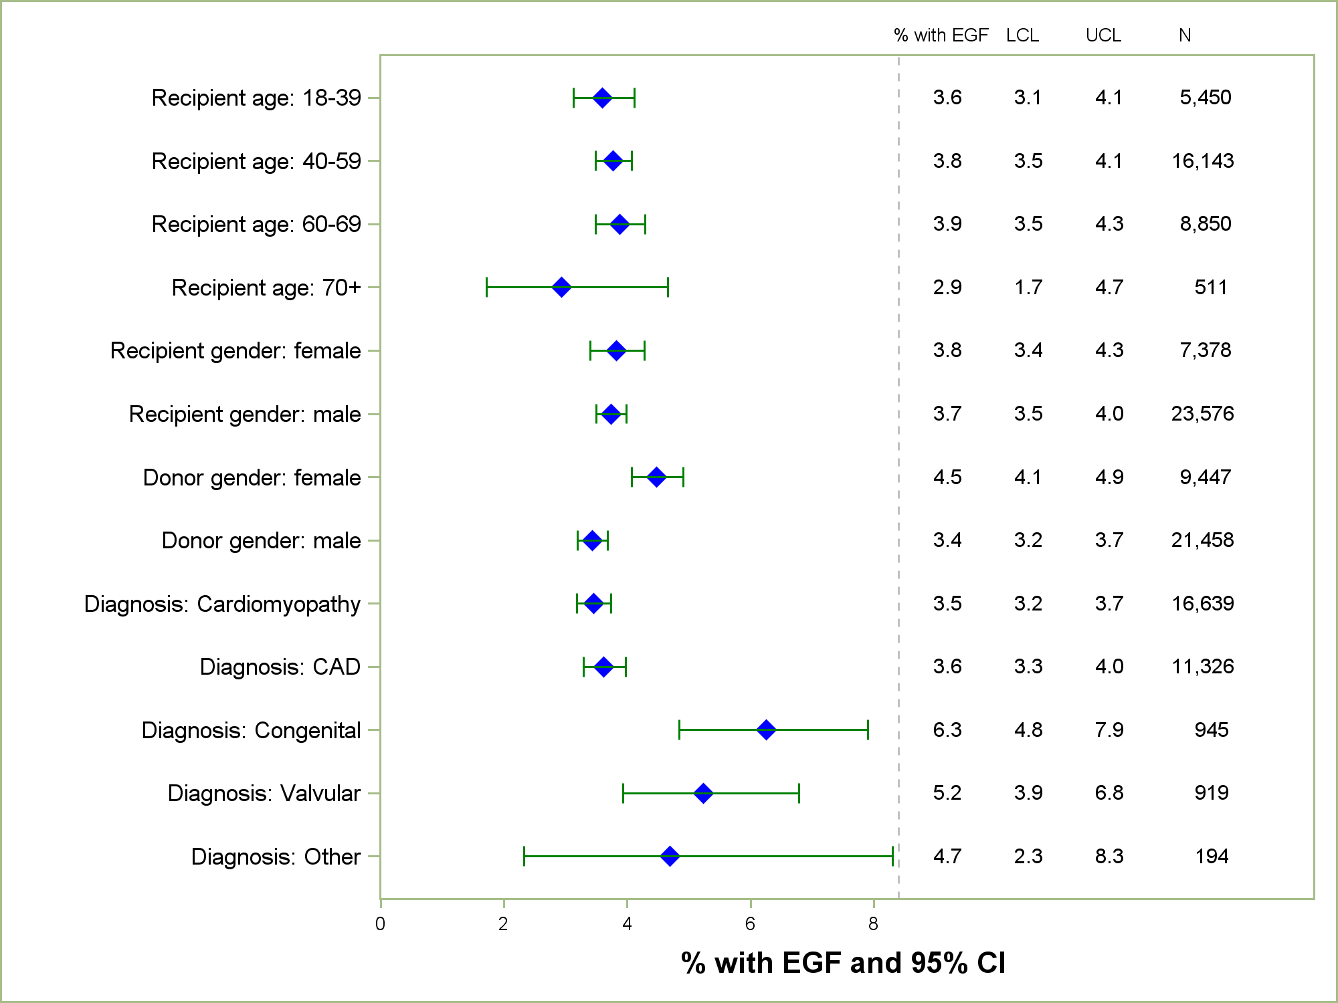
Adult Heart Transplants
% with EGF by Donor and Recipient Characteristics
(Primary Transplants: January 2005 – December 2013)
2015
JHLT. 2015 Oct; 34(10): 1244-1254
Notes:
Only transplants with known EGF status are included in the tabulation. Percentage with EGF was computed using a competing-risks extension of the Kaplan-Meier method.

Slide 191
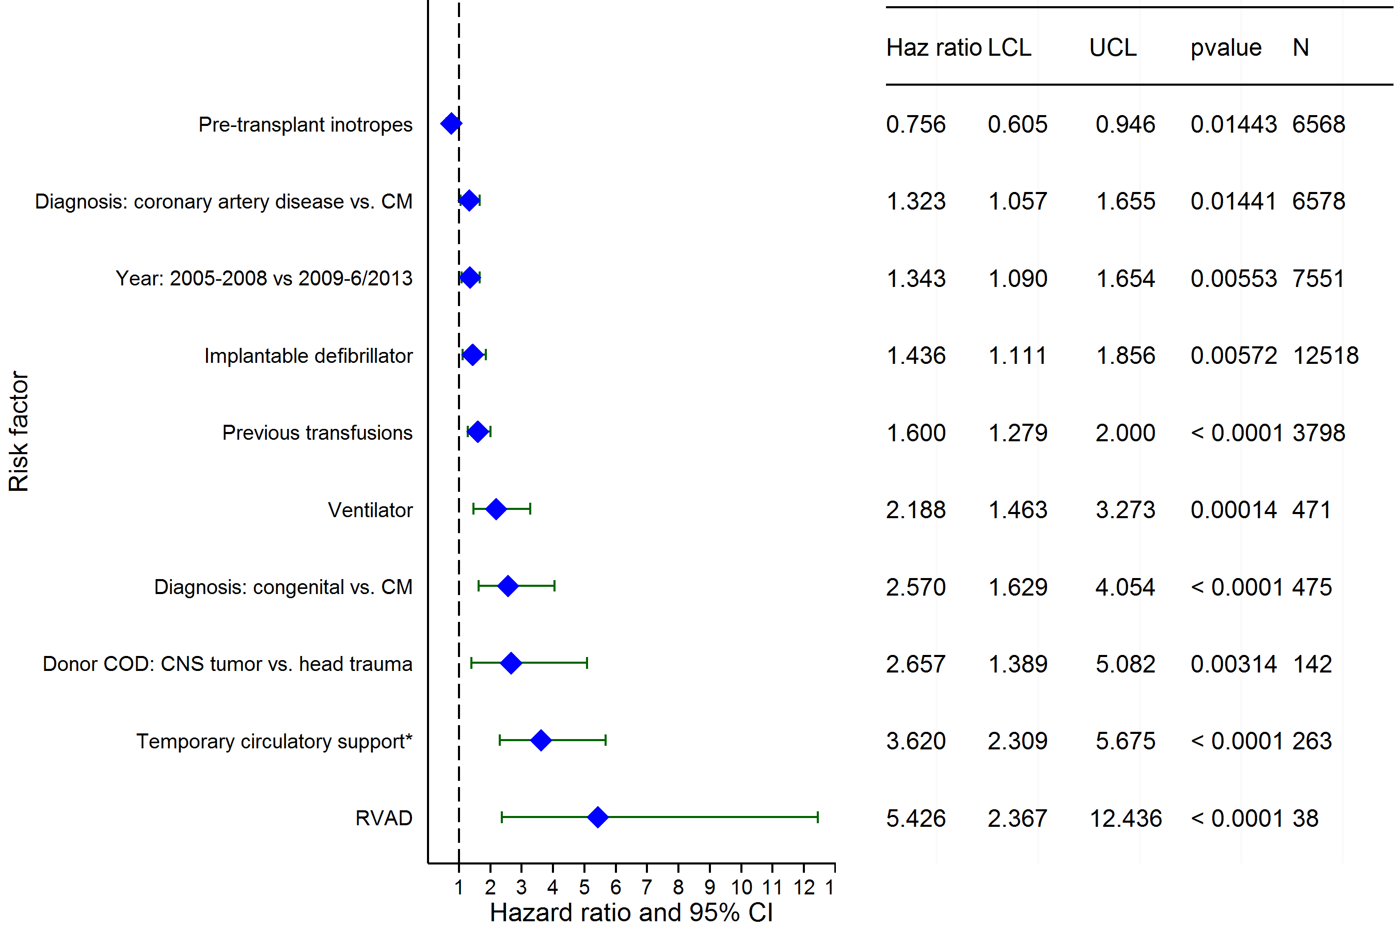
Adult Heart Transplants (2005-6/2013)
Risk Factors for EGF within 30 days with 95% CL
(N = 16,627)
2015
* Temporary circulatory support includes ECMO and temporary pulsatile flow devices.
JHLT. 2015 Oct; 34(10): 1244-1254

Slide 192
Adult Heart Transplants (2005-6/2013)
Risk Factors for EGF within 30 days
Continuous Factors (see figures)
Donor Age | Recipient pre-transplant creatinine
Ischemia time | Recipient pre-transplant bilirubin
Recipient height | Recipient weight
Transplant center volume | Recipient transpulmonary gradient
2015
JHLT. 2015 Oct; 34(10): 1244-1254

Slide 193
Adult Heart Transplants (2005-6/2013)
Donor Age
Risk Factors for EGF within 30 days with 95% CL
p < 0.0001
2015
(N = 16,627)
JHLT. 2015 Oct; 34(10): 1244-1254
Notes:
Multivariable analysis was performed using a proportional hazards model censoring all patients at 30 days. Continuous factors were fit using a restricted cubic spline.
Analyses were limited to transplants having essentially complete information regarding risk factors.

Slide 194
Adult Heart Transplants (2005-6/2013)
Recipient pre-transplant creatinine
Risk Factors for EGF within 30 days with 95% CL
p < 0.0001
2015
(N = 16,627)
JHLT. 2015 Oct; 34(10): 1244-1254
Notes:
Multivariable analysis was performed using a proportional hazards model censoring all patients at 30 days. Continuous factors were fit using a restricted cubic spline.
Analyses were limited to transplants having essentially complete information regarding risk factors.

Slide 195
Adult Heart Transplants (2005-6/2013)
Ischemia time
Risk Factors for EGF within 30 days with 95% CL
p < 0.0001
2015
(N = 16,627)
JHLT. 2015 Oct; 34(10): 1244-1254
Notes:
Multivariable analysis was performed using a proportional hazards model censoring all patients at 30 days. Continuous factors were fit using a restricted cubic spline.
Analyses were limited to transplants having essentially complete information regarding risk factors.

Slide 196
Adult Heart Transplants (2005-6/2013)
Recipient pre-transplant bilirubin
Risk Factors for EGF within 30 days with 95% CL
p = 0.0004
2015
(N = 16,627)
JHLT. 2015 Oct; 34(10): 1244-1254
Notes:
Multivariable analysis was performed using a proportional hazards model censoring all patients at 30 days. Continuous factors were fit using a restricted cubic spline.
Analyses were limited to transplants having essentially complete information regarding risk factors.

Slide 197
Adult Heart Transplants (2005-6/2013)
Recipient height
Risk Factors for EGF within 30 days with 95% CL
p < 0.0001
2015
(N = 16,627)
JHLT. 2015 Oct; 34(10): 1244-1254
Notes:
Multivariable analysis was performed using a proportional hazards model censoring all patients at 30 days. Continuous factors were fit using a restricted cubic spline.
Analyses were limited to transplants having essentially complete information regarding risk factors.

Slide 198
Adult Heart Transplants (2005-6/2013)
Recipient weight
Risk Factors for EGF within 30 days with 95% CL
p = 0.0016
2015
(N = 16,627)
JHLT. 2015 Oct; 34(10): 1244-1254
Notes:
Multivariable analysis was performed using a proportional hazards model censoring all patients at 30 days. Continuous factors were fit using a restricted cubic spline.
Analyses were limited to transplants having essentially complete information regarding risk factors.

Slide 199
Adult Heart Transplants (2005-6/2013)
Transplant center volume
Risk Factors for EGF within 30 days with 95% CL
p = 0.0319
2015
(N = 16,627)
JHLT. 2015 Oct; 34(10): 1244-1254
Notes:
Multivariable analysis was performed using a proportional hazards model censoring all patients at 30 days. Continuous factors were fit using a restricted cubic spline.
Analyses were limited to transplants having essentially complete information regarding risk factors.

Slide 200
Adult Heart Transplants (2005-6/2013)
Recipient transpulmonary gradient
Risk Factors for EGF within 30 days with 95% CL
p = 0.0028
2015
(N = 16,627)
JHLT. 2015 Oct; 34(10): 1244-1254
Notes:
Multivariable analysis was performed using a proportional hazards model censoring all patients at 30 days. Continuous factors were fit using a restricted cubic spline.
Analyses were limited to transplants having essentially complete information regarding risk factors.

