Slide 1

HEART-LUNG TRANSPLANTATION
Adult Recipients
2015
JHLT. 2015 Oct; 34(10): 1264-1277

Slide 2
Table of Contents
Donor and recipient characteristics: slides 3-13
Post transplant survival and other outcomes: slides 14-23
Induction and maintenance immunosuppression: slides 24-29
Post transplant morbidities: slides 30-40
Multivariable analyses: slides 41-42
Early Graft Failure (EGF): slides 43-59
2015
JHLT. 2015 Oct; 34(10): 1264-1277
JHLT. 2014 Oct; 33(10): 1009-1024

Slide 3
Donor and Recipient Characteristics
2015
JHLT. 2015 Oct; 34(10): 1264-1277
JHLT. 2014 Oct; 33(10): 1009-1024

Slide 4
Adult Heart-Lung Transplants
Number of Transplants Reported by Year
NOTE: This figure includes only the heart-lung transplants that are reported to the ISHLT Transplant Registry. As such, this should not be construed as evidence that the number of heart-lung transplants worldwide has declined in recent years.
2015
JHLT. 2015 Oct; 34(10): 1264-1277
JHLT. 2014 Oct; 33(10): 1009-1024

Slide 5
Adult Heart-Lung Transplants
Average Center Volume by Location
(Transplants: January 2009 – June 2014)
2015
JHLT. 2015 Oct; 34(10): 1264-1277

Slide 6
Adult Heart-Lung Retransplants
Retransplants by Year and Location
2015
JHLT. 2015 Oct; 34(10): 1264-1277

Slide 7
Adult Heart-Lung Transplants
Diagnosis (Transplants: January 1982 – June 2014)
Diagnosis | N (%)
Congenital Heart Disease | 1188 (35.4%)
Idiopathic Pulmonary Arterial Hypertension | 927 (27.6%)
Cystic Fibrosis | 458 (13.6%)
Acquired Heart Disease | 186 (5.5%)
COPD/Emphysema | 142 (4.2%)
Idiopathic Pulmonary Fibrosis | 113 (3.4%)
Alpha-1 | 63 (1.9%)
Sarcoidosis | 57 (1.7%)
Retransplant: Not Obliterative Bronchiolitis | 33 (1.0%)
Retransplant: Obliterative Bronchiolitis | 22 (0.7%)
Bronchiectasis | 30 (0.9%)
Obliterative Bronchiolitis (not Retransplant) | 25 (0.7%)
Other | 112 (3.3%)
2015
For some retransplants a diagnosis other than retransplant is reported, so the total number and percentage of retransplants may be greater.
JHLT. 2015 Oct; 34(10): 1264-1277
JHLT. 2014 Oct; 33(10): 1009-1024

Slide 8
Adult Heart-Lung Transplants
Diagnosis by Era (Transplants: January 1982 – June 2014)
2015
NOTE: “Other” includes OB (non-retx) and Bronchiectasis.
JHLT. 2015 Oct; 34(10): 1264-1277
JHLT. 2014 Oct; 33(10): 1009-1024

Slide 9
Adult Heart-Lung Transplants
Major Indications by Year (%)
2015
Since only major indications are shown, sum of percentages for each year is less than 100%.
JHLT. 2015 Oct; 34(10): 1264-1277
JHLT. 2014 Oct; 33(10): 1009-1024

Slide 10
Adult Heart-Lung Transplants
Major Indications by Year (Number)
2015
JHLT. 2015 Oct; 34(10): 1264-1277
JHLT. 2014 Oct; 33(10): 1009-1024

Slide 11
Adult Heart-Lung Transplants
Age Distribution by Location
(Transplants: January 2004 – June 2014)
2015
JHLT. 2015 Oct; 34(10): 1264-1277
JHLT. 2014 Oct; 33(10): 1009-1024

Slide 12
Adult Heart-Lung Transplants
Diagnosis Distribution by Location
(Transplants: January 2004 – June 2014)
2015
JHLT. 2015 Oct; 34(10): 1264-1277
JHLT. 2014 Oct; 33(10): 1009-1024
Notes:
NOTE: Transplants with unknown diagnoses are excluded from this tabulation.

Slide 13
Adult Heart-Lung Transplants
Donor Age Distribution by Location
(Transplants: January 2004 – June 2014)
2015
JHLT. 2015 Oct; 34(10): 1264-1277
JHLT. 2014 Oct; 33(10): 1009-1024
Notes:
NOTE: Transplants with unknown donor ages are excluded from this tabulation.

Slide 14
Post Transplant Survival and Other Outcomes
2015
JHLT. 2015 Oct; 34(10): 1264-1277
JHLT. 2014 Oct; 33(10): 1009-1024

Slide 15
Adult Heart-Lung Transplants
Kaplan-Meier Survival
(Transplants: January 1982 – June 2013)
2015
JHLT. 2015 Oct; 34(10): 1264-1277
JHLT. 2014 Oct; 33(10): 1009-1024
Notes:
Survival was calculated using the Kaplan-Meier method, which incorporates information from all transplants for whom any follow-up has been provided. Since many patients are still alive and some patients have been lost to follow-up, the survival rates are estimates rather than exact rates because the time of death is not known for all patients. Therefore, 95% confidence limits are provided about the survival rate estimate; the survival rate shown is the best estimate but the true rate will most likely fall within these limits.
The median survival is the estimated time point at which 50% of all of the recipients have died. The conditional median survival is the estimated time point at which 50% of the recipients who survive to at least 1 year have died. Because the decline in survival is greatest during the first year following transplantation, the conditional survival provides a more realistic expectation of survival time for recipients who survive the early post-transplant period.

Slide 16
Adult Heart-Lung Transplants
Kaplan-Meier Survival by Transplant Type
(Transplants: January 1982 – June 2013)
p = 0.0017
2015
JHLT. 2015 Oct; 34(10): 1264-1277
JHLT. 2014 Oct; 33(10): 1009-1024
Notes:
Survival was calculated using the Kaplan-Meier method, which incorporates information from all transplants for whom any follow-up has been provided. Since many patients are still alive and some patients have been lost to follow-up, the survival rates are estimates rather than exact rates because the time of death is not known for all patients.
The median survival is the estimated time point at which 50% of all of the recipients have died. The conditional median survival is the estimated time point at which 50% of the recipients who survive to at least 1 year have died. Because the decline in survival is greatest during the first year following transplantation, the conditional survival provides a more realistic expectation of survival time for recipients who survive the early post-transplant period.
Survival rates were compared using the log-rank test statistic.

Slide 17
Adult Heart-Lung Transplants
Kaplan-Meier Survival by Era
(Transplants: January 1982 – June 2013)
2015
JHLT. 2015 Oct; 34(10): 1264-1277
JHLT. 2014 Oct; 33(10): 1009-1024
Notes:
Survival was calculated using the Kaplan-Meier method, which incorporates information from all transplants for whom any follow-up has been provided. Since many patients are still alive and some patients have been lost to follow-up, the survival rates are estimates rather than exact rates because the time of death is not known for all patients. The median survival is the estimated time point at which 50% of all of the recipients have died. The conditional median survival is the estimated time point at which 50% of the recipients who survive to at least 1 year have died. Because the decline in survival is greatest during the first year following transplantation, the conditional survival provides a more realistic expectation of survival time for recipients who survive the early post-transplant period.
Survival rates were compared using the log-rank test statistic. Adjustments for multiple comparisons were done using Scheffe’s method.

Slide 18
Adult Heart-Lung Transplants
Kaplan-Meier Survival by Diagnosis
(Transplants: January 1990 – June 2013)
2015
JHLT. 2015 Oct; 34(10): 1264-1277
JHLT. 2014 Oct; 33(10): 1009-1024
Notes:
Survival was calculated using the Kaplan-Meier method, which incorporates information from all transplants for whom any follow-up has been provided. Since many patients are still alive and some patients have been lost to follow-up, the survival rates are estimates rather than exact rates because the time of death is not known for all patients. The median survival is the estimated time point at which 50% of all of the recipients have died.
Survival rates were compared using the log-rank test statistic. Adjustments for multiple comparisons were done using Scheffe’s method. Results of log-rank test should be interpreted with caution when curves cross.

Slide 19
Adult Heart-Lung Transplants
Kaplan-Meier Survival by Diagnosis Conditional on Survival to 1 Year (Transplants: January 1990 – June 2013)
No pair-wise comparisons were significant at p < 0.05
2015
JHLT. 2015 Oct; 34(10): 1264-1277
JHLT. 2014 Oct; 33(10): 1009-1024
Notes:
Survival was calculated using the Kaplan-Meier method, which incorporates information from all transplants for whom any follow-up has been provided. Since many patients are still alive and some patients have been lost to follow-up, the survival rates are estimates rather than exact rates because the time of death is not known for all patients. The median survival is the estimated time point at which 50% of all of the recipients have died.
Survival rates were compared using the log-rank test statistic. Adjustments for multiple comparisons were done using Scheffe’s method. Results of log-rank test should be interpreted with caution when curves cross.

Slide 20
Adult Heart-Lung Transplants
Functional Status of Surviving Recipients
(Follow-ups: March 2005 – June 2014)
2015
JHLT. 2015 Oct; 34(10): 1264-1277
JHLT. 2014 Oct; 33(10): 1009-1024
Notes:
Functional status is collected using Karnofsky score for adult recipients.
This figure shows the functional status reported on the 1-year, 2-year and 3-year annual follow-ups. Because all follow-ups between March 2005 and June 2014 were included, the bars do not include the same patients.

Slide 21
Adult Heart-Lung Transplants
Employment Status of Surviving Recipients
(Follow-ups: April 1994 – June 2014)
2015
JHLT. 2015 Oct; 34(10): 1264-1277
JHLT. 2014 Oct; 33(10): 1009-1024
Notes:
This figure shows the employment status reported on the 1-year, 3-year and 5-year annual follow-ups. Because all follow-ups between April 1994 and June 2014 were included, the bars do not include the same patients.

Slide 22
Adult Heart-Lung Transplants
Employment Status of Surviving Recipients by Era
(Follow-ups: April 1994 – June 2014)
2015
JHLT. 2015 Oct; 34(10): 1264-1277
JHLT. 2014 Oct; 33(10): 1009-1024
Notes:
This figure shows the employment status reported on the 1-year, 3-year and 5-year annual follow-ups. Because all follow-ups between April 1994 and June 2014 were included, the bars do not include the same patients.

Slide 23
Adult Heart-Lung Transplants
Rehospitalization Post-transplant of Surviving Recipients
(Follow-ups: April 1994 – June 2014)
2015
JHLT. 2015 Oct; 34(10): 1264-1277
JHLT. 2014 Oct; 33(10): 1009-1024
Notes:
This figure shows the hospitalizations reported on the 1-year, 3-year and 5-year annual follow-ups, representing the hospitalizations between discharge and 1 year, between the 2-year and 3-year follow-up and between the 4-year and 5-year follow-up, respectively. Because all follow-ups between April 1994 and June 2014 were included, the bars do not include the same patients.

Slide 24
Induction and Maintenance Immunosuppression
2015
JHLT. 2015 Oct; 34(10): 1264-1277
JHLT. 2014 Oct; 33(10): 1009-1024

Slide 25
Adult Heart-Lung Transplants
Induction Immunosuppression
(Transplants: January 2004 – June 2014)
2015
Analysis is limited to patients who were alive at the time of the discharge.
JHLT. 2015 Oct; 34(10): 1264-1277
JHLT. 2014 Oct; 33(10): 1009-1024

Slide 26
Adult Heart-Lung Transplants
Induction Immunosuppression by Year
(Transplants: January 2004 – December 2013)
2015
Analysis is limited to patients who were alive at the time of the discharge.
JHLT. 2015 Oct; 34(10): 1264-1277
JHLT. 2014 Oct; 33(10): 1009-1024

Slide 27
Adult Heart-Lung Transplants
Induction Immunosuppression
(Transplants: January 2004 – December 2013)
2015
Analysis is limited to patients who were alive at the time of the discharge.
JHLT. 2015 Oct; 34(10): 1264-1277
JHLT. 2014 Oct; 33(10): 1009-1024

Slide 28
Adult Heart-Lung Transplants
Maintenance Immunosuppression at Time of Follow-up
(Follow-ups: January 2004 – June 2014)
NOTE: Different patients are analyzed in Year 1 and Year 5
2015
Analysis is limited to patients who were alive at the time of the follow-up.
JHLT. 2015 Oct; 34(10): 1264-1277
JHLT. 2014 Oct; 33(10): 1009-1024
Notes:
This figure shows the maintenance immunosuppression reported as being provided at the time of the 1-year and 5-year annual follow-up forms. To provide a snapshot of current practice, only follow-ups occurring between January 2004 and June 2014 were included. Therefore, this figure does not represent changes in practice between the 1-year follow-up and 5-year follow-up on a cohort of patients. The patients in the 1-year tabulation are not the same patients as in the 5-year tabulation.

Slide 29
Adult Heart-Lung Transplants
Maintenance Immunosuppression Drug Combinations at Time of Follow-up (Follow-ups: January 2004 – June 2014)
NOTE: Different patients are analyzed in Year 1 and Year 5
2015
Analysis is limited to patients who were alive at the time of the follow-up.
JHLT. 2015 Oct; 34(10): 1264-1277
JHLT. 2014 Oct; 33(10): 1009-1024
Notes:
This figure shows the maintenance immunosuppression reported as being provided at the time of the 1-year and 5-year annual follow-up forms. To provide a snapshot of current practice, only follow-ups occurring between January 2004 and June 2014 were included. Therefore, this figure does not represent changes in practice between the 1-year follow-up and 5-year follow-up on a cohort of patients. The patients in the 1-year tabulation are not the same patients as in the 5-year tabulation.

Slide 30
Post Transplant Morbidities
2015
JHLT. 2015 Oct; 34(10): 1264-1277
JHLT. 2014 Oct; 33(10): 1009-1024

Slide 31
Adult Heart-Lung Transplants
Cumulative Post Transplant Morbidity Rates in Survivors within 1 and 5 Years (Follow-ups: April 1994 – June 2014)
Outcome | Within 1 Year | Total number with known response | Within 5 Years | Total number with known response
Hypertension | 59.1% | (N=447) | 88.2% | (N=153)
Renal Dysfunction | 19.0% | (N=505) | 44.7% | (N=197)
Abnormal Creatinine ≤ 2.5 mg/dl | 11.9% |  | 30.5%
Creatinine > 2.5 mg/dl | 3.0% |  | 10.7%
Chronic Dialysis | 4.0% |  | 2.5%
Renal Transplant | 0.2% |  | 1.0%
Hyperlipidemia | 26.8% | (N=467) | 70.4% | (N=162)
Diabetes | 18.0% | (N=512) | 28.9% | (N=194)
Coronary Artery Vasculopathy | 2.7% | (N=405) | 9.0% | (N=100)
Bronchiolitis Obliterans Syndrome | 7.6% | (N=473) | 29.0% | (N=162)
2015
JHLT. 2015 Oct; 34(10): 1264-1277
JHLT. 2014 Oct; 33(10): 1009-1024
Notes:
This table shows the percentage of patients experiencing various morbidities as reported on the 1-year annual follow-up form and within 5 years following transplantation. The percentages are based on patients with known responses. To reduce bias, only patients with responses reported on every follow-up through the 5-year annual follow-up were included in the 5-year analysis. Because the outcomes are reported to be unknown at different rates the number with known responses for each outcome are also provided

Slide 32
Adult Heart-Lung Transplants
Freedom from Coronary Artery Vasculopathy and Bronchiolitis Obliterans Syndrome
(Follow-ups: April 1994 – June 2014)
2015
JHLT. 2015 Oct; 34(10): 1264-1277
JHLT. 2014 Oct; 33(10): 1009-1024
Notes:
Freedom from CAV and from bronchiolitis obliterans rates were computed using the Kaplan-Meier method.
The development of CAV and bronchiolitis obliterans is reported on annual follow-ups; a date of diagnosis is not provided. For this figure the midpoint between the date of previous follow-up (when event had not occurred) and the date of follow-up when the event was reported was used as the date of occurrence. Patients were included in the analysis until an unknown response for CAV was reported. Therefore, the rates seen here may differ from those reported in the cumulative prevalence slide which is based on only those patients with known responses for CAV at all follow-up time points.

Slide 33
Adult Heart-Lung Transplants
Freedom from Coronary Artery Vasculopathy by Diagnosis Type (Follow-ups: April 1994 – June 2014)
2015
JHLT. 2015 Oct; 34(10): 1264-1277
JHLT. 2014 Oct; 33(10): 1009-1024
Notes:
Freedom from CAV rates were computed using the Kaplan-Meier method.
The development of CAV is reported on annual follow-ups; a date of diagnosis is not provided. For this figure the midpoint between the date of previous follow-up (when event had not occurred) and the date of follow-up when the event was reported was used as the date of occurrence. Patients were included in the analysis until an unknown response for CAV was reported. Therefore, the rates seen here may differ from those reported in the cumulative prevalence slide which is based on only those patients with known responses for CAV at all follow-up time points.
Rates were compared using the log-rank test statistic.

Slide 34
Adult Heart-Lung Transplants
Freedom from Bronchiolitis Obliterans Syndrome by Diagnosis Type (Follow-ups: April 1994 – June 2014)
2015
JHLT. 2015 Oct; 34(10): 1264-1277
JHLT. 2014 Oct; 33(10): 1009-1024
Notes:
Freedom from bronchiolitis obliterans rates were computed using the Kaplan-Meier method.
The development of bronchiolitis obliterans is reported on annual follow-ups; a date of diagnosis is not provided. For this figure the midpoint between the date of previous follow-up (when event had not occurred) and the date of follow-up when the event was reported was used as the date of occurrence. Patients were included in the analysis until an unknown response for bronchiolitis obliterans was reported. Therefore, the rates seen here may differ from those reported in the cumulative prevalence slide which is based on only those patients with known responses for bronchiolitis obliterans at all follow-up time points.

Slide 35
Adult Heart-Lung Transplants
Freedom from Severe Renal Dysfunction*
(Follow-ups: April 1994 – June 2014)
N = 506
2015
JHLT. 2015 Oct; 34(10): 1264-1277
JHLT. 2014 Oct; 33(10): 1009-1024
Notes:
Freedom from severe renal dysfunction rates were computed using the Kaplan-Meier method.
The development of severe renal dysfunction is reported on annual follow-ups; a date of diagnosis is not provided. For this figure the midpoint between the date of previous follow-up (when event had not occurred) and the date of follow-up when the event was reported was used as the date of occurrence. Patients were included in the analysis until an unknown response for severe renal dysfunction was reported. Therefore, the rates seen here may differ from those reported in the cumulative prevalence slide which is based on only those patients with known responses for severe renal dysfunction at all follow-up time points.

Slide 36
Adult Heart-Lung Transplants
Cumulative Post Transplant Malignancy Rates in Survivors (Follow-ups: April 1994 – June 2014)
Malignancy/Type |  | 1-Year Survivors | 5-Year Survivors | 10-Year Survivors
No Malignancy |  | 491 (94.2%) | 181 (89.2%) | 66 (84.6%)
Malignancy (all types combined) |  | 30 (5.8%) | 22 (10.8%) | 12 (15.4%)
Malignancy Type* | Skin | 2 | 8 | 10
 | Lymphoma | 21 | 6 | 1
 | Other | 4 | 6 | 2
 | Type Not Reported | 3 | 2 | 0
* Recipients may have experienced more than one type of malignancy so the sum of individual malignancy types may be greater than the total number with malignancy.
2015
JHLT. 2015 Oct; 34(10): 1264-1277
JHLT. 2014 Oct; 33(10): 1009-1024
Notes:
This table shows the percentage of patients with malignancies reported within 1 year, within 5 years and within 10 years following transplantation. The percentages are based on patients with known responses. To reduce bias, only patients with responses reported on every follow-up through the 5-year (or 10-year) annual follow-up were included in the “5-Year Survivors” (or “10-Year Survivors”) column.

Slide 37
Adult Heart-Lung Transplants
Freedom from Malignancy
(Follow-ups: April 1994 – June 2014)
2015
JHLT. 2015 Oct; 34(10): 1264-1277
JHLT. 2014 Oct; 33(10): 1009-1024
Notes:
Freedom from malignancy rates were computed using the Kaplan-Meier method.
The development of malignancy is reported on annual follow-ups; a date of diagnosis is not provided. For this figure the midpoint between the date of previous follow-up (when event had not occurred) and the date of follow-up when the event was reported was used as the date of occurrence. Patients were included in the analysis until an unknown response for malignancy was reported. Therefore, the rates seen here may differ from those reported in the cumulative prevalence slide which is based on only those patients with known responses for malignancy at all follow-up time points.

Slide 38
Adult-Heart Lung Transplants
Cause of Death (Deaths: January 1992 – June 2014)
CAUSE OF DEATH | 0-30 Days (N=437) | 31 Days - 1 Year (N=344) | >1 Year - 3 Years (N=279) | >3 Years - 5 Years (N=170) | >5 Years (N = 465)
BRONCHIOLITIS | 0 | 13 (3.8%) | 68 (24.4%) | 38 (22.4%) | 99 (21.3%)
ACUTE REJECTION | 7 (1.6%) | 9 (2.6%) | 6 (2.2%) | 2 (1.2%) | 3 (0.6%)
LYMPHOMA | 0 | 8 (2.3%) | 12 (4.3%) | 9 (5.3%) | 10 (2.2%)
MALIGNANCY, OTHER | 1 (0.2%) | 7 (2.0%) | 12 (4.3%) | 6 (3.5%) | 33 (7.1%)
CMV | 0 | 2 (0.6%) | 2 (0.7%) | 1 (0.6%) | 1 (0.2%)
INFECTION, NON-CMV | 73 (16.7%) | 117 (34.0%) | 78 (28.0%) | 41 (24.1%) | 107 (23.0%)
GRAFT FAILURE | 119 (27.2%) | 69 (20.1%) | 37 (13.3%) | 30 (17.6%) | 63 (13.5%)
CARDIOVASCULAR | 32 (7.3%) | 15 (4.4%) | 23 (8.2%) | 19 (11.2%) | 44 (9.5%)
TECHNICAL | 95 (21.7%) | 12 (3.5%) | 3 (1.1%) | 3 (1.8%) | 6 (1.3%)
OTHER | 110 (25.2%) | 92 (26.7%) | 38 (13.6%) | 21 (12.4%) | 99 (21.3%)
2015
JHLT. 2015 Oct; 34(10): 1264-1277
JHLT. 2014 Oct; 33(10): 1009-1024
Notes:
Only known causes of death are included in the tabulation.

Slide 39
Adult Heart-Lung Transplants
Cause of Death Stratified by Transplant Type
(Deaths: January 1992 – June 2014)
Transplant Type | Cause of Death | 0-30 Days | 31 Days - 1 Year | >1 Year - 3 Years | >3 Years - 5 Years | >5 Years
Primary | Bronchiolitis | 0 | 13 (3.9%) | 68 (24.6%) | 38 (22.6%) | 97 (21.0%)
 | Malignancy | 1 (0.2%) | 15 (4.5%) | 23 (8.3%) | 15 (8.9%) | 43 (9.3%)
 | Infection | 71 (16.7%) | 114 (33.9%) | 79 (28.6%) | 42 (25.0%) | 107 (23.2%)
 | Graft Failure | 115 (27.0%) | 69 (20.5%) | 37 (13.4%) | 30 (17.9%) | 63 (13.7%)
 | Cardiovascular | 32 (7.5%) | 13 (3.9%) | 22 (8.0%) | 19 (11.3%) | 43 (9.3%)
 | Technical | 94 (22.1%) | 12 (3.6%) | 3 (1.1%) | 3 (1.8%) | 6 (1.3%)
 | All known causes | 426 | 336 | 276 | 168 | 461
Retransplant | Bronchiolitis | 0 | 0 | 0 | 0 | 2 (50.0%)
 | Malignancy | 0 | 0 | 1 (33.3%) | 0 | 0
 | Infection | 2 (18.2%) | 5 (62.5%) | 1 (33.3%) | 0 | 1 (25.0%)
 | Graft Failure | 4 (36.4%) | 0 | 0 | 0 | 0
 | Cardiovascular | 0 | 2 (25.0%) | 1 (33.3%) | 0 | 1 (25.0%)
 | Technical | 1 (9.1%) | 0 | 0 | 0 | 0
 | All known causes | 11 | 8 | 3 | 2 | 4
2015
Acute rejection and other causes of death are not shown on the slide.
JHLT. 2015 Oct; 34(10): 1264-1277
JHLT. 2014 Oct; 33(10): 1009-1024
Notes:
Only known causes of death are included in the tabulation.

Slide 40
Adult Heart-Lung Transplants
Relative Incidence of Leading Causes of Death
(Deaths: January 1992 – June 2014)
2015
JHLT. 2015 Oct; 34(10): 1264-1277
JHLT. 2014 Oct; 33(10): 1009-1024
Notes:
Only known causes of death are included in the tabulation.

Slide 41
Multivariable Analysis
2015
JHLT. 2015 Oct; 34(10): 1264-1277
Notes:
Analysis excludes living donor transplants unless specifically stated otherwise.

Slide 42
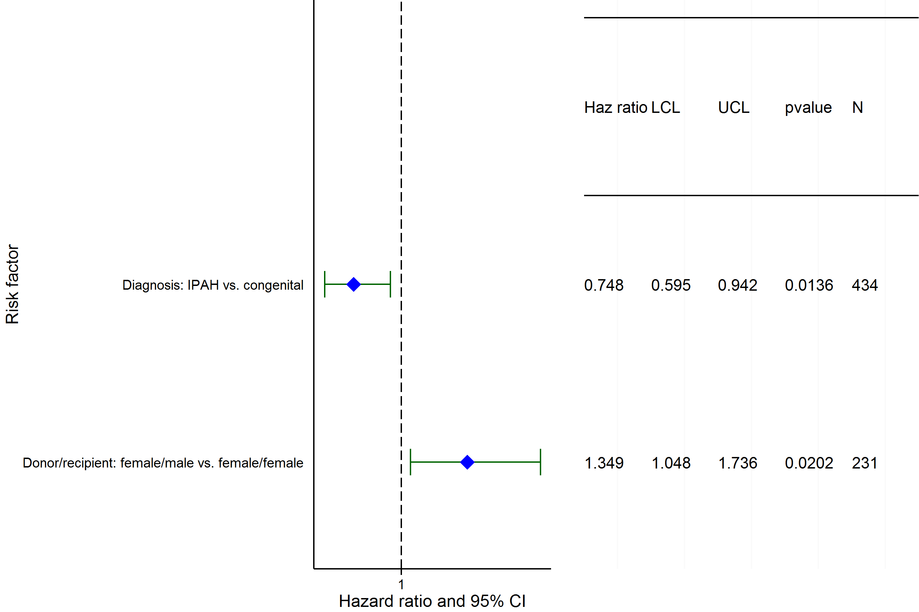
Adult Heart-Lung Transplants (January 1996 – June 2013)
Risk Factors For 1 Year Mortality
N = 1,622
2015
NOTE: No continuous factors were significant.
JHLT. 2015 Oct; 34(10): 1264-1277
JHLT. 2014 Oct; 33(10): 1009-1024
Notes:
Multivariable analysis was performed using a proportional hazards model censoring all patients at 1 year. Continuous factors were fit using a restricted cubic spline.
Analyses were limited to transplants having essentially complete information regarding risk factors.

Slide 43
Early Graft Failure (EGF)
2015
JHLT. 2015 Oct; 34(10): 1264-1277
Notes:
Analysis excludes living donor transplants unless specifically stated otherwise.

Slide 44
Adult Heart-Lung Transplants
Cumulative Incidence of EGF
(Primary Transplants: January 2005 – December 2013)
N = 687
2015
JHLT. 2015 Oct; 34(10): 1264-1277
JHLT. 2014 Oct; 33(10): 1009-1024
Notes:
Only transplants with known EGF status are included in the tabulation. Incidence was computed using a competing-risks extension of the Kaplan-Meier method.

Slide 45
Adult Heart-Lung Transplants
% with EGF by EGF Type and Year for Primary Transplants
2015
JHLT. 2015 Oct; 34(10): 1264-1277
JHLT. 2014 Oct; 33(10): 1009-1024
Notes:
Only transplants with known EGF status are included in the tabulation. Percentage with EGF was computed using a competing-risks extension of the Kaplan-Meier method.

Slide 46
Adult Heart-Lung Transplants
Cumulative Incidence of EGF by Era
(Transplants: January 2005 – December 2013)
p = 0.4306
2015
JHLT. 2015 Oct; 34(10): 1264-1277
JHLT. 2014 Oct; 33(10): 1009-1024
Notes:
Only transplants with known EGF status are included in the tabulation. Incidence was computed using a competing-risks extension of the Kaplan-Meier method.

Slide 47
Adult Heart-Lung Transplants
Cumulative Incidence of EGF by Diagnosis
(Primary Transplants: January 2005 – December 2013)
No pair-wise comparisons were significant at p < 0.05.
2015
JHLT. 2015 Oct; 34(10): 1264-1277
JHLT. 2014 Oct; 33(10): 1009-1024
Notes:
Only transplants with known EGF status are included in the tabulation. Incidence was computed using a competing-risks extension of the Kaplan-Meier method.

Slide 48
Adult Heart-Lung Transplants
Cumulative Incidence of EGF by Diagnosis and Era
(Primary Transplants: January 2005 – December 2013)
No pair-wise comparisons between eras within each diagnosis and between diagnoses within each era were significant at p < 0.05.
2015
JHLT. 2015 Oct; 34(10): 1264-1277
JHLT. 2014 Oct; 33(10): 1009-1024
Notes:
Only transplants with known EGF status are included in the tabulation. Incidence was computed using a competing-risks extension of the Kaplan-Meier method.

Slide 49
Adult Heart-Lung Transplants
% with EGF by EGF Type and Age Group
(Primary Transplants: January 2005 – December 2013)
2015
JHLT. 2015 Oct; 34(10): 1264-1277
JHLT. 2014 Oct; 33(10): 1009-1024
Notes:
Only transplants with known EGF status are included in the tabulation. Percentage with EGF was computed using a competing-risks extension of the Kaplan-Meier method.
Comparisons were made using the chi-square statistic or Fisher's exact test. Adjustments for multiple comparisons were done using Bonferroni method.

Slide 50
Adult Heart-Lung Transplants
% with EGF by EGF Type, Gender and Diagnosis
(Primary Transplants: January 2005 – December 2013)
No comparisons of % with EGF within each diagnosis were significant at p < 0.05.
Other Congenital
Eisenmenger's
2015
JHLT. 2015 Oct; 34(10): 1264-1277
JHLT. 2014 Oct; 33(10): 1009-1024
Notes:
Only transplants with known EGF status are included in the tabulation. Percentage with EGF was computed using a competing-risks extension of the Kaplan-Meier method.
Comparisons were made using the chi-square statistic or Fisher's exact test. Adjustments for multiple comparisons were done using Bonferroni method.

Slide 51
Adult Heart-Lung Transplants
Cumulative Incidence of EGF by Donor Gender
(Primary Transplants: January 2005 – December 2013)
2015
JHLT. 2015 Oct; 34(10): 1264-1277
JHLT. 2014 Oct; 33(10): 1009-1024
Notes:
Only transplants with known EGF status are included in the tabulation. Incidence was computed using a competing-risks extension of the Kaplan-Meier method.

Slide 52
Adult Heart-Lung Transplants
Cumulative Incidence of EGF by Donor Age Group
(Transplants: January 2005 – December 2013)
2015
JHLT. 2015 Oct; 34(10): 1264-1277
JHLT. 2014 Oct; 33(10): 1009-1024
Notes:
Only transplants with known EGF status are included in the tabulation. Incidence was computed using a competing-risks extension of the Kaplan-Meier method.

Slide 53
Adult Heart-Lung Transplants
% with EGF by Location and Era for Primary Transplants
No pair-wise comparisons between eras within each location and between locations within each era were significant at p < 0.05.
Europe
North America
Other
2015
JHLT. 2015 Oct; 34(10): 1264-1277
JHLT. 2014 Oct; 33(10): 1009-1024
Notes:
Only transplants with known EGF status are included in the tabulation. Percentage with EGF was computed using a competing-risks extension of the Kaplan-Meier method.

Slide 54
Adult Heart-Lung Transplants
% with EGF and non-EGF Early Failures by Location and Era for Primary Transplants
No pair-wise comparisons of % with EGF and % with non-EGF early failures between eras within each location and between locations within each era were significant at p < 0.05.
Europe
North America
Other
2015
* non-EGF early failures include non-EGF retransplants and deaths within 30 days
JHLT. 2015 Oct; 34(10): 1264-1277
JHLT. 2014 Oct; 33(10): 1009-1024
Notes:
Only transplants with known EGF status are included in the tabulation. Percentage with EGF was computed using a competing-risks extension of the Kaplan-Meier method.

Slide 55
Adult Heart-Lung Transplants
% with EGF by EGF Type and Center Volume
(Primary Transplants: January 2005 – December 2013)
2015
JHLT. 2015 Oct; 34(10): 1264-1277
JHLT. 2014 Oct; 33(10): 1009-1024
Notes:
Only transplants with known EGF status are included in the tabulation. Percentage with EGF was computed using a competing-risks extension of the Kaplan-Meier method.

Slide 56
Adult Heart-Lung Transplants
Cumulative Incidence of EGF by Ischemic Time
(Transplants: January 2005 – December 2013)
p = 0.0956
2015
JHLT. 2015 Oct; 34(10): 1264-1277
JHLT. 2014 Oct; 33(10): 1009-1024
Notes:
Only transplants with known EGF status are included in the tabulation. Incidence was computed using a competing-risks extension of the Kaplan-Meier method.

Slide 57
Adult Heart-Lung Transplants
Cumulative Incidence of EGF by Donor/Recipient BMI Ratio
(Transplants: January 2005 – December 2013)
2015
JHLT. 2015 Oct; 34(10): 1264-1277
JHLT. 2014 Oct; 33(10): 1009-1024
Notes:
Only transplants with known EGF status are included in the tabulation. Incidence was computed using a competing-risks extension of the Kaplan-Meier method.

Slide 58
Adult Heart-Lung Transplants
Cumulative Incidence of EGF by Donor Cause of Death
(Transplants: January 2005 – December 2013)
No pair-wise comparisons were significant at p < 0.05.
2015
JHLT. 2015 Oct; 34(10): 1264-1277
JHLT. 2014 Oct; 33(10): 1009-1024
Notes:
Only transplants with known EGF status are included in the tabulation. Incidence was computed using a competing-risks extension of the Kaplan-Meier method.

Slide 59
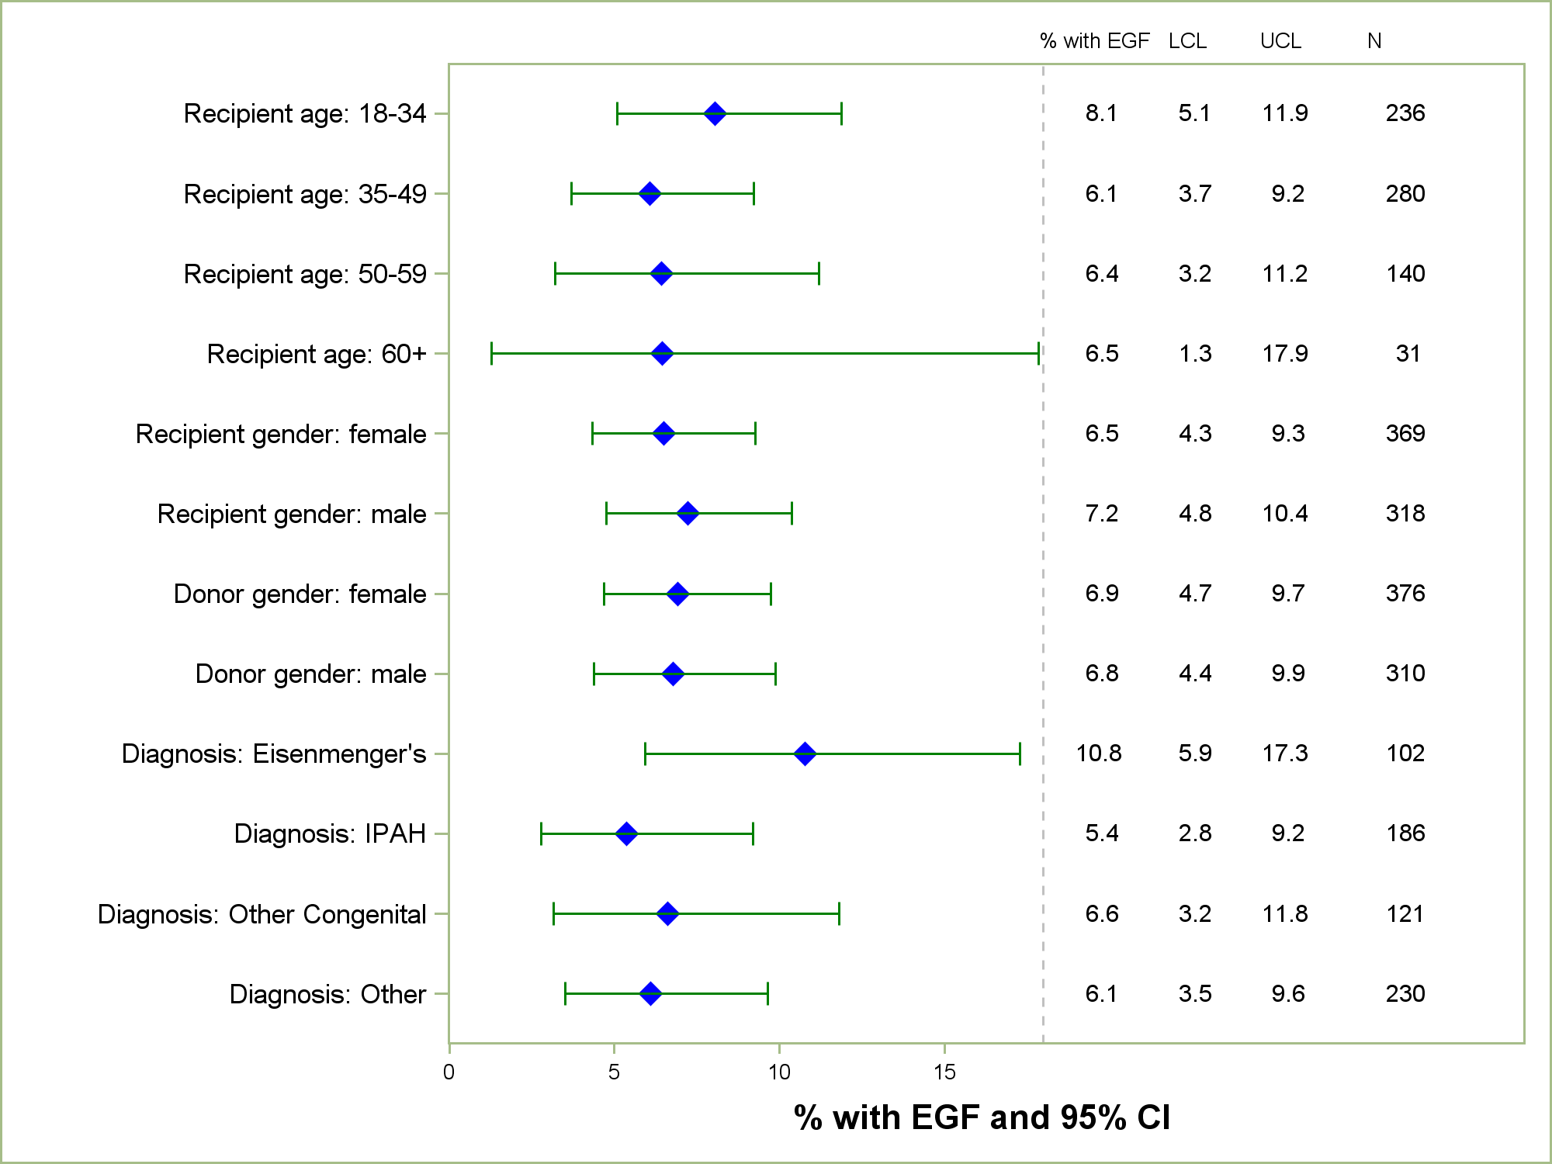
Adult Heart-Lung Transplants
% with EGF by Donor and Recipient Characteristics
(Primary Transplants: January 2005 – December 2013)
2015
JHLT. 2015 Oct; 34(10): 1264-1277
Notes:
Only transplants with known EGF status are included in the tabulation. Percentage with EGF was computed using a competing-risks extension of the Kaplan-Meier method.

