Slide 1

HEART TRANSPLANTATION
Pediatric Recipients
2014
JHLT. 2014 Oct; 33(10): 985-995

Slide 2
Table of Contents
Donor, recipient and center characteristics: slides 3-25
Post transplant – survival and other outcomes: slides 26-46
Induction and maintenance immunosuppression: slides 47-61
Rejection and post transplant morbidities: slides 62-98
Multivariable analyses: slides 99-163 and 177-181
Retransplantation: slides 164-181
2014
JHLT. 2014 Oct; 33(10): 985-995

Slide 3
Donor, Recipient and Center Characteristics
2014
JHLT. 2014 Oct; 33(10): 985-995

Slide 4
Pediatric Heart Transplants
Number of Centers Reporting Transplants
2014
JHLT. 2014 Oct; 33(10): 985-995

Slide 5
Pediatric Heart Transplants
Number of Centers by Center Volume
(Transplants: January 2000 – June 2013)
2014
JHLT. 2014 Oct; 33(10): 985-995

Slide 6
Pediatric Heart Transplants
Distribution of Transplants by Center Volume
(Transplants: January 2000 – June 2013)
2014
JHLT. 2014 Oct; 33(10): 985-995

Slide 7
Pediatric Heart Transplants
Recipient Age Distribution by Center Volume
(Transplants: January 2000 – June 2013)
2014
JHLT. 2014 Oct; 33(10): 985-995

Slide 8
Pediatric Heart Transplants
Distribution of Transplants by Location and Average Center Volume (Transplants: January 2000 – June 2013)
2014
JHLT. 2014 Oct; 33(10): 985-995

Slide 9
Pediatric Heart Transplants
Recipient Age Distribution (Transplants: January 2000 – June 2013)
2014
JHLT. 2014 Oct; 33(10): 985-995

Slide 10
Pediatric Heart Transplants
Recipient Age Distribution by Year of Transplant
NOTE: This figure includes only the heart transplants that are reported to the ISHLT Transplant Registry. As such, this should not be construed as evidence that the number of hearts transplanted worldwide has increased and/or decreased in recent years.
2014
JHLT. 2014 Oct; 33(10): 985-995

Slide 11
Pediatric Heart Transplants
Recipient Age Distribution by Location
(Transplants: January 2000 – June 2013)
2014
JHLT. 2014 Oct; 33(10): 985-995

Slide 12
Pediatric Heart Transplants
Donor Age Distribution (Transplants: January 2000 – June 2013)
2014
JHLT. 2014 Oct; 33(10): 985-995
Notes:
NOTE: Transplants where donor age is unknown are excluded from this tabulation.

Slide 13
Pediatric Heart Transplants
Donor and Recipient Age
(Transplants: January 2000 – June 2013)
2014
JHLT. 2014 Oct; 33(10): 985-995

Slide 14
Pediatric Heart Transplants
Donor Age Distribution by Location
(Transplants: January 2000 – June 2013)
2014
JHLT. 2014 Oct; 33(10): 985-995
Notes:
NOTE: Transplants where donor age is unknown are excluded from this tabulation.

Slide 15
Pediatric Heart Transplants
Distribution of Transplants by Donor/Recipient Weight Ratio
(Transplants: January 2000 – June 2013)
2014
JHLT. 2014 Oct; 33(10): 985-995

Slide 16
Pediatric Heart Transplants
Recipient Diagnosis (Age: < 1 Year)
2014
For some retransplants diagnosis other than retransplant is reported, so the total percentage of retransplants may be greater.
JHLT. 2014 Oct; 33(10): 985-995
Notes:
NOTE: Transplants with unknown diagnoses are excluded from this tabulation

Slide 17
Pediatric Heart Transplants
Recipient Diagnosis (Age: 1-5 Years)
2014
For some retransplants diagnosis other than retransplant is reported, so the total percentage of retransplants may be greater.
JHLT. 2014 Oct; 33(10): 985-995
Notes:
NOTE: Transplants with unknown diagnoses are excluded from this tabulation

Slide 18
Pediatric Heart Transplants
Recipient Diagnosis (Age: 6-10 Years)
2014
For some retransplants diagnosis other than retransplant is reported, so the total percentage of retransplants may be greater.
JHLT. 2014 Oct; 33(10): 985-995
Notes:
NOTE: Transplants with unknown diagnoses are excluded from this tabulation

Slide 19
Pediatric Heart Transplants
Recipient Diagnosis (Age: 11-17 Years)
2014
For some retransplants diagnosis other than retransplant is reported, so the total percentage of retransplants may be greater.
JHLT. 2014 Oct; 33(10): 985-995
Notes:
NOTE: Transplants with unknown diagnoses are excluded from this tabulation

Slide 20
Pediatric Heart Transplants
Diagnosis Distribution by Location
(Transplants: January 2000 – June 2013)
2014
For some retransplants diagnosis other than retransplant is reported, so the total percentage of retransplants may be greater.
JHLT. 2014 Oct; 33(10): 985-995
Notes:
NOTE: Transplants with unknown diagnoses are excluded from this tabulation.

Slide 21
Pediatric Heart Transplants
% of Patients Bridged with Mechanical Circulatory Support* by Year (Transplants: January 2005 – December 2012)
2014
* LVAD, RVAD, TAH, ECMO
JHLT. 2014 Oct; 33(10): 985-995

Slide 22
Pediatric Heart Transplants
% of Patients Bridged with Mechanical Circulatory Support*
(Transplants: July 2004 – June 2013)
2014
* LVAD, RVAD, TAH, ECMO
JHLT. 2014 Oct; 33(10): 985-995

Slide 23
Pediatric Heart Transplants
% of Patients Bridged with Mechanical Circulatory Support* by Age Group (Transplants: July 2004 – June 2013)
2014
* LVAD, RVAD, TAH, ECMO
JHLT. 2014 Oct; 33(10): 985-995

Slide 24
Pediatric Heart Transplants
PRA Distribution by Year
(Transplants: January 2005 – December 2012)
2014
If Class I and Class II values were reported separately, the higher of the two values was used.
JHLT. 2014 Oct; 33(10): 985-995

Slide 25
Pediatric Heart Transplants
PRA Distribution by Age Group (Transplants: July 2004 – June 2013)
p<0.0001
2014
If Class I and Class II values were reported separately, the higher of the two values was used.
JHLT. 2014 Oct; 33(10): 985-995

Slide 26
Post Transplant:
Survival and Other Outcomes
2014
JHLT. 2014 Oct; 33(10): 985-995

Slide 27
Pediatric Heart Transplants
Kaplan-Meier Survival (Transplants: January 1982 – June 2012)
1-5 vs. 11-17: p = 0.0133
6-10 vs. 11-17: p = 0.0298
No other pair-wise comparisons were significant at p < 0.05.
2014
JHLT. 2014 Oct; 33(10): 985-995
Notes:
Survival was calculated using the Kaplan-Meier method, which incorporates information from all transplants for whom any follow-up has been provided. Since many patients are still alive and some patients have been lost to follow-up, the survival rates are estimates rather than exact rates because the time of death is not known for all patients. The median survival is the estimated time point at which 50% of all of the recipients have died.
Survival rates were compared using the log-rank test statistic. Adjustments for multiple comparisons were done using Scheffe’s method. Results of log-rank test should be interpreted with caution when curves cross.

Slide 28
Pediatric Heart Transplants
Kaplan-Meier Survival Conditional on Survival to 1 Year (Transplants: January 1982 – June 2012)
All pair-wise comparisons were significant at p < 0.05 except <1 vs. 1-5.
2014
JHLT. 2014 Oct; 33(10): 985-995
Notes:
Survival was calculated using the Kaplan-Meier method, which incorporates information from all transplants for whom any follow-up has been provided. Since many patients are still alive and some patients have been lost to follow-up, the survival rates are estimates rather than exact rates because the time of death is not known for all patients. Conditional survival is shown in this figure; this is the survival following 1 year for all patients who survived to 1 year. The conditional median survival is the estimated time point at which 50% of the recipients who survive to at least 1 year have died. Because the decline in survival is greatest during the first year following transplantation, the conditional survival provides a more realistic expectation of survival time for recipients who survive the early post-transplant period.
Survival rates were compared using the log-rank test statistic. Adjustments for multiple comparisons were done using Scheffe’s method. Results of log-rank test should be interpreted with caution when curves cross.

Slide 29
Pediatric Heart Transplants
Kaplan-Meier Survival Conditional on Survival to 5 Years (Transplants: January 1982 – June 2008)
All pair-wise comparisons were significant at p < 0.05 except 6-10 vs. 11-17.
2014
JHLT. 2014 Oct; 33(10): 985-995
Notes:
Survival was calculated using the Kaplan-Meier method, which incorporates information from all transplants for whom any follow-up has been provided. Since many patients are still alive and some patients have been lost to follow-up, the survival rates are estimates rather than exact rates because the time of death is not known for all patients. Conditional survival is shown in this figure; this is the survival following 5 years for all patients who survived to 5 years.
Survival rates were compared using the log-rank test statistic. Adjustments for multiple comparisons were done using Scheffe’s method. Results of log-rank test should be interpreted with caution when curves cross.

Slide 30
Pediatric Heart Transplants
Kaplan-Meier Survival Conditional on Survival to 10 Years (Transplants: January 1982 – June 2003)
All pair-wise comparisons with <1 were significant at p<0.0001.
1-5 vs. 6-10 was significant at p<0.05 (p=0.0199). No other pair-wise comparisons were significant at p<0.05.
2014
JHLT. 2014 Oct; 33(10): 985-995
Notes:
Survival was calculated using the Kaplan-Meier method, which incorporates information from all transplants for whom any follow-up has been provided. Since many patients are still alive and some patients have been lost to follow-up, the survival rates are estimates rather than exact rates because the time of death is not known for all patients. Conditional survival is shown in this figure; this is the survival following 10 years for all patients who survived to 10 years.
Survival rates were compared using the log-rank test statistic. Adjustments for multiple comparisons were done using Scheffe’s method. Results of log-rank test should be interpreted with caution when curves cross.

Slide 31
Pediatric Heart Transplants
Kaplan-Meier Survival by Era
(Transplants: January 1982 – June 2012)
All p-values significant at p < 0.0001 except 2000-2004 vs. 2005-6/2012 (p = 0.0587).
2014
JHLT. 2014 Oct; 33(10): 985-995
Notes:
Survival was calculated using the Kaplan-Meier method, which incorporates information from all transplants for whom any follow-up has been provided. Since many patients are still alive and some patients have been lost to follow-up, the survival rates are estimates rather than exact rates because the time of death is not known for all patients. The median survival is the estimated time point at which 50% of all of the recipients have died.
Survival rates were compared using the log-rank test statistic. Adjustments for multiple comparisons were done using Scheffe’s method.

Slide 32
Pediatric Heart Transplants
Conditional Kaplan-Meier Survival for Recent Era
(Transplants: January 2000 – June 2012)
All pair-wise comparisons with 11-17 were significant at p<0.05. No other pair-wise comparisons were significant at p<0.05.
2014
JHLT. 2014 Oct; 33(10): 985-995
Notes:
Survival was calculated using the Kaplan-Meier method, which incorporates information from all transplants for whom any follow-up has been provided. Since many patients are still alive and some patients have been lost to follow-up, the survival rates are estimates rather than exact rates because the time of death is not known for all patients. Conditional survival is shown in this figure; this is the survival following 1 year for all patients who survived to 1 year. Because the decline in survival is greatest during the first year following transplantation, the conditional survival provides a more realistic expectation of survival time for recipients who survive the early post-transplant period.
Survival rates were compared using the log-rank test statistic. Adjustments for multiple comparisons were done using Scheffe’s method. Results of log-rank test should be interpreted with caution when curves cross.

Slide 33
Pediatric Heart Transplants
Kaplan-Meier Survival by Era
Age: < 1 Year (Transplants: January 1982 – June 2012)
All pair-wise comparisons were significant at p<0.05 except 1982-1989 vs. 1990-1999 and 2000-2004 vs. 2005-6/2012.
Median survival (years): 1982-1989=10.8; 1990-1999=19.3; 2000-2004=NA; 2005-6/2012=NA
2014
JHLT. 2014 Oct; 33(10): 985-995
Notes:
Survival was calculated using the Kaplan-Meier method, which incorporates information from all transplants for whom any follow-up has been provided. Since many patients are still alive and some patients have been lost to follow-up, the survival rates are estimates rather than exact rates because the time of death is not known for all patients. The median survival is the estimated time point at which 50% of all of the recipients have died.
Survival rates were compared using the log-rank test statistic. Adjustments for multiple comparisons were done using Scheffe’s method.

Slide 34
Pediatric Heart Transplants
Kaplan-Meier Survival by Era
Age: 1-5 Years (Transplants: January 1982 – June 2012)
All p-values significant at p<0.05 except 2000-2004 vs. 2005-6/2012 (p=0.5431).
Median survival (years): 1982-1989=9.1; 1990-1999=15.4; 2000-2004=NA; 2005-6/2012=NA
2014
JHLT. 2014 Oct; 33(10): 985-995
Notes:
Survival was calculated using the Kaplan-Meier method, which incorporates information from all transplants for whom any follow-up has been provided. Since many patients are still alive and some patients have been lost to follow-up, the survival rates are estimates rather than exact rates because the time of death is not known for all patients. The median survival is the estimated time point at which 50% of all of the recipients have died.
Survival rates were compared using the log-rank test statistic. Adjustments for multiple comparisons were done using Scheffe’s method.

Slide 35
Pediatric Heart Transplants
Kaplan-Meier Survival by Era
Age: 6-10 Years (Transplants: January 1982 – June 2012)
All p-values significant at < 0.05 except 1982-1989 vs. 1990-1999 and 2000-2004 vs. 2005-6/2012.
Median survival (years): 1982-1989 = 9.4; 1990-1999 = 12.9; 2000-2004 = NA; 2005-6/2012 = NA
2014
JHLT. 2014 Oct; 33(10): 985-995
Notes:
Survival was calculated using the Kaplan-Meier method, which incorporates information from all transplants for whom any follow-up has been provided. Since many patients are still alive and some patients have been lost to follow-up, the survival rates are estimates rather than exact rates because the time of death is not known for all patients. The median survival is the estimated time point at which 50% of all of the recipients have died.
Survival rates were compared using the log-rank test statistic. Adjustments for multiple comparisons were done using Scheffe’s method.

Slide 36
Pediatric Heart Transplants
Kaplan-Meier Survival by Era
Age: 11-17 Years (Transplants: January 1982 – June 2012)
Median survival (years): 1982-1989=9.9; 1990-1999=12.1; 2000-2004=11.8; 2005-6/2012=NA
1982-1989 vs. 2000-2004: p=0.0364
1982-1989 vs. 2005-6/2012: p<0.0001
1990-1999 vs. 2005-6/2012: p=0.0003
No other pair-wise comparisons were significant at p<0.05.
2014
JHLT. 2014 Oct; 33(10): 985-995
Notes:
Survival was calculated using the Kaplan-Meier method, which incorporates information from all transplants for whom any follow-up has been provided. Since many patients are still alive and some patients have been lost to follow-up, the survival rates are estimates rather than exact rates because the time of death is not known for all patients. The median survival is the estimated time point at which 50% of all of the recipients have died.
Survival rates were compared using the log-rank test statistic. Adjustments for multiple comparisons were done using Scheffe’s method. Results of log-rank test should be interpreted with caution when curves cross.

Slide 37
Pediatric Heart Transplants
Kaplan-Meier Survival by Recipient Gender
(Transplants: January 2000 – June 2012)
p = 0.1667
2014
JHLT. 2014 Oct; 33(10): 985-995
Notes:
Survival was calculated using the Kaplan-Meier method, which incorporates information from all transplants for whom any follow-up has been provided. Since many patients are still alive and some patients have been lost to follow-up, the survival rates are estimates rather than exact rates because the time of death is not known for all patients.
Survival rates were compared using the log-rank test statistic.

Slide 38
Pediatric Heart Transplants
Kaplan-Meier Survival by Donor/Recipient Gender
(Transplants: January 2000 – June 2012)
No pair-wise comparisons were significant at p<0.05.
2014
JHLT. 2014 Oct; 33(10): 985-995
Notes:
Survival was calculated using the Kaplan-Meier method, which incorporates information from all transplants for whom any follow-up has been provided. Since many patients are still alive and some patients have been lost to follow-up, the survival rates are estimates rather than exact rates because the time of death is not known for all patients.
Survival rates were compared using the log-rank test statistic. Adjustments for multiple comparisons were done using Scheffe’s method.

Slide 39
Pediatric Heart Transplants
Kaplan-Meier Survival by Diagnosis
Age: < 1 Year (Transplants: January 2000 – June 2012)
p<0.0001
2014
JHLT. 2014 Oct; 33(10): 985-995
Notes:
Survival was calculated using the Kaplan-Meier method, which incorporates information from all transplants for whom any follow-up has been provided. Since many patients are still alive and some patients have been lost to follow-up, the survival rates are estimates rather than exact rates because the time of death is not known for all patients.
Survival rates were compared using the log-rank test statistic.

Slide 40
Pediatric Heart Transplants
Kaplan-Meier Survival by Diagnosis
Age: 1-5 Years (Transplants: January 2000 – June 2012)
Congenital vs. Cardiomyopathy: p < 0.0001
Congenital vs. Retransplant: p = 0.5814
Cardiomyopathy vs. Retransplant: p = 0.0057
2014
For some retransplants diagnosis other than retransplant is reported, so the total number of retransplants may be greater.
JHLT. 2014 Oct; 33(10): 985-995
Notes:
Survival was calculated using the Kaplan-Meier method, which incorporates information from all transplants for whom any follow-up has been provided. Since many patients are still alive and some patients have been lost to follow-up, the survival rates are estimates rather than exact rates because the time of death is not known for all patients.
Survival rates were compared using the log-rank test statistic. Adjustments for multiple comparisons were done using Scheffe’s method.

Slide 41
Pediatric Heart Transplants
Kaplan-Meier Survival by Diagnosis
Age: 6-10 Years (Transplants: January 2000 – June 2012)
Congenital vs. Cardiomyopathy: p = 0.0772
Congenital vs. Retransplant: p = 0.6779
Cardiomyopathy vs. Retransplant: p = 0.0369
2014
For some retransplants diagnosis other than retransplant is reported, so the total number of retransplants may be greater.
JHLT. 2014 Oct; 33(10): 985-995
Notes:
Survival was calculated using the Kaplan-Meier method, which incorporates information from all transplants for whom any follow-up has been provided. Since many patients are still alive and some patients have been lost to follow-up, the survival rates are estimates rather than exact rates because the time of death is not known for all patients.
Survival rates were compared using the log-rank test statistic. Adjustments for multiple comparisons were done using Scheffe’s method. Results of log-rank test should be interpreted with caution when curves cross.

Slide 42
Pediatric Heart Transplants
Kaplan-Meier Survival by Diagnosis
Age: 11-17 Years (Transplants: January 2000 – June 2012)
Congenital vs. Cardiomyopathy: p = 0.0017
Congenital vs. Retransplant: p = 0.1382
Cardiomyopathy vs. Retransplant: p<0.0001
2014
For some retransplants diagnosis other than retransplant is reported, so the total number of retransplants may be greater.
JHLT. 2014 Oct; 33(10): 985-995
Notes:
Survival was calculated using the Kaplan-Meier method, which incorporates information from all transplants for whom any follow-up has been provided. Since many patients are still alive and some patients have been lost to follow-up, the survival rates are estimates rather than exact rates because the time of death is not known for all patients.
Survival rates were compared using the log-rank test statistic. Adjustments for multiple comparisons were done using Scheffe’s method. Results of log-rank test should be interpreted with caution when curves cross.

Slide 43
Pediatric Heart Transplants
Kaplan-Meier Patient vs. Graft Survival
(Transplants: January 2000 – June 2012)
p<0.0001
2014
JHLT. 2014 Oct; 33(10): 985-995
Notes:
Survival was calculated using the Kaplan-Meier method, which incorporates information from all transplants for whom any follow-up has been provided. Since many patients are still alive and some patients have been lost to follow-up, the survival rates are estimates rather than exact rates because the time of death is not known for all patients.
Survival rates were compared using the log-rank test statistic.

Slide 44
Pediatric Heart Transplants
Kaplan-Meier Survival by Mechanical Circulatory Support Usage* (Transplants: January 2005 – June 2012)
All pair-wise comparisons were significant at p < 0.0001 except No ECMO/VAD/TAH vs. VAD or TAH, no ECMO.
2014
* LVAD, RVAD, TAH, ECMO
JHLT. 2014 Oct; 33(10): 985-995
Notes:
Survival was calculated using the Kaplan-Meier method, which incorporates information from all transplants for whom any follow-up has been provided. Since many patients are still alive and some patients have been lost to follow-up, the survival rates are estimates rather than exact rates because the time of death is not known for all patients.
Survival rates were compared using the log-rank test statistic. Adjustments for multiple comparisons were done using Scheffe’s method. Results of log-rank test should be interpreted with caution when curves cross.

Slide 45
Pediatric Heart Transplants
Functional Status of Surviving Recipients
(Follow-ups: March 2005 – June 2013)
2014
JHLT. 2014 Oct; 33(10): 985-995
Notes:
Functional status is collected using Lansky score for pediatric recipients.
This figure shows the functional status reported on the 1-year, 2-year and 3-year annual follow-ups. Because all follow-ups between March 2005 and June 2013 were included, the bars do not include the same patients.

Slide 46
Pediatric Heart Transplants
Rehospitalization Post-transplant of Surviving Recipients
(Follow-ups: January 2000 – June 2013)
2014
JHLT. 2014 Oct; 33(10): 985-995
Notes:
This figure shows the hospitalizations reported on the 1-year, 3-year and 5-year annual follow-ups, representing the hospitalizations between discharge and 1 year, between the 2-year and 3-year follow-up, and between the 4-year and 5-year follow-up, respectively. Because all follow-ups between January 2000 and June 2013 were included, the bars do not include the same patients.

Slide 47
Induction and Maintenance Immunosuppression
2014
JHLT. 2014 Oct; 33(10): 985-995

Slide 48
Pediatric Heart Transplants
Induction Immunosuppression
(Transplants: January 2001 – June 2013)
2014
Analysis is limited to patients who were alive at the time of the discharge.
JHLT. 2014 Oct; 33(10): 985-995

Slide 49
Pediatric Heart Transplants
Induction Immunosuppression by Era
(Transplants: January 2000 – June 2013)
2014
Analysis is limited to patients who were alive at the time of the discharge.
JHLT. 2014 Oct; 33(10): 985-995

Slide 50
Pediatric Heart Transplants
Induction Immunosuppression by Year
(Transplants: January 2001 – June 2013)
Test of increasing trend over time:
Any induction p < 0.0001
Polyclonal p < 0.0001
IL-2R p < 0.0001
2014
Analysis is limited to patients who were alive at the time of the discharge.
JHLT. 2014 Oct; 33(10): 985-995

Slide 51
Pediatric Heart Transplants
Kaplan-Meier Survival by Induction Group Conditional on Survival to 14 Days (Transplants: January 2000 – June 2012)
2014
JHLT. 2014 Oct; 33(10): 985-995
Notes:
Survival was calculated using the Kaplan-Meier method, which incorporates information from all transplants for whom any follow-up has been provided. Since many patients are still alive and some patients have been lost to follow-up, the survival rates are estimates rather than exact rates because the time of death is not known for all patients.
Survival rates were compared using the log-rank test statistic. Adjustments for multiple comparisons were done using Scheffe’s method.

Slide 52
Pediatric Heart Transplants
Kaplan-Meier Survival by Induction and Treated Rejection Between Transplant Discharge and 1-Year Follow-up
Conditional on Survival to 1 Year (1-Year Follow-ups: July 2004 – June 2012)
Treated rejection = Recipient was reported to (1) have at least one acute rejection episode that was treated with an anti-rejection agent; or (2) have been hospitalized for rejection.
No rejection = Recipient had (i) no acute rejection episodes and (ii) was reported either as not hospitalized for rejection or did not receive anti-rejection agents.
2014
JHLT. 2014 Oct; 33(10): 985-995
Notes:
Because of a modification in the data collection, the analysis is limited to follow-ups occurring on or after July 2004.
Survival was calculated using the Kaplan-Meier method, which incorporates information from all transplants for whom any follow-up has been provided. Since many patients are still alive and some patients have been lost to follow-up, the survival rates are estimates rather than exact rates because the time of death is not known for all patients.
Survival rates were compared using the log-rank test statistic. Adjustments for multiple comparisons were done using Scheffe’s method.

Slide 53
Pediatric Heart Transplants
Maintenance Immunosuppression at Time of Transplant Discharge by Era (Transplants: January 2001 – June 2013)
2014
Analysis is limited to patients who were alive at the time of the discharge.
JHLT. 2014 Oct; 33(10): 985-995

Slide 54
Pediatric Heart Transplants
Maintenance Immunosuppression at Time of Follow-up
(Follow-ups: January 2001 – June 2013)
2014
Analysis is limited to patients who were alive at the time of the follow-up
JHLT. 2014 Oct; 33(10): 985-995
Notes:
This figure shows the maintenance immunosuppression reported as being provided at the time of the 1-year and 5-year annual follow-up forms. To provide a snapshot of current practice, only follow-ups occurring between January 2001 and June 2013 were included. Therefore, this figure does not represent changes in practice between the 1-year follow-up and 5-year follow-up on a cohort of patients. The patients in the 1-year tabulation are not the same patients as in the 5-year tabulation.

Slide 55
Pediatric Heart Transplants
Maintenance Immunosuppression at Time of Follow-up for Same Patients at Each Time Point
(Follow-ups: January 2001 – June 2013)
2014
Analysis is limited to patients who were alive at the time of the follow-up.
JHLT. 2014 Oct; 33(10): 985-995
Notes:
This figure shows the maintenance immunosuppression reported as being provided at the time of the 1-year and 5-year annual follow-up forms for the same patients based on follow-ups between January 2001 and June 2013.

Slide 56
Pediatric Heart Transplants
Maintenance Immunosuppression Drug Combinations at Time of Follow-up (Follow-ups: January 2001 – June 2013)
NOTE: Different patients are analyzed in Year 1 and Year 5.
2014
Analysis is limited to patients who were alive at the time of the follow-up.
JHLT. 2014 Oct; 33(10): 985-995
Notes:
This figure shows the maintenance immunosuppression reported as being provided at the time of the 1-year and 5-year annual follow-up forms for the same patients based on follow-ups between January 2001 and June 2013.

Slide 57
Pediatric Heart Transplants
Kaplan-Meier Survival Based on Prednisone Use
Conditional on Survival to 1 Year (Transplants: January 2000 – June 2012)
2014
JHLT. 2014 Oct; 33(10): 985-995
Notes:
Survival was calculated using the Kaplan-Meier method, which incorporates information from all transplants for whom any follow-up has been provided. Since many patients are still alive and some patients have been lost to follow-up, the survival rates are estimates rather than exact rates because the time of death is not known for all patients. The cohorts were conditioned on survival to 1 year, so that prednisone use during the first year could be used as a stratification factor.
Survival rates were compared using the log-rank test statistic. A significant p-value means that at least one of the groups is different than the others but it doesn’t identify which group it is.

Slide 58
Pediatric Heart Transplants
Kaplan-Meier Survival by Calcineurin Inhibitor Use at Discharge (Transplants: January 2000 – June 2012)
Conditional on Survival to 14 Days
2014
JHLT. 2014 Oct; 33(10): 985-995
Notes:
Survival was calculated using the Kaplan-Meier method, which incorporates information from all transplants for whom any follow-up has been provided. Since many patients are still alive and some patients have been lost to follow-up, the survival rates are estimates rather than exact rates because the time of death is not known for all patients.
Survival rates were compared using the log-rank test statistic. Results of log-rank test should be interpreted with caution when curves cross.

Slide 59
Pediatric Heart Transplants
Kaplan-Meier Survival by Maintenance Immunosuppression at Discharge (Transplants: January 2000 – June 2012)
Conditional on Survival to 14 Days
2014
JHLT. 2014 Oct; 33(10): 985-995
Notes:
Survival was calculated using the Kaplan-Meier method, which incorporates information from all transplants for whom any follow-up has been provided. Since many patients are still alive and some patients have been lost to follow-up, the survival rates are estimates rather than exact rates because the time of death is not known for all patients.
Survival rates were compared using the log-rank test statistic. Results of log-rank test should be interpreted with caution when curves cross. Adjustments for multiple comparisons were done using Scheffe’s method.

Slide 60
Pediatric Heart Transplants
Kaplan-Meier Survival by Calcineurin Inhibitor Use
Conditional on Survival to 1 Year (Transplants: January 2000 – June 2012)
2014
JHLT. 2014 Oct; 33(10): 985-995
Notes:
Survival was calculated using the Kaplan-Meier method, which incorporates information from all transplants for whom any follow-up has been provided. Since many patients are still alive and some patients have been lost to follow-up, the survival rates are estimates rather than exact rates because the time of death is not known for all patients. The cohorts were conditioned on survival to 1 year, so that cyclosporine vs. tacrolimus use during the first year could be used as a stratification factor.
Survival rates were compared using the log-rank test statistic. A significant p-value means that at least one of the groups is different than the others but it doesn’t identify which group it is. Results of log-rank test should be interpreted with caution when curves cross.

Slide 61
Pediatric Heart Transplants
Kaplan-Meier Survival by Calcineurin Inhibitor Use
(Transplants: January 2000 – June 2007)
Conditional on Survival to 5 Years
2014
JHLT. 2014 Oct; 33(10): 985-995
Notes:
Survival was calculated using the Kaplan-Meier method, which incorporates information from all transplants for whom any follow-up has been provided. Since many patients are still alive and some patients have been lost to follow-up, the survival rates are estimates rather than exact rates because the time of death is not known for all patients.
Survival rates were compared using the log-rank test statistic. Adjustments for multiple comparisons were done using Scheffe’s method. Results of log-rank test should be interpreted with caution when curves cross.

Slide 62
Rejection and Post Transplant Morbidities
2014
JHLT. 2014 Oct; 33(10): 985-995

Slide 63
Pediatric Heart Transplants
Kaplan-Meier Survival Based on Treated Rejection within 1st Year
Conditional on survival to 1 year (1-Year Follow-ups: July 2004 – June 2012)
Treated rejection = Recipient was reported to (1) have at least one acute rejection episode that was treated with an anti-rejection agent; or (2) have been hospitalized for rejection.
No rejection = Recipient had (i) no acute rejection episodes and (ii) was reported either as not hospitalized for rejection or did not receive anti-rejection agents.
2014
JHLT. 2014 Oct; 33(10): 985-995
Notes:
Because of a modification in the data collection, the analysis is limited to follow-ups occurring on or after July 2004.
Survival was calculated using the Kaplan-Meier method, which incorporates information from all transplants for whom any follow-up has been provided. Since many patients are alive and some patients have been lost to follow-up, the survival rates are estimates rather than exact rates because the time of death is not known for all patients and may never occur for some patients. Conditional survival is shown in this figure; this is the survival rate following 1 year for all patients who survived to 1 year.
Survival rates were compared using the log-rank test statistic.

Slide 64
Pediatric Heart Transplants
Kaplan-Meier Survival Based on Treated Rejection within 1st Year
Conditional on survival to 1 year (1-Year Follow-ups: July 2004 – June 2012)
Age = < 1 Year
Treated rejection = Recipient was reported to (1) have at least one acute rejection episode that was treated with an anti-rejection agent; or (2) have been hospitalized for rejection.
No rejection = Recipient had (i) no acute rejection episodes and (ii) was reported either as not hospitalized for rejection or did not receive anti-rejection agents.
2014
JHLT. 2014 Oct; 33(10): 985-995
Notes:
Because of a modification in the data collection, the analysis is limited to follow-ups occurring on or after July 2004.
Survival was calculated using the Kaplan-Meier method, which incorporates information from all transplants for whom any follow-up has been provided. Since many patients are alive and some patients have been lost to follow-up, the survival rates are estimates rather than exact rates because the time of death is not known for all patients and may never occur for some patients. Conditional survival is shown in this figure; this is the survival rate following 1 year for all patients who survived to 1 year.
Survival rates were compared using the log-rank test statistic.

Slide 65
Pediatric Heart Transplants
Kaplan-Meier Survival Based on Treated Rejection within 1st Year
Conditional on survival to 1 year (1-Year Follow-ups: July 2004 – June 2012)
Age = 1-5 Years
Treated rejection = Recipient was reported to (1) have at least one acute rejection episode that was treated with an anti-rejection agent; or (2) have been hospitalized for rejection.
No rejection = Recipient had (i) no acute rejection episodes and (ii) was reported either as not hospitalized for rejection or did not receive anti-rejection agents.
2014
JHLT. 2014 Oct; 33(10): 985-995
Notes:
Because of a modification in the data collection, the analysis is limited to follow-ups occurring on or after July 2004.
Survival was calculated using the Kaplan-Meier method, which incorporates information from all transplants for whom any follow-up has been provided. Since many patients are alive and some patients have been lost to follow-up, the survival rates are estimates rather than exact rates because the time of death is not known for all patients and may never occur for some patients. Conditional survival is shown in this figure; this is the survival rate following 1 year for all patients who survived to 1 year.
Survival rates were compared using the log-rank test statistic.

Slide 66
Pediatric Heart Transplants
Kaplan-Meier Survival Based on Treated Rejection within 1st Year
Conditional on survival to 1 year (1-Year Follow-ups: July 2004 – June 2012)
Age = 6-10 Years
Treated rejection = Recipient was reported to (1) have at least one acute rejection episode that was treated with an anti-rejection agent; or (2) have been hospitalized for rejection.
No rejection = Recipient had (i) no acute rejection episodes and (ii) was reported either as not hospitalized for rejection or did not receive anti-rejection agents.
2014
JHLT. 2014 Oct; 33(10): 985-995
Notes:
Because of a modification in the data collection, the analysis is limited to follow-ups occurring on or after July 2004.
Survival was calculated using the Kaplan-Meier method, which incorporates information from all transplants for whom any follow-up has been provided. Since many patients are alive and some patients have been lost to follow-up, the survival rates are estimates rather than exact rates because the time of death is not known for all patients and may never occur for some patients. Conditional survival is shown in this figure; this is the survival rate following 1 year for all patients who survived to 1 year.
Survival rates were compared using the log-rank test statistic. Results of log-rank test should be interpreted with caution when curves cross.

Slide 67
Pediatric Heart Transplants
Kaplan-Meier Survival Based on Treated Rejection within 1st Year
Conditional on survival to 1 year (1-Year Follow-ups: July 2004 – June 2012)
Age = 11-17 Years
Treated rejection = Recipient was reported to (1) have at least one acute rejection episode that was treated with an anti-rejection agent; or (2) have been hospitalized for rejection.
No rejection = Recipient had (i) no acute rejection episodes and (ii) was reported either as not hospitalized for rejection or did not receive anti-rejection agents.
2014
JHLT. 2014 Oct; 33(10): 985-995
Notes:
Because of a modification in the data collection, the analysis is limited to follow-ups occurring on or after July 2004.
Survival was calculated using the Kaplan-Meier method, which incorporates information from all transplants for whom any follow-up has been provided. Since many patients are alive and some patients have been lost to follow-up, the survival rates are estimates rather than exact rates because the time of death is not known for all patients and may never occur for some patients. Conditional survival is shown in this figure; this is the survival rate following 1 year for all patients who survived to 1 year.
Survival rates were compared using the log-rank test statistic.

Slide 68
Pediatric Heart Transplants
Kaplan-Meier Survival Based on Treated Rejection within 1st Year by Calcineurin Use at Discharge
Conditional on survival to 1 year (1-Year Follow-ups: July 2004 – June 2012)
Treated rejection = Recipient was reported to (1) have at least one acute rejection episode that was treated with an anti-rejection agent; or (2) have been hospitalized for rejection.
No rejection = Recipient had (i) no acute rejection episodes and (ii) was reported either as not hospitalized for rejection or did not receive anti-rejection agents.
2014
JHLT. 2014 Oct; 33(10): 985-995
Notes:
Because of a modification in the data collection, the analysis is limited to follow-ups occurring on or after July 2004.
Survival was calculated using the Kaplan-Meier method, which incorporates information from all transplants for whom any follow-up has been provided. Since many patients are alive and some patients have been lost to follow-up, the survival rates are estimates rather than exact rates because the time of death is not known for all patients and may never occur for some patients. Conditional survival is shown in this figure; this is the survival rate following 1 year for all patients who survived to 1 year.
Survival rates were compared using the log-rank test statistic. Adjustments for multiple comparisons were done using Bonferroni method.

Slide 69
Pediatric Heart Transplants
Percentage Experiencing Treated Rejection between Discharge and 1-Year Follow-Up by Era (Follow-ups: July 2004 – June 2013)
Analysis is limited to patients who were alive at the time of the follow-up.
Treated rejection = Recipient was reported to (1) have at least one acute rejection episode that was treated with an anti-rejection agent; or (2) have been hospitalized for rejection.
2014
JHLT. 2014 Oct; 33(10): 985-995
Notes:
Because of a modification in the data collection, the analysis is limited to follow-ups occurring on or after July 2004.
Comparisons were made using the chi-square statistic. Adjustments for multiple comparisons were done using Bonferroni method.

Slide 70
Pediatric Heart Transplants
Percentage Experiencing Treated Rejection between Discharge and 1-Year Follow-Up by Induction (Follow-ups: July 2004 – June 2013)
Analysis is limited to patients who were alive at the time of the follow-up.
Treated rejection = Recipient was reported to (1) have at least one acute rejection episode that was treated with an anti-rejection agent; or (2) have been hospitalized for rejection.
2014
JHLT. 2014 Oct; 33(10): 985-995
Notes:
Because of a modification in the data collection, the analysis is limited to follow-ups occurring on or after July 2004.
Comparisons were made using the chi-square statistic. Adjustments for multiple comparisons were done using Bonferroni method.

Slide 71
Pediatric Heart Transplants
Percentage Experiencing Treated Rejection between Discharge and 1-Year Follow-Up by Induction Type (Follow-ups: July 2004 – June 2013)
Analysis is limited to patients who were alive at the time of the follow-up.
Treated rejection = Recipient was reported to (1) have at least one acute rejection episode that was treated with an anti-rejection agent; or (2) have been hospitalized for rejection.
2014
JHLT. 2014 Oct; 33(10): 985-995
Notes:
Because of a modification in the data collection, the analysis is limited to follow-ups occurring on or after July 2004.
Comparisons were made using the chi-square statistic. Adjustments for multiple comparisons were done using Bonferroni method.

Slide 72
Pediatric Heart Transplants
Percentage Experiencing Treated Rejection between Discharge and 1-Year Follow-Up by Maintenance Immunosuppression and Induction (Follow-ups: July 2004 – June 2013)
Analysis is limited to patients who were alive at the time of the follow-up.
Treated rejection = Recipient was reported to (1) have at least one acute rejection episode that was treated with an anti-rejection agent; or (2) have been hospitalized for rejection.
2014
JHLT. 2014 Oct; 33(10): 985-995
Notes:
Because of a modification in the data collection, the analysis is limited to follow-ups occurring on or after July 2004.
Comparisons were made using the chi-square statistic. Adjustments for multiple comparisons were done using Bonferroni method.

Slide 73
Pediatric Heart Transplants
Percentage Experiencing Treated Rejection between Discharge and 1-Year Follow-Up by Maintenance Immunosuppression
(Follow-ups: July 2004 – June 2013)
Analysis is limited to patients who were alive at the time of the follow-up.
Treated rejection = Recipient was reported to (1) have at least one acute rejection episode that was treated with an anti-rejection agent; or (2) have been hospitalized for rejection.
2014
JHLT. 2014 Oct; 33(10): 985-995
Notes:
Because of a modification in the data collection, the analysis is limited to follow-ups occurring on or after July 2004.
Comparisons were made using the chi-square statistic. Adjustments for multiple comparisons were done using Bonferroni method.

Slide 74
Pediatric Heart Transplants
Percentage Experiencing Treated Rejection between Discharge and 1-Year Follow-Up by Calcineurin Inhibitor Use at Discharge
(Follow-ups: July 2004 – June 2013)
Analysis is limited to patients who were alive at the time of the follow-up.
Treated rejection = Recipient was reported to (1) have at least one acute rejection episode that was treated with an anti-rejection agent; or (2) have been hospitalized for rejection.
2014
JHLT. 2014 Oct; 33(10): 985-995
Notes:
Because of a modification in the data collection, the analysis is limited to follow-ups occurring on or after July 2004.
Comparisons were made using the chi-square statistic. Adjustments for multiple comparisons were done using Bonferroni method.

Slide 75
Pediatric Heart Transplants
Freedom from Coronary Artery Vasculopathy
(Follow-ups: April 1994 – June 2013)
2014
JHLT. 2014 Oct; 33(10): 985-995
Notes:
Freedom from CAV was computed using the Kaplan-Meier method.
The development of CAV is reported on annual follow-ups; a date of diagnosis is not provided. For this figure the midpoint between the date of previous follow-up (when event had not occurred) and the date of follow-up when the event was reported was used as the date of occurrence. Patients were included in the analysis until an unknown response for the outcome of interest was reported. Therefore, the rates seen here may differ from those reported in the cumulative prevalence slide which is based on only those patients with known responses for each of the outcomes at all follow-up time points.

Slide 76
Pediatric Heart Transplants
Freedom from Coronary Artery Vasculopathy by Induction (Follow-ups: April 1994 – June 2013)
2014
JHLT. 2014 Oct; 33(10): 985-995
Notes:
Freedom from CAV was computed using the Kaplan-Meier method.
The development of CAV is reported on annual follow-ups; a date of diagnosis is not provided. For this figure the midpoint between the date of previous follow-up (when event had not occurred) and the date of follow-up when the event was reported was used as the date of occurrence. Patients were included in the analysis until an unknown response for the outcome of interest was reported. Therefore, the rates seen here may differ from those reported in the cumulative prevalence slide which is based on only those patients with known responses for each of the outcomes at all follow-up time points.
Freedom from CAV rates were compared using the log-rank test statistic.

Slide 77
Pediatric Heart Transplants
Freedom from Coronary Artery Vasculopathy by Calcineurin Inhibitor Use (Follow-ups: 2000 – June 2013)
Conditional on Survival to 1 Year
2014
JHLT. 2014 Oct; 33(10): 985-995
Notes:
Freedom from CAV was computed using the Kaplan-Meier method.
The development of CAV is reported on annual follow-ups; a date of diagnosis is not provided. For this figure the midpoint between the date of previous follow-up (when event had not occurred) and the date of follow-up when the event was reported was used as the date of occurrence. Patients were included in the analysis until an unknown response for the outcome of interest was reported. Therefore, the rates seen here may differ from those reported in the cumulative prevalence slide which is based on only those patients with known responses for each of the outcomes at all follow-up time points.
Freedom from CAV rates were compared using the log-rank test statistic. A significant p-value means that at least one of the groups is different than the others but it doesn’t identify which group it is. Results of log-rank test should be interpreted with caution when curves cross.

Slide 78
Pediatric Heart Transplants
Freedom from Coronary Artery Vasculopathy by Age Group (Follow-ups: 2000 – June 2013)
2014
JHLT. 2014 Oct; 33(10): 985-995
Notes:
Freedom from CAV was computed using the Kaplan-Meier method.
The development of CAV is reported on annual follow-ups; a date of diagnosis is not provided. For this figure the midpoint between the date of previous follow-up (when event had not occurred) and the date of follow-up when the event was reported was used as the date of occurrence. Patients were included in the analysis until an unknown response for the outcome of interest was reported. Therefore, the rates seen here may differ from those reported in the cumulative prevalence slide which is based on only those patients with known responses for each of the outcomes at all follow-up time points.
Freedom from CAV rates were compared using the log-rank test statistic. A significant p-value means that at least one of the groups is different than the others but it doesn’t identify which group it is. Results of log-rank test should be interpreted with caution when curves cross.

Slide 79
Pediatric Heart Transplants
Freedom from Coronary Artery Vasculopathy by Ischemia Time (Follow-ups: 2000 – June 2013)
2014
JHLT. 2014 Oct; 33(10): 985-995
Notes:
Freedom from CAV was computed using the Kaplan-Meier method.
The development of CAV is reported on annual follow-ups; a date of diagnosis is not provided. For this figure the midpoint between the date of previous follow-up (when event had not occurred) and the date of follow-up when the event was reported was used as the date of occurrence. Patients were included in the analysis until an unknown response for the outcome of interest was reported. Therefore, the rates seen here may differ from those reported in the cumulative prevalence slide which is based on only those patients with known responses for each of the outcomes at all follow-up time points.
Freedom from CAV rates were compared using the log-rank test statistic. A significant p-value means that at least one of the groups is different than the others but it doesn’t identify which group it is. Results of log-rank test should be interpreted with caution when curves cross.

Slide 80
Pediatric Heart Transplants
Freedom from Coronary Artery Vasculopathy by Ischemia Time and Recipient Age (Follow-ups: 2000 – June 2013)
2014
JHLT. 2014 Oct; 33(10): 985-995
Notes:
Freedom from CAV was computed using the Kaplan-Meier method.
The development of CAV is reported on annual follow-ups; a date of diagnosis is not provided. For this figure the midpoint between the date of previous follow-up (when event had not occurred) and the date of follow-up when the event was reported was used as the date of occurrence. Patients were included in the analysis until an unknown response for the outcome of interest was reported. Therefore, the rates seen here may differ from those reported in the cumulative prevalence slide which is based on only those patients with known responses for each of the outcomes at all follow-up time points.
Freedom from CAV rates were compared using the log-rank test statistic. Adjustments for multiple comparisons were done using Scheffe’s method. Results of log-rank test should be interpreted with caution when curves cross.

Slide 81
Pediatric Heart Transplants
Graft Survival Following Report of Coronary Artery Vasculopathy by Age Group (Follow-ups: 2000 – June 2013)
2014
JHLT. 2014 Oct; 33(10): 985-995
Notes:
Survival was computed using the Kaplan-Meier method.
The development of CAV is reported on annual follow-ups; a date of diagnosis is not provided. For this figure the midpoint between the date of previous follow-up (when event had not occurred) and the date of follow-up when the event was reported was used as the date of occurrence. Survival was computed from this time point.
Survival rates were compared using the log-rank test statistic. A significant p-value means that at least one of the groups is different than the others but it doesn’t identify which group it is. Results of log-rank test should be interpreted with caution when curves cross.

Slide 82
Pediatric Heart Transplants
Freedom from Severe Renal Dysfunction* by Age Group
(Follow-ups: 2000 – June 2013)
2014
JHLT. 2014 Oct; 33(10): 985-995
Notes:
Freedom from severe renal dysfunction rate was computed using the Kaplan-Meier method.
The development of severe renal dysfunction is reported on annual follow-ups; a date of diagnosis is not provided. For this figure the midpoint between the date of previous follow-up (when event had not occurred) and the date of follow-up when the event was reported was used as the date of occurrence. Patients were included in the analysis until an unknown response for the outcome of interest was reported. Therefore, the rates seen here may differ from those reported in the cumulative prevalence slide which is based on only those patients with known responses for each of the outcomes at all follow-up time points.
Freedom from severe renal dysfunction rates were compared using the log-rank test statistic. Adjustments for multiple comparisons were done using Scheffe’s method. Results of log-rank test should be interpreted with caution when curves cross.

Slide 83
Pediatric Heart Transplants
Freedom from Severe Renal Dysfunction* by Calcineurin Inhibitor Use (Follow-ups: 2000 – June 2013)
Conditional on Survival to 1 Year
2014
JHLT. 2014 Oct; 33(10): 985-995
Notes:
Freedom from severe renal dysfunction rate was computed using the Kaplan-Meier method.
The development of severe renal dysfunction is reported on annual follow-ups; a date of diagnosis is not provided. For this figure the midpoint between the date of previous follow-up (when event had not occurred) and the date of follow-up when the event was reported was used as the date of occurrence. Patients were included in the analysis until an unknown response for the outcome of interest was reported. Therefore, the rates seen here may differ from those reported in the cumulative prevalence slide which is based on only those patients with known responses for each of the outcomes at all follow-up time points.
Freedom from severe renal dysfunction rates were compared using the log-rank test statistic. A significant p-value means that at least one of the groups is different than the others but it doesn’t identify which group it is. Results of log-rank test should be interpreted with caution when curves cross.

Slide 84
Pediatric Heart Transplants
Freedom from Renal Replacement Therapy by Age Group (Follow-ups: April 1994 – June 2013)
<1 vs. 11-17: p=0.038
1-5 vs. 6-10: p=0.0471
1-5 vs. 11-17: p=0.0033
No other pair-wise comparisons were significant at <0.05.
2014
JHLT. 2014 Oct; 33(10): 985-995
Notes:
Freedom from renal replacement therapy rate was computed using the Kaplan-Meier method.
The development of renal replacement therapy is reported on annual follow-ups; a date of diagnosis is not provided. For this figure the midpoint between the date of previous follow-up (when event had not occurred) and the date of follow-up when the event was reported was used as the date of occurrence. Patients were included in the analysis until an unknown response for the outcome of interest was reported. Therefore, the rates seen here may differ from those reported in the cumulative prevalence slide which is based on only those patients with known responses for each of the outcomes at all follow-up time points.
Freedom from renal replacement therapy rates were compared using the log-rank test statistic. Adjustments for multiple comparisons were done using Scheffe’s method. Results of log-rank test should be interpreted with caution when curves cross.

Slide 85
Pediatric Heart Transplants
Post Transplant Malignancy (Follow-ups: April 1994 – June 2013)
Cumulative Morbidity Rates in Survivors
Malignancy/Type |  | 1-Year Survivors | 5-Year Survivors | 10-Year Survivors
No Malignancy |  | 5,013 (98.4%) | 2,317 (95.2%) | 763 (90.7%)
Malignancy (all types combined) |  | 82 (1.6%) | 117 (4.8%) | 78 (9.3%)
Malignancy Type* | Lymphoma | 76 | 111 | 75
 | Other | 5 | 7 | 5
 | Skin | 0 | 1 | 1
 | Type Not Reported | 1 | 0 | 0
*Recipients may have experienced more than one type of malignancy so sum of individual malignancy types may be greater than total number with malignancy.
2014
JHLT. 2014 Oct; 33(10): 985-995
Notes:
This table shows the percentage of patients with malignancies reported within 1, 5 and 10 years following transplantation. The percentages are based on patients with known responses. To reduce bias, only patients with responses reported on every follow-up through the 5-year annual follow-up were included in the “5-Year Survivors” column. Similarly, only patients with responses reported on every follow-up through the 10-year annual follow-up were included in the “10-Year Survivors” column.

Slide 86
Pediatric Heart Transplants
Post Transplant Malignancy (Follow-ups: April 1994 – June 2013)
Cumulative Morbidity Rates in Survivors
 | Malignancy/Type | Recipient Age
 |  | <1 | 1-5 | 6-10 | 11-17
1-Year Survivors | No Malignancy | 1,367 (99.0%) | 1,152 (98.7%) | 713 (97.3%) | 1,781 (98.2%)
 | Malignancy* | 14 (1.0%) | 15 (1.3%) | 20 (2.7%) | 33 (1.8%)
5-Year Survivors | No Malignancy | 631 (95.3%) | 542 (93.0%) | 372 (95.1%) | 772 (96.7%)
 | Malignancy* | 31 (4.7%) | 41 (7.0%) | 19 (4.9%) | 26 (3.3%)
10-Year Survivors | No Malignancy | 261 (90.9%) | 189 (88.7%) | 108 (93.1%) | 205 (91.1%)
 | Malignancy* | 26 (9.1%) | 24 (11.3%) | 8 (6.9%) | 20 (8.9%)
2014
* All types combined
JHLT. 2014 Oct; 33(10): 985-995
Notes:
This table shows the percentage of patients with malignancies reported within 1, 5 and 10 years following transplantation. The percentages are based on patients with known responses. To reduce bias, only patients with responses reported on every follow-up through the 5-year annual follow-up were included in the “5-Year Survivors” rows. Similarly, only patients with responses reported on every follow-up through the 10-year annual follow-up were included in the “10-Year Survivors” rows.

Slide 87
Pediatric Heart Transplants
Freedom from Malignancy (Follow-ups: April 1994 – June 2013)
2014
JHLT. 2014 Oct; 33(10): 985-995
Notes:
Freedom from malignancy rates were computed using the Kaplan-Meier method.
The development of malignancy is reported on annual follow-ups; a date of diagnosis is not provided. For this figure the midpoint between the date of previous follow-up (when malignancy had not been reported) and the date of follow-up when the malignancy was reported was used as the date of occurrence. Patients were included in the analysis until an unknown response for malignancy was reported. Therefore, the rates seen here may differ from those reported in the cumulative prevalence slide which is based on only those patients with known responses for malignancy at all follow-up time points.

Slide 88
Pediatric Heart Transplants
Freedom from Malignancy by Maintenance Immunosuppression Combinations (Follow-ups: January 2000 – June 2013)
Conditional on Survival to 1 year
p = 0.3064
2014
JHLT. 2014 Oct; 33(10): 985-995
Notes:
Freedom from malignancy rates were computed using the Kaplan-Meier method.
The development of malignancy is reported on annual follow-ups; a date of diagnosis is not provided. For this figure the midpoint between the date of previous follow-up (when malignancy had not been reported) and the date of follow-up when the malignancy was reported was used as the date of occurrence. Patients were included in the analysis until an unknown response for malignancy was reported. Therefore, the rates seen here may differ from those reported in the cumulative prevalence slide which is based on only those patients with known responses for malignancy at all follow-up time points.
Freedom from malignancy rates were compared using the log-rank test statistic. A significant p-value means that at least one of the groups is different than the others but it doesn’t identify which group it is.

Slide 89
Pediatric Heart Transplants
Freedom from Lymphoma by Induction
(Follow-ups: April 1994 – June 2013)
p = 0.5283
2014
JHLT. 2014 Oct; 33(10): 985-995
Notes:
Freedom from malignancy rates were computed using the Kaplan-Meier method.
The development of malignancy is reported on annual follow-ups; a date of diagnosis is not provided. For this figure the midpoint between the date of previous follow-up (when malignancy had not been reported) and the date of follow-up when the malignancy was reported was used as the date of occurrence. Patients were included in the analysis until an unknown response for malignancy was reported. Therefore, the rates seen here may differ from those reported in the cumulative prevalence slide which is based on only those patients with known responses for malignancy at all follow-up time points.
Freedom from malignancy rates were compared using the log-rank test statistic.

Slide 90
Pediatric Heart Transplants
Incidence of Hypertension between 1 and 3 Years
(Transplants: January 2000 – June 2010)
Maintenance Immunosuppression at discharge and 1 year | % HTN reported between 1 and 3 years |  | P-value
 | For Patients on drug | For Patients not on drug
Azathioprine | 18.8 | 25.2 | 0.0522
Cyclosporine | 22.8 | 23.0 | 0.9513
MMF/MPA | 23.9 | 22.9 | 0.7729
Prednisone | 27.2 | 19.5 | 0.0123
Sirolimus/Everolimus | 40.0 | 23.3 | 0.1070
Tacrolimus | 24.0 | 22.9 | 0.6979
2014
Only patients without hypertension reported by 1 year were analyzed.
JHLT. 2014 Oct; 33(10): 985-995
Notes:
Percentages were compared using the chi-squared test statistic.

Slide 91
Pediatric Heart Transplants
Incidence of Hypertension between 3 and 5 Years
(Transplants: January 2000 – June 2008)
Maintenance Immunosuppression at discharge and 1 year | % HTN reported between 3 and 5 years |  | P-value
 | For Patients on drug | For Patients not on drug
Azathioprine | 11.5 | 19.1 | 0.0566
Cyclosporine | 11.5 | 19.6 | 0.0209
MMF/MPA | 16.7 | 14.2 | 0.5398
Prednisone | 20.0 | 9.8 | 0.0082
Sirolimus/Everolimus | 14.3 | 15.6 | 0.9999
Tacrolimus | 20.7 | 12.1 | 0.0152
2014
Only patients without hypertension reported by 3 years were analyzed.
JHLT. 2014 Oct; 33(10): 985-995
Notes:
Percentages were compared using the chi-squared test statistic.

Slide 92
Pediatric Heart Transplants
Relationship of Rejection and Coronary Artery Vasculopathy
(Follow-ups: July 2004 – June 2013)
Rejection During 1st Year | Reported CAV between 1st and 3rd years post-transplant
 | Yes | No | All
Yes | 31 6.7% | 434 93.3% | 465 100%
No | 39 4.3% | 876 95.7% | 915 100%
p = 0.0544
2014
JHLT. 2014 Oct; 33(10): 985-995
Notes:
Because of a modification in the data collection, the analysis is limited to follow-ups occurring on or after July 2004.
Percentages were compared using the chi-squared test statistic.

Slide 93
Pediatric Heart Transplants
Cause of Death (Deaths: January 2000 – June 2013)
CAUSE OF DEATH | 0-30 Days (N = 312) | 31 Days - 1 Year (N = 338) | >1 Year - 3 Years (N = 284) | >3 Years - 5 Years (N = 235) | >5 Years - 10 Years (N = 416) | >10 Years (N = 366)
CORONARY ARTERY VASCULOPATHY | 4 (1.3%) | 17 (5.0%) | 45 (15.8%) | 55 (23.4%) | 95 (22.8%) | 94 (25.7%)
ACUTE REJECTION | 24 (7.7%) | 54 (16.0%) | 55 (19.4%) | 32 (13.6%) | 53 (12.7%) | 16 (4.4%)
LYMPHOMA |  | 6 (1.8%) | 9 (3.2%) | 7 (3.0%) | 26 (6.3%) | 20 (5.5%)
MALIGNANCY, OTHER |  | 4 (1.2%) | 3 (1.1%) | 2 (0.9%) | 8 (1.9%) | 12 (3.3%)
CMV |  | 8 (2.4%) | 1 (0.4%)
INFECTION, NON-CMV | 36 (11.5%) | 40 (11.8%) | 17 (6.0%) | 11 (4.7%) | 19 (4.6%) | 24 (6.6%)
GRAFT FAILURE | 111 (35.6%) | 62 (18.3%) | 96 (33.8%) | 84 (35.7%) | 145 (34.9%) | 119 (32.5%)
TECHNICAL | 24 (7.7%) | 3 (0.9%) | 1 (0.4%) | 1 (0.4%) | 4 (1.0%) | 6 (1.6%)
OTHER | 23 (7.4%) | 26 (7.7%) | 23 (8.1%) | 16 (6.8%) | 30 (7.2%) | 23 (6.3%)
MULTIPLE ORGAN FAILURE | 41 (13.1%) | 62 (18.3%) | 14 (4.9%) | 9 (3.8%) | 14 (3.4%) | 22 (6.0%)
RENAL FAILURE |  | 7 (2.1%) | 2 (0.7%) | 1 (0.4%) | 1 (0.2%) | 11 (3.0%)
PULMONARY | 14 (4.5%) | 33 (9.8%) | 12 (4.2%) | 9 (3.8%) | 12 (2.9%) | 9 (2.5%)
CEREBROVASCULAR | 35 (11.2%) | 16 (4.7%) | 6 (2.1%) | 8 (3.4%) | 9 (2.2%) | 10 (2.7%)
2014
JHLT. 2014 Oct; 33(10): 985-995
Notes:
Percentages were based only on known causes of death.

Slide 94
Pediatric Heart Transplants
Cause of Death for Age = <1 Year (Deaths: January 2000 - June 2013)
CAUSE OF DEATH | 0-30 Days (N = 98) | 31 Days - 1 Year (N = 121) | >1 Year - 3 Years (N = 65) | >3 Years - 5 Years (N = 43) | >5 Years - 10 Years (N = 55) | >10 Years (N = 54)
CORONARY ARTERY VASCULOPATHY | 3 (3.1%) | 4 (3.3%) | 8 (12.3%) | 7 (16.3%) | 14 (25.5%) | 18 (33.3%)
ACUTE REJECTION | 9 (9.2%) | 12 (9.9%) | 11 (16.9%) | 3 (7.0%) | 3 (5.5%) | 2 (3.7%)
LYMPHOMA |  |  | 4 (6.2%) | 2 (4.7%) | 8 (14.5%) | 6 (11.1%)
MALIGNANCY, OTHER |  |  | 1 (1.5%) | 1 (2.3%) | 1 (1.8%)
CMV |  | 3 (2.5%)
INFECTION, NON-CMV | 13 (13.3%) | 11 (9.1%) | 5 (7.7%) | 3 (7.0%) | 6 (10.9%) | 5 (9.3%)
GRAFT FAILURE | 39 (39.8%) | 25 (20.7%) | 16 (24.6%) | 13 (30.2%) | 17 (30.9%) | 13 (24.1%)
TECHNICAL | 6 (6.1%) |  | 1 (1.5%) |  | 1 (1.8%) | 1 (1.9%)
OTHER | 5 (5.1%) | 13 (10.7%) | 9 (13.8%) | 4 (9.3%) |  | 1 (1.9%)
MULTIPLE ORGAN FAILURE | 11 (11.2%) | 25 (20.7%) | 4 (6.2%) | 4 (9.3%) | 2 (3.6%) | 6 (11.1%)
RENAL FAILURE |  | 5 (4.1%) | 1 (1.5%) |  |  | 1 (1.9%)
PULMONARY | 5 (5.1%) | 19 (15.7%) | 5 (7.7%) | 2 (4.7%) | 3 (5.5%)
CEREBROVASCULAR | 7 (7.1%) | 4 (3.3%) |  | 4 (9.3%) |  | 1 (1.9%)
2014
JHLT. 2014 Oct; 33(10): 985-995
Notes:
Percentages were based only on known causes of death.

Slide 95
Pediatric Heart Transplants
Cause of Death for Age = 1-5 Years (Deaths: January 2000 – June 2013)
CAUSE OF DEATH | 0-30 Days (N = 55) | 31 Days - 1 Year (N = 83) | >1 Year - 3 Years (N = 67) | >3 Years - 5 Years (N = 48) | >5 Years - 10 Years (N = 62) | >10 Years (N = 84)
CORONARY ARTERY VASCULOPATHY |  | 4 (4.8%) | 15 (22.4%) | 9 (18.8%) | 14 (22.6%) | 17 (20.2%)
ACUTE REJECTION | 9 (16.4%) | 23 (27.7%) | 13 (19.4%) | 8 (16.7%) | 8 (12.9%) | 6 (7.1%)
LYMPHOMA |  |  | 2 (3.0%) | 3 (6.3%) | 5 (8.1%) | 6 (7.1%)
MALIGNANCY, OTHER |  | 1 (1.2%) | 1 (1.5%) |  | 1 (1.6%) | 2 (2.4%)
CMV |  | 1 (1.2%)
INFECTION, NON-CMV | 5 (9.1%) | 10 (12.0%) | 6 (9.0%) | 1 (2.1%) | 3 (4.8%) | 3 (3.6%)
GRAFT FAILURE | 23 (41.8%) | 17 (20.5%) | 21 (31.3%) | 16 (33.3%) | 21 (33.9%) | 26 (31.0%)
TECHNICAL | 4 (7.3%) |  |  |  |  | 1 (1.2%)
OTHER |  | 3 (3.6%) | 2 (3.0%) | 5 (10.4%) | 3 (4.8%) | 7 (8.3%)
MULTIPLE ORGAN FAILURE | 6 (10.9%) | 16 (19.3%) | 2 (3.0%) | 1 (2.1%) | 2 (3.2%) | 8 (9.5%)
RENAL FAILURE |  | 1 (1.2%) |  |  |  | 1 (1.2%)
PULMONARY | 3 (5.5%) | 3 (3.6%) | 1 (1.5%) | 5 (10.4%) | 2 (3.2%) | 2 (2.4%)
CEREBROVASCULAR | 5 (9.1%) | 4 (4.8%) | 4 (6.0%) |  | 3 (4.8%) | 5 (6.0%)
2014
JHLT. 2014 Oct; 33(10): 985-995
Notes:
Percentages were based only on known causes of death.

Slide 96
Pediatric Heart Transplants
Cause of Death for Age = 6-10 Years (Deaths: January 2000 – June 2013)
CAUSE OF DEATH | 0-30 Days (N = 49) | 31 Days - 1 Year (N = 24) | >1 Year - 3 Years (N = 25) | >3 Years - 5 Years (N = 38) | >5 Years - 10 Years (N = 65) | >10 Years (N = 78)
CORONARY ARTERY VASCULOPATHY | 1 (2.0%) |  | 6 (24.0%) | 9 (23.7%) | 17 (26.2%) | 16 (20.5%)
ACUTE REJECTION | 1 (2.0%) | 3 (12.5%) | 3 (12.0%) | 10 (26.3%) | 8 (12.3%) | 2 (2.6%)
LYMPHOMA |  | 1 (4.2%) | 2 (8.0%) | 1 (2.6%) | 7 (10.8%) | 4 (5.1%)
MALIGNANCY, OTHER |  |  |  |  | 3 (4.6%) | 2 (2.6%)
CMV |  | 3 (12.5%)
INFECTION, NON-CMV | 4 (8.2%) | 5 (20.8%) | 2 (8.0%) | 2 (5.3%) | 4 (6.2%) | 4 (5.1%)
GRAFT FAILURE | 12 (24.5%) | 1 (4.2%) | 8 (32.0%) | 12 (31.6%) | 17 (26.2%) | 31 (39.7%)
TECHNICAL | 3 (6.1%) |  |  | 1 (2.6%) | 1 (1.5%)
OTHER | 8 (16.3%) | 1 (4.2%) | 1 (4.0%) |  | 2 (3.1%) | 3 (3.8%)
MULTIPLE ORGAN FAILURE | 10 (20.4%) | 5 (20.8%) | 1 (4.0%) |  | 3 (4.6%) | 4 (5.1%)
RENAL FAILURE |  |  | 1 (4.0%) |  |  | 6 (7.7%)
PULMONARY |  | 1 (4.2%) | 1 (4.0%) | 2 (5.3%) | 1 (1.5%) | 4 (5.1%)
CEREBROVASCULAR | 10 (20.4%) | 4 (16.7%) |  | 1 (2.6%) | 2 (3.1%) | 2 (2.6%)
2014
JHLT. 2014 Oct; 33(10): 985-995
Notes:
Percentages were based only on known causes of death.

Slide 97
Pediatric Heart Transplants
Cause of Death for Age = 11-17 Years (Deaths: January 2000 – June 2013)
CAUSE OF DEATH | 0-30 Days (N = 110) | 31 Days - 1 Year (N = 110) | >1 Year - 3 Years (N = 127) | >3 Years - 5 Years (N = 106) | >5 Years - 10 Years (N = 234) | >10 Years (N = 150)
CORONARY ARTERY VASCULOPATHY |  | 9 (8.2%) | 16 (12.6%) | 30 (28.3%) | 50 (21.4%) | 43 (28.7%)
ACUTE REJECTION | 5 (4.5%) | 16 (14.5%) | 28 (22.0%) | 11 (10.4%) | 34 (14.5%) | 6 (4.0%)
LYMPHOMA |  | 5 (4.5%) | 1 (0.8%) | 1 (0.9%) | 6 (2.6%) | 4 (2.7%)
MALIGNANCY, OTHER |  | 3 (2.7%) | 1 (0.8%) | 1 (0.9%) | 3 (1.3%) | 8 (5.3%)
CMV |  | 1 (0.9%) | 1 (0.8%)
INFECTION, NON-CMV | 14 (12.7%) | 14 (12.7%) | 4 (3.1%) | 5 (4.7%) | 6 (2.6%) | 12 (8.0%)
GRAFT FAILURE | 37 (33.6%) | 19 (17.3%) | 51 (40.2%) | 43 (40.6%) | 90 (38.5%) | 49 (32.7%)
TECHNICAL | 11 (10.0%) | 3 (2.7%) |  |  | 2 (0.9%) | 4 (2.7%)
OTHER | 10 (9.1%) | 9 (8.2%) | 11 (8.7%) | 7 (6.6%) | 25 (10.7%) | 12 (8.0%)
MULTIPLE ORGAN FAILURE | 14 (12.7%) | 16 (14.5%) | 7 (5.5%) | 4 (3.8%) | 7 (3.0%) | 4 (2.7%)
RENAL FAILURE |  | 1 (0.9%) |  | 1 (0.9%) | 1 (0.4%) | 3 (2.0%)
PULMONARY | 6 (5.5%) | 10 (9.1%) | 5 (3.9%) |  | 6 (2.6%) | 3 (2.0%)
CEREBROVASCULAR | 13 (11.8%) | 4 (3.6%) | 2 (1.6%) | 3 (2.8%) | 4 (1.7%) | 2 (1.3%)
2014
JHLT. 2014 Oct; 33(10): 985-995
Notes:
Percentages were based only on known causes of death.

Slide 98
Pediatric Heart Transplants
Relative Incidence of Leading Causes of Death
(Deaths: January 2000 – June 2013)
2014
JHLT. 2014 Oct; 33(10): 985-995

Slide 99
Multivariable Analyses
2014
JHLT. 2014 Oct; 33(10): 985-995

Slide 100
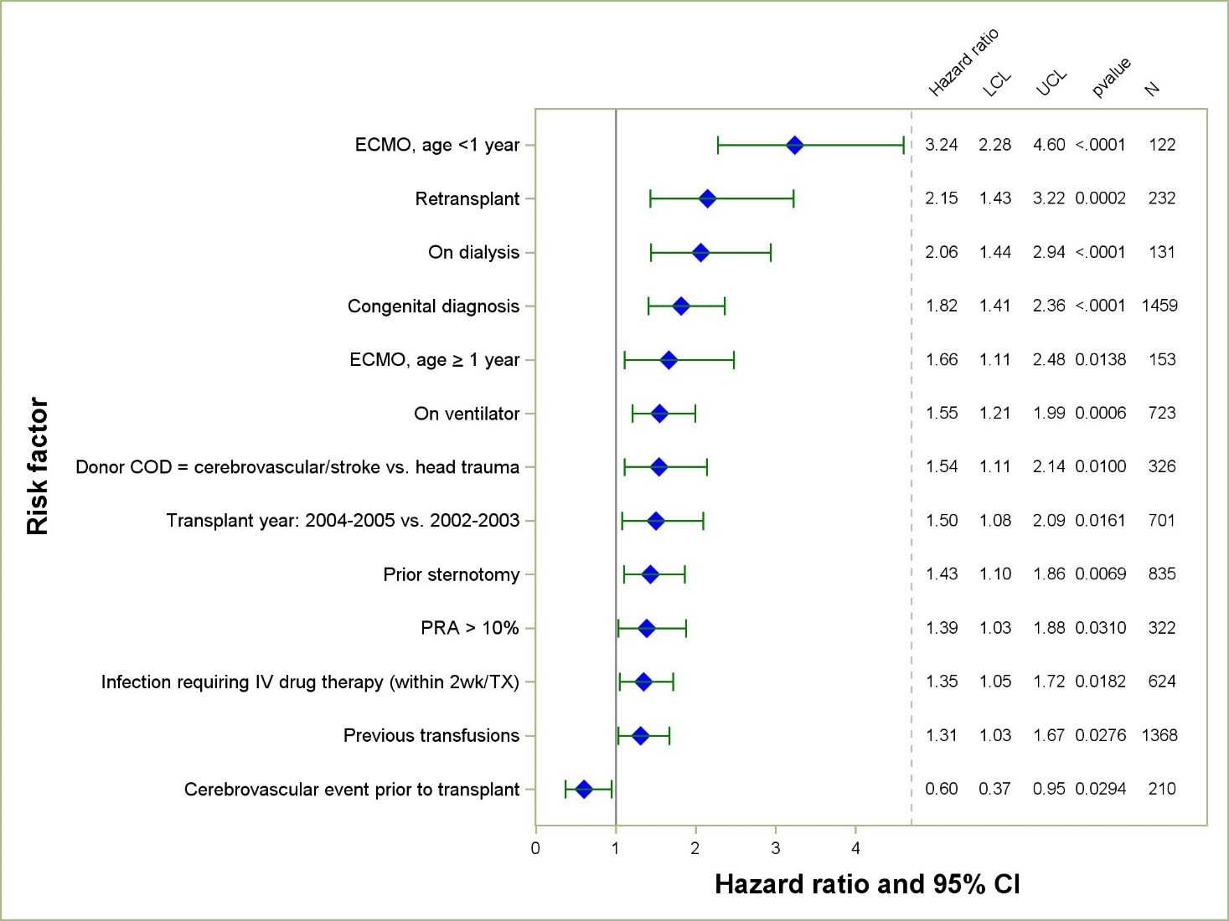
Pediatric Heart Transplants (January 2002 – December 2011)
Risk Factors For 1 Year Mortality
2014
N = 3,649
JHLT. 2014 Oct; 33(10): 985-995
Reference group = Cardiomyopathy, no devices
Notes:
Multivariable analysis was performed using a proportional hazards model censoring all patients at 1 year. Continuous factors were fit using a restricted cubic spline.
Analyses were limited to transplants having essentially complete information regarding risk factors.

Slide 101
Pediatric Heart Transplants (January 2002 – December 2011)
Risk Factors For 1 Year Mortality
Continuous Factors (see figures)
Recipient height | Recipient pre-transplant creatinine
Ischemia time
2014
JHLT. 2014 Oct; 33(10): 985-995
Notes:
Multivariable analysis was performed using a proportional hazards model censoring all patients at 1 year. Continuous factors were fit using a restricted cubic spline.
Analyses were limited to transplants having essentially complete information regarding risk factors.

Slide 102
Pediatric Heart Transplants (January 2002 – December 2011)
Risk Factors For 1 Year Mortality with 95% Confidence Limits
Recipient Height
p = 0.0027
(N = 3,649)
2014
JHLT. 2014 Oct; 33(10): 985-995
Notes:
Multivariable analysis was performed using a proportional hazards model censoring all patients at 1 year. Continuous factors were fit using a restricted cubic spline.
Analyses were limited to transplants having essentially complete information regarding risk factors.

Slide 103
Pediatric Heart Transplants (January 2002 – December 2011)
Risk Factors For 1 Year Mortality with 95% Confidence Limits
Ischemia time
p = 0.0002
2014
(N = 3,649)
JHLT. 2014 Oct; 33(10): 985-995
Notes:
Multivariable analysis was performed using a proportional hazards model censoring all patients at 1 year. Continuous factors were fit using a restricted cubic spline.
Analyses were limited to transplants having essentially complete information regarding risk factors.

Slide 104
Pediatric Heart Transplants (January 2002 – December 2011)
Risk Factors For 1 Year Mortality with 95% Confidence Limits
Recipient Pre-Transplant Creatinine
p = 0.0025
2014
(N = 3,649)
JHLT. 2014 Oct; 33(10): 985-995
Notes:
Multivariable analysis was performed using a proportional hazards model censoring all patients at 1 year. Continuous factors were fit using a restricted cubic spline.
Analyses were limited to transplants having essentially complete information regarding risk factors.

Slide 105
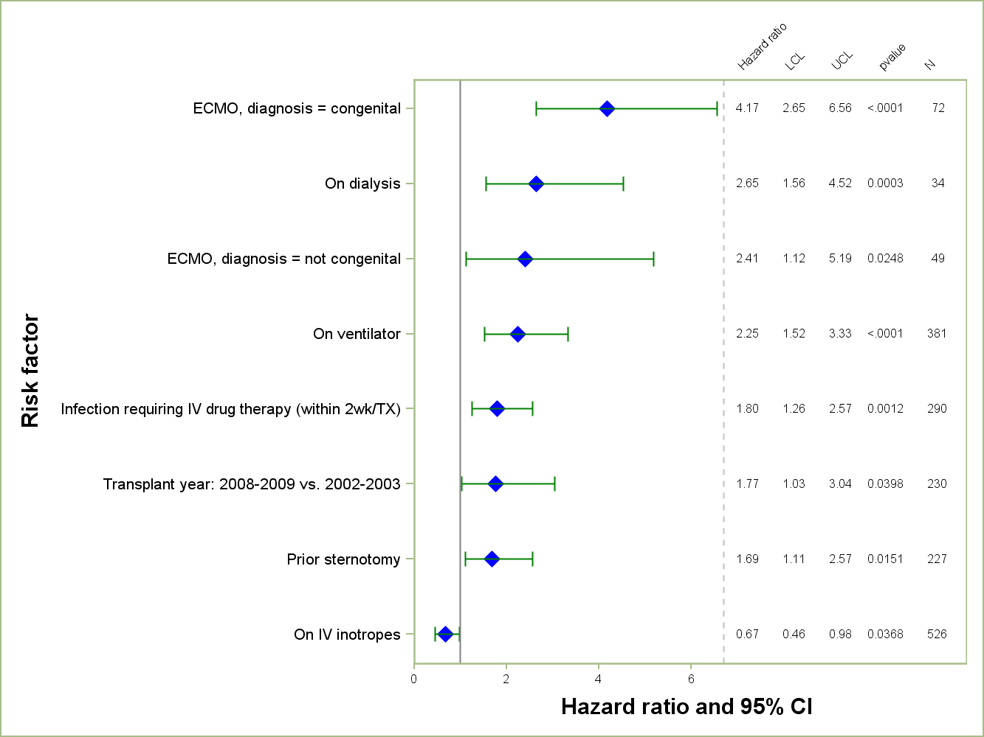
Pediatric Heart Transplants (January 2002 – December 2011)
Age = <1 Year
Risk Factors For 1 Year Mortality
2014
N = 990
JHLT. 2014 Oct; 33(10): 985-995
Reference group = Congenital, no devices
Notes:
Multivariable analysis was performed using a proportional hazards model censoring all patients at 1 year. Continuous factors were fit using a restricted cubic spline.
Analyses were limited to transplants having essentially complete information regarding risk factors.

Slide 106
Pediatric Heart Transplants (January 2002 – December 2011)
Age = <1 Year
Risk Factors For 1 Year Mortality
Continuous Factors (see figures)
Recipient age | Ischemia time
Recipient pre-transplant creatinine | Donor height
Donor/recipient height ratio
2014
JHLT. 2014 Oct; 33(10): 985-995
Notes:
Multivariable analysis was performed using a proportional hazards model censoring all patients at 1 year. Continuous factors were fit using a restricted cubic spline.
Analyses were limited to transplants having essentially complete information regarding risk factors.

Slide 107
Pediatric Heart Transplants (January 2002 – December 2011)
Risk Factors For 1 Year Mortality in Age = <1 Year
Recipient Age
p = 0.0076
2014
(N = 990)
JHLT. 2014 Oct; 33(10): 985-995
Notes:
Multivariable analysis was performed using a proportional hazards model censoring all patients at 1 year. Continuous factors were fit using a restricted cubic spline.
Analyses were limited to transplants having essentially complete information regarding risk factors.

Slide 108
Pediatric Heart Transplants (January 2002 – December 2011)
Risk Factors For 1 Year Mortality in Age = <1 Year
Donor height
p = 0.0006
The impact of donor height must be considered in the context of height ratio.
2014
(N = 990)
JHLT. 2014 Oct; 33(10): 985-995
Notes:
Multivariable analysis was performed using a proportional hazards model censoring all patients at 1 year. Continuous factors were fit using a restricted cubic spline.
Analyses were limited to transplants having essentially complete information regarding risk factors.

Slide 109
Pediatric Heart Transplants (January 2002 – December 2011)
Risk Factors For 1 Year Mortality in Age = <1 Year
Donor/recipient height ratio
p = 0.0038
The impact of height ratio must be considered in the context of donor height.
2014
(N = 990)
JHLT. 2014 Oct; 33(10): 985-995
Notes:
Multivariable analysis was performed using a proportional hazards model censoring all patients at 1 year. Continuous factors were fit using a restricted cubic spline.
Analyses were limited to transplants having essentially complete information regarding risk factors.

Slide 110
Pediatric Heart Transplants (January 2002 – December 2011)
Risk Factors For 1 Year Mortality in Age = <1 Year
Recipient Pre-Transplant Creatinine
p = 0.0007
2014
(N = 990)
JHLT. 2014 Oct; 33(10): 985-995
Notes:
Multivariable analysis was performed using a proportional hazards model censoring all patients at 1 year. Continuous factors were fit using a restricted cubic spline.
Analyses were limited to transplants having essentially complete information regarding risk factors.

Slide 111
Pediatric Heart Transplants (January 2002 – December 2011)
Risk Factors For 1 Year Mortality in Age = <1 Year
Ischemia time
p = 0.0028
2014
(N = 990)
JHLT. 2014 Oct; 33(10): 985-995
Notes:
Multivariable analysis was performed using a proportional hazards model censoring all patients at 1 year. Continuous factors were fit using a restricted cubic spline.
Analyses were limited to transplants having essentially complete information regarding risk factors.

Slide 112
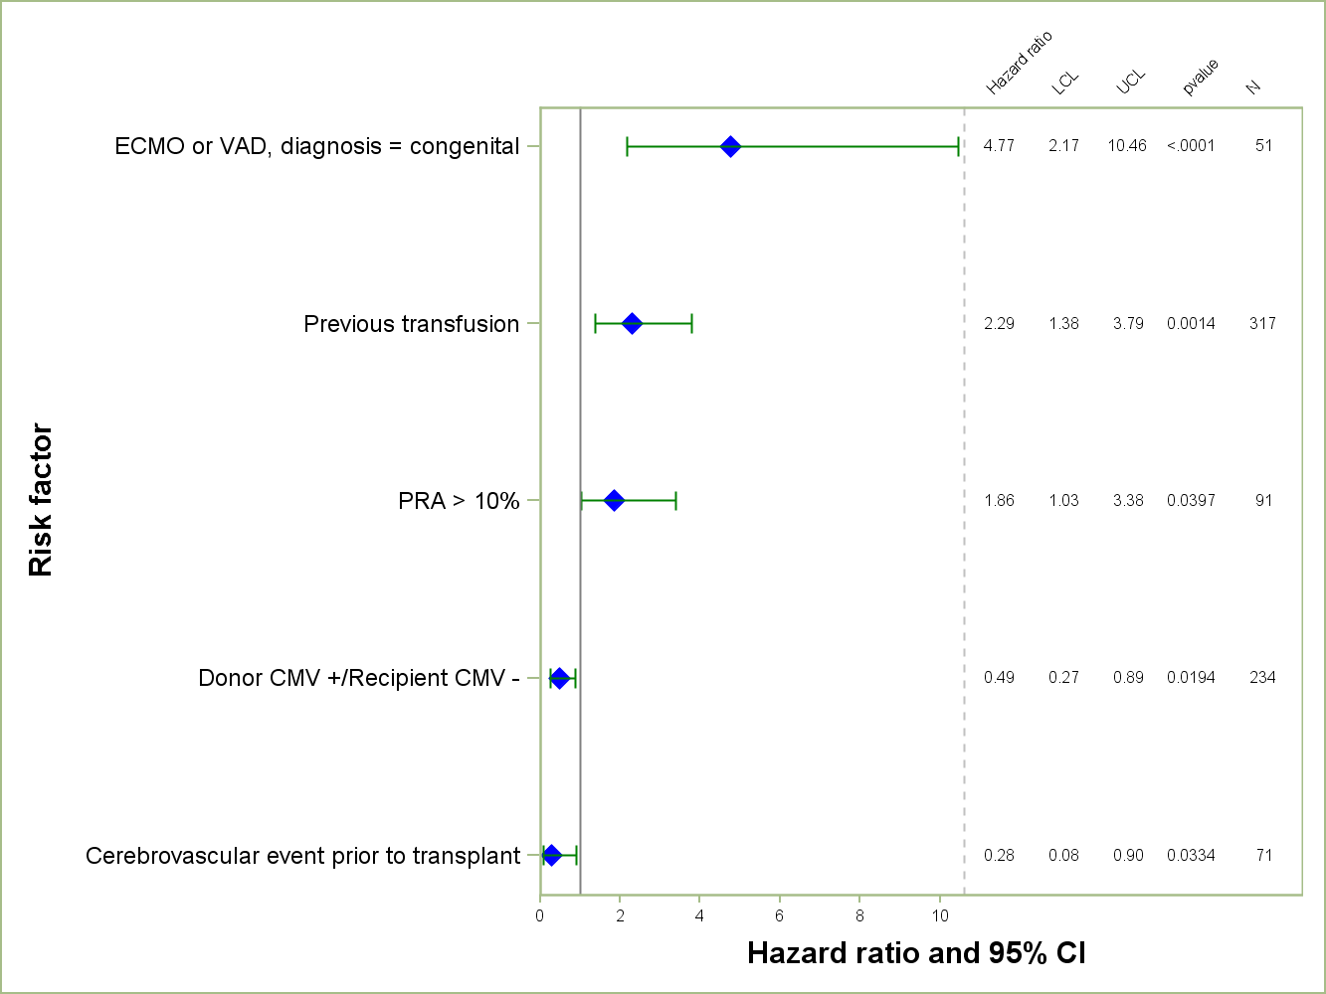
Pediatric Heart Transplants (January 2002 – December 2011)
Age = 1-5 Years
Risk Factors For 1 Year Mortality
2014
N = 852
JHLT. 2014 Oct; 33(10): 985-995
Reference group = Cardiomyopathy, no devices
Notes:
Multivariable analysis was performed using a proportional hazards model censoring all patients at 1 year. Continuous factors were fit using a restricted cubic spline.
Analyses were limited to transplants having essentially complete information regarding risk factors.

Slide 113
Pediatric Heart Transplants (January 2002 – December 2011)
Age = 1-5 Years
Risk Factors For 1 Year Mortality
Continuous Factors (see figures)
Recipient age | Donor/recipient BSA ratio
Recipient pre-transplant creatinine | Volume of pediatric transplants
Recipient height | Ratio of pediatric transplant volume to total transplant volume
2014
JHLT. 2014 Oct; 33(10): 985-995
Notes:
Multivariable analysis was performed using a proportional hazards model censoring all patients at 1 year. Continuous factors were fit using a restricted cubic spline.
Analyses were limited to transplants having essentially complete information regarding risk factors.

Slide 114
Pediatric Heart Transplants (January 2002 – December 2011)
Risk Factors For 1 Year Mortality in Age = 1-5 Years
Recipient Age
p = 0.0434
The impact of recipient age must be considered in the context of recipient height.
2014
(N = 852)
JHLT. 2014 Oct; 33(10): 985-995
Notes:
Multivariable analysis was performed using a proportional hazards model censoring all patients at 1 year. Continuous factors were fit using a restricted cubic spline.
Analyses were limited to transplants having essentially complete information regarding risk factors.

Slide 115
Pediatric Heart Transplants (January 2002 – December 2011)
Risk Factors For 1 Year Mortality in Age = 1-5 Year
Recipient Pre-Transplant Creatinine
p = 0.0097
2014
(N = 852)
JHLT. 2014 Oct; 33(10): 985-995
Notes:
Multivariable analysis was performed using a proportional hazards model censoring all patients at 1 year. Continuous factors were fit using a restricted cubic spline.
Analyses were limited to transplants having essentially complete information regarding risk factors.

Slide 116
Pediatric Heart Transplants (January 2002 – December 2011)
Risk Factors For 1 Year Mortality in Age = 1-5 Years
Recipient Height
p = 0.0049
(N = 852)
2014
The impact of recipient height must be considered in the context of recipient age.
JHLT. 2014 Oct; 33(10): 985-995
Notes:
Multivariable analysis was performed using a proportional hazards model censoring all patients at 1 year. Continuous factors were fit using a restricted cubic spline.
Analyses were limited to transplants having essentially complete information regarding risk factors.

Slide 117
Pediatric Heart Transplants (January 2002 – December 2011)
Risk Factors For 1 Year Mortality in Age = 1-5 Years
Donor/Recipient BSA Ratio
p = 0.0357
2014
(N = 852)
JHLT. 2014 Oct; 33(10): 985-995
Notes:
Multivariable analysis was performed using a proportional hazards model censoring all patients at 1 year. Continuous factors were fit using a restricted cubic spline.
Analyses were limited to transplants having essentially complete information regarding risk factors.

Slide 118
Pediatric Heart Transplants (January 2002 – December 2011)
Risk Factors For 1 Year Mortality in Age = 1-5 Years
Center Volume for Pediatric Transplants
p = 0.0091
(N = 852)
2014
The impact of pediatric volume must be considered in the context of percentage of total volume.
JHLT. 2014 Oct; 33(10): 985-995
Notes:
Multivariable analysis was performed using a proportional hazards model censoring all patients at 1 year. Continuous factors were fit using a restricted cubic spline.
Analyses were limited to transplants having essentially complete information regarding risk factors.

Slide 119
Pediatric Heart Transplants (January 2002 – December 2011)
Risk Factors For 1 Year Mortality in Age = 1-5 Years
Ratio of Pediatric Transplant Volume to Total Transplant Volume
p = 0.0118
2014
(N = 852)
The impact of percentage volume must be considered in the context of pediatric volume.
JHLT. 2014 Oct; 33(10): 985-995
Notes:
Multivariable analysis was performed using a proportional hazards model censoring all patients at 1 year. Continuous factors were fit using a restricted cubic spline.
Analyses were limited to transplants having essentially complete information regarding risk factors.

Slide 120
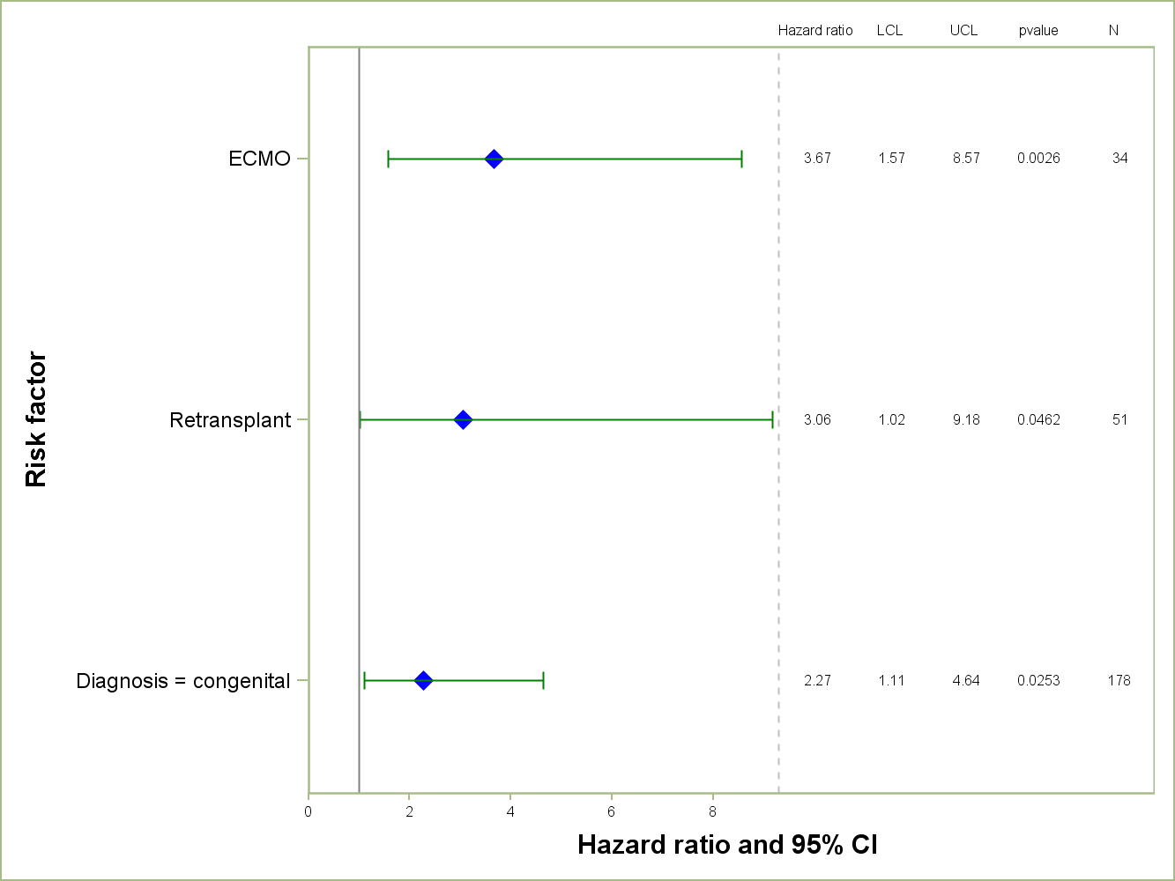
Pediatric Heart Transplants (January 2002 – December 2011)
Age = 6-10 Years
Risk Factors For 1 Year Mortality
2014
N = 523
JHLT. 2014 Oct; 33(10): 985-995
Reference group = Cardiomyopathy, no devices
Notes:
Multivariable analysis was performed using a proportional hazards model censoring all patients at 1 year. Continuous factors were fit using a restricted cubic spline.
Analyses were limited to transplants having essentially complete information regarding risk factors.

Slide 121
Pediatric Heart Transplants (January 2002 – December 2011)
Age = 6-10 Years
Risk Factors For 1 Year Mortality
Continuous Factors (see figures)
Recipient pre-transplant bilirubin
2014
JHLT. 2014 Oct; 33(10): 985-995
Notes:
Multivariable analysis was performed using a proportional hazards model censoring all patients at 1 year. Continuous factors were fit using a restricted cubic spline.
Analyses were limited to transplants having essentially complete information regarding risk factors.

Slide 122
Pediatric Heart Transplants (January 2002 – December 2011)
Risk Factors For 1 Year Mortality in Age = 6-10 Years
Recipient Pre-Transplant Bilirubin
p = 0.0137
2014
(N = 523)
JHLT. 2014 Oct; 33(10): 985-995
Notes:
Multivariable analysis was performed using a proportional hazards model censoring all patients at 1 year. Continuous factors were fit using a restricted cubic spline.
Analyses were limited to transplants having essentially complete information regarding risk factors.

Slide 123
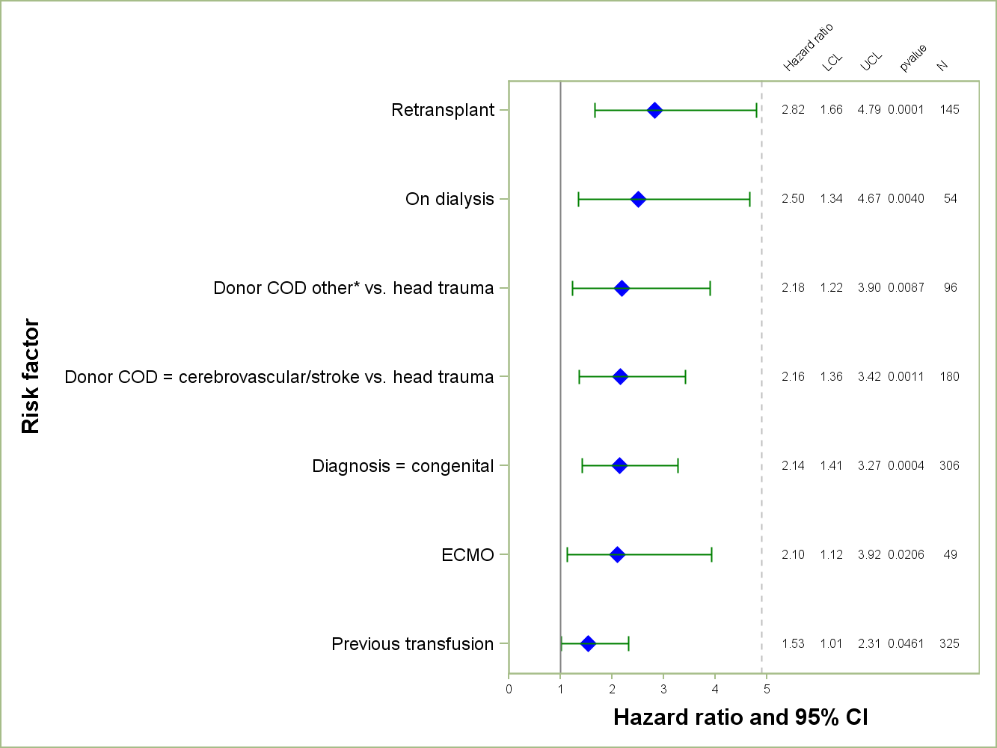
Pediatric Heart Transplants (January 2002 – December 2011)
Age = 11-17 Years
Risk Factors For 1 Year Mortality
N = 1,275
2014
* Other = Not head trauma, cerebrovascular/stroke, anoxia, or CNS tumor
JHLT. 2014 Oct; 33(10): 985-995
Reference group = Cardiomyopathy, no devices
Notes:
Multivariable analysis was performed using a proportional hazards model censoring all patients at 1 year. Continuous factors were fit using a restricted cubic spline.
Analyses were limited to transplants having essentially complete information regarding risk factors.

Slide 124
Pediatric Heart Transplants (January 2002 – December 2011)
Age = 11-17 Years
Risk Factors For 1 Year Mortality
Continuous Factors
No statistically significant continuous risk factors were identified
2014
JHLT. 2014 Oct; 33(10): 985-995
Notes:
Multivariable analysis was performed using a proportional hazards model censoring all patients at 1 year. Continuous factors were fit using a restricted cubic spline.
Analyses were limited to transplants having essentially complete information regarding risk factors.

Slide 125
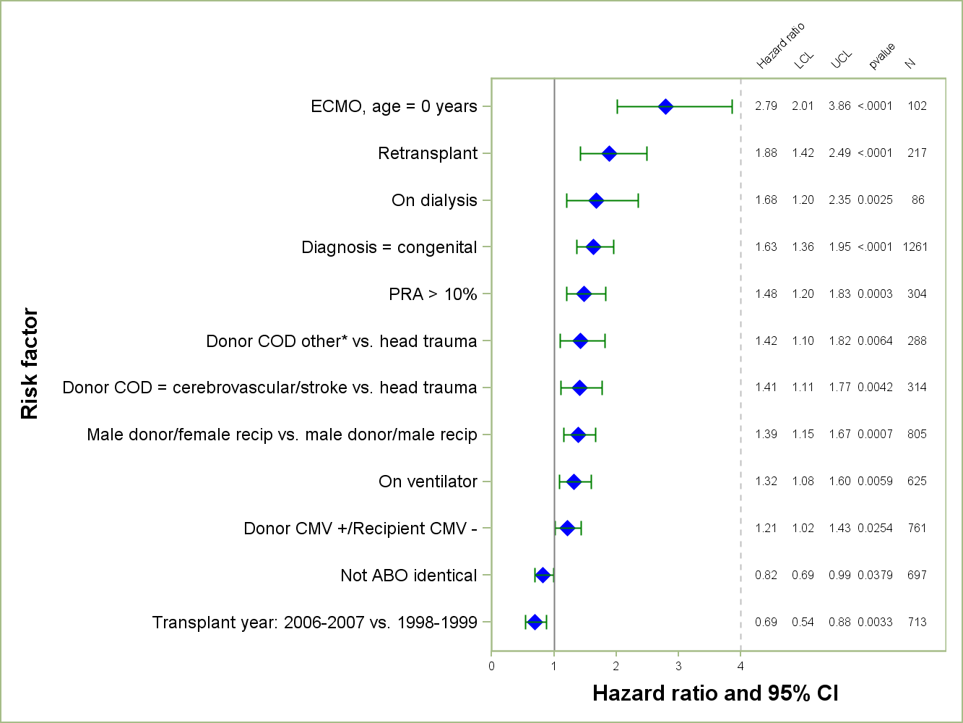
Pediatric Heart Transplants (January 1998 – December 2007)
Risk Factors For 5 Year Mortality
N = 3,143
2014
* Other = Not head trauma, cerebrovascular/stroke, anoxia, or CNS tumor
JHLT. 2014 Oct; 33(10): 985-995
Reference group = Cardiomyopathy, no devices
Notes:
Multivariable analysis was performed using a proportional hazards model censoring all patients at 5 years. Continuous factors were fit using a restricted cubic spline.
Analyses were limited to transplants having essentially complete information regarding risk factors.

Slide 126
Pediatric Heart Transplants (January 1998 – December 2007)
Risk Factors For 5 Year Mortality
Continuous Factors (see figures)
Recipient age | Ratio of pediatric transplant volume to total transplant volume
Ischemia time
2014
JHLT. 2014 Oct; 33(10): 985-995
Notes:
Multivariable analysis was performed using a proportional hazards model censoring all patients at 5 years. Continuous factors were fit using a restricted cubic spline.
Analyses were limited to transplants having essentially complete information regarding risk factors.

Slide 127
Pediatric Heart Transplants (January 1998 – December 2007)
Risk Factors For 5 Year Mortality with 95% Confidence Limits
Recipient Age
p < 0.0001
2014
(N = 3,143)
JHLT. 2014 Oct; 33(10): 985-995
Notes:
Multivariable analysis was performed using a proportional hazards model censoring all patients at 5 years. Continuous factors were fit using a restricted cubic spline.
Analyses were limited to transplants having essentially complete information regarding risk factors.

Slide 128
Pediatric Heart Transplants (January 1998 – December 2007)
Risk Factors For 5 Year Mortality with 95% Confidence Limits
Ischemia time
p = 0.0232
2014
(N = 3,143)
JHLT. 2014 Oct; 33(10): 985-995
Notes:
Multivariable analysis was performed using a proportional hazards model censoring all patients at 1 year. Continuous factors were fit using a restricted cubic spline.
Analyses were limited to transplants having essentially complete information regarding risk factors.

Slide 129
Pediatric Heart Transplants (January 1998 – December 2007)
Risk Factors For 5 Year Mortality with 95% Confidence Limits
Ratio of Pediatric Transplant Volume to Total Transplant Volume
p = 0.0368
2014
(N = 3,143)
JHLT. 2014 Oct; 33(10): 985-995
Notes:
Multivariable analysis was performed using a proportional hazards model censoring all patients at 1 year. Continuous factors were fit using a restricted cubic spline.
Analyses were limited to transplants having essentially complete information regarding risk factors.

Slide 130
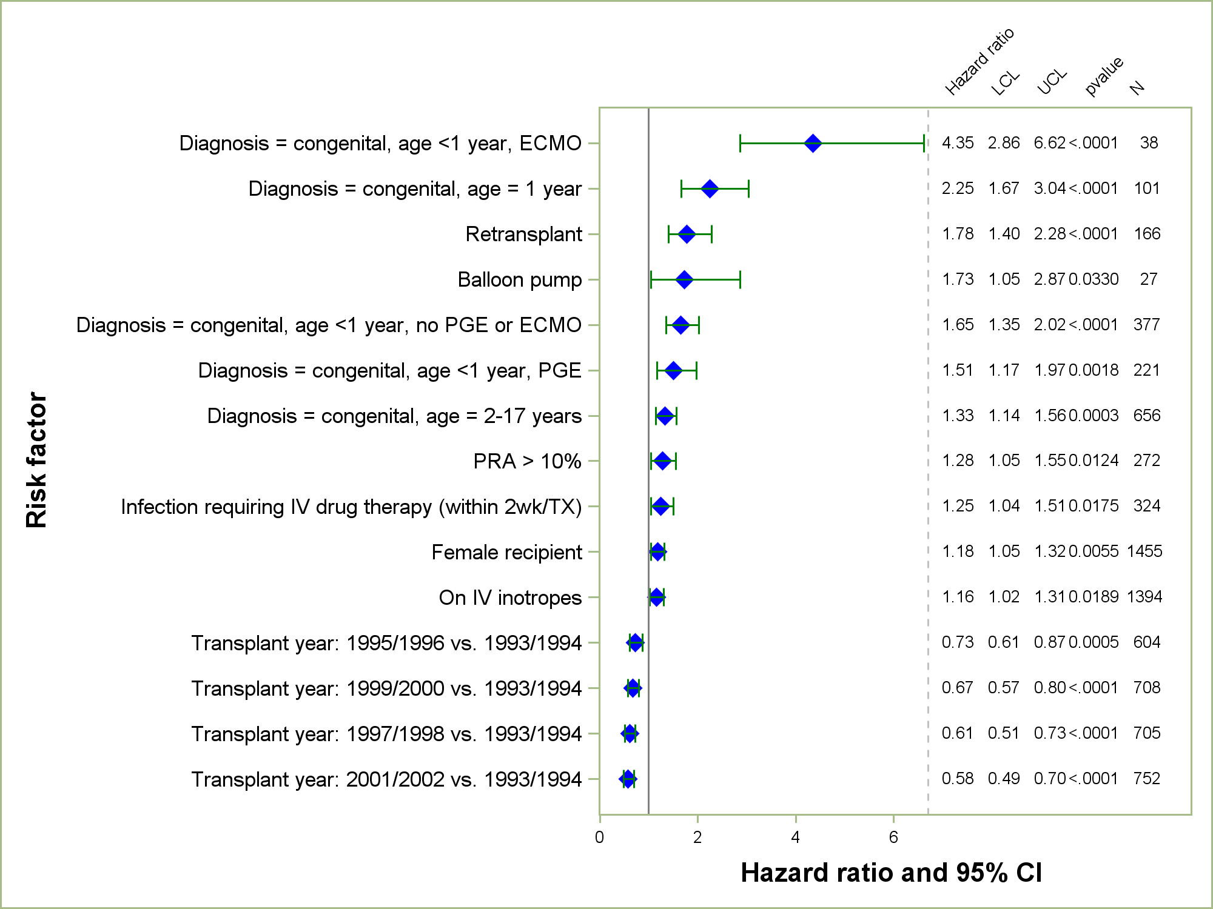
Pediatric Heart Transplants (January 1993 – December 2002)
Risk Factors For 10 Year Mortality
2014
Reference group = Cardiomyopathy, no devices
N = 3,400
JHLT. 2014 Oct; 33(10): 985-995
Notes:
Multivariable analysis was performed using a proportional hazards model censoring all patients at 10 years. Continuous factors were fit using a restricted cubic spline.
Analyses were limited to transplants having essentially complete information regarding risk factors.

Slide 131
Pediatric Heart Transplants (January 1993 – December 2002)
Risk Factors For 10 Year Mortality
Continuous Factors (see figures)
Difference in age | Ratio of pediatric transplant volume to total transplant volume
Recipient BMI | Recipient pre-transplant serum creatinine
2014
JHLT. 2014 Oct; 33(10): 985-995
Notes:
Multivariable analysis was performed using a proportional hazards model censoring all patients at 10 years. Continuous factors were fit using a restricted cubic spline.
Analyses were limited to transplants having essentially complete information regarding risk factors.

Slide 132
Pediatric Heart Transplants (January 1993 – December 2002)
Risk Factors For 10 Year Mortality with 95% Confidence Limits
Difference in Age
p = 0.0034
2014
(N = 3,400)
JHLT. 2014 Oct; 33(10): 985-995
Notes:
Multivariable analysis was performed using a proportional hazards model censoring all patients at 10 years. Continuous factors were fit using a restricted cubic spline.
Analyses were limited to transplants having essentially complete information regarding risk factors.

Slide 133
Pediatric Heart Transplants (January 1993 – December 2002)
Risk Factors For 10 Year Mortality with 95% Confidence Limits
Recipient BMI
p = 0.0056
(N = 3,400)
2014
JHLT. 2014 Oct; 33(10): 985-995
Notes:
Multivariable analysis was performed using a proportional hazards model censoring all patients at 1 year. Continuous factors were fit using a restricted cubic spline.
Analyses were limited to transplants having essentially complete information regarding risk factors.

Slide 134
Pediatric Heart Transplants (January 1993 – December 2002)
Risk Factors For 10 Year Mortality with 95% Confidence Limits
Ratio of Pediatric Transplant Volume to Total Transplant Volume
p = 0.0043
2014
(N = 3,400)
JHLT. 2014 Oct; 33(10): 985-995
Notes:
Multivariable analysis was performed using a proportional hazards model censoring all patients at 1 year. Continuous factors were fit using a restricted cubic spline.
Analyses were limited to transplants having essentially complete information regarding risk factors.

Slide 135
Pediatric Heart Transplants (January 1993 – December 2002)
Risk Factors For 10 Year Mortality with 95% Confidence Limits
Recipient Pre-Transplant Creatinine
p = 0.0197
2014
(N = 3,400)
JHLT. 2014 Oct; 33(10): 985-995
Notes:
Multivariable analysis was performed using a proportional hazards model censoring all patients at 1 year. Continuous factors were fit using a restricted cubic spline.
Analyses were limited to transplants having essentially complete information regarding risk factors.

Slide 136
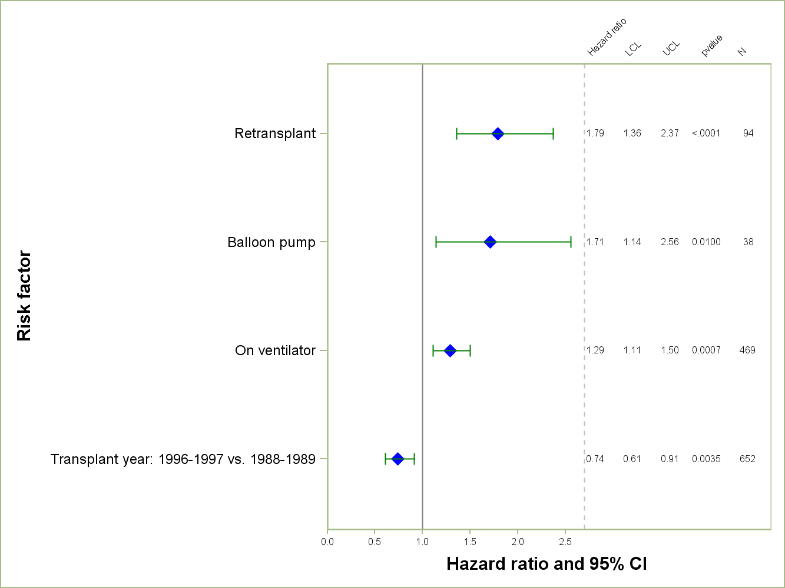
Pediatric Heart Transplants (January 1988 – December 1997)
Risk Factors For 15 Year Mortality
2014
N = 2,755
JHLT. 2014 Oct; 33(10): 985-995
Reference group = Cardiomyopathy, no devices
Notes:
Multivariable analysis was performed using a proportional hazards model censoring all patients at 15 years. Continuous factors were fit using a restricted cubic spline.
Analyses were limited to transplants having essentially complete information regarding risk factors.

Slide 137
Pediatric Heart Transplants (January 1988 – December 1997)
Risk Factors For 15 Year Mortality
Continuous Factors (see figures)
Donor age | Volume of pediatric transplants
2014
JHLT. 2014 Oct; 33(10): 985-995
Notes:
Multivariable analysis was performed using a proportional hazards model censoring all patients at 15 years. Continuous factors were fit using a restricted cubic spline.
Analyses were limited to transplants having essentially complete information regarding risk factors.

Slide 138
Pediatric Heart Transplants (January 1988 – December 1997)
Risk Factors For 15 Year Mortality with 95% Confidence Limits
Donor Age
p = 0.0119
2014
(N = 2,755)
JHLT. 2014 Oct; 33(10): 985-995
Notes:
Multivariable analysis was performed using a proportional hazards model censoring all patients at 15 years. Continuous factors were fit using a restricted cubic spline.
Analyses were limited to transplants having essentially complete information regarding risk factors.

Slide 139
Pediatric Heart Transplants (January 1988 – December 1997)
Risk Factors For 15 Year Mortality with 95% Confidence Limits
Center Volume for Pediatric Transplants
p = 0.0002
2014
(N = 2,755)
JHLT. 2014 Oct; 33(10): 985-995
Notes:
Multivariable analysis was performed using a proportional hazards model censoring all patients at 15 years. Continuous factors were fit using a restricted cubic spline.
Analyses were limited to transplants having essentially complete information regarding risk factors.

Slide 140
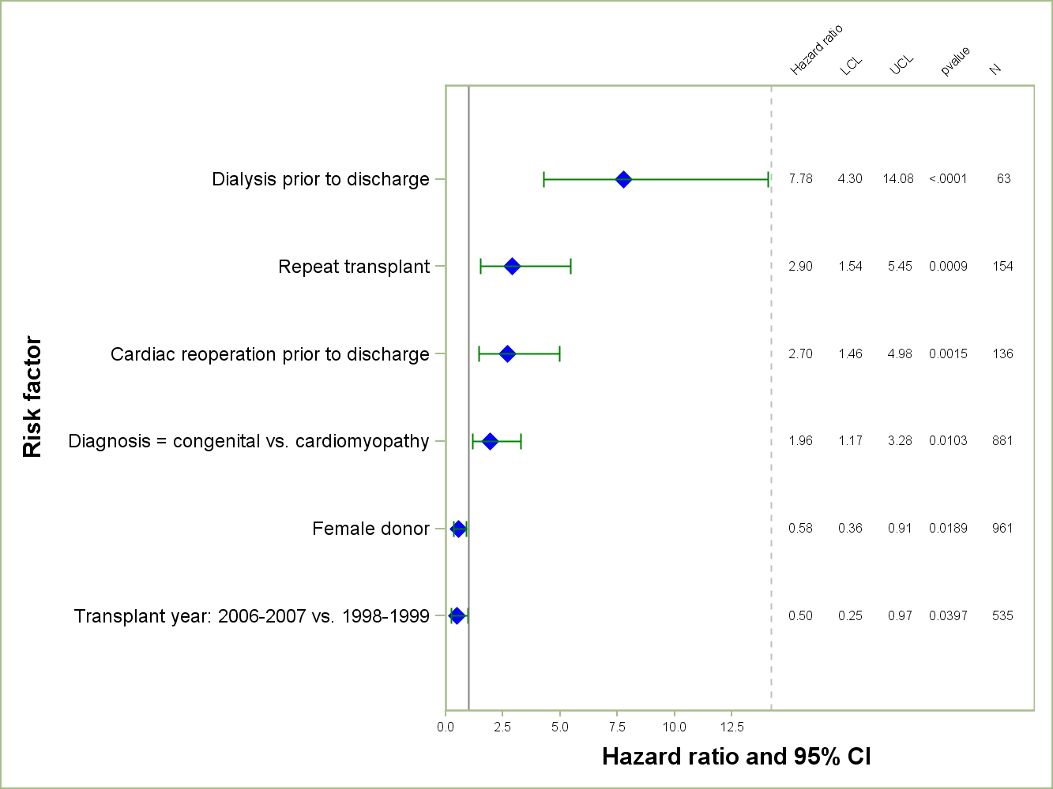
PEDIATRIC HEART TRANSPLANTS (1998-2007)
Risk Factors for Developing Severe Renal Dysfunction within 5 Years
Limited to Recipients without Severe Renal Dysfunction* Pre-Transplant
Conditional on Survival to Transplant Discharge
2014
N = 2,260
JHLT. 2014 Oct; 33(10): 985-995
*Severe renal dysfunction = creatinine > 2.5 mg/dl or dialysis
Notes:
Multivariable analysis was performed using a proportional hazards model censoring all patients at 5 Years. Continuous factors were fit using a restricted cubic spline.
Analyses were limited to transplants having essentially complete information regarding risk factors.

Slide 141
PEDIATRIC HEART TRANSPLANTS (1998-2007)
Risk Factors for Developing Severe Renal Dysfunction within 5 Years
Limited to Recipients without Severe Renal Dysfunction* Pre-Transplant
Conditional on Survival to Transplant Discharge
Continuous Factors (see figures)
Recipient BSA | Ischemia time
*Severe renal dysfunction = creatinine > 2.5 mg/dl or dialysis
2014
JHLT. 2014 Oct; 33(10): 985-995
Notes:
Multivariable analysis was performed using a proportional hazards model censoring all patients at 5 Years. Continuous factors were fit using a restricted cubic spline.
Analyses were limited to transplants having essentially complete information regarding risk factors.

Slide 142
PEDIATRIC HEART TRANSPLANTS (1998-2007)
Risk Factors for Developing Severe Renal Dysfunction within 5 Years
Limited to Recipients without Severe Renal Dysfunction* Pre-Transplant
Conditional on Survival to Transplant Discharge
Recipient BSA
p < 0.0001
*Severe renal dysfunction = creatinine > 2.5 mg/dl or dialysis
2014
(N = 2,260)
JHLT. 2014 Oct; 33(10): 985-995
Notes:
Multivariable analysis was performed using a proportional hazards model censoring all patients at 5 Years. Continuous factors were fit using a restricted cubic spline.
Analyses were limited to transplants having essentially complete information regarding risk factors.

Slide 143
PEDIATRIC HEART TRANSPLANTS (1998-2007)
Risk Factors for Developing Severe Renal Dysfunction within 5 Years
Limited to Recipients without Severe Renal Dysfunction* Pre-Transplant
Conditional on Survival to Transplant Discharge
Ischemia time
p = 0.0367
*Severe renal dysfunction = creatinine > 2.5 mg/dl or dialysis
2014
(N = 2,260)
JHLT. 2014 Oct; 33(10): 985-995
Notes:
Multivariable analysis was performed using a proportional hazards model censoring all patients at 5 Years. Continuous factors were fit using a restricted cubic spline.
Analyses were limited to transplants having essentially complete information regarding risk factors.

Slide 144
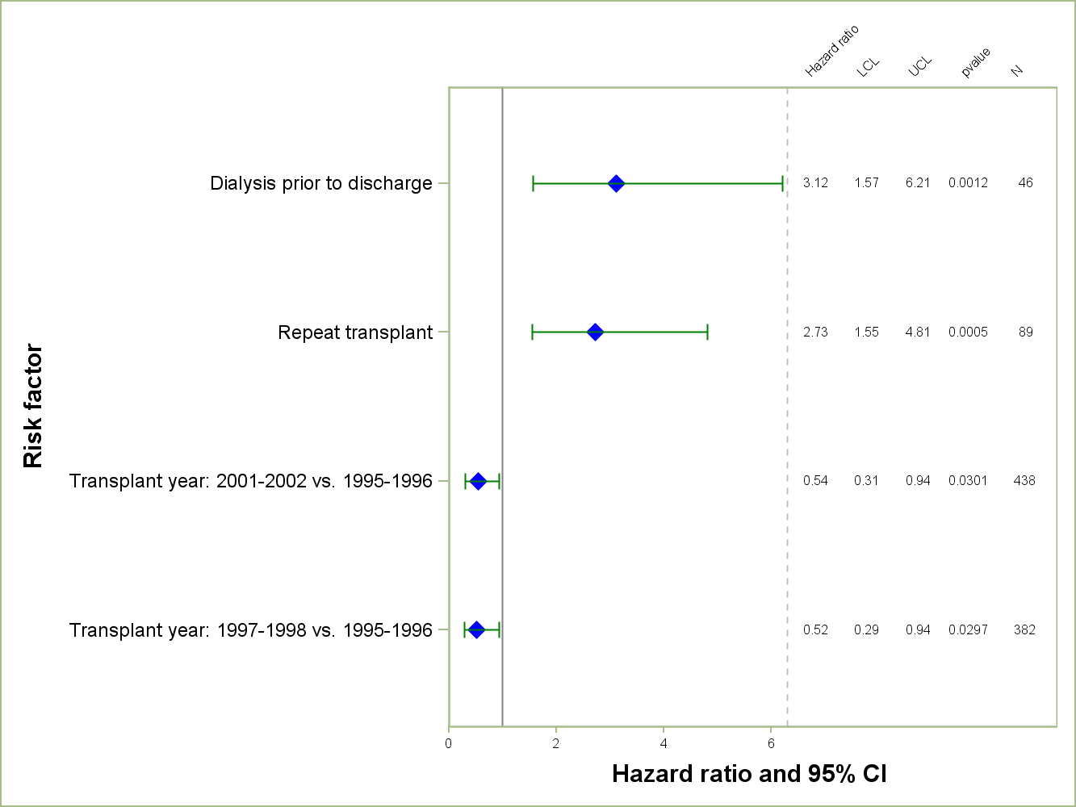
PEDIATRIC HEART TRANSPLANTS (1995-2002)
Risk Factors for Developing Severe Renal Dysfunction within 10 Years
Limited to Recipients without Severe Renal Dysfunction* Pre-Transplant
Conditional on Survival to Transplant Discharge
2014
N = 1,564
JHLT. 2014 Oct; 33(10): 985-995
*Severe renal dysfunction = creatinine > 2.5 mg/dl or dialysis
Notes:
Multivariable analysis was performed using a proportional hazards model censoring all patients at 5 Years. Continuous factors were fit using a restricted cubic spline.
Analyses were limited to transplants having essentially complete information regarding risk factors.

Slide 145
PEDIATRIC HEART TRANSPLANTS (1995-2002)
Risk Factors for Developing Severe Renal Dysfunction within 10 Years
Limited to Recipients without Severe Renal Dysfunction* Pre-Transplant
Conditional on Survival to Transplant Discharge
Continuous Factors (see figures)
Recipient height
*Severe renal dysfunction = creatinine > 2.5 mg/dl or dialysis
2014
JHLT. 2014 Oct; 33(10): 985-995
Notes:
Multivariable analysis was performed using a proportional hazards model censoring all patients at 5 Years. Continuous factors were fit using a restricted cubic spline.
Analyses were limited to transplants having essentially complete information regarding risk factors.

Slide 146
PEDIATRIC HEART TRANSPLANTS (1995-2002)
Risk Factors for Developing Severe Renal Dysfunction within 10 Years
Limited to Recipients without Severe Renal Dysfunction* Pre-Transplant
Conditional on Survival to Transplant Discharge
Recipient Height
p < 0.0001
*Severe renal dysfunction = creatinine > 2.5 mg/dl or dialysis
2014
(N = 1,564)
JHLT. 2014 Oct; 33(10): 985-995
Notes:
Multivariable analysis was performed using a proportional hazards model censoring all patients at 5 Years. Continuous factors were fit using a restricted cubic spline.
Analyses were limited to transplants having essentially complete information regarding risk factors.

Slide 147
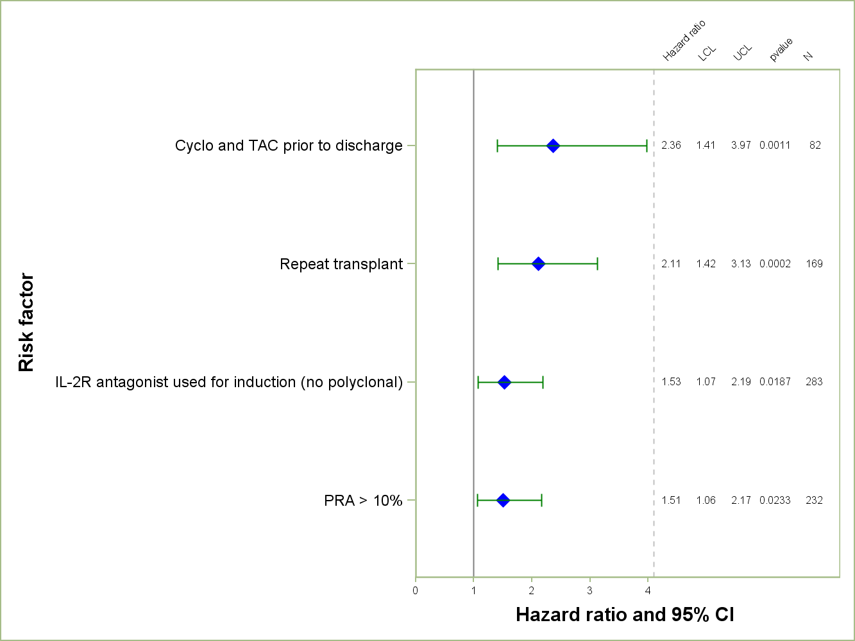
Pediatric Heart Transplants (January 1998 – December 2007)
Risk Factors for Developing CAV within 5 Years
Conditional on Survival to Transplant Discharge
2014
N = 2,251
JHLT. 2014 Oct; 33(10): 985-995
Notes:
Multivariable analysis was performed using a proportional hazards model censoring all patients at 10 Years. Continuous factors were fit using a restricted cubic spline.
Analyses were limited to transplants having essentially complete information regarding risk factors.

Slide 148
Pediatric Heart Transplants (January 1998 – December 2007)
Risk Factors for Developing CAV within 5 Years
Conditional on Survival to Transplant Discharge
Continuous Factors (see figures)
Difference in age | Transplant center volume
Recipient weight
2014
JHLT. 2014 Oct; 33(10): 985-995
Notes:
Multivariable analysis was performed using a proportional hazards model censoring all patients at 5 Years. Continuous factors were fit using a restricted cubic spline.
Analyses were limited to transplants having essentially complete information regarding risk factors.

Slide 149
Pediatric Heart Transplants (January 1998 – December 2007)
Risk Factors for Developing CAV within 5 Years
Conditional on Survival to Transplant Discharge
Difference in Age
p = 0.001
2014
(N = 2,251)
JHLT. 2014 Oct; 33(10): 985-995
Notes:
Multivariable analysis was performed using a proportional hazards model censoring all patients at 5 Years. Continuous factors were fit using a restricted cubic spline.
Analyses were limited to transplants having essentially complete information regarding risk factors.

Slide 150
Pediatric Heart Transplants (January 1998 – December 2007)
Risk Factors for Developing CAV within 5 Years
Conditional on Survival to Transplant Discharge
Recipient Weight
p < 0.0001
2014
(N = 2,251)
JHLT. 2014 Oct; 33(10): 985-995
Notes:
Multivariable analysis was performed using a proportional hazards model censoring all patients at 5 Years. Continuous factors were fit using a restricted cubic spline.
Analyses were limited to transplants having essentially complete information regarding risk factors.

Slide 151
Pediatric Heart Transplants (January 1998 – December 2007)
Risk Factors for Developing CAV within 5 Years
Conditional on Survival to Transplant Discharge
Total Program Volume (Pediatric and Adult)
p = 0.0289
2014
(N = 2,251)
JHLT. 2014 Oct; 33(10): 985-995
Notes:
Multivariable analysis was performed using a proportional hazards model censoring all patients at 5 Years. Continuous factors were fit using a restricted cubic spline.
Analyses were limited to transplants having essentially complete information regarding risk factors.

Slide 152
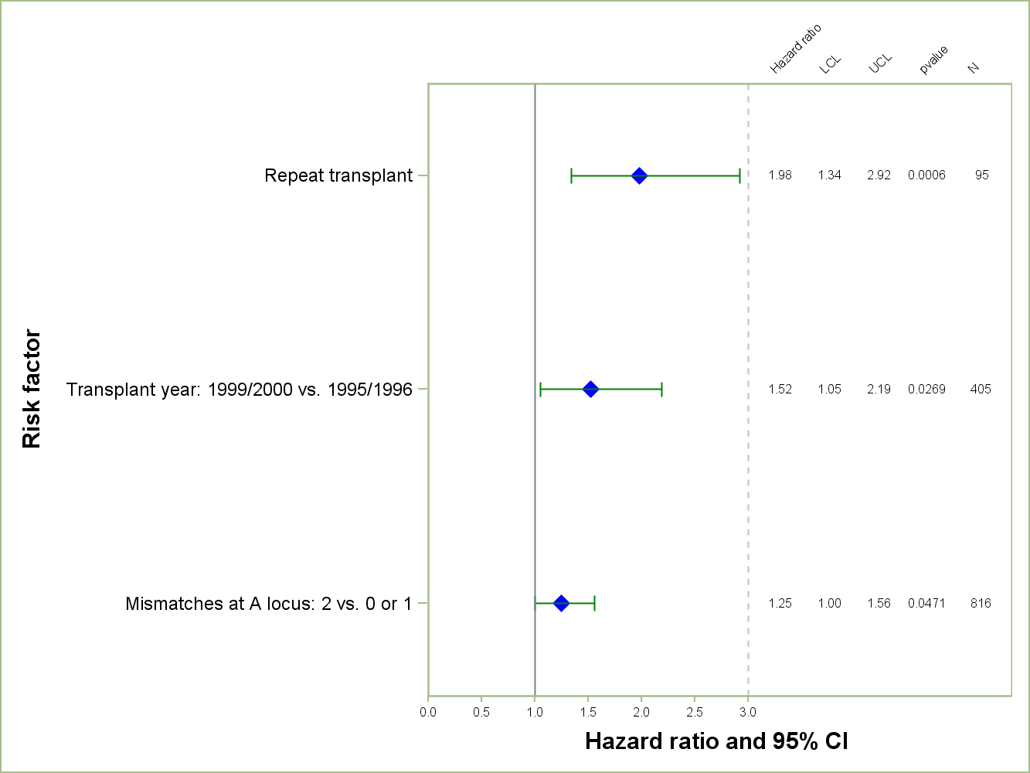
Pediatric Heart Transplants (January 1995 – December 2002)
Risk Factors for Developing CAV within 10 Years
Conditional on Survival to Transplant Discharge
2014
N = 1,494
JHLT. 2014 Oct; 33(10): 985-995
Notes:
Multivariable analysis was performed using a proportional hazards model censoring all patients at 10 Years. Continuous factors were fit using a restricted cubic spline.
Analyses were limited to transplants having essentially complete information regarding risk factors.

Slide 153
Pediatric Heart Transplants (January 1995 – December 2002)
Risk Factors for Developing CAV within 10 Years
Conditional on Survival to Transplant Discharge
Continuous Factors (see figures)
Recipient weight | Transplant center volume
2014
JHLT. 2014 Oct; 33(10): 985-995
Notes:
Multivariable analysis was performed using a proportional hazards model censoring all patients at 5 Years. Continuous factors were fit using a restricted cubic spline.
Analyses were limited to transplants having essentially complete information regarding risk factors.

Slide 154
Pediatric Heart Transplants (January 1995 – December 2002)
Risk Factors for Developing CAV within 10 Years
Conditional on Survival to Transplant Discharge
Recipient Weight
p < 0.0001
2014
(N = 1,494)
JHLT. 2014 Oct; 33(10): 985-995
Notes:
Multivariable analysis was performed using a proportional hazards model censoring all patients at 5 Years. Continuous factors were fit using a restricted cubic spline.
Analyses were limited to transplants having essentially complete information regarding risk factors.

Slide 155
Pediatric Heart Transplants (January 1995 – December 2002)
Risk Factors for Developing CAV within 10 Years
Conditional on Survival to Transplant Discharge
Total Program Volume (Pediatric and Adult)
p = 0.0216
2014
(N = 1,494)
JHLT. 2014 Oct; 33(10): 985-995
Notes:
Multivariable analysis was performed using a proportional hazards model censoring all patients at 5 Years. Continuous factors were fit using a restricted cubic spline.
Analyses were limited to transplants having essentially complete information regarding risk factors.

Slide 156
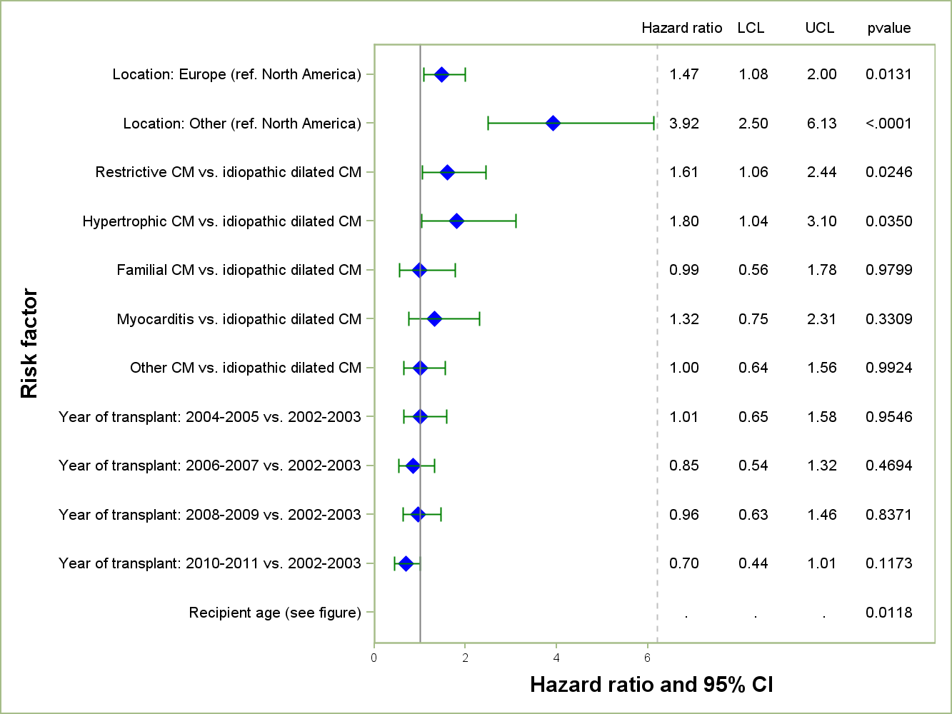
Pediatric Heart Transplants (2002 – 2011)
Risk Factors For 1 Year Mortality: Diagnosis = Cardiomyopathy*
2014
N = 2,701
* Please refer to notes section for important supplemental information
JHLT. 2014 Oct; 33(10): 985-995
Notes:
Cox proportional hazards regression was performed for cardiomyopathy and congenital diagnosis groups, adjusting for the impact of recipient age, year of transplant, and geographic location. Additional risk factors for the type of cardiomyopathy (e.g., hypertrophic, restrictive) were included in the cardiomyopathy model. Further specification on the complexity of the congenital diagnosis is not available in the ISHLT Registry database so any differences seen by geography may be partially a function of differences in complexity. Due to different levels of reporting by geography, the models were not adjusted for other risk factors.
In addition to differences in patient and donor characteristics and center volumes between the geographic regions, multivariable model results could also relate to differences in the organization of post transplant follow-up care and behavioral factors, including non-adherence.
Interactions between recipient age and geographic location were examined, but were retained only if significant.

Slide 157
Pediatric Heart Transplants (2002 – 2011)
Risk Factors For 1 Year Mortality: Diagnosis = Cardiomyopathy*
Recipient Age
2014
* Please refer to notes section for important supplemental information
JHLT. 2014 Oct; 33(10): 985-995
Notes:
Cox proportional hazards regression was performed for cardiomyopathy and congenital diagnosis groups, adjusting for the impact of recipient age, year of transplant, and geographic location. Additional risk factors for the type of cardiomyopathy (e.g., hypertrophic, restrictive) were included in the cardiomyopathy model. Further specification on the complexity of the congenital diagnosis is not available in the ISHLT Registry database so any differences seen by geography may be partially a function of differences in complexity. Due to different levels of reporting by geography, the models were not adjusted for other risk factors.
In addition to differences in patient and donor characteristics and center volumes between the geographic regions, multivariable model results could also relate to differences in the organization of post transplant follow-up care and behavioral factors, including non-adherence.
Interactions between recipient age and geographic location were examined, but were retained only if significant.

Slide 158
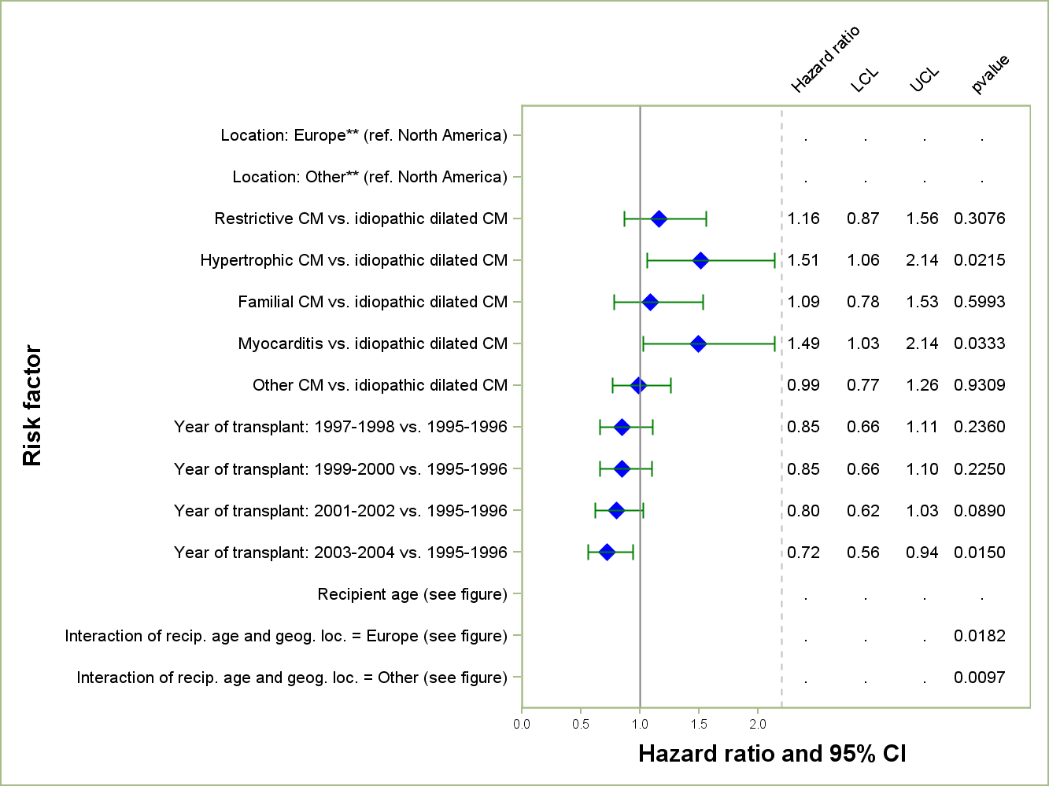
Pediatric Heart Transplants (1995 – 2004)
Risk Factors For 8 Year Mortality: Diagnosis = Cardiomyopathy*
N = 2,072
* Please refer to notes section for important supplemental information
2014
* *The hazard ratio and p-value for the main effect for Europe and for age can not be interpreted in isolation; they must be interpreted in combination with the interaction between recipient age and Europe.
JHLT. 2014 Oct; 33(10): 985-995
Notes:
Cox proportional hazards regression was performed for cardiomyopathy and congenital diagnosis groups, adjusting for the impact of recipient age, year of transplant, and geographic location. Additional risk factors for the type of cardiomyopathy (e.g., hypertrophic, restrictive) were included in the cardiomyopathy model. Further specification on the complexity of the congenital diagnosis is not available in the ISHLT Registry database so any differences seen by geography may be partially a function of differences in complexity. Due to different levels of reporting by geography, the models were not adjusted for other risk factors.
In addition to differences in patient and donor characteristics and center volumes between the geographic regions, multivariable model results could also relate to differences in the organization of post transplant follow-up care and behavioral factors, including non-adherence.
Interactions between recipient age and geographic location were examined in both models but were retained only if significant.

Slide 159
Pediatric Heart Transplants (1995-2004)
Risk Factors For 8 Year Mortality: Diagnosis = Cardiomyopathy*
Combined effect of age, geography, and age*geography interaction
2014
* Please refer to notes section for important supplemental information
JHLT. 2014 Oct; 33(10): 985-995
Notes:
Cox proportional hazards regression was performed for cardiomyopathy and congenital diagnosis groups, adjusting for the impact of recipient age, year of transplant, and geographic location. Additional risk factors for the type of cardiomyopathy (e.g., hypertrophic, restrictive) were included in the cardiomyopathy model. Further specification on the complexity of the congenital diagnosis is not available in the ISHLT Registry database so any differences seen by geography may be partially a function of differences in complexity. Due to different levels of reporting by geography, the models were not adjusted for other risk factors.
In addition to differences in patient and donor characteristics and center volumes between the geographic regions, multivariable model results could also relate to differences in the organization of post transplant follow-up care and behavioral factors, including non-adherence.
Interactions between recipient age and geographic location were examined in both models but were retained only if significant.

Slide 160
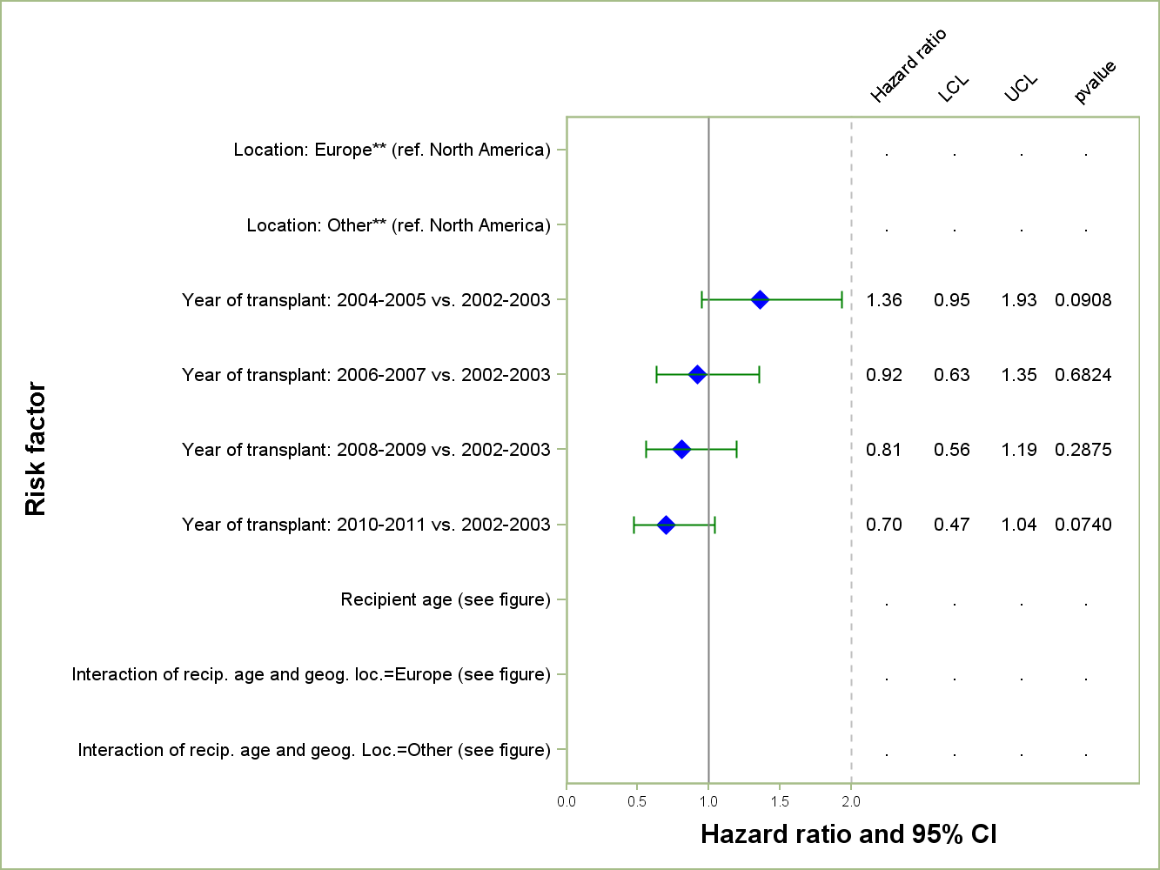
Pediatric Heart Transplants (2002 – 2011)
Risk Factors For 1 Year Mortality: Diagnosis = Congenital*
N = 1,711
* Please refer to notes section for important supplemental information
2014
* *The hazard ratio and p-value for the main effect for Europe and for age can not be interpreted in isolation; they must be interpreted in combination with the interaction between recipient age and Europe.
JHLT. 2014 Oct; 33(10): 985-995
Notes:
Cox proportional hazards regression was performed for cardiomyopathy and congenital diagnosis groups, adjusting for the impact of recipient age, year of transplant, and geographic location. Additional risk factors for the type of cardiomyopathy (e.g., hypertrophic, restrictive) were included in the cardiomyopathy model. Further specification on the complexity of the congenital diagnosis is not available in the ISHLT Registry database so any differences seen by geography may be partially a function of differences in complexity. Due to different levels of reporting by geography, the models were not adjusted for other risk factors.
In addition to differences in patient and donor characteristics and center volumes between the geographic regions, multivariable model results could also relate to differences in the organization of post transplant follow-up care and behavioral factors, including non-adherence.
Interactions between recipient age and geographic location were examined, but were retained only if significant.

Slide 161
Pediatric Heart Transplants (1995-2004)
Risk Factors For 1 Year Mortality: Diagnosis = Congenital*
Combined effect of age, geography, and age*geography interaction
2014
* Please refer to notes section for important supplemental information
JHLT. 2014 Oct; 33(10): 985-995
Notes:
Cox proportional hazards regression was performed for cardiomyopathy and congenital diagnosis groups, adjusting for the impact of recipient age, year of transplant, and geographic location. Additional risk factors for the type of cardiomyopathy (e.g., hypertrophic, restrictive) were included in the cardiomyopathy model. Further specification on the complexity of the congenital diagnosis is not available in the ISHLT Registry database so any differences seen by geography may be partially a function of differences in complexity. Due to different levels of reporting by geography, the models were not adjusted for other risk factors.
In addition to differences in patient and donor characteristics and center volumes between the geographic regions, multivariable model results could also relate to differences in the organization of post transplant follow-up care and behavioral factors, including non-adherence.
Interactions between recipient age and geographic location were examined, but were retained only if significant.

Slide 162
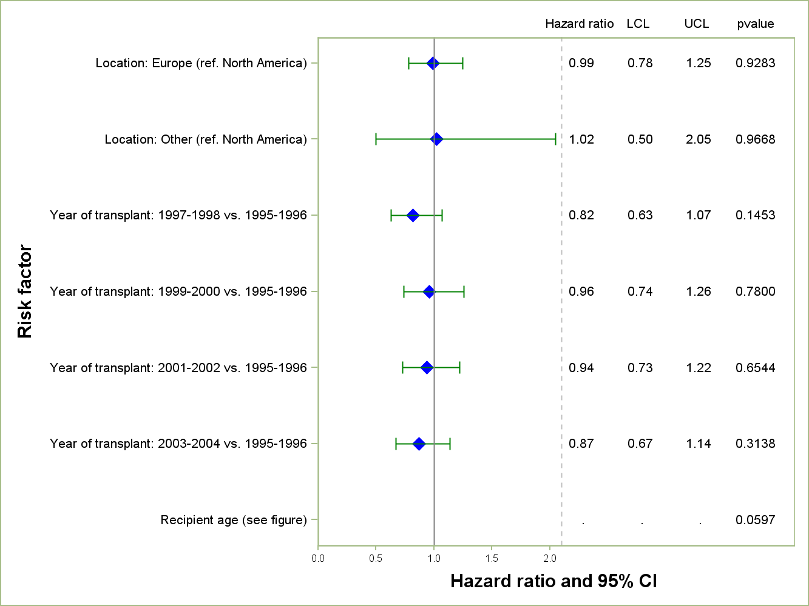
Pediatric Heart Transplants (1995-2004)
Risk Factors For 8 Year Mortality: Diagnosis = Congenital*
2014
N = 1,568
* Please refer to notes section for important supplemental information
JHLT. 2014 Oct; 33(10): 985-995
Notes:
Cox proportional hazards regression was performed for cardiomyopathy and congenital diagnosis groups, adjusting for the impact of recipient age, year of transplant, and geographic location. Additional risk factors for the type of cardiomyopathy (e.g., hypertrophic, restrictive) were included in the cardiomyopathy model. Further specification on the complexity of the congenital diagnosis is not available in the ISHLT Registry database so any differences seen by geography may be partially a function of differences in complexity. Due to different levels of reporting by geography, the models were not adjusted for other risk factors.
In addition to differences in patient and donor characteristics and center volumes between the geographic regions, multivariable model results could also relate to differences in the organization of post transplant follow-up care and behavioral factors, including non-adherence.
Interactions between recipient age and geographic location were examined in both models but were retained only if significant.

Slide 163
Pediatric Heart Transplants (1995-2004)
Risk Factors For 8 Year Mortality: Diagnosis = Congenital*
Recipient Age
2014
* Please refer to notes section for important supplemental information
JHLT. 2014 Oct; 33(10): 985-995
Notes:
Cox proportional hazards regression was performed for cardiomyopathy and congenital diagnosis groups, adjusting for the impact of recipient age, year of transplant, and geographic location. Additional risk factors for the type of cardiomyopathy (e.g., hypertrophic, restrictive) were included in the cardiomyopathy model. Further specification on the complexity of the congenital diagnosis is not available in the ISHLT Registry database so any differences seen by geography may be partially a function of differences in complexity. Due to different levels of reporting by geography, the models were not adjusted for other risk factors.
In addition to differences in patient and donor characteristics and center volumes between the geographic regions, multivariable model results could also relate to differences in the organization of post transplant follow-up care and behavioral factors, including non-adherence.
Interactions between recipient age and geographic location were examined, but were retained only if significant.

Slide 164
Retransplantation
2014
JHLT. 2014 Oct; 33(10): 985-995

Slide 165
Pediatric Heart Retransplants by Year of Retransplant
2014
Only patients who were less than 18 years old at the time of retransplant are included.
JHLT. 2014 Oct; 33(10): 985-995

Slide 166
Pediatric Heart Retransplants by Inter-transplant Interval and Recipient Age
(Retransplants: January 1994 – June 2013)
2014
Only patients who were less than 18 years old at the time of retransplant are included. Analysis is based on the recipient age at the time of retransplant.
JHLT. 2014 Oct; 33(10): 985-995

Slide 167
Pediatric Heart Retransplants
Kaplan-Meier Survival Rates for Primary and Repeat Transplants (Transplants: January 1994 – June 2012)
p < 0.0001
2014
Only patients who were less than 18 years old at the time of retransplant are included.
JHLT. 2014 Oct; 33(10): 985-995
Notes:
Survival was calculated using the Kaplan-Meier method, which incorporates information from all transplants for whom any follow-up has been provided. Since many patients are still alive and some patients have been lost to follow-up, the survival rates are estimates rather than exact rates because the time of death is not known for all patients.
Survival rates were compared using the log-rank test statistic.

Slide 168
Pediatric Heart Retransplants
Kaplan-Meier Survival Rates by Inter-transplant Interval (Transplants: January 1994 – June 2012)
Comparison of survival for retransplant groups: p<0.0001.
2014
Only patients who were less than 18 years old at the time of retransplant are included.
JHLT. 2014 Oct; 33(10): 985-995
Notes:
Survival was calculated using the Kaplan-Meier method, which incorporates information from all transplants for whom any follow-up has been provided. Since many patients are still alive and some patients have been lost to follow-up, the survival rates are estimates rather than exact rates because the time of death is not known for all patients.
Survival rates were compared using the log-rank test statistic. A significant p-value means that at least one of the groups is different than the others but it doesn’t identify which group it is. Results of log-rank test should be interpreted with caution when curves cross.

Slide 169
Pediatric Heart Retransplants
Kaplan-Meier Survival Rates by Retransplant Reason
(Retransplants: January 1994 – June 2012)
2014
Only patients who were less than 18 years old at the time of retransplant are included.
JHLT. 2014 Oct; 33(10): 985-995
Notes:
Survival was calculated using the Kaplan-Meier method, which incorporates information from all transplants for whom any follow-up has been provided. Since many patients are still alive and some patients have been lost to follow-up, the survival rates are estimates rather than exact rates because the time of death is not known for all patients.
Survival rates were compared using the log-rank test statistic.

Slide 170
Pediatric Heart Transplants
Kaplan-Meier Survival Conditional on Survival to 1 Year for Primary and Repeat Transplants (Transplants: January 1994 – June 2012)
p < 0.0001
2014
Only patients who were less than 18 years old at the time of retransplant are included.
JHLT. 2014 Oct; 33(10): 985-995
Notes:
Survival was calculated using the Kaplan-Meier method, which incorporates information from all transplants for whom any follow-up has been provided. Since many patients are still alive and some patients have been lost to follow-up, the survival rates are estimates rather than exact rates because the time of death is not known for all patients. Conditional survival is shown in this figure; this is the survival following 1 year for all patients who survived to 1 year.
Survival rates were compared using the log-rank test statistic.

Slide 171
Pediatric Heart Retransplants
Percentage Experiencing Treated Rejection between Discharge and 1-Year Follow-Up by Age and Gender (Follow-ups: July 2004 – June 2013)
Analysis is limited to patients who were alive at the time of the follow-up. Number of <1 retransplant recipients with known rejection status is <10.
Treated rejection = Recipient was reported to (1) have at least one acute rejection episode that was treated with an anti-rejection agent; or (2) have been hospitalized for rejection.
2014
JHLT. 2014 Oct; 33(10): 985-995
Notes:
Because of a modification in the data collection, the analysis is limited to follow-ups occurring on or after July 2004.
Comparisons were made using the chi-square statistic or Fisher's exact test . Adjustments for multiple comparisons were done using Bonferroni method.

Slide 172
Pediatric Heart Retransplants
Percentage Experiencing Treated Rejection between Discharge and 1-Year Follow-Up by Era (Follow-ups: July 2004 – June 2013)
Analysis is limited to patients who were alive at the time of the follow-up.
Treated rejection = Recipient was reported to (1) have at least one acute rejection episode that was treated with an anti-rejection agent; or (2) have been hospitalized for rejection.
2014
JHLT. 2014 Oct; 33(10): 985-995
Notes:
Because of a modification in the data collection, the analysis is limited to follow-ups occurring on or after July 2004.
Comparisons were made using the chi-square statistic. Adjustments for multiple comparisons were done using Bonferroni method.

Slide 173
Pediatric Heart Retransplants
Freedom from Coronary Artery Vasculopathy
(Retransplants: April 1994 – June 2012)
2014
Only patients who were less than 18 years old at the time of retransplant are included.
JHLT. 2014 Oct; 33(10): 985-995
Notes:
Freedom from CAV was computed using the Kaplan-Meier method.
The development of CAV is reported on annual follow-ups; a date of diagnosis is not provided. For this figure the midpoint between the date of previous follow-up (when event had not occurred) and the date of follow-up when the event was reported was used as the date of occurrence. Patients were included in the analysis until an unknown response for the outcome of interest was reported. Therefore, the rates seen here may differ from those reported in the cumulative prevalence slide which is based on only those patients with known responses for each of the outcomes at all follow-up time points.

Slide 174
Pediatric Heart Retransplants
Freedom from Severe Renal Dysfunction*
(Retransplants: April 1994 – June 2012)
2014
Only patients who were less than 18 years old at the time of retransplant are included.
JHLT. 2014 Oct; 33(10): 985-995
Notes:
Freedom from severe renal dysfunction rate was computed using the Kaplan-Meier method.
The development of severe renal dysfunction is reported on annual follow-ups; a date of diagnosis is not provided. For this figure the midpoint between the date of previous follow-up (when event had not occurred) and the date of follow-up when the event was reported was used as the date of occurrence. Patients were included in the analysis until an unknown response for the outcome of interest was reported. Therefore, the rates seen here may differ from those reported in the cumulative prevalence slide which is based on only those patients with known responses for each of the outcomes at all follow-up time points.

Slide 175
Pediatric Heart Retransplants
Freedom from Malignancy (Retransplants: April 1994 – June 2012)
2014
JHLT. 2014 Oct; 33(10): 985-995
Notes:
Freedom from malignancy rates were computed using the Kaplan-Meier method.
The development of malignancy is reported on annual follow-ups; a date of diagnosis is not provided. For this figure the midpoint between the date of previous follow-up (when malignancy had not been reported) and the date of follow-up when the malignancy was reported was used as the date of occurrence. Patients were included in the analysis until an unknown response for malignancy was reported. Therefore, the rates seen here may differ from those reported in the cumulative prevalence slide which is based on only those patients with known responses for malignancy at all follow-up time points.

Slide 176
Pediatric Heart Retransplants
Cause of Death (Deaths: January 2000 – June 2013)
CAUSE OF DEATH | 0-30 Days (N = 20) | 31 Days - 1 Year (N = 29) | >1 Year - 3 Years (N = 21) | >3 Years - 5 Years (N = 28) | >5 Years - 10 Years (N = 26) | >10 Years (N = 10)
CORONARY ARTERY VASCULOPATHY |  | 3 (10.3%) | 1 (4.8%) | 10 (35.7%) | 9 (34.6%) | 1 (10.0%)
ACUTE REJECTION |  | 2 (6.9%) | 6 (28.6%) | 5 (17.9%) | 1 (3.8%)
LYMPHOMA |  | 1 (3.4%) | 1 (4.8%)
MALIGNANCY, OTHER |  |  |  |  | 1 (3.8%) | 1 (10.0%)
INFECTION, NON-CMV | 5 (25.0%) | 6 (20.7%) |  | 4 (14.3%) | 2 (7.7%) | 1 (10.0%)
GRAFT FAILURE | 5 (25.0%) | 6 (20.7%) | 7 (33.3%) | 5 (17.9%) | 10 (38.5%) | 5 (50.0%)
TECHNICAL | 3 (15.0%)
OTHER |  | 1 (3.4%) | 1 (4.8%) | 2 (7.1%) |  | 1 (10.0%)
MULTIPLE ORGAN FAILURE | 2 (10.0%) | 6 (20.7%) | 3 (14.3%) | 1 (3.6%) | 1 (3.8%)
RENAL FAILURE |  |  | 1 (4.8%) |  |  | 1 (10.0%)
PULMONARY | 3 (15.0%) | 2 (6.9%) | 1 (4.8%) | 1 (3.6%) | 1 (3.8%)
CEREBROVASCULAR | 2 (10.0%) | 2 (6.9%) |  |  | 1 (3.8%)
2014
JHLT. 2014 Oct; 33(10): 985-995
Notes:
Percentages were based only on known causes of death.

Slide 177
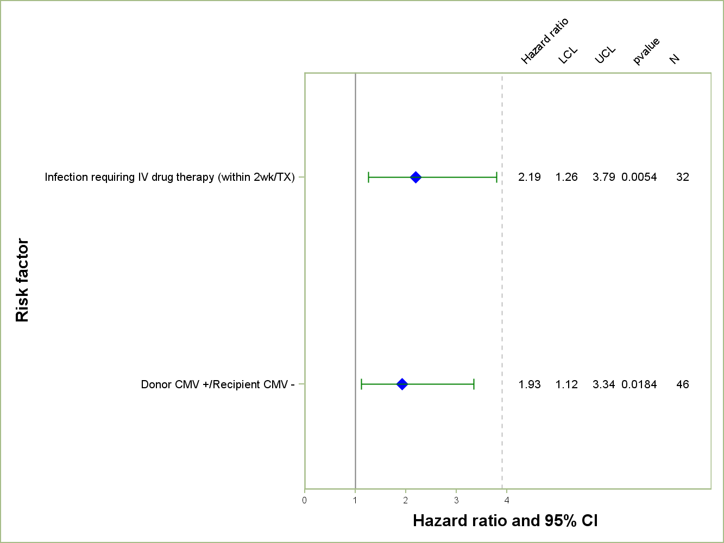
Pediatric Heart Retransplants (January 1998 – December 2007)
Risk Factors For 5 Year Mortality after Retransplant
2014
Reference group = Cardiomyopathy, no devices
N = 255
JHLT. 2014 Oct; 33(10): 985-995
Notes:
Multivariable analysis was performed using a proportional hazards model censoring all patients at 5 years. Continuous factors were fit using a restricted cubic spline.
Analyses were limited to transplants having essentially complete information regarding risk factors.

Slide 178
Pediatric Heart Retransplants (January 1998 – December 2007)
Risk Factors For 5 Year Mortality After Retransplant
Continuous Factors (see figures)
Recipient BSA | Days between primary and retransplant
Donor height/recipient height ratio
2014
JHLT. 2014 Oct; 33(10): 985-995
Notes:
Multivariable analysis was performed using a proportional hazards model censoring all patients at 5 years. Continuous factors were fit using a restricted cubic spline.
Analyses were limited to transplants having essentially complete information regarding risk factors.

Slide 179
Pediatric Heart Retransplants (January 1998 – December 2007)
Risk Factors For 5 Year Mortality with 95% Confidence Limits
Recipient BSA
p = 0.0434
2014
(N = 255)
JHLT. 2014 Oct; 33(10): 985-995
Notes:
Multivariable analysis was performed using a proportional hazards model censoring all patients at 5 years. Continuous factors were fit using a restricted cubic spline.
Analyses were limited to transplants having essentially complete information regarding risk factors.

Slide 180
Pediatric Heart Retransplants (January 1998 – December 2007)
Risk Factors For 5 Year Mortality with 95% Confidence Limits
Donor/Recipient Height Ratio
p = 0.0232
2014
(N = 255)
JHLT. 2014 Oct; 33(10): 985-995
Notes:
Multivariable analysis was performed using a proportional hazards model censoring all patients at 1 year. Continuous factors were fit using a restricted cubic spline.
Analyses were limited to transplants having essentially complete information regarding risk factors.

Slide 181
Pediatric Heart Retransplants (January 1998 – December 2007)
Risk Factors For 5 Year Mortality with 95% Confidence Limits
Days between Primary Transplant and Retransplant
p = 0.0064
2014
(N = 255)
JHLT. 2014 Oct; 33(10): 985-995
Notes:
Multivariable analysis was performed using a proportional hazards model censoring all patients at 1 year. Continuous factors were fit using a restricted cubic spline.
Analyses were limited to transplants having essentially complete information regarding risk factors.

