Slide 1

LUNG TRANSPLANTATION
Adult Recipients
2014
JHLT. 2014 Oct; 33(10): 1009-1024

Slide 2
Table of Contents
Donor, recipient and center characteristics: slides 3-24
Post transplant survival and rejection: slides 25-56
Functional and employment status and rehospitalization post transplant: slides 58-61
Induction and maintenance immunosuppression: slides 62-84
Post transplant morbidities: slides 85-107
Multivariable analyses: slides 108-169
2014
JHLT. 2014 Oct; 33(10): 1009-1024

Slide 3
Donor, Recipient and Center Characteristics
2014
JHLT. 2014 Oct; 33(10): 1009-1024

Slide 4
Adult Lung Retransplants
Retransplants by Year and Location
2014
JHLT. 2014 Oct; 33(10): 1009-1024

Slide 5
Adult Lung Retransplants
Retransplants by Inter-transplant Interval
(Retransplants: January 1990 – June 2013)
2014
JHLT. 2014 Oct; 33(10): 1009-1024

Slide 6
Adult Lung Transplants
Average Center Volume by Location
(Transplants: January 2000 – June 2013)
2014
JHLT. 2014 Oct; 33(10): 1009-1024

Slide 7
Adult Lung Transplants
Average Center Volume by Location
(Transplants: January 2008 – June 2013)
2014
JHLT. 2014 Oct; 33(10): 1009-1024

Slide 8
Adult Lung Transplants
Indications (Transplants: January 1995 – June 2013)
Diagnosis | SLT (N = 15,321) | BLT (N = 26,579) | TOTAL (N = 41,900)
COPD/Emphysema | 6,594 ( 43.0%) | 7,078 ( 26.6%) | 13,672 ( 32.6%)
Idiopathic Pulmonary Fibrosis | 5,354 ( 34.9%) | 4,825 ( 18.2%) | 10,179 ( 24.3%)
Cystic Fibrosis | 234 ( 1.5%) | 6,628 ( 24.9%) | 6,862 ( 16.4%)
Alpha-1 | 771 ( 5.0%) | 1,572 ( 5.9%) | 2,343 ( 5.6%)
Idiopathic Pulmonary Arterial Hypertension | 92 ( 0.6%) | 1,158 ( 4.4%) | 1,250 ( 3.0%)
Pulmonary Fibrosis, Other | 677 ( 4.4%) | 970 ( 3.6%) | 1,647 ( 3.9%)
Bronchiectasis | 62 ( 0.4%) | 1,069 ( 4.0%) | 1,131 ( 2.7%)
Sarcoidosis | 280 ( 1.8%) | 776 ( 2.9%) | 1,056 ( 2.5%)
Retransplant: Obliterative Bronchiolitis | 312 ( 2.0%) | 379 ( 1.4%) | 691 ( 1.6%)
Connective Tissue Disease | 177 ( 1.2%) | 409 ( 1.5%) | 586 ( 1.4%)
Obliterative Bronchiolitis (Not Retransplant) | 105 ( 0.7%) | 351 ( 1.3%) | 456 ( 1.1%)
LAM | 138 ( 0.9%) | 302 ( 1.1%) | 440 ( 1.1%)
Retransplant: Not Obliterative Bronchiolitis | 205 ( 1.3%) | 227 ( 0.9%) | 432 ( 1.0%)
Congenital Heart Disease | 58 ( 0.4%) | 291 ( 1.1%) | 349 ( 0.8%)
Cancer | 7 ( 0.0%) | 29 ( 0.1%) | 36 ( 0.1%)
Other | 255 ( 1.7%) | 515 ( 1.9%) | 770 ( 1.8%)
2014
For some retransplants, diagnosis other than retransplant was reported, so the total number and percentage of retransplants may be greater.
JHLT. 2014 Oct; 33(10): 1009-1024
Notes:
Transplants with unknown diagnoses are excluded from this tabulation.

Slide 9
Adult Lung Transplants
Distribution of Procedure Type for Major Indications by Year
Year of TX | Alpha-1 |  | COPD |  | Cystic Fibrosis |  | IPF |  | IPAH
 | Double | Single | Double | Single | Double | Single | Double | Single | Double | Single
1998 | 49.3 | 50.7 | 29.8 | 70.2 | 93.6 | 6.4 | 19.2 | 80.8 | 87.0 | 13.0
1999 | 46.6 | 53.4 | 28.1 | 71.9 | 91.3 | 8.7 | 23.3 | 76.7 | 86.4 | 13.6
2000 | 57.9 | 42.1 | 29.3 | 70.7 | 93.9 | 6.1 | 30.9 | 69.1 | 93.0 | 7.0
2001 | 60.1 | 39.9 | 30.0 | 70.0 | 93.8 | 6.2 | 31.4 | 68.6 | 89.8 | 10.2
2002 | 56.6 | 43.4 | 38.9 | 61.1 | 96.2 | 3.8 | 35.1 | 64.9 | 87.9 | 12.1
2003 | 65.7 | 34.3 | 43.0 | 57.0 | 95.6 | 4.4 | 41.6 | 58.4 | 95.5 | 4.5
2004 | 73.4 | 26.6 | 45.9 | 54.1 | 96.3 | 3.7 | 44.7 | 55.3 | 94.4 | 5.6
2005 | 77.0 | 23.0 | 49.0 | 51.0 | 97.3 | 2.7 | 46.0 | 54.0 | 92.4 | 7.6
2006 | 71.8 | 28.2 | 58.2 | 41.8 | 98.5 | 1.5 | 47.6 | 52.4 | 100.0 | 0.0
2007 | 81.7 | 18.3 | 63.4 | 36.6 | 97.6 | 2.4 | 49.4 | 50.6 | 94.7 | 5.3
2008 | 80.2 | 19.8 | 65.4 | 34.6 | 98.6 | 1.4 | 52.0 | 48.0 | 94.1 | 5.9
2009 | 86.7 | 13.3 | 66.3 | 33.7 | 99.6 | 0.4 | 51.8 | 48.2 | 97.3 | 2.7
2010 | 85.8 | 14.2 | 70.3 | 29.7 | 99.4 | 0.6 | 55.8 | 44.2 | 94.7 | 5.3
2011 | 87.7 | 12.3 | 72.8 | 27.2 | 98.6 | 1.4 | 54.5 | 45.5 | 96.8 | 3.2
2012 | 92.1 | 7.9 | 73.9 | 26.1 | 98.4 | 1.6 | 60.1 | 39.9 | 95.0 | 5.0
2014
JHLT. 2014 Oct; 33(10): 1009-1024

Slide 10
Adult Lung Transplants
Procedure Type within Indication, by Year
2014
JHLT. 2014 Oct; 33(10): 1009-1024

Slide 11
Adult Lung Transplants
Indications for Single Lung Transplants
(Transplants: January 1995 – June 2013)
2014
For some retransplants, diagnosis other than retransplant was reported, so the total percentage of retransplants may be greater.
JHLT. 2014 Oct; 33(10): 1009-1024

Slide 12
Adult Lung Transplants
Indications for Bilateral/Double Lung Transplants
(Transplants: January 1995 – June 2013)
2014
For some retransplants, diagnosis other than retransplant was reported, so the total percentage of retransplants may be greater.
JHLT. 2014 Oct; 33(10): 1009-1024

Slide 13
Adult Lung Transplants
Major Indications by Year (%)
2014
For some retransplants, diagnosis other than retransplant was reported, so the total percentage of retransplants may be greater.
JHLT. 2014 Oct; 33(10): 1009-1024

Slide 14
Adult Lung Transplants
Major Indications by Year (Number)
2014
For some retransplants, diagnosis other than retransplant was reported, so the total number of retransplants may be greater.
JHLT. 2014 Oct; 33(10): 1009-1024

Slide 15
Adult Lung Transplants
Diagnosis Distribution by Location
(Transplants: January 2000 – June 2013)
2014
For some retransplants, diagnosis other than retransplant was reported, so the total percentage of retransplants may be greater.
JHLT. 2014 Oct; 33(10): 1009-1024
Notes:
Transplants with unknown diagnoses are excluded from this tabulation.

Slide 16
Adult Lung Transplants
Diagnosis Distribution by Location and Era
(Transplants: January 2000 – June 2013)
2014
For some retransplants, diagnosis other than retransplant was reported, so the total percentage of retransplants may be greater.
JHLT. 2014 Oct; 33(10): 1009-1024
Notes:
Transplants with unknown diagnoses are excluded from this tabulation.

Slide 17
Adult Lung Transplants
Recipient Characteristics by Transplant Type
(Transplants: January 2000 – June 2013)
 |  | Primary (N=34,408) | First Retransplant (N=1,443) | p-value
Recipient age (years) |  | 55.0 (23.0 - 67.0) | 46.0 (21.0 - 65.0) | <0.0001
Recipient gender | Male | 56.3% | 53.4% | 0.0330
 | Female | 43.7% | 46.6%
Diagnosis | Alpha-1 | 5.0% | 1.2% | <0.0001
 | COPD | 32.9% | 5.7%
 | CF | 16.6% | 6.5%
 | IPF | 26.5% | 7.6%
 | IPAH | 2.7% | 1.4%
 | Retx | 0.0% | 65.9%
 | Other | 16.4% | 11.6%
Location | Europe | 36.4% | 38.8% | 0.0714
 | North America | 56.9% | 55.6%
 | Other | 6.7% | 5.5%
2014
Age is expressed as median (5th-95th percentiles)
JHLT. 2014 Oct; 33(10): 1009-1024
Notes:
Comparisons for categorical variables were made using the chi-square statistic. Multiple groups were compared using single p-value. A significant p-value means that at least one of the groups is different than the others but it doesn’t identify which group it is.
Comparisons for continuous variables were made using Wilcoxon–Mann–Whitney test.

Slide 18
Adult Lung Transplants
Donor and Donor/Recipient Characteristics by Transplant Type (Transplants: January 2000 – June 2013)
 |  | Primary (N=34,408) | First Retransplant* (N=1,443) | p-value
Donor age (years) |  | 38.0 (16.0 - 61.0) | 38.0 (16.0 - 62.0) | 0.7457
Donor/recipient CMV status | D(-)/R(-) | 17.5% | 11.8% | <0.0001
 | D(-)/R(+) | 21.8% | 19.4%
 | D(+)/R(-) | 24.2% | 20.0%
 | D(+)/R(+) | 36.4% | 48.8%
Donor cause of death | Head Trauma | 40.2% | 42.7% | 0.1879
 | Stroke | 39.8% | 37.3%
 | Other | 20.0% | 20.0%
2014
Age is expressed as median (5th-95th percentiles)
* at time of retransplant
JHLT. 2014 Oct; 33(10): 1009-1024
Notes:
Comparisons for categorical variables were made using the chi-square statistic. Multiple groups were compared using single p-value. A significant p-value means that at least one of the groups is different than the others but it doesn’t identify which group it is.
Comparisons for continuous variables were made using Wilcoxon–Mann–Whitney test.

Slide 19
Adult Lung Transplants
Transplant Type Distribution by Era
(Transplants: January 1990 – June 2013)
2014
JHLT. 2014 Oct; 33(10): 1009-1024

Slide 20
Adult Lung Transplants
Transplant Type Distribution by Recipient Age Group
(Transplants: January 1990 – June 2013)
2014
JHLT. 2014 Oct; 33(10): 1009-1024

Slide 21
Adult Lung Transplants
Transplant Type Distribution by Recipient Age Group
(Transplants: January 2005 – June 2013)
2014
JHLT. 2014 Oct; 33(10): 1009-1024

Slide 22
Adult Lung Transplants
Transplant Type Distribution by Recipient Gender
(Transplants: January 1990 – June 2013)
2014
JHLT. 2014 Oct; 33(10): 1009-1024

Slide 23
Adult Lung Transplants
Transplant Type Distribution by Diagnosis
(Transplants: January 1990 – June 2013)
2014
JHLT. 2014 Oct; 33(10): 1009-1024

Slide 24
Adult Lung Transplants
Transplant Type Distribution by Location
(Transplants: January 1990 – June 2013)
2014
JHLT. 2014 Oct; 33(10): 1009-1024

Slide 25
Post Transplant Survival and Rejection
2014
JHLT. 2014 Oct; 33(10): 1009-1024

Slide 26
Adult Lung Transplants
Kaplan-Meier Survival (Transplants: January 1990 – June 2012)
2014
JHLT. 2014 Oct; 33(10): 1009-1024
Notes:
Survival was calculated using the Kaplan-Meier method, which incorporates information from all transplants for whom any follow-up has been provided. Since many patients are still alive and some patients have been lost to follow-up, the survival rates are estimates rather than exact rates because the time of death is not known for all patients. Therefore, 95% confidence limits are provided about the survival rate estimate; the survival rate shown is the best estimate but the true rate will most likely fall within these limits.
The median survival is the estimated time point at which 50% of all of the recipients have died.

Slide 27
Adult Lung Transplants
Kaplan-Meier Survival Conditional on Survival to 1 Year (Transplants: January 1990 – June 2012)
2014
JHLT. 2014 Oct; 33(10): 1009-1024
Notes:
Survival was calculated using the Kaplan-Meier method, which incorporates information from all transplants for whom any follow-up has been provided. Since many patients are still alive and some patients have been lost to follow-up, the survival rates are estimates rather than exact rates because the time of death is not known for all patients. Therefore, 95% confidence limits are provided about the survival rate estimate; the survival rate shown is the best estimate but the true rate will most likely fall within these limits.
The conditional median survival is the estimated time point at which 50% of the recipients who survive to at least 1 year have died. Because the decline in survival is greatest during the first year following transplantation, the conditional survival provides a more realistic expectation of survival time for recipients who survive the early post-transplant period.

Slide 28
Adult Lung Transplants
Kaplan-Meier Survival by Procedure Type
(Transplants: January 1994 – June 2012)
p < 0.0001
2014
JHLT. 2014 Oct; 33(10): 1009-1024
Notes:
Survival was calculated using the Kaplan-Meier method, which incorporates information from all transplants for whom any follow-up has been provided. Since many patients are still alive and some patients have been lost to follow-up, the survival rates are estimates rather than exact rates because the time of death is not known for all patients.
The median survival is the estimated time point at which 50% of all of the recipients have died. The conditional median survival is the estimated time point at which 50% of the recipients who survive to at least 1 year have died. Because the decline in survival is greatest during the first year following transplantation, the conditional survival provides a more realistic expectation of survival time for recipients who survive the early post-transplant period.
Survival rates were compared using the log-rank test statistic.

Slide 29
Adult Lung Retransplants
Kaplan-Meier Survival (Retransplants: January 1982 – June 2011)
2014
JHLT. 2014 Oct; 33(10): 1009-1024
Notes:
Survival was calculated using the Kaplan-Meier method, which incorporates information from all transplants for whom any follow-up has been provided. Since many patients are still alive and some patients have been lost to follow-up, the survival rates are estimates rather than exact rates because the time of death is not known for all patients. Therefore, 95% confidence limits are provided about the survival rate estimate; the survival rate shown is the best estimate but the true rate will most likely fall within these limits.
The median survival is the estimated time point at which 50% of all of the recipients have died. The conditional median survival is the estimated time point at which 50% of the recipients who survive to at least 1 year have died. Because the decline in survival is greatest during the first year following transplantation, the conditional survival provides a more realistic expectation of survival time for recipients who survive the early post-transplant period.

Slide 30
Adult Lung Transplants
Kaplan-Meier Survival by Transplant Type
(Transplants: January 1990 – June 2012)
p < 0.0001
2014
JHLT. 2014 Oct; 33(10): 1009-1024
Notes:
Survival was calculated using the Kaplan-Meier method, which incorporates information from all transplants for whom any follow-up has been provided. Since many patients are still alive and some patients have been lost to follow-up, the survival rates are estimates rather than exact rates because the time of death is not known for all patients.
The median survival is the estimated time point at which 50% of all of the recipients have died. The conditional median survival is the estimated time point at which 50% of the recipients who survive to at least 1 year have died. Because the decline in survival is greatest during the first year following transplantation, the conditional survival provides a more realistic expectation of survival time for recipients who survive the early post-transplant period.
Survival rates were compared using the log-rank test statistic. Adjustments for multiple comparisons were done using Scheffe’s method.

Slide 31
Adult Lung Transplants
Kaplan-Meier Survival by Inter-transplant Interval
(Transplants: January 1990 – June 2012)
All pair-wise comparisons were significant at p < 0.05 except Primary vs. 5+ years, 1 month–<1 year vs. 1-<3 years, 1 month-<1 year vs. 3-<5 years, 1-<3 years vs. 3-<5 years and 3-<5 years vs. 5+ years
2014
Retransplants are limited to first retransplant recipients
JHLT. 2014 Oct; 33(10): 1009-1024
Notes:
Survival was calculated using the Kaplan-Meier method, which incorporates information from all transplants for whom any follow-up has been provided. Since many patients are still alive and some patients have been lost to follow-up, the survival rates are estimates rather than exact rates because the time of death is not known for all patients.
Survival rates were compared using the log-rank test statistic. Adjustments for multiple comparisons were done using Scheffe’s method.

Slide 32
Adult Lung Transplants
Kaplan-Meier Survival by Era
(Transplants: January 1990 – June 2012)
All pair-wise comparisons were significant at p <0.001
2014
JHLT. 2014 Oct; 33(10): 1009-1024
Notes:
Survival was calculated using the Kaplan-Meier method, which incorporates information from all transplants for whom any follow-up has been provided. Since many patients are still alive and some patients have been lost to follow-up, the survival rates are estimates rather than exact rates because the time of death is not known for all patients.
The median survival is the estimated time point at which 50% of all of the recipients have died. The conditional median survival is the estimated time point at which 50% of the recipients who survive to at least 1 year have died. Because the decline in survival is greatest during the first year following transplantation, the conditional survival provides a more realistic expectation of survival time for recipients who survive the early post-transplant period.
Survival rates were compared using the log-rank test statistic. Adjustments for multiple comparisons were done using Scheffe’s method.

Slide 33
Adult Lung Transplants
Kaplan-Meier Survival by Era and Transplant Type
(Transplants: January 1990 – June 2012)
All pair-wise comparisons between transplant types within each era and between eras within each transplant type were significant at p < 0.05 except for
Retx: 1990-1997 vs. 1998-2004
Retx: 1998-2004 vs. 2005-6/2012
2014
JHLT. 2014 Oct; 33(10): 1009-1024
Notes:
Survival was calculated using the Kaplan-Meier method, which incorporates information from all transplants for whom any follow-up has been provided. Since many patients are still alive and some patients have been lost to follow-up, the survival rates are estimates rather than exact rates because the time of death is not known for all patients. The median survival is the estimated time point at which 50% of all of the recipients have died.
Survival rates were compared using the log-rank test statistic. Adjustments for multiple comparisons were done using Bonferroni method.

Slide 34
Adult Lung Transplants
Kaplan-Meier Survival by Transplant Type and Age Group
(Transplants: January 1990 – June 2012)
All pair-wise comparisons between transplant types within each age group and between age groups for primary transplants were significant at p < 0.05. No pair-wise comparisons between age groups for first retransplants were significant at p < 0.05 except 18-34 vs. 60+ and 35-49 vs. 60+.
2014
JHLT. 2014 Oct; 33(10): 1009-1024
Notes:
Survival was calculated using the Kaplan-Meier method, which incorporates information from all transplants for whom any follow-up has been provided. Since many patients are still alive and some patients have been lost to follow-up, the survival rates are estimates rather than exact rates because the time of death is not known for all patients. The median survival is the estimated time point at which 50% of all of the recipients have died.
Survival rates were compared using the log-rank test statistic. Adjustments for multiple comparisons were done using Bonferroni method. Results of log-rank test should be interpreted with caution when curves cross.

Slide 35
Adult Lung Transplants
Kaplan-Meier Survival by Gender
(Transplants: January 1990 – June 2012)
p < 0.0001
N at risk = 88
N at risk = 78
2014
JHLT. 2014 Oct; 33(10): 1009-1024
Notes:
Survival was calculated using the Kaplan-Meier method, which incorporates information from all transplants for whom any follow-up has been provided. Since many patients are still alive and some patients have been lost to follow-up, the survival rates are estimates rather than exact rates because the time of death is not known for all patients. The median survival is the estimated time point at which 50% of all of the recipients have died.
Survival rates were compared using the log-rank test statistic.

Slide 36
Adult Lung Transplants
Kaplan-Meier Survival by Transplant Type and Gender
(Transplants: January 1990 – June 2012)
All pair-wise comparisons were significant at p < 0.05 except
Retx: male vs. female
2014
JHLT. 2014 Oct; 33(10): 1009-1024
Notes:
Survival was calculated using the Kaplan-Meier method, which incorporates information from all transplants for whom any follow-up has been provided. Since many patients are still alive and some patients have been lost to follow-up, the survival rates are estimates rather than exact rates because the time of death is not known for all patients. The median survival is the estimated time point at which 50% of all of the recipients have died.
Survival rates were compared using the log-rank test statistic. Adjustments for multiple comparisons were done using Scheffe’s method.

Slide 37
Adult Lung Transplants
Kaplan-Meier Survival by Diagnosis
(Transplants: January 1990 – June 2012)
All pair-wise comparisons with CF were significant at p < 0.0001
Alpha-1 vs. COPD: p < 0.0001
Alpha-1 vs. IPF: p < 0.0001
COPD vs. IPF: p < 0.001
IPF vs. IPAH: p = 0.0362
2014
JHLT. 2014 Oct; 33(10): 1009-1024
Notes:
Survival was calculated using the Kaplan-Meier method, which incorporates information from all transplants for whom any follow-up has been provided. Since many patients are still alive and some patients have been lost to follow-up, the survival rates are estimates rather than exact rates because the time of death is not known for all patients. The median survival is the estimated time point at which 50% of all of the recipients have died.
Survival rates were compared using the log-rank test statistic. Adjustments for multiple comparisons were done using Scheffe’s method. Results of log-rank test should be interpreted with caution when curves cross. Only pair-wise comparisons statistically significant at p < 0.05 are shown on the slide.

Slide 38
Adult Lung Transplants
Kaplan-Meier Survival by Transplant Type and Diagnosis
(Transplants: January 1990 – June 2012)
All pair-wise comparisons between transplant types within COPD and CF and between diagnoses for primary transplants were significant at p < 0.001. No other pair-wise comparisons within diagnosis or transplant type were significant at < 0.05
2014
JHLT. 2014 Oct; 33(10): 1009-1024
Notes:
Survival was calculated using the Kaplan-Meier method, which incorporates information from all transplants for whom any follow-up has been provided. Since many patients are still alive and some patients have been lost to follow-up, the survival rates are estimates rather than exact rates because the time of death is not known for all patients. The median survival is the estimated time point at which 50% of all of the recipients have died.
Survival rates were compared using the log-rank test statistic. Adjustments for multiple comparisons were done using Bonferroni method.

Slide 39
Adult Lung Transplants
Kaplan-Meier Survival by Diagnosis Conditional on
Survival to 3 Months (Transplants: January 1990 – June 2012)
All pair-wise comparisons were significant at p < 0.05 except
Alpha-1 vs. Sarcoidosis, COPD vs. IPF, CF vs. IPAH and IPAH vs. Sarcoidosis
2014
JHLT. 2014 Oct; 33(10): 1009-1024
Notes:
Survival was calculated using the Kaplan-Meier method, which incorporates information from all transplants for whom any follow-up has been provided. Since many patients are still alive and some patients have been lost to follow-up, the survival rates are estimates rather than exact rates because the time of death is not known for all patients. This figure shows survival conditional on survival to 3 months. Therefore, only patients surviving to at least 3 months were included in the calculation. The conditional median survival is the estimated time point at which 50% of the recipients who survive to at least 3 months have died.
Survival rates were compared using the log-rank test statistic. Adjustments for multiple comparisons were done using Scheffe’s method.

Slide 40
Adult Lung Transplants
Kaplan-Meier Survival by Transplant Type and Diagnosis Conditional on Survival to 3 Months (Transplants: January 1990 – June 2012)
No pair-wise comparisons between transplant types within each diagnosis and between diagnoses within each transplant type were significant at p < 0.05 except Primary: CF vs. COPD and Primary: CF vs. IPF
2014
JHLT. 2014 Oct; 33(10): 1009-1024
Notes:
Survival was calculated using the Kaplan-Meier method, which incorporates information from all transplants for whom any follow-up has been provided. Since many patients are still alive and some patients have been lost to follow-up, the survival rates are estimates rather than exact rates because the time of death is not known for all patients. This figure shows survival conditional on survival to 3 months. Therefore, only patients surviving to at least 3 months were included in the calculation. The conditional median survival is the estimated time point at which 50% of the recipients who survive to at least 3 months have died.
Survival rates were compared using the log-rank test statistic. Adjustments for multiple comparisons were done using Bonferroni method.

Slide 41
Adult Lung Transplants
Kaplan-Meier Survival by Diagnosis Conditional on
Survival to 1 Year (Transplants: January 1990 – June 2012)
All pair-wise comparisons were significant at p < 0.05 except CF vs. IPAH, COPD vs. IPF and IPAH vs. Sarcoidosis
2014
JHLT. 2014 Oct; 33(10): 1009-1024
Notes:
Survival was calculated using the Kaplan-Meier method, which incorporates information from all transplants for whom any follow-up has been provided. Since many patients are still alive and some patients have been lost to follow-up, the survival rates are estimates rather than exact rates because the time of death is not known for all patients. This figure shows survival conditional on survival to 12 months. Therefore, only patients surviving to at least 12 months were included in the calculation. The conditional median survival is the estimated time point at which 50% of the recipients who survive to at least 12 months have died.
Survival rates were compared using the log-rank test statistic. Adjustments for multiple comparisons were done using Scheffe’s method.

Slide 42
Adult Lung Transplants
Kaplan-Meier Survival by Procedure Type
(Transplants: January 1990 – June 2012)
Diagnosis: Alpha-1 Antitrypsin Deficiency
p < 0.0001
2014
JHLT. 2014 Oct; 33(10): 1009-1024
Notes:
Survival was calculated using the Kaplan-Meier method, which incorporates information from all transplants for whom any follow-up has been provided. Since many patients are still alive and some patients have been lost to follow-up, the survival rates are estimates rather than exact rates because the time of death is not known for all patients.
Survival rates were compared using the log-rank test statistic.

Slide 43
Adult Lung Transplants
Kaplan-Meier Survival by Procedure Type
(Transplants: January 1990 – June 2012)
Diagnosis: COPD/Emphysema
p < 0.0001
2014
JHLT. 2014 Oct; 33(10): 1009-1024
Notes:
Survival was calculated using the Kaplan-Meier method, which incorporates information from all transplants for whom any follow-up has been provided. Since many patients are still alive and some patients have been lost to follow-up, the survival rates are estimates rather than exact rates because the time of death is not known for all patients.
Survival rates were compared using the log-rank test statistic.

Slide 44
Adult Lung Transplants
Kaplan-Meier Survival by Procedure Type and Era
(Transplants: January 1990 – June 2012)
Diagnosis: COPD/Emphysema, Single Lung
1990-1997 vs. 1998-2004: p < 0.0001
1990-1997 vs. 2005-6/2012: p < 0.0001
1998-2004 vs. 2005-6/2012: p = 0.9981
2014
JHLT. 2014 Oct; 33(10): 1009-1024
Notes:
Survival was calculated using the Kaplan-Meier method, which incorporates information from all transplants for whom any follow-up has been provided. Since many patients are still alive and some patients have been lost to follow-up, the survival rates are estimates rather than exact rates because the time of death is not known for all patients.
Survival rates were compared using the log-rank test statistic. Adjustments for multiple comparisons were done using Scheffe’s method.

Slide 45
Adult Lung Transplants
Kaplan-Meier Survival by Procedure Type and Era
(Transplants: January 1990 – June 2012)
Diagnosis: COPD/Emphysema, Bilateral/Double Lung
1990-1997 vs. 1998-2004: p = 0.0131
1990-1997 vs. 2005-6/2012: p = 0.0031
1998-2004 vs. 2005-6/2012: p = 0.7588
2014
JHLT. 2014 Oct; 33(10): 1009-1024
Notes:
Survival was calculated using the Kaplan-Meier method, which incorporates information from all transplants for whom any follow-up has been provided. Since many patients are still alive and some patients have been lost to follow-up, the survival rates are estimates rather than exact rates because the time of death is not known for all patients.
Survival rates were compared using the log-rank test statistic. Adjustments for multiple comparisons were done using Scheffe’s method.

Slide 46
Adult Lung Transplants
Kaplan-Meier Survival by Procedure Type
(Transplants: January 1990 – June 2012)
Diagnosis: Idiopathic Pulmonary Fibrosis
p < 0.0001
2014
JHLT. 2014 Oct; 33(10): 1009-1024
Notes:
Survival was calculated using the Kaplan-Meier method, which incorporates information from all transplants for whom any follow-up has been provided. Since many patients are still alive and some patients have been lost to follow-up, the survival rates are estimates rather than exact rates because the time of death is not known for all patients.
Survival rates were compared using the log-rank test statistic.

Slide 47
Adult Lung Transplants
Kaplan-Meier Survival by Procedure Type and Era
(Transplants: January 1990 – June 2012)
Diagnosis: Idiopathic Pulmonary Fibrosis, Single Lung
1990-1997 vs. 1998-2004: p = 0.0154
1990-1997 vs. 2005-6/2012: p = 0.0044
1998-2004 vs. 2005-6/2012: p = 0.7211
2014
JHLT. 2014 Oct; 33(10): 1009-1024
Notes:
Survival was calculated using the Kaplan-Meier method, which incorporates information from all transplants for whom any follow-up has been provided. Since many patients are still alive and some patients have been lost to follow-up, the survival rates are estimates rather than exact rates because the time of death is not known for all patients.
Survival rates were compared using the log-rank test statistic. Adjustments for multiple comparisons were done using Scheffe’s method.

Slide 48
Adult Lung Transplants
Kaplan-Meier Survival by Procedure Type and Era
(Transplants: January 1990 – June 2012)
Diagnosis: Idiopathic Pulmonary Fibrosis, Bilateral/Double Lung
1990-1997 vs. 1998-2004: p = 0.0022
1990-1997 vs. 2005-6/2012: p < 0.0001
1998-2004 vs. 2005-6/2012: p = 0.0035
2014
JHLT. 2014 Oct; 33(10): 1009-1024
Notes:
Survival was calculated using the Kaplan-Meier method, which incorporates information from all transplants for whom any follow-up has been provided. Since many patients are still alive and some patients have been lost to follow-up, the survival rates are estimates rather than exact rates because the time of death is not known for all patients.
Survival rates were compared using the log-rank test statistic. Adjustments for multiple comparisons were done using Scheffe’s method.

Slide 49
Adult Lung Transplants
Kaplan-Meier Survival by Procedure Type
(Transplants: January 1990 – June 2012)
Diagnosis: Idiopathic Arterial Pulmonary Hypertension
p < 0.0001
2014
JHLT. 2014 Oct; 33(10): 1009-1024
Notes:
Survival was calculated using the Kaplan-Meier method, which incorporates information from all transplants for whom any follow-up has been provided. Since many patients are still alive and some patients have been lost to follow-up, the survival rates are estimates rather than exact rates because the time of death is not known for all patients.
Survival rates were compared using the log-rank test statistic.

Slide 50
Adult Lung Transplants
Kaplan-Meier Survival by Procedure Type and Era
(Transplants: January 1990 – June 2012)
Diagnosis: Cystic Fibrosis, Bilateral/Double Lung
1990-1997 vs. 1998-2004: p < 0.0001
1990-1997 vs. 2005-6/2012: p < 0.0001
1998-2004 vs. 2005-6/2012: p = 0.0032
2014
JHLT. 2014 Oct; 33(10): 1009-1024
Notes:
Survival was calculated using the Kaplan-Meier method, which incorporates information from all transplants for whom any follow-up has been provided. Since many patients are still alive and some patients have been lost to follow-up, the survival rates are estimates rather than exact rates because the time of death is not known for all patients.
Survival rates were compared using the log-rank test statistic. Adjustments for multiple comparisons were done using Scheffe’s method.

Slide 51
Adult Lung Transplants
Percentage Experiencing Treated Rejection between Discharge and 1-Year Follow-Up (Follow-ups: July 2004 – June 2013)
No pair-wise comparisons were significant at < 0.05 except 18-34 vs. 35-49 and 18-34 vs. 60-65
Analysis is limited to patients who were alive at the time of the follow-up
Treated rejection = Recipient was reported to (1) have at least one acute rejection episode that was treated with an anti-rejection agent; or (2) have been hospitalized for rejection.
2014
JHLT. 2014 Oct; 33(10): 1009-1024
Notes:
Comparisons were made using the chi-square statistic. Adjustments for multiple comparisons were done using Bonferroni method.
Ns represent those at risk for rejection.

Slide 52
Adult Lung Transplants
Percentage Experiencing Any Rejection between Discharge and 1-Year Follow-Up (Follow-ups: July 2004 – June 2013)
No pair-wise comparisons were significant at < 0.05 except 18-34 vs. 35-49 and 18-34 vs. 60-65
Analysis is limited to patients who were alive at the time of the follow-up
No rejection = Recipient had (i) no acute rejection episodes and (ii) was reported either as not hospitalized for rejection or did not receive anti-rejection agents.
2014
JHLT. 2014 Oct; 33(10): 1009-1024
Notes:
Comparisons were made using the chi-square statistic. Adjustments for multiple comparisons were done using Bonferroni method.
N represents those at risk for rejection.

Slide 53
Adult Lung Transplants
Percentage Experiencing Treated Rejection between Discharge and 1-Year Follow-Up (Follow-ups: July 2004 – June 2013)
No pair-wise comparisons were significant at < 0.05
Analysis is limited to patients who were alive at the time of the follow-up
Treated rejection = Recipient was reported to (1) have at least one acute rejection episode that was treated with an anti-rejection agent; or (2) have been hospitalized for rejection.
2014
JHLT. 2014 Oct; 33(10): 1009-1024
Notes:
Comparisons were made using the chi-square statistic. Adjustments for multiple comparisons were done using Bonferroni method.
N represents those at risk for rejection.

Slide 54
Adult Lung Transplants
Kaplan-Meier Survival by Donor/Recipient CMV Status
(Transplants: October 1999 – June 2012)
All pair-wise comparisons were significant at p < 0.05 except D(+)/R(-) vs. D(+)/R(+)
2014
JHLT. 2014 Oct; 33(10): 1009-1024
Notes:
Survival was calculated using the Kaplan-Meier method, which incorporates information from all transplants for whom any follow-up has been provided. Since many patients are still alive and some patients have been lost to follow-up, the survival rates are estimates rather than exact rates because the time of death is not known for all patients.
Survival rates were compared using the log-rank test statistic. Adjustments for multiple comparisons were done using Scheffe’s method.

Slide 55
Adult Lung Transplants
Kaplan-Meier Survival by Donor/Recipient CMV Status and Era (Transplants: October 1999 – June 2012)
Era 1 = 10/1999-2004; Era 2 = 2005-6/2012
No pair-wise comparisons between eras within each CMV group and between CMV groups within each era were significant at p<0.05 except
10/1999-2004: D(-)/R(-) vs. D(+)/R(-) and D(-)/R(-) vs. D(+)/R(+)
2005-6/2012: D(-)/R(-) vs. D(+)/R(-), D(-)/R(-) vs. D(+)/R(+) and D(-)/R(+) vs. D(+)/R(-)
2014
JHLT. 2014 Oct; 33(10): 1009-1024
Notes:
Survival was calculated using the Kaplan-Meier method, which incorporates information from all transplants for whom any follow-up has been provided. Since many patients are still alive and some patients have been lost to follow-up, the survival rates are estimates rather than exact rates because the time of death is not known for all patients.
Survival rates were compared using the log-rank test statistic. Adjustments for multiple comparisons were done using Bonferroni method.

Slide 56
Adult Lung Transplants
Percentage Experiencing Treated Rejection between Discharge and 1-Year Follow-Up by Donor/Recipient CMV Status
(Follow-ups: July 2004 – June 2013)
Analysis is limited to patients who were alive at the time of the follow-up
Treated rejection = Recipient was reported to (1) have at least one acute rejection episode that was treated with an anti-rejection agent; or (2) have been hospitalized for rejection.
2014
JHLT. 2014 Oct; 33(10): 1009-1024
Notes:
Comparisons were made using the chi-square statistic. Adjustments for multiple comparisons were done using Bonferroni method.
Ns represent those at risk for rejection.

Slide 57
Adult Lung Transplants
Percentage Experiencing Any Rejection between Discharge and 1-Year Follow-Up by Donor/Recipient CMV Status
(Follow-ups: July 2004 – June 2013)
Analysis is limited to patients who were alive at the time of the follow-up
2014
Any rejection = Recipient was reported to (1) have at least one acute rejection episode; or (2) have been hospitalized for rejection.
JHLT. 2014 Oct; 33(10): 1009-1024
Notes:
Comparisons were made using the chi-square statistic. Adjustments for multiple comparisons were done using Bonferroni method.
Ns represent those at risk for rejection.

Slide 58
Functional and Employment Status and Rehospitalization Post Transplant
2014
JHLT. 2014 Oct; 33(10): 1009-1024

Slide 59
Adult Lung Transplants
Functional Status of Surviving Recipients
(Follow-ups: March 2005 – June 2013)
2014
JHLT. 2014 Oct; 33(10): 1009-1024
Notes:
Functional status is collected using Karnofsky score for adult recipients and Lansky score for pediatric recipients.
This figure shows the functional status reported on the 1-year, 2-year and 3-year annual follow-ups. Because all follow-ups between March 2005 and June 2013 were included, the bars do not include the same patients.

Slide 60
Adult Lung Transplants
Employment Status of Surviving Recipients
(Follow-ups: April 1994 – June 2013)
2014
JHLT. 2014 Oct; 33(10): 1009-1024
Notes:
This figure shows the employment status reported on the 1-year, 3-year and 5-year annual follow-ups. Because all follow-ups between April 1994 and June 2013 were included, the bars do not include the same patients.

Slide 61
Adult Lung Transplants
Rehospitalization Post Transplant of Surviving Recipients
(Follow-ups: April 1994 – June 2013)
2014
JHLT. 2014 Oct; 33(10): 1009-1024
Notes:
This figure shows the hospitalizations reported on the 1-year, 3-year, 5-year and 10-year annual follow-ups, representing the hospitalizations between discharge and 1 year, between the 2-year and 3-year follow-up, and between the 4-year and 5-year follow-up, respectively. Because all follow-ups between April 1994 and June 2013 were included, the bars do not include the same patients.

Slide 62
Induction and Maintenance Immunosuppression
2014
JHLT. 2014 Oct; 33(10): 1009-1024

Slide 63
Adult Lung Transplants
Induction Immunosuppression
Analysis limited to patients receiving prednisone
(Transplants: January 2002 – June 2013)
2014
Analysis is limited to patients who were alive at the time of the discharge
JHLT. 2014 Oct; 33(10): 1009-1024

Slide 64
Adult Lung Transplants
Induction Immunosuppression
Analysis limited to patients receiving prednisone
(Transplants: 2002, 2006 and January 2013 – June 2013)
2014
Analysis is limited to patients who were alive at the time of the discharge
JHLT. 2014 Oct; 33(10): 1009-1024

Slide 65
Adult Lung Transplants
Induction Immunosuppression
Analysis limited to patients receiving prednisone
(Transplants: January 2000 – December 2012)
2014
Analysis is limited to patients who were alive at the time of the discharge
JHLT. 2014 Oct; 33(10): 1009-1024

Slide 66
Adult Lung Transplants
Survival by Induction Usage Conditional on Survival to 14 Days (Transplants: April 1994 – June 2012)
p < 0.0001
2014
JHLT. 2014 Oct; 33(10): 1009-1024
Notes:
Survival was calculated using the Kaplan-Meier method, which incorporates information from all transplants for whom any follow-up has been provided. Since many patients are still alive and some patients have been lost to follow-up, the survival rates are estimates rather than exact rates because the time of death is not known for all patients.
Survival rates were compared using the log-rank test statistic.

Slide 67
Adult Lung Transplants
Survival by Induction Usage Conditional on Survival to 14 Days (Transplants: January 2000 – June 2012)
p < 0.0001
2014
JHLT. 2014 Oct; 33(10): 1009-1024
Notes:
Survival was calculated using the Kaplan-Meier method, which incorporates information from all transplants for whom any follow-up has been provided. Since many patients are still alive and some patients have been lost to follow-up, the survival rates are estimates rather than exact rates because the time of death is not known for all patients.
Survival rates were compared using the log-rank test statistic.

Slide 68
Adult Lung Transplants
Maintenance Immunosuppression at Time of Follow-up
Analysis limited to patients receiving prednisone
(Follow-ups: January 2002 – June 2013)
2014
Analysis is limited to patients who were alive at the time of the follow-up
JHLT. 2014 Oct; 33(10): 1009-1024
Notes:
This figure shows the maintenance immunosuppression reported as being provided at the time of the 1-year and 5-year annual follow-up forms. To provide a snapshot of current practice, only follow-ups occurring between January 2002 and June 2013 were included. Therefore, this figure does not represent changes in practice between the 1-year follow-up and 5-year follow-up on a cohort of patients. The patients in the 1-year tabulation are not the same patients as in the 5-year tabulation.

Slide 69
Adult Lung Transplants
Maintenance Immunosuppression at Time of Follow-up
Analysis limited to patients receiving prednisone
(Follow-ups: January 2002 – June 2013)
NOTE: Different patients are analyzed in Year 1 and Year 5
2014
Analysis is limited to patients who were alive at the time of the discharge
JHLT. 2014 Oct; 33(10): 1009-1024
Notes:
This figure shows the maintenance immunosuppression reported as being provided at the time of the 1-year and 5-year annual follow-up forms. To provide a snapshot of current practice, only follow-ups occurring between January 2002 and June 2013 were included. Therefore, this figure does not represent changes in practice between the 1-year follow-up and 5-year follow-up on a cohort of patients. The patients in the 1-year tabulation are not the same patients as in the 5-year tabulation.

Slide 70
Adult Lung Transplants
Maintenance Immunosuppression at Time of 1 Year Follow-up
Analysis limited to patients receiving prednisone
(Follow-ups: 2002, 2006 and July 2011 – June 2013)
NOTE: Different patients are analyzed in each time frame
2014
Analysis is limited to patients who were alive at the time of the follow-up
JHLT. 2014 Oct; 33(10): 1009-1024
Notes:
This figure shows the maintenance immunosuppression reported as being provided at the time of the 1-year annual follow-up forms. As different patients were transplanted each year this figure does not represent changes in immunosuppression for individual patients but may represent changes in practice.

Slide 71
Adult Lung Transplants
Maintenance Immunosuppression at Time of Follow-up
Analysis limited to patients receiving prednisone
(Follow-ups: January 2002 – June 2013)
2014
Analysis is limited to patients who were alive at the time of the follow-up
JHLT. 2014 Oct; 33(10): 1009-1024
Notes:
This figure shows the maintenance immunosuppression reported as being provided at the time of the 1-year and 5-year annual follow-up forms. To provide a snapshot of current practice, only follow-ups occurring between January 2002 and June 2013 were included. Therefore, this figure does not represent changes in practice between the 1-year follow-up and 5-year follow-up on a cohort of patients. The patients in the 1-year tabulation are not the same patients as in the 5-year tabulation.

Slide 72
Adult Lung Transplants
Maintenance Immunosuppression Drug Combinations at Time of Follow-up (Follow-ups: January 2002 – June 2013)
Analysis limited to patients receiving prednisone
NOTE: Different patients are analyzed in Year 1 and Year 5
2014
Analysis is limited to patients who were alive at the time of the follow-up
JHLT. 2014 Oct; 33(10): 1009-1024
Notes:
This figure shows the maintenance immunosuppression reported as being provided at the time of the 1-year and 5-year annual follow-up forms. To provide a snapshot of current practice, only follow-ups occurring between January 2002 and June 2013 were included. Therefore, this figure does not represent changes in practice between the 1-year follow-up and 5-year follow-up on a cohort of patients. The patients in the 1-year tabulation are not the same patients as in the 5-year tabulation.

Slide 73
Adult Lung Transplants
Kaplan-Meier Survival by Maintenance Immunosuppression Combinations Conditional on Survival to 1 Year (Transplants: January 2000 – June 2012)
Analysis limited to patients receiving prednisone
p < 0.0001
2014
JHLT. 2014 Oct; 33(10): 1009-1024
Notes:
Survival was calculated using the Kaplan-Meier method, which incorporates information from all transplants for whom any follow-up has been provided. Since many patients are still alive and some patients have been lost to follow-up, the survival rates are estimates rather than exact rates because the time of death is not known for all patients. The cohorts were conditioned on survival to 1 year, so that maintenance immunosuppression combinations use during the first year could be used as a stratification factor.
Survival rates were compared using the log-rank test statistic. A significant p-value means that at least one of the groups is different than the others but it doesn’t identify which group it is.

Slide 74
Adult Lung Transplants
Kaplan-Meier Survival by Maintenance Immunosuppression Combinations Conditional on Survival to 1 Year (Transplants: January 2000 – June 2012)
Analysis limited to patients receiving prednisone
Diagnosis: COPD/Emphysema
p = 0.0088
2014
JHLT. 2014 Oct; 33(10): 1009-1024
Notes:
Survival was calculated using the Kaplan-Meier method, which incorporates information from all transplants for whom any follow-up has been provided. Since many patients are still alive and some patients have been lost to follow-up, the survival rates are estimates rather than exact rates because the time of death is not known for all patients. The cohorts were conditioned on survival to 1 year, so that maintenance immunosuppression combinations use during the first year could be used as a stratification factor.
Survival rates were compared using the log-rank test statistic. A significant p-value means that at least one of the groups is different than the others but it doesn’t identify which group it is.

Slide 75
Adult Lung Transplants
Kaplan-Meier Survival by Maintenance Immunosuppression Combinations Conditional on Survival to 1 Year (Transplants: January 2000 – June 2012)
Analysis limited to patients receiving prednisone
Diagnosis: Idiopathic Pulmonary Fibrosis
p = 0.0019
2014
JHLT. 2014 Oct; 33(10): 1009-1024
Notes:
Survival was calculated using the Kaplan-Meier method, which incorporates information from all transplants for whom any follow-up has been provided. Since many patients are still alive and some patients have been lost to follow-up, the survival rates are estimates rather than exact rates because the time of death is not known for all patients. The cohorts were conditioned on survival to 1 year, so that maintenance immunosuppression combinations use during the first year could be used as a stratification factor.
Survival rates were compared using the log-rank test statistic. A significant p-value means that at least one of the groups is different than the others but it doesn’t identify which group it is.

Slide 76
Adult Lung Transplants
Kaplan-Meier Survival by Maintenance Immunosuppression Combinations Conditional on Survival to 1 Year (Transplants: January 2000 – June 2012)
Analysis limited to patients receiving prednisone
Diagnosis: Cystic Fibrosis
p = 0.5040
2014
JHLT. 2014 Oct; 33(10): 1009-1024
Notes:
Survival was calculated using the Kaplan-Meier method, which incorporates information from all transplants for whom any follow-up has been provided. Since many patients are still alive and some patients have been lost to follow-up, the survival rates are estimates rather than exact rates because the time of death is not known for all patients. The cohorts were conditioned on survival to 1 year, so that maintenance immunosuppression combinations use during the first year could be used as a stratification factor.
Survival rates were compared using the log-rank test statistic. A significant p-value means that at least one of the groups is different than the others but it doesn’t identify which group it is.

Slide 77
Adult Lung Transplants
Percentage Experiencing Treated Rejection between Discharge and 1-Year Follow-Up by Type of Induction (Follow-ups: July 2004 – June 2013)
No pair-wise comparisons were significant at p < 0.05 except No induction vs. IL-2R and IL-2R vs. Alemtuzumab
Analysis is limited to patients who were alive at the time of the follow-up
Treated rejection = Recipient was reported to (1) have at least one acute rejection episode that was treated with an anti-rejection agent; or (2) have been hospitalized for rejection.
2014
JHLT. 2014 Oct; 33(10): 1009-1024
Notes:
Comparisons were made using the chi-square statistic. Adjustments for multiple comparisons were done using Bonferroni method.

Slide 78
Adult Lung Transplants
Percentage Experiencing Any Rejection between Discharge and 1-Year Follow-Up by Type of Induction (Follow-ups: July 2004 – June 2013)
No pair-wise comparisons were significant at p < 0.05 except No induction vs. IL-2R and IL-2R vs. Alemtuzumab
Analysis is limited to patients who were alive at the time of the follow-up
No rejection = Recipient had (i) no acute rejection episodes and (ii) was reported either as not hospitalized for rejection or did not receive anti-rejection agents.
2014
JHLT. 2014 Oct; 33(10): 1009-1024
Notes:
Comparisons were made using the chi-square statistic. Adjustments for multiple comparisons were done using Bonferroni method.
N represents those at risk for rejection.

Slide 79
Adult Lung Transplants
Percentage Experiencing Treated Rejection between Discharge and 1-Year Follow-Up by Type of Induction (Follow-ups: July 2004 – June 2013)
Analysis is limited to patients who were alive at the time of the follow-up
Treated rejection = Recipient was reported to (1) have at least one acute rejection episode that was treated with an anti-rejection agent; or (2) have been hospitalized for rejection.
2014
JHLT. 2014 Oct; 33(10): 1009-1024
Notes:
Comparisons were made using the chi-square statistic. Adjustments for multiple comparisons were done using Bonferroni method.
Ns represent those at risk for rejection.

Slide 80
Adult Lung Transplants
Percentage Experiencing Any Rejection between Discharge and 1-Year Follow-Up by Type of Induction (Follow-ups: July 2004 – June 2012)
Analysis is limited to patients who were alive at the time of the follow-up
No rejection = Recipient had (i) no acute rejection episodes and (ii) was reported either as not hospitalized for rejection or did not receive anti-rejection agents.
2014
JHLT. 2014 Oct; 33(10): 1009-1024
Notes:
Comparisons were made using the chi-square statistic. Adjustments for multiple comparisons were done using Bonferroni method.
Ns represent those at risk for rejection.

Slide 81
Adult Lung Transplants
Percentage Experiencing Treated Rejection between Discharge and 1-Year Follow-Up by Maintenance Immunosuppression
(Follow-ups: July 2004 – June 2013)
Analysis is limited to patients who were alive at the time of the follow-up
Treated rejection = Recipient was reported to (1) have at least one acute rejection episode that was treated with an anti-rejection agent; or (2) have been hospitalized for rejection.
2014
JHLT. 2014 Oct; 33(10): 1009-1024
Notes:
Comparisons were made using the chi-square statistic. Adjustments for multiple comparisons were done using Bonferroni method.
Ns represent those at risk for rejection.

Slide 82
Adult Lung Transplants
Percentage Experiencing Rejection between Discharge and 1-Year Follow-Up by Maintenance Immunosuppression
(Follow-ups: July 2004 – June 2013)
Analysis is limited to patients who were alive at the time of the follow-up
2014
No rejection = Recipient had (i) no acute rejection episodes and (ii) was reported either as not hospitalized for rejection or did not receive anti-rejection agents.
JHLT. 2014 Oct; 33(10): 1009-1024
Notes:
Comparisons were made using the chi-square statistic. Adjustments for multiple comparisons were done using Bonferroni method.
Ns represent those at risk for rejection.

Slide 83
Adult Lung Transplants
Percentage Experiencing Treated Rejection between Discharge and 1-Year Follow-Up by Maintenance Immunosuppression
(Follow-ups: July 2004 – June 2012)
Analysis is limited to patients who were alive at the time of the follow-up
Treated rejection = Recipient was reported to (1) have at least one acute rejection episode that was treated with an anti-rejection agent; or (2) have been hospitalized for rejection.
2014
JHLT. 2014 Oct; 33(10): 1009-1024
Notes:
Comparisons were made using the chi-square statistic. Adjustments for multiple comparisons were done using Bonferroni method.
N represents those at risk for rejection.

Slide 84
Adult Lung Transplants
Percentage Experiencing Rejection between Discharge and 1-Year Follow-Up by Maintenance Immunosuppression
(Follow-ups: July 2004 – June 2013)
Analysis is limited to patients who were alive at the time of the follow-up
No rejection = Recipient had (i) no acute rejection episodes and (ii) was reported either as not hospitalized for rejection or did not receive anti-rejection agents.
2014
JHLT. 2014 Oct; 33(10): 1009-1024
Notes:
Comparisons were made using the chi-square statistic. Adjustments for multiple comparisons were done using Bonferroni method.
Ns represent those at risk for rejection.

Slide 85
Post Transplant Morbidities
2014
JHLT. 2014 Oct; 33(10): 1009-1024

Slide 86
Adult Lung Transplants
Cumulative Morbidity Rates in Survivors within 1 Year Post Transplant (Follow-ups: April 1994 – June 2013)
Outcome | Follow-ups: April 1994 – June 2003 |  | Follow-ups: July 2003– June 2013
 | Within 1 Year | Total number with known response | Within 1 Year | Total number with known response
Hypertension | 50.8% | (N = 5,982) | 52.3% | (N = 10,503)
Renal Dysfunction | 26.1% | (N = 5,991) | 21.6% | (N = 12,890)
Abnormal Creatinine ≤ 2.5 mg/dl | 15.8% |  | 16.1%
Creatinine > 2.5 mg/dl | 8.3% |  | 3.8%
Chronic Dialysis | 2.0% |  | 1.7%
Renal Transplant | 0.0% |  | 0.1%
Hyperlipidemia | 16.3% | (N = 6,264) | 31.3% | (N = 10,937)
Diabetes | 20.1% | (N = 5,959) | 25.6% | (N = 12,856)
Bronchiolitis Obliterans Syndrome | 9.4% | (N = 5,592) | 9.4% | (N = 12,169)
2014
JHLT. 2014 Oct; 33(10): 1009-1024
Notes:
This table shows the percentage of patients experiencing various morbidities as reported on the 1-year annual follow-up form. The percentages are based on patients with known responses. Because the outcomes are reported to be unknown at different rates the number with known responses for each outcome are also provided.

Slide 87
Adult Lung Transplants
Cumulative Morbidity Rates in Survivors within 1 Year Post Transplant by Transplant Type (Follow-ups: April 1994 – June 2013)
Outcome | Primary |  | First Retransplant
 | Within 1 Year | Total number with known response | Within 1 Year | Total number with known response
Hypertension | 51.5% | (N = 15,962) | 58.1% | (N = 516)
Renal Dysfunction | 22.9% | (N = 18,269) | 27.2% | (N = 604)
Abnormal Creatinine ≤ 2.5 mg/dl | 16.0% |  | 16.4%
Creatinine > 2.5 mg/dl | 5.1% |  | 7.0%
Chronic Dialysis | 1.7% |  | 3.1%
Renal Transplant | 0.1% |  | 0.7%
Hyperlipidemia | 25.8% | (N = 16,653) | 26.6% | (N = 541)
Diabetes | 23.9% | (N = 18,206) | 22.8% | (N = 601)
Bronchiolitis Obliterans Syndrome | 9.2% | (N = 17,185) | 16.7% | (N = 568)
2014
JHLT. 2014 Oct; 33(10): 1009-1024
Notes:
This table shows the percentage of patients experiencing various morbidities as reported on the 1-year annual follow-up form. The percentages are based on patients with known responses. Because the outcomes are reported to be unknown at different rates the number with known responses for each outcome are also provided.

Slide 88
Adult Lung Transplants
Cumulative Morbidity Rates in Survivors within 1 and 5 Years
Post Transplant (Follow-ups: April 1994 – June 2013)
Outcome | Within 1 Year | Total number with known response | Within 5 Years | Total number with known response
Hypertension | 51.8% | (N = 16,485) | 81.7% | (N = 4,866)
Renal Dysfunction | 23.1% | (N = 18,881) | 54.8% | (N = 6,278)
Abnormal Creatinine ≤ 2.5 mg/dl | 16.0% |  | 36.3%
Creatinine > 2.5 mg/dl | 5.2% |  | 14.6%
Chronic Dialysis | 1.8% |  | 3.2%
Renal Transplant | 0.1% |  | 0.7%
Hyperlipidemia | 25.9% | (N = 17,201) | 58.7% | (N = 5,222)
Diabetes | 23.8% | (N = 18,815) | 40.2% | (N = 6,175)
Bronchiolitis Obliterans Syndrome | 9.4% | (N = 17,761) | 40.6% | (N = 5,328)
2014
JHLT. 2014 Oct; 33(10): 1009-1024
Notes:
This table shows the percentage of patients experiencing various morbidities as reported on the 1-year annual follow-up form and within 5 years following transplantation. The percentages are based on patients with known responses. To reduce bias, only patients with responses reported on every follow-up through the 5-year annual follow-up were included in the 5-year analysis. Because the outcomes are reported to be unknown at different rates the number with known responses for each outcome are also provided.

Slide 89
Adult Lung Retransplants
Cumulative Morbidity Rates in Survivors within 1 and 5 Years
Post First Retransplant (Follow-ups: April 1994 – June 2013)
Outcome | Within 1 Year | Total number with known response | Within 5 Years | Total number with known response
Hypertension | 58.1% | (N = 516) | 83.9% | (N = 87)
Renal Dysfunction | 27.2% | (N = 604) | 61.6% | (N = 146)
Abnormal Creatinine ≤ 2.5 mg/dl | 16.4% |  | 34.9%
Creatinine > 2.5 mg/dl | 7.0% |  | 16.4%
Chronic Dialysis | 3.1% |  | 7.5%
Renal Transplant | 0.7% |  | 2.7%
Hyperlipidemia | 26.6% | (N = 541) | 59.0% | (N = 100)
Diabetes | 22.8% | (N = 601) | 39.9% | (N = 138)
Bronchiolitis Obliterans Syndrome | 16.7% | (N = 568) | 53.4% | (N = 118)
2014
JHLT. 2014 Oct; 33(10): 1009-1024
Notes:
This table shows the percentage of patients experiencing various morbidities as reported on the 1-year annual follow-up form and within 5 years following transplantation. The percentages are based on patients with known responses. To reduce bias, only patients with responses reported on every follow-up through the 5-year annual follow-up were included in the 5-year analysis. Because the outcomes are reported to be unknown at different rates the number with known responses for each outcome are also provided.

Slide 90
Adult Lung Transplants
Cumulative Morbidity Rates in Survivors within 10 Years Post-Transplant (Follow-ups: April 1994 – June 2013)
Outcome | Within 10 Years | Total number with known response
Renal Dysfunction | 73.5% | (N = 1,270)
Abnormal Creatinine ≤ 2.5 mg/dl | 41.1%
Creatinine > 2.5 mg/dl | 19.4%
Chronic Dialysis | 7.8%
Renal Transplant | 5.3%
Bronchiolitis Obliterans Syndrome | 63.4% | (N = 946)
2014
JHLT. 2014 Oct; 33(10): 1009-1024
Notes:
This table shows the percentage of patients experiencing various morbidities as reported within 10 years following transplantation. The percentages are based on patients with known responses. To reduce bias, only patients with responses reported on every follow-up through the 10-year annual follow-up were included. Because the outcomes are reported to be unknown at different rates the number with known responses for each outcome are also provided.

Slide 91
Adult Lung Transplants
Freedom from Bronchiolitis Obliterans Syndrome
Conditional on Survival to 14 days (Follow-ups: April 1994 – June 2013)
2014
JHLT. 2014 Oct; 33(10): 1009-1024
Notes:
Freedom from bronchiolitis obliterans rates were computed using the Kaplan-Meier method.
The development of bronchiolitis obliterans is reported on annual follow-ups; a date of diagnosis is not provided. For this figure the date of follow-up was used as the date of occurrence. Patients were included in the analysis until an unknown response for bronchiolitis obliterans was reported. Therefore, the rates seen here may differ from those reported in the cumulative prevalence slide which is based on only those patients with known responses for bronchiolitis obliterans at all follow-up time points.

Slide 92
Adult Lung Transplants
Freedom from Bronchiolitis Obliterans Syndrome by Diagnosis Conditional on Survival to 14 days
(Follow-ups: April 1994 – June 2013)
No pair-wise comparisons were significant at p < 0.05 except CF vs. COPD
2014
JHLT. 2014 Oct; 33(10): 1009-1024
Notes:
Freedom from bronchiolitis obliterans rates were computed using the Kaplan-Meier method.
The development of bronchiolitis obliterans is reported on annual follow-ups; a date of diagnosis is not provided. For this figure the date of follow-up was used as the date of occurrence. Patients were included in the analysis until an unknown response for bronchiolitis obliterans was reported. Therefore, the rates seen here may differ from those reported in the cumulative prevalence slide which is based on only those patients with known responses for bronchiolitis obliterans at all follow-up time points.
Rates were compared using the log-rank test statistic. Adjustments for multiple comparisons were done using Scheffe’s method.

Slide 93
Adult Lung Transplants
Freedom from Bronchiolitis Obliterans Syndrome by Induction Use Conditional on Survival to 14 days
(Follow-ups: April 1994 – June 2013)
p = 0.0002
2014
JHLT. 2014 Oct; 33(10): 1009-1024
Notes:
Freedom from bronchiolitis obliterans rates were computed using the Kaplan-Meier method.
The development of bronchiolitis obliterans is reported on annual follow-ups; a date of diagnosis is not provided. For this figure the date of follow-up was used as the date of occurrence. Patients were included in the analysis until an unknown response for bronchiolitis obliterans was reported. Therefore, the rates seen here may differ from those reported in the cumulative prevalence slide which is based on only those patients with known responses for bronchiolitis obliterans at all follow-up time points.
Rates were compared using the log-rank test statistic.

Slide 94
Adult Lung Transplants
Freedom from Bronchiolitis Obliterans Syndrome by Induction Use Conditional on Survival to 1 Year
(Follow-ups: April 1994 – June 2013)
p = 0.0003
2014
JHLT. 2014 Oct; 33(10): 1009-1024
Notes:
Freedom from bronchiolitis obliterans rates were computed using the Kaplan-Meier method.
The development of bronchiolitis obliterans is reported on annual follow-ups; a date of diagnosis is not provided. For this figure the date of follow-up was used as the date of occurrence. Patients were included in the analysis until an unknown response for bronchiolitis obliterans was reported. Therefore, the rates seen here may differ from those reported in the cumulative prevalence slide which is based on only those patients with known responses for bronchiolitis obliterans at all follow-up time points.
Rates were compared using the log-rank test statistic.

Slide 95
Adult Lung Transplants
Freedom from Bronchiolitis Obliterans Syndrome by Donor/Recipient CMV Status Conditional on Survival to 14 Days (Follow-ups: April 1994 – June 2013)
N at risk = 14
No pair-wise comparisons were significant at p < 0.05 except D(+)/R(-) vs. D(+)/R(+): p = 0.0113
N at risk = 11
2014
JHLT. 2014 Oct; 33(10): 1009-1024
Notes:
Freedom from bronchiolitis obliterans rates were computed using the Kaplan-Meier method.
The development of bronchiolitis obliterans is reported on annual follow-ups; a date of diagnosis is not provided. For this figure the date of follow-up was used as the date of occurrence. Patients were included in the analysis until an unknown response for bronchiolitis obliterans was reported. Therefore, the rates seen here may differ from those reported in the cumulative prevalence slide which is based on only those patients with known responses for bronchiolitis obliterans at all follow-up time points.
Rates were compared using the log-rank test statistic. Adjustments for multiple comparisons were done using Scheffe’s method.

Slide 96
Adult Lung Transplants
Freedom from Bronchiolitis Obliterans Syndrome by Donor/Recipient CMV Status
Conditional on Survival to 1 Year (Follow-ups: April 1994 – June 2013)
N at risk = 21
No p-values were significant at p < 0.05
N at risk = 18
2014
JHLT. 2014 Oct; 33(10): 1009-1024
Notes:
Freedom from bronchiolitis obliterans rates were computed using the Kaplan-Meier method.
The development of bronchiolitis obliterans is reported on annual follow-ups; a date of diagnosis is not provided. For this figure the date of follow-up was used as the date of occurrence. Patients were included in the analysis until an unknown response for bronchiolitis obliterans was reported. Therefore, the rates seen here may differ from those reported in the cumulative prevalence slide which is based on only those patients with known responses for bronchiolitis obliterans at all follow-up time points.
Rates were compared using the log-rank test statistic. Adjustments for multiple comparisons were done using Scheffe’s method.

Slide 97
Adult Lung Transplants
Freedom from Severe Renal Dysfunction*
(Follow-ups: April 1994 – June 2013)
* Severe renal dysfunction = Creatinine > 2.5 mg/dl (221 μmol/L), dialysis or renal transplant
2014
JHLT. 2014 Oct; 33(10): 1009-1024
Notes:
Freedom from severe renal dysfunction rates were computed using the Kaplan-Meier method.
The development of severe renal dysfunction is reported on annual follow-ups; a date of diagnosis is not provided. For this figure the date of follow-up was used as the date of occurrence. Patients were included in the analysis until an unknown response for severe renal dysfunction was reported. Therefore, the rates seen here may differ from those reported in the cumulative prevalence slide which is based on only those patients with known responses for severe renal dysfunction at all follow-up time points.

Slide 98
Adult Lung Transplants
Freedom from Severe Renal Dysfunction* Conditional on Survival to 1 Year (Follow-ups: April 1994 – June 2013)
* Severe renal dysfunction = Creatinine > 2.5 mg/dl (221 μmol/L), dialysis or renal transplant
2014
JHLT. 2014 Oct; 33(10): 1009-1024
Notes:
Freedom from severe renal dysfunction rates were computed using the Kaplan-Meier method.
The development of severe renal dysfunction is reported on annual follow-ups; a date of diagnosis is not provided. For this figure the date of follow-up was used as the date of occurrence. Patients were included in the analysis until an unknown response for severe renal dysfunction was reported. Therefore, the rates seen here may differ from those reported in the cumulative prevalence slide which is based on only those patients with known responses for severe renal dysfunction at all follow-up time points.

Slide 99
Adult Lung Transplants
Freedom from Severe Renal Dysfunction* by Maintenance Immunosuppression Combinations at Discharge
Conditional on Survival to 14 Days (Transplants: January 2000 – June 2012)
Analysis limited to patients receiving prednisone
* Severe renal dysfunction = Creatinine > 2.5 mg/dl (221 μmol/L), dialysis or renal transplant
All pair-wise comparisons with CyA + MMF/MPA were significant at p < 0.001. No other pair-wise comparisons were significant at p < 0.05.
2014
JHLT. 2014 Oct; 33(10): 1009-1024
Notes:
Freedom from severe renal dysfunction rates were computed using the Kaplan-Meier method.
The development of severe renal dysfunction is reported on annual follow-ups; a date of diagnosis is not provided. For this figure the date of follow-up was used as the date of occurrence. Patients were included in the analysis until an unknown response for severe renal dysfunction was reported. Therefore, the rates seen here may differ from those reported in the cumulative prevalence slide which is based on only those patients with known responses for severe renal dysfunction at all follow-up time points.
Rates were compared using the log-rank test statistic. Adjustments for multiple comparisons were done using Scheffe’s method.

Slide 100
Adult Lung Transplants
Cumulative Post Transplant Malignancy Rates in Survivors(Follow-ups: April 1994 – June 2013)
Malignancy/Type |  | 1-Year Survivors | 5-Year Survivors | 10-Year Survivors
No Malignancy |  | 18,644 (96.4%) | 5,600 (84.3%) | 1,049 (72.2%)
Malignancy (all types combined) |  | 701 (3.6%) | 1,042 (15.7%) | 403 (27.8%)
Malignancy Type* | Skin | 237 | 724 | 284
 | Lymphoma | 261 | 101 | 43
 | Other | 176 | 263 | 113
 | Type Not Reported | 27 | 9 | 0
Other malignancies reported include: adenocarcinoma (2; 2; 1), bladder (2; 1; 0), lung (2; 4; 0), breast (1; 5; 2); prostate (0; 5; 1), cervical (1; 1; 0); liver (1; 1; 1); colon (1; 1; 0). Numbers in parentheses represent the number of reported cases within each time period.
* Recipients may have experienced more than one type of malignancy so sum of individual malignancy types may be greater than total number with malignancy.
2014
JHLT. 2014 Oct; 33(10): 1009-1024
Notes:
This table shows the percentage of patients with malignancies reported within 1 year, within 5 years and within 10 years following transplantation. The percentages are based on patients with known responses. To reduce bias, only patients with responses reported on every follow-up through the 5-year (10-year) annual follow-up were included in the “5-Year Survivors” (“10-Year Survivors”) column.

Slide 101
Adult Lung Transplants
Freedom from Malignancy (Follow-ups: April 1994 – June 2013)
2014
JHLT. 2014 Oct; 33(10): 1009-1024
Notes:
Freedom from malignancy rates were computed using the Kaplan-Meier method.
The development of malignancy is reported on annual follow-ups; a date of diagnosis is not provided. For this figure the date of follow-up was used as the date of occurrence. Patients were included in the analysis until an unknown response for malignancy was reported. Therefore, the rates seen here may differ from those reported in the cumulative prevalence slide which is based on only those patients with known responses for malignancy at all follow-up time points.

Slide 102
Adult Lung Transplants
Freedom from Malignancy Conditional on Survival to 1 Year
(Follow-ups: April 1994 – June 2013)
2014
JHLT. 2014 Oct; 33(10): 1009-1024
Notes:
Freedom from malignancy rates were computed using the Kaplan-Meier method.
The development of malignancy is reported on annual follow-ups; a date of diagnosis is not provided. For this figure the date of follow-up was used as the date of occurrence. Patients were included in the analysis until an unknown response for malignancy was reported. Therefore, the rates seen here may differ from those reported in the cumulative prevalence slide which is based on only those patients with known responses for malignancy at all follow-up time points.

Slide 103
Adult Lung Transplants
Cause of Death (Deaths: January 1992 – June 2013)
Cause of Death | 0-30 Days (N = 2,905) | 31 Days - 1 Year (N = 5,098) | >1 Year - 3 Years (N = 4,797) | >3 Years - 5 Years (N = 2,746) | >5 Years – 10 Years (N = 3,263) | >10 Years (N = 1,092)
Bronchiolitis | 8 (0.3%) | 233 (4.6%) | 1,230 (25.6%) | 804 (29.3%) | 806 (24.7%) | 219 (20.1%)
Acute Rejection | 96 (3.3%) | 93 (1.8%) | 75 (1.6%) | 17 (0.6%) | 18 (0.6%) | 2 (0.2%)
Lymphoma | 1 (0.0%) | 114 (2.2%) | 84 (1.8%) | 42 (1.5%) | 60 (1.8%) | 35 (3.2%)
Malignancy, Non-Lymphoma | 5 (0.2%) | 144 (2.8%) | 380 (7.9%) | 300 (10.9%) | 448 (13.7%) | 135 (12.4%)
CMV | 0 | 116 (2.3%) | 48 (1.0%) | 7 (0.3%) | 4 (0.1%) | 1 (0.1%)
Infection, Non-CMV | 550 (18.9%) | 1,803 (35.4%) | 1,041 (21.7%) | 506 (18.4%) | 586 (18.0%) | 182 (16.7%)
Graft Failure | 702 (24.2%) | 844 (16.6%) | 906 (18.9%) | 493 (18.0%) | 558 (17.1%) | 181 (16.6%)
Cardiovascular | 329 (11.3%) | 257 (5.0%) | 210 (4.4%) | 138 (5.0%) | 182 (5.6%) | 83 (7.6%)
Technical | 330 (11.4%) | 180 (3.5%) | 45 (0.9%) | 14 (0.5%) | 28 (0.9%) | 8 (0.7%)
Other | 884 (30.4%) | 1,314 (25.8%) | 778 (16.2%) | 425 (15.5%) | 573 (17.6%) | 246 (22.5%)
2014
Percentages represent % of deaths in the respective time period
JHLT. 2014 Oct; 33(10): 1009-1024
Notes:
Only known causes of death are included in the tabulation.

Slide 104
Adult Lung Retransplants
Cause of Death (Deaths: January 1992 – June 2013)
Cause of Death | 0-30 Days (N = 226) | 31 Days - 1 Year (N = 306) | >1 Year - 3 Years (N = 215) | >3 Years - 5 Years (N = 80) | >5 Years – 10 Years (N = 88) | >10 Years (N = 18)
Bronchiolitis | 4 (1.8%) | 26 (8.5%) | 78 (36.3%) | 30 (37.5%) | 22 (25.0%) | 6 (33.3%)
Acute Rejection | 6 (2.7%) | 8 (2.6%) | 0 | 0 | 0 | 0
Lymphoma | 0 | 4 (1.3%) | 4 (1.9%) | 2 (2.5%) | 3 (3.4%) | 0
Malignancy, Non-Lymphoma | 0 | 3 (1.0%) | 11 (5.1%) | 5 (6.3%) | 6 (6.8%) | 2 (11.1%)
CMV | 0 | 5 (1.6%) | 3 (1.4%) | 0 | 0 | 0
Infection, Non-CMV | 39 (17.3%) | 102 (33.3%) | 39 (18.1%) | 16 (20.0%) | 13 (14.8%) | 0
Graft Failure | 56 (24.8%) | 49 (16.0%) | 45 (20.9%) | 15 (18.8%) | 20 (22.7%) | 2 (11.1%)
Cardiovascular | 24 (10.6%) | 16 (5.2%) | 10 (4.7%) | 2 (2.5%) | 3 (3.4%) | 1 (5.6%)
Technical | 31 (13.7%) | 7 (2.3%) | 1 (0.5%) | 0 | 1 (1.1%) | 1 (5.6%)
Other | 66 (29.2%) | 86 (28.1%) | 24 (11.2%) | 10 (12.5%) | 20 (22.7%) | 6 (33.3%)
2014
Percentages represent % of deaths in the respective time period
JHLT. 2014 Oct; 33(10): 1009-1024
Notes:
Only known causes of death are included in the tabulation.

Slide 105
Adult Lung Transplants
Cause of Death Stratified by Transplant Type
(Deaths: January 1992 – June 2013)
Transplant Type | Cause of Death | 0-30 Days | 31 Days - 1 Year | >1 Year - 3 Years | >3 Years - 5 Years | >5 Years
Primary | Bronchiolitis | 4 (0.1%) | 207 (4.3%) | 1,152 (25.1%) | 774 (29.0%) | 997 (23.5%)
 | Malignancy | 6 (0.2%) | 251 (5.2%) | 449 (9.8%) | 335 (12.6%) | 667 (15.7%)
 | Infection | 511 (19.1%) | 1,812 (37.8%) | 1,047 (22.9%) | 497 (18.6%) | 760 (17.9%)
 | Graft Failure | 646 (24.1%) | 795 (16.6%) | 861 (18.8%) | 478 (17.9%) | 717 (16.9%)
 | Cardiovascular | 305 (11.4%) | 241 (5.0%) | 200 (4.4%) | 136 (5.1%) | 261 (6.1%)
 | Technical | 299 (11.2%) | 173 (3.6%) | 44 (1.0%) | 14 (0.5%) | 34 (0.8%)
 | All known causes | 2,679 | 4,792 | 4,582 | 2,666 | 4,249
Retransplant | Bronchiolitis | 4 (1.8%) | 26 (8.5%) | 78 (36.3%) | 30 (37.5%) | 28 (26.4%)
 | Malignancy | 0 | 7 (2.3%) | 15 (7.0%) | 7 (8.8%) | 11 (10.4%)
 | Infection | 39 (17.3%) | 107 (35.0%) | 42 (19.5%) | 16 (20.0%) | 13 (12.3%)
 | Graft Failure | 56 (24.8%) | 49 (16.0%) | 45 (20.9%) | 15 (18.8%) | 22 (20.8%)
 | Cardiovascular | 24 (10.6%) | 16 (5.2%) | 10 (4.7%) | 2 (2.5%) | 4 (3.8%)
 | Technical | 31 (13.7%) | 7 (2.3%) | 1 (0.5%) | 0 | 2 (1.9%)
 | All known causes | 226 | 306 | 215 | 80 | 106
2014
Acute rejection and other causes of death are not shown on the slide
JHLT. 2014 Oct; 33(10): 1009-1024
Notes:
Only known causes of death are included in the tabulation.

Slide 106
Adult Lung Transplants
Relative Incidence of Leading Causes of Death
(Deaths: January 1992 – June 2013)
2014
JHLT. 2014 Oct; 33(10): 1009-1024
Notes:
Only known causes of death are included in the tabulation.

Slide 107
Adult Lung Retransplants
Relative Incidence of Leading Causes of Death
(Deaths: January 1992 – June 2013)
2014
JHLT. 2014 Oct; 33(10): 1009-1024
Notes:
Only known causes of death are included in the tabulation.

Slide 108
Multivariable Analyses
2014
JHLT. 2014 Oct; 33(10): 1009-1024

Slide 109
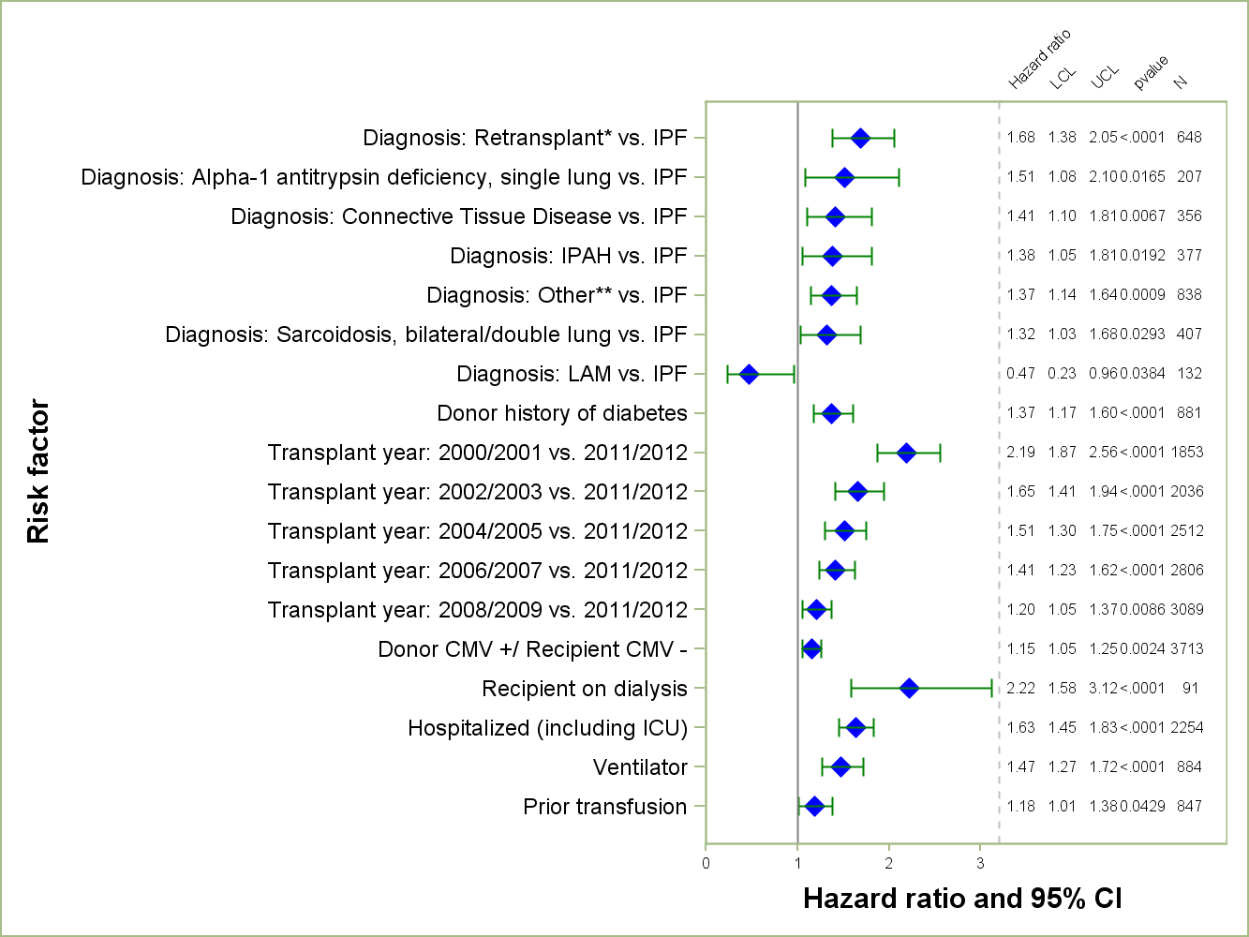
Adult Lung Transplants (January 2000 – June 2012)
Risk Factors For 1 Year Mortality
N = 16,785
* Retransplant includes those with a retransplant diagnosis or a previous transplant was reported.
** Other = All diagnoses other than COPD, IPAH, IPF, cystic fibrosis, sarcoidosis, pulmonary fibrosis, bronchiectasis, alpha-1 antitrypsin deficiency, retransplant , LAM and Connective Tissue Disease.
2014
JHLT. 2014 Oct; 33(10): 1009-1024
Notes:
Multivariable analysis was performed using a proportional hazards model censoring all patients at 1 year. Continuous factors were fit using a restricted cubic spline.
Analyses were limited to transplants having essentially complete information regarding risk factors.

Slide 110
Adult Lung Transplants (January 2000 – June 2012)
Risk Factors For 1 Year Mortality
Continuous Factors (see figures)
Recipient age | Recipient oxygen required at rest
Transplant center volume | Cardiac output
Height difference | Recipient FVC % predicted
Bilirubin | Creatinine
2014
JHLT. 2014 Oct; 33(10): 1009-1024
Notes:
Multivariable analysis was performed using a proportional hazards model censoring all patients at 1 year. Continuous factors were fit using a restricted cubic spline.
Analyses were limited to transplants having essentially complete information regarding risk factors.

Slide 111
Adult Lung Transplants (January 2000 – June 2012)
Risk Factors For 1 Year Mortality with 95% Confidence Limits
Recipient Age
p < 0.0001
2014
JHLT. 2014 Oct; 33(10): 1009-1024
Notes:
Multivariable analysis was performed using a proportional hazards model censoring all patients at 1 year. Continuous factors were fit using a restricted cubic spline.
Analyses were limited to transplants having essentially complete information regarding risk factors.

Slide 112
Adult Lung Transplants (January 2000 – June 2012)
Risk Factors For 1 Year Mortality with 95% Confidence Limits
Center Volume
p < 0.0001
2014
JHLT. 2014 Oct; 33(10): 1009-1024
Notes:
Multivariable analysis was performed using a proportional hazards model censoring all patients at 1 year. Continuous factors were fit using a restricted cubic spline.
Analyses were limited to transplants having essentially complete information regarding risk factors.

Slide 113
Adult Lung Transplants (January 2000 – June 2012)
Risk Factors For 1 Year Mortality with 95% Confidence Limits
Height Difference
p = 0.0037
2014
JHLT. 2014 Oct; 33(10): 1009-1024
Notes:
Multivariable analysis was performed using a proportional hazards model censoring all patients at 1 year. Continuous factors were fit using a restricted cubic spline.
Analyses were limited to transplants having essentially complete information regarding risk factors.

Slide 114
Adult Lung Transplants (January 2000 – June 2012)
Risk Factors For 1 Year Mortality with 95% Confidence Limits
Recipient Pre-Transplant Bilirubin
p = 0.0002
2014
JHLT. 2014 Oct; 33(10): 1009-1024
Notes:
Multivariable analysis was performed using a proportional hazards model censoring all patients at 1 year. Continuous factors were fit using a restricted cubic spline.
Analyses were limited to transplants having essentially complete information regarding risk factors.

Slide 115
Adult Lung Transplants (January 2000 – June 2012)
Risk Factors For 1 Year Mortality with 95% Confidence Limits
Recipient Oxygen Required at Rest
p < 0.0001
2014
JHLT. 2014 Oct; 33(10): 1009-1024
Notes:
Multivariable analysis was performed using a proportional hazards model censoring all patients at 1 year. Continuous factors were fit using a restricted cubic spline.
Analyses were limited to transplants having essentially complete information regarding risk factors.

Slide 116
Adult Lung Transplants (January 2000 – June 2012)
Risk Factors For 1 Year Mortality with 95% Confidence Limits
Recipient Pre-Transplant Cardiac Output
p = 0.0011
2014
JHLT. 2014 Oct; 33(10): 1009-1024
Notes:
Multivariable analysis was performed using a proportional hazards model censoring all patients at 1 year. Continuous factors were fit using a restricted cubic spline.
Analyses were limited to transplants having essentially complete information regarding risk factors.

Slide 117
Adult Lung Transplants (January 2000 – June 2012)
Risk Factors For 1 Year Mortality with 95% Confidence Limits
Recipient FVC (% predicted)
p < 0.0001
2014
JHLT. 2014 Oct; 33(10): 1009-1024
Notes:
Multivariable analysis was performed using a proportional hazards model censoring all patients at 1 year. Continuous factors were fit using a restricted cubic spline.
Analyses were limited to transplants having essentially complete information regarding risk factors.

Slide 118
Adult Lung Transplants (January 2000 – June 2012)
Risk Factors For 1 Year Mortality with 95% Confidence Limits
Recipient Creatinine at Transplant
p = 0.0022
2014
JHLT. 2014 Oct; 33(10): 1009-1024
Notes:
Multivariable analysis was performed using a proportional hazards model censoring all patients at 1 year. Continuous factors were fit using a restricted cubic spline.
Analyses were limited to transplants having essentially complete information regarding risk factors.

Slide 119
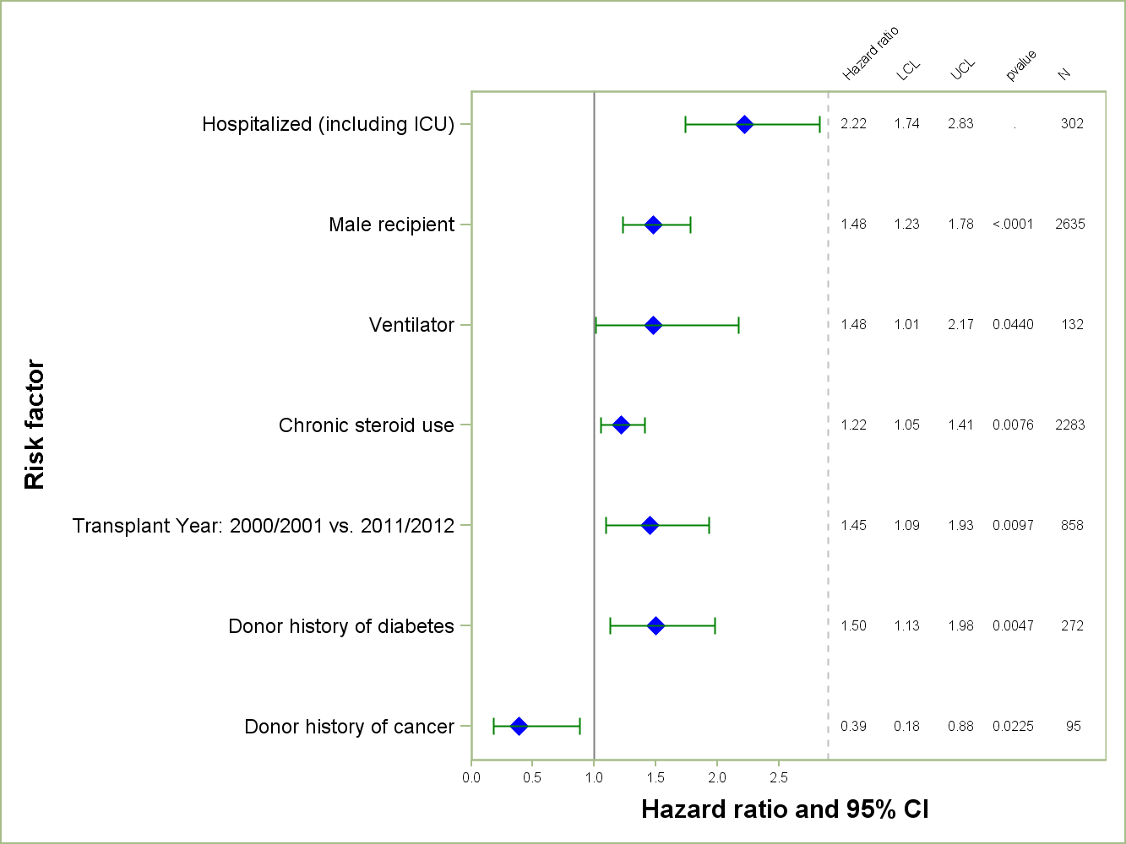
Adult Lung Transplants (January 2000 – June 2012)
Diagnosis = COPD/Emphysema
Risk Factors For 1 Year Mortality
2014
N = 5,314
JHLT. 2014 Oct; 33(10): 1009-1024
Notes:
NOTE: A separate model was fit for recipients with a diagnosis of COPD/emphysema.
Multivariable analysis was performed using a proportional hazards model censoring all patients at 1 year. Continuous factors were fit using a restricted cubic spline.
Analyses were limited to transplants having essentially complete information regarding risk factors.

Slide 120
Adult Lung Transplants (January 2000 – June 2012)
Diagnosis = COPD/Emphysema
Risk Factors For 1 Year Mortality
Continuous Factors (see figures)
Recipient age | Cardiac output
Transplant center volume | Recipient FVC % predicted
Donor height | Recipient FEV1 % predicted
Recipient oxygen required at rest
2014
JHLT. 2014 Oct; 33(10): 1009-1024
Notes:
NOTE: A separate model was fit for recipients with a diagnosis of COPD/emphysema.
Multivariable analysis was performed using a proportional hazards model censoring all patients at 1 year. Continuous factors were fit using a restricted cubic spline.
Analyses were limited to transplants having essentially complete information regarding risk factors.

Slide 121
Adult Lung Transplants (January 2000 – June 2012)
Diagnosis = COPD/Emphysema
Risk Factors For 1 Year Mortality with 95% Confidence Limits
Recipient Age
p < 0.0001
2014
JHLT. 2014 Oct; 33(10): 1009-1024
Notes:
NOTE: A separate model was fit for recipients with a diagnosis of COPD/emphysema.
Multivariable analysis was performed using a proportional hazards model censoring all patients at 1 year. Continuous factors were fit using a restricted cubic spline.
Analyses were limited to transplants having essentially complete information regarding risk factors.

Slide 122
Adult Lung Transplants (January 2000 – June 2012)
Diagnosis = COPD/Emphysema
Risk Factors For 1 Year Mortality with 95% Confidence Limits
Center Volume
p = 0.0016
2014
JHLT. 2014 Oct; 33(10): 1009-1024
Notes:
NOTE: A separate model was fit for recipients with a diagnosis of COPD/emphysema.
Multivariable analysis was performed using a proportional hazards model censoring all patients at 1 year. Continuous factors were fit using a restricted cubic spline.
Analyses were limited to transplants having essentially complete information regarding risk factors.

Slide 123
Adult Lung Transplants (January 2000 – June 2012)
Diagnosis = COPD/Emphysema
Risk Factors For 1 Year Mortality with 95% Confidence Limits
Donor Height
p = 0.0321
2014
JHLT. 2014 Oct; 33(10): 1009-1024
Notes:
NOTE: A separate model was fit for recipients with a diagnosis of COPD/emphysema.
Multivariable analysis was performed using a proportional hazards model censoring all patients at 1 year. Continuous factors were fit using a restricted cubic spline.
Analyses were limited to transplants having essentially complete information regarding risk factors.

Slide 124
Adult Lung Transplants (January 2000 – June 2012)
Diagnosis = COPD/Emphysema
Risk Factors For 1 Year Mortality with 95% Confidence Limits
Recipient Oxygen Required at Rest
p = 0.0192
2014
JHLT. 2014 Oct; 33(10): 1009-1024
Notes:
NOTE: A separate model was fit for recipients with a diagnosis of COPD/emphysema.
Multivariable analysis was performed using a proportional hazards model censoring all patients at 1 year. Continuous factors were fit using a restricted cubic spline.
Analyses were limited to transplants having essentially complete information regarding risk factors.

Slide 125
Adult Lung Transplants (January 2000 – June 2012)
Diagnosis = COPD/Emphysema
Risk Factors For 1 Year Mortality with 95% Confidence Limits
Recipient Pre-Transplant Cardiac Output
p = 0.0063
2014
JHLT. 2014 Oct; 33(10): 1009-1024
Notes:
NOTE: A separate model was fit for recipients with a diagnosis of COPD/emphysema.
Multivariable analysis was performed using a proportional hazards model censoring all patients at 1 year. Continuous factors were fit using a restricted cubic spline.
Analyses were limited to transplants having essentially complete information regarding risk factors.

Slide 126
Adult Lung Transplants (January 2000 – June 2012)
Diagnosis = COPD/Emphysema
Risk Factors For 1 Year Mortality with 95% Confidence Limits
Recipient FVC (% predicted)
p = 0.0310
2014
JHLT. 2014 Oct; 33(10): 1009-1024
Notes:
NOTE: A separate model was fit for recipients with a diagnosis of COPD/emphysema.
Multivariable analysis was performed using a proportional hazards model censoring all patients at 1 year. Continuous factors were fit using a restricted cubic spline.
Analyses were limited to transplants having essentially complete information regarding risk factors.

Slide 127
Adult Lung Transplants (January 2000 – June 2012)
Diagnosis = COPD/Emphysema
Risk Factors For 1 Year Mortality with 95% Confidence Limits
Recipient FEV1 (% predicted)
p = 0.0262
2014
JHLT. 2014 Oct; 33(10): 1009-1024
Notes:
NOTE: A separate model was fit for recipients with a diagnosis of COPD/emphysema.
Multivariable analysis was performed using a proportional hazards model censoring all patients at 1 year. Continuous factors were fit using a restricted cubic spline.
Analyses were limited to transplants having essentially complete information regarding risk factors.

Slide 128
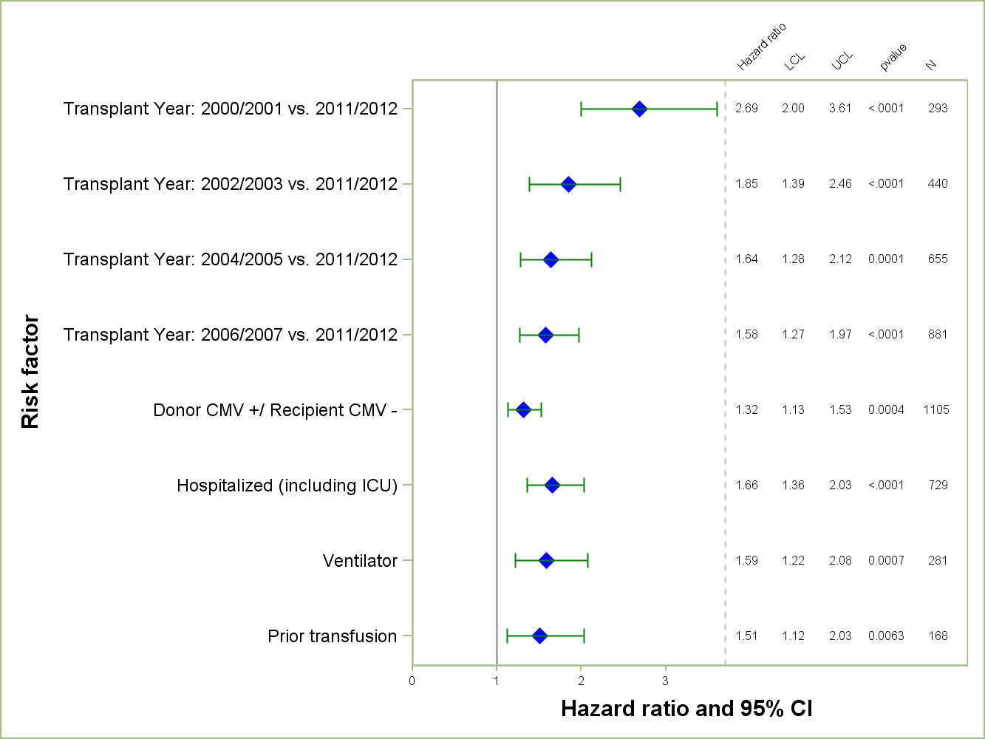
Adult Lung Transplants (January 2000 – June 2012)
Diagnosis = IPF
Risk Factors For 1 Year Mortality
2014
N = 5,004
JHLT. 2014 Oct; 33(10): 1009-1024
Notes:
NOTE: A separate model was fit for recipients with a diagnosis of IPF.
Multivariable analysis was performed using a proportional hazards model censoring all patients at 1 year. Continuous factors were fit using a restricted cubic spline.
Analyses were limited to transplants having essentially complete information regarding risk factors.

Slide 129
Adult Lung Transplants (January 2000 – June 2012)
Diagnosis = IPF
Risk Factors For 1 Year Mortality
Continuous Factors (see figures)
Recipient age | Recipient oxygen required at rest
Transplant center volume | Bilirubin
Donor height | Creatinine
2014
JHLT. 2014 Oct; 33(10): 1009-1024
Notes:
NOTE: A separate model was fit for recipients with a diagnosis of IPF.
Multivariable analysis was performed using a proportional hazards model censoring all patients at 1 year. Continuous factors were fit using a restricted cubic spline.
Analyses were limited to transplants having essentially complete information regarding risk factors.

Slide 130
Adult Lung Transplants (January 2000 – June 2012)
Diagnosis = IPF
Risk Factors For 1 Year Mortality with 95% Confidence Limits
Recipient Age
p < 0.0001
2014
JHLT. 2014 Oct; 33(10): 1009-1024
Notes:
NOTE: A separate model was fit for recipients with a diagnosis of IPF.
Multivariable analysis was performed using a proportional hazards model censoring all patients at 1 year. Continuous factors were fit using a restricted cubic spline.
Analyses were limited to transplants having essentially complete information regarding risk factors.

Slide 131
Adult Lung Transplants (January 2000 – June 2012)
Diagnosis = IPF
Risk Factors For 1 Year Mortality with 95% Confidence Limits
Center Volume
p < 0.0001
2014
JHLT. 2014 Oct; 33(10): 1009-1024
Notes:
NOTE: A separate model was fit for recipients with a diagnosis of IPF.
Multivariable analysis was performed using a proportional hazards model censoring all patients at 1 year. Continuous factors were fit using a restricted cubic spline.
Analyses were limited to transplants having essentially complete information regarding risk factors.

Slide 132
Adult Lung Transplants (January 2000 – June 2012)
Diagnosis = IPF
Risk Factors For 1 Year Mortality with 95% Confidence Limits
Donor Height
p < 0.0001
2014
JHLT. 2014 Oct; 33(10): 1009-1024
Notes:
NOTE: A separate model was fit for recipients with a diagnosis of IPF.
Multivariable analysis was performed using a proportional hazards model censoring all patients at 1 year. Continuous factors were fit using a restricted cubic spline.
Analyses were limited to transplants having essentially complete information regarding risk factors.

Slide 133
Adult Lung Transplants (January 2000 – June 2012)
Diagnosis = IPF
Risk Factors For 1 Year Mortality with 95% Confidence Limits
Recipient Oxygen Required at Rest
p = 0.0020
2014
JHLT. 2014 Oct; 33(10): 1009-1024
Notes:
NOTE: A separate model was fit for recipients with a diagnosis of IPF.
Multivariable analysis was performed using a proportional hazards model censoring all patients at 1 year. Continuous factors were fit using a restricted cubic spline.
Analyses were limited to transplants having essentially complete information regarding risk factors.

Slide 134
Adult Lung Transplants (January 2000 – June 2012)
Diagnosis = IPF
Risk Factors For 1 Year Mortality with 95% Confidence Limits
Recipient Bilirubin
p < 0.0001
2014
JHLT. 2014 Oct; 33(10): 1009-1024
Notes:
NOTE: A separate model was fit for recipients with a diagnosis of IPF.
Multivariable analysis was performed using a proportional hazards model censoring all patients at 1 year. Continuous factors were fit using a restricted cubic spline.
Analyses were limited to transplants having essentially complete information regarding risk factors.

Slide 135
Adult Lung Transplants (January 2000 – June 2012)
Diagnosis = IPF
Risk Factors For 1 Year Mortality with 95% Confidence Limits
Recipient Creatinine at Transplant
p = 0.0037
2014
JHLT. 2014 Oct; 33(10): 1009-1024
Notes:
NOTE: A separate model was fit for recipients with a diagnosis of IPF.
Multivariable analysis was performed using a proportional hazards model censoring all patients at 1 year. Continuous factors were fit using a restricted cubic spline.
Analyses were limited to transplants having essentially complete information regarding risk factors.

Slide 136
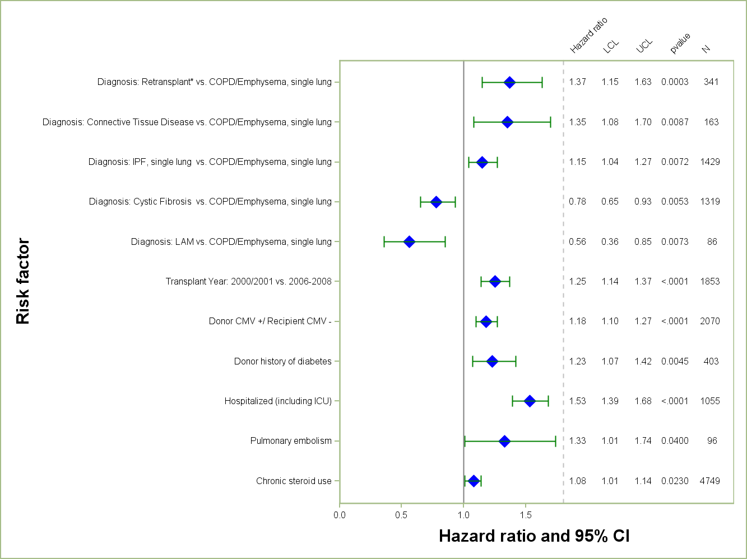
Adult Lung Transplants (January 2000 – June 2008)
Risk Factors For 5 Year Mortality
N = 9,930
2014
* Retransplant includes those with a retransplant diagnosis or a previous transplant was reported
JHLT. 2014 Oct; 33(10): 1009-1024
Notes:
Multivariable analysis was performed using a proportional hazards model censoring all patients at 5 years. Continuous factors were fit using a restricted cubic spline.
Analyses were limited to transplants having essentially complete information regarding risk factors.

Slide 137
Adult Lung Transplants (January 2000 – June 2008)
Risk Factors For 5 Year Mortality
Continuous Factors (see figures)
Recipient age | Recipient oxygen required at rest
Transplant center volume | Cardiac output
Height difference
2014
JHLT. 2014 Oct; 33(10): 1009-1024
Notes:
Multivariable analysis was performed using a proportional hazards model censoring all patients at 5 years. Continuous factors were fit using a restricted cubic spline.
Analyses were limited to transplants having essentially complete information regarding risk factors.

Slide 138
Adult Lung Transplants (January 2000 – June 2008)
Risk Factors For 5 Year Mortality with 95% Confidence Limits
Recipient Age
p < 0.0001
2014
JHLT. 2014 Oct; 33(10): 1009-1024
Notes:
Multivariable analysis was performed using a proportional hazards model censoring all patients at 5 years. Continuous factors were fit using a restricted cubic spline.
Analyses were limited to transplants having essentially complete information regarding risk factors.

Slide 139
Adult Lung Transplants (January 2000 – June 2008)
Risk Factors For 5 Year Mortality with 95% Confidence Limits
Center Volume
p < 0.0001
2014
JHLT. 2014 Oct; 33(10): 1009-1024
Notes:
Multivariable analysis was performed using a proportional hazards model censoring all patients at 5 years. Continuous factors were fit using a restricted cubic spline.
Analyses were limited to transplants having essentially complete information regarding risk factors.

Slide 140
Adult Lung Transplants (January 2000 – June 2008)
Risk Factors For 5 Year Mortality with 95% Confidence Limits
Height Difference
p = 0.0260
2014
JHLT. 2014 Oct; 33(10): 1009-1024
Notes:
Multivariable analysis was performed using a proportional hazards model censoring all patients at 5 years. Continuous factors were fit using a restricted cubic spline.
Analyses were limited to transplants having essentially complete information regarding risk factors.

Slide 141
Adult Lung Transplants (January 2000 – June 2008)
Risk Factors For 5 Year Mortality with 95% Confidence Limits
Recipient Oxygen Required at Rest
p = 0.0013
2014
JHLT. 2014 Oct; 33(10): 1009-1024
Notes:
Multivariable analysis was performed using a proportional hazards model censoring all patients at 5 years. Continuous factors were fit using a restricted cubic spline.
Analyses were limited to transplants having essentially complete information regarding risk factors.

Slide 142
Adult Lung Transplants (January 2000 – June 2008)
Risk Factors For 5 Year Mortality with 95% Confidence Limits
Recipient Pre-Transplant Cardiac Output
p < 0.0001
2014
JHLT. 2014 Oct; 33(10): 1009-1024
Notes:
Multivariable analysis was performed using a proportional hazards model censoring all patients at 5 years. Continuous factors were fit using a restricted cubic spline.
Analyses were limited to transplants having essentially complete information regarding risk factors.

Slide 143
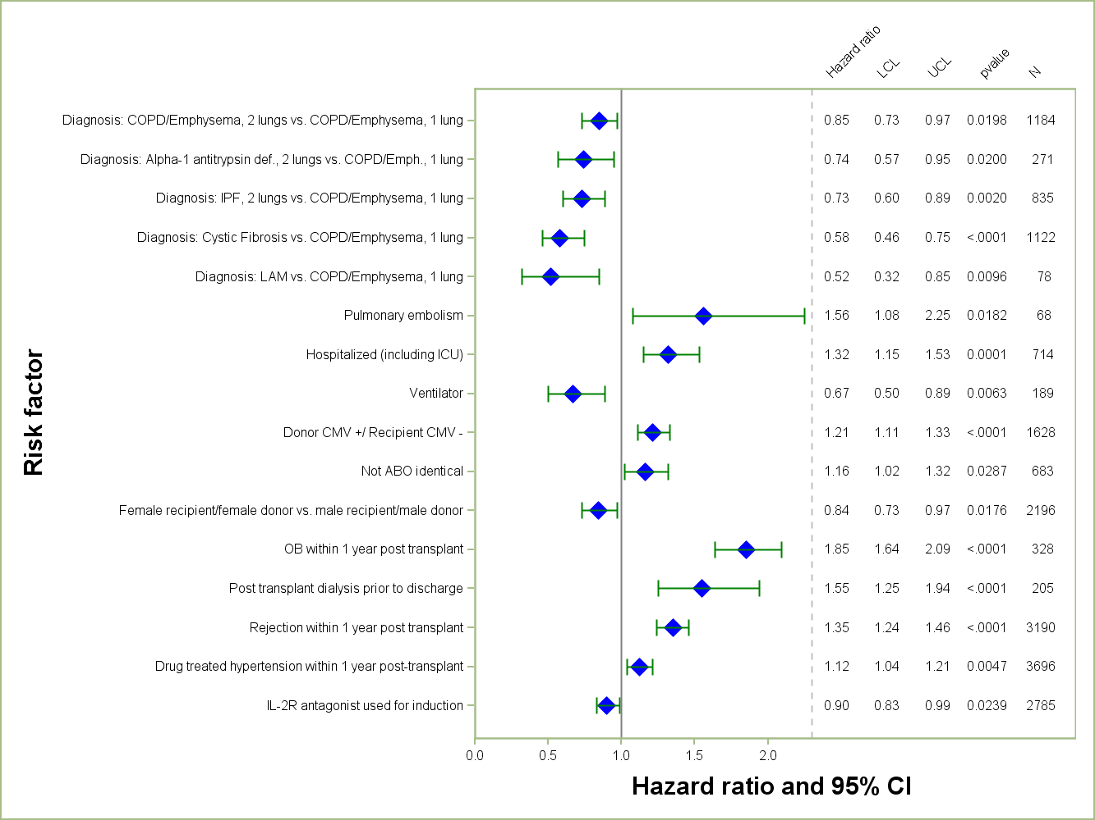
Adult Lung Transplants (January 2000 – June 2008)
Risk Factors For 5 Year Mortality
Conditional on Survival to 1 Year
2014
N = 7,890
JHLT. 2014 Oct; 33(10): 1009-1024
Notes:
Multivariable analysis was performed using a proportional hazards model censoring all patients at 5 years. Continuous factors were fit using a restricted cubic spline.
Analyses were limited to transplants having essentially complete information regarding risk factors.

Slide 144
Adult Lung Transplants (January 2000 – June 2008)
Risk Factors For 5 Year Mortality
Conditional on Survival to 1 Year
Continuous Factors (see figures)
Recipient age | Recipient oxygen required at rest
Transplant center volume | Cardiac output
BMI difference | PVR
2014
JHLT. 2014 Oct; 33(10): 1009-1024
Notes:
Multivariable analysis was performed using a proportional hazards model censoring all patients at 5 years. Continuous factors were fit using a restricted cubic spline.
Analyses were limited to transplants having essentially complete information regarding risk factors.

Slide 145
Adult Lung Transplants (January 2000 – June 2008)
Risk Factors For 5 Year Mortality with 95% Confidence Limits
Conditional on Survival to 1 Year
Recipient Age
p < 0.0001
2014
JHLT. 2014 Oct; 33(10): 1009-1024
Notes:
Multivariable analysis was performed using a proportional hazards model censoring all patients at 5 years. Continuous factors were fit using a restricted cubic spline.
Analyses were limited to transplants having essentially complete information regarding risk factors.

Slide 146
Adult Lung Transplants (January 2000 – June 2008)
Risk Factors For 5 Year Mortality with 95% Confidence Limits
Conditional on Survival to 1 Year
Center Volume
p = 0.0003
2014
JHLT. 2014 Oct; 33(10): 1009-1024
Notes:
Multivariable analysis was performed using a proportional hazards model censoring all patients at 5 years. Continuous factors were fit using a restricted cubic spline.
Analyses were limited to transplants having essentially complete information regarding risk factors.

Slide 147
Adult Lung Transplants (January 2000 – June 2008)
Risk Factors For 5 Year Mortality with 95% Confidence Limits
Conditional on Survival to 1 Year
BMI Difference
p = 0.0087
2014
JHLT. 2014 Oct; 33(10): 1009-1024
Notes:
Multivariable analysis was performed using a proportional hazards model censoring all patients at 5 years. Continuous factors were fit using a restricted cubic spline.
Analyses were limited to transplants having essentially complete information regarding risk factors.

Slide 148
Adult Lung Transplants (January 2000 – June 2008)
Risk Factors For 5 Year Mortality with 95% Confidence Limits
Conditional on Survival to 1 Year
Recipient Oxygen Required at Rest
p = 0.0082
2014
JHLT. 2014 Oct; 33(10): 1009-1024
Notes:
Multivariable analysis was performed using a proportional hazards model censoring all patients at 5 years. Continuous factors were fit using a restricted cubic spline.
Analyses were limited to transplants having essentially complete information regarding risk factors.

Slide 149
Adult Lung Transplants (January 2000 – June 2008)
Risk Factors For 5 Year Mortality with 95% Confidence Limits
Conditional on Survival to 1 Year
Recipient Pre-Transplant Cardiac Output
p = 0.0142
2014
JHLT. 2014 Oct; 33(10): 1009-1024
Notes:
Multivariable analysis was performed using a proportional hazards model censoring all patients at 5 years. Continuous factors were fit using a restricted cubic spline.
Analyses were limited to transplants having essentially complete information regarding risk factors.

Slide 150
Adult Lung Transplants (January 2000 – June 2008)
Risk Factors For 5 Year Mortality with 95% Confidence Limits
Conditional on Survival to 1 Year
Recipient PVR
p = 0.0018
2014
JHLT. 2014 Oct; 33(10): 1009-1024
Notes:
Multivariable analysis was performed using a proportional hazards model censoring all patients at 5 years. Continuous factors were fit using a restricted cubic spline.
Analyses were limited to transplants having essentially complete information regarding risk factors.

Slide 151
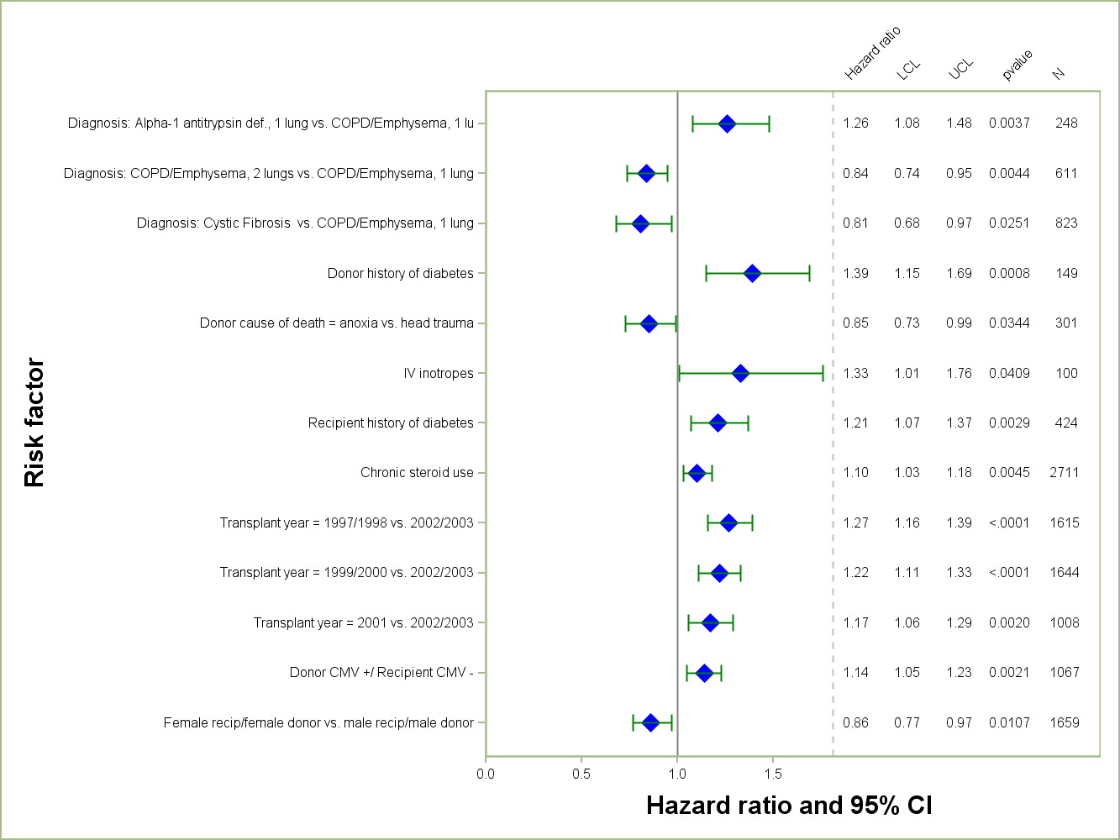
Adult Lung Transplants (January 1997 – June 2003)
Risk Factors For 10 Year Mortality
2014
N = 5,776
JHLT. 2014 Oct; 33(10): 1009-1024
Notes:
Multivariable analysis was performed using a proportional hazards model censoring all patients at 10 years. Continuous factors were fit using a restricted cubic spline.
Analyses were limited to transplants having essentially complete information regarding risk factors.

Slide 152
Adult Lung Transplants (January 1997 – June 2003)
Risk Factors For 10 Year Mortality
Continuous Factors (see figures)
Recipient age | Recipient oxygen required at rest
Transplant center volume | Cardiac output
Donor Age | Creatinine
BMI difference
2014
JHLT. 2014 Oct; 33(10): 1009-1024
Notes:
Multivariable analysis was performed using a proportional hazards model censoring all patients at 10 years. Continuous factors were fit using a restricted cubic spline.
Analyses were limited to transplants having essentially complete information regarding risk factors.

Slide 153
Adult Lung Transplants (January 1997 – June 2003)
Risk Factors For 10 Year Mortality with 95% Confidence Limits
Recipient Age
p < 0.0001
2014
JHLT. 2014 Oct; 33(10): 1009-1024
Notes:
Multivariable analysis was performed using a proportional hazards model censoring all patients at 10 years. Continuous factors were fit using a restricted cubic spline.
Analyses were limited to transplants having essentially complete information regarding risk factors.

Slide 154
Adult Lung Transplants (January 1997 – June 2003)
Risk Factors For 10 Year Mortality with 95% Confidence Limits
Center Volume
p < 0.0001
2014
JHLT. 2014 Oct; 33(10): 1009-1024
Notes:
Multivariable analysis was performed using a proportional hazards model censoring all patients at 10 years. Continuous factors were fit using a restricted cubic spline.
Analyses were limited to transplants having essentially complete information regarding risk factors.

Slide 155
Adult Lung Transplants (January 1997 – June 2003)
Risk Factors For 10 Year Mortality with 95% Confidence Limits
Donor Age
p = 0.0009
2014
JHLT. 2014 Oct; 33(10): 1009-1024
Notes:
Multivariable analysis was performed using a proportional hazards model censoring all patients at 10 years. Continuous factors were fit using a restricted cubic spline.
Analyses were limited to transplants having essentially complete information regarding risk factors.

Slide 156
Adult Lung Transplants (January 1997 – June 2003)
Risk Factors For 10 Year Mortality with 95% Confidence Limits
BMI Difference
p < 0.0001
2014
JHLT. 2014 Oct; 33(10): 1009-1024
Notes:
Multivariable analysis was performed using a proportional hazards model censoring all patients at 10 years. Continuous factors were fit using a restricted cubic spline.
Analyses were limited to transplants having essentially complete information regarding risk factors.

Slide 157
Adult Lung Transplants (January 1997 – June 2003)
Risk Factors For 10 Year Mortality with 95% Confidence Limits
Recipient Oxygen Required at Rest
p = 0.0057
2014
JHLT. 2014 Oct; 33(10): 1009-1024
Notes:
Multivariable analysis was performed using a proportional hazards model censoring all patients at 10 years. Continuous factors were fit using a restricted cubic spline.
Analyses were limited to transplants having essentially complete information regarding risk factors.

Slide 158
Adult Lung Transplants (January 1997 – June 2003)
Risk Factors For 10 Year Mortality with 95% Confidence Limits
Recipient Pre-Transplant Cardiac Output
p = 0.0326
2014
JHLT. 2014 Oct; 33(10): 1009-1024
Notes:
Multivariable analysis was performed using a proportional hazards model censoring all patients at 10 years. Continuous factors were fit using a restricted cubic spline.
Analyses were limited to transplants having essentially complete information regarding risk factors.

Slide 159
Adult Lung Transplants (January 1997 – June 2003)
Risk Factors For 10 Year Mortality with 95% Confidence Limits
Recipient Creatinine at Transplant
p = 0.0242
2014
JHLT. 2014 Oct; 33(10): 1009-1024
Notes:
Multivariable analysis was performed using a proportional hazards model censoring all patients at 10 years. Continuous factors were fit using a restricted cubic spline.
Analyses were limited to transplants having essentially complete information regarding risk factors.

Slide 160
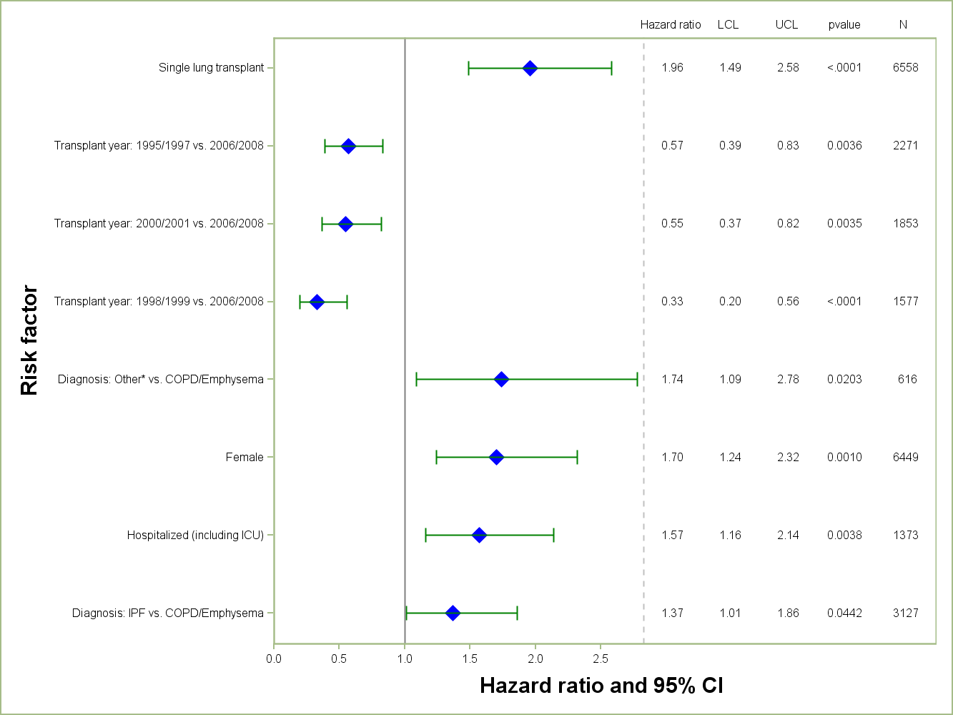
Adult Lung Transplants (January 1995 – June 2008)
Risk Factors For Retransplantation within 5 Years
N = 13,778
2014
* Other = All diagnoses other than COPD, IPAH, IPF, cystic fibrosis, sarcoidosis, pulmonary fibrosis, bronchiectasis, alpha-1 antitrypsin deficiency, retransplant , LAM and Connective Tissue Disease.
JHLT. 2014 Oct; 33(10): 1009-1024
Notes:
Multivariable analysis was performed using a proportional hazards model censoring all patients at 5 years. Continuous factors were fit using a restricted cubic spline.
Analyses were limited to transplants having essentially complete information regarding risk factors.

Slide 161
Adult Lung Transplants (January 1995 – June 2008)
Risk Factors For Retransplantation within 5 Years
Continuous Factors (see figures)
Recipient age | Recipient height
Donor age | BMI ratio
2014
JHLT. 2014 Oct; 33(10): 1009-1024
Notes:
Multivariable analysis was performed using a proportional hazards model censoring all patients at 5 years. Continuous factors were fit using a restricted cubic spline.
Analyses were limited to transplants having essentially complete information regarding risk factors.

Slide 162
Adult Lung Transplants (January 1995 – June 2008)
Risk Factors For Retransplantation within 5 Years with 95% Confidence Limits
Recipient Age
p < 0.0001
2014
JHLT. 2014 Oct; 33(10): 1009-1024
Notes:
Multivariable analysis was performed using a proportional hazards model censoring all patients at 5 years. Continuous factors were fit using a restricted cubic spline.
Analyses were limited to transplants having essentially complete information regarding risk factors.

Slide 163
Adult Lung Transplants (January 1995 – June 2008)
Risk Factors For Retransplantation within 5 Years with 95% Confidence Limits
Donor Age
p = 0.0048
2014
JHLT. 2014 Oct; 33(10): 1009-1024
Notes:
Multivariable analysis was performed using a proportional hazards model censoring all patients at 5 years. Continuous factors were fit using a restricted cubic spline.
Analyses were limited to transplants having essentially complete information regarding risk factors.

Slide 164
Adult Lung Transplants (January 1995 – June 2008)
Risk Factors For Retransplantation within 5 Years with 95% Confidence Limits
Recipient Height
p < 0.0001
2014
JHLT. 2014 Oct; 33(10): 1009-1024
Notes:
Multivariable analysis was performed using a proportional hazards model censoring all patients at 5 years. Continuous factors were fit using a restricted cubic spline.
Analyses were limited to transplants having essentially complete information regarding risk factors.

Slide 165
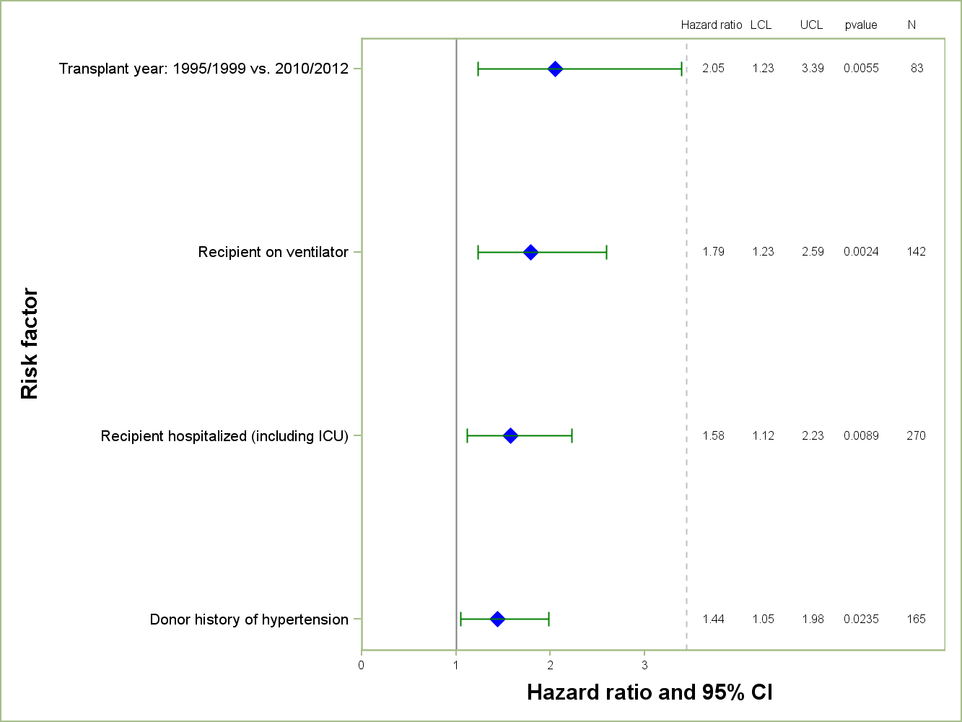
Adult Lung Retransplants (January 1995 – June 2012)
Retransplant recipients
Risk Factors For 1 Year Mortality
2014
N = 731
JHLT. 2014 Oct; 33(10): 1009-1024
Notes:
NOTE: A separate model was fit for retransplant recipients.
Multivariable analysis was performed using a proportional hazards model censoring all patients at 1 year. Continuous factors were fit using a restricted cubic spline.
Analyses were limited to transplants having essentially complete information regarding risk factors.

Slide 166
Adult Lung Retransplants (January 1995 – June 2012)
Retransplant recipients
Risk Factors For 1 Year Mortality
Continuous Factors (see figures)
Transplant center volume | Creatinine
Donor height
2014
JHLT. 2014 Oct; 33(10): 1009-1024
Notes:
NOTE: A separate model was fit for retransplant recipients.
Multivariable analysis was performed using a proportional hazards model censoring all patients at 1 year. Continuous factors were fit using a restricted cubic spline.
Analyses were limited to transplants having essentially complete information regarding risk factors.

Slide 167
Adult Lung Retransplants (January 1995 – June 2012)
Retransplant recipients
Risk Factors For 1 Year Mortality with 95% Confidence Limits
Center Volume
p = 0.0170
2014
JHLT. 2014 Oct; 33(10): 1009-1024
Notes:
NOTE: A separate model was fit for retransplant recipients.
Multivariable analysis was performed using a proportional hazards model censoring all patients at 1 year. Continuous factors were fit using a restricted cubic spline.
Analyses were limited to transplants having essentially complete information regarding risk factors.

Slide 168
Adult Lung Retransplants (January 1995 – June 2012)
Retransplant recipients
Risk Factors For 1 Year Mortality with 95% Confidence Limits
Donor Height
p = 0.0133
2014
JHLT. 2014 Oct; 33(10): 1009-1024
Notes:
NOTE: A separate model was fit for retransplant recipients.
Multivariable analysis was performed using a proportional hazards model censoring all patients at 1 year. Continuous factors were fit using a restricted cubic spline.
Analyses were limited to transplants having essentially complete information regarding risk factors.

Slide 169
Adult Lung Retransplants (January 1995 – June 2012)
Retransplant recipients
Risk Factors For 1 Year Mortality with 95% Confidence Limits
Recipient Creatinine at Transplant
p = 0.0054
2014
JHLT. 2014 Oct; 33(10): 1009-1024
Notes:
NOTE: A separate model was fit for retransplant recipients.
Multivariable analysis was performed using a proportional hazards model censoring all patients at 1 year. Continuous factors were fit using a restricted cubic spline.
Analyses were limited to transplants having essentially complete information regarding risk factors.

