Slide 1

HEART TRANSPLANTATION
Adult Recipients
2014
JHLT. 2014 Oct; 33(10): 996-1008

Slide 2
Table of Contents
Donor and recipient characteristics: slides 3-53
Immunosuppression: slides 54-71
Survival slides: slides 72-140
Morbidity: slides 141-169
Multivariable analyses: slides 170-246
2014
JHLT. 2014 Oct; 33(10): 996-1008

Slide 3
Donor and Recipient Characteristics:
Diagnosis and retransplant indications: slides 4-11 and 14
Retransplants by year: slide 12
Retransplants by inter-transplant interval: slides 13-15
Recipient and donor characteristics: slides 16-49
2014
JHLT. 2014 Oct; 33(10): 996-1008

Slide 4
Adult Heart Transplants
Diagnosis
2014
For some retransplants diagnosis other than retransplant was reported, so the total percentage of retransplants may be greater.
JHLT. 2014 Oct; 33(10): 996-1008

Slide 5
Adult Heart Retransplants
Indications
2014
JHLT. 2014 Oct; 33(10): 996-1008

Slide 6
Adult Heart Transplants
Diagnosis by Location and Era
Europe
North America
Other
2014
For some retransplants diagnosis other than retransplant is reported, so the total percentage of retransplants may be greater.
JHLT. 2014 Oct; 33(10): 996-1008

Slide 7
Adult Heart Transplants
Diagnosis by Location
(Transplants: January 2006 – June 2013)
2014
For some retransplants diagnosis other than retransplant is reported, so the total percentage of retransplants may be greater.
JHLT. 2014 Oct; 33(10): 996-1008

Slide 8
Adult Heart Retransplants
Indications by Location
(Retransplants: January 2006 – June 2013)
2014
JHLT. 2014 Oct; 33(10): 996-1008

Slide 9
Adult Heart Retransplants
Indication by Diagnosis at Original Transplant
(Retransplants: January 2006 – June 2013)
2014
For some retransplants diagnosis of retransplant is reported
JHLT. 2014 Oct; 33(10): 996-1008

Slide 10
Adult Heart Transplants
Diagnosis by Age Group
(Transplants: January 2006 – June 2013)
2014
For some retransplants diagnosis other than retransplant is reported, so the total percentage of retransplants may be greater.
JHLT. 2014 Oct; 33(10): 996-1008

Slide 11
Adult Heart Retransplants
Indication by Age Group
(Retransplants: January 2006 – June 2013)
2014
There were only 11 retransplants in 70+ years age group
JHLT. 2014 Oct; 33(10): 996-1008

Slide 12
Adult Heart Retransplants by Year of Retransplant
2014
JHLT. 2014 Oct; 33(10): 996-1008

Slide 13
Adult Heart Retransplants by Inter-Transplant Interval
(Retransplants: January 2006 – June 2013)
2014
JHLT. 2014 Oct; 33(10): 996-1008

Slide 14
Adult Heart Retransplants
Indication by Inter-Transplant Interval
(Retransplants: January 2006 – June 2013)
2014
For some retransplants diagnosis of retransplant is reported
JHLT. 2014 Oct; 33(10): 996-1008

Slide 15
Adult Heart Retransplants
Recipient Age by Inter-Transplant Interval
(Retransplants: January 2006 – June 2013)
2014
JHLT. 2014 Oct; 33(10): 996-1008

Slide 16
Adult Heart Transplants
Donor and Recipient Characteristics
 | 1992-2000 (N = 37,538) | 2001-2005 (N = 17,249) | 2006-6/2013 (N = 26,294) | p-value
Recipient age (years) | 54.0 (28.0 - 65.0) | 54.0 (26.0 - 66.0) | 54.0 (24.0 - 67.0) | <0.0001
Donor age (years) | 31.0 (15.0 - 54.0) | 33.0 (16.0 - 55.0) | 35.0 (17.0 - 57.0) | <0.0001
Donor and recipient age difference (years) | -19.0 (-44.0 - 7.0) | -17.0 (-43.0 - 10.0) | -16.0 (-43.0 - 12.0) | <0.0001
Recipient weight (kg) | 75.0 (51.0 - 102.0) | 77.6 (53.0 - 106.6) | 79.1 (53.3 - 110.0) | <0.0001
Recipient height (cm) | 173.0 (157.0 - 188.0) | 174.0 (157.5 - 188.0) | 174.0 (157.4 - 188.0) | 0.0014
Recipient BMI | 22.7 (19.5 - 31.7) | 24.2 (19.6 - 33.1) | 24.4 (19.7 - 34.2) | <0.0001
Donor weight (kg) | 75.0 (52.0 - 103.0)¹ | 76.7 (55.0 - 108.6) | 79.4 (56.7 - 113.4) | <0.0001
Donor height (cm) | 175.0 (155.0 - 188.0)¹ | 175.3 (157.5 - 189.0) | 175.0 (157.5 - 189.2) | <0.0001
Donor BMI | 24.2 (18.8 - 32.9)¹ | 24.8 (19.5 - 34.4) | 25.6 (19.9 - 36.5) | <0.0001
Continuous factors are expressed as median (5th-95th percentiles)
2014
¹ Based on 4/1994-2000 transplants.
JHLT. 2014 Oct; 33(10): 996-1008
Notes:
Comparisons for categorical variables were made using the chi-square statistic. Multiple groups were compared using single p-value.
Comparisons for continuous variables were made using Kruskal-Wallis test.
A significant p-value means that at least one of the groups is different than the others but it doesn’t identify which group it is.

Slide 17
Adult Heart Transplants
Donor and Recipient Characteristics
 | 1992-2000 (N = 37,538) | 2001-2005 (N = 17,249) | 2006-6/2013 (N = 26,294) | p-value
Recipient/donor gender (% male) | 80.7%/ 68.4% | 77.9%/ 69.1% | 75.8%/ 68.9% | <0.0001/ 0.2358
Male recipient/ female donor | 21.3% | 18.6% | 16.8% | <0.0001
Female recipient/ male donor | 9.2% | 9.7% | 10.0% | 0.0022
Recipient/donor diabetes mellitus | 13.1%¹/ 1.6%¹ | 19.8%/ 2.0% | 25.4%/ 3.0% | <0.0001/ <0.0001
Recipient prior history of dialysis | 3.0%¹ | 4.2% | 4.3% | <0.0001
Recipient amiodarone use | 22.2%¹ | 28.8% | 30.9% | <0.0001
Recipient/donor cigarette history | -/ 37.9%¹ | 46.8%²/ 29.2% | 46.3%/ 18.5% | 0.6517/ <0.0001
Recipient/donor hypertension | 34.9%¹/ 10.6%¹ | 38.2%/ 11.4% | 46.5%/ 14.0% | <0.0001/ <0.0001
Recipient prior cardiac surgery | - | 39.1%² | 46.5% | <0.0001
Recipient Peripheral Vascular Disease | 3.8%¹ | 3.2% | 3.0% | 0.0001
Recipient previous malignancy | 3.3%¹ | 4.4% | 6.8% | <0.0001
Recipient COPD | 3.3%¹ | 3.2% | 4.4% | <0.0001
Ischemic time (hours) | 2.9 (1.3 - 4.8) | 3.1 (1.5 - 5.0) | 3.3 (1.6 - 5.1) | <0.0001
(Cont’d)
Continuous factors are expressed as median (5th-95th percentiles)
2014
¹ Based on 4/1994-2000 transplants.
² Based on 7/2004-2005 transplants.
JHLT. 2014 Oct; 33(10): 996-1008
Notes:
Comparisons for categorical variables were made using the chi-square statistic. Multiple groups were compared using single p-value.
Comparisons for continuous variables were made using Kruskal-Wallis test.
A significant p-value means that at least one of the groups is different than the others but it doesn’t identify which group it is.

Slide 18
Adult Heart Transplants
Donor and Recipient Characteristics
 | 1992-2000 (N = 37,538) | 2001-2005 (N = 17,249) | 2006-6/2013 (N = 26,294) | p-value
Most recent PRA > 10%¹
Overall | 7.4% | 9.0%² | 12.4%³ | <0.0001
Class I | - | - | 14.5%⁴ | -
Class II | - | - | 10.0%⁴ | -
Creatinine at time of transplant (mg/dL) | 1.2 (0.7 - 2.5) | 1.2 (0.7 - 2.4) | 1.2 (0.7 - 2.3) | <0.0001
Pulmonary vascular resistance (Wood units) | 2.2 (0.5 - 6.1)⁵ | 2.0 (0.5 - 5.7) | 2.1 (0.4 - 5.4) | <0.0001
HLA Mismatches
0-2 | 4.4% | 4.4% | 3.8% | <0.0001
3-4 | 40.4% | 40.2% | 38.7%
5-6 | 55.2% | 55.4% | 57.6%
(Cont’d)
Continuous factors are expressed as median (5th-95th percentiles)
¹ PRA was collected as a single percentage outside of US. Until mid-2004 PRA was collected in US as a single percentage. After this date, PRA was collected separately for Class I and Class II.
² Based on US 2001-6/2004 transplants and non US 2001 - 2005 transplants.
³ Based on non US transplants.
⁴ Based on US transplants.
⁵ Based on 4/1994-2000 transplants.
2014
JHLT. 2014 Oct; 33(10): 996-1008
Notes:
Comparisons for categorical variables were made using the chi-square statistic. Multiple groups were compared using single p-value.
Comparisons for continuous variables were made using Kruskal-Wallis test.
A significant p-value means that at least one of the groups is different than the others but it doesn’t identify which group it is.

Slide 19
Adult Heart Transplants
Donor and Recipient Characteristics
 | 1992-2000 (N = 37,538) | 2001-2005 (N = 17,249) | 2006-6/2013 (N = 26,294) | p-value
Diagnosis
Cardiomyopathy | 46.5% | 48.4% | 54.6% | <0.0001
Coronary artery disease | 45.8% | 42.7% | 36.4%
Valvular | 3.9% | 3.6% | 2.8%
Retransplant | 1.9% | 2.2% | 2.5%
Congenital | 1.8% | 2.7% | 3.1%
Other causes | 0.2% | 0.3% | 0.6%
Donor cause of death
Head trauma | 45.5% | 53.9% | 45.3% | <0.0001
Stroke | 28.7% | 32.5% | 24.4%
Other | 25.8% | 13.5% | 30.3%
(Cont’d)
2014
For some retransplants diagnosis other than retransplant is reported, so the total percentage of retransplants may be greater.
JHLT. 2014 Oct; 33(10): 996-1008
Notes:
Comparisons for categorical variables were made using the chi-square statistic. Multiple groups were compared using single p-value.
Comparisons for continuous variables were made using Kruskal-Wallis test.
A significant p-value means that at least one of the groups is different than the others but it doesn’t identify which group it is.

Slide 20
Adult Heart Transplants
Donor and Recipient Characteristics
 | 1992-2000 (N = 37,538) | 2001-2005 (N = 17,249) | 2006-6/2013 (N = 26,294) | p-value
Pre-operative support (multiple items may be reported)
Hospitalized at time of transplant | 60.4% | 47.9% | 44.5% | <0.0001
On IV inotropes | 55.8%¹ | 47.3% | 42.2% | <0.0001
Ventilator | 3.4% | 3.3% | 2.7% | 0.0005
IABP | 6.5% | 6.8% | 6.6% | 0.6612
Mechanical circulatory support | 18.8² | 24.1 | 35.1 | <0.0001
LVAD | 11.9%² | 16.9% | 29.8% | <0.0001
RVAD | - | 4.9%³ | 3.6% | 0.0031
TAH | 0.1%² | 0.1% | 1.0% | <0.0001
ECMO | 0.3%⁴ | 0.5% | 1.1% | <0.0001
(Cont’d)
¹ Based on 4/1994-2000 transplants.
² Based on 11/1999-2000 transplants.
³ Based on 2005 transplants.
⁴ Based on 5/1995-2000 transplants.
2014
JHLT. 2014 Oct; 33(10): 996-1008
Notes:
Comparisons for categorical variables were made using the chi-square statistic. Multiple groups were compared using single p-value.
Comparisons for continuous variables were made using Kruskal-Wallis test.
A significant p-value means that at least one of the groups is different than the others but it doesn’t identify which group it is.

Slide 21
Adult Heart Retransplants
Donor and Recipient Characteristics
 | 1992-2000 (N = 1,026) | 2001-2005 (N = 508) | 2006-6/2013 (N = 820) | p-value
Recipient age (years) | 51.0 (23.0 - 64.0) | 50.5 (22.0 - 65.0) | 46.0 (20.0 - 65.0) | <0.0001
Donor age (years) | 32.0 (15.0 - 54.0) | 34.0 (17.0 - 55.0) | 32.0 (16.0 - 56.0) | 0.0642
Donor and recipient age difference (years) | -16.0 (-40.0 - 11.0) | -12.5 (-40.0 - 16.0) | -10.0 (-40.0 - 19.0) | <0.0001
Recipient weight (kg) | 76.2 (49.9 - 105.0) | 76.2 (51.0 - 105.0) | 75.0 (51.0 - 105.2) | 0.6153
Recipient height (cm) | 174.0 (157.5 - 188.0) | 172.7 (157.0 - 188.0) | 172.7 (154.9 - 187.5) | 0.0005
Recipient BMI | 22.6 (19.6 - 32.8) | 24.1 (19.2 - 33.1) | 23.9 (18.4 - 34.5) | 0.0062
Donor weight (kg) | 75.0 (50.0 - 100.2)¹ | 75.0 (54.0 - 104.5) | 76.3 (55.0 - 109.0) | 0.0103
Donor height (cm) | 175.0 (152.0 - 188.0)¹ | 175.0 (157.5 - 188.0) | 172.7 (157.0 - 188.0) | 0.0002
Donor BMI | 24.4 (18.4 - 31.9)¹ | 24.8 (18.9 - 33.2) | 25.6 (19.5 - 36.5) | <0.0001
Continuous factors are expressed as median (5th-95th percentiles)
2014
¹ Based on 4/1994-2000 retransplants.
JHLT. 2014 Oct; 33(10): 996-1008
Notes:
Comparisons for categorical variables were made using the chi-square statistic. Multiple groups were compared using single p-value.
Comparisons for continuous variables were made using Kruskal-Wallis test.
A significant p-value means that at least one of the groups is different than the others but it doesn’t identify which group it is.

Slide 22
Adult Heart Retransplants
Donor and Recipient Characteristics
 | 1992-2000 (N = 1,026) | 2001-2005 (N = 508) | 2006-6/2013 (N = 820) | p-value
Recipient/donor gender (% male) | 82.8%/ 70.9% | 76.0%/ 66.7% | 67.4%/ 63.3% | <0.0001/ 0.0025
Male recipient/ female donor | 20.6% | 19.3% | 16.4% | 0.075
Female recipient/ male donor | 8.6% | 10.4% | 12.6% | 0.0213
Recipient/donor diabetes mellitus | 10.8%¹/ 1.0%¹ | 17.8%/ 2.8% | 22.7%/ 3.2% | <0.0001/ 0.0867
Recipient prior history of dialysis | 13.9%¹ | 15.7% | 15.6% | 0.7616
Recipient amiodarone use | 5.1%¹ | 10.2% | 10.1% | 0.0268
Donor cigarette history | 33.8%¹ | 27.0% | 16.9% | <0.0001
Recipient/donor hypertension | 55.0%¹/ 10.6%¹ | 49.5%/ 10.5% | 57.2%/ 11.7% | 0.1047/ 0.7904
Recipient Peripheral Vascular Disease | 4.6%¹ | 2.9% | 2.5% | 0.2245
Recipient previous malignancy | 3.9%¹ | 5.3% | 10.4% | 0.0004
Recipient COPD | 1.5%¹ | 2.7% | 1.4% | 0.4034
Ischemic time (hours) | 3.0 (1.5 - 5.0) | 3.1 (1.7 - 4.9) | 3.4 (1.7 - 5.2) | <0.0001
(Cont’d)
Continuous factors are expressed as median (5th-95th percentiles)
2014
¹ Based on 4/1994-2000 retransplants.
JHLT. 2014 Oct; 33(10): 996-1008
Notes:
Comparisons for categorical variables were made using the chi-square statistic. Multiple groups were compared using single p-value.
Comparisons for continuous variables were made using Kruskal-Wallis test.
A significant p-value means that at least one of the groups is different than the others but it doesn’t identify which group it is.

Slide 23
Adult Heart Retransplants
Donor and Recipient Characteristics
 | 1992-2000 (N = 1,026) | 2001-2005 (N = 508) | 2006-6/2013 (N = 820) | p-value
Creatinine at time of transplant (mg/dL) | 1.7 (0.9 - 4.1) | 1.5 (0.9 - 3.5) | 1.5 (0.8 - 3.6) | 0.0011
Pulmonary vascular resistance (Wood units) | 1.3 (0.4 - 4.1)¹ | 1.4 (0.0 - 4.3) | 1.3 (0.2 - 4.3) | 0.1608
HLA Mismatches | 2.2% | 5.8% | 5.4%
0-2 | 42.1% | 46.3% | 35.9% | 0.0015
3-4 | 55.7% | 48.0% | 58.6%
5-6 | 1.7 (0.9 - 4.1) | 1.5 (0.9 - 3.5) | 1.5 (0.8 - 3.6)
Donor cause of death
Head trauma | 45.9% | 52.6% | 46.1% | <0.0001
Stroke | 30.2% | 34.5% | 23.4%
Other | 23.9% | 12.8% | 30.5%
(Cont’d)
Continuous factors are expressed as median (5th-95th percentiles)
2014
¹ Based on 4/1994-2000 retransplants.
JHLT. 2014 Oct; 33(10): 996-1008
Notes:
Comparisons for categorical variables were made using the chi-square statistic. Multiple groups were compared using single p-value.
Comparisons for continuous variables were made using Kruskal-Wallis test.
A significant p-value means that at least one of the groups is different than the others but it doesn’t identify which group it is.

Slide 24
Adult Heart Retransplants
Donor and Recipient Characteristics
 | 1992-2000 (N = 1,026) | 2001-2005 (N = 508) | 2006-6/2013 (N = 820) | p-value
Retransplant indication
Cardiomyopathy | 19.3% | 13.1% | 13.2% | 0.0016
Primary Failure | 6.3% | 7.4% | 5.8%
Coronary artery disease | 46.7% | 49.1% | 47.8%
Rejection | 10.6% | 15.0% | 16.2%
Non-specific | 14.8% | 12.3% | 14.8%
Valvular | 1.2% | 1.4% | 0.5%
Other causes | 1.1% | 1.6% | 1.6%
(Cont’d)
2014
For some retransplants diagnosis of retransplant is reported
JHLT. 2014 Oct; 33(10): 996-1008
Notes:
Comparisons for categorical variables were made using the chi-square statistic. Multiple groups were compared using single p-value.
Comparisons for continuous variables were made using Kruskal-Wallis test.
A significant p-value means that at least one of the groups is different than the others but it doesn’t identify which group it is.

Slide 25
Adult Heart Retransplants
Donor and Recipient Characteristics
 | 1992-2000 (N = 1,026) | 2001-2005 (N = 508) | 2006-6/2013 (N = 820) | p-value
Pre-operative support (multiple items may be reported)
Hospitalized at time of transplant | 65.9% | 46.7% | 51.6% | <0.0001
On IV inotropes | 54.6%¹ | 48.2% | 48.0% | 0.1181
LVAD | - | 4.1% | 6.7% | 0.1101
IABP | 6.9% | 11.7% | 7.2% | 0.042
RVAD | - | - | 4.6% | -
Ventilator | 11.6% | 11.3% | 8.0% | 0.1051
TAH | - | 0.3% | 2.0% | 0.0554
ECMO | 1.3%² | 2.5% | 5.8% | 0.0028
(Cont’d)
¹ Based on 4/1994-2000 retransplants.
² Based on 5/1995-2000 retransplants.
2014
JHLT. 2014 Oct; 33(10): 996-1008
Notes:
Comparisons for categorical variables were made using the chi-square statistic. Multiple groups were compared using single p-value.
Comparisons for continuous variables were made using Kruskal-Wallis test.
A significant p-value means that at least one of the groups is different than the others but it doesn’t identify which group it is.

Slide 26
Adult Heart Transplants
Donor and Recipient Characteristics by Transplant Type
(Transplants: January 2006 – June 2013)
 | Primary (N = 25,474) | Retransplant (N = 820) | p-value
Recipient age (years) | 54.0 (25.0 - 67.0) | 46.0 (20.0 - 65.0) | <0.0001
Donor age (years) | 35.0 (17.0 - 57.0) | 32.0 (16.0 - 56.0) | 0.0002
Donor and recipient age difference (years) | -16.0 (-43.0 - 12.0) | -10.0 (-40.0 - 19.0) | <0.0001
Recipient weight (kg) | 79.4 (53.5 - 110.0) | 75.0 (51.0 - 105.2) | <0.0001
Recipient height (cm) | 175.0 (157.5 - 188.0) | 172.7 (154.9 - 187.5) | <0.0001
Recipient BMI | 24.4 (19.7 - 34.2) | 23.9 (18.4 - 34.5) | 0.0004
Donor weight (kg) | 79.6 (56.7 - 113.4) | 76.3 (55.0 - 109.0) | 0.0003
Donor height (cm) | 175.0 (157.5 - 190.0) | 172.7 (157.0 - 188.0) | <0.0001
Donor BMI | 25.6 (19.9 - 36.5) | 25.6 (19.5 - 36.5) | 0.9067
Continuous factors are expressed as median (5th-95th percentiles)
2014
JHLT. 2014 Oct; 33(10): 996-1008
Notes:
Comparisons for categorical variables were made using the chi-square statistic. Multiple groups were compared using single p-value.
Comparisons for continuous variables were made using Kruskal-Wallis test.
A significant p-value means that at least one of the groups is different than the others but it doesn’t identify which group it is.

Slide 27
Adult Heart Transplants
Donor and Recipient Characteristics by Transplant Type
(Transplants: January 2006 – June 2013)
 | Primary (N = 25,474) | Retransplant (N = 820) | p-value
Recipient/donor gender (% male) | 76.0%/ 69.1% | 67.4%/ 63.3% | <0.0001/ 0.0004
Male recipient/ female donor | 16.8% | 16.4% | 0.7909
Female recipient/ male donor | 9.9% | 12.6% | 0.011
Recipient/donor diabetes mellitus | 25.5%/ 3.0% | 22.7%/ 3.2% | 0.1325/ 0.7748
Recipient prior history of dialysis | 3.9% | 15.6% | <0.0001
Recipient amiodarone use | 31.6% | 10.1% | <0.0001
Donor cigarette history | 18.6% | 16.9% | 0.3123
Recipient/donor hypertension | 46.1%/ 14.1% | 57.2%/ 11.7% | <0.0001/ 0.1122
Recipient Peripheral Vascular Disease | 3.0% | 2.5% | 0.5455
Recipient previous malignancy | 6.7% | 10.4% | 0.0006
Recipient COPD | 4.6% | 1.4% | 0.0017
Ischemic time (hours) | 3.3 (1.6 - 5.1) | 3.4 (1.7 - 5.2) | 0.0058
2014
(Cont’d)
JHLT. 2014 Oct; 33(10): 996-1008
Notes:
Comparisons for categorical variables were made using the chi-square statistic. Multiple groups were compared using single p-value.
Comparisons for continuous variables were made using Kruskal-Wallis test.
A significant p-value means that at least one of the groups is different than the others but it doesn’t identify which group it is.

Slide 28
Adult Heart Transplants
Donor and Recipient Characteristics by Transplant Type
(Transplants: January 2006 – June 2013)
 | Primary (N = 25,474) | Retransplant (N = 820) | p-value
Creatinine at time of transplant (mg/dL) | 1.2 (0.7 - 2.3) | 1.5 (0.8 - 3.6) | <0.0001
Pulmonary vascular resistance (Wood units) | 2.1 (0.4 - 5.5) | 1.3 (0.2 - 4.3) | <0.0001
HLA Mismatches
0-2 | 3.7% | 5.4% | 0.0629
3-4 | 38.8% | 35.9%
5-6 | 57.5% | 58.6%
Donor cause of death
Head trauma | 45.2% | 46.1% | 0.7980
Stroke | 24.5% | 23.4%
Other | 30.3% | 30.5%
(Cont’d)
Continuous factors are expressed as median (5th-95th percentiles)
2014
JHLT. 2014 Oct; 33(10): 996-1008
Notes:
Comparisons for categorical variables were made using the chi-square statistic. Multiple groups were compared using single p-value.
Comparisons for continuous variables were made using Kruskal-Wallis test.
A significant p-value means that at least one of the groups is different than the others but it doesn’t identify which group it is.

Slide 29
Adult Heart Transplants
Donor and Recipient Characteristics by Transplant Type
(Transplants: January 2006 – June 2013)
 | Primary (N = 25,474) | Retransplant (N = 820) | p-value
Pre-operative support (multiple items may be reported)
Hospitalized at time of transplant | 44.2% | 51.6% | 0.0008
On IV inotropes | 42.0% | 48.0% | 0.0073
Ventilator | 2.5% | 8.0% | <0.0001
IABP | 6.5% | 7.2% | 0.5268
Mechanical circulatory support | 35.8 | 15.6 | <0.0001
LVAD | 30.7% | 6.7% | <0.0001
RVAD | 3.6% | 4.6% | 0.2069
TAH | 1.0% | 2.0% | 0.0270
ECMO | 0.9% | 5.8% | <0.0001
2014
(Cont’d)
JHLT. 2014 Oct; 33(10): 996-1008
Notes:
Comparisons for categorical variables were made using the chi-square statistic. Multiple groups were compared using single p-value.
Comparisons for continuous variables were made using Kruskal-Wallis test.
A significant p-value means that at least one of the groups is different than the others but it doesn’t identify which group it is.

Slide 30
Adult Heart Transplants
Donor and Recipient Age
(Transplants: January 2006 – June 2013)
2014
JHLT. 2014 Oct; 33(10): 996-1008

Slide 31
Adult Heart Transplants
Donor and Recipient Age
(Transplants: January 2006 – June 2013)
2014
JHLT. 2014 Oct; 33(10): 996-1008

Slide 32
Adult Heart Transplants
Donor and Recipient Age by Transplant Type
(Transplants: January 2006 – June 2013)
Primary
Retransplant
2014
There were only 11 retransplants in 70+ years recipient age group
JHLT. 2014 Oct; 33(10): 996-1008

Slide 33
Adult Heart Transplants
Donor and Recipient Age by Transplant Type
(Transplants: January 2006 – June 2013)
2014
There was only 1 retransplant in 0-10 years donor age group and 12 retransplants in donor 60+ age group
JHLT. 2014 Oct; 33(10): 996-1008

Slide 34
Adult Heart Transplants
Donor and Recipient Age (Transplants: January 2006 – June 2013)
2014
R² = 0.01, p < 0.0001
JHLT. 2014 Oct; 33(10): 996-1008
Notes:
R² - squared Pearson correlation coefficient.

Slide 35
Adult Heart Retransplants
Donor and Recipient Age (Retransplants: January 2006 – June 2013)
2014
R² = 0.04, p < 0.0001
JHLT. 2014 Oct; 33(10): 996-1008
Notes:
R² - squared Pearson correlation coefficient.

Slide 36
Adult Heart Transplants
Recipient Gender by Location
(Transplants: January 2006 – June 2013)
2014
JHLT. 2014 Oct; 33(10): 996-1008

Slide 37
Adult Heart Transplants
Donor Gender by Location
(Transplants: January 2006 – June 2013)
2014
JHLT. 2014 Oct; 33(10): 996-1008

Slide 38
Adult Heart Transplants
Recipient Gender by Transplant Type
(Transplants: January 2006 – June 2013)
2014
JHLT. 2014 Oct; 33(10): 996-1008

Slide 39
Adult Heart Transplants
Donor Gender by Transplant Type
(Transplants: January 2006 – June 2013)
2014
JHLT. 2014 Oct; 33(10): 996-1008

Slide 40
Adult Heart Transplants by PRA Value by Transplant Type
(Transplants: January 2006 – June 2013)
2014
If Class I and Class II values were reported separately, the greater of the two values was used.
JHLT. 2014 Oct; 33(10): 996-1008
Notes:
Only known PRA values are included in the tabulation.

Slide 41
Adult Heart Transplants
% of Patients Bridged with Mechanical Circulatory Support* (Transplants: January 2000 – December 2012)
2014
* LVAD, RVAD, TAH, ECMO
JHLT. 2014 Oct; 33(10): 996-1008

Slide 42
Adult Heart Transplants
% of Patients Bridged with Mechanical Circulatory Support* by Era and Transplant Type
(Transplants: January 2000 – June 2013)
2014
* LVAD, RVAD, TAH, ECMO
JHLT. 2014 Oct; 33(10): 996-1008

Slide 43
Adult Heart Transplants
% of Patients Bridged with Mechanical Circulatory Support* by Year and Device Type
2014
* LVAD, RVAD, TAH, ECMO
JHLT. 2014 Oct; 33(10): 996-1008

Slide 44
Adult Heart Transplants
Number and % of Combined Organ Transplants Reported by Year and Type of Transplant
2014
JHLT. 2014 Oct; 33(10): 996-1008

Slide 45
Adult Heart Transplants
Number of Combined Organ Transplants Reported by Year and Type of Transplant
2014
For heart retransplant patients, all combined organ transplants were heart-kidney except for one heart-liver transplant performed in 2009.
JHLT. 2014 Oct; 33(10): 996-1008

Slide 46
Adult Heart Transplants
Recipient BMI Distribution by Location
(Transplants: January 2006 – June 2013)
2014
JHLT. 2014 Oct; 33(10): 996-1008

Slide 47
Adult Heart Transplants
Recipient BMI Distribution by Diagnosis
(Transplants: January 2006 – June 2013)
2014
For some retransplants diagnosis other than retransplant was reported, so the total percentage of retransplants may be greater.
JHLT. 2014 Oct; 33(10): 996-1008

Slide 48
Adult Heart Transplants
Recipient Diabetes Mellitus Distribution by Location
(Transplants: January 2006 – June 2013)
2014
JHLT. 2014 Oct; 33(10): 996-1008

Slide 49
Adult Heart Transplants
Recipient Diabetes Mellitus Distribution by Diagnosis
(Transplants: January 2006 – June 2013)
2014
For some retransplants diagnosis other than retransplant was reported, so the total percentage of retransplants may be greater.
JHLT. 2014 Oct; 33(10): 996-1008

Slide 50
Adult Heart Transplants
Recipient Cigarette History by Location
(Transplants: January 2006 – June 2013)
2014
JHLT. 2014 Oct; 33(10): 996-1008

Slide 51
Adult Heart Transplants
Recipient Cigarette and COPD History by Diagnosis
(Transplants: January 2006 – June 2013)
2014
JHLT. 2014 Oct; 33(10): 996-1008

Slide 52
Adult Heart Transplants
Ischemic Time Distribution by Location
(Transplants: January 2006 – June 2013)
2014
JHLT. 2014 Oct; 33(10): 996-1008

Slide 53
Adult Heart Transplants
Ischemic Time Distribution by Location and Transplant Type
(Transplants: January 2006 – June 2013)
2014
JHLT. 2014 Oct; 33(10): 996-1008

Slide 54
Immunosuppression:
Induction: slides 55-58 and 66-67
Maintenance: slides 59-63 and 68-69
Rejection: slides 64-71
2014
JHLT. 2014 Oct; 33(10): 996-1008

Slide 55
Adult Heart Transplants
Induction Immunosuppression by Transplant Type
(Transplants: January 2005 – June 2013)
2014
Analysis is limited to patients who were alive at the time of the discharge.
JHLT. 2014 Oct; 33(10): 996-1008

Slide 56
Adult Heart Transplants
Induction Immunosuppression by Location and Transplant Type (Transplants: January 2005 – June 2013)
Any Induction
IL-2R Antagonist
Polyclonal ALG/ATG
2014
Analysis is limited to patients who were alive at the time of the discharge.
JHLT. 2014 Oct; 33(10): 996-1008

Slide 57
Adult Heart Transplants
Kaplan-Meier Survival by Induction Type
Conditional on Survival to 14 Days
(Transplants: January 2001 – June 2012)
No induction vs. IL-2R: p = 0.0098
IL-2R vs. Polyclonal: p = 0.0179
No other pair-wise comparisons were significant at p < 0.05.
2014
JHLT. 2014 Oct; 33(10): 996-1008
Notes:
Survival was calculated using the Kaplan-Meier method, which incorporates information from all transplants for whom any follow-up has been provided. Since many patients are still alive and some patients have been lost to follow-up, the survival rates are estimates rather than exact rates because the time of death is not known for all patients.
Survival rates were compared using the log-rank test statistic. Adjustments for multiple comparisons were done using Scheffe’s method.

Slide 58
Adult Heart Transplants
Kaplan-Meier Survival by Induction and Transplant Type
Conditional on Survival to 14 Days
(Transplants: January 2001 – June 2012)
No pair-wise comparisons were significant at p < 0.05 except Primary/No induction vs. Primary/IL-2R and Primary/IL-2R vs. Primary/Polyclonal.
2014
JHLT. 2014 Oct; 33(10): 996-1008
Notes:
Survival was calculated using the Kaplan-Meier method, which incorporates information from all transplants for whom any follow-up has been provided. Since many patients are still alive and some patients have been lost to follow-up, the survival rates are estimates rather than exact rates because the time of death is not known for all patients.
Survival rates were compared using the log-rank test statistic. Adjustments for multiple comparisons were done using Scheffe’s method.

Slide 59
Adult Heart Transplants
Maintenance Immunosuppression at Time of Follow-up by Transplant Type (Follow-ups: January 2008 – June 2013)
Cyclosporine
Tacrolimus
Sirolimus/ Everolimus
MMF/MPA
Azathioprine
Prednisone
Number of transplants:
Year 1: Primary= 9,428, Retransplant= 307
Year 5: Primary= 5,779, Retransplant= 174
2014
Analysis is limited to patients who were alive at the time of the follow-up.
JHLT. 2014 Oct; 33(10): 996-1008
Notes:
This figure shows the maintenance immunosuppression reported as being provided at the time of the 1-year and 5-year annual follow-up forms. To provide a snapshot of current practice, only follow-ups occurring between January 2008 and June 2013 were included. Therefore, this figure does not represent changes in practice between the 1-year follow-up and 5-year follow-up on a cohort of patients. The patients in the 1-year tabulation are not the same patients as in the 5-year tabulation.

Slide 60
Adult Heart Transplants
Maintenance Immunosuppression at Time of 1 Year Follow-up by Year
NOTE: Different patients are analyzed in each timeframe.
2014
Analysis is limited to patients who were alive at the time of the follow-up.
JHLT. 2014 Oct; 33(10): 996-1008
Notes:
This figure shows the maintenance immunosuppression reported as being provided at the time of the 1-year annual follow-up forms. As different patients were transplanted each year this figure does not represent changes in immunosuppression for individual patients but may represent changes in practice.

Slide 61
Adult Heart Transplants
Maintenance Immunosuppression Drug Combinations at Time of Follow-up (Follow-ups: January 2001 – June 2013)
For the Same Patients at Year 1 and 5
2014
Analysis is limited to patients who were alive at the time of the follow-up.
JHLT. 2014 Oct; 33(10): 996-1008
Notes:
This figure shows the maintenance immunosuppression reported as being provided at the time of the 1-year and 5-year annual follow-up forms for the same patients based on follow-ups occurring between January 2001 and June 2013.

Slide 62
Adult Heart Retransplants
Maintenance Immunosuppression Drug Combinations at Time of Follow-up (Follow-ups: January 2001 – June 2013)
For the Same Retransplant Patients at Year 1 and 5
2014
Analysis is limited to patients who were alive at the time of the follow-up.
JHLT. 2014 Oct; 33(10): 996-1008
Notes:
This figure shows the maintenance immunosuppression reported as being provided at the time of the 1-year and 5-year annual follow-up forms for the same patients based on follow-ups occurring between January 2001 and June 2013.

Slide 63
Adult Heart Transplants
Kaplan-Meier Survival by Maintenance Immunosuppression at 1 year (Transplants: January 2001 – June 2012)
Conditional on Survival to 1 Year
No pair-wise comparisons were significant at p < 0.05
2014
JHLT. 2014 Oct; 33(10): 996-1008
Notes:
Survival was calculated using the Kaplan-Meier method, which incorporates information from all transplants for whom any follow-up has been provided. Since many patients are still alive and some patients have been lost to follow-up, the survival rates are estimates rather than exact rates because the time of death is not known for all patients.
Survival rates were compared using the log-rank test statistic. Adjustments for multiple comparisons were done using Scheffe’s method.

Slide 64
Adult Heart Transplants
% of Recipients Experiencing Treated Rejection Between Transplant Discharge and 1-Year Follow-Up by Era and Transplant Type
Treated rejection = Recipient was reported to (1) have at least one acute rejection episode that was treated with an anti-rejection agent; or (2) have been hospitalized for rejection.
2014
JHLT. 2014 Oct; 33(10): 996-1008

Slide 65
Adult Heart Transplants
% of Recipients Experiencing Any Rejection Between Transplant Discharge and 1-Year Follow-Up by Era and Transplant Type
Treated rejection = Recipient was reported to (1) have at least one acute rejection episode that was treated with an anti-rejection agent; or (2) have been hospitalized for rejection.
2014
JHLT. 2014 Oct; 33(10): 996-1008

Slide 66
Adult Heart Transplants
% of Recipients Experiencing Treated Rejection Between Transplant Discharge and 1-Year Follow-Up by Type of Induction
(Follow-ups: January 2005 – June 2013)
Analysis is limited to patients who were alive at the time of the follow-up.
Treated rejection = Recipient was reported to (1) have at least one acute rejection episode that was treated with an anti-rejection agent; or (2) have been hospitalized for rejection.
2014
JHLT. 2014 Oct; 33(10): 996-1008
Notes:
Comparisons were made using the chi-square statistic. Adjustments for multiple comparisons were done using Bonferroni method.

Slide 67
Adult Heart Transplants
% of Recipients Experiencing Any Rejection Between Transplant Discharge and 1-Year Follow-Up by Type of Induction
(Follow-ups: January 2005 – June 2013)
Analysis is limited to patients who were alive at the time of the follow-up.
2014
Any rejection = Recipient was reported to (1) have at least one acute rejection episode; or (2) have been hospitalized for rejection.
JHLT. 2014 Oct; 33(10): 996-1008
Notes:
Comparisons were made using the chi-square statistic. Adjustments for multiple comparisons were done using Bonferroni method.

Slide 68
Adult Heart Transplants
% of Recipients Experiencing Treated Rejection Between Transplant Discharge and 1-Year Follow-Up by Maintenance Immunosuppression (Follow-ups: January 2005 – June 2013)
Analysis is limited to patients who were alive at the time of the follow-up.
Treated rejection = Recipient was reported to (1) have at least one acute rejection episode that was treated with an anti-rejection agent; or (2) have been hospitalized for rejection.
2014
JHLT. 2014 Oct; 33(10): 996-1008
Notes:
Comparisons were made using the chi-square statistic. Adjustments for multiple comparisons were done using Bonferroni method.

Slide 69
Adult Heart Transplants
% of Recipients Experiencing Any Rejection Between Transplant Discharge and 1-Year Follow-Up by Maintenance Immunosuppression (Follow-ups: January 2005 – June 2013)
Analysis is limited to patients who were alive at the time of the follow-up.
2014
Any rejection = Recipient was reported to (1) have at least one acute rejection episode; or (2) have been hospitalized for rejection.
JHLT. 2014 Oct; 33(10): 996-1008
Notes:
Comparisons were made using the chi-square statistic. Adjustments for multiple comparisons were done using Bonferroni method.

Slide 70
Adult Heart Transplants
Kaplan-Meier Survival by Treatment for Rejection Within 1st Year and Transplant Type (1 Year Follow-ups: January 2005 – June 2012)
Conditional on survival to 1 year
No pair-wise comparisons were significant at p < 0.05 except:
primary/no rejection vs. primary/treated rejection and retx/treated rejection,
primary/untreated rejection vs. primary/ treated rejection and retx/treated rejection
Treated rejection = Recipient was reported to (1) have at least one acute rejection episode that was treated with an anti-rejection agent; or (2) have been hospitalized for rejection.
No rejection = Recipient had (i) no acute rejection episodes and (ii) was reported either as not hospitalized for rejection or did not receive anti-rejection agents.
2014
JHLT. 2014 Oct; 33(10): 996-1008
Notes:
Survival was calculated using the Kaplan-Meier method, which incorporates information from all transplants for whom any follow-up has been provided. Since many patients are still alive and some patients have been lost to follow-up, the survival rates are estimates rather than exact rates because the time of death is not known for all patients.
Survival rates were compared using the log-rank test statistic. Adjustments for multiple comparisons were done using Scheffe’s method.

Slide 71
Adult Heart Transplants
Freedom from Hospitalization for Rejection by Era
(Transplants: April 1994 – June 2012)
All pair-wise comparisons were statistically significant at p < 0.0001.
2014
JHLT. 2014 Oct; 33(10): 996-1008
Notes:
Freedom from hospitalization for rejection rates by era were computed using the Kaplan-Meier method.
Hospitalizations for rejections are reported on annual follow-ups; a date of diagnosis is not provided. For this figure the midpoint between the date of previous follow-up (when event had not occurred) and the date of follow-up when the event was reported was used as the date of occurrence. Patients were included in the analysis until an unknown response for the outcome of interest was reported. Therefore, the rates seen here may differ from those reported in the cumulative prevalence slide which is based on only those patients with known responses for each of the outcomes at all follow-up time points.
Rates were compared using the log-rank test statistic. Adjustments for multiple comparisons were done using Scheffe’s method.

Slide 72
Survival Analyses:
by era: slides 73-74, 87-88, 105-113 and 127
by diagnosis: slides 75-80, 101-108 and 113
by transplant type: slides 58, 63, 70, 81-82, 87-88, 96, 98, 118, 120, 125-127 and 129
by retransplant indication: slides 83-86 and 109-112
by age group: slides 89-94
by gender: slides 95-100
by PVR: slide 114
by BMI: slides 115-116
by comorbidities: slides 117-118 and 121
by cigarette history: slides 119-120
by VAD usage: slides 122-126
by employment status post transplant: slides 128-129
by induction and immunosuppression: slides 57-58 and 63
by PRA: slide 140
Cause of death: slides 130-139
2014
JHLT. 2014 Oct; 33(10): 996-1008

Slide 73
Adult Heart Transplants
Kaplan-Meier Survival by Era
(Transplants: January 1982 – June 2012)
All pair-wise comparisons were significant at p < 0.0001 except 2002-2005 vs. 2006-6/2012 (p = 0.9863).
2014
JHLT. 2014 Oct; 33(10): 996-1008
Notes:
Survival was calculated using the Kaplan-Meier method, which incorporates information from all transplants for whom any follow-up has been provided. Since many patients are still alive and some patients have been lost to follow-up, the survival rates are estimates rather than exact rates because the time of death is not known for all patients. The median survival is the estimated time point at which 50% of all of the recipients have died.
Survival rates were compared using the log-rank test statistic. Adjustments for multiple comparisons were done using Scheffe’s method.

Slide 74
Adult Heart Transplants
Kaplan-Meier Survival by Era Conditional on Survival to 1 Year (Transplants: January 1982 – June 2012)
All pair-wise comparisons were significant at p < 0.001 except 1992-2001 vs. 2006-6/2012 (p=0.3066) and 2002-2005 vs. 2006-6/2012 (p=0.0804).
2014
JHLT. 2014 Oct; 33(10): 996-1008
Notes:
Survival was calculated using the Kaplan-Meier method, which incorporates information from all transplants for whom any follow-up has been provided. Since many patients are still alive and some patients have been lost to follow-up, the survival rates are estimates rather than exact rates because the time of death is not known for all patients. Conditional survival is shown in this figure; this is the survival following 1 year for all patients who survived to 1 year. The conditional median survival is the estimated time point at which 50% of the recipients who survive to at least 1 year have died.
Survival rates were compared using the log-rank test statistic. Adjustments for multiple comparisons were done using Scheffe’s method.

Slide 75
Adult Heart Transplants
Kaplan-Meier Survival Within 1 Year by Diagnosis
(Transplants: January 1982 – June 2012)
All pair-wise comparisons were significant at p < 0.05 except congenital vs. valvular
2014
For some retransplants diagnosis other than retransplant is reported, so the total number of retransplants may be greater.
JHLT. 2014 Oct; 33(10): 996-1008
Notes:
Survival was calculated using the Kaplan-Meier method, which incorporates information from all transplants for whom any follow-up has been provided. Since many patients are still alive and some patients have been lost to follow-up, the survival rates are estimates rather than exact rates because the time of death is not known for all patients.
Survival rates were compared using the log-rank test statistic. Adjustments for multiple comparisons were done using Scheffe’s method.

Slide 76
Adult Heart Transplants
Kaplan-Meier Survival by Diagnosis
(Transplants: January 1982 – June 2012)
Median survival (years): Cardiomyopathy= 11.8; CAD=9.5; Congenital=14.7; Retransplant=6.6; Valvular=11.0
All pair-wise comparisons were significant at p < 0.01 except cardiomyopathy vs. congenital (p=0.8042).
2014
For some retransplants diagnosis other than retransplant was reported, so the total number of retransplants may be greater.
JHLT. 2014 Oct; 33(10): 996-1008
Notes:
Survival was calculated using the Kaplan-Meier method, which incorporates information from all transplants for whom any follow-up has been provided. Since many patients are still alive and some patients have been lost to follow-up, the survival rates are estimates rather than exact rates because the time of death is not known for all patients. The median survival is the estimated time point at which 50% of all of the recipients have died.
Survival rates were compared using the log-rank test statistic. Adjustments for multiple comparisons were done using Scheffe’s method. Results of log-rank test should be interpreted with caution when curves cross.

Slide 77
Adult Heart Transplants
Kaplan-Meier Survival by Diagnosis Conditional on Survival to 1 Year (Transplants: January 1982 – June 2012)
Median survival (years): Cardiomyopathy=14.5; CAD=12.0; Congenital=20.5; Retransplant=11.2; Valvular=14.7
All pair-wise comparisons were significant at p < 0.05 except cardiomyopathy vs. valvular and CAD vs. retransplant.
2014
For some retransplants diagnosis other than retransplant was reported, so the total number of retransplants may be greater.
JHLT. 2014 Oct; 33(10): 996-1008
Notes:
Survival was calculated using the Kaplan-Meier method, which incorporates information from all transplants for whom any follow-up has been provided. Since many patients are still alive and some patients have been lost to follow-up, the survival rates are estimates rather than exact rates because the time of death is not known for all patients. The median survival is the estimated time point at which 50% of all of the recipients have died.
Survival rates were compared using the log-rank test statistic. Adjustments for multiple comparisons were done using Scheffe’s method. Results of log-rank test should be interpreted with caution when curves cross.
Conditional survival was performed by limiting the group of patients analyzed to those who have survived to at least 1 year. Thus it is possible to examine longer term survival after excluding early deaths.

Slide 78
Adult Heart Transplants
Kaplan-Meier Survival Within 1 Year (Panel A), Overall (Panel B) and Conditional on Survival to 1 Year (Panel C) by Diagnosis (Transplants: January 1982 – June 2012)
Panel A
Panel B
Panel C
All pair-wise comparisons were significant at p < 0.05 except congenital vs. valvular
2014
For some retransplants diagnosis other than retransplant is reported, so the total number of retransplants may be greater.
JHLT. 2014 Oct; 33(10): 996-1008
Notes:
Survival was calculated using the Kaplan-Meier method, which incorporates information from all transplants for whom any follow-up has been provided. Since many patients are still alive and some patients have been lost to follow-up, the survival rates are estimates rather than exact rates because the time of death is not known for all patients.
Survival rates were compared using the log-rank test statistic. Adjustments for multiple comparisons were done using Scheffe’s method.

Slide 79
Adult Heart Transplants
Kaplan-Meier Survival by Diagnosis
(Transplants: January 2003 – June 2012)
All pair-wise comparisons with cardiomyopathy were significant at p < 0.05 except cardiomyopathy vs. congenital. No other pair-wise comparisons were significant at p < 0.05.
2014
For some retransplants diagnosis other than retransplant was reported, so the total number of retransplants may be greater.
JHLT. 2014 Oct; 33(10): 996-1008
Notes:
Survival was calculated using the Kaplan-Meier method, which incorporates information from all transplants for whom any follow-up has been provided. Since many patients are still alive and some patients have been lost to follow-up, the survival rates are estimates rather than exact rates because the time of death is not known for all patients.
Survival rates were compared using the log-rank test statistic. Adjustments for multiple comparisons were done using Scheffe’s method. Results of log-rank test should be interpreted with caution when curves cross.

Slide 80
Adult Heart Transplants
Kaplan-Meier Survival by Diagnosis Conditional on Survival to 1 Year (Transplants: January 2003 – June 2012)
No pair-wise comparisons were significant at p < 0.05 except cardiomyopathy vs. CAD, CAD vs. congenital and congenital vs. retransplant
2014
For some retransplants diagnosis other than retransplant was reported, so the total number of retransplants may be greater.
JHLT. 2014 Oct; 33(10): 996-1008
Notes:
Survival was calculated using the Kaplan-Meier method, which incorporates information from all transplants for whom any follow-up has been provided. Since many patients are still alive and some patients have been lost to follow-up, the survival rates are estimates rather than exact rates because the time of death is not known for all patients.
Survival rates were compared using the log-rank test statistic. Adjustments for multiple comparisons were done using Scheffe’s method. Results of log-rank test should be interpreted with caution when curves cross.
Conditional survival was performed by limiting the group of patients analyzed to those who have survived to at least 1 year. Thus it is possible to examine longer term survival after excluding early deaths.

Slide 81
Adult Heart Transplants
Kaplan-Meier Survival by Transplant Type
(Transplants: January 1982 – June 2012)
p < 0.0001
2014
JHLT. 2014 Oct; 33(10): 996-1008
Notes:
Survival was calculated using the Kaplan-Meier method, which incorporates information from all transplants for whom any follow-up has been provided. Since many patients are still alive and some patients have been lost to follow-up, the survival rates are estimates rather than exact rates because the time of death is not known for all patients. The median survival is the estimated time point at which 50% of all of the recipients have died.
Survival rates were compared using the log-rank test statistic.

Slide 82
Adult Heart Transplants
Kaplan-Meier Survival by Transplant Type Conditional on Survival to 1 Year (Transplants: January 1982 – June 2012)
p < 0.0001
2014
JHLT. 2014 Oct; 33(10): 996-1008
Notes:
Survival was calculated using the Kaplan-Meier method, which incorporates information from all transplants for whom any follow-up has been provided. Since many patients are still alive and some patients have been lost to follow-up, the survival rates are estimates rather than exact rates because the time of death is not known for all patients. Conditional survival is shown in this figure; this is the survival following 1 year for all patients who survived to 1 year. The conditional median survival is the estimated time point at which 50% of the recipients who survive to at least 1 year have died.
Survival rates were compared using the log-rank test statistic.

Slide 83
Adult Heart Retransplants
Kaplan-Meier Survival Within 1 Year by Retransplant Indication (Retransplants: January 1982 – June 2012)
All pair-wise comparisons with CAD were significant at p < 0.05. No other pair-wise comparisons were significant at p < 0.05
2014
JHLT. 2014 Oct; 33(10): 996-1008
Notes:
Survival was calculated using the Kaplan-Meier method, which incorporates information from all transplants for whom any follow-up has been provided. Since many patients are still alive and some patients have been lost to follow-up, the survival rates are estimates rather than exact rates because the time of death is not known for all patients. The median survival is the estimated time point at which 50% of all of the recipients have died.
Survival rates were compared using the log-rank test statistic. Adjustments for multiple comparisons were done using Scheffe’s method. Results of log-rank test should be interpreted with caution when curves cross.

Slide 84
Adult Heart Retransplants
Kaplan-Meier Survival by Retransplant Indication
(Retransplants: January 1982 – June 2012)
No pair-wise comparisons were significant at p < 0.05 except Myopathy vs. CAD and CAD vs. Non-specific.
2014
JHLT. 2014 Oct; 33(10): 996-1008
Notes:
Survival was calculated using the Kaplan-Meier method, which incorporates information from all transplants for whom any follow-up has been provided. Since many patients are still alive and some patients have been lost to follow-up, the survival rates are estimates rather than exact rates because the time of death is not known for all patients. The median survival is the estimated time point at which 50% of all of the recipients have died.
Survival rates were compared using the log-rank test statistic. Adjustments for multiple comparisons were done using Scheffe’s method. Results of log-rank test should be interpreted with caution when curves cross.

Slide 85
Adult Heart Retransplants
Kaplan-Meier Survival by Retransplant Indication Conditional on Survival to 1 Year (Retransplants: January 1982 – June 2012)
No pair-wise comparisons were significant at p < 0.05.
2014
JHLT. 2014 Oct; 33(10): 996-1008
Notes:
Survival was calculated using the Kaplan-Meier method, which incorporates information from all transplants for whom any follow-up has been provided. Since many patients are still alive and some patients have been lost to follow-up, the survival rates are estimates rather than exact rates because the time of death is not known for all patients. Conditional survival is shown in this figure; this is the survival following 1 year for all patients who survived to 1 year. The conditional median survival is the estimated time point at which 50% of the recipients who survive to at least 1 year have died.
Survival rates were compared using the log-rank test statistic. Adjustments for multiple comparisons were done using Scheffe’s method. Results of log-rank test should be interpreted with caution when curves cross.

Slide 86
Adult Heart Retransplants
Kaplan-Meier Survival Within 1 Year (Panel A), Overall (Panel B) and Conditional on Survival to 1 Year (Panel C) by Retransplant Indication (Retransplants: January 1982 – June 2012)
Panel B
Panel C
Panel A
2014
JHLT. 2014 Oct; 33(10): 996-1008
Notes:
Survival was calculated using the Kaplan-Meier method, which incorporates information from all transplants for whom any follow-up has been provided. Since many patients are still alive and some patients have been lost to follow-up, the survival rates are estimates rather than exact rates because the time of death is not known for all patients.
Survival rates were compared using the log-rank test statistic. Adjustments for multiple comparisons were done using Scheffe’s method.

Slide 87
Adult Heart Transplants
Kaplan-Meier Survival by Era and Transplant Type
(Transplants: January 1982 – June 2012)
All pair-wise comparisons between transplant types within each era and between eras within each transplant type were significant at p < 0.0001.
2014
JHLT. 2014 Oct; 33(10): 996-1008
Notes:
Survival was calculated using the Kaplan-Meier method, which incorporates information from all transplants for whom any follow-up has been provided. Since many patients are still alive and some patients have been lost to follow-up, the survival rates are estimates rather than exact rates because the time of death is not known for all patients. The median survival is the estimated time point at which 50% of all of the recipients have died.
Survival rates were compared using the log-rank test statistic. Adjustments for multiple comparisons were done using Bonferroni method.

Slide 88
Adult Heart Transplants
Kaplan-Meier Survival by Era and Transplant Type Conditional on Survival to 1 Year (Transplants: January 1982 – June 2012)
All pair-wise comparisons between transplant types within each era and between eras within each transplant type were significant at p < 0.05 except retransplants 1992-2001 vs. 2002-6/2012.
2014
JHLT. 2014 Oct; 33(10): 996-1008
Notes:
Survival was calculated using the Kaplan-Meier method, which incorporates information from all transplants for whom any follow-up has been provided. Since many patients are still alive and some patients have been lost to follow-up, the survival rates are estimates rather than exact rates because the time of death is not known for all patients. Conditional survival is shown in this figure; this is the survival following 1 year for all patients who survived to 1 year. The conditional median survival is the estimated time point at which 50% of the recipients who survive to at least 1 year have died.
Survival rates were compared using the log-rank test statistic. Adjustments for multiple comparisons were done using Bonferroni method.

Slide 89
Adult Heart Transplants
Kaplan-Meier Survival by Age Group
(Transplants: January 1982 – June 2012)
All pair-wise comparisons were significant at p < 0.05 except 60-69 vs. 70+.
2014
JHLT. 2014 Oct; 33(10): 996-1008
Notes:
Survival was calculated using the Kaplan-Meier method, which incorporates information from all transplants for whom any follow-up has been provided. Since many patients are still alive and some patients have been lost to follow-up, the survival rates are estimates rather than exact rates because the time of death is not known for all patients. The median survival is the estimated time point at which 50% of all of the recipients have died.
Survival rates were compared using the log-rank test statistic. Adjustments for multiple comparisons were done using Scheffe’s method.

Slide 90
Adult Heart Transplants
Kaplan-Meier Survival by Age Group
(Transplants: January 2006 – June 2012)
No pair-wise comparisons were significant at p < 0.05 except
18-39 vs. 60-69: p = 0.0010
40-59 vs. 60-69: p < 0.0001.
2014
JHLT. 2014 Oct; 33(10): 996-1008
Notes:
Survival was calculated using the Kaplan-Meier method, which incorporates information from all transplants for whom any follow-up has been provided. Since many patients are still alive and some patients have been lost to follow-up, the survival rates are estimates rather than exact rates because the time of death is not known for all patients.
Survival rates were compared using the log-rank test statistic. Adjustments for multiple comparisons were done using Scheffe’s method. Results of log-rank test should be interpreted with caution when curves cross.

Slide 91
Adult Heart Transplants
Kaplan-Meier Survival by Donor Age Group
(Transplants: January 1982 – June 2012)
All pair-wise comparisons were significant at p < 0.05 except 0-10 vs. 11-39 and 0-10 vs. 40-59.
2014
JHLT. 2014 Oct; 33(10): 996-1008
Notes:
Survival was calculated using the Kaplan-Meier method, which incorporates information from all transplants for whom any follow-up has been provided. Since many patients are still alive and some patients have been lost to follow-up, the survival rates are estimates rather than exact rates because the time of death is not known for all patients. The median survival is the estimated time point at which 50% of all of the recipients have died.
Survival rates were compared using the log-rank test statistic. Adjustments for multiple comparisons were done using Scheffe’s method. Results of log-rank test should be interpreted with caution when curves cross.

Slide 92
Adult Heart Retransplants
Kaplan-Meier Survival by Age Group for Retransplant Recipients (Retransplants: January 1982 – June 2012)
All pair-wise comparisons were significant at p < 0.001 except 40-59 vs. 60-69.
2014
JHLT. 2014 Oct; 33(10): 996-1008
Notes:
Survival was calculated using the Kaplan-Meier method, which incorporates information from all transplants for whom any follow-up has been provided. Since many patients are still alive and some patients have been lost to follow-up, the survival rates are estimates rather than exact rates because the time of death is not known for all patients. The median survival is the estimated time point at which 50% of all of the recipients have died.
Survival rates were compared using the log-rank test statistic. Adjustments for multiple comparisons were done using Scheffe’s method.

Slide 93
Adult Heart Retransplants
Kaplan-Meier Survival by Age Group for Retransplant Recipients (Retransplants: January 2006 – June 2012)
No pair-wise comparisons were significant at p < 0.05.
2014
JHLT. 2014 Oct; 33(10): 996-1008
Notes:
Survival was calculated using the Kaplan-Meier method, which incorporates information from all transplants for whom any follow-up has been provided. Since many patients are still alive and some patients have been lost to follow-up, the survival rates are estimates rather than exact rates because the time of death is not known for all patients.
Survival rates were compared using the log-rank test statistic. Adjustments for multiple comparisons were done using Scheffe’s method.

Slide 94
Adult Heart Retransplants
Kaplan-Meier Survival by Donor Age Group for Retransplant Recipients (Retransplants: January 1982 – June 2012)
p = 0.0001
2014
JHLT. 2014 Oct; 33(10): 996-1008
Notes:
Survival was calculated using the Kaplan-Meier method, which incorporates information from all transplants for whom any follow-up has been provided. Since many patients are still alive and some patients have been lost to follow-up, the survival rates are estimates rather than exact rates because the time of death is not known for all patients.
Survival rates were compared using the log-rank test statistic.

Slide 95
Adult Heart Transplants
Kaplan-Meier Survival by Recipient Gender
(Transplants: January 1982 – June 2012)
p < 0.0001
2014
JHLT. 2014 Oct; 33(10): 996-1008
Notes:
Survival was calculated using the Kaplan-Meier method, which incorporates information from all transplants for whom any follow-up has been provided. Since many patients are still alive and some patients have been lost to follow-up, the survival rates are estimates rather than exact rates because the time of death is not known for all patients. The median survival is the estimated time point at which 50% of all of the recipients have died.
Survival rates were compared using the log-rank test statistic.

Slide 96
Adult Heart Transplants
Kaplan-Meier Survival by Recipient Gender and Transplant Type (Transplants: January 1982 – June 2012)
All pair-wise comparisons were significant at p < 0.05 except Retransplant/Male vs. Retransplant/Female.
2014
JHLT. 2014 Oct; 33(10): 996-1008
Notes:
Survival was calculated using the Kaplan-Meier method, which incorporates information from all transplants for whom any follow-up has been provided. Since many patients are still alive and some patients have been lost to follow-up, the survival rates are estimates rather than exact rates because the time of death is not known for all patients. The median survival is the estimated time point at which 50% of all of the recipients have died.
Survival rates were compared using the log-rank test statistic. Adjustments for multiple comparisons were done using Scheffe’s method.

Slide 97
Adult Heart Transplants
Kaplan-Meier Survival by Recipient Gender Conditional on Survival to 1 Year (Transplants: January 1982 – June 2012)
p < 0.0001
2014
JHLT. 2014 Oct; 33(10): 996-1008
Notes:
Survival was calculated using the Kaplan-Meier method, which incorporates information from all transplants for whom any follow-up has been provided. Since many patients are still alive and some patients have been lost to follow-up, the survival rates are estimates rather than exact rates because the time of death is not known for all patients. Conditional survival is shown in this figure; this is the survival following 1 year for all patients who survived to 1 year. The conditional median survival is the estimated time point at which 50% of the recipients who survive to at least 1 year have died.
Survival rates were compared using the log-rank test statistic.

Slide 98
Adult Heart Transplants
Kaplan-Meier Survival by Recipient Gender and Transplant Type Conditional on Survival to 1 Year
(Transplants: January 1982 – June 2012)
All pair-wise comparisons were significant at p < 0.05 except Primary/Male vs. Retransplant/Female and Retransplant/Male vs. Retransplant/Female.
2014
JHLT. 2014 Oct; 33(10): 996-1008
Notes:
Survival was calculated using the Kaplan-Meier method, which incorporates information from all transplants for whom any follow-up has been provided. Since many patients are still alive and some patients have been lost to follow-up, the survival rates are estimates rather than exact rates because the time of death is not known for all patients. Conditional survival is shown in this figure; this is the survival following 1 year for all patients who survived to 1 year. The conditional median survival is the estimated time point at which 50% of the recipients who survive to at least 1 year have died.
Survival rates were compared using the log-rank test statistic. Adjustments for multiple comparisons were done using Scheffe’s method.

Slide 99
Adult Heart Transplants
Kaplan-Meier Survival by Donor/Recipient Gender
(Transplants: January 1982 – June 2012)
All pair-wise comparisons with Female/Male were significant at p < 0.0001. No other pair-wise comparisons were significant at p < 0.05.
2014
JHLT. 2014 Oct; 33(10): 996-1008
Notes:
Survival was calculated using the Kaplan-Meier method, which incorporates information from all transplants for whom any follow-up has been provided. Since many patients are still alive and some patients have been lost to follow-up, the survival rates are estimates rather than exact rates because the time of death is not known for all patients. The median survival is the estimated time point at which 50% of all of the recipients have died.
Survival rates were compared using the log-rank test statistic. Adjustments for multiple comparisons were done using Scheffe’s method.

Slide 100
Adult Heart Transplants
Kaplan-Meier Survival by Donor/Recipient Gender Conditional on Survival to 1 Year
(Transplants: January 1982 – June 2012)
All pair-wise comparisons were significant at p < 0.05 except Male/Male vs. Male/Female and Male/Female vs. Female/Female.
2014
JHLT. 2014 Oct; 33(10): 996-1008
Notes:
Survival was calculated using the Kaplan-Meier method, which incorporates information from all transplants for whom any follow-up has been provided. Since many patients are still alive and some patients have been lost to follow-up, the survival rates are estimates rather than exact rates because the time of death is not known for all patients. Conditional survival is shown in this figure; this is the survival following 1 year for all patients who survived to 1 year. The conditional median survival is the estimated time point at which 50% of the recipients who survive to at least 1 year have died.
Survival rates were compared using the log-rank test statistic. Adjustments for multiple comparisons were done using Scheffe’s method.

Slide 101
Adult Heart Retransplants
Kaplan-Meier Survival by Diagnosis at Original Transplant
(Retransplants: January 1982 – June 2012)
Median survival (years): Cardiomyopathy=6.9; CAD=3.5
p-value < 0.0001
2014
JHLT. 2014 Oct; 33(10): 996-1008
Notes:
Survival was calculated using the Kaplan-Meier method, which incorporates information from all transplants for whom any follow-up has been provided. Since many patients are still alive and some patients have been lost to follow-up, the survival rates are estimates rather than exact rates because the time of death is not known for all patients. The median survival is the estimated time point at which 50% of all of the recipients have died.
Survival rates were compared using the log-rank test statistic.

Slide 102
Adult Heart Retransplants
Kaplan-Meier Survival by Diagnosis at Original Transplant Conditional on Survival to 1 Year (Retransplants: January 1982 – June 2012)
p-value < 0.0001
Median survival (years): Cardiomyopathy=12.4; CAD=9.0
2014
JHLT. 2014 Oct; 33(10): 996-1008
Notes:
Survival was calculated using the Kaplan-Meier method, which incorporates information from all transplants for whom any follow-up has been provided. Since many patients are still alive and some patients have been lost to follow-up, the survival rates are estimates rather than exact rates because the time of death is not known for all patients. The median survival is the estimated time point at which 50% of all of the recipients have died.
Survival rates were compared using the log-rank test statistic.
Conditional survival was performed by limiting the group of patients analyzed to those who have survived to at least 1 year. Thus it is possible to examine longer term survival after excluding early deaths.

Slide 103
Adult Heart Retransplants
Kaplan-Meier Survival by Diagnosis at Original Transplant
(Retransplants: January 2003 – June 2012)
p-value = 0.0034
2014
JHLT. 2014 Oct; 33(10): 996-1008
Notes:
Survival was calculated using the Kaplan-Meier method, which incorporates information from all transplants for whom any follow-up has been provided. Since many patients are still alive and some patients have been lost to follow-up, the survival rates are estimates rather than exact rates because the time of death is not known for all patients.
Survival rates were compared using the log-rank test statistic.

Slide 104
Adult Heart Retransplants
Kaplan-Meier Survival by Diagnosis at Original Transplant Conditional on Survival to 1 Year (Retransplants: January 2003 – June 2012)
p-value = 0.0845
2014
JHLT. 2014 Oct; 33(10): 996-1008
Notes:
Survival was calculated using the Kaplan-Meier method, which incorporates information from all transplants for whom any follow-up has been provided. Since many patients are still alive and some patients have been lost to follow-up, the survival rates are estimates rather than exact rates because the time of death is not known for all patients.
Survival rates were compared using the log-rank test statistic.
Conditional survival was performed by limiting the group of patients analyzed to those who have survived to at least 1 year. Thus it is possible to examine longer term survival after excluding early deaths.

Slide 105
Adult Heart Transplants
Kaplan-Meier Survival by Era (Transplants: January 1982 – June 2012)
Diagnosis: Cardiomyopathy
All comparisons were significant at p < 0.05 except 2002-2005 vs. 2006-6/2012.
2014
JHLT. 2014 Oct; 33(10): 996-1008
Notes:
Survival was calculated using the Kaplan-Meier method, which incorporates information from all transplants for whom any follow-up has been provided. Since many patients are still alive and some patients have been lost to follow-up, the survival rates are estimates rather than exact rates because the time of death is not known for all patients. The median survival is the estimated time point at which 50% of all of the recipients have died.
Survival rates were compared using the log-rank test statistic. Adjustments for multiple comparisons were done using Scheffe’s method.

Slide 106
Adult Heart Transplants
Kaplan-Meier Survival by Era (Transplants: January 1982 – June 2012)
Diagnosis: Coronary Artery Disease
2014
JHLT. 2014 Oct; 33(10): 996-1008
Notes:
Survival was calculated using the Kaplan-Meier method, which incorporates information from all transplants for whom any follow-up has been provided. Since many patients are still alive and some patients have been lost to follow-up, the survival rates are estimates rather than exact rates because the time of death is not known for all patients. The median survival is the estimated time point at which 50% of all of the recipients have died.
Survival rates were compared using the log-rank test statistic. Adjustments for multiple comparisons were done using Scheffe’s method.

Slide 107
Adult Heart Transplants
Kaplan-Meier Survival by Era (Transplants: January 1982 – June 2012)
Diagnosis: Congenital
No pair-wise comparisons were significant at p < 0.05.
2014
JHLT. 2014 Oct; 33(10): 996-1008
Notes:
Survival was calculated using the Kaplan-Meier method, which incorporates information from all transplants for whom any follow-up has been provided. Since many patients are still alive and some patients have been lost to follow-up, the survival rates are estimates rather than exact rates because the time of death is not known for all patients. The median survival is the estimated time point at which 50% of all of the recipients have died.
Survival rates were compared using the log-rank test statistic. Adjustments for multiple comparisons were done using Scheffe’s method.

Slide 108
Adult Heart Transplants
Kaplan-Meier Survival by Era (Transplants: January 1982 – June 2012)
Diagnosis: Retransplant
2014
For some retransplants diagnosis other than retransplant was reported, so the total number of retransplants may be greater.
JHLT. 2014 Oct; 33(10): 996-1008
Notes:
Survival was calculated using the Kaplan-Meier method, which incorporates information from all transplants for whom any follow-up has been provided. Since many patients are still alive and some patients have been lost to follow-up, the survival rates are estimates rather than exact rates because the time of death is not known for all patients. The median survival is the estimated time point at which 50% of all of the recipients have died.
Survival rates were compared using the log-rank test statistic. Adjustments for multiple comparisons were done using Scheffe’s method.

Slide 109
Adult Heart Retransplants
Kaplan-Meier Survival by Era (Retransplants: January 1982 – June 2012)
Retransplant Indication: Cardiomyopathy
2014
JHLT. 2014 Oct; 33(10): 996-1008
Notes:
Survival was calculated using the Kaplan-Meier method, which incorporates information from all transplants for whom any follow-up has been provided. Since many patients are still alive and some patients have been lost to follow-up, the survival rates are estimates rather than exact rates because the time of death is not known for all patients. The median survival is the estimated time point at which 50% of all of the recipients have died.
Survival rates were compared using the log-rank test statistic. Adjustments for multiple comparisons were done using Scheffe’s method. Results of log-rank test should be interpreted with caution when curves cross.

Slide 110
Adult Heart Retransplants
Kaplan-Meier Survival by Era (Retransplants: January 1982 – June 2012)
Retransplant Indication: Coronary Artery Disease
2014
JHLT. 2014 Oct; 33(10): 996-1008
Notes:
Survival was calculated using the Kaplan-Meier method, which incorporates information from all transplants for whom any follow-up has been provided. Since many patients are still alive and some patients have been lost to follow-up, the survival rates are estimates rather than exact rates because the time of death is not known for all patients. The median survival is the estimated time point at which 50% of all of the recipients have died.
Survival rates were compared using the log-rank test statistic. Adjustments for multiple comparisons were done using Scheffe’s method. Results of log-rank test should be interpreted with caution when curves cross.

Slide 111
Adult Heart Retransplants
Kaplan-Meier Survival by Era (Retransplants: January 1982 – June 2012)
Retransplant Indication: Rejection
2014
JHLT. 2014 Oct; 33(10): 996-1008
Notes:
Survival was calculated using the Kaplan-Meier method, which incorporates information from all transplants for whom any follow-up has been provided. Since many patients are still alive and some patients have been lost to follow-up, the survival rates are estimates rather than exact rates because the time of death is not known for all patients. The median survival is the estimated time point at which 50% of all of the recipients have died.
Survival rates were compared using the log-rank test statistic. Adjustments for multiple comparisons were done using Scheffe’s method. Results of log-rank test should be interpreted with caution when curves cross.

Slide 112
Adult Heart Retransplants
Kaplan-Meier Survival by Era (Retransplants: January 1982 – June 2012)
Retransplant Indication: Non-specific
2014
JHLT. 2014 Oct; 33(10): 996-1008
Notes:
Survival was calculated using the Kaplan-Meier method, which incorporates information from all transplants for whom any follow-up has been provided. Since many patients are still alive and some patients have been lost to follow-up, the survival rates are estimates rather than exact rates because the time of death is not known for all patients. The median survival is the estimated time point at which 50% of all of the recipients have died.
Survival rates were compared using the log-rank test statistic. Adjustments for multiple comparisons were done using Scheffe’s method.

Slide 113
Adult Heart Transplants
Kaplan-Meier Survival by Era (Transplants: January 1982 – June 2012)
Diagnosis: Valvular
No pair-wise comparisons were significant at p < 0.05 except 1982-1991 vs. 1992-2001.
2014
JHLT. 2014 Oct; 33(10): 996-1008
Notes:
Survival was calculated using the Kaplan-Meier method, which incorporates information from all transplants for whom any follow-up has been provided. Since many patients are still alive and some patients have been lost to follow-up, the survival rates are estimates rather than exact rates because the time of death is not known for all patients. The median survival is the estimated time point at which 50% of all of the recipients have died.
Survival rates were compared using the log-rank test statistic. Adjustments for multiple comparisons were done using Scheffe’s method. Results of log-rank test should be interpreted with caution when curves cross.

Slide 114
Adult Heart Transplants
Kaplan-Meier Survival by PVR
(Transplants: January 2003 – June 2012)
1-<3 vs. 3-<5: p = 0.0120
No other pair-wise comparisons were significant at p < 0.05
2014
JHLT. 2014 Oct; 33(10): 996-1008
Notes:
Survival was calculated using the Kaplan-Meier method, which incorporates information from all transplants for whom any follow-up has been provided. Since many patients are still alive and some patients have been lost to follow-up, the survival rates are estimates rather than exact rates because the time of death is not known for all patients.
Survival rates were compared using the log-rank test statistic. Adjustments for multiple comparisons were done using Scheffe’s method. Results of log-rank test should be interpreted with caution when curves cross.

Slide 115
Adult Heart Transplants
Kaplan-Meier Survival by BMI Group
(Transplants: January 2006 – June 2012)
No pair-wise comparisons were significant at p < 0.05 except 18.5<25 vs. 25-<30.
2014
JHLT. 2014 Oct; 33(10): 996-1008
Notes:
Survival was calculated using the Kaplan-Meier method, which incorporates information from all transplants for whom any follow-up has been provided. Since many patients are still alive and some patients have been lost to follow-up, the survival rates are estimates rather than exact rates because the time of death is not known for all patients.
Survival rates were compared using the log-rank test statistic. Adjustments for multiple comparisons were done using Scheffe’s method. Results of log-rank test should be interpreted with caution when curves cross.

Slide 116
Adult Heart Retransplants
Kaplan-Meier Survival by BMI Group
(Retransplants: January 2006 – June 2012)
No pair-wise comparisons were significant at p < 0.05.
2014
JHLT. 2014 Oct; 33(10): 996-1008
Notes:
Survival was calculated using the Kaplan-Meier method, which incorporates information from all transplants for whom any follow-up has been provided. Since many patients are still alive and some patients have been lost to follow-up, the survival rates are estimates rather than exact rates because the time of death is not known for all patients.
Survival rates were compared using the log-rank test statistic. Adjustments for multiple comparisons were done using Scheffe’s method. Results of log-rank test should be interpreted with caution when curves cross.

Slide 117
Adult Heart Transplants
Kaplan-Meier Survival by Recipient Diabetes Mellitus
(Transplants: January 2003 – June 2012)
p < 0.0001
2014
JHLT. 2014 Oct; 33(10): 996-1008
Notes:
Survival was calculated using the Kaplan-Meier method, which incorporates information from all transplants for whom any follow-up has been provided. Since many patients are still alive and some patients have been lost to follow-up, the survival rates are estimates rather than exact rates because the time of death is not known for all patients.
Survival rates were compared using the log-rank test statistic.

Slide 118
Adult Heart Transplants
Kaplan-Meier Survival by Recipient Diabetes Mellitus and Transplant Type (Transplants: January 2003 – June 2012)
All pair-wise comparisons with Primary/No diabetes were significant at p < 0.05. No other pair-wise comparisons were significant at p < 0.05.
2014
JHLT. 2014 Oct; 33(10): 996-1008
Notes:
Survival was calculated using the Kaplan-Meier method, which incorporates information from all transplants for whom any follow-up has been provided. Since many patients are still alive and some patients have been lost to follow-up, the survival rates are estimates rather than exact rates because the time of death is not known for all patients.
Survival rates were compared using the log-rank test statistic. Adjustments for multiple comparisons were done using Scheffe’s method. Results of log-rank test should be interpreted with caution when curves cross.

Slide 119
Adult Heart Transplants
Kaplan-Meier Survival by Recipient Cigarette History
(Transplants: July 2004 – June 2012)
p = 0.0303
2014
JHLT. 2014 Oct; 33(10): 996-1008
Notes:
Survival was calculated using the Kaplan-Meier method, which incorporates information from all transplants for whom any follow-up has been provided. Since many patients are still alive and some patients have been lost to follow-up, the survival rates are estimates rather than exact rates because the time of death is not known for all patients.
Survival rates were compared using the log-rank test statistic. Results of log-rank test should be interpreted with caution when curves cross.

Slide 120
Adult Heart Transplants
Kaplan-Meier Survival by Recipient Cigarette History and Transplant Type (Transplants: July 2004 – June 2012)
2014
JHLT. 2014 Oct; 33(10): 996-1008
Notes:
Survival was calculated using the Kaplan-Meier method, which incorporates information from all transplants for whom any follow-up has been provided. Since many patients are still alive and some patients have been lost to follow-up, the survival rates are estimates rather than exact rates because the time of death is not known for all patients.
Survival rates were compared using the log-rank test statistic. Adjustments for multiple comparisons were done using Scheffe’s method. Results of log-rank test should be interpreted with caution when curves cross.

Slide 121
Adult Heart Transplants
Kaplan-Meier Survival by Recipient COPD History
(Transplants: January 2003 – June 2012)
p = 0.5544
2014
JHLT. 2014 Oct; 33(10): 996-1008
Notes:
Survival was calculated using the Kaplan-Meier method, which incorporates information from all transplants for whom any follow-up has been provided. Since many patients are still alive and some patients have been lost to follow-up, the survival rates are estimates rather than exact rates because the time of death is not known for all patients.
Survival rates were compared using the log-rank test statistic. Results of log-rank test should be interpreted with caution when curves cross.

Slide 122
Adult Heart Transplants
Kaplan-Meier Survival by VAD usage
(Transplants: January 1999 – June 2012)
All pair-wise comparisons with pulsatile flow and ECMO were significant at p < 0.05. No other pair-wise comparisons were significant at p < 0.05.
2014
JHLT. 2014 Oct; 33(10): 996-1008
Notes:
Survival was calculated using the Kaplan-Meier method, which incorporates information from all transplants for whom any follow-up has been provided. Since many patients are still alive and some patients have been lost to follow-up, the survival rates are estimates rather than exact rates because the time of death is not known for all patients.
Survival rates were compared using the log-rank test statistic. Adjustments for multiple comparisons were done using Scheffe’s method. Results of log-rank test should be interpreted with caution when curves cross.

Slide 123
Adult Heart Transplants
Kaplan-Meier Survival by VAD usage Conditional on Survival to 6 Months (Transplants: January 1999 – June 2012)
No pair-wise comparisons were significant at p < 0.05.
2014
JHLT. 2014 Oct; 33(10): 996-1008
Notes:
Survival was calculated using the Kaplan-Meier method, which incorporates information from all transplants for whom any follow-up has been provided. Since many patients are still alive and some patients have been lost to follow-up, the survival rates are estimates rather than exact rates because the time of death is not known for all patients.
Survival rates were compared using the log-rank test statistic. Adjustments for multiple comparisons were done using Scheffe’s method. Results of log-rank test should be interpreted with caution when curves cross.

Slide 124
Adult Heart Transplants
Kaplan-Meier Survival by VAD usage
(Transplants: January 2005 – June 2012)
All pair-wise comparisons with LVAD+RVAD Pulsatile and ECMO were significant at p < 0.05. No other pair-wise comparisons were significant at p < 0.05.
2014
JHLT. 2014 Oct; 33(10): 996-1008
Notes:
Survival was calculated using the Kaplan-Meier method, which incorporates information from all transplants for whom any follow-up has been provided. Since many patients are still alive and some patients have been lost to follow-up, the survival rates are estimates rather than exact rates because the time of death is not known for all patients.
Survival rates were compared using the log-rank test statistic. Adjustments for multiple comparisons were done using Scheffe’s method. Results of log-rank test should be interpreted with caution when curves cross.

Slide 125
Adult Heart Transplants
Kaplan-Meier Survival by VAD usage and Transplant Type
(Transplants: January 1999 – June 2012)
All pair-wise comparisons with Retx–VAD were significant at p < 0.05 except Retx–VAD vs. Retx–No LVAD/Inotropes. No other pair-wise comparisons were significant at p < 0.05 except Primary–VAD vs. Primary–No LVAD/No inotropes.
2014
JHLT. 2014 Oct; 33(10): 996-1008
Notes:
Survival was calculated using the Kaplan-Meier method, which incorporates information from all transplants for whom any follow-up has been provided. Since many patients are still alive and some patients have been lost to follow-up, the survival rates are estimates rather than exact rates because the time of death is not known for all patients.
Survival rates were compared using the log-rank test statistic. Adjustments for multiple comparisons were done using Scheffe’s method. Results of log-rank test should be interpreted with caution when curves cross.

Slide 126
Adult Heart Transplants
Kaplan-Meier Survival by VAD Usage and Transplant Type Conditional on Survival to 6 Months (Transplants: January 1999 – June 2012)
No pair-wise comparisons were significant at p < 0.05.
2014
JHLT. 2014 Oct; 33(10): 996-1008
Notes:
Survival was calculated using the Kaplan-Meier method, which incorporates information from all transplants for whom any follow-up has been provided. Since many patients are still alive and some patients have been lost to follow-up, the survival rates are estimates rather than exact rates because the time of death is not known for all patients.
Survival rates were compared using the log-rank test statistic. Adjustments for multiple comparisons were done using Scheffe’s method. Results of log-rank test should be interpreted with caution when curves cross.

Slide 127
Adult Heart Retransplants
1 Year Survival
Comparison of survival for interval ≤ 12 months vs. > 12 months: p < 0.0001
Comparison of survival for interval ≤ 12 months vs. > 12 months for 2006-6/2012: p < 0.0001
20,608
38,376
13,128
22,100
64
112
23
66
45
423
246
420
109
105
26
48
312
247
54
76
Time between previous and current transplant
2014
JHLT. 2014 Oct; 33(10): 996-1008
Notes:
Survival was computed using the Kaplan-Meier method. Rates were compared using the log-rank test statistic. Numbers on the slide show total number of transplants for each era and transplant type.
Rates are shown only for groups with 10 or more patients at risk (alive with follow-up) at 1 year.

Slide 128
Adult Heart Transplants
Kaplan-Meier Survival by Employment Status at 1 Year
Conditional on Survival to 1 Year
(1 Year Follow-ups: January 2000 – June 2012)
p < 0.0001
2014
JHLT. 2014 Oct; 33(10): 996-1008
Notes:
Survival was calculated using the Kaplan-Meier method, which incorporates information from all transplants for whom any follow-up has been provided. Since many patients are still alive and some patients have been lost to follow-up, the survival rates are estimates rather than exact rates because the time of death is not known for all patients.
Survival rates were compared using the log-rank test statistic.

Slide 129
Adult Heart Transplants
Kaplan-Meier Survival by Employment Status at 1 Year and Transplant Type Conditional on Survival to 1 Year
(1 Year Follow-ups: January 2000 – June 2012)
No pair-wise comparisons were significant at p < 0.05 except Primary/Working vs. Not working groups.
2014
JHLT. 2014 Oct; 33(10): 996-1008
Notes:
Survival was calculated using the Kaplan-Meier method, which incorporates information from all transplants for whom any follow-up has been provided. Since many patients are still alive and some patients have been lost to follow-up, the survival rates are estimates rather than exact rates because the time of death is not known for all patients.
Survival rates were compared using the log-rank test statistic. Adjustments for multiple comparisons were done using Scheffe’s method. Results of log-rank test should be interpreted with caution when curves cross.

Slide 130
Adult Heart Transplants
Cause of Death (Deaths: January 1994 – June 2013)
CAUSE OF DEATH | 0-30 Days (N = 5,609) | 31 Days – 1 Year (N = 4,800) | >1 Year – 3 Years (N = 3,511) | >3 Years – 5 Years (N = 3,085) | >5 Years – 10 Years (N = 7,717) | >10 Years – 15 Years (N = 5,186) | >15 Years (N = 2,959)
Cardiac Allograft Vasculopathy | 81 (1.4%) | 176 (3.7%) | 423 (12.0%) | 427 (13.8%) | 1,055 (13.7%) | 706 (13.6%) | 345 (11.7%)
Acute Rejection | 256 (4.6%) | 457 (9.5%) | 357 (10.2%) | 149 (4.8%) | 149 (1.9%) | 47 (0.9%) | 18 (0.6%)
Lymphoma | 3 (0.1%) | 57 (1.2%) | 84 (2.4%) | 104 (3.4%) | 286 (3.7%) | 154 (3.0%) | 75 (2.5%)
Malignancy, Other | 2 (0.0%) | 117 (2.4%) | 424 (12.1%) | 592 (19.2%) | 1,633 (21.2%) | 1,090 (21.0%) | 568 (19.2%)
CMV | 3 (0.1%) | 51 (1.1%) | 17 (0.5%) | 6 (0.2%) | 7 (0.1%) | 3 (0.1%) | 0
Infection, Non-CMV | 713 (12.7%) | 1,470 (30.6%) | 432 (12.3%) | 311 (10.1%) | 813 (10.5%) | 538 (10.4%) | 333 (11.3%)
Graft Failure | 2,186 (39.0%) | 827 (17.2%) | 914 (26.0%) | 695 (22.5%) | 1,406 (18.2%) | 885 (17.1%) | 487 (16.5%)
Technical | 411 (7.3%) | 74 (1.5%) | 24 (0.7%) | 26 (0.8%) | 89 (1.2%) | 67 (1.3%) | 40 (1.4%)
Other | 330 (5.9%) | 340 (7.1%) | 288 (8.2%) | 245 (7.9%) | 627 (8.1%) | 355 (6.8%) | 247 (8.3%)
Multiple Organ Failure | 1,010 (18.0%) | 746 (15.5%) | 213 (6.1%) | 191 (6.2%) | 531 (6.9%) | 429 (8.3%) | 272 (9.2%)
Renal Failure | 30 (0.5%) | 48 (1.0%) | 53 (1.5%) | 94 (3.0%) | 438 (5.7%) | 433 (8.3%) | 291 (9.8%)
Pulmonary | 167 (3.0%) | 186 (3.9%) | 142 (4.0%) | 143 (4.6%) | 335 (4.3%) | 221 (4.3%) | 137 (4.6%)
Cerebrovascular | 417 (7.4%) | 251 (5.2%) | 140 (4.0%) | 102 (3.3%) | 348 (4.5%) | 258 (5.0%) | 146 (4.9%)
Total Deaths (N) | 6,363 | 5,481 | 4,222 | 3,781 | 9,534 | 6,679 | 3,874
2014
Percentages represent % of deaths in the respective time period. Total number of deaths includes deaths with unknown causes.
JHLT. 2014 Oct; 33(10): 996-1008
Notes:
Only known causes of death are included in the tabulation.

Slide 131
Adult Heart Retransplants
Cause of Death (Deaths: January 1994 – June 2013)
CAUSE OF DEATH | 0-30 Days (N = 289) | 31 Days – 1 Year (N = 194) | >1 Year – 3 Years (N = 121) | >3 Years – 5 Years (N = 99) | >5 Years – 10 Years (N = 208) | >10 Years – 15 Years (N = 83) | >15 Years (N = 40)
Cardiac Allograft Vasculopathy | 4 (1.4%) | 6 (3.1%) | 22 (18.2%) | 13 (13.1%) | 30 (14.4%) | 13 (15.7%) | 9 (22.5%)
Acute Rejection | 14 (4.8%) | 10 (5.2%) | 13 (10.7%) | 6 (6.1%) | 1 (0.5%) | 2 (2.4%) | 0
Lymphoma | 0 | 3 (1.5%) | 1 (0.8%) | 4 (4.0%) | 6 (2.9%) | 1 (1.2%) | 1 (2.5%)
Malignancy, Other | 1 (0.3%) | 2 (1.0%) | 14 (11.6%) | 9 (9.1%) | 32 (15.4%) | 17 (20.5%) | 3 (7.5%)
CMV | 0 | 0 | 1 (0.8%) | 0 | 0 | 0 | 0
Infection, Non-CMV | 38 (13.1%) | 46 (23.7%) | 14 (11.6%) | 11 (11.1%) | 14 (6.7%) | 7 (8.4%) | 4 (10.0%)
Graft Failure | 105 (36.3%) | 46 (23.7%) | 31 (25.6%) | 23 (23.2%) | 55 (26.4%) | 20 (24.1%) | 7 (17.5%)
Technical | 26 (9.0%) | 0 | 0 | 4 (4.0%) | 3 (1.4%) | 1 (1.2%) | 0
Other | 11 (3.8%) | 18 (9.3%) | 12 (9.9%) | 4 (4.0%) | 18 (8.7%) | 4 (4.8%) | 2 (5.0%)
Multiple Organ Failure | 64 (22.1%) | 45 (23.2%) | 7 (5.8%) | 8 (8.1%) | 20 (9.6%) | 7 (8.4%) | 5 (12.5%)
Renal Failure | 1 (0.3%) | 4 (2.1%) | 1 (0.8%) | 6 (6.1%) | 9 (4.3%) | 4 (4.8%) | 4 (10.0%)
Pulmonary | 7 (2.4%) | 8 (4.1%) | 1 (0.8%) | 7 (7.1%) | 9 (4.3%) | 3 (3.6%) | 0
Cerebrovascular | 18 (6.2%) | 6 (3.1%) | 4 (3.3%) | 4 (4.0%) | 11 (5.3%) | 4 (4.8%) | 5 (12.5%)
Total Deaths (N) | 316 | 218 | 148 | 118 | 258 | 118 | 55
2014
Percentages represent % of deaths in the respective time period. Total number of deaths includes deaths with unknown causes.
JHLT. 2014 Oct; 33(10): 996-1008
Notes:
Only known causes of death are included in the tabulation.

Slide 132
Adult Heart Transplants
Relative Incidence of Leading Causes of Death
(Deaths: January 1994 – June 2013)
2014
Since only leading causes of death are shown, sum of percentages for each time period is less than 100%.
JHLT. 2014 Oct; 33(10): 996-1008

Slide 133
Adult Heart Transplants
Cumulative Incidence of Leading Causes of Death
(Transplants: January 1994 – June 2012)
2014
JHLT. 2014 Oct; 33(10): 996-1008
Notes:
Incidence was computed using a competing-risks extension of the Kaplan-Meier method.

Slide 134
Adult Heart Transplants
Relative Incidence of Leading Causes of Death
(Deaths: January 2006 – June 2013)
2014
Since only leading causes of death are shown, sum of percentages for each time period is less than 100%.
JHLT. 2014 Oct; 33(10): 996-1008

Slide 135
Adult Heart Transplants
Cumulative Incidence of Leading Causes of Death
(Transplants: January 2005 – June 2012)
2014
JHLT. 2014 Oct; 33(10): 996-1008
Notes:
Incidence was computed using a competing-risks extension of the Kaplan-Meier method.

Slide 136
Adult Heart Retransplants
Relative Incidence of Leading Causes of Death for Retransplants (Deaths: January 1994 – June 2013)
2014
Since only leading causes of death are shown, sum of percentages for each time period is less than 100%.
JHLT. 2014 Oct; 33(10): 996-1008

Slide 137
Adult Heart Retransplants
Cumulative Incidence of Leading Causes of Death
(Retransplants: January 1994 – June 2012)
2014
JHLT. 2014 Oct; 33(10): 996-1008
Notes:
Incidence was computed using a competing-risks extension of the Kaplan-Meier method.

Slide 138
Adult Heart Retransplants
Relative Incidence of Leading Causes of Death for Retransplants (Deaths: January 2006 – June 2013)
2014
Since only leading causes of death are shown, sum of percentages for each time period is less than 100%.
JHLT. 2014 Oct; 33(10): 996-1008

Slide 139
Adult Heart Transplants
Cause of Death from Leading Causes by Retransplant Indication and for Primary Transplant (Deaths: January 1994 – June 2013)
2014
Since only leading causes of death are shown, sum of percentages for each time period is less than 100%.
JHLT. 2014 Oct; 33(10): 996-1008
Notes:
Only known causes of death are included in the tabulation.

Slide 140
Adult Heart Transplants
Kaplan-Meier Survival by PRA Group
(Transplants: January 2006 – June 2012)
No pair-wise comparisons were significant at p < 0.05 except 0% vs. 40-79%.
2014
If Class I and Class II values were reported separately, the greater of the two values was used.
JHLT. 2014 Oct; 33(10): 996-1008
Notes:
Survival was calculated using the Kaplan-Meier method, which incorporates information from all transplants for whom any follow-up has been provided. Since many patients are still alive and some patients have been lost to follow-up, the survival rates are estimates rather than exact rates because the time of death is not known for all patients.
Survival rates were compared using the log-rank test statistic. Adjustments for multiple comparisons were done using Scheffe’s method.

Slide 141
Morbidity:
Functional status: slide 142 and 145
Employment: slides 143-144 and 146-147
Hospitalization: slide 148
CAV: slides 149-156
Renal dysfunction: slides 149-151 and 157-159
Malignancy: slides 160-169
Other morbidities: slides 149-151
2014
JHLT. 2014 Oct; 33(10): 996-1008

Slide 142
Adult Heart Transplants
Functional Status of Surviving Recipients by Karnofsky Score (Follow-ups: January 2006 – June 2013)
2014
JHLT. 2014 Oct; 33(10): 996-1008
Notes:
This figure shows the functional status reported on the 1-year, 2-year and 3-year annual follow-ups. Because all follow-ups between January 2006 and June 2013 were included, the bars do not include the same patients.

Slide 143
Adult Heart Transplants
Employment Status of Surviving Recipients
(Follow-ups: January 2000 – June 2013)
2014
JHLT. 2014 Oct; 33(10): 996-1008
Notes:
This figure shows the employment status reported on annual follow-ups. Because all follow-ups between 2000 and June 2013 were included, the bars do not include the same patients.

Slide 144
Adult Heart Transplants
Employment Status of Surviving Recipients
Age at Follow-up: 25-60 Years
(Follow-ups: January 2000 – June 2013)
2014
JHLT. 2014 Oct; 33(10): 996-1008
Notes:
This figure shows the employment status reported on annual follow-ups. Because all follow-ups between 2000 and June 2013 were included, the bars do not include the same patients.

Slide 145
Adult Heart Transplants
Functional Status of Surviving Recipients by Karnofsky Score and Transplant Type (Follow-ups: January 2006 – June 2013)
2014
JHLT. 2014 Oct; 33(10): 996-1008
Notes:
This figure shows the functional status reported on the 1-year, 2-year and 3-year annual follow-ups. Because all follow-ups between January 2006 and June 2013 were included, the bars do not include the same patients.

Slide 146
Adult Heart Transplants
Employment Status of Surviving Recipients by Transplant Type (Follow-ups: January 2000 – June 2013)
2014
JHLT. 2014 Oct; 33(10): 996-1008
Notes:
This figure shows the employment status reported on annual follow-ups. Because all follow-ups between 2000 and June 2013 were included, the bars do not include the same patients.

Slide 147
Adult Heart Transplants
Employment Status of Surviving Recipients by Transplant Type
Age at Follow-up: 25-60 Years
(Follow-ups: January 2000 – June 2013)
2014
JHLT. 2014 Oct; 33(10): 996-1008
Notes:
This figure shows the employment status reported on annual follow-ups. Because all follow-ups between 2000 and June 2013 were included, the bars do not include the same patients.

Slide 148
Adult Heart Transplants
Rehospitalization Post Transplant of Surviving Recipients
(Follow-ups: January 2000 – June 2013)
2014
JHLT. 2014 Oct; 33(10): 996-1008
Notes:
This figure shows the hospitalizations reported on the annual follow-ups, representing the hospitalizations between discharge and 1 year, between the 2-year and 3-year follow-up, and between the 4-year and 5-year follow-ups, respectively. Because all follow-ups between 2000 and June 2013 were included, the bars do not include the same patients.

Slide 149
Adult Heart Transplants
Cumulative Morbidity Rates in Survivors within 1, 5 and 10 Years Post Transplant (Follow-ups: January 1995 – June 2013)
Outcome | Within 1 Year | Total N with known response | Within 5 Years | Total N with known response | Within 10 Years | Total N with known response
Hypertension* | 71.8% | (N = 28,163) | 91.7% | (N = 13,023) | -
Renal Dysfunction | 25.8% | (N = 31,118) | 51.7% | (N = 15,769) | 68.1% | (N = 5,428)
Abnormal Creatinine ≤ 2.5 mg/dl | 17.7% |  | 33.1% |  | 38.5%
Creatinine > 2.5 mg/dl | 6.3% |  | 14.6% |  | 20.0%
Chronic Dialysis | 1.5% |  | 2.9% |  | 6.0%
Renal Transplant | 0.3% |  | 1.1% |  | 3.6%
Hyperlipidemia* | 59.8% | (N = 29,413) | 87.6% | (N = 14,372) | -
Diabetes* | 24.8% | (N = 31,120) | 37.5% | (N = 15,458) | -
Cardiac Allograft Vasculopathy | 7.8% | (N = 28,259) | 30.1% | (N = 11,511) | 49.7% | (N = 3,146)
* Data are not available 10 years post transplant
2014
JHLT. 2014 Oct; 33(10): 996-1008
Notes:
This table shows the percentage of patients experiencing various morbidities as reported within 1, 5 and 10 years following transplantation. The percentages are based on patients with known responses. To reduce bias, only patients with responses reported on every follow-up through the 5-year annual (or 10-year annual) follow-up were included in the 5-year (or 10-year) analysis. Because the outcomes are reported to be unknown at different rates the number with known responses for each outcome are also provided.

Slide 150
Adult Heart Transplants
Cumulative Morbidity Rates in Survivors within 1, 5 and 10 Years Post Transplant (Transplants: January 1995 – June 2003)
For the Same Patients
Outcome | Within 1 Year | Total N with known response | Within 5 Years | Total N with known response | Within 10 Years | Total N with known response
Renal Dysfunction | 23.5% | (N = 2,566) | 49.3% | (N = 2,566) | 65.3% | (N = 2,566)
Abnormal Creatinine ≤ 2.5 mg/dl | 17.2% |  | 35.0% |  | 40.1%
Creatinine > 2.5 mg/dl | 5.9% |  | 12.4% |  | 17.5%
Chronic Dialysis | 0.2% |  | 0.9% |  | 4.3%
Renal Transplant | 0.2% |  | 1.0% |  | 3.4%
Cardiac Allograft Vasculopathy | 6.9% | (N = 2,566) | 29.3% | (N = 2,566) | 48.9% | (N = 2,566)
2014
Only patients with known responses reported on every annual follow-up through the 10-year follow-up were included.
JHLT. 2014 Oct; 33(10): 996-1008
Notes:
This table shows the percentage of patients experiencing various morbidities as reported within 1, 5 and 10 years following transplantation. The percentages are based on patients with known responses. To reduce bias, only patients with responses reported on every follow-up through 10-year annual follow-up were included in the analysis.

Slide 151
Adult Heart Retransplants
Cumulative Morbidity Rates in Survivors within 1, 5 and 10 Years Post Transplant (Follow-ups: January 1995 – June 2013)
Outcome | Within 1 Year | Total N with known response | Within 5 Years | Total N with known response | Within 10 Years | Total N with known response
Hypertension* | 67.3% | (N = 733) | 87.4% | (N = 278) | -
Renal Dysfunction | 29.6% | (N = 838) | 52.1% | (N = 365) | 69.7% | (N = 109)
Abnormal Creatinine ≤ 2.5 mg/dl | 17.1% |  | 28.8% |  | 25.7%
Creatinine > 2.5 mg/dl | 6.0% |  | 10.4% |  | 19.3%
Chronic Dialysis | 4.3% |  | 5.2% |  | 7.3%
Renal Transplant | 2.3% |  | 7.7% |  | 17.4%
Hyperlipidemia* | 58.6% | (N = 775) | 87.5% | (N = 311) | -
Diabetes* | 22.0% | (N = 840) | 37.4% | (N = 353) | -
Cardiac Allograft Vasculopathy | 9.2% | (N = 764) | 32.6% | (N = 291) | 52.7% | (N = 74)
* Data are not available 10 years post transplant
2014
JHLT. 2014 Oct; 33(10): 996-1008
Notes:
This table shows the percentage of patients experiencing various morbidities as reported within 1, 5 and 10 years following transplantation. The percentages are based on patients with known responses. To reduce bias, only patients with responses reported on every follow-up through the 5-year annual (or 10-year annual) follow-up were included in the 5-year (or 10-year) analysis. Because the outcomes are reported to be unknown at different rates the number with known responses for each outcome are also provided.

Slide 152
Adult Heart Transplants
Freedom from Cardiac Allograft Vasculopathy by Transplant Type and Era (Transplants: April 1994 – June 2012)
No pair-wise comparisons within each transplant type and within each era were significant at p < 0.05 except:
2003-6/2012: primary vs. retransplant,
primary: 4/1994-2002 vs. 2003-6/2012
2014
JHLT. 2014 Oct; 33(10): 996-1008
Notes:
Freedom from CAV rates by era were computed using the Kaplan-Meier method.
The development of CAV is reported on annual follow-ups; a date of diagnosis is not provided. For this figure the midpoint between the date of previous follow-up (when event had not occurred) and the date of follow-up when the event was reported was used as the date of occurrence. Patients were included in the analysis until an unknown response for the outcome of interest was reported. Therefore, the rates seen here may differ from those reported in the cumulative prevalence slide which is based on only those patients with known responses for each of the outcomes at all follow-up time points.
Freedom from CAV rates were compared using the log-rank test statistic. Adjustments for multiple comparisons were done using Bonferroni method.

Slide 153
Adult Heart Transplants
Freedom from Cardiac Allograft Vasculopathy by Transplant Type and Ischemia Time (Transplants: April 1994 – June 2012)
No pair-wise comparisons within each transplant type and within each ischemia group were significant at p < 0.05 except 2-<4 hours – primary vs. retransplant
2014
JHLT. 2014 Oct; 33(10): 996-1008
Notes:
Freedom from CAV rates were computed using the Kaplan-Meier method.
The development of CAV is reported on annual follow-ups; a date of diagnosis is not provided. For this figure the midpoint between the date of previous follow-up (when event had not occurred) and the date of follow-up when the event was reported was used as the date of occurrence. Patients were included in the analysis until an unknown response for the outcome of interest was reported. Therefore, the rates seen here may differ from those reported in the cumulative prevalence slide which is based on only those patients with known responses for each of the outcomes at all follow-up time points.
Freedom from CAV rates were compared using the log-rank test statistic. Adjustments for multiple comparisons were done using Bonferroni method.

Slide 154
Adult Heart Transplants
Freedom from Cardiac Allograft Vasculopathy by Transplant Type and Gender (Transplants: April 1994 – June 2012)
All pair-wise comparisons with Primary/Female were significant at p < 0.05. No other pair-wise comparisons were significant at p < 0.05.
2014
JHLT. 2014 Oct; 33(10): 996-1008
Notes:
Freedom from CAV rates were computed using the Kaplan-Meier method.
The development of CAV is reported on annual follow-ups; a date of diagnosis is not provided. For this figure the midpoint between the date of previous follow-up (when event had not occurred) and the date of follow-up when the event was reported was used as the date of occurrence. Patients were included in the analysis until an unknown response for the outcome of interest was reported. Therefore, the rates seen here may differ from those reported in the cumulative prevalence slide which is based on only those patients with known responses for each of the outcomes at all follow-up time points.
Freedom from CAV rates were compared using the log-rank test statistic. Adjustments for multiple comparisons were done using Scheffe’s method.

Slide 155
Adult Heart Transplants
Survival After Report of CAV Within 3 Years of Transplant and Survival In Patients Without CAV* by Transplant Type
(Transplants: April 1994 – June 2012)
No pair-wise comparisons were significant at p < 0.05 except Primary/No CAV vs. Primary/CAV, Primary/No CAV vs. Retx/CAV and Primary/CAV vs. Retx/No CAV.
* Patient survival for those without CAV within 3 years after transplant was conditioned on survival to median time of CAV development (514 days). Median time to CAV development is based on patients who developed CAV within 3 years of transplant.
2014
JHLT. 2014 Oct; 33(10): 996-1008
Notes:
Survival following CAV and survival from the median time to CAV development were computed using the Kaplan-Meier method.
The development of CAV is reported on annual follow-ups; a date of diagnosis is not provided. For this figure the midpoint between the date of previous follow-up (when event had not occurred) and the date of follow-up when the event was reported was used as the date of occurrence.
Survival rates were compared using the log-rank test statistic. Adjustments for multiple comparisons were done using Scheffe’s method.

Slide 156
Adult Heart Transplants
Survival After Report of CAV Within 3 Years of Transplant and Survival In Patients Without CAV* by Era
(Transplants: April 1994 – June 2012)
All pair-wise comparisons within each CAV group and within each era were significant at p < 0.05 except:
No CAV: 4/1994-2002 vs. 2003-6/2012.
* Patient survival for those without CAV within 3 years after transplant was conditioned on survival to median time of CAV development (514 days). Median time to CAV development is based on patients who developed CAV within 3 years of transplant.
2014
JHLT. 2014 Oct; 33(10): 996-1008
Notes:
Survival following CAV and survival from the median time to CAV development were computed using the Kaplan-Meier method.
The development of CAV is reported on annual follow-ups; a date of diagnosis is not provided. For this figure the midpoint between the date of previous follow-up (when event had not occurred) and the date of follow-up when the event was reported was used as the date of occurrence.
Survival rates were compared using the log-rank test statistic. Adjustments for multiple comparisons were done using Bonferroni method.

Slide 157
Adult Heart Transplants
Freedom from Severe Renal Dysfunction by Transplant Type and Era* (Transplants: April 1994 – June 2012)
All pair-wise comparisons within each transplant type and within each era were significant at p < 0.05.
* Severe renal dysfunction = Creatinine > 2.5 mg/dl (221 μmol/L), dialysis or renal transplant
2014
JHLT. 2014 Oct; 33(10): 996-1008
Notes:
Freedom from severe renal dysfunction rates by era were computed using the Kaplan-Meier method.
The development of severe renal dysfunction is reported on annual follow-ups; a date of diagnosis is not provided. For this figure the midpoint between the date of previous follow-up (when event had not occurred) and the date of follow-up when the event was reported was used as the date of occurrence. Patients were included in the analysis until an unknown response for the outcome of interest was reported. Therefore, the rates seen here may differ from those reported in the cumulative prevalence slide which is based on only those patients with known responses for each of the outcomes at all follow-up time points.
Freedom from severe renal dysfunction rates were compared using the log-rank test statistic. Adjustments for multiple comparisons were done using Bonferroni method.

Slide 158
Adult Heart Transplants
Freedom from Severe Renal Dysfunction* Stratified by Ischemia Time (Transplants: April 1994 – June 2012)
* Severe renal dysfunction = Creatinine > 2.5 mg/dl (221 μmol/L), dialysis or renal transplant
No pair-wise comparisons within each transplant type and within each ischemia group were significant at p < 0.05 except
2-<4 hours: Primary vs. Retx and 4+ hours: Primary vs. Retx.
2014
JHLT. 2014 Oct; 33(10): 996-1008
Notes:
Freedom from severe renal dysfunction rates were computed using the Kaplan-Meier method.
The development of severe renal dysfunction is reported on annual follow-ups; a date of diagnosis is not provided. For this figure the midpoint between the date of previous follow-up (when event had not occurred) and the date of follow-up when the event was reported was used as the date of occurrence. Patients were included in the analysis until an unknown response for the outcome of interest was reported. Therefore, the rates seen here may differ from those reported in the cumulative prevalence slide which is based on only those patients with known responses for each of the outcomes at all follow-up time points.
Freedom from severe renal dysfunction rates were compared using the log-rank test statistic. Adjustments for multiple comparisons were done using Bonferroni method.

Slide 159
Adult Heart Transplants
Kaplan-Meier Survival by Renal Dysfunction Within 1st Year
Conditional on Survival to 1 Year
(1 year follow-ups: April 1994 – June 2012)
No pair-wise comparisons were significant at p < 0.05 except Primary/No Renal Dysfunction (RD) vs. Primary/Severe RD and Primary/Severe RD vs. Retx/No RD.
2014
JHLT. 2014 Oct; 33(10): 996-1008
Notes:
Survival was calculated using the Kaplan-Meier method, which incorporates information from all transplants for whom any follow-up has been provided. Since many patients are still alive and some patients have been lost to follow-up, the survival rates are estimates rather than exact rates because the time of death is not known for all patients.
Survival rates were compared using the log-rank test statistic. Adjustments for multiple comparisons were done using Scheffe’s method.

Slide 160
Adult Heart Transplants
Post Transplant Malignancy (Follow-ups: April 1994 – June 2013)
Cumulative Morbidity Rates in Survivors
Malignancy/Type |  | Primary transplants |  |  | Retransplants
 |  | 1-Year Survivors | 5-Year Survivors | 10-Year Survivors | 1-Year Survivors | 5-Year Survivors | 10-Year Survivors
No Malignancy |  | 31,821 (97.4%) | 14,416 (85.8%) | 4,462 (72.3%) | 882 (97.0%) | 342 (85.3%) | 82 (71.3%)
Malignancy (all types combined) |  | 853 (2.6%) | 2,380 (14.2%) | 1,710 (27.7%) | 27 (3.0%) | 59 (14.7%) | 33 (28.7%)
Malignancy Type* | Skin | 416 (1.3%) | 1,583 (9.4%) | 1,209 (19.6%) | 17 (1.9%) | 36 (9%) | 21 (18.3%)
 | Lymphoma | 174 (0.5%) | 182 (1.1%) | 105 (1.7%) | 6 (0.7%) | 6 (1.5%) | 2 (1.7%)
 | Other | 203 (0.6%) | 696 (4.1%) | 540 (8.7%) | 2 (0.2%) | 17 (4.2%) | 10 (8.7%)
 | Type Not Reported | 60 (0.2%) | 46 (0.3%) | 19 (0.3%) | 2 (0.2%) | 3 (0.7%) | 1 (0.9%)
For primary transplants “Other” includes: prostate (11, 35, 21), adenocarcinoma (7, 7, 4), lung (6, 4, 1), bladder (4, 5, 4), Kaposi's sarcoma (0, 3, 1), breast (2, 7, 2), cervical (2, 5, 2), colon (2, 4, 2), and renal (2, 7, 2). Numbers in parentheses are those reported within 1 year, 5 years and 10 years, respectively.
* Recipients may have experienced more than one type of malignancy so sum of individual malignancy types may be greater than total number with malignancy.
2014
JHLT. 2014 Oct; 33(10): 996-1008
Notes:
This table shows the percentage of patients with malignancies reported within 1, 5 and 10 years following transplantation. The percentages are based on patients with known responses. To reduce bias, only patients with responses reported on every follow-up through the 5-year annual follow-up were included in the “5-Year Survivors” column. Similarly, only patients with responses reported on every follow-up through the 10-year annual follow-up were included in the “10-Year Survivors” column.

Slide 161
Adult Heart Transplants
Freedom from Malignancy by Transplant and Malignancy Type (Follow-ups: April 1994 – June 2013)
No pair-wise comparisons between different transplant types within each malignancy type were significant at p < 0.05.
2014
JHLT. 2014 Oct; 33(10): 996-1008
Notes:
Freedom from malignancy rates were computed using the Kaplan-Meier method.
The development of malignancy is reported on annual follow-ups; a date of diagnosis is not provided. For this figure the midpoint between the date of previous follow-up (when malignancy had not been reported) and the date of follow-up when the malignancy was reported was used as the date of occurrence. Patients were included in the analysis until an unknown response for malignancy was reported. Therefore, the rates seen here may differ from those reported in the cumulative prevalence slide which is based on only those patients with known responses for malignancy at all follow-up time points.
Freedom from malignancy rates were compared using the log-rank test statistic. Adjustments for multiple comparisons were done using Bonferroni method.

Slide 162
Adult Heart Transplants
Freedom from Malignancy by Maintenance Immunosuppression Combinations at Discharge
Conditional on Survival to 14 days (Transplants: January 2001 – June 2012)
No pair-wise comparisons were significant at p < 0.05 except primary/TAC+MMF/MPA vs. primary/CyA+MMF/MPA and
primary/TAC+MMF/MPA vs. primary/CyA+AZA.
2014
JHLT. 2014 Oct; 33(10): 996-1008
Notes:
Freedom from malignancy rates were computed using the Kaplan-Meier method.
The development of malignancy is reported on annual follow-ups; a date of diagnosis is not provided. For this figure the midpoint between the date of previous follow-up (when malignancy had not been reported) and the date of follow-up when the malignancy was reported was used as the date of occurrence. Patients were included in the analysis until an unknown response for malignancy was reported. Therefore, the rates seen here may differ from those reported in the cumulative prevalence slide which is based on only those patients with known responses for malignancy at all follow-up time points.
Freedom from malignancy rates were compared using the log-rank test statistic. Adjustments for multiple comparisons were done using Scheffe’s method.

Slide 163
Adult Heart Transplants
Freedom from Malignancy by Transplant Type and Era
(Transplants: April 1994 – June 2012)
No pair-wise comparisons within each transplant type and within each era were significant at p < 0.05 except
primary: 4/1994-2002 vs. 2003-6/2012.
2013
2014
JHLT. 2014 Oct; 33(10): 996-1008
Notes:
Freedom from malignancy rates were computed using the Kaplan-Meier method.
The development of malignancy is reported on annual follow-ups; a date of diagnosis is not provided. For this figure the midpoint between the date of previous follow-up (when malignancy had not been reported) and the date of follow-up when the malignancy was reported was used as the date of occurrence. Patients were included in the analysis until an unknown response for malignancy was reported. Therefore, the rates seen here may differ from those reported in the cumulative prevalence slide which is based on only those patients with known responses for malignancy at all follow-up time points.
Freedom from malignancy rates were compared using the log-rank test statistic. Adjustments for multiple comparisons were done using Bonferroni method.

Slide 164
Adult Heart Transplants
Freedom from Malignancy by Era and Gender
(Transplants: April 1994 – June 2012)
All pair-wise comparisons were significant at p < 0.05 except Female: 4/1994-2002 vs. 2003-06/2012.
2014
JHLT. 2014 Oct; 33(10): 996-1008
Notes:
Freedom from malignancy rates were computed using the Kaplan-Meier method.
The development of malignancy is reported on annual follow-ups; a date of diagnosis is not provided. For this figure the midpoint between the date of previous follow-up (when malignancy had not been reported) and the date of follow-up when the malignancy was reported was used as the date of occurrence. Patients were included in the analysis until an unknown response for malignancy was reported. Therefore, the rates seen here may differ from those reported in the cumulative prevalence slide which is based on only those patients with known responses for malignancy at all follow-up time points.
Freedom from malignancy rates were compared using the log-rank test statistic. Adjustments for multiple comparisons were done using Scheffe’s method.

Slide 165
Adult Heart Transplants
Freedom from Skin Malignancy by Transplant Type and Era
(Transplants: April 1994 – June 2012)
No pair-wise comparisons within each transplant type and within each era were significant at p < 0.05 except
Primary: 4/1994-2002 vs. 2003-6/2012.
2014
JHLT. 2014 Oct; 33(10): 996-1008
Notes:
Freedom from malignancy rates were computed using the Kaplan-Meier method.
The development of malignancy is reported on annual follow-ups; a date of diagnosis is not provided. For this figure the midpoint between the date of previous follow-up (when malignancy had not been reported) and the date of follow-up when the malignancy was reported was used as the date of occurrence. Patients were included in the analysis until an unknown response for malignancy was reported. Therefore, the rates seen here may differ from those reported in the cumulative prevalence slide which is based on only those patients with known responses for malignancy at all follow-up time points.
Freedom from malignancy rates were compared using the log-rank test statistic. Adjustments for multiple comparisons were done using Bonferroni method.

Slide 166
Adult Heart Transplants
Freedom from Lymphoma by Transplant Type and Era
(Transplants: April 1994 – June 2012)
No pair-wise comparisons within each transplant type and within each era were significant at p < 0.05 except
Primary: 4/1994-2002 vs. 2003-6/2012 and
2003-6/2012: Primary vs. Retx.
2014
JHLT. 2014 Oct; 33(10): 996-1008
Notes:
Freedom from malignancy rates were computed using the Kaplan-Meier method.
The development of malignancy is reported on annual follow-ups; a date of diagnosis is not provided. For this figure the midpoint between the date of previous follow-up (when malignancy had not been reported) and the date of follow-up when the malignancy was reported was used as the date of occurrence. Patients were included in the analysis until an unknown response for malignancy was reported. Therefore, the rates seen here may differ from those reported in the cumulative prevalence slide which is based on only those patients with known responses for malignancy at all follow-up time points.
Freedom from malignancy rates were compared using the log-rank test statistic. Adjustments for multiple comparisons were done using Bonferroni method.

Slide 167
Adult Heart Transplants
Freedom from Other* Malignancy by Era
(Transplants: April 1994 – June 2012)
No pair-wise comparisons within each transplant type and within each era were significant at p < 0.05 except
Primary: 4/1994-2002 vs. 2003-6/2012 and
Retx: 4/1994-2002 vs. 2003-6/2012.
2014
* Other malignancy includes all types of malignancy except skin and lymphoma.
JHLT. 2014 Oct; 33(10): 996-1008
Notes:
Freedom from malignancy rates were computed using the Kaplan-Meier method.
The development of malignancy is reported on annual follow-ups; a date of diagnosis is not provided. For this figure the midpoint between the date of previous follow-up (when malignancy had not been reported) and the date of follow-up when the malignancy was reported was used as the date of occurrence. Patients were included in the analysis until an unknown response for malignancy was reported. Therefore, the rates seen here may differ from those reported in the cumulative prevalence slide which is based on only those patients with known responses for malignancy at all follow-up time points.
Freedom from malignancy rates were compared using the log-rank test statistic. Adjustments for multiple comparisons were done using Bonferroni method.

Slide 168
Adult Heart Transplants
Survival After Report of Malignancy Within 3 Years of Transplant and Survival In Patients Without Malignancy* (Transplants: April 1994 – June 2012)
p < 0.0001
* Patient survival for those without malignancy within 3 years after transplant was conditioned on survival to median time of malignancy development (546 days). Median time to malignancy development is based on patients who developed malignancy within 3 years of transplant.
2014
JHLT. 2014 Oct; 33(10): 996-1008
Notes:
Survival following malignancy and survival from the median time to malignancy development were computed using the Kaplan-Meier method.
The development of malignancy is reported on annual follow-ups; a date of diagnosis is not provided. For this figure the midpoint between the date of previous follow-up (when event had not occurred) and the date of follow-up when the event was reported was used as the date of occurrence.
Survival rates were compared using the log-rank test statistic.

Slide 169
Adult Heart Transplants
Survival After Report of Skin Malignancy or Lymphoma Within 3 Years of Transplant and Survival In Patients Without Malignancy* (Transplants: April 1994 – June 2012)
All pair-wise comparisons were significant at p < 0.0001.
* Patient survival for those without malignancy within 3 years after transplant was conditioned on survival to median time of malignancy development (546 days). Median time to malignancy development is based on patients who developed malignancy within 3 years of transplant.
2014
JHLT. 2014 Oct; 33(10): 996-1008
Notes:
Survival following malignancy and survival from the median time to malignancy development were computed using the Kaplan-Meier method.
The development of malignancy is reported on annual follow-ups; a date of diagnosis is not provided. For this figure the midpoint between the date of previous follow-up (when event had not occurred) and the date of follow-up when the event was reported was used as the date of occurrence.
Survival rates were compared using the log-rank test statistic. Adjustments for multiple comparisons were done using Scheffe’s method.

Slide 170
Multivariable analyses
Mortality
  Within 1 year: slides 171-179
  Within 5 years: slides 180-191
  Within 5 years conditional on survival to 1 year: slides 192-196
  Within 10 years: slides 197-206
  Within 15 years: slides 207-214
  Within 20 years: slides 215-219
Severe renal dysfunction
  Within 1 year: slides 220-224
  Within 5 years: slides 225-231
Non-skin malignancy within 8 years: slides 232-239
CAV within 5 years: slides 240-246
2014
JHLT. 2014 Oct; 33(10): 996-1008

Slide 171
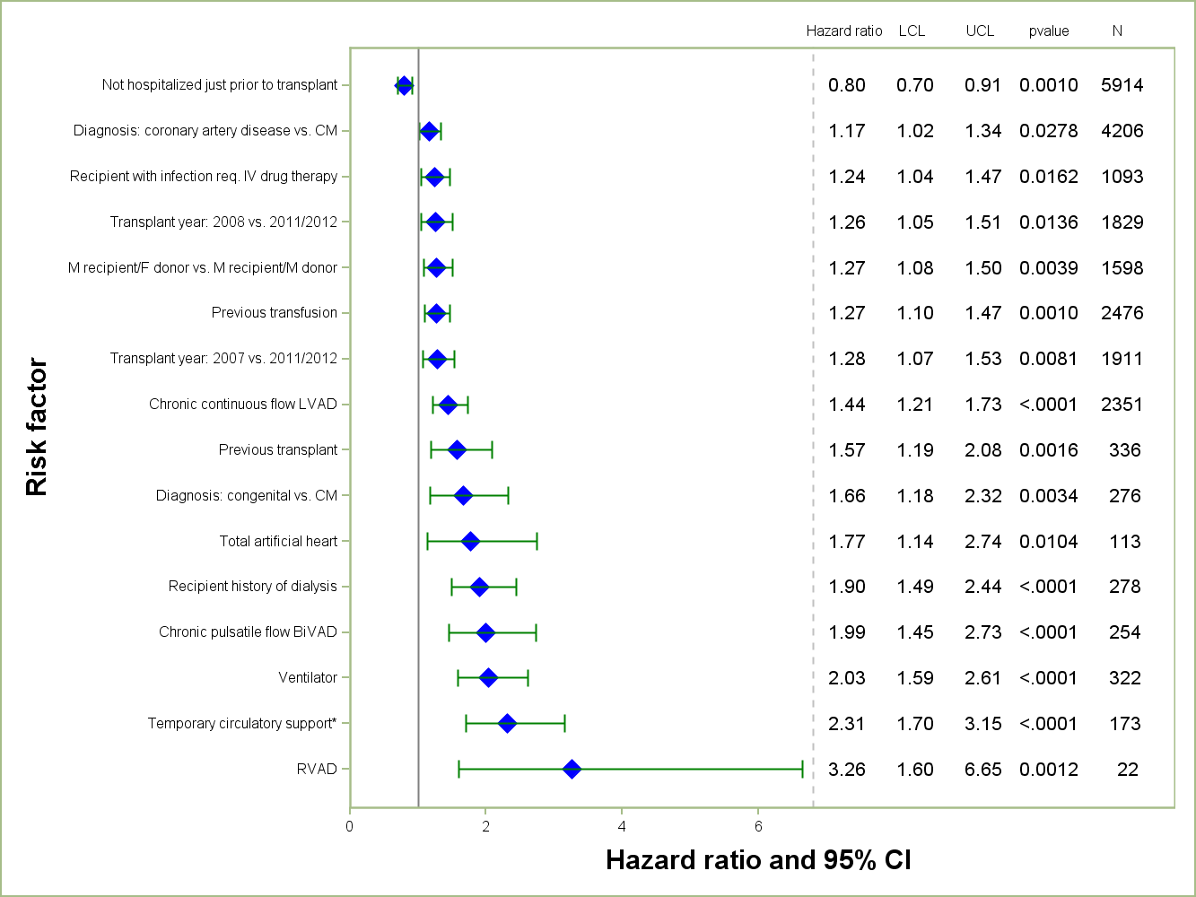
ADULT HEART TRANSPLANTS (2007-6/2012)
Risk Factors For 1 Year Mortality
2014
N = 10,739
* Temporary circulatory support includes ECMO and temporary pulsatile flow devices.
JHLT. 2014 Oct; 33(10): 996-1008
Notes:
Multivariable analysis was performed using a proportional hazards model censoring all patients at 1 year. Continuous factors were fit using a restricted cubic spline.
Analyses were limited to transplants having essentially complete information regarding risk factors.

Slide 172
ADULT HEART TRANSPLANTS (2007-6/2012)
Risk Factors For 1 Year Mortality
Continuous Factors (see figures)
Recipient age | Ischemia time
Recipient height | Recipient pre-transplant bilirubin
Donor age | Recipient pre-transplant creatinine
Transplant center volume
2014
JHLT. 2014 Oct; 33(10): 996-1008
Notes:
Multivariable analysis was performed using a proportional hazards model censoring all patients at 1 year. Continuous factors were fit using a restricted cubic spline.
Analyses were limited to transplants having essentially complete information regarding risk factors.

Slide 173
ADULT HEART TRANSPLANTS (2007-6/2012)
Risk Factors For 1 Year Mortality with 95% Confidence Limits
Recipient Age
p < 0.0001
2014
(N = 10,739)
JHLT. 2014 Oct; 33(10): 996-1008
Notes:
Multivariable analysis was performed using a proportional hazards model censoring all patients at 1 year. Continuous factors were fit using a restricted cubic spline.
Analyses were limited to transplants having essentially complete information regarding risk factors.

Slide 174
ADULT HEART TRANSPLANTS (2007-6/2012)
Risk Factors For 1 Year Mortality with 95% Confidence Limits
Donor Age
p < 0.0001
2014
(N = 10,739)
JHLT. 2014 Oct; 33(10): 996-1008
Notes:
Multivariable analysis was performed using a proportional hazards model censoring all patients at 1 year. Continuous factors were fit using a restricted cubic spline.
Analyses were limited to transplants having essentially complete information regarding risk factors.

Slide 175
ADULT HEART TRANSPLANTS (2007-6/2012)
Risk Factors For 1 Year Mortality with 95% Confidence Limits
Recipient Height
p < 0.0001
2014
(N = 10,739)
JHLT. 2014 Oct; 33(10): 996-1008
Notes:
Multivariable analysis was performed using a proportional hazards model censoring all patients at 1 year. Continuous factors were fit using a restricted cubic spline.
Analyses were limited to transplants having essentially complete information regarding risk factors.

Slide 176
ADULT HEART TRANSPLANTS (2007-6/2012)
Risk Factors For 1 Year Mortality with 95% Confidence Limits
Ischemia Time
p < 0.0001
2014
(N = 10,739)
JHLT. 2014 Oct; 33(10): 996-1008
Notes:
Multivariable analysis was performed using a proportional hazards model censoring all patients at 1 year. Continuous factors were fit using a restricted cubic spline.
Analyses were limited to transplants having essentially complete information regarding risk factors.

Slide 177
ADULT HEART TRANSPLANTS (2007-6/2012)
Risk Factors For 1 Year Mortality with 95% Confidence Limits
Center Volume
p < 0.0001
2014
(N = 10,739)
JHLT. 2014 Oct; 33(10): 996-1008
Notes:
Multivariable analysis was performed using a proportional hazards model censoring all patients at 1 year. Continuous factors were fit using a restricted cubic spline.
Analyses were limited to transplants having essentially complete information regarding risk factors.

Slide 178
ADULT HEART TRANSPLANTS (2007-6/2012)
Risk Factors For 1 Year Mortality with 95% Confidence Limits
Recipient Pre-Transplant Bilirubin
p < 0.0001
2014
(N = 10,739)
JHLT. 2014 Oct; 33(10): 996-1008
Notes:
Multivariable analysis was performed using a proportional hazards model censoring all patients at 1 year. Continuous factors were fit using a restricted cubic spline.
Analyses were limited to transplants having essentially complete information regarding risk factors.

Slide 179
ADULT HEART TRANSPLANTS (2007-6/2012)
Risk Factors For 1 Year Mortality with 95% Confidence Limits
Recipient Pre-Transplant Creatinine
p < 0.0001
2014
(N = 10,739)
JHLT. 2014 Oct; 33(10): 996-1008
Notes:
Multivariable analysis was performed using a proportional hazards model censoring all patients at 1 year. Continuous factors were fit using a restricted cubic spline.
Analyses were limited to transplants having essentially complete information regarding risk factors.

Slide 180
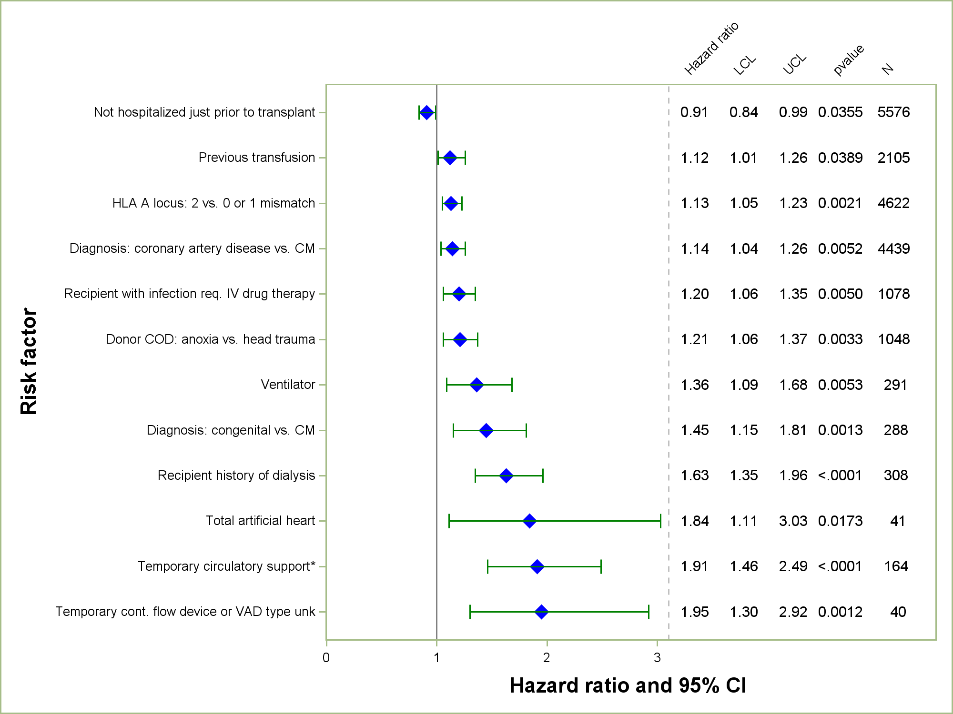
ADULT HEART TRANSPLANTS (2003-6/2008)
Risk Factors For 5 Year Mortality
2014
N = 10,306
* Temporary circulatory support includes ECMO and temporary pulsatile flow devices.
JHLT. 2014 Oct; 33(10): 996-1008
Notes:
Multivariable analysis was performed using a proportional hazards model censoring all patients at 5 years. Continuous factors were fit using a restricted cubic spline.
Analyses were limited to transplants having essentially complete information regarding risk factors.

Slide 181
ADULT HEART TRANSPLANTS (2003-6/2008)
Risk Factors For 5 Year Mortality
Continuous Factors (see figures)
Recipient age | Ischemia time
Recipient height | Recipient pre-transplant bilirubin
Recipient BMI | Recipient pre-transplant creatinine
Donor age | Recipient most recent Class I PRA (%)
Donor BMI | Recipient transpulmonary gradient
Transplant center volume
2014
JHLT. 2014 Oct; 33(10): 996-1008
Notes:
Multivariable analysis was performed using a proportional hazards model censoring all patients at 5 years. Continuous factors were fit using a restricted cubic spline.
Analyses were limited to transplants having essentially complete information regarding risk factors.

Slide 182
ADULT HEART TRANSPLANTS (2003-6/2008)
Risk Factors For 5 Year Mortality with 95% Confidence Limits
Recipient Age
p < 0.0001
2014
(N = 10,306)
JHLT. 2014 Oct; 33(10): 996-1008
Notes:
Multivariable analysis was performed using a proportional hazards model censoring all patients at 5 years. Continuous factors were fit using a restricted cubic spline.
Analyses were limited to transplants having essentially complete information regarding risk factors.

Slide 183
ADULT HEART TRANSPLANTS (2003-6/2008)
Risk Factors For 5 Year Mortality with 95% Confidence Limits
Donor Age
p < 0.0001
2014
(N = 10,306)
JHLT. 2014 Oct; 33(10): 996-1008
Notes:
Multivariable analysis was performed using a proportional hazards model censoring all patients at 5 years. Continuous factors were fit using a restricted cubic spline.
Analyses were limited to transplants having essentially complete information regarding risk factors.

Slide 184
ADULT HEART TRANSPLANTS (2003-6/2008)
Risk Factors For 5 Year Mortality with 95% Confidence Limits
Recipient Height
p = 0.0006
2014
(N = 10,306)
JHLT. 2014 Oct; 33(10): 996-1008
Notes:
Multivariable analysis was performed using a proportional hazards model censoring all patients at 5 years. Continuous factors were fit using a restricted cubic spline.
Analyses were limited to transplants having essentially complete information regarding risk factors.

Slide 185
ADULT HEART TRANSPLANTS (2003-6/2008)
Risk Factors For 5 Year Mortality with 95% Confidence Limits
Recipient and Donor BMI
Recipient BMI: p = 0.0022
Donor BMI: p = 0.0227
2014
(N = 10,306)
JHLT. 2014 Oct; 33(10): 996-1008
Notes:
Multivariable analysis was performed using a proportional hazards model censoring all patients at 5 years. Continuous factors were fit using a restricted cubic spline.
Analyses were limited to transplants having essentially complete information regarding risk factors.

Slide 186
ADULT HEART TRANSPLANTS (2003-6/2008)
Risk Factors For 5 Year Mortality with 95% Confidence Limits
Ischemia Time
p < 0.0001
2014
(N = 10,306)
JHLT. 2014 Oct; 33(10): 996-1008
Notes:
Multivariable analysis was performed using a proportional hazards model censoring all patients at 5 years. Continuous factors were fit using a restricted cubic spline.
Analyses were limited to transplants having essentially complete information regarding risk factors.

Slide 187
ADULT HEART TRANSPLANTS (2003-6/2008)
Risk Factors For 5 Year Mortality with 95% Confidence Limits
Center Volume
p = 0.0036
2014
(N = 10,306)
JHLT. 2014 Oct; 33(10): 996-1008
Notes:
Multivariable analysis was performed using a proportional hazards model censoring all patients at 5 years. Continuous factors were fit using a restricted cubic spline.
Analyses were limited to transplants having essentially complete information regarding risk factors.

Slide 188
ADULT HEART TRANSPLANTS (2003-6/2008)
Risk Factors For 5 Year Mortality with 95% Confidence Limits
Recipient Pre-Transplant Bilirubin
p = 0.0109
2014
(N = 10,306)
JHLT. 2014 Oct; 33(10): 996-1008
Notes:
Multivariable analysis was performed using a proportional hazards model censoring all patients at 5 years. Continuous factors were fit using a restricted cubic spline.
Analyses were limited to transplants having essentially complete information regarding risk factors.

Slide 189
ADULT HEART TRANSPLANTS (2003-6/2008)
Risk Factors For 5 Year Mortality with 95% Confidence Limits
Recipient Pre-Transplant Creatinine
p < 0.0001
2014
(N = 10,306)
JHLT. 2014 Oct; 33(10): 996-1008
Notes:
Multivariable analysis was performed using a proportional hazards model censoring all patients at 5 years. Continuous factors were fit using a restricted cubic spline.
Analyses were limited to transplants having essentially complete information regarding risk factors.

Slide 190
ADULT HEART TRANSPLANTS (2003-6/2008)
Risk Factors For 5 Year Mortality with 95% Confidence Limits
Recipient Most Recent Class I PRA (%)
p < 0.0001
2014
(N = 10,306)
JHLT. 2014 Oct; 33(10): 996-1008
Notes:
Multivariable analysis was performed using a proportional hazards model censoring all patients at 5 years. Continuous factors were fit using a restricted cubic spline.
Analyses were limited to transplants having essentially complete information regarding risk factors.

Slide 191
ADULT HEART TRANSPLANTS (2003-6/2008)
Risk Factors For 5 Year Mortality with 95% Confidence Limits
Transpulmonary Pressure Gradient (TPG)
p = 0.0024
2014
(N = 10,306)
JHLT. 2014 Oct; 33(10): 996-1008
Notes:
Multivariable analysis was performed using a proportional hazards model censoring all patients at 5 years. Continuous factors were fit using a restricted cubic spline.
Analyses were limited to transplants having essentially complete information regarding risk factors.

Slide 192
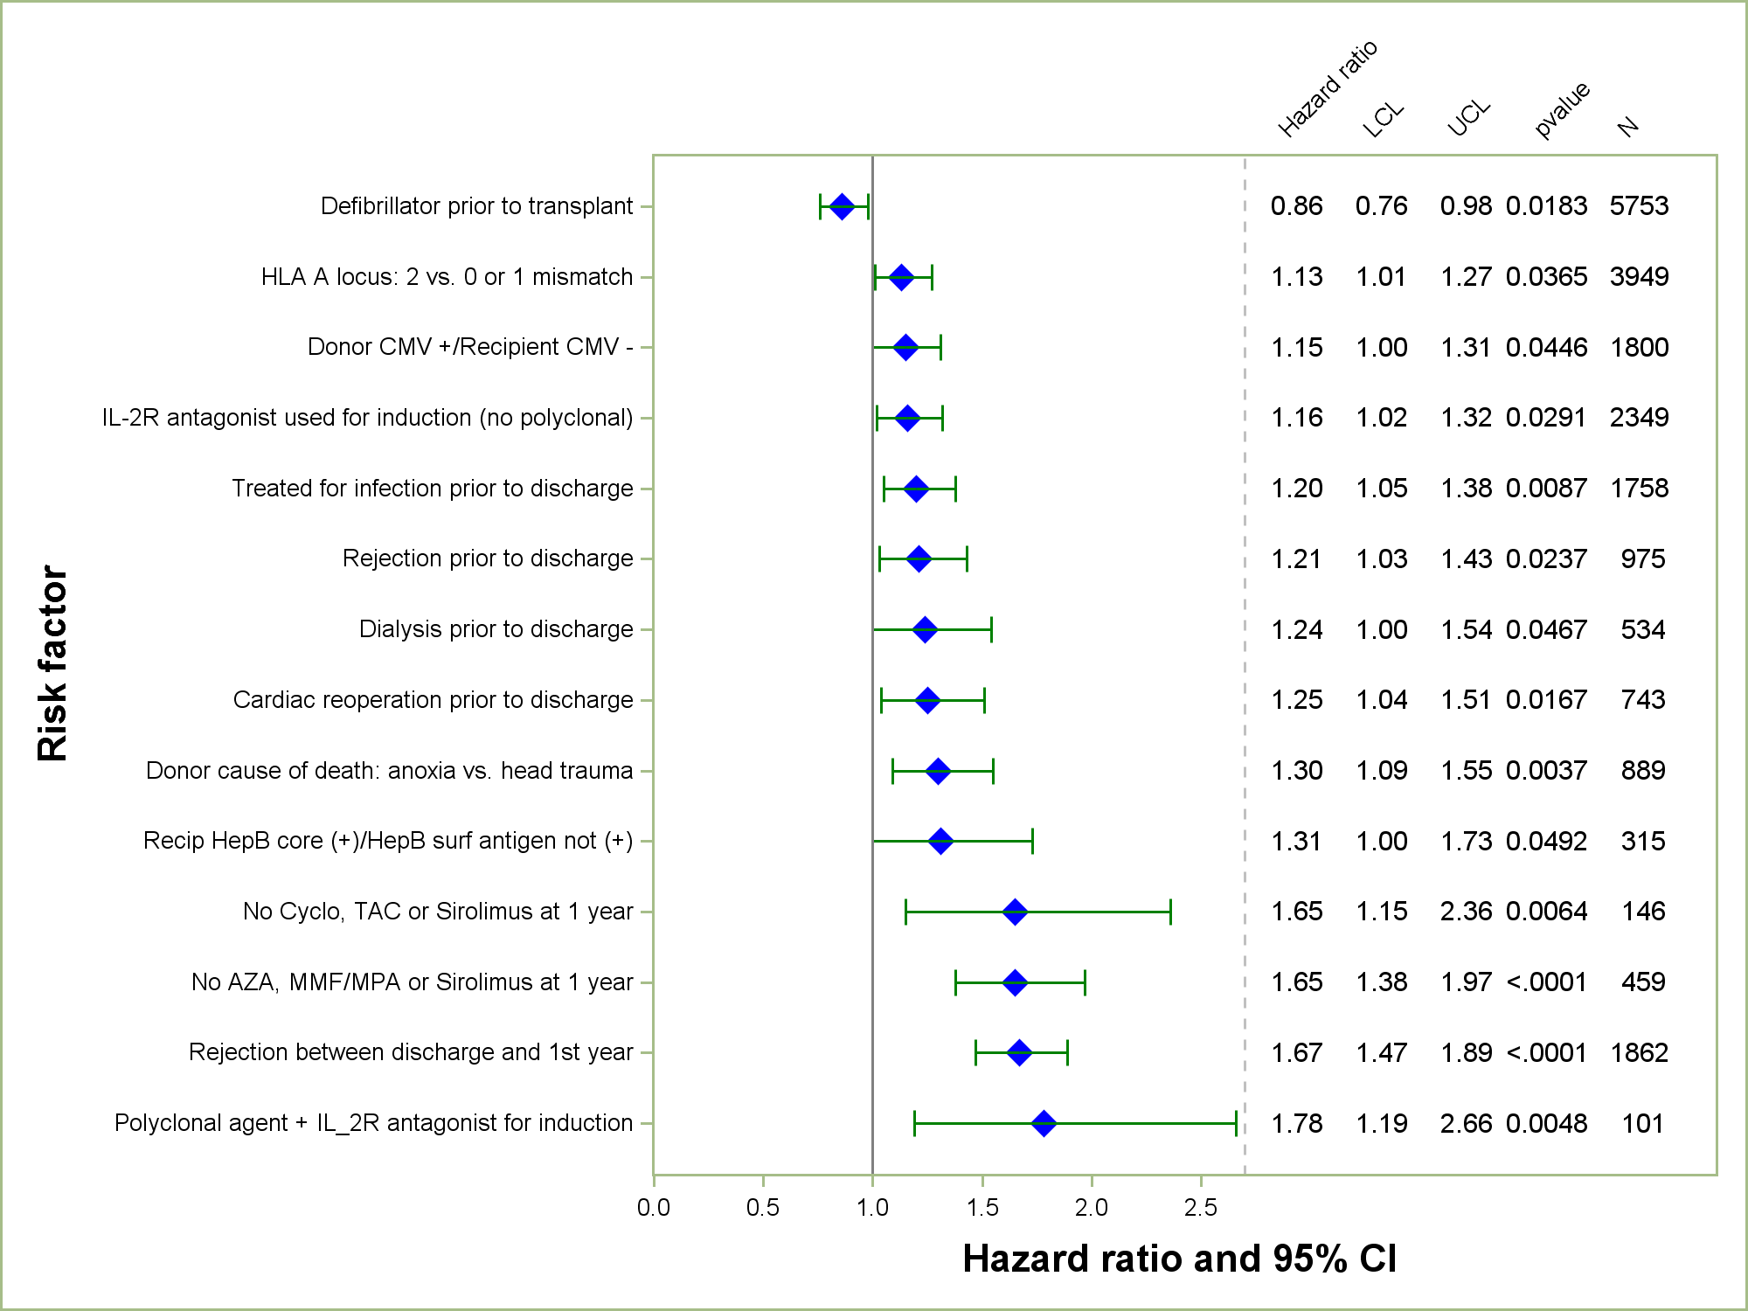
ADULT HEART TRANSPLANTS (2003-6/2008)
Risk Factors For 5 Year Mortality
Conditional on Survival to 1 Year
2014
N = 8,777
JHLT. 2014 Oct; 33(10): 996-1008
Notes:
Multivariable analysis was performed using a proportional hazards model censoring all patients at 5 years. Continuous factors were fit using a restricted cubic spline.
Analyses were limited to transplants having essentially complete information regarding risk factors.

Slide 193
ADULT HEART TRANSPLANTS (2003-6/2008)
Risk Factors For 5 Year Mortality
Conditional on Survival to 1 Year
Continuous Factors (see figures)
Difference in donor and recipient age | Recipient height
Recipient pre-transplant creatinine
2014
JHLT. 2014 Oct; 33(10): 996-1008
Notes:
Multivariable analysis was performed using a proportional hazards model censoring all patients at 5 years. Continuous factors were fit using a restricted cubic spline.
Analyses were limited to transplants having essentially complete information regarding risk factors.

Slide 194
ADULT HEART TRANSPLANTS (2003-6/2008)
Risk Factors For 5 Year Mortality with 95% Confidence Limits
Conditional on Survival to 1 Year
Donor Age - Recipient Age
p < 0.0001
2014
(N = 8,777)
JHLT. 2014 Oct; 33(10): 996-1008
Notes:
Multivariable analysis was performed using a proportional hazards model censoring all patients at 5 years. Continuous factors were fit using a restricted cubic spline.
Analyses were limited to transplants having essentially complete information regarding risk factors.

Slide 195
ADULT HEART TRANSPLANTS (2003-6/2008)
Risk Factors For 5 Year Mortality with 95% Confidence Limits
Conditional on Survival to 1 Year
Recipient Height
p = 0.0474
2014
(N = 8,777)
JHLT. 2014 Oct; 33(10): 996-1008
Notes:
Multivariable analysis was performed using a proportional hazards model censoring all patients at 5 years. Continuous factors were fit using a restricted cubic spline.
Analyses were limited to transplants having essentially complete information regarding risk factors.

Slide 196
ADULT HEART TRANSPLANTS (2003-6/2008)
Risk Factors For 5 Year Mortality with 95% Confidence Limits
Conditional on Survival to 1 Year
Recipient Pre-Transplant Creatinine
P = 0.0398
2014
(N = 8,777)
JHLT. 2014 Oct; 33(10): 996-1008
Notes:
Multivariable analysis was performed using a proportional hazards model censoring all patients at 5 years. Continuous factors were fit using a restricted cubic spline.
Analyses were limited to transplants having essentially complete information regarding risk factors.

Slide 197
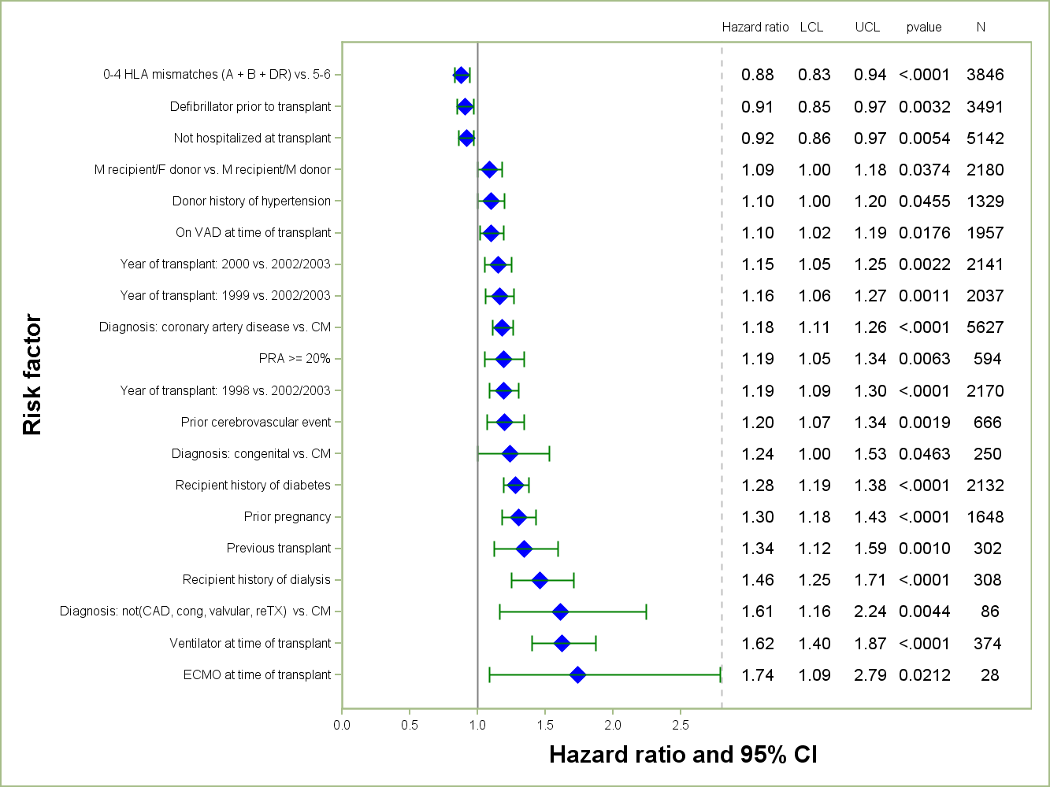
ADULT HEART TRANSPLANTS (1998-6/2003)
Risk Factors For 10 Year Mortality
2014
N = 11,641
JHLT. 2014 Oct; 33(10): 996-1008
Notes:
Multivariable analysis was performed using a proportional hazards model censoring all patients at 10 years. Continuous factors were fit using a restricted cubic spline.
Analyses were limited to transplants having essentially complete information regarding risk factors.

Slide 198
ADULT HEART TRANSPLANTS (1998-6/2003)
Risk Factors For 10 Year Mortality
Continuous Factors (see figures)
Recipient age | Ischemia time
Recipient weight | Recipient pre-transplant bilirubin
Donor age | Recipient pre-transplant creatinine
Donor weight | Transplant center volume
2014
JHLT. 2014 Oct; 33(10): 996-1008
Notes:
Multivariable analysis was performed using a proportional hazards model censoring all patients at 10 years. Continuous factors were fit using a restricted cubic spline.
Analyses were limited to transplants having essentially complete information regarding risk factors.

Slide 199
ADULT HEART TRANSPLANTS (1998-6/2003)
Risk Factors For 10 Year Mortality with 95% Confidence Limits
Recipient Age
p < 0.0001
2014
(N = 11,641)
JHLT. 2014 Oct; 33(10): 996-1008
Notes:
Multivariable analysis was performed using a proportional hazards model censoring all patients at 10 years. Continuous factors were fit using a restricted cubic spline.
Analyses were limited to transplants having essentially complete information regarding risk factors.

Slide 200
ADULT HEART TRANSPLANTS (1998-6/2003)
Risk Factors For 10 Year Mortality with 95% Confidence Limits
Donor Age
p < 0.0001
2014
(N = 11,641)
JHLT. 2014 Oct; 33(10): 996-1008
Notes:
Multivariable analysis was performed using a proportional hazards model censoring all patients at 10 years. Continuous factors were fit using a restricted cubic spline.
Analyses were limited to transplants having essentially complete information regarding risk factors.

Slide 201
ADULT HEART TRANSPLANTS (1998-6/2003)
Risk Factors For 10 Year Mortality with 95% Confidence Limits
Recipient Weight
p = 0.0007
2014
(N = 11,641)
JHLT. 2014 Oct; 33(10): 996-1008
Notes:
Multivariable analysis was performed using a proportional hazards model censoring all patients at 10 years. Continuous factors were fit using a restricted cubic spline.
Analyses were limited to transplants having essentially complete information regarding risk factors.

Slide 202
ADULT HEART TRANSPLANTS (1998-6/2003)
Risk Factors For 10 Year Mortality with 95% Confidence Limits
Donor Weight
p = 0.0456
2014
(N = 11,641)
JHLT. 2014 Oct; 33(10): 996-1008
Notes:
Multivariable analysis was performed using a proportional hazards model censoring all patients at 10 years. Continuous factors were fit using a restricted cubic spline.
Analyses were limited to transplants having essentially complete information regarding risk factors.

Slide 203
ADULT HEART TRANSPLANTS (1998-6/2003)
Risk Factors For 10 Year Mortality with 95% Confidence Limits
Ischemia Time
p = 0.0007
2014
(N = 11,641)
JHLT. 2014 Oct; 33(10): 996-1008
Notes:
Multivariable analysis was performed using a proportional hazards model censoring all patients at 10 years. Continuous factors were fit using a restricted cubic spline.
Analyses were limited to transplants having essentially complete information regarding risk factors.

Slide 204
ADULT HEART TRANSPLANTS (1998-6/2003)
Risk Factors For 10 Year Mortality with 95% Confidence Limits
Center Volume
p < 0.0001
2014
(N = 11,641)
JHLT. 2014 Oct; 33(10): 996-1008
Notes:
Multivariable analysis was performed using a proportional hazards model censoring all patients at 10 years. Continuous factors were fit using a restricted cubic spline.
Analyses were limited to transplants having essentially complete information regarding risk factors.

Slide 205
ADULT HEART TRANSPLANTS (1998-6/2003)
Risk Factors For 10 Year Mortality with 95% Confidence Limits
Recipient Pre-Transplant Bilirubin
p = 0.0002
2014
(N = 11,641)
JHLT. 2014 Oct; 33(10): 996-1008
Notes:
Multivariable analysis was performed using a proportional hazards model censoring all patients at 10 years. Continuous factors were fit using a restricted cubic spline.
Analyses were limited to transplants having essentially complete information regarding risk factors.

Slide 206
ADULT HEART TRANSPLANTS (1998-6/2003)
Risk Factors For 10 Year Mortality with 95% Confidence Limits
Recipient Pre-Transplant Creatinine
p < 0.0001
2014
(N = 11,641)
JHLT. 2014 Oct; 33(10): 996-1008
Notes:
Multivariable analysis was performed using a proportional hazards model censoring all patients at 10 years. Continuous factors were fit using a restricted cubic spline.
Analyses were limited to transplants having essentially complete information regarding risk factors.

Slide 207
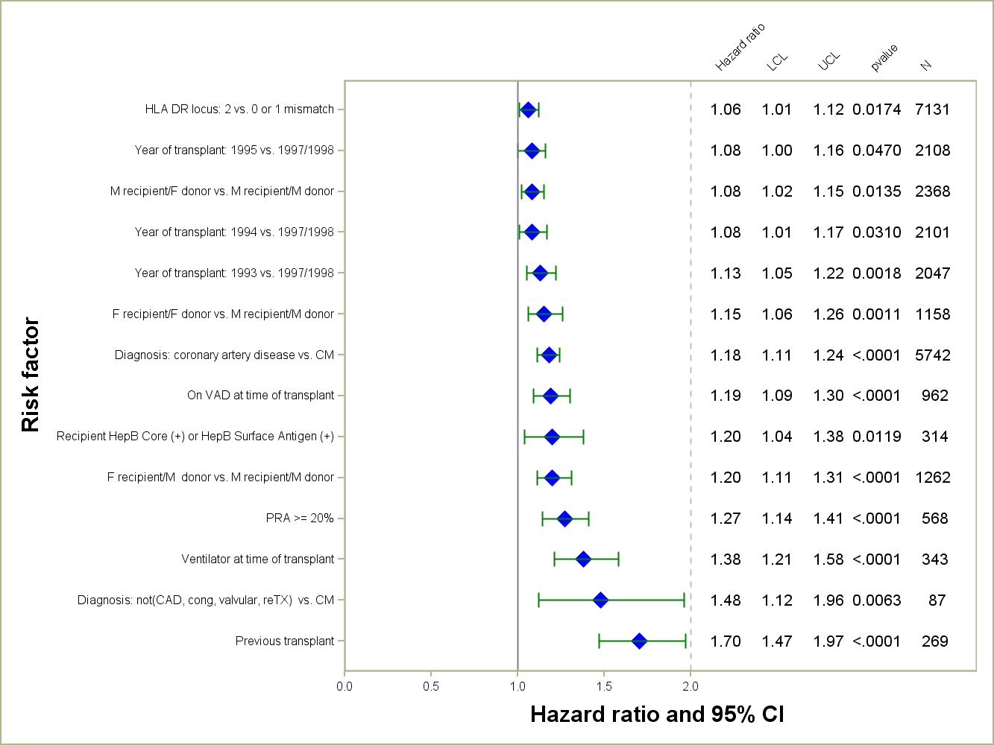
ADULT HEART TRANSPLANTS (1993-6/1998)
Risk Factors For 15 Year Mortality
2014
N = 11,423
JHLT. 2014 Oct; 33(10): 996-1008
Notes:
Multivariable analysis was performed using a proportional hazards model censoring all patients at 15 years. Continuous factors were fit using a restricted cubic spline.
Analyses were limited to transplants having essentially complete information regarding risk factors.

Slide 208
ADULT HEART TRANSPLANTS (1993-6/1998)
Risk Factors For 15 Year Mortality
Continuous Factors (see figures)
Recipient age | Ischemia time
Difference in recipient and donor age | Recipient pre-transplant creatinine
Recipient BMI | Transplant center volume
2014
JHLT. 2014 Oct; 33(10): 996-1008
Notes:
Multivariable analysis was performed using a proportional hazards model censoring all patients at 15 years. Continuous factors were fit using a restricted cubic spline.
Analyses were limited to transplants having essentially complete information regarding risk factors.

Slide 209
ADULT HEART TRANSPLANTS (1993-6/1998)
Risk Factors For 15 Year Mortality with 95% Confidence Limits
Recipient Age
p < 0.0001
2014
(N = 11,423)
JHLT. 2014 Oct; 33(10): 996-1008
Notes:
Multivariable analysis was performed using a proportional hazards model censoring all patients at 15 years. Continuous factors were fit using a restricted cubic spline.
Analyses were limited to transplants having essentially complete information regarding risk factors.

Slide 210
ADULT HEART TRANSPLANTS (1993-6/1998)
Risk Factors For 15 Year Mortality with 95% Confidence Limits
Donor Age – Recipient Age
p < 0.0001
2014
(N = 11,423)
JHLT. 2014 Oct; 33(10): 996-1008
Notes:
Multivariable analysis was performed using a proportional hazards model censoring all patients at 15 years. Continuous factors were fit using a restricted cubic spline.
Analyses were limited to transplants having essentially complete information regarding risk factors.

Slide 211
ADULT HEART TRANSPLANTS (1993-6/1998)
Risk Factors For 15 Year Mortality with 95% Confidence Limits
Recipient BMI
p < 0.0001
2014
(N = 11,423)
JHLT. 2014 Oct; 33(10): 996-1008
Notes:
Multivariable analysis was performed using a proportional hazards model censoring all patients at 15 years. Continuous factors were fit using a restricted cubic spline.
Analyses were limited to transplants having essentially complete information regarding risk factors.

Slide 212
ADULT HEART TRANSPLANTS (1993-6/1998)
Risk Factors For 15 Year Mortality with 95% Confidence Limits
Ischemia Time
p = 0.0003
2014
(N = 11,423)
JHLT. 2014 Oct; 33(10): 996-1008
Notes:
Multivariable analysis was performed using a proportional hazards model censoring all patients at 15 years. Continuous factors were fit using a restricted cubic spline.
Analyses were limited to transplants having essentially complete information regarding risk factors.

Slide 213
ADULT HEART TRANSPLANTS (1993-6/1998)
Risk Factors For 15 Year Mortality with 95% Confidence Limits
Center Volume
p = 0.0009
2014
(N = 11,423)
JHLT. 2014 Oct; 33(10): 996-1008
Notes:
Multivariable analysis was performed using a proportional hazards model censoring all patients at 15 years. Continuous factors were fit using a restricted cubic spline.
Analyses were limited to transplants having essentially complete information regarding risk factors.

Slide 214
ADULT HEART TRANSPLANTS (1993-6/1998)
Risk Factors For 15 Year Mortality with 95% Confidence Limits
Recipient Pre-Transplant Creatinine
p < 0.0001
2014
(N = 11,423)
JHLT. 2014 Oct; 33(10): 996-1008
Notes:
Multivariable analysis was performed using a proportional hazards model censoring all patients at 15 Year. Continuous factors were fit using a restricted cubic spline.
Analyses were limited to transplants having essentially complete information regarding risk factors.

Slide 215
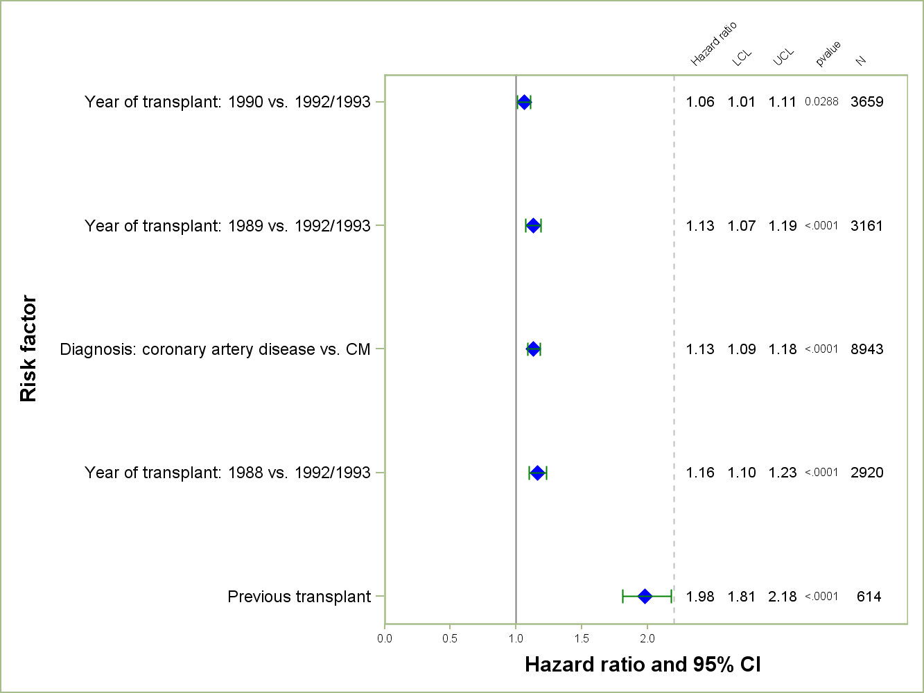
ADULT HEART TRANSPLANTS (1988-6/1993)
Risk Factors For 20 Year Mortality
2014
N = 19,208
JHLT. 2014 Oct; 33(10): 996-1008
Notes:
Multivariable analysis was performed using a proportional hazards model censoring all patients at 20 years. Continuous factors were fit using a restricted cubic spline.
Analyses were limited to transplants having essentially complete information regarding risk factors.

Slide 216
ADULT HEART TRANSPLANTS (1988-6/1993)
Risk Factors For 20 Year Mortality
Continuous Factors (see figures)
Recipient age | Transplant center volume
Difference in donor age and recipient age as a percentage of recipient age
2014
JHLT. 2014 Oct; 33(10): 996-1008
Notes:
Multivariable analysis was performed using a proportional hazards model censoring all patients at 20 years. Continuous factors were fit using a restricted cubic spline.
Analyses were limited to transplants having essentially complete information regarding risk factors.

Slide 217
ADULT HEART TRANSPLANTS (1988-6/1993)
Risk Factors For 20 Year Mortality with 95% Confidence Limits
Recipient Age
p < 0.0001
2014
(N = 19,208)
JHLT. 2014 Oct; 33(10): 996-1008
Notes:
Multivariable analysis was performed using a proportional hazards model censoring all patients at 20 years. Continuous factors were fit using a restricted cubic spline.
Analyses were limited to transplants having essentially complete information regarding risk factors.

Slide 218
ADULT HEART TRANSPLANTS (1988-6/1993)
Risk Factors For 20 Year Mortality with 95% Confidence Limits
Percentage Difference in Donor Age and Recipient Age
p < 0.0001
If the donor is younger than the recipient then the percentage will be negative. If the difference is relatively small, the percentage difference will be close to 0%.
Example: If a donor was 30 years old and the recipient was 50 years old, the difference between the two ages would be -20. Therefore the percentage would be 100*(-20/50) = -40%
2014
(N = 19,208)
JHLT. 2014 Oct; 33(10): 996-1008
Notes:
Multivariable analysis was performed using a proportional hazards model censoring all patients at 20 years. Continuous factors were fit using a restricted cubic spline.
Analyses were limited to transplants having essentially complete information regarding risk factors.

Slide 219
ADULT HEART TRANSPLANTS (1988-6/1993)
Risk Factors For 20 Year Mortality with 95% Confidence Limits
Center Volume
p < 0.0001
2014
(N = 19,208)
JHLT. 2014 Oct; 33(10): 996-1008
Notes:
Multivariable analysis was performed using a proportional hazards model censoring all patients at 20 years. Continuous factors were fit using a restricted cubic spline.
Analyses were limited to transplants having essentially complete information regarding risk factors.

Slide 220
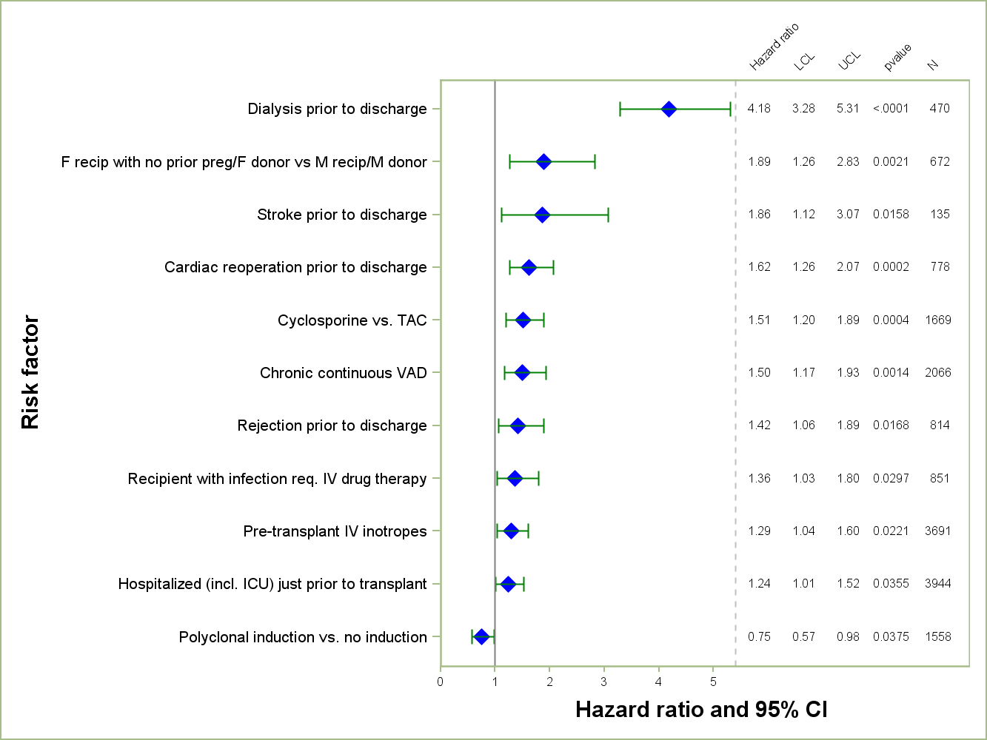
ADULT HEART TRANSPLANTS (2007-6/2012)
Risk Factors for Developing Severe Renal Dysfunction within 1 Year
Limited to Recipients without Severe Renal Dysfunction* Pre-Transplant
Conditional on Survival to Transplant Discharge
N = 9,019
2014
*Severe renal dysfunction = creatinine > 2.5 mg/dl or dialysis
JHLT. 2014 Oct; 33(10): 996-1008
Notes:
Multivariable analysis was performed using a proportional hazards model censoring all patients at 1 year. Continuous factors were fit using a restricted cubic spline.
Analyses were limited to transplants having essentially complete information regarding risk factors.

Slide 221
ADULT HEART TRANSPLANTS (2007-6/2012)
Risk Factors for Developing Severe Renal Dysfunction within 1 Year
Limited to Recipients without Severe Renal Dysfunction* Pre-Transplant
Conditional on Survival to Transplant Discharge
Continuous Factors (see figures)
Recipient age | Recipient pre-transplant creatinine
Recipient weight
*Severe renal dysfunction = creatinine > 2.5 mg/dl or dialysis
2014
JHLT. 2014 Oct; 33(10): 996-1008
Notes:
Multivariable analysis was performed using a proportional hazards model censoring all patients at 1 year. Continuous factors were fit using a restricted cubic spline.
Analyses were limited to transplants having essentially complete information regarding risk factors.

Slide 222
ADULT HEART TRANSPLANTS (2007-6/2012)
Risk Factors for Developing Severe Renal Dysfunction within 1 Year
Limited to Recipients without Severe Renal Dysfunction* Pre-Transplant
Conditional on Survival to Transplant Discharge
Recipient Age
p = 0.0107
*Severe renal dysfunction = creatinine > 2.5 mg/dl or dialysis
2014
(N = 9,019)
JHLT. 2014 Oct; 33(10): 996-1008
Notes:
Multivariable analysis was performed using a proportional hazards model censoring all patients at 1 year. Continuous factors were fit using a restricted cubic spline.
Analyses were limited to transplants having essentially complete information regarding risk factors.

Slide 223
ADULT HEART TRANSPLANTS (2007-6/2012)
Risk Factors for Developing Severe Renal Dysfunction within 1 Year
Limited to Recipients without Severe Renal Dysfunction* Pre-Transplant
Conditional on Survival to Transplant Discharge
Recipient Weight
p = 0.0059
*Severe renal dysfunction = creatinine > 2.5 mg/dl or dialysis
2014
(N = 9,019)
JHLT. 2014 Oct; 33(10): 996-1008
Notes:
Multivariable analysis was performed using a proportional hazards model censoring all patients at 1 year. Continuous factors were fit using a restricted cubic spline.
Analyses were limited to transplants having essentially complete information regarding risk factors.

Slide 224
ADULT HEART TRANSPLANTS (2007-6/2012)
Risk Factors for Developing Severe Renal Dysfunction within 1 Year
Limited to Recipients without Severe Renal Dysfunction* Pre-Transplant
Conditional on Survival to Transplant Discharge
Recipient Pre-Transplant Creatinine
p < 0.0001
*Severe renal dysfunction = creatinine > 2.5 mg/dl or dialysis
2014
(N = 9,019)
JHLT. 2014 Oct; 33(10): 996-1008
Notes:
Multivariable analysis was performed using a proportional hazards model censoring all patients at 1 year. Continuous factors were fit using a restricted cubic spline.
Analyses were limited to transplants having essentially complete information regarding risk factors.

Slide 225
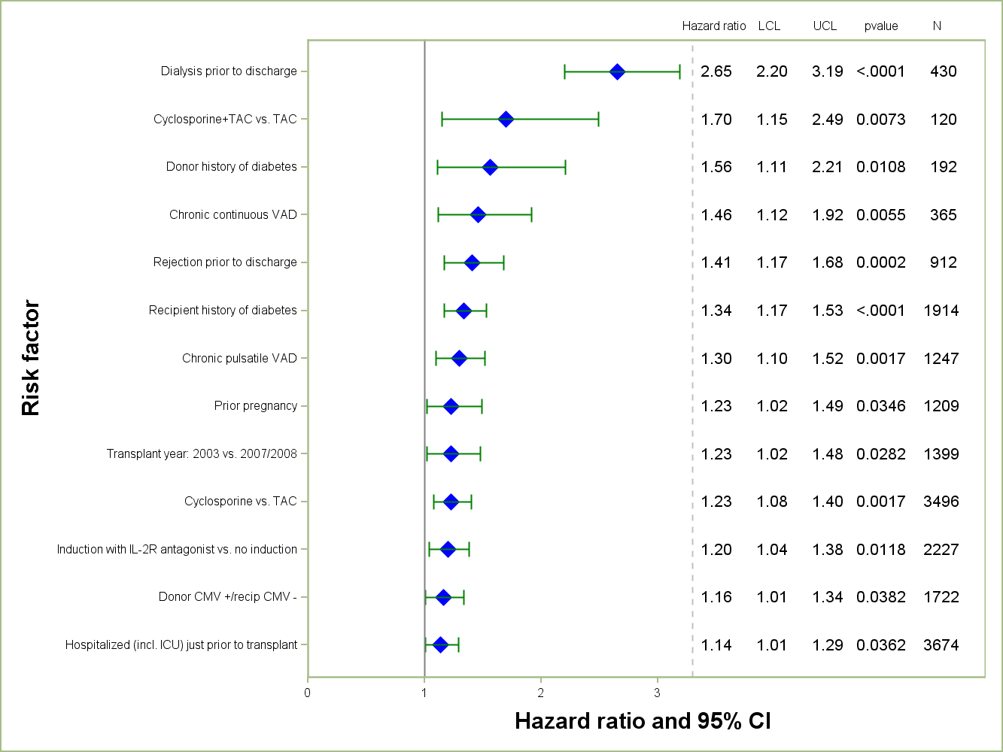
ADULT HEART TRANSPLANTS (2003-6/2008)
Risk Factors for Developing Severe Renal Dysfunction within 5 Years
Limited to Recipients without Severe Renal Dysfunction* Pre-Transplant
Conditional on Survival to Transplant Discharge
2014
N = 8,239
*Severe renal dysfunction = creatinine > 2.5 mg/dl or dialysis
JHLT. 2014 Oct; 33(10): 996-1008
Notes:
Multivariable analysis was performed using a proportional hazards model censoring all patients at 5 years. Continuous factors were fit using a restricted cubic spline.
Analyses were limited to transplants having essentially complete information regarding risk factors.

Slide 226
ADULT HEART TRANSPLANTS (2003-6/2008)
Risk Factors for Developing Severe Renal Dysfunction within 5 Years
Limited to Recipients without Severe Renal Dysfunction* Pre-Transplant
Conditional on Survival to Transplant Discharge
Continuous Factors (see figures)
Recipient age | Recipient pre-transplant bilirubin
Recipient weight | Recipient pulmonary artery systolic pressure
Recipient pre-transplant creatinine
*Severe renal dysfunction = creatinine > 2.5 mg/dl or dialysis
2014
JHLT. 2014 Oct; 33(10): 996-1008
Notes:
Multivariable analysis was performed using a proportional hazards model censoring all patients at 5 years. Continuous factors were fit using a restricted cubic spline.
Analyses were limited to transplants having essentially complete information regarding risk factors.

Slide 227
ADULT HEART TRANSPLANTS (2003-6/2008)
Risk Factors for Developing Severe Renal Dysfunction within 5 Years
Limited to Recipients without Severe Renal Dysfunction* Pre-Transplant
Conditional on Survival to Transplant Discharge
Recipient Age
p = 0.0149
*Severe renal dysfunction = creatinine > 2.5 mg/dl or dialysis
2014
(N = 8,239)
JHLT. 2014 Oct; 33(10): 996-1008
Notes:
Multivariable analysis was performed using a proportional hazards model censoring all patients at 5 years. Continuous factors were fit using a restricted cubic spline.
Analyses were limited to transplants having essentially complete information regarding risk factors.

Slide 228
ADULT HEART TRANSPLANTS (2003-6/2008)
Risk Factors for Developing Severe Renal Dysfunction within 5 Years
Limited to Recipients without Severe Renal Dysfunction* Pre-Transplant
Conditional on Survival to Transplant Discharge
Recipient Weight
p = 0.0021
*Severe renal dysfunction = creatinine > 2.5 mg/dl or dialysis
2014
(N = 8,239)
JHLT. 2014 Oct; 33(10): 996-1008
Notes:
Multivariable analysis was performed using a proportional hazards model censoring all patients at 5 years. Continuous factors were fit using a restricted cubic spline.
Analyses were limited to transplants having essentially complete information regarding risk factors.

Slide 229
ADULT HEART TRANSPLANTS (2003-6/2008)
Risk Factors for Developing Severe Renal Dysfunction within 5 Years
Limited to Recipients without Severe Renal Dysfunction* Pre-Transplant
Conditional on Survival to Transplant Discharge
Recipient Pre-Transplant Creatinine
p < 0.0001
*Severe renal dysfunction = creatinine > 2.5 mg/dl or dialysis
2014
(N = 8,239)
JHLT. 2014 Oct; 33(10): 996-1008
Notes:
Multivariable analysis was performed using a proportional hazards model censoring all patients at 5 years. Continuous factors were fit using a restricted cubic spline.
Analyses were limited to transplants having essentially complete information regarding risk factors.

Slide 230
ADULT HEART TRANSPLANTS (2003-6/2008)
Risk Factors for Developing Severe Renal Dysfunction within 5 Years
Limited to Recipients without Severe Renal Dysfunction* Pre-Transplant
Conditional on Survival to Transplant Discharge
Recipient Pre-Transplant Bilirubin
p = 0.0178
*Severe renal dysfunction = creatinine > 2.5 mg/dl or dialysis
2014
(N = 8,239)
JHLT. 2014 Oct; 33(10): 996-1008
Notes:
Multivariable analysis was performed using a proportional hazards model censoring all patients at 5 years. Continuous factors were fit using a restricted cubic spline.
Analyses were limited to transplants having essentially complete information regarding risk factors.

Slide 231
ADULT HEART TRANSPLANTS (2003-6/2008)
Risk Factors for Developing Severe Renal Dysfunction within 5 Years
Limited to Recipients without Severe Renal Dysfunction* Pre-Transplant
Conditional on Survival to Transplant Discharge
Recipient Pulmonary Artery Systolic Pressure
p = 0.0163
*Severe renal dysfunction = creatinine > 2.5 mg/dl or dialysis
2014
(N = 8,239)
JHLT. 2014 Oct; 33(10): 996-1008
Notes:
Multivariable analysis was performed using a proportional hazards model censoring all patients at 5 years. Continuous factors were fit using a restricted cubic spline.
Analyses were limited to transplants having essentially complete information regarding risk factors.

Slide 232
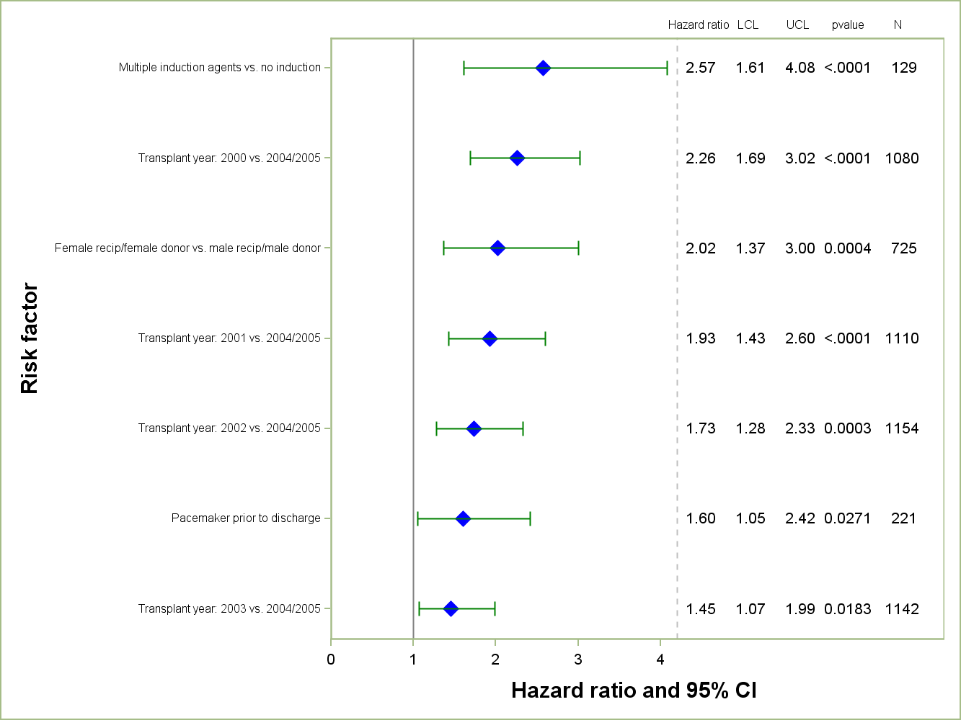
ADULT HEART TRANSPLANTS (2000-6/2005)
Risk Factors for Developing Non-Skin Malignancy within 8 Years
Limited to Recipients without Malignancy Pre-Transplant
Conditional on Survival to Transplant Discharge
2014
N = 6,214
JHLT. 2014 Oct; 33(10): 996-1008
Notes:
Multivariable analysis was performed using a proportional hazards model censoring all patients at 8 years. Continuous factors were fit using a restricted cubic spline.
Analyses were limited to transplants having essentially complete information regarding risk factors.

Slide 233
ADULT HEART TRANSPLANTS (2000-6/2005)
Risk Factors for Developing Non-Skin Malignancy within 8 Years
Limited to Recipients without Malignancy Pre-Transplant
Conditional on Survival to Transplant Discharge
Continuous Factors (see figures)
Recipient age | Donor weight
Ischemia time | Donor height
Transplant center volume | Donor/recipient height ratio
2014
JHLT. 2014 Oct; 33(10): 996-1008
Notes:
Multivariable analysis was performed using a proportional hazards model censoring all patients at 8 years. Continuous factors were fit using a restricted cubic spline.
Analyses were limited to transplants having essentially complete information regarding risk factors.

Slide 234
ADULT HEART TRANSPLANTS (2000-6/2005)
Risk Factors for Developing Non-Skin Malignancy within 8 Years
Limited to Recipients without Malignancy Pre-Transplant
Conditional on Survival to Transplant Discharge
Recipient Age
p < 0.0001
2014
(N = 6,214)
JHLT. 2014 Oct; 33(10): 996-1008
Notes:
Multivariable analysis was performed using a proportional hazards model censoring all patients at 8 years. Continuous factors were fit using a restricted cubic spline.
Analyses were limited to transplants having essentially complete information regarding risk factors.

Slide 235
ADULT HEART TRANSPLANTS (2000-6/2005)
Risk Factors for Developing Non-Skin Malignancy within 8 Years
Limited to Recipients without Malignancy Pre-Transplant
Conditional on Survival to Transplant Discharge
Ischemia Time
p = 0.0469
2014
(N = 6,214)
JHLT. 2014 Oct; 33(10): 996-1008
Notes:
Multivariable analysis was performed using a proportional hazards model censoring all patients at 8 years. Continuous factors were fit using a restricted cubic spline.
Analyses were limited to transplants having essentially complete information regarding risk factors.

Slide 236
ADULT HEART TRANSPLANTS (2000-6/2005)
Risk Factors for Developing Non-Skin Malignancy within 8 Years
Limited to Recipients without Malignancy Pre-Transplant
Conditional on Survival to Transplant Discharge
Center Volume
p = 0.0006
2014
(N = 6,214)
JHLT. 2014 Oct; 33(10): 996-1008
Notes:
Multivariable analysis was performed using a proportional hazards model censoring all patients at 8 years. Continuous factors were fit using a restricted cubic spline.
Analyses were limited to transplants having essentially complete information regarding risk factors.

Slide 237
ADULT HEART TRANSPLANTS (2000-6/2005)
Risk Factors for Developing Non-Skin Malignancy within 8 Years
Limited to Recipients without Malignancy Pre-Transplant
Conditional on Survival to Transplant Discharge
Donor Weight
p = 0.0382
2014
(N = 6,214)
JHLT. 2014 Oct; 33(10): 996-1008
Notes:
Multivariable analysis was performed using a proportional hazards model censoring all patients at 8 years. Continuous factors were fit using a restricted cubic spline.
Analyses were limited to transplants having essentially complete information regarding risk factors.

Slide 238
ADULT HEART TRANSPLANTS (2000-6/2005)
Risk Factors for Developing Non-Skin Malignancy within 8 Years
Limited to Recipients without Malignancy Pre-Transplant
Conditional on Survival to Transplant Discharge
Donor Height
p = 0.0058
2014
(N = 6,214)
JHLT. 2014 Oct; 33(10): 996-1008
Notes:
Multivariable analysis was performed using a proportional hazards model censoring all patients at 8 years. Continuous factors were fit using a restricted cubic spline.
Analyses were limited to transplants having essentially complete information regarding risk factors.

Slide 239
ADULT HEART TRANSPLANTS (2000-6/2005)
Risk Factors for Developing Non-Skin Malignancy within 8 Years
Limited to Recipients without Malignancy Pre-Transplant
Conditional on Survival to Transplant Discharge
Donor/Recipient Height Ratio
p = 0.0349
2014
(N = 6,214)
JHLT. 2014 Oct; 33(10): 996-1008
Notes:
Multivariable analysis was performed using a proportional hazards model censoring all patients at 8 years. Continuous factors were fit using a restricted cubic spline.
Analyses were limited to transplants having essentially complete information regarding risk factors.

Slide 240
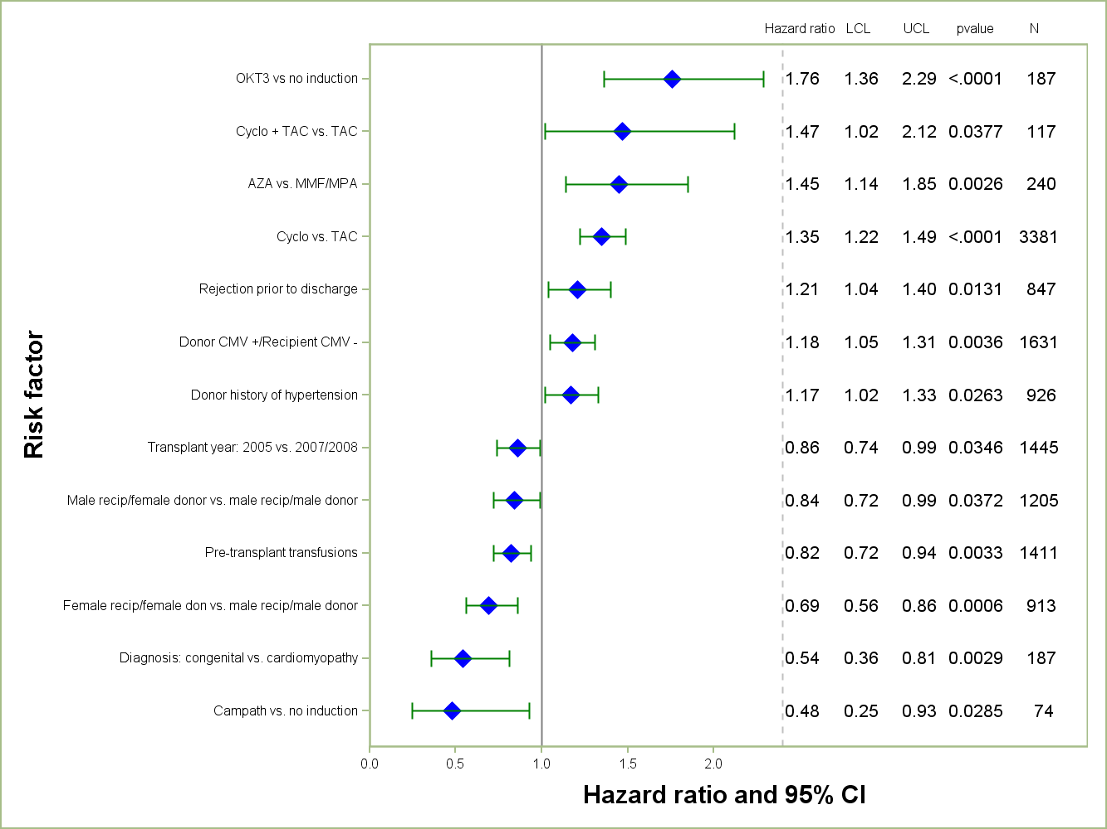
ADULT HEART TRANSPLANTS (2003-6/2008)
Risk Factors for Developing CAV within 5 Years
Conditional on Survival to Transplant Discharge
2014
N = 7,800
JHLT. 2014 Oct; 33(10): 996-1008
Notes:
Multivariable analysis was performed using a proportional hazards model censoring all patients at 5 years. Continuous factors were fit using a restricted cubic spline.
Analyses were limited to transplants having essentially complete information regarding risk factors.

Slide 241
ADULT HEART TRANSPLANTS (2003-6/2008)
Risk Factors for Developing CAV within 5 Years
Conditional on Survival to Transplant Discharge
Continuous Factors (see figures)
Recipient BMI | Donor height
Donor BMI | Donor age
Donor/recipient weight ratio
2014
JHLT. 2014 Oct; 33(10): 996-1008
Notes:
Multivariable analysis was performed using a proportional hazards model censoring all patients at 5 years. Continuous factors were fit using a restricted cubic spline.
Analyses were limited to transplants having essentially complete information regarding risk factors.

Slide 242
ADULT HEART TRANSPLANTS (2003-6/2008)
Risk Factors for Developing CAV within 5 Years
Conditional on Survival to Transplant Discharge
Recipient BMI
p = 0.0054
2014
(N = 7,800)
JHLT. 2014 Oct; 33(10): 996-1008
Notes:
Multivariable analysis was performed using a proportional hazards model censoring all patients at 5 years. Continuous factors were fit using a restricted cubic spline.
Analyses were limited to transplants having essentially complete information regarding risk factors.

Slide 243
ADULT HEART TRANSPLANTS (2003-6/2008)
Risk Factors for Developing CAV within 5 Years
Conditional on Survival to Transplant Discharge
Donor BMI
p = 0.0323
2014
(N = 7,800)
JHLT. 2014 Oct; 33(10): 996-1008
Notes:
Multivariable analysis was performed using a proportional hazards model censoring all patients at 5 years. Continuous factors were fit using a restricted cubic spline.
Analyses were limited to transplants having essentially complete information regarding risk factors.

Slide 244
ADULT HEART TRANSPLANTS (2003-6/2008)
Risk Factors for Developing CAV within 5 Years
Conditional on Survival to Transplant Discharge
Donor Height
p = 0.0105
2014
(N = 7,800)
JHLT. 2014 Oct; 33(10): 996-1008
Notes:
Multivariable analysis was performed using a proportional hazards model censoring all patients at 5 years. Continuous factors were fit using a restricted cubic spline.
Analyses were limited to transplants having essentially complete information regarding risk factors.

Slide 245
ADULT HEART TRANSPLANTS (2003-6/2008)
Risk Factors for Developing CAV within 5 Years
Conditional on Survival to Transplant Discharge
Donor Weight/Recipient Weight
p = 0.0325
2014
(N = 7,800)
JHLT. 2014 Oct; 33(10): 996-1008
Notes:
Multivariable analysis was performed using a proportional hazards model censoring all patients at 5 years. Continuous factors were fit using a restricted cubic spline.
Analyses were limited to transplants having essentially complete information regarding risk factors.

Slide 246
ADULT HEART TRANSPLANTS (2003-6/2008)
Risk Factors for Developing CAV within 5 Years
Conditional on Survival to Transplant Discharge
Donor Age
p < 0.0001
2014
(N = 7,800)
JHLT. 2014 Oct; 33(10): 996-1008
Notes:
Multivariable analysis was performed using a proportional hazards model censoring all patients at 5 years. Continuous factors were fit using a restricted cubic spline.
Analyses were limited to transplants having essentially complete information regarding risk factors.

